Slide 1
Estimating damages from climate change and air pollution for subnational incentives for green on-road freight
Rebecca Saari
Ushnik Mukherjee, Chris Bachmann, Wilson Wang
Department of Civil and Environmental Engineering
21st October, 2019, CMAS

Slide 2
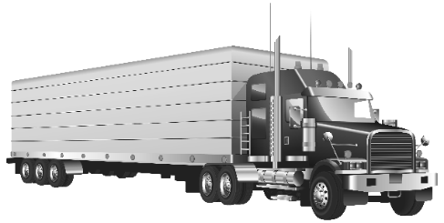
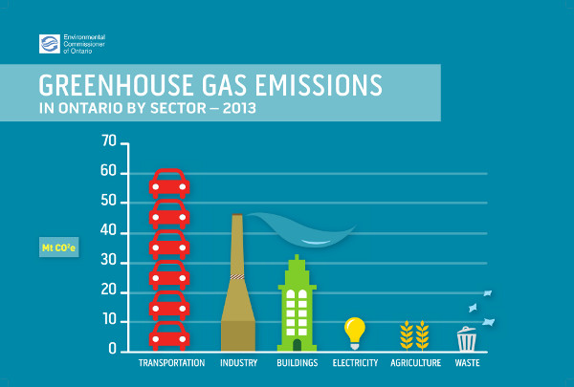
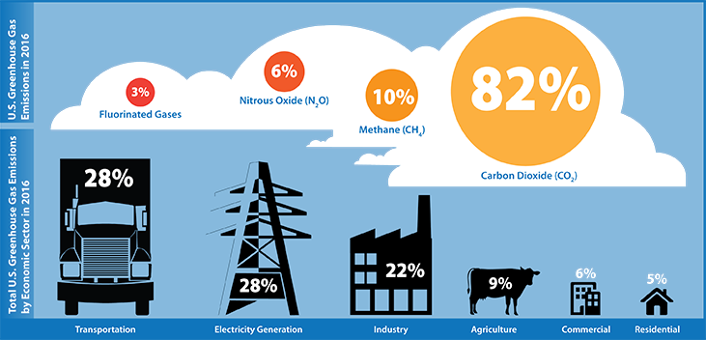
Climate Impacts of On-Road Freight
Transportation-related GHGs have grown 250% in last 40 years
Transportation is the largest source of GHG emissions in US and Ontario; in Ontario, nearly one quarter of this is on-road freight
Heavy-duty long haul trucks have slower adoption of zero-emission vehicles (ZEVs)

Slide 3
Air Pollutant Impacts of On-Road Freight
Transportation emissions linked to 11% of air pollution-related deaths and $1 trillion annual damages globally (Anenberg et al., 2019).
Contributes 70% of carbon monoxide (CO) and nitrogen oxides (NOx) emissions in Ontario

Slide 4
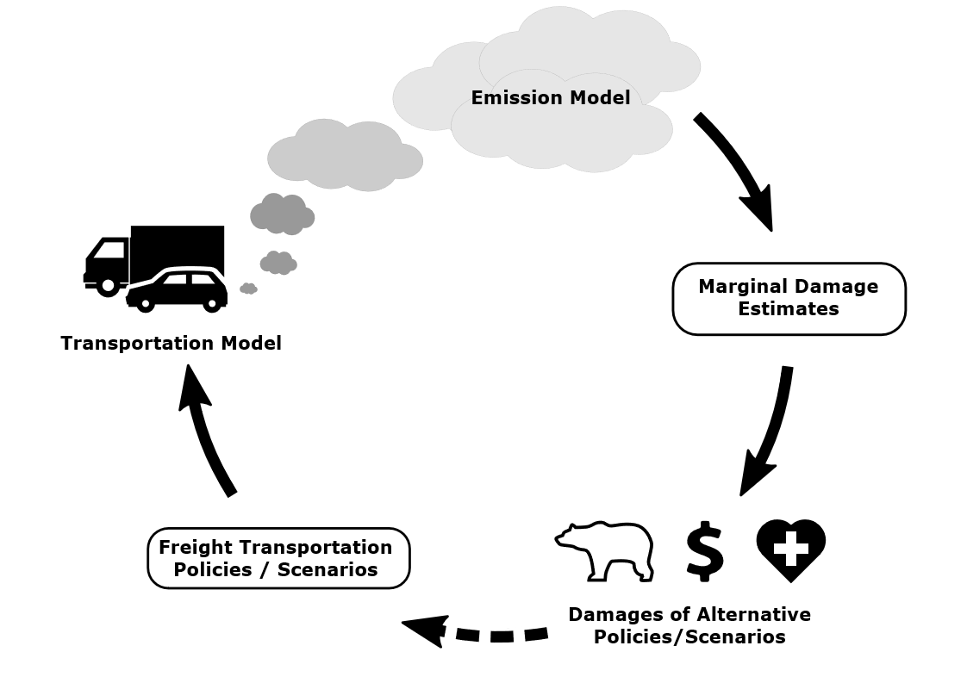
Research Objectives
Estimate multipollutant economic costs of Ontario on-road freight for U.S. receptors
Evaluate benefits of ZEV adoption
Evaluate contribution of major freight corridor

Slide 5
Approach: Integrated Assessment Model
Economic Impacts of Health Outcomes
Travel Demand Model
Emission Estimation Model
EMME 4
MOVES
EASIUR
Estimating Air Pollution Social Impact using Regression

Slide 6
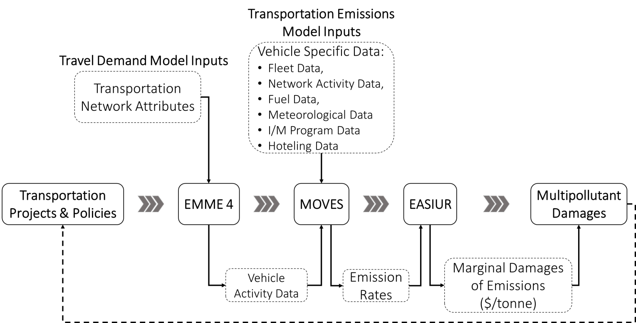
Approach: Integrated Assessment Model

Slide 7
Travel Demand Model: EMME (4 step model)
Trip Generation: Measuring the number of trips produced and attracted at census levels.
Output: Vehicle Activity Data
Speed
Travel time
Number of starts
Distance travelled
Types of roads used
Trip Distribution: Produced and attracted trips are organized into an ‘Origin and Destination (O-D)’ matrix.
Mode Split: Assigning mode of travel for each trip in the O-D matrix.
Traffic Assignment: Assigning an optimal path/route to each trip.
Details and validation in Ashrafi et al. (2017), Transportation Research Record, 2610 10-18

Slide 8
Travel Demand Model: EMME (4 step model)
Domain
Ontario 2012 baseline conditions
49 Census Divisions
Data
truck demands from the Ontario Ministry of Transportation (MTO) Commercial Vehicle Survey (CVS)
car demands (to set congestion, speeds) from Transportation Tomorrow Survey
Output
Vehicle activity data over 24 hours

Slide 9
Multipollutant Impacts: EASIUR
Marginal damages of emissions on U.S. receptors on a 36 km x 36 km grid of the continental US, parts of Canada and Mexico based on 2005 air quality
Pollutants included: Primary PM_{2.5} and inorganic secondary PM_{2.5} precursors (NOx, SO₂, NH₃)
Impacts included: PM_{2.5}-related adult premature mortality (Krewski et al. (2009))
Ground-level annual marginal damage found for each EMME census division weighted by road length.
Social cost of carbon of $32.9 per tonne of CO_{2,e} (US EPA) for 2012
Heo et al. (2016) Atmospheric Environment & Environmental Science & Technology

Slide 10
Baseline Multipollutant Emissions
16 Mt
361 t
160 t
3 kt
72 kt

Slide 11
Baseline Multipollutant Impacts
Annual impact from Ontario is $1.9 billion (USD 2010).
Most damaging CDs:
Toronto: $182 million
York: $166 million and
Peel: $136 million
Impacts per freight vehicle per year: $8,100
External costs: 16 ȼ/VKT (11.3 ȼ/VKT AP; 4.3 ȼ/VKT GHG)
Notes:
The 2019 update of this Handbook includes EU28 average per vehicle costs of 10 ȼ/VKT for air pollutants and 8 ȼ/VKT for greenhouse gases for heavy goods vehicles

Slide 12
Sensitivity of Baseline Damages
One-at-a-time (OAT) parameter changes based on:
Speed
Vehicle pop data
Weather variation
Overall within ±25%

Slide 13
Benefits of ZEV Adoption
Comparative static change for 2012 fleet
Provincial goal of 5% ZEV adoption yields:
800 ktCO₂e avoided (exceeding provincial goal of 240 ktCO₂e/yr)
$89 Million (2010 USD) in benefits annually
Including air quality co-benefits of $83/tCO₂e
Notes:
1.9 billion (2010 USD). These are attributable to a vehicle population of 233,000 MDV and HDV, corresponding to $8,100 (2010 USD) per vehicle per year. Such damages could be used to estimate subsidies to incentivise the adoptio

Slide 14
Effect of Major Freight Corridor (401)
The 401 highway passes through 17 of the 49 census divisions in Ontario.
On average, the total impacts in these 17 census divisions is ~2.6 times higher.
Less than 8% of damages from local freight

Slide 15
Implications
Highest damages occur along regional freight corridors, including the 401 highway route.
A zero emission vehicle mandate can:
Meet stated provincial climate targets, and
Achieve significant air quality co-benefits for U.S. receptors

Slide 16
Thank you!

Slide 17
Made in Ontario Environment Plan
Targets 2.88 Mt of CO_{2,e} reduction by 2030 via uptake of low carbon vehicles.
Annual Targets from Made in Ontario Environment Plan
0.24 Mt of CO_{2,e} reduction per year.
Hypothetical ZEV Penetration Scenario
A 5% ZEV penetration rate achieves a GHG reduction of 0.8 Mt CO_{2,e} per year.

Slide 18
Approach: Trips Considered

Slide 19
Ontario’s New Drive Clean Program
Current program only prioritizes emissions testing for heavy duty diesel vehicles.
We do not assess the change in impacts due to discontinuing emissions testing for light and heavy duty diesel vehicles (MOVES limitation).
However, we observe that discontinuing emissions testing for light duty gasoline vehicles leads to an increase of ~1.54% (~$337 million) in multipollutant impacts.

