Slide 1
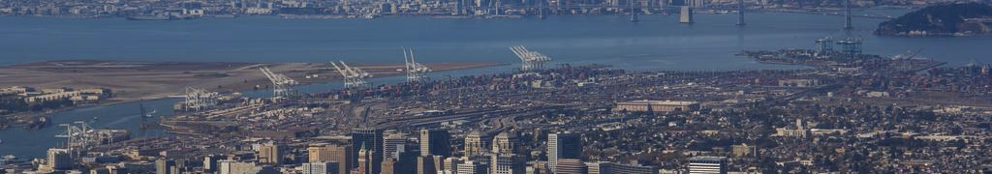

Hybrid Air Quality Modeling in West Oakland to Support the Development of an Emissions Reduction Program
Stephen Reid, Bonyoung Koo, Yiqin Jia, James Cordova, Virginia Lau, Annie Seagram, Yuan Du, David Holstius, Phil Martien
Bay Area Air Quality Management District, San Francisco, CA
The 18th Annual CMAS Conference
October 21, 2019

Slide 2
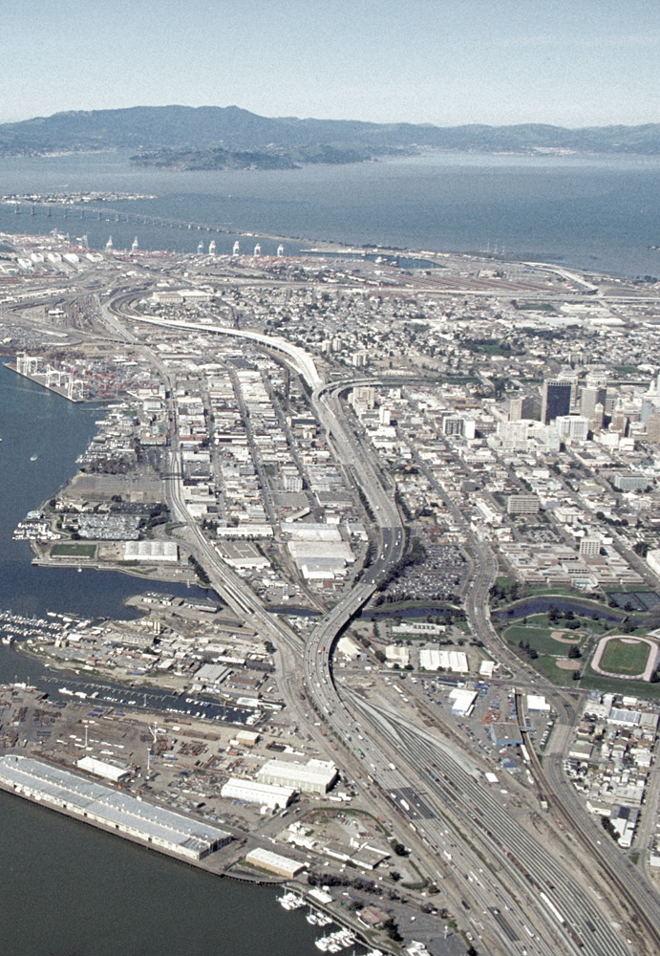
Presentation Outline
Background
  Assembly Bill (AB) 617 overview
  Why West Oakland?
Technical Approach
  Emissions inventory development
  Hybrid modeling: CMAQ+AERMOD
Modeling Results
  Local vs. background
  Source apportionment analyses
Action Plan Development
West Oakland

Slide 3
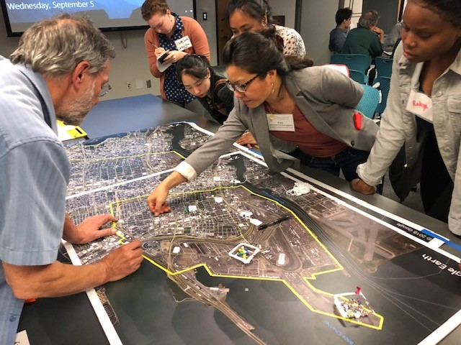
AB 617 Background
Originated in negotiations over the extension of California’s cap-and-trade program for greenhouse gases (AB 398)
Responds to environmental justice concerns regarding high levels of air pollution in local communities
Requires local air districts to partner with community groups and develop plans for reducing criteria pollutant and air toxic emissions in communities most impacted by air pollution

Slide 4

Why West Oakland?
Established partnership with the West Oakland Environmental Indicators Project (WOEIP)
Prior monitoring, emissions inventory, and health risk assessment efforts in the community
High mobile source emissions
    Adjacent to the Port of Oakland
    Surrounded by the I-880, I-80, I-580, and I-980 freeways
High health burdens and socio-economic vulnerabilities

Slide 5
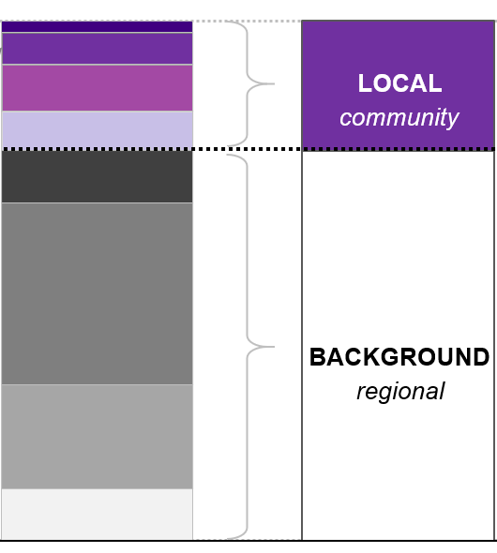
Overview of Technical Approach
CMAQ was run at 1-km grid resolution to estimate background PM_{2.5} and air toxics concentrations in West Oakland
AERMOD was run for significant emission sources within West Oakland
Combined CMAQ+AERMOD results provide total pollutant concentrations
AERMOD results used for source apportionment analyses to inform local emission reduction strategies
AERMOD
Local West Oakland Sources
CMAQ
Regional sources outside West Oakland

Slide 6
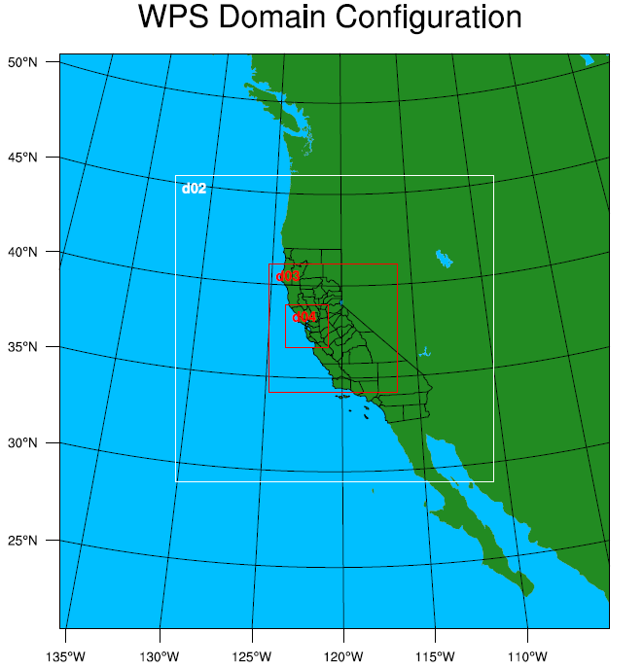
CMAQ Modeling (1)
Meteorological Inputs
Weather Research and Forecasting (WRF) Model 3.8
4 nested domains (36-, 12-, 4-, and 1-km)
Four-dimensional data assimilation (FDDA)
Emissions Inputs
Internal District emissions data for stationary sources
California Air Resources Board (CARB) data for nonroad mobile sources
CARB’s EMFAC2017 model for onroad mobile sources
Emissions processed using SMOKE version 4.5

Slide 7
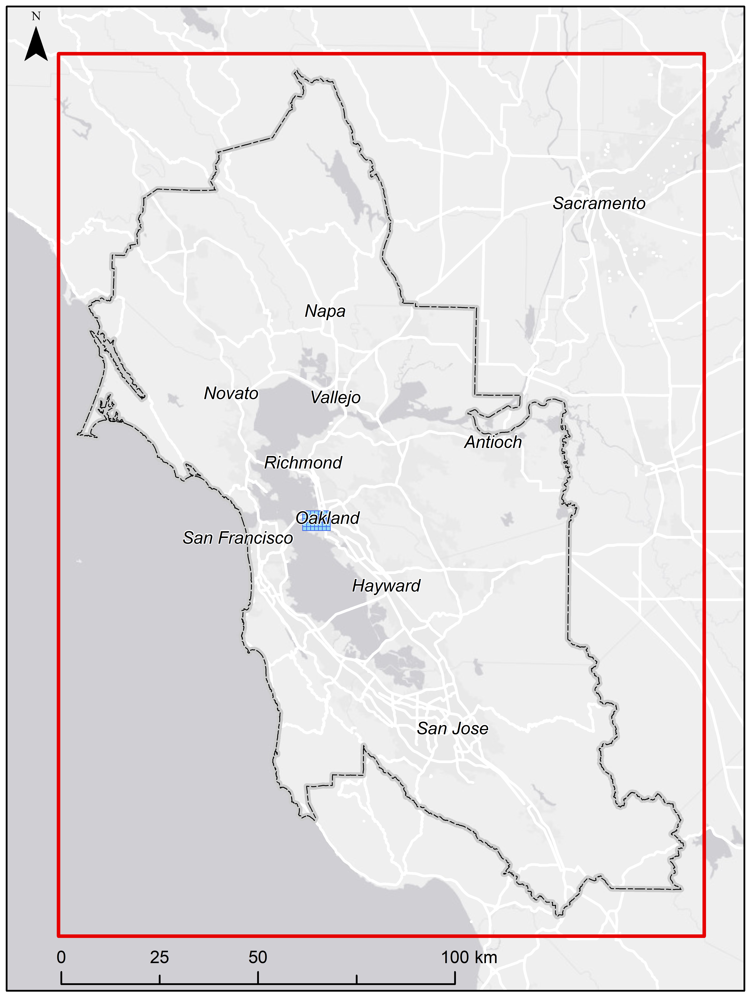
CMAQ Modeling (2)
CMAQ version 5.2
Nested 4-km and 1-km grids
SAPRC07TC mechanism; AERO6 module
Modeled PM_{2.5}; diesel PM (DPM); 10 other air toxics (see list at right)
Two annual simulations for 2016:
  Baseline case (all emissions included)
  Control case (West Oakland emissions zeroed out)
  Differences provide an estimate of local vs. background concentrations in West Oakland
Other Toxics Modeled:
Acetaldehyde Cadmium
Acrolein Chromium VI
Benzene Lead
1,3-butadiene Mercury
Formaldehyde Nickel

Slide 8
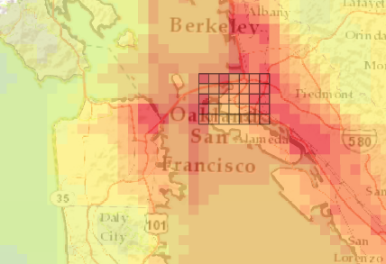
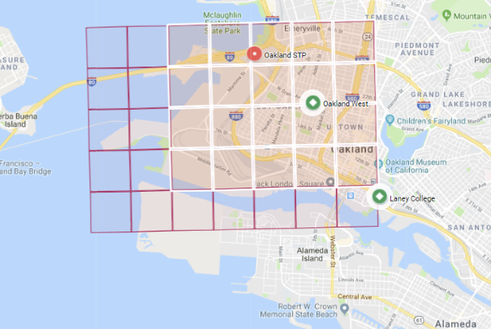
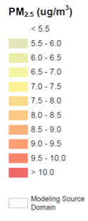
AERMOD Modeling (1)
Wind Measurement Site
Air Quality Measurement Site
Regional-scale modeling: covers the Bay Area
Local-scale modeling: covers West Oakland, including impacts in receptor area (white) from sources in source area (red)

Slide 9
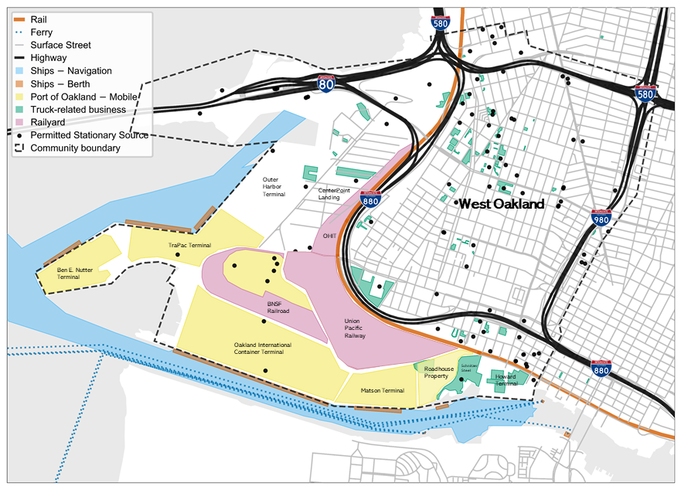
AERMOD Modeling (2)
Pollutants modeled:
PM_{2.5}
Diesel PM
Air toxics (cancer risk)
Sources modeled
Port of Oakland/marine
Railyards/trains
Permitted stationary sources
Vehicles on freeways and surface streets
Truck related businesses

Slide 10
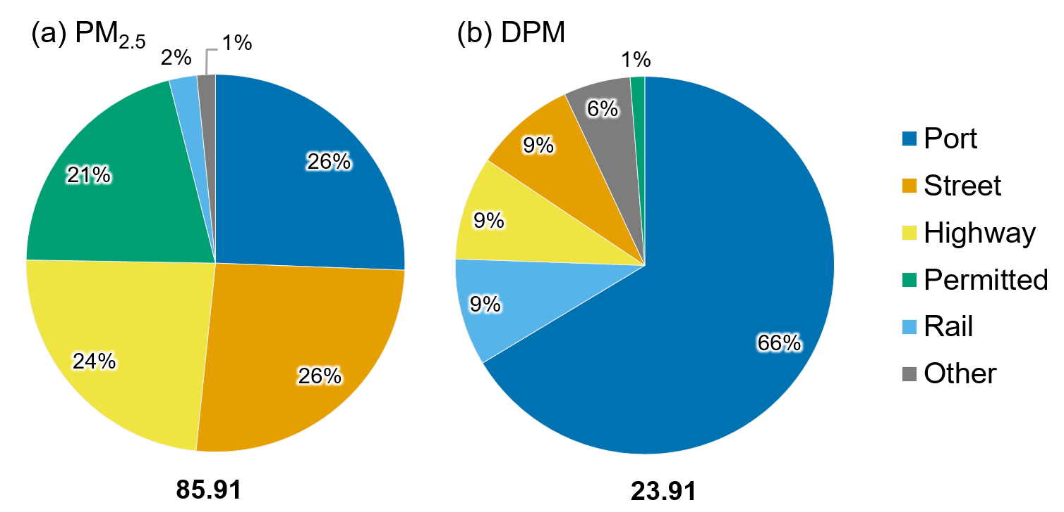
AERMOD Modeling (3)
Bottom-up Emissions Inventory—Key Sources:
Port of Oakland/Marine Sources
  Port of Oakland 2017 Emissions Inventory
  Contractor support for spatial/temporal allocation
  Supplemented with information from CARB
Onroad Motor Vehicles
  Road network and activity data from Citilabs
  Fleet mix from Caltrans data, Streetlight data, West Oakland traffic counts
  Emission factors from CT-EMFAC
Permitted Sources
  Emissions and stack parameters from District permit program; reviewed by District engineering section
86 tpy
24 tpy

Slide 11
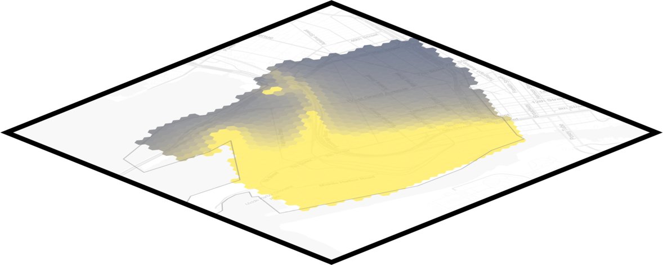
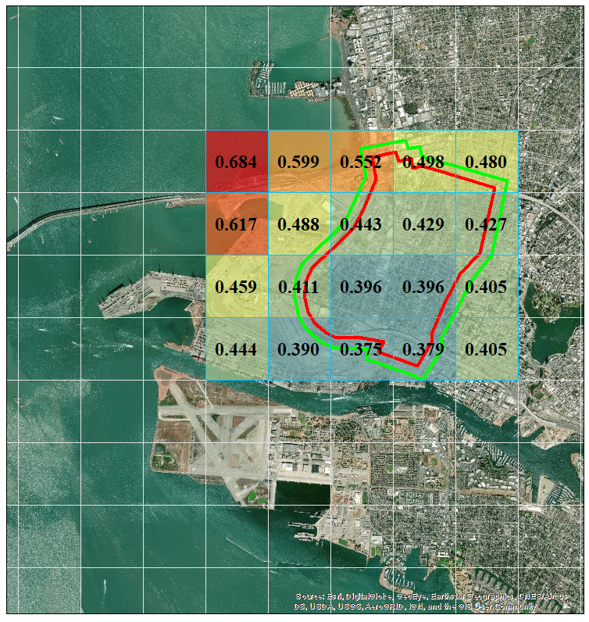
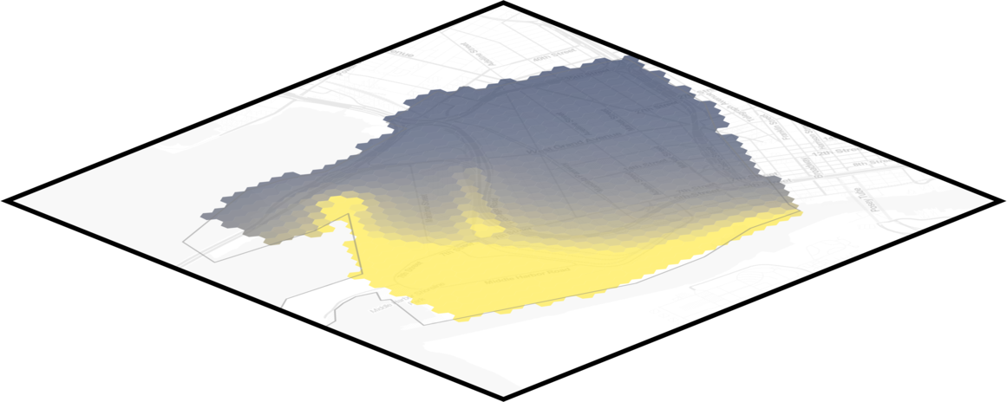

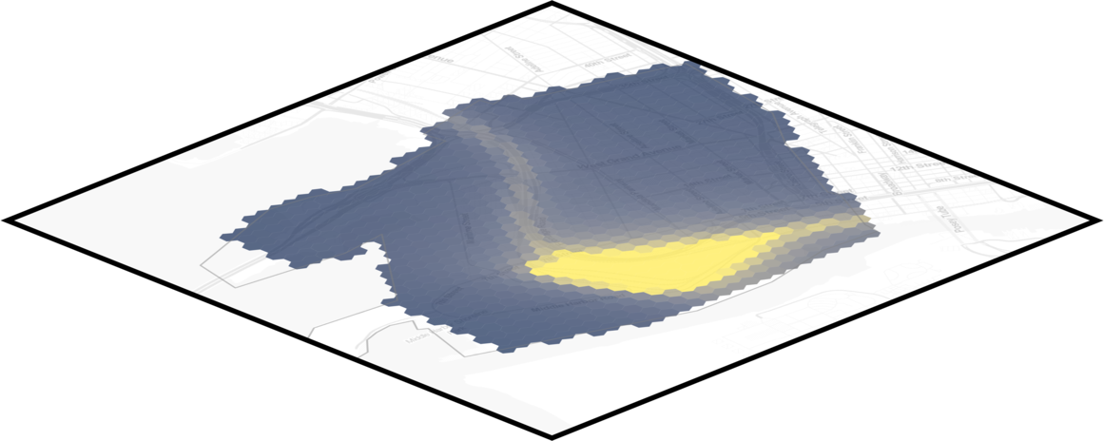

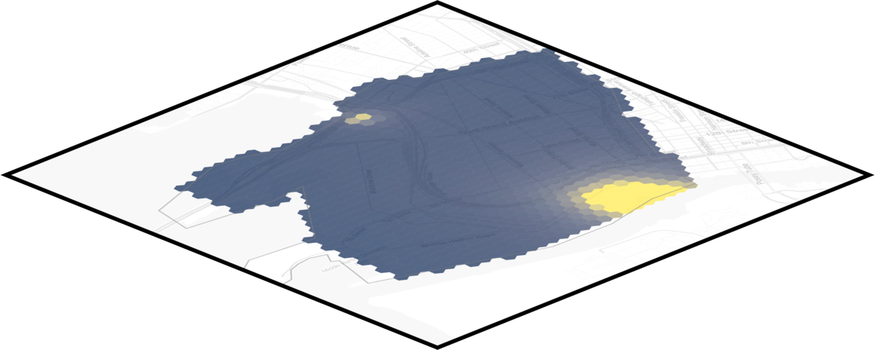

Post-processing Model Results
AERMOD Outputs
CMAQ Outputs
( grand total )
Sub-total of impacts from marine vessels, as modeled (dredging, at berth, ...)
Sub-total from locomotive engines and railyards
UP railyard
Sub-total from permitted facilities, including fugitive emissions
Permitted Source
Annual average background DPM concentration = 0.46 µg/m³

Slide 12
Background vs. Local
Cancer Risk
DPM
PM_{2.5}
1.7
0.3
200
µg/m³
µg/m³
per million

Slide 13
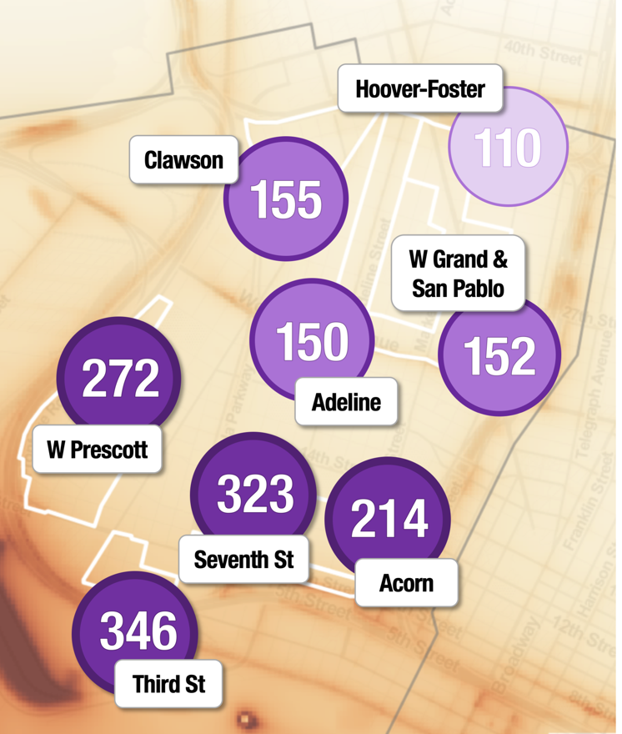
Source Apportionment Results (1)
Per million cancer risk by impact zone

Slide 14
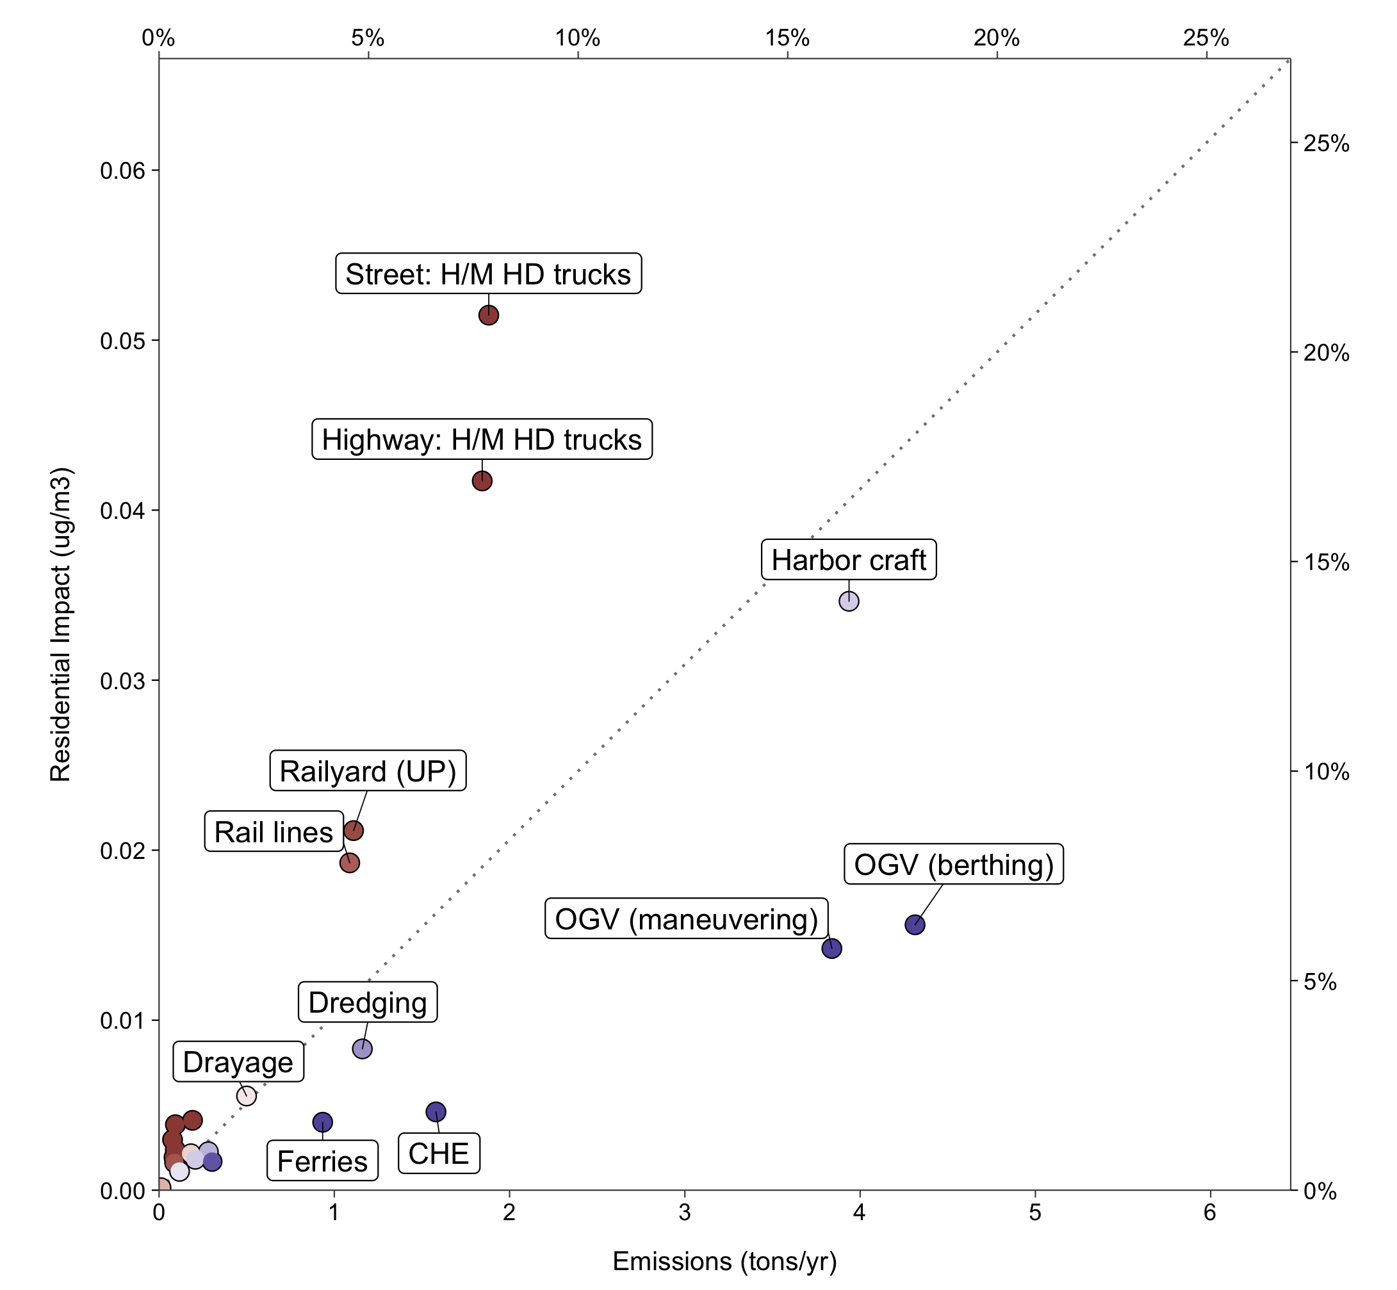
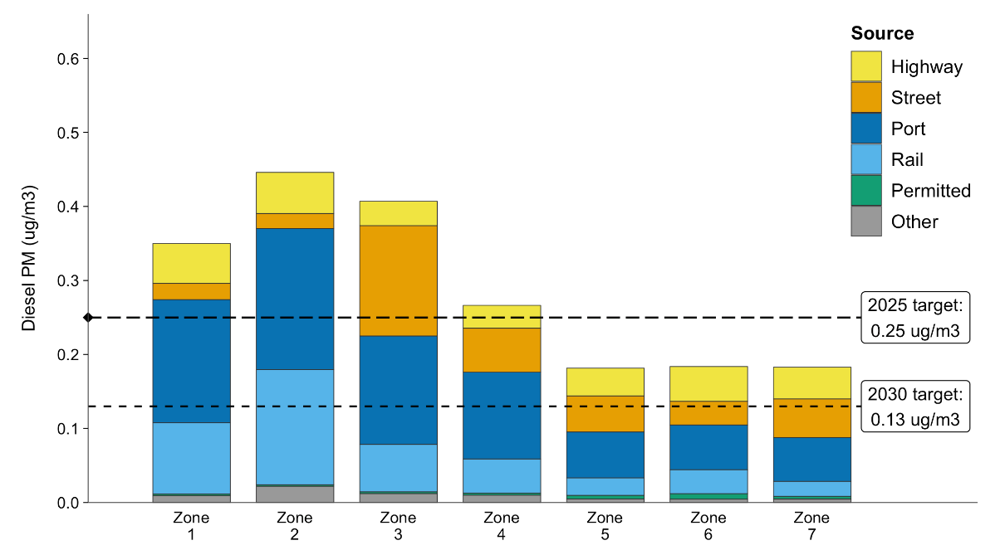
Source Apportionment Results (2)
Impact per Ton of Emissions: Diesel PM
Targets and Source Apportionment for Diesel PM

Slide 15
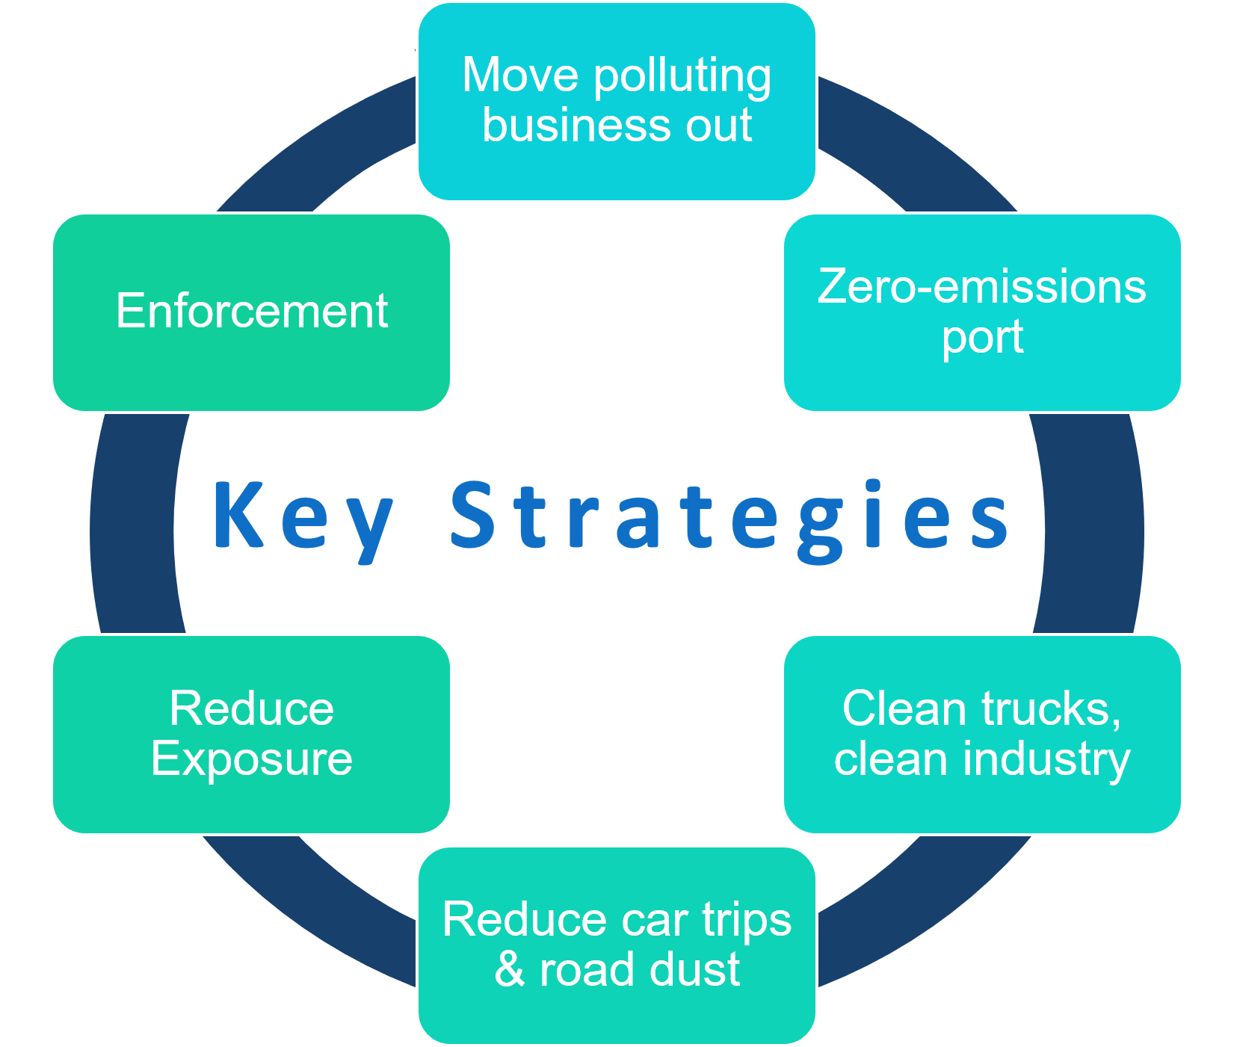
Action Plan Development (1)
Action Plan Goals:
2025 - All neighborhoods have the same air quality as the average West Oakland neighborhood
2030 - All neighborhoods have the same air quality as the cleanest West Oakland neighborhood
84 Strategies:
Reduce emissions and exposures
Require action by state, regional, and local agencies

Slide 16
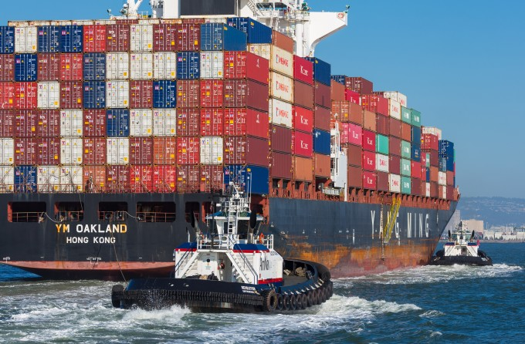
Action Plan Development (2)
Example Strategies:
Incentivize repowers of 3 assist tugs by 2022, reducing DPM emissions by 1.4 tons between 2017 and 2024
Incentivize upgrades of 5 switcher engines at UP Railyard to Tier 4, reducing DPM emissions by 0.3 tons between 2017 and 2024

Slide 17
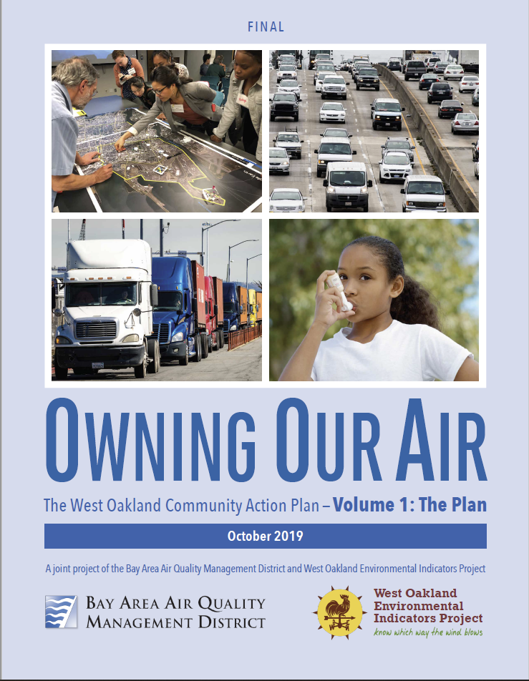
Next Steps
Currently comparing AERMOD results with black carbon measurements from the 2017 “100x100” study in West Oakland
December 5, 2019 – CARB Board meeting in West Oakland to consider plan approval
Early 2020 – West Oakland steering committee begins quarterly implementation meetings
2020+ - similar technical analyses will be conducted for Richmond and other AB 617 communities in the Bay Area

