Slide 1
Particulate matter sensitivity to local emissions and meteorology over a Latin American megacity for source apportionment and uncertainty analysis
James East¹
Juan Montealegre²
Jorge E. Pachón²
Fernando García Menendez¹
¹ North Carolina State University, Raleigh, NC, USA
² Centro Lasallista de Investigación y Modelación Ambiental (CLIMA), Universidad de La Salle, Bogotá

Slide 2
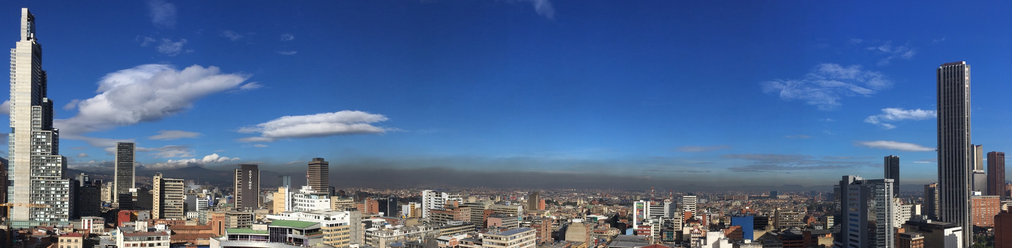
Bogota Air Quality
2014 PM:
  PM_{2.5}: 38.3 µg/m³ (Seasonal), 70.0 µg/m³ (24h max)
  PM₁₀: 95.4 µg/m³ (Seasonal), 152.0 µg/m³ (24h max)
Though annual average PM_{2.5} and PM₁₀ levels have decreased in recent years, frequent exceedances lead to high exposures and negative health impacts
Emissions from various sectors across the city contribute to excessive pollutant concentrations.
Although annual average PM_{2.5} and PM₁₀ levels have decreased in recent years, frequent exceedances lead to high exposures and negative health impacts.
We model Bogota air quality during a year using CMAQ.
Notes:
First, I want to give some background on air quality in Bogota.
High PM2.5 and PM10 levels threaten human health in the city
2nd most populous city in South America
Little modeling of the city has been done in past
Coarser PM a greater concern in Bogota than in US.
PM10 is major pollutant and concern in much of developing world, esp megacities
Roads are main source of PM10 (RPM)
Different problem => different approach
WHO PM25: 10ug/m3 annual, 25ug/m3 24hr
WHO PM10: 20 ug/m3 annual, 50 ug/m3 24hr
https://www.who.int/en/news-room/fact-sheets/detail/ambient-(outdoor)-air-quality-and-health
Bogota is 10th worst polluted city in Latin America
https://thecitypaperbogota.com/bogota/dying-for-a-breath-of-bogota-air/17387
https://www.who.int/news-room/fact-sheets/detail/ambient-(outdoor)-air-quality-and-health
Bogotá Downtown Bacatá is 4th tallest building in South America, 67 stories tall (https://en.wikipedia.org/wiki/BD_Bacatá)

Slide 3
Observation trends for study year 2014
2014 Mean PM_{2.5}
PM_{2.5}
µg m⁻³
Notes:
Impacts vary across city, but on average exceed local and global standards

Slide 4
RMCAB Observations
13 sites from the RMCAB network are used for model evaluation
Monitors record hourly air quality and meteorological parameters
Notes:
Observation sites are spatially distributed and capture variety of emissions sources. Measure PM Mass Only

Slide 5
Base case model setup
Domain | Four domains with increasing resolution. Model runs use 64x64 km at 1 km resolution over Bogota.
Emissions | Local inventory developed by Pachon et al. (2018), with adjusted RPM emissions
Chemical Boundary Conditions | Derived from GEOS-Chem and provided to coarsest domain
Meteorology | 2014 meteorology generated with WRF.
Simulations | Jan. – Mar. (JFM) & Oct. – Dec. (OND)
Notes:
High resolution model provides ability for (mega) city-level analysis
- Uses CMAQv5.0.2

Slide 6
Model Performance – JFM Season
PM₁₀
PM_{2.5}
Normalized Mean Error
Normalized Mean Bias
Maximum Observed (µg m⁻³)
Maximum Observed (µg m⁻³)
Notes:
Performance metrics are from recent recommendations (Emery et al. 2017) developed for modeling in US, where modeling systems, emissions estimates, and observation networks have been developed over many years.
Despite uncertainties in modeling over Bogota, most sites fall within these recommended levels.
The model is adequate for use in our source apportionment exercise

Slide 7
  Emissions scaling and source apportionment
  Model structural uncertainty
  Sensitivity to meteorological parameterizations
Notes:
We address uncertainty in the simulation over Bogota:
Some uncertainty in emissions
Source apportionment not done before
Near equator, high altitude, complex terrain = difficult to model meteorology
We identify model sensitivities to 3 sources of uncertainty

Slide 8
  Emissions scaling and source apportionment
  Model structural uncertainty
  Sensitivity to meteorological parameterizations

Slide 9
Background - Emissions
Resuspended particulate matter (RPM) and traffic emissions are largest sources of PM (Ramirez et al., 2018; Pachon et al. 2018)
Previous modelling studies overestimated PM, but recent modelling efforts have improved predictions (Nedbor-Gross et al., 2017)
Systematic sensitivity analysis for chemical transport modeling of source apportionment has not been done for Bogota
Notes:
Source apportionment will build on previous work and increase understanding of air quality problem in Bogota

Slide 10
Emissions sectors
Emissions sectors scaled for source apportionment
On-road combustion
Industrial point source
Building construction RPM
Quarrying RPM
Main paved road RPM
Secondary paved road RPM
Unpaved industrial road RPM
Unpaved public road RPM
All other sources
RPM = Resuspended Particulate Matter
Notes:
Emissions are spatially and temporally resolved; all major emissions sources are represented. Remaining sources lumped into ‘all other’

Slide 11
Source apportionment
Largest PM_{2.5} contributors
Unpaved Industrial Road RPM
Unpaved Public Road RPM
Industrial Facilities
On-road emissions
13.92
Unpaved Industrial and Public road RPM leads to highest PM_{2.5} values.
Impacts from RPM vary spatially, there are ‘hot spots.’
On-road emissions are more spatially homogeneous.
Notes:
Emissions impacts vary widely by source and spatially. Unpaved RPM emissions are clearly highest, on road emissions are more spread out.

Slide 12
Source apportionment – OND PM_{2.5}
RPM from unpaved roads, industrial point source emissions, and on-road combustion emissions dominate at a polluted site
Notes:
Emissions impacts vary over time. At this polluted site: RPM, industrial source, on-road emissions dominate.
Some PM is ‘unapportioned’ – gap between modeled and apportioned PM.
- range is 40% to 95%
- mean 73% in JFM, mean 86% in OND
- Sulfate scales positive > 100%
- nitrate scales negatively

Slide 13
Mean Fractional Contributions (PM_{2.5})
Emissions sectors
Site type
Notes:
Take aways:
Show results/what is possible with source apportionment
Major differences: Industrial, RPM, On-road, ‘Other’
Some PM is unnapportioned
Highest unnapportioned at background sites. More secondary formation?

Slide 14
  Emissions scaling and source apportionment
  Model structural uncertainty
  Sensitivity to meteorological parameterizations

Slide 15
Impact of model upgrades on performance
WRFv3.5.1 → WRFv4.1.3
CMAQv5.0.2 → CMAQv5.3
With upgrades, overall performance
is improved, bias becomes negative
 | NME | NMB | r
Hourly | 57.7 | -14.9 | -0.39
24-hr | 29.9 | -15.8 | -0.49
v5.3
v5.0.2
Hourly | 83.4 | 23.2 | 0.30
24-hr | 45.0 | 22.1 | 0.33
Hourly and 24-hr PM_{2.5} at a polluted site (Kennedy)
Notes:
With upgrades, overall performance is improved, but model is biased low
Table = entire JFM season
Plot = 2 weeks in January
Performance of all NAAQS pollutants improved except ozone (but Bogota NOx emissions have problem)

Slide 16
  Emissions scaling and source apportionment
  Model structural uncertainty
  Sensitivity to meteorological parameterizations

Slide 17
WRF parameterizations
Simulation period: 14 days from 2014-01-14 to 2014-01-27
11 WRFv4.1.3 runs performed, driving 11 CMAQv5.3 runs:
Base case
Base case
Mellor-Yamada-Janjic PBL scheme
MRF PBL scheme
ACM2 PBL scheme
Bougeault-Lacarrère PBL scheme
Purdue Lin microphysics scheme
Thompson microphysics scheme
Morrison 2-moment microphysics scheme
Thompson aerosol-aware microphysics scheme
Full diffusion option
Slope and shading effects for short wave radiation
PBL Scheme varied
Microphysics Scheme varied
Topography related options
Notes:
Each option varied 1-at-a-time from base case.
Simulation period chosen because model showed false spike in PM2.5 not reflected in obs. Can any of these sensitivity settings better capture obs?

Slide 18
Sensitivity to meteorological parameterizations
Mean range of hourly PM_{2.5}due to choice of meteorological parameterizations
 | NME | NMB | R
YSU PBL | 29.9 | -15.8 | -0.70
MJY PBL | 30.1 | -15.3 | -0.69
MRF PBL | 29.1 | -10.3 | -0.71
ACM2 PBL | 32.3 | -15.1 | -0.68
BouLac PBL | 35.4 | -15.9 | -0.62
Purdue-Lin MP | 38.1 | -11.2 | -0.55
Thompson MP | 40.3 | -2.9 | -0.56
Morrison 2m MP | 31.8 | -13.5 | -0.68
Thom. aer. MP | 34.2 | -12.0 | -0.61
Diffusion | 31.4 | -7.5 | -0.71
Slope effects | 32.6 | -19.5 | -0.67
Base
case
PBL Scheme
Microphysics
Topography
related
Notes:
This gives us an idea of the sensitivity of PM2.5 in CMAQ to these options

Slide 19
Conclusions
Unpaved road RPM is the largest contributor to overall PM_{2.5} and pollution.
On-road vehicle emissions are second largest contributors to PM_{2.5} pollution.
Relative influence of different emissions sectors is highly localized within the city.
Model updates lead to improved PM_{2.5} performance in Bogota for JFM season, introduce negative bias.
PM_{2.5} is most sensitive to choice of PBL scheme in WRF meteorological modeling.
MRF PBL scheme improves performance over base case scheme, and full diffusion option decreases bias.

Slide 20


Thank you
This research supported in part by:
James East
jdeast2@ncsu.edu

Slide 21
MRF PBL & Full diffusion option

Slide 22
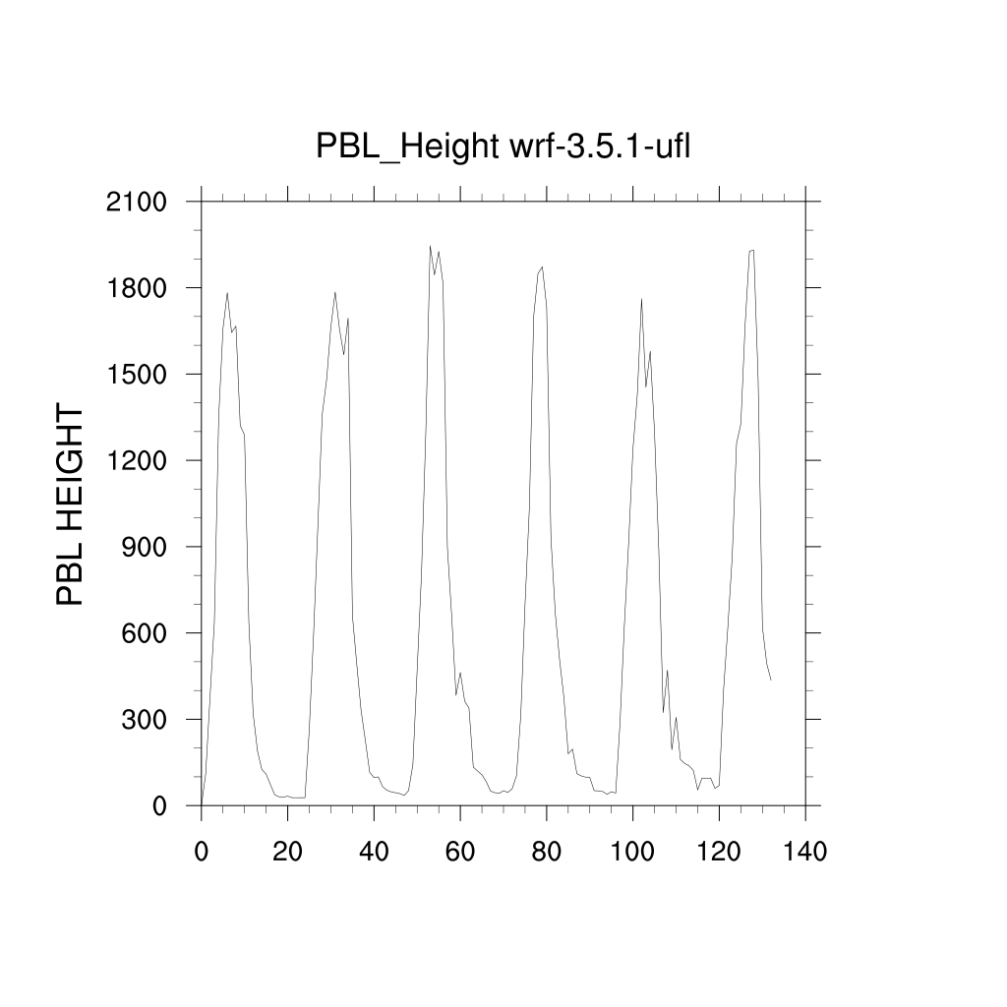
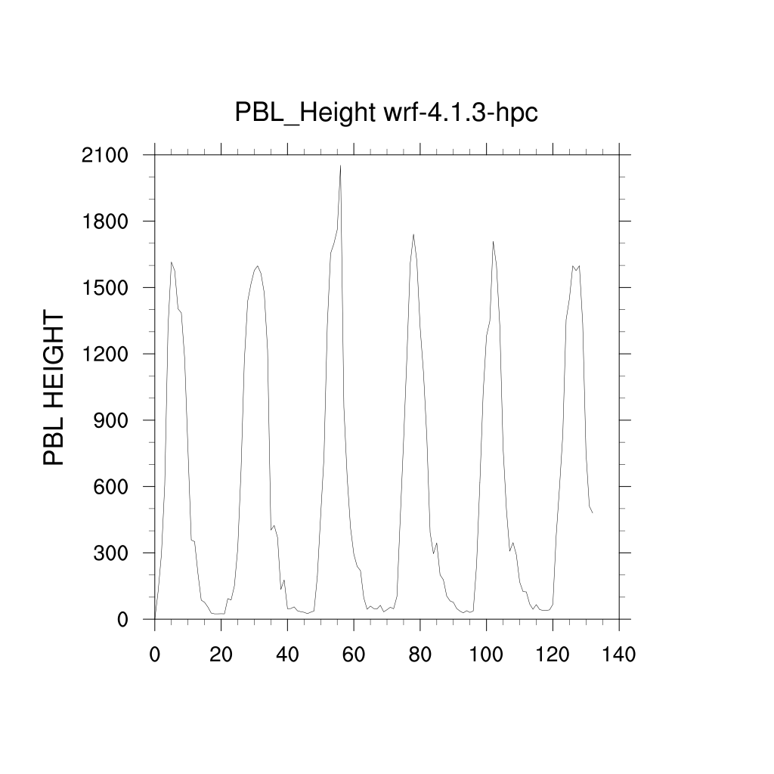
PBL Height

Slide 23
Source Scaling
Emission sector scaled by -20%
Air quality simulation run with scaled emissions
Source contributions are calculated by applying source scaling to each sector
(9 sectors + 1 base case) x 2 seasons = 20 model runs of 3-months each
Base case and scaled simulation compared
Rescaled differences are source contributions
Notes:
Method is ‘one-at-a-time’ scaling

Slide 24
Conclusions
Relative influence of different emissions sectors is highly localized within the city.
Controlling dust from unpaved roads could dramatically decrease PM₁₀ & PM_{2.5} concentration and exposure.
Source-scaling is an effective method to quantify highly spatially resolved source impacts. It is particularly useful in Bogota, where it can be used to further improve the local emissions inventory.

Slide 25
Model Performance – OND Season
PM₁₀
PM_{2.5}
Normalized Mean Error
Normalized Mean Bias
Maximum Observed (µg m⁻³)
Maximum Observed (µg m⁻³)
Notes:
Performance metrics are from recent recommendations (Emery et al. 2017) developed for modeling in US, where modeling systems, emissions estimates, and observation networks have been developed over many years.
Despite uncertainties in modeling over Bogota, most sites fall within these recommended levels.
The model is adequate for use in our source apportionment exercise

Slide 26
Background – Uncertainties in modeling
Some uncertainty in emissions
Source apportionment not done before
Near equator, high altitude, complex terrain = difficult to model meteorology
Notes:
Source apportionment will build on previous work and increase understanding of air quality problem in Bogota

Slide 27
Source apportionment
Resuspended PM (RPM) from unpaved roads add 42% - 70% of total PM₁₀, 18% - 44% of total PM_{2.5} across the city
On-road vehicle emissions are 2nd highest PM_{2.5} source
Notes:
RPM and On road emissions are greatest contributors to air pollution
Values are averaged over 5 ULS observation sites and 1 week. Not over whole domain.

Slide 28
12. Source apportionment – OND PM_{2.5}
On-road combustion emissions dominate at a relatively clean site. Gaps between modeled PM and source total represents imperfect scaling

