Slide 1
Impacts of volatile chemical products on PM_{2.5} and O₃ in an urban atmosphere
The views expressed in this presentation are those of the authors and do not necessarily reflect the views or policies of the U.S. EPA.
Momei Qin^{1,2}, Benjamin N. Murphy¹, Brian C. McDonald³, Stuart A. McKeen³, Lauren Koval¹, Kristin K. Isaacs¹, Quanyang Lu⁴, Allen L. Robinson⁴, Madeleine Strum⁵, Jennifer Snyder⁵, Christos Efstathiou⁶, Chris Allen⁶, and Havala O. T. Pye¹
¹EPA Office of Research and Development, ²Nanjing University of Information Science and Technology, ³CIRES/NOAA,
⁴Carnegie Mellon University, ⁵EPA Office of Air Quality Planning and Standards, ⁶General Dynamics Information Technology
Office of Research and Development
Atmospheric and Environmental Systems Modeling Division
22 October 2019
CMAS Conference
Notes:
Alternate title: Criteria pollutant impacts of volatile chemical products informed by near-field modeling

Slide 2
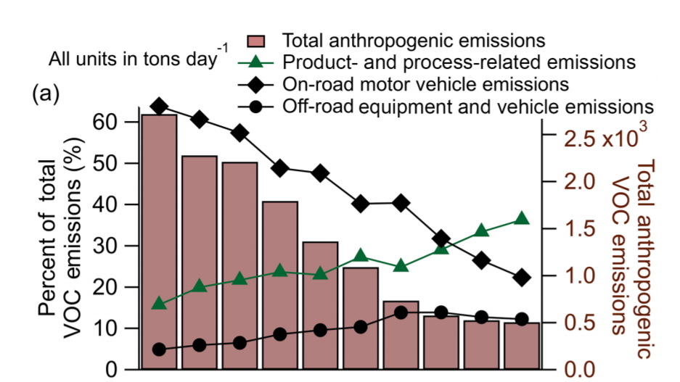
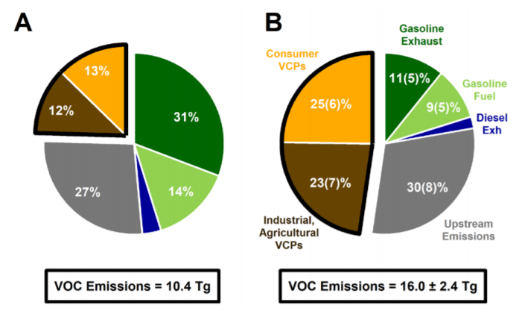
Volatile chemical products (VCPs) emit VOCs
VCPs (pesticides, coatings, cleaning agents, personal care products) growing in importance relative to combustion
Recent work suggests VCP emissions are low in the EPA National Emission Inventory (NEI)
South Coast Air Basin (Los Angeles) Emissions
U.S. Nationwide Emissions
EPA NEI
McDonald et al.
Khare and Gentner ACP 2018
McDonald et al. Science 2018
Notes:
VCPs include residential and commercial application of pesticides, coatings, cleaning agents, personal care products, adhesives, and paints. Given the declines in combustion emissions over the past few decades, emissions of VOCs from evaporative processes are likely increasing in relative importance. This can be seen in this plot by Khare and Gentner where product and process-related emissions have increased from about 15% of the SoCAB VOC emissions in 1975 to about 35% today.
Emissions of VOCs from VCPs are inventoried in the NEI, however recent work by McDonald et al. indicates VCP emissions could be higher than previously thought. McDonald et al. indicates about 4 Tg/yr while the NEI indicates 1.3 Tg/yr for consumer VCPs. McDonald et al. has also indicated California’s estimates of VCP emissions may be low.

Slide 3
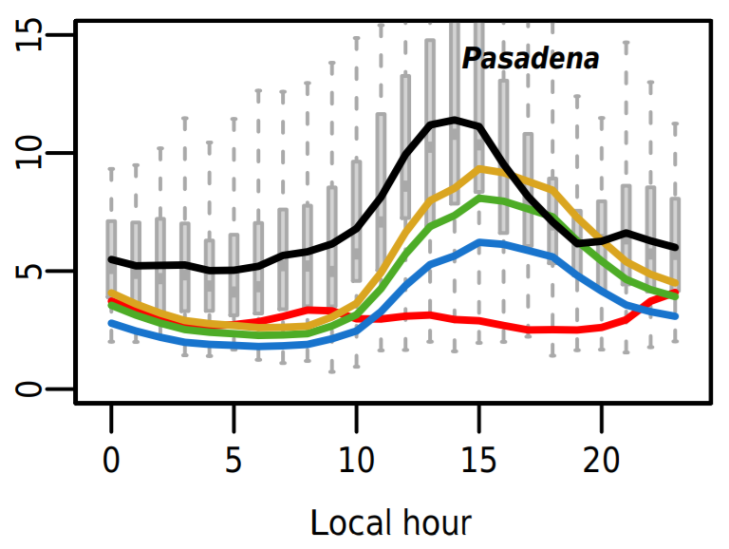
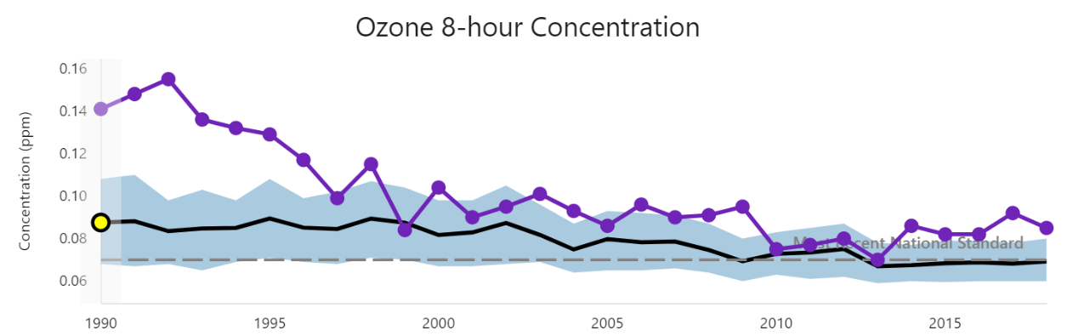
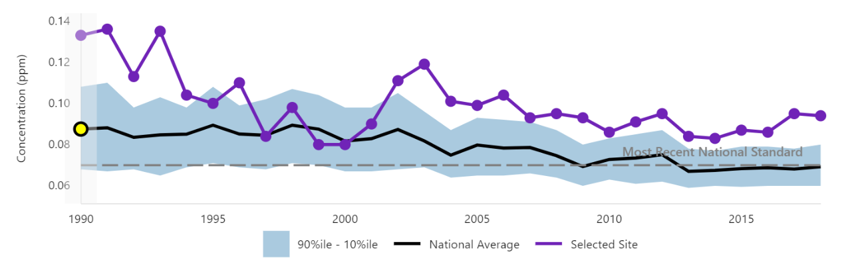
Are VCPs a missing criteria pollutant source?
CMAQ organic PM_{2.5} biased low in Los Angeles (particularly secondary organic aerosol, SOA)
VCP emissions coincide with locations having persistent ozone in excess of the NAAQS
Ozone 8-hour Concentration
Observed
Top-down estimates
Pasadena, CA
Reseda, CA
Bottom-up CMAQ estimate
EPA Annual Air Trends Report 2019
Murphy et al. ACP 2017
https://gispub.epa.gov/air/trendsreport/2019/#welcome
Notes:
VCPs emissions coincide with air quality model performance issues. A series of papers on the CalNex 2010 field study have indicated models tend to underpredict the secondary organic aerosol component of PM2.5 and have debated whether gasoline or diesel vehicles are more important for organic PM. CMAQ, without top-down corrections like pcSOA, underestimates organic PM2.5 for CalNex and particularly underestimates the daytime peak.
There are also locations like Southern California where Ozone exceeds the NAAQS and has been relatively constant over the past decade. VCPs could be playing a significant role.

Slide 4
Objectives
Photo: https://esrl.noaa.gov/csd/news/2018/231_0416.html
1. Understand emissions
Estimate magnitude of VOC emissions from VCPs
Identify role for near-field exposure models (SHEDS)
2. Estimate air quality impacts
Predict SOA and ozone
Identify limitations of current operational models (CMAQ)
Notes:
Two main objectives

Slide 5
Emission Methodology
Emissions (Gg yr⁻¹)
Multiple inventory methods
NEI (2011 state submitted unless EPA fallback method)
NEI (CA) (California submission to 2011 NEI)
Solvent Tool v1.7 (2014 NEI method)
Stochastic Human Exposure and Dose Simulation Model for High-Throughput (SHEDS-HT)
McDonald et al. Science 2018
Converted all methods to a population-based emission factor (EF)
E = $\sum_{i}{{EF}_{i}×A_{i}}$
Emission Factor (kg person⁻¹ yr⁻¹)
Activity (population)
${EF}_{i}$ = $S_{i}×γ_{i}$
Solvent usage from products
(kg person⁻¹ yr⁻¹)
Volatilization factor
(fraction)
i = sectors (personal care, pesticides, coatings, etc) or categories (shampoo, deodorant, etc)
Notes:
We used 5 different approaches to understand emissions from the VCP sector.
This included the NEI which uses state submitted estimates with EPA fallback methods where required. We focused on the 2011 NEI given data from CalNex 2010 field campaign which remains one of the most complete datasets for understanding photochemically driven SOA in an urban atmosphere.
We also considered that CA state submission to the 2011 NEI. California uses information such as product sales and product surveys as well as fate and transport adjustments to estimate VCP emissions.
The Solvent Tool v1.7 was first distributed in support of the 2014 NEI. It uses activity surrogates such as population, lane miles, and employment to estimate emissions.
Stochastic Human Exposure and Dose Simulation Model for High-Throughput (SHEDS-HT, Isaacs et al. ES&T 2014) is a near-field exposure model for the residential environment.
We also compared to McDonald et al. estimates based on a chemical industry mass balance and product sales along with fate and transport adjustments.
(CLICK) In some inventory methods, an emission factor per person is explicitly provided (SHEDS, Solvent Tool). Where not provided, we calculate one using total emissions divided by population.
These air emission factors can be related to the solvent content of products and the fraction of those products that evaporates.

Slide 6
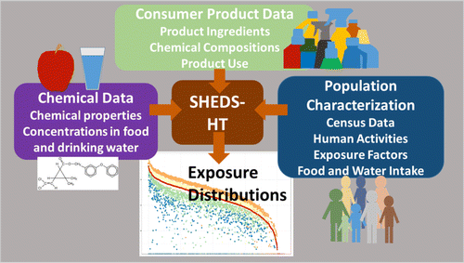
SHEDS-HT synthesizes consumer product usage
Provides conservative near-field exposure to individual chemicals for a population (e.g. 10,000 people)
Informed by consumer product use patterns: What products are people using? How often do they use it? How much do they use?
Assumes 100% chemical prevalence (if a chemical is in any product in a category, it is in all products in that category)
Conservative volatilization assumptions (e.g. dermally applied products do not volatilize)
(Isaacs et al. ES&T 2014)
Conservative near-field exposure assumptions require revision for far-field (ambient air) emission estimates
Notes:
SHEDS synthesizes information on consumer product usage by taking into account consumer product data and consumer habits and practices.
(CLICK) It is meant to provide conservative (upper-bound) near-field exposure to individual chemicals for a population of individuals of different age and gender.
(CLICK) The model uses information on what products people use, how often, and how much to aggregate up to a total exposure and dose of a chemical received via different pathways.
(CLICK) Other critical assumptions include 100% chemical prevalence. This means if a chemical is in any product in a category, it is assumed to be in all products in that category.
(CLICK) SHEDS also makes conservative assumptions in terms of volatilization to maximize exposure. Chemicals applied to surface are allowed to volatilize by default, but products applied to skin do not volatilize in order to obtain maximum dermal exposures.
(CLICK) By default, SHEDS estimates a fraction of chemicals escape “out-the-window”
(CLICK) These two assumptions are fit for the purpose of providing conservative, near-field exposure estimates, but require revision to use the model for far-field (ambient air) emissions

Slide 7
SHEDS estimates 20 kg person⁻¹ yr⁻¹ air emission
${EF}_{i}$ = $S_{i}×γ_{i}$
Critical adjustments resulting in a posteriori:
100% chemical prevalence relaxed to reduce potential for overcounting (S_{i} reduced)
Parameterized volatilization based on vapor pressure and type of usage (effective $γ_{i}$increased from 0.015% to 26%)
Notes:
Here, we show the a priori, out of the box SHEDS product use and air emission factor as well as our a posteriori estimates
By default, when summing across species for which SHEDS estimates product use, SHEDS estimates 1630 kg/person/yr of product solvent is used. Only 0.2 kg/person/yr escapes out the window indicating a volatilization fraction of 0.015%. These numbers are consistent with the goal of providing conservative near-field exposure estimates.
To use SHEDS for far-field chemical release, two critical adjustments were made:
--read bullets—
This resulted in a posteriori estimates of 75 kg/person/yr of product solvent use and 20 kg/person/yr ambient air emission.

Slide 8
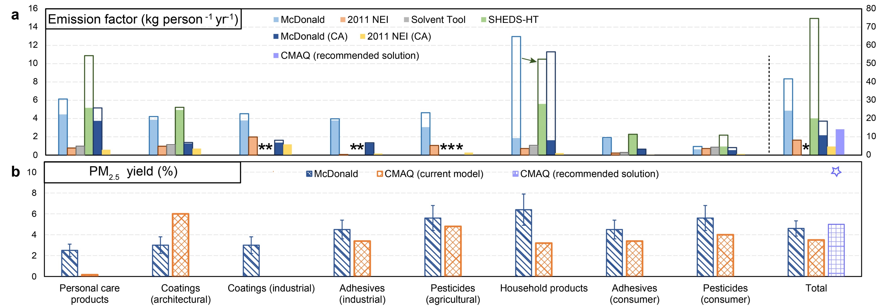
NEI methods based on product (solvent) use
*Indicates EF not available; SHEDS Arrow and Total on right axis
16
80
McDonald
2011 NEI
Solvent Tool
SHEDS-HT
McDonald (CA)
2011 NEI (CA)
Pers. Care
Coatings (arch.)
Coatings (indust.)
Adhesives (indust.)
Pesticides (agricult.)
Household products
Adhesives (consumer)
Pesticides (consumer)
TOTAL
NEI (CA): S_{i} not shown (CARB considers $γ_{i}$ ≠ 1)
CA emission factors likely lower than nationwide ones
NEI (2011)/Solvent Tool (2014 NEI) Methodology
No fate and transport (volatilization) adjustment ($γ_{i}$ = 1)
Low emissions driven by low solvent usage estimates
Product (solvent) usage, S_{i}
Emission Factor to Air,
${EF}_{i}$ = $S_{i}×γ_{i}$
Notes:
We can take information such as the SHEDS product solvent use number and air releases from the previous slide and create stacked bars where the height of the bar is the solvent usage and the filled portion is the emission to air. The SHEDS information from the previous slide, which is a total across subsectors, is shown on the right in green.
Here, we also show estimates from McDonald et al, the NEI, and Solvent Tool for the entire VCP sector and subsectors such as personal care products and household cleaning.
Yellow bars show the CA component of the 2011 NEI. While CA does apply fate and transport assumptions and thus calculates the fraction volatilized, that information is not shown here since it is not routinely reported to the NEI. Both the McDonald et al. methods as well as NEI indicate that California emission factors are lower than nationwide ones.
For the national level fall-back methodology as indicated in the solvent tool (Grey bars), no fate and transport assumptions are applied to volatilization and thus all the product used is assumed to volatilize. The NEI emission estimates tend to be lower than the other methods and this is entirely driven by low product usage estimates and suggests constraining product usage should be a priority.
--read bullets--

Slide 9
SHEDS and McDonald et al. indicate higher product solvent usage
*Indicates EF not available; Arrow and Total on right axis
McDonald
2011 NEI
Solvent Tool
SHEDS-HT
McDonald (CA)
2011 NEI (CA)
Pers. Care
Coatings (arch.)
Coatings (indust.)
Adhesives (indust.)
Pesticides (agricult.)
Household products
Adhesives (consumer)
Pesticides (consumer)
TOTAL
SHEDS and McDonald et al.
Higher product solvent usage
Fate and transport (volatilization) plays a significant role
$γ_{i}$= 58% for McDonald et al.
$γ_{i}$= 27% for SHEDS
Product (solvent) usage, S_{i}
Emission Factor to Air,
${EF}_{i}$ = $S_{i}×γ_{i}$
Notes:
SHEDS and McDonald et al. indicate higher product solvent usage with McDonald et al. indicating about 40 kg/person/yr compared to the 75 kg/person/yr in SHEDS. This is essentially a factor of 4 or more higher than the NEI air emission estimates. Both SHEDS a posteriori and McDonald et al. indicate fate and transport volatilization adjustments play a significant role in modulating emissions. Overall, McDonald et al. indicates about 60% of VCP VOCs volatilize into ambient air while SHEDS indicates 27%. Household cleaning products have some of the lowest volatilization due to usage in aqueous environments where we in a posteriori SHEDS, we assume products that go down the drain do not volatilize into air.

Slide 10
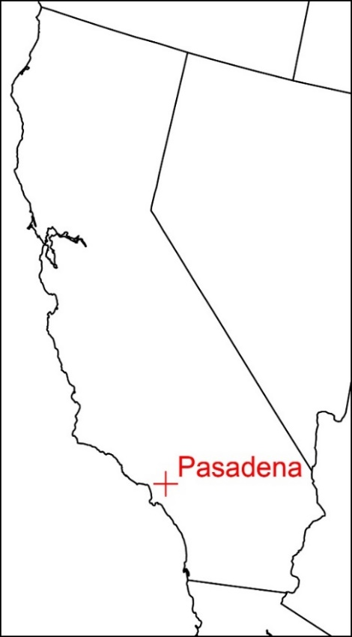
Objective 2: Estimate VCP air quality impacts
Base Model: Community Multiscale Air Quality (CMAQ) model version 5.3
State-of-the-science S/IVOC emissions and SOA from combustion (Lu et al. 2019 in prep)
California and the CalNex campaign (at Pasadena) from May 15 to June 15, 2010
Sensitivity Simulations
Imposed VCP VOC emission magnitudes: 1× (base), 2×, 3×, 4×
Imposed SOA yields: 1%, 5%, 10% by mass
Notes:
Our second objective was to estimate the ambient air impacts of VCPs.
We used CMAQv5.3 and further updated it with a state-of-the-science treatment for semivolatile and intermediate volatility organic compounds as well as SOA from combustion sources
We simulated the 2010 CalNex field campaign with a focus on Pasadena, CA
We then conducted a series of sensitivity simulations focusing on emission magnitude and SOA yield. We used baseline VCP emissions as well as a factor of 2, 3, and 4 increase. These increased emissions fed into gas-phase and ozone chemistry via traditional VOC speciation. We also imposed SOA yields of 1, 5, and 10% by mass of VOC. These effective SOA yields overwrote the baseline CMAQ SOA for the VCP sector using the chemical reaction shown here with non-methane organic gas. Other sources of SOA remained as in the traditional model or as in the Lu et al. updates.

Slide 11
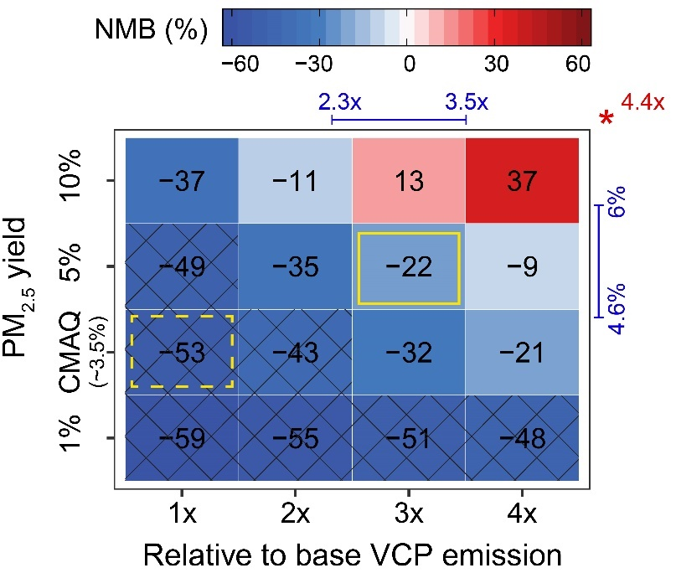
3× emissions and 5% SOA yield are suggested
Normalized mean bias (NMB) in modeled vs observed SOA at Pasadena
(background corrected)
Prompt SOA in CMAQ compared with background corrected measurements of SOA during CalNex
Current emission magnitude (1x) and SOA yield (~3.5%) inconsistent with observed SOA magnitude
The cross-hatched boxes show NMB > uncertainty in measured SOA
Both higher emissions and higher yields likely needed to resolve model-measurement bias in SOA
3x emissions and 5% SOA yield suggested as plausible solution
SOA yields close to 10% required to fully resolve model-measurement SOA bias using VCP sector only
SOA yield by mass
SHEDS Emission Magnitude
McDonald SOA yield (emission magnitude on top margin)
Notes:
We evaluated CMAQ predictions of prompt SOA to background corrected SOA measured during CalNex. The normalized mean bias is shown here in colors as a function of the VCP emission strength and SOA yield. The baseline
Top-down constraints impose by compared observed and modeled SOA concentrations indicates a factor of 3 higher emissions than default and a 5% SOA yield are recommended

Slide 12
3× VCP emissions eliminates ozone bias
VCPs responsible for ~17% of maximum daily 8-hr average O₃ (MDA8) at Pasadena
(9 ± 2 ppb VCP contribution) with 3x emissions
Notes:
The factor of 3 increase in VCP emissions also resolves the ozone bias in the model. CMAQ predicts 46 ppb of O3 for CalNex. Our CMAQ recommended solution is 51 ppb, only 1 ppb shy of the observed value. We find VCPs are responsible for !17% of the MDA8 ozone or 9 ppb.

Slide 13
Ambient air evaluation constrains emissions from VCPs
*Indicates EF not available; Arrow and Total on right axis
McDonald
2011 NEI
Solvent Tool
SHEDS-HT
McDonald (CA)
2011 NEI (CA)
Pers. Care
Coatings (arch.)
Coatings (indust.)
Adhesives (indust.)
Pesticides (agricult.)
Household products
Adhesives (consumer)
Pesticides (consumer)
TOTAL
Top-down constraints imposed by ambient air quality measurements suggest 14 kg person⁻¹ yr⁻¹ emissions to air (CMAQ solution)
Notes:
The improved SOA and ozone predictions in CMAQ suggest that a factor of 3 increase in emissions are consistent with ambient air constraints. This translates to about 14 kg/person/yr emissions to air, only slightly lower than the 20 kg/person/yr suggested by SHEDS and slightly higher than the McDonald et al. CA estimates.

Slide 14
Conclusions
High ambient air emissions (≥ 14 kg person⁻¹ yr⁻¹) from VCP usage are supported by multiple inventory methods and top-down constraints imposed by ambient pollutant concentrations
Ambient air constraints are consistent with product solvent usage up to 75 kg person⁻¹ yr⁻¹ (higher than NEI/Solvent Tool estimates and lower than a priori near-field exposure modeling estimates)
CMAQ indicates VCPs are responsible for ~41% of the photochemical organic PM_{2.5} (1.1 ± 0.3 $μ$g m⁻³) and ~17% of maximum daily 8-hr average O₃ (9 ±2 ppb) in summer Los Angeles
pye.havala@epa.gov
Notes:
This may change the role of inhalation as a near-field exposure pathway (0.2% by default-10x increase in air concentration could lead to 10x increase in inhalation making it comparable to object-to-mouth ingestion)

Slide 15
Extra

Slide 16
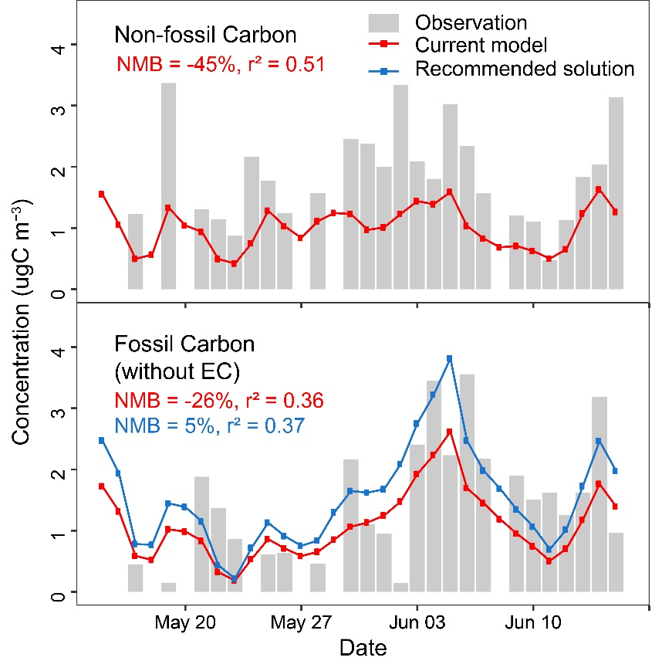
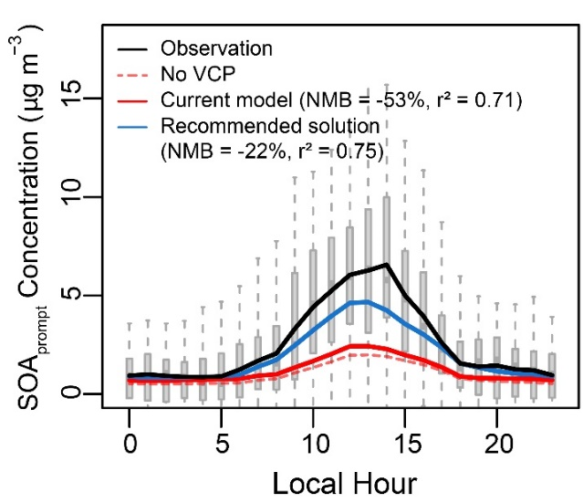
VCP recommended solution points to other missing SOA sources
Biogenic SOC + biomass burning POC + cooking POC
mobile POC +
VCP SOC + other anthropogenic OC
VCPs are responsible for ~41% of the prompt SOA (1.1 ± 0.3 $μ$g m⁻³)
Daytime increase requires high yield (5-10%)
Fossil carbon consistent with recommended solution
Likely missing modern carbon sources that contribute to background OA level
Notes:
After accounting for VCPs, there remains a gap in SOA predictions: this is likely modern and background/long-range sources.
High yield-SOA formation efficiency too low if yield is low

Slide 17
OH reactivity improved with higher VCP emissions
OH reactivity is indication of ambient VOC burden (and speciation)
CMAQ still missing some reactivity
Observed OH Reactivity: 21 s⁻¹ (Griffith et al. JGR 2016)
Base CMAQ OH Reactivity: 12.8 s⁻¹
Recommended Solution CMAQ OH Reactivity: 15.5 s⁻¹
CMAQ Predictions as a Function of Emissions

Slide 18
Lack of SOA in CMAQ due to emissions and/or yields (depending on sector)
S_{i}, EF_{i}
Plausible upper-bound (based on top-down constraint)
McDonald
CMAQ v5.3
SOA yield (%)
CMAQ recommended (based on top-down constraint)
Pesticide and adhesive emission underestimates drive PM_{2.5} emission underestimates (115 Gg yr⁻¹ underestimate)
Personal care emission underestimates, combined with low PM_{2.5} yields in CMAQ, drive SOA underestimates for that sector (35 Gg yr⁻¹)
Notes:
The top-down yield inferred from SOA model-obs comparison is different than the bottom up yield currently in CMAQ. We can break it down by sub-sector using speciation profiles in SPECIATE and information from McDonald et al. to identify sub-sectors where speciation is likely the driver of underestimate AQ impacts.
--read bullets--

Slide 19
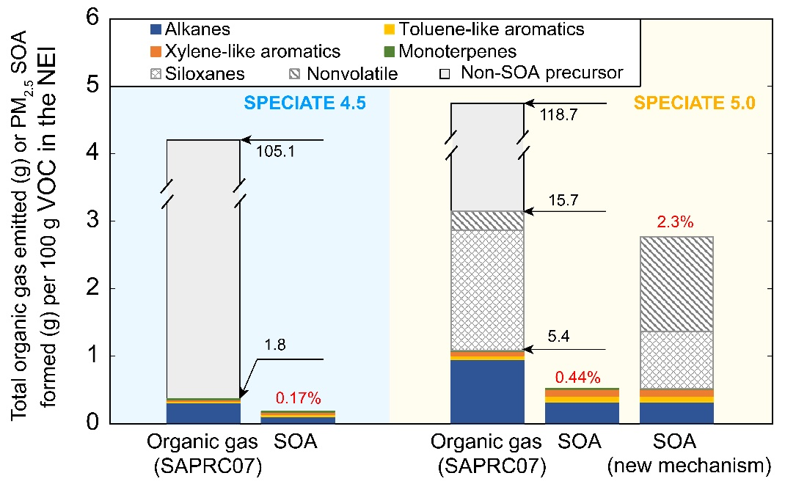
How do we get higher SOA yields in CMAQ?
Emissions and SOA formation for personal care sector
The majority of the SOA comes from mass that is discarded from CMAQ mechanism species (mapped to NROG, NVOL, or other unrecognized species)
Current Operations CMAQv5.3+SPECIATE 4.5
0.17% SOA yield
Possible updates with existing information
2.3% SOA yield
Biggest issue: model mechanisms and lack of suitable SOA precursors
Notes:
For personal care, we can increase SOA in CMAQ using existing information.

Slide 20
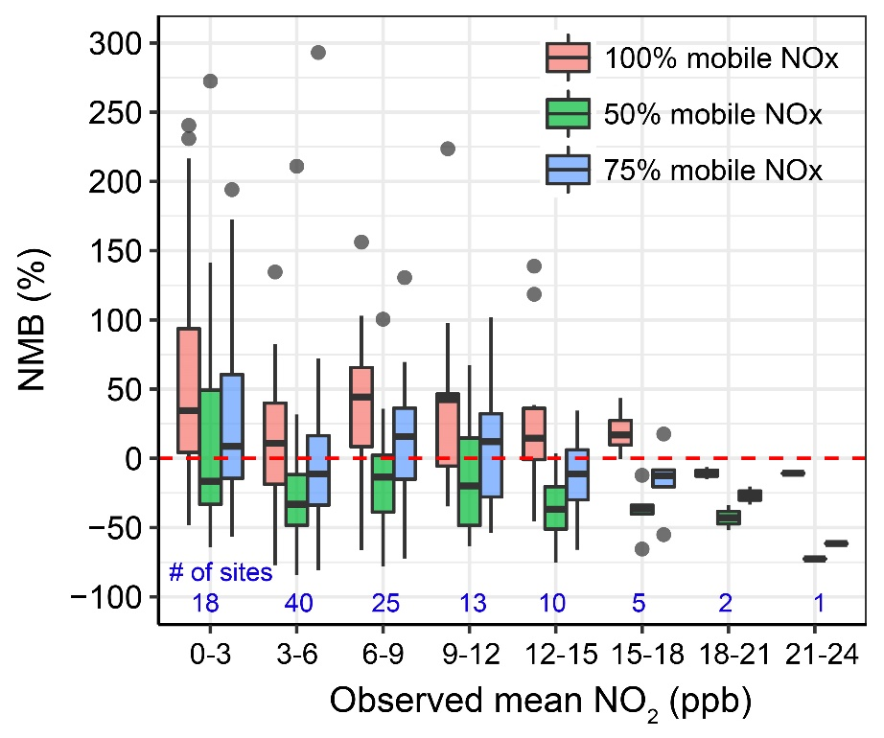
AQS Sites NOx Evaluation

