Slide 1
Source Attribution of Global PM_{2.5} Mortality Using the Adjoint of Hemispheric CMAQ
Yasar Burak Oztaner, Shunliu Zhao, Amir Hakami (Carleton University); Amanda Pappin (Health Canada); Rohit Mathur (EPA); the CMAQ-Adjoint Development Team

Slide 2
INTRODUCTION
Long-term PM_{2.5} exposure results in significant mortality worldwide.
The Global Burden of Disease (GBD, 2015) estimates that outdoor fine particulate matter causes over 4 million premature deaths annually.
In this study, we present backward/adjoint analysis to provide location-specific source attribution of the long-term mortality from exposure to fine particles in the Northern Hemisphere.

Slide 3
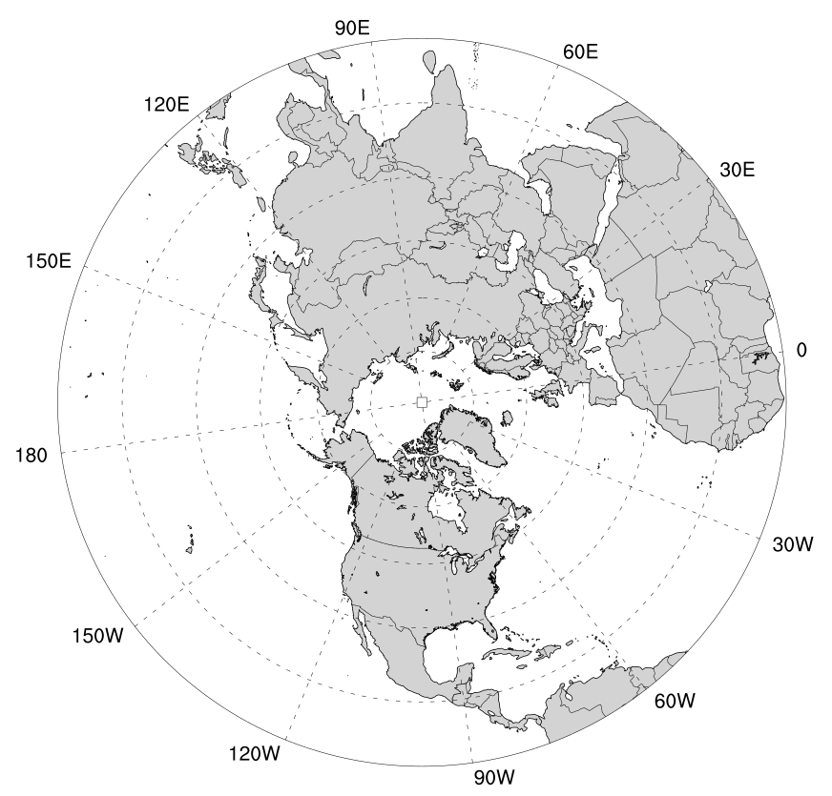
Methodology
 | Northern Hemisphere | USA
Study Period | 2 weeks in January, April, July, and October, 2010, each (plus 1 week for Forward and 1 week for Backward spin-up period)
Meteorology | GFS initialization / WRF v3.8.1
Emissions | SMOKEv4.0 → EDGAR/HTAP2 (Separate sectors)
Spatial Resolution | 108km - Polar Stereographic Projection (187 x 187)
CTM | CMAQ v5.0 and its ADJOINT
Epidemiological model | Global Exposure Mortality Model (GEMM) (Burnett et al., 2018)
Adjoint cost function | Annual Chronic exposure mortality, constructed from two-week simulations in each season.

Slide 4
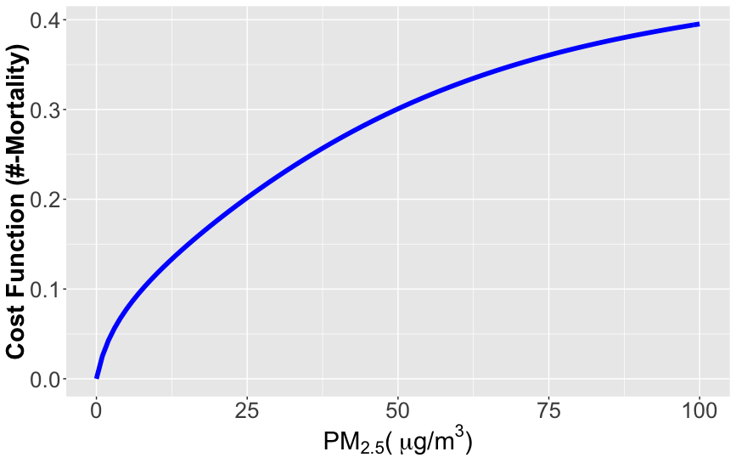
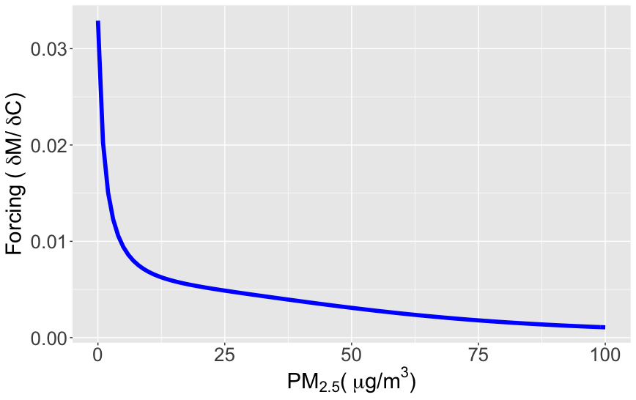
Benefit per ton (BPT) using GEMM
COST FUNCTION
GEMM
Global Exposure Mortality Model (GEMM) (Burnett et al., 2018)
Based on a number of cohorts from around the world.
Heavily informed by American (ACS) and Canadian cohorts (CanCHEC)
Cause-specific mortality, but here non-communicable disease (NCD) NCD + lower respiratory infection (LRI) mortality for 25+ years populations.
The supra-linear concentration response function (CRF), nearly doubles GBD estimates.
FORCINGS

Slide 5
Baseline Data
Baseline Mortality Rates (BMR):
Obtained from IHME (2019, http://ghdx.healthdata.org/gbd-results-tool) for the year of 2010
NCD + LRI, age 25+
Population
NASA Socio-Economic Data and Application Center (SEDAC)
The Gridded Population of the World (Version 4.2: Basic Demographic Characteristics, ~5km resolution).
Population by age, aggregated to the our domain (108 km spatial resolution).

Slide 6
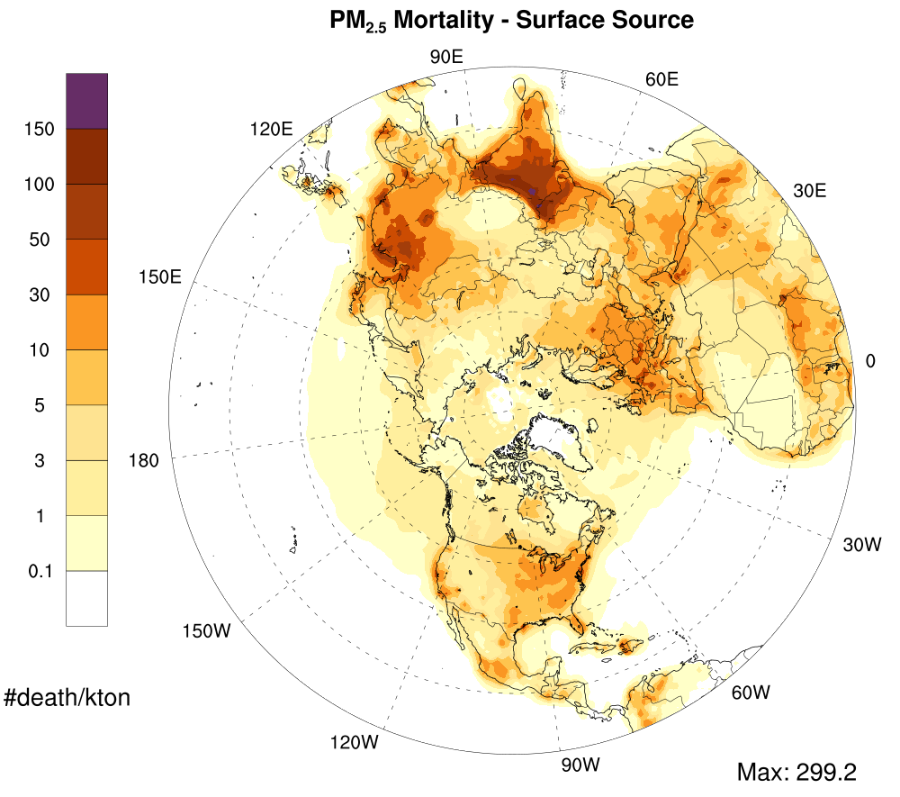
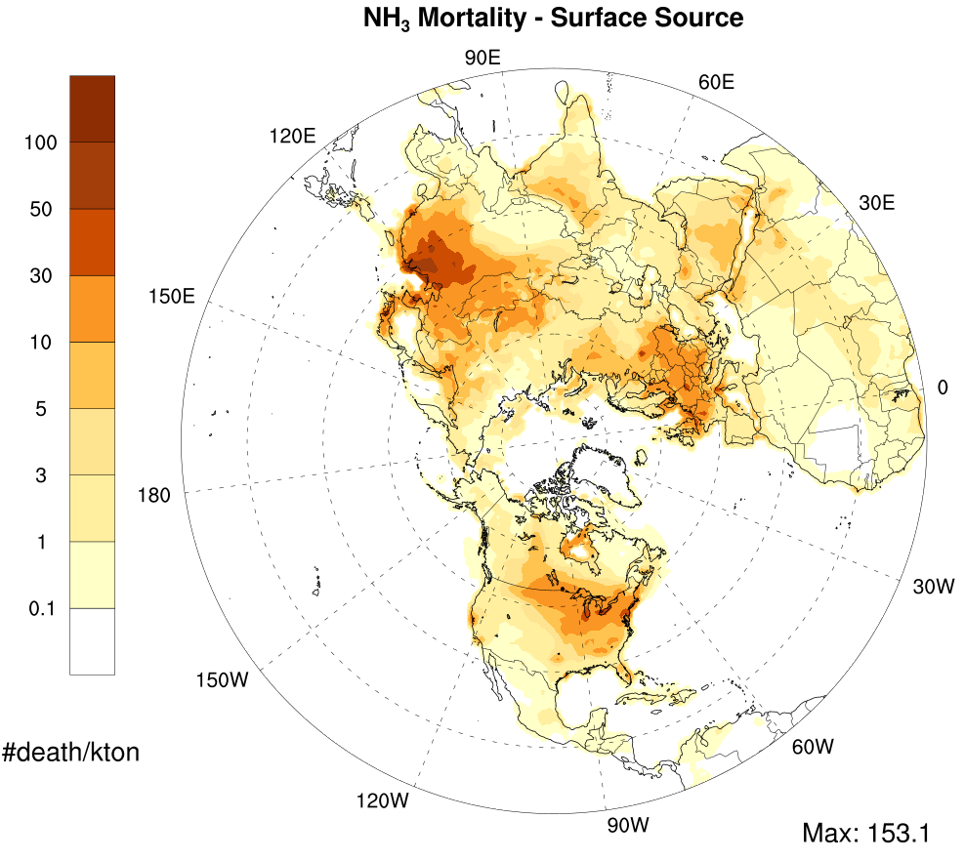
RESULTS: BPT– Northern Hemisphere (Surface Sources)

Slide 7
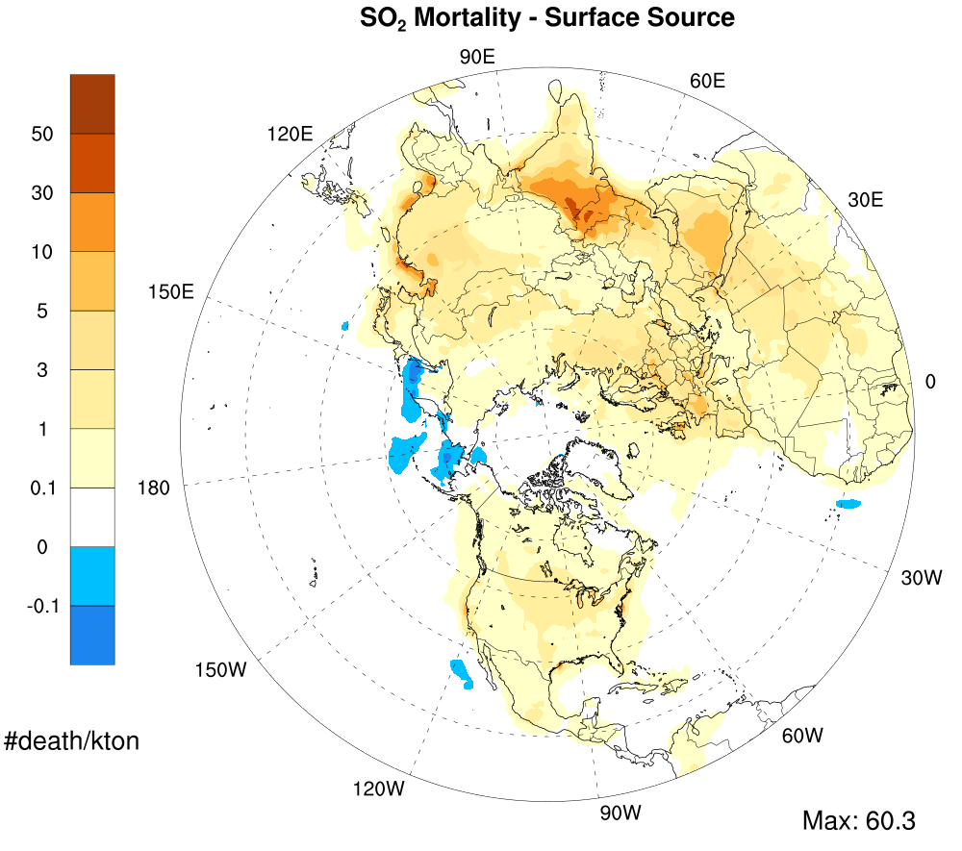
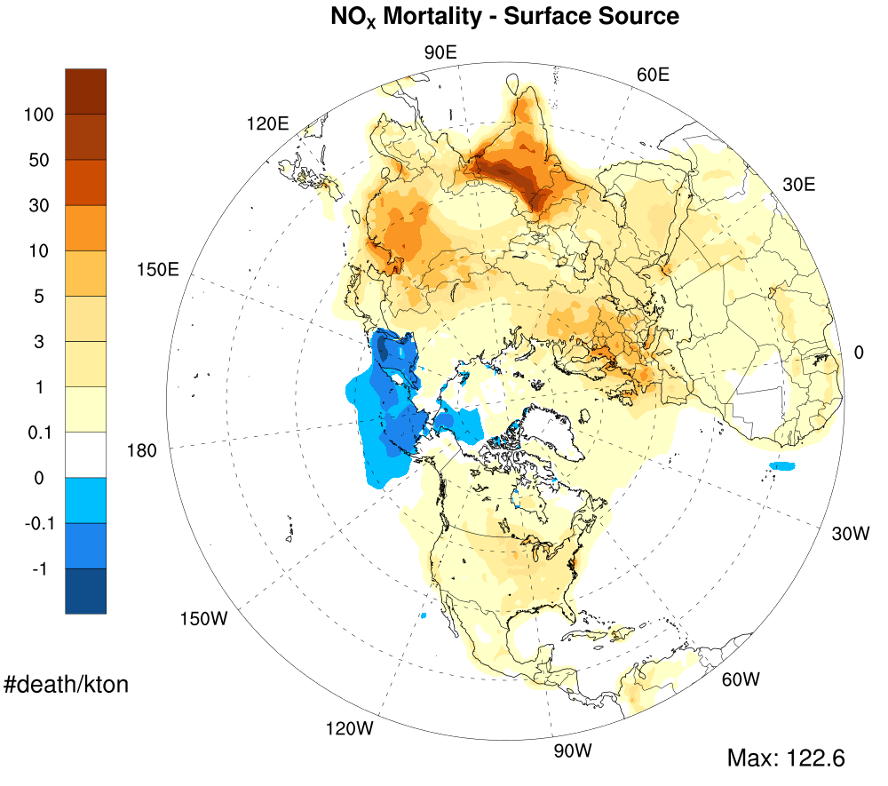
RESULTS: BPT– Northern Hemisphere (Surface Sources) cont.

Slide 8
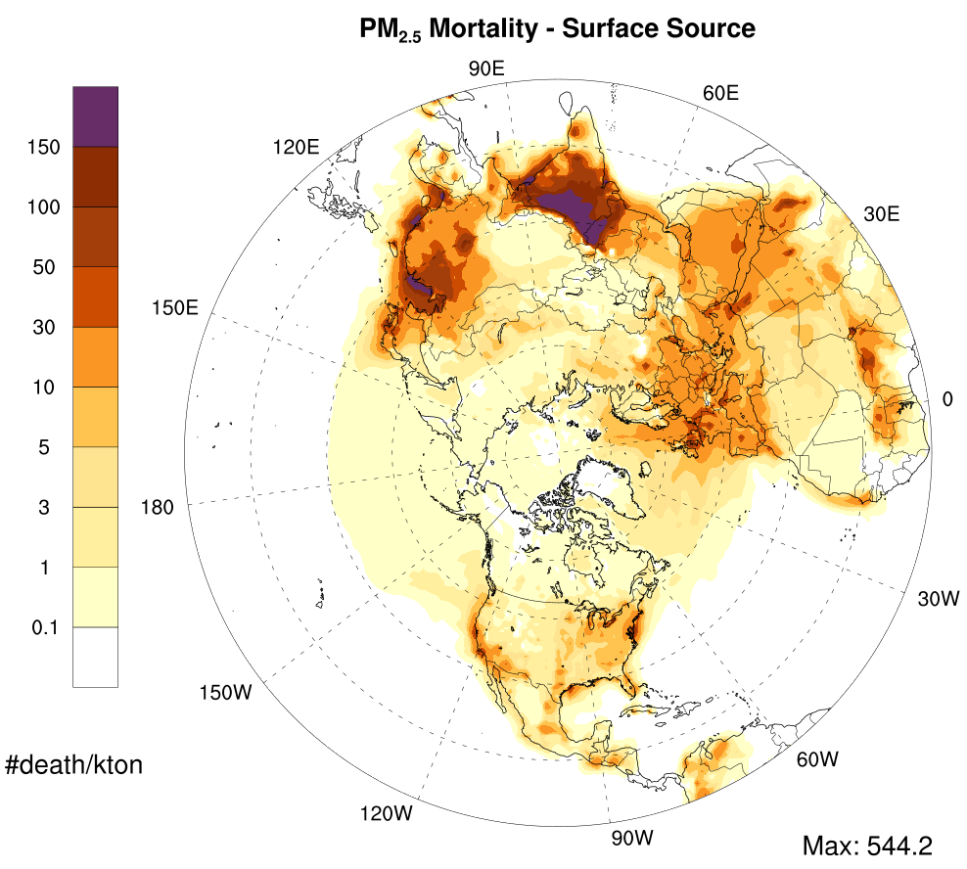
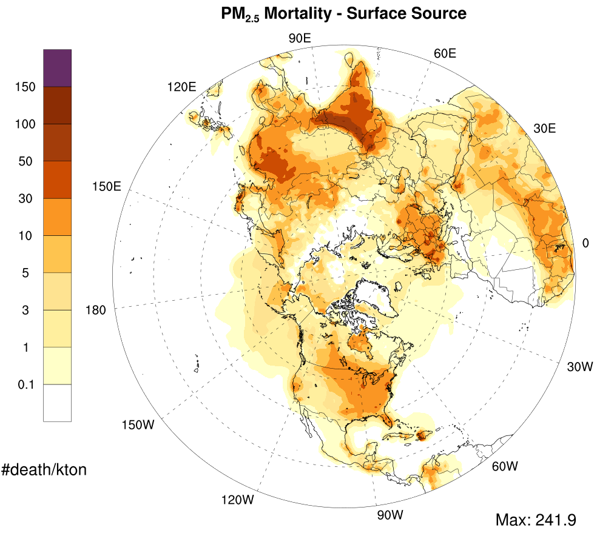
Seasonal Variability In BPT (PM_{2.5}, Winter/Summer)
Summer (July)
Winter (Jan)

Slide 9
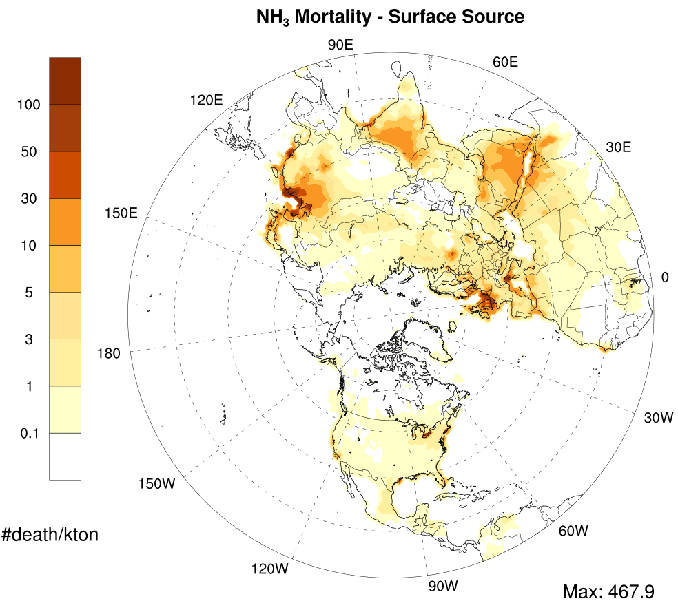
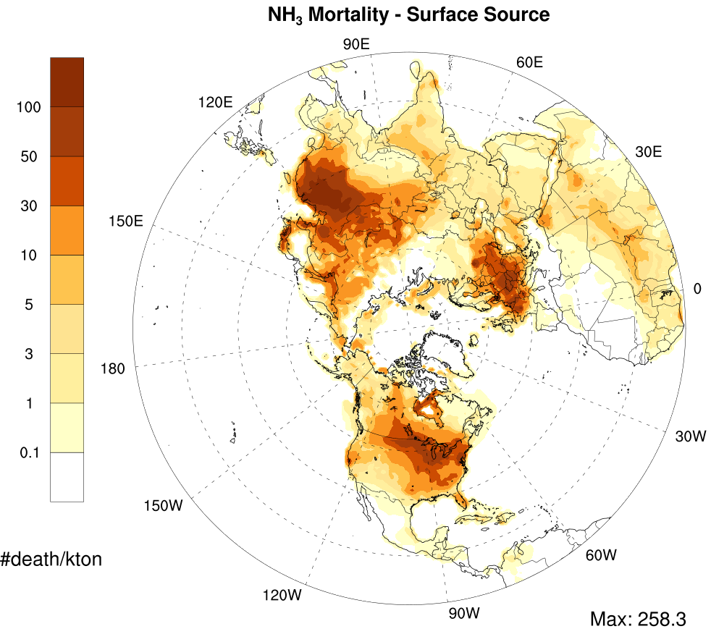
Seasonal Variability In BPT (NH₃, Winter/Summer)
Summer (July)
Winter (Jan)

Slide 10
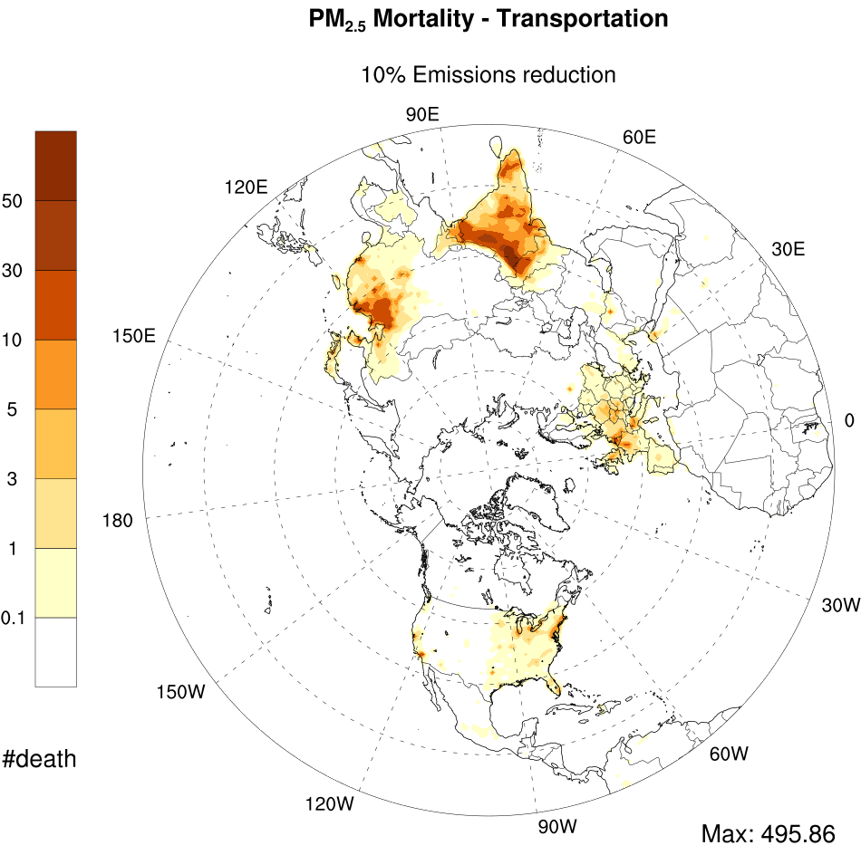
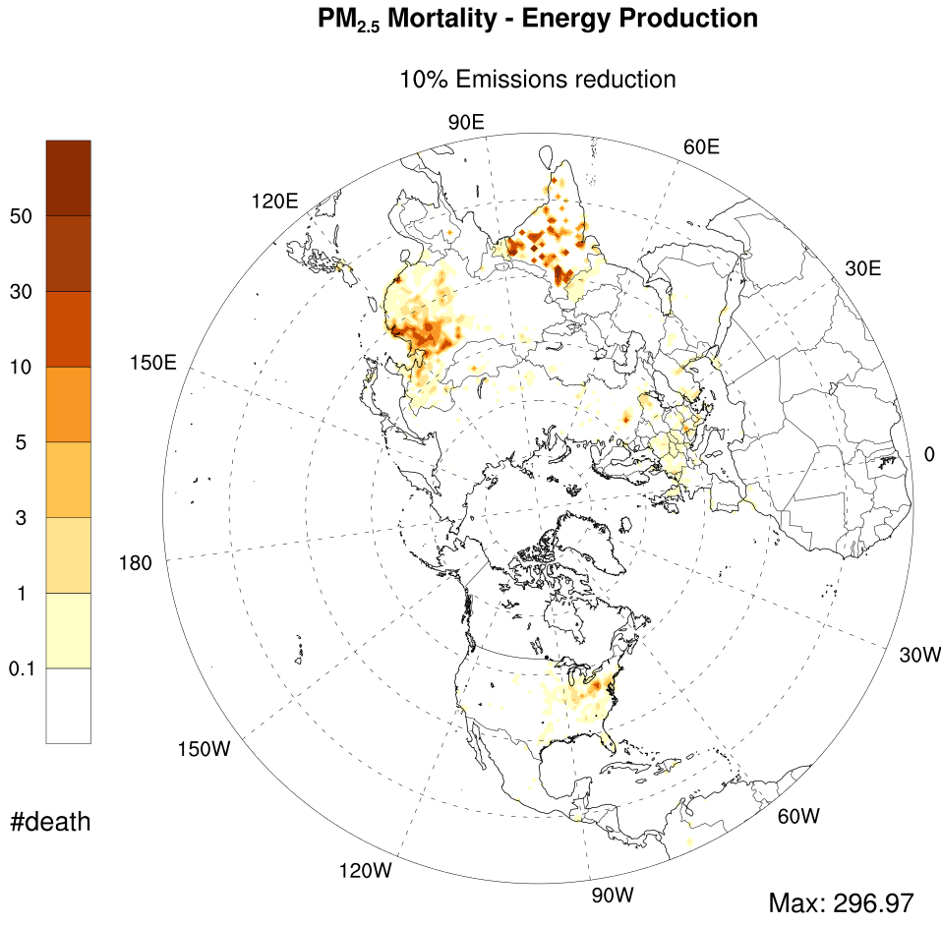
AVOIDED DEATH in 10% emission reduction
TRANSPORTATION
ENERGY

Slide 11
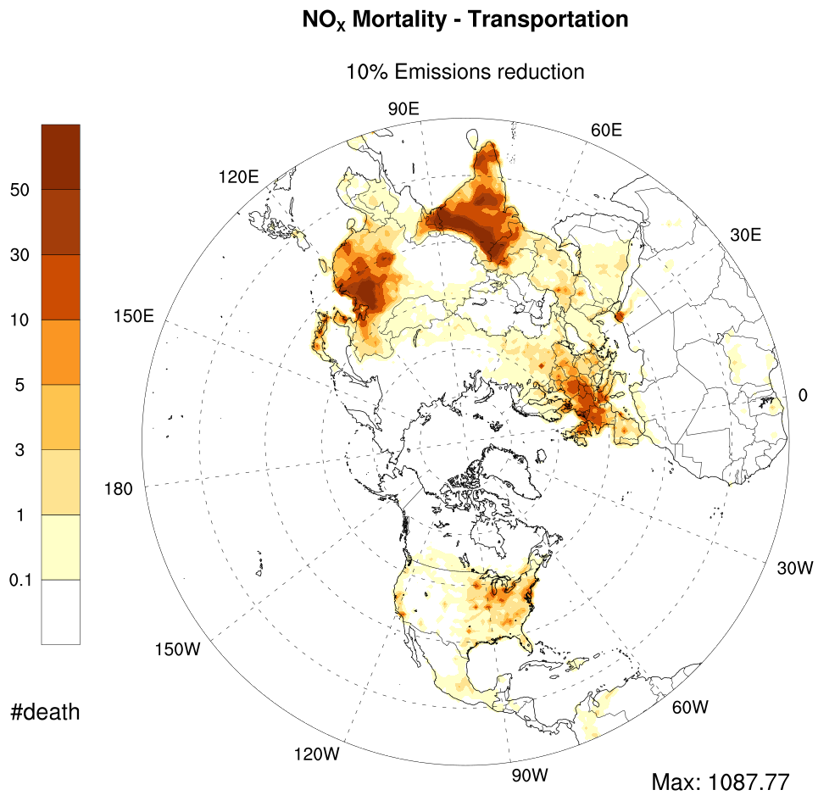
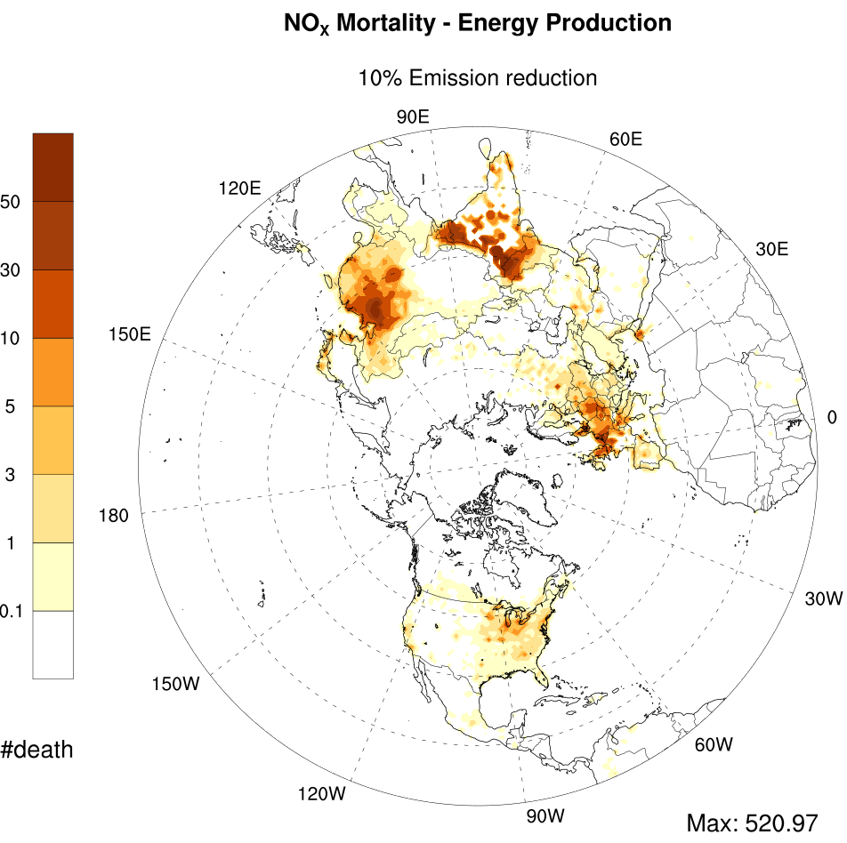
AVOIDED DEATH in 10% emission reduction cont.
TRANSPORTATION
ENERGY

Slide 12
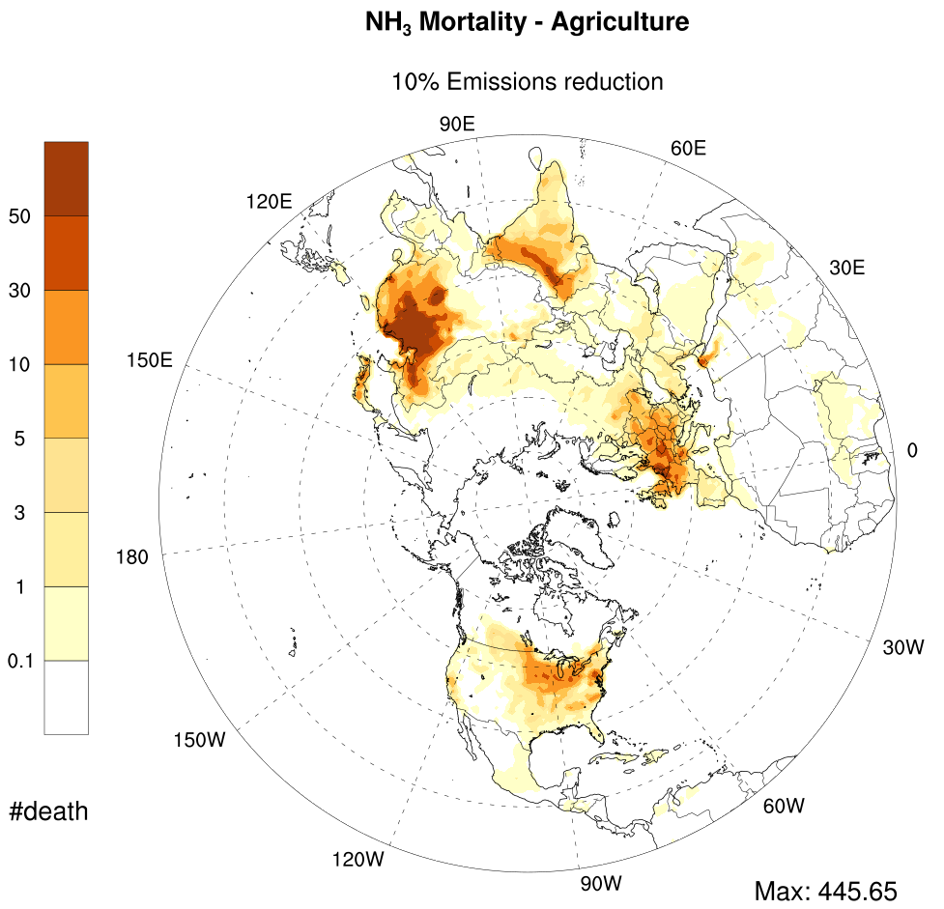
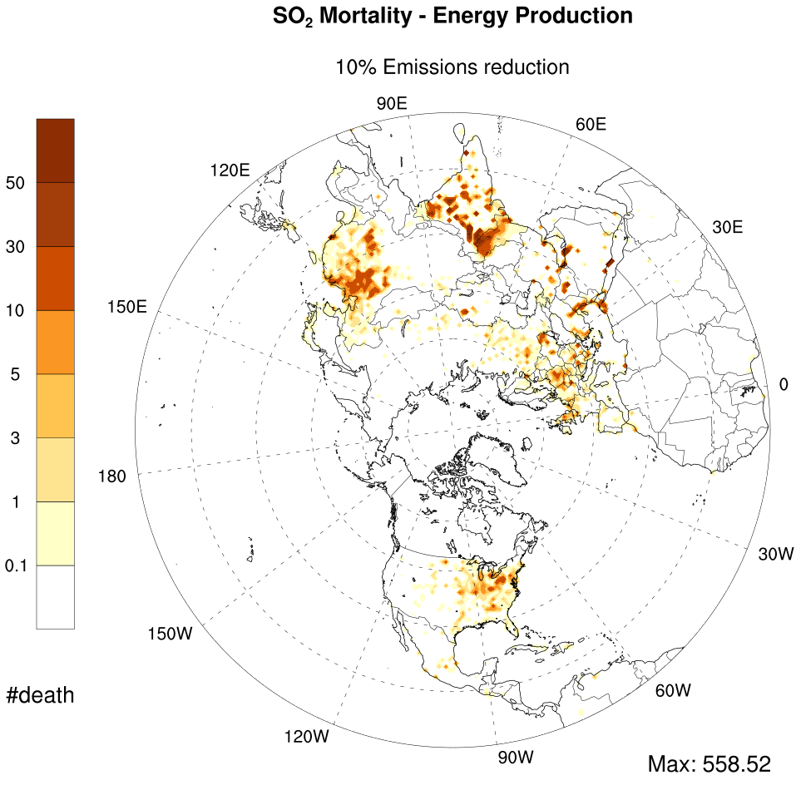
AVOIDED DEATH in 10% emission reduction cont.
NH₃ - AGRICULTURE
SO₂ – ENERGY

Slide 13
AVOIDED mortality due to 10% emission reduction
Region | Energy | Industry | Transport | Other Surface | All Sources
India | 10181 | 5472 | 19367 | 26017 | 61037
China | 7456 | 18246 | 9397 | 43557 | 78656
Rest of Asia | 5197 | 3295 | 4415 | 9296 | 22203
North America | 1671 | 931 | 1772 | 4890 | 9264
Europe | 3048 | 1575 | 3746 | 7462 | 15831
Northern Africa | 264 | 113 | 215 | 525 | 1117

Slide 14
AVOIDED mortality by 10% emission reduction
Region | Primary PM_{2.5} | NH₃ | SO₂ | NO_{X}
India | 27619 | 4131 | 6089 | 23198
China | 26751 | 25718 | 7298 | 18889
Rest of Asia | 7036 | 2516 | 5599 | 7052
North America | 1771 | 3828 | 1157 | 2509
Europe | 2615 | 5157 | 1977 | 6081
Northern Africa | 191 | 316 | 298 | 311

Slide 15
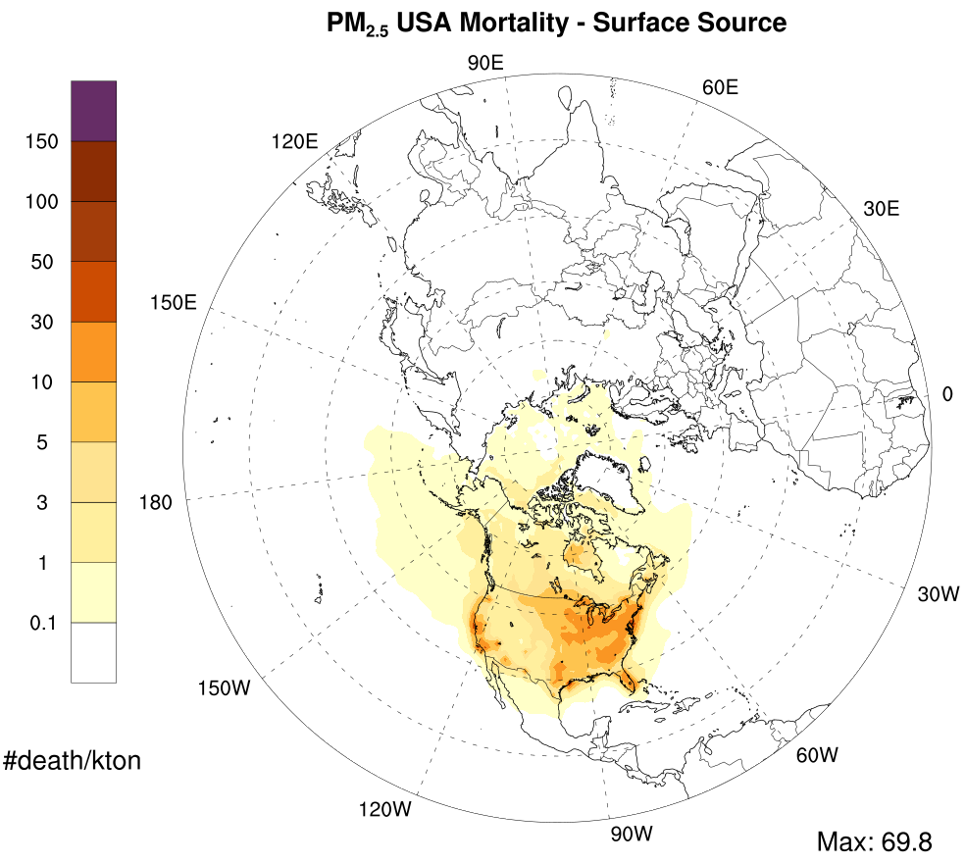
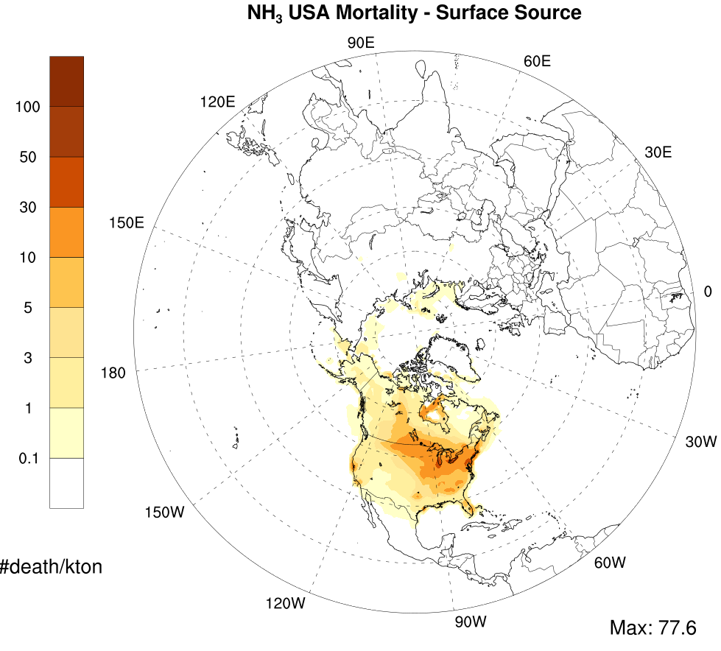
RESULTS: BPT– USA (Surface Sources)

Slide 16
TOTAL AVOIDED DEATHS in THE US
Source | USA | Transboundary
Energy | 1075 | 59
Industry | 609 | 274
Transportation | 1507 | 163
Other Surface | 4041 | 635
All Source | 7231 | 1131
Pollutant | USA | Transboundary
PM_{2.5} | 1497 | 184
NH₃ | 3201 | 490
SO₂ | 858 | 232
NO_{X} | 1675 | 225

Slide 17
CONCLUSION
India (61k) and China (78k) represent more than 70% of avoided mortality in the case of 10% emission reduction in all sources.
Surface sources in general inflict much larger burden than elevated sources.
188,000 avoided mortality estimated in response to 10% emission reduction from all sources over the Northern Hemisphere.
Secondary PM contribution to mortality is larger than primary PM.
Number of total avoided death in the US is mostly attributed to local sources (86%). Secondary PM species, again, show larger contribution than primary PM.
Better representation of annual mortality may require longer simulations.

Slide 18
Acknowledgements
Funding from the Health Effects Institute, Natural Science and Engineering Research Council of Canada, Health Canada
Computational resources from Compute Canada

Slide 19
EXTRA SLIDES

Slide 20
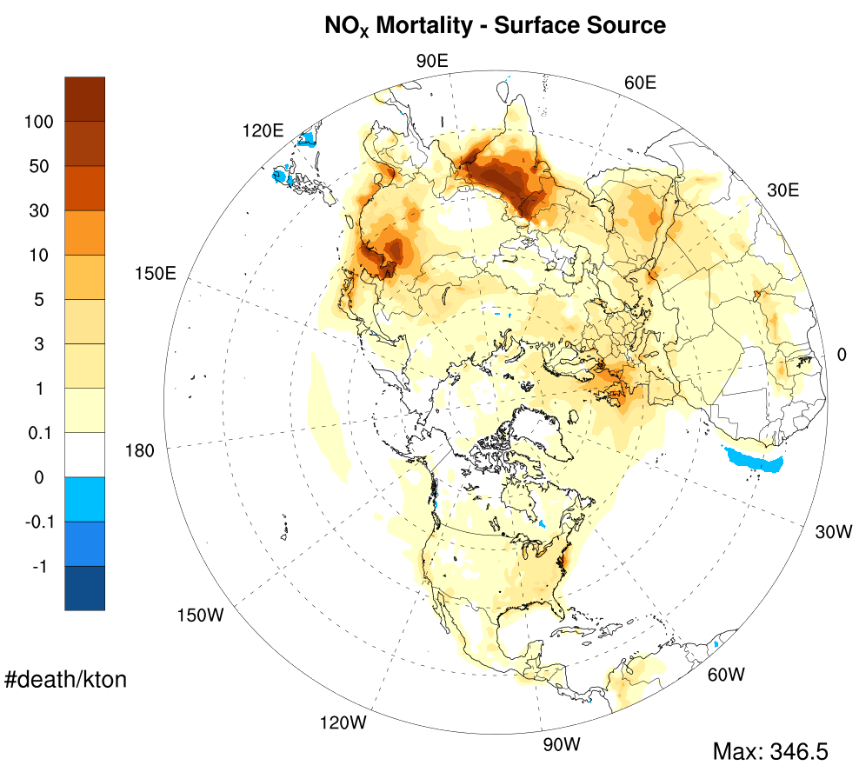
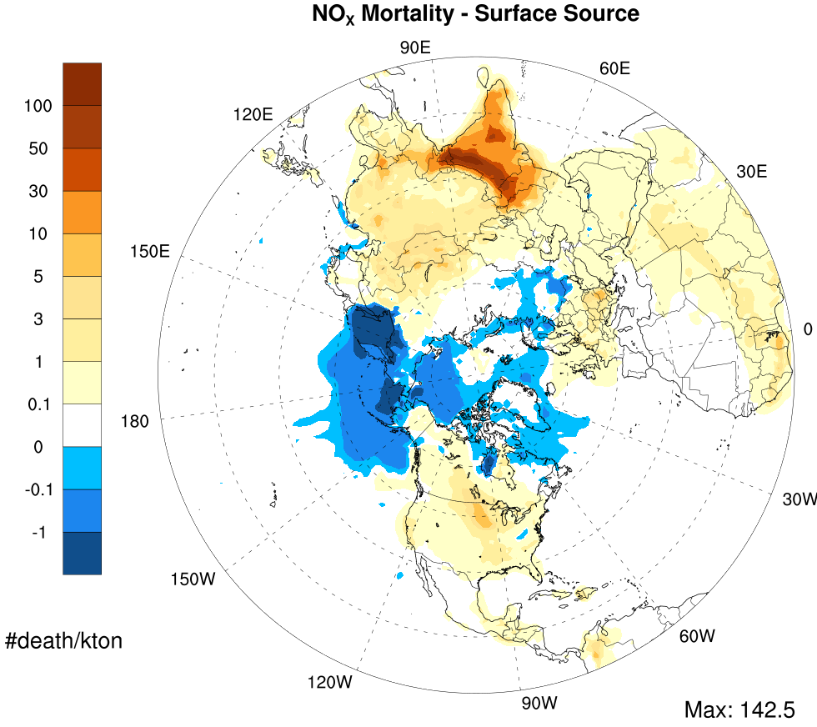
Seasonal Variability In BPT (NO_{X}, Winter/Summer)
Summer (July)
Winter (Jan)

Slide 21
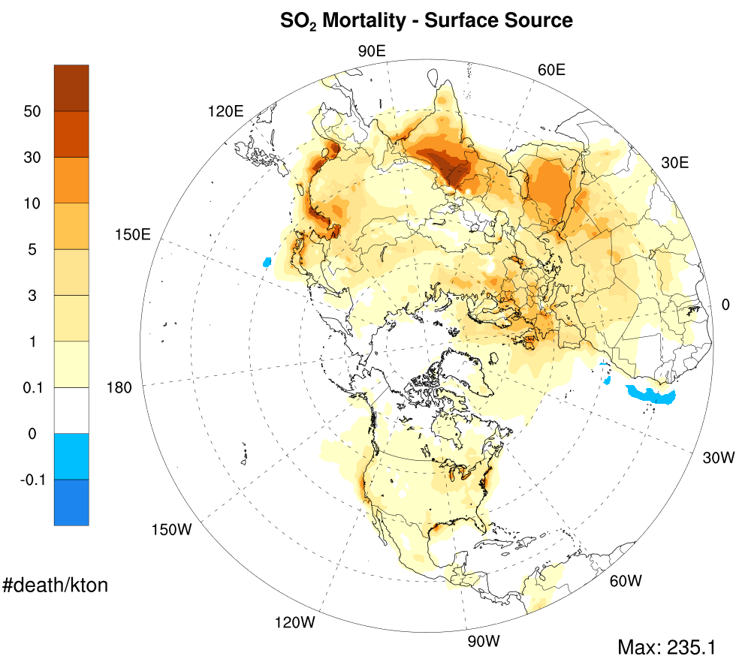
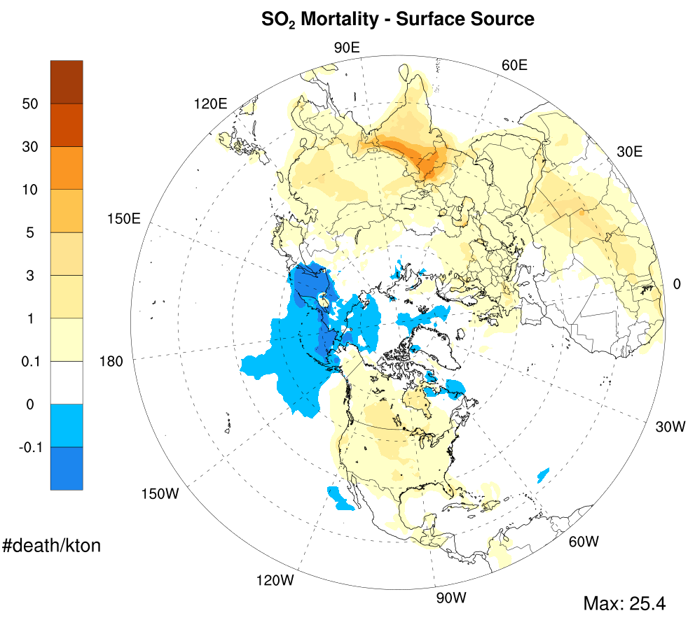
Seasonal Variability In BPT (SO₂, Winter/Summer)
Summer (July)
Winter (Jan)

