Slide 1
Predicting the phase state of atmospherically relevant aerosols and its impact on multiphase chemistry in a regional-scale atmospheric model (CMAQ)
Quazi Z Rasool¹, Ryan Schmedding¹, Yue Zhang^{1,4}, Havala Pye², Haofei Zhang³, Sara Farrel¹, Yuzhi Chen¹, Jason Surratt¹, William Vizuete¹
1. Department of Environmental Science and Engineering, The University of North Carolina at Chapel Hill, Chapel Hill, North Carolina, 27516
2. National Exposure Research Laboratory, Office of Research and Development, Environmental Protection Agency, Research Triangle Park, Durham, NC
3. Department of Chemistry, University of California at Riverside, Riverside, California, 92521
4. Aerodyne Research, Inc., Billeria, MA, 01821
CMAS 2019, 21st October 2019

Slide 2
Background
Accurate prediction of phase state and mixing state of mixed inorganic-secondary organic aerosol (SOA) critical to quantify their impact on climate and air quality (Freedman, 2017, ACS)
Organic Aerosols (OA) ~ 20-60% of PM_{2.5} in continental mid latitudes (Carlton et al., 2009; Jimenez et al., 2009; Kroll et al., 2011)
During Southeastern Oxidant and Aerosol Study (SOAS) 2013:
Aerosol from Isoprene-derived epoxydiols (IEPOX) ~ 1/3rd of PM₁ OA (Budisulistiorini et al., 2015)
Aerosols phase separate to form SOA coatings on acidified sulfate seed aerosol
Impedes acid–catalyzed multiphase reactions of IEPOX impacting SOA budget (Zhang et al. ES&T Letters, 2018)

Slide 3
Overview
Current state of atmospheric models (Budisulistiorini et al. ES&T, 2017; Pye et al., 2017):
IEPOX-derived aerosol-
Heterogeneous equilibrium uptake to an internally mixed, homogeneous population of particles
Consideration for aerosol phase state and phase separation is absent
Diffusional resistance through coatings can change PM_{2.5} predictions
Uncertainty in modeled gas-particle partitioning (For IEPOX multiphase chemistry) (Zhao et al., 2013; Isaacman-VanWertz et al., 2016)
This study determines aerosol phase transitions and phase separation and their impact on multiphase chemistry (aerosol budget) by accounting for:
OA composition: products of oxidizing precursor organics (biogenic and anthropogenic), aerosol water
OA constituent-specific properties (O:C ratio, molecular weight)
Ambient meteorology (T, RH)

Slide 4
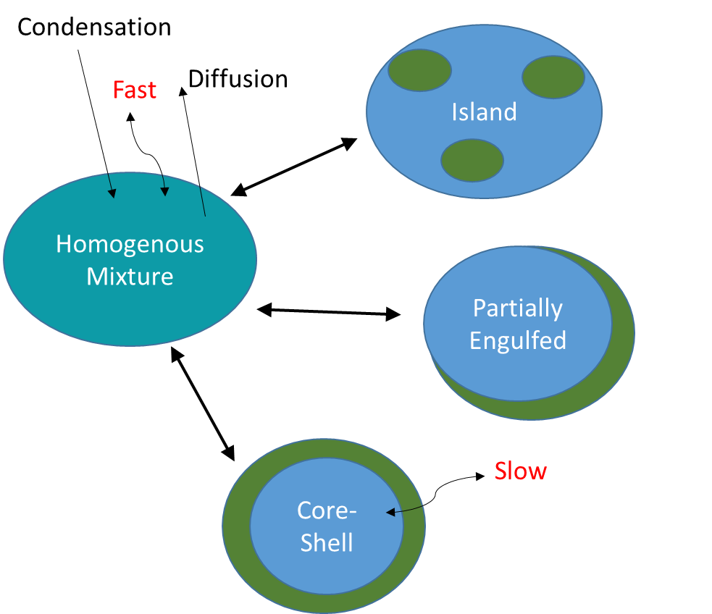
SOA Phase State and Morphology (organic coating impact)
Aerosols phase separate under atmospherically relevant conditions – (up to 95% RH)
Core-Shell morphology on phase separation:
Viscous outer organic coating
Less viscous inner aqueous inorganic core particle
SOA viscosity =
f (phase state, morphology, chemical composition, aerosol water uptake)
Island
Homogenous Mixture
Partially
Engulfed
Partially
Engulfed
Core-Shell
(O’Brien et al., 2015; Renbaum-Wolff et al., 2016; You et al., 2012)
Notes:
Aerosols have been shown to phase separate under atmospherically relevant conditions – (up to 95% RH)Viscous outer organic coatingLess viscous inner aqueous/inorganic core particle

Slide 5
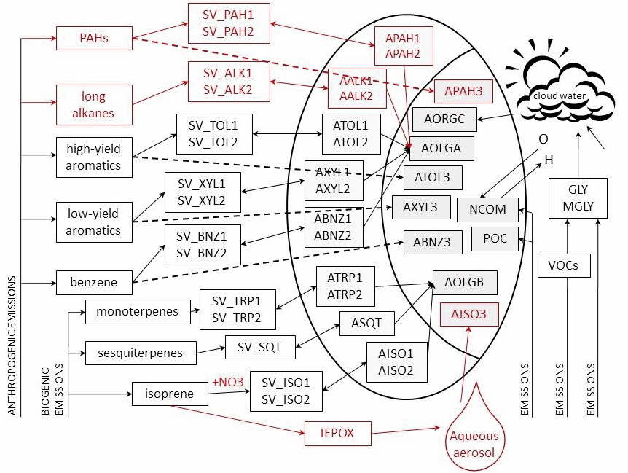
SOA Formation in Chemical Transport Models
khet
Low NOx Pathway:
Based on Pye et al. (2013)

Slide 6
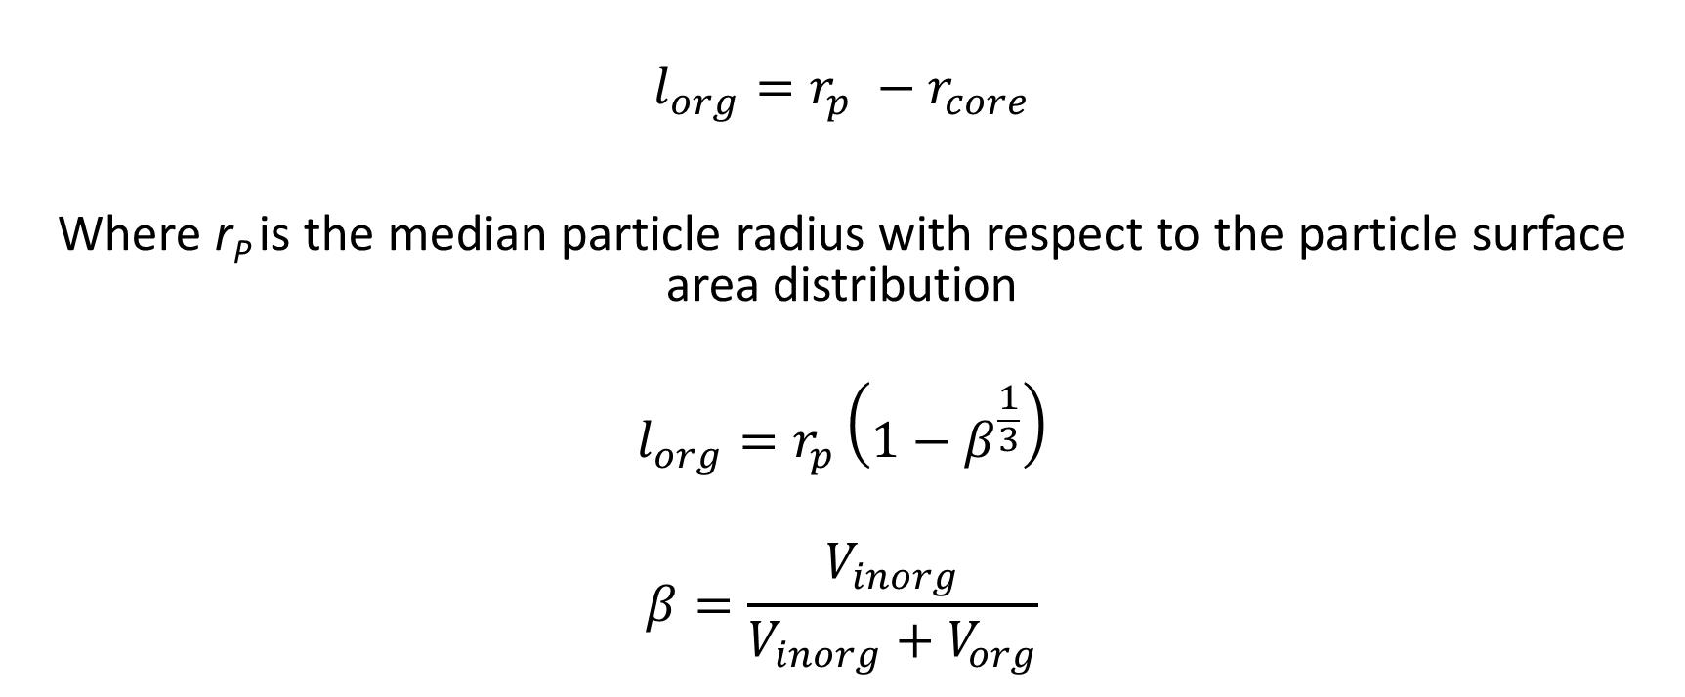
Reactive Uptake (IEPOX multiphase chemistry)
Reactive uptake coefficient (ϒ)
For Homogenous particle:
r_{p} = r_{core}
l_{org = 0}
(Pye et al., 2013; Anttila et al., 2006; Gaston et al., 2014; McNeill et al., 2012; Ryder et al., 2014; Budisulistiorini et al., 2017)
Diffuso-reactive Parameter,
Bulk phase processes in Organic shell/coating
Organic Coating thickness,
(Evoy et al., 2019; Ullmann et al., 2019)
[Nucleophiles] and [acids]: higher in Phase separated core than in homogenous mixture

Slide 7
Modified Vogel-Tamman-Fulcher Equation
Gordon-Taylor Mixing rule
K_{GT} is the Gordon-Taylor coefficient: assumed to be 2.5
wa and wb -> mass fractions of anthropogenic and biogenic OA species, respectively.
ws(RH) or ws -> mass fraction of organic aerosol water. [assumed as 10% of ALW in agreement with findings of Pye et al., 2017]
(DeRieux et al., 2018; Shiraiwa et al., 2017; Koop et al., 2011; Fulcher, 1925; Tamman and Hesse, 1926; Vogel, 1921; Gordan and Taylor, 1952)

Slide 8
Phase state and Phase separation (morphology)
Ice nuclei SLPS LLPS Homogeneous Inverted
liquid core-shell
T_{org}:T =1 RH decreases (T_{org}:T >0.8)
T_{org}:T =1 RH decreases (T_{org}:T >0.8)
RH increases (T_{org}:T < 0.8)
η_{org} = 10¹² Pa.s ----------------η_{org} = 100 Pa.s------------------------------
η_{org} = 10¹² Pa.s ----------------η_{org} = 100 Pa.s------------------------------
*
*
For Homogenous liquid:
Reid et al. (2018); Zuend and Seinfeld (2012); Song et al. (2018)
*morphologies need more exploration and not addressed in this work

Slide 9
Modeling set-up and episode
Atmospheric model: US EPA’s Community Multiscale Air Quality Model (CMAQ) v 5.2.1:
Resolution- 12km x 12km grid cells, 36 vertical layers, CB6r3 chemical solver.
Spatial extent: Continental US (459x299 grids)
Simulation time period: SOAS 2013 period (6/1/2013 – 7/15/2013), 10 days of spin-up
Meteorological inputs: WRFv3.8 with lightning
Emission inputs: NEI 2011v2 (Anthropogenic), BEISv3.6.1 (Biogenic)- 1.5x Isoprene emissions(Pye et al., 2017)
Simulations:
1) NonPhaseSep (Base CMAQ v5.2.1)
2) PhaseSep-
CMAQ with updated reactive uptake calculation to capture the impact of phase state and phase separation
Sensitivity cases: (Control case- PhaseSep)
3) Emissions reduction –
PhaseSep with EPA recommended emissions reductions 34% and 48% for NO_{x} and SO₂ from 2013 to 2025
4) HighHorg - 3 orders of magnitude higher H_{org} (3*10⁸ M/atm) in PhaseSep
5) PhaseSep2 - PhaseSep with SLPS following LLPS criteria

Slide 10
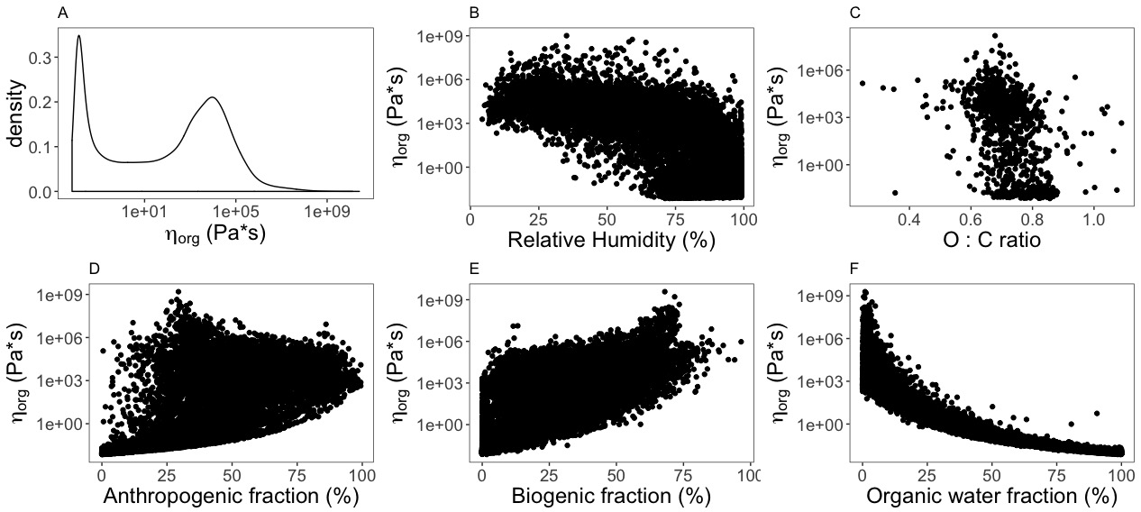
Parameters impacting aerosol phase i.e. viscosity (η_{org})
Correl. = 0.68
Correl. = 0.62
for CONUS, SOAS 2013
@ surface layer
PhaseSep
Correl. =0.62
Correl. = 0.74
Correl. = 0.92

Slide 11
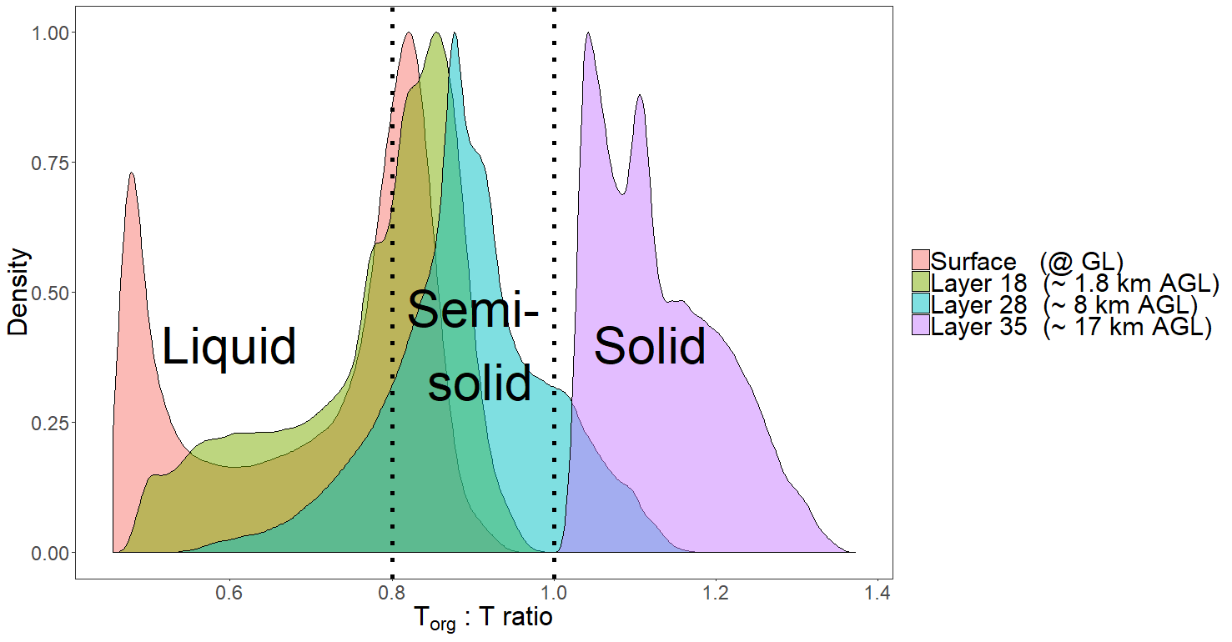
Phase state (T_{org}:T) vertical distribution
A
B
Solid
Semi-solid
C
Liquid
D
A) Surface Layer
B) Lower troposphere
C) Upper troposphere
D) Stratosphere

Slide 12
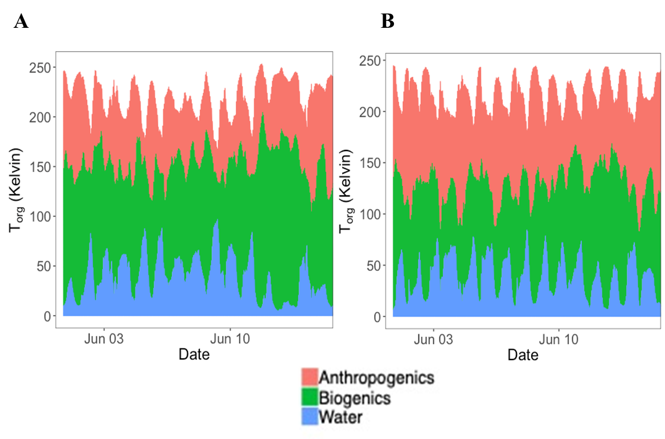
Impact of SOA constituents on phase state predictions
Centerville, AL (rural) Jefferson Street, Atlanta, GA (urban)
Discernable diurnal pattern:
Higher aerosol water between 18:00-08:00 LST -> Lower T_{org}
Rural SE US -> Higher aerosol water, higher biogenic OA
Higher OA -> Higher T_{org}
Same trend for T_{org}:T ratio
Anthropogenic OA
Biogenic OA
OA water
@ surface layer during SOAS 2013

Slide 13
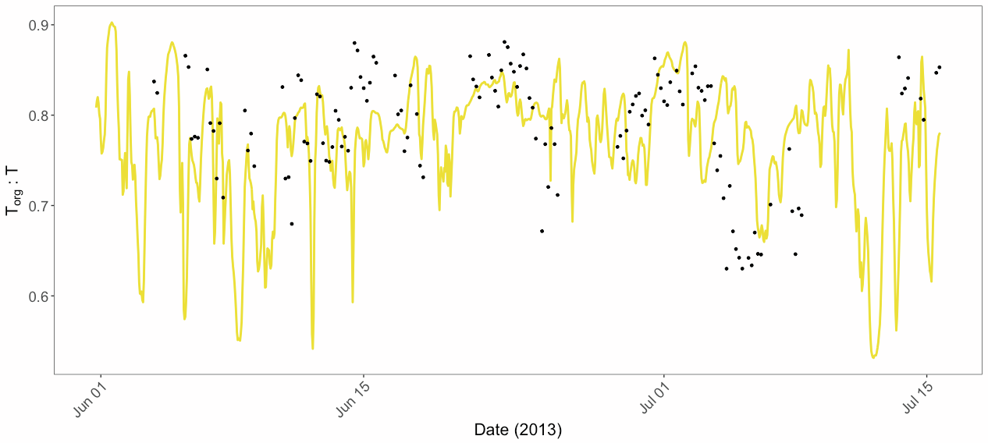
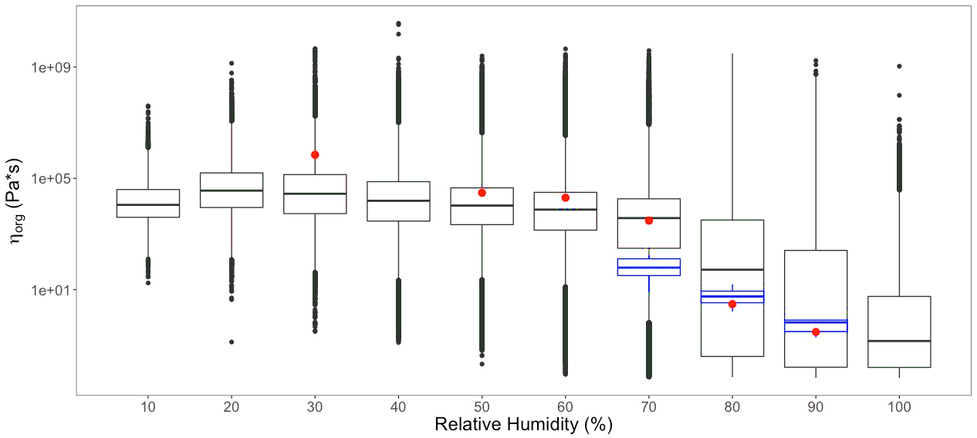
Evaluation with observations (phase state metrics)
Modeled η_{org} at varying % RH compared to experimental data from Zhang et al. ES&T Letters (2018) and Song et al. ACP (2016)
T_{org}:T based on Zhang et al. PNAS (2018), SOAS observations [0.63-0.88, mean = 0.7885]
vs modeled T_{org}:T at Centreville, AL [0.53-0.9, mean= 0.7698] (P = 0.001, correl. =0.66, NMB =2.37%)

Slide 14
Impact of phase state and phase separation updates on IEPOX reactive uptake
PhaseSep
Eastern US -> significant aerosol water -> Higher ϒ_{IEPOX}
Western US -> lower aerosol water -> Lower ϒ_{IEPOX}
PhaseSep (organic coating, more viscous OA) -> Lowers ϒ_{IEPOX}
(w.r.t. NonPhaseSep)
NonPhaseSep
SOAS 2013 Average @ Surface Layer

Slide 15
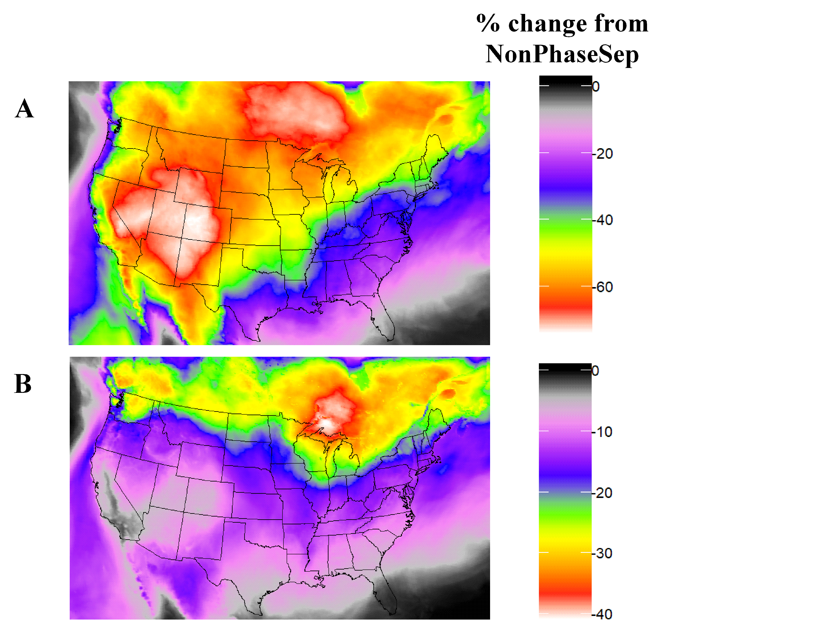
Impact of phase state and phase separation updates on IEPOX SOA and biogenic SOA
B
% Change from PhaseSep
A
IEPOX SOA
C
Change in Biogenic SOA w.r.t. PhaseSep
PM_{2.5} organic carbon (OC)
Biogenic SOA
NO_{x} and SO₂ emissions reduction,
HighHorg sensitivity, and
PhaseSep2
SOAS 2013 average @ Surface Layer
Overall phase separation frequency in PhaseSep -> 68.5% (54.8% SSPS, 13.7% LLPS)
Emission Reduction ->70.5% (57.0% SSPS, 13.5% LLPS), HighHorg -> 68.3% (55.8% SSPS, 12.5% LLPS), PhaseSep2 -> 42.7% (29% SSPS, 13.7% LLPS)

Slide 16
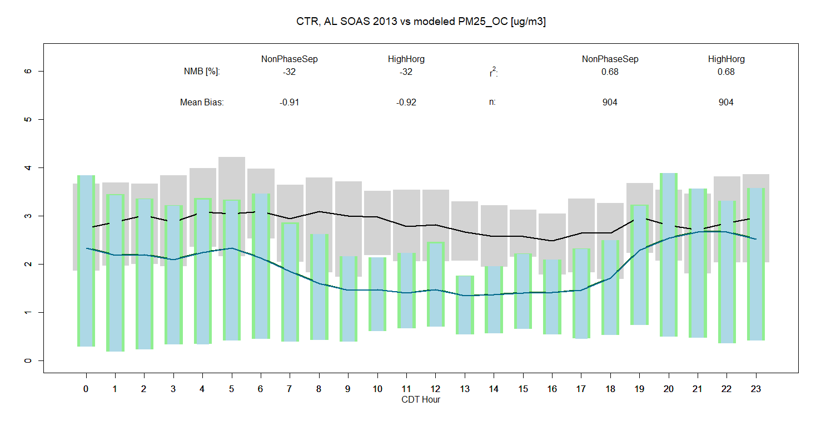
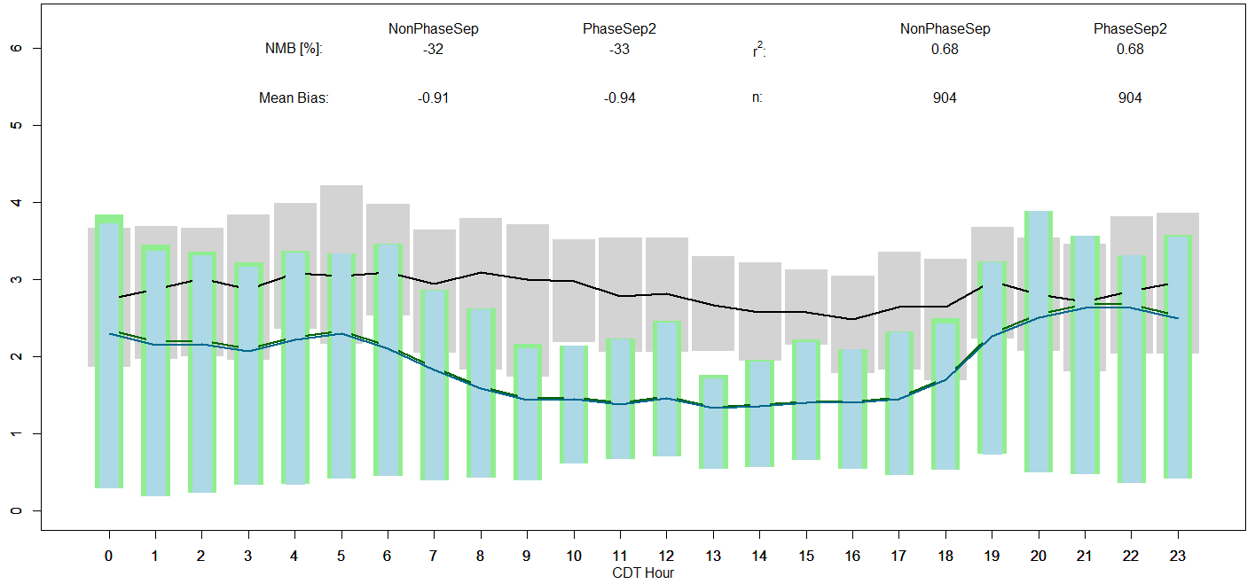
Model performance (w.r.t. SEARCH PM_{2.5}OC observations)
NonPhaseSep vs PhaseSep
@ Centerville, AL
ΔNMB ~ -4% at both urban and rural sites
NonPhaseSep vs Sensitivity cases
(PhaseSep2, HighHorg)
ΔNMB ~ 0% at both urban and rural sites

Slide 17
Conclusions
This work updates the CMAQ model to account for the impact of phase state and phase separation on multiphase chemistry of atmospherically relevant aerosols focusing on IEPOX
Model prediction of phase separation frequency at surface level for Centerville, AL site in agreement with prediction from observations coupled with thermodynamic models (~70% for SOAS 2013 period, Pye et al., 2017)
Most of SOA in upper troposphere is phase separated with organics in semi-solid or glassy state
LLPS more dominant in the eastern US (prevalence of ALW: Pye et al. 2017, 2018),
while semi-solid phase state more prevalent in western US
SOA dominated by anthropogenic constituents -> thick semi-solid organic coating -> reactive uptake of IEPOX becomes diffusion limited
Regions with larger fractions of biogenic SOA mass and abundant aerosol water -> LLPS morphology -> No diffusion limitations
Constraining factors such as, phase separation or morphology (PhaseSep2) and H_{org} (HighH_{org}) factor critical to model performance

Slide 18
Ongoing work and future scope
Further experimental and modeling work required:
Reactive uptake’s impact on viscosity of the inorganic core (η_{core} )-> variability in D_{a} and aerosol pH (Possible with formation of extremely-low volatile organic compounds (ELVOCs) and organosulfates; Olson et al., 2019)
Conditions under which highly viscous SOA phase separates from inorganics (SSPS) in a particle need to be further explored
Particle morphology: ‘core-shell’ or ‘partially engulfed’ or ‘emulsified’ <- Δinterfacial surface tensions (Gorkowski et al., 2017)
Recent studies show core-shell morphology even at very high RH ~ 95-100%, but poorly understood (Ham et al., 2019; Renbaum-Wolff et al., 2016)
Ongoing work:
Implementing ‘PhaseSep’ with updates in CMAQ v5.3
(hygroscopocity of OA constituents- κ_{org}, updated Monoterpene chemistry)
Predicting Viscosity or T_{org} based on volatility basis (more thermodynamic approach)

Slide 19
Acknowledgements
Thornton research group (Dept. of Atmospheric Sciences, University of Washington, Seattle, WA)
Goldstein research group (UC Berkley)
Computational Exposure Division, NERL, US EPA, RTP, NC
Disclaimer: The US Environmental Protection Agency through its Office of Research and Development collaborated in the research described here. The research has been subjected to Agency administrative review and approved for publication. The views expressed in this article are those of the authors and do not necessarily represent the views or policies of the U.S. Environmental Protection Agency.

Slide 20
Extra Slides

Slide 21
Organic coating thickness
l_{org} (nm)
Phasesep
SOAS 2013 average @ surface layer

Slide 22
IEPOX SOA : Total biogenic SOA
A
NonPhasesep
Fraction (0-1)
Phasesep
B
SOAS 2013 average @ surface layer

Slide 23
Reduced inorganic SO₄ aerosol with Emission reduction
% change from PhaseSep
SOAS 2013 average @ surface layer

