Slide 1
Modeling of U.S. and International Contributions to Visibility Impairment at Class I Areas
Brian Timin EPA/OAQPS
October 23, 2019

Slide 2
Modeling Study Results
2028 visibility projections at Class I areas
US emissions sector contributions to visibility impairment
International anthropogenic contributions
Potential adjustment to regional haze “glidepath”

Slide 3
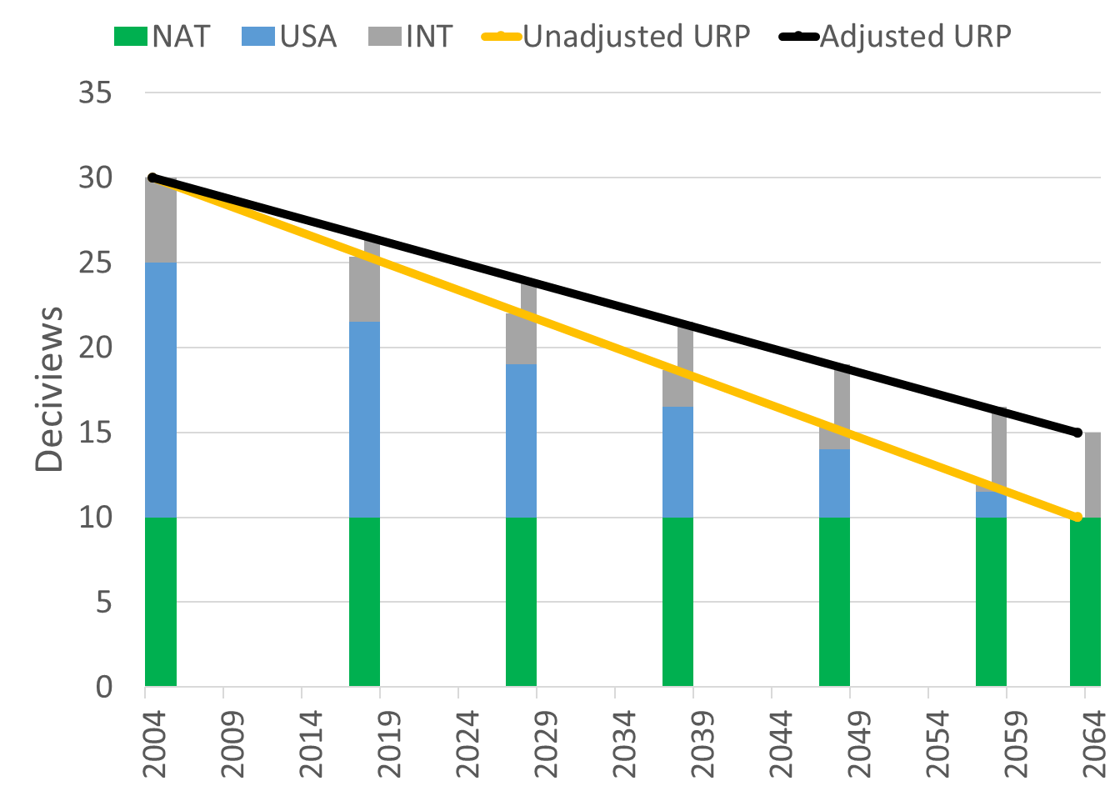
Technical Guidance on Tracking Visibility Progress
The 2017 Regional Haze Rule revisions require a revised approach to tracking visibility improvements over time.
December 2018 Technical Guidance finalizes a recommended methodology to develop baseline and current visibility conditions, and natural conditions on the 20% most anthropogenically impaired and clearest days at Class I areas.
The recommended visibility tracking metric focuses on anthropogenic visibility impairment
The 2017 Regional Haze Rule also includes a provision that allows states to propose an adjustment to the URP glidepath to account for anthropogenic international sources (and prescribed fires).
The Technical Guidance describes recommended tools and methods to develop optional URP adjustments

Slide 4
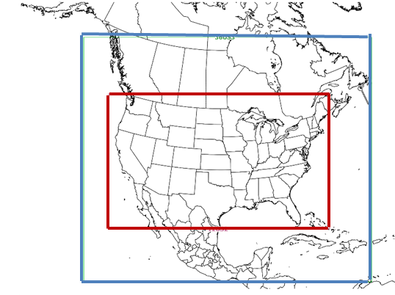
Updated EPA Regional Haze Modeling
New 2016 modeling platform with projections to 2028, including sector-based and international contribution
2028 projected deciviews and glidepath estimates at Class I areas
Estimate of international anthropogenic contributions
Model improvements from EPA’s 2011/2028 platform
New 2016 and 2028 emissions from the State/EPA platform collaborative
Similar to 2016 beta emissions with a few fixes and updates
Larger regional domain (including 36km outer domain)
Updated international boundary conditions
Generated from Hemispheric CMAQ modeling (2016 emissions)
12 km
36 km

Slide 5
CAMx Model Improvements
EPA is using what will eventually become CAMx version 7.0
Improvement in biogenic SOA (terpene) yields
Decreases biogenic SOA concentrations (especially in the South)
Dimethyl sulfide (DMS) emissions and chemistry over the oceans
Adds an additional source of natural sulfate
Additional explicit elemental PM species (Al, Si, Ti, Mn, Mg, etc.), including tracking within Particulate Source Apportionment Technology (PSAT)
Allows for better consistency and tracking of fine crustal emissions between CMAQ and CAMx and within PSAT
Update to PSAT tracking of boundary conditions
Provides ability to separately track international anthropogenic and natural emissions components of the boundary conditions

Slide 6
2028 Projected Emissions
Emissions modeling TSD
2028 projections consistent with 2016 base case for Regional Haze includes “on-the-books” emissions controls
2028 EGU emissions from IPM
November 2018 IPM version
2028 boundary conditions were held constant from 2016
From 2016 Hemispheric CMAQ
Wildfire, prescribed fire, and ag fire are 2016 year specific and held constant
Canadian emissions were projected to 2028 from 2015 based on factors provided by Environment and Climate Change Canada
Mexico emissions were projected to 2028 from their 2008 inventory
Onroad mobile sources were overridden with outputs from MOVES-Mexico
We requested new 2016 emissions data from Mexico, but have not received anything yet

Slide 7
Emissions Summary Category | Emissions Sectors (PSAT tags)
US Anthropogenic | On-road mobile Non-road mobile EGUs NonEGU point Oil and Gas Nonpoint (area) Commercial marine (C1C2 and C3 onshore and within ECA) Agricultural fires Rail Residential Wood Anthropogenic Dust* Agricultural ammonia
International Anthropogenic | Anthropogenic Canada Anthropogenic Mexico Offshore C3 marine (outside ECA) International anthropogenic from boundary conditions
Natural | Biogenic* (SOA and nitrate) Wildfires (US, Canada, and Mexico) Natural dust* Sea salt Ocean (sulfate from DMS and sea salt) Natural from boundary conditions
Prescribed Fires (US) | Prescribed fires from US sources
2028
CAMx PSAT
22 Emissions Sectors + Boundary Conditions
Tags

Slide 8
2028 Visibility Projections
Projected 2028 visibility using CAMx 2016 base case and 2028 future case
2014-2017 IMPROVE data (4-year average) is the anchor point for the future year projection
A 5-year average cannot be calculated (yet) because final 2018 IMPROVE data is not available (preliminary data just became available)
Species specific modeled RRFs calculated for 2016 to 2028
2028 deciview values calculated using SMAT software
Calculated 2028 visibility impairment for 99 IMPROVE monitors (142 Class I areas).
All 99 sites (142 areas) have a “valid” glidepath.

Slide 9
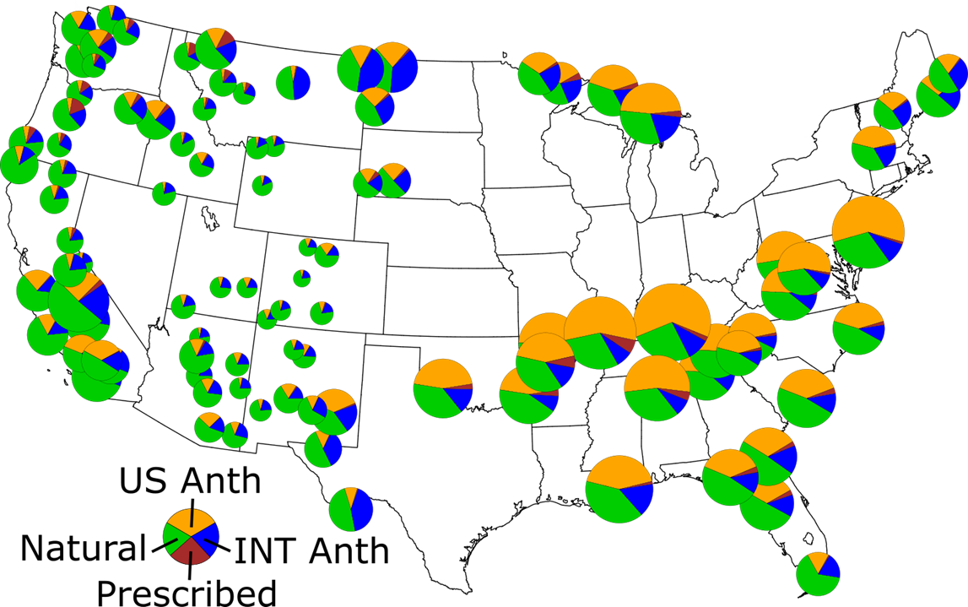
2028 Total Visibility Impairment Components
(20% most impaired days)
2028 Visibility Impairment | Range (Mm-1)
US anthropogenic | 0.98–45.68
International anthropogenic | 2.88–19.33
Prescribed Fires | 0.03-5.15
Modeled natural (including Rayleigh) | 11.72-29.83
(including Rayleigh)
Percentage of US anthropogenic higher in the East
Percentage of natural higher in the West
International anthropogenic contribution largest near border areas
Prescribed fire contribution highest in the Northwest

Slide 10
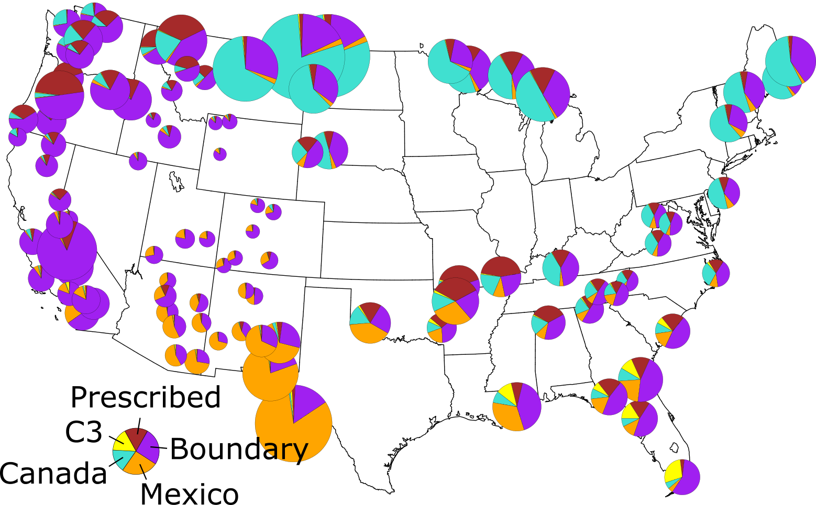
International Anthropogenic and Prescribed Fire Contributions (20% most impaired days)
Glidepath Adjustment components | Range (Mm-1)
Prescribed fires | 0.03-5.15
C3 commercial marine outside the US ECA region | 0-2.28
Canada anthropogenic | 0.01–15.49
Mexico anthropogenic | 0.02–14.39
International anthropogenic from outside the 36km domain (boundary conditions) | 1.19–11.73

Slide 11
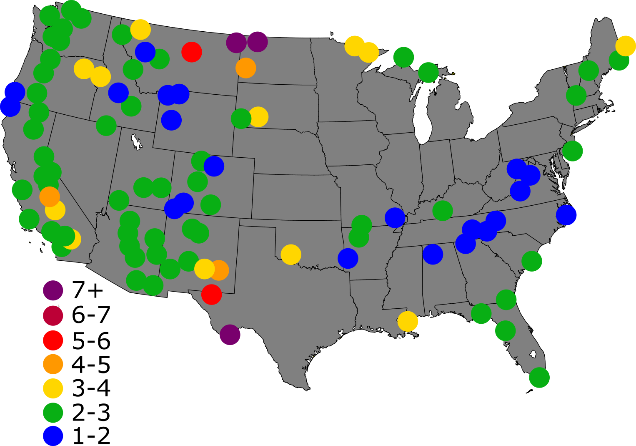
“Default” Glidepath 2064 Endpoint Adjustment in deciviews (20% most impaired days)
Glidepath Adjustment components (international anthropogenic only)
C3 commercial marine from outside the US ECA region
Canada anthropogenic
Mexico anthropogenic
International anthropogenic from outside the 36km domain (boundary conditions)
Glidepath adjustment is highest near border areas
Adjustment ranges from 15-130% of natural conditions values
Adjustment Range is 1.45-7.26 dv
Natural conditions range is 3-11 dv

Slide 12
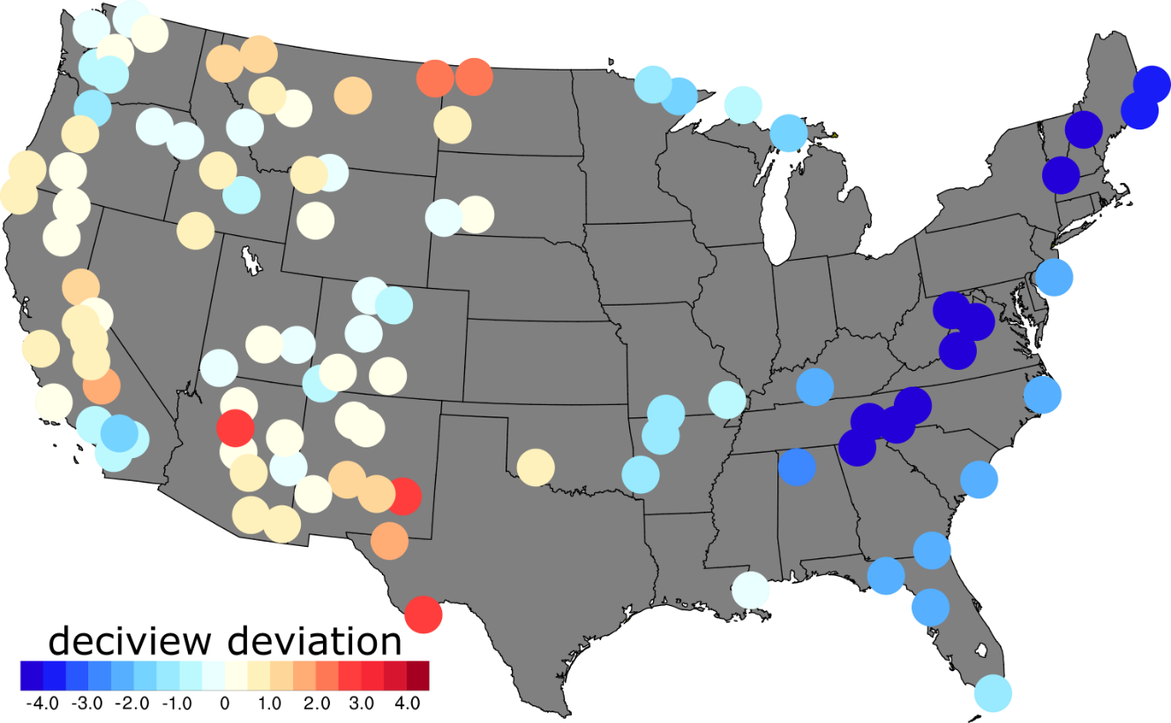
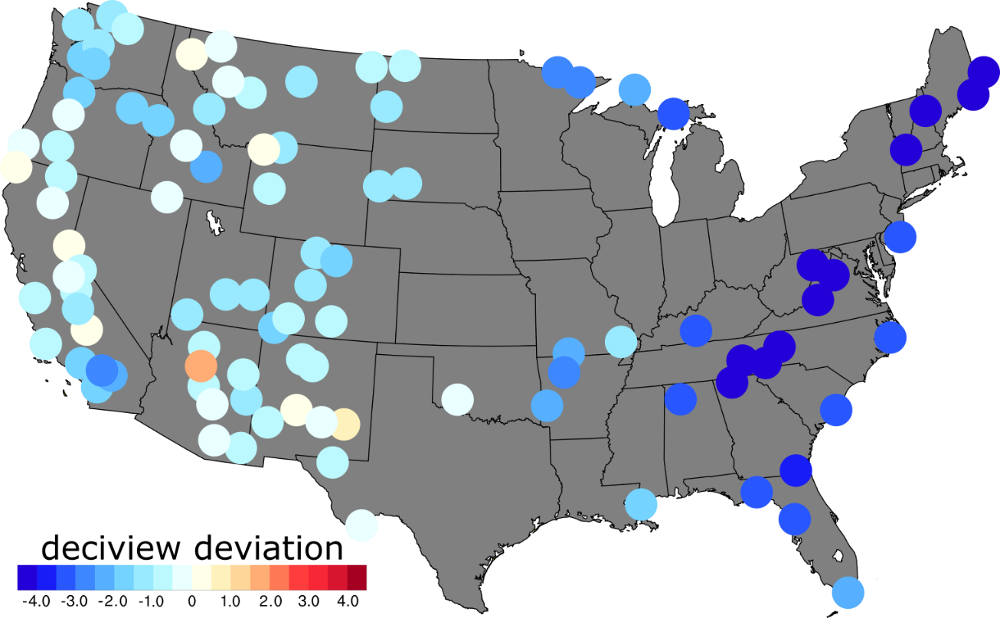
Updated EPA Regional Haze Modeling Deviation from 2028 Glidepath (20% most impaired days)
Deviation from Unadjusted Glidepath
Deviation from Default Adjusted Glidepath
 | Unadjusted Glidepath | Adjusted Glidepath
Number of IMPROVE sites below the glidepath | 51 | 91
Number of IMPROVE sites above the glidepath | 47 | 8
Total | 99 | 99
Note that the 99 IMPROVE sites represent 142 Class I areas
Notes:
The 8 IMPROVE sites above the default adjusted glidepath are:
Sycamore Canyon AZ
Salt Creek NM
Desolation Wilderness CA
Redwood NP CA
Bosque del Apache NM
Dome Land Wilderness CA
Cabinet Mountains MT
Yellowstone NP WY

Slide 13
Conclusions and Deliverables
Nearly all IMPROVE sites (Class I areas) are below the “default” adjusted glidepath in 2028
Eight IMPROVE sites remain above the adjusted glidepath
The modeled glidepath adjustments range from 1.5 to 7 deciviews
The largest adjustments are at IMPROVE sites near the Canada and Mexico borders
Prescribed fire impacts can be included in the adjustment, but are more uncertain
Updated 2028 Modeling Technical Support Document: https://www.epa.gov/visibility/technical-support-document-epas-updated-2028-regional-haze-modeling
2028 unadjusted and adjusted glidepath projections for Class I areas
International anthropogenic and prescribed fire contribution estimates
2028 national sector-based contributions

Slide 14
Questions and data requests Brian Timin timin.brian@epa.gov

Slide 15
Appendix

Slide 16
CAMx 2016 and 2028 Emissions Sector Totals
 |  | 2016fg Annual Emissions |  |  |  |  |  | 2028fg Annual Emissions
Tag # | Tag Name | NH3 | NOX | PM2.5 | SO2 | VOC |  | NH3 | NOX | PM2.5 | SO2 | VOC
1 | Biogenics | - | 975,807 | - | - | 43,161,614 |  | - | 975,807 | - | - | 43,161,614
2 | Point EGUs | 23,977 | 1,290,226 | 133,515 | 1,540,557 | 33,771 |  | 39,555 | 804,093 | 111,632 | 878,680 | 29,816
3 | Onroad mobile | 100,856 | 4,066,815 | 130,614 | 27,550 | 1,986,602 |  | 83,643 | 1,354,187 | 63,060 | 11,550 | 886,243
4 | Nonroad mobile | 1,783 | 1,081,598 | 102,159 | 2,198 | 1,164,615 |  | 2,028 | 604,942 | 55,094 | 1,536 | 825,951
5 | C1 & C2 commercial marine | 309 | 514,611 | 13,720 | 3,130 | 9,546 |  | 312 | 287,866 | 7,945 | 1,252 | 5,904
6 | C3 commercial marine | 96 | 567,284 | 6,870 | 15,144 | 25,013 |  | 139 | 486,975 | 9,968 | 21,969 | 36,328
7 | C3 commercial marine - non-US | - | 1,043,852 | 81,432 | 657,836 | 37,557 |  | - | 1,482,984 | 116,059 | 133,509 | 53,535
8 | Railroads | 323 | 558,732 | 16,158 | 364 | 26,062 |  | 340 | 588,788 | 17,036 | 383 | 27,469
9 | Agricultural burning | 54,454 | 10,825 | 28,632 | 3,909 | 18,323 |  | 54,454 | 10,825 | 28,632 | 3,909 | 18,323
10 | Agricultural ammonia | 2,862,779 | - | - | - | 186,941 |  | 2,990,703 | - | - | - | 198,161
11 | Nonpoint and point oil and gas | 4,376 | 955,824 | 26,021 | 57,475 | 3,092,777 |  | 4,394 | 930,941 | 30,783 | 72,187 | 3,577,561
12 | Point non-EGU sources | 63,613 | 1,087,999 | 261,565 | 675,797 | 816,127 |  | 64,188 | 1,140,722 | 144,393 | 641,564 | 820,105
13 | Residential wood combustion | 15,554 | 31,492 | 318,999 | 7,739 | 342,959 |  | 14,627 | 32,128 | 300,284 | 6,722 | 326,350
14 | US wildfires | 125,577 | 110,960 | 665,171 | 59,430 | 1,804,428 |  | 125,577 | 110,960 | 665,171 | 59,430 | 1,804,428
15 | US prescribed fires | 128,554 | 121,368 | 640,518 | 56,376 | 1,513,923 |  | 128,554 | 121,368 | 640,518 | 56,376 | 1,513,923
16 | Area source fugitive dust | - | - | 1,006,412 | - | - |  | - | - | 1,017,675 | - | -
17 | Non-point | 121,721 | 759,882 | 499,779 | 161,732 | 3,718,709 |  | 123,021 | 763,173 | 543,498 | 119,048 | 3,937,967
18 | Canada fires | 104,683 | 134,301 | 580,958 | 60,914 | 1,501,988 |  | 104,683 | 134,301 | 580,958 | 60,914 | 1,501,988
19 | Canada anthropogenic | 533,657 | 1,926,159 | 584,899 | 1,147,090 | 2,023,308 |  | 730,509 | 1,244,887 | 588,794 | 1,245,794 | 1,905,101
20 | Mexico fires | 120,627 | 347,132 | 746,107 | 45,222 | 2,260,695 |  | 120,627 | 347,132 | 746,107 | 45,222 | 2,260,695
21 | Mexico anthropogenic | 925,033 | 3,029,834 | 677,215 | 2,344,667 | 4,649,026 |  | 936,519 | 3,352,508 | 802,946 | 2,865,746 | 5,349,517
22 | Oceanic sea salt and DMS | - | - | - | - | - |  | - | - | - | - | -
 | US Anthropogenic Total | 3,249,840 | 10,925,288 | 2,544,443 | 2,495,595 | 11,421,444 |  | 3,377,404 | 7,004,640 | 2,329,998 | 1,758,801 | 10,690,177
 |  | Percent change in US anthropogenic between 2016 and 2028 |  |  |  |  |  | 3.9% | -35.9% | -8.4% | -29.5% | -6.4%

Slide 17
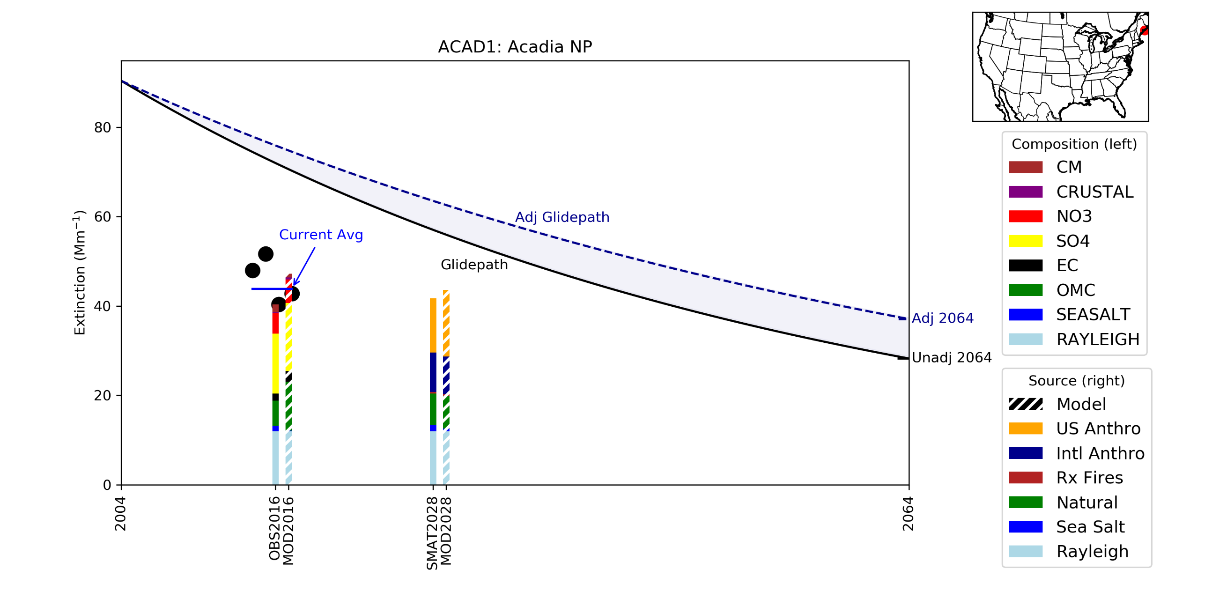
Acadia NP (ME) 2004-2064

Slide 18
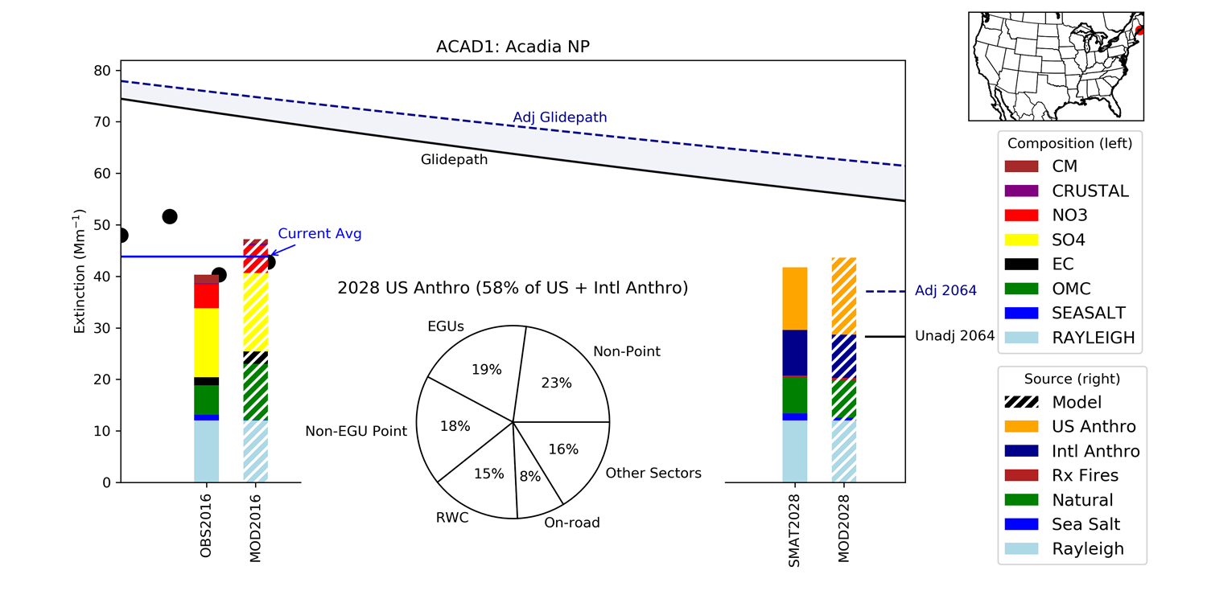
Acadia NP (ME) 2016-2028

Slide 19
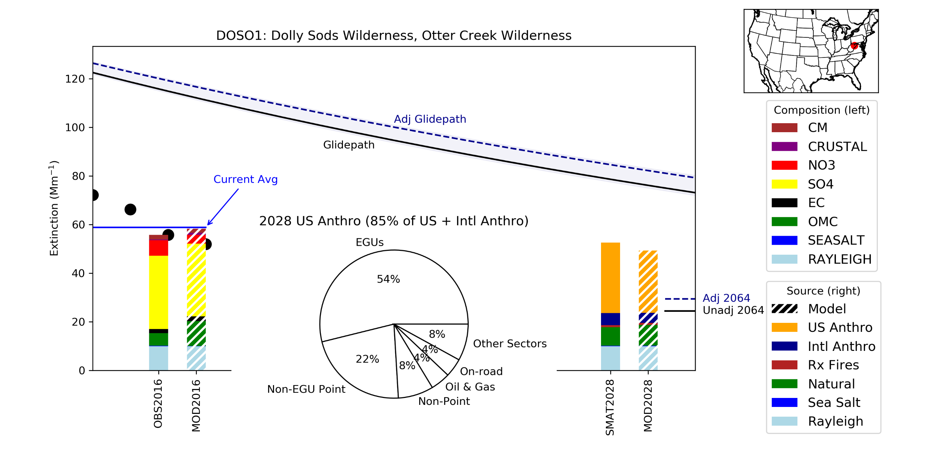
Dolly Sods (WV) 2016-2028

Slide 20
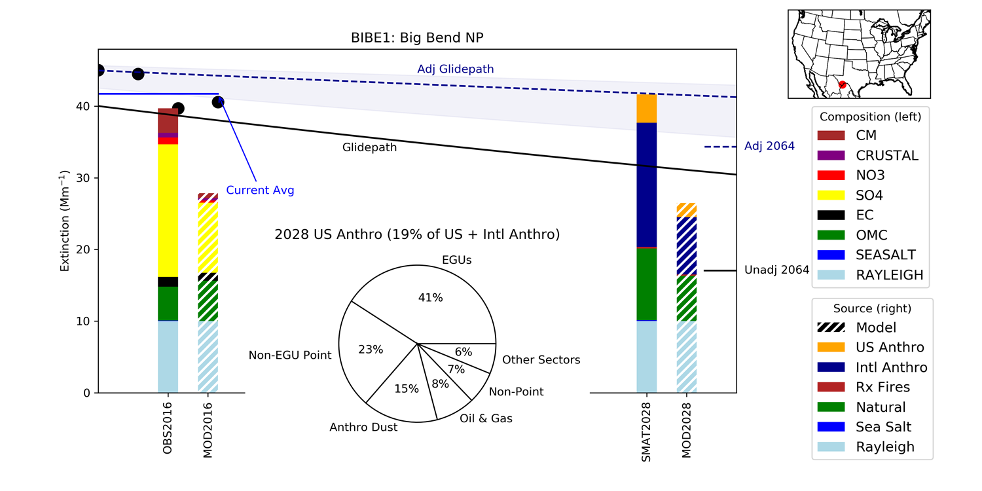
Big Bend NP (TX) 2016-2028

Slide 21
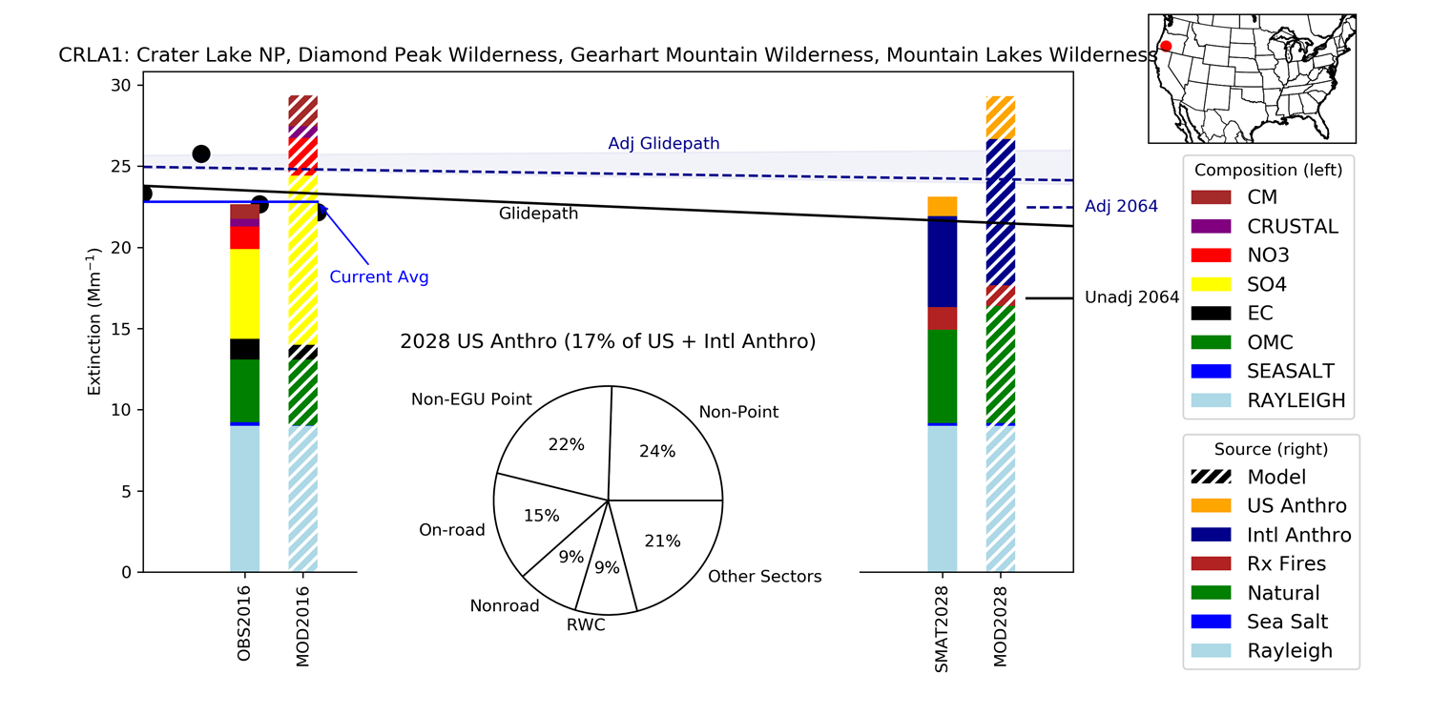
Crater Lake NP (OR) 2016-2028

