Slide 1
Assessing PM_{2.5} model performance with comparison to statistics for 2007-2015
18th Community Modeling and Analysis System (CMAS) Conference
23 October 2019, Chapel Hill, NC
James T. Kelly¹, Shannon N. Koplitz¹, Kirk R. Baker¹, Amara L. Holder², Havala O.T. Pye², Benjamin N. Murphy², Jesse O. Bash², Barron H. Henderson¹, Norman C. Possiel¹, Heather Simon¹, Alison M. Eyth¹, Carey Jang¹, Sharon Phillips¹, and Brian Timin¹
U.S. Environmental Protection Agency
¹Office of Air Quality Planning & Standards
²Office of Research and Development
Research Triangle Park, NC

Slide 2
Background
Air quality models are used in human health risk assessments, policy cost-benefit analyses, and air quality management and forecasting
Confidence in model predictions derives in part from the scientific basis of model parameterizations and diagnostic performance evaluations conducted during model development
Operational model performance evaluations involving statistical comparisons of model predictions and routine observations are also done to support individual model applications
Statistical benchmarks are sometimes used in interpreting operational model performance statistics

Slide 3
Boylan and Russell (2006) Performance Recommendations
Boylan and Russell (2006) recommended goals and criteria for model performance statistics for PM_{2.5}
Criteria: performance that may be deemed acceptable without further analysis
Goal: best performance one can hope to achieve
The BR2006 benchmarks were derived from model performance for previous simulations of air quality during 1996-2006 in the U.S.
Boylan and Russell (2006) Atmospheric Environment https://doi.org/10.1016/j.atmosenv.2005.09.087

Slide 4
Emery et al. (2017) Performance Recommendations
Emery et al. (2017) compiled model performance statistics from 38* peer-reviewed studies for simulations of 2005 to 2015 to develop statistical benchmarks for model performance
Criteria: model performance statistics in the top 67% of past studies
Goal: model performance statistics in the top 33% of past studies
*31 of the studies were based on the compilation of Simon et al. (2012) Atmos. Environ.; https://doi.org/10.1016/j.atmosenv.2012.07.012
Emery et al. (2017) Journal of Air and Waste Management Association; https://doi.org/10.1080/10962247.2016.1265027

Slide 5
Limitations in Methods for Benchmarking Performance
Challenges in compiling model performance from the literature
Inconsistency in the statistics reported and temporal and spatial scales of aggregation
Varying grid resolution and region of modeling
Relatively large influence on multi-study compilations of a minority of studies that report many statistics
Possible publication bias
Outdated modeling in some cases (e.g., before 2000)
Challenges in setting benchmarks
Judgements on performance criteria and goals are subjective and do not reflect the context in specific applications
Model performance varies widely by region and season but performance criteria and goals do not

Slide 6
Current Study
An approach is developed to benchmark model performance for new model applications against performance in previous applications
Model performance statistics are calculated consistently by region, season, and PM component for national 12-km CMAQ simulations (v4.7.1-5.2.1) for 2007-2015
Performance statistics for 2015 are ranked against statistics for the years 2007-2015
Advantages
Avoids subjective judgements about “goals” and “criteria”
Accounts for spatially and temporally varying nature of model performance
Statistics calculated consistently across model simulations w/ same grid resolution
Sensitivity simulations with alternative model configuration are also examined to help interpret causes of model performance issues
For more details, see Kelly et al. (2019) Atmospheric Environment; https://doi.org/10.1016/j.atmosenv.2019.116872

Slide 7
Seasonal and Region Performance for Sulfate in 2015

Slide 8
Ranking 2015 Sulfate Performance Against 2007-2015
Green indicates high rank (relatively good performance) for 2015 compared with 2007-2015, and red indicates low rank (relatively poor performance)
Overall, performance for sulfate generally ranks high against previous modeling, with exceptions such as in the Northwest and for Pearson r

Slide 9
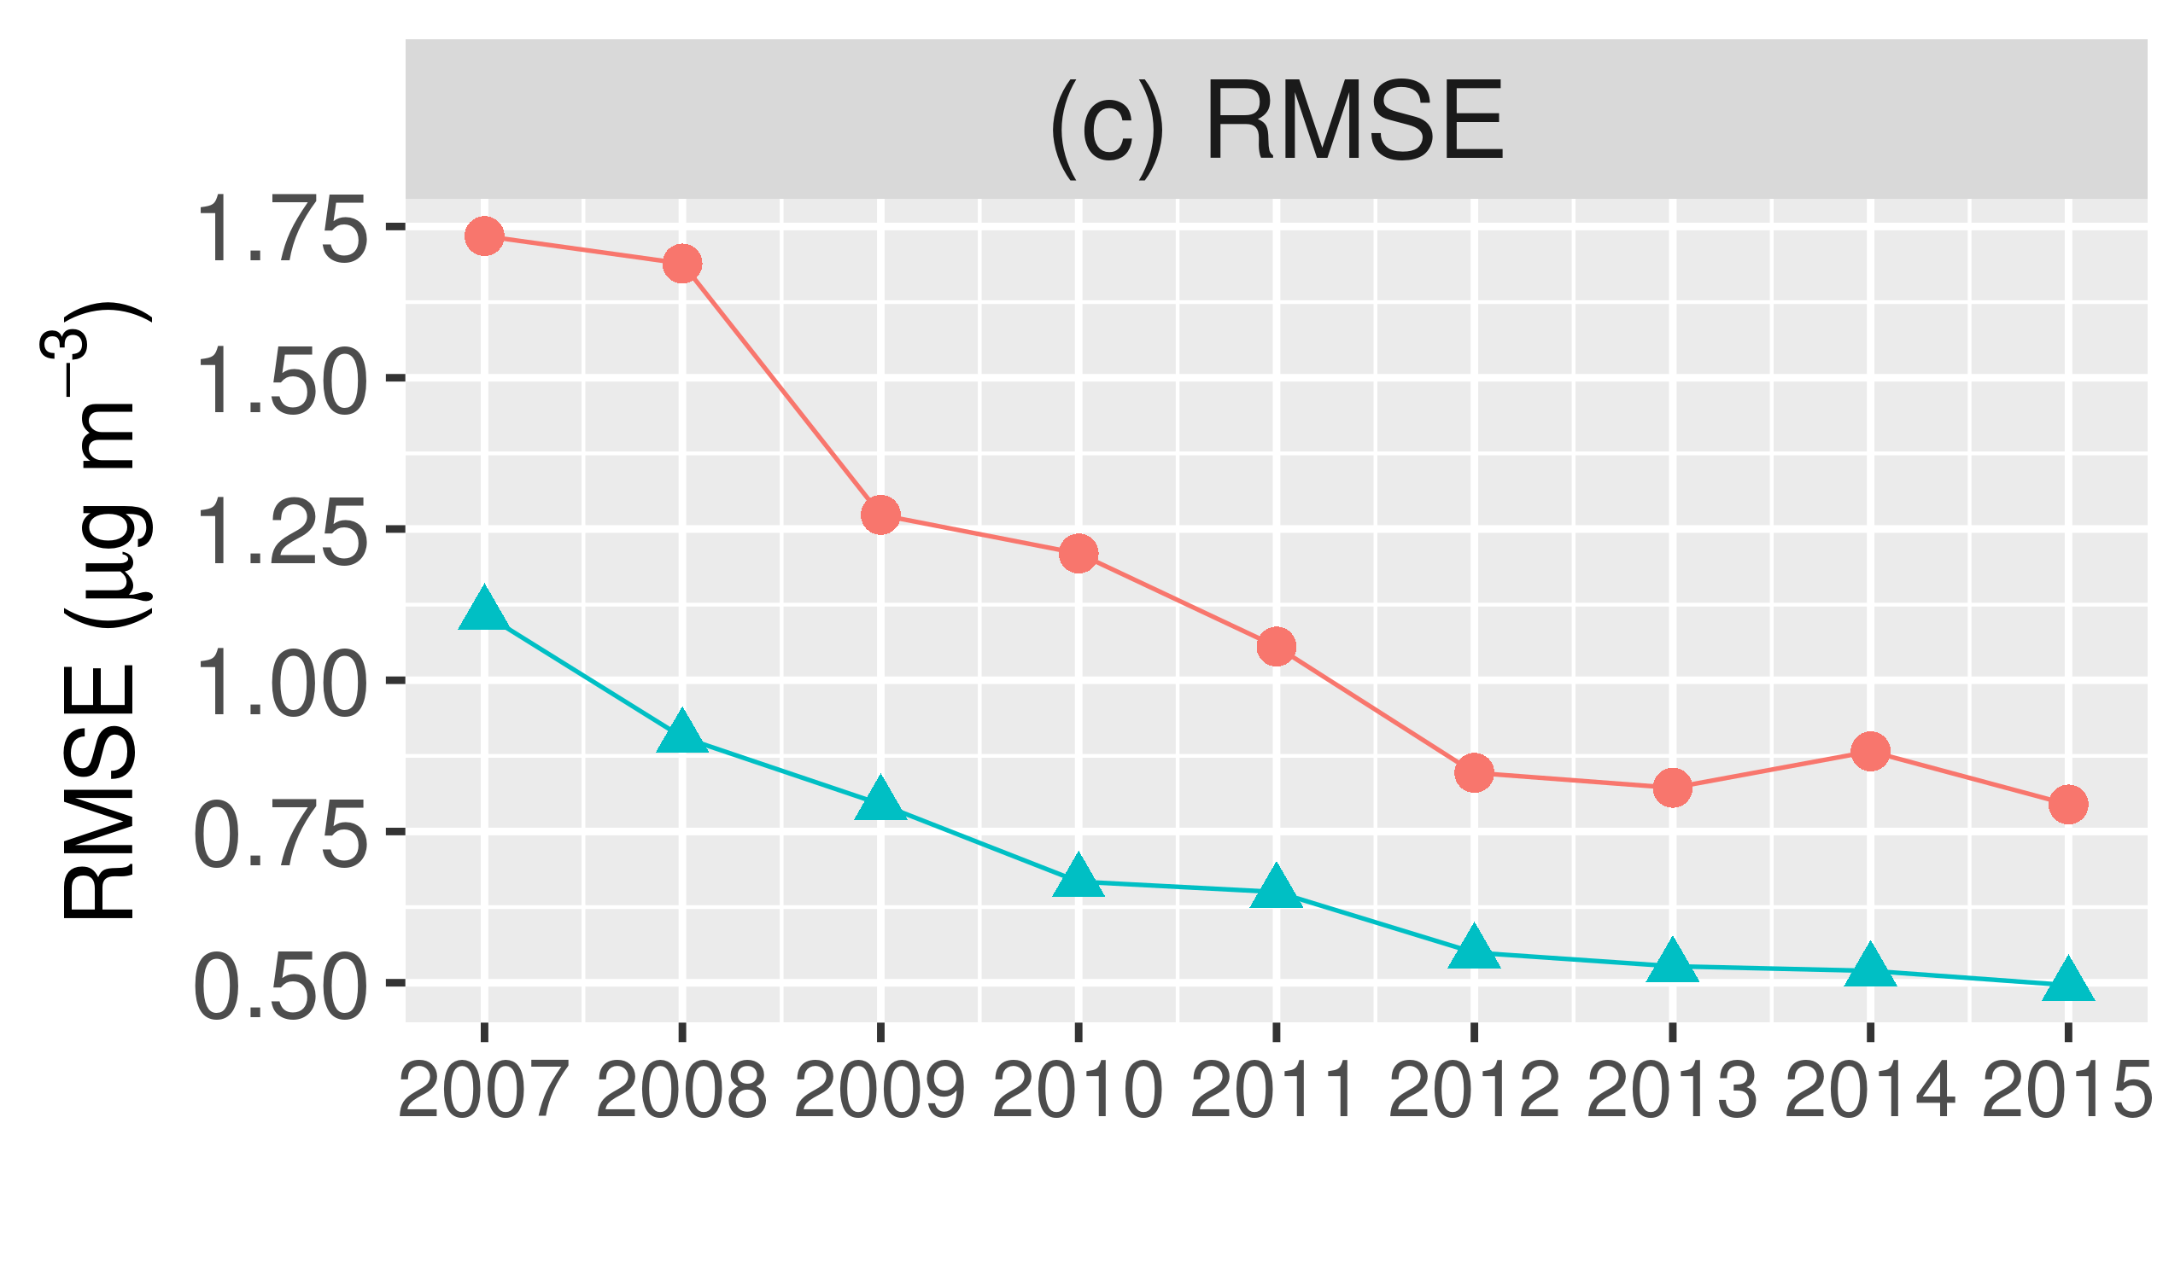
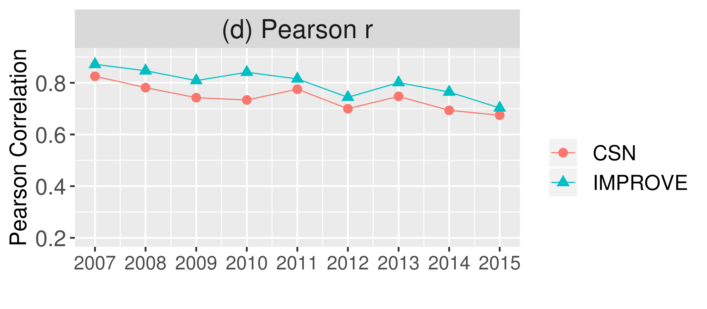
Challenges in Benchmarking Sulfate Performance
Trends in Sulfate Concentration
Trends in Sulfate Performance Statistics

Slide 10
Sensitivity Simulations to Explore Sulfate Performance
Figure: Kirk Baker
Improved performance at IMPROVE sites in the western U.S. with updated BC’s having lower SO₂ concentrations (nei.bc.nh3)
Slightly improved performance in the western U.S. in simulation with wildland fire emissions removed (no.fire)

Slide 11
Seasonal and Regional Performance for Nitrate in 2015
Apparently large NMB in SE in Fall
Apparently large MB in SW & W in Winter

Slide 12
Ranking 2015 Nitrate Performance Against 2007-2015
Apparently large NMB (previous slide) corresponds to rank in 20-40% category
Apparently large NMB (previous slide) corresponds to rank in 20-40% category
Model performance statistics can rank high against previous performance statistics even when performance do not appear favorable, and vice-versa

Slide 13
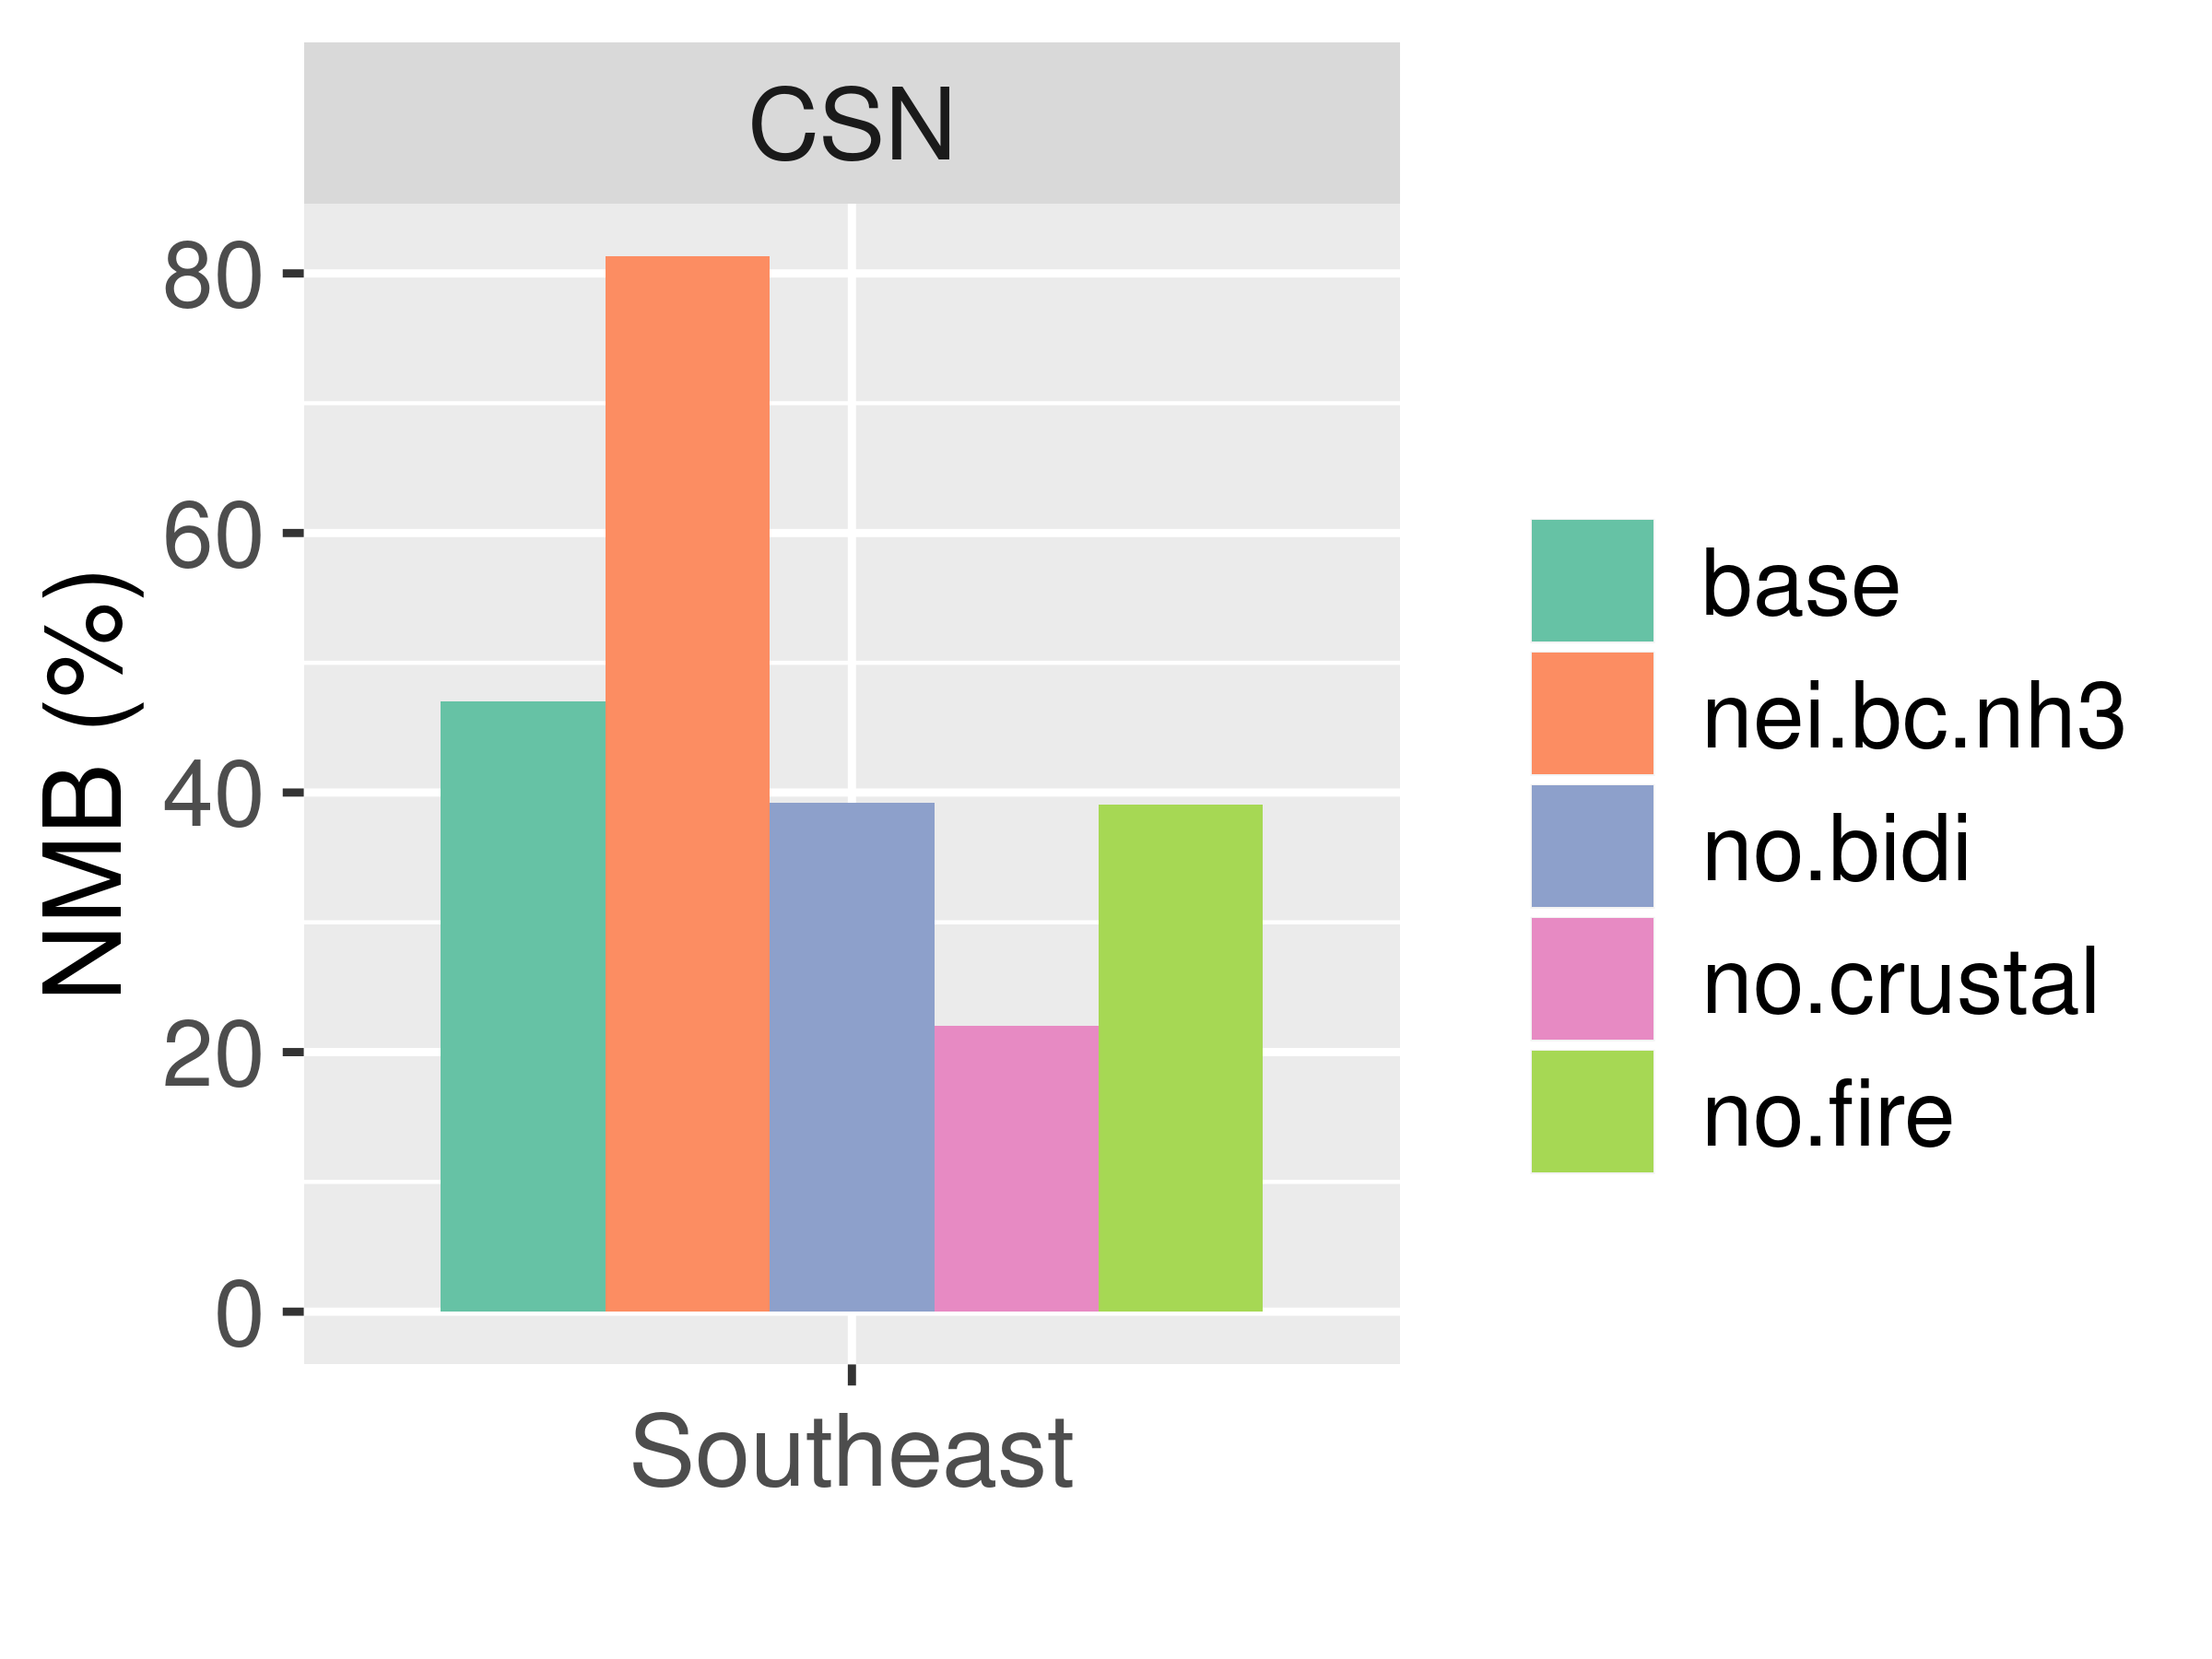
Sensitivity Simulations to Explore Nitrate Performance
Nitrate performance in the Southeast is affected to varying degrees by
Changing the NH₃ surface-exchange parameterization (nei.bc.nh3)
Turning off bi-directional surface exchange for NH₃ (no.bidi)
Removing crustal cation emissions (no.crustal)
Removing wildland fire emissions (no.fire)
Other factors (e.g., γ_{N2O5} – not shown)
Note: nitrate made up only about 6% of PM_{2.5} in the Southeast in 2015

Slide 14
Seasonal and Region NMB for Elemental Carbon in 2015
The NMB for EC is positive in all regions and seasons
Since EC is primary PM_{2.5} component (i.e., not secondarily formed), the overpredictions are likely due to emissions and meteorology

Slide 15
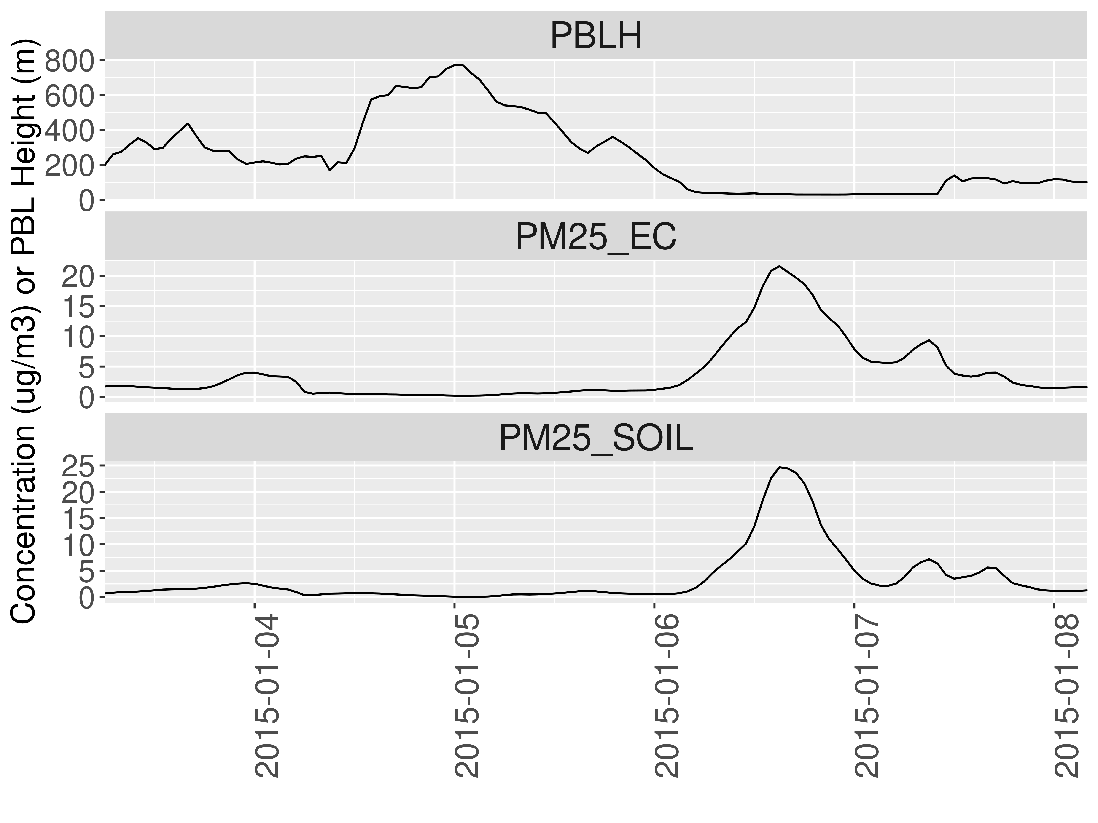
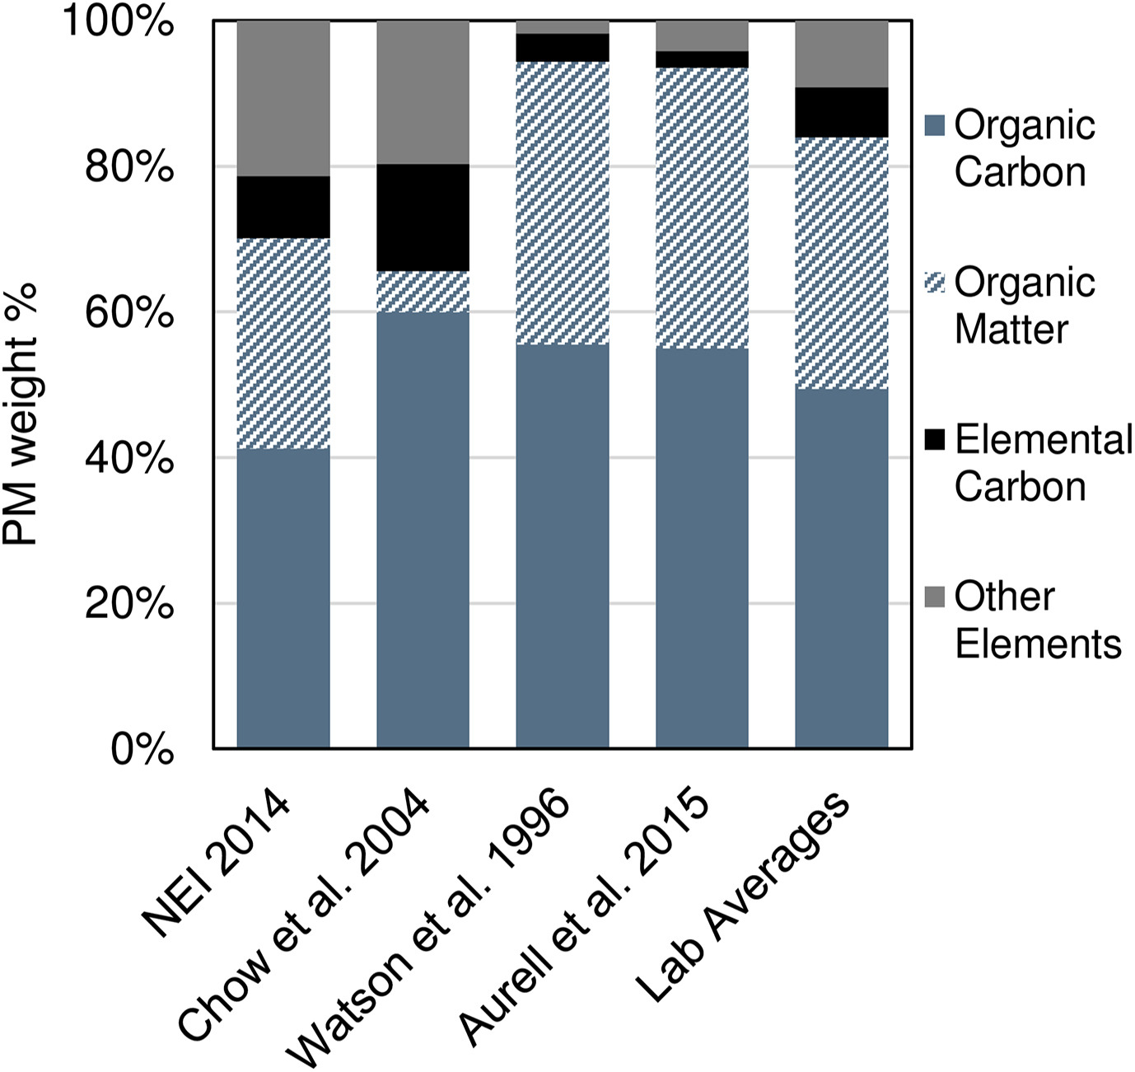
Challenges in Modeling EC Concentrations
Mixing Height
Fire Emission Speciation
Figure: Amara Holder
Challenges in modeling the mixing height at coastal sites can cause model performance issues for EC and other primary PM components
The EC fraction of PM_{2.5} emissions from fires may be overestimated in NEI 2014

Slide 16
Conclusions
Ranking performance statistics for new modeling against a consistent set of statistics for previous modeling was found to be useful for interpreting and providing quantitative context for the new modeling
However, limitations in benchmarking model performance with results from previous modeling were identified; e.g.,
Trends in ambient concentrations can influence model performance statistics and limit the representativeness of previous modeling
Model performance statistics can rank low against previous performance statistics even when performance is good, and vice-versa
Sensitivity simulations demonstrated the importance of model parameterizations for NH₃ surface exchange, organic aerosol volatility and production*, and emissions of crustal cations for predicting PM_{2.5} species concentrations
*Not shown, see Kelly et al. (2019) Atmos. Environ.; https://doi.org/10.1016/j.atmosenv.2019.116872

Slide 17
Disclaimer
The views expressed in this presentation are those of the authors and do not necessarily represent the views or policies of the U.S. Environmental Protection Agency

Slide 18
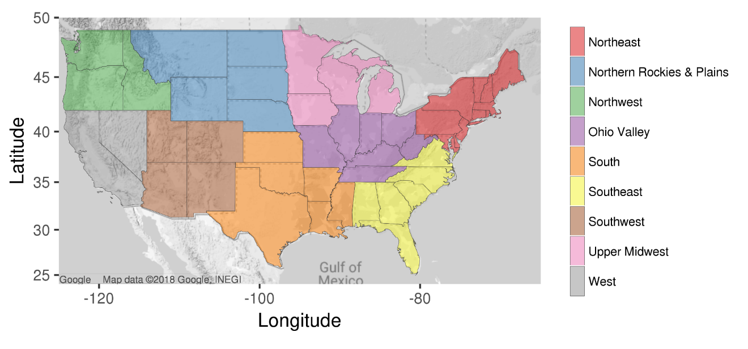
Model Performance Regions
U.S. Climate Regions
https://www.ncdc.noaa.gov/monitoring-references/maps/us-climate-regions.php

