Slide 1
Air pollution control strategies directly limiting national health damages in the US
Yang Ou^{1,2}, J. Jason West², Steven J. Smith³, Christopher G. Nolte¹, Daniel H. Loughlin¹
¹ U.S. EPA Center for Environmental Measurement and Modeling
² University of North Carolina at Chapel Hill
³ Joint Global Change Research Institute, PNNL

Slide 2
Disclaimer
The views expressed in this presentation are those of the authors and do not necessarily represent the views or policies of the U.S. Environmental Protection Agency

Slide 3
PM_{2.5} pollution and public health
Globally, ambient PM_{2.5} was the tenth-ranked mortality risk factor in 2017, causing 4.6 million deaths (GBD 2017).
Recent epidemiological evidence indicates significant adverse health effects associated with PM_{2.5} exposure at approximately the current concentration levels in the US (Pope 2019; Bennett 2019).
Notes:
Maybe find GBD estimates for US

Slide 4
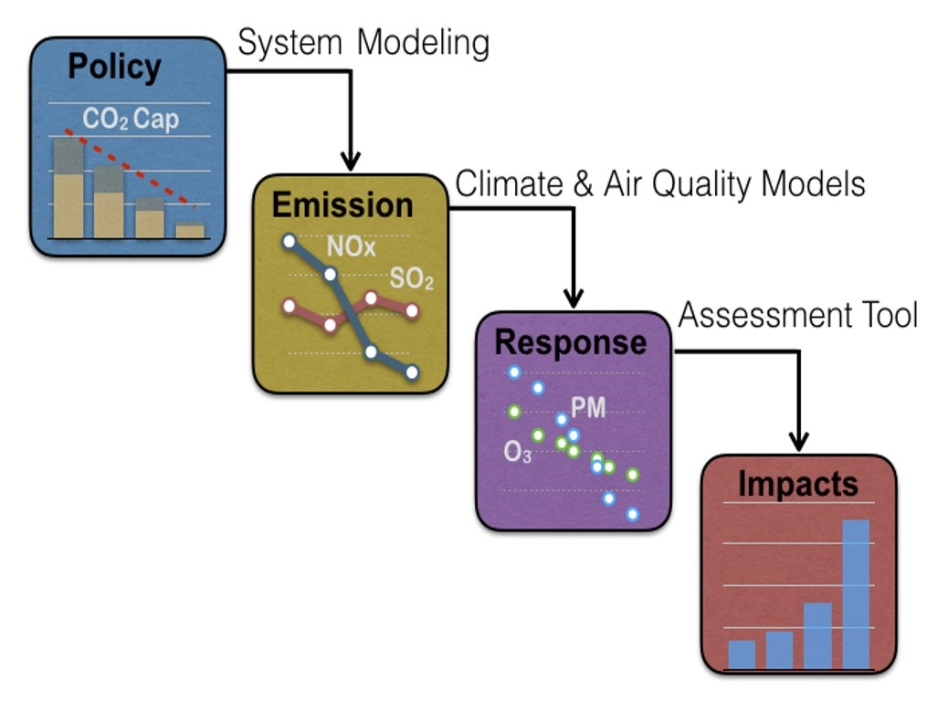
Traditional air quality research paradigm:
Emission reduction targets
Health impacts
Possibly a large number of iterations to adjust the emission reduction for each emission sector and species in order to reach a certain level of health benefit
There could be numerous combinations of specific emission reductions to test, and the most cost-effective combination is not guaranteed

Slide 5
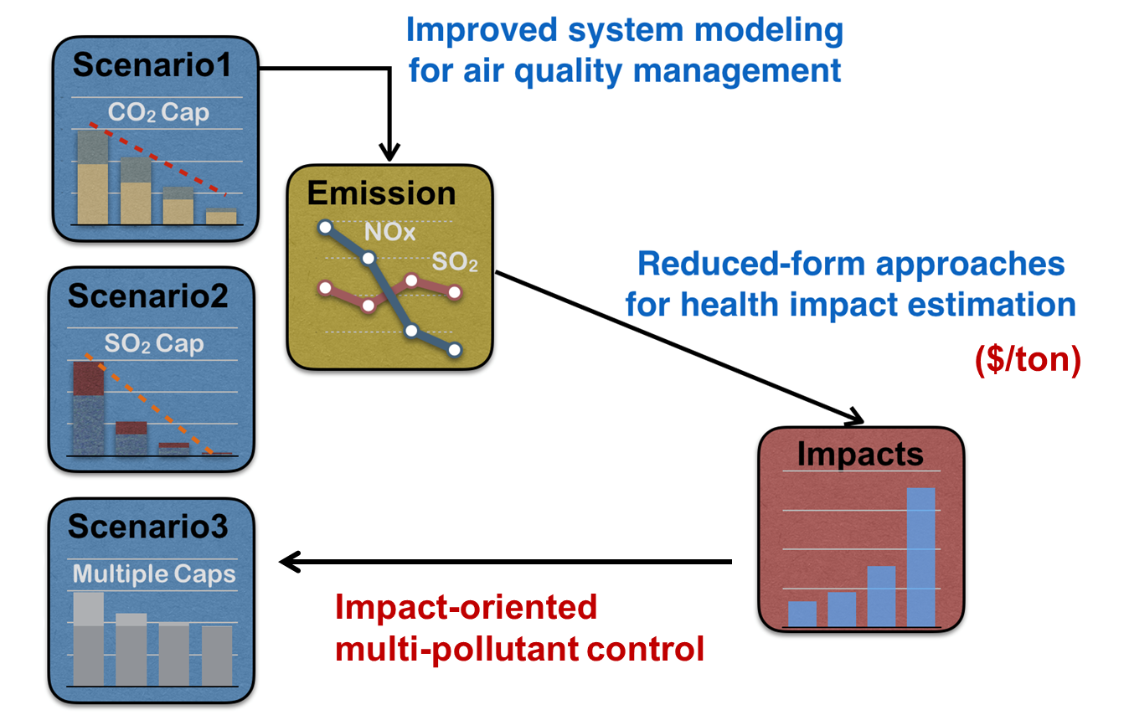
An outcome-driven control strategy:
Emission reduction targets
Health impacts
Which sectors, technologies, and states can most cost-effectively reduce emissions to achieve various levels of US national PM_{2.5} mortality costs (PMMC) reduction target to 2050 ?

Slide 6
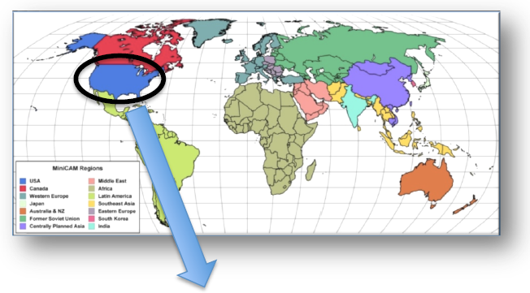
Integrated assessment model – GCAM
The Global Change Assessment Model
32 economic and energy regions globally
5-year time steps, extending from 2005 to 2100
Technology-rich energy system detail
Emission coverage:
GHGs (e.g., CO₂, CH_{4,} etc)
Air pollutants (e.g., SO₂, NO_{x}, PM_{2.5} etc.)
PM_{2.5}-related mortality cost (PMMC):
$/ton coefficients derived from EASIUR (Heo et al. 2016)
Differ by state, sector, pollutant, year
GCAM global model
State-level energy system representation
GCAM-USA
Heo et al. (2016). Reduced-form modeling of public health impacts of inorganic PM_{2.5} and precursor emissions. Atmospheric Environment
Notes:
Say something about how GCAM determines the least-cost pathways

Slide 7
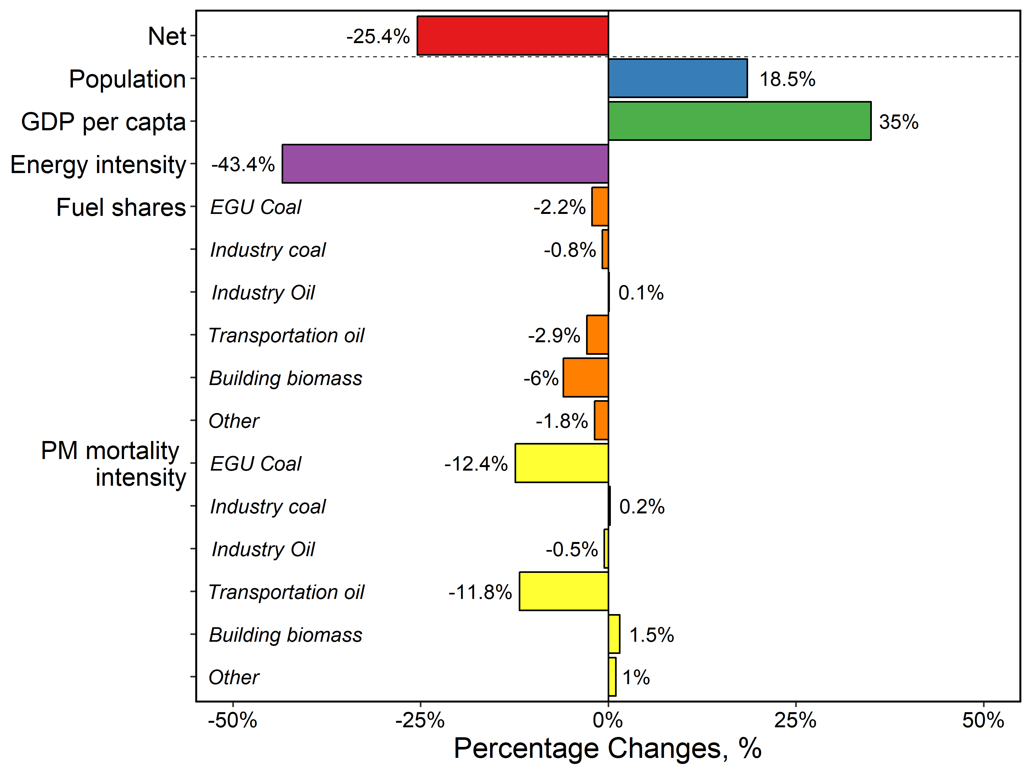
Drivers of future PMMC in a current legislation scenario (REF)
Decreases in energy intensity, PM_{2.5} mortality per unit of EGU coal and transportation liquids consumption outweigh contributions from growth in population and GPD per capita
Contributions to national changes in 2050 relative to 2015 estimated using LMDI
Ou, Y., Smith, S. J., West, J. J., Nolte, C. G., Loughlin, D. H. State-level drivers of future fine particulate matter mortality in the United States. In Review.
Notes:
we put EASIUR into GCAM for this study, and that you also analyzed drivers in each state.

Slide 8
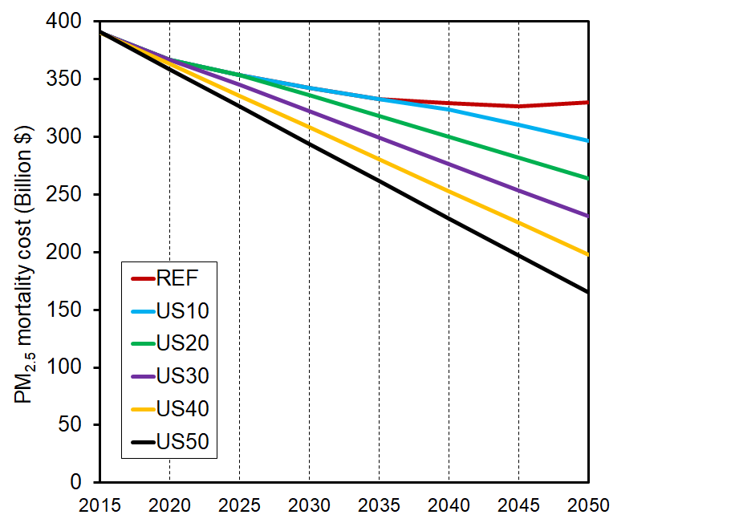
Study design: PMMC reduction targets
10% - 50% reduction in 2050 (US10 to US50) relative to REF in 2050 at the national level
Reduction targets are assumed to be linearly applied for each modeling year after 2015

Slide 9
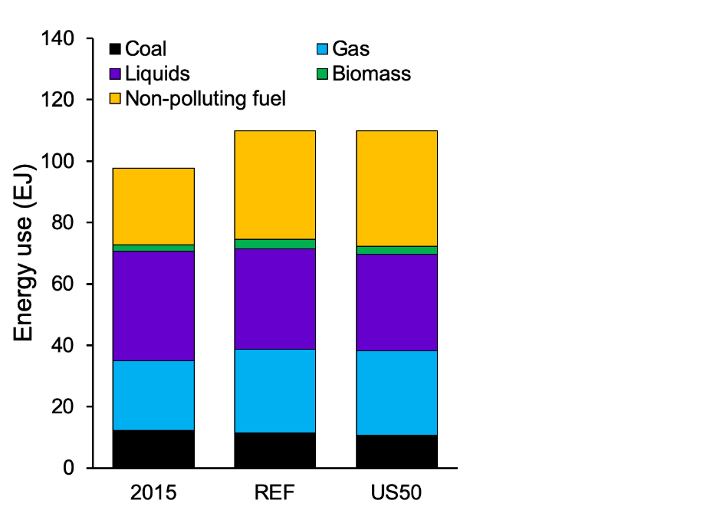
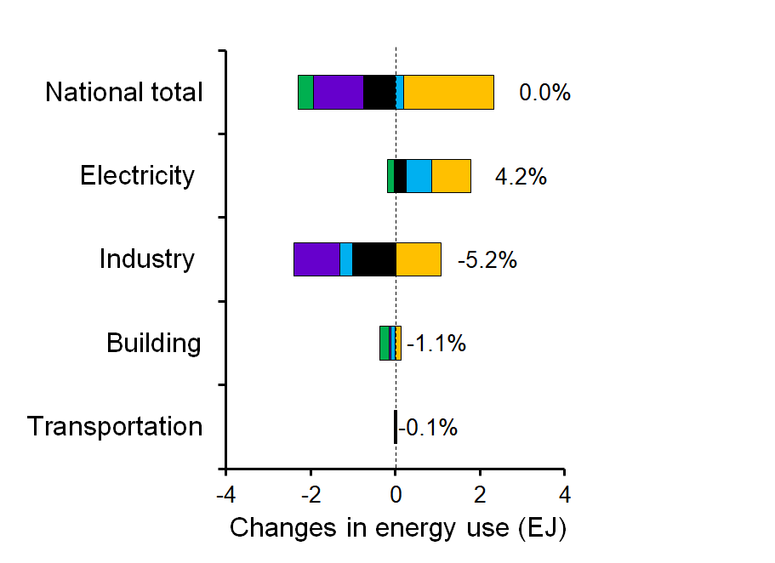
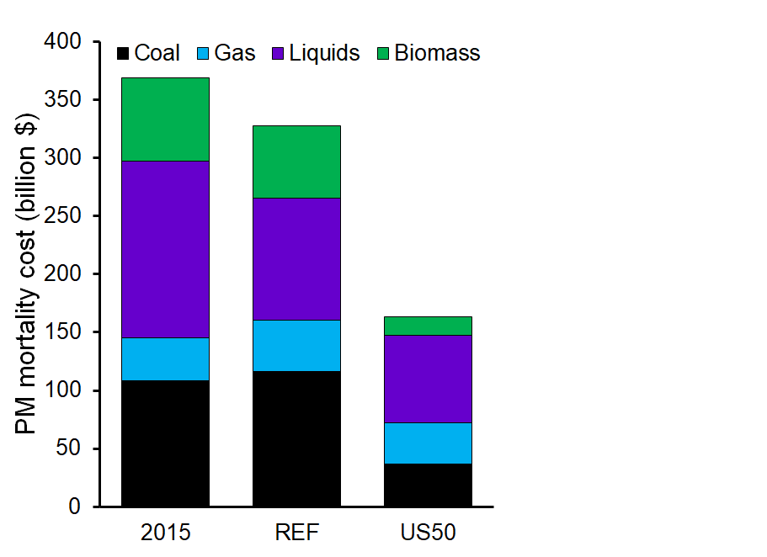
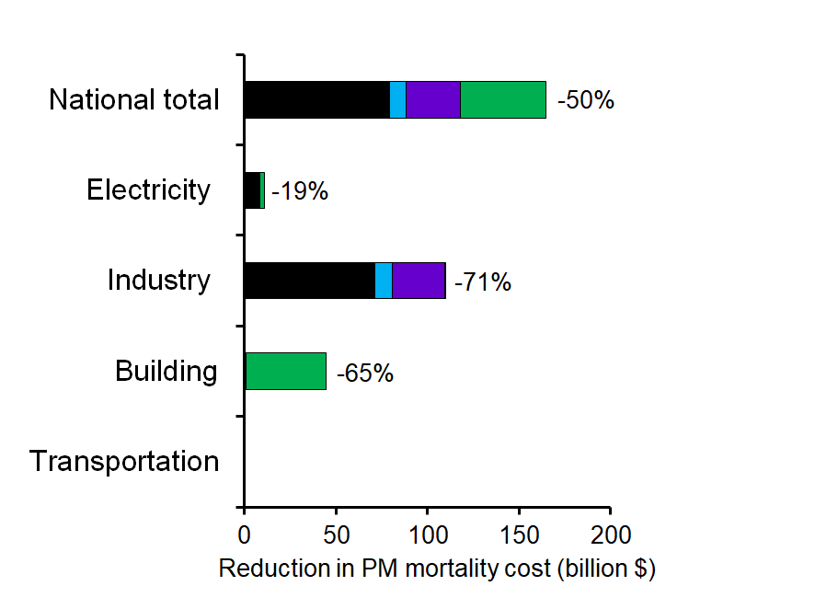
National energy system and emission responses to US50 2050
Total energy use (EJ)
∆ Energy use (US50 - REF)
The decreased use of industrial coal, building biomass, and industrial liquids
is equivalent to only 2% of the total energy consumption in 2050
contributes 87% of the total PMMC reductions relative to REF.
PMMC (Billion $)
∆ PMMC (REF – US50)
Industrial coal
Industrial liquids
Building biomass
Notes:
Use the top right graph to explain that the decreases are mainly made up by electrifying those sectors

Slide 10
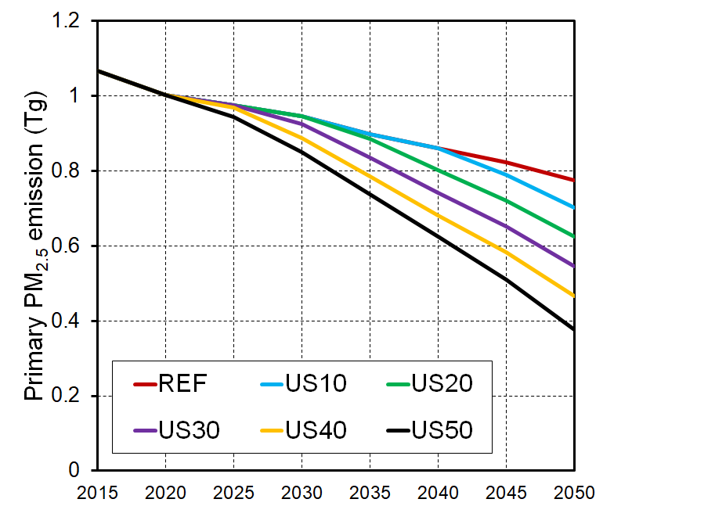
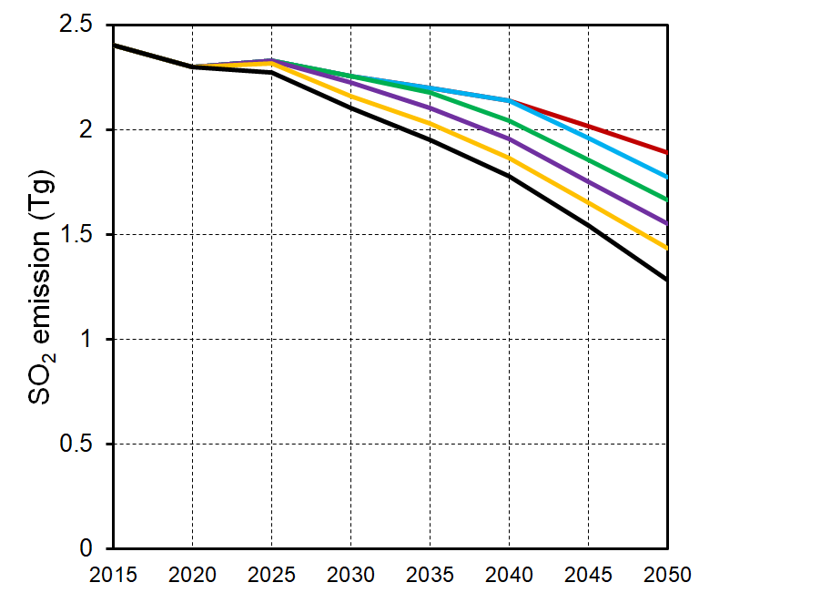
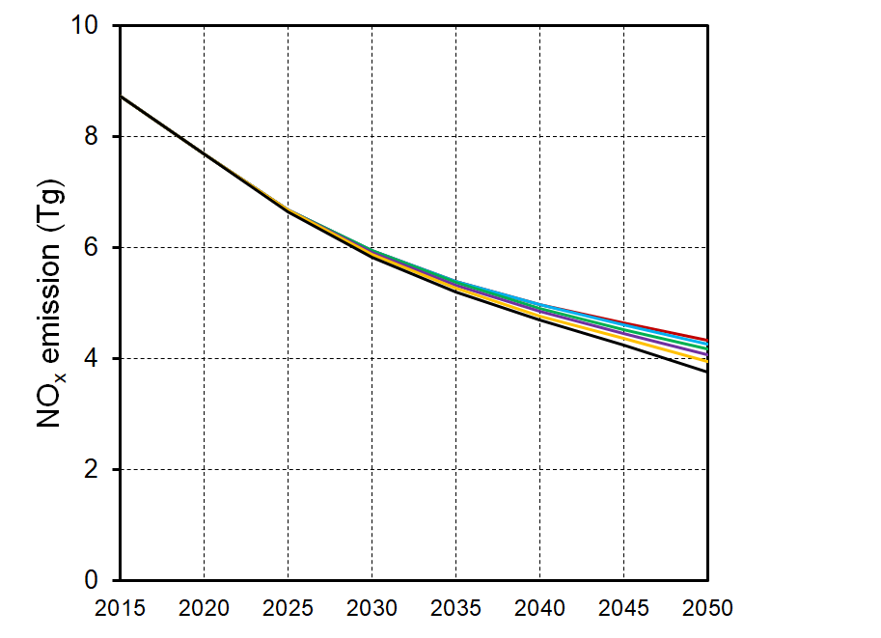
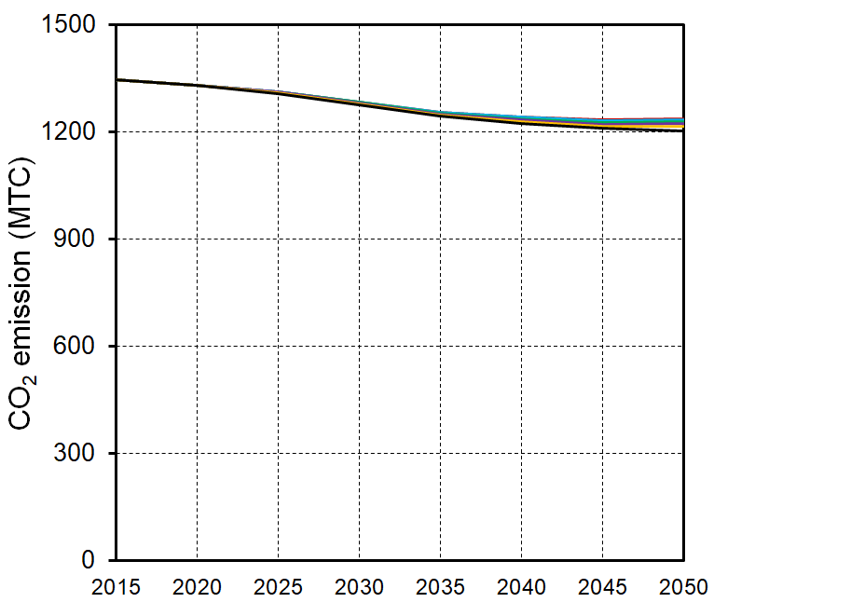
Effects of PMMC reduction stringency on emissions
a
b
PM_{2.5}
SO₂
c
d
NO_{x}
CO₂

Slide 11
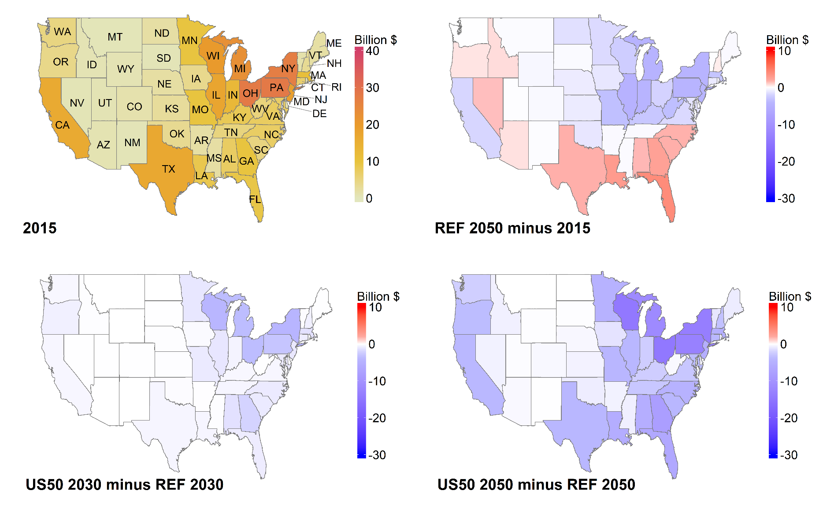
Regional PMMC reductions
Increased PMMC in REF
2015
REF 2050 - 2015
In US50, all states have lower PMMC compared with REF
The greatest emission reductions for PM_{2.5} health benefits are obtained in the East North Central and Middle Atlantic states
US50 2050 - 2015
Notes:
Verbally, give some reasons why these regions – population density, polluting industries, low cost of reductions on these sectors

Slide 12
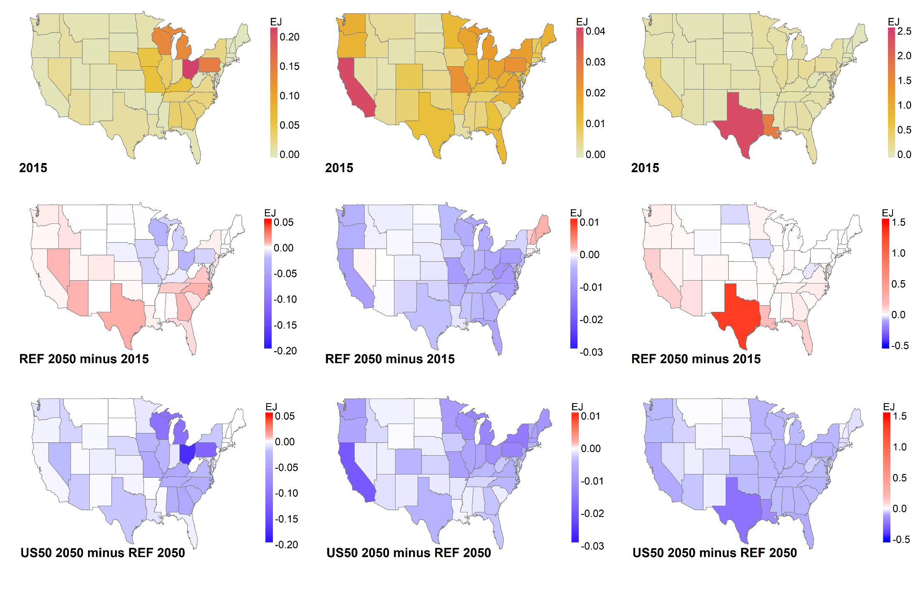
Energy consumption changes (EJ) in high emission intensity sources
Industrial coal
Building biomass
Industrial liquids
2015
REF 2050 - 2015
US50 2050 - 2015

Slide 13
Schematic of national policy cost and health benefit
Y(50%)
Marginal cost of 50% PMMC reduction relative to 40% reduction
Price of reduction in 2050 ($/$ of health cost)
Y(40%)
Marginal benefit of 50% PMMC relative to 40% reduction
Y(30%)
Y(20%)
Y(10%)
X(10%)
X(20%)
X(30%)
X(40%)
X(50%)
PMMC reduction ($ of health cost)

Slide 14
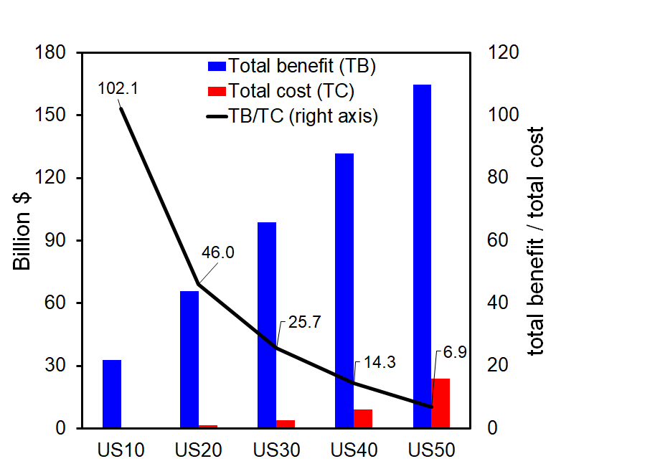
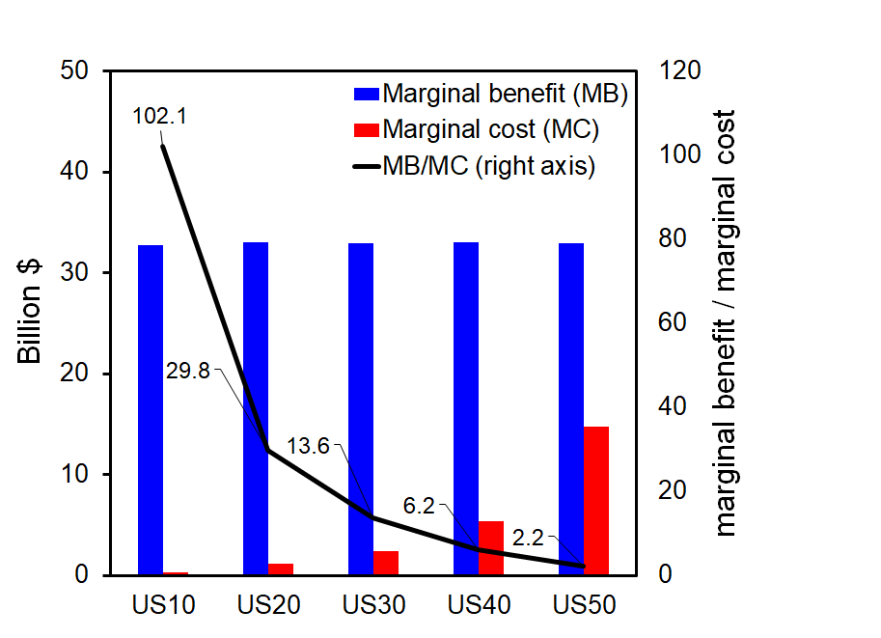
Cost-effectiveness of national PMMC reductions
Total cost and benefit
Marginal cost and benefit
All PMMC reduction scenarios are cost effective.
In US50, the marginal PM benefit of avoided mortality in 2050 is 2.2 times the marginal policy cost, while the national total health benefit in US50 is 6.9 times the corresponding policy cost.

Slide 15
Caveats
PMMC coefficients derived from EASIUR
only considering inorganic PM_{2.5} mortality, ignoring morbidity effects or effect of organic PM_{2.5}
are based on a log-linear exposure-response function with equal toxicity of all PM_{2.5} components
are based on emissions and meteorology in 2005
only represent state-level health impacts, while real-world exposure happens at much finer spatial scale
National targets cannot guarantee maximum benefits or environmental equality for each state

Slide 16
Conclusions
PMMC constraints can be directly applied within an IAM, allowing the model to endogenously identify the states and actions that can most cost-effectively reduce national PMMC
Substantial health benefits (up to 50% PMMC reductions in 2050 relative to the REF) can be cost-effectively achieved by using electricity to replace sources with high primary PM_{2.5} emission intensities, including industrial coal, building biomass, and industrial liquids.
Increasing the stringency of PM_{2.5} reduction targets decreases major air pollutant emissions such as primary PM_{2.5} and SO₂, but very limited co-benefits in reducing CO₂ emissions.
Control strategies achieve the greatest emission reductions for PM_{2.5} health benefits in the East North Central and Middle Atlantic states.

