Slide 1
Evaluation of the CMAQv5.3 Modeling System
K. Wyat Appel, Christian Hogrefe, Kristen Foley, George Pouliot, Robert Gilliam,
Benjamin Murphy, Havala Pye, Jesse Bash, Jonathan Pleim, Golam Sarwar, Tanya Spero,
Deborah Luecken (retired), Shawn Roselle (retired), Rohit Mathur,
and the CMAQ Development Team
Atmospheric and Environmental Systems Modeling Division
Center for Environmental Measurement and Modeling
Office of Research and Development
U.S. Environmental Protection Agency
22 October 2019
18th Annual CMAS Conference
Chapel Hill, NC

Slide 2
CMAQv5.3 – Major Updates
Science updates and new features
Aerosols
Increased monoterpene SOA (Pye et al. 2015 ES&T, Xu et al. 2018 ACP), uptake of water onto hydrophilic organic aerosol (Pye et al. 2017 ACP), and reorganization of anthropogenic SOA (M. Qin)
Gas chemistry
Minor updates to CB6r3 (ClNO3 reaction added; first-order O₃ depletion)
Updated full halogen chemistry and added dimethyl sulfide (DMS) chemistry – included in optional detailed mechanism (Sarwar et al., Atmospheric Environment, 2019)
Deposition
Multiple updates to M3Dry deposition scheme (dependence of ozone soil resistance on moisture, gas phase deposition to snow, aerosol deposition)
New Surface Tiled Aerosol and Gaseous Exchange (STAGE) deposition scheme available
Emissions
New Detailed Emissions Scaling, Isolation, and Diagnostic (DESID) module (easier scaling of emissions)
Source apportionment
The Integrated Source Apportionment Method (ISAM) has been updated to greatly improve efficiency and runtime
Updated CMAQ documentation
Updated CMAQ User’s Guide, science documentation and website (https://www.epa.gov/cmaq)
Updated CMAQ tools
ICON, BCON, Site compare, AMETv1.4, MCIPv5.0
Release schedule
Beta version released October 2018
Final version released August 2019: https://github.com/USEPA/CMAQ
Instrumented models – ISAM, Sulfur tracking (available w/ final release); DDM available with future v5.3.1 release (12/2019)

Slide 3
CMAQ Inputs and Configuration
 | CMAQv5.2.1 | CMAQv5.3
WRF Version | 3.8.1 | 3.8.1 and 4.1.1
MCIP Version | 4.5 | 4.5 and 5.0
Boundary Conditions | v5.2.1 Hemispheric CMAQ (with detailed halogen mechanism) | v5.3 Hemispheric CMAQ (with detailed DMS/halogen mechanism)
Chemical Mechanism | CB6r3 | CB6r3
Aerosol Module | AERO6 | AERO7
Deposition Scheme | M3Dry | M3Dry and STAGE
Bi-directional Ammonia | No | Yes and No
Wind-blown Dust | No | No
Lightning NOx | Yes | Yes
All simulations are 2016 CONUS 12-km annual simulation
MCIP from the same 2016 WRF v3.8 simulation used in all simulations (WRF simulations use lightning assimilation)
2016 emissions based on “fe” and “ff” beta platform versions (final 2016v1 platform emissions coming soon)

Slide 4
MDA8 O₃ Bias (Daily) – v5.2.1 vs v5.3 (M3Dry)
v5.2.1
Reduced wintertime O₃ underestimation with v5.3
v5.3
Lower O₃ in the late spring, summer, and fall with v5.3

Slide 5
MDA8 O₃ Bias (Monthly) – v5.2.1 vs v5.3 (M3Dry)
v5.2.1

Slide 6
MDA8 O₃ Bias (Monthly) – v5.2.1 vs v5.3 (M3Dry)
v5.2.1
v5.3

Slide 7
MDA8 O₃ Bias (Monthly) – v5.2.1 vs v5.3 (M3Dry)
v5.2.1
v5.3
v5.3 w/ v5.3β BCs

Slide 8
MDA8 O₃ Bias (Monthly) – v5.2.1 vs v5.3 (M3Dry)
v5.2.1
v5.3
v5.3 w/ v5.3β BCs
v5.3 w/ “ff” platform

Slide 9
MDA8 O₃ Bias (Monthly) – v5.2.1 vs v5.3 (M3Dry)
v5.2.1
v5.3
v5.3 w/ v5.3β BCs
v5.3 w/ “ff” platform
v5.3 w/ WRFv4.1.1

Slide 10
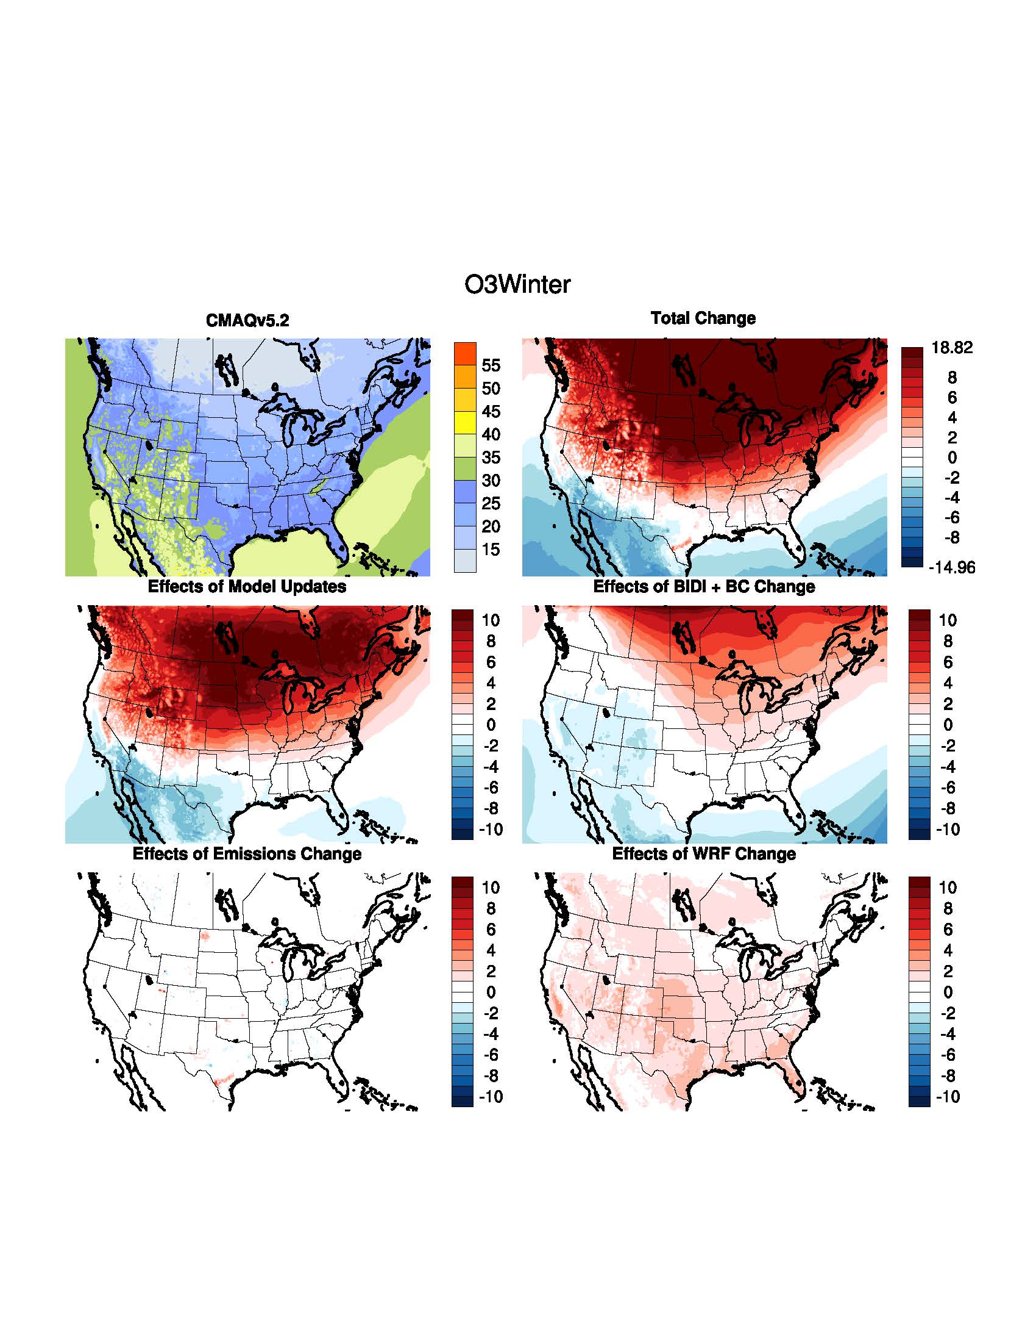
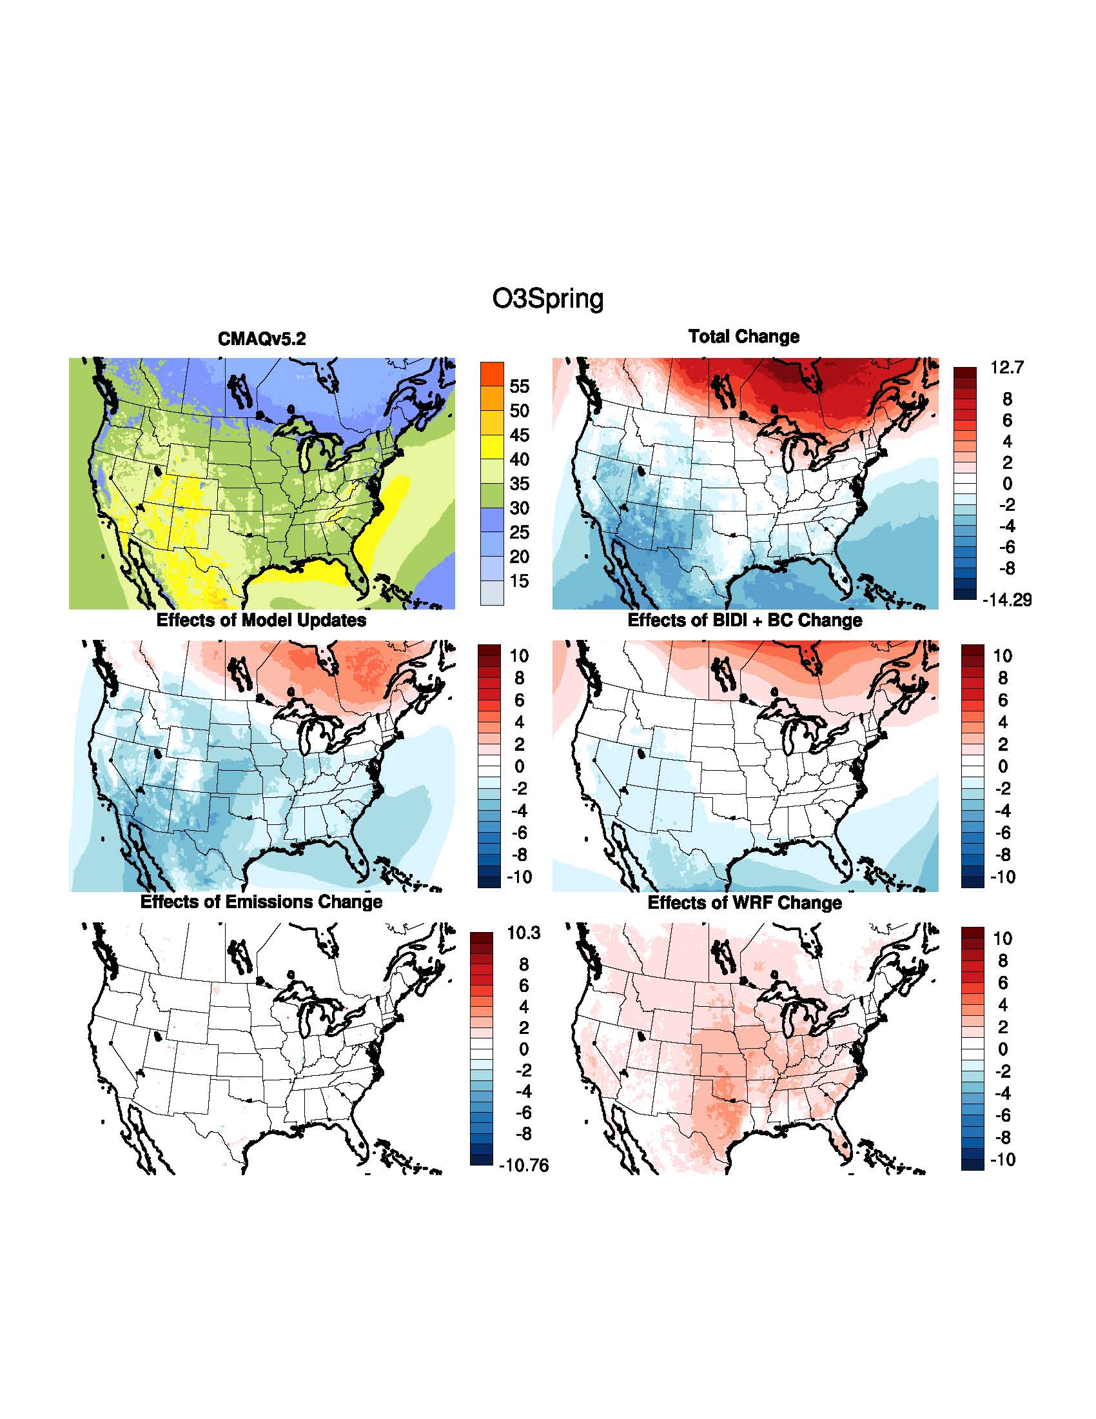
O₃: Impact of Incremental System Updates
Winter
Spring
Large increase in wintertime O₃ w/ v5.3 due to reduced deposition to snow
Decrease in springtime O₃ due to chemistry updates and BCs

Slide 11
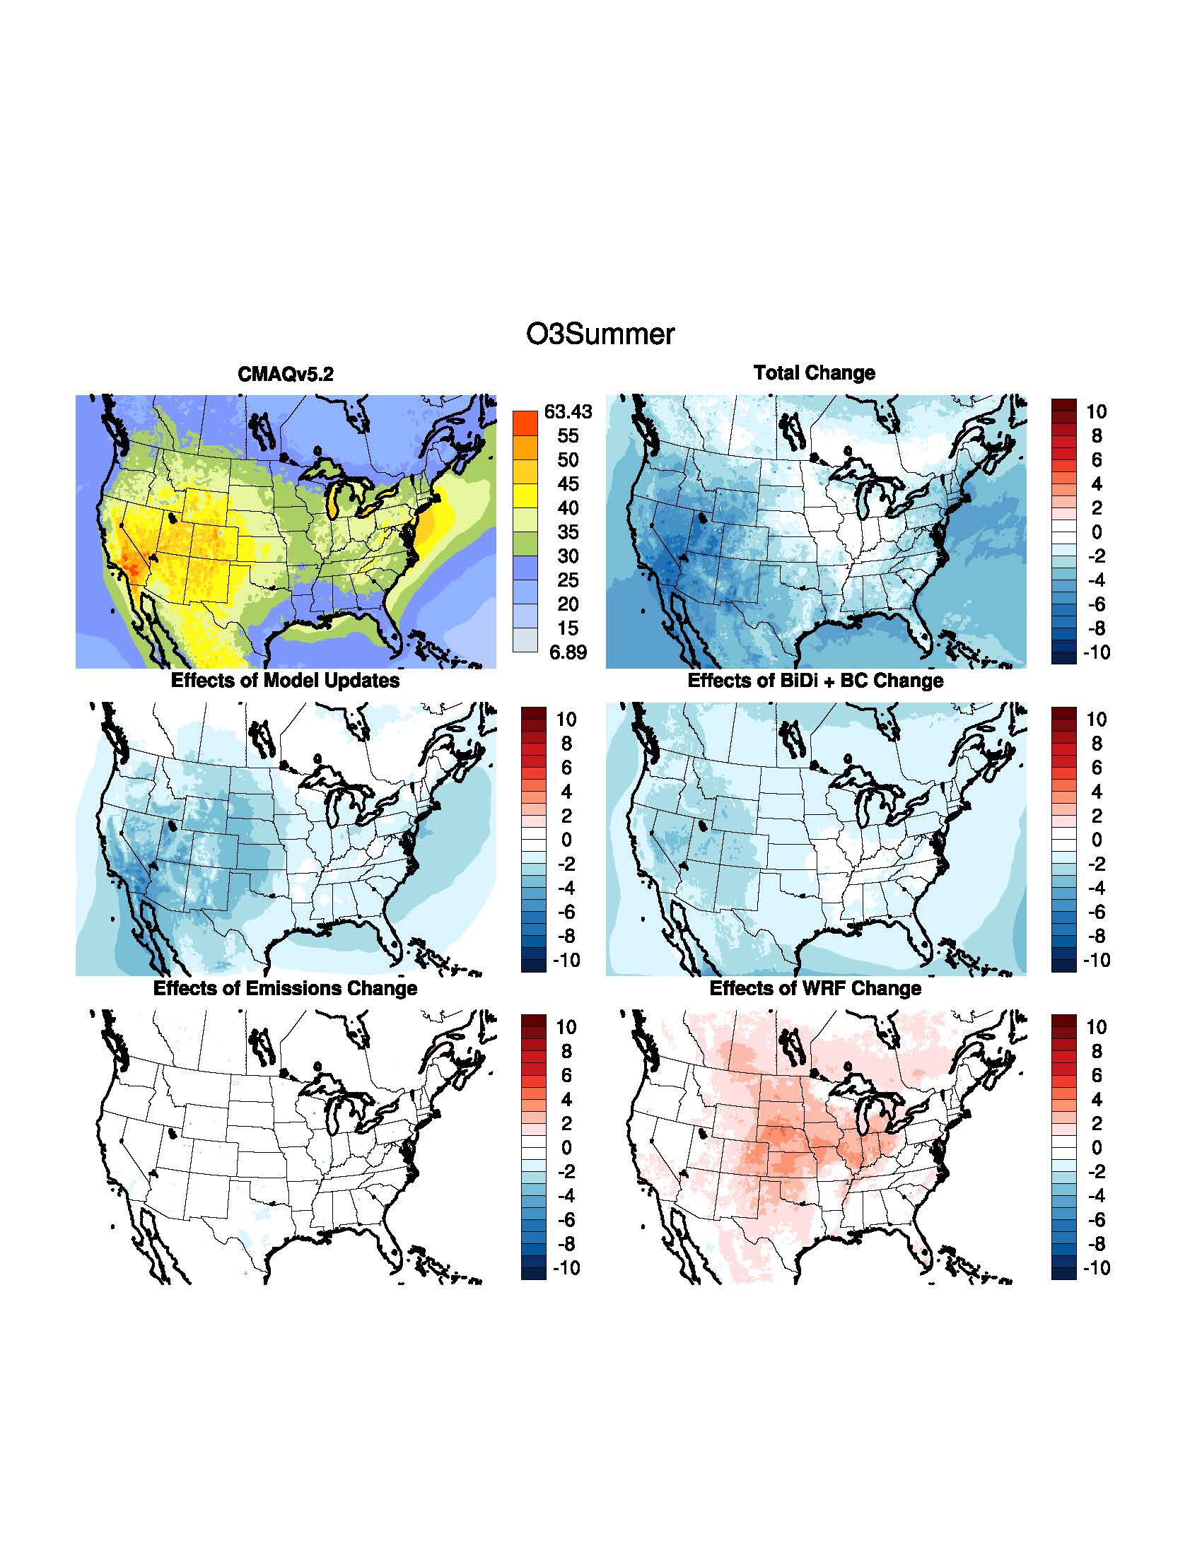
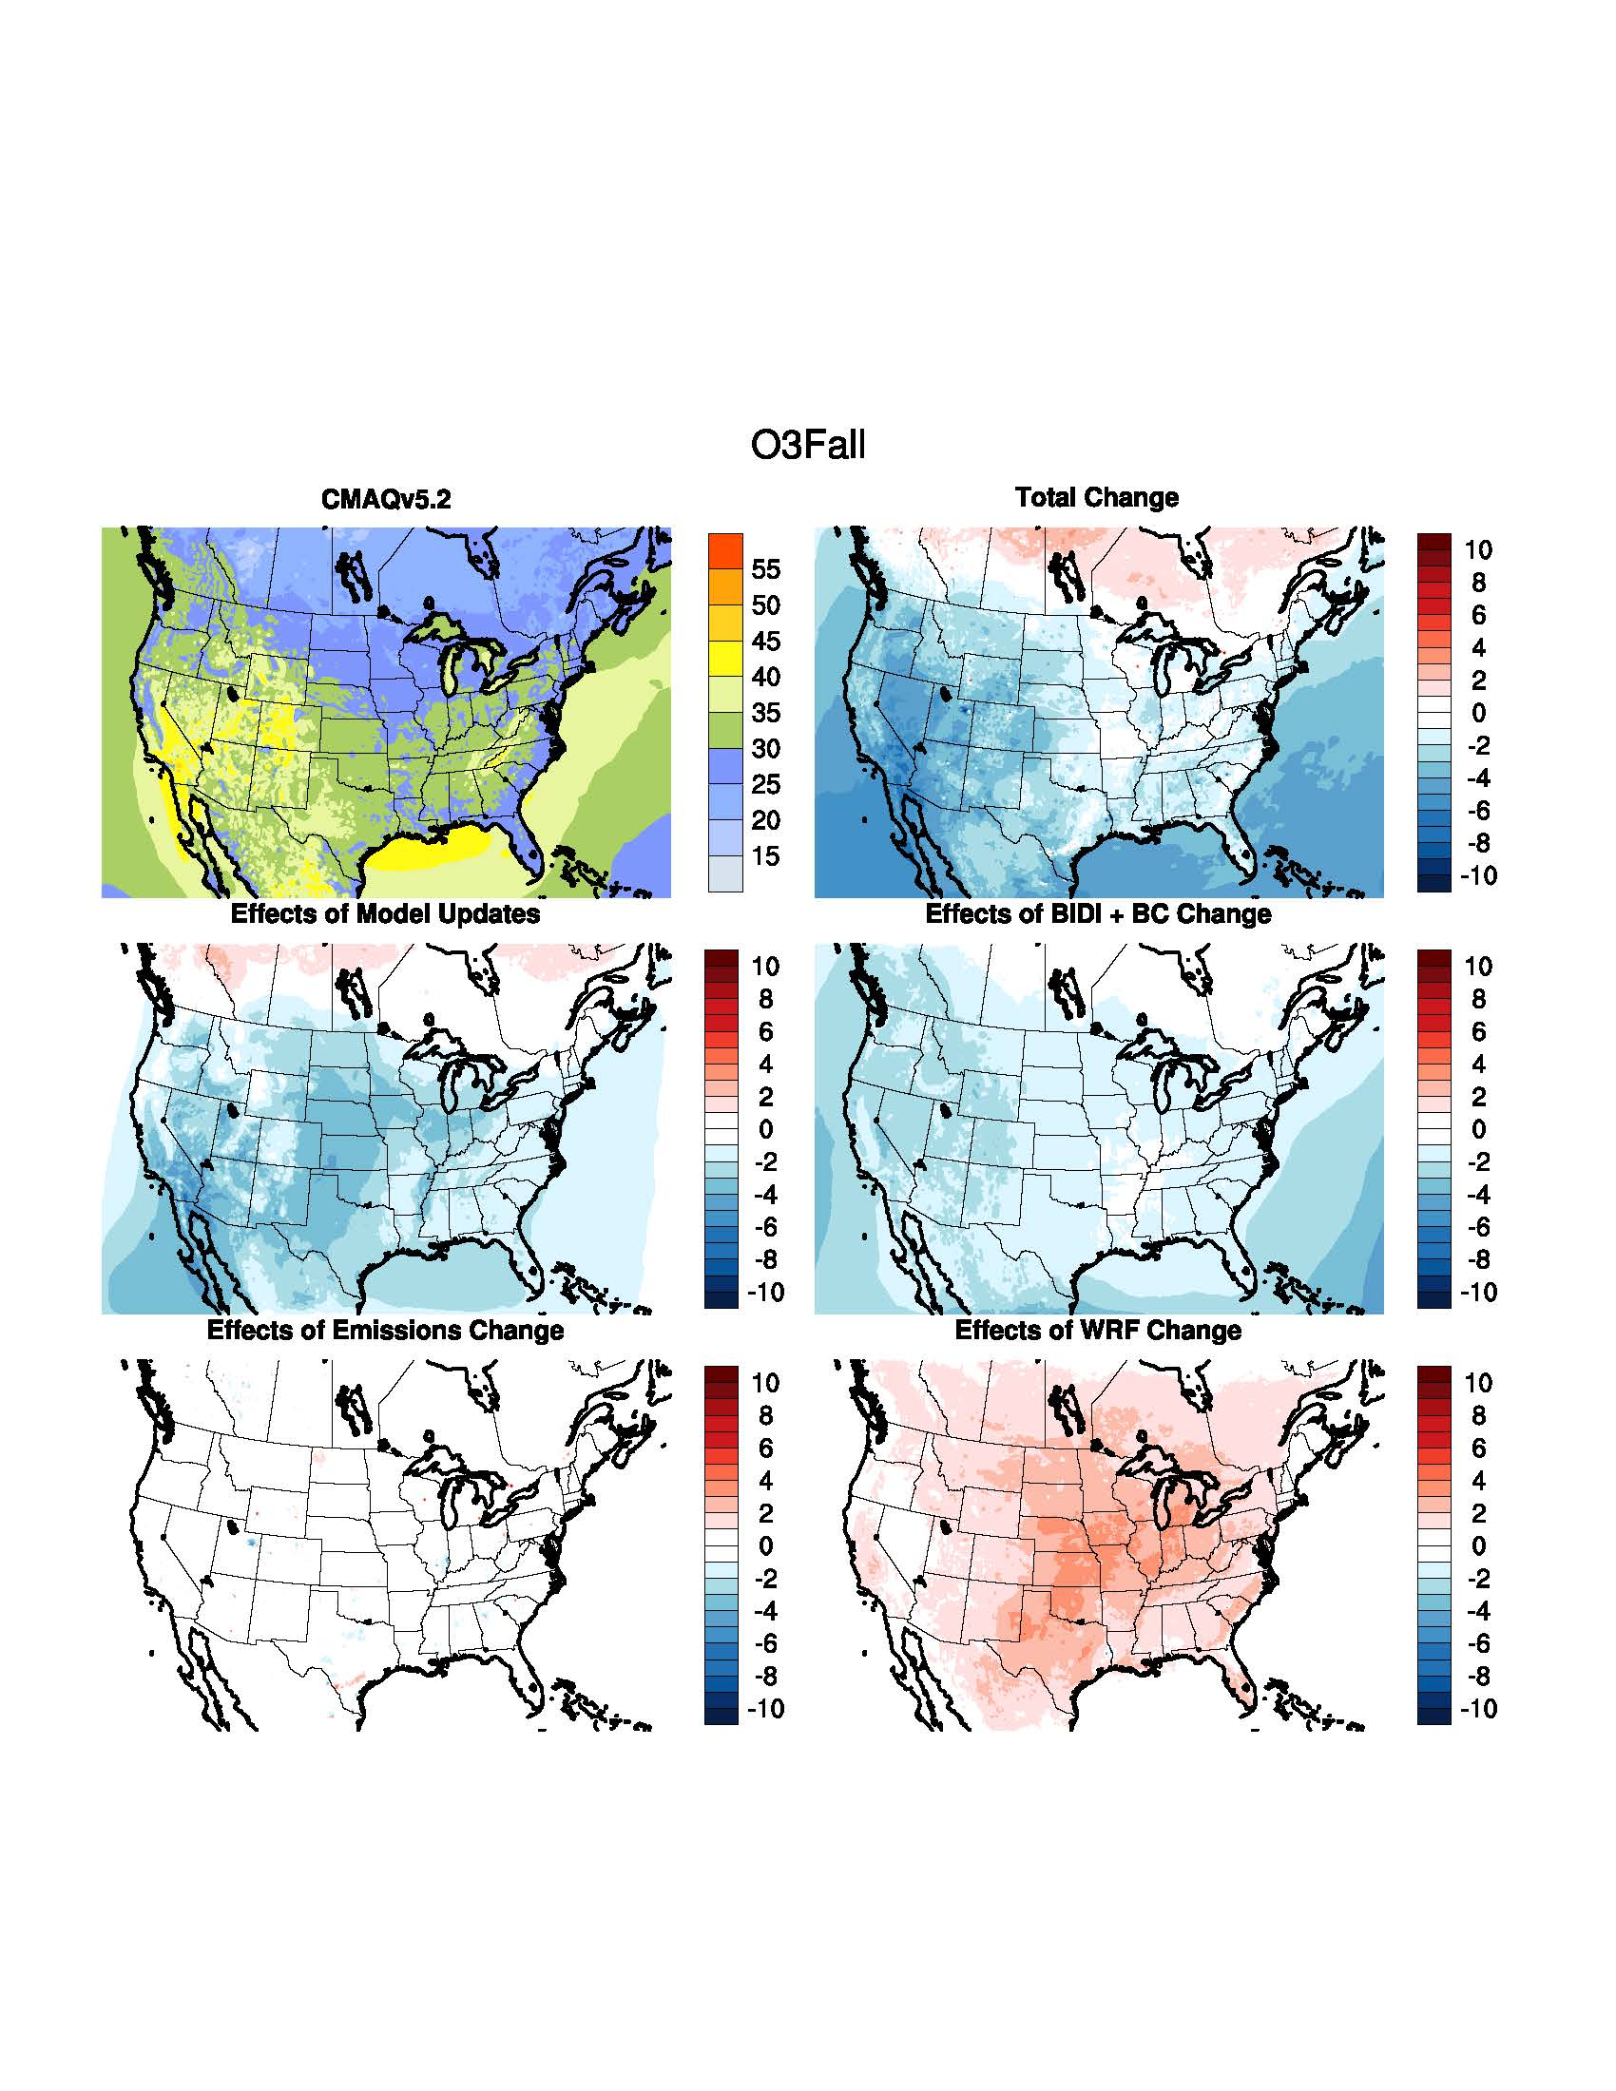
O₃: Impact of Incremental System Updates
Summer
Fall
Decrease in summer/fall O₃ due to chemistry updates and BCs
Increase in summer and fall O₃ due to WRFv4.1.1

Slide 12
PX LSM Vegetation Fraction and LAI Update
WRFv4.1.1 – WRFv3.8.1 using updated PX LSM (April 2016)
Use of time-varying Veg Fraction and LAI from MODIS satellite retrievals instead of FPAR/LAI from look-up tables significantly reduces vegetation fraction, which in turn reduces O₃ dry deposition and increases O₃ mixing ratios, particularly in the western US.

Slide 13
MDA8 O₃: CMAQv5.3 - v5.2.1 Seasonal Bias Difference
Improved Bias
Improved Bias
Winter
Worse Bias
Spring
Worse Bias
Improved Bias
Improved Bias
Summer
Worse Bias
Fall
Worse Bias
Cool colors indicate lower bias with v5.3; Warm colors indicate higher bias with v5.3 (range is -10 to +10 ppb)

Slide 14
PM_{2.5} Bias (Daily) – v5.2.1 vs v5.3 (M3Dry)
v5.3
v5.2.1
Generally higher PM_{2.5} in late spring, summer, and fall with v5.3

Slide 15
PM_{2.5} Bias (Monthly) – v5.2.1 vs v5.3 (M3Dry)
v5.2.1

Slide 16
PM_{2.5} Bias (Monthly) – v5.2.1 vs v5.3 (M3Dry)
v5.2.1
v5.3 (w/o bidi)

Slide 17
PM_{2.5} Bias (Monthly) – v5.2.1 vs v5.3 (M3Dry)
v5.2.1
v5.3 (w/o bidi)
v5.3 (w/ bidi)

Slide 18
PM_{2.5} Bias (Monthly) – v5.2.1 vs v5.3 (M3Dry)
v5.2.1
v5.3 (w/o bidi)
v5.3 (w/ bidi)
v5.3 w/ new BCs

Slide 19
PM_{2.5} Bias (Monthly) – v5.2.1 vs v5.3 (M3Dry)
v5.2.1
v5.3 (w/o bidi)
v5.3 (w/ bidi)
v5.3 w/ new BCs
v5.3 w/ “ff” platform

Slide 20
PM_{2.5} Bias (Monthly) – v5.2.1 vs v5.3 (M3Dry)
v5.2.1
v5.3 (w/o bidi)
v5.3 (w/ bidi)
v5.3 w/ new BCs
v5.3 w/ “ff” platform
v5.3 w/ WRFv4.1.1

Slide 21
Quick PSA on Emissions with v5.3
Potential Combustion SOA (PCSOA)
Added to CMAQ in v5.2
Intended to help account for missing PM_{2.5} from fossil-fuel combustion sources
PCSOA was not intended to be applied to all combustion sources
However, limitation prior to CMAQv5.3 to read multiple gridded emissions files lead to PCSOA being applied to unintended sources (e.g. Residential Wood Combustion (RWC))
As such, CMAQv5.2 simulations with PCSOA enabled would overestimate PM_{2.5} from RWC
CMAQv5.3 contains the new DESID option and ability to read multiple gridded emissions files
This allows for RWC to be treated as an entirely separate emissions source from the rest of the gridded emissions
As such, DESID allows for PCSOA to be applied to the other gridded combustion sources, but not RWC
This correctly results in a reduction in PM_{2.5} from the unintentional application of PCSOA to RWC
If using cb6r3_ae7 with offline biogenic emissions, separate α-pinene from all other monoterpenes:
Prevents overestimates in PM_{2.5} SOA as α-pinene should not make SOA through NO₃ reaction
Can still use existing biogenic emission files by updating the emission control file
No action required for ae6 (any mechanism), in-line biogenics (any mechanism, any aero), or aero7 with SAPRC mechanisms
See AERO7 overview release notes at https://github.com/USEPA/CMAQ/blob/master/DOCS/Release_Notes/aero7_overview.md
In CMAQv5.3 with PCSOA (default setting):
1. All fire and wood-burning related emissions should be separated from other emissions streams
2. If using CB6r3 with AERO7 and offline biogenics, separate α-pinene from all other monoterpenes

Slide 22
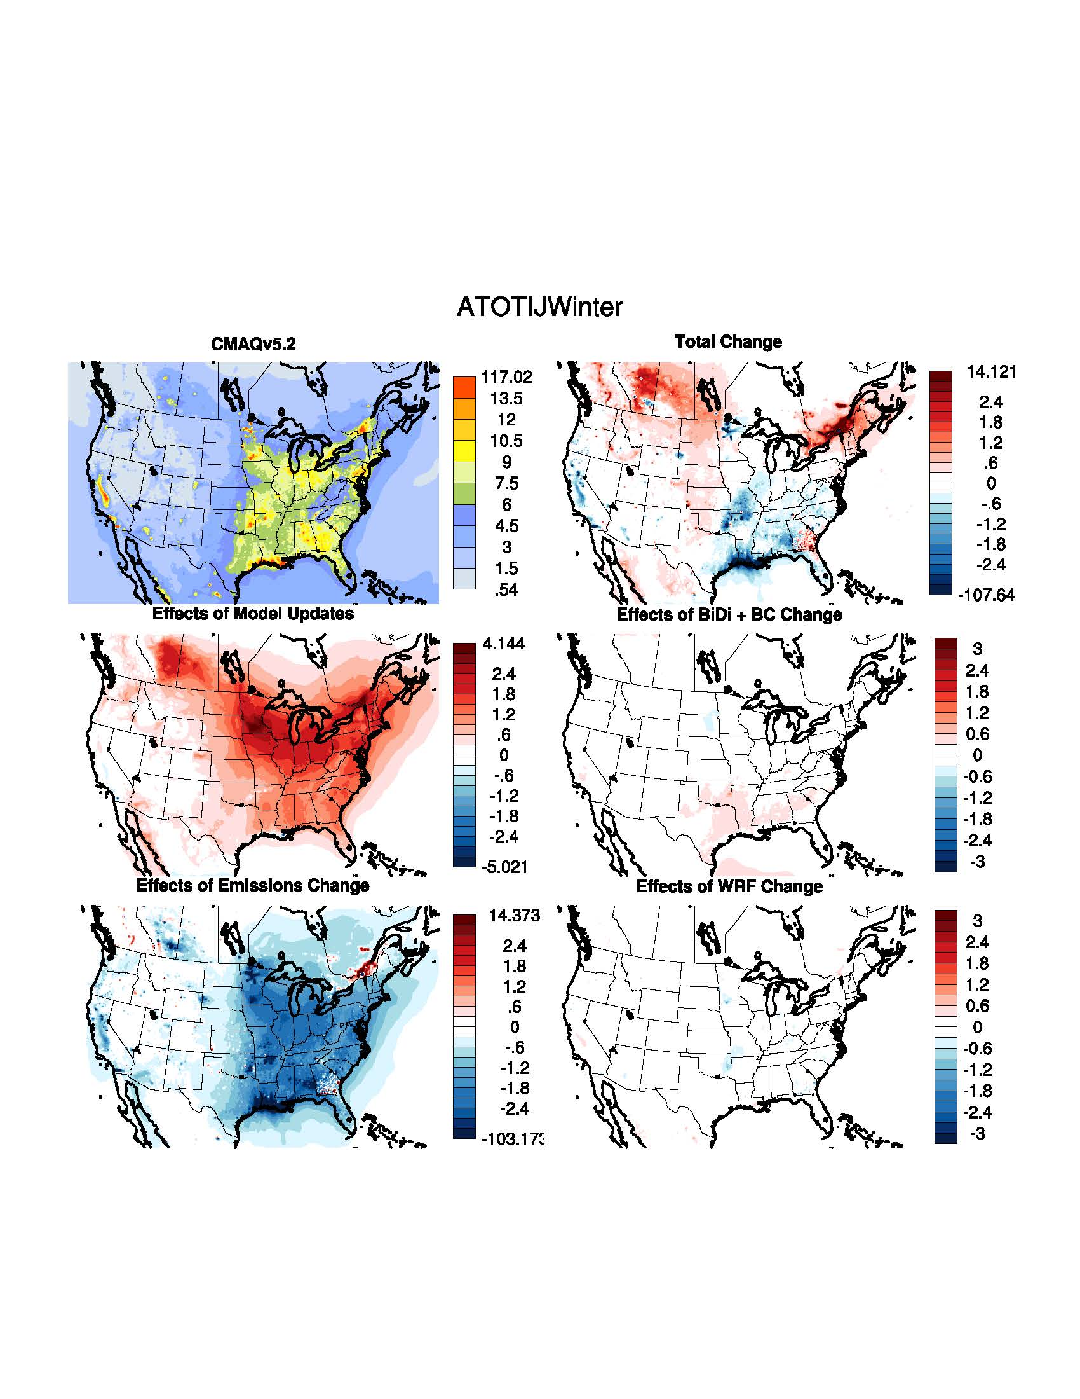
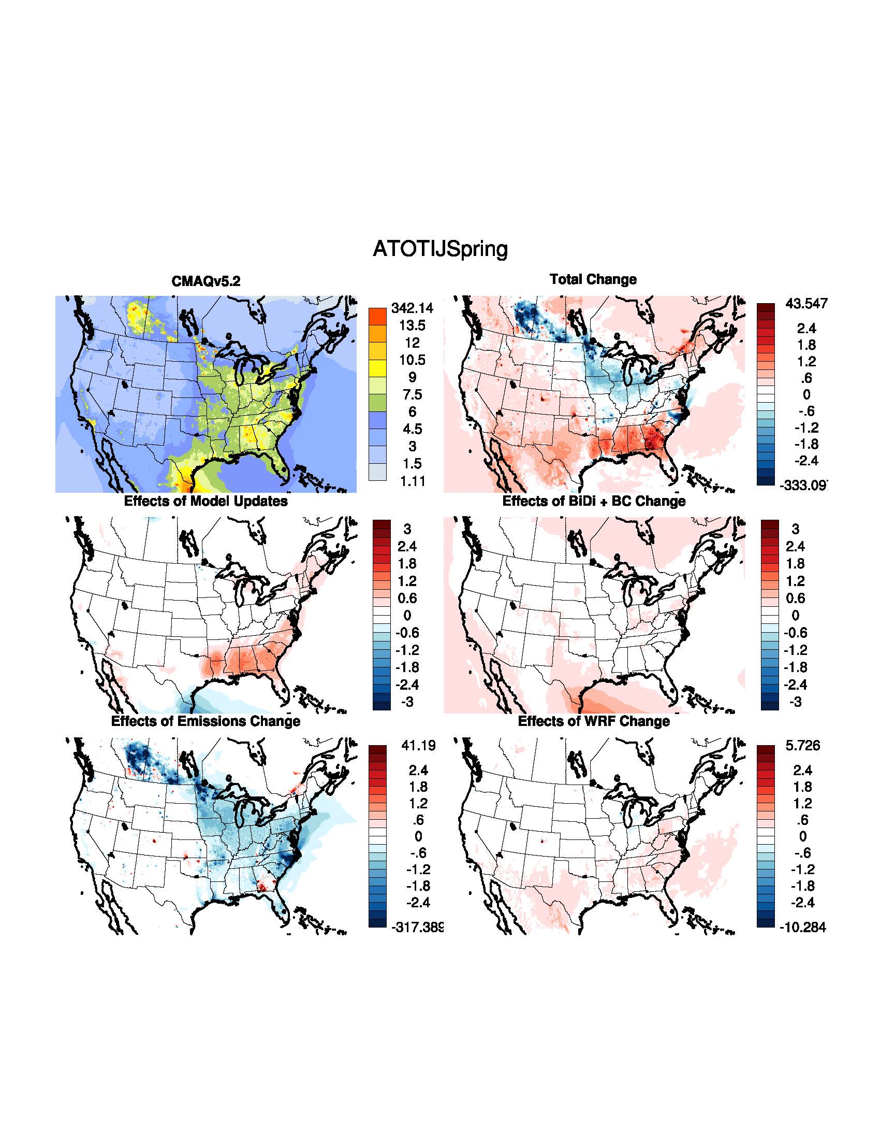
PM_{2.5}: Impact of Incremental System Updates
Winter
Spring
Large increase in wintertime PM_{2.5} due to increased oxidants in v5.3
PM_{2.5} reduced with emission update by not applying PCSOA to res-wood burning

Slide 23
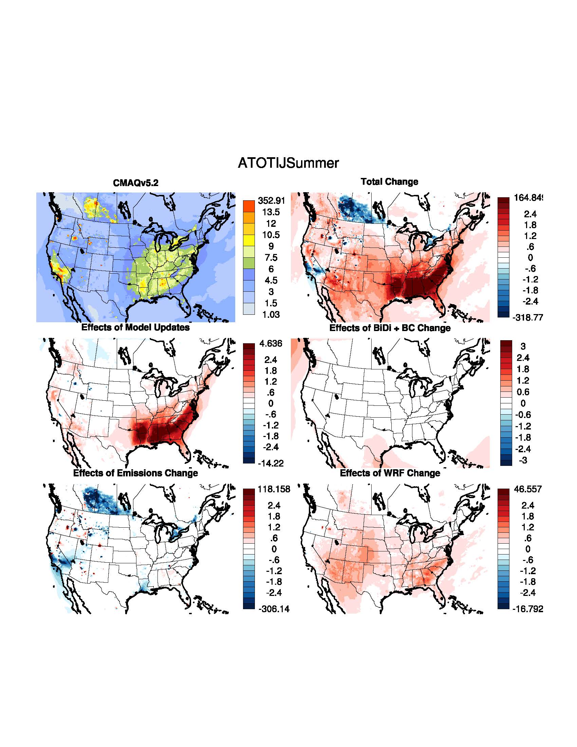
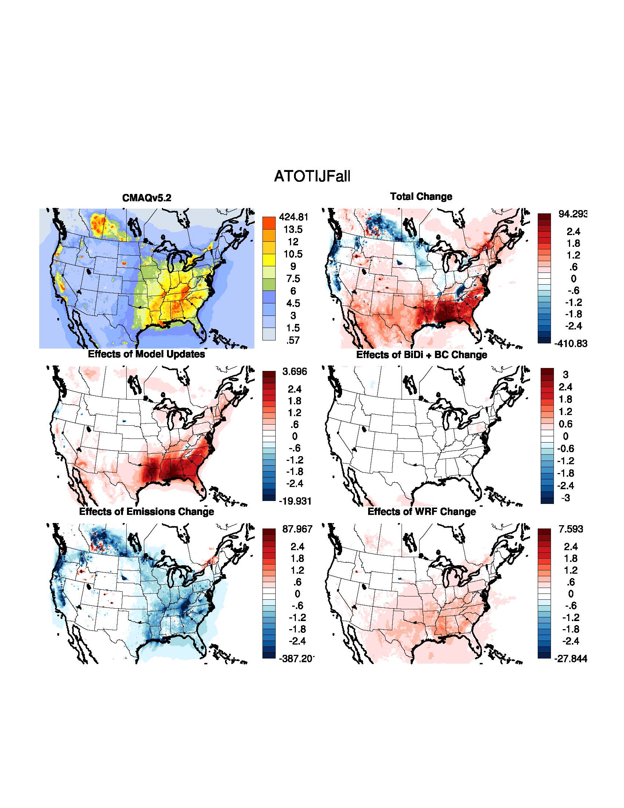
PM_{2.5}: Impact of Incremental System Updates
Summer
Fall
Large increase in summer/fall PM_{2.5} due to increased SOA from monoterpene oxidation

Slide 24
PM_{2.5}: CMAQv5.3 - v5.2.1 Seasonal Bias Difference
Improved Bias
Improved Bias
Winter
Worse Bias
Spring
Worse Bias
Increased SOA in the Southeast with v5.3 leads to higher PM_{2.5} bias in summer and fall versus v5.2.1
Improved Bias
Improved Bias
Summer
Worse Bias
Fall
Worse Bias
Cool colors indicate lower bias with M3Dry; Warm colors indicate lower bias with STAGE

Slide 25
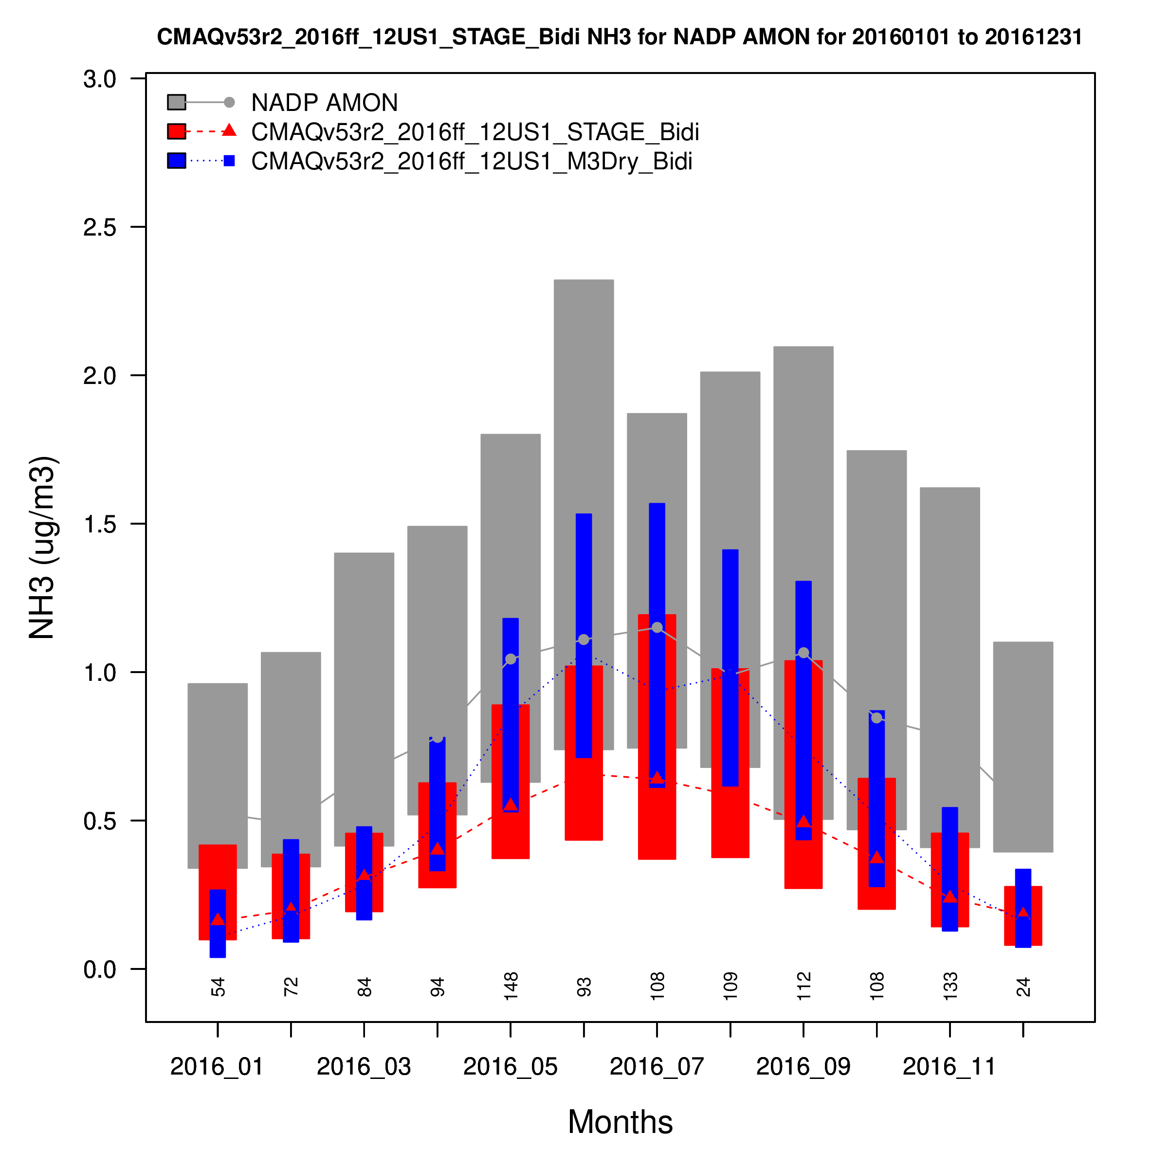
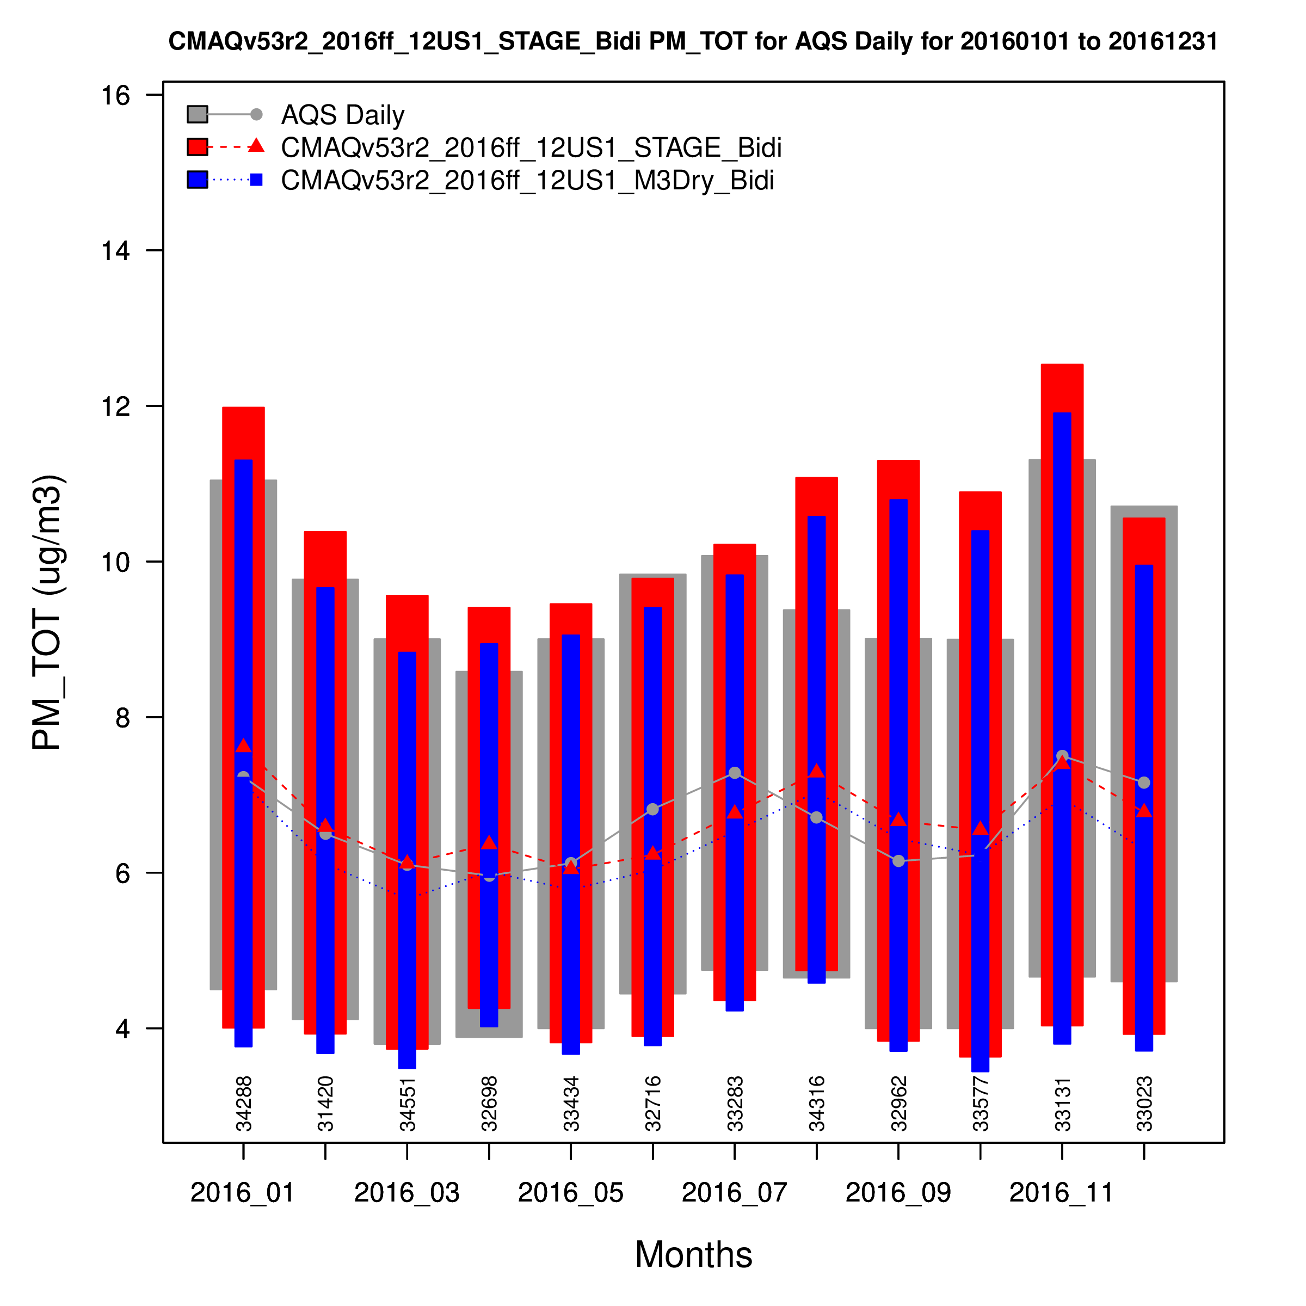
CMAQv5.3 – STAGE vs. M3Dry
STAGE
NH₃
STAGE
PM_{2.5}
M3Dry
M3Dry

Slide 26
PM_{2.5} – STAGE vs. M3Dry Seasonal Bias Difference
M3Dry Better
M3Dry Better
Winter
STAGE Better
Spring
STAGE Better
Reduced PM_{2.5} bias in the eastern US with M3Dry
Reduced PM_{2.5} bias in the western US with STAGE
M3Dry Better
M3Dry Better
Summer
STAGE Better
Fall
STAGE Better

Slide 27
Summary
Ozone
Higher O₃ with v5.3 in winter improves underestimation vs. v5.2.1
Largely due to changes in the representation of dry deposition in v5.3
Lower O₃ with v5.3 in spring increases underestimation vs. v5.2.1
Lower O₃ with v5.3 in summer/fall improves overestimation vs. v5.2.1
BCs created using v5.3β (M3Dry) hemispheric CMAQ simulation contribute to lower O₃ (vs BCs using v5.2.1)
largest in the winter and fall
WRFv4.1.1 results in generally higher O₃ mixing ratios, particularly in the winter and spring
result of time-varying VEGFRA and LAI derived from MODIS instead of the look-up values in the PX data table
Total PM_{2.5}
Generally higher PM_{2.5} in the summer/fall with v5.3 vs. v5.2.1
primarily the result of increased SOA from monoterpene oxidation products
Similar PM_{2.5} (to v5.2.1) outside of the summer
STAGE has consistently higher PM_{2.5} than M3Dry throughout the year
M3Dry has smaller warm-season NH₃ bias vs. STAGE
WRFv4.1.1 has a generally small effect on PM_{2.5} concentration throughout the year

Slide 28
Acknowledgements and Disclaimer
CMAQ Development Team and Others
Wyat Appel
Jesse Bash
Brian Eder
Kathleen Fahey
Kristen Foley
Robert Gilliam
Christian Hogrefe
Bill Hutzell
Daiwen Kang
Deborah Luecken (retired)
Rohit Mathur
Benjamin Murphy
Sergey Napelenok
Chris Nolte
Jonathan Pleim
George Pouliot
Havala Pye
Limei Ran
Shawn Roselle (retired)
Golam Sarwar
Donna Schwede
Fahim Sidi
Tanya Spero
David Wong
The views expressed in this presentation are those of the authors and do not necessarily reflect the views or policies of the U.S. Environmental Protection Agency.

Slide 29
Extra Slides

Slide 30
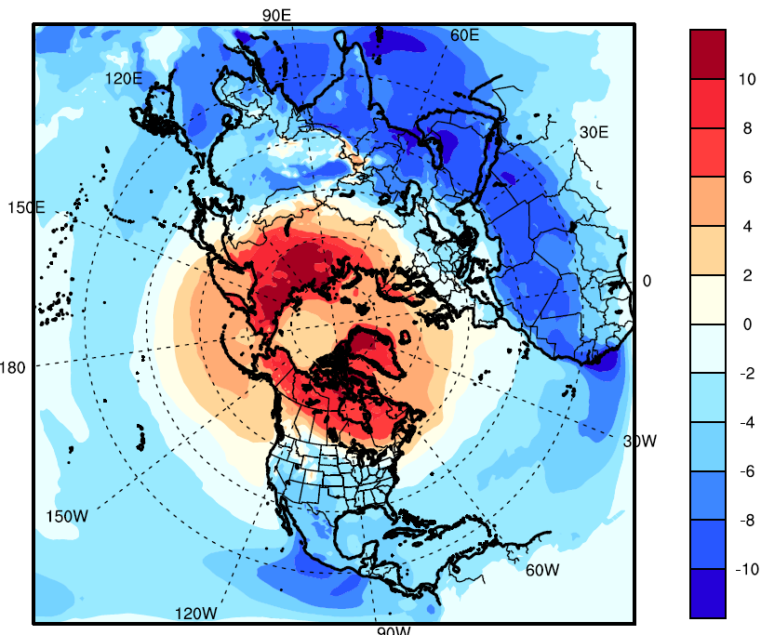
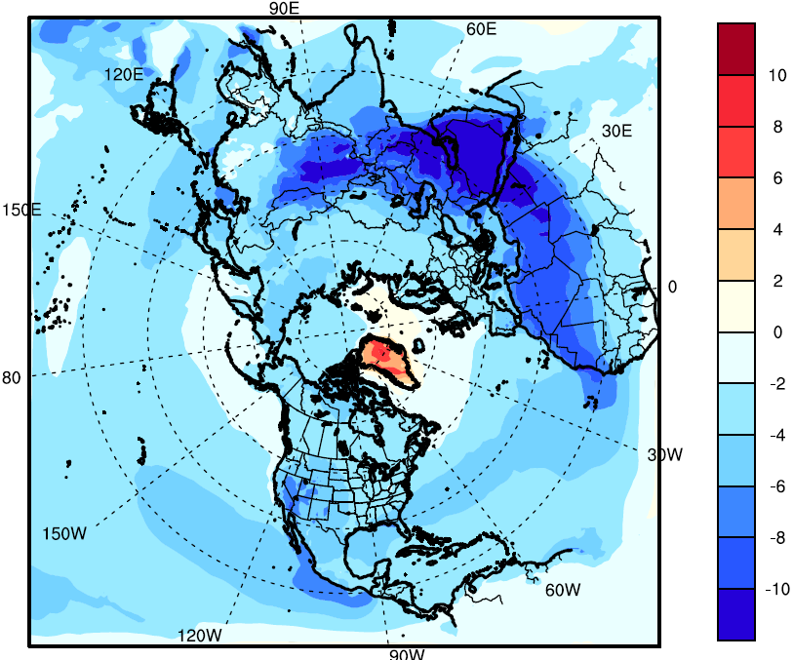
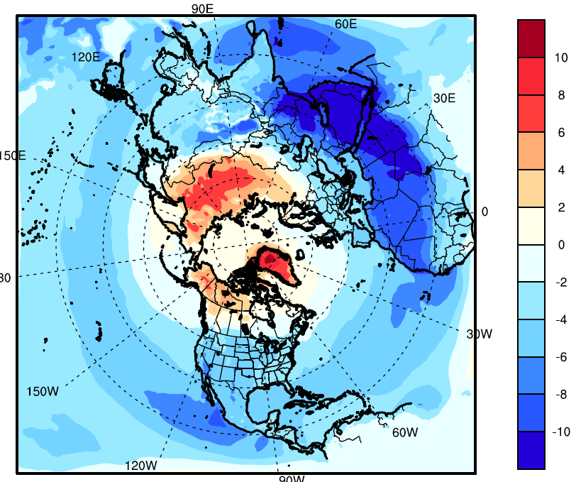
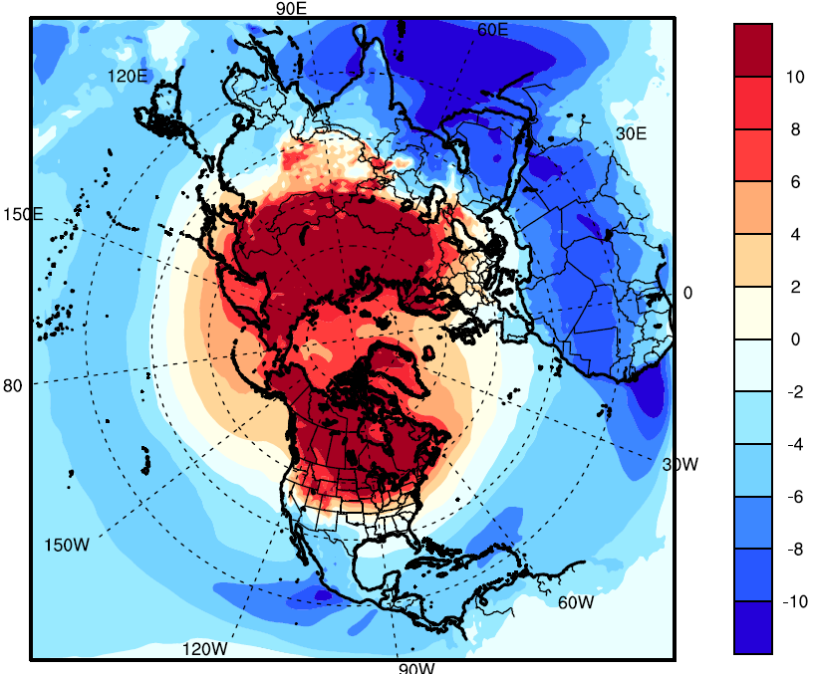
O₃ Changes CMAQv5.3β Minus CMAQv5.2.1
Spring 2016
Summer 2016
Annual Average 2016
Increased deposition to soil
Increased depletion due to updated halogen chemistry
Fall 2016
Winter 2016
Decreased deposition to snow
Overall result of moving to CMAQv5.3β BCs is reduced O₃ over the CONUS from the lateral boundaries
30

Slide 31
MDA8 O₃ – CMAQv5.2.1 vs v5.3 (STAGE)

Slide 32
PM_{2.5} – CMAQv5.2.1 vs v5.3

Slide 33
CMAQv5.3 - v5.2.1 (January)
Organic Carbon
Non-Carbon Organic Matter

Slide 34
CMAQv5.3 - v5.2.1 (July)
Organic Carbon
Non-Carbon Organic Matter

Slide 35
CMAQv5.2.1 vs v5.3 (Jun – Aug)
Organic Carbon
Non-Carbon Organic Matter

Slide 36
Hemispheric CMAQ – Winter MDA O₃

Slide 37
Hemispheric CMAQ – Summer MDA O₃

Slide 38
CMAQv5.3 PM_{2.5} – STAGE vs. M3Dry
1.5
STAGE
- 1
M3Dry
Jan
Mar
May
Jul
Sep
Nov

Slide 39
CMAQv5.3 NH₃ – STAGE vs. M3Dry
- 0.1
M3Dry
STAGE
- 0.8
Jan
Mar
May
Jul
Sep
Nov

Slide 40
PM_{2.5}: STAGE - M3Dry Seasonal Difference
PM_{2.5} with STAGE higher in all seasons vs. M3Dry, particularly in the Eastern U.S. and the San Joaquin Valley in California

