Slide 1
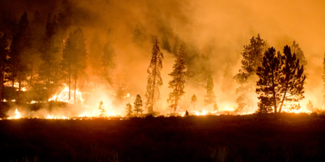
Estimating Emissions from Fires for Air Quality Modeling: Status Update
George Pouliot, ORD
Jeff Vukovich, OAQPS
Venkatesh Rao, OAQPS
James Beidler, OAQPS
Joseph Wilkins, ORD
Image source: U.S. Forest Service
18th Annual CMAS 2019 Conference
Chapel Hill NC October 21-23, 2019
Office of Research and Development
Center for Environmental Measurements & Modeling/Atmospheric & Environmental Systems Modeling Division
October 22, 2019
Notes:
Time Slot: 9:30 AM – 9:45 AM with 5 min for questions (9:45-9:50 AM)

Slide 2
Disclaimer
The views expressed in this presentation are those of the authors and do not necessarily reflect the views or policies of the U.S. EPA

Slide 3
Definitions of fire types
Wild fire - uncontrolled fire in an area of combustible vegetation; can occur over any land types include grasslands and croplands
Prescribed fires - controlled fires for purposes of forest management, farming, prairie restoration or greenhouse gas abatement
Grassland/rangeland fires - special case of prescribed burning for ecological and/or agricultural purposes over grasslands: example-Kansas Flint Hills
Crop Residue Burning - special case of prescribed fire over croplands:
Established crop areas that produce food, fiber, and seeds
Fallow fields
Categories include: bluegrass, corn, cotton, rice, soy, sugarcane, wheat
Pile burns - newest type that we are just beginning to study
Biomass that is placed into a pile (agriculture or forestry)

Slide 4
Outline
Brief review of emissions calculations in CONSUME
Recent advances in modeling fires
Flaming and smoldering redistribution
Geospatial location of fires
Plume injection height algorithms
Crop residue burning inventories
Bluesky pipeline vs Bluesky framework
Grassland fires and emissions processing workflow
Vision for the future

Slide 5
Review of how emissions are calculated using CONSUMEv3.0: Shrubs example
Consumption (Shrubs) (tons/acre)= Proportion consumed x pre-burn loading
Proportion consumed = EXP (y) / (1 + EXP (y))
y = -2.6573 + (0.0956 x pre-burn loading ) + (0.0473 x Percent Black)
Percent black (%) = % of surface fuel area blackened by burn (input variable)
Equations are empirically derived - linear regression models for each fuel bed type

Slide 6
Flaming vs Smoldering
Combustion Phases defined in modeling (CONSUME)
Flaming
most efficient phase of combustion
produces the least amount of smoke per unit of fuel consumed
Smoldering
wrapped up in convective plume
less efficient phase of combustion
occurs during flaming
Residual Smoldering
continued smoldering after flaming
“unlofted” emissions
NEI2014v1
Smoldering
Notes:
Note: heat flux is an output from CONSUME used for plume rise

Slide 7
Redistribution of Smoldering Emissions 2016 modeling, 2017 NEI
Flaming
most efficient phase of combustion
produces the least amount of smoke per unit of fuel consumed
Smoldering
wrapped up in convective plume
less efficient phase of combustion
occurs during flaming, likely has both "smoldering and flaming components in it
Residual smoldering
continued smoldering after flaming
“unlofted” emissions
Same heat flux value applied to each
Low heat flux value applied: put in surface layer

Slide 8
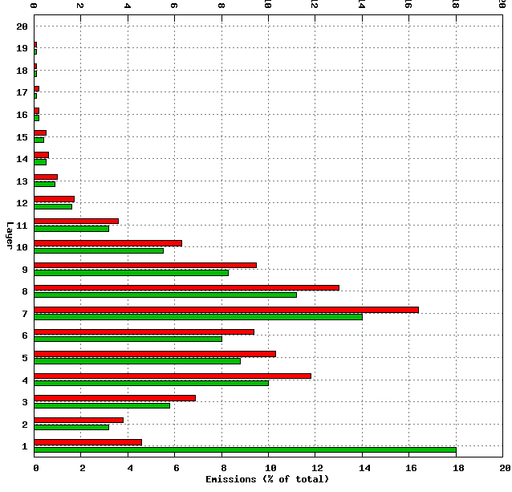
Example: March 25-31 2014 PM2.5 Emissions from Fires
RED: Same heat flux applied to all combustion phases (pre 2014 method)
GREEN: residual smoldering emissions in layer 1
Redistribution increases emissions in layer 1 and reduces emission aloft

Slide 9
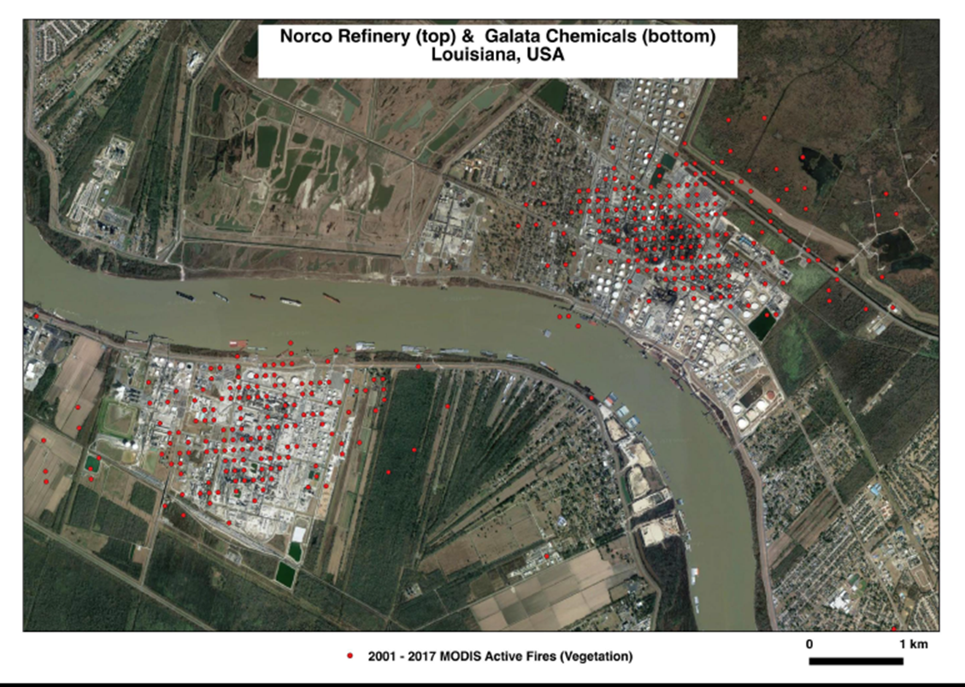
False detections in MODIS fire product
16 year MODIS record incorrectly identifies this facility as a “fire”;
Note: regular grid pattern in the detections due to truncation of decimal places in lat/long
Notes:
Example shows how the MCD14ML MODIS fire detections will sometimes detect industrial and other non-fire sources. This information can be used to modify the MODIS algorithms to reduce false detections.

Slide 10
Geospatial locations and false detections in MODIS product
Updates to MODIS fire product (MCD14ML) as of 5/24/2019
Improved precision (latitude & longitude) in MODIS fire detections
Additional masks to remove point sources that are not fires
Not yet tested for an annual inventory

Slide 11
Plume Injection Height
Presentation by Joseph Wilkins: “Exploring the Vertical distribution of Wildland Fire Smoke in CMAQ” given yesterday
Main Results
Estimates of plume rise for prescribed burns in the Flint Hills region of Kansas are improved when a more realistic burn window (~3 hours) is assumed rather than the 12-hour interval that is typically used.
The default Briggs method usually performed as well or better than the two alternative methods examined.
Lidar and satellite data indicate that plumes often rise above the planetary boundary layer or partially penetrate the stable layer aloft.

Slide 12
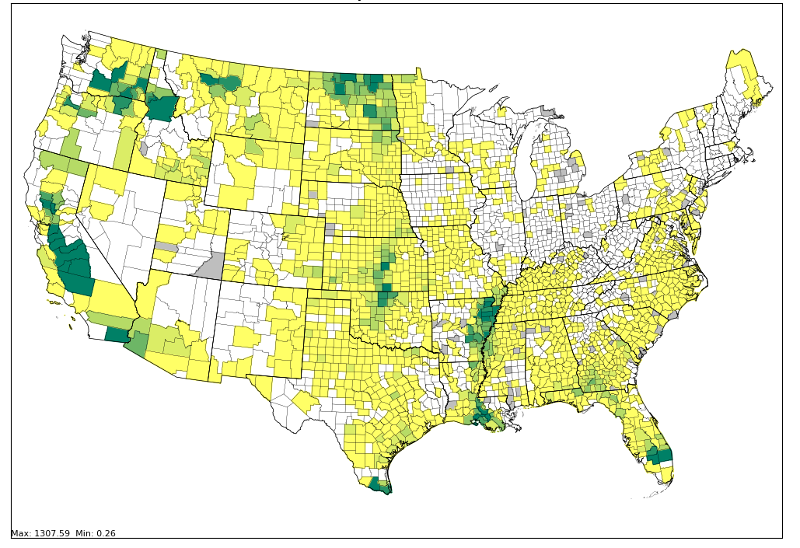
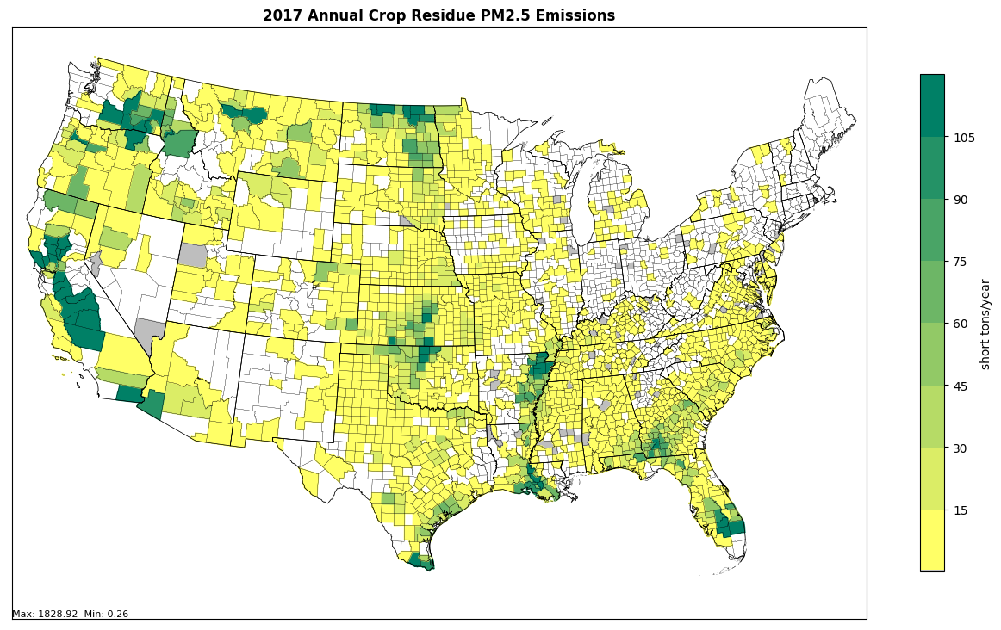
Crop Residue Burning
2016 CRB PM_{2.5} Emissions
2017 CRB PM_{2.5} Emissions
A method has been developed for crop residue burning https://doi.org/10.1080/10962247.2016.1268982
Has been used for 2014-2018 modeling years and we plan to apply to 2002-2013 time period.
Notes:
Pouliot G, Rao V, McCarty JL, Soja A. Development of the crop residue and rangeland burning in the 2014 National Emissions Inventory using information from multiple sources. Journal of the Air & Waste Management Association. 2017 Apr 27;67(5):613-22.

Slide 13
Fire Emissions Processing Workflow (2016 beta platform)
Notes:
Slide Courtesy of Jeff Vukovich

Slide 14
BlueSky Pipeline vs Bluesky Framework
New Fire Tools that are now available
Bluesky Framework w/ Smartfire2 has been used for WLF emissions inventory development through the 2017 NEI
Next Presentation by James Beidler will provide details

Slide 15
Wildland Fire Emissions: Vision for the Future
Key Characteristics
Robust, open source fire processing tools
Publicly available fire activity database with special attention to the large fires (i.e. fires with “names” and/or significance)
Flexible approach for emission factors, consumption, fuel loading
Use and build off of what we learned from the 2016 modeling platform workgroup
Robust annual inventories not just NEI years
Simplify process to study sensitivities.

Slide 16
Wildland Fire Emissions: Vision for the Future
Proposed Improvements to Fire Emissions Processing
MODIS detections (use HMS detections and MCD14ML together by using the improved latitude/longitude in the MCD14ML dataset and omitting any detections not found in both)
Use Fire perimeter databases for large fires and include the shape files in the emission processing so that the emissions are spatially allocated based on the fire specific shape files
Goal: best possible spatial accuracy of fire detections

Slide 17
Wildland Fire Emissions: Vision for the Future
Proposed Improvements to Fire Emissions Processing
Temporal allocation of grass and small fires: use time of satellite detect with a short time window to allocate emissions
Transparent fire emission factor database that can be updated easily when new speciation and or emission factor information becomes available

Slide 18
Wildland Fire Emissions: Vision for the Future
Proposed Improvements to Fire Emissions Processing
Use shape files for spatial allocation when available (Kansas Flint Hills e.g.)
Include pile burns as a new source and not double count with other fires. Develop default method
Canada: collaborate with Environment Canada and explore use of remote sensing data and fuel bed information
Mexico: explore use of remote sensing data and FINN dataset

Slide 19
Questions
Contact info: pouliot.george@epa.gov
This presentation has been reviewed and approved in accordance with U.S. Environmental Protection Agency policy.

