Slide 1
Optimal Use of Grid-Connected Energy Storage to Reduce Human Health Impacts
Qian Luo (qluo4@ncsu.edu)
Fernando Garcia Menendez
Jeremiah Johnson
Department of Civil, Construction, and the Environmental Engineering North Carolina State University
Notes:
Hello everyone, my name is Qian Luo, from North Carolina State University. Today, I will talk about the optimal use of grid-connected energy storage to reduce human health impacts.

Slide 2
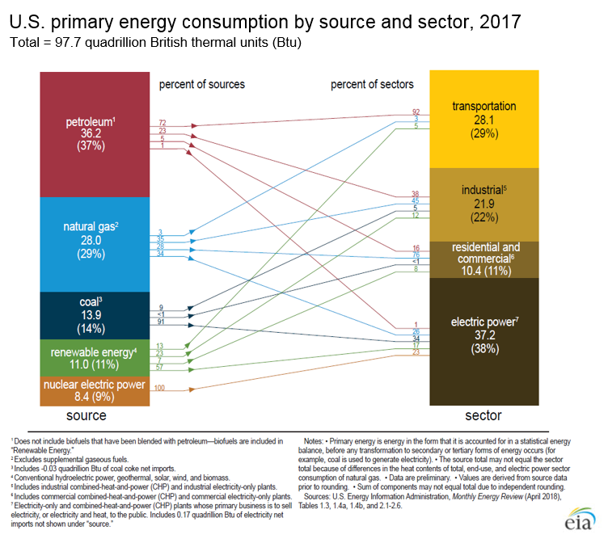
Background
38% of energy consumption goes to electricity generation
Majority of power sector energy consumption is from the combustion of fossil fuels
Over 60% SO2 in the atmosphere is from power plants
Important precursors of PM2.5
Even with over 80% emission reduction from power plants since 1990, there are still over 20,000 mortalities caused by power sector every year in the U.S (Penn et al., 2017).
Data sources: EIA, EPA
Notes:
Among all the energy we consume every day, 38% goes to electricity generation and most of the power sector energy consumption is from the combustion of fossil fuels. So massive emissions of air pollutants often accompany the electricity generation. For example, over 60% SO2 in the atmosphere is from power plants. These emissions are important precursors of PM2.5 which causes many human health issues.
Our electricity generation has been quite steady in the past 30 years but the emissions have been cut a lot, which is a huge success.
However, there are still over 20,000 premature deaths caused by the emissions from power sector in the United States every year.

Slide 3
Research Question
End-of-pipe devices only control the amount of pollutant emissions.
Temporal and spatial distributions of emissions are determinants of pollution impacts.
Energy storage can shift both the time and location of electricity generation.
Studies have been done to explore energy storage’s ability to reduce GHG emissions.
Can operational strategies for grid-connected energy storage yield reductions in the human health impacts from power sector emissions?
Notes:
Current controlling measures adopted by power plants are mainly end-of-pipe devices, which only control the amount of emitted pollutants. However, the formation of air pollution is also determined by the physical and chemical conditions in the atmosphere which vary by time and location.
So, the temporal and spatial distribution of emissions is also of key importance in determining the magnitude of pollution impacts.
At this point, we should think of energy storage which is able to shift both the time and location of electricity generation, as well as emissions from power plants.
Energy storage has been serving a lot of roles in current power system, like peak shifting and frequency regulation. Many studies have been done to explore its environmental impacts but most of them focus on reducing greenhouse gas emissions. There is a knowledge gap regarding its capacity to dynamically reduce humans’ exposure to air pollutants caused by electricity generation. Therefore, this study is designed to answer this question:

Slide 4
Method
[Task 1]
Quantification of Health Damage Impacts
[Task 2]
Unit Commitment and Electricity Dispatch
CALPUFF
Concentration-response function
Marginal health damage cost
System with energy storage
[Task 3]
Determine the Contribution of Energy Storage to the Health Impacts Mitigation
Addition of Energy storage
Integration of health damage costs
Notes:
In brief, there are three steps in the method. First of all, we need to find a way to quantify the health impacts of these emissions associated with electricity generation
and then determine the unit commitment and electricity dispatch in terms of these health impacts for a system with gridded energy storage.
The last step is to determine how much the energy storage contributes to the health impacts mitigation.

Slide 5
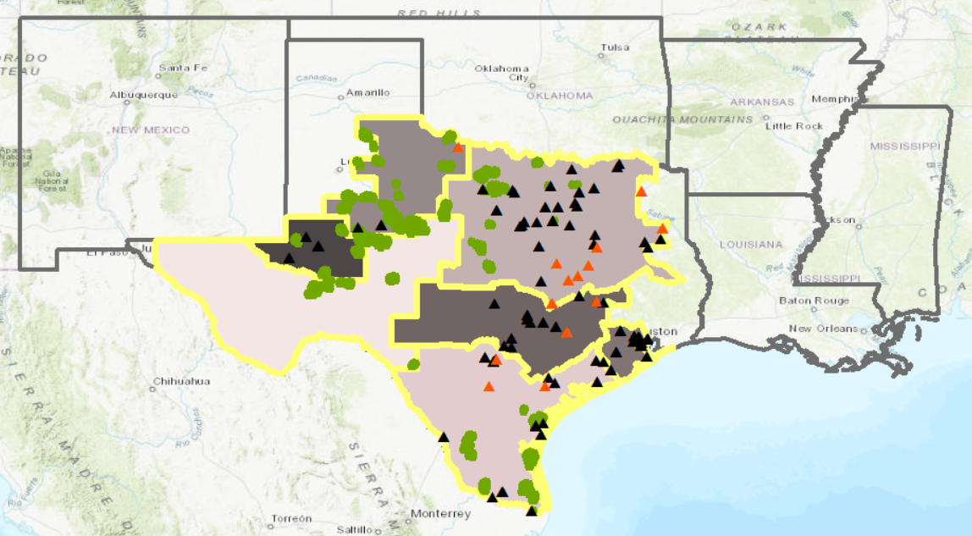
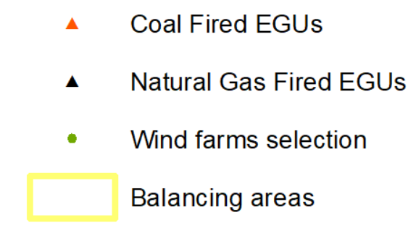
Study Domain
The domain to estimate the health impacts from Limestone power plant
285 km
Limestone power plant
Data sources: NREL, ERCOT
Notes:
We applied this model to the power market in Texas, which is called ERCOT. It has over 200 fossil fuel electricity generating units whose capacity is over 20 MW. Coal fired generators are represented by the red triangles and natural gas generators are black triangles in the map. The green dots are the wind farms in Texas. Areas surrounded by yellow lines are the balancing areas and we assume that there is no transmission limit within each balancing area. Each generator will have its own domain to estimate the health impacts caused by the unit which is at the center of the domain.
For example, the blue triangle is a power plant called Limestone and this area surrounded by the blue dash line is the domain for it.

Slide 6
Health Impacts Quantification
PM2.5 concentration increase 9 hours after 1 am emissions
SO2 and NOX are emitted from Limestone at 1 am for one hour
CALPUFF simulates hourly secondary PM2.5 after the emissions
Map shows the pollutant puff 9 hours after the emissions
Limestone
More details about Limestone:
Capacity | Primary Fuel | Fuel Cost | SO₂ Emission Rate | NO_{x} Emission Rate
956.8 MW | Lignite Coal | $17.2/MWh | 2.7 kg/MWh | 1.1 kg/MWh
Notes:
To demonstrate how to quantify the health impacts caused by a single generator, I would like to take Limestone as an example as it is a coal fired power plant with high emissions. The triangle is the location of it. Assuming it generates some electricity and emits some amount of SO2 and Nox at 1 am for only one hour, the air quality model CALPUFF is able to simulate the increment of secondary PM2.5 which is sulfate and nitrate after the emission hour by hour. On the map is the location of the pollutant puff 9 hours after the emission, which is the PM concentration caused by limestone at 10 am

Slide 7
Health Impacts Quantification
PM2.5 concentration 9 hours after emissions
Base mortality
Concentration-response function:
$$∆\$_{1, 9}=VSL×y_{0}×(1−exp⁡(−\frac{lnRR}{10}×∆c_{1, 9}))$$
Single hour’s health damage costs occurring at 10 am caused by emissions at 1 am
Notes:
Then a concentration-response function is used to convert PM2.5 concentration increase to monetized health damage happening during this hour. Y0 is the base mortality from the map on your right side, delta C 1, 9 is the PM concentration increase 9 hours after the power plant emissions at 1 am. VSL is the value of a statistical life, RR is the relative risk of PM2.5. so the delta dollar is the health damage happening at 10 am caused by the pollutants emitted at 1 am.

Slide 8
Health Impacts Quantification
Overall health impacts caused by one-hour emissions at 1 am from Limestone
$$\sum_{k=1}^{48}{{∆\$}_{1,k}}$$
Concentration-response function:
$$∆\$_{1, 9}=VSL×y_{0}×(1−exp⁡(−\frac{lnRR}{10}×∆c_{1, 9}))$$
Single hour’s health damage costs occurring at 10 am caused by emissions at 1 am
Consider the health impacts in the following 48 hours as the total impacts of single hour’s emission
Notes:
The map shows the spatial distribution of delta dollar 1, 9.
However, the single hour’s health impacts is far from enough to quantify the overall impacts caused by one hour’s emissions. These air pollutants will stay in the atmosphere for a long time, so we include all the health impacts happening in the following 2 days since the pollutants are emitted as the total impacts of single hour’s emissions.
For example, to get the total health impacts caused by the one-hour emission at 1 am from Limestone, we will need 48 maps like this to quantify the hourly health impacts one hour after the emission, two hours after the emission, until 48 hours after the emission and then add them up which is shown in this map.

Slide 9
Marginal Health Damage Costs
Temporal variation of the marginal health damage cost of Limestone on 12/18/2015
Marginal health damage cost at 12 pm including all health impacts from Limestone in following 48 hours
Notes:
After finishing all the previous steps, we will only get one point here which is the marginal health damage at 1 am. And we can change the emission time and repeat the whole process for 24 times and get the temporal distribution of the marginal health damage cost of limestone on that particular day. So, Marginal health damage cost at 12 pm means that for every MWh electricity generated at 12 pm, its health impacts in the following 48 hours will lead to over 40 dollars’ health damage cost, which is higher than the fuel cost.

Slide 10
Unit Commitment and Electricity Dispatch
Unit Commitment and Economic Dispatch Model
$F_{j}$: fuel cost for unit j ($/MWh)
𝐹_𝑗 : fuel cost for unit j ($/MWh)
$R_{j}$: operating and maintenance costs for unit $j$ ($/MWh)
𝑅_𝑗: operating and maintenance costs for unit 𝑗 ($/MWh)
$z_{j,h}$: electricity generated by unit j at hour h (MWh)
𝑧_(𝑗,ℎ) : electricity generated by unit j at hour h (MWh)
$T_{j}$: start-up costs of the plant ($/start)
𝑇_𝑗 : start-up costs of the plant ($/start)
$v_{j,h}$: binary start up variable for unit $j$ in hour $h$ (1 or 0)
𝑣_(𝑗,ℎ): binary start up variable for unit 𝑗 in hour ℎ (1 or 0)
Minimize generation cost
$$min\sum_{h∈H}{\sum_{j∈J}{\left[\left(F_{j}+R_{j}\right)z_{j,h}+T_{j}{×v}_{j,h}\right]}}$$
Notes:
Then, the second step is to apply the health damage cost into the power system operation. The unit commitment and economic dispatch model is commonly used to coordinate the electricity generation to meet the demand and also minimize the electricity generation cost, which include the fuel cost, operation and maintenance cost and start-up cost in a traditional model. and of course there are many constraints in that model, like the ramping limit, transmission limit and minimum operation time.

Slide 11
Unit Commitment and Electricity Dispatch
Unit Commitment and Economic Dispatch Model
$F_{j}$: fuel cost for unit j ($/MWh)
𝐹_𝑗 : fuel cost for unit j ($/MWh)
$R_{j}$: operating and maintenance costs for unit $j$ ($/MWh)
𝑅_𝑗: operating and maintenance costs for unit 𝑗 ($/MWh)
$z_{j,h}$: electricity generated by unit j at hour h (MWh)
𝑧_(𝑗,ℎ) : electricity generated by unit j at hour h (MWh)
$T_{j}$: start-up costs of the plant ($/start)
𝑇_𝑗 : start-up costs of the plant ($/start)
$v_{j,h}$: binary start up variable for unit $j$ in hour $h$ (1 or 0)
𝑣_(𝑗,ℎ): binary start up variable for unit 𝑗 in hour ℎ (1 or 0)
Minimize (generation + health damage costs)
$H_{j,h}$: health damage cost caused by unit j at hour h ($/MWh)
𝑯_(𝒋,𝒉): health damage cost caused by unit j at hour h ($/MWh)
$$min\sum_{h∈H}{\sum_{j∈J}{\left[\left(F_{j}+R_{j}+H_{j,h}\right)z_{j,h}+T_{j}{×v}_{j,h}\right]}}$$
Notes:
What is new in our model is the internalization of the health damage cost, and I have explained how we got this temporally varying value H for each EGU in previous slides. Now, the objective of this model is to minimize the system cost, including both electricity generating costs and health damage costs.

Slide 12
Results
Temporal variation of the marginal health damage cost for EGUs on 12/18/2015 (Top 5 coal and natural gas generators)
The health costs vary greatly for each generator
Marginal health damages of coal-fired generators are much higher than those of natural gas generators.
Notes:
Here are what we get from this model. this figure displays the temporal distribution of the marginal heath costs for 10 generators on that day. They are coal top 5 and natural gas top 5 in health damage costs. Generally, The health costs vary greatly for each generator and it can be explained by weather. Sometimes, emissions pass regions with high population so more people will get exposed to these air pollutants, leading to greater impacts.
And impacts of coal fired power plants are much higher than natural gas power plants because the major contributor to PM2.5 from power plants are SO2 and natural gas generators have much less emission of it.

Slide 13
Results
Reduction of coal use after the optimization with health impacts and energy storage.
Electricity generated by coal has been reduced by 20%.
Total health damages have been reduced from $1.14M to $0.04M, over 95%.
Notes:
After the system is optimized with both health impacts and energy storage, Electricity generated by coal has been reduced by 20%. With a little surprise, the health impacts have been reduced by over 95%.
If we look into the details of the unit commitment of coal fired generators which is not here, only one generator has been turned off after the optimization and that one is the top 1 in health damage cost in last slide.
Compared with traditional unit commitment and economical dispatch model, we introduced two new factors here. One is the incorporation of health damage cost in the objective function and another one is the energy storage. I am curious about which one contributed to the health impacts reduction more so several scenarios were built to quantify their contribution separately.

Slide 14
Scenario Analysis
Health
Impacts
Scenario 1: optimization not considering health impacts in a system with no energy storage
Scenario 2: optimization considering health impacts in a system with no energy storage
Scenario 3: optimization considering health impacts in a system with energy storage
Energy Storage
S2
S3
S1
 | Scenario 1 | Scenario 2 | Scenario 3
Monetized Health Impacts (Million $) | 1.14 | 0.041 | 0.039
Generation Costs (Million $) | 17.65 | 17.79 | 17.76
Total Costs (Million $) | 18.79 | 17.83 | 17.80
Notes:
I have three scenarios here. Scenario 1 is the optimization without energy storage or health impacts. The second scenarios is the operation considering health impacts but no storage. The last one is the optimization with both energy storage and health damage costs. Compared with scenario 1, The internalization of health damage costs into the model helps reduce the adverse health impacts remarkably but increases the generation cost a little bit. From S3, the addition of energy storage to the grid can help reduce a little bit health, while also reducing the electricity generation costs. However, this reduction is too little to be noticed.

Slide 15
Using this method, energy storage is not able to reduce human health impacts from power sector !
Notes:
It seems that energy storage is not able to reduce human health impacts from power sector when we use this method.
But is it a reliable conclusion?

Slide 16
Using this method, energy storage is not able to reduce human health impacts from power sector ?
On 12/18/2015:
Low natural gas prices: most natural gas plants are cheaper than coal plants in $ per MWh.
Low load: high flexibility existed in the system.
Low wind: no curtailment
More scenarios are needed.
Notes:
The day I randomly selected for the model has very low natural gas prices, Low demand and few wind. None of them favors the use of energy storage.
Cuz when gas is cheaper than coal, most coal generators will be turned off only from the perspective of economics. Meanwhile, the health impacts from coal burning will also be reduced. The low demand leads to high flexibility in the system so the health impacts can be reduced greatly only by electricity dispatch without the use of energy storage. And when there is no wind curtailment, energy storage will not be able to store this clean energy for use at a later time.
Therefore, more scenarios are needed to test if energy storage will work.

Slide 17
Much more wind on 12/14/2018
Compare the contribution of energy storage from S2 to S3
 | Monetized Health Impacts Reduction | Generation Costs Reduction
Windy Day | 14% | 12%
Less Wind | 5% | <1%
Wind curtailment was reduced from 15% to 0.5%.
The total health impacts keeps rising with increasing natural gas prices
Less wind: energy storage does not help reducing health impacts
Less wind
Notes:
Here, we found a windy day on 12/14/2018 and compare the cost reduction from scenaio2 to scenario3 defined in previous slides. Both the health impacts and generation costs have been reduced much more when there was much wind cuz the extra clean wind energy did not have to be curtailed but stored in the battery.
Then we tested various natural gas prices to see if there was a range where energy storage can work to reduce health impacts. The figure here says no. The health impacts rise with increasing gas prices, and the two lines, with and without energy storage, are basically the same when there is not much wind. However, what if we add more wind?

Slide 18
Much more wind on 12/14/2018
Compare the contribution of energy storage from S2 to S3
 | Monetized Health Impacts Reduction | Generation Costs Reduction
Windy Day | 14% | 12%
Less Wind | 5% | <1%
Wind curtailment was reduced from 15% to 0.5%.
The total health impacts keeps rising with increasing natural gas prices
Less wind: energy storage did not help reduce health impacts
More wind: energy storage slowed down the increase of health impacts
Notes:
The health impacts still keep rising but the addition of energy storage slowed down the increasing process.

Slide 19
Conclusions
Emissions’ Impacts
The health impacts caused by the emissions from power sector are significantly influenced by the fuel type, as well as the time and location of the emissions from power plants.
Health Damage Costs
Internalizing the time- and location- varying health damage costs into the unit commitment and economic dispatch model helps reduce the adverse health impacts from electricity generation.
Energy Storage
Addition of energy storage to the grid can help reduce additional health impacts when considering health damage costs, while also reducing the electricity generation costs when there is a large amount wind.
Notes:
To wrap up, I have three takeaway messeges here.

Slide 20
Future Work
One day is never enough
Re-estimate the health impacts before and after the optimization using a state-of-the-science chemical transport model
Test the model for a longer time
More accurate health impact estimation
One week or one month in each season
Notes:
I only tested the model for a single day To get started which is far from enough. So I will apply the model for a longer time, like one week or one month in each season to see how health impacts change after the optimization in this model.
The second job is to re-estimate the health impacts before and after the optimization using some chemical transport model, like CMAQ, thus we will get a more accurate estimation of the health impacts reduction.

Slide 21
Thanks!
We acknowledge the funding from NC State Research and Innovation Seed Funding (RISF) Program.

