Slide 1
Development of a Year
2016 Fire inventory for United States through a Multi-Agency Inventory Collaboration Effort
CMAS Conference
October 22, 2019
Jeff Vukovich, EPA Office of Air Quality Planning and Standards
James Beidler, General Dynamics Information Technology

Slide 2
Acknowledgements
The 2016 Fire Workgroup
  US Forest Service, US National Park Service, USEPA (Regions, OAQPS, ORD) staff
  WESTAR/Western Regional Air Partnership (WRAP)
  State agencies: AK, AL, CA, CO, GA, ID, KS, MT, NC, NJ, NM, NV, NY, TX, UT, WA and WY
  Tribes: Nez Perce (ID) and Kootenai (ID)
  George Pouliot, EPA ORD (Crop Residue and Rangeland Burning)
  http://views.cira.colostate.edu/wiki/wiki/9175

Slide 3
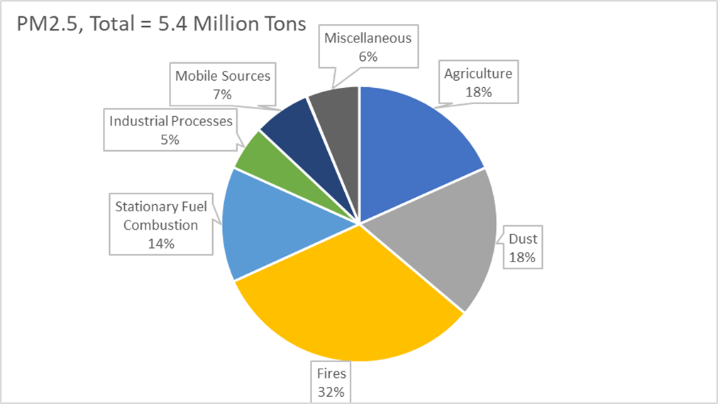
Outline
Goals of 2016 Fire Workgroup
Approach
Methods/Tools
Data used
Results
Summary

Slide 4
Goals of Collaboration Effort
Produce daily emissions for wildfire, prescribed burn and agricultural burns for year 2016 inventory for Contiguous U.S. and Alaska for use in Emissions Modeling Platforms
  Day-specific emissions calculated include:
    Criteria Air Pollutants (CAPs)
    36 hazardous air pollutants (HAPs) (U.S. only)
Produce ancillary data needed for using inventory in air quality modeling (e.g. heat flux, profiles)
Provide documentation

Slide 5
2016 Approach: Similarities to 2014 NEI version2 approach
Use existing inventory methods and tools
  Wildfire and Prescribed burns used SmartFire2 and Bluesky Modeling Framework
  Agricultural burns used G. Pouliot (2015) approach
    https://www.epa.gov/sites/production/files/2015-08/documents/crop_residue_burning_in_2014.pdf
Input data sources
  National datasets
  Any submitted State/Local/Tribes data

Slide 6
2016 Approach: Differences with
2014 NEI v2 approach
Collaborative Workgroup effort
Grassland fires
  Pouliot approach was used in 2014NEI for all grassland fires
  In 2016 inventory, grassland fires moves into the SmartFire2-Bluesky Framework processing
  Largest fire in 2016 (Anderson Creek) involved mainly grassland fuels in Kansas and Oklahoma
Combustion phases for Plume Rise purposes
  2014NEI provided two phases: 1) flaming and 2) smoldering (co-existing smoldering with the flaming and residual smoldering)
  2016 provides two phases: 1) flaming (includes the co-existing smoldering) and 2) residual smoldering
New fuel bed data used from Landfire version 1.4
  https://www.landfire.gov/fccs.php
Inventory Versions

Slide 7
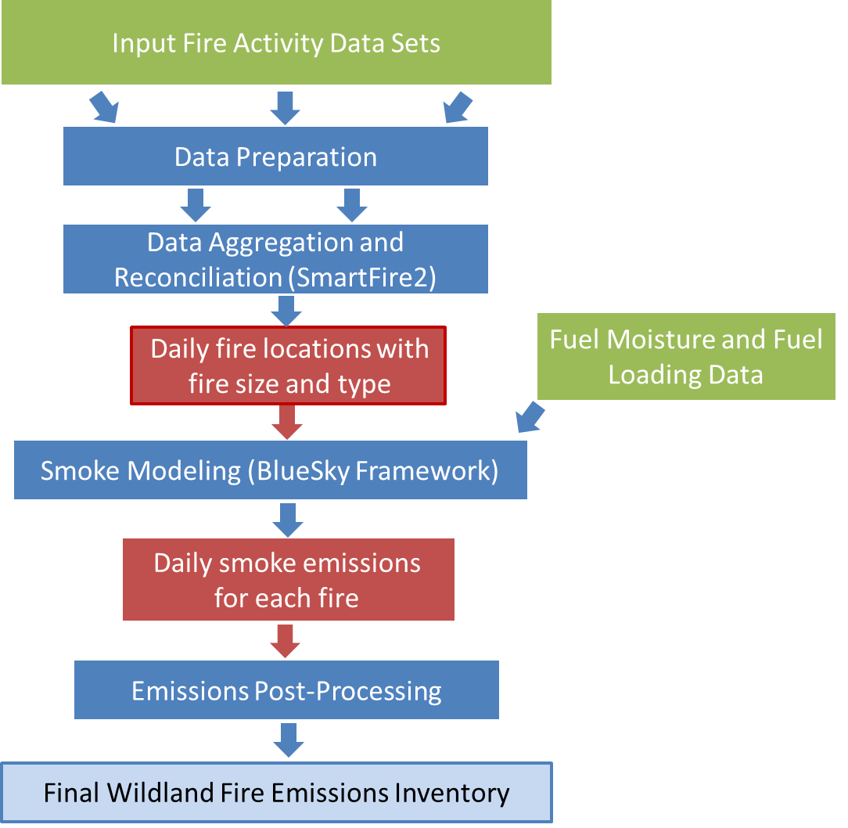
Fire Inventory
Development
Method
Notes:
Processing flow for emission estimates in the WLF EI. Green boxes represent input data sets, dark blue boxes represent steps in the WLF EI development, and red boxes represent intermediate data.

Slide 8
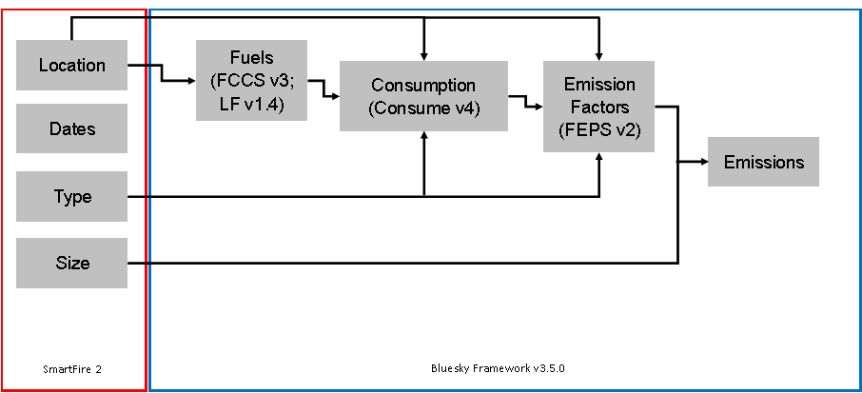
Tools:
Blue Sky Modeling Framework
Smartfire2
BlueSky Modeling Framework

Slide 9
Input Data Sources: National Fire Activity
Data Set | Agency | Coverage
Hazard Mapping System (HMS) | National Oceanic and Atmospheric Administration (NOAA) | Satellite fire detections
Incident Status Summary (ICS-209) | National Wildfire Coordinating Group | Wildfire
U.S. Fish and Wildlife Service (USFWS) | USFWS | USFWS-managed lands: wildfire and prescribed
National Association of State Foresters (NASF) | NASF | State-managed lands: wildfires
Forest Service Activity Tracking System (FACTS) Perimeters | USFS | Prescribed fires on USFS-managed lands
Geospatial Multi-Agency Coordination (GeoMAC) Perimeters | GeoMAC Group | Wildfire perimeters
Monitoring Trends in Burn Severity (MTBS) | USGS, USFS | Wildfire and Prescribed perimeters
Notes:
Red = comma-delimited info; lat-lon, acresburned, start and end dates, type
Green = shapefiles, acresburned, start and end dates, type
MTBS not usually in NEI efforts due to availability reasons

Slide 10
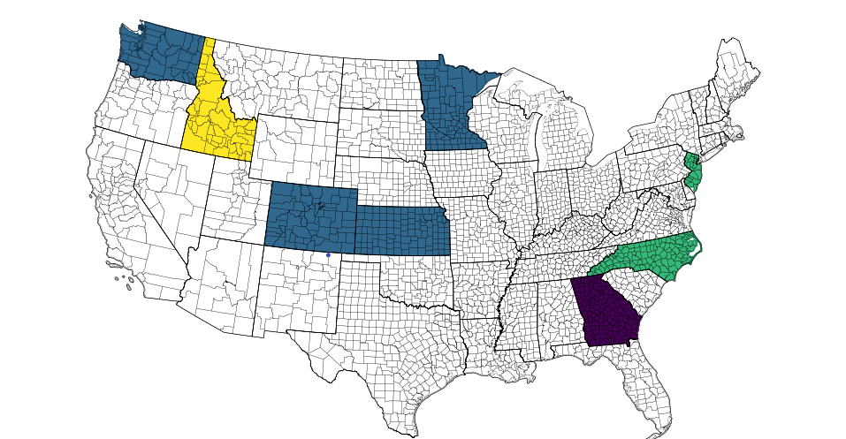
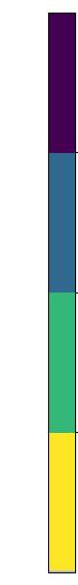
Input Data Sources: State/Tribe Submitted Fire Activity Data
Fire Types
ALL
AG+RX
WF+RX
AG only

Slide 11
2016 Inventory Versions
2016 alpha
  HMS detects, ICS209 and GeoMAC shapefiles
  Release March 2018
2016 beta
  Added National Assoc. of State Foresters (NASF), MTBS shapefiles, and state/local agency data
  Released February 2019
2016 version 1 (2016v1)
  Added USFS FACTS prescribed burn database, US Fish and Wildland Service data, and more state agency data
  To be released in October 2019
Notes:
Unique because of how databases added incrementally throughout the different versions; 2016alpha = typical approach for non-NEI year

Slide 12
Results: Sample 2016 Fire
Inventory Totals
Fire Type | Millions of Acres Burned | PM2.5 (tons) | VOC (tons) | NOX (tons)
CONUS Wildfires * | 4.7 | 580,000 | 1,562,000 | 99,900
CONUS Prescribed Fires | 11.9 | 655,000 | 1,547,000 | 127,500
CONUS Ag Burns | 2.0 | 24,000 | 18,300 | 10,800
Alaska All Fires | 0.5 | 263,000 | 743,000 | 30,000
Total | 19.1 | 1,522,000 | 3,870,300 | 268,200
* National Interagency Fire Center (NIFC) indicated 2016
CONUS Wildfire acres burn was ~5M
Notes:
AK separately out because not in most regional AQ modeling domains.

Slide 13
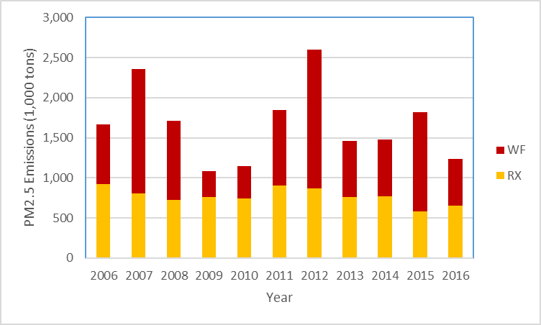
Annual Comparison:
Contiguous United States
NEI years = 2008, 2011, 2014
EPA generated other years with national inputs 2006-2015

Slide 14
Results – Top 5 states

Slide 15
Results – Top 10 Wildfires

Slide 16
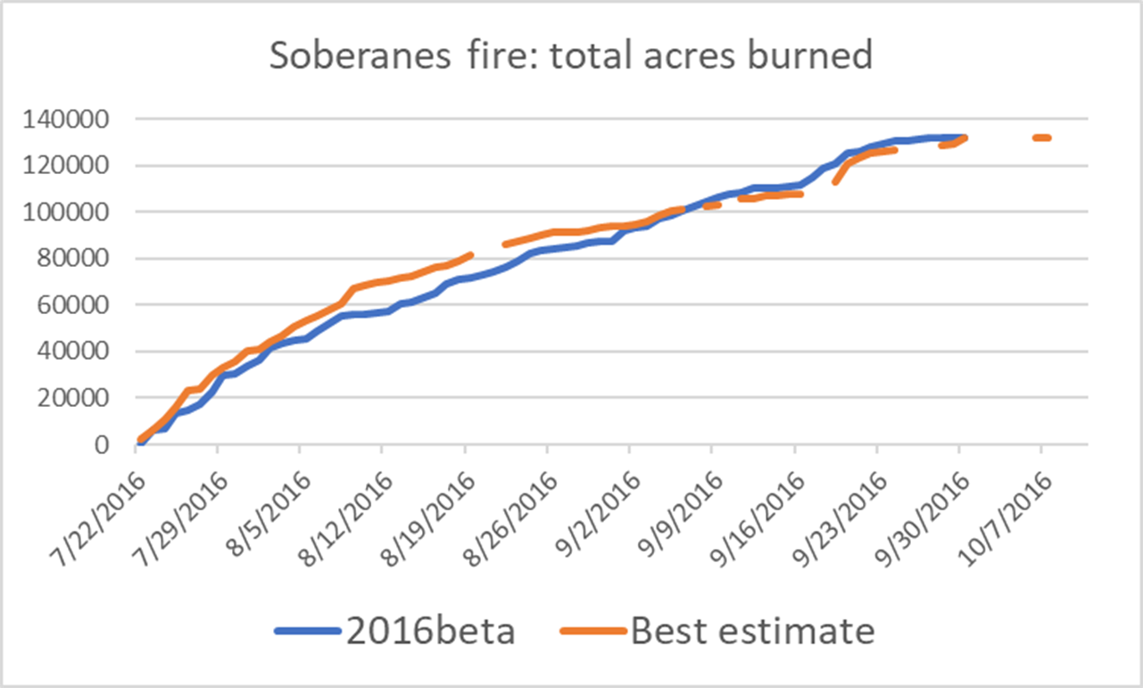
Daily allocation challenges
2016v1 Estimate from media reports

Slide 17
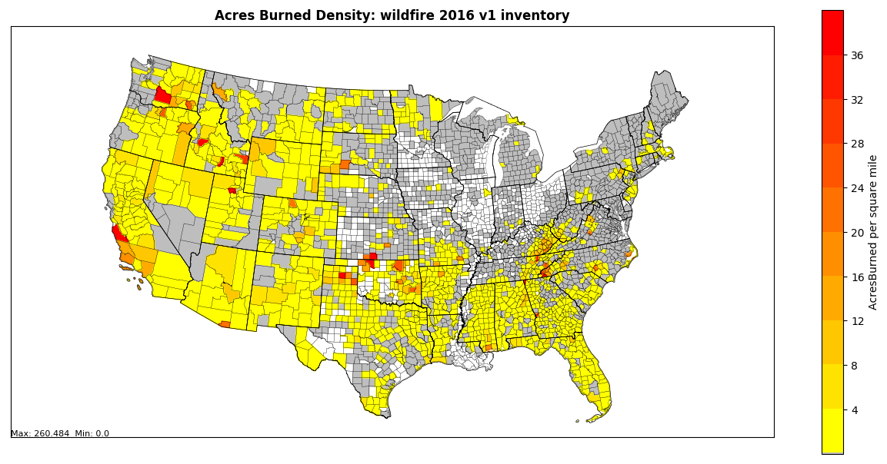
Wildfires: acres burned per square mile
Notes:
640 acres in a square mile

Slide 18
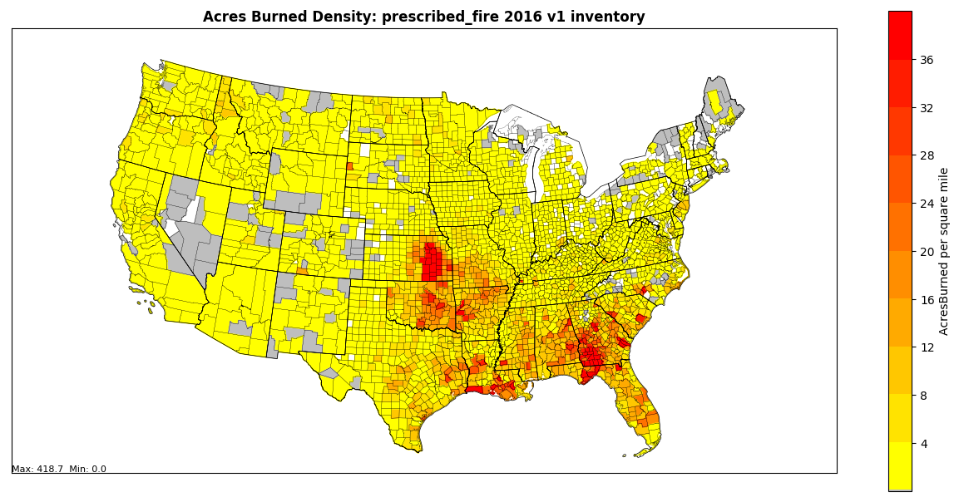
Prescribed burns: acres burned per square mile

Slide 19
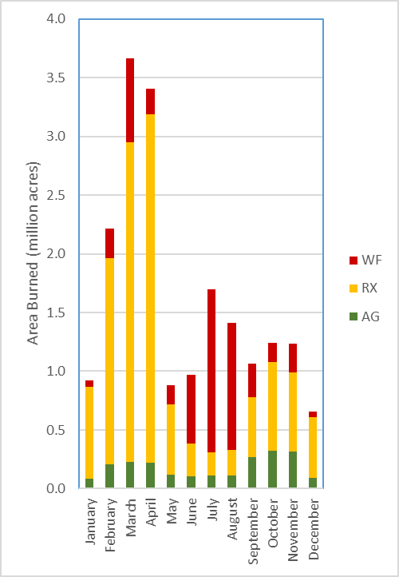
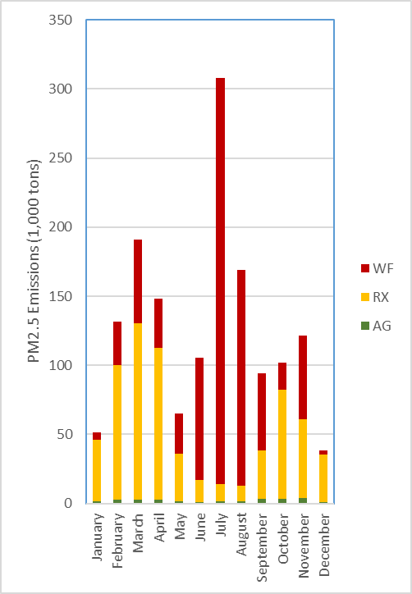
Results: U.S. Type Monthly
Notes:
July has a huge amount of PM because it has a lot of wildfires and they are in forests. March has more total acres, but they are prescribed grass burns.

Slide 20
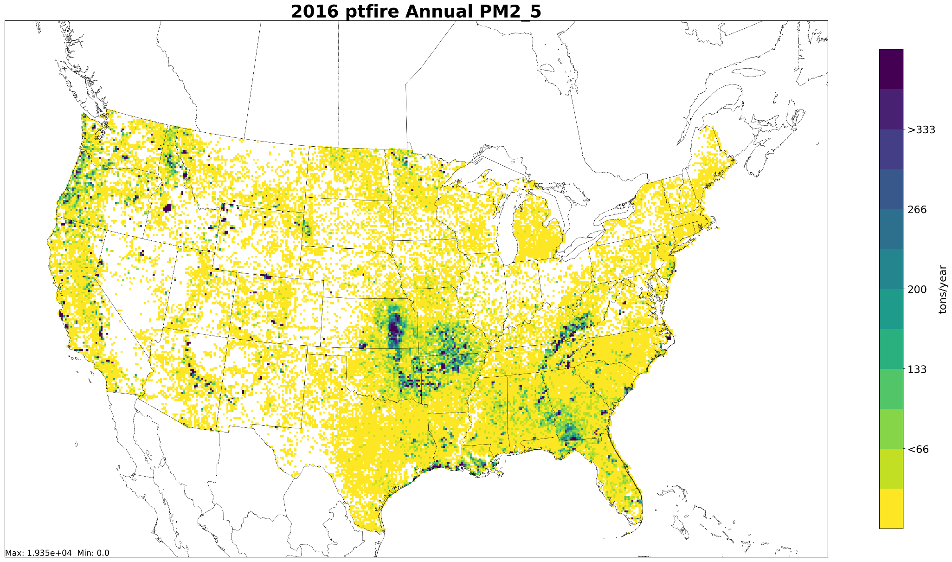
Gridded Annual PM2.5: 12km resolution
Includes wildfires and prescribed burns

Slide 21
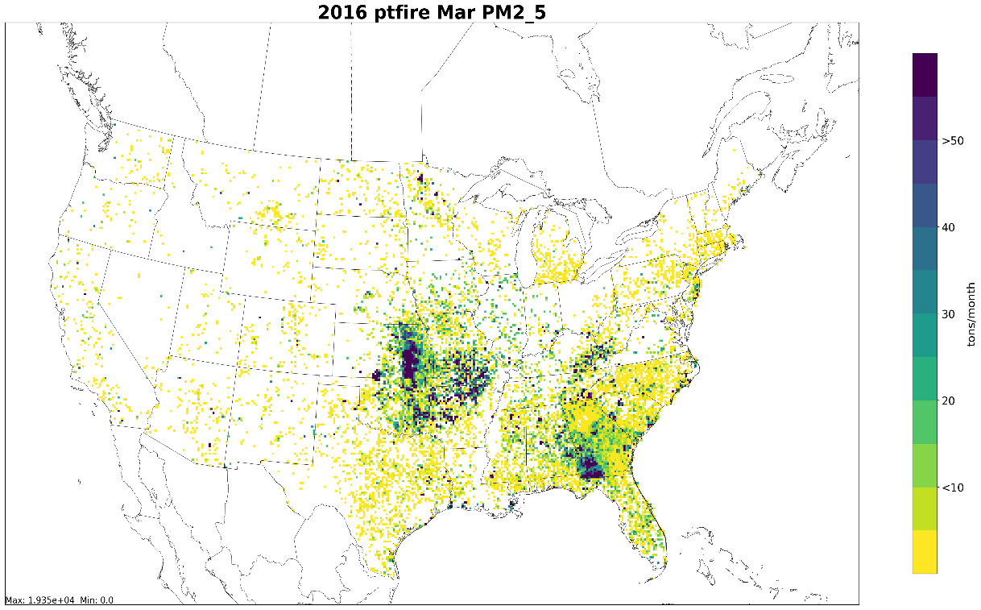
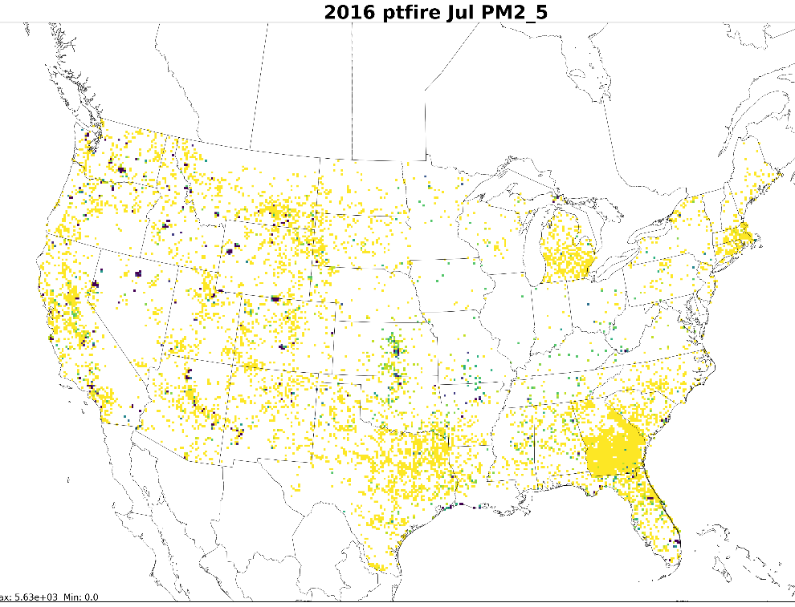
Gridded Monthly PM2.5: 12km resolution
March
July
60
Includes wildfires and prescribed burns

Slide 22
Summary
Multi-agency Collaborative over a 1.5 year period has been successful in producing a 2016 wildfire, prescribed burn and agricultural burn day-specific emissions inventory for Contiguous U.S. and Alaska for use in Emissions and Air Quality Modeling Platforms
Input data and tools used similar to NEI efforts, with updates to fuel bed information
Large wild grassland fires in Spring 2016 played a role in changing approach for all grassland fires
Total acres burned for top wildfire events in 2016 were generally captured well

Slide 23
Possible improvements
Need community fire emissions modeling system
  Allows updates to emissions factors
  Fuel bed information
Continued education to state/local/tribes/other agencies on what fire information is most desired for daily emissions estimates
Fuel bed assignments
Capturing daily emissions for large multi-day wildfires

Slide 24
Extra Slides

Slide 25
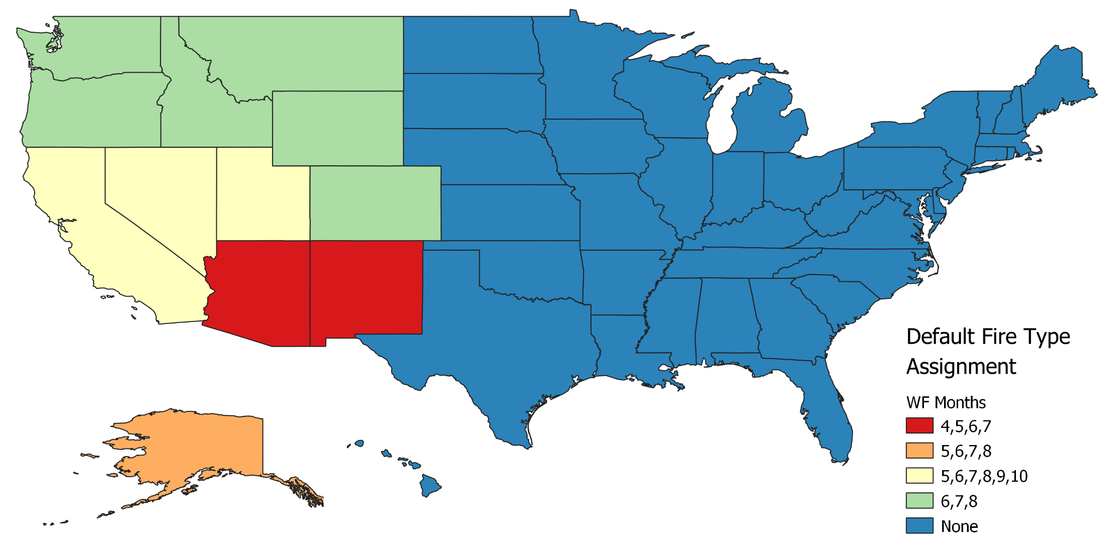
Default Fire Type Assignment
When satellite detect is the only fire activity data available

Slide 26
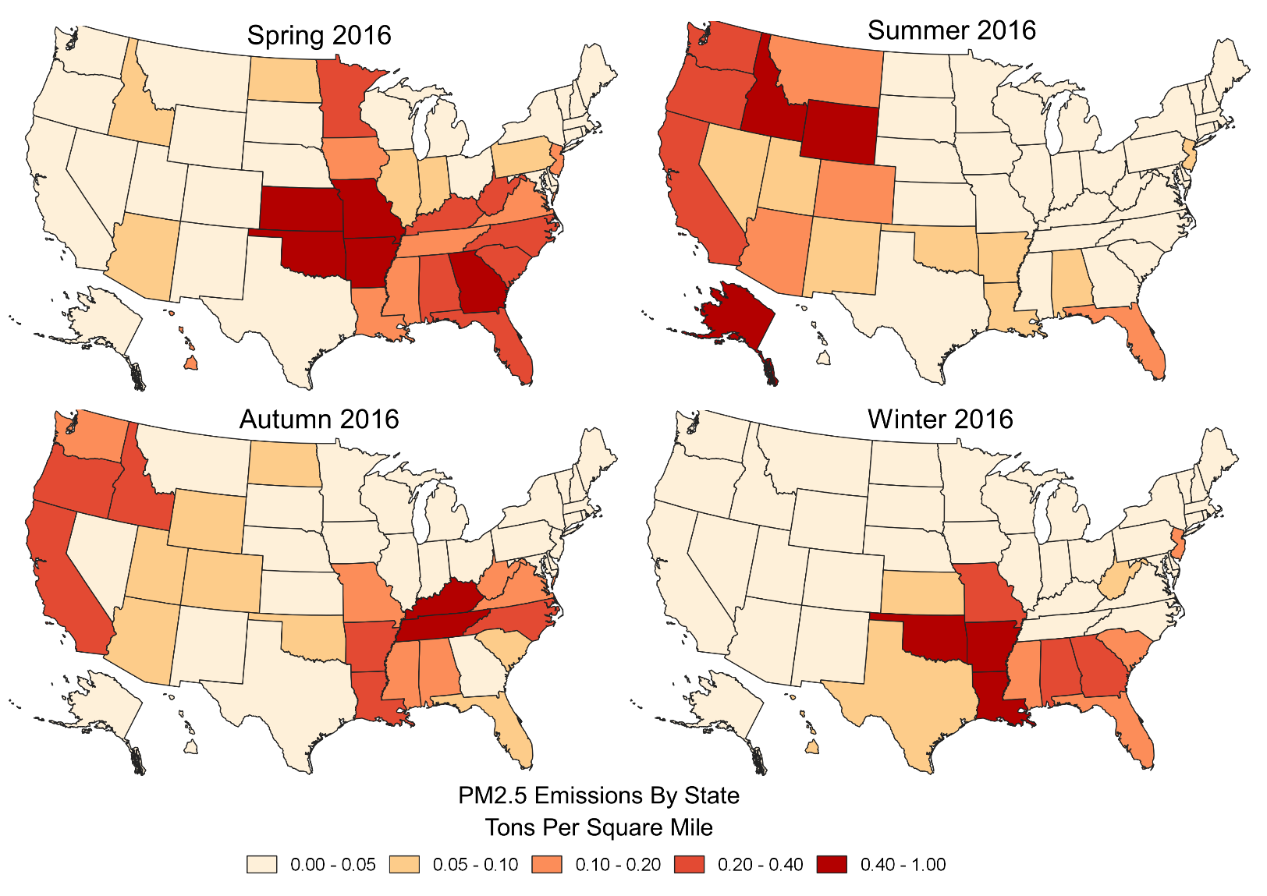
Results: U.S. Seasonality for
Wildfires and Prescribed Burns
Spring: March, April, and May
Summer: June, July, and August
Autumn: September, October, and November
Winter: December, January and February

Slide 27
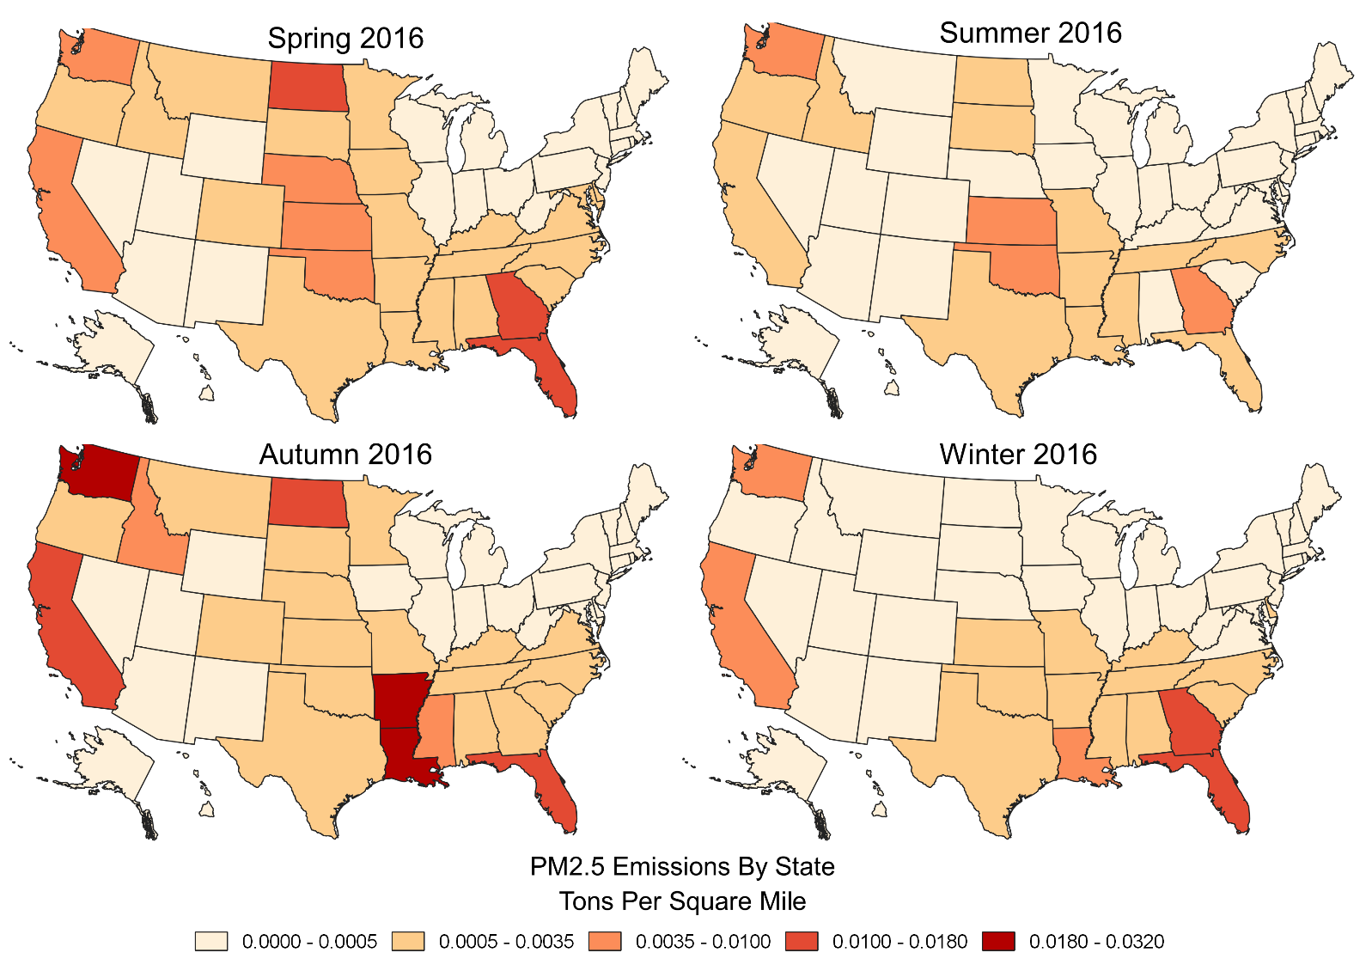
Results: U.S. Seasonality for
Agricultural Burns
Spring: March, April, and May
Summer: June, July, and August
Autumn: September, October, and November
Winter: January, February, and December
Notes:
Note that GA and WA have emissions that are consistently higher than may other states. These two states have at least some state-submitted ag burning data that may lack temporal allocation down to the day.

