Slide 1
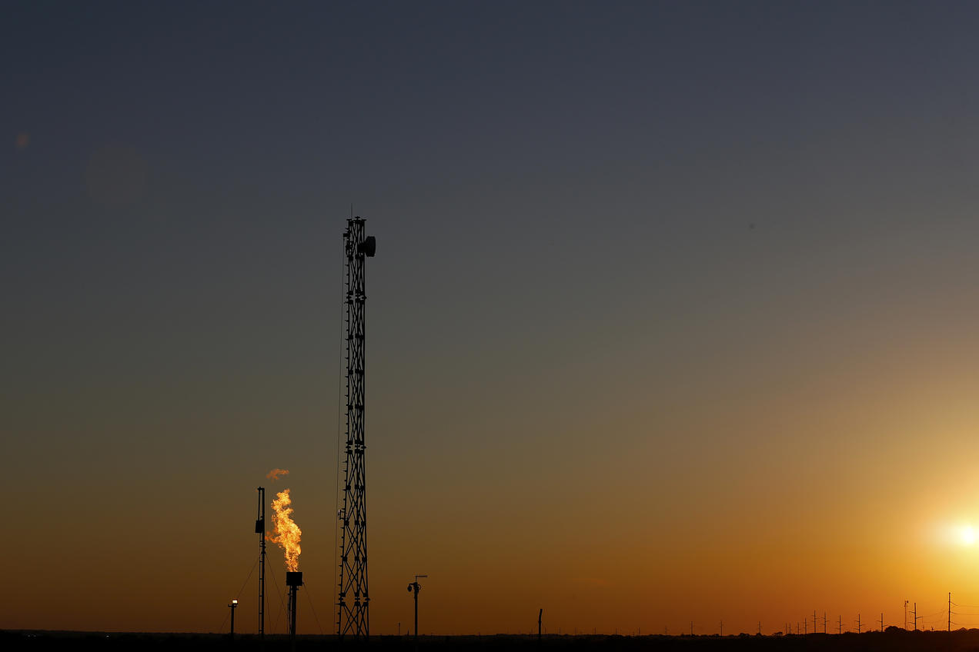
Air Quality Modeling of Oil and Gas Emissions
Saravanan Arunachalam¹, Srinivas Reka¹, Dongmei Yang¹,
David Lyon², Hillary Hull², Ryan O Connell², Ananya Roy²,
Beth Trask², & Jonathan Buonocore³
¹Institute for the Environment, The University of North Carolina at Chapel Hill, NC, USA
²Environmental Defense Fund, Washington DC, USA
³Harvard TH Chan School of Public Health, Boston, MA, USA
Presenting at
The 18th Annual CMAS Conference, Chapel Hill, NC, USA
October 21 – 23, 2019

Slide 2
Introduction
Background:
Air pollution is the largest environmental risk to human health and well-being
Oil and Natural Gas (O/NG) is a key anthropogenic source of air pollution worldwide
O/NG is key fast growing source, with total impact on U.S. GDP was $1.3 trillion in 2015 (API, 2017)
17.6 million people live within ∼1 mile of at least one active O/NG well in the U.S. (Czolowski et al, 2017)
O/NG activities have the potential to increase emissions of VOCs (and methane). Largest source of industrial methane emissions is from O/NG activities
Methane is a potent greenhouse gas (0.97 W/m² to climate forcing) that also contributes to background levels of ozone pollution (~4 ppbV to surface O₃ in 2030)​ (Fiore et al, 2008)
Methane emissions are underestimated in the U.S. inventories by > 60%, due to missing emissions released during abnormal operating conditions (Alvarez et al, 2018)
Objectives:
Assess air quality (and health) impacts due to O/NG activities in the U.S.
Review/update VOC emissions in NEI based on new synthesis study
Use CMAQ-DDM (Napelenok et al, 2006) to assess source-specific sensitivities of O₃ and PM_{2.5} to individual shale play precursors

Slide 3
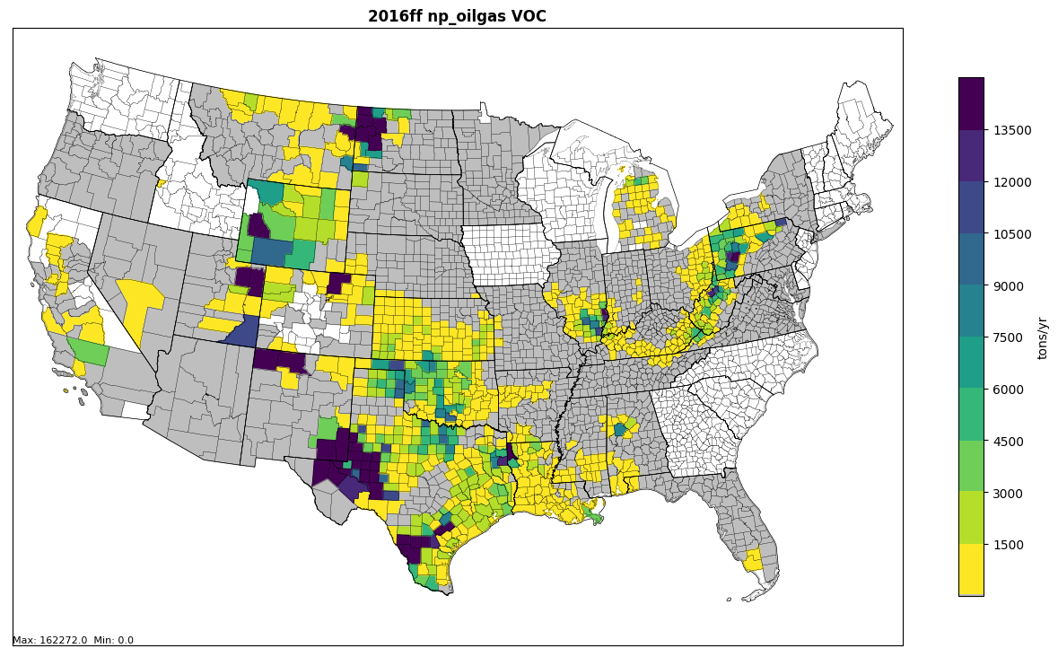
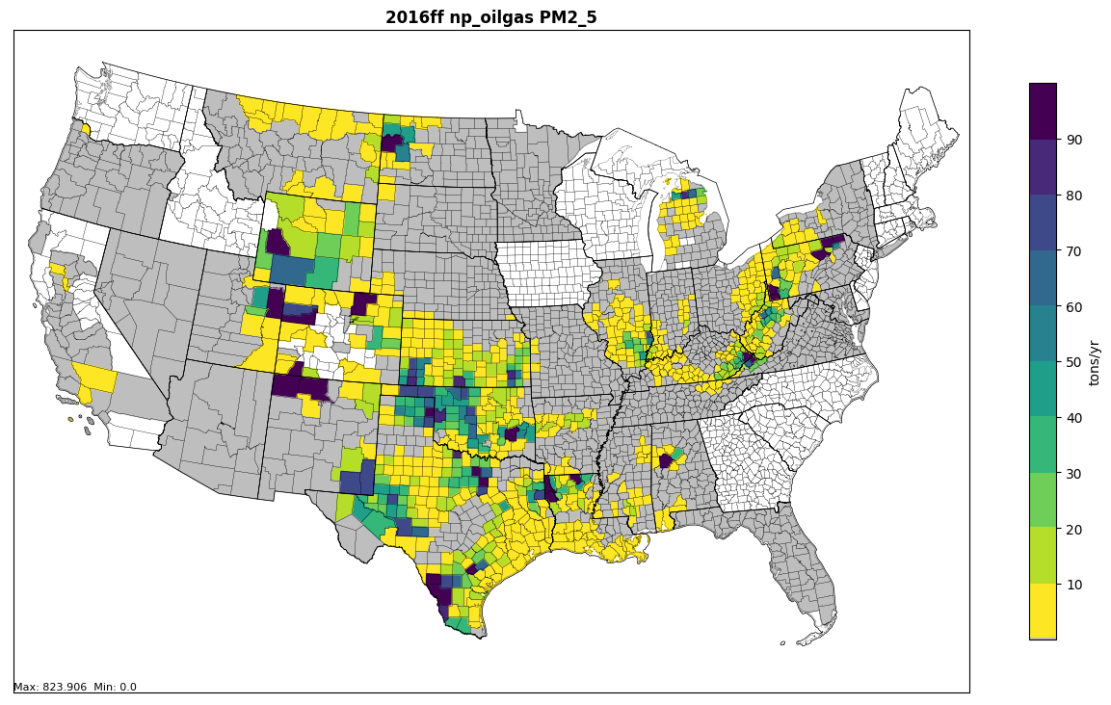
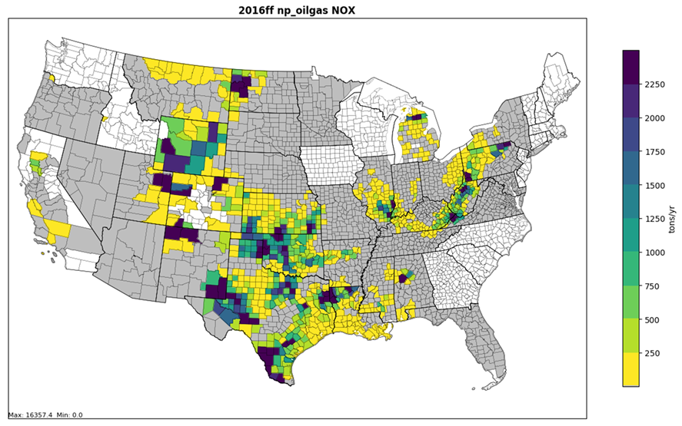
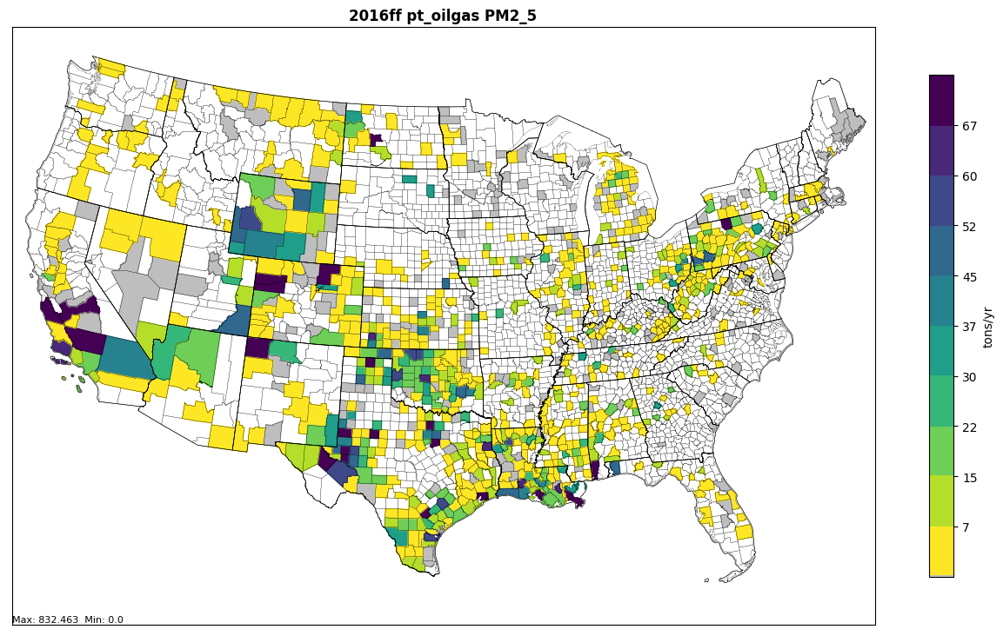
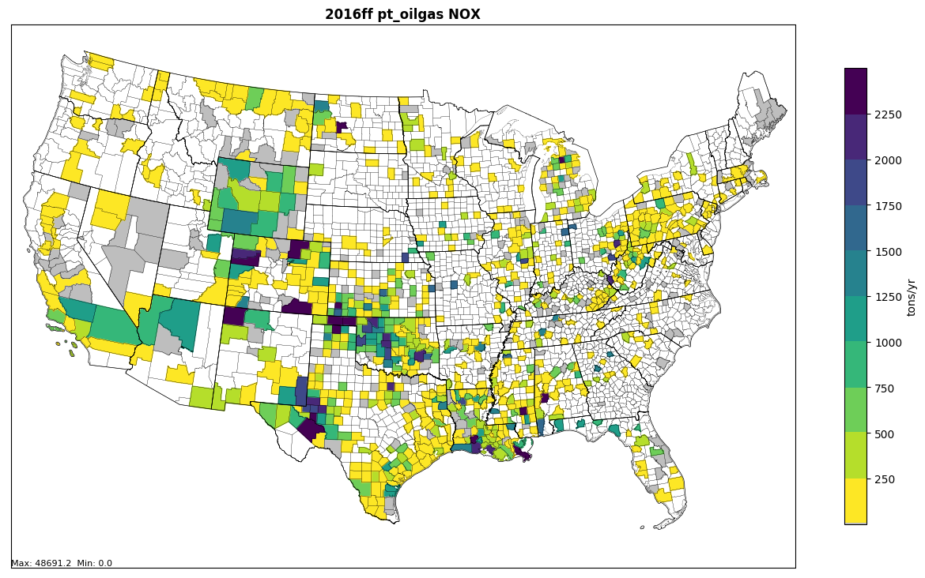
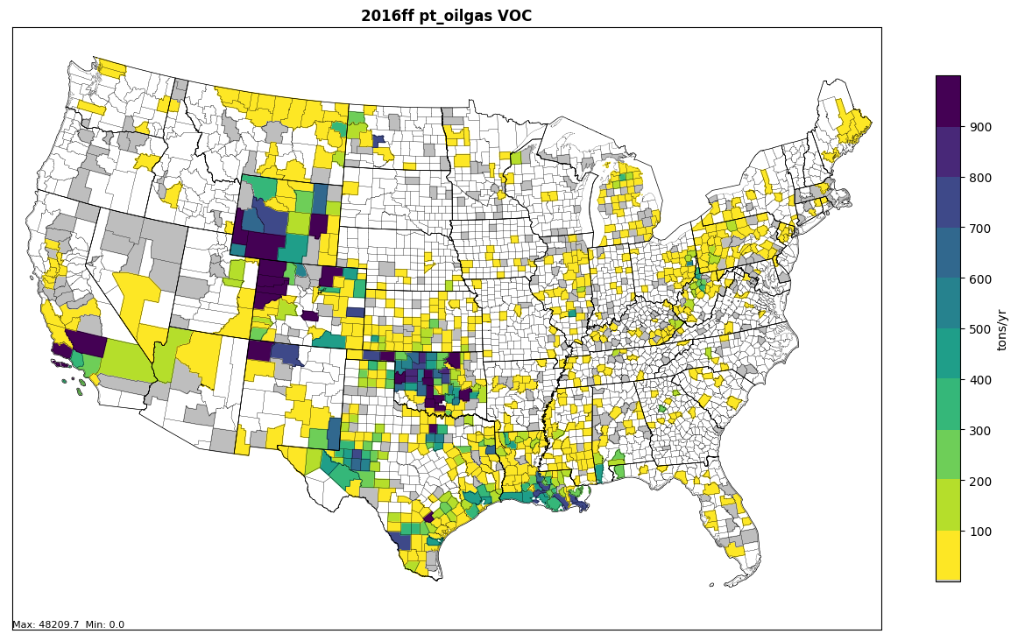
Oil and Gas (O/NG) Activity and Emissions in the U.S.
np_OG_VOC
np_OG_PM_{2.5}
np_OG_NOx
pt_OG_PM2.5
pt_OG_NOx
pt_OG_VOC
VOCs contribution from O/NG activity is ~25%

Slide 4
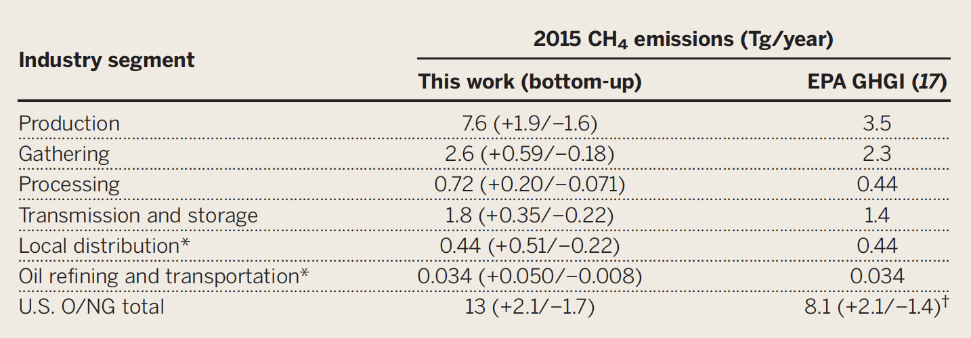
Methane Synthesis Study - Ground-based facility-scale measurements (BU) vs. aircraft measurements (TD)
Alvarez et al, 2018
Top-down (TD) vs. Bottom-up (BU) estimates for 9 regions in the U.S.
9 regions contribute to ~30% of U.S. O/NG production

Slide 5
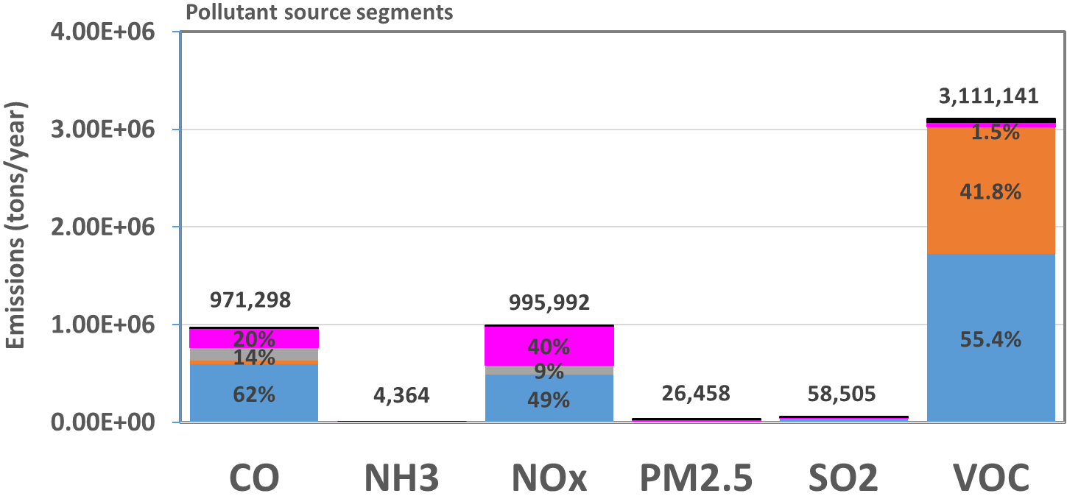
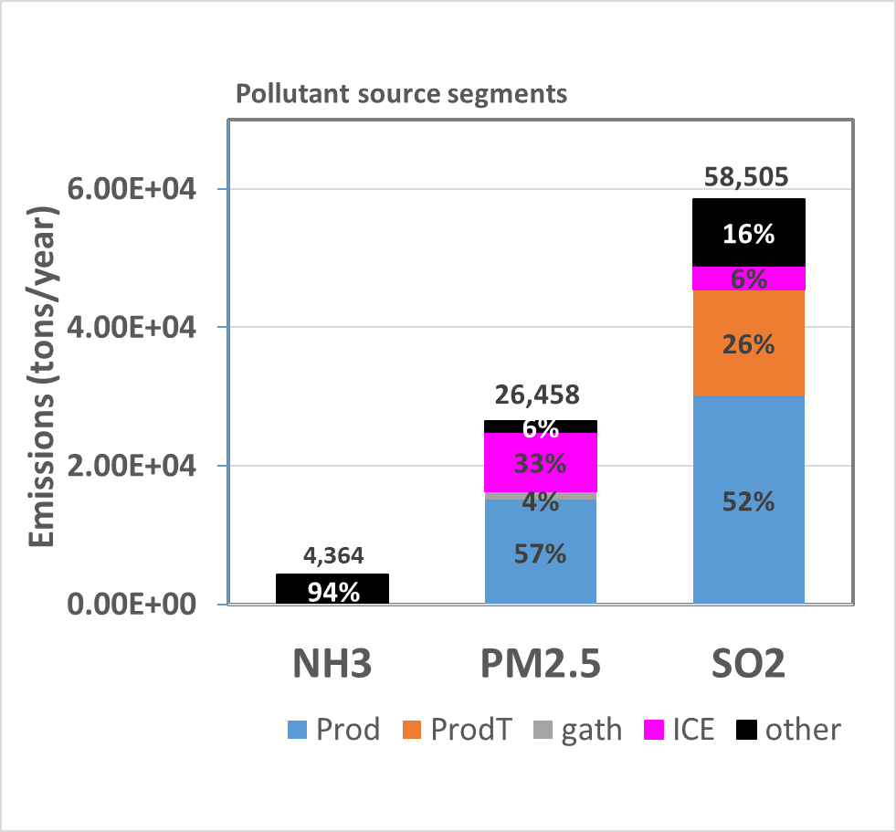
Breakdown of O/NG Emissions Precursors by Processing Segment (2016 Beta)
VOCs: Production and production tanks contribution is ~97%

Slide 6
Approach: CMAQ Model Simulations
 |  | Emissions Year | Brute Force | CMAQ-DDM Inputs
 |  |  |  | Production | Production Tank | Gathering | I CE | Other | # Precursors | Total # Input Parameters
1 | Base Case (Unadjusted) | 2016 | X
2 | Adjusted Base Case (EDF inputs) | 2016 | X
3 | Adjusted Base Case (EDF inputs) | 2016 |  | X | X | X | X | X | 4 | 20
4 | Group 1 States (TX, PA, CO) | 2016 |  | X | X | X | X | X | 4 | 20
5 | Group 2 States (LA, WY, NM) | 2016 |  | X | X | X | X | X | 4 | 20
6 | Group 3 States (UT, OH) | 2016 |  | X | X | X | X | X | 4 | 20
7 | Group 4 States (ND, OK) | 2016 |  | X | X | X | X | X | 4 | 20
8 | Group 5 States (CA, WV) | 2016 |  | X | X | X | X | X | 4 | 20
9 | Regulatory Scenarios - BAU | 2016 |  | X | X | X | X | X | 4 | 20
10 | Projection Year Scenarios ( 5 ) | 2023 / 2028 |  | X | X | X | X | X | 4 | 20
Use “footprint” CMAQ simulations to isolate plumes from each state/shale play
Track O₃ and PM_{2.5} precursors in CMAQ-DDM from each group separately

Slide 7
CMAQ Model Settings & Key Inputs
Option | Description
Model version | CMAQv5.2.1 w/ DDM (Napelenok et al, 2006)
Model resolution | 12x12-km
Grid details | 299 rows, 459 cols, 35 layers
Model Period | January, April, July, and October-2016
Chemical mechanism | cb6r3_ae6_aq
Emissions | EPA’s 2016 Beta emissions (2016ff_16j)
CTM_WB_DUST | Use in-line windblown dust emissions
CTM_BIOGEMIS | Calculate in-line biogenic emissions
CTM_PT3DEMIS | Calculate in-line plume rise for elevated point emissions
LTNG_NOx | Included
Meteorology | WRFv3.8.1

Slide 8
July & Annual 2016 MDA8 O₃ Contributions
July
w_OG
Delta
% Delta
Annual
w_OG
Delta
% Delta
MDA8 O₃: O/NG contribute a max of up to ~7 ppb (16%) increase in July
vs. ~3 ppb (7%) for Annual Average

Slide 9
Jan & Jul 2016 Average PM_{2.5} Contributions
January
w_OG
Delta
% Delta
July
w_OG
Delta
% Delta
PM_{2.5}: O/NG contribute a max of upto ~3 $μ$g/m³ (48%) in January
vs. ~2 $μ$g/m³ (34%) Annual

Slide 10
PM_{2.5} Annual Average Contributions
Annual
w_OG
wo_OG
Delta
% Delta
PM_{2.5}: Denver Basin and Lewis Basin are the highest contributors for Delta and % Delta

Slide 11
Speciated PM_{2.5} Contributions
OM aerosol is the highest (Delta) contributor among PM_{2.5} components

Slide 12
Speciated PM_{2.5} Contributions (%)
NO₃ aerosol is the highest (% Delta) contributor among PM_{2.5} components

Slide 13
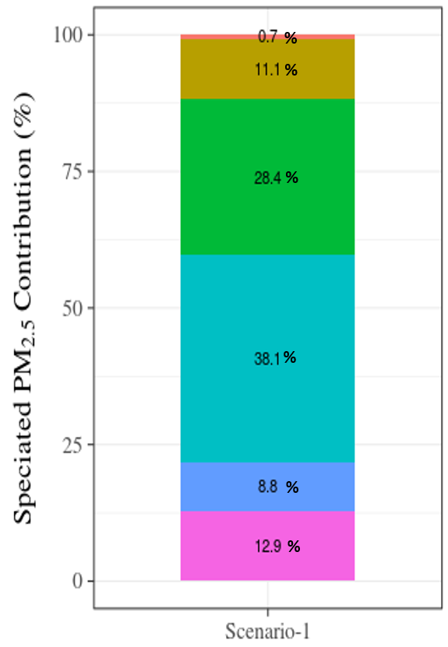
Domain-wide O₃ and PM_{2.5} Contributions
Speciated PM_{2.5} Contribution
Delta PM_{2.5}
 | Domain Max |  | Domain average
 | Diff (µg/m³) | Perc Diff (%) | Diff (µg/m³) | Perc Diff (%)
January | 2.916 | 47.6 | 0.033 | 1.9
April | 1.054 | 28.1 | 0.018 | 1.0
July | 1.205 | 28.6 | 0.024 | 1.4
October | 1.481 | 34.7 | 0.030 | 1.6
Annual | 1.653 | 33.8 | 0.026 | 1.5
Delta O₃
 | Domain Max |  | Domain average
 | Diff (ppbV) | Perc Diff (%) | Diff (ppbV) | Perc Diff (%)
July | 6.66 | 16.1 | 0.370 | 2.1
Annual | 2.67 | 6.7 | 0.239 | 1.6
OM aerosol is the highest (%) contributor among PM_{2.5} components

Slide 14
Brute Force vs. DDM for O₃ from Key O/NG Segments
O/NG segment: Production
O/NG segment: Production tanks
July: Brute Force (All OG)
O₃_ENOx
O₃_ENOX
O₃_EVOC
O₃_EVOC
Production Segment exhibit higher sensitivity to O₃ than Production Tanks

Slide 15
Brute Force vs. DDM for PM_{2.5} from
Key O/NG Segments
O/NG segment: Production
O/NG segment: Production tanks
July: Brute Force (All OG)
PM_{2.5}_ENOX
PM_{2.5}_ENOX
PM_{2.5}_EVOC
PM_{2.5}_EVOC
PM_{2.5}_EPM
PM_{2.5}_EPM
Production exhibits higher sensitivity to PM_{2.5} than Production Tanks

Slide 16
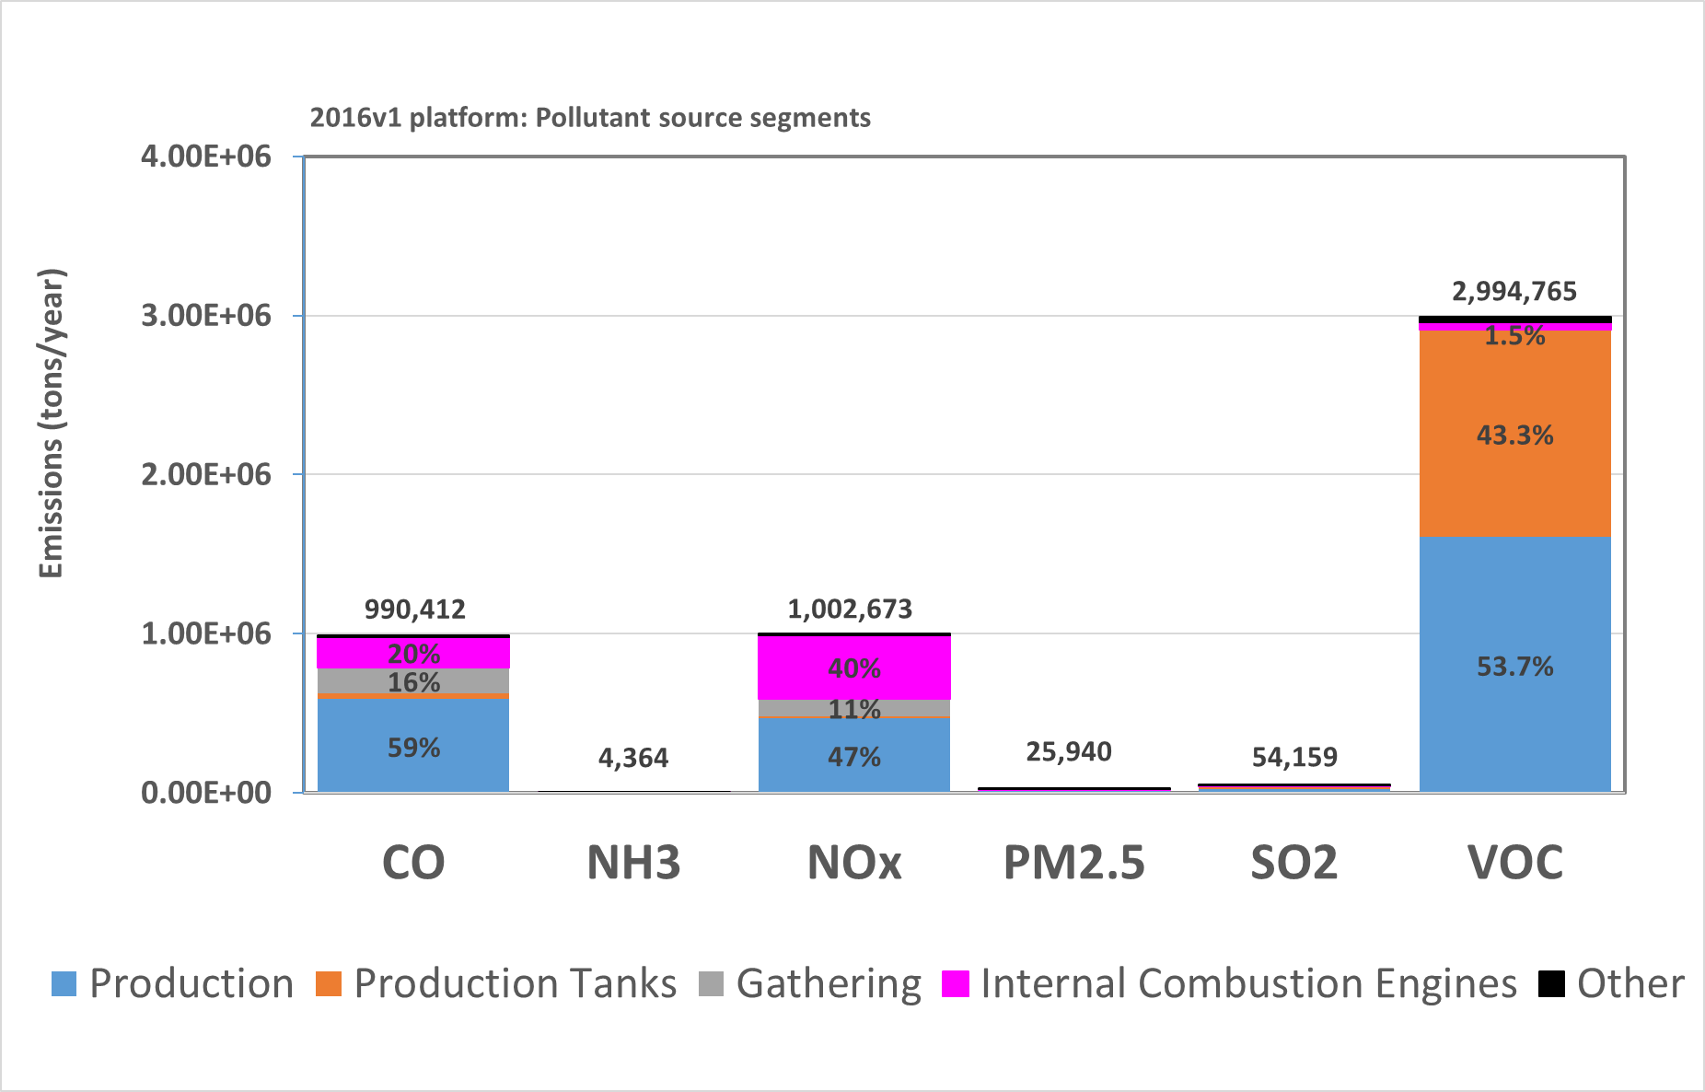
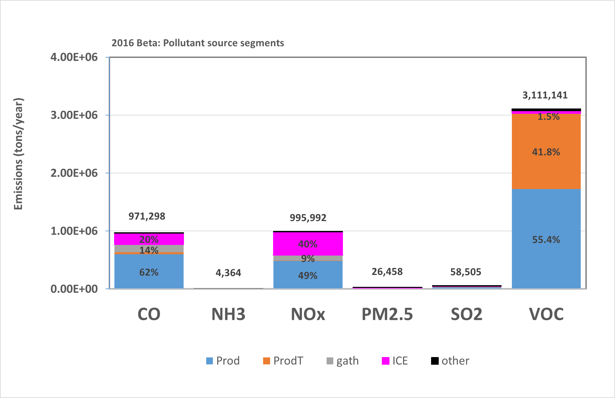
2016v1 platform vs. 2016 Beta emissions
2016v1 platform VOCs emissions decrease by ~3.7%

Slide 17
Summary
Preliminary assessment of O/NG impacts on O₃ and PM_{2.5} complete, using EPA’s 2016 Beta emissions
Production and Production tanks contribute ~97% of all O/NG emissions
Domain average contributions are 1.6% and 1.5% for O₃ and PM_{2.5}, while maximum contributions are 16% for O₃ (July) and 48% for PM_{2.5} in Jan
OM is the largest component (38%) of O/NG-attributable PM_{2.5}
CMAQ-DDM based results highlight ability to attribute O₃ and PM_{2.5} impacts to specific precursors from specific O/NG segments
Revised assessment using updated VOC estimates in 2016v1 platform in progress
Next Steps
Calculate sensitivities of O₃ and PM_{2.5} to O/NG emissions precursors from state-specific shale plays using CMAQ-DDM by segment
Perform health-risk assessment due to O₃ and PM_{2.5} for baseline and various policy options

Slide 18
Acknowledgments
Saravanan Arunachalam, PI
Environmental Defense Fund (EDF)
U.S. EPA OAQPS
Alison Eyth and Jeff Vukovich
UNC-IE team
Collaborators
This work used the Extreme Science and Engineering Discovery Environment (XSEDE), which is supported by National Science Foundation grant number ACI-1548562. This work used the XSEDE's Stampede2 at the Texas Advanced Computing Center (TACC) through allocation TG-ATM190010.

Slide 19
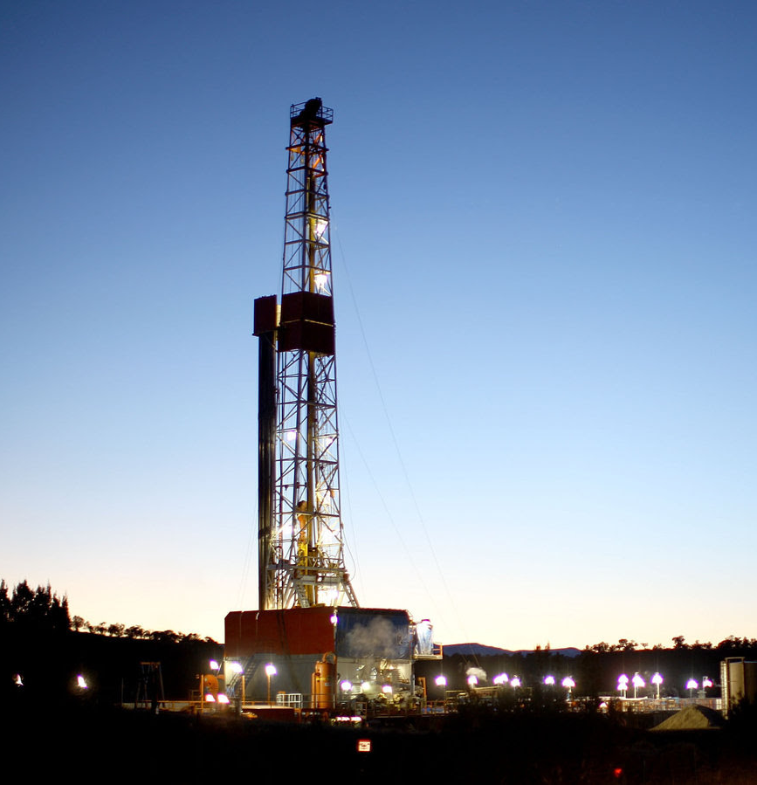
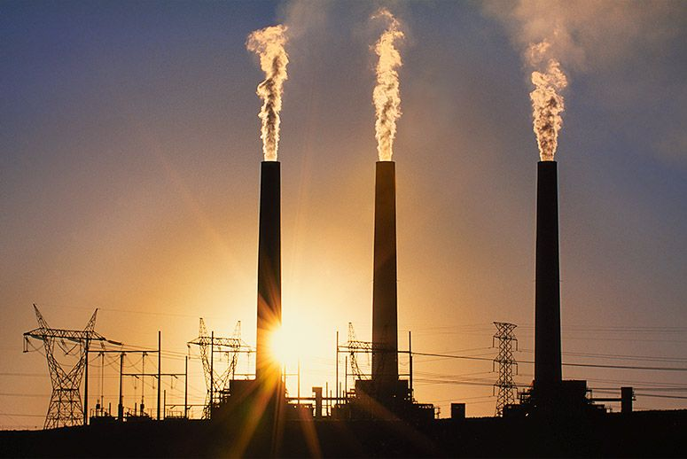
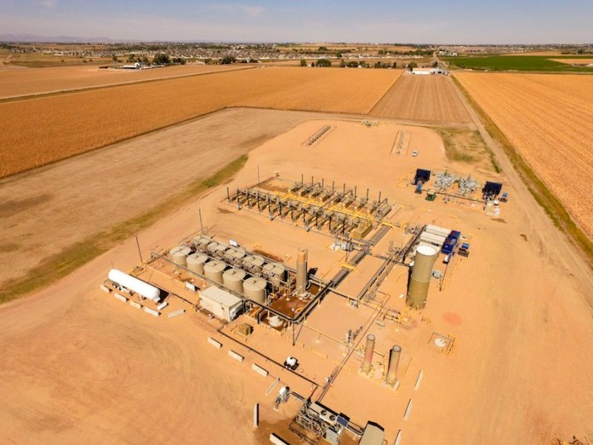
Frans Lanting/Getty Images
Ted Wood/Photo Group
Thank you

Slide 20
Extra slides

Slide 21
O/NG segments

Slide 22
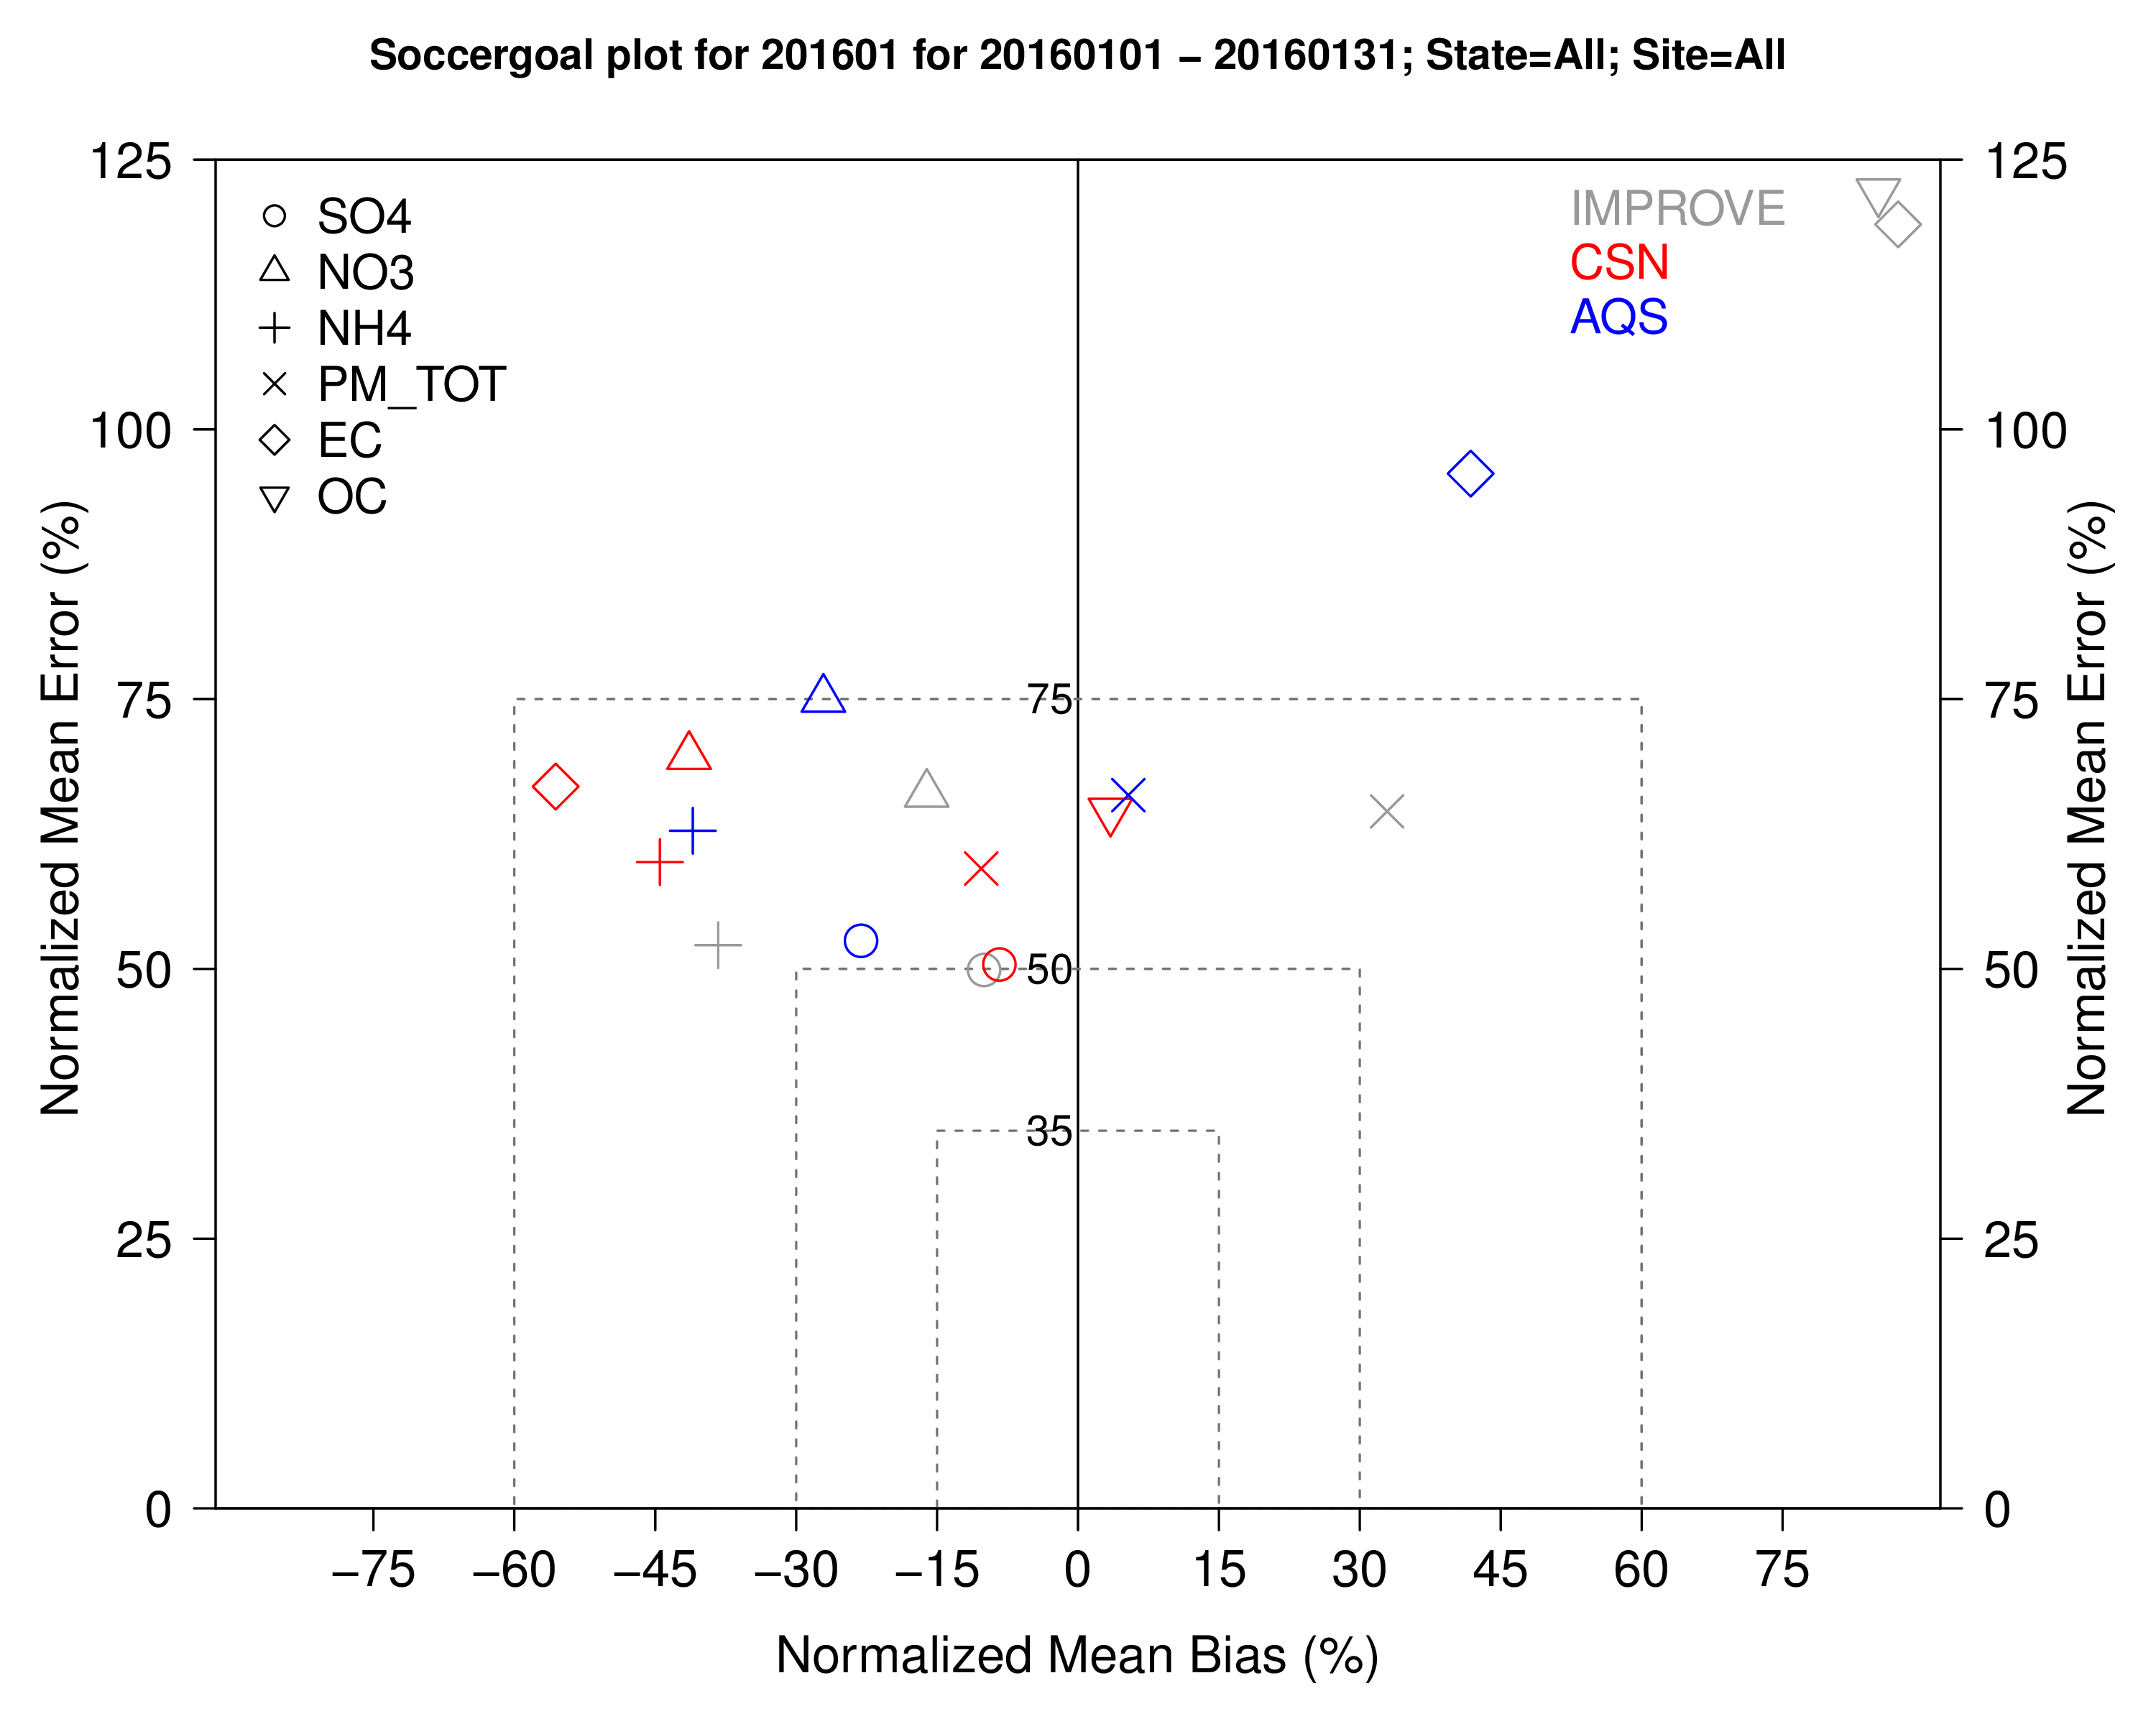
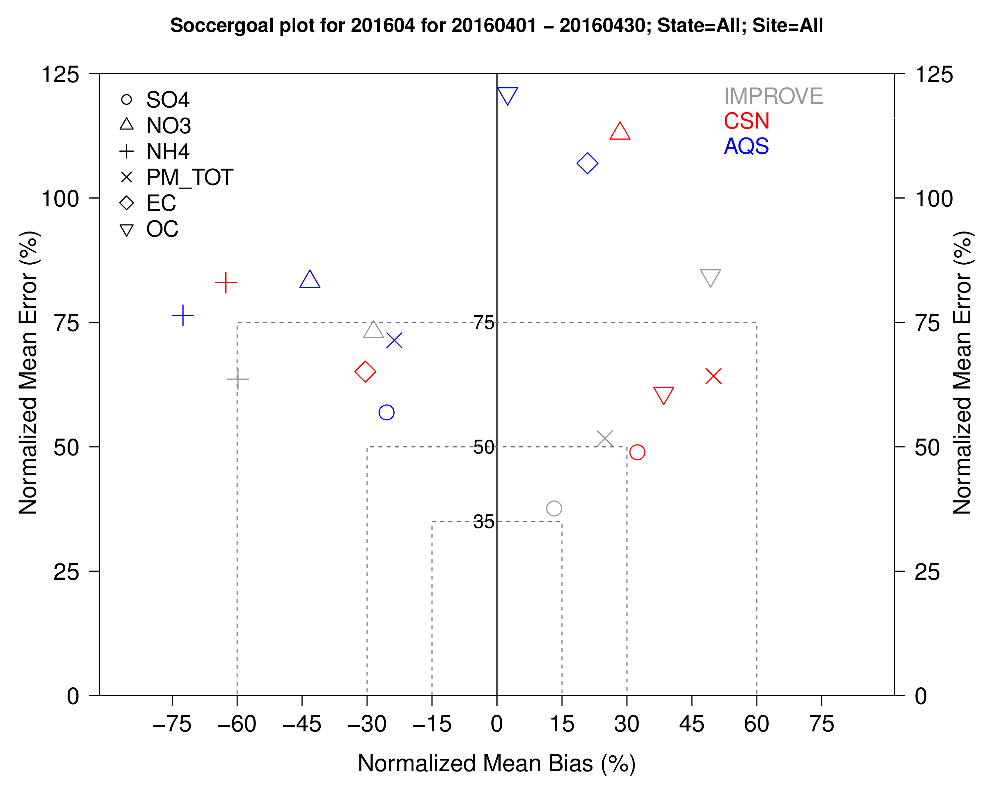
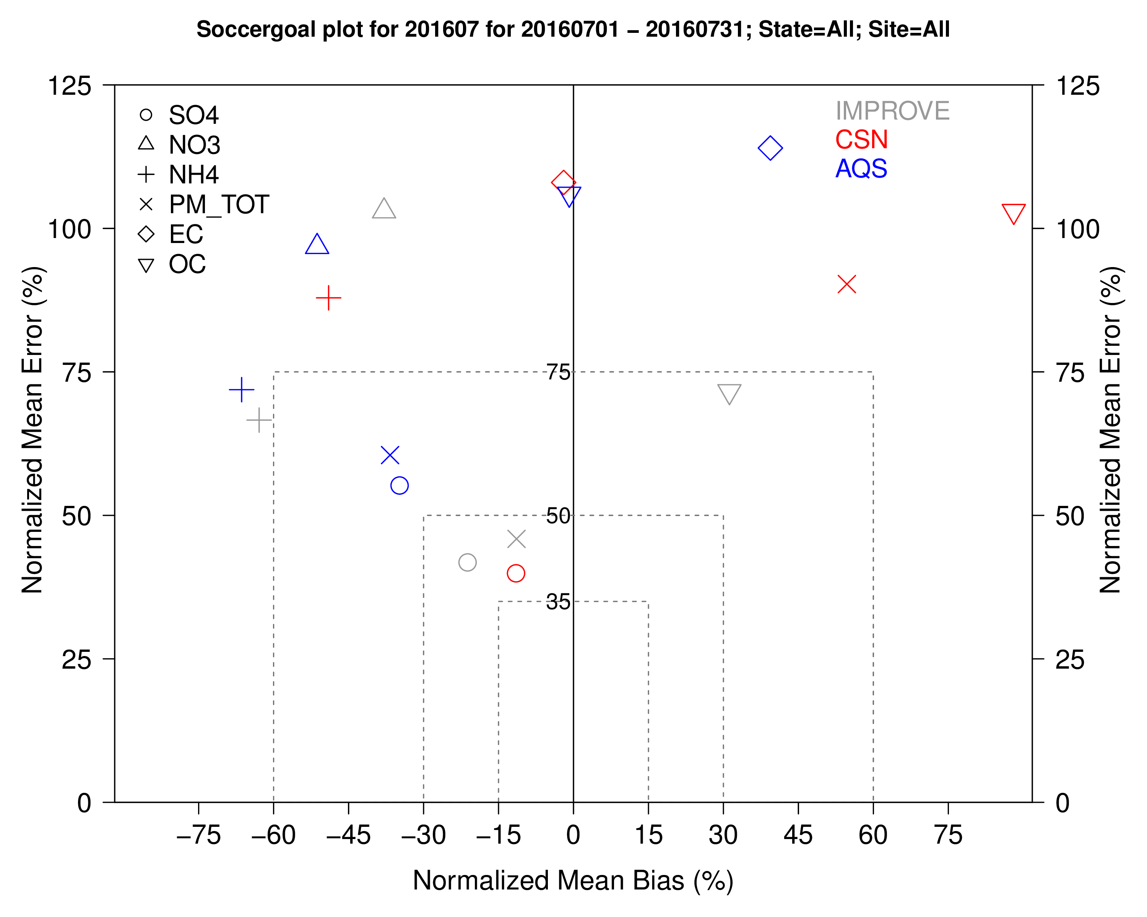
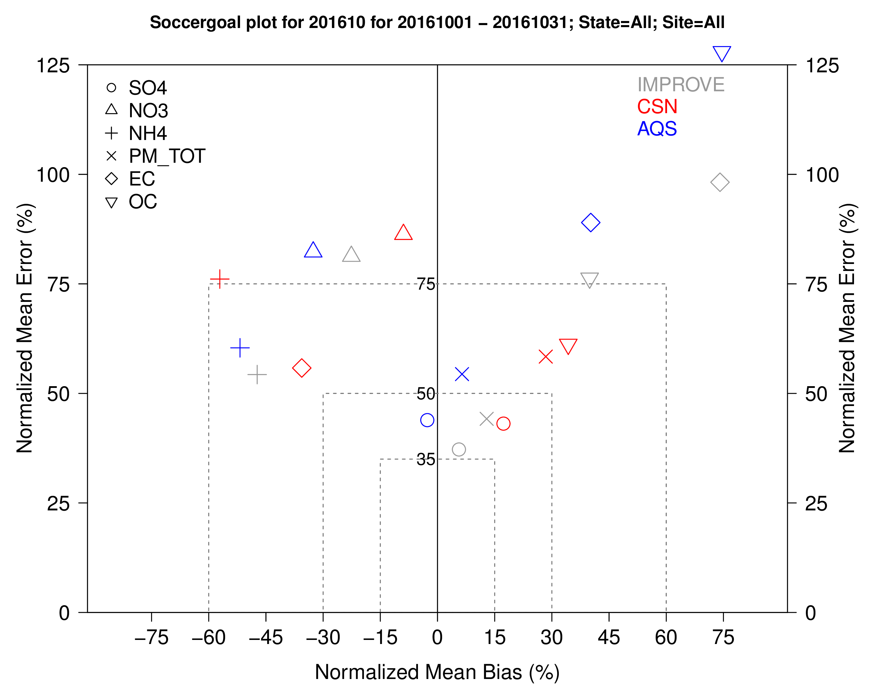
PM_{2.5}: Model Evaluation

Slide 23
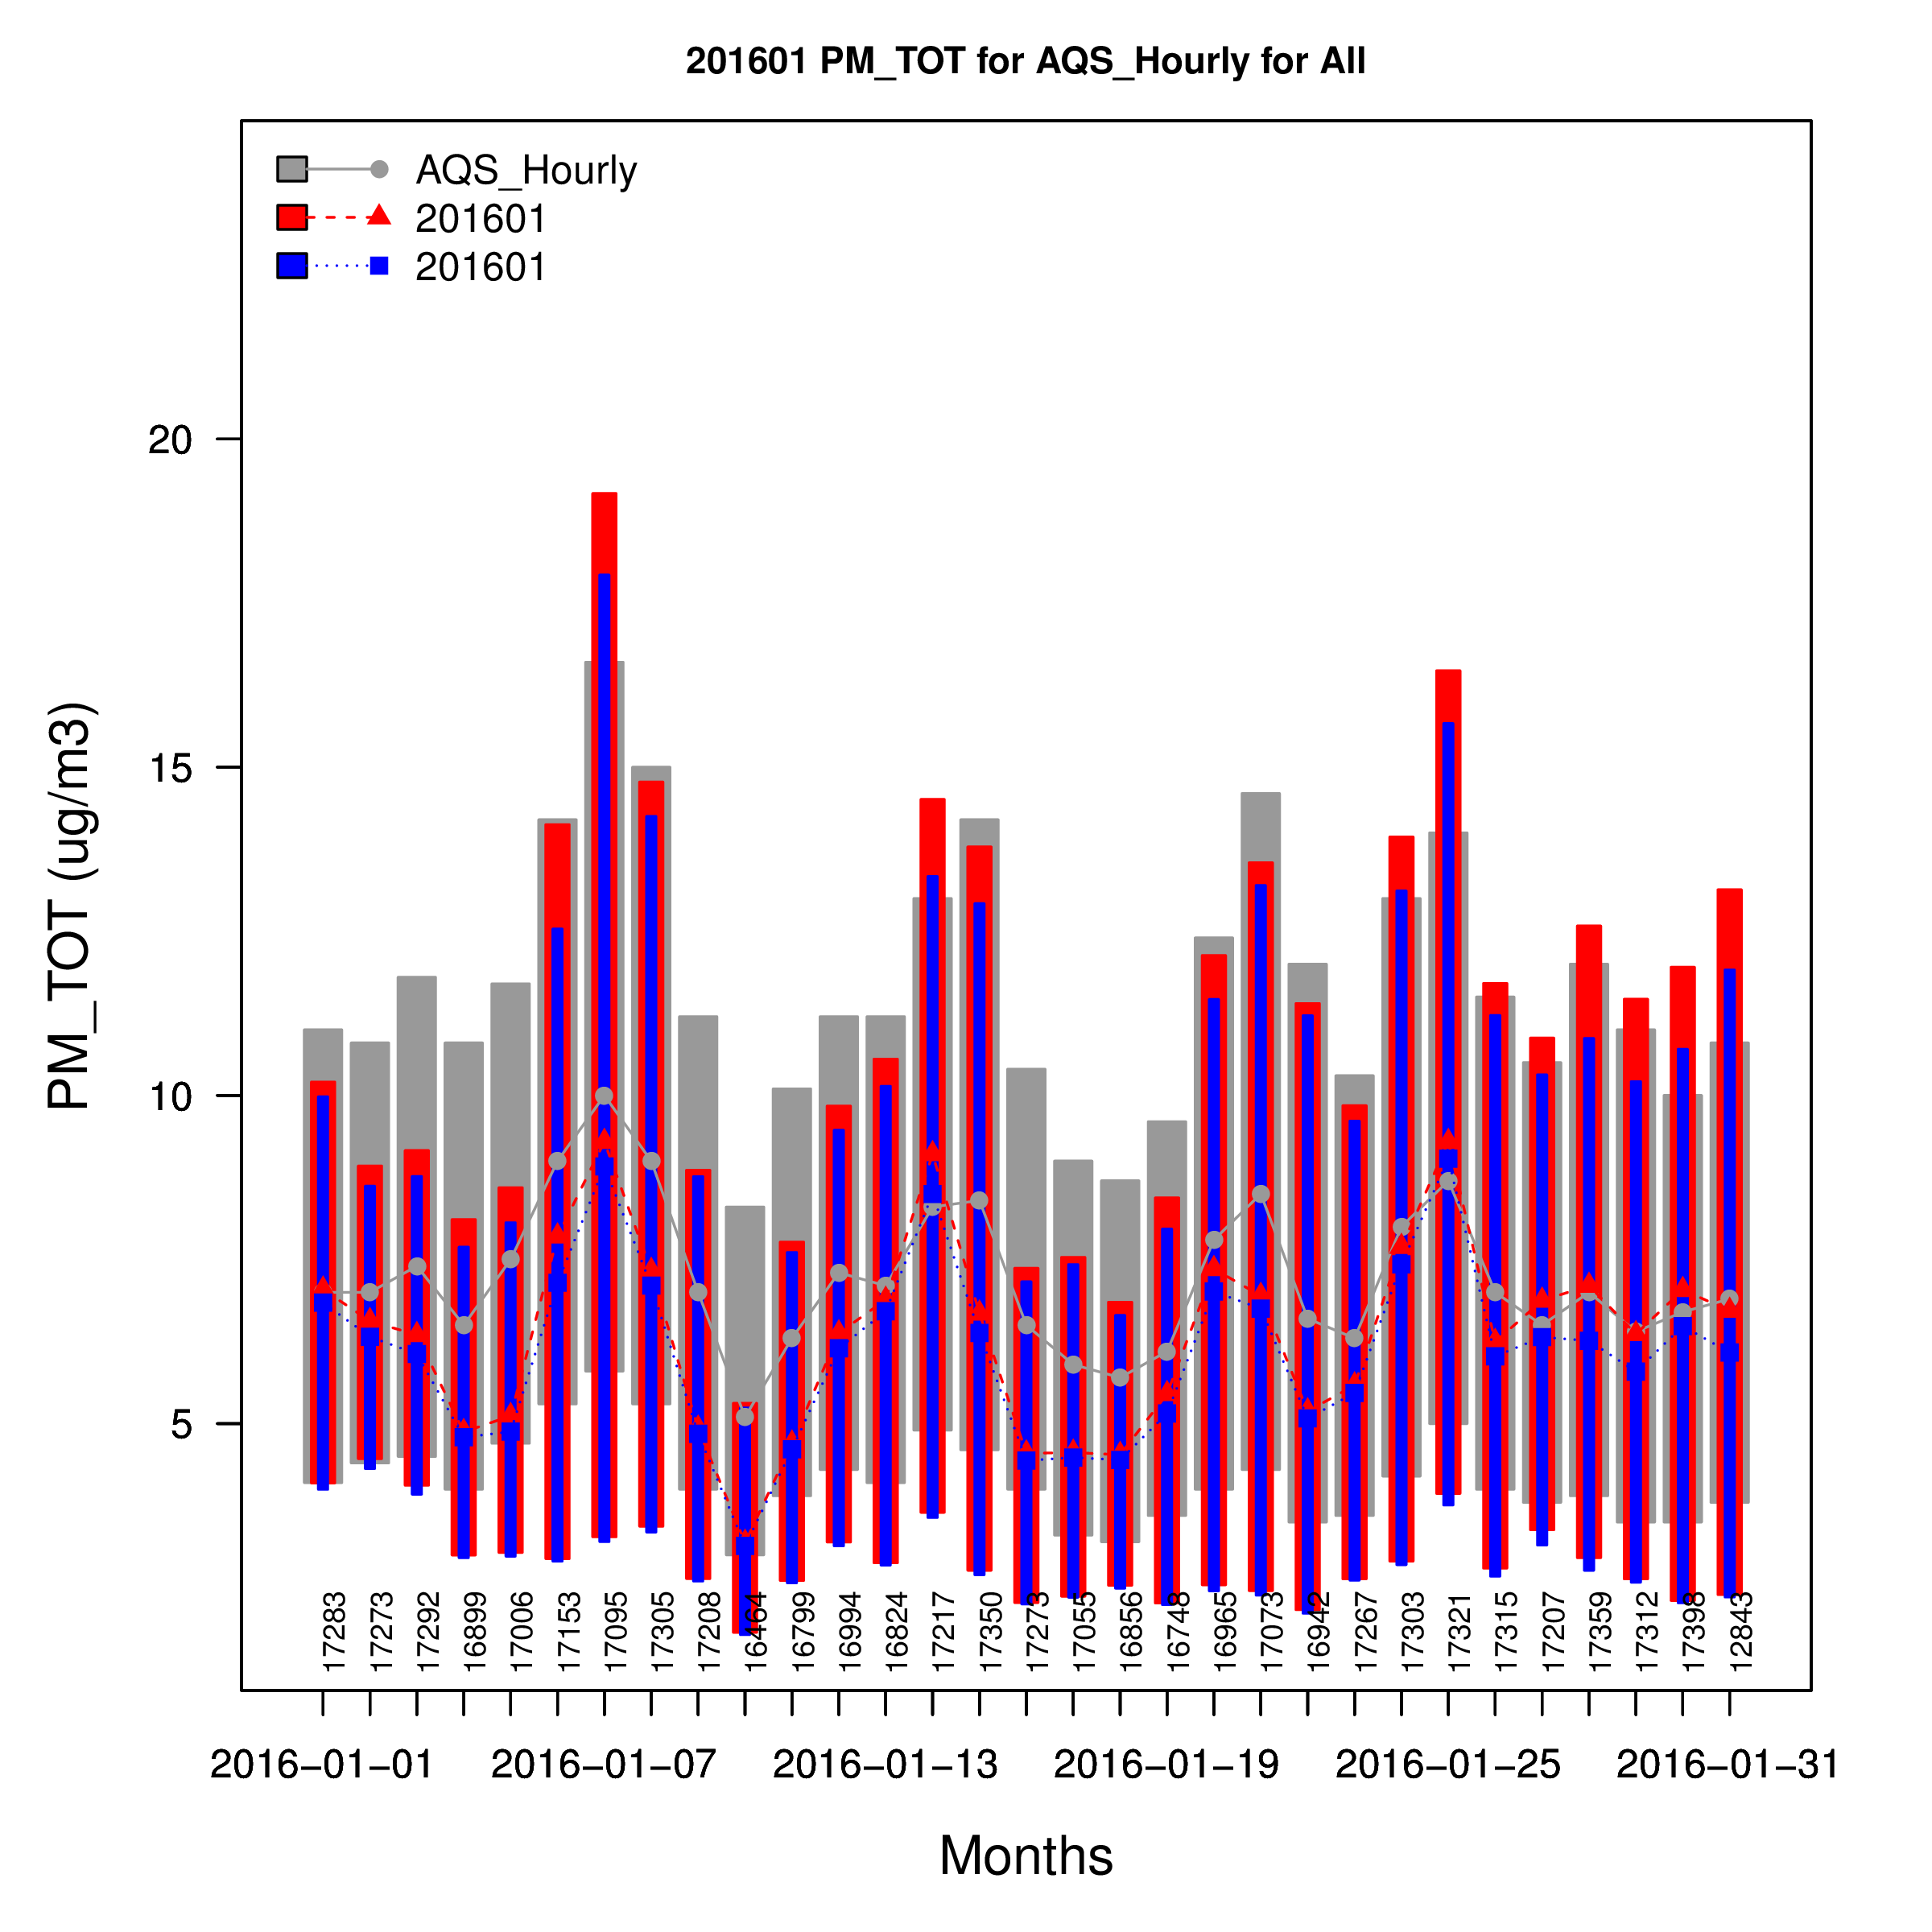
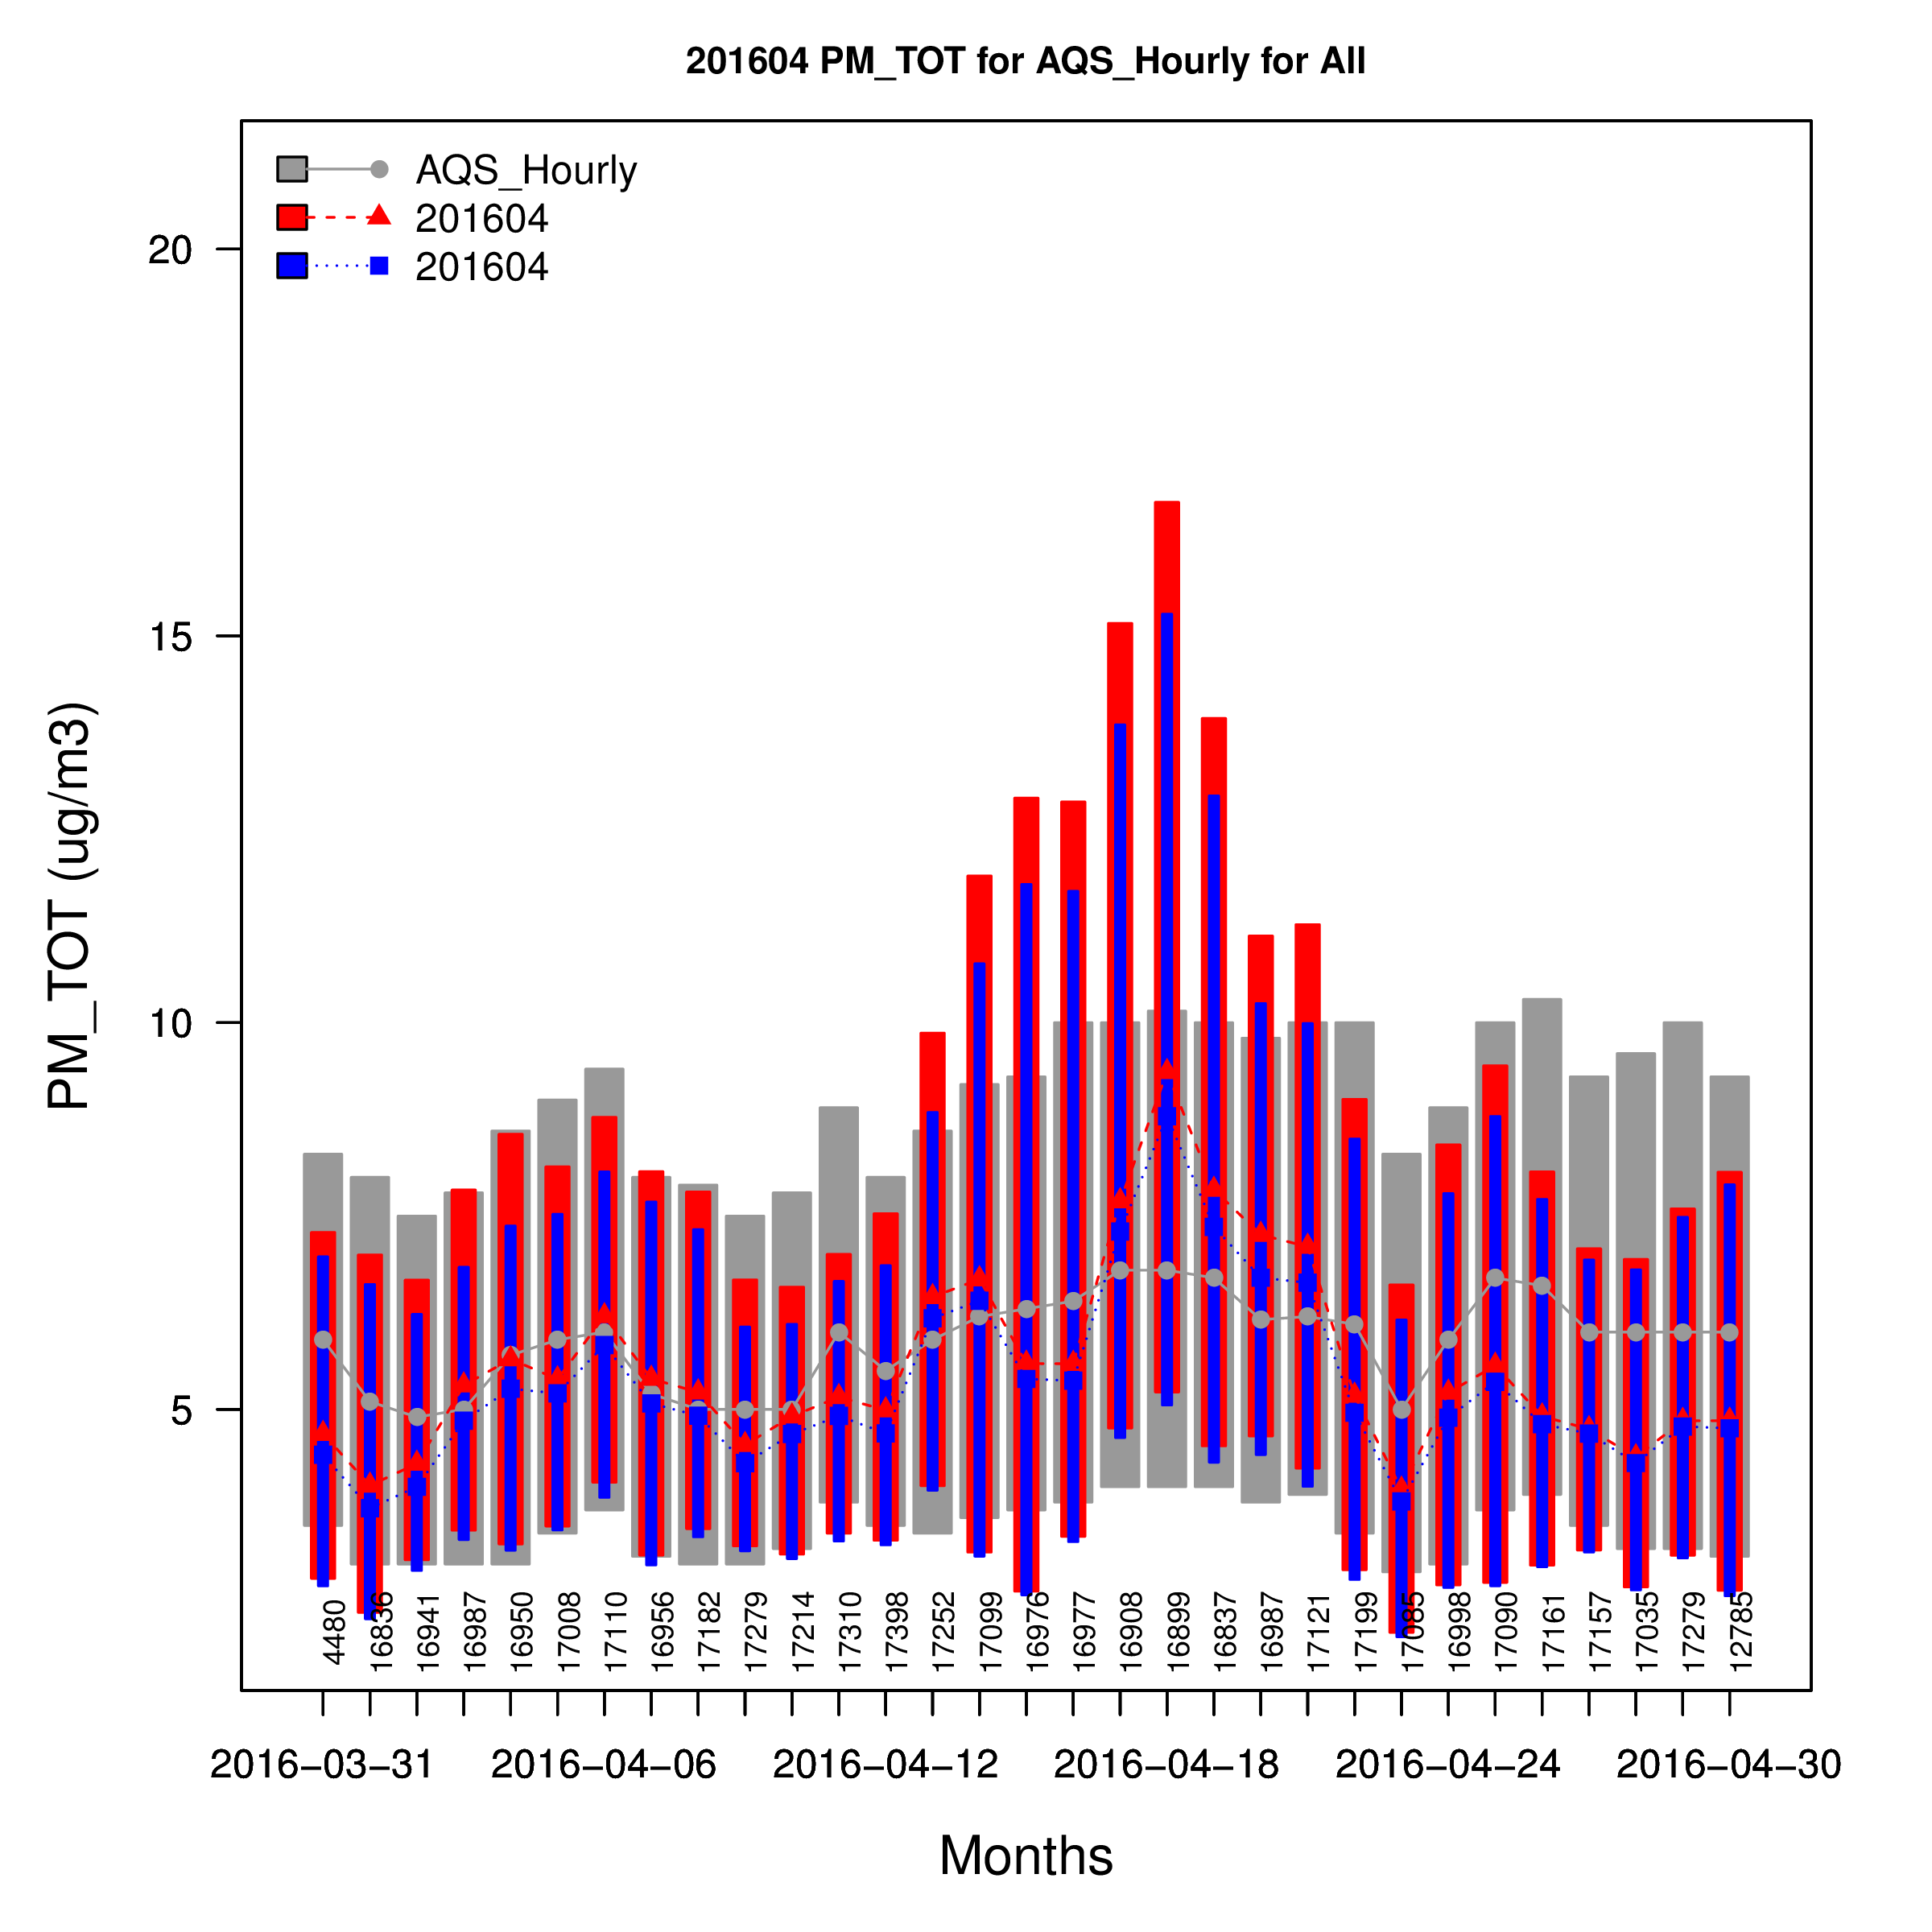
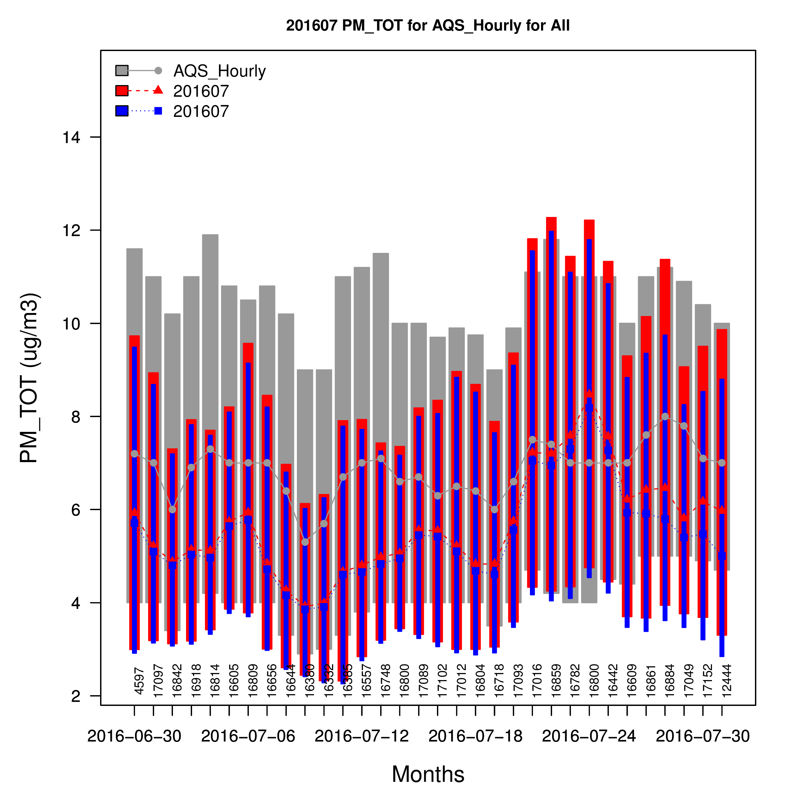
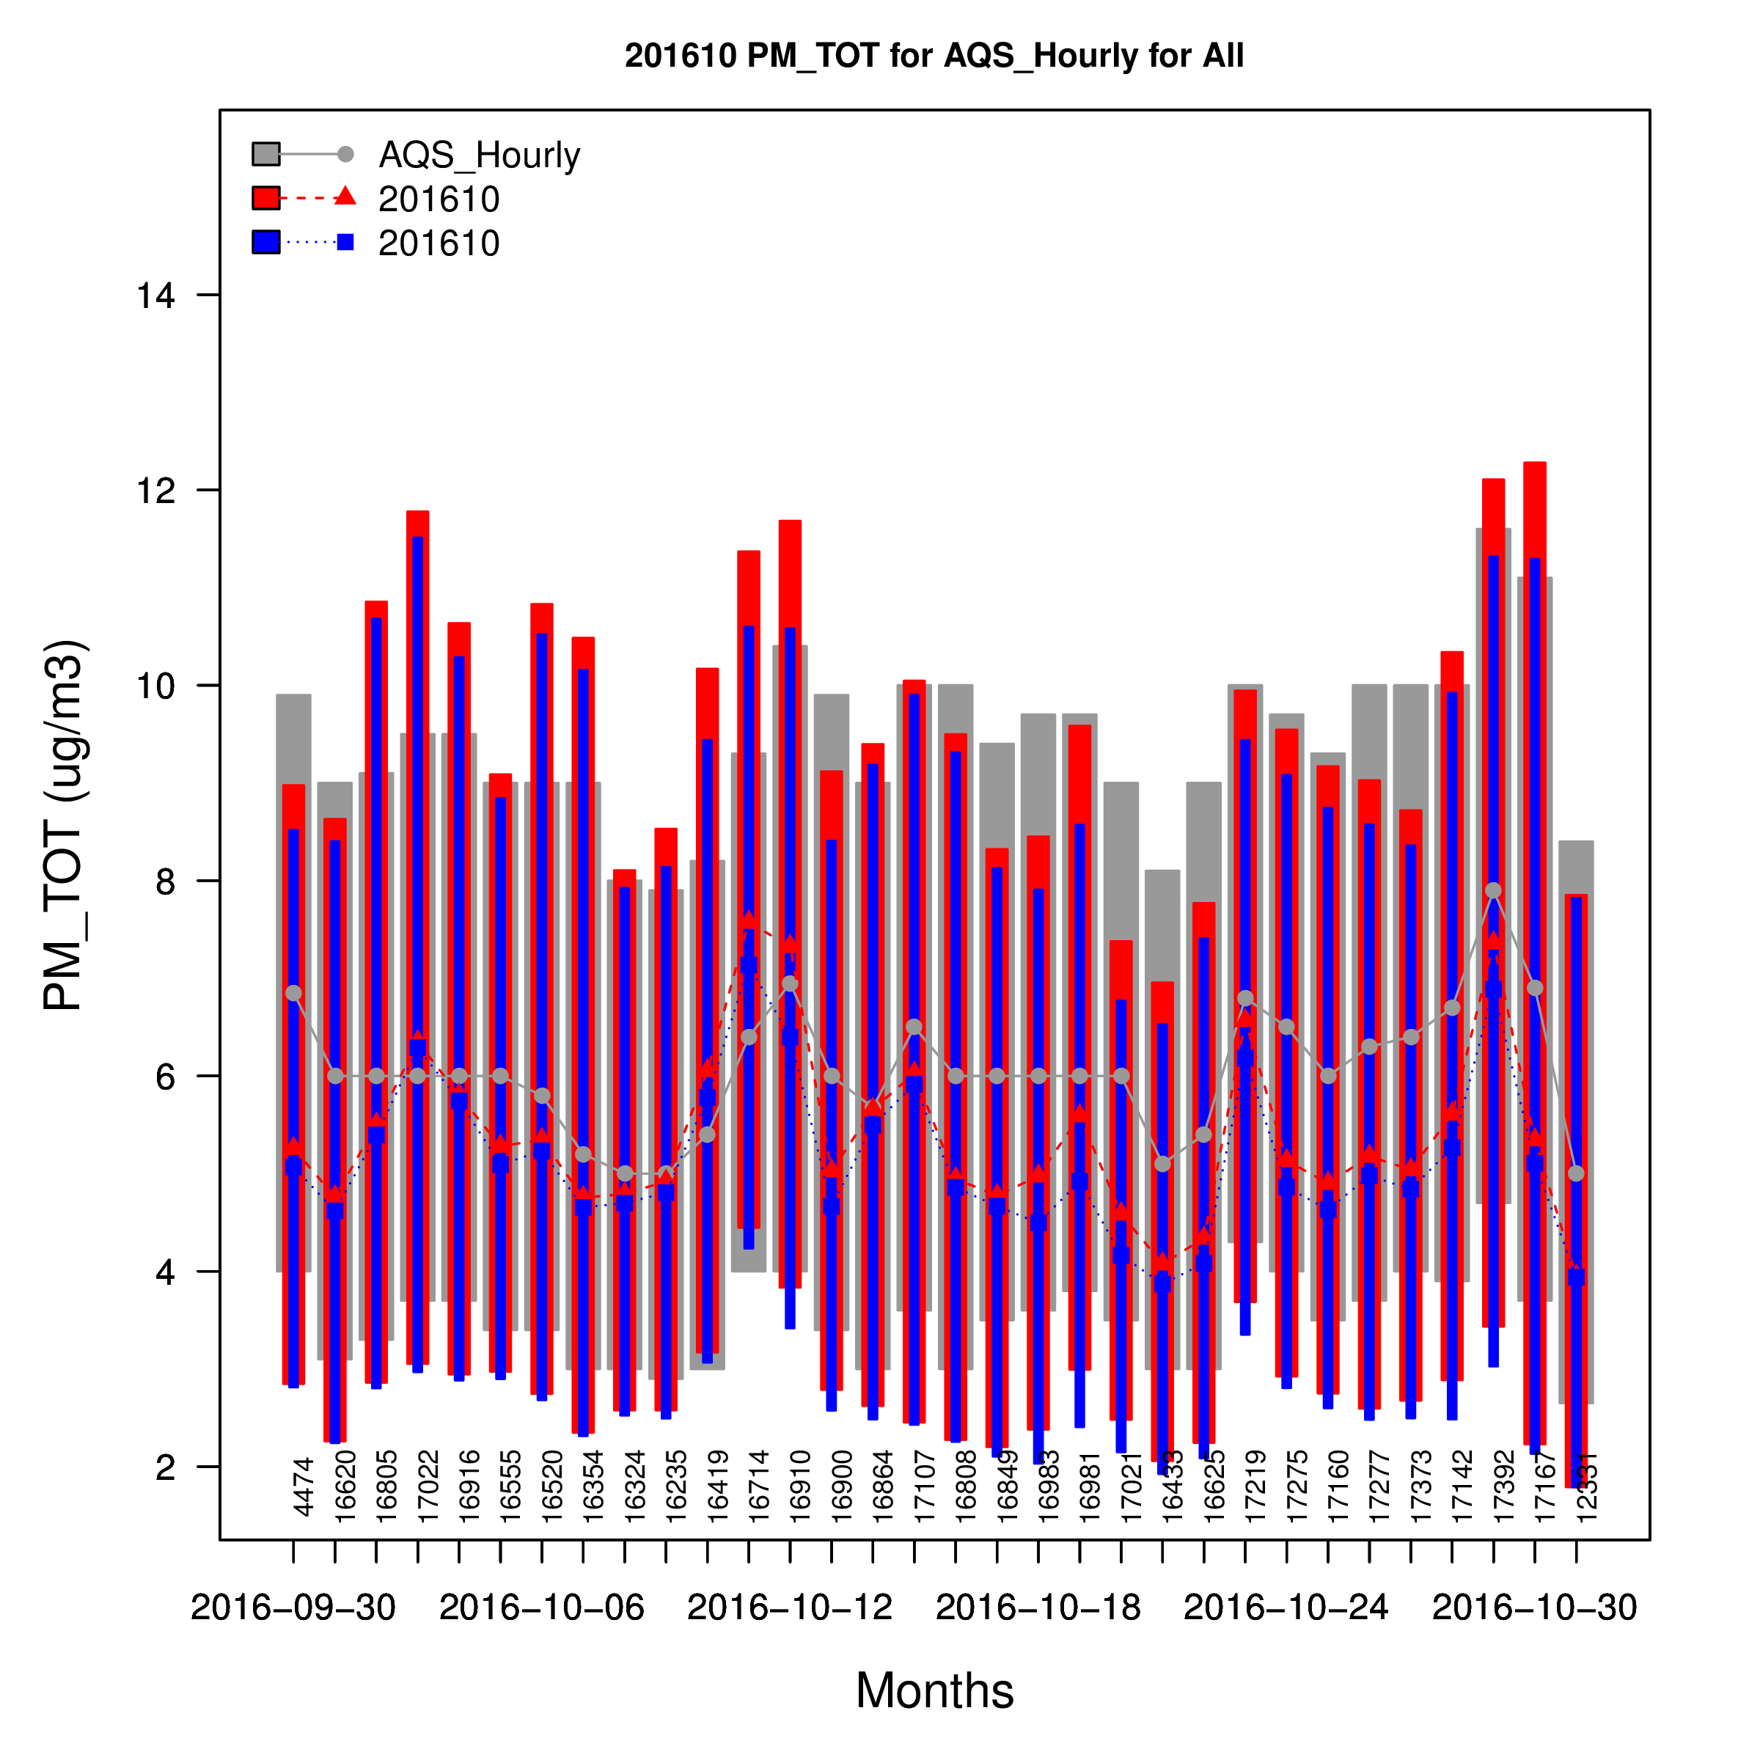
PM_{2.5}: Model Evaluation

Slide 24
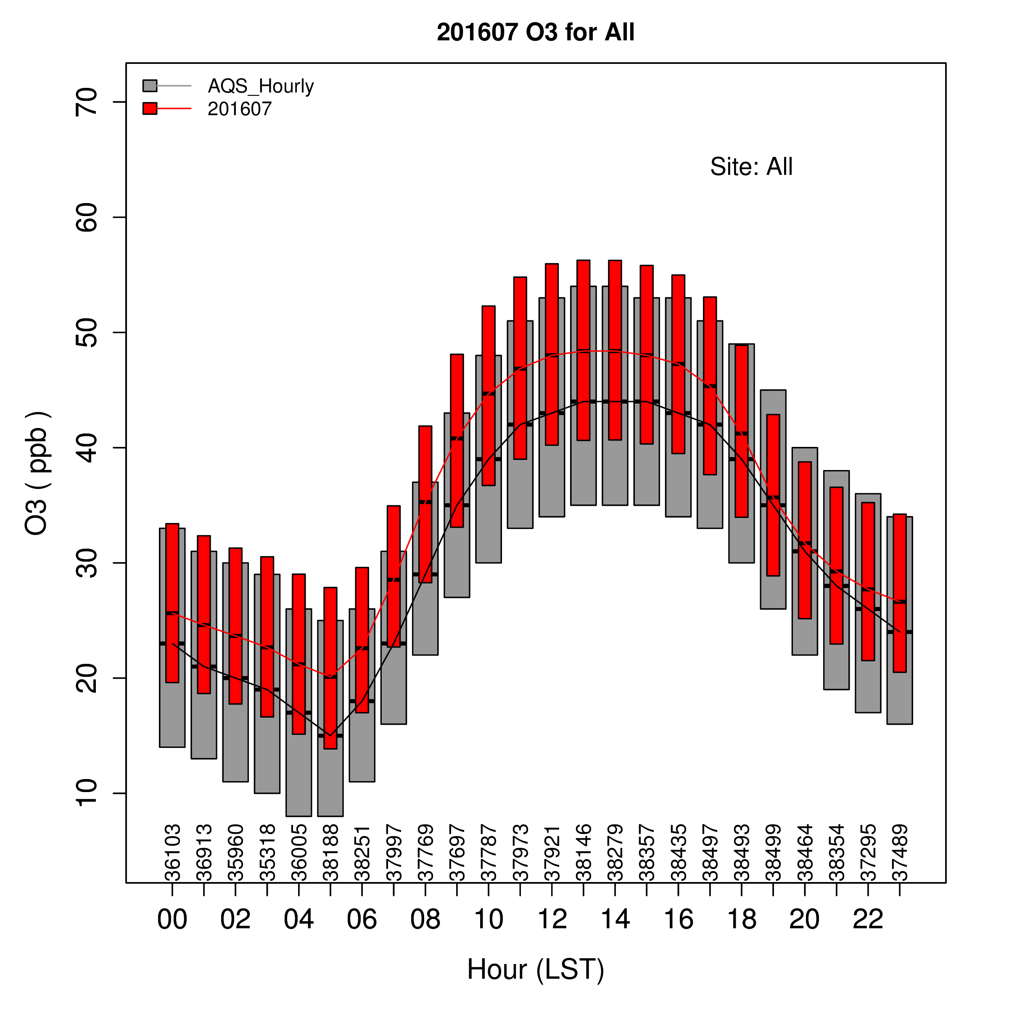
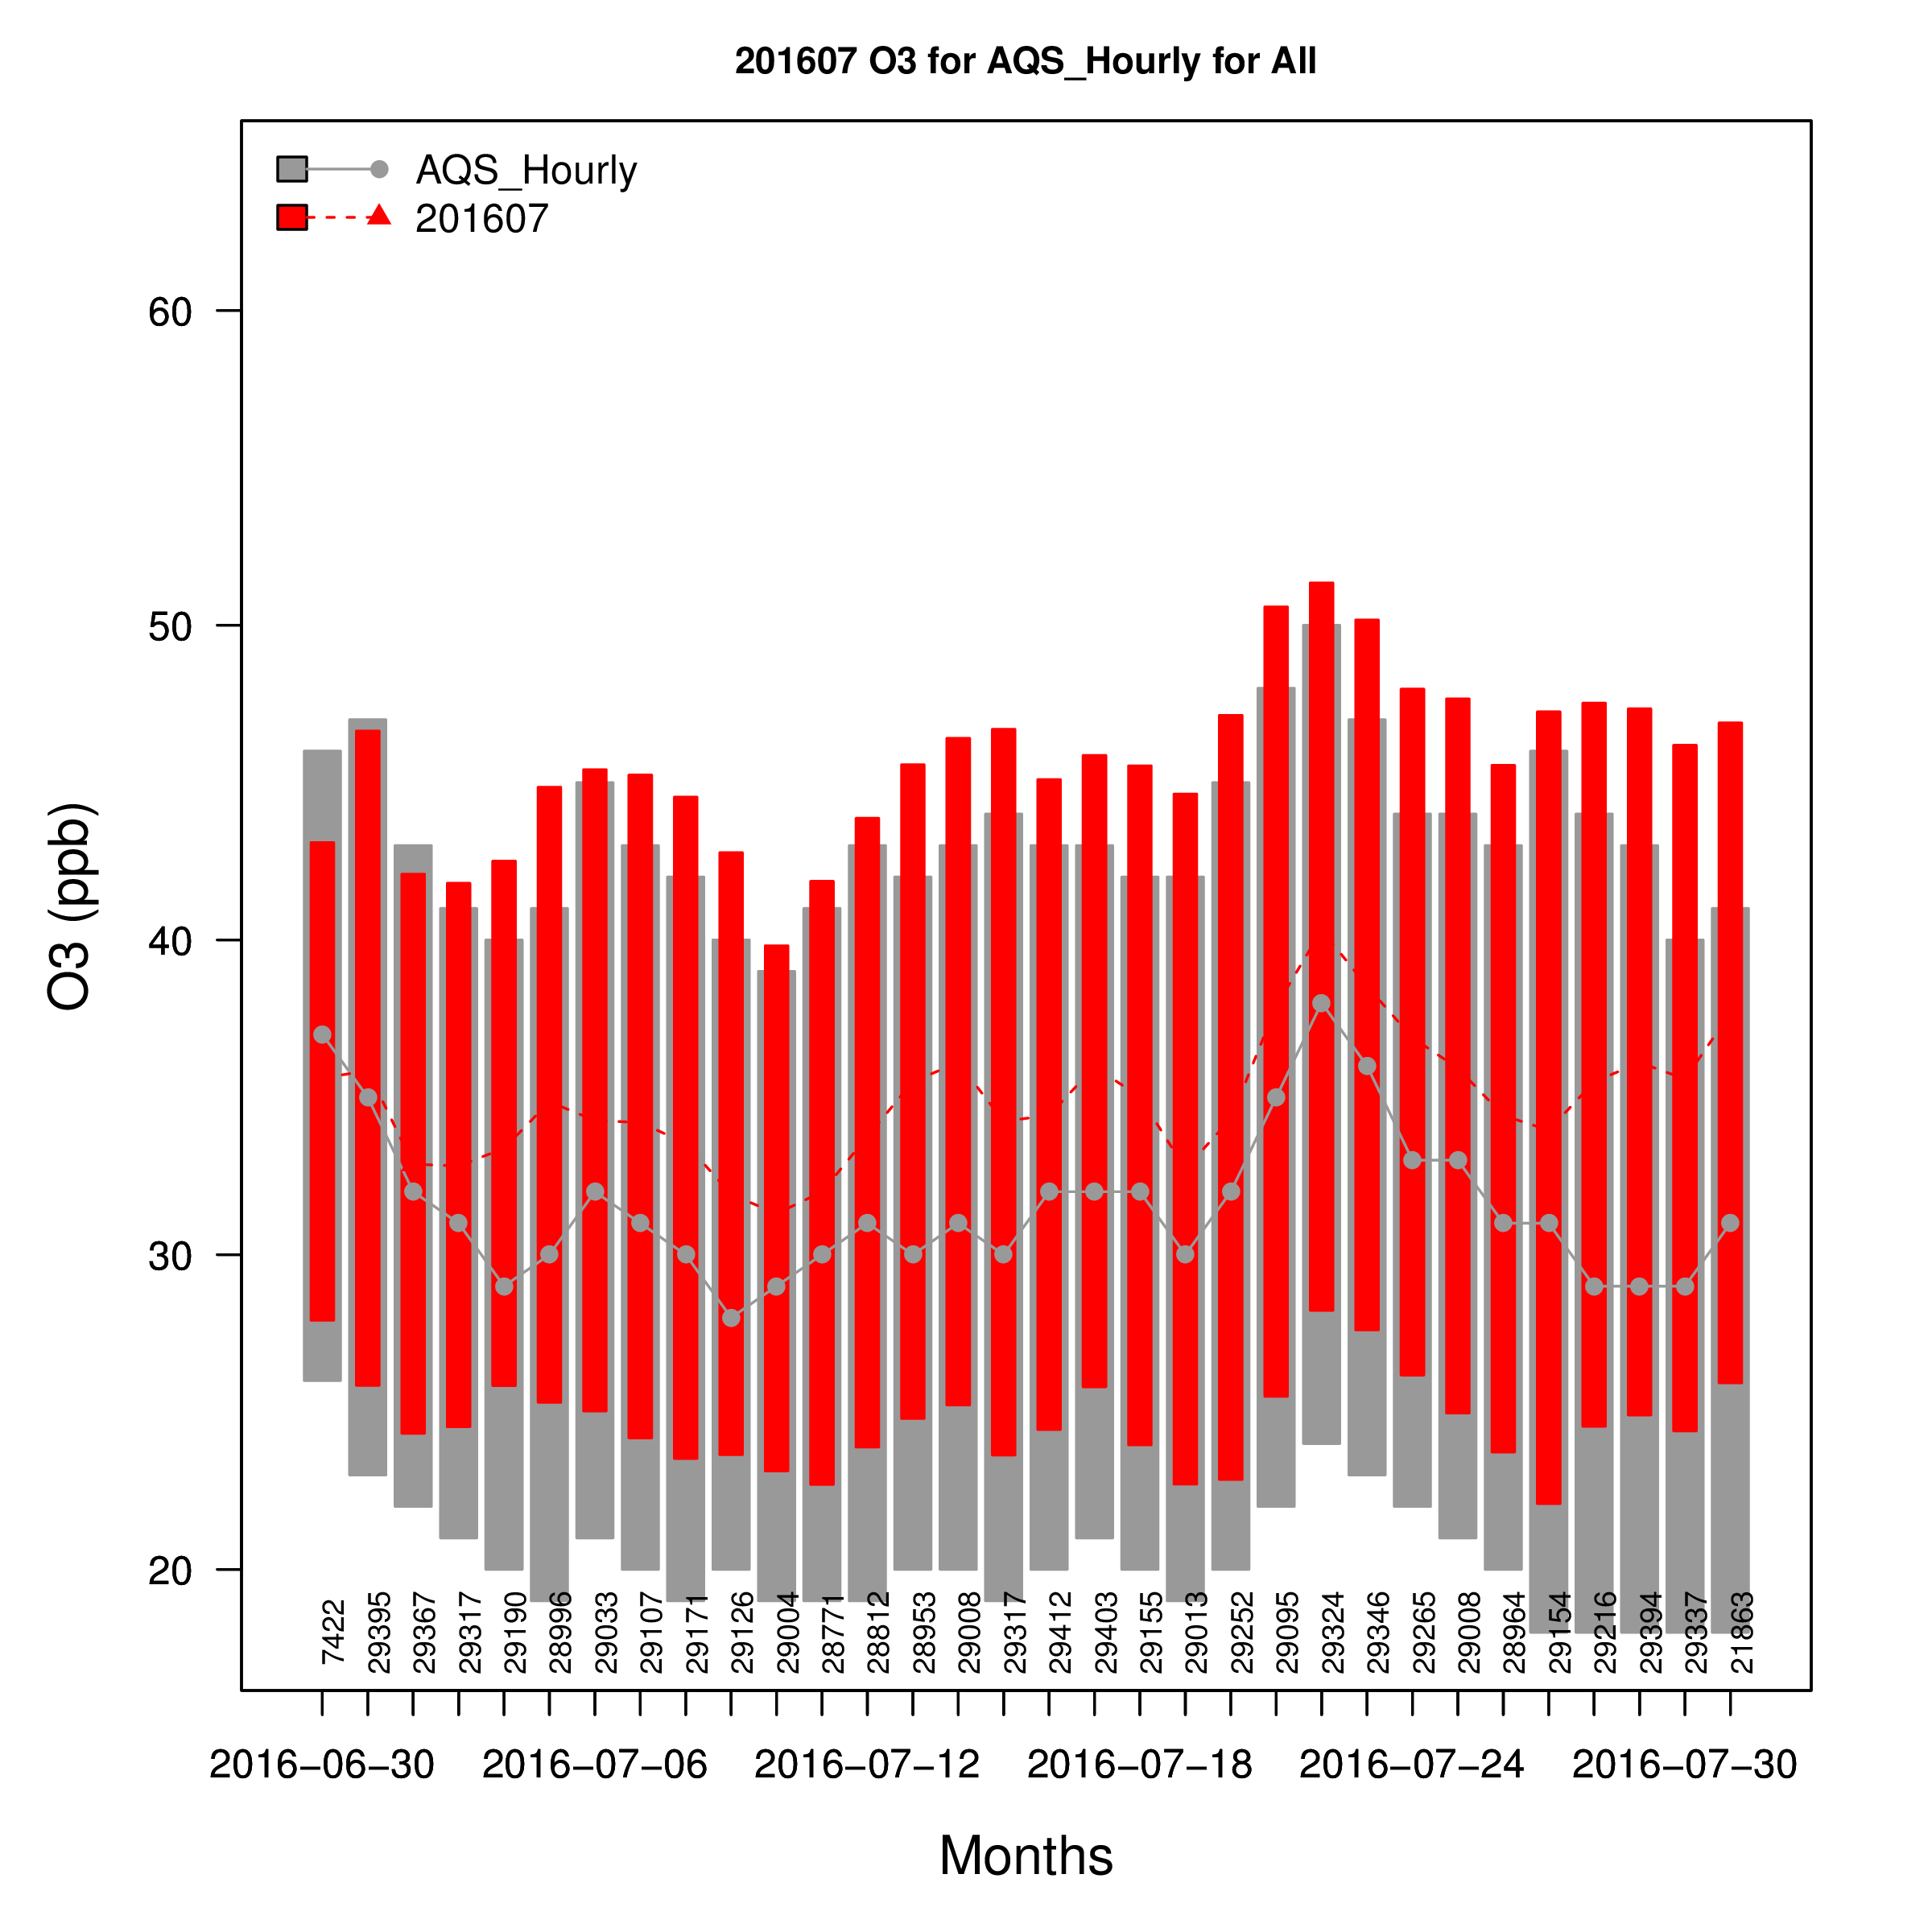
O₃: Model Evaluation

