Slide 1
Global Sources of North American Ozone
Barron H. Henderson
U.S. EPA/OAQPS/AQAD/AQMG
EPA Collaborators: Pat Dolwick, Carey Jang, Alison Eyth, Jeff Vukovich, Rohit Mathur, Christian Hogrefe, Norm Possiel, George Pouliot, Brian Timin, K. Wyat Appel
GD-IT Collaborators: Kathy Brehme, Nancy Hwang
Disclaimer: The views expressed in this presentation are those of the authors and do not necessarily reflects the views or policies of the U.S. Environmental Protection Agency.

Slide 2
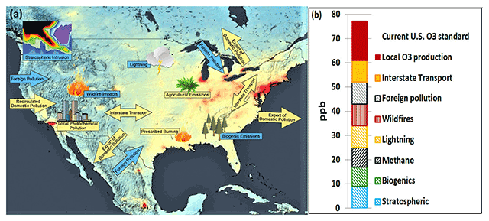
What are background concentrations?
Jaffe et al. (2018) uses a source oriented definition
Non-Controllable Ozone Sources contribute to background ozone.
What is controllable, to some extent, depends on context.
“Non-Controllable” Ozone Sources
Stratosphere
Lightning NOx
Wildfires, Biogenics
Seasonal uncertainty ±10 ppb
“Controllable”
Depends on Context…
Non-Attainment Area
State, Country
International?
Ambient air has all sources
NCOS can be important
NCOS vary from year to year
NCOS vary from model to model
doi: 10.1525/elementa.309

Slide 3
Zero-out estimates of ozone contributions
Motivations:
Interannual variability (e.g., Lin et al., 2017)
Modeling system (e.g., Huang et al. 2017)
2016 platform (α)
New Estimates:
Northern Hemispheric: Natural
International anthropogenic: Intl
Domestic anthropogenic: USA
And either: Residual…
Long range transport and aloft results
At 108km & Separating China and India
Surface results
108km and 12 km nested from 108 km LBC
Natural, Intl, USA

Slide 4
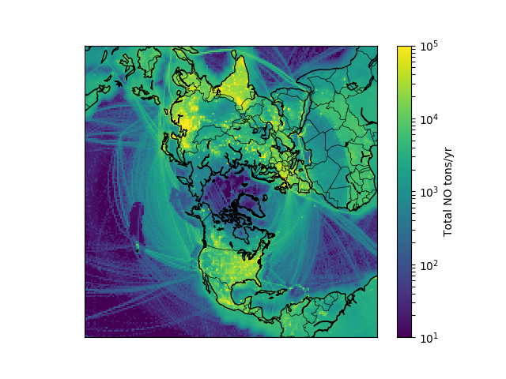
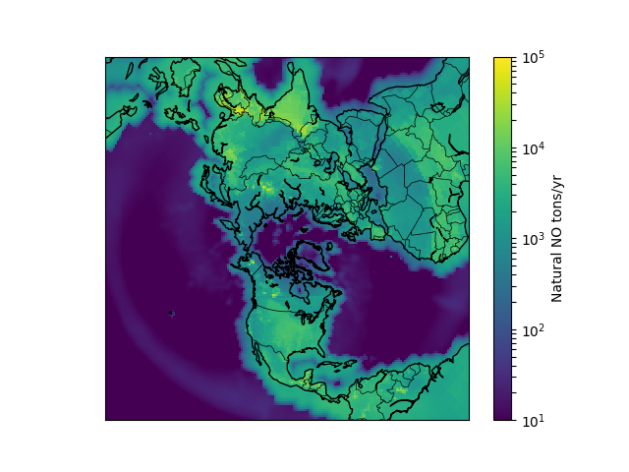
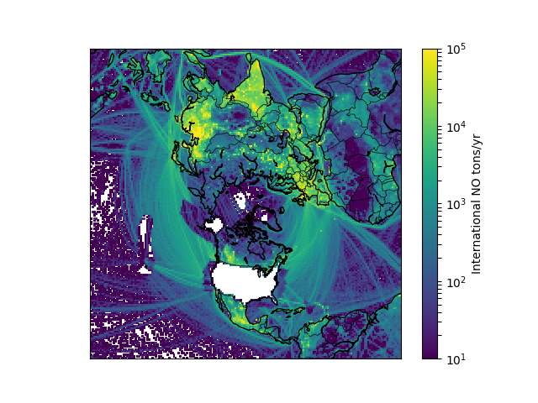
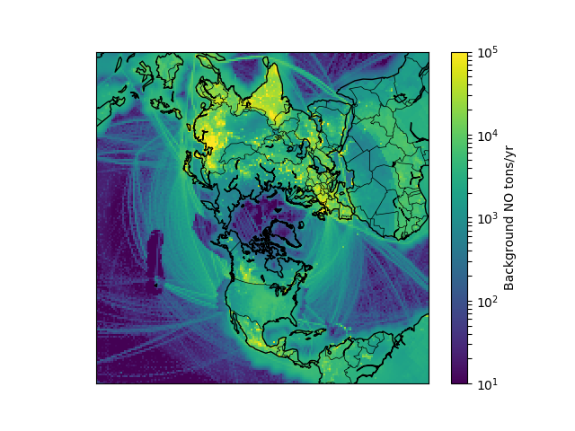
Estimates of 2016 Ozone Components
Evaluations: Henderson CMAS 2018; IGC9 2019; CMAS-SA 2019
Predictions = F(M, E)
Total : E = sum({nat, usa, sum(intl)})
Natural : E = sum({nat}); soil NOx and methane are treated as natural
ZINTL : E = sum({nat, usa}); Prescribed fires are treated as anthropogenic
ZUSA aka USB : E = sum({nat, sum(intl)}); Others…
Total
Natural
Intl Anthro
ZUSA
NOx Emissions
Contributions
Natural = ZANTH
USA = Total - ZUSA
Intl = Total - ZINTL
RES* = Total - USA - INTL – NAT
International Parts
CHN = Total - ZCHN
SHIP = Total - ZSHIP
IND = Total - ZIND
CANMEX = Total – ZCANMEX
OTHER = Intl - CHN - IND - SHIP - CANMEX
Notes:
Evaluations: Henderson CMAS 2018; Henderson IGC9 2019; Henderson CMAS-SA 2019

Slide 5
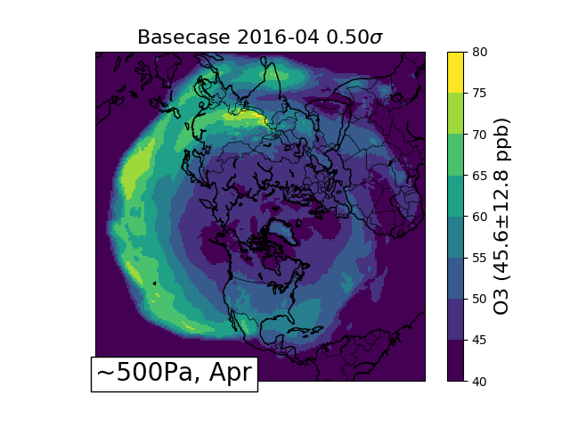
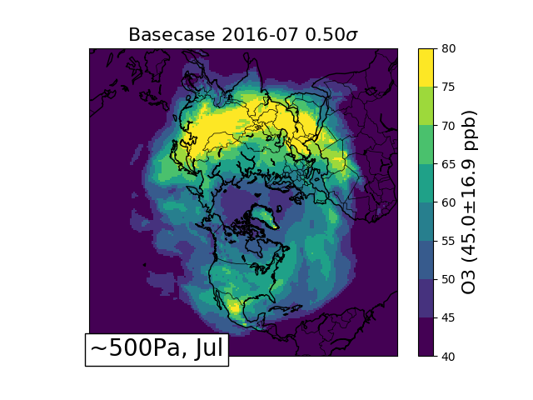
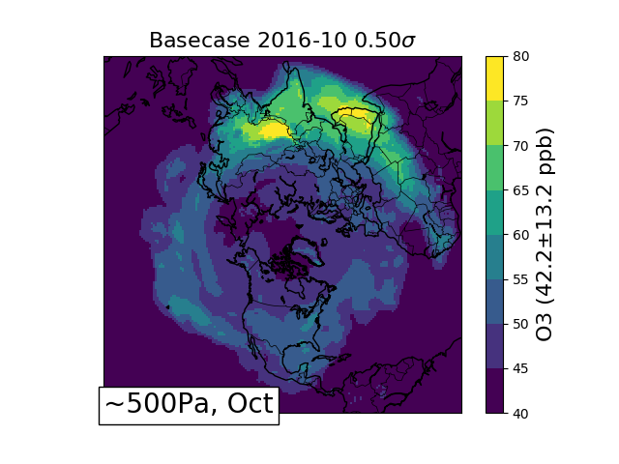
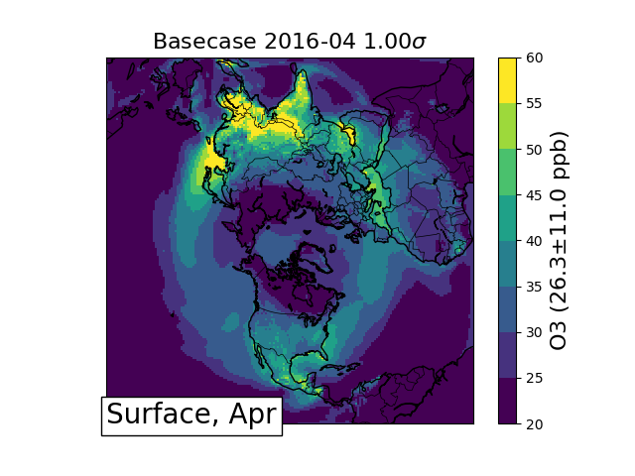
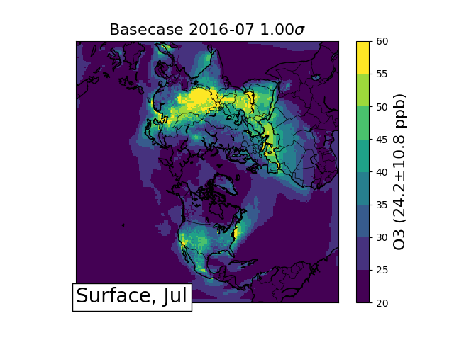
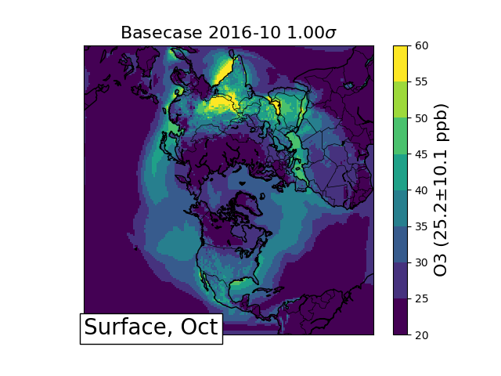
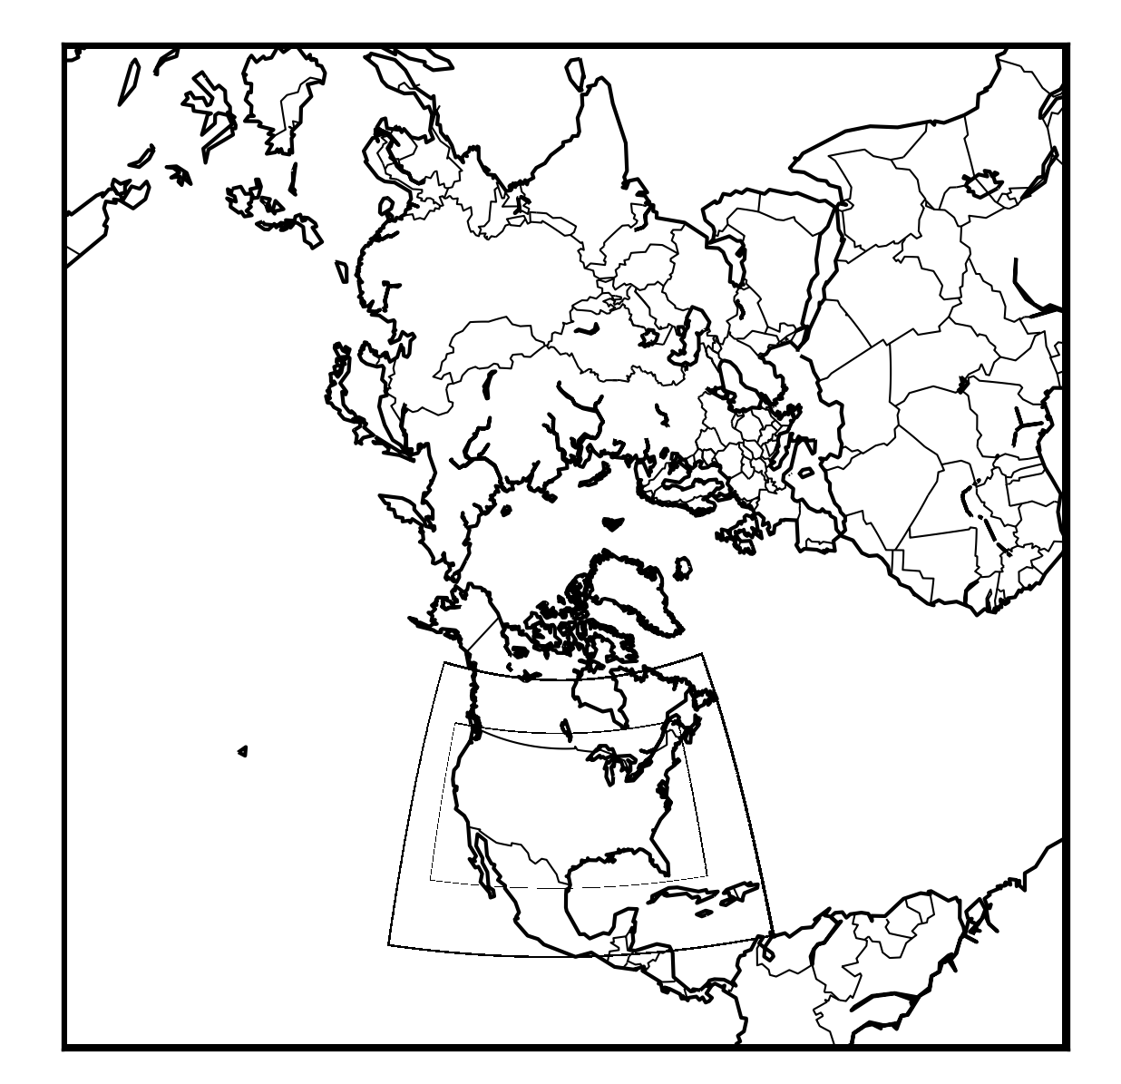
Monthly average ozone illustrate transport
Evaluations: Henderson CMAS 2018; IGC9 2019; CMAS-SA 2019
China
Africa
USA
SA

Slide 6
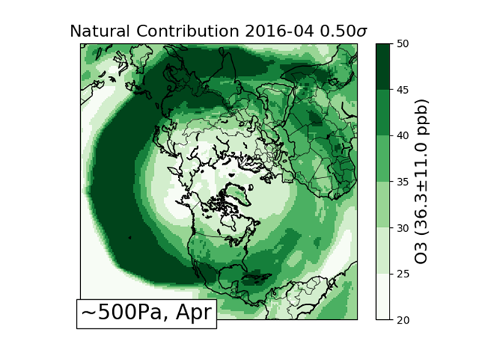
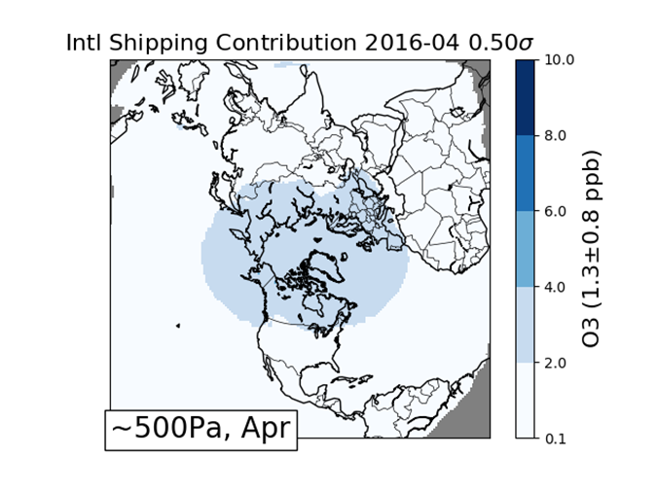
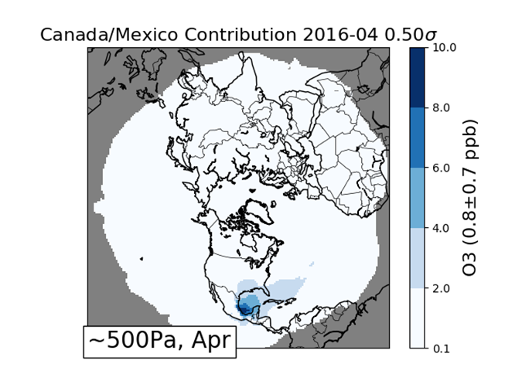
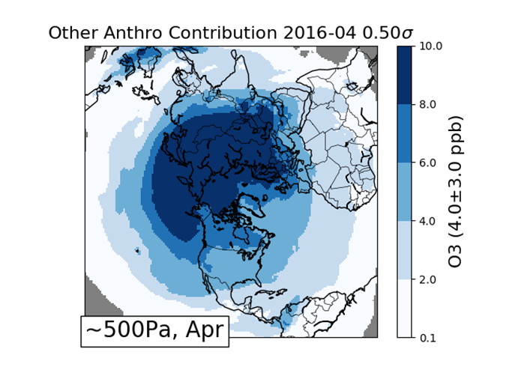
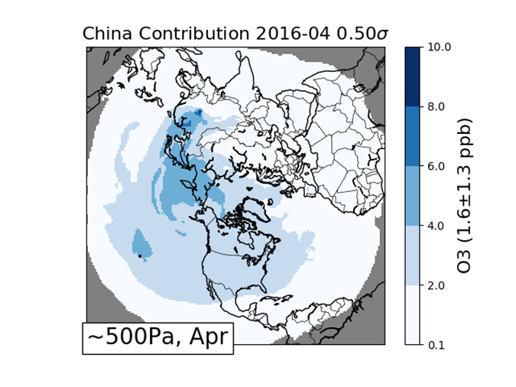
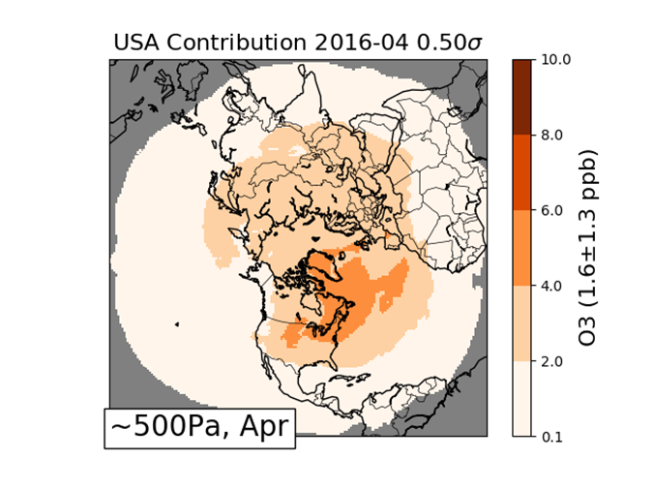
Ozone source contributions in April aloft

Slide 7
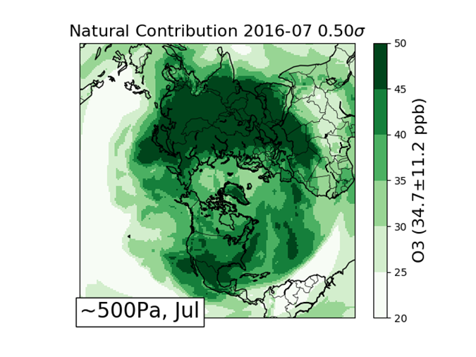
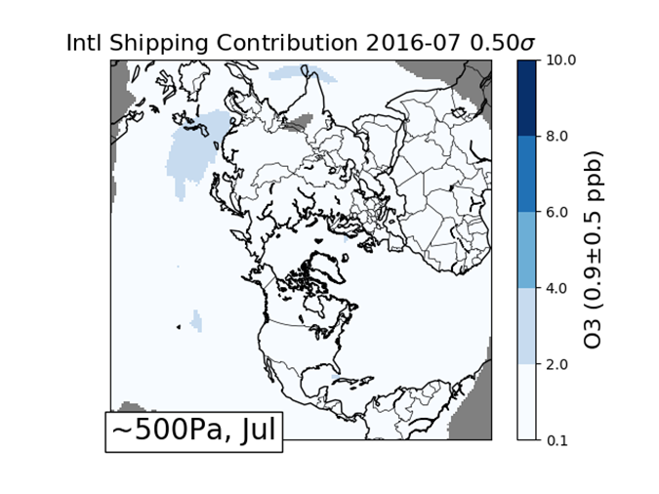
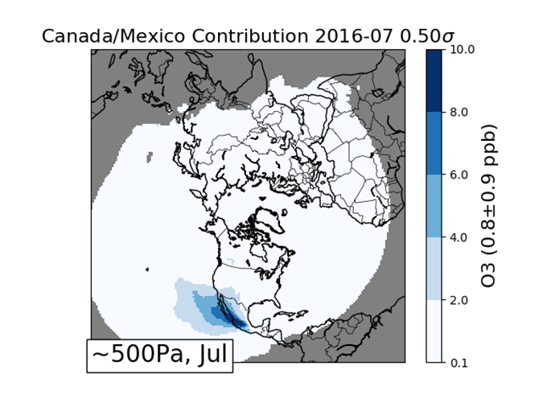
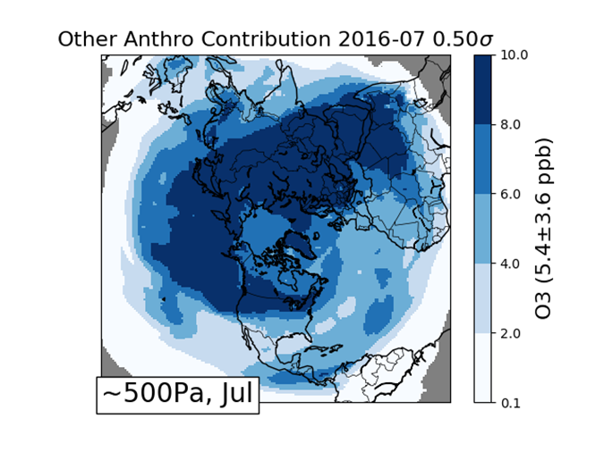
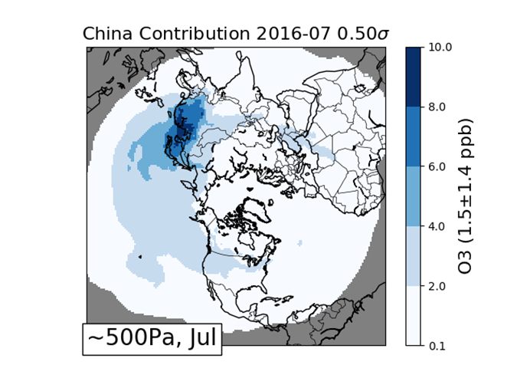
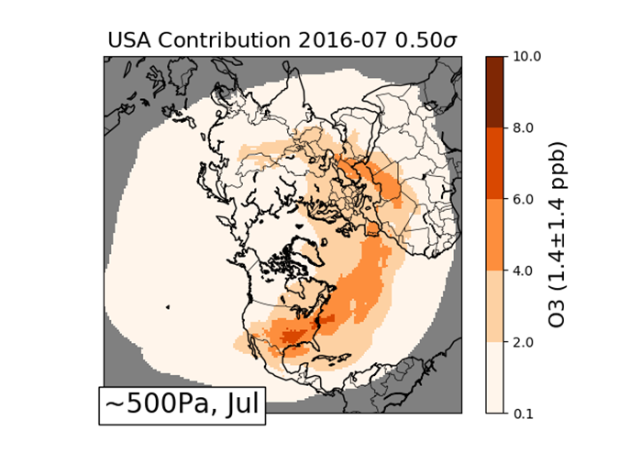
Ozone source contribution in July aloft

Slide 8
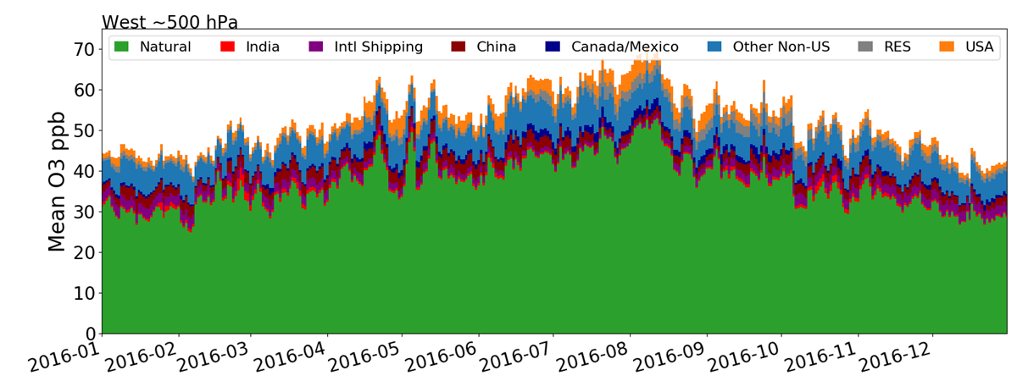
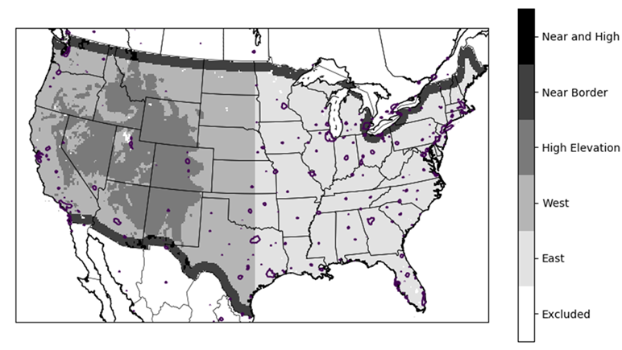
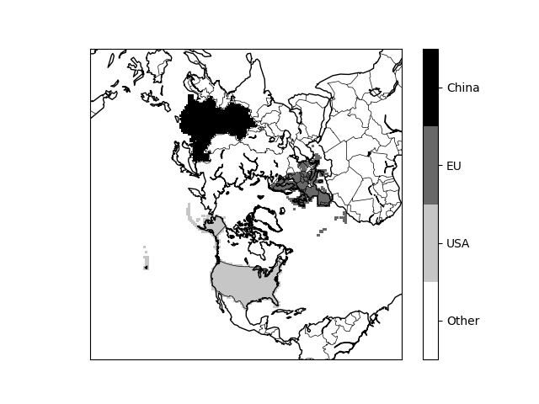
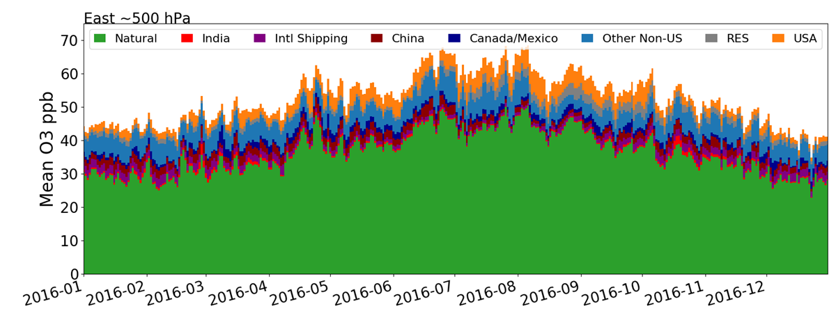
Difference between West and East aloft (108km)
West Contributions
Other countries 10-15 ppb
East Contributions

Slide 9
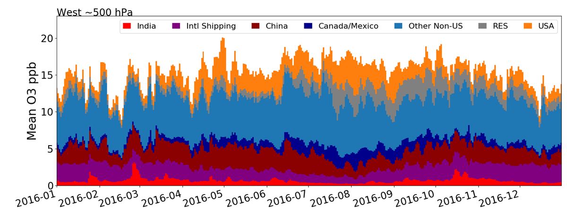
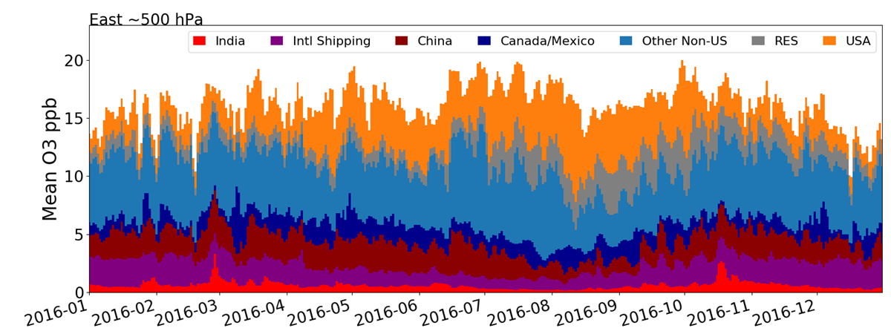
Difference between West and East Aloft (108km)
West Anthropogenic
Other countries 10-15 ppb
East Anthropogenic

Slide 10
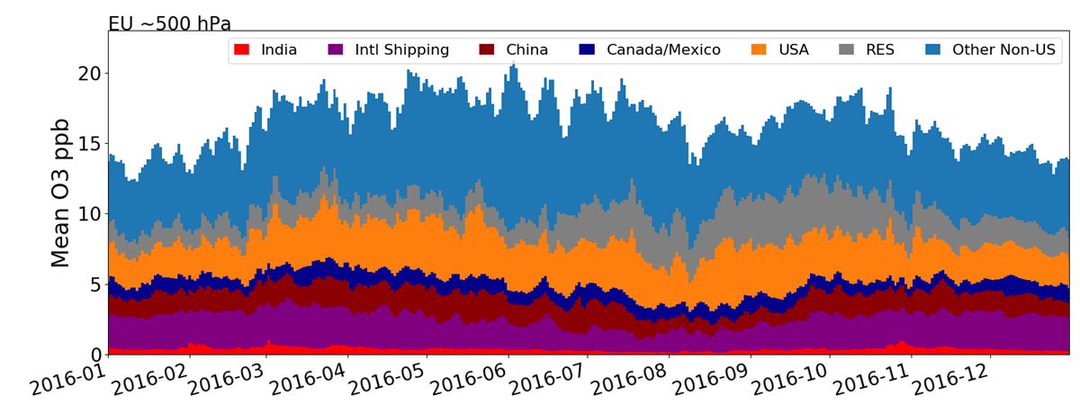
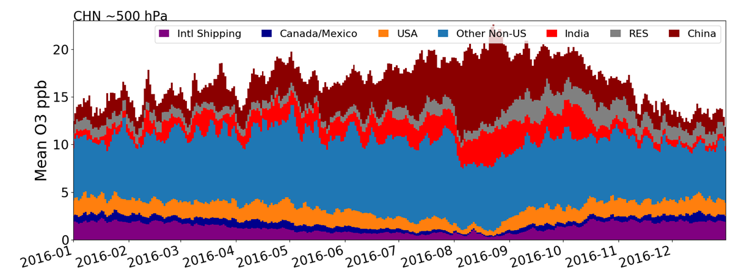
China and the European Union (108km)
Other Non-US is not all EU, but this gives us a sense that upwind contributions similar in the EU as in the West.
Anthro over the EU
(UK in EU at time of writing)
Anthro Over China
China Aloft ozone from other countries is 10-15 ppb

Slide 11
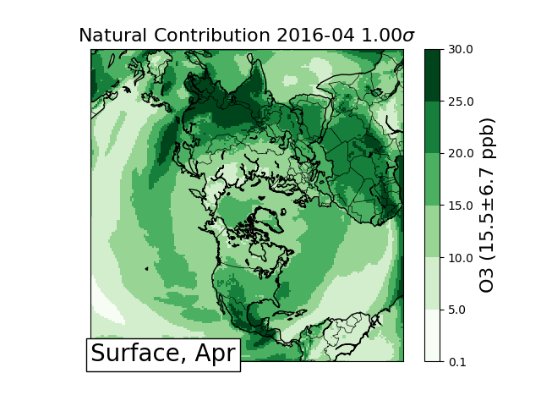
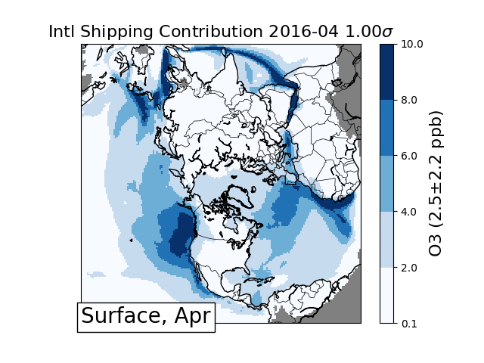
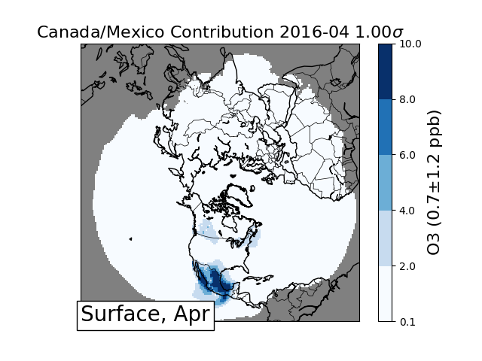
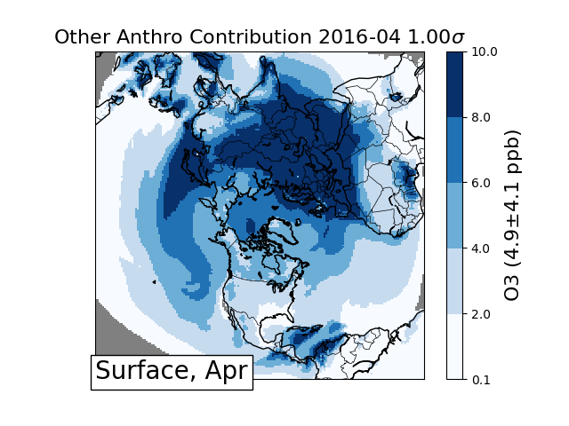
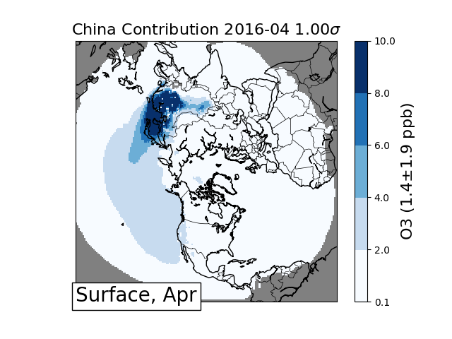
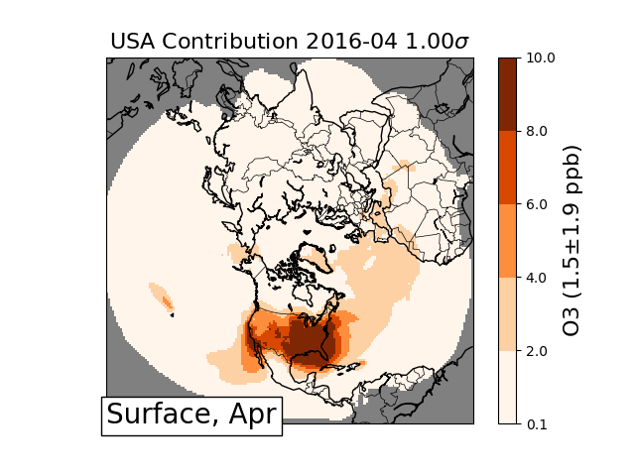
Ozone source contributions in April at the Surface
“The only reliable quantitative ozone measurements from the late 19th century were made at Montsouris near Paris where ozone averaged 11 ± 2 ppbv from 1876 to 1910.” ... “While these measurements indicate that late 19th century ozone in western Europe was much lower than today, there is no way to know if these values were representative of other surface locations in the NH.” - Cooper et al., 2014. doi: 10.12952/journal.elementa.000029

Slide 12
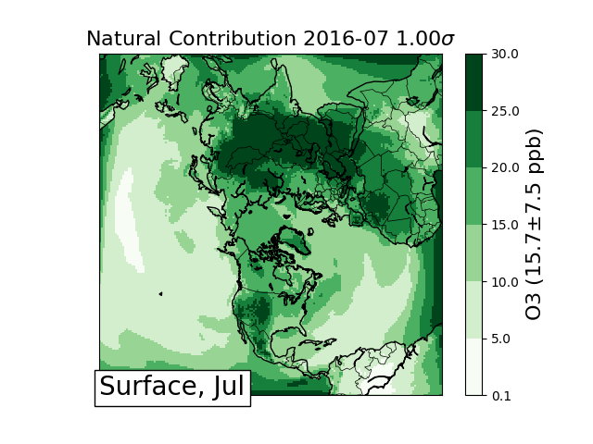
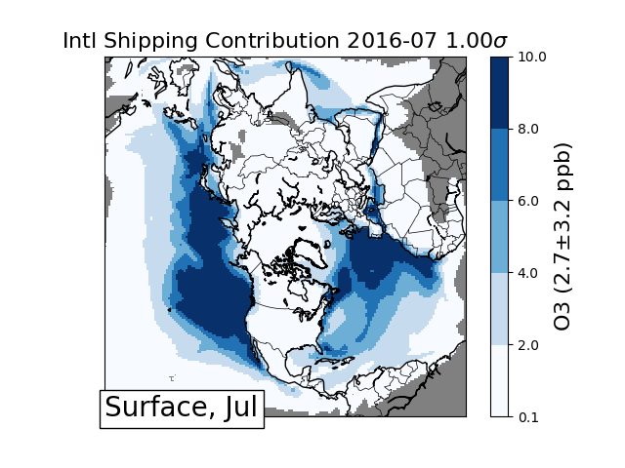
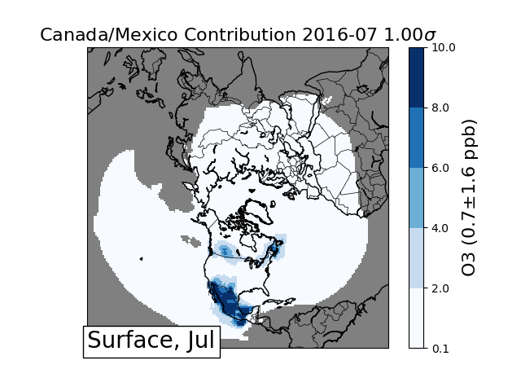
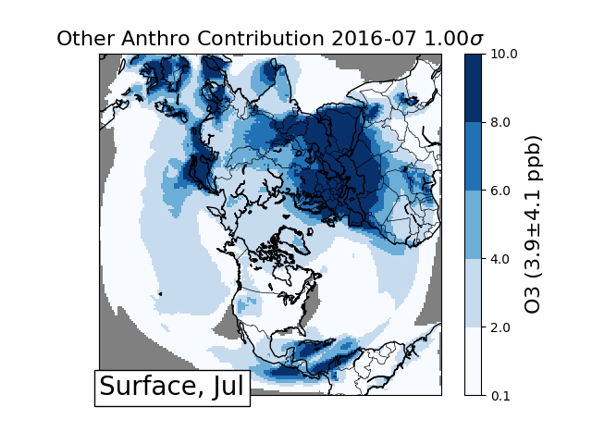
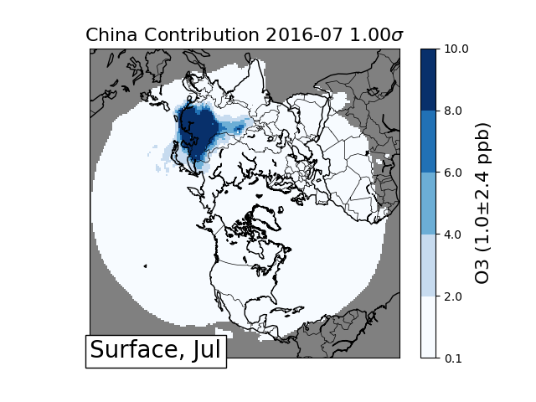
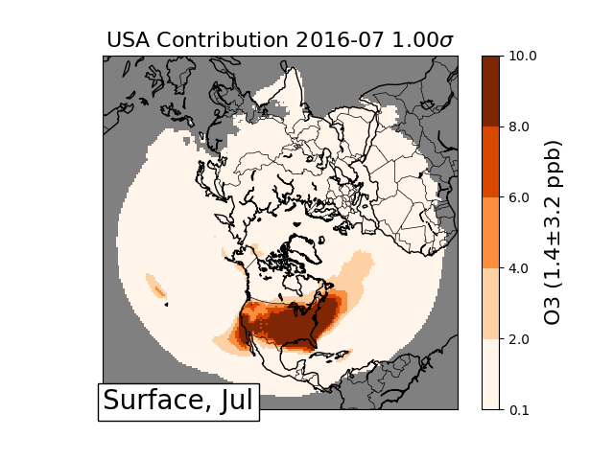
Ozone source contributions in July at the Surface

Slide 13
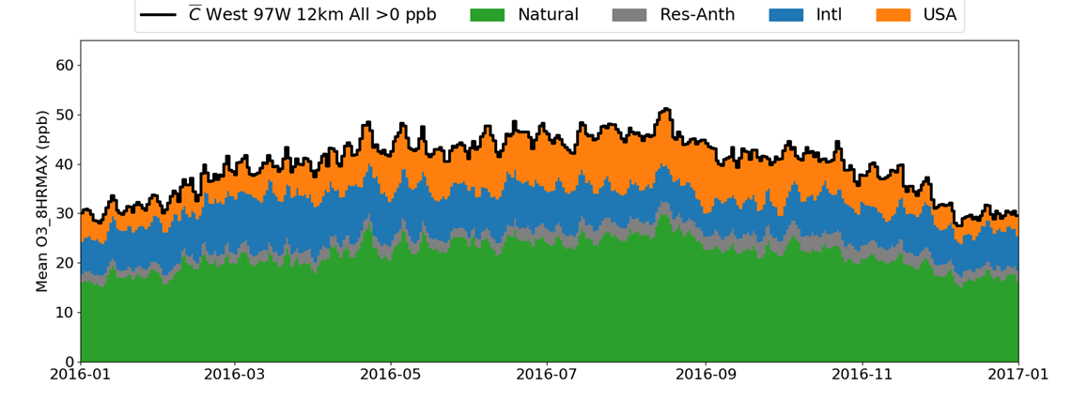
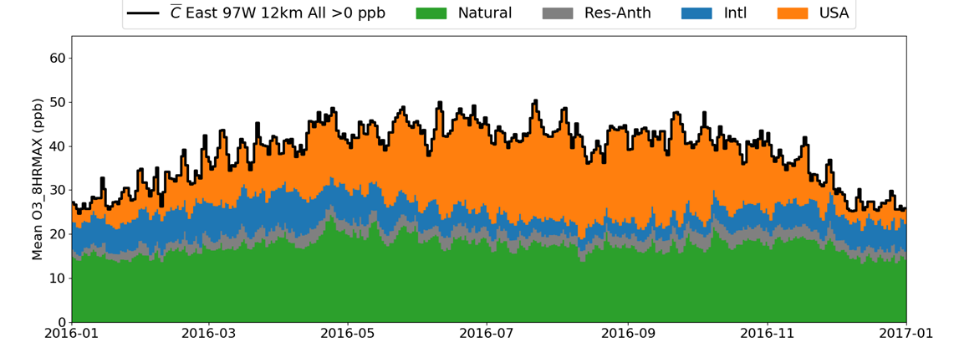
Difference between West and East Surface (12km)
West Contributions
West gets more natural to the surface; think stratosphere.
East Contributions

Slide 14
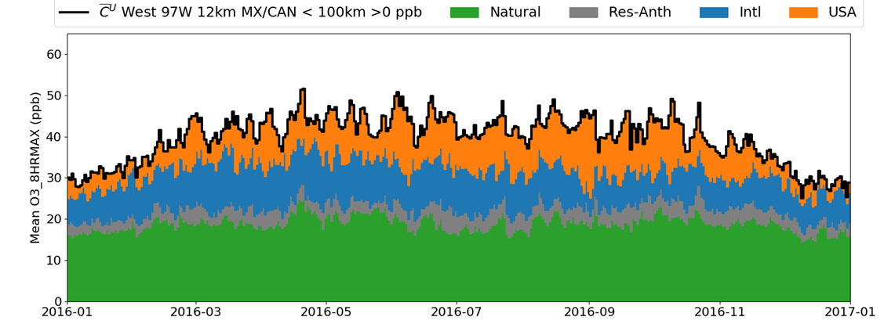
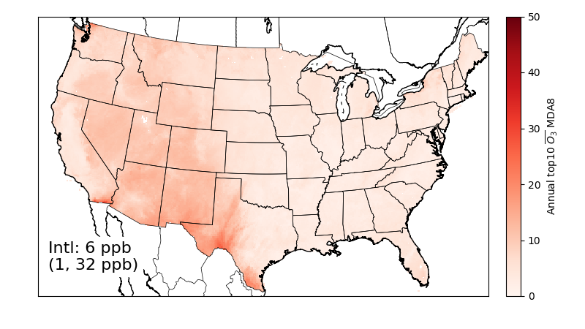
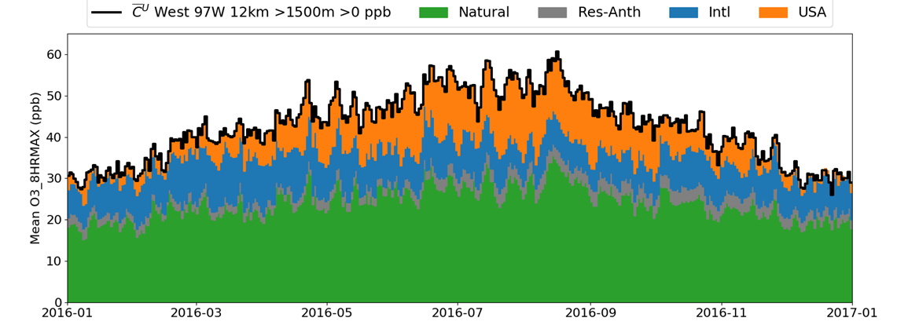
Differences within the West at the Surface (12km)
Near Border has consistent international
High Elevation more Natural

Slide 15
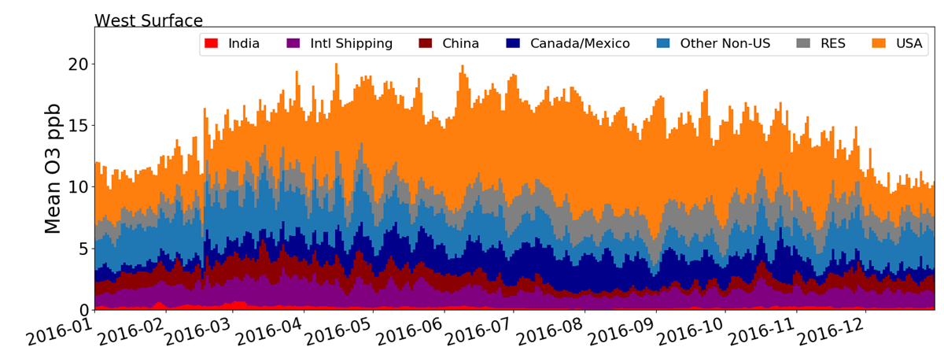
Difference between West and East Surface (108km)
West: Canada increases as long-range decrease
Other countries 2-5 ppb on average
East: International decreases in summer
India/China pop-weighted impact higher, but consistent with West, Horowitz, Fiore doi:10.5194/acp-9-6095-2009, see supplement Tables S1
Notes:
Consistent with https://www.atmos-chem-phys.net/9/6095/2009/acp-9-6095-2009.pdf, see supplement JJA Tables S1 dO3_receptor/dNOx_source; receptor = NA ~ US
pncload -f ioapi agg/monthly/HEMIS/US/all/all/monthly_HEMIS_US_all_all_pop_ind_zo.nc emis/inputs/2016fe_cb6r3_ae6nvpoa_16j_HEMIS_annual.ncf emis/inputs/2016fe_zind_cb6r3_ae6nvpoa_16j_HEMIS_annual.ncf
O3_0[6:9].mean() / ((NOX_1[:].sum() - NOX_2[:].sum()) * 0.907 / 1e6 * 14 / 46)
India = 0.017 compare to -0.01
China = 0.045 compare to 0.02
China is ~2x more influential per TgN

Slide 16
Summary
Zero-out simulations provide estimates of contributions
Global Natural, International Anthropogenic, Domestic Anthropogenic
India, China, International Shipping, more to come
Generally consistent with the literature
HTAP Phase I and Phase II; Jaffe et al. (2018)
USB is higher in the West than in the East, USB can be a significant contributor on high ozone days.
Long-range transport contributes more in the spring than summer
Canada and Mexico operate as short-range transport to most of the West
Largest West/East difference at the surface was natural
International Contribution on top 10 days at the surface
Summer most places: 1-15 ppb
Near-border: up to 30 ppb (no bias correction)
Eastern US decreases from all sources in summer
Western US increases from Canada/Mexico

Slide 17
APPENDIX

Slide 18
Coupled at multiple scales
v5.2.1 (IPV, dust, halogens)
8 month spinup period
Polar stereographic (~1x1 deg)
44 Layers up to 50mb
Weather Research and Forecasting
Hemispheric 108km, 44 layers – today
North America 36km, 35 layers
United States+ 12km , 35 layers
China
Africa
USA
SA

Slide 19
Natural Emissions
Anthropogenic Emissions
Biogenics (plants and soils):
Global: Model of Emissions of Gases and Aerosols from Nature (MEGAN) v2.1
North America: Biogenic Emission Inventory System (BEIS)
Wild and Prescribed Fires:
Global: FINN v1.5
North America: 2016 platform (α)
Lightning: GEIA climatological
averages by latitude & season
Inline Dust: Inline CMAQ algorithm
Sea Salt: similar in-line schemes
Global
EDGAR-HTAP base year 2010
Interpolated to 2014 by CEDS sector/country scalars
Includes shipping and aircraft
North America : 2016fe Platform
Asia (non-China): MIXv1
China: Tsinghua University (THU)
More in Vukovich et al. CMAS 2018

Slide 20
Satellites and Sondes Evaluation avail elsewhere
SAO Formaldehyde
(González Abad et al., 2015)
NASA Nitrogen Dioxide (Krotkov et al., 2017, Lamsal OMNO2D_HR)
SAO Ozone Profiles (Huang et al., 2017))
Henderson CMAS 2018
Notes:
Henderson CMAS 2018

