Slide 1
Recent Improvements to FireWork: Environment and Climate Change Canada’s Operational Air Quality Forecast System with Near-real-time Wildfire Emissions
Environment and Climate Change Canada:
Jack Chen, Radenko Pavlovic, Mike Moran, Hugo Landry, Rodrigo Munoz-Alpizar, Sétigui Keita
Natural Resources Canada - Canadian Forest Service:
Kerry Anderson⁺, Peter Englefield, Daniel Thompson
⁺retired
Presented by
Mike Moran
24 October 2018
2018 CMAS Conference, 22-24 Oct. 2018, Chapel Hill, North Carolina

Slide 2
Outline
Overview of FireWork wildfire smoke forecast system
Description of new FireWork-CFFEPS system
Operational performance evaluation for 2017 and 2018 wildfire seasons
Summary
Next steps

Slide 3
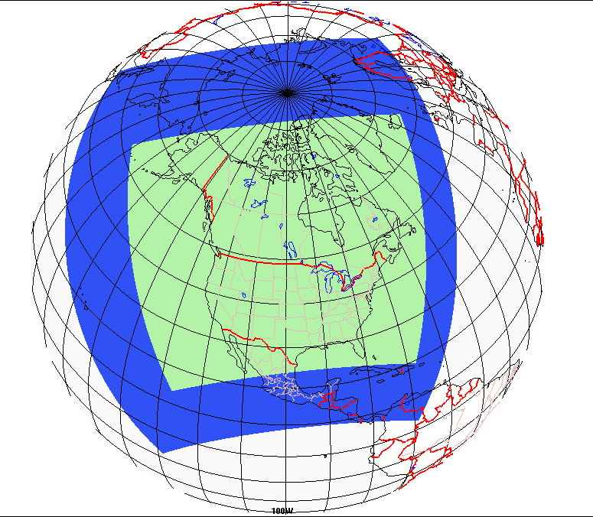
ECCC Operational AQ Forecast Systems
The GEM-MACH in-line chemical transport model is the core of both of ECCC's regional AQF systems (RAQDPS and FireWork).
Some essential characteristics:
  limited-area (LAM) configuration
  meteorology provided by the GEM NWP model (initial and boundary conditions)
  10-km horizontal grid spacing, 80 vertical levels, lid at 0.1 hPa
  one-way coupling (meteorology affects chemistry)
  2-bin sectional representation of PM size distribution (i.e., 0-2.5 μm and 2.5-10 μm) with 8 chemical PM components
  full process representation of oxidant and aerosol chemistry:
    gas-, aqueous-, & heterogeneous chemistry mechanisms
    aerosol dynamics
    dry and wet deposition (including in- and below-cloud scavenging)
  48-hour runs launched twice daily (00, 12 UTC)
GEM-MACH Grid
GEM-LAM10 Grid
EMISSION Inventories | In operations until Sept. 2018 | In operations since Sept. 2018
Canada | 2010 | 2013
U.S.A. | 2011 | 2017*
Mexico | 1999 | 2008
* Projected from 2011

Slide 4
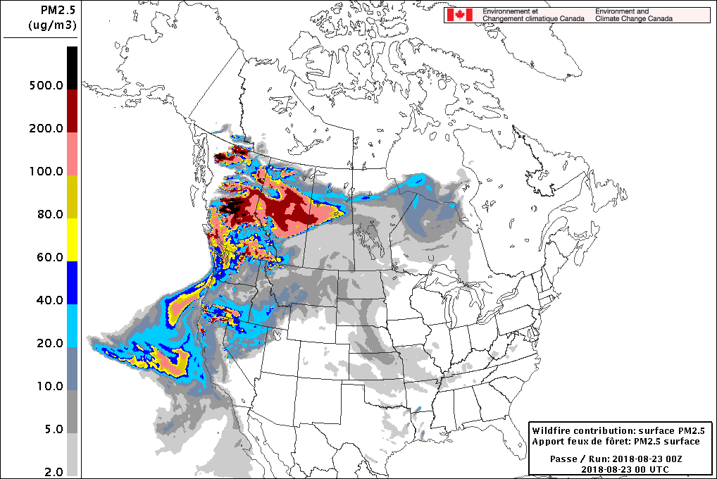
Operational FireWork System
Official operational system since April 2016 - https://weather.gc.ca/firework
System runs twice daily (00/12 UTC) during Canadian fire season from April to October
Near-real-time fire data from Canadian Wildland Fire Information System (CWFIS)
Hourly fire emissions (PM, VOC, NOx, NH₃, CO, SO₂) are input by FireWork, a clone of the ECCC Regional Air Quality Deterministic Prediction System (RAQDPS)
Differences in PM forecasts with / without fire emissions (i.e., FireWork – RAQDPS) represent PM contributions from fire sources (fire-PM_{2.5})
FireWork products
  PM_{2.5}/PM₁₀ maps and animations from fire sources
  AQHI based on FireWork forecasts
  Accumulated PM_{2.5} impacts over 24h
  Total column PM_{2.5} / PM₁₀
  Other specialized products upon request
  (e.g., special fire activity near urban areas)
  http://collaboration.cmc.ec.gc.ca/cmc/air/firework
Hourly surface fire-PM_{2.5} concentrations for 23 Aug. 2018
Notes:
Example PM2.5 animation, zoomed into BC for 2018-Aug-23 when fire activity was very high in BC. Copied from: http://collaboration.cmc.ec.gc.ca/cmc/air/firework/

Slide 5
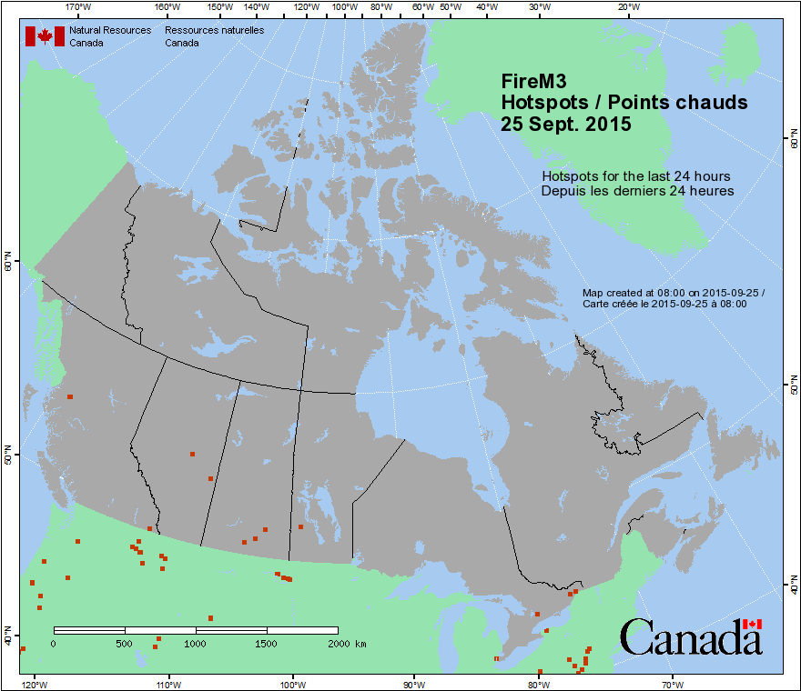


Operational FireWork Dataflow
Canadian Wildland Fire Information System
CWFIS
Hotspot lat. / lon.
Fuel type
Fuel consumption
AVHRR / MODIS / VIIRS
obs. and forecast meteorology
valid at local noon
  SMOKE Processor
  Uses one diurnal profile to convert emissions into hourly values
  Converts VOC, NOx, PM into model species
  Merges emissions with other major anthropogenic point sources
FEPS (BlueSky)
Total Daily Emissions per hotspot for
PM, VOCs, NOx, SO₂, CO and NH₃
AQ model (GEM-MACH)
Notes:
CWFIS gets ignition/burning information from satellite retrievals – NOAA/NASA/USDA-Remote Sensing Applications Center
Advanced Very High Resolution Radiometer (AVHRR) imagery of NOAA
Moderate Resolution Imaging Spectroradiometer (MODIS) imagery of NASA and Remote Sensing Applications Center (RSAC) of US Forest Service
Visible Infrared Imaging Radiometer Suite (VIIRS) imagery of NASA, University of Maryland and RSAC

Slide 6

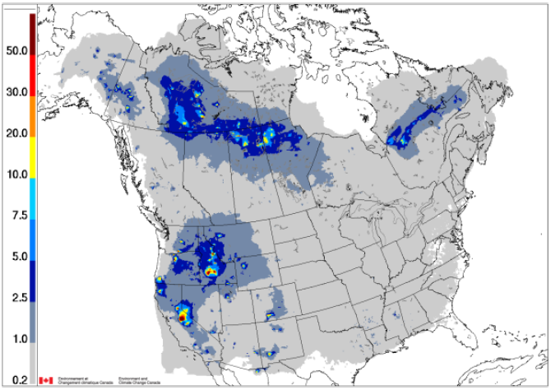
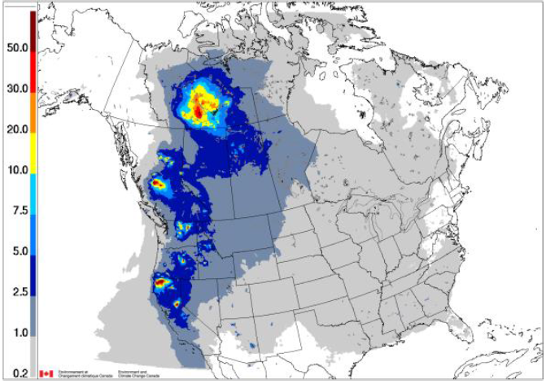
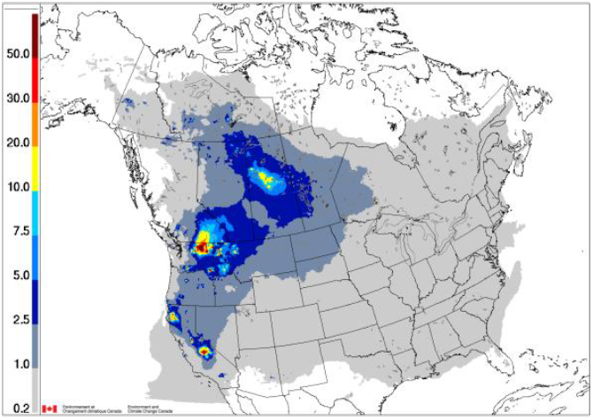
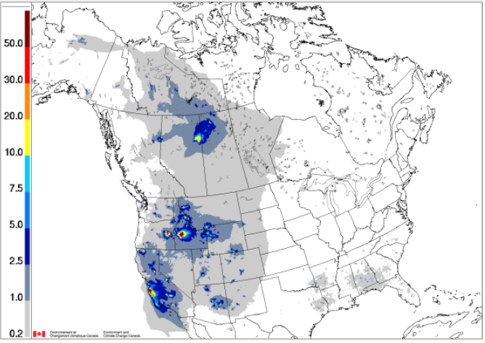
Mean 2013-16 Seasonal Fire-PM_{2.5} Surface Concentration Fields from FireWork
µg m⁻³
2013
2014
2015
2016
(from Munoz-Alpizar et al., 2017, Atmosphere, 8, 179, 24 pp., https://doi.org/10.3390/atmos8090179)

Slide 7
Current Limitations / Weaknesses
Limited interaction between meteorology ↔ fire fuel consumption
  Fixed fire size per hotspot (38.5 hectares/350 m burn radius)
Coarse temporal resolution – daily vs. hourly
  fixed diurnal emissions profile by local time
  same emissions assumed for 2nd forecast day (f24-f48)
Default approach to model plume injection height (Briggs scheme with fixed ‘stack’ height and temperature)
Limited to emission factors used by FEPS
Fixed VOC and PM chemical speciation profiles

Slide 8
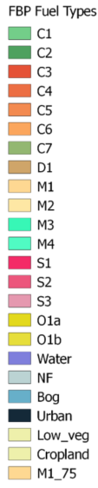
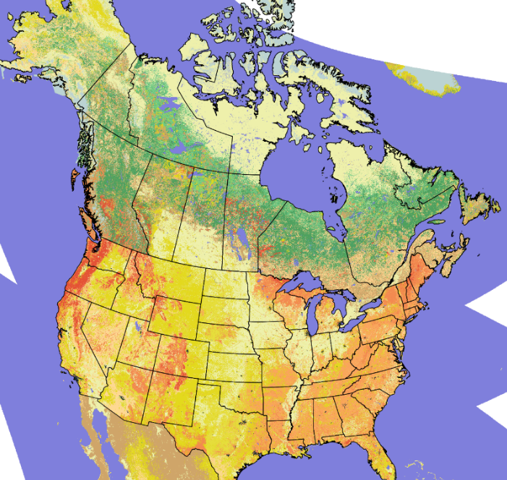
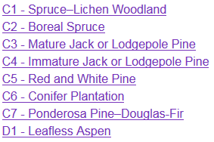
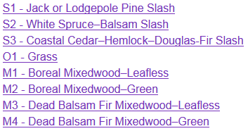
Canadian Forest Fire Emissions Prediction System (CFFEPS)
Developed jointly with Canadian Forest Service of Natural Resources Canada
Fuel consumption and rate of spread are adjusted using forecast meteorology
Three emission types: flaming / smoldering / residual
Updated emission factors by fire type for PM, NO, NMHC, NH₃, CO, CO₂, and CH₄ (Urbanski 2014) – extensible to fuel type dependence
Different chemical speciation profiles for flaming and smoldering emissions
More consistent fuel map across U.S. and Canada
Plume injection height based on fire energy thermodynamics
Notes:
Injection height considers energy released to the atmosphere by the fire and the ambient (environmental) lapse rate. Fraction of energy that goes to the plume is mixed through air column above the fire, the plume will rise until thermal equilibrium with the environment. The plume is being raised by dry adiabatic lapse rate.
interpret the US 13 Anderson Fire Behavior Fuel Model land cover maps to CFFDRS fuel types

Slide 9
FireWork-CFFEPS System
FireWork-OPS System
AVHRR / MODIS / VIIRS
Canadian Wildland Fire Information System
CWFIS
Hotspot lat. / lon.
Fuel type
Fuel consumption
obs. and forecast meteorology
valid at local noon
GEM hourly forecast meteorology
  SMOKE Processor
  Uses one diurnal profile to convert emissions into hourly values
  Converts VOC, NOx, PM into model species
  Merges emissions with other major anthropogenic point sources
FEPS (BlueSky)
Total Daily Emissions per hotspot for
PMs, VOCs, NOx, SO₂, CO and NH₃
Post Processing
Fire-specific point source with plume injection heights
chemical speciation (smoldering vs. flaming)
unit / format conversions, QA / summary
CFFEPS
Hourly Emissions,
Hourly plume-rise parameters, fire energy etc.
AQ model (GEM-MACH)
AQ model (GEM-MACH)

Slide 10
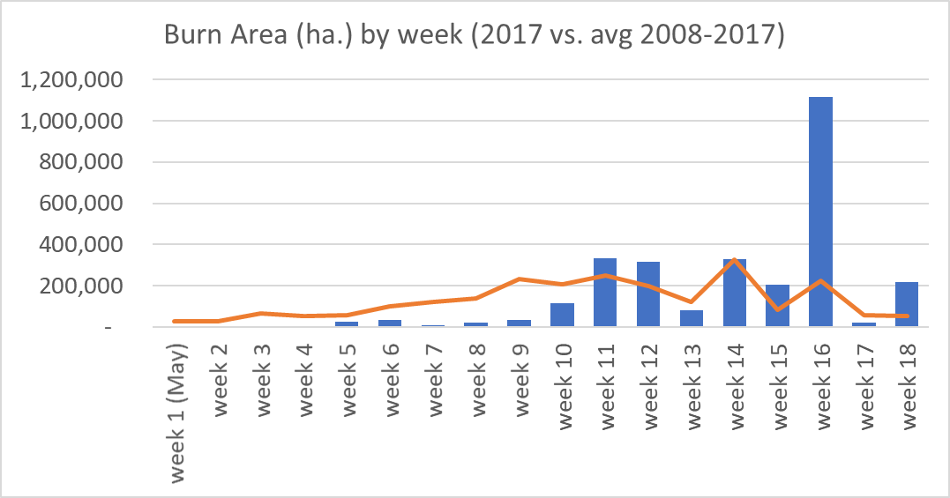
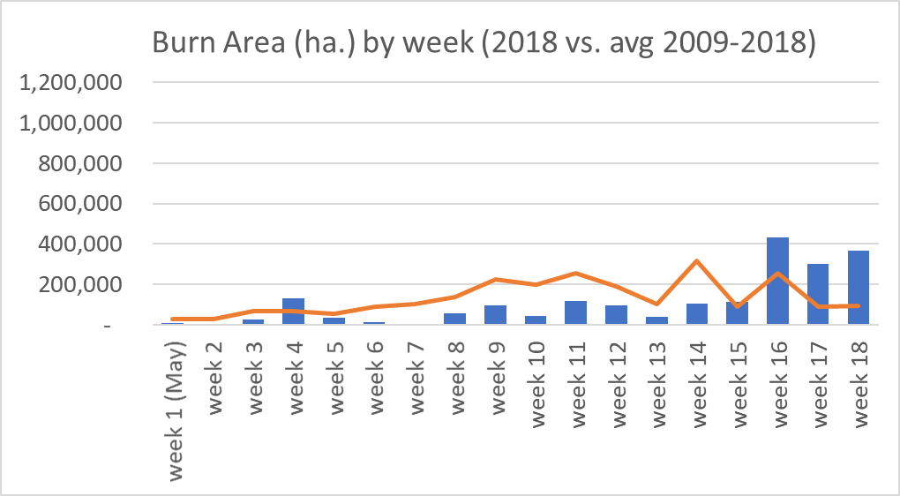
FireWork-CFFEPS Evaluation Periods (1)
FireWork-CFFEPS run in forecast mode for
  2017 July-Sept. and 2018 June-Aug.
Both years started slow but turned out to be two of the worst fire seasons in western Canada and U.S.
British Columbia: >1.2 million hectares burned in both 2017 and 2018 (provincial records since 1950)
Burn Area, All Canada
Data source: http://www.ciffc.ca/

Slide 11
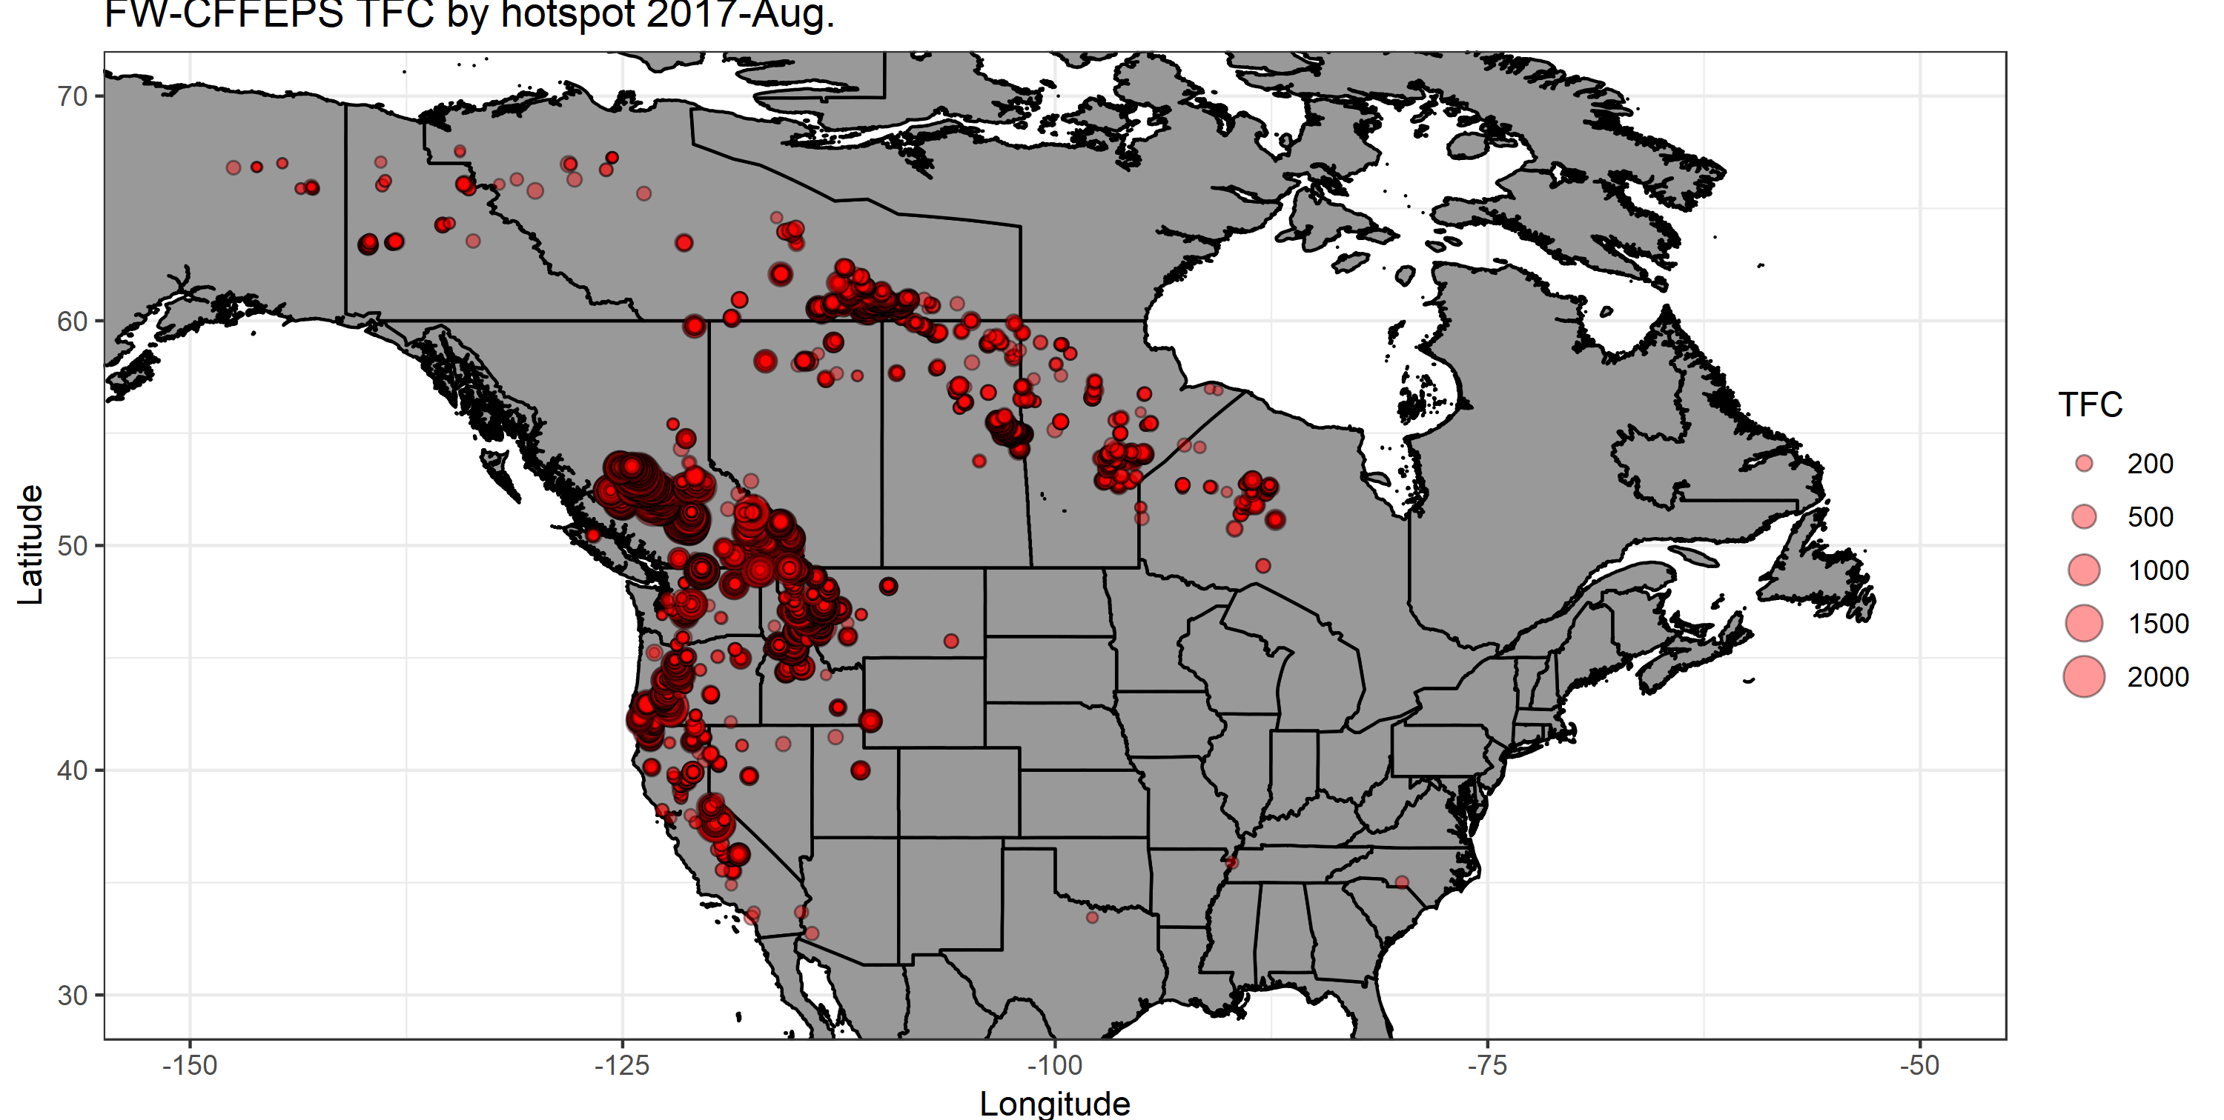
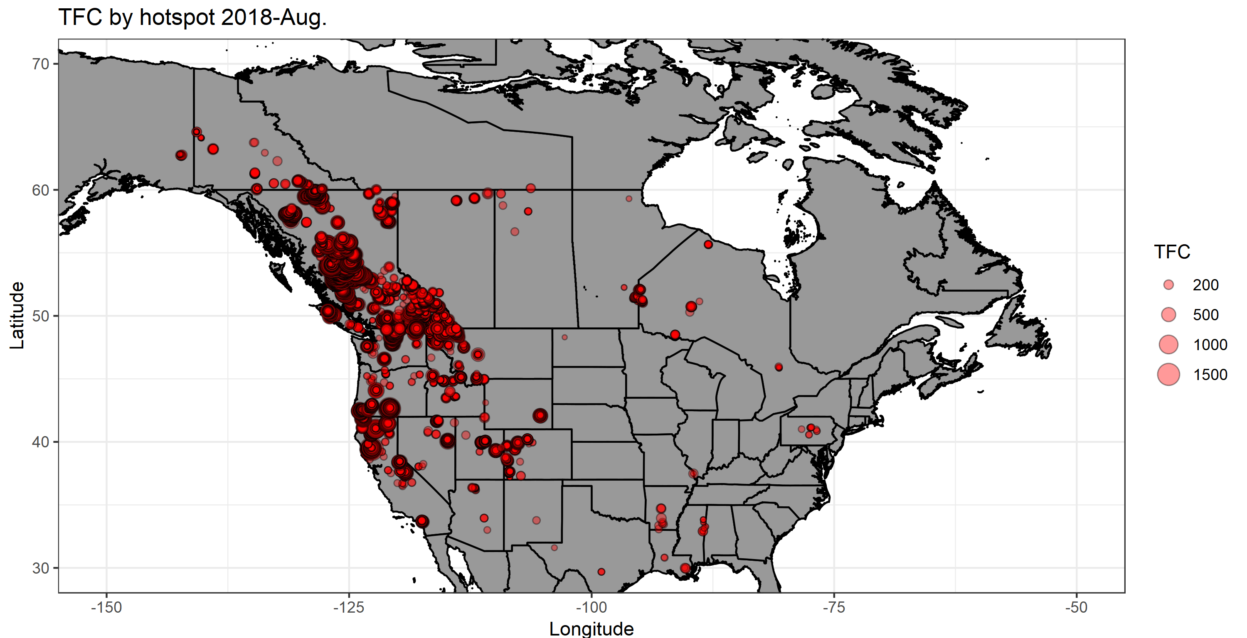
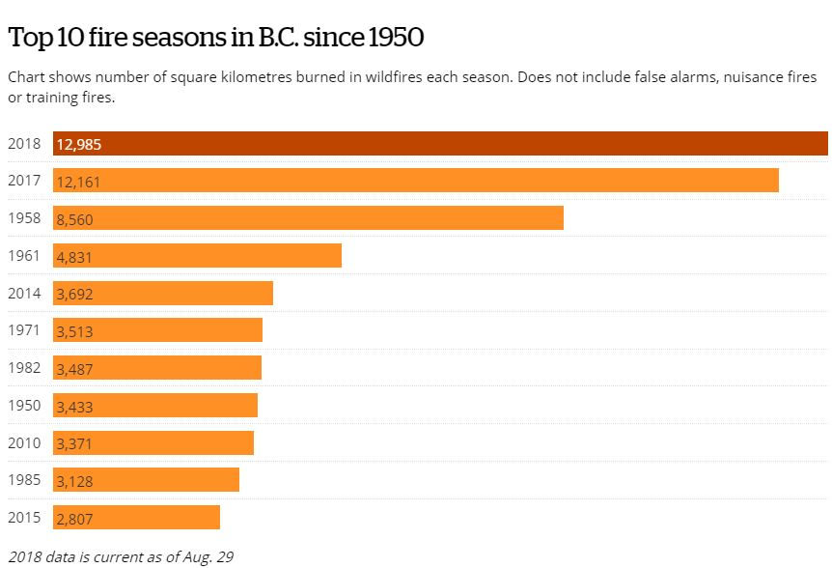
FireWork-CFFEPS Evaluation Periods (2)
Kamloops, B.C.
Data source: http://www.ciffc.ca/

Slide 12
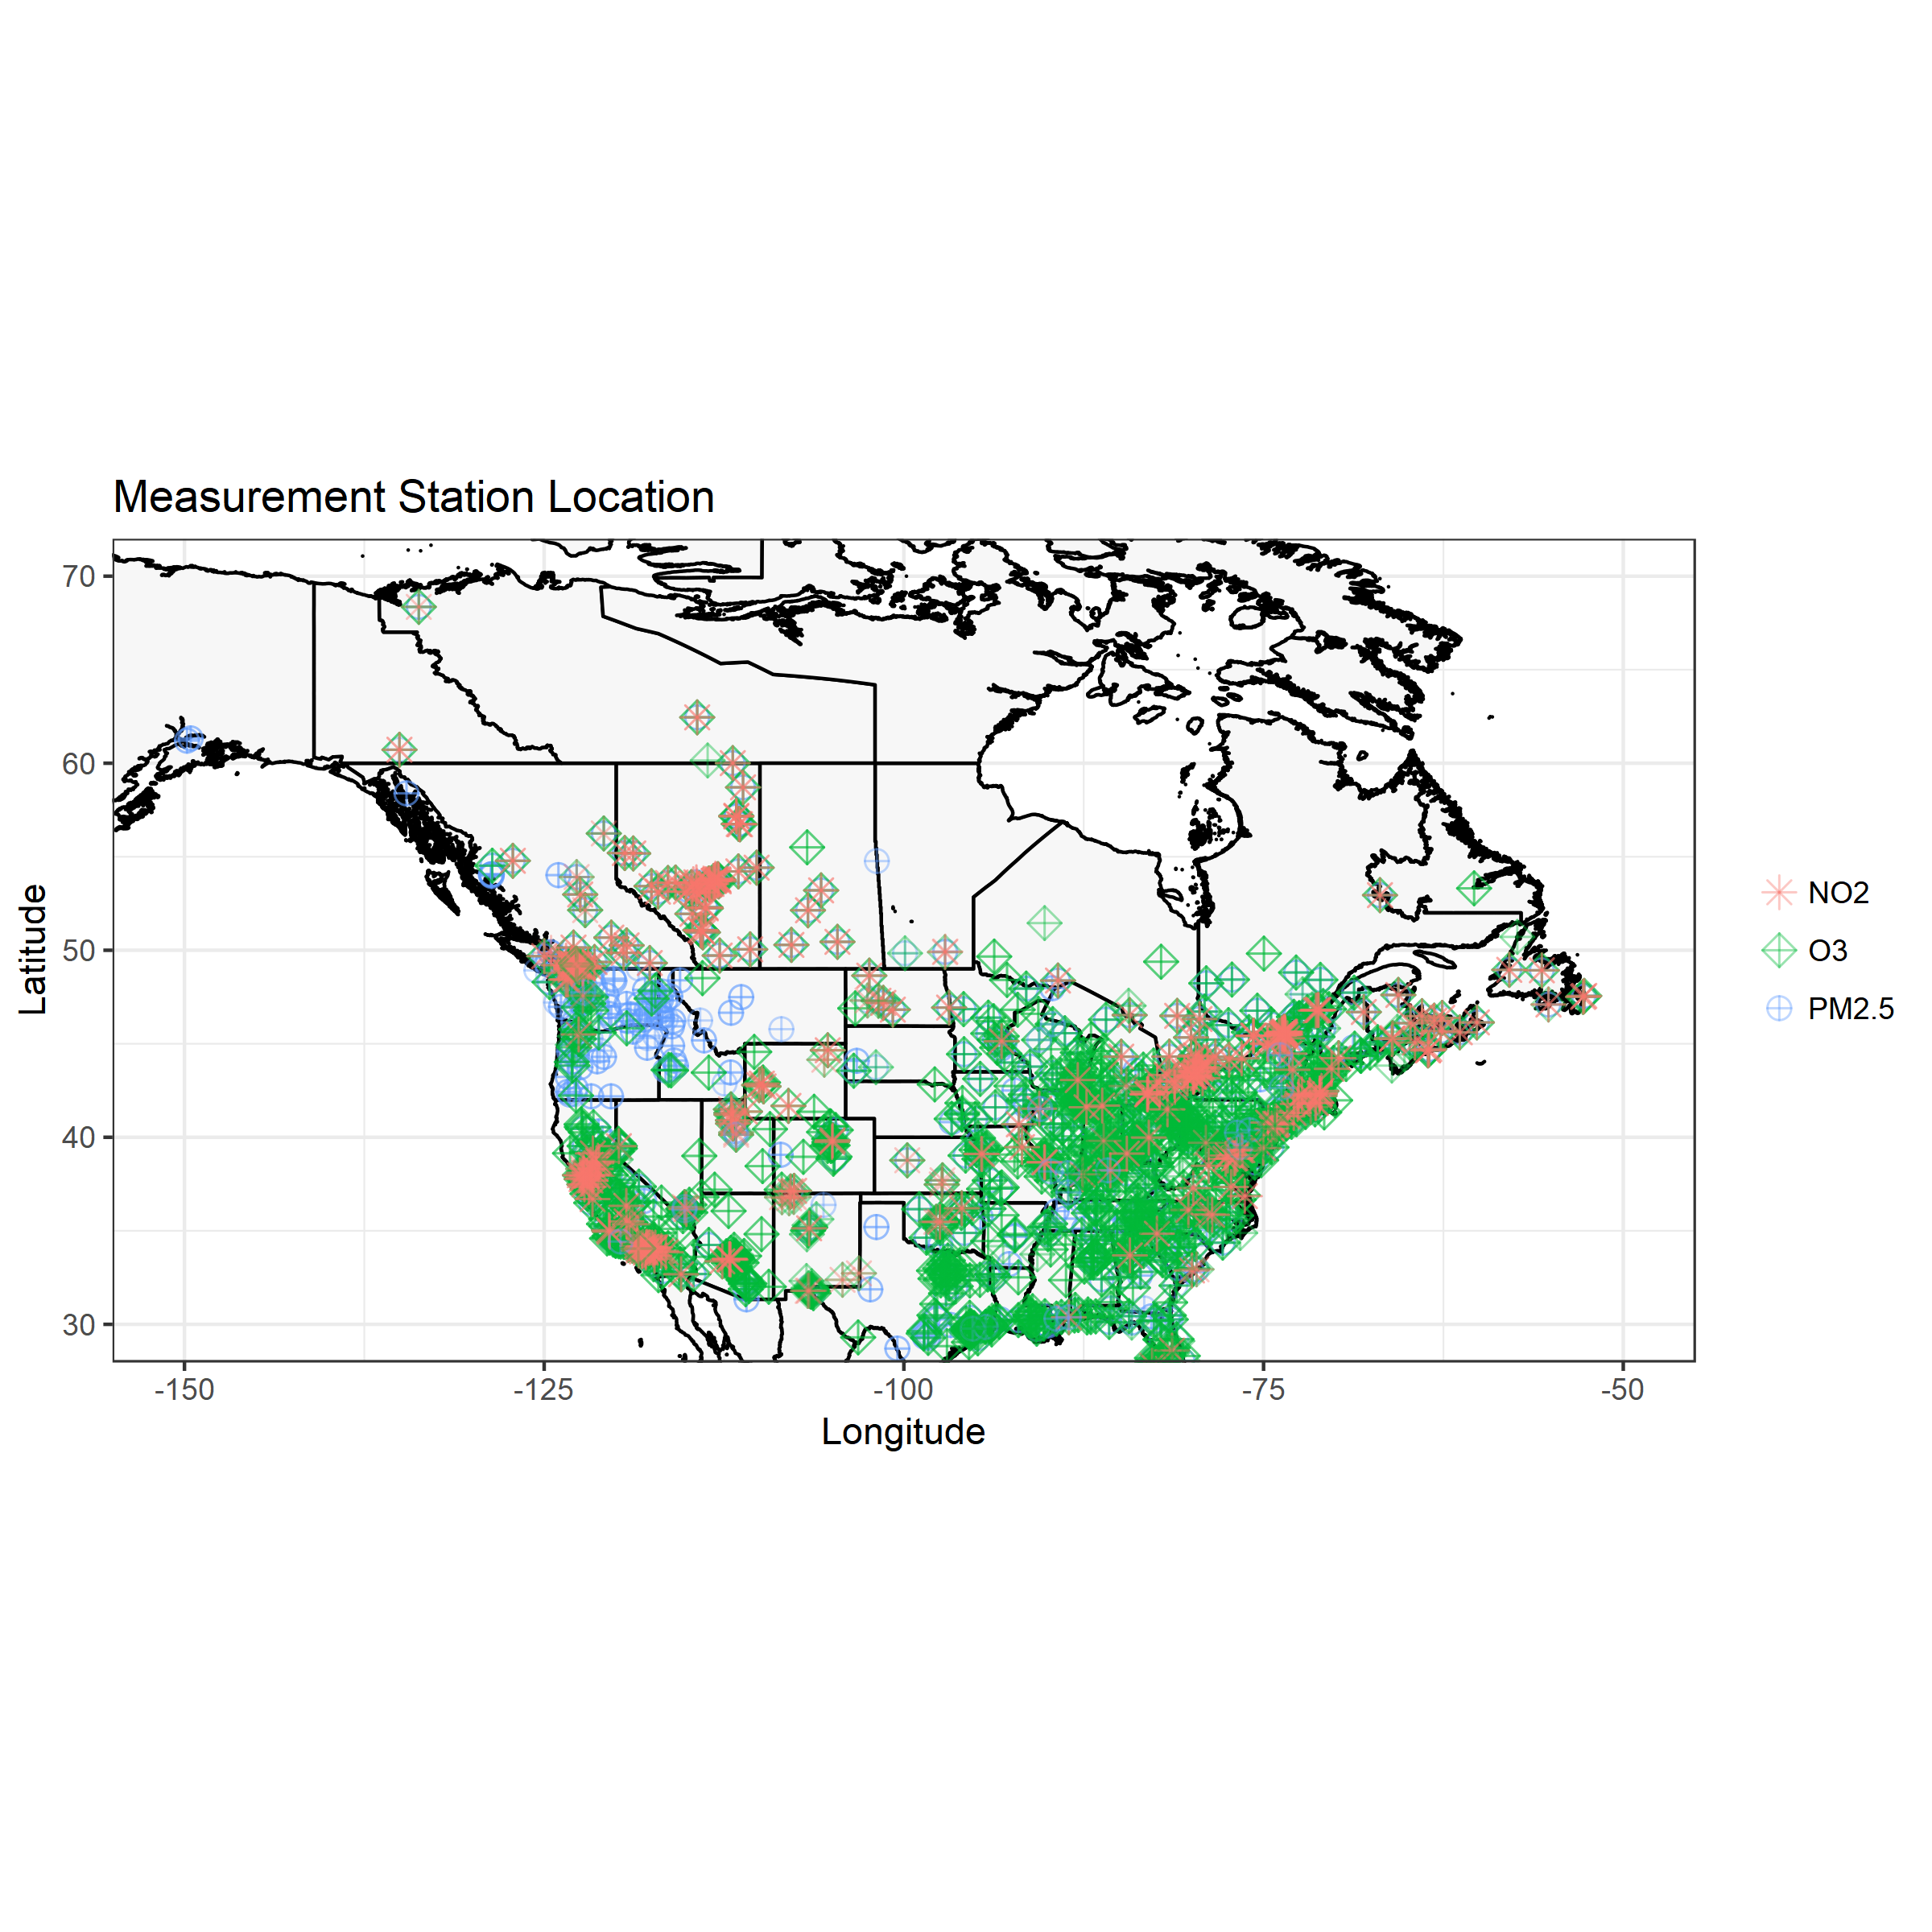
FireWork-OPS vs. FireWork-CFFEPS
Operational forecast evaluation with hourly NAPS (Canada) and AQS (U.S.) measurements (75% measurement completeness criterion applied)
FireWork-CFFEPS forecast benchmarked with FireWork-OPS for western Canada and U.S. Pacific Northwest
# of Stations (2017 / 2018) | PM_{2.5} | O₃ | NO₂
NAPS (AB+BC) | 79 / 74 | 64 / 66 | 71 / 69
AQS (WA+OR+ID+MT) | 89 / 77 | 25 / 25 | 1 / 2
Focus on AB,BC and WA,OR,ID,MT
Notes:
All stations (2017 / 2018)
PM2.5 | O3 | NO2
NAPS | 198 / 79 | 187 / 177 | 154 / 149
AQS | 591 / 522 | 982 / 962 | 148 / 149
There are ~130 NAPS, ~80 AQS co-locating stations that measured all 3 species

Slide 13
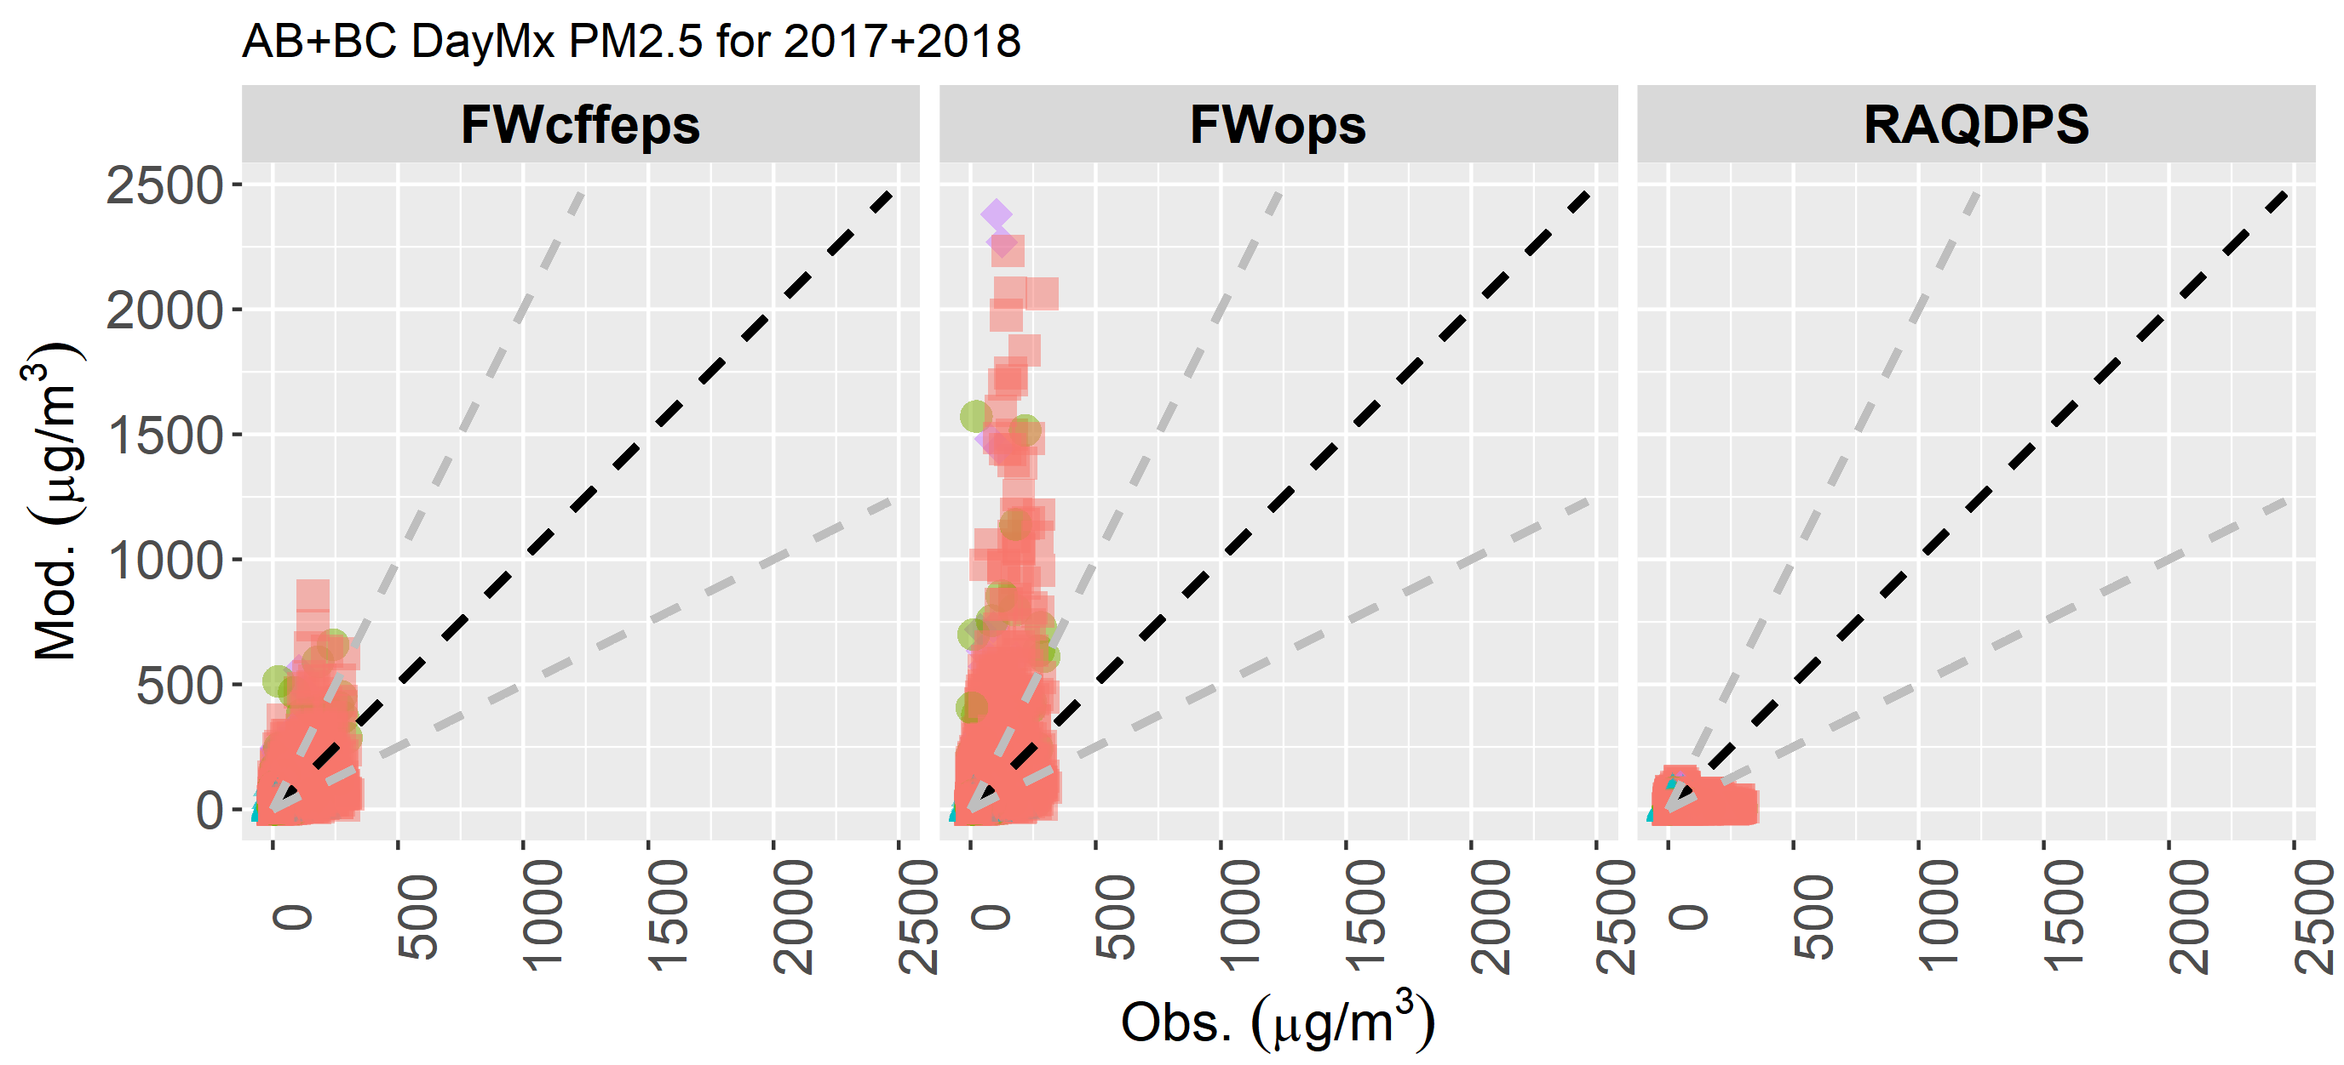
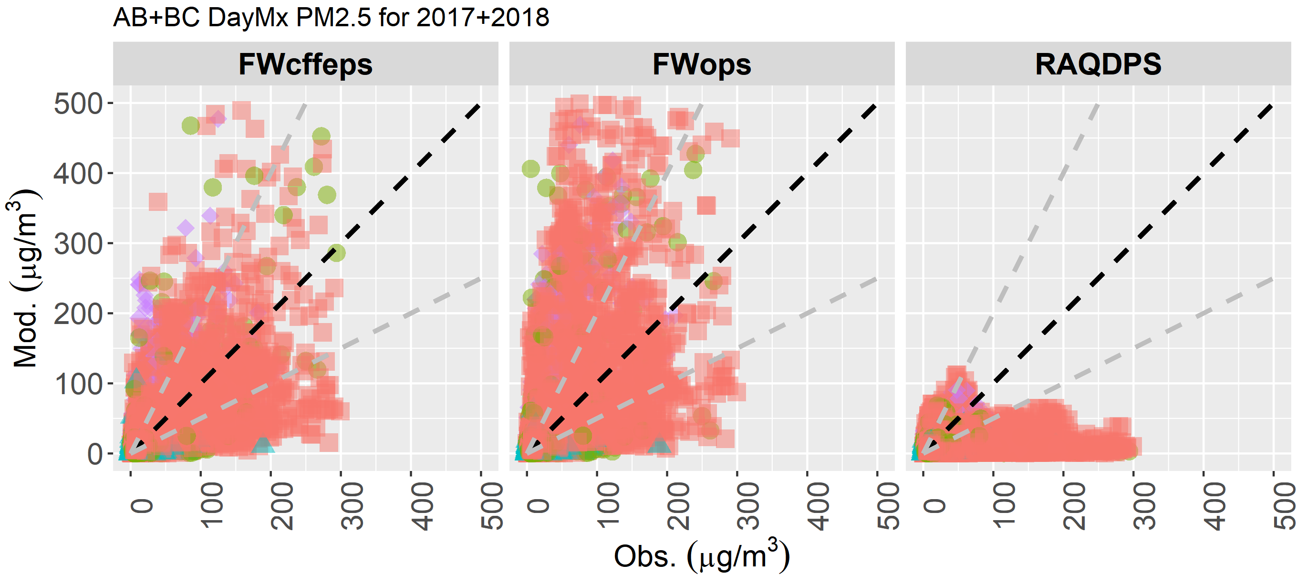
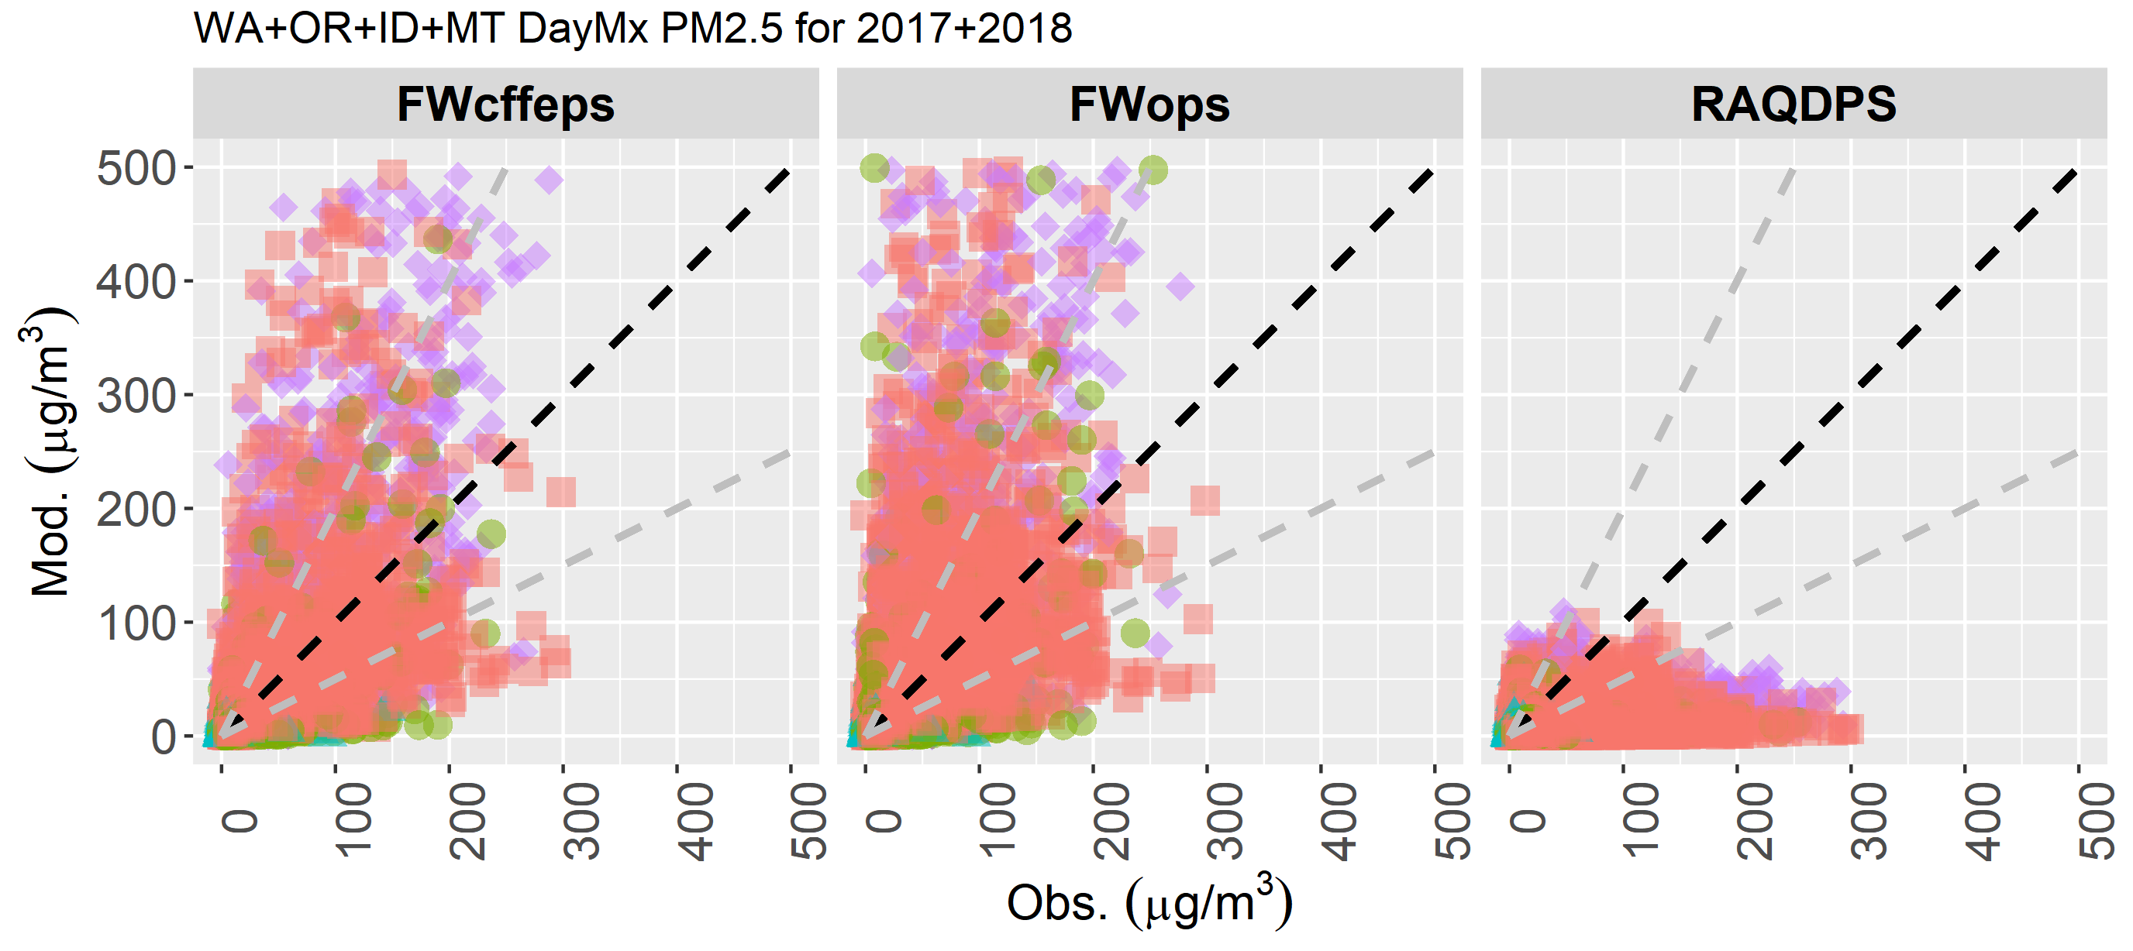
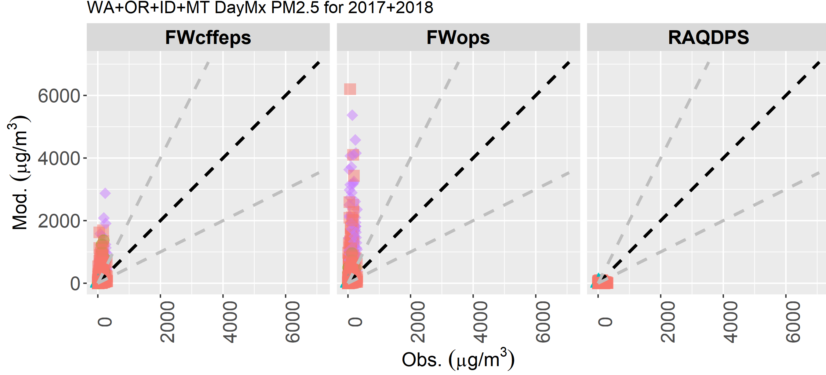
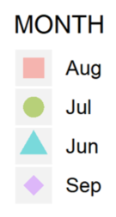
Evaluation Results – Daily Max. Surface PM_{2.5}
AB+BC | FWcffeps | FWops | RAQDPS
r | 0.63 | 0.53 | 0.14
FAC2 | 51% | 47% | 40%
MB | 0.8 | 14.3 | -13.4
NMB | 3% | 57% | -53%
RMSE | 35.6 | 93.7 | 39.2
OBS_Mean | 25.2
MOD_Mean | 26.0 | 39.5 | 11.8
OBS_P50 | 12.2
MOD_P50 | 12.1 | 12.6 | 7.9
OBS_P90 | 58.9
MOD_P90 | 60.1 | 90.3 | 27.1
WA+OR+ID+MT | FWcffeps | FWops | RAQDPS
r | 0.59 | 0.45 | 0.24
FAC2 | 60% | 57% | 41%
MB | 8.0 | 24.7 | -15.0
NMB | 31% | 96% | -58%
RMSE | 73.2 | 187.3 | 37.8
OBS_Mean | 25.6
MOD_Mean | 33.6 | 50.3 | 10.6
OBS_P50 | 11.5
MOD_P50 | 12.0 | 12.5 | 7.2
OBS_P90 | 63.4
MOD_P90 | 66.2 | 90.6 | 23.5
Notes:
Number of points used in AB+BC=13810 ; WA+OR+ID+MT=14779

Slide 14
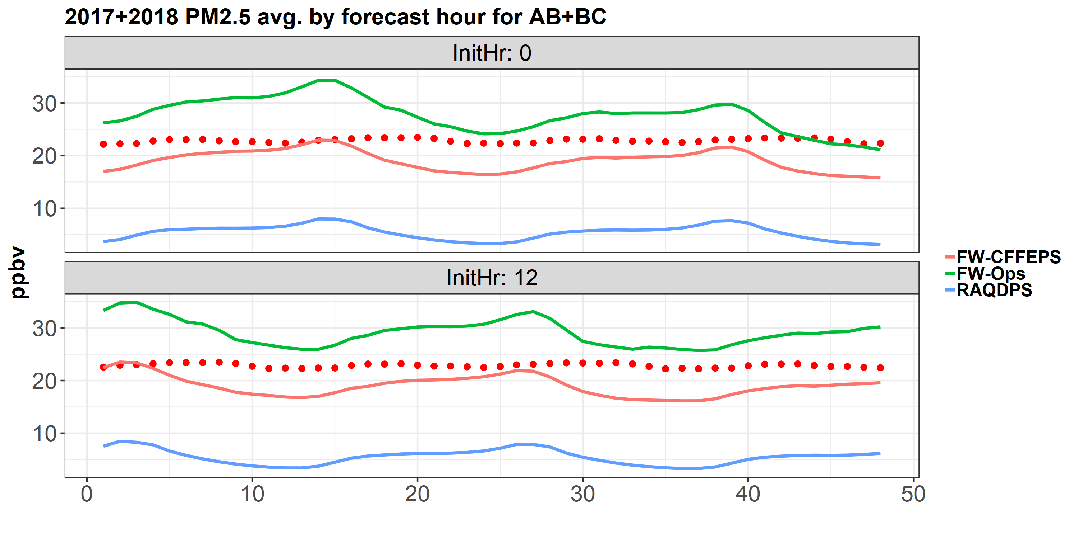
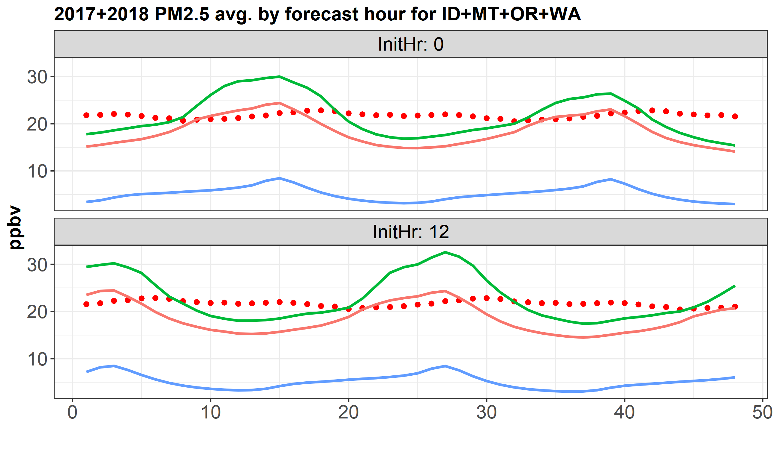
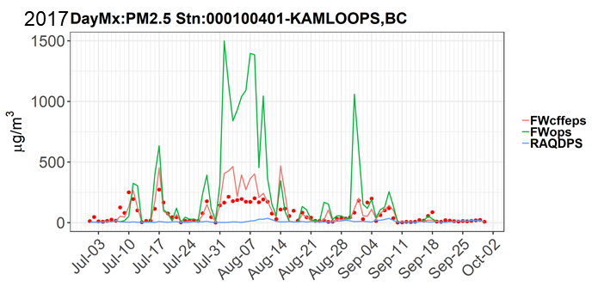
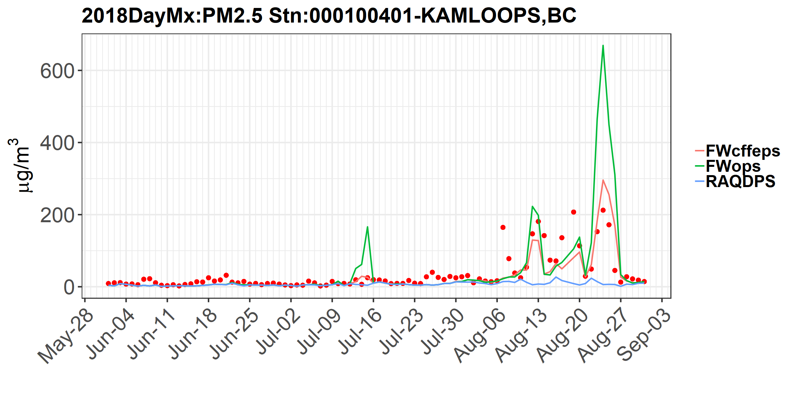
Evaluation Results – Surface PM_{2.5}
Observed values indicated by red dots
2017
2018

Slide 15
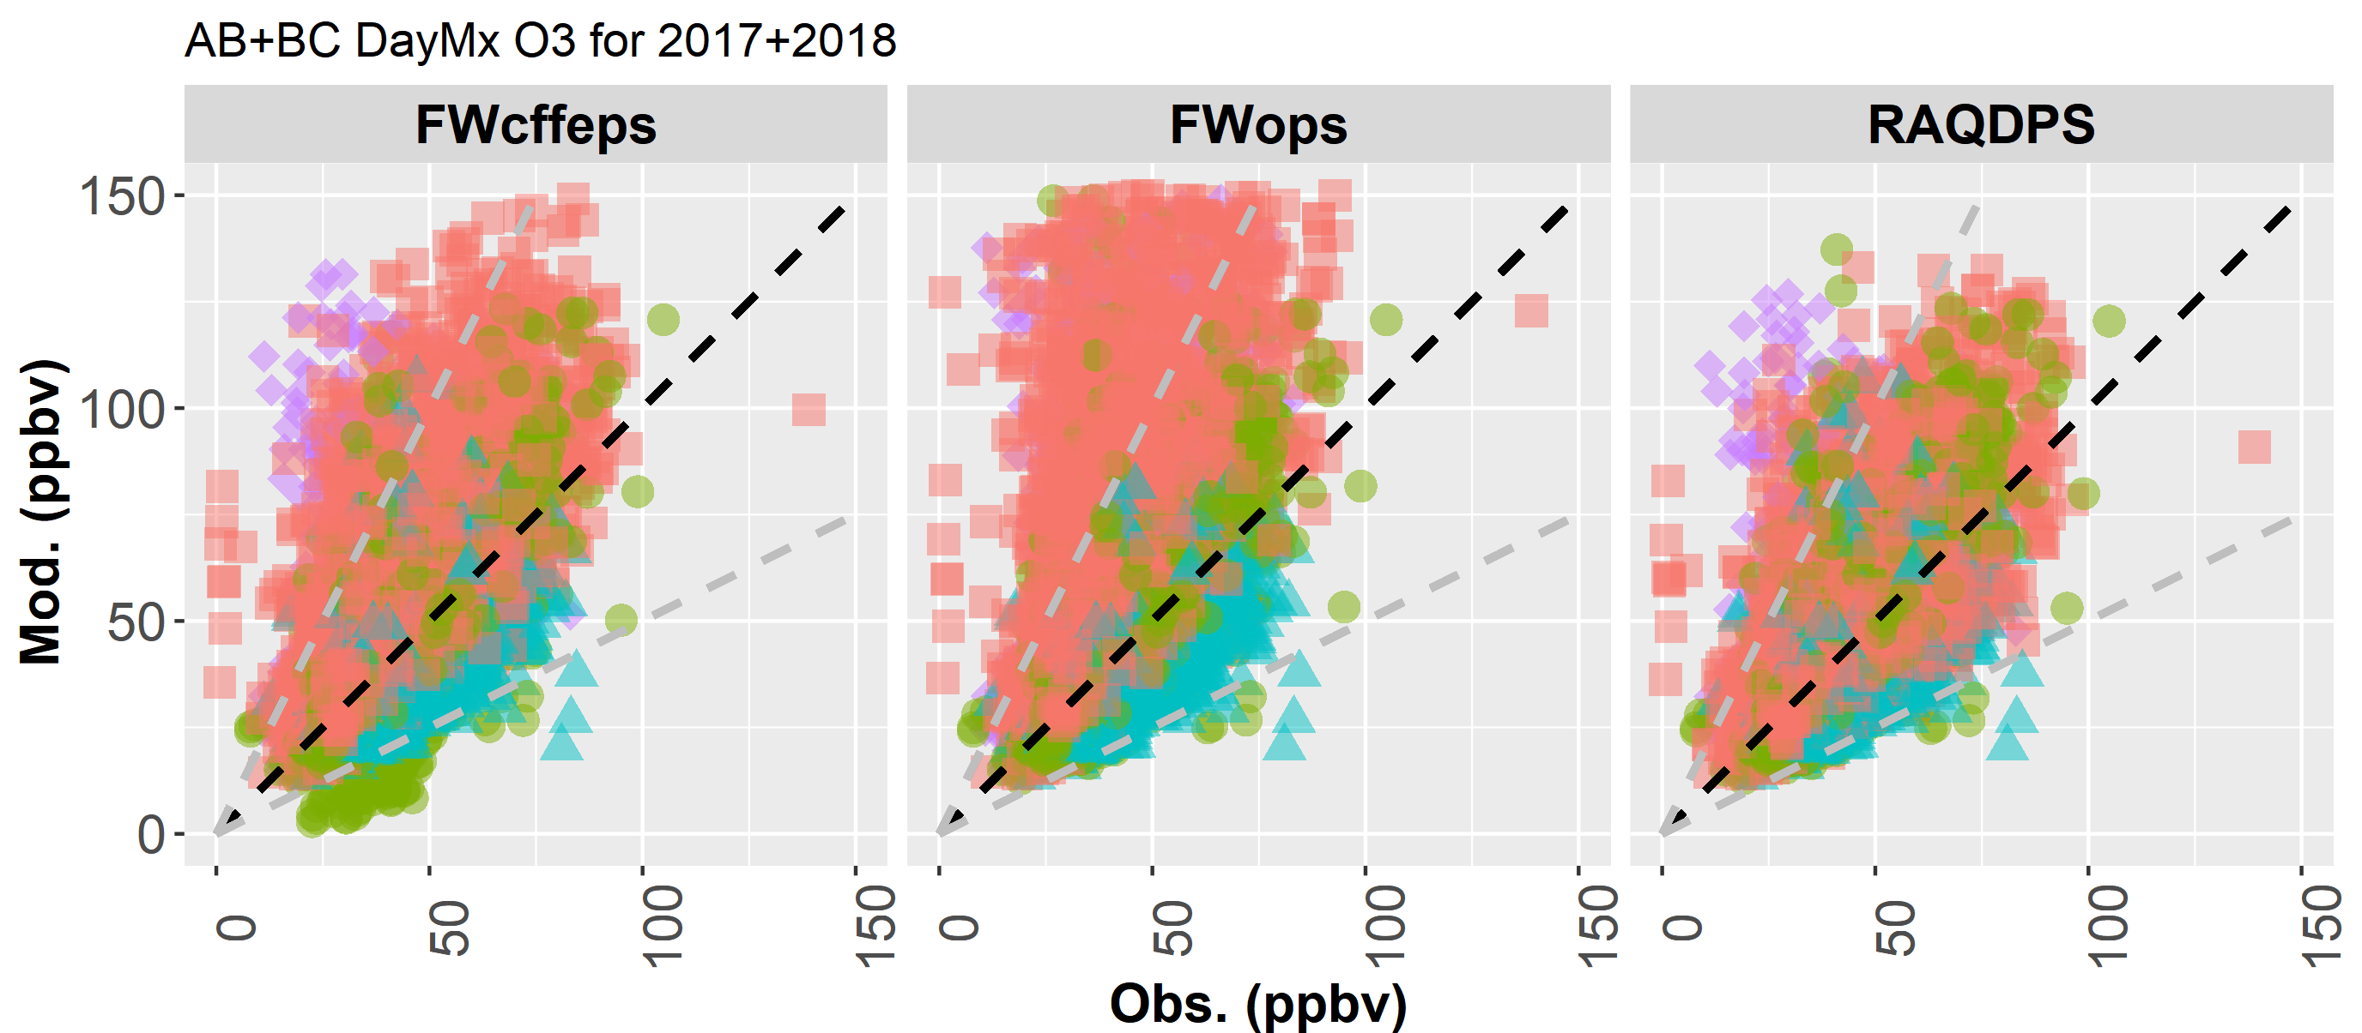
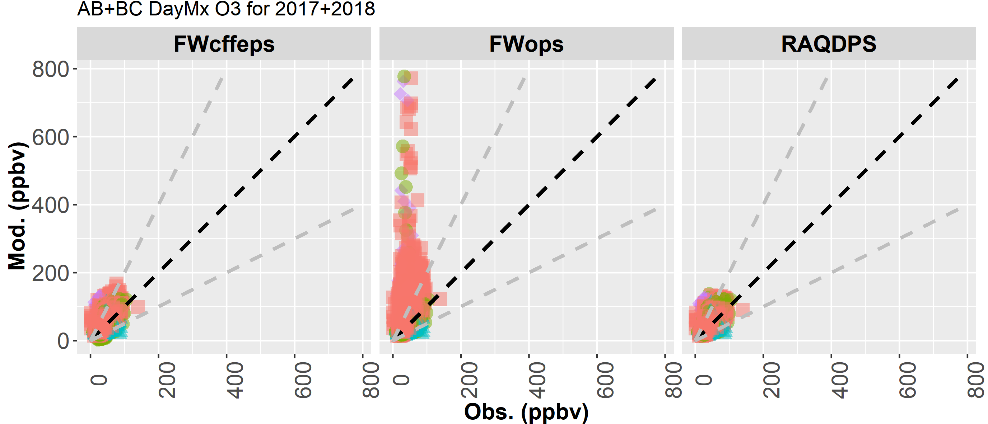
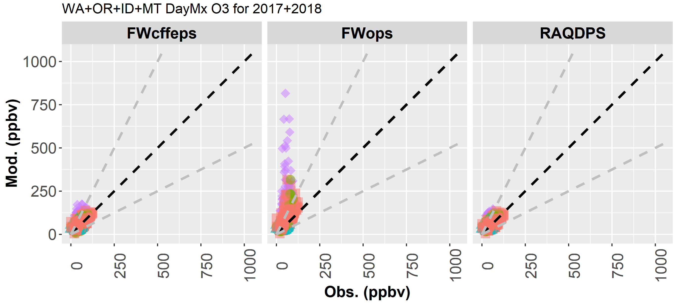
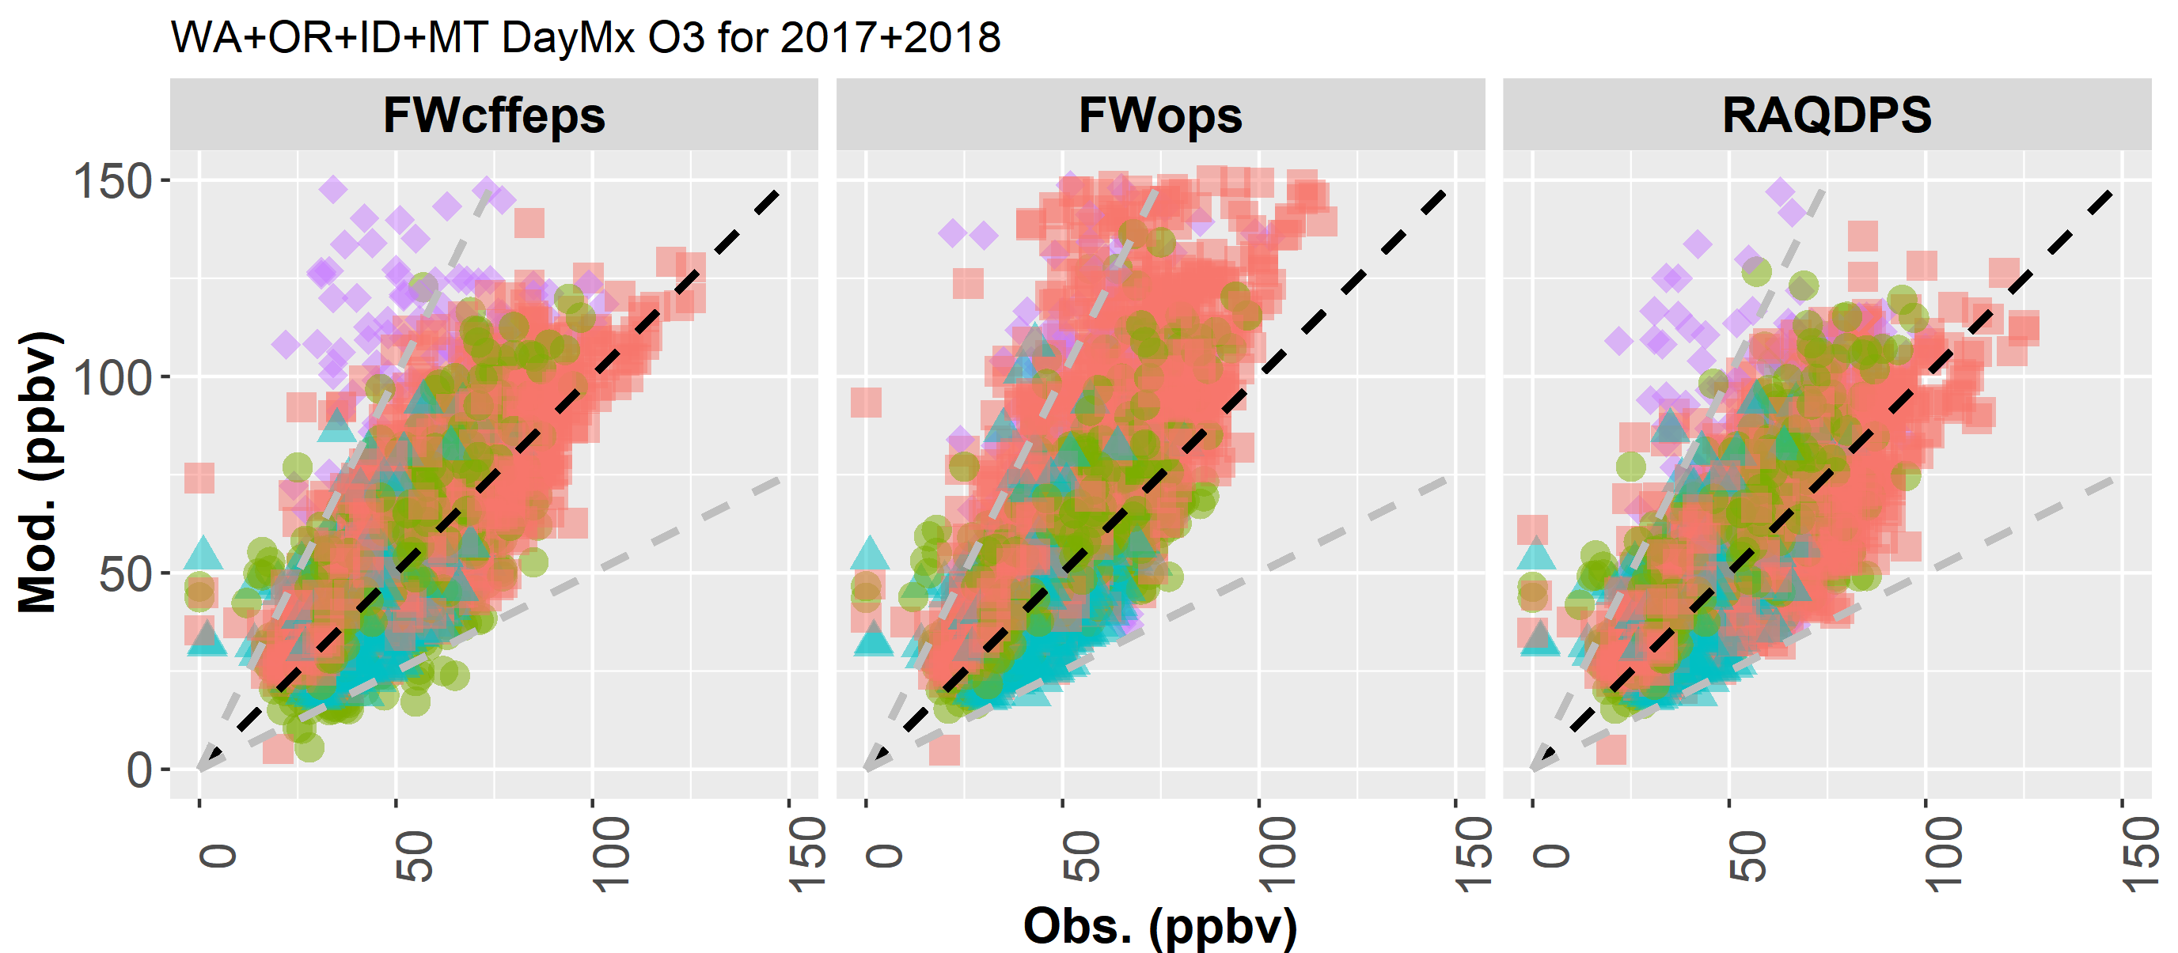
Evaluation Results – Daily Max. Surface O₃
AB+BC | FWcffeps | FWops | RAQDPS
r | 0.61 | 0.37 | 0.64
FAC2 | 95% | 88% | 97%
MB | 4.3 | 15.5 | 3.1
NMB | 10% | 38% | 8%
RMSE | 16.2 | 44.2 | 14.2
OBS_Mean | 40.9
MOD_Mean | 45.2 | 56.4 | 44.0
OBS_P50 | 39.0
MOD_P50 | 40.3 | 44.3 | 39.9
OBS_P90 | 58.0
MOD_P90 | 71.2 | 95.4 | 67.4
WA+OR+ID+MT | FWcffeps | FWops | RAQDPS
r | 0.72 | 0.49 | 0.73
FAC2 | 98% | 94% | 98%
MB | 2.5 | 12.7 | 1.4
NMB | 5% | 25% | 3%
RMSE | 15.2 | 43.1 | 13.5
OBS_Mean | 50.3
MOD_Mean | 52.8 | 63.0 | 51.7
OBS_P50 | 48.0
MOD_P50 | 47.5 | 51.0 | 47.3
OBS_P90 | 72.0
MOD_P90 | 82.9 | 103.9 | 79.8
Notes:
Number of points used in AB+BC=11886 ; WA+OR+ID+MT=4500

Slide 16
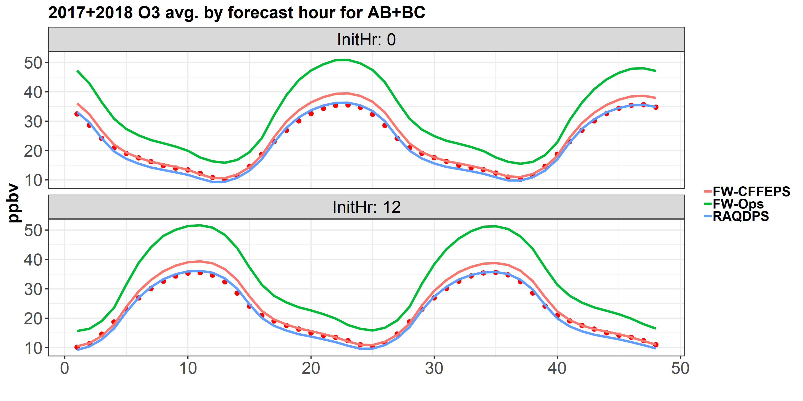
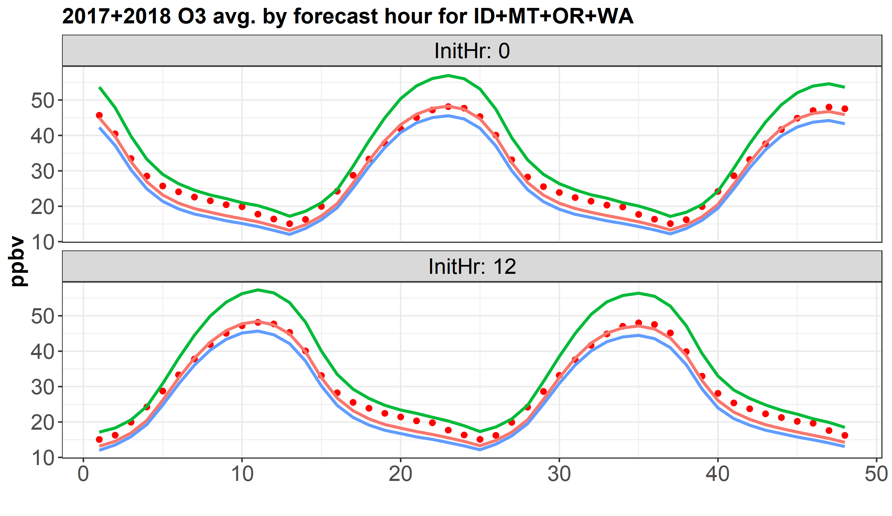
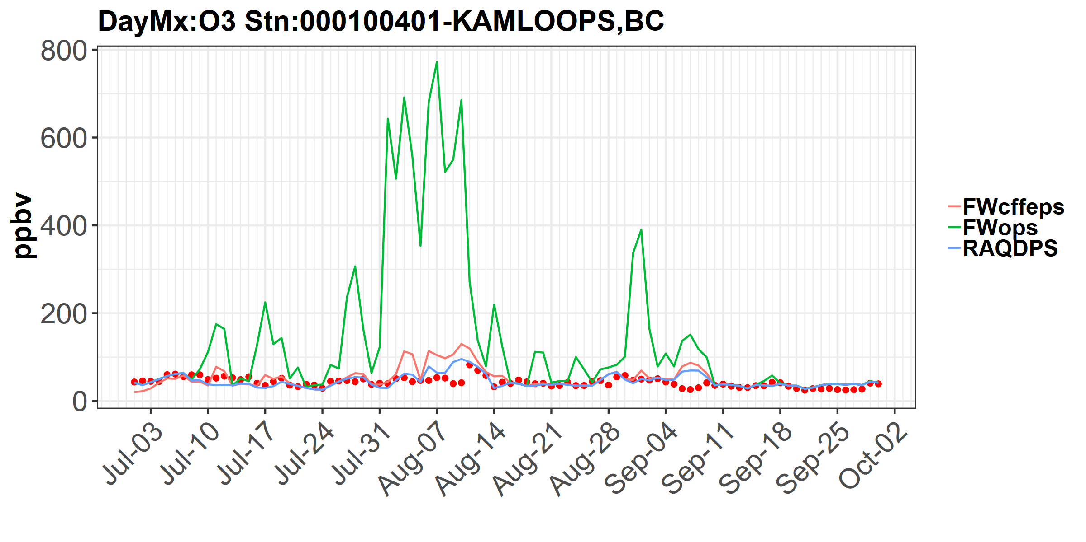
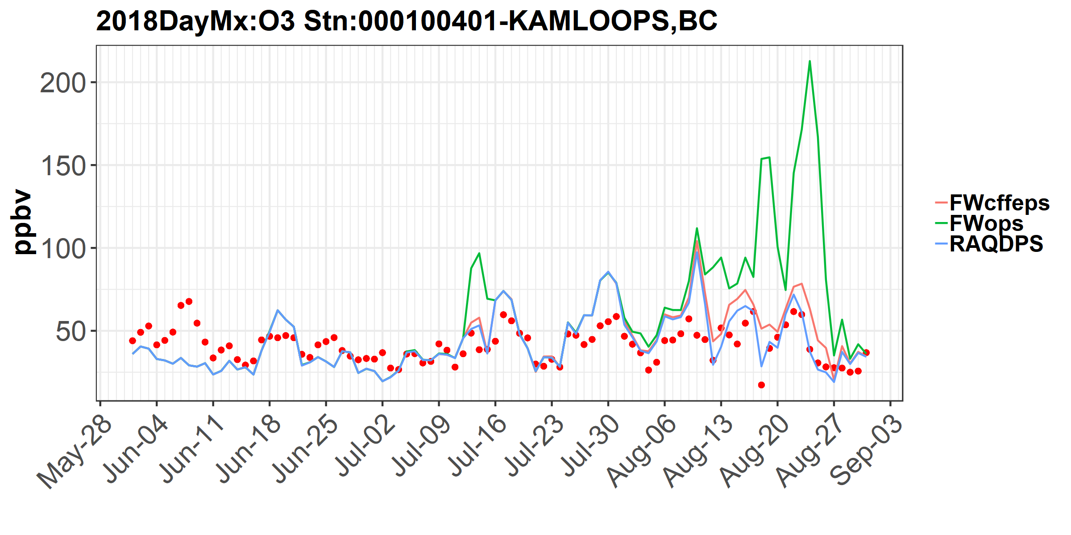
Evaluation Results – Surface O₃
2017
Observed values indicated by red dots
2017
2018

Slide 17
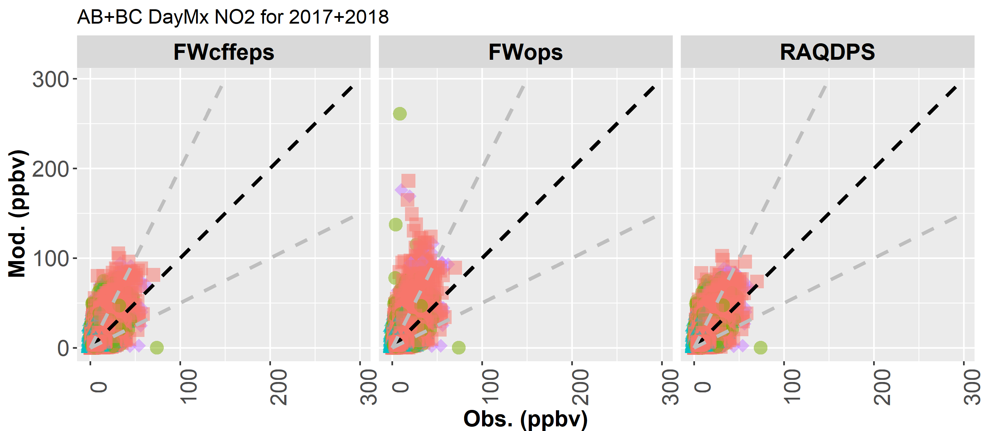
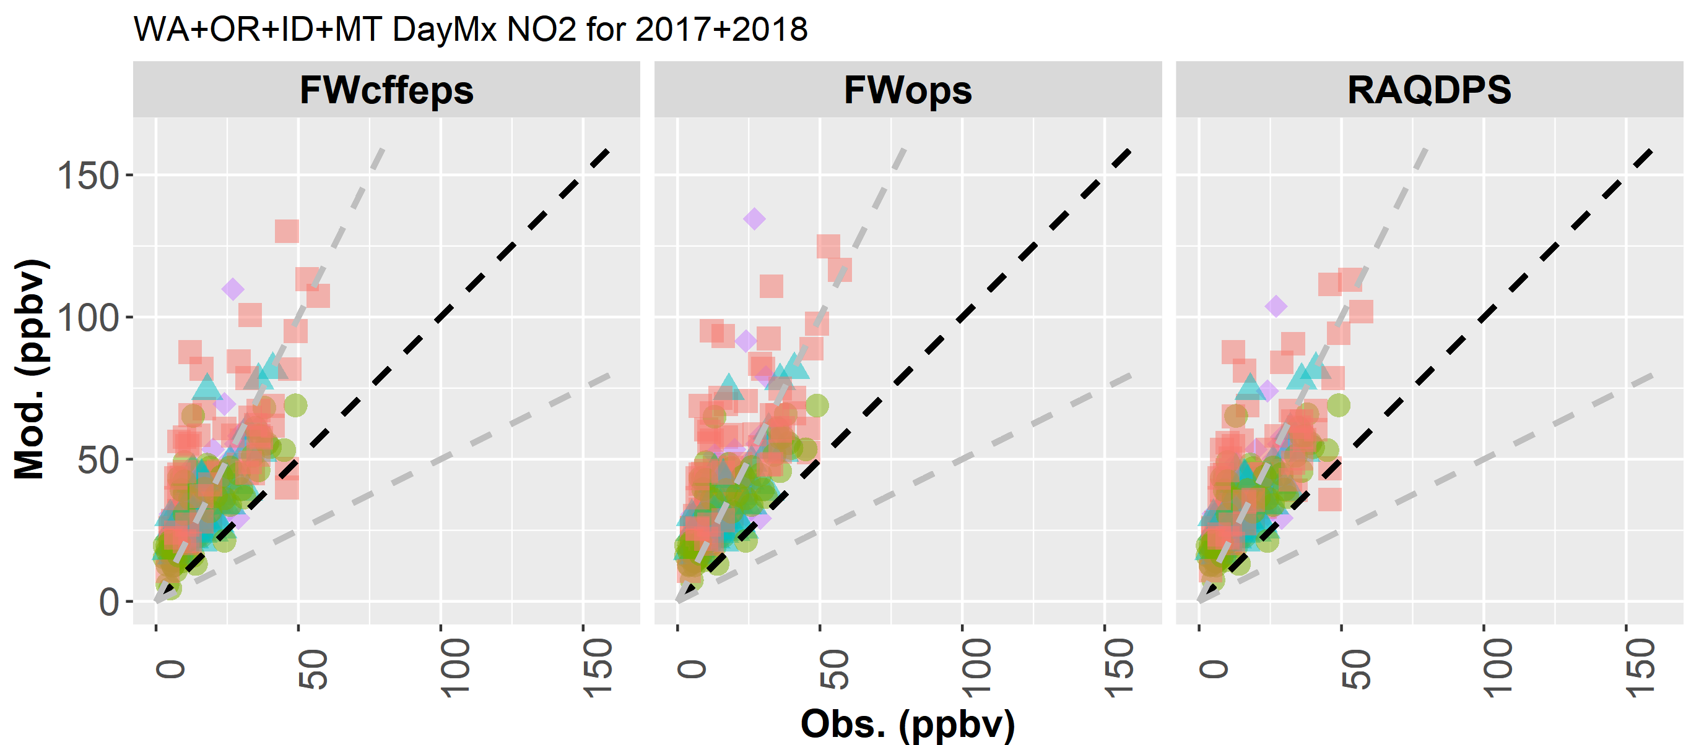
Evaluation Results – Daily Max. Surface NO₂
AB+BC | FWcffeps | FWops | RAQDPS
r | 0.60 | 0.57 | 0.60
FAC2 | 54% | 52% | 54%
MB | 5.9 | 7.0 | 6.0
NMB | 48% | 58% | 49%
RMSE | 13.2 | 15.5 | 13.1
OBS_Mean | 12.1
MOD_Mean | 18.0 | 19.2 | 18.1
OBS_P50 | 10.1
MOD_P50 | 14.3 | 14.9 | 14.5
OBS_P90 | 23.6
MOD_P90 | 38.5 | 40.8 | 38.7
WA+OR+ID+MT | FWcffeps | FWops | RAQDPS
r | 0.74 | 0.71 | 0.74
FAC2 | 40% | 37% | 40%
MB | 19.9 | 21.6 | 19.6
NMB | 117% | 127% | 115%
RMSE | 24.1 | 27.1 | 23.4
OBS_Mean | 17.0
MOD_Mean | 36.9 | 38.7 | 36.6
OBS_P50 | 13.0
MOD_P50 | 31.8 | 32.5 | 32.1
OBS_P90 | 35.0
MOD_P90 | 60.9 | 65.7 | 60.3
Notes:
Number of points used in AB+BC=12816 ; WA+OR+ID+MT=266

Slide 18
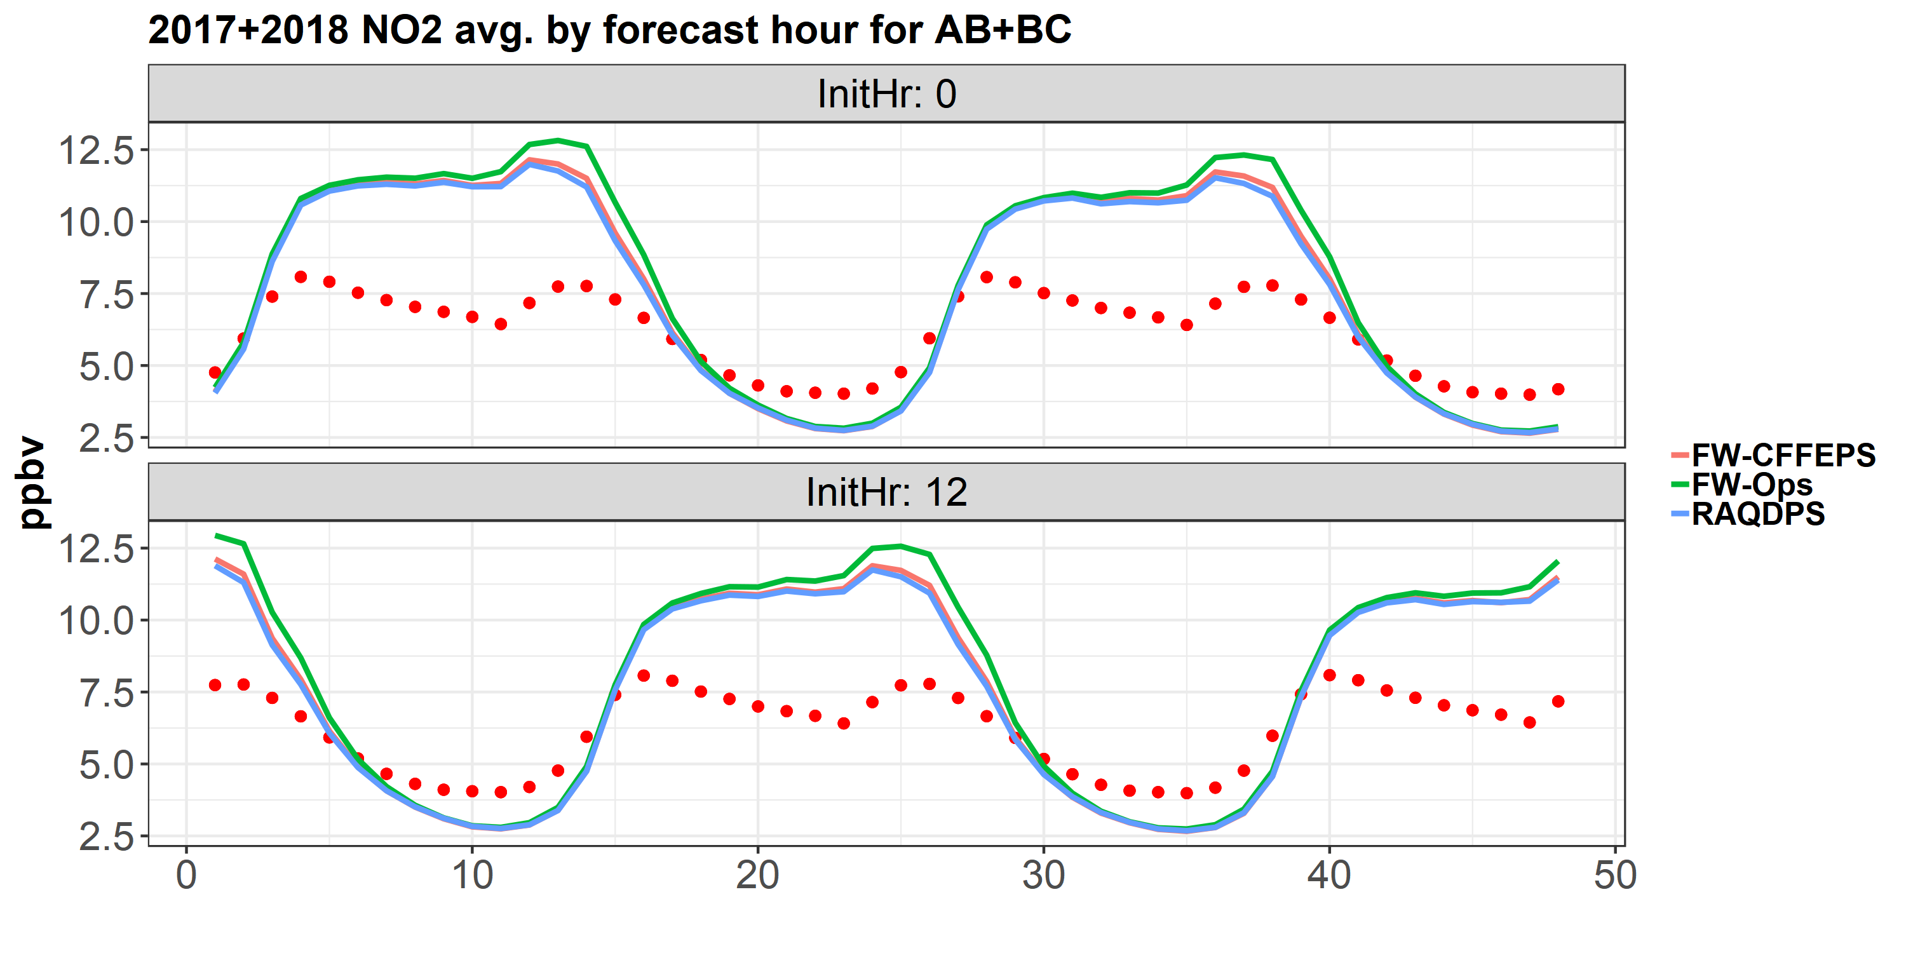
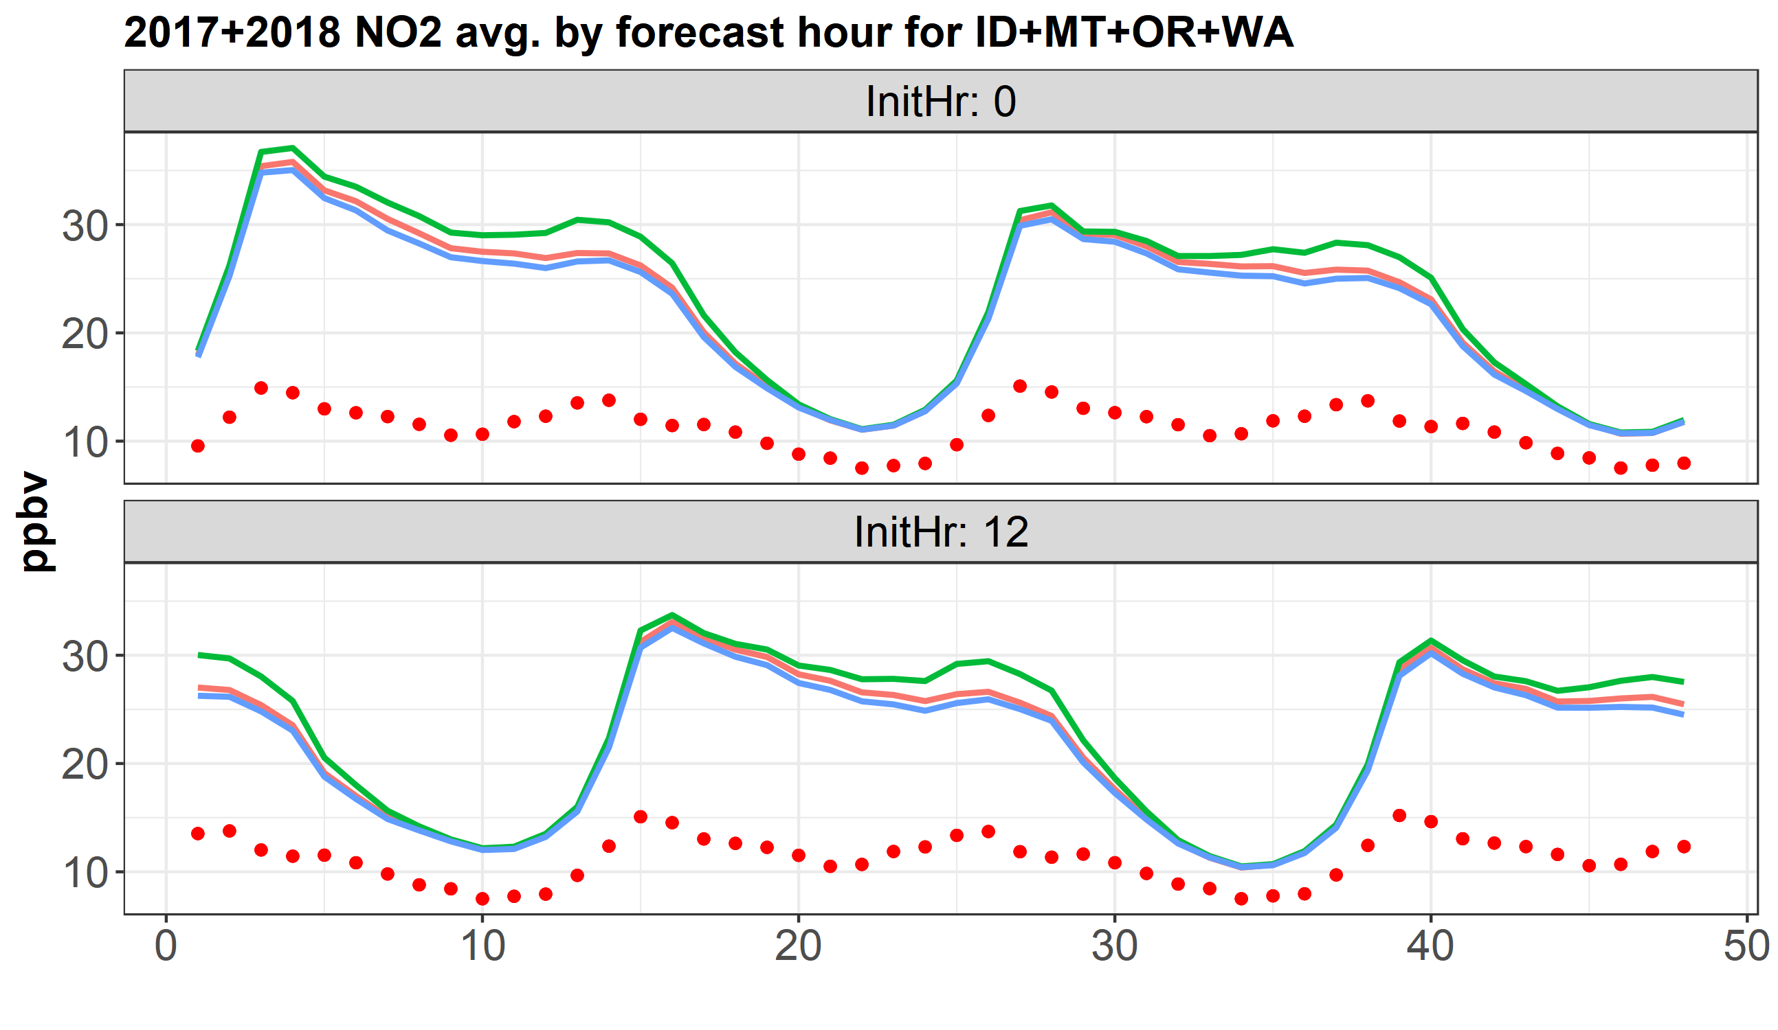
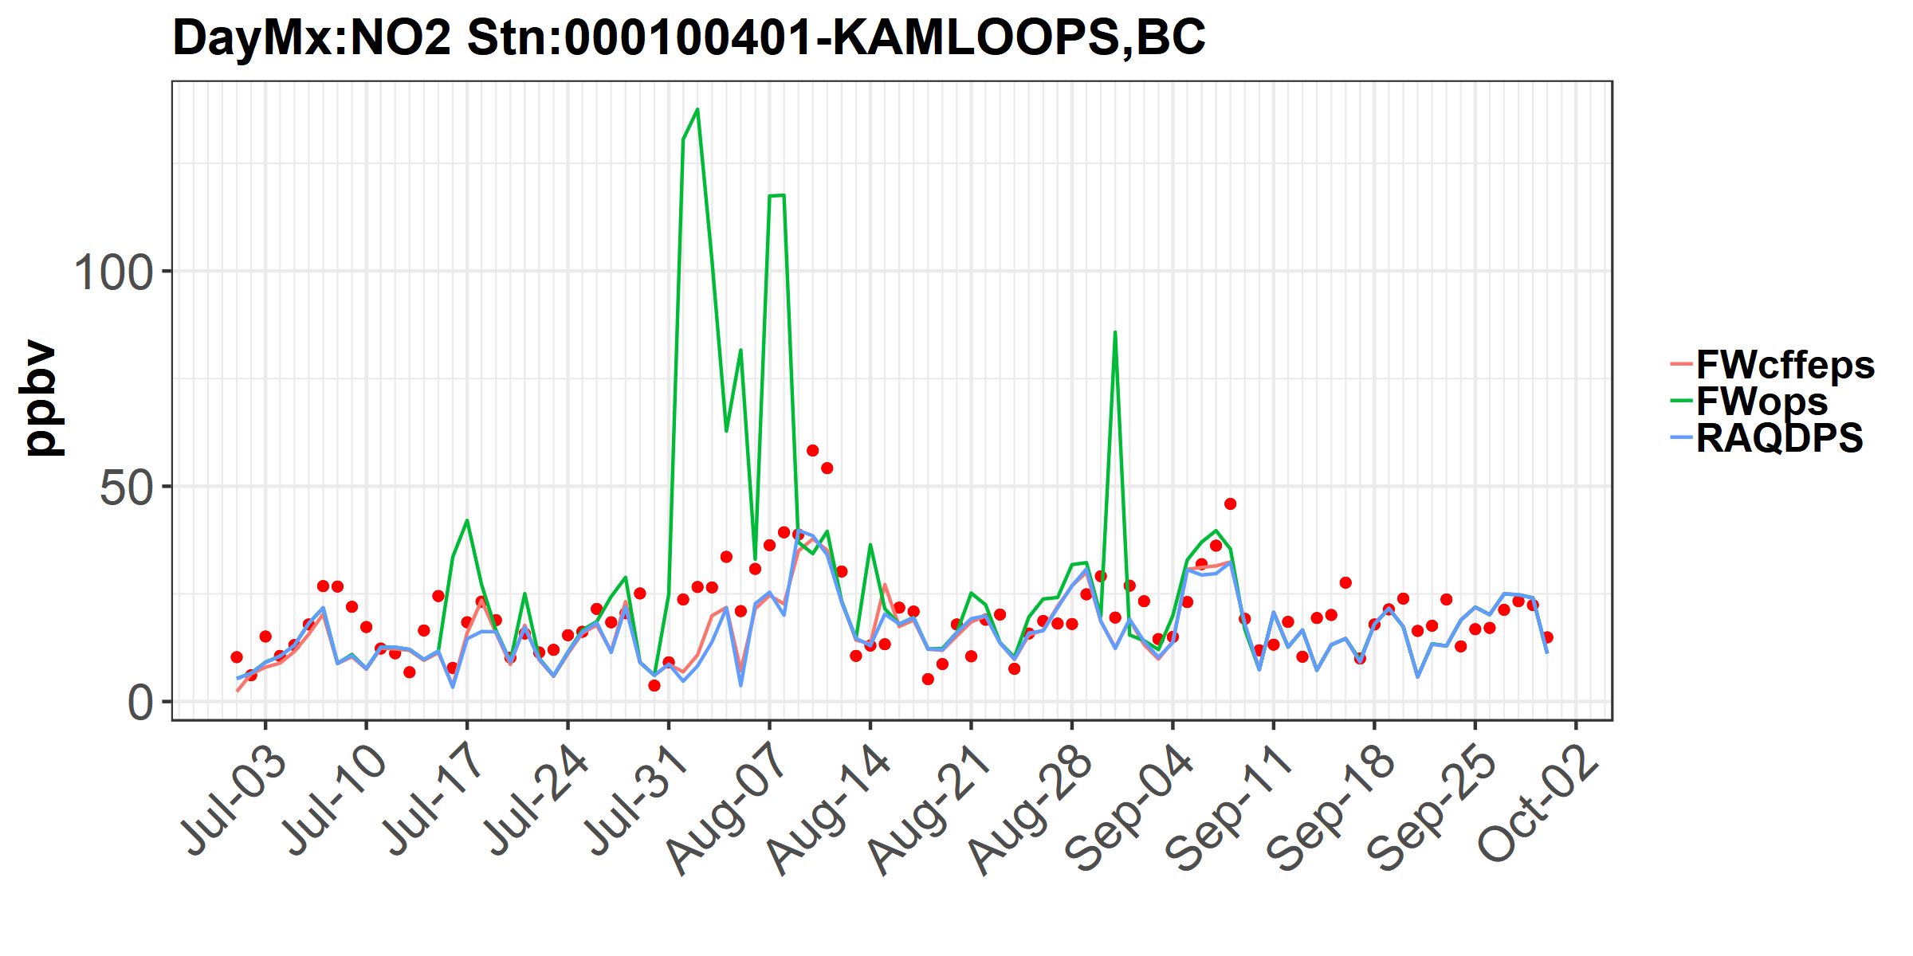
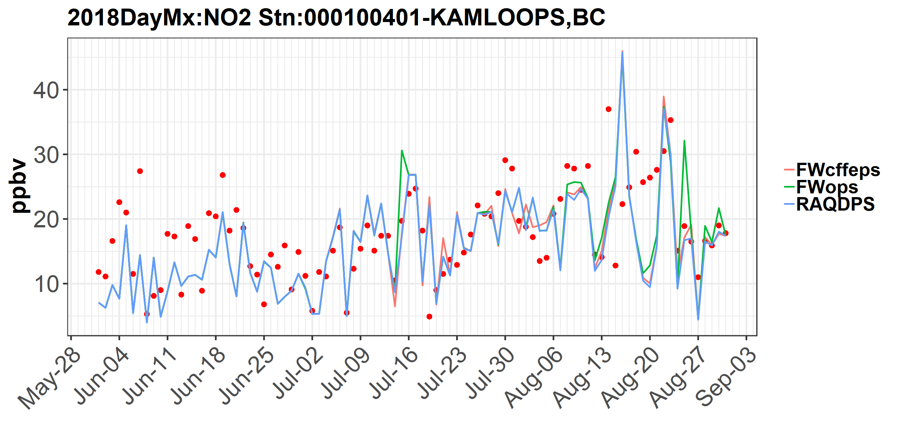
Evaluation Results – Surface NO₂
Observed values indicated by red dots
2017
2018

Slide 19
Summary
FireWork system has been updated to integrate with the Canadian Forest Fire Emissions Prediction System (CFFEPS)
Fire emissions depend on fuel-dependent consumption that varies by forecast hour
Fire emission injection height is parameterized by fire thermodynamics
Evaluation for 2017/2018 active fire months showed improved forecast model performances for all 3 AQHI species (PM_{2.5}, O₃, NO₂) and reduced over-predictions in many areas
Forecast performance is generally better for stations in Canada than U.S. (lower error and biases)
FW-CFFEPS improves diurnal forecasts (f00-f48) vs. RAQDPS and FW-OPS but still overestimates hourly variability of PM_{2.5} and NO₂ concentrations

Slide 20
Next Steps
Operations:
Deliver FireWork-CFFEPS system to operations for a parallel run for the early 2019 fire season
Perform evaluation and, if successful, operational switch later in 2019
Research:
High-resolution FireWork-CFFEPS domain for Western Canada at 10km ➔ 2.5km and PM 2-bin ➔ 12-bin for comparison with AOD (described in Rita So’s talk on Tuesday, Oct. 23, 1:40 p.m.)
Continue evaluation of model performance:
  compare with July 2018 Alberta wildfire aircraft measurements
  compare model plume injection height with MISR and CALIOP satellite products
  compare bottom-up CFFEPS emissions estimates with top-down emissions estimates (OMI, TROPOMI)
Integrate CFFEPS into GEM-MACH 2-way feedback version

Slide 21
Thank you.
Questions?

Slide 22
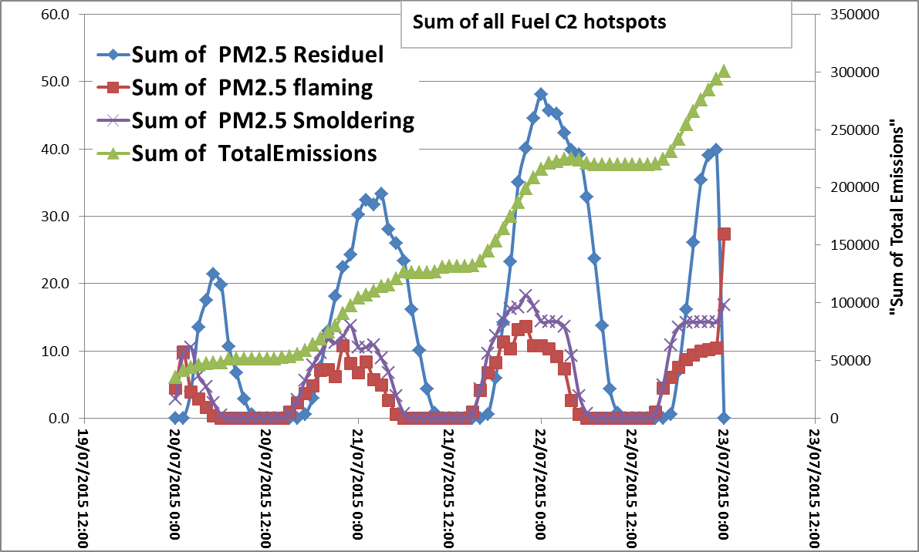
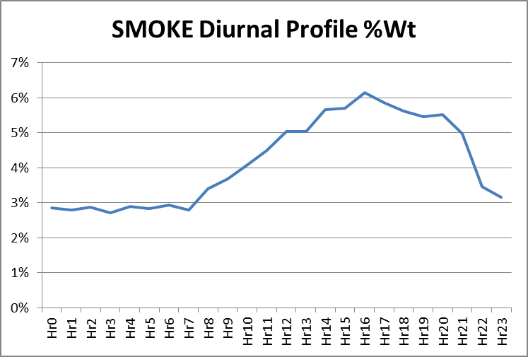
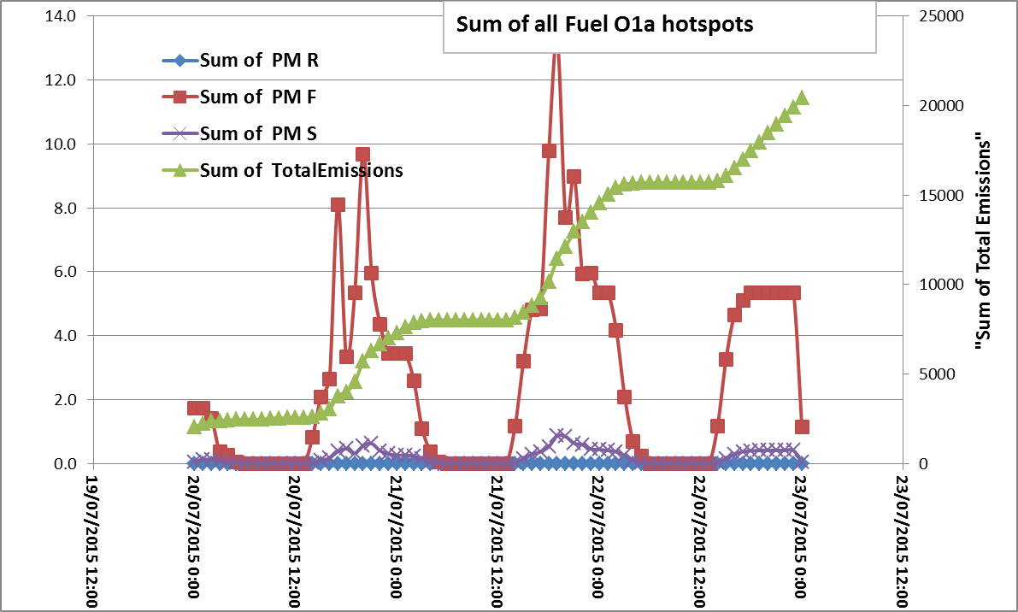
Temporal Allocation
From fixed diurnal profile to one based on fuel type and estimated fuel consumption
PM - Fuel C2-Boreal Spruce
PM – Fuel O1 - Grass

Slide 23
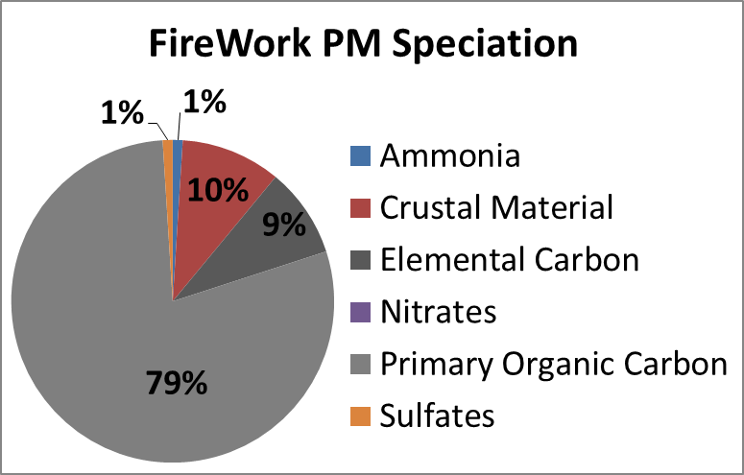
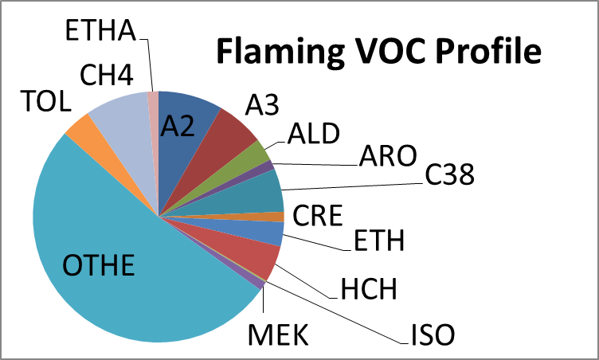
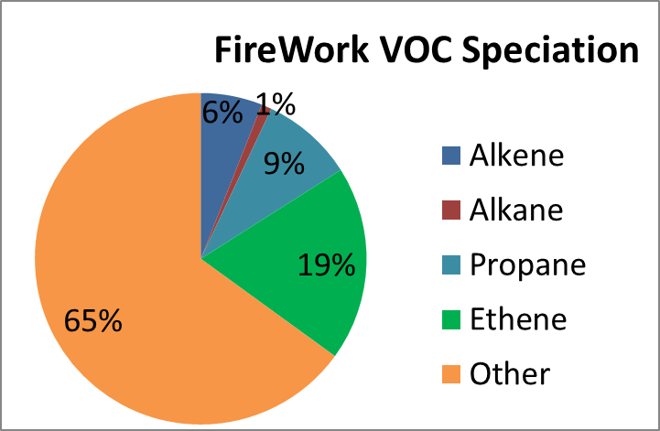
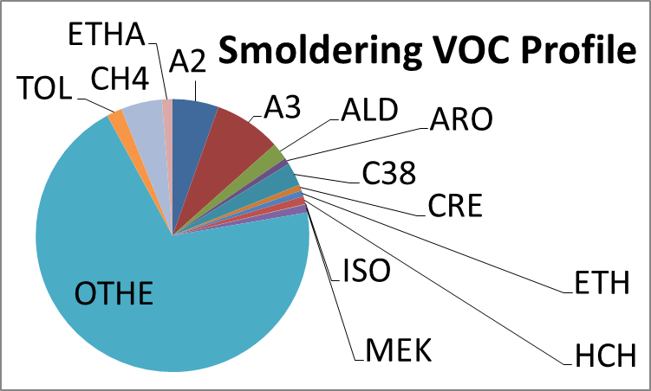
Chemical Speciation
Based on EPA SPECIATE v4.5
Notes:
– chemical speciation is extensible to fuel type dependence but not currently applied (under review/experiment)

Slide 24
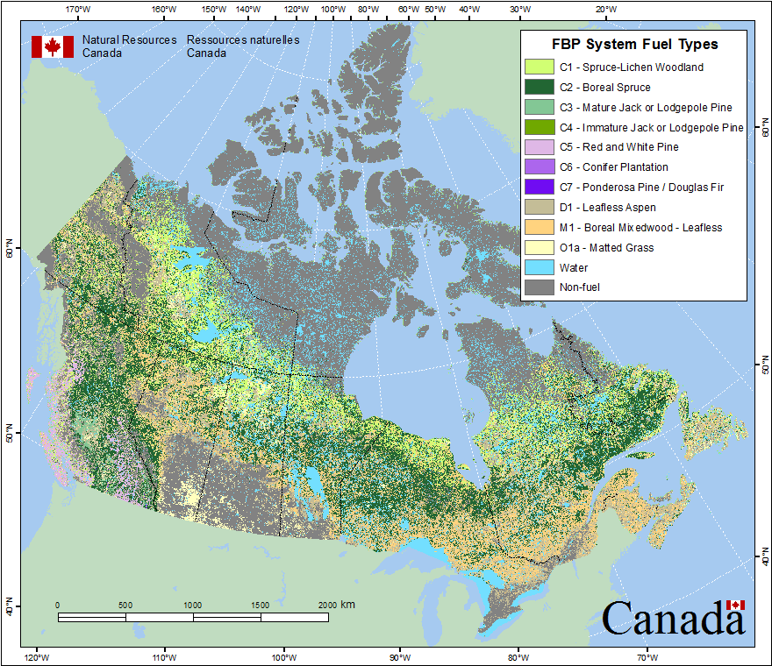

Slide 25
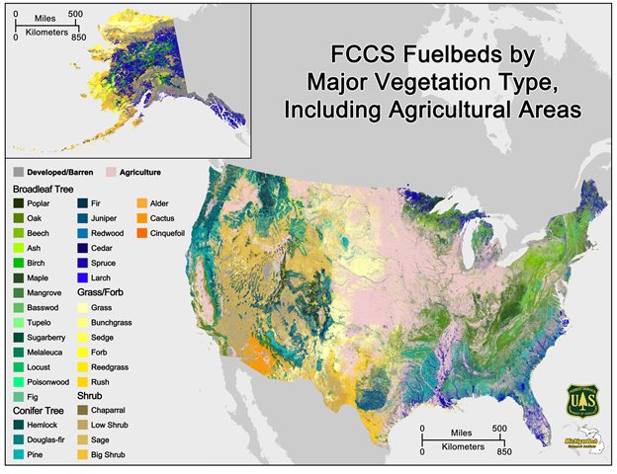

Slide 26

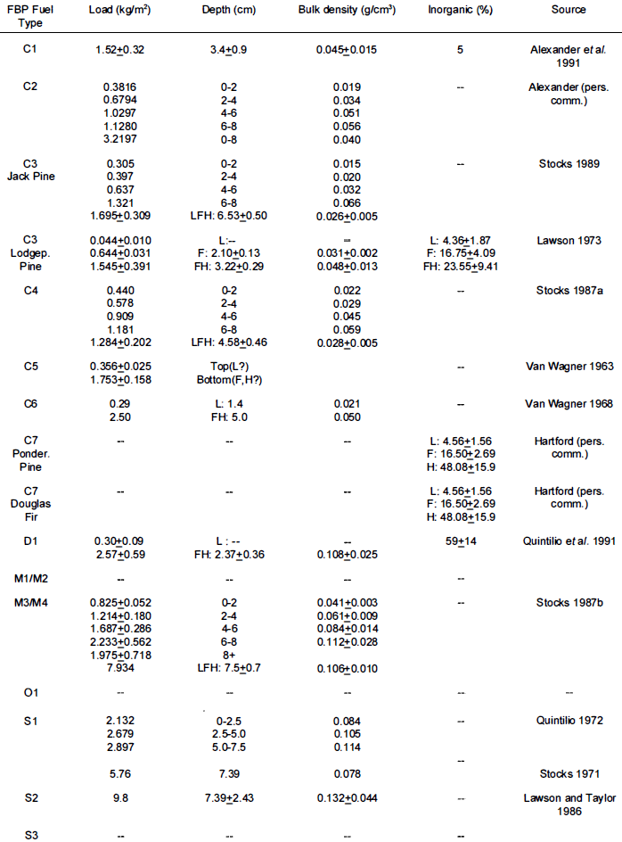

FBP Fuel type
http://cwfis.cfs.nrcan.gc.ca/background/fueltypes/c1

