Slide 1
A new RFM Based on SRSM and DDM for Efficient Uncertainty Analysis of Atmospheric Chemical Transport Models
Zhijiong Dennis Huangª, Junyu Allen Zhengª, Yongtao Hu^{b}
ªInstitute for Environmental and Climate Research, Jinan University
^{b}School of Civil and Environmental Engineering, Georgia Institute of Technology
Notes:
I am Dennis, from Jinan Univeristy. I am very honored to have this opportunity to share with all of you about my research work. Today, I will talk about a new RFM and its application to uncertainty analysis of atmospheric chemical Transport Models. Before these, I would like to first give some background information about the uncertainty analysis of CTMs.

Slide 2
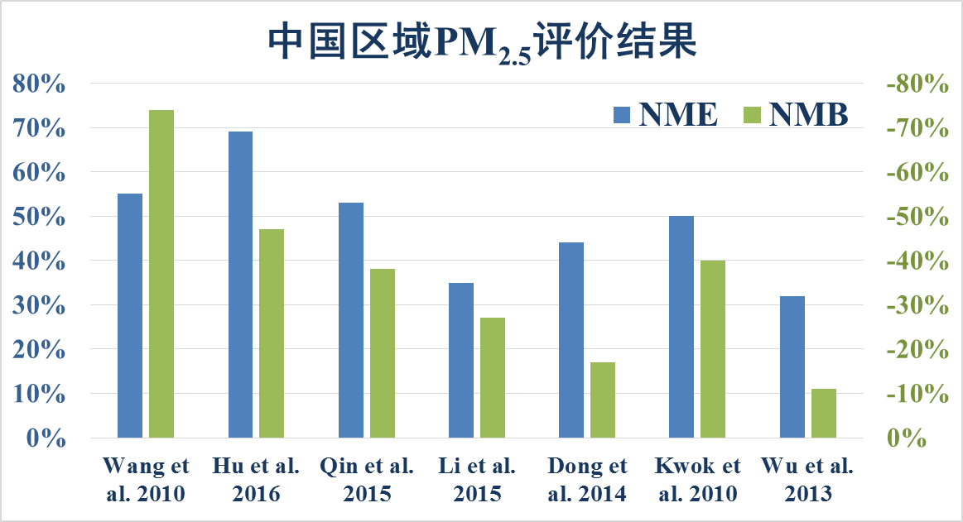
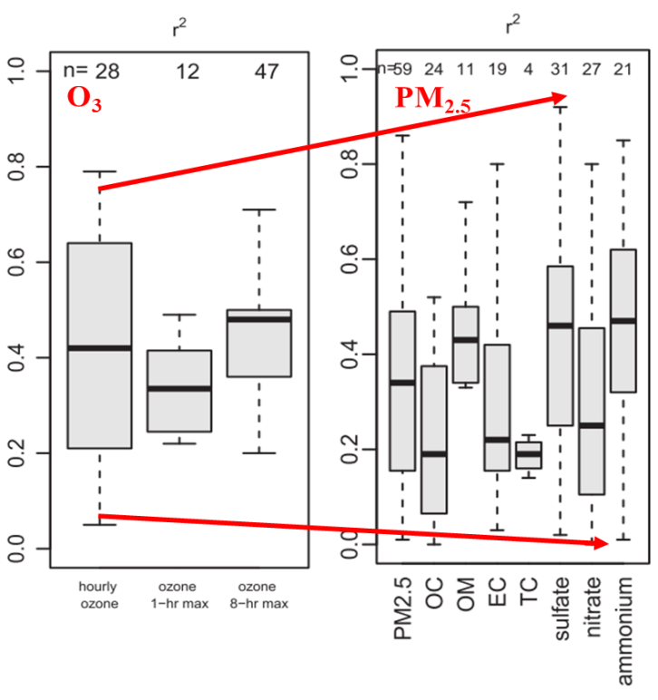
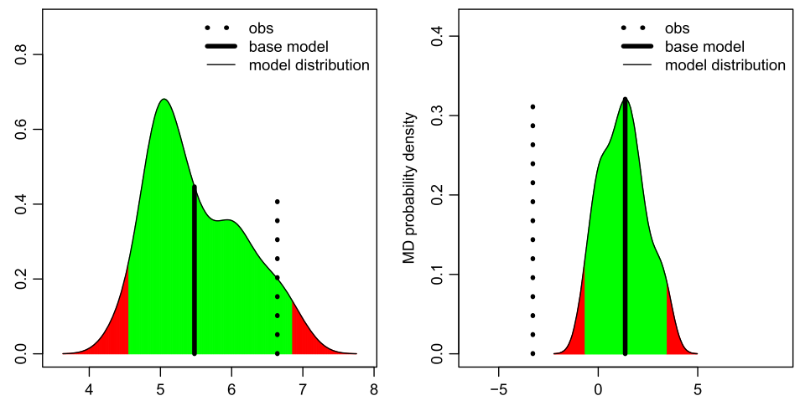
Large bias in current chemical transport models (CTMs)
Evaluation of PM_{2.5} simulation in China
Model performance in U.S.
La
Simon et al. 2012
Reduces reliability of model application
Control measures assessments
Air quality forecasting
Risk assessments
Pollution formation mechanism
Notes:
Although some great progresses have been made in chemical transport model in recent years, there are still large biases in simulating PM2.5 concentrations and their species components both in China and the U.S.A. These biases will reduce the reliability of model application, for instance, control measures assessments, air quality forecasting and risk assessments.

Slide 3
Numerous uncertainty sources in CTMs
Structural uncertainty sources
Parametric uncertainty sources
Aerosol modules
ISORROPIA (Nenes, et al., 1998)
ISORROPIA II (Nenes, et al., 2009)
MARS (Saxena, et al., 1986 )
SEQUILIB (Pilinis, et al., 1987)
SORGAM (Schell et al., 2001)
VBS-1D/1.5D …..
Chemical reaction rates: e.g. 182 reactions in CB05
CTMs
CMAQ
Emission rates:
SO₂、NOx、PM_{2.5}、VOC (anthropologic and biogenic)、NH₃、CO、BC、OC…
CAMx
WRF-Chem
Gas-phase mechanisms
CB-IV (Gery,1989)
CB05 (Yarwoo et al, 2005)
SAPRC99 (Carter et al, 2000)
SAPRC07 (Carter et al, 2010)
RACM2 (Goliff et al, 2013)
…….
Meteorological inputs (WRF/MM5):
T, Wind speed, PBL, RH,….
NAQPMS
…
Initial conditions (ICs)
Boundary conditions (LBCs)
Notes:
The major reason leading to model bias is because the CTMs models still have a lot of uncertainty sources, including structural uncertainty sources that refer to the modules or mechanisms used in models and parametric uncertainty sources that refer to uncertainties in model inputs. In this study, we focused on parametric uncertainty since we only used one model to conduct the simulation.

Slide 4
Quantitative uncertainty analysis can help CTM improvements
Uncertainties in model inputs
Uncertainties in outputs
Uncertainty propagation
Uncertainty apportionment
Quantify uncertainties in model outputs associated with uncertainties in model inputs
Identify the key uncertainty sources and provide insights for model improvements
Notes:
Uncertainty analysis had been proposed to help model improvement. First, it can quantify uncertainties in model output associated with uncertainties in model inputs. Second, it can identify the key uncertainties sources and provide insights for model improvement. In fact, previous studies had made some progress on uncertainty analysis of CTM.

Slide 5
Monte Carlo (MCM) & Reduced-form (RFM)
MCM
RFM
Input uncertainty
Input uncertainty
CTMs
CTMs
PDFs of output
PDFs of output
RFMs
Randomly selects a set of inputs
Randomly selects a set of inputs
Repeat >1000 runs
(Hanna et al,2001;Zheng et al,2009;He et al,2011)
(Isukapalli et al,2000,2004; Androulakis et al,2006 )
Generally requires > 1000 runs for a accurate uncertainty propagation
Used for simple CTMs, e.g. AERMOD, but becomes cumbersome for complex CTMs, e.g. CMAQ
Low efficiency
Use a RFM that approximates the underlying CTMs for uncertainty propagation
E.g. SRSM, HDDM-RFM, PCM
High efficiency
Require a number of up-front CTM runs to build the RFM
Notes:
Most these studies relied on Monte Carlo to propagate uncertainty. But this method generally require 1000 model runs for a accuracy uncertainty propagation and therefore it is cumbersome for CTMs. Alternative approaches were developed to reduce the computational cost, including SRSM, HDDM-RFM, PCM. These approaches all use an RFM, in most case a polynomial, to approximate the original CTM and substitute the original CTM in uncertainty propagation. The only computational cost is the up-front model runs required to build the RFM. However, these method also have limitations.
Probabilistic Collocation Method

Slide 6
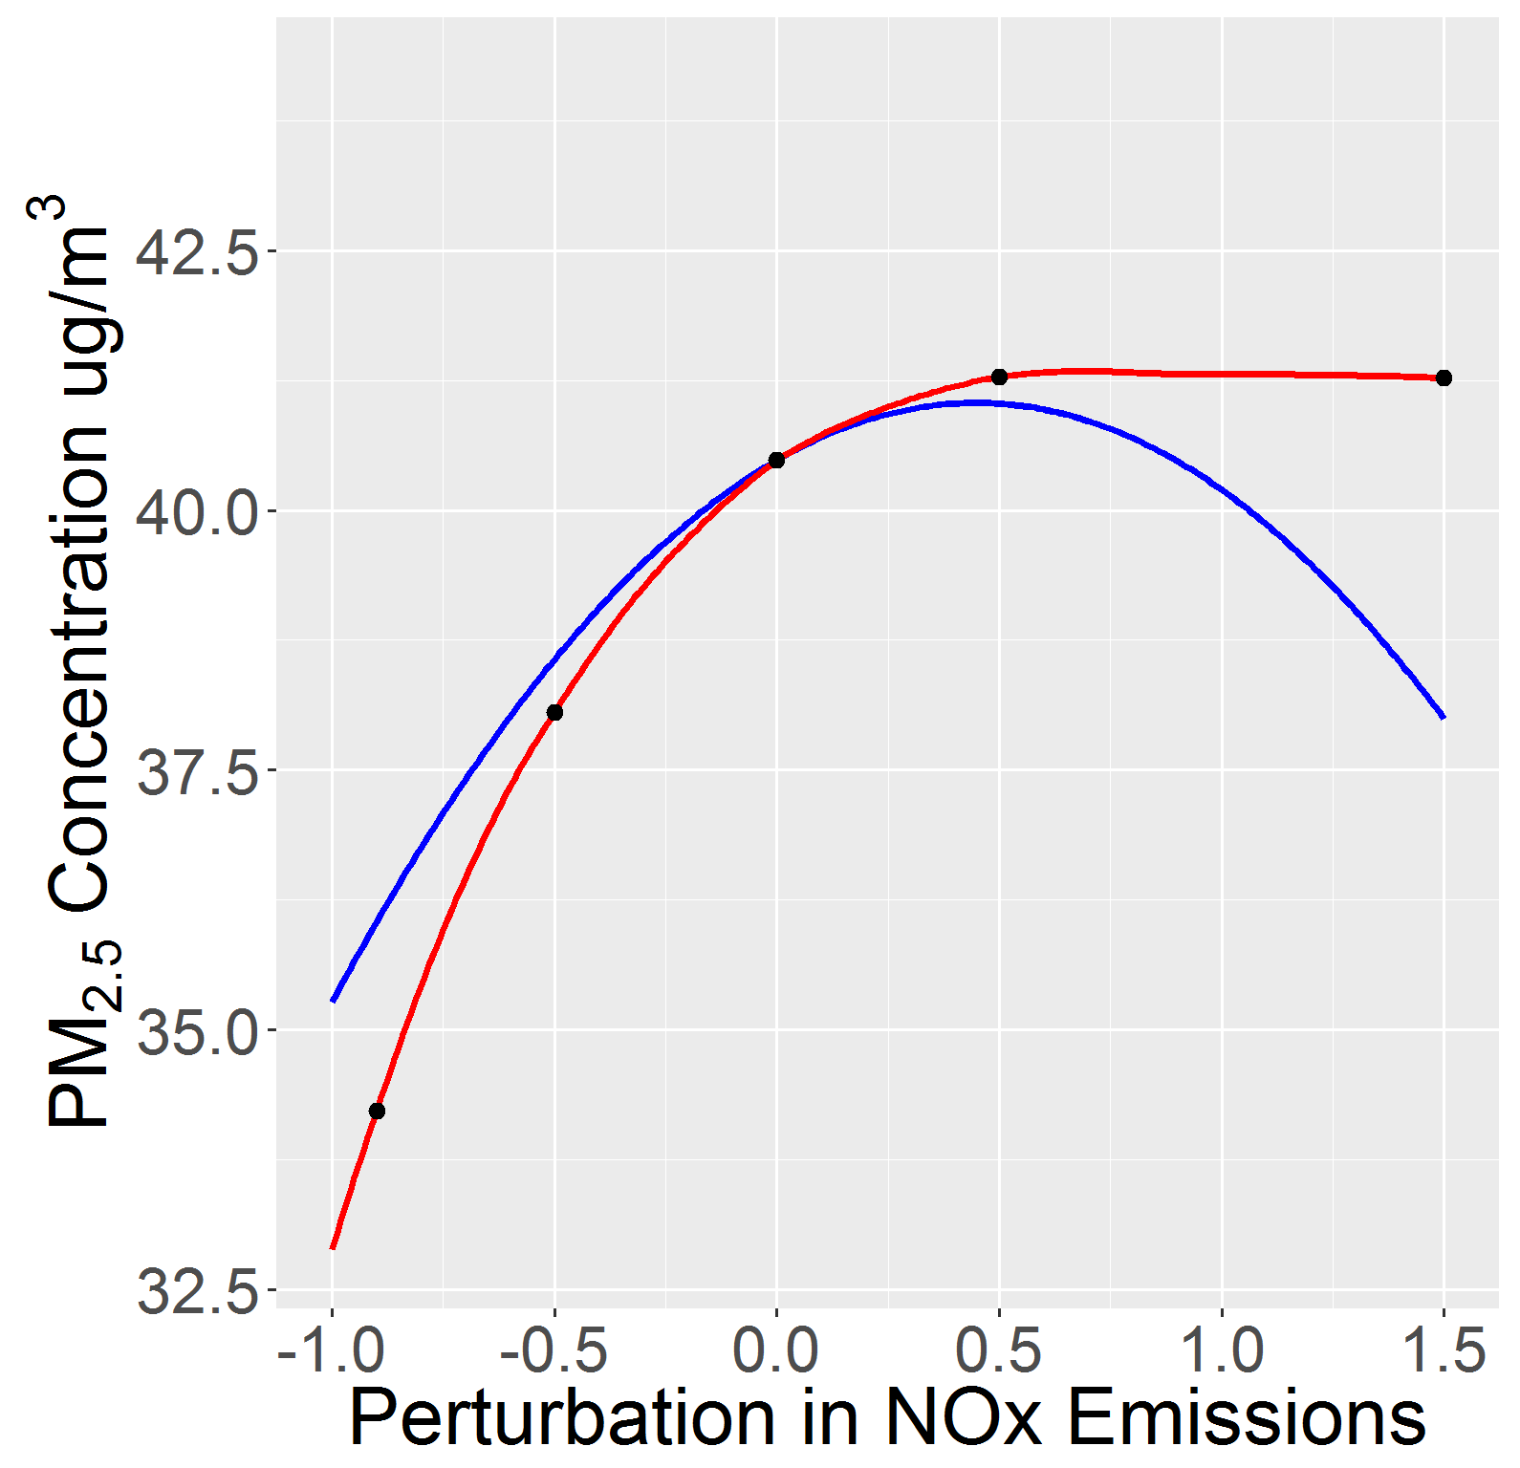
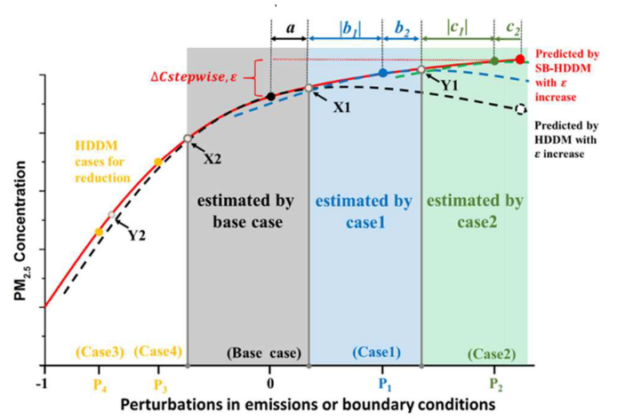
Limitation of HDDM-RFM: low accuracy
HDDM-RFM：uses Taylor expansion and HDDM sensitivity coefficients at the base level to simulate the response of model outputs to model inputs
CMAQ
HDDM
Limitation: HDDM is not reliable for approximating highly nonlinear responses to large perturbations of inputs.
The accurate perturbation
range < 50%
Stepwise-based HDDM-RFM：combines several sets of local sensitive coefficients under different conditions
Limitation: has limitations because it ignores the high-order cross sensitivities and assumes the interaction among inputs is linear.
Notes:
The HDDM-RFM uses Taylor expansion and HDDM sensitivity coefficients at the base level to simulate the response of model outputs to model inputs. However, HDDM is not reliable to simulate highly nonlinear responses to large perturbations of inputs, As revealed by previous studies, the accurate perturbation range of HDDM for nonlinear responses is generally below 50%. Therefore, if the uncertainty inputs is large, HDDM-RFM will bring bias in uncertainty propagation. Although we had updated this method and extend the accurate perturbation range by combines several sets of local sensitive coefficients under different input conditions . It still have limitation because it assume the interactions among inputs is linear, but in fact the interaction might be nonlinear.

Slide 7
Limitation of SRSM: dramatically decrease of efficiency
1. Normal representation of model inputs
2. Output expressed as polynomial with unknown coefficients
3. coefficient estimations and RFM evaluations
Normal random variables
Hermite polynomial
Regression methods
Hermite polynomials
Based on the response surface method
Uncertain inputs are expressed as functions of a set of “standard random variables (SRV)”
Model responses are expressed as a Hermite polynomial with unknown coefficients
The unknown coefficients are solved by regression on up-front model runs (singular value decomposition)
Notes:
Another widely used RFM approach is the SRSM, a statistical method. This approach is based on the response surface methods. But the major different is that in SRSM, uncertain inputs are expressed as functions of a set of “standard random variables” while the responses are expressed as a Hermite polynomials with unknown coefficients. And the unknow coefficients are solved by regression on known model response. A Know model response is a model run.

Slide 8
Limitation of SRSM: dramatically decrease of efficiency
To obtain a robust approximation, the number of up-front model runs must equal twice the number of unknown coefficients
The up-front model runs dramatically increase with the number of model inputs (572 model runs for ten uncertainty inputs)
SRSM is inefficient while there are many uncertainty sources.
Notes:
To obtain a robust approximation, the number of original model runs must equal twice the number of unknown coefficients that depend on the number of inputs. Therefore, the up-front model runs will dramatically increases with the number of model inputs. For instance, if we consider 10 uncertainty inputs, we need to runs the original model 572 times to developed a accurate RFM using SRSM. This means that SRSM is inefficient while there are many uncertainty sources.

Slide 9
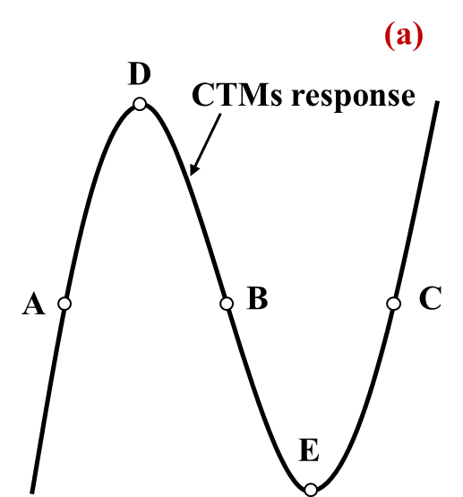
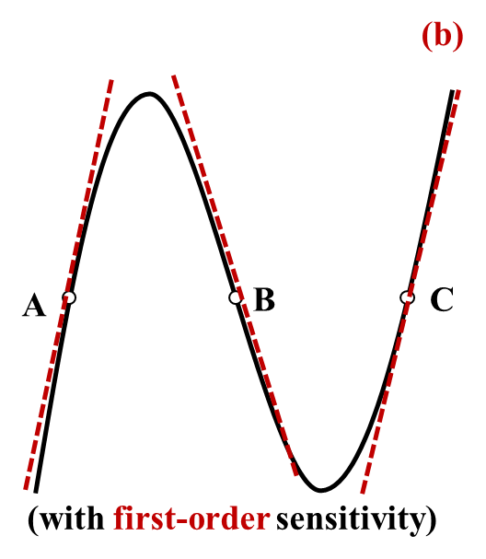
A new RFM approach: DDM-SRSM
Calculated by DDM/HDDM
(Isukapalli, et al. 1998)
SRSM
DDM-SRSM
Concentrations:
1 known
concentration
+
1st sensitivities:
n known
sensitivities:
The number of up-front model runs depends upon the number of uncertainty inputs and the number of sensitivity coefficients calculated in each model runs
Notes:
To partly solve this limitation, we developed a new RFM approach by combining the DDM with SRSM. Here, I briefly illustrate why DDM-SRSM can reduce the computational cost. The traditional SRSM requires at least five well-distributed model runs to approximate the true model response. But if we also use the first-order sensitivity, it only requires at least three model runs to get a similar approximation. So, in this way, coupling first-order sensitivity coefficients with concentrations can reduce the up-front model runs. In DDM-SRSM, The number of model runs not only depend upon the number of uncertainty inputs, but also depend upon the number of sensitivities in each model runs. The more first-order sensitivity coefficient is available in a model run, the less of up-front model run is required to develop RFM.

Slide 10
A new RFM approach: DDM-SRSM
The up-front model runs dramatically decrease in DDM-SRSM
Notes:
Here, we compared the number of model runs required by SRSM, and the new approach. As shown in the figure, the new approach dramatically reduce the number of model runs. But regarding the computational time, the difference will be smaller. This is because the DDM also need some time to calculate the sensitivity coefficient, but the time requirement is less than that to calculate concentrations.

Slide 11
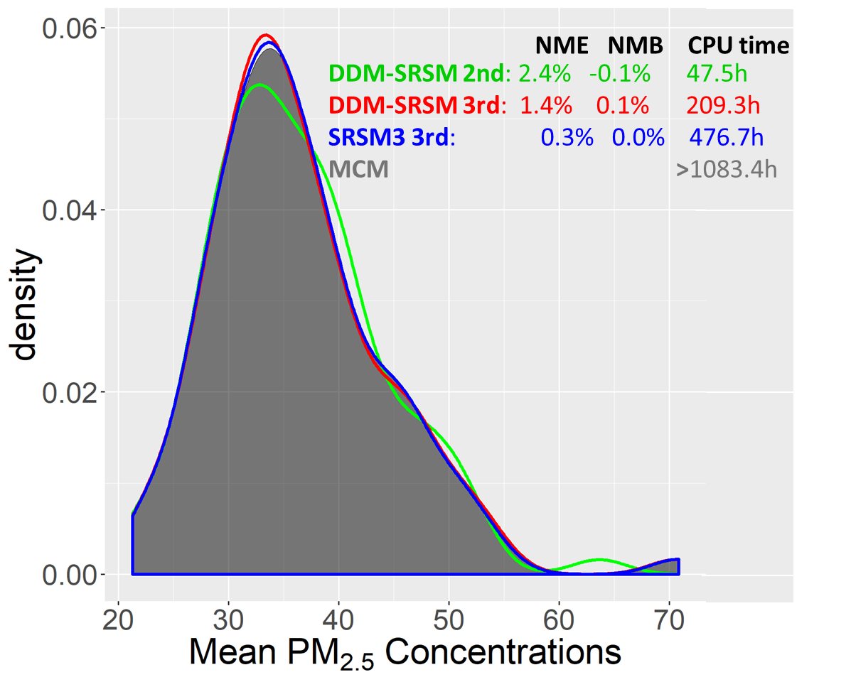
Evaluations of DDM-SRSM: accuracy and efficiency
With the increase of the order of Hermite, DDM-SRSM becomes more accuracy, but less efficiency
Compared with SRSM, the 3-order DDM-SRSM saves ~64% of up-front computational cost
The 3-order DDM-SRSM gains right balance between accuracy and efficiency
High-order DDM-SRSM still has slight bias due to the overfitting
HPC: Intel High-Performance Computing cluster with one node (CPU: 2×E5-2680V3)
MCM and RFM approaches: 10 uncertainty sources
Notes:
Next, we further evaluated the new approach regarding the accuracy and efficiency. 2-order DDM-SRSM was evaluated because a second-order polynomial is recommended as a first attempt. To evaluate the accuracy, the Probability Distribution Function predicted by RFM approaches are compared with that predicted by MCM, the most accurate uncertainty propagation approach. To evaluate the efficiency, the up-front computational time required by RFM approaches were estimated using the Intel High-Performance Computing cluster with one node. All these four approaches all involve ten model inputs.
From the results, we can see: the two-order DDM-SRSM is the most efficient, it has large biases in uncertainty propagation. This mean that low order DDM-SRSM cannot precisely simulate the true PM2.5 response to model inputs. In comparison, the three-order DDM-SRSM achieves a right balance between accuracy and efficiency; Also the new approach can save ~64% of up-front computational cost required by the traditional SRSM, while still keeping a high accurate, However, the accuracy of DDM-SRSM still slightly decrease, and this is might be associated with overfitting.

Slide 12
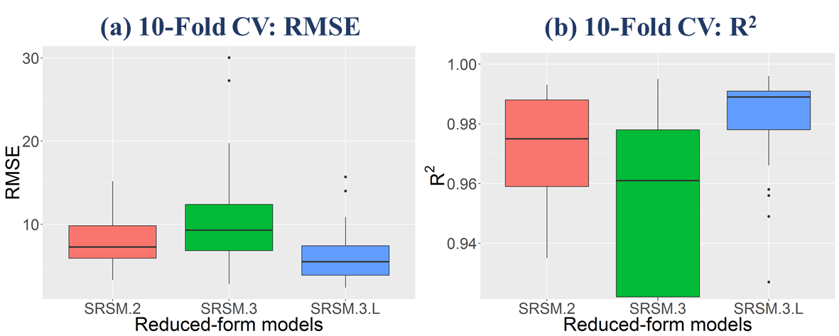
Overfitting in high-order DDM-SRSM
DDM-SRSM
2nd
DDM-SRSM
3rd
DDM-SRSM
3rd with LASSO
DDM-SRSM
2nd
DDM-SRSM
3rd
DDM-SRSM
3rd with LASSO
10-fold cross-validation：assesses the overfitting of RFM developed by DDM-SRSM
LASSO: to reduces the degree of overfitting by setting unknown coefficients that less than a fixed value to zero
high-order DDM-SRSM is highly affected by the overfitting
TIPS: The best performance of an RFM developed by high-order DDM-SRSM is confined to the original uncertainties in inputs, if uncertainties changes, the RFM must be rebuilt.
Notes:
When a model is overfitting, it fits the training data well but fails in prediction. It generally occur in the case with many unknown coefficients but few model runs. For instance, in 3-order DDM-SRSM, there are more than two hundreds of unknown coefficient, but we only run model 60 times.
The overfitting can be revealed by the cross-validation. In CV, model runs were randomly partitioned into ten groups of equal size and the development of RFM was repeated ten times with each time a different group was withheld as validation data. Also we use LASSO to reduces the degree of overfitting by setting coefficients that less than a fixed value to zero.
The results also shown that the 3-order DDM-SRSM has largest biases in CV, even larger than the 2-order DDM-SRSM. Also when we used LASSO to reduce the unknown coefficient, the performance of 3-order DDM-SRSM dramatically increase in CV. This mean that the 3-order DDM-SRSM is highly affected by the overfitting. What we can learn from the overfitting is that the best performance of an RFM developed by DDM-SRSM is confined to the original input uncertainties. If input uncertainties change, the RFM might not be any longer reliable and thus must be rebuilt based on the new uncertainties.

Slide 13
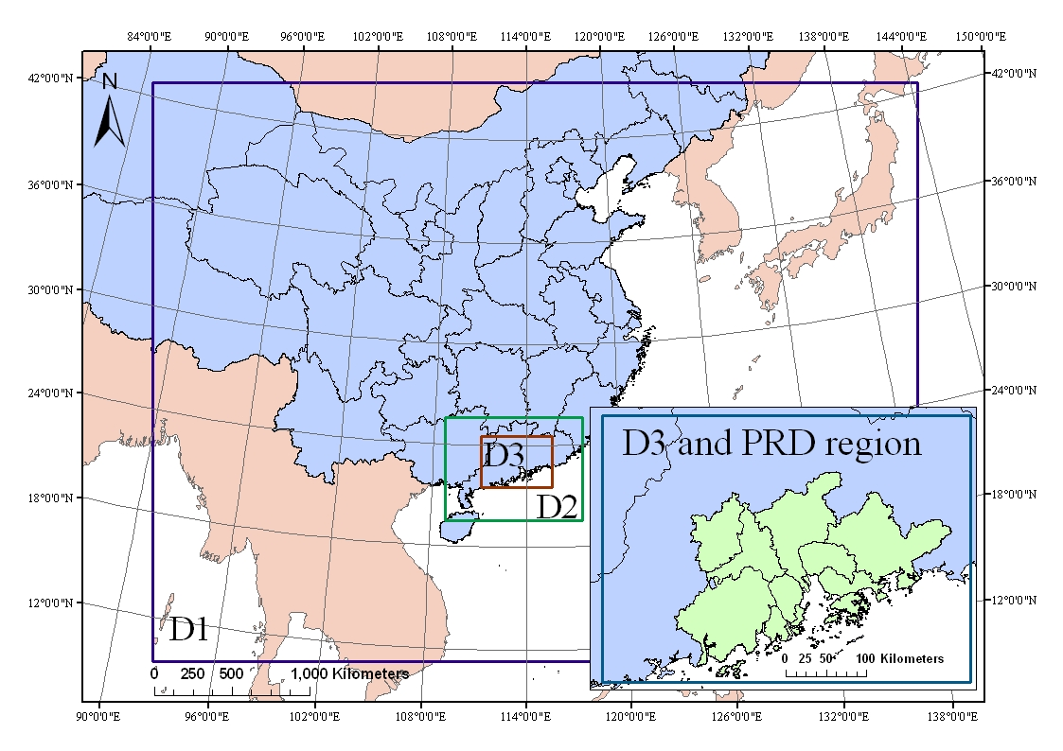
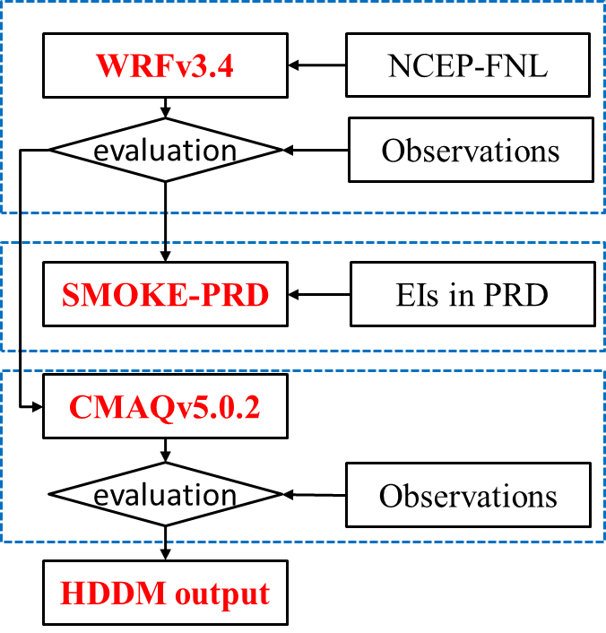
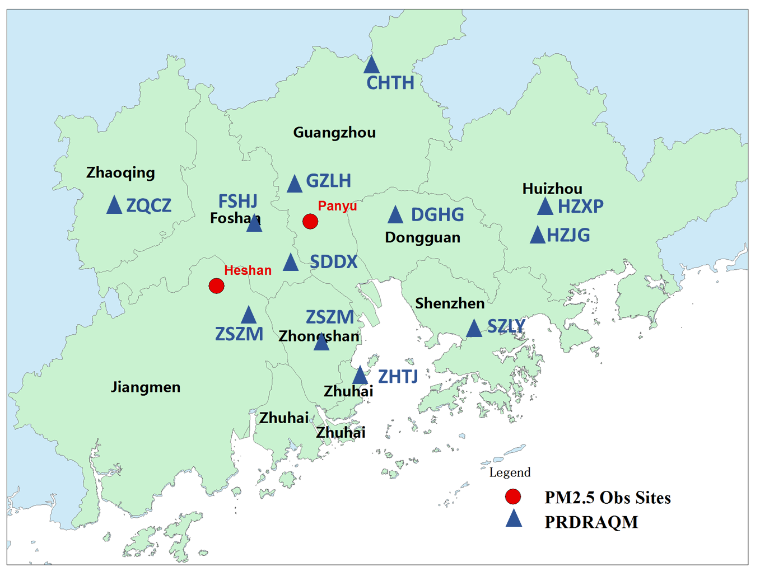
A case study: uncertainty analysis of PM_{2.5} simulations in the Pearl River Delta (PRD)
Domains (D1/D2/D3)
WRF/SMOKE-PRD/CMAQv5.10
Simulation periods: April 2013
Observations Data：PRDRAQM network (12 sites) + Online specie observations (Panyu site)
Metrics：FB，FE，PIT，reliability diagram…
Notes:
We applied the new RFM approach to conduct the uncertainty analysis of PM2.5 simulation in the PRD region with the use of CMAQ model version 5.0.2. We focused on the third domain, which covers the PRD region. We used April 2013 as a simulation period, when local sources and cross-boundary transport have a parallel impact on PM_{2.5} formation in PRD.

Slide 14
A schematic of the steps involved in the uncertainty analysis of CTMs
Uncertainty in inputs
Uncertainty propagation
Uncertainty in
outputs
Identify key sources
Quantify input uncertainty
Observations
CMAQ
Uncertainty evaluation
Sensitivity analysis
DDM-SRSM
Quantification of uncertainty
Source Attribution
Improvement of the key sources
Sensitivity analysis filter out unimportant inputs for further uncertainty analysis
Notes:
Here shows the schematic of the steps involved in the uncertainty analysis of CTMs. Because CTM model have numerous inputs, but most of them are insensitive inputs and pose slight impact on model simulation. Therefore, we use sensitivity analysis to filter out unimportant inputs to reduce the number of uncertainty sources that consider in uncertainty propagation. This can make it feasble to use RFM approach to propagate uncertainty. For the rest of the steps, I I won't go into detail due to the limited time.

Slide 15
Sensitivity analysis: filter out unimportant inputs
PM_{2.5}
Based on the sensitivity analysis, 10 out of 210 uncertainty sources were considered in the case study:
Emission rates（PM_{2.5}、NH₃、SO₂、NOx、VOC）
PM_{2.5} and O₃ concentrations in BCs
Wind speed, temperature and RH
None of chemical reaction rates was considered due to the relatively low sensitivity and uncertainty (most of them < ±20% in IUPAC or JPL database)
Notes:
Based on the sensitivity analysis, we identify 10 important inputs for further uncertainty analysis. Them are ****, But none of chemical reaction rates were considered. Most of their uncertainties are less than plus or minus 20%.

Slide 16
Uncertainties in selected model inputs
Inputs uncertainties
Uncertainty sources | Distribution type | Uncertainty rage
SO₂ emissions | Lognormal | (-30%, 45%)
NOx emissions | Lognormal | (-30%, 50%)
NH₃ emissions | Lognormal | (-40%, 80%)
VOCs emissions | Lognormal | (-50%, 100%)
PM_{2.5} emissions | Lognormal | (-50%, 100%)
O₃ LBCs | Lognormal | (-50%, 65%)
PM_{2.5} LBCs | Lognormal | (-38%, 148%)
Temperature | Normal | （-3℃,3℃)
Wind speed | Lognormal | (-50%, 60%)
Relative humidity | Normal | (-20%, 20%)
Quantitative approach: bootstrap simulation was used to quantify uncertainties in emission factors and emissions parameters. Can be done by AuvToolPro
Based on simulation bias: the uncertainty was estimated based on simulation bias, assuming that the uncertainty range can cover most of the observed data.
Notes:
The uncertainties (Table S4) in these selected inputs were quantified. For emissions, their uncertainty were quantified using a statistical method based on bootstrap simulation and monte Carlo simulation. For other measurable inputs, their uncertainties were estimated based on simulation bias and the assumption that uncertainty range can cover most of the observed data.

Slide 17
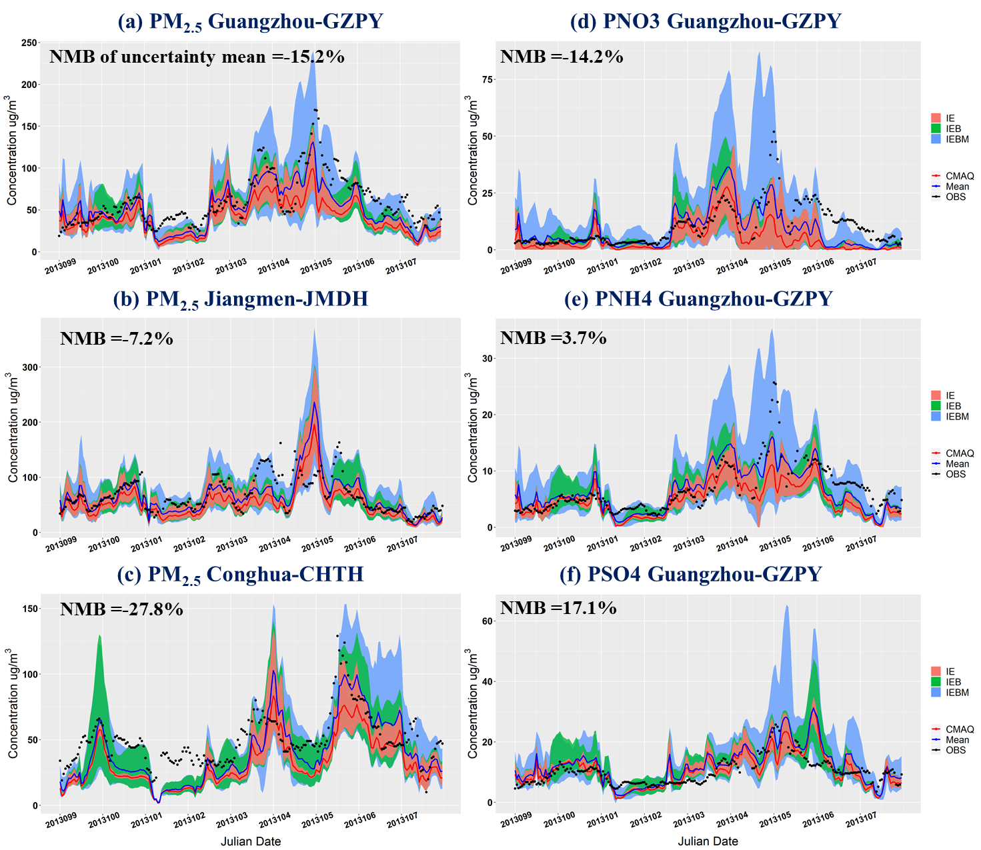
Parametric uncertainties in PM_{2.5} simulations in the PRD
Relative uncertainty (RUN)=61.2%
RUN=202.2%
Relative Uncertainty: PNO3>PNH4>PSO4> mass PM_{2.5} , explains why nitrate simulation generally has significant bias.
The uncertainty mean improves model performance (NMB: from -36% to -15%), but was still underestimated
Partly due to systematical underestimates in SOA simulations. (uncertainty range of SOA:4.5 – 5.2 μg/m³ < SOA observations: 6.4 – 8.5 μg/m³)
RUN=60.2%
RUN=83.3%
RUN= 59.3%
RUN= 62.2%
$$Relative uncertainty= \frac{95\% CI}{2×Q_{median}}$$
Notes:
We use relative uncertainty that defined as the ratio of 95% CI to the double median to measure the uncertainty. Guangzhou (GZLH), Jiangmen (JMDH) and Conghua (CHTH), which are located in the urban, rural and downwind areas of the PRD region, were selected as examples. in Guangzhou, the uncertainty in PM_{2.5} species were also quantified. We used different color to denote the uncertainty from emission, Boundary condition and meteorology. As we can see in the figure, there is largest parametric uncertainties in nitrate simulation, followed by PNH4, PSO4 and the mass PM2.5. This can partly explain why current CTMs generally have poor performance in simulating nitrate.
Also, when we average the uncertainty, we found that the uncertainty mean can improve model performance, this is because The average of uncertainty cancel out part of uncertainties in model inputs. However, the uncertainty mean was still underestimated, Partly due to systematical underestimates in SOA simulations.

Slide 18
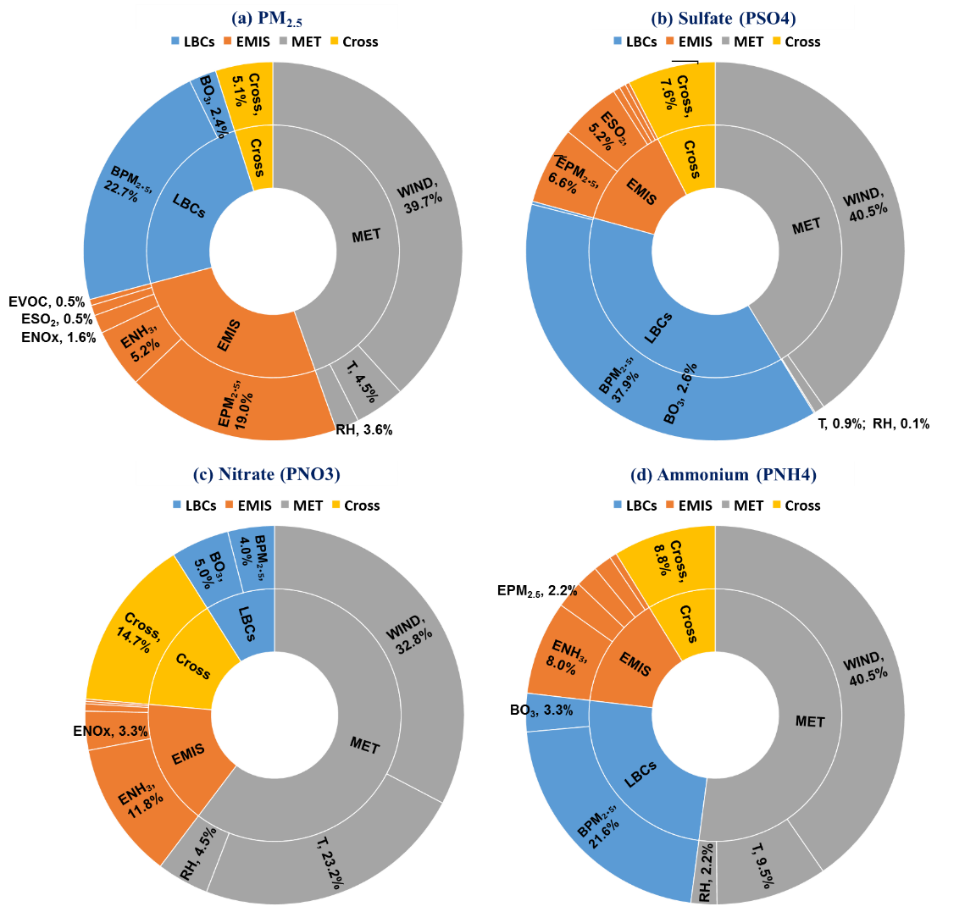
Attribution of uncertainties in PM_{2.5} simulations to model inputs
Wind speed (39.7%), PM_{2.5} boundary conditions (22.7%) and PM_{2.5} emission (19.0%) are the main parametric uncertainty sources for PM_{2.5} simulations in PRD
Temperature and NH₃ emissions become the two key uncertainty sources for nitrate simulations.
Key uncertainty sources might vary case by case
Notes:
In RFM approach, the Coefficient values encompass a quantitative measure of the contribution of uncertainties in inputs to uncertainties in model outputs. Based on this idea, we attribute the uncertainties in PM_{2.5} simulations to model inputs. Results reveal that Wind speed (39.7%), PM_{2.5} boundary conditions (22.7%) and PM_{2.5} emission (19.0%) are the main parametric uncertainty sources for PM_{2.5} simulations in PRD. For species, the key uncertainty sources are slight different. For nitrate simulation Temperature and NH₃ emissions become the two key uncertainty sources. Therefore, a better NH₃ emissions and temperature simulations can enhance the nitrate simulation.

Slide 19
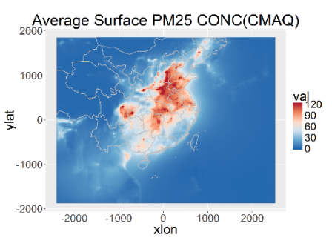
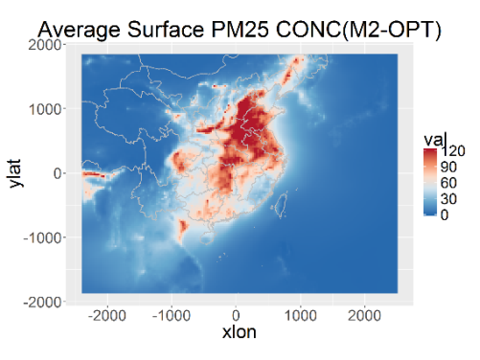
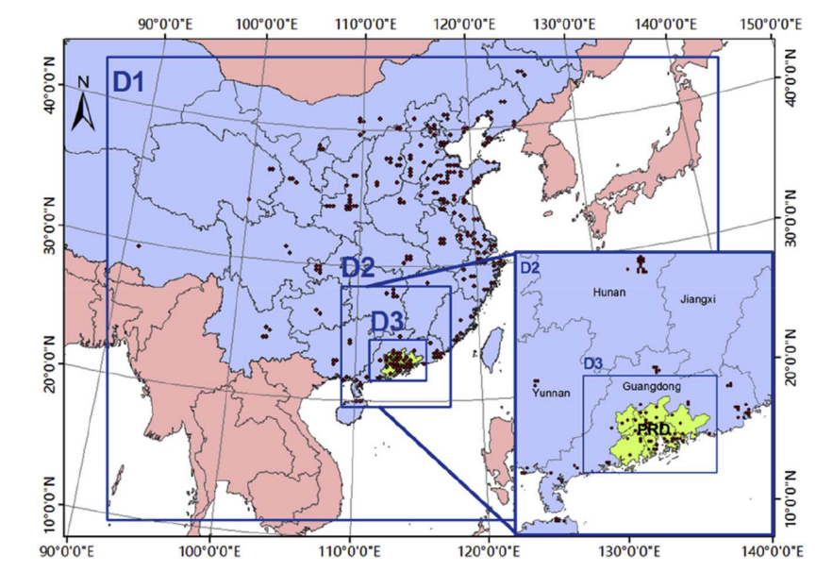
Data fusion to enhance LBCs
CMAQ fields
Fused PM_{2.5} concentrations
Data fusion
Enhanced LBCs
PM_{2.5} Observations
Huang, Z., Hu, Y., et al. 2018, AE
LBCs generally derived from CTM output that contains simulation bias.
Data fusion blends the observations with gridded model output
The fused data maintains the accuracy of observations and the wide spatial coverage of CTMs output.
We fused the daily observations and daily CTM output to enhance LBCs
Notes:
In order to evaluate whether or not key uncertainty sources identified in this case study can help us improve model performance, we used a data fusion approach to reduce uncertainty in PM2.5 concentrations in BC
The data fusion method blends the observation with model output. The fused data can maintain the accuracy of observations and the wide spatial coverage of CTMs output, and thereby is more reliable than the model output. Then this fused data was used to create LBCs

Slide 20
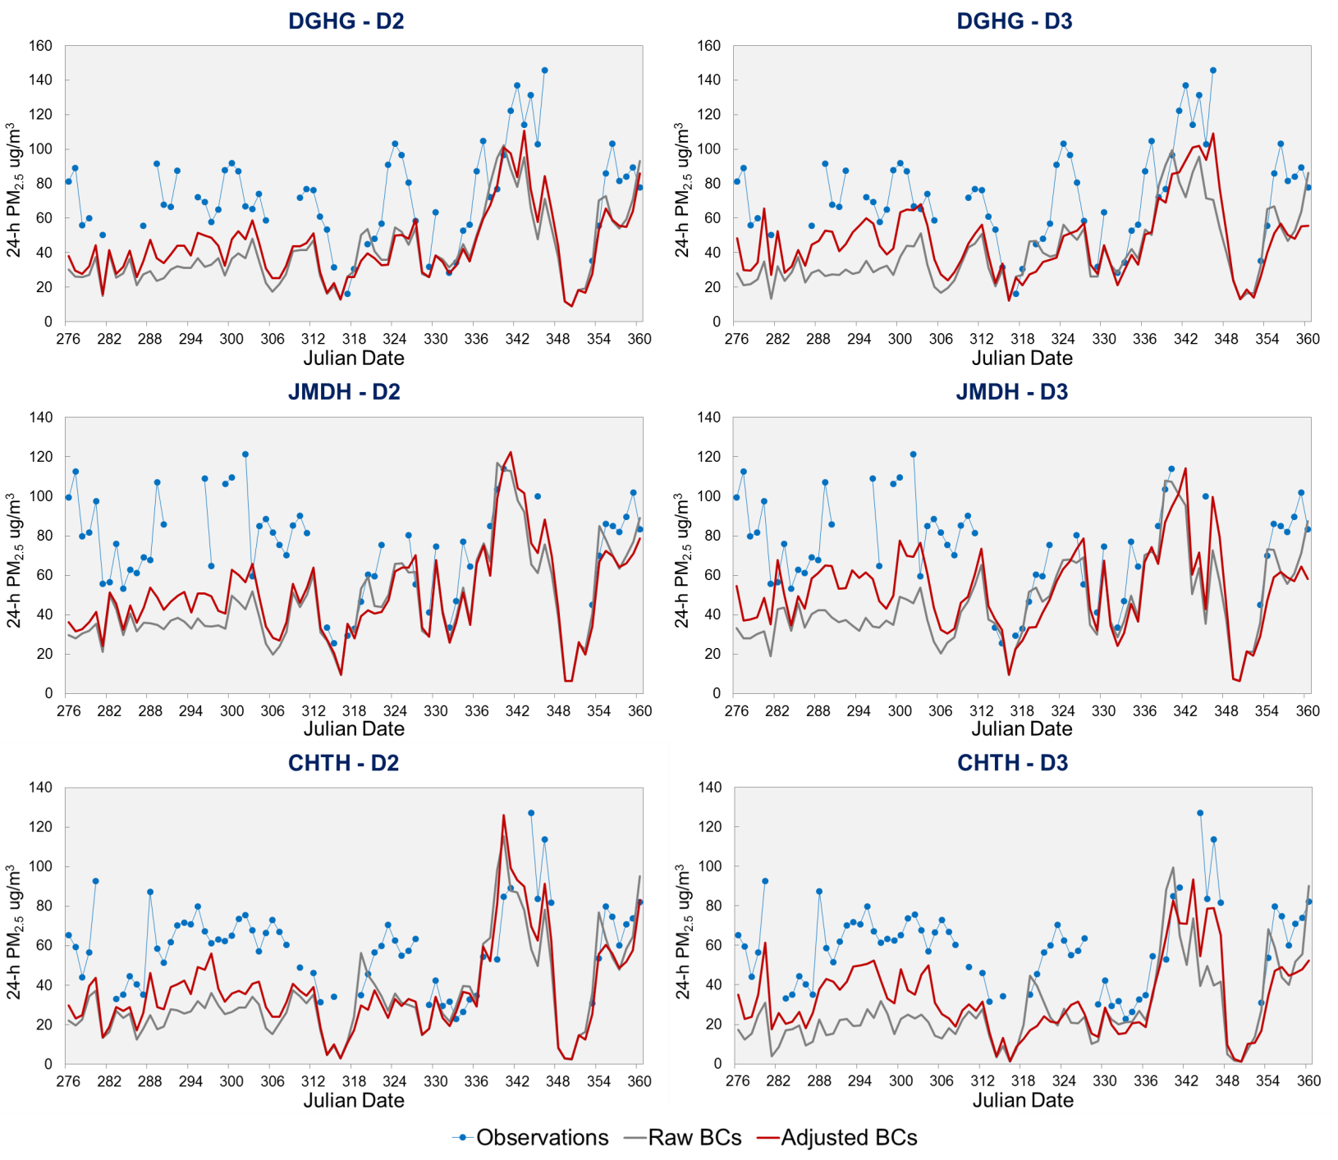
Impacts of enhanced LBCs on PM_{2.5} simulations
Urban site
Downwind
site
Upwind
site
Notes:
the results showed, with the improved BCs, the models have better performance in simulating PM2.5 concentrations, indicating that the uncertainty analysis can help us improve CTMs.

Slide 21
Take home messages
Sensitivity analysis can boost the uncertainty analysis of CTMs by filtering out unimportant uncertainty inputs.
The coupling of DDM/HDDM with SRSM saves approximate 64% of the up-front computational cost compared with the traditional SRSM. This idea can also be used to improve the efficiency of RSM.
There is light overfitting in high-order (>3) DDM-SRSM. If uncertainties in inputs change, the RFM must be rebuilt based on new uncertainties in inputs.
Uncertainty analysis is a effective means to diagnosis CTMs. In the case study, systematic bias in SOA simulations and the key uncertainty sources of PM_{2.5} simulations were identified.
Identifying key uncertainty sources can help CTM improvements.

Slide 22
Thanks for your attention！

Slide 23
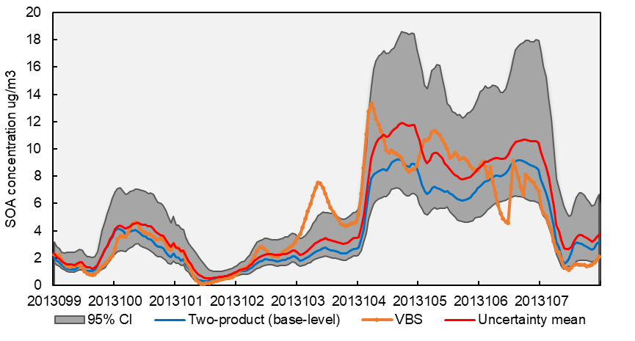
Systematic underestimates in SOA simulations identified by uncertainty analysis
Uncertainties in SOA simulations
95% CI of uncertainty in SOA associated with emissions, LBCs and MET:
4.5 – 5.2 μg/m³
<
Averaged SOA concentrations based on field measurements:
6.4 – 8.5 μg/m³
The parametric uncertainty range of SOA is lower than the averaged observed SOA concentrations, revealing the systematic underestimates in SOA simulations using the two-product method applied in CMAQv5.0.2.
Using the volatility basis set (VBS), a new SOA module, the simulated SOA concentrations increase by 16%.

Slide 24
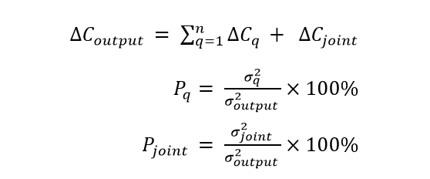
Identify the key uncertainty sources impact model simulations
Method 1: based on correlation coefficient, for MC and RFM
Method 2: Regression model, for MC
Method 3: Variance-based method, for RFM, similar to PSAT/OSAT, but based on variance
The total concentration change is separated into concentration changes due to the perturbation in each single input and changes due to perturbations in multiple inputs. Then, the total variance and variances in MCM for each input are calculated.

Slide 25
LASSO： least absolute shrinkage and selection operator, a regression analysis method that performs both variable selection and regularization to reduce the overfitting and enhance the prediction accuracy.

