Slide 1
Investigating the formation of the high ozone exceedance on 25th September 2013 during the NASA DISCOVER-AQ Texas campaign
17th Annual CMAS Conference
Shuai Pan, University of Houston (UH), now postdoc at Cornell University
Yunsoo Choi, UH
Wonbae Jeon, UH, now at Pusan National University
Anirban Roy, UH, now at California Air Resources Board (CARB)
David Westenbarger, Texas Commission on Environmental Quality (TCEQ)
Hyun Cheol Kim, NOAA Air Resources Laboratory; University of Maryland
10/23/2018

Slide 2
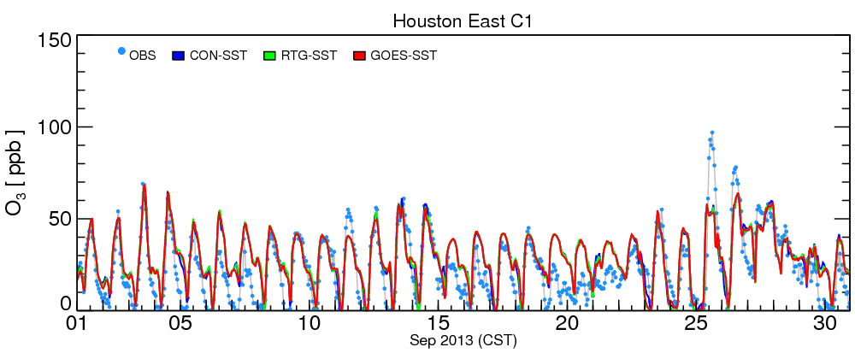
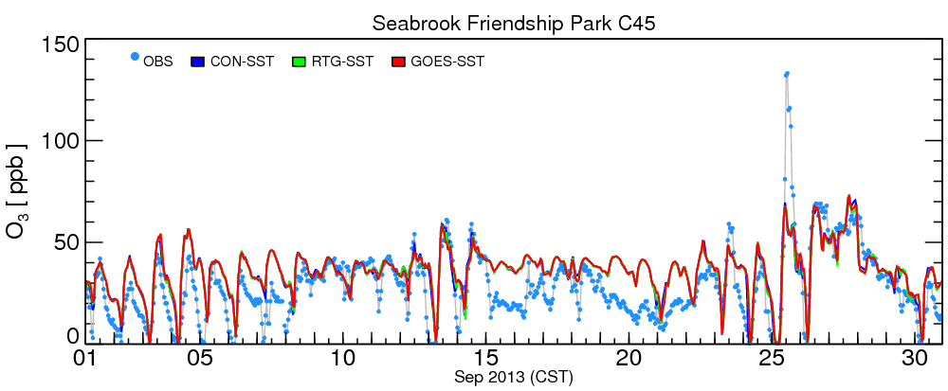
O3 time series of the month of Sept. 2013
urban site
High O3 episode
industrial/coastal site

Slide 3
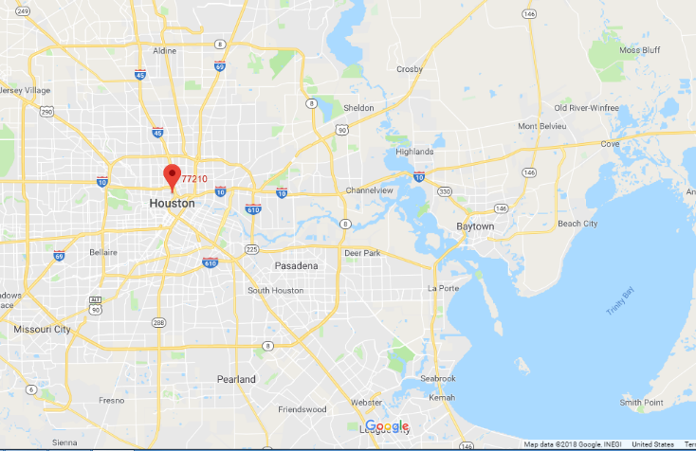
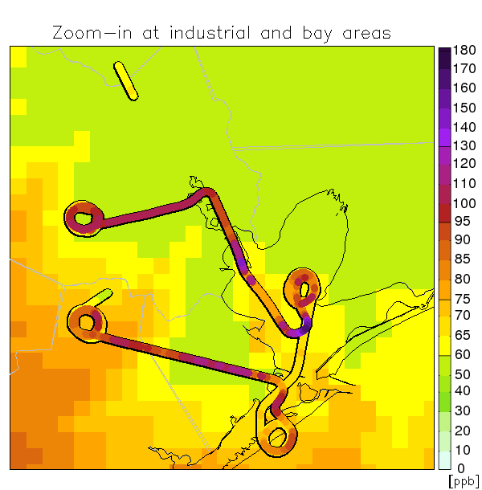
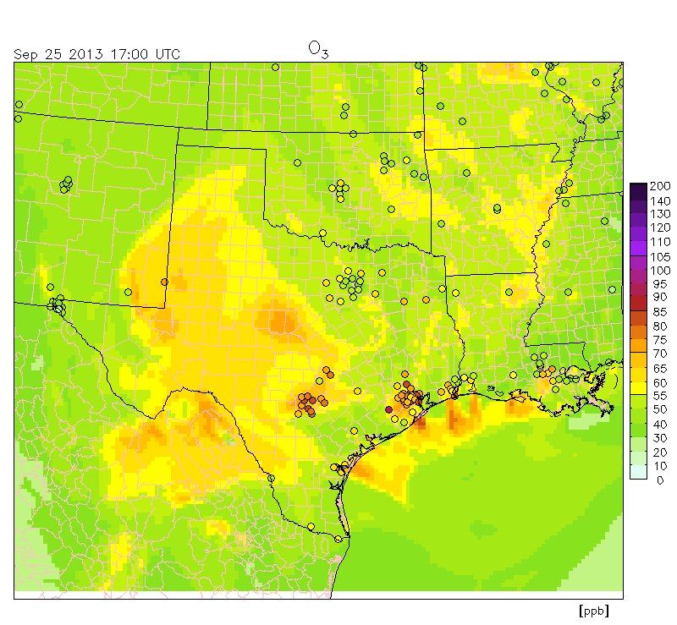
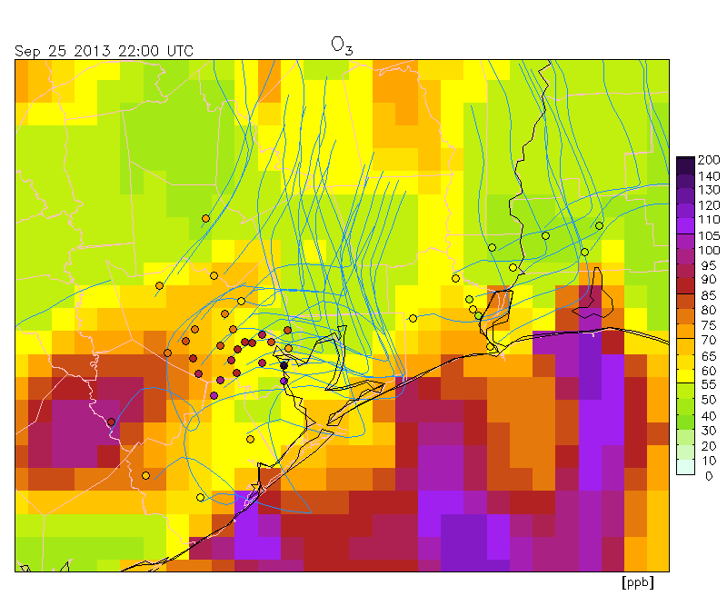
O3 obs-model discrepancy in the afternoon of 09/25
Ship channel
industrial area
Zoom-in at industrial and bay areas
P3B vs CMAQ
petrochemical and chemical manufacturing facilities
1-3 pm 2 pm
11 am - 5 pm
AirNow vs CMAQ

Slide 4
Possible causes of the high O3

Slide 5
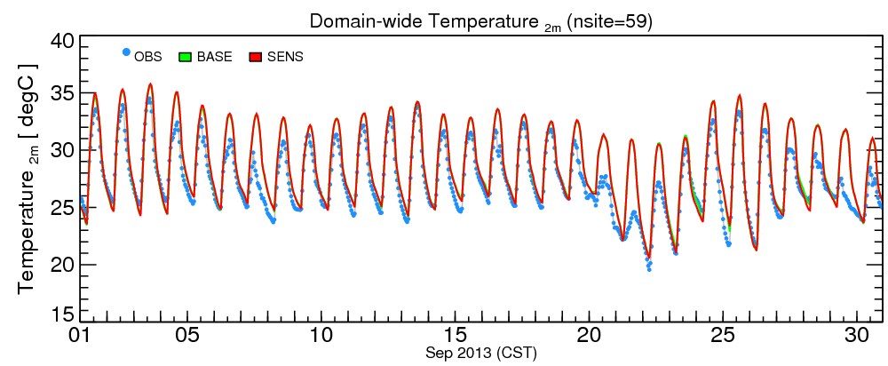
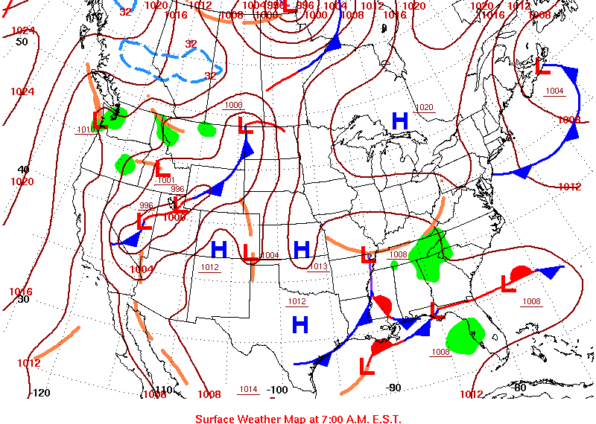
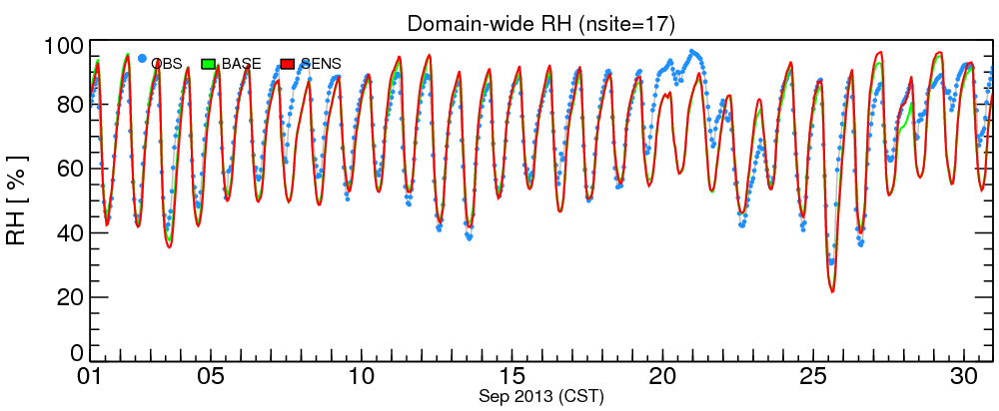
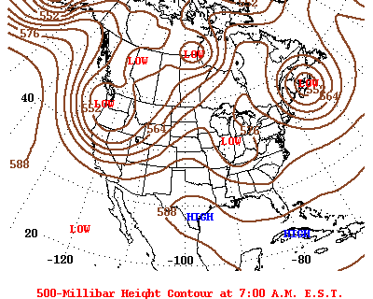
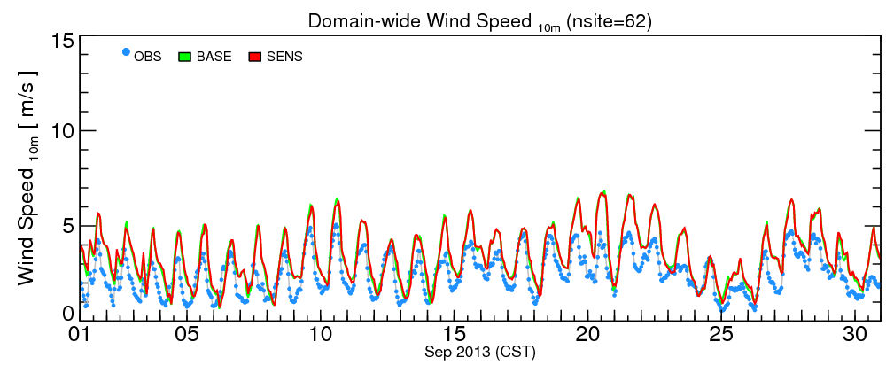
Meteorological conditions favoring O3 production
frontal passage
sunny
dry
weak wind
High O3 caused by
postfrontal conditions
(Rappenglück et al., 2008;
Ngan and Byun, 2011)

Slide 6
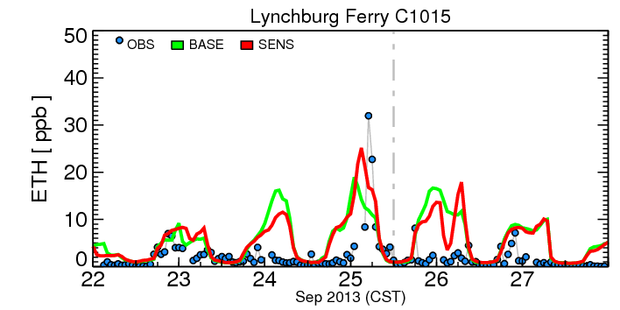
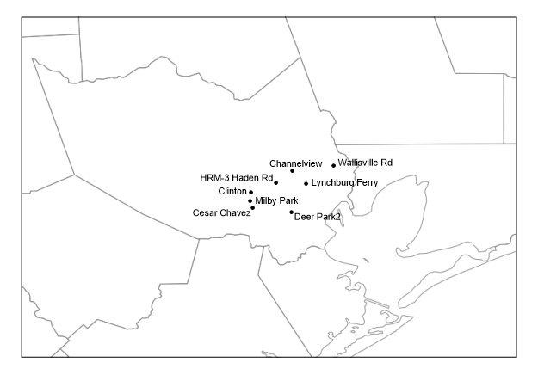
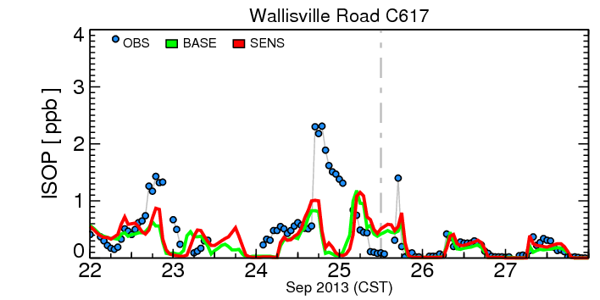
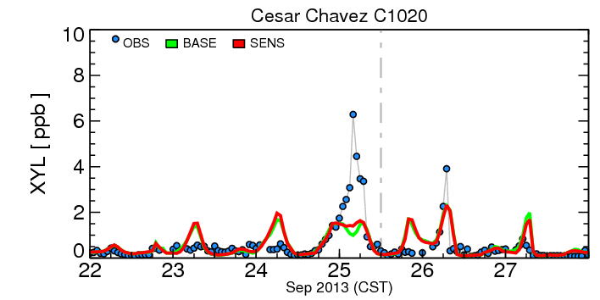
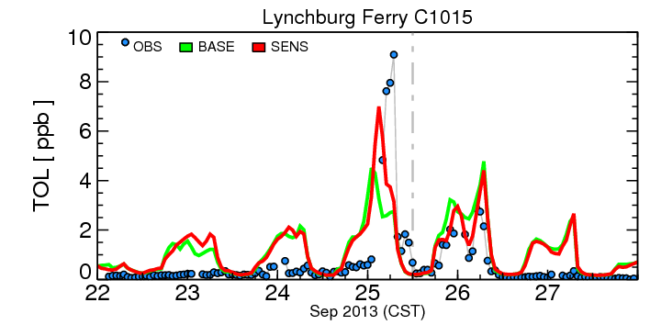
HRVOCs’ amount
12CST
unexpected episodic flare emissions (Murphy and Allen 2005; Vizuete et al. 2008)
emission upset?

Slide 7
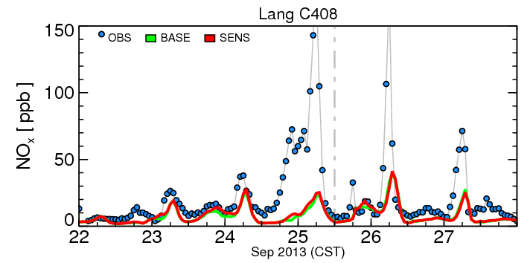
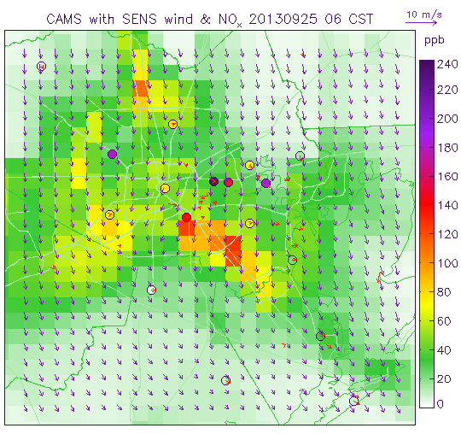
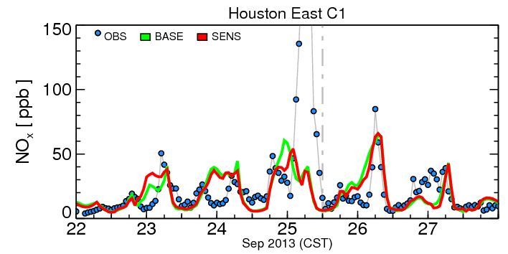
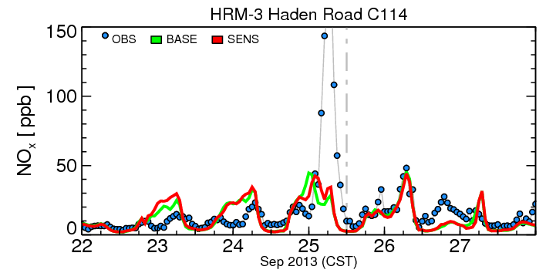
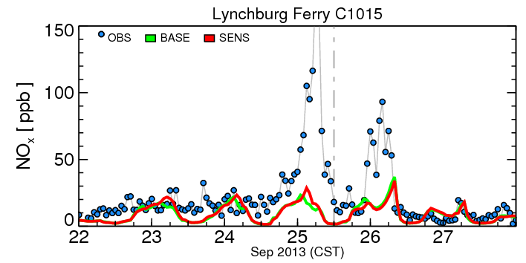
NOx and local wind
exceptional high obs.
At early morning time,
OBS: calm or very weak westerly
Model: weak northerly, or northwesterly

Slide 8
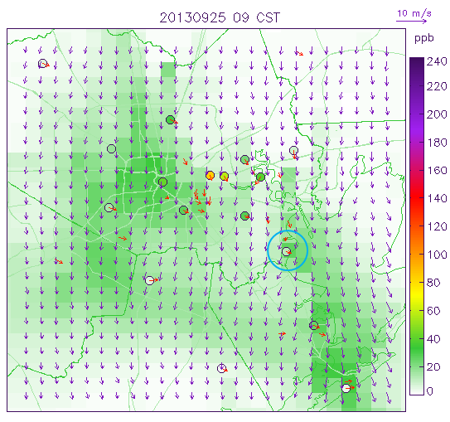
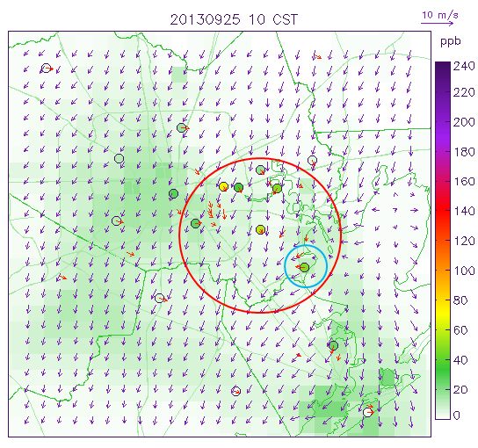
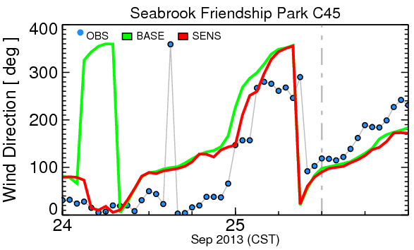
Wind reversal and converging zone
09 -> 10 CST
Wind reversal at west coastline of Galveston Bay transported back the pollutants which were previously blown into the bay.
After that, a wind converging zone formed at Ship Channel, and lasted for several hours.

Slide 9
Possible causes of the high O3
Causes of the high O₃ on 25 September 2013
possible episodic flare emissions,
dry sunny postfrontal conditions,
calm or light wind,
nocturnal shallow boundary layer,
land-bay/sea breeze transition, wind reversal.
Reasons of model insufficient performance
Discrepancy in local wind patterns and precursors’ conditions

Slide 10
Emission and wind adjustment and sensitivity simulations

Slide 11
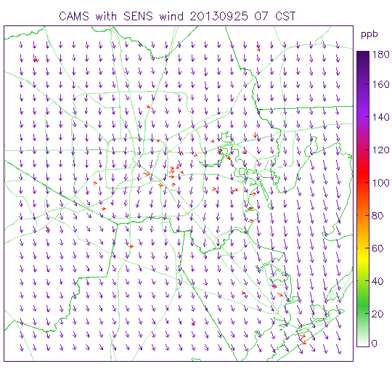
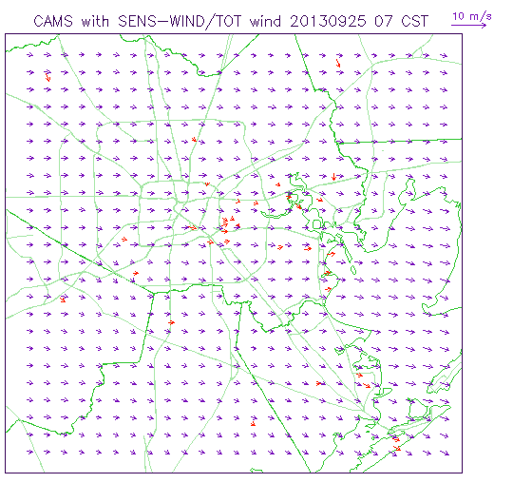
Adjusted conceptual wind fields
ratiohr = ave(sim)/ave(obs)
Adjusted wind 1
00 - 07 CST 3 layers, ~160m
UWIND_adj = 1/ratio*abs(VWIND)
VWIND_adj = -1/ratio*abs(UWIND)
weak westerly

Slide 12
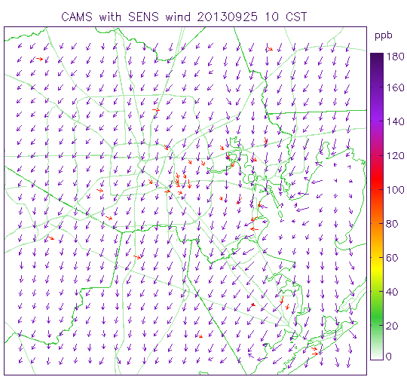
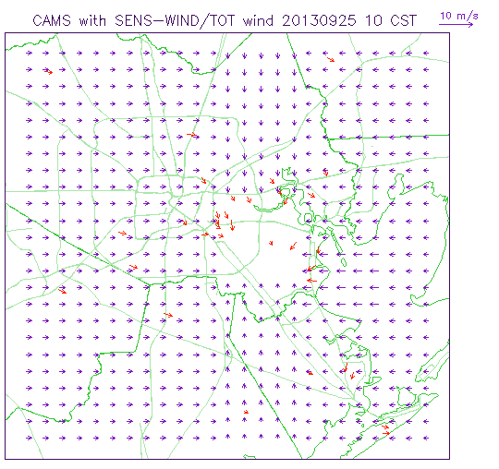
Adjusted conceptual wind fields
Adjusted wind 2
09 - 16 CST 17 layers, ~2000m
Same converging wind for each hour

Slide 13
4 Simulation Cases
SENS: SST (updating WRF with hourly NOAA GOES SST)
SENS-EMIS: SST+ unexpected NOx and VOC emissions
SENS-WIND: SST + wind fields adjustments
SENS-TOT: (2)+(3)

Slide 14
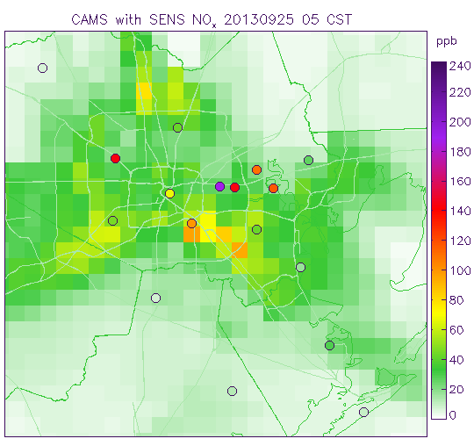
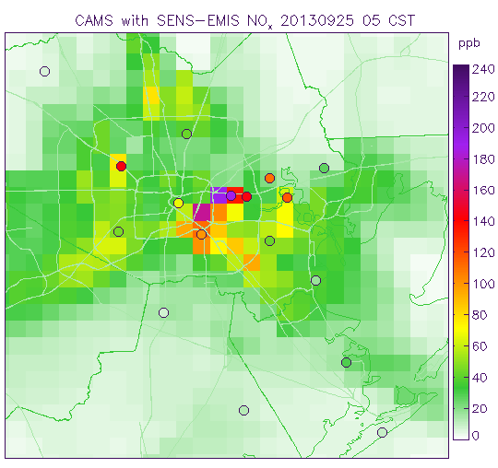
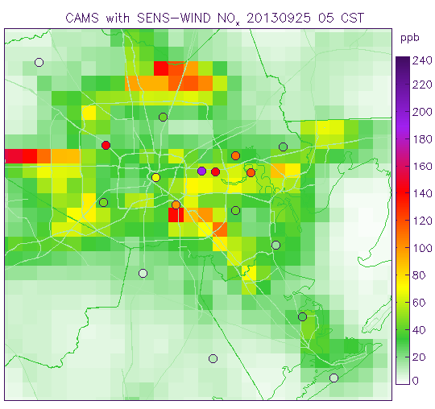
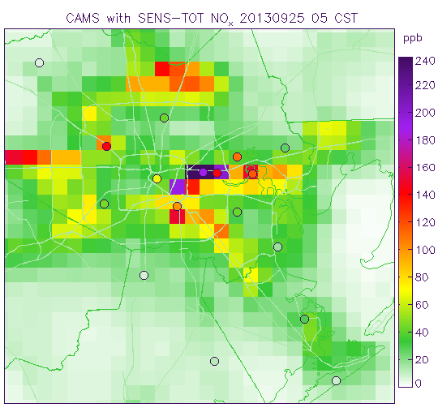
NOx at 05CST
increase at grid cells
SENS SENS-EMIS
SENS-WIND SENS-TOT
domain-wide increase

Slide 15
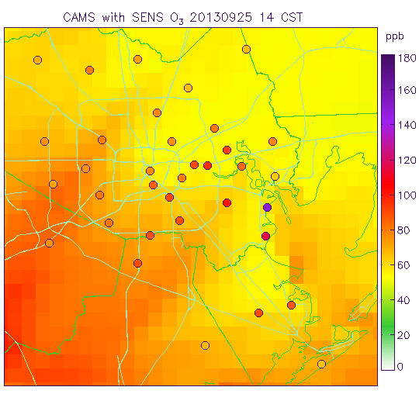
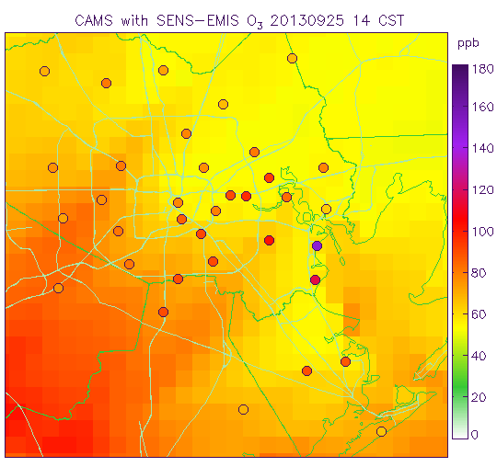
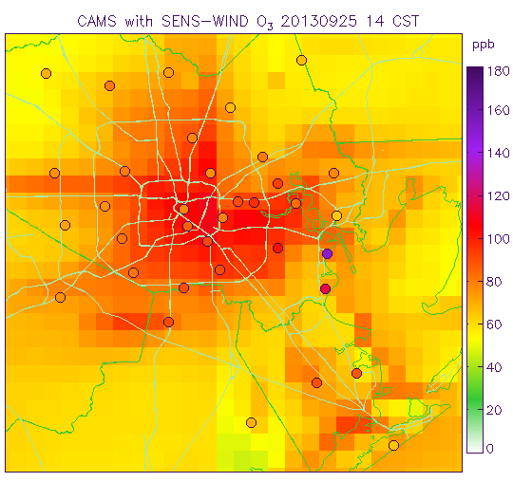
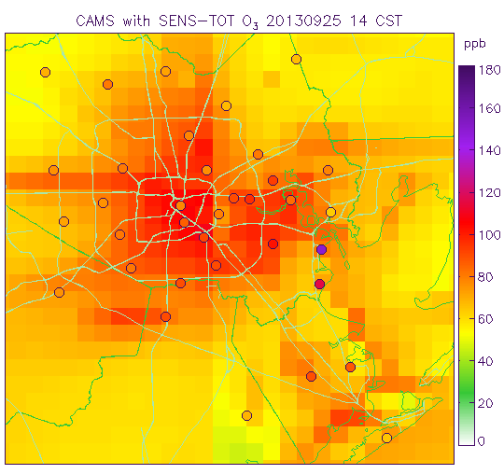
O3 at 14CST
SENS SENS-EMIS
SENS-WIND SENS-TOT

Slide 16
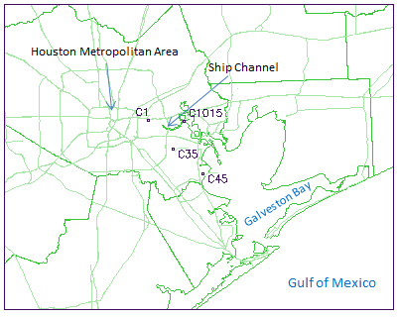
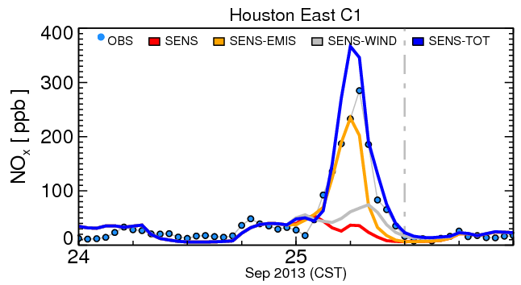
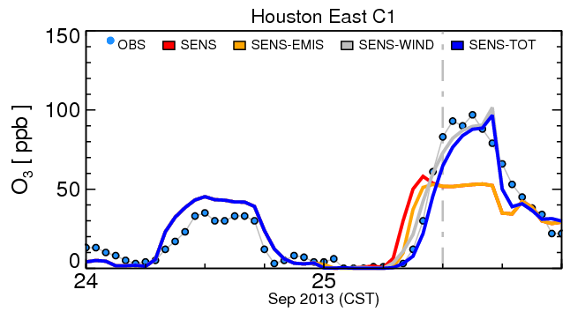
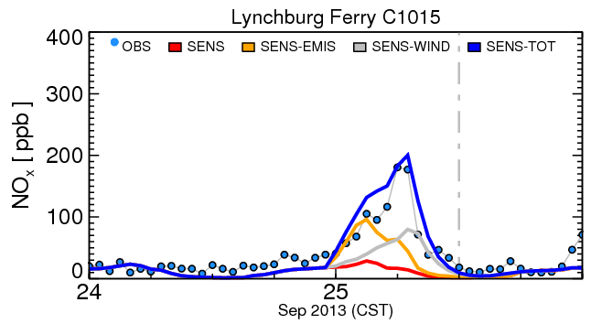
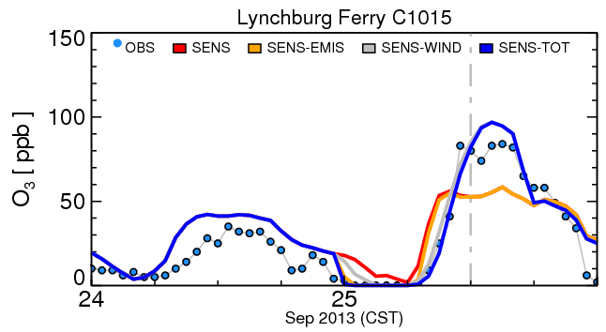
NOx and O3

Slide 17
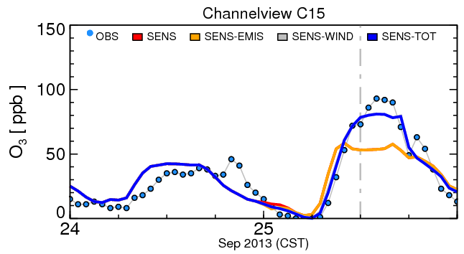
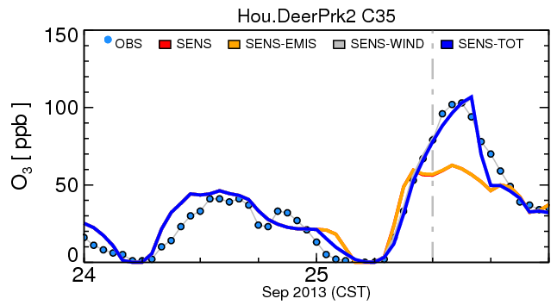
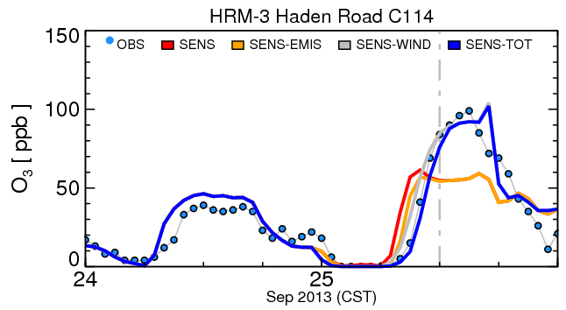
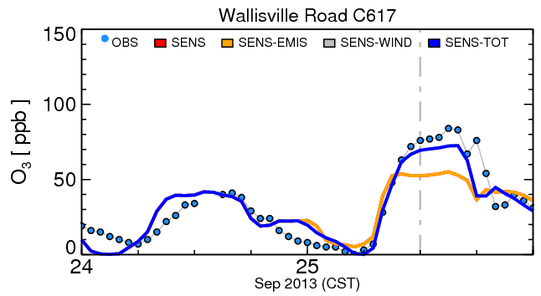
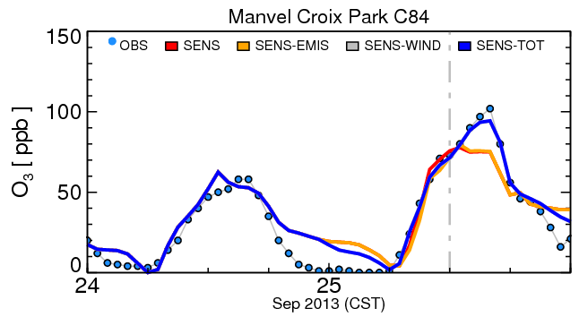
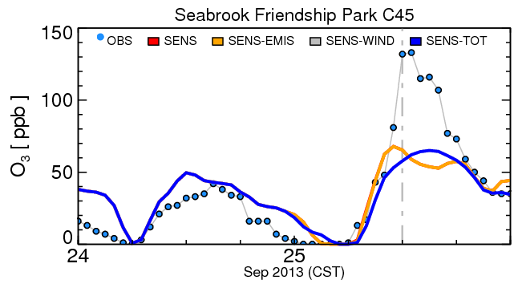
O3 at other sites

Slide 18
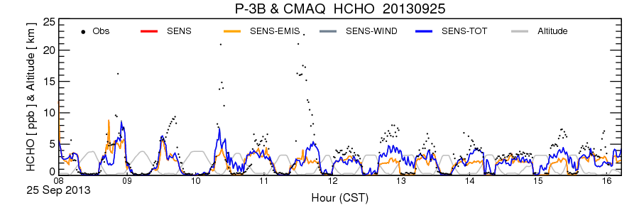
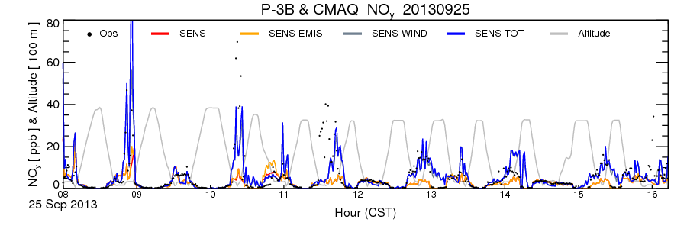
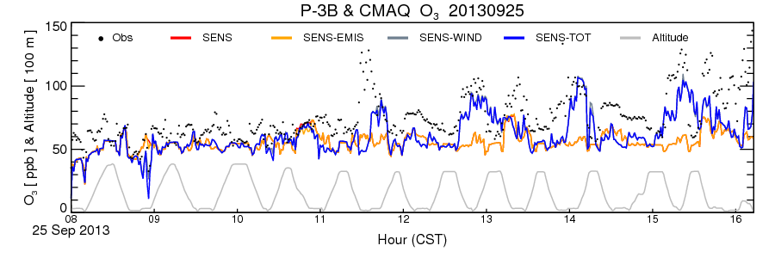
P3B vs CMAQ

Slide 19
Summary
Causes of the high O₃ on 25 September 2013
possible episodic flare emissions,
dry sunny postfrontal conditions,
calm or light wind,
nocturnal shallow boundary layer,
land-bay/sea breeze transition, wind reversal.
With “better” emission and wind, model predictions can become more accurate (amount, location, timing).
Suggestions
Improving model’s capability to reproduce small scale meteorological conditions favoring O₃ production, such as stagnation and wind reversals, is needed.
Land-sea/bay circulation patterns may last for long time.
Need better industry emissions management, clean transportation.

Slide 20
Thank you! Questions?
Further questions can be sent to: sp694@cornell.edu or shuaipan87@qq.com

Slide 21
Observed wind during flight taking off and landing
0-1000 m at 7 CST and 10 CST
weak westerly
0-2000 m at 13 CST and 16 CST
roughly converging
NOAA MADIS Aircraft Communications Addressing and Reporting System (ACARS)

Slide 22
PBL
(Haman et al., 2012; 2014)
On high ozone days,
PBL heights are consistently lower during nighttime/morning;
observed PBL growth rates are lower during early morning
UH
A rapid increase (>1000 m) at noon
06 CST
nocturnal shallow boundary layer
14 CST

Slide 23
Dominate flow patterns
09/24 16CST
09/25 16CST
1-day backward trajectory using MCIP 10-m wind

Slide 24
Impact of biomass burning
Base: baseline emission
BB: Base + fire emission

