Slide 1
2018 CMAS Users Forum: CMAS Data Warehouse and Modeling Platform
Facilitator : B.H. Baek
Panelists : Alison Eyth (U.S. EPA)
Barron Henderson (U.S. EPA)
Weining Zhao (TCEQ)
Talat Odman (Georgia Tech University)
Mathew Alvarado (AER)
Notes:
Good Morning Everyone. Thanks for joining our 2018 CMAS Users Forum discussion. From time to time, we have been having this users forum with the CMAS participants to discuss various topics that matters to the air quality communities. Few years back, we had another user’s forum to discuss about the the concept of data, model and other tools sharing within the air quality community. Since then we have made some progress on that subject and we would like to share some of work we have started with US EPA and open this floor to you guys to hear what you want. To start the conversations, we have invited five panelists today across various fields.
First, we have an emissions inventory modeling expert, Ms. Alison Eyth from Inventory and Analysis Group in U.S. EPA, Modeling expert across various field from air quality to climate, Dr. Barron Henderson from the air quality modeling group in US EPA, Also, we have Weining Zhao from Texas Commission on Environmental Quality who have been working on developing an air quality modeling web tool, Professor Talat Odman from Georgia Tech who represets the researchers in academia, and the last is Dr. Alvarado who recently worked on air quality modeling on cloud computing resources.

Slide 2
Motivations
The m3users community would benefit from access to new, open datasets
Modeling Inputs and outputs
Share their own models, datasets and tools
Better/Easier Discoverability
With more download options
Citations for models, datasets, and tools
How can we make modeling setup and runs easy, affordable, and portable?
Easier Installation and setup of modeling systems
Low cost option for air quality modeling system
Global Support

Slide 3
Panelist Presentations
Barron Henderson: AQ Modeling Group, OAQPS, U.S. EPA
Alison Eyth: Inventory and Analysis Group, OAPQS, U.S. EPA
Weining Zhao: Texas Commission on Environmental Quality (TCEQ)
Matthew Alvarado: Atmospheric and Environment Research (AER)
Talat Odman: Professor, Georgia Tech University

Slide 4
CMAS Cloud Data Warehouse
Product | Storage (GB)
CMAQ | 876
12US1 (2002-2014) | 68 per year
SMOKE
2014fd_2015fd_2016fd | 300
NEIshare | 506
Onroad (MOVES) | 83
Surrogates | 25
MCIP
soas_2013_cb6 | 875
WRFv3.8_12US_2015 | 4,354
WRFv3.8_4NE2_2015 | 565
IC/BC
2014_12US1 | 0.660
cb6r3_ae6_aq | 359
Total | 8,588

Slide 5
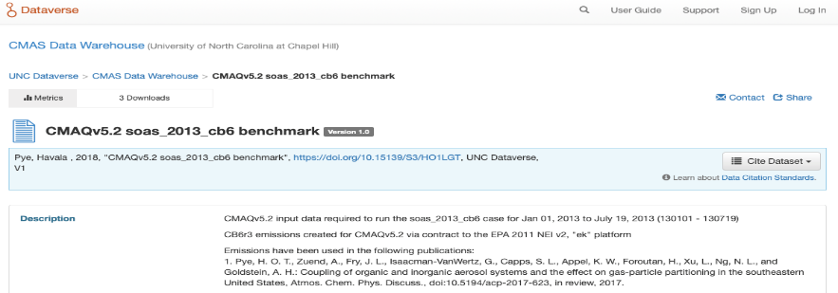
CMAS Data Warehouse:Dataverse

Slide 6
Dataverse Features:
Metadata Support
Versioning Capability
Discoverability and Searchability
Published Data and Models Citation
DOI : Digital Object Identifier
Data File types
Data Provenance
Any types of datasets: NCF, JPG, Rdata, Various Tabular formats, Geospatial, Compressed Files,,,
Cloud Storage + Computing

Slide 7
CMAS Cloud Modeling Platform
Cloud Computing Platforms:
Google Cloud Platform and Amazon Web Services
Cloud Ecosystem:
Direct Access to the Cloud Data Storage
Cloud-based Modeling System Instances
Individual or multiple modeling system Instances
CMAQ, SMOKE, WRF, EMF, AMET, Spatial Allocator, Speciation Tool Instances including input datasets, and run scripts

Slide 8
Benefits of CMAS Cloud Modeling Platform
Easy to Scale Up (More Computing Power and Storage)
Facilitate Collaborations (Sharing identical Instances)
No Hardware and System Maintenance and Updates
No full-time IT Support Staff (No Overhead)
On-Demand Usages: (Low Modeling Costs)
Data Safety and Automatic Backups
World-Wide Zone Support for the fastest connectivity to the Cloud Platforms

Slide 9
Use Case: MARAMA EMF-SMOKE-MOVES in AWS
Notes:
Amazon Elastic Block Store (EBS), LTS (Long-Term Stoarge), NFS (Network File System)

Slide 10
Use Case: Cost Estimates using AWS
On-Demand instance
Shut down during the night and the weekend
Cost Estimates: [Total : Average $300/month]
EMF on AWS Instance m3.xlarge ($0.266/hr) : 226 hours ≃ $71/month
2 TB shared EBS HDDs: 0.10 per GB-Month ≃ $200 per month
SMOKE Modeling Runs on m3.xlarge instance ($0.266/hr)
One month of regional SMOKE run: 22 hours run times = $6 /month
MOVES modeling runs on m4.xlarge instance ($0.252 per hour)
One reference county MOVES 2014a : 80 hours ≃ Approx. $20 per county
304 reference counties * $20 ≃ over $6,000 for CONUS modeling domain
Notes:
EBS (Elastic Block Store)

Slide 11
PollEv.com/cmas
What is your organization sector?
What is the Biggest Challenges in your current workflow?
What Models/Tools do you use in your current workflow?
What pre-built images on Cloud Computing would you want to use?

Slide 12
Data Sharing from a Few Perspectives
Barron H. Henderson
Private consultant (2002-2006, and here and there)
Academic at the UNC and UF (2006-2016)
Government Scientist at EPA (2016-present)

Slide 13
Competing Generator and User interests
Generating data takes your time and is risky
If the process is simple and quick, will the research community accept the methods?
Will the regulatory community accept the results?
Data Users benefit by collecting data
Storing data is cheap (for many organizations)
Time lost hurts: profit, publications, other?
So the tendency is to request data from providers/generators…
even if you might not need it
Zac Adelman told me he called folks that do this “data collectors”
Perhaps there is a role for “data collectors”…

Slide 14
Ideal world
Data generators want to share
Data collectors act as intermediate repositories
Data users only get what they need from data collectors
This is really the Amazon Web Services model (and others)
Data generators may generate on AWS and store data
Agreements can be reached to host data “long-term”, where AWS acts as the data collector
Data users can independently connect to the data store.

Slide 15
My AWS Experience
CPU time on AWS is reasonably cheap
Data storage on AWS is reasonably cheap
Data download is expensive
Incentive: generate where ever, store in cloud, download only what is necessary and/or use in the cloud
Dr. Alvarado has good news on these fronts
Reality check
Most users do not need to look at every 4-D DENS variable in MCIP
Most users do not need to look at every 4-D XO2 variable in CONC
Most don’t want WRF… etc

Slide 16
Cloud Computing Limitations
By itself, cloud computing does not solve our organization problems.
Cataloguing and discovery is a separate equally important issue.
Can we partner with library sciences?
Geographic Information Systems already has made a lot of progress.

Slide 17
Appendix
My initial thoughts on questions we will be asked.

Slide 18
1. What kind of data can be shared?
Anything can be shared on cloud computing, because whole disks can be almost instantly shared

Slide 19
2. What are the most common constraints with sharing data?
Data ownership and credits
Proprietary value
Fear of unconstructive criticism

Slide 20
3. How the data can be shared? Data discoverability and Data citation (DOI)
Not sure I get this one
availability of documentation that describes the data, how the data were generated, and any limitations/caveats about the data;
ability of data users to interact with the data generators to ask questions about the data; and
responsibility, if any, of the data generator to notify the data users when errors are discovered in the data and/or when updates are made.

Slide 21
4. How can we leverage cloud computing to facilitate Emissions, Air Quality Modeling and Data Analysis?
Great question!
Analysis systems are notoriously hard to install.
Clonable nodes with analysis systems seems like a great place to start.
Clonable data stores means easy application of analysis systems to other data stores.
Instead of getting data providers to put data in special formats and upload to special systems, analysis systems need to be more nimble
Meta-data conventions are important
Analysis system conventions is key too.

Slide 22
5. What is your experience with the cost (financial and personnel) of using cloud computing versus purchasing in-house hardware?
Benefits of in-house is of budget applications
Buy once
Use til it dies
Increasingly against the “rules”
Benefits of cloud computing
Management costs included in price
Package management mostly included in price
Backup availability included in price
Amazon likely has lower overhead per node than smaller providers

Slide 23
6. What benefits or advances do you foresee from data sharing and cloud computing?
Connecting systems to data and data to systems (see question 4)
Are you willing to throw more resources at a problem? Now you could.

Slide 24
Data Sharing and Cloud Computing for Emissions and Air Quality Modeling
Alison Eyth
U.S. EPA Office of Air Quality Planning & Standards
Emission Inventory and Analysis Group
October 24, 2018

Slide 25
Data Sharing Requests
EPA receives dozens of requests for emissions and air quality model input and output data each year
Requestors are from state/local governments, academia, consultants, non-profits, regional organizations, etc.
Requests are for SMOKE, WRF, CMAQ, and CAMx input and output files for regulatory and non-regulatory cases
Most SMOKE input files are small enough to make available on EPA’s web/FTP site, but reassembly for use can be tricky
https://www.epa.gov/air-emissions-modeling
Many other files are too large for the FTP area and are transferred via physical hard drives
For popular data, sometimes we transfer drives to regional organizations who send the drive around to the others
Servicing of data requests requires significant staff time
Notes:
Q: who has asked for data from EPA?

Slide 26
Future Directions in Data Sharing
Today’s network speeds make it easier to transfer larger data sets
Would like to get away from shipping drives around
Ideal solutions allow us to post data once, where everyone who needs the data can retrieve them
OAQPS is working with UNC to post full distributions of emissions modeling inputs and selected outputs
https://drive.google.com/drive/folders/1caRJVHx_SzY0sSD6DL-TE7rgAoSDqrt-
Helps reduce issues with reassembly compared to the split up versions on our FTP site
Also posting some sector-specific SMOKE outputs
More work on this is needed (2016 platform beta and v1.0)

Slide 27
Use of Cloud Computing
Cloud computing is useful for easily decomposed problems
Use MOVES to compute winter and summer onroad emission factors (EFs) for each of 300 representative counties
Use independent nodes / instances to run each of the 600 county-months and download EFs after runs complete
Cloud computing could make emissions and AQ modeling accessible to more organizations
Provide working compiled versions of models (yay!)
Make available key input data sets with working scripts
Streamline applications to new grids / scenarios
Reduces need for hardware and system administration

Slide 28
EPA’s 2019 International Emission Inventory Conference
Biennial conference that connects offices across EPA, regional/state/local/tribal staff, researchers, consultants, and students who work on various aspects of emissions inventory development
2019 Theme: “Collaborative Partnerships to Advance Science and Policy”
July 29-August 2, 2019 in Dallas, Texas
Training on Monday, July 29
Tuesday-Friday: plenary session, technical sessions, lightning talks
More info coming soon to: https://www.epa.gov/ air-emissions-inventories/international-emission-inventory-conference

Slide 29
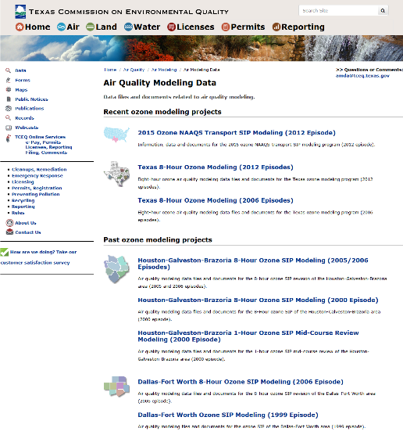
Air Quality Modeling Data on TCEQ Website
https://www.tceq.texas.gov/airquality/airmod/data

Slide 30
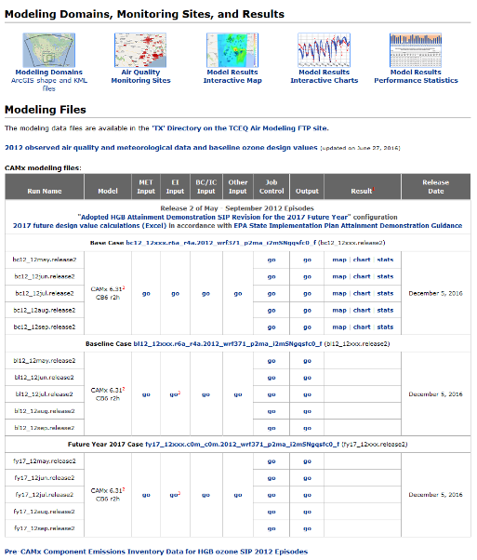
Texas Ozone SIP Modeling Data (2012 Episodes)
Weining Zhao, Texas Commission on Environmental Quality, October 24, 2018

Slide 31
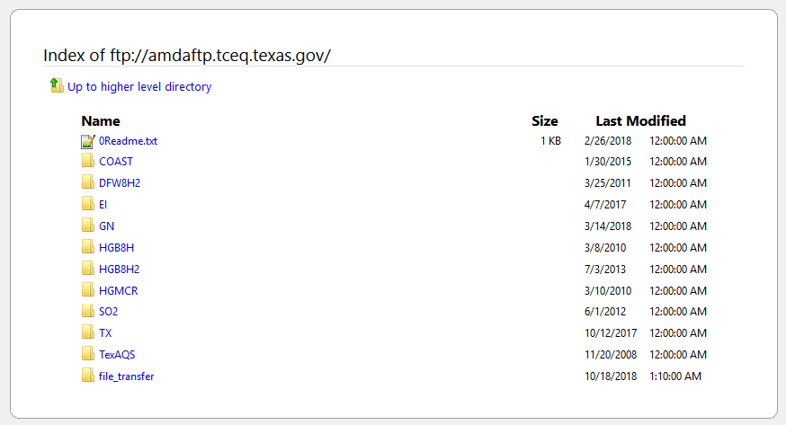
TCEQ Modeling Data FTP Site
2.5 TB
raw EI data
CAMx input and output data
no WRF data

Slide 32
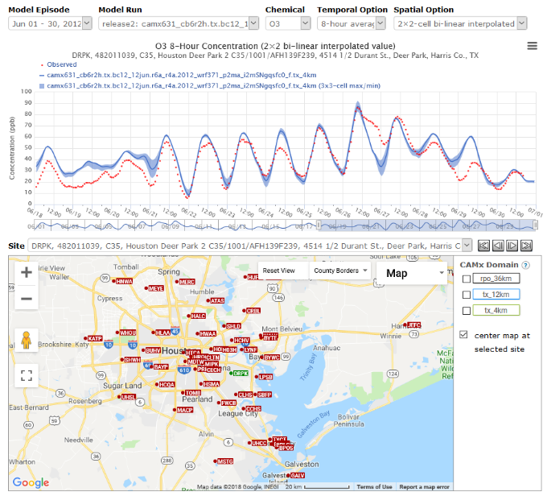
Interactive Time-Series Evaluation Tool

Slide 33
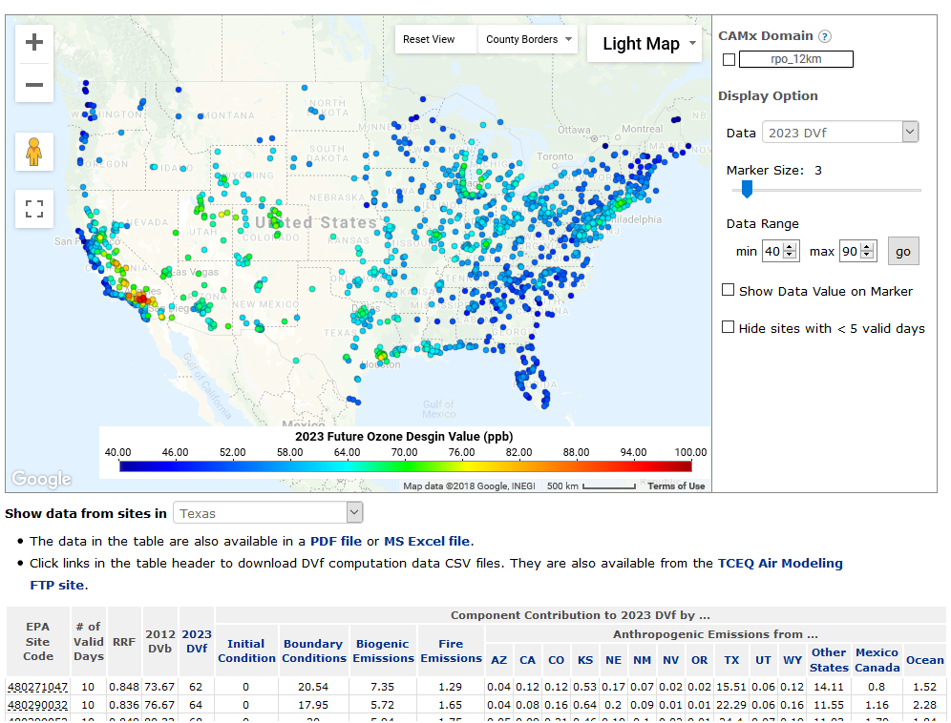
Ozone Design Value Visualization Tool
Ozone Transport SIP Modeling

Slide 34
Cloud Computing: An Academic Perspective Talat Odman and Kevin Kelly
17th Annual CMAS Conference
Chapel Hill, North Carolina
October 24, 2018

Slide 35
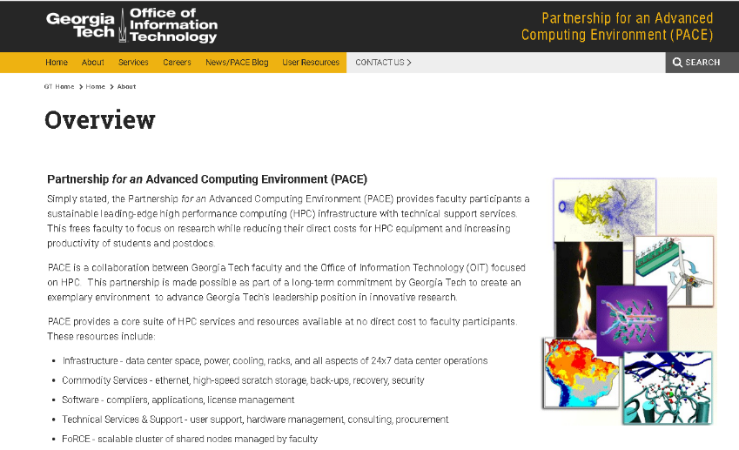

Slide 36
Challenge - Moving the Data
Too much data!
Copying TBs over the Internet
Variable speeds
Sometimes lacks reliability
Wait hours to find out results

Slide 37
Cloud HPC
On-Demand Capacity
Public Cloud HPC
Computation
Environment
Data Store
End Users

Slide 38
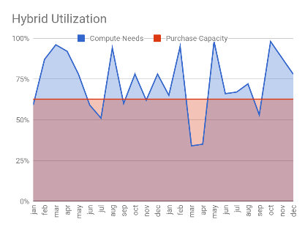
Cloud Computing vs On-Premise
Optimize costs for spiky compute patterns
On-demand for unexpected compute needs
Increase capacity without commitments
Control user access and billing
Provide users a familiar HPC platform
Manage hybrid compute by splitting workloads between on-premise and cloud

Slide 39
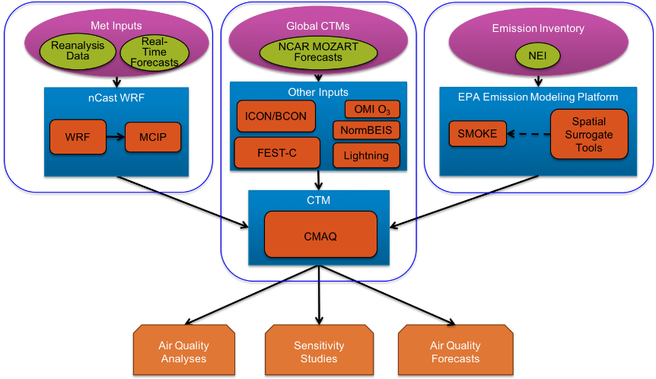
AQcast System for CMAQ on Amazon Cloud (Also have CAMx and WRF-Chem variants)
Features
Automatically performs all pre-processing steps, including weather modeling
Flexible and simple interface
Benefits
High number of simultaneous runs (ensembles, sensitivity studies)
Reduces labor cost of modeling studies

Slide 40
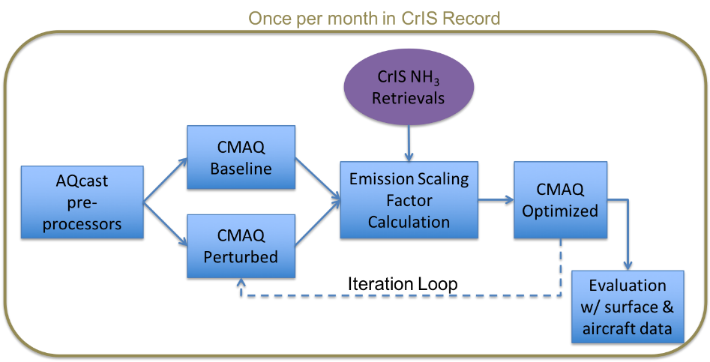
NASA Applied Science Project: Use AQcast to improve monthly-mean NH₃ emissions

Slide 41
“Let me explain. No, there is too much. Let me sum up.”
Inigo Montoya, The Princess Bride
Sharing data is a great idea!
Cuts down on unnecessary duplication
Facilitates review, reproducibility, and sensitivity studies
A CMAS Data Warehouse is a great idea!
Providing access to complete input/output data from past projects would be a great benefit to the community
Releasing CMAQ and other models as virtual machines or containers is a great idea!
All libraries already included
No more compiler/OS errors wasting user’s time

Slide 42
“Let me explain. No, there is too much. Let me sum up.”
Inigo Montoya, The Princess Bride
Cloud computing has effectively no limits, so you need to set your own. Controlling costs requires planning ahead.
Sharing data is great, but moving data is expensive
Data and computation should stay in the same cloud
Need methods to review runs without downloading data
CMAS Data Warehouse should include complete projects
Multiple project types with links to ALL of the input data, model containers/VMs, run scripts, and output
Different run types (e.g, HDDM, Adjoint) in separate containers?
Need to consider Warehouse cost and permission issues
Is everyone going to have read/write/execute permission?
Who pays for storage? Downloads?
Negotiating discounts will likely require picking a cloud provider

Slide 43
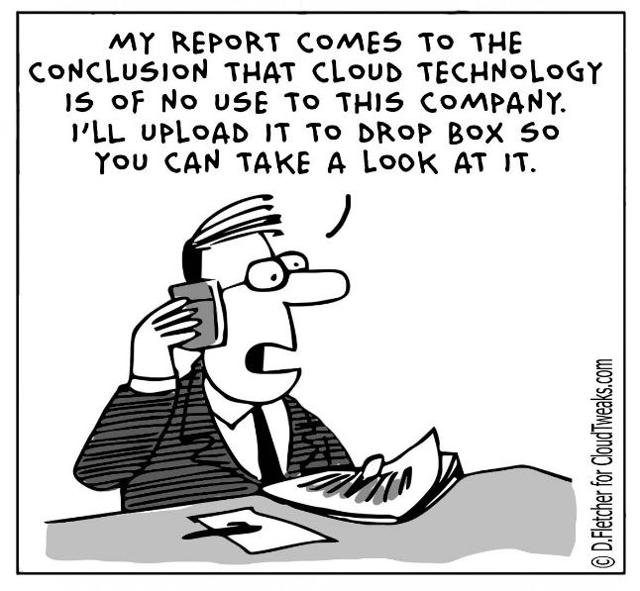
Questions? Email Matt Alvarado (malvarad@aer.com)

