Slide 1



Characterizing the Spatial Variability of Traffic-Related Air Pollution Around the Houston Ship Channel Area and a Application of RLINE in Epidemiology
Xueying Zhang, Hua Zhao, Wong-ho Chow, Elena Craft, Kai Zhang.

Slide 2
Contents
Houston Ship Channel Study
Mano a Mano Cohort Study
Study type: exposure assessment
Pollution source: traffic
Pollutants: PM_{2.5} and NO_{x}
Study area: the Houston Ship Channel and nearby neighborhoods
Study period: 2011
Study type: epidemiological study
Pollution source: traffic
Pollutant: PM_{2.5}
Outcome: obesity
Study area: the Greater Houston Area.
Study period: 2008-2013
Notes:
.

Slide 3
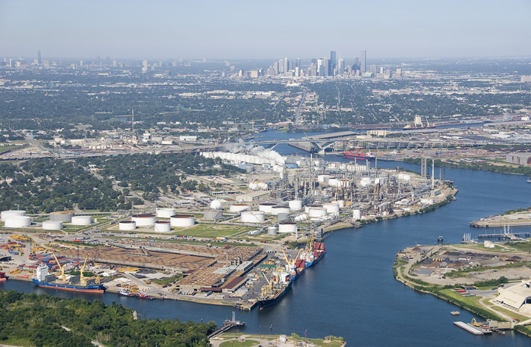
Houston Ship Channel Study

Slide 4
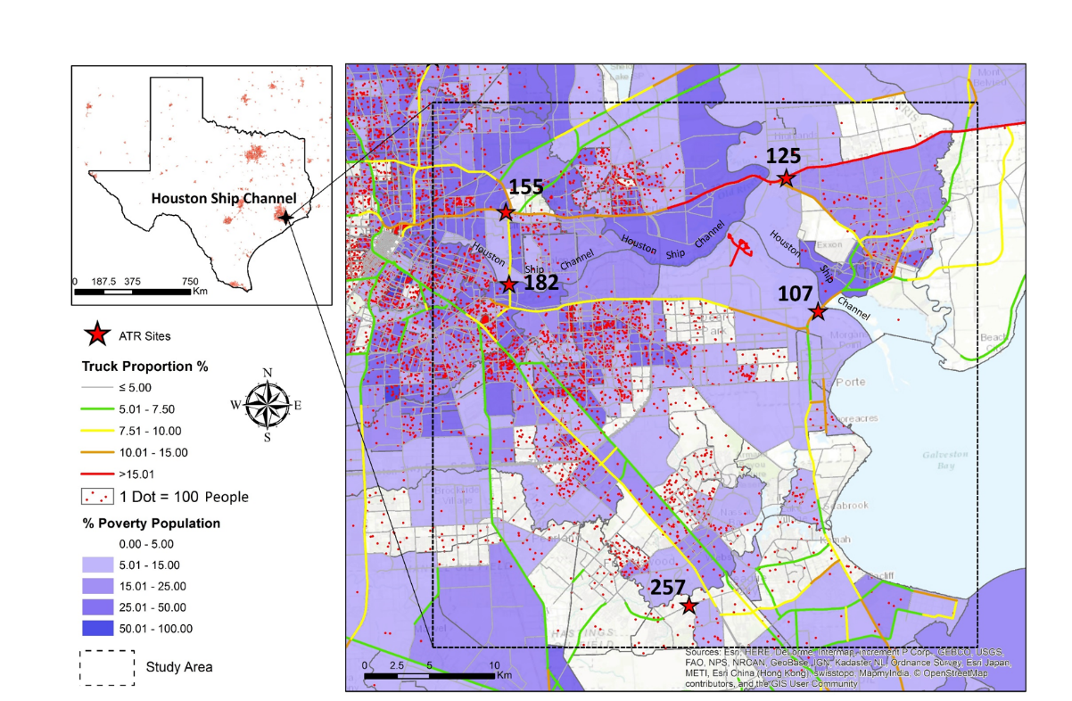
Background
Extended from the Port of Houston, Gulf of Mexico to the Downtown Houston.
Home to a world-class commercial port.
High density of diesel trucks.
Low-income neighborhoods and population.

Slide 5
Methods and Data Sources
RLINE is a dispersion model based on a steady-state Gaussian formulation. The “line source” design made it a powerful tool to derive the concentrations of air pollutants exclusively from traffic.
RLINE Inputs:
    link-specific emission rate (g/s/m)
        Annual Average Daily Traffic (AADT) and road profiles from the Roadway Inventory shapefile obtained from the Texas Department of Transportation
        Vehicle emission factors (g/vehicle/mi) were extracted from 2014 EPA Motor Vehicle Emission Simulator Model (MOVES2014a) on 12 months, 13 vehicle types, 2 fuel types, and 4 road types.
    Meteorology data from Texas Commission on Environmental Quality and pre-processed with EPA AERMET.
Two resolutions of receptors were placed: 50*50m for less than 300m near major roads (road segments that have 4 or more lanes), and 150*150m for the rest of area.

Slide 6
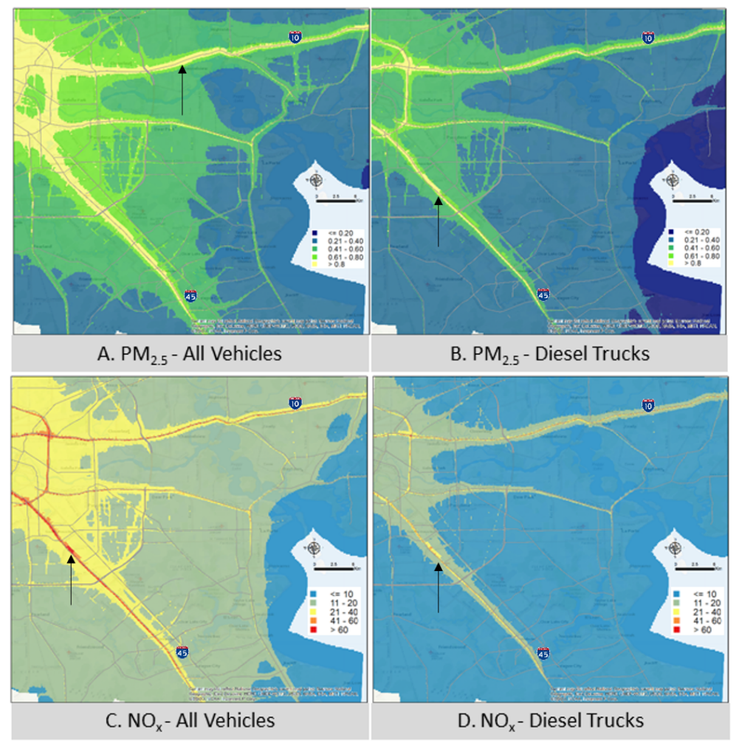
Modeled Annual Average Concentrations of Traffic-Related Air Pollution

Slide 7
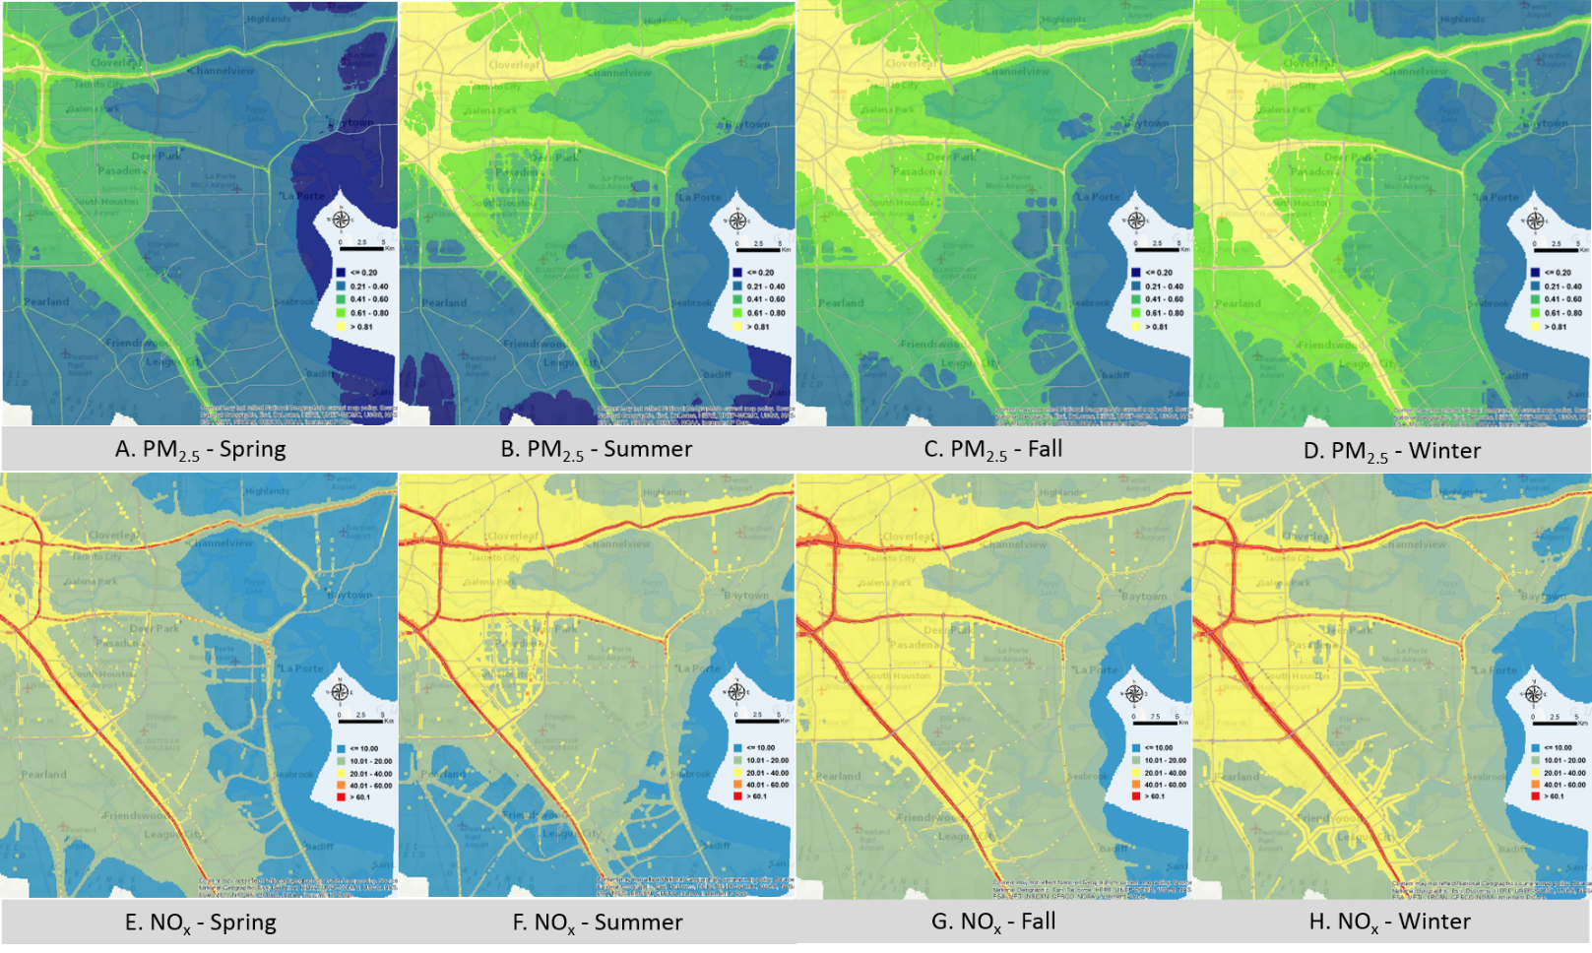
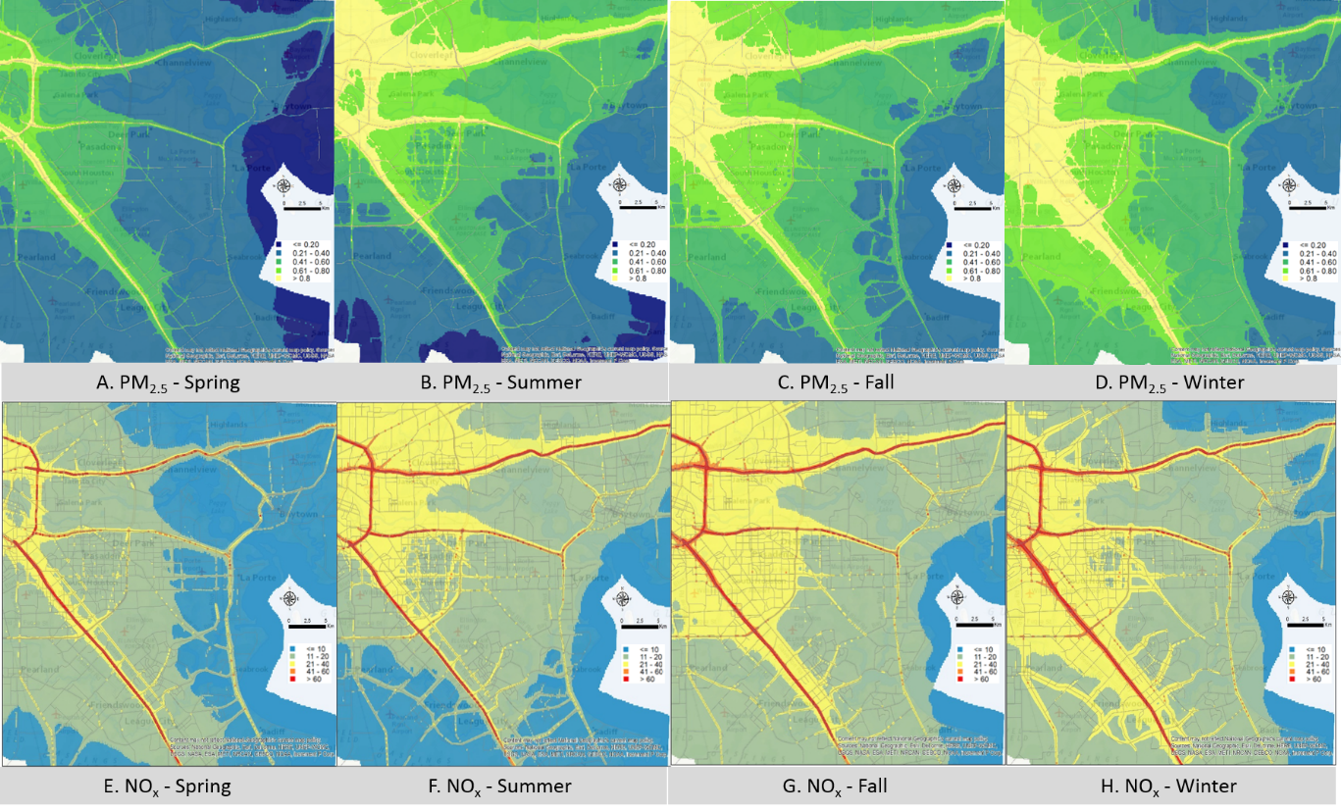
Modeled Seasonal Average Concentrations of Traffic-Related Air Pollution
A. Spring
B. Summer
C. Fall
D. Winter

Slide 8
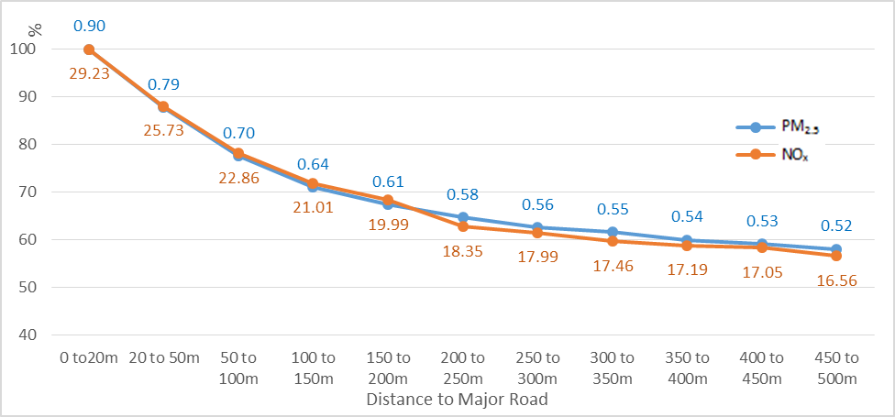
Results – Near-road Gradient
<50%

Slide 9
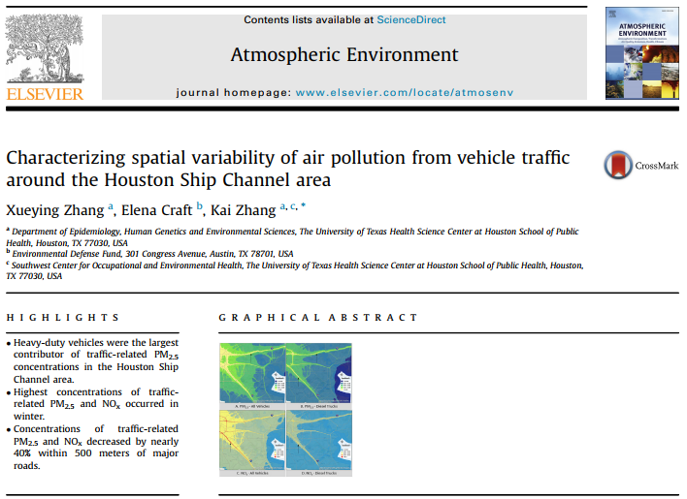
Conclusions
Heavy-duty vehicles were the major contributor of traffic-related PM_{2.5} concentrations in the Houston Ship Channel area.
Highest concentrations of traffic-related PM_{2.5} and NO_{x} occurred in winter.
Concentrations of traffic-related PM_{2.5} and NO_{x} decreased by nearly 40% within 500 meters of major roads.
Notes:
We actually have more results and discussions, more details could be found in our publication in the atmospheric environment.

Slide 10
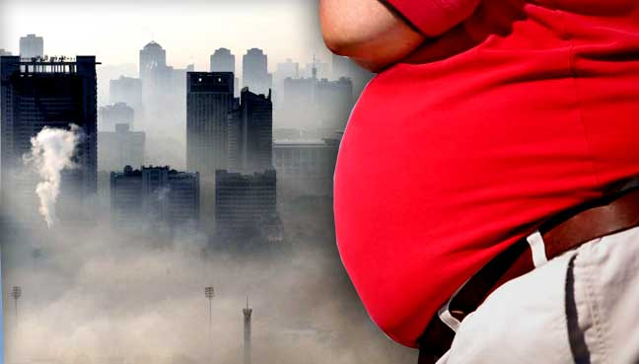
Traffic-Related Air Pollution and Obesity Study

Slide 11
Obesity is a Environmental Problem
Vehicle exhausts contain hundreds types of pollutants.
Many types of pollutants may cause oxidative stress and inflammation.
Continuous inflammation and metabolic dysfunction leads to weight gain.
New researches find that typical amounts and types of air pollution promoted the growth of fat cells in mouse.

Slide 12
Study Design
Cross-sectional
Study period: 2008-2013
Sample size: 9,541 participants
Age of participants: 19-65
Gender distribution: 80% females
Data Source: baseline survey of the MD Anderson Cancer Center Mano a Mano Mexican American Cohort
Cohort established at 2001
Total population in the Cohort is 26,512
Recruited self-reported Mexican descendants from the Greater Houston Area.

Slide 13

Statistical Methods
Exposure: 1-year residential exposure to traffic-related PM_{2.5}, modeled using RLINE
Outcome: Body mass index (BMI) and obesity (BMI ≥30)
Covariates: age, gender, household income, country of born (US or Mexico), working status, insurance coverage and so on.
Multi-linear regression model
$$BMI= β_{0}+ β_{1} PM2.5+ β_{2 }Covariate1+…+ β_{i}Covariate i+ ε$$
Logistic regression model
$$Obesity status= β_{0}+ β_{1} PM2.5+ β_{2 }Covariate1+…+ β_{i}Covariate i+ ε$$

Slide 14
Results
 |  | Man | Woman
 |  | N (percent) | N (percent) | P-value*
Obesity (BMI ≥ 30) | Yes | 908 (49.05) | 3689 (55.62) | <0.001
 | No | 943 (50.95) | 2943 (44.38)
Currently employed | Yes | 1395 (75.36) | 2524 (38.06) | <0.001
 | No | 456 (24.64) | 4108 (61.94)
Total |  | 1851 | 6632
 |  | Mean (Standard Deviation) | Mean (Standard Deviation) | P-value**
Primary PM_{2.5} exposure (µg/m³) |  | 0.72 (0.32) | 0.73 (0.31) | 0.06
Distance to highway (m) |  | 1113.57 (836.01) | 1145.01 (886.27) | 0.16
*P-value are estimated through chi-square test. ** P-value are estimated through student t-test.
Notes:
Here

Slide 15
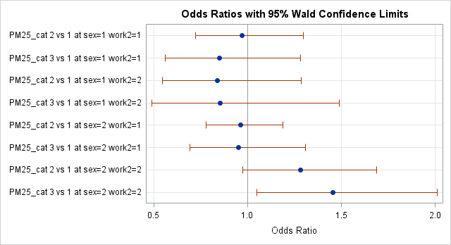
Exposure to Traffic-Related PM_{2.5}
10th – 90th , man, employed
≥ 90th , man, employed
10th – 90th , man, unemployed
≥ 90th , man, unemployed
10th – 90th , woman, employed
≥ 90th , woman, employed
10th – 90th , woman, unemployed
≥ 90th , woman, unemployed
Reference: <10th Traffic-Related PM_{2.5} Exposure

Slide 16
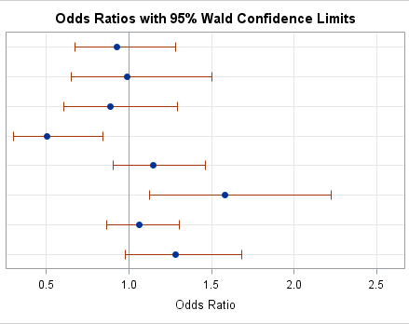
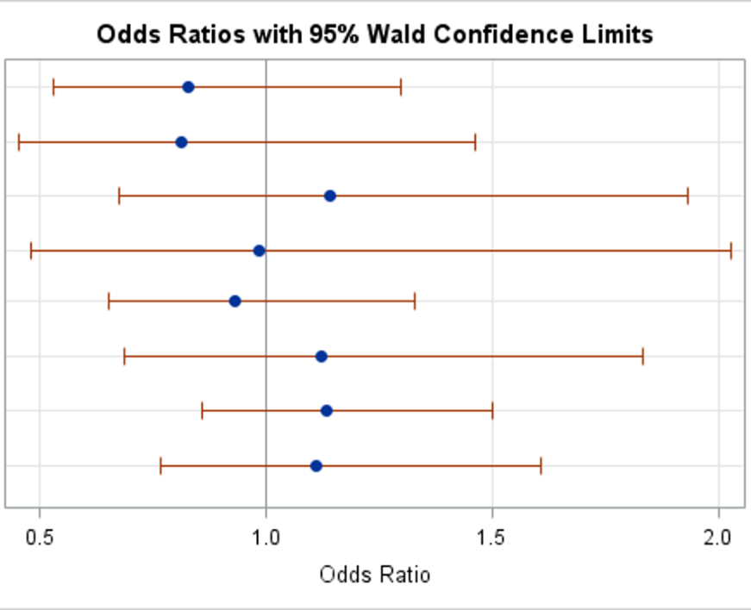
Distance to Highway
90th – 10th, man, employed
< 10th, man, employed
90th – 10^{t}, man, unemployed
< 10th, man, unemployed
90th – 10th, woman, employed
< 10th, woman, employed
90th – 10th , woman, unemployed
< 10th , woman, unemployed
Reference: ≥90th Distance to Highway
All participants
Within 1000 m from highway

Slide 17
Why do we choose RLINE?
Include the emissions from both major roads and non-major roads
Control the seasonal variation

Slide 18
Acknowledgement
Dr. Wong-Ho Chow and Dr. Hua Zhao from the Department of Epidemiology, MD Anderson Cancer Center
Dr. Elena Craft from the Environmental Defense Fund
Dr. Kai Zhang and Dr. Casey Durand from the University of Texas Health Science Center at Houston
More comments please send to: xueying.zhang@uth.tmc.edu

