Slide 1
Evaluation and intercomparison of five major dry deposition algorithms in North America
Zhiyong Wu^{1,2,*}, Donna Schwede¹, Robert Vet², John T. Walker¹, Mike Shaw², Ralf Staebler², Leiming Zhang²
¹US EPA; ²Environment and Climate Change Canada
*ORISE Fellow; wu.zhiyong@epa.gov
16th Annual CMAS Conference – Oct. 25, 2017

Slide 2
Outline
Background and Objectives
Description of dry deposition models and measured V_{d} dataset
Evaluation and inter-comparison of five models
Conclusions

Slide 3
Background
The inferential method is commonly used in dry deposition monitoring networks and atmospheric chemical transport models (CTMs).
Different dry deposition algorithms are used in monitoring networks and models:
CAPMoN & GEM-MACH: Zhang et al. (2003)
CASTNET: Meyers et al. (1998)
EMEP: Simpson et al. (2003)
WRF-Chem & GEOS-Chem: Wesely (1989)
CMAQ: Pleim and Ran (2011)
…

Slide 4
CAPMoN vs CASTNET
Similar concentration
Very different V_{d}
Schwede et al.(2011), AE

Slide 5
A comparison of inferential models across the NitroEurope network
(UK)
(Canada)
(Europe)
(Holland)
Flechard et al. (2011), ACP
Differences between models reach a factor 2–3 and are often greater than differences between monitoring sites.

Slide 6
Objectives
The objectives of this study are:
to evaluate and inter-compare the dry deposition algorithms used in US and Canada
to quantify the magnitudes of model uncertainties
to explore the dominant factors causing the discrepancies.

Slide 7
The five dry deposition models
One-big-leaf framework
the Zhang et al. (2003) scheme used in the Canadian Air and Precipitation Monitoring Network (CAPMoN) and several Canadian and American air quality models (termed as ZHANG)
the Noah land surface model coupled with a photosynthesis-based Gas Exchange Model (Niyogi et al., 2009; Wu et al., 2012) (termed as Noah-GEM)
the dry deposition module of the Community Multiscale Air Quality (CMAQ) model version 5.0.2 (Pleim and Ran, 2011) (termed as C5DRY)
the dry deposition module of WRF-Chem which employs the widely-used Wesely (1989) scheme (termed as WESELY)
The multi-layer model used in the US Clean Air Status and Trends Network (CASTNET) based on Meyers et al. (1998)(termed as MLM)
Multi-layer framework

Slide 8
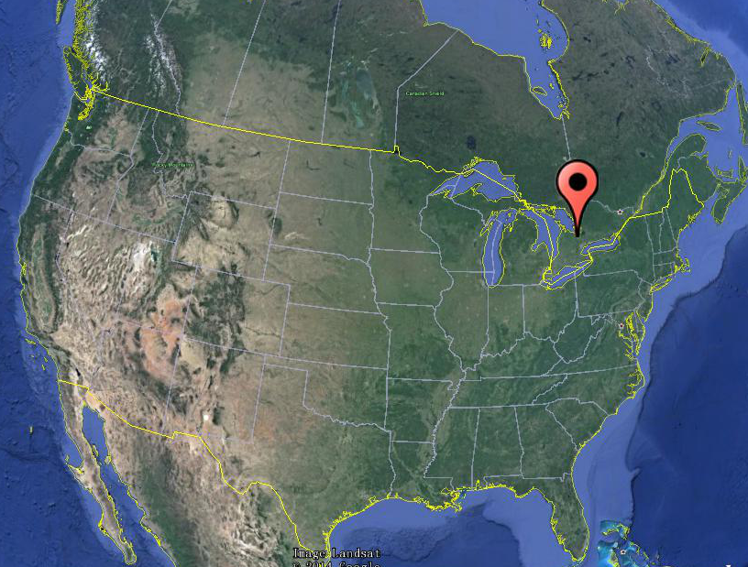
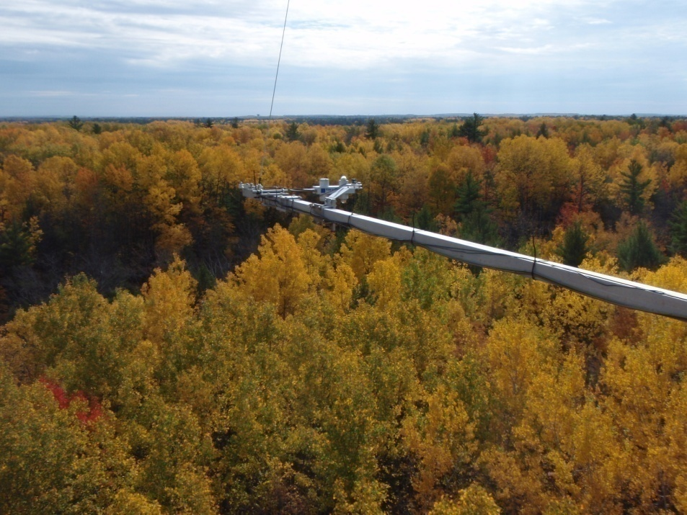
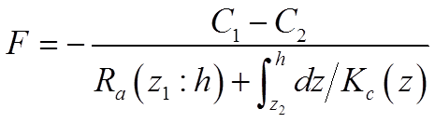
Measurements of O₃ and SO₂ dry depositions at Borden Forest
Borden Forest
Wu et al. (2016), EP
Vegetation Type: 100-year old mixed forest
Canopy Height: 22 m
Peak Leaf Area Index: 4.6 m² m⁻²
Observation: 6 levels of O₃ and SO₂ concentrations
Period : May 2008 - April 2013
Modified gradient method:
Wu et al. (2015), ACP

Slide 9
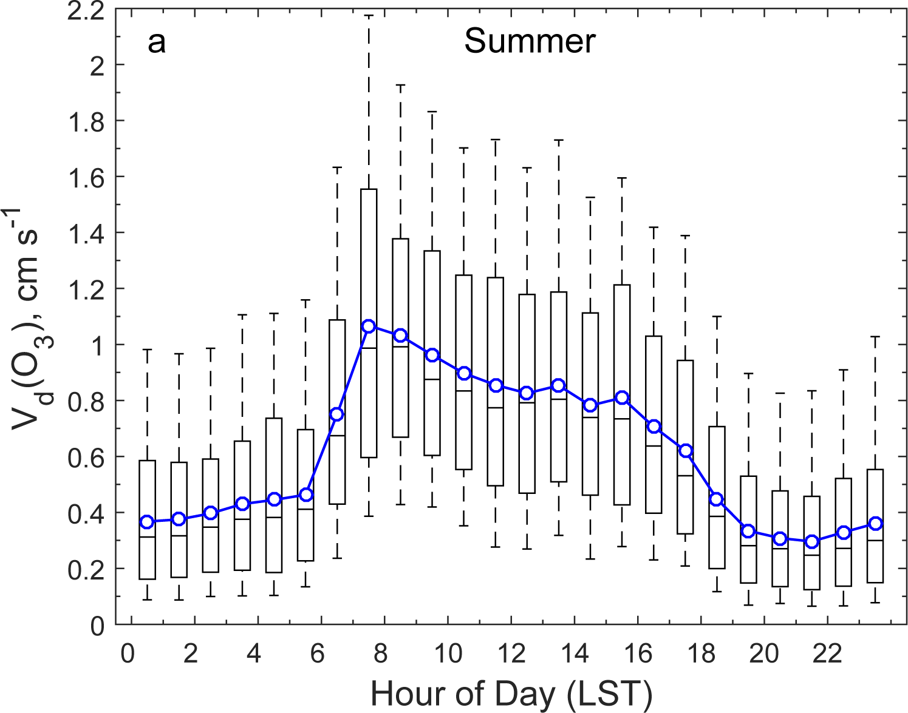
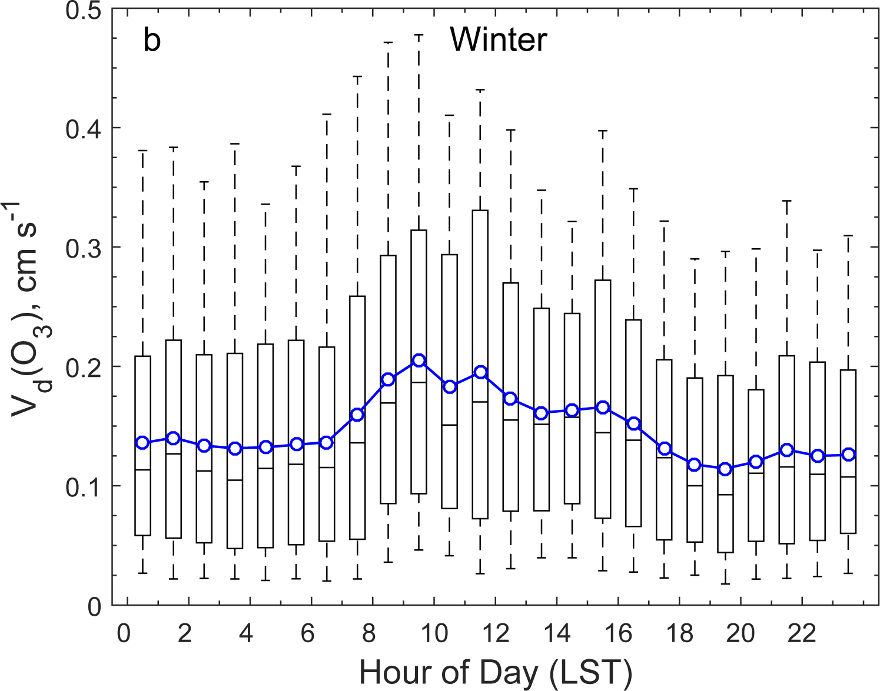
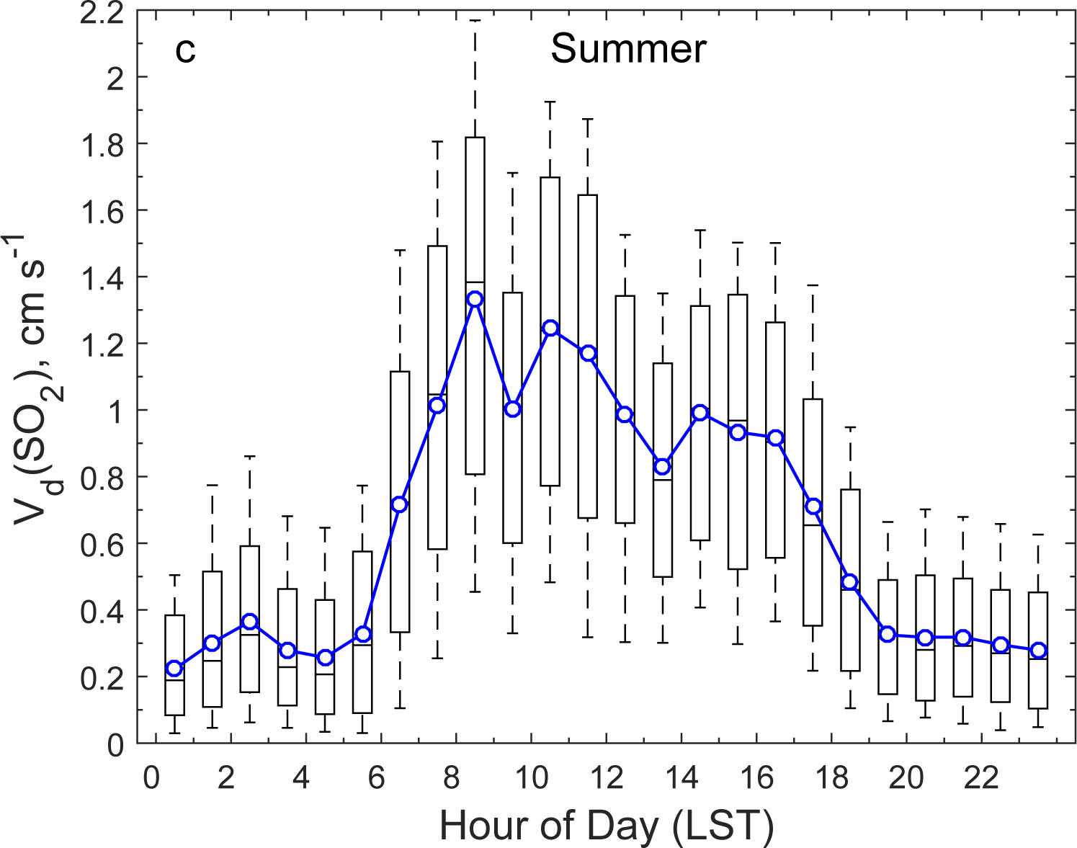
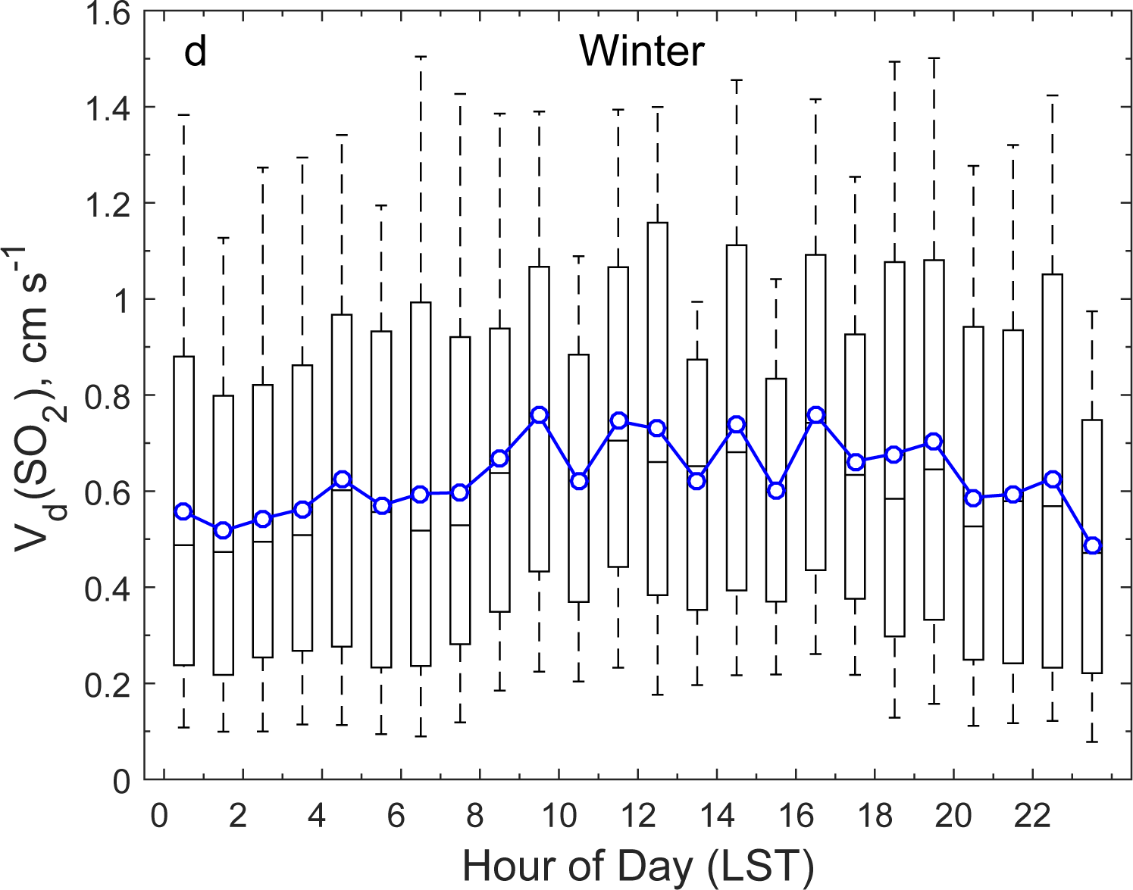
Measured V_{d}(O₃) and V_{d}(SO₂) at Borden Forest
Wu et al.(2016), EP

Slide 10
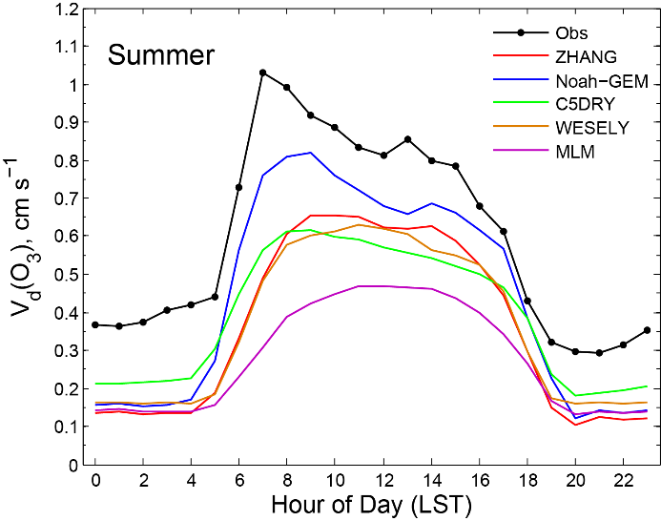
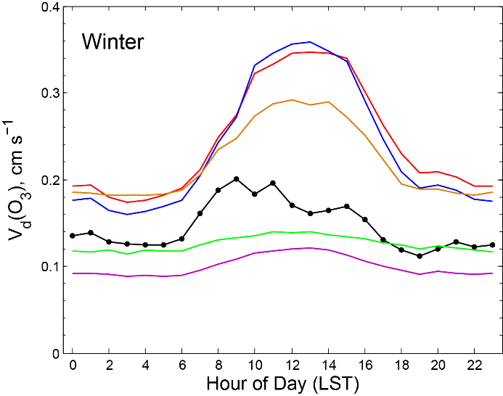
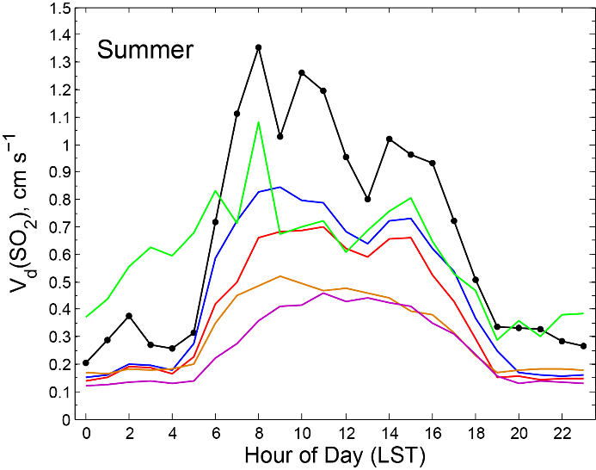
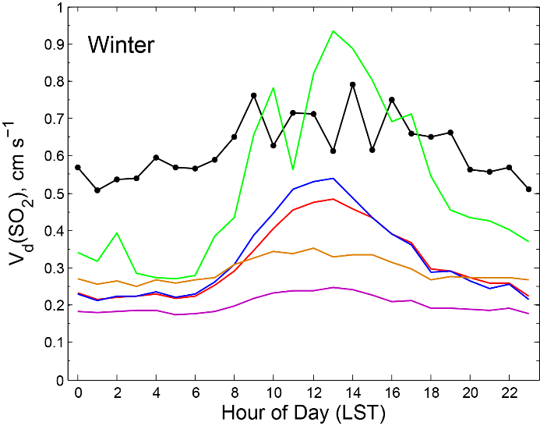
Evaluation and inter-comparison of five models
All models produced lower V_{d} values than measured for O₃ in summer and SO₂ in summer and winter;
There was not a consistent tendency in the models to over- or underpredict for O₃ in winter.
Differences in mean V_{d} values between models were on the order of a factor of 2.

Slide 11
Air resistances (R_{a} & R_{b})
Monin-Obukhov Similarity Theory (MOST) based
(WESELY, Noah-GEM, C5DRY & ZHANG)
or
where u* is friction velocity, ψ_{h} the stability correction function, S_{c} the Schmidt number, P_{r} Prandtl number for air (0.72), D_{θ} thermal diffusivity, and D_{c} molecular diffusivity of a specific gas.
Wind based:
(MLM)
where a is a constant depending on stability, u mean wind speed, σ_{ɵ} standard deviation of the wind direction, α constant depending on gas species, δ characteristic leaf dimension.

Slide 12
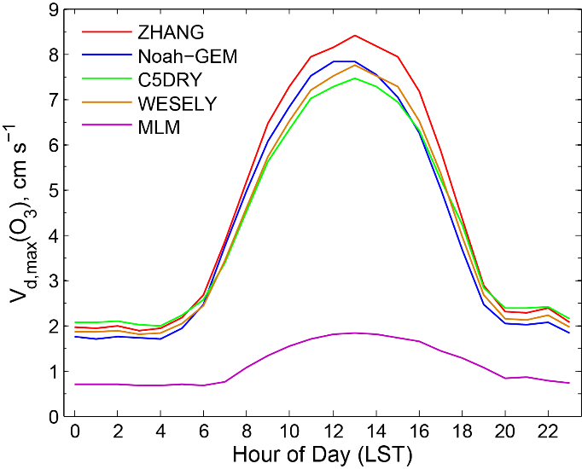
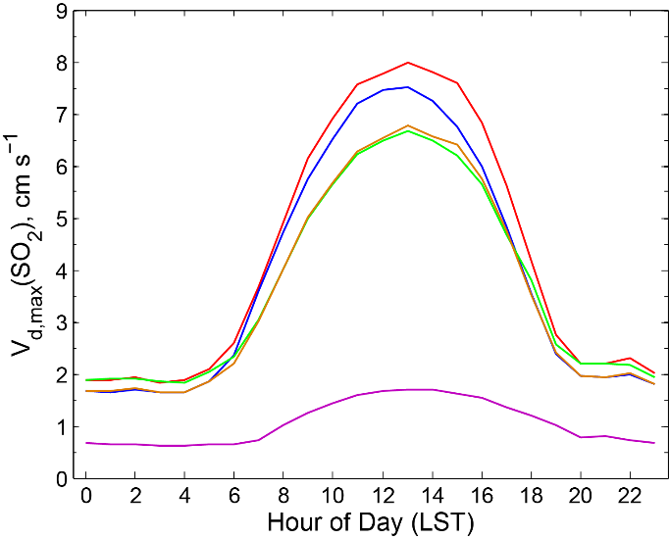
V_{d,max} = 1 / (R_{a}+R_{b})
MOST type
MOST type
Wind type
Wind type
MLM produced larger R_{a} and R_{b} than the MOST-based approaches (WESELY, Noah-GEM, C5DRY & ZHANG).

Slide 13
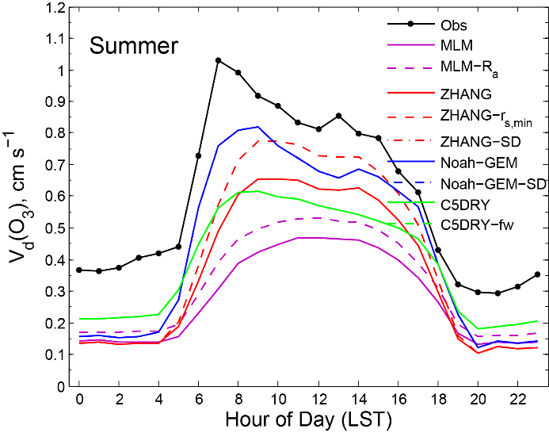
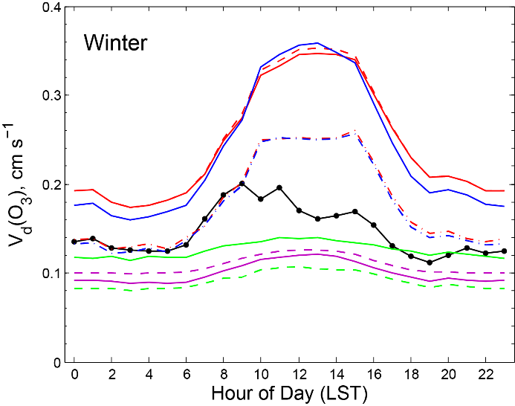
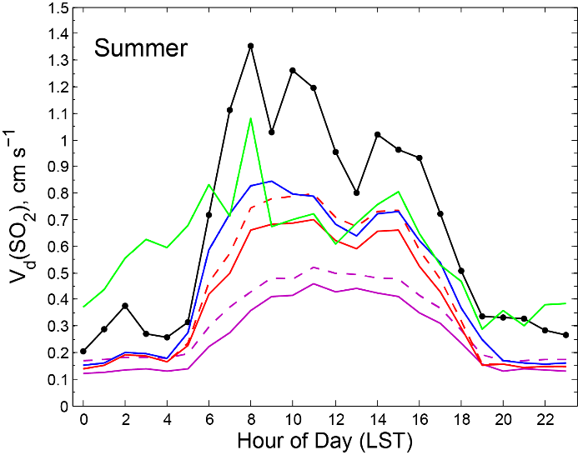
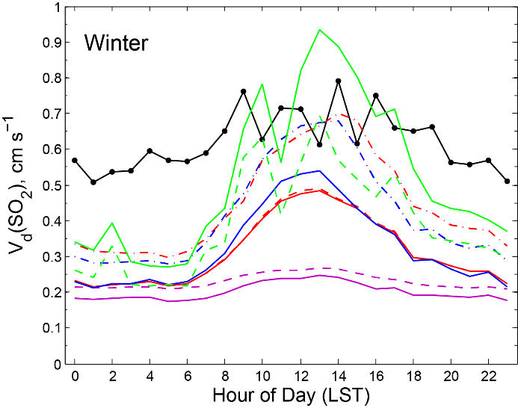
The contribution of atmospheric resistances to the total resistances of O₃ and SO₂ was generally small (5-15% in this study).
With reduced R_{a} in MLM, mean V_{d} only increased by about 10%.
The main causes of the differences in V_{d} across the models is mainly due to the differences in the calculated R_{c.}

Slide 14
1/R_{c} = 1/R_{s} + 1/R_{ns}
Surface uptake = Stomatal uptake + Non-stomatal uptake
Stomatal resistance (R_{s}) formulations
Jarvis-style R_{s} scheme:
(C5DRY, ZHANG & MLM)
(WESELY)
Ball-Berry R_{s} scheme:
(Noah-GEM)

Slide 15
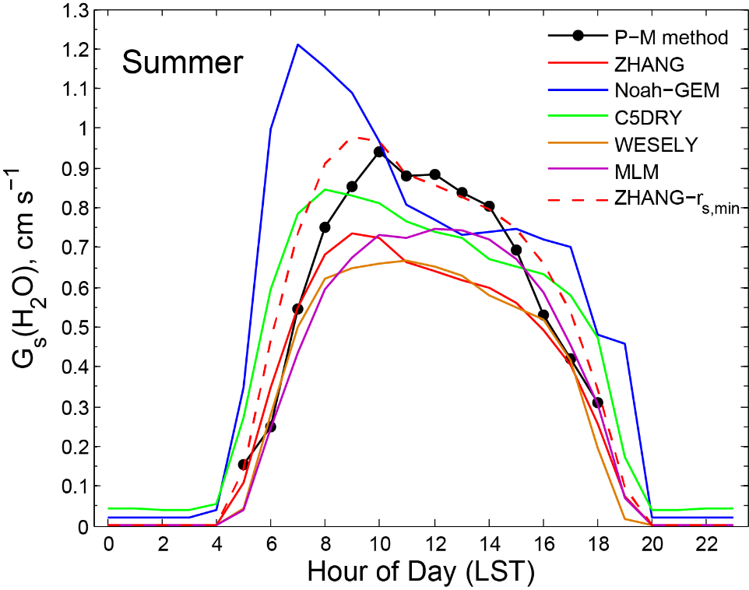
Stomatal conductance (G_{s,x}) = 1 / R_{s,H2O} × (D_{x}/D_{H2O})
The Penman-Monteith method:
R_{s,min}=200s/m
R_{s,min}=100 s/m
R_{s,min}=150 s/m
The R_{s} by the Jarvis-style scheme is very sensitive to the prescribed value of R_{s,min}.
However, this parameter is mainly derived from empirical fits to field measurements and suffers from large uncertainties.
Notes:
Here are the modeled Rs for water vapor. Rs for the O3 or SO2 is scaled by the molecular diffusitivity ratio. Because the MLM model calculates Rs at many layers, it is not easy to input Rs as one value to compare with the other models. Rs by MLM is not shown here. Also I calculated Rs using the inverse of the penman-monteith method which is based on the measurements of water vapor flux. This method works well in summer when the water vapor flux is dominately from plants evaportranspiration.It is the black line with filled circles. As we see, the Rs by Zhang is slightly higher than that from the Penman-Monteith method.
Both Jarvis-style and Ball-Berry-style schemes can produce a reasonable R_{s} if the main environmental factors are included and the key parameters are proper prescribed.

Slide 16
The mean V_{d} for O₃ and SO₂ in ZHANG increased by 14% and 12%, respectively, if r_{s,min} was reduced by 25%. Similar for the other Javis-type models.
Large discrepancies still exist in V_{d} between ZHANG and the observations, which can be further attributed to the non-stomatal parameterization (R_{ns}) of the model.

Slide 17
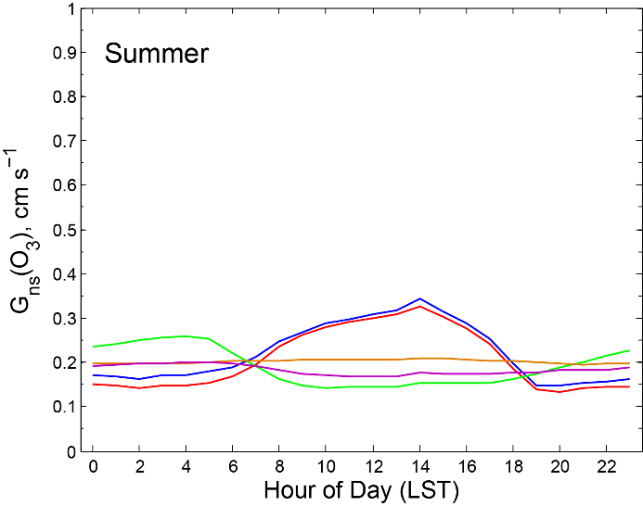
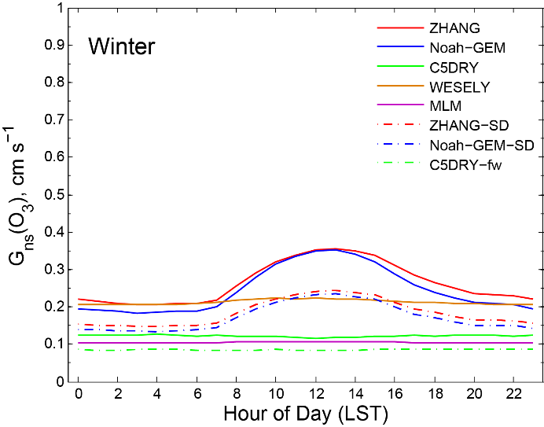
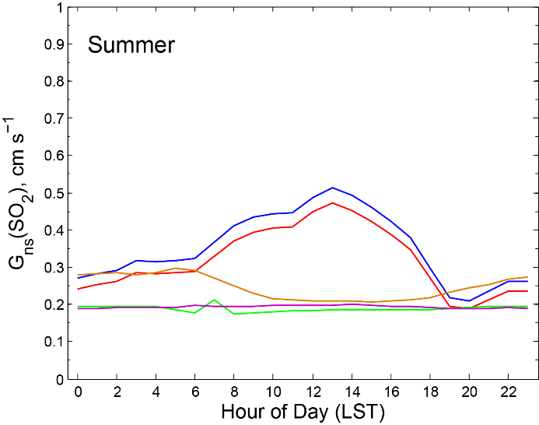
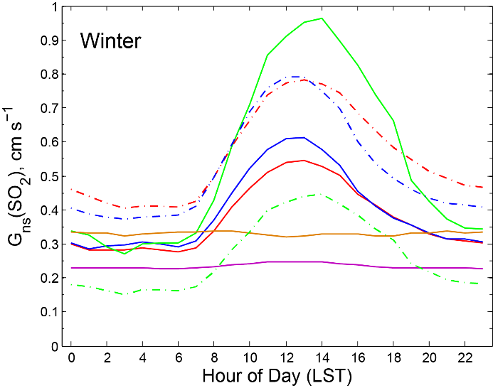
Non-stomatal conductance (G_{ns}) = 1 / R_{ns}
leaf cuticle
ground
Some model (e.g., ZHANG, Noah-GEM) R_{ns} estimates showed significant diurnal variations, while others do not.
New measurements from chamber and field studies are needed to better understand processes influencing R_{ns.}

Slide 18
Conclusions and Recommendations
The models performed better in summer than in winter with correlation coefficients for hourly V_{d} between models and measurements being approximately 0.6 and 0.3, respectively.
All models produced lower V_{d} values than measured for O₃ in summer and SO₂ in summer and winter. There was not a consistent tendency in the models to over- or underpredict for O₃ in winter.
Differences in mean V_{d} values of O₃ and SO₂ between models were on the order of a factor of 2.
Model differences were mainly due to different surface resistance parameterizations for stomatal and non-stomatal uptake pathways.
Although it cannot be concluded which algorithm is most accurate, it is recommended that users of inferential dry deposition models consider an uncertainty factor of 2 or use ensemble modeling results for ecosystem assessment analysis.

Slide 19
Thank you!
Any questions ?
Notes:
Thank you. I am happy to take any question. That is a good question!

Slide 20
Additional Slides

Slide 21
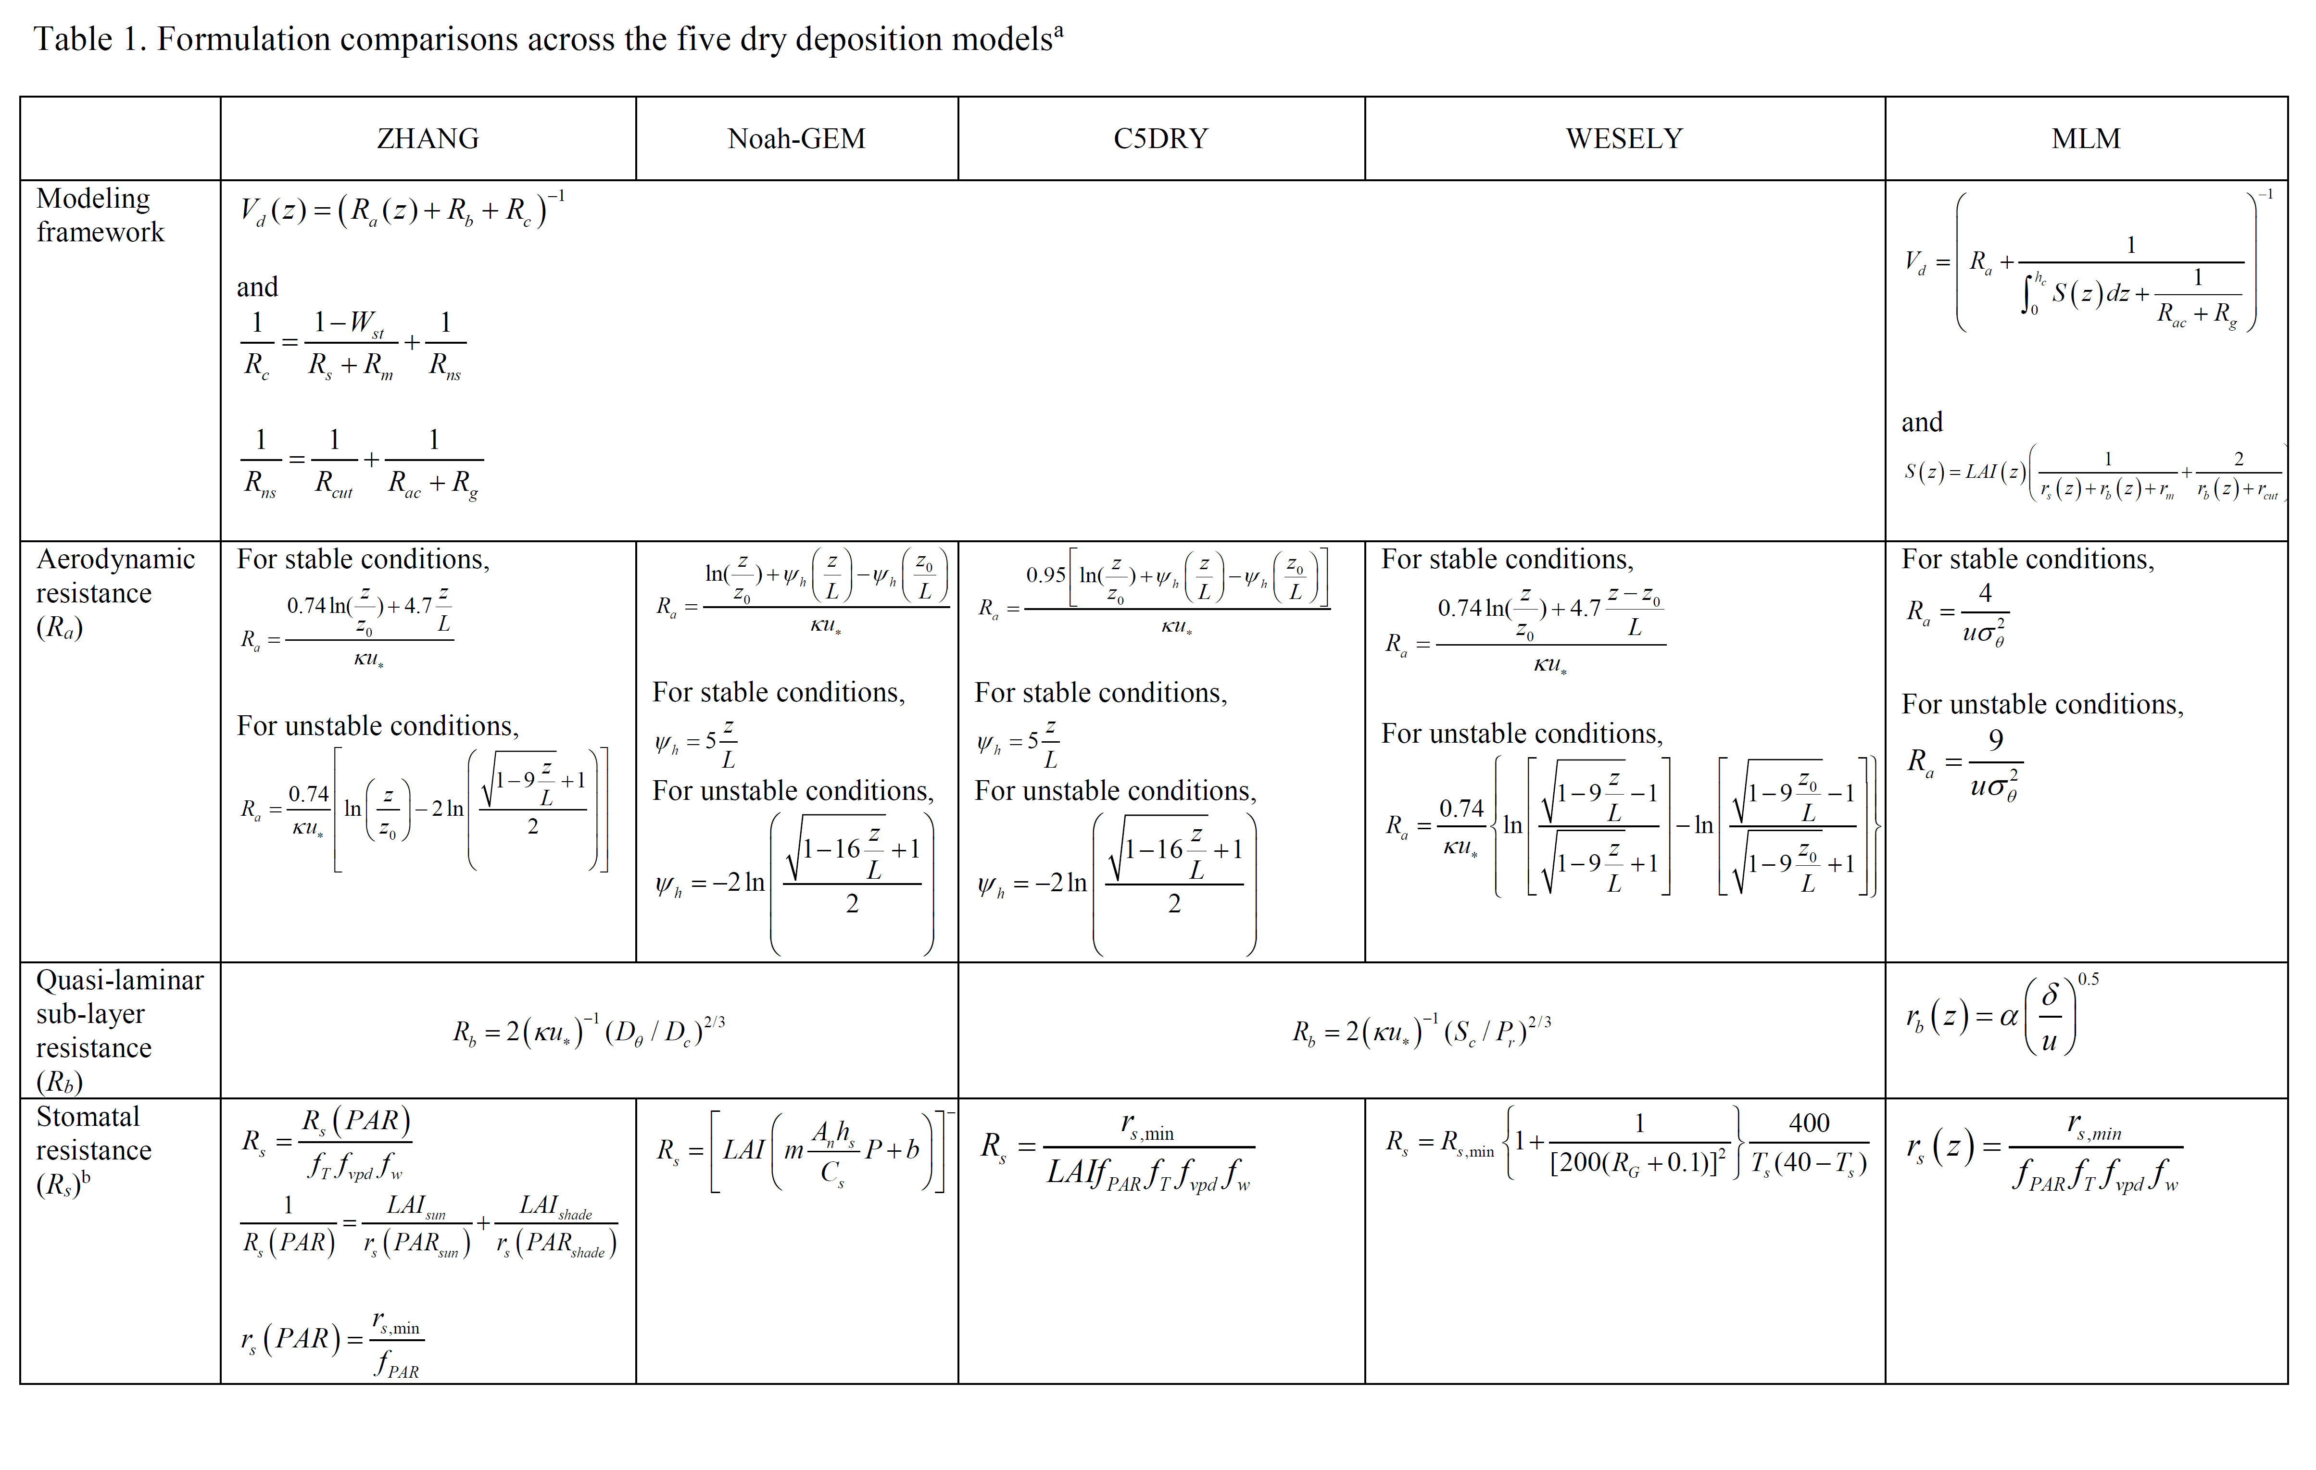

Slide 22
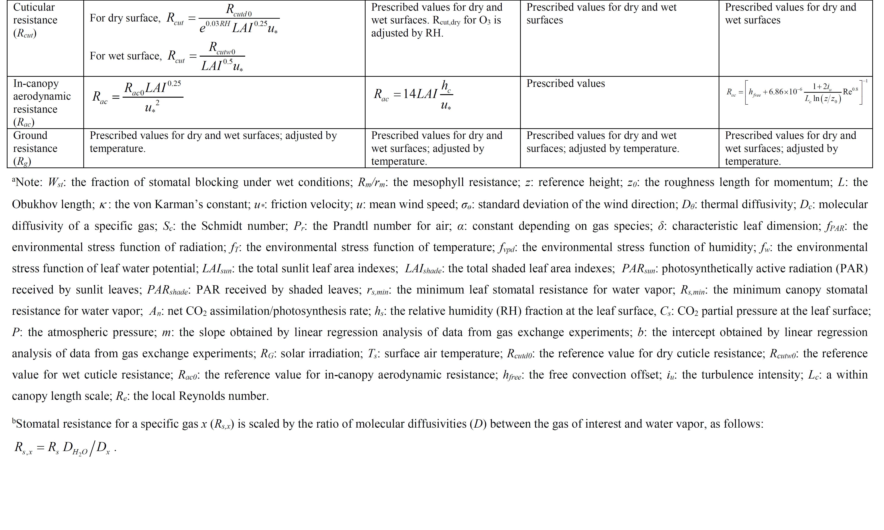

Slide 23
