Slide 1
Impact of Chemical Lateral Boundary Conditions (LBC) from GEOS-5 Global Chemical Transport Model Compared to the Operational NGAC LBC
Youhua Tang^{1,2}, Huisheng Bian^{3,4}, Zhining Tao^{3,5}, Luke Oman³, Daniel Tong^{1,2,6}, Li Pan^{1,2},
Pius Lee¹, and Barry Baker^{1,2} , Cheng-Hsuan Lu⁷, Jun Wang⁸, Jeffery McQueen⁸, Sikchya Upadhayay^{9,10} , Ivanka Stajner⁹
1. NOAA Air Resources Laboratory.
2. University of Maryland, College Park, MD 20740.
3. NASA Goddard Space Flight Center
4. University of Maryland at Baltimore County
5. Universities Space Research Association, Columbia, MD 21046
6. George Mason University, Fairfax, VA 22030.
7. Atmospheric Sciences Research Center, State University of New York at Albany
8. NOAA/NCEP/Environmental Modeling Center
9. NOAA/NWS/Office of Science and Technology Integration.
10. SynerenTechnologiesCorporation, Arlington, VA

Slide 2
Background
The existing National Air Quality Forecast Capability (NAQFC) run in NOAA uses the relatively old monthly-mean gaseous lateral boundary condition (LBC) and aerosol LBC from NEMS GFS Aerosol Component (NGAC) that uses GOCART aerosol module in GFS spectral global model.
This LBC needs to be updated, and we are making comparison for selected 2-month period (June-July 2015).

Slide 3
Settings of the Model and Testing
CMAQ 5.0.2 with NEI-2011 emission driven by NOAA/NCEP’s North American Mesoscale Model (NAM).
US Forest Service BlueSky fire emission with NOAA Hazard Mapping System (HMS) fire location.
4 LBC cases: the existing gaseous monthly-mean LBC (CMAQ_Base), NGAC aerosol dynamic LBC (NGAC-LBC), NASA GEOS-5 dynamic full-chemistry LBC (GEOS5-LBC), and GEOS-5 monthly-mean LBC (GLBC-monthly)

Slide 4
Global Model Outputs
Spatial Mapping (trilinear interpolation)
Species Mapping
NAM Meteorology
LBCs to CMAQ
PreMAQ
CMAQ Run
Fire Emissions
Anthropogenic and Normalized Biogenic Emissions
Verification
HMS Fire locations

Slide 5
Gaseous Species Mapping Table from GEOS-5 to CMAQ CB05tucl
GEOS-5 species (mole) | CMAQ Species (mole)
HCOOH | FACD
MO₂ (CH₃O₂) | XO₂
MP (methylhydroperoxide) | MEPX
A₃O₂ (primary RO₂ from C₃H₈: CH₃CH₂CH₂OO) | PAR + XO₂
ACTA (acetic acid) | AACD
ATO₂ (RO₂ from acetone: CH₃C(O)CH₂O₂) | 2*PAR + XO₂
B₃O₂ (secondary RO₂ from C₃H₈: CH₃CH(OO)CH₃) | 2*PAR + XO₂
ALK4 (C₄ or higher alkanes) | 4*PAR
C₃H₈ | 1.5*PAR + NR
ETO₂ (ethylperoxy radical: CH₃CH₂OO) | MEO₂ + PAR
ETP (ethylhydroperoxide: CH₃CH₂OOH ) | MEPX + PAR
GCO₃ (hydroxy peroxyacetyl radical: HOCH₂C(O)OO ) | C₂O₃
GLYX (glyoxal) | FORM + PAR
GLYC (glycolaldehyde: HOCH₂CHO ) | FORM + 2*PAR
GP (peroxide from GCO₃: HOCH₂C(O)OOH ) | ROOH
GPAN (Peroxyacylnitrate: HOCH₂C(O)OONO₂ ) | PANX
HAC (hydroxyacetone: HOCH₂C(O)CH₃ ) | 2*PAR
IALD (hydroxy carbonyl alkenes from isoprene) | ISOPX
IAO₂ (RO₂ from isoprene oxidation products) | ISOPO₂
IAP (peroxide from IAO₂) | ROOH
INO₂ (RO₂ from ISOP+NO₃) | 0.2*ISPD + 0.8*NTR+ XO₂ + 0.8*HO₂ + 0.2*NO₂ + 0.8*ALDX + 2.4*PAR
INPN (peroxide from INO₂ ) | 0.2*ISPD + 0.8*NTR+ ROOH + 0.8*H₂O₂ + 0.2*PNA + 0.8*ALDX + 2.4*PAR
ISN1 (RO₂ from isoprene nitrate) | NTRI
ISNP (peroxide from ISN1) | NTRIO₂
KO₂ (RO₂ from C₃ or higher ketones ) | XO₂ + PAR
MACR (methacrolein) | ISPD
MAN2 (RO₂ from MACR+NO₃) | 0.925*HO₂ + 0.075*XO₂
MAO₃ (peroxyacyl from MVK and MACR) | MACO₃
MAOP (peroxide from MAO₃) | ISPD
MAP (peroxyacetic acid, CH₃C(O)OOH ) | PACD
MCO₃ (peroxyacetyl radical) | C₂O₃
MEK (C₃ or higher ketones) | 4*PAR
MRO₂ (RO₂ from MACR+OH) | 0.713*XO₂ + 0.503*HO₂
MRP (Peroxide from MRO₂) | ROOH
MVK (methylvinylketone) | ISPD
MVN2 (RO₂ from MVK+NO₃) | 0.925*HO₂ + 0.075*XO₂
PMN (peroxymethacryloyl nitrate) | OPEN
PO₂ (RO₂ from propene) | XO₂
GEOS-5 reaction: ISOP + NO3 → INO2
CB05 reaction:
ISOP + NO3 → 0.200*ISPD + 0.800*NTR + XO2 + 0.800*HO2 +
0.200*NO2 + 0.800*ALDX + 2.400*PAR
ALK4 → 4*PAR
……………………….

Slide 6
Aerosol Mapping Table from GEOS-5 to CMAQ Aero6
GEOS-5 Aerosol (µg/m³) | CMAQ Aerosol Mass Concentration (µg/m³) | CMAQ Aerosol Number Concentration (#/m³)
BCPHILIC | AECJ | 2.72×10⁷ (ACC)
BCPHOBIC | AECJ | 2.72×10⁷ (ACC)
OCPHILIC | APOCJ | 2.72×10⁷ (ACC)
SO4 | ASO4J | 2.72×10⁷ (ACC)
NH4a | ANH4J | 2.72×10⁷ (ACC)
NO3an1 (mean D=0.5µm) | ANO3J | 2.72×10⁷ (ACC)
NO3an2 (mean D=4.2µm) | 0.8*ANO3J + 0.2 *ANO3K | 5.4×10⁶(ACC) + 1.2×10⁴(COR)
NO3an2 (mean D=15µm) | ANO3K | 6×10³(COR)
DU001 (D: 0.2 – 2 µm) | AOTHRJ | 2.72×10⁷ (ACC)
DU002 (D: 2 – 3.6 µm) | 0.45*AOTHRJ+0.55*ASOIL | 3.3×10⁵ (ACC)+5.1×10⁴(COR)
DU003 (D: 3.6 – 6 µm) | ASOIL | 1.15×10⁴(COR)
DU004 (D: 6 – 12 µm) | 0.75*ASOIL | 1.4×10³(COR)
SS001 (D: 0.06-0.2 µm) | 0.39*ANAI+0.61*ACLI | 7.4×10⁸(ATKN)
SS002 (D: 0.2 - 1µm) | 0.39*ANAJ+0.61*ACLJ | 2.72×10⁷ (ACC)
SS003 (D: 1- 3µm) | 0.312*ANAJ+0.488*ACLJ +0.078*ASEACAT+0.122*ACLK | 1.7×10⁵(ACC)+1.26×10⁴(COR)
SS004 (D: 3- 10µm) | 0.39*ASEACAT+0.61*ACLK | 1.36×10⁴ (COR)
NGAC/GOCART does not have these aerosols

Slide 7
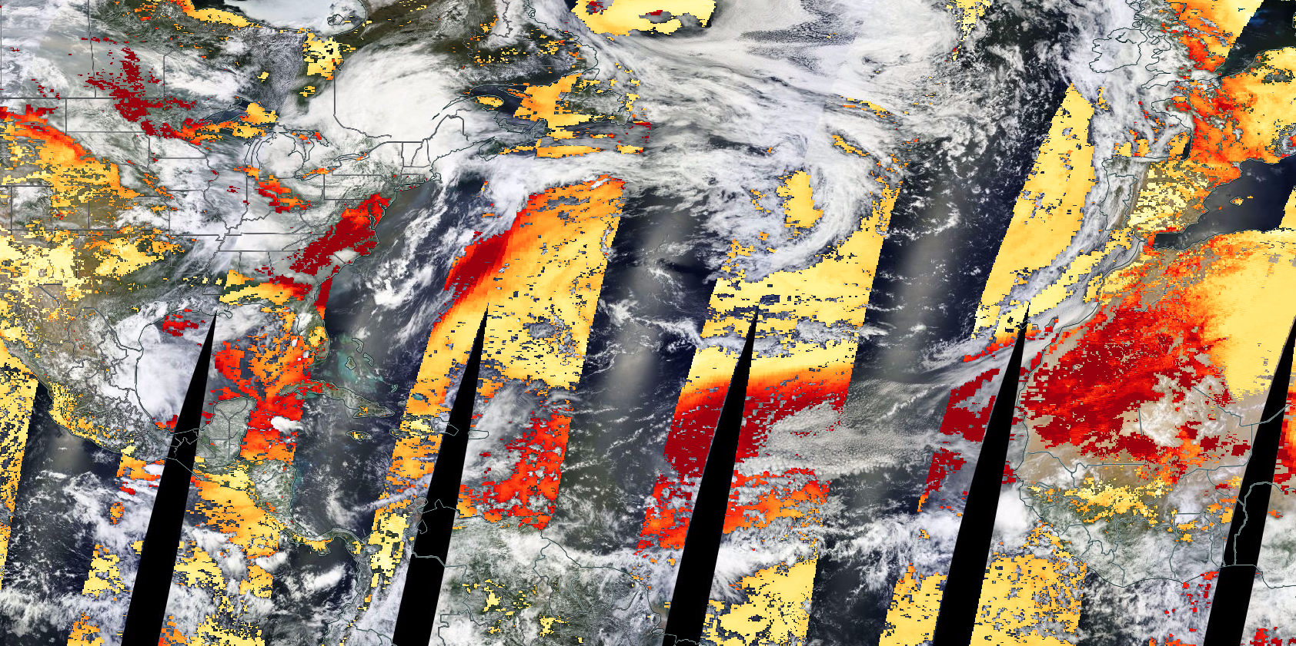
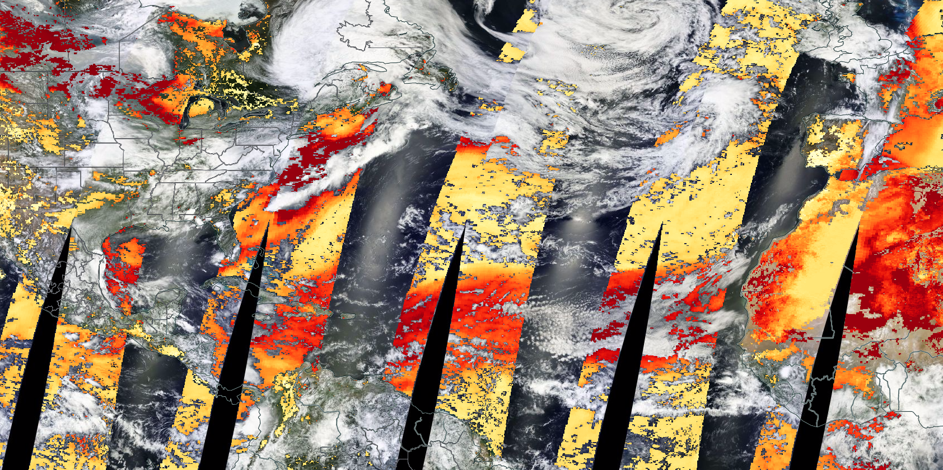
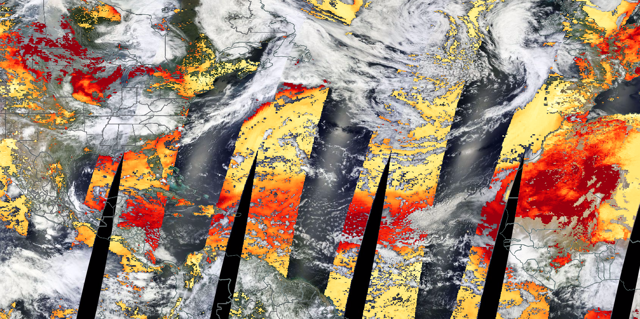
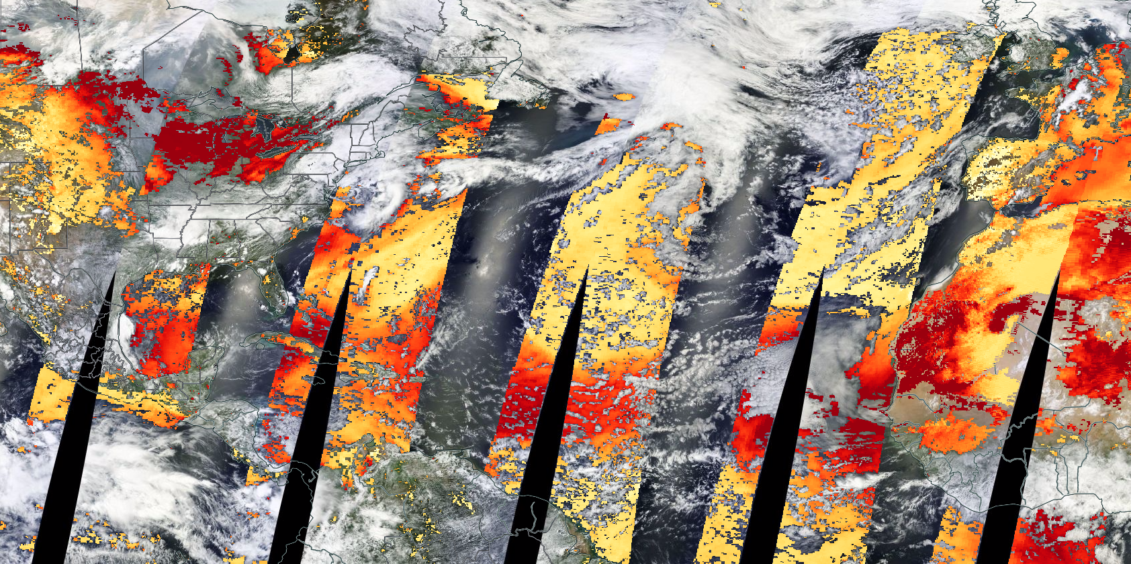
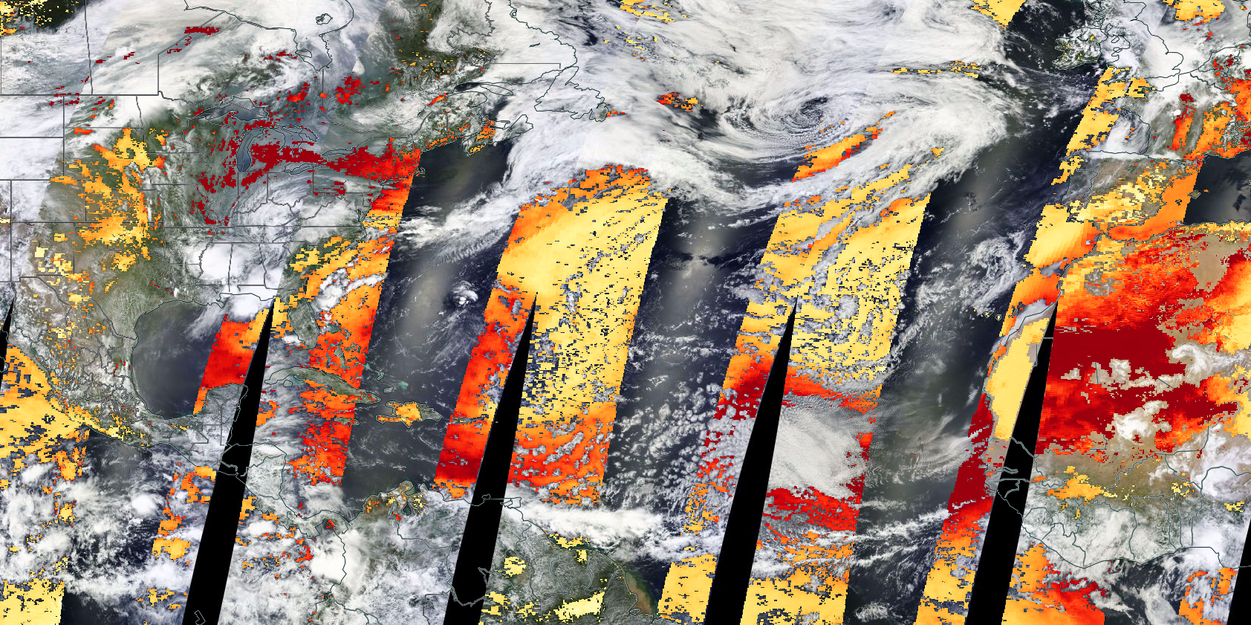
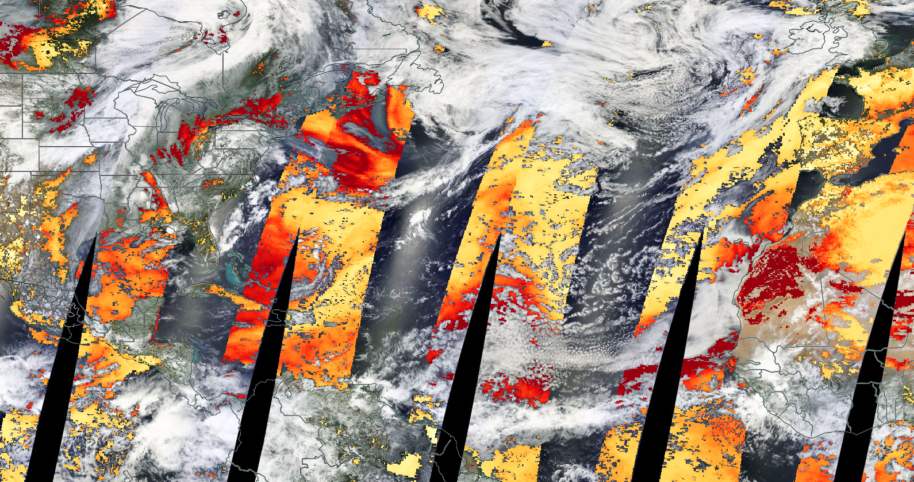
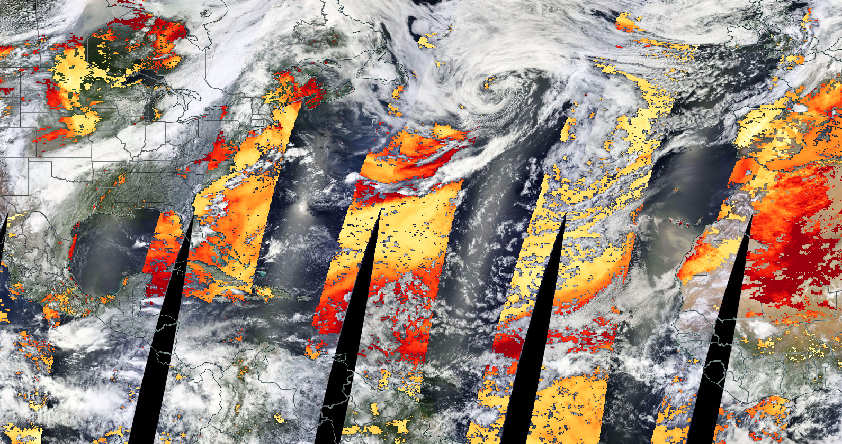
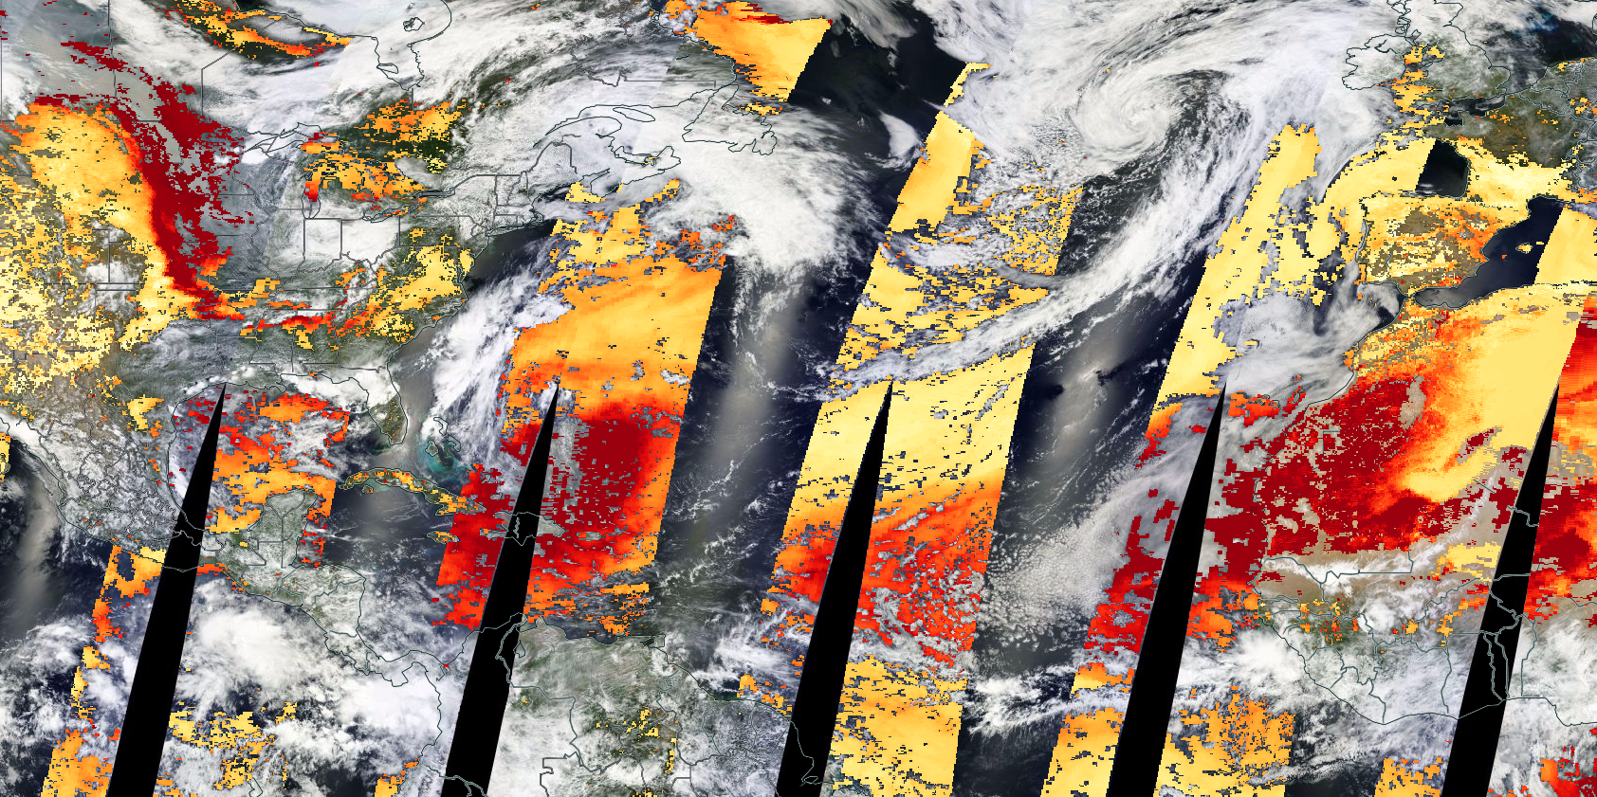
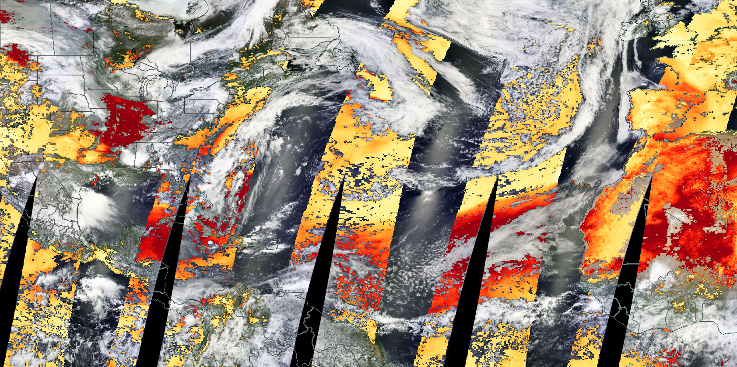
Dust Storm Transported Across the Atlantic Ocean shown by MODIS AOD
June 29, 2015
June 30, 2015
July 07, 2015
July 02, 2015
July 04, 2015
July 05, 2015
July 06, 2015
July 01, 2015
July 03, 2015
0
0.2
0.4
0.6
5

Slide 8
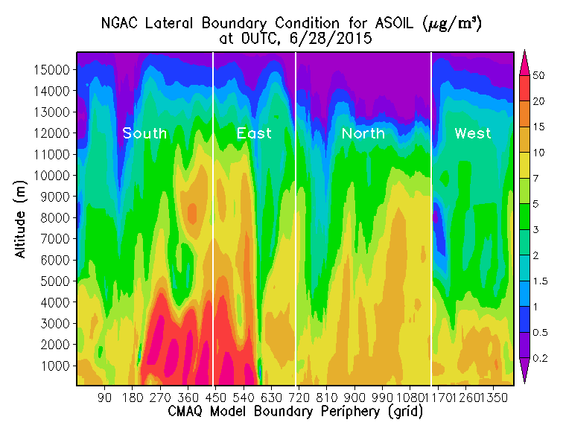
NGAC and GEOS-5 LBCs show similar patterns for dust intrusion, though NGAC yield higher backgrounddust.

Slide 9
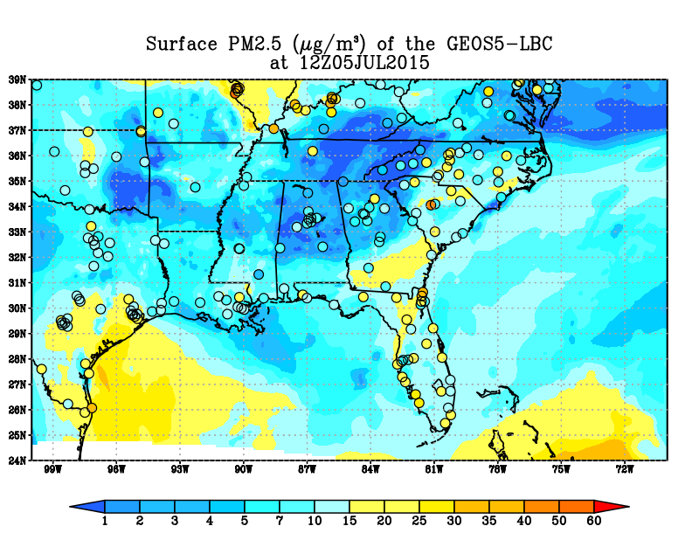
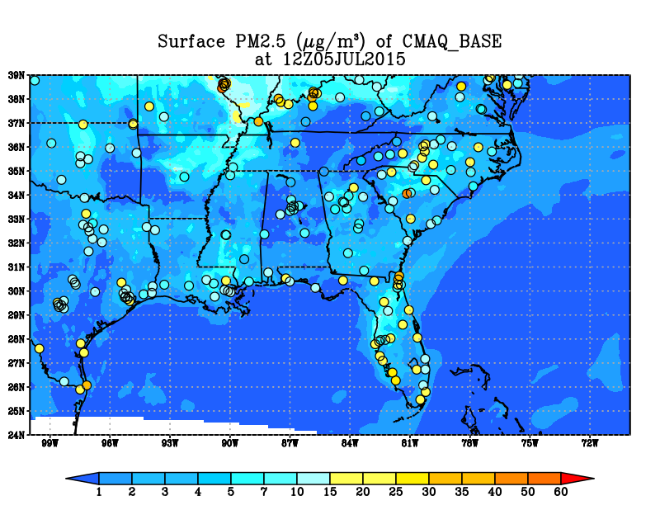
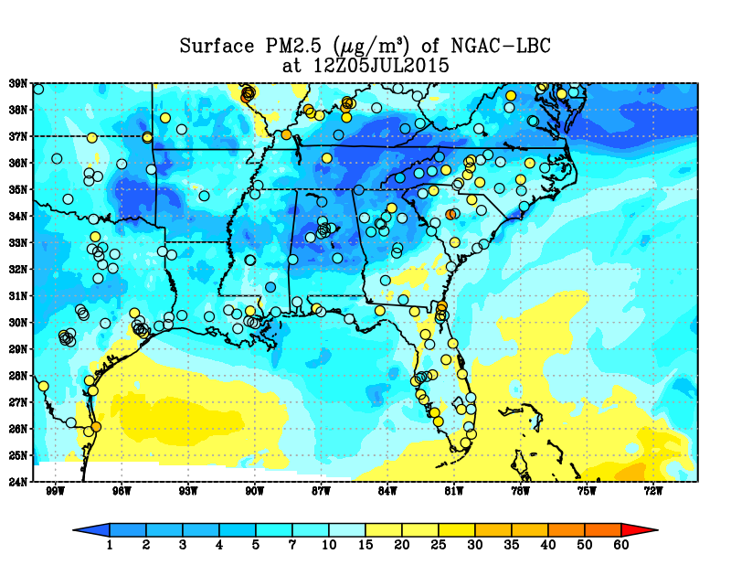
Surface PM2.5 over the Southeast at 12Z, 07/05/2015

Slide 10
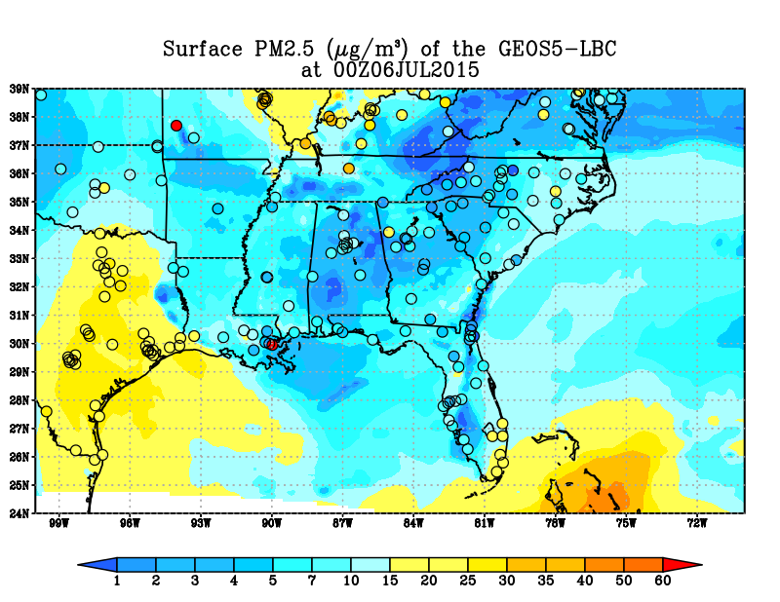
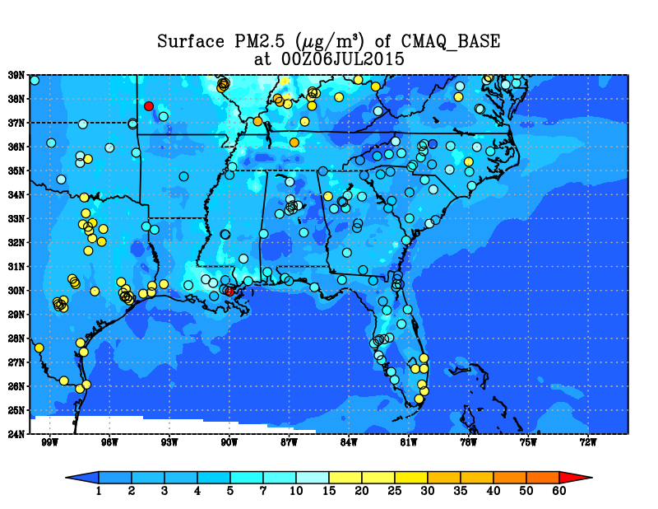
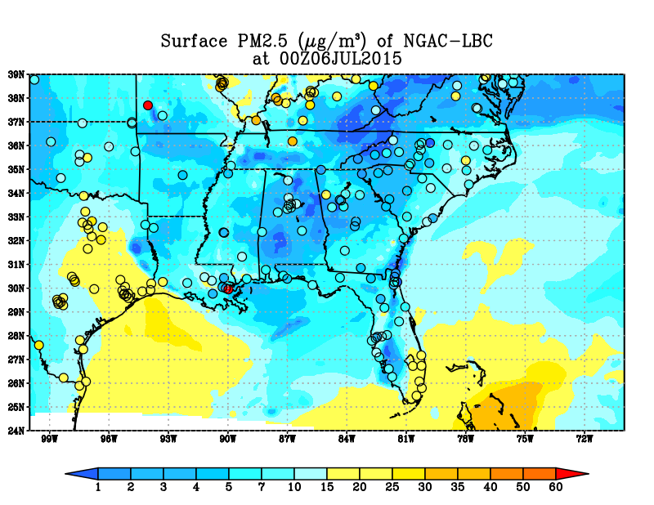
Surface PM2.5 over the Southeast at 00Z, 07/06/2015

Slide 11
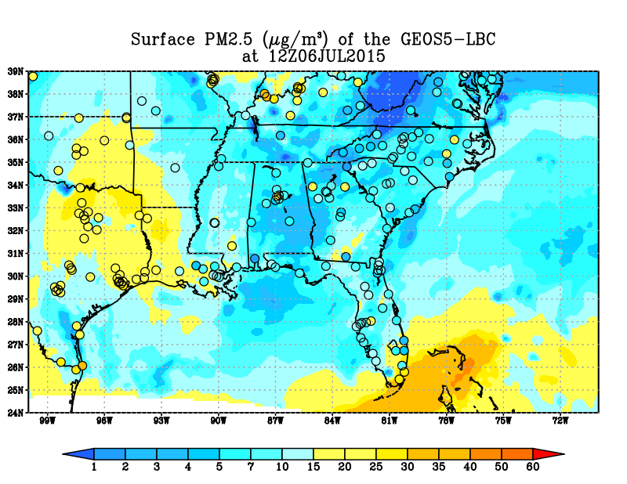
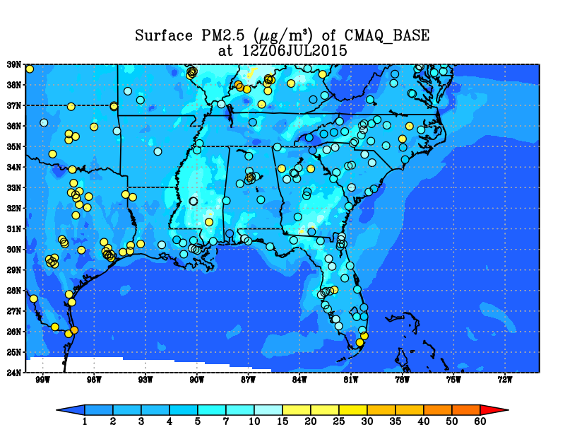
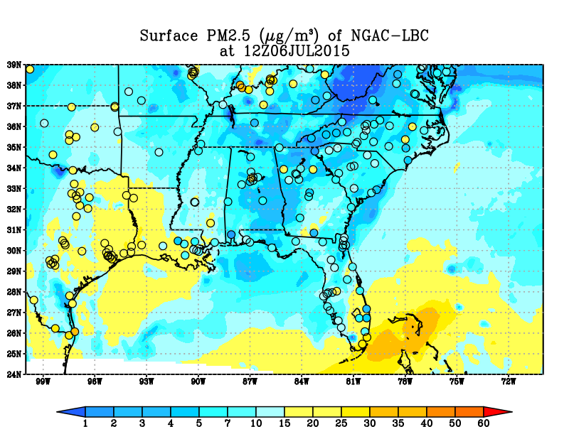
Surface PM2.5 over the Southeast at 12Z, 07/06/2015

Slide 12
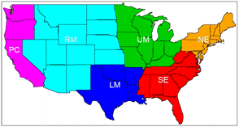
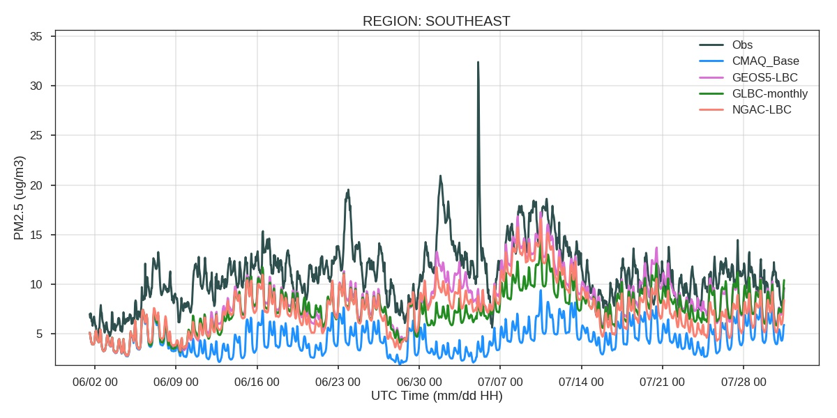
Comparison against Surface Sites

Slide 13
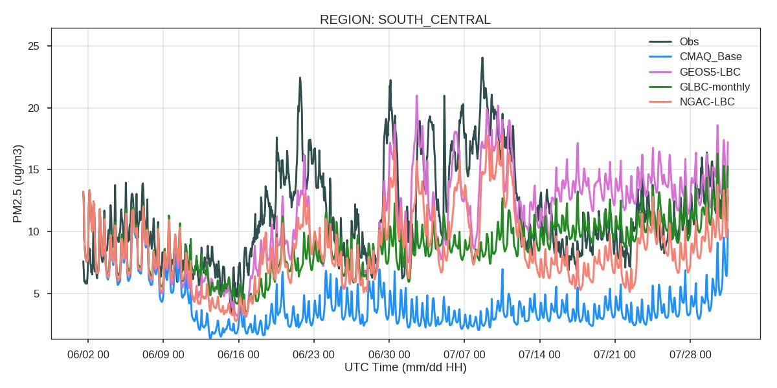
Comparison against Surface Sites: LM = South_Central

Slide 14
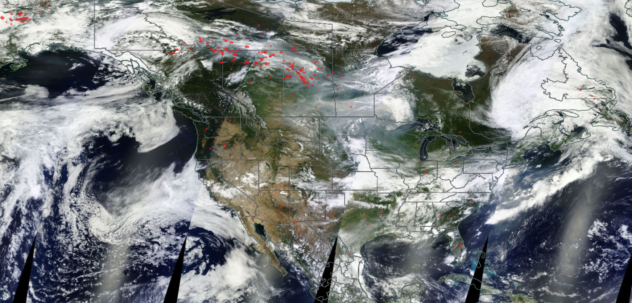
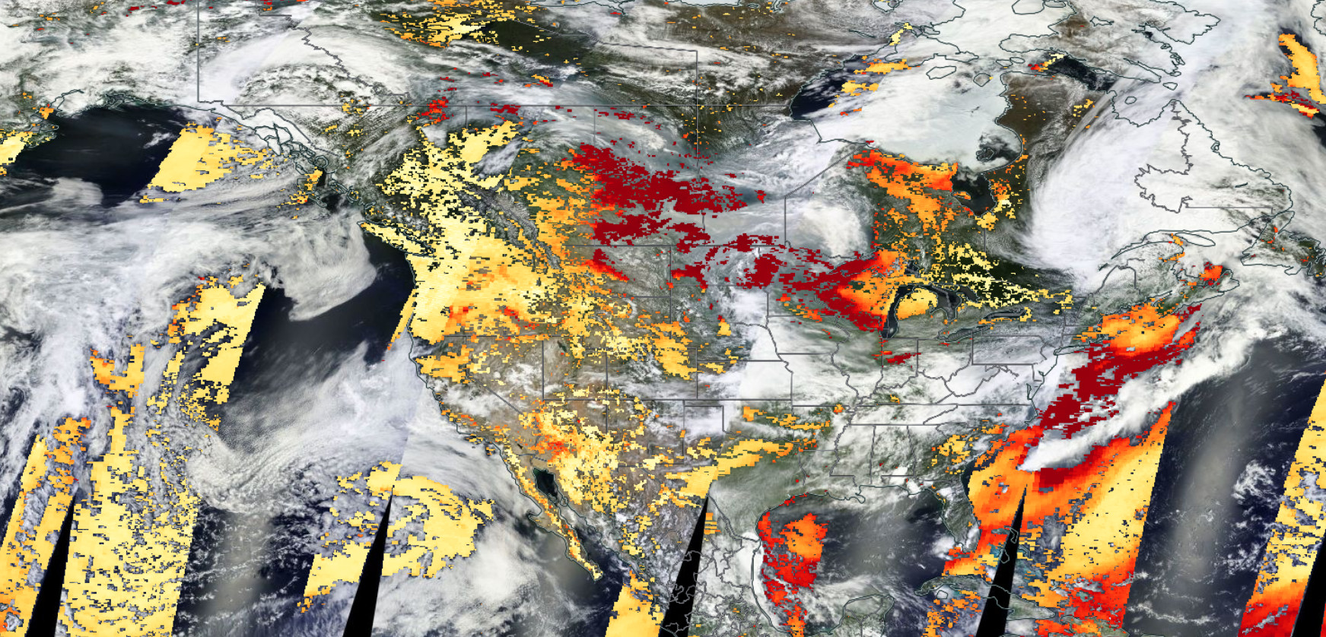
Another Event: Forest Fires from Canada
July 02, 2015

Slide 15
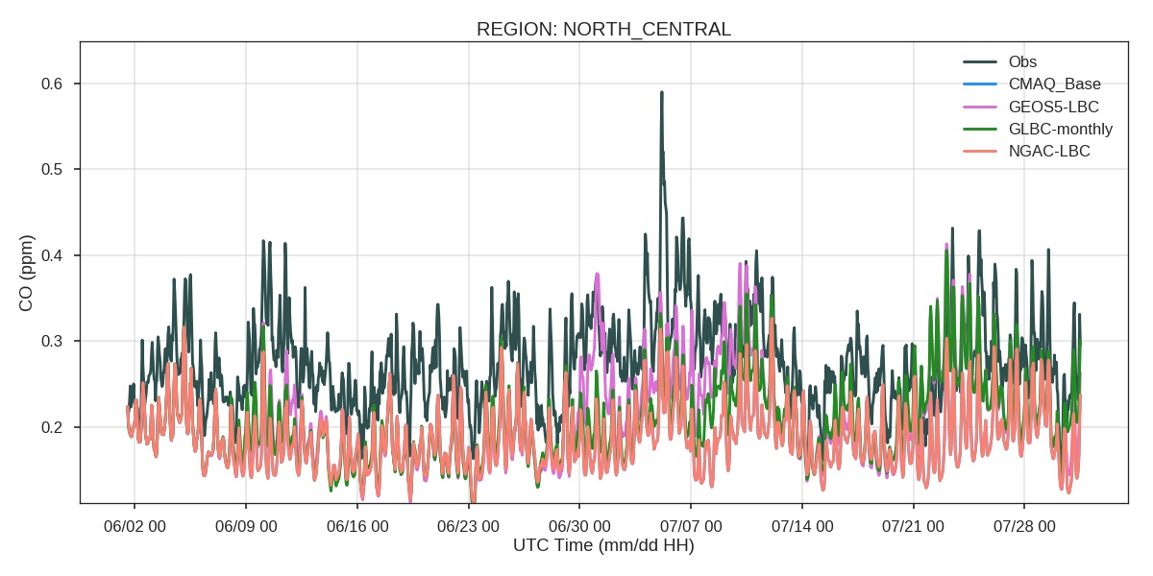
Comparison against Surface Sites: UM = North_Central

Slide 16
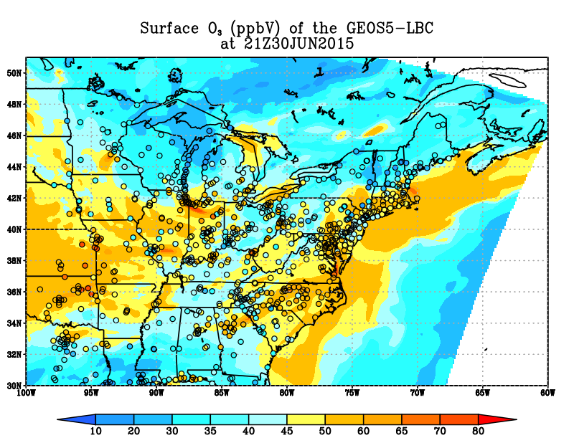
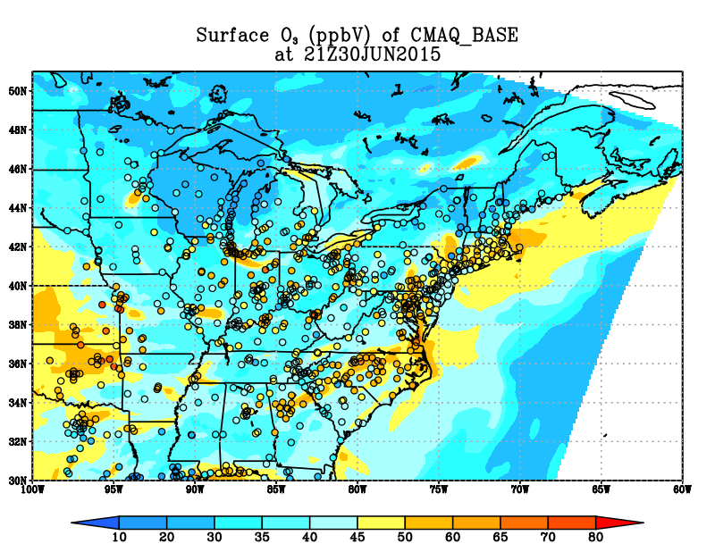
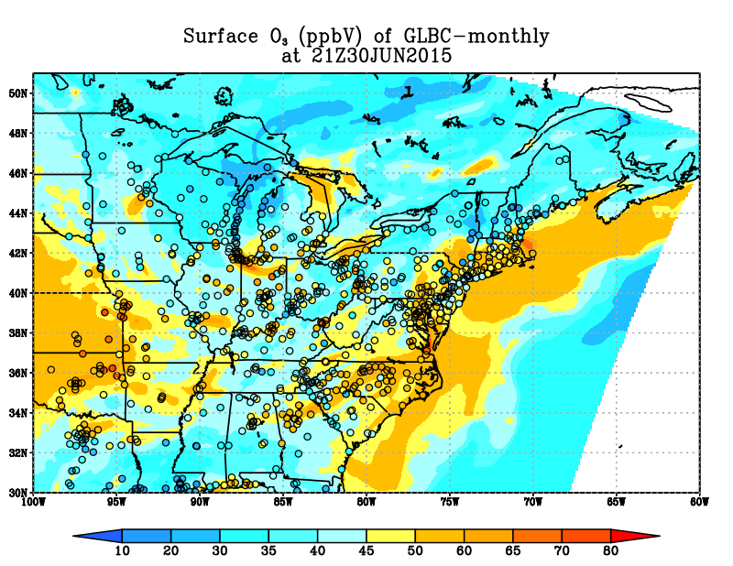
Ozone Comparison against AQS Surface Sites

Slide 17
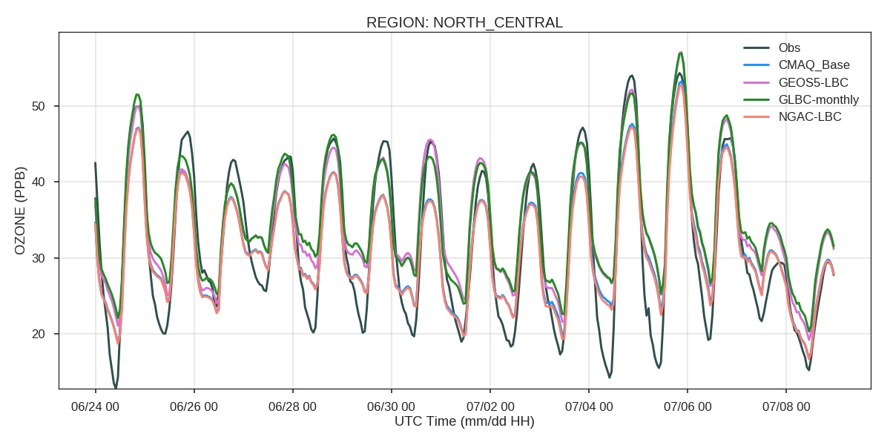
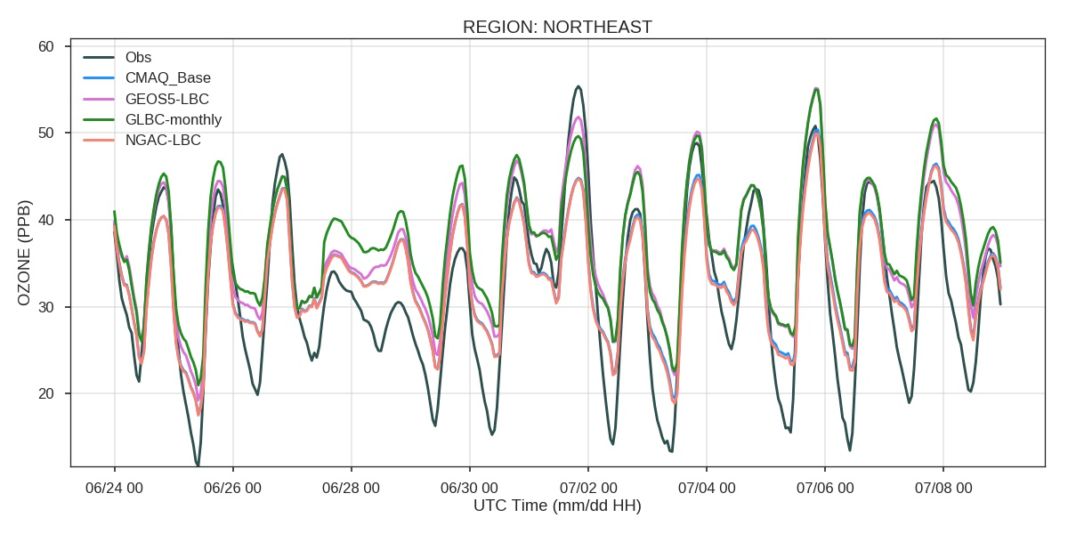

Slide 18
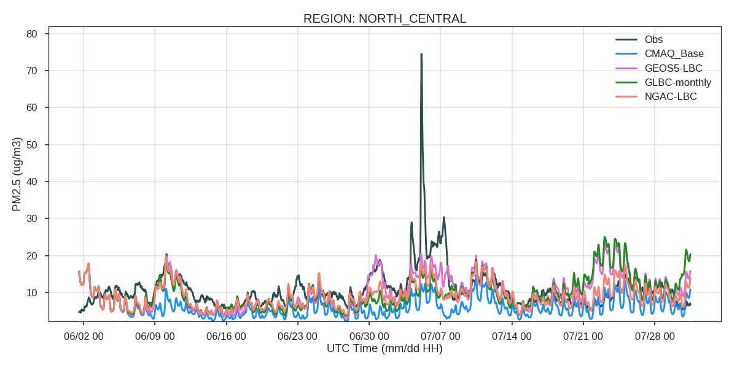
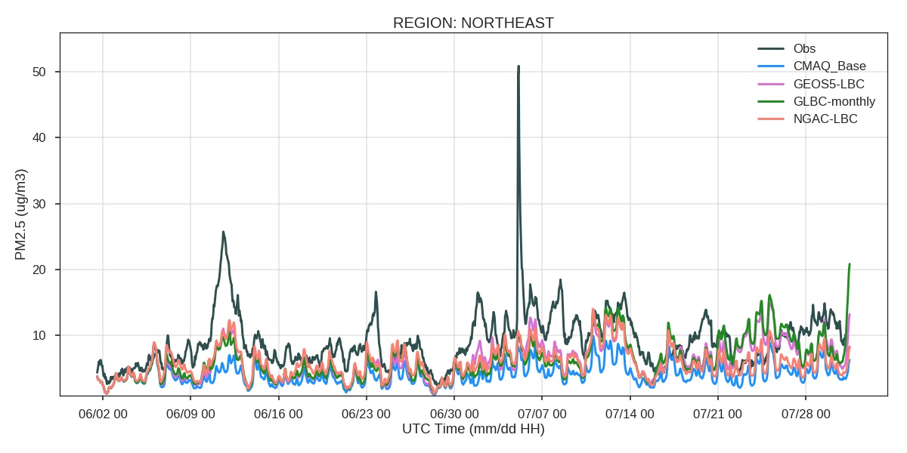

Slide 19
Statistic of the 2-month Performance: Surface PM2.5
Regions | Simulations | Mean Bias (µg/m³) | Root Mean Square Error (µg/m³) | Correlation Coefficient, R | Index of Agreement
CONUS | CMAQ_BASE | -4.51 | 9.45 | 0.22 | 0.44
 | GEOS5-LBC | -1.17 | 8.69 | 0.35 | 0.57
 | GLBC-monthly | -1.80 | 8.72 | 0.27 | 0.48
 | NGAC-LBC | -1.84 | 8.34 | 0.33 | 0.53
Northeastern USA | CMAQ_BASE | -4.70 | 8.67 | 0.31 | 0.47
 | GEOS5-LBC | -2.71 | 7.76 | 0.36 | 0.54
 | GLBC-monthly | -2.64 | 8.00 | 0.30 | 0.51
 | NGAC-LBC | -3.02 | 7.75 | 0.37 | 0.52
Southeastern USA | CMAQ_BASE | -6.35 | 9.37 | 0.24 | 0.47
 | GEOS5-LBC | -2.63 | 7.32 | 0.41 | 0.61
 | GLBC-monthly | -3.43 | 7.67 | 0.33 | 0.53
 | NGAC-LBC | -3.46 | 7.45 | 0.41 | 0.60
North Central | CMAQ_BASE | -4.31 | 11.11 | 0.20 | 0.42
 | GEOS5-LBC | -0.23 | 10.79 | 0.33 | 0.55
 | GLBC-monthly | -0.69 | 11.06 | 0.19 | 0.44
 | NGAC-LBC | -1.48 | 10.14 | 0.30 | 0.50
South Central | CMAQ_BASE | -7.18 | 10.46 | 0.04 | 0.44
 | GEOS5-LBC | -0.42 | 6.86 | 0.46 | 0.68
 | GLBC-monthly | -2.51 | 7.47 | 0.26 | 0.50
 | NGAC-LBC | -2.85 | 6.89 | 0.48 | 0.66

Slide 20
Statistic of the 2-month Performance: Surface Ozone
Regions | Simulations | Mean Bias (ppbV) | Root Mean Square Error (ppbV) | Correlation Coefficient, R | Index of Agreement
CONUS | CMAQ_BASE | 1.98 | 12.20 | 0.66 | 0.78
 | GEOS5-LBC | 3.90 | 11.98 | 0.71 | 0.80
 | GLBC-monthly | 4.35 | 12.22 | 0.70 | 0.79
Northeastern USA | CMAQ_BASE | 1.36 | 10.95 | 0.68 | 0.80
 | GEOS5-LBC | 4.47 | 11.65 | 0.69 | 0.79
 | GLBC-monthly | 4.53 | 11.71 | 0.69 | 0.78
North Central | CMAQ_BASE | 0.22 | 11.09 | 0.65 | 0.77
 | GEOS5-LBC | 2.38 | 10.98 | 0.68 | 0.79
 | GLBC-monthly | 2.69 | 11.14 | 0.67 | 0.78
Pacific Coast | CMAQ_BASE | -2.08 | 11.26 | 0.790 | 0.87
 | GEOS5-LBC | 0.45 | 11.07 | 0.792 | 0.88
 | GLBC-monthly | 0.98 | 11.01 | 0.795 | 0.88
Rockies | CMAQ_BASE | -1.86 | 10.63 | 0.69 | 0.80
 | GEOS5-LBC | 0.88 | 10.34 | 0.71 | 0.83
 | GLBC-monthly | 1.47 | 10.51 | 0.70 | 0.82
South Central | CMAQ_BASE | 11.66 | 17.06 | 0.56 | 0.63
 | GEOS5-LBC | 9.98 | 14.80 | 0.69 | 0.71
 | GLBC-monthly | 10.93 | 15.55 | 0.68 | 0.69

Slide 21
Summary
The updated global LBCs generally improve the overall model performance, especially during the intrusion events near the inflow border areas. The only side effect is increasing ozone mean bias.
The dynamic LBCs yield the best result. The monthly-mean LBC is also helpful, though its correlation is not as good as the dynamic LBCs.
The full-chemistry LBCs is more helpful than the NGAC LBC, especially during the Canadian fire intrusion case.

