Slide 1
Evaluation of Emissions of Nitrogen Oxides in Houston, Texas Using Three-Dimensional Aircraft Observations during the DISCOVER-AQ 2013 Mission
Ou Nopmongcol², Jim Smith¹, Greg Yarwood², Zhen Liu², Jeremiah Johnson², Wei Chun²
¹Texas Commission on Environmental Quality
²Ramboll Environ, Inc.
Community Modeling and Analysis System (CMAS) 2017 Annual Conference
October 23, 2017
Air Quality Division

Slide 2
NO_{X} Emission Over-Estimation?
Many authors have concluded that emissions of Nitrogen Oxides (NO_{X}) used in recent photochemical modeling studies are over-estimated by up to 100% or even more.
The usual suspect is MOVES model-predicted on- and non-road mobile sources.
However, performance evaluation of modeling conducted by the TCEQ shows reasonable agreement between predicted and observed ambient NO_{X} concentrations.
What gives?

Slide 3
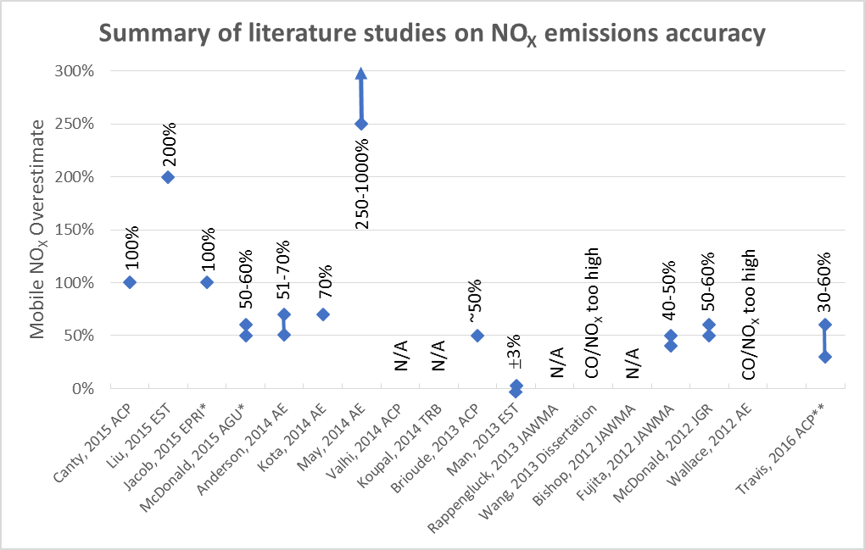
NO_{X} Emission Over-Estimation?
Bai, et al summarized literature studies between 2012 and 2015, results are displayed below:
ACP – Atmospheric Chemistry and Physics
EST – Environmental Science and Technology
EPRI – Electric Power Research Institute
AGU – American Geophysical Union
AE – Atmospheric Environment
TRB – Transportation Research Board
JAWMA – Journal of Air and Waste Management Assn.
JGR – Journal of Geophysical Research
* Presentations
** Added

Slide 4
Houston-Galveston-Brazoria (HGB) On-Road Mobile Source Emissions
State Implementation Plan revision in 2016: Attainment Demonstration for 2008 Ozone Standard
  2012 base year
  4 km East Texas subgrid
  Travel-demand modeling for HGB was conducted by Houston-Galveston Area Council
  Emissions by link, day-of-week, time-of-day developed by Texas Transportation Institute using MOVES2014

Slide 5
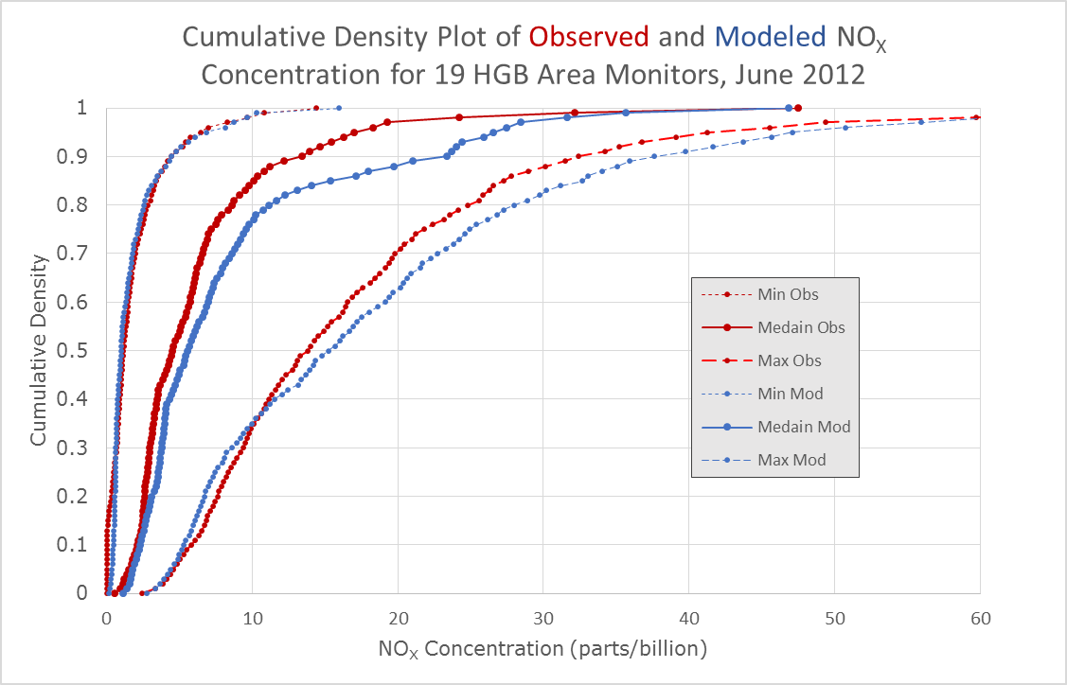
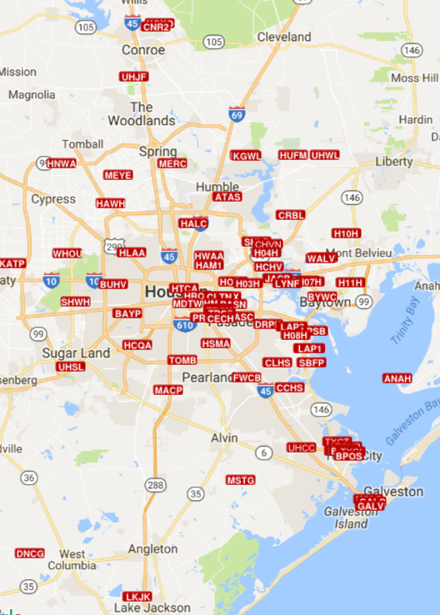
Houston-Galveston-Brazoria NO_{X} Performance
2012 Base Case (2016 HGB O₃ Attainment Demonstration)

Slide 6
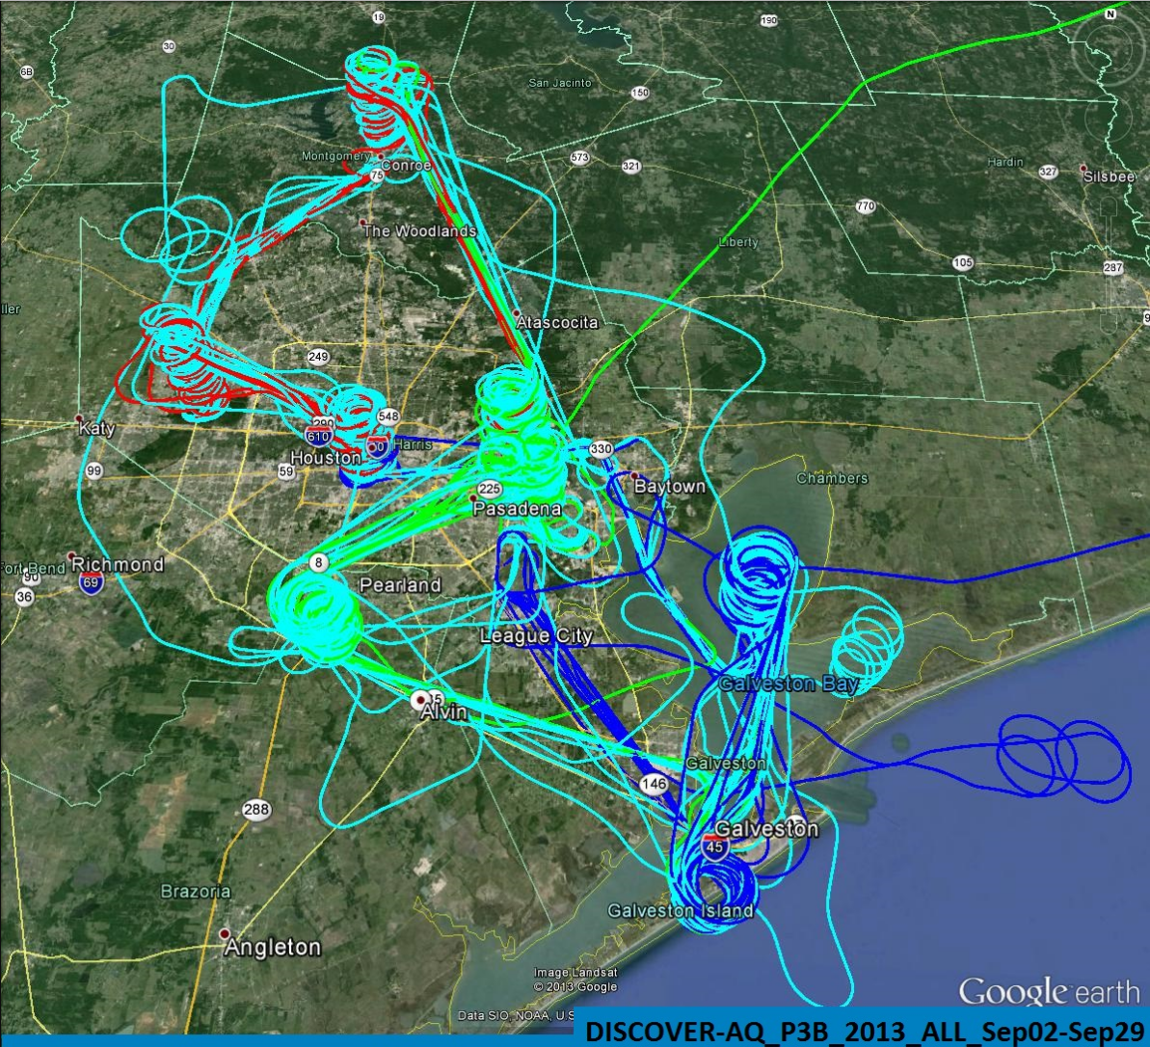
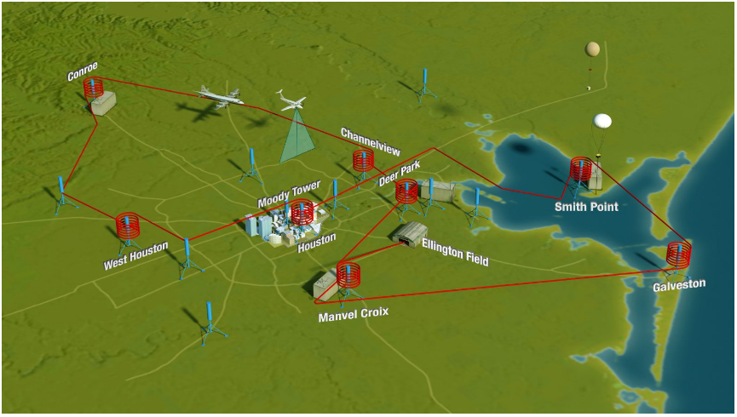
DISCOVER-AQ 2013 Houston
Deriving Information on Surface Conditions from COlumn and VERtically resolved observations – Air Quality

Slide 7
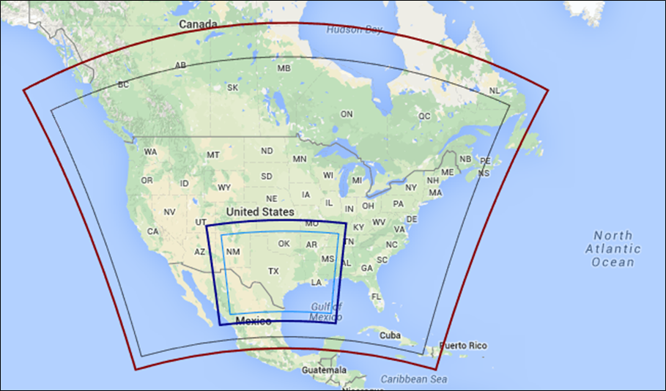
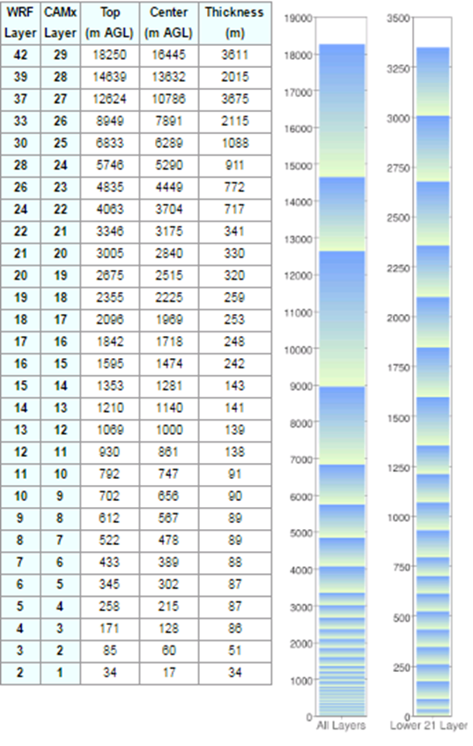
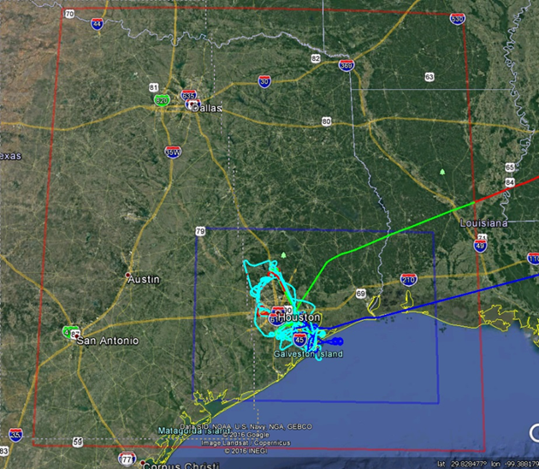
Modeling the 2013 DISCOVER-AQ Period
36 km
12 km
4 km
WRF (red) and CAMx (blue) modeling domains.

Slide 8
Meteorological Modeling
WRF test case | Original | ERA.FNMOC | ERA.FNMOC.NoOBS | ERA.G1 | NAM.FNMOC | NAM.FNMOC.KF
Domains | 36/12/4/1.33 km | 36/12/4 km | 36/12/4 km | 36/12/4 km | 36/12/4 km | 36/12/4 km
Microphysics | WSM6 | Thompson | Thompson | Thompson | Thompson | Thompson
LW Radiation | RRTMG | RRTMG | RRTMG | RRTMG | RRTMG | RRTMG
SW Radiation | RRTMG | RRTMG | RRTMG | RRTMG | RRTMG | RRTMG
Surface Layer Physics | MM5 similarity | MM5 similarity | MM5 similarity | MM5 similarity | MM5 similarity | MM5 similarity
Land Surface Model | Noah | Noah | Noah | Noah | Noah | Noah
PBL scheme | Yonsei University (YSU) | YSU | YSU | YSU | YSU | YSU
Cumulus Scheme | 36/12 km: Kain-Fritsch 4/1.3 km: none | 36/12/4 km: Multi-scale K-F(MSKF) | 36/12/4 km: MSKF | 36/12/4 km: MSKF | 36/12/4 km: Grell-Freitas | 36/12/4 km: K-F
BC and IC Source | 12 km NAM | ERA-Interim | ERA-Interim | ERA-Interim | 12 km NAM | 12 km NAM
Analysis Nudging | 36/12 km | 36/12 km | 36/12 km | 36/12 km | 36/12 km | 36/12 km
Obs Nudging | None | 4 km | None | 4 km | 4 km | 4 km
Sea Surface Temp. | RTG | FNMOC | FNMOC | G1 | FNMOC | FNMOC
WRF – Weather Research and Forecasting Model
ERA – European Center for Medium Range Weather Forecasting Re-Analysis
FNMOC – Fleet Numerical Meteorology and Oceanogaphy Center
G1 – NASA Global 1-km Sea Surface Temperature
RRTMG - Rapid Radiative Transfer Model for Global Climate Models
RTG – Real-Time Global Sea Surface Temperatures
MM5 – Mesoscale mMeteorological Model version 5
NAM – North American Meteorological Model
WSM6 – WRF Single-Moment 6-Class Microphysics Scheme

Slide 9
Meteorological Modeling
WRF test case | Original | ERA.FNMOC | ERA.FNMOC.NoOBS | ERA.G1 | NAM.FNMOC | NAM.FNMOC.KF
Domains | 36/12/4/1.33 km | 36/12/4 km | 36/12/4 km | 36/12/4 km | 36/12/4 km | 36/12/4 km
Microphysics | WSM6 | Thompson | Thompson | Thompson | Thompson | Thompson
LW Radiation | RRTMG | RRTMG | RRTMG | RRTMG | RRTMG | RRTMG
SW Radiation | RRTMG | RRTMG | RRTMG | RRTMG | RRTMG | RRTMG
Surface Layer Physics | MM5 similarity | MM5 similarity | MM5 similarity | MM5 similarity | MM5 similarity | MM5 similarity
Land Surface Model | Noah | Noah | Noah | Noah | Noah | Noah
PBL scheme | Yonsei University (YSU) | YSU | YSU | YSU | YSU | YSU
Cumulus Scheme | 36/12 km: Kain-Fritsch 4/1.3 km: none | 36/12/4 km: Multi-scale K-F(MSKF) | 36/12/4 km: MSKF | 36/12/4 km: MSKF | 36/12/4 km: Grell-Freitas | 36/12/4 km: K-F
BC and IC Source | 12 km NAM | ERA-Interim | ERA-Interim | ERA-Interim | 12 km NAM | 12 km NAM
Analysis Nudging | 36/12 km | 36/12 km | 36/12 km | 36/12 km | 36/12 km | 36/12 km
Obs Nudging | None | 4 km | None | 4 km | 4 km | 4 km
Sea Surface Temp. | RTG | FNMOC | FNMOC | G1 | FNMOC | FNMOC
WRF – Weather Research and Forecasting Model
ERA – European Center for Medium Range Weather Forecasting Re-Analysis
FNMOC – Fleet Numerical Meteorology and Oceanogaphy Center
G1 – NASA Global 1-km Sea Surface Temperature
RRTMG - Rapid Radiative Transfer Model for Global Climate Models
RTG – Real-Time Global Sea Surface Temperatures
MM5 – Mesoscale Meteorological Model version 5
NAM – North American Meteorological Model
WSM6 – WRF Single-Moment 6-Class Microphysics Scheme

Slide 10
Meteorological Modeling
Notes:
Soccer-goal plots show pairs of model performance statistics compared with nominal performance goals. ERA_FNMOC was chosen from among the candidate model configurations based on this analysis.

Slide 11
Emissions/Boundary Conditions
2012 to 2013 Scaling Factors for Mobile Sources
Mobile source emissions were
based on TCEQ’s 2012 modeling
platform, scaled to 2013.
Episode-specific emissions:
  Model of Emissions of Gases and Aerosols from Nature (MEGAN) with updated isoprene emission factors
  Sea-salt
  Fires using Fire Inventory from NCAR (FINN)
  Hourly emissions from Acid Rain Program Database
2013 boundary conditions from GEOS-Chem
Source |  | NOx | VOC | CO | SO₂ | PM_{2.5}
Texas
Non-road |  | 0.934 | 0.947 | 0.985 | 0.897 | 0.926
On-road |  | 0.916 | 0.943 | 0.965 | 0.900 | 0.910
Other states
Non-road | 0.951 |  | 0.943 | 0.989 | 1.009 | 0.946
On-road | 0.920 |  | 0.921 | 0.936 | 0.891 | 0.932

Slide 12
CAMx Model Configuration
Science Options | Configurations
Model Code | Version 6.4
Horizontal Grid Mesh | 36/12/4 km
Vertical Grid Mesh | 29 Layers
Initial Conditions | 15 days full spin-up for 36/12 km; 5 days for 4 km
Boundary Conditions | Extracted from CAMx 12 km
Emissions Processing | Described in Section 2
Gas-Phase Chemistry | CB6r4 + Halogen
Aerosol Chemistry | ISORROPIA equilibrium and SOAP; CF scheme
Meteorological Processor | WRFCAMx
Horizontal Transport | Piecewise Parabolic Method (PPM scheme)
Horizontal Diffusion | K-theory
Vertical Advection Scheme | WRF
Vertical Eddy Diffusivity Scheme | K-theory
Vertical Diffusivity Corrections | Kv-patch depending on landuse category up to 100 m and to cloud tops
Deposition Scheme | Zhang
CF – Coarse-Fine
ISORROPIA – Greek for Equilibrium
SOAP – Secondary Organic Aerosol Processor
CB6r4 – Carbon Bond Mechanism ver. 6 rel. 4

Slide 13
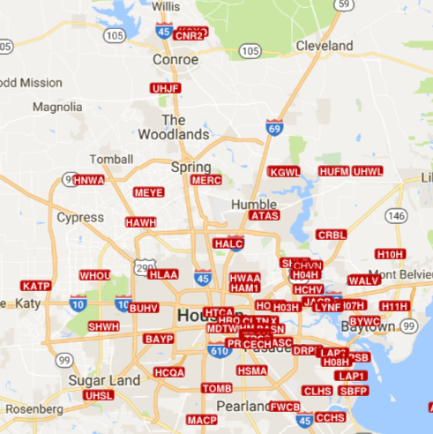
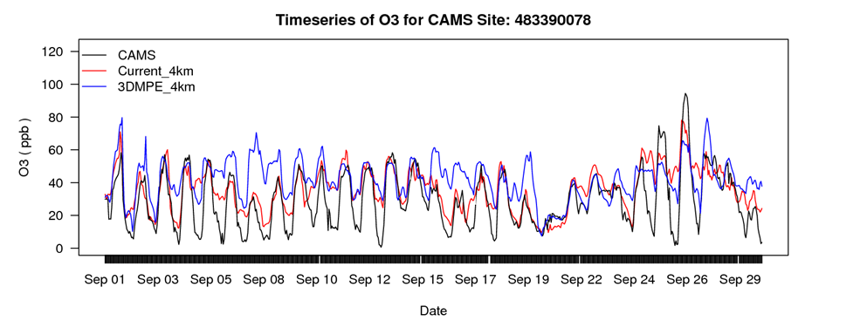
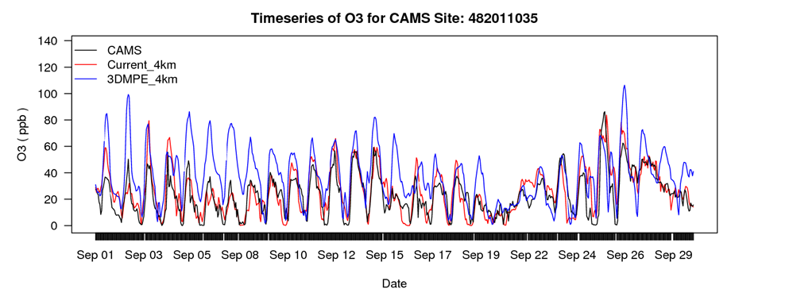
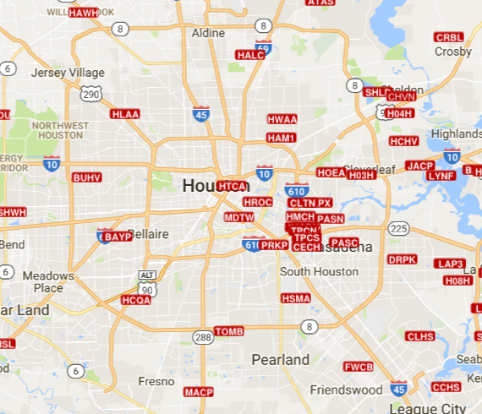
CAMx Model Performance: O₃
Conroe
Clinton Drive
Notes:
3DMPE_4km was an earlier model run conducted for a previous work order. Generally model performance is much improved.

Slide 14
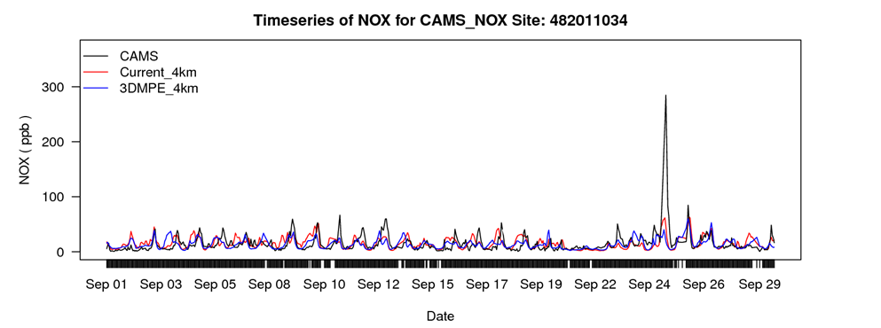
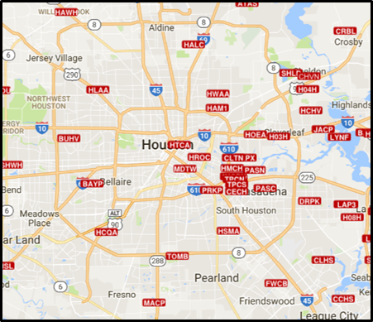
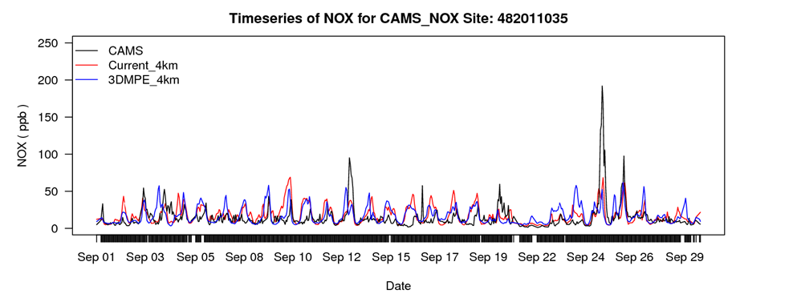
CAMx Model Performance: NO_{X}
Houston East
Clinton Drive

Slide 15
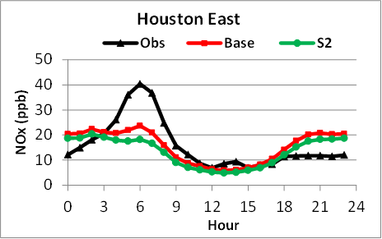
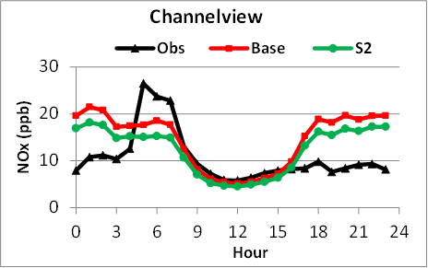
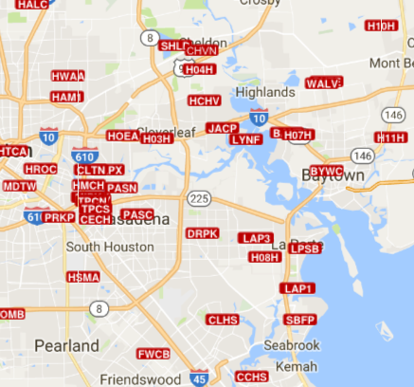
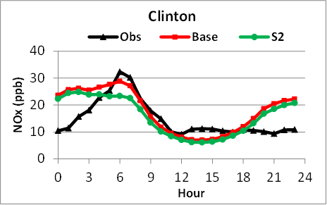
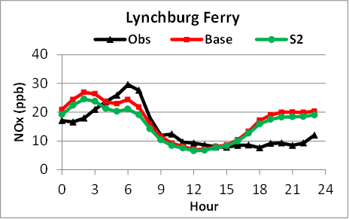
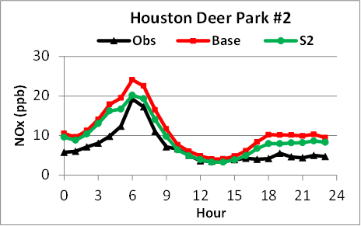
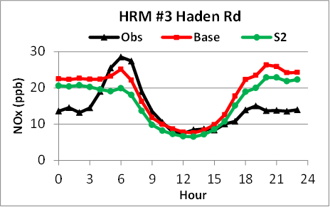
September Hourly Average NO_{X}
Base and 50% Texas Onroad NO_{X} Emissions

Slide 16
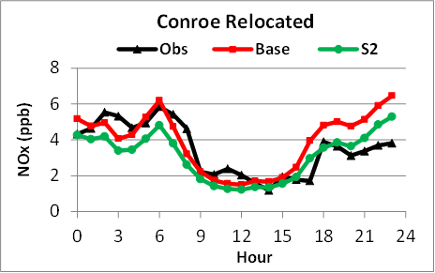
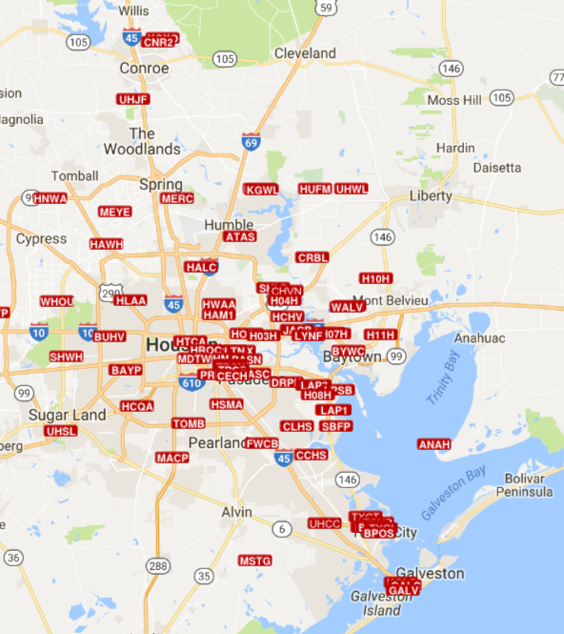
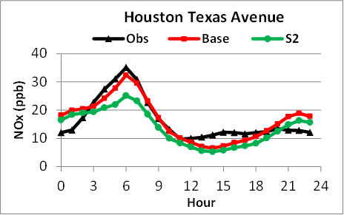
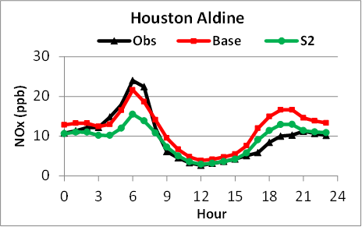
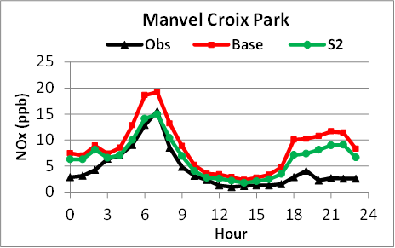
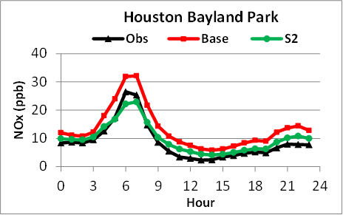
September Hourly Average NO_{X}
Base and 50% Texas Onroad NO_{X} Emissions

Slide 17
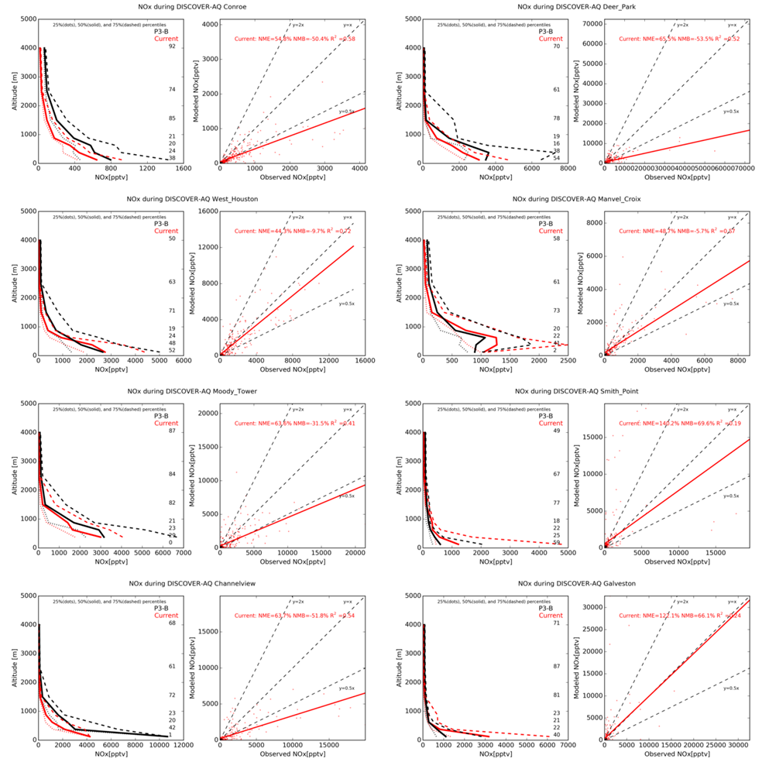
Vertical Profile Comparison: NO_{X} during DISCOVER-AQ
Conroe
Deer Park
West Houston
Manvel Croix Park

Slide 18
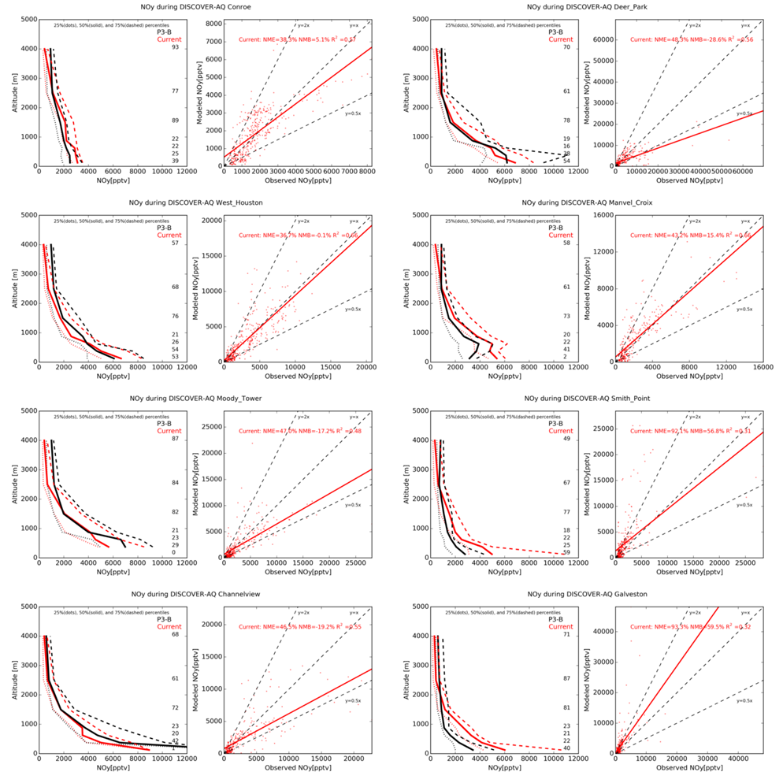
Vertical Profile Comparison : NO_{Y}
Conroe
Deer Park
West Houston
Manvel Croix Park
Notes:
NOy is NOx (NO+NO2) + product species such as nitric acid & PAN species.

Slide 19
Vertical Profile Comparison : NO_{X}
Moody Tower
Smith Point
Channelview
Galveston

Slide 20
Vertical Profile Comparison : NO_{Y}
Moody Tower
Smith Point
Channelview
Galveston

Slide 21
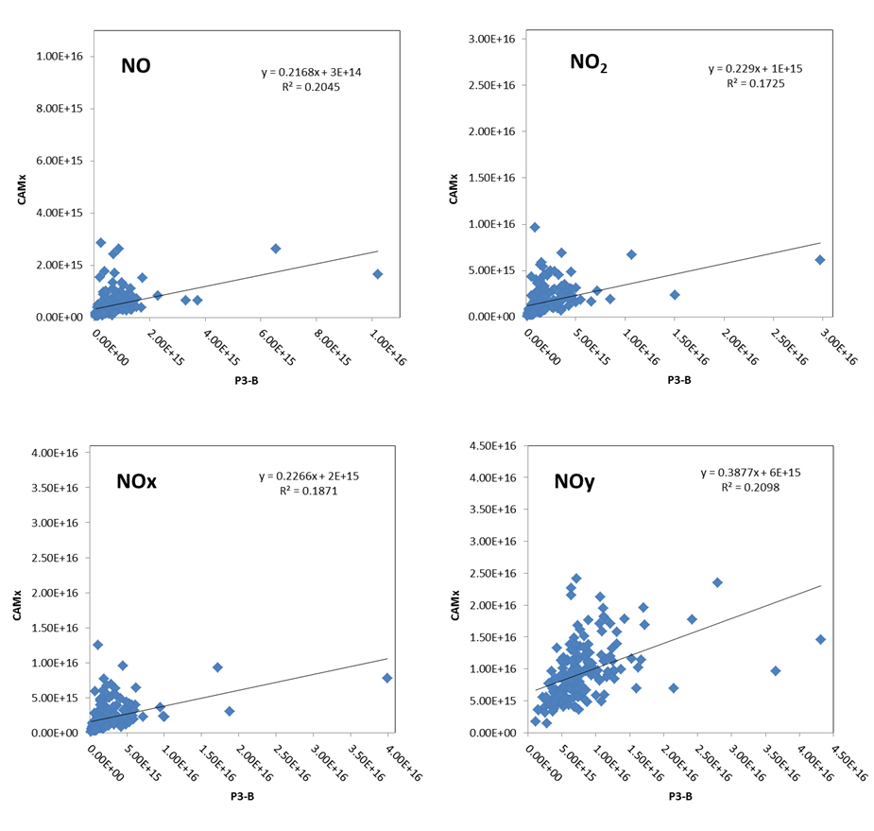
Column Densities for NO Species
Column densities are layer concentrations integrated vertically. A few large observations skew the regression lines clockwise.

Slide 22
Conclusions
The new base case significantly improves both meteorological and ozone model performance compared with the simulation conducted for a previous TCEQ project.
Modeled NO_{X} concentrations match observations well during morning rush hour and during day-time, especially at sites near the Houston city core (e.g., Clinton and Houston Texas Avenue).

Slide 23
Conclusions
We find no strong evidence that TCEQ’s NO_{X} on-road emissions are overstated in contrast to reports that on-road NO_{X} emissions in the NEI are overestimated.
MOVES can produce reasonably accurate NO_{X} inputs for modeling if supplied with accurate, location-specific, temporally and spatially resolved input data.

