Slide 1
Mechanistic representation of Soil N in CMAQ v5.1
Quazi Z. Rasool¹, Jesse O. Bash², Ellen J. Cooter² and Daniel S. Cohan¹
¹Department of Civil engineering, Rice University
²Computational Exposure Division, NERL, US Environmental Protection Agency
16th Annual CMAS Conference, UNC-Chapel Hill
October 24, 2017

Slide 2
Reactive soil N in air quality models
Parametrized oxidized N (NO) and soil-atmosphere exchange of NH₃
Contributes to ozone and particulate matter
Soil NO_{x} ~ 19% of Global NO_{x} Budget
Large underestimations and uncertainties in modeled soil NO
Yienger-Levy scheme: No deposition, poor soil moisture representation
Updated parameterized approach (enhanced BDSNP)

Slide 3
Motivation
Soil nitrogen emissions altered by increasing fertilizer use
Inconsistent treatment of N species in soils and fluxes
Bi-directional scheme for ammonia but not other species
NO parameterized; HONO ignored
Nitrification and denitrification not represented
Need consistent mechanism to model impact of agricultural management on reactive N emissions and air quality

Slide 4
Reactive N cycling schematic
(Parametrized vs Mechanistic)
Mechanistic
Parametrized
NH₃
NO N₂O
N₂
NO N₂O HONO
HNO₃
Fertilizer, Deposition, Biome
NO₂
NO
Atmosphere
Soil
NH₃
N₂
N₂O
NO
NO
N₂O
NO₂
HNO₃
HNO₂
H⁺
H⁺
Denitrification
NH₄⁺
NO₂⁻
NO₃⁻
Org N
Org N
Total N
N (-3)
N (+5)
Nitrification
Adapted from Su et al., 2011; Pilegaard, 2013 and Medinets et al., 2015

Slide 5
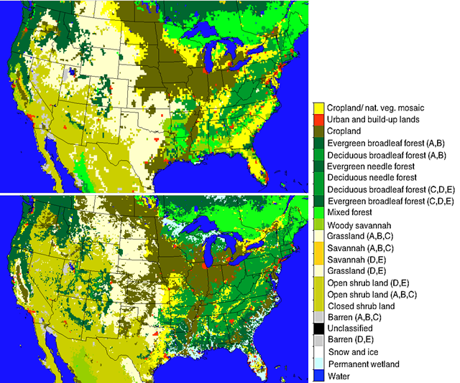
Soil biome / Land Cover Dataset Enhancements
GEOS-Chem (0.25° x 0.25°)
GEOS-Chem
24 MODIS land cover categories
Too coarse for regional modeling
CMAQ
Mapped 40 NLCD categories from Pleim-Xiu to 24 MODIS categories
Köppen-Geiger climate zones
Sub-grid fractionation of biomes
CMAQ (12 km x 12 km)

Slide 6
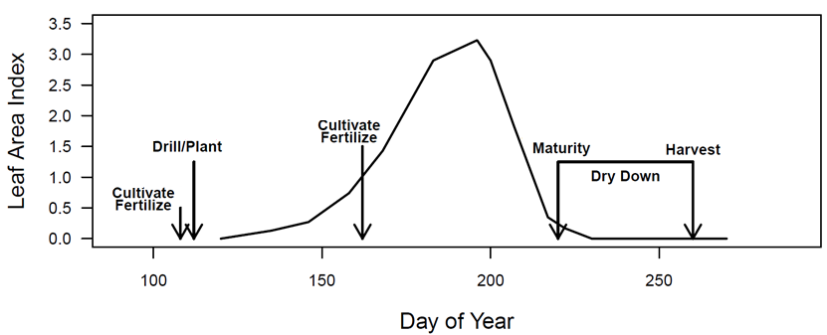
Environmental Policy Integrated Climate (EPIC) agricultural model
Fertilizer quantity: USDA Agricultural Resource Management Survey database, validated with fertilizer sales data
Fertilizer timing: Determined by plant nutrient stress
Can simulate varied agricultural practices (e.g., tillage, fertilizer type)
Fertilizer Emission Scenario Tool for CMAQ (FEST-C) incorporates EPIC simulated agricultural soil N into CMAQ runs
[Source: Cooter et al., 2012]
Notes:
HUSC to Schedule Vegetable Plantings, Predict Harvest Dates and Manage Crops
Temperature controls the development of many organisms that don’t have complex thermoregulatory systems. This allows us to predict the development of different organisms by accurately using development or phenology models which are based on the accumulation of heat units (i.e. degree days) during a growing season.

Slide 7
Reactive soil N modeling (Parametrized vs Mechanistic)
EPIC
(N for Agricultural soil)
Fertilizer
Deposition
Soil T and moisture
Canopy reduction factor
Pulsing = f (rain, dry period)
Emission Factor for each biome
Non-Agricultural soil properties and
nutrient data#
Land use specific HONO, NO estimates*
Parametrized
Mechanistic
Soil NO
DAYCENT N module!
(in-line in CMAQ)
Nitrification and Denitrification
NO
HONO
N₂O
*Oswald et al., 2013; Su et al., 2011
#Xu et al., 2014
!Parton et al., 2001; Del Grosso et al., 2000

Slide 8
Updates in CMAQ : parameterized to mechanistic
Features in CMAQ | Parameterized | Mechanistic
Species emitted | Nitric oxide (NO), NH₃ | NO, NH₃, HONO, N₂O
Approach | BDSNP equations for NO CMAQ bi-directional for NH₃ | DayCENT submodel representing nitrification, denitrification, and mineralization
Variables considered | Total soil N, soil T, soil moisture, rainfall, and biome type | Soil water content, T, NH₄⁺, NO₃⁻, gas diffusivity, and labile C by soil layer
Soil N data source | EPIC (agricultural soil only) | EPIC for agricultural soil Microbial biomass C, N, and properties for non-agricultural
Notes:
DAYCENT and EPIC model both based on CENTURY ecosystem model
CENTURY simulates cycling of reactive N (along with other nutrients) between soil, vegetation, atmosphere and water
EPIC differs from DAYCENT since:
EPIC has been implemented on a regional scale in CMAQ and,
NH₃ Bi-directional feedback implemented in EPIC-CMAQ framework
(Cooter et al., 2012)
EPIC does not give how much of NO and N₂O each came from nitrification and denitrification
N sub model of DAYCENT addresses that mechanistically based on
soil water content (WFPS), temp, soil NH₄⁺ and NO₃⁻ concentrations, gas diffusivity and labile C availability at various soil layers
(Parton et al 1998; Del Grosso et al., 2000; Parton et al., 2001)
Soil HONO still not addressed in current biogeochemical models

Slide 9
Approach to include soil HONO
NO and HONO flux from nitrification and denitrification based on:
NH₄⁺, NO₂⁻, and NO₃⁻ availability in soils
Soil pH
Soil moisture:
Nitrification for water-filled pore space <55%
Denitrification for water-filled pore space >55%
HONO for water-filled pore space <40%
For water-filled pore space <20%
More HONO than NO emissions
Soil temperature
Heterotrophic respiration of Soil Org C as CO₂

Slide 10
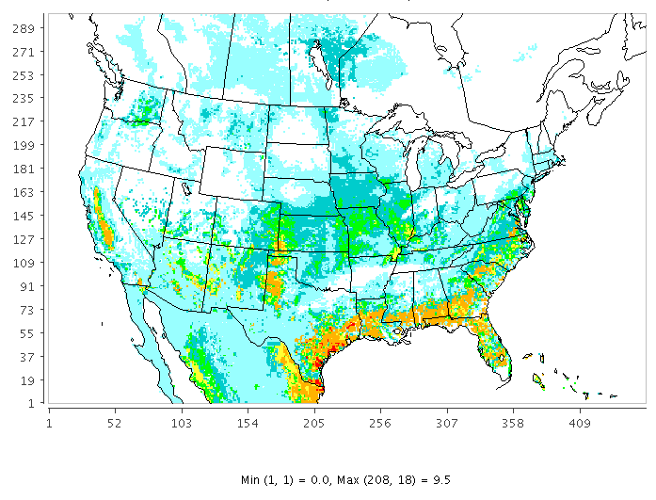
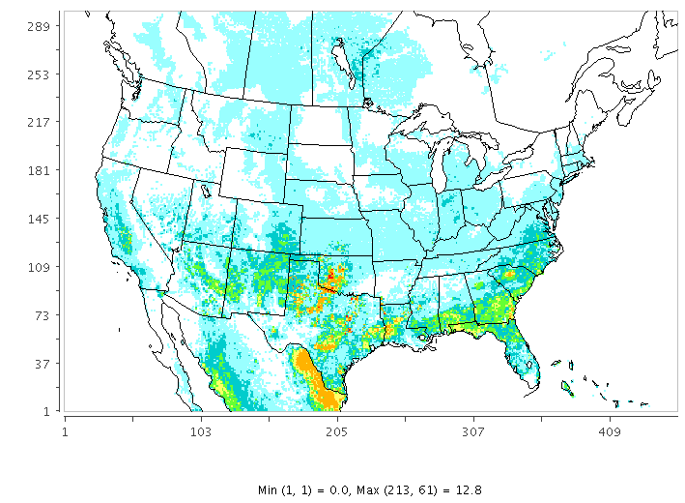
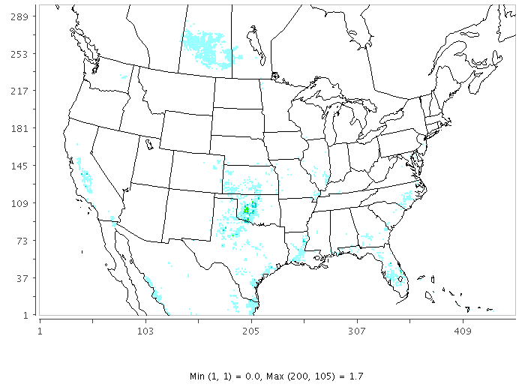
Comparison of soil NO_{x} flux across schemes
NO (Parametrized)
NO (Mechanistic)
Daily Average soil N flux
(21 April, 2011)
HONO (Mechanistic)

Slide 11
Modeling NH₄ and NO₃ available in non-agricultural soil
Enzyme Loss
CO₂ respiration from:
Enzyme production
Maintenance
Growth
Overflow mechanism
Soil Org C
Recycle
Soil microbial C
Decay/death
F( C:N ratio)
Soil Org N
Soil microbial N
Immobilization
Mineralization
NO₃-N
NH₄-N
Nitrification
f (soil pH, WFPS, soil Temp, volatilization)
Mass balance approach
for C-N dynamics in soil*
Nitrification estimation as done in EPIC and NH₃ scheme in CMAQ
*Schimel and Weintraub (2003); Manzoni and Porporato (2009)

Slide 12
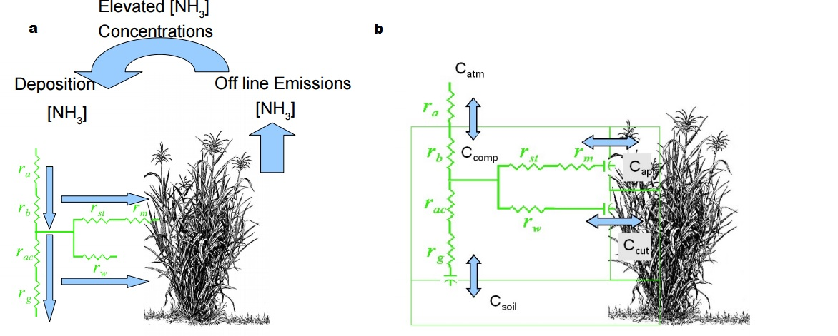
Soil-atmosphere exchange in CMAQ
Uni-directional Bi-directional

Slide 13
Significance and broader impacts
Key enhancements
Consistent representation across N species
Mechanistic representation of actual soil processes
Next steps
Extend to non-agricultural soil types
Influence of land management practices on NO and HONO emissions
Ozone & PM responsiveness to soil emissions
Validating with DISCOVER-AQ, OMI NO₂

Slide 14
Acknowledgements
NASA Air Quality Applied Sciences Team
NASA grant NNX15AN63G (via UAH)
CED, NERL at US EPA for the opportunity as a visiting researcher
Rui Zhang (Colorado State University)

Slide 15
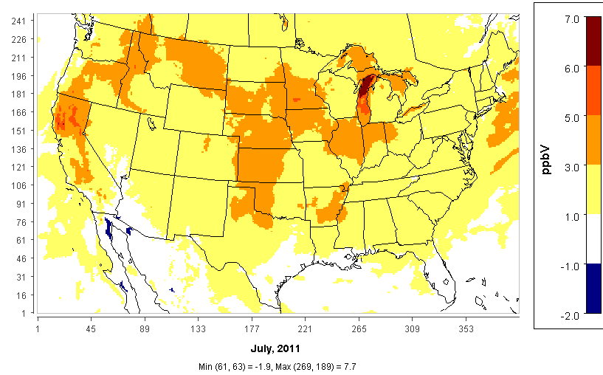
Impact of Soil NO scheme on Ozone
Daily Average 8-hourly max. Ozone (Updated Parametrization – Base CMAQ v5.1)

Slide 16
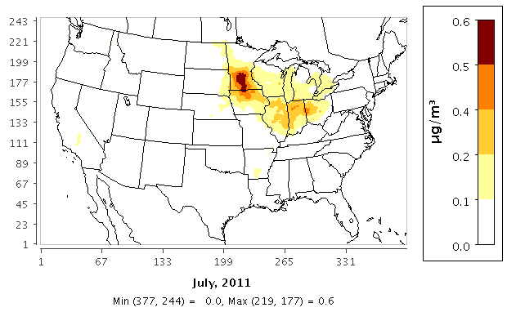
Impact of Soil NO scheme on PM
Daily Average PM_{2.5} (Updated Parametrization – Base CMAQ v5.1)

Slide 17
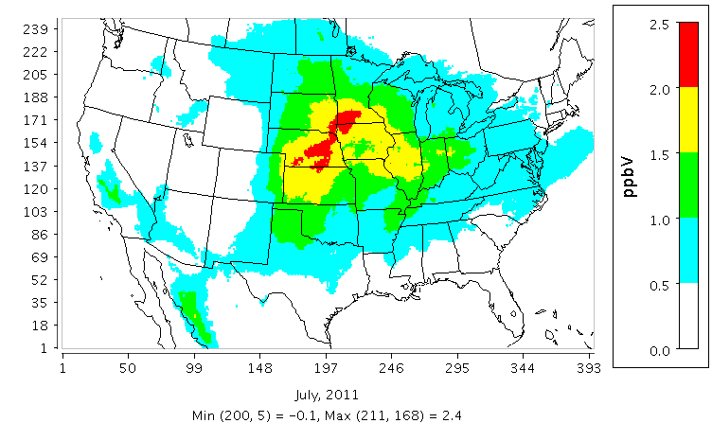
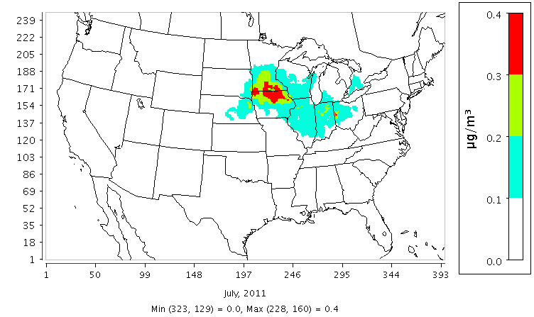
Biochar as N emission amendment
Studies differ on whether biochar reduces soil NO by 47-67% (Nelissen et al, 2014) or not at all (Xiang et al., 2015)
Impact on PM_{2.5}
Impact on O₃

Slide 18
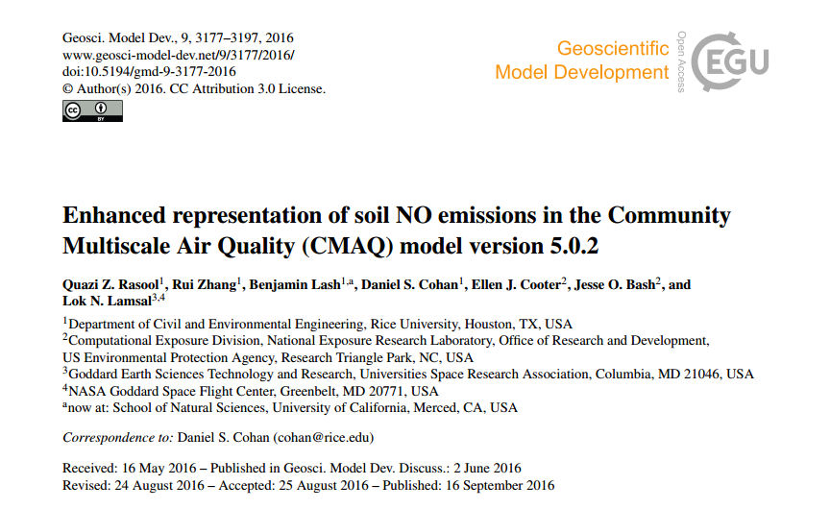
Rasool GMD paper header

Slide 19
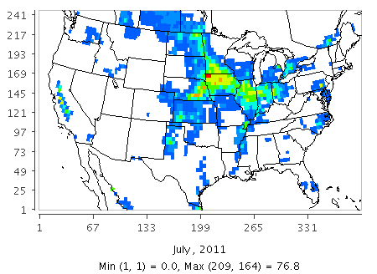
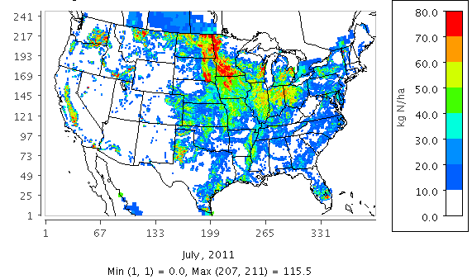
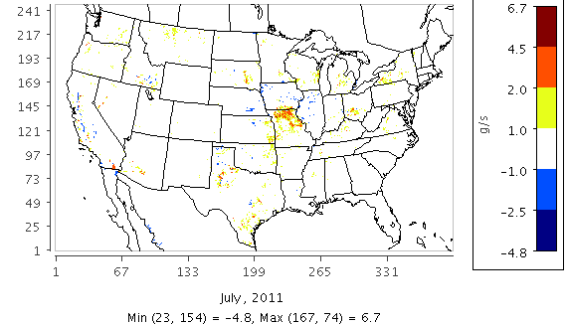
Impact of Potter vs EPIC Fertilizer Data on Soil NO
Potter
EPIC
Fertilizer
Application (kgN/ha)
EPIC - Potter
Difference in BDSNP
Soil NO (g/s)
*Averaged over July 2011

Slide 20
Outline: Soil N emissions in CMAQ
Bi-directional NH₃ soil-atmosphere exchange already available
Updated parametrized approach to soil NO (Rasool et al. 2016)
Replaces Yienger & Levy scheme in CMAQ
Emissions are function of soil N, biome, and meteorology
Soil N from EPIC agricultural model
Modeled impact of soil NO on ozone and PM_{2.5}
Next: Mechanistic approach with consistent representation of multiple N species (NO, HONO, N₂O, NH₃)
Accounts for soil processes (nitrification, denitrification)

Slide 21
Mechanistic soil N modeling
DAYCENT and EPIC model both based on CENTURY ecosystem model
CENTURY simulates cycling of reactive N (along with other nutrients) between soil, vegetation, atmosphere and water
EPIC differs from DAYCENT since:
EPIC has been implemented on a regional scale in CMAQ and,
NH₃ Bi-directional feedback implemented in EPIC-CMAQ framework
(Cooter et al., 2012)
EPIC does not give how much of NO and N₂O each came from nitrification and denitrification
N sub model of DAYCENT addresses that mechanistically based on
soil water content (WFPS), temp, soil NH₄⁺ and NO₃⁻ concentrations, gas diffusivity and labile C availability at various soil layers
(Parton et al 1998; Del Grosso et al., 2000; Parton et al., 2001)
Soil HONO still not addressed in current biogeochemical models

Slide 22
References
Bash, J., Cooter, E., Dennis, R., Walker, J., and Pleim, J. (2013). Evaluation of a regional air-quality model with bidirectional NH 3 exchange coupled to an agroecosystem model, Biogeosciences, 10, 1635-1645.
Cooter, E., Bash, J., Benson, V. and Ran, L. (2012). Linking Agricultural Crop Management and Air Quality Models for Regional to National-Scale Nitrogen Assessments. Biogeosciences Discussions, 9: 6095-6127.
CMAS FEST-C 2015: User’s Guide for the Fertilizer Emission Scenario Tool for CMAQ (FEST-C) Version 1.2, Institute of Environment, The University of North Carolina at Chapel Hill, Chapel Hill, NC, available at: https://www.cmascenter.org/fest-c/documentation/1.2/FESTC1_2_userManual.pdf.
Del Grosso, S.J., White, J.W., Wilson, G., Vandenberg, B., Karlen, D.L., Follett, R.F., Johnson, J.M.F., Franzluebbers, A.J., Archer, D.W., Gollany, H.T. and Liebig, M.A., 2013. Introducing the GRACEnet/REAP data contribution, discovery, and retrieval system. Journal of environmental quality, 42(4), pp.1274-1280.
Dinnes, D. L., Karlen, D. L., Jaynes, D. B., Kaspar, T. C., Hatfield, J. L., Colvin, T. S., and Cambardella, C. A. (2002). Nitrogen management strategies to reduce nitrate leaching in tile-drained Midwestern soils, Agronomy journal, 94, 153-171.
Hudman, R. C., Moore, N. E., Mebust, A. K., Martin, R. V., Russell, A. R., Valin, L. C., and Cohen, R. C. (2012). Steps towards a mechanistic model of global soil nitric oxide emissions: implementation and space based-constraints, Atmos. Chem. Phys., 12, 7779-7795, doi:10.5194/acp-12-7779-2012.
Medinets, S., Skiba, U., Rennenberg, H., & Butterbach-Bahl, K. (2015). A review of soil NO transformation: Associated processes and possible physiological significance on organisms. Soil Biology and Biochemistry, 80, 92-117.
Pilegaard, K. (2013). Processes regulating nitric oxide emissions from soils. Philisophical Transactions of the Royal Society: Biological Sciences, (368). Retrieved from http://dx.doi.org/10.1098/rstb.2013.0126.
Pleim, J. E. X. A. (1811). Development of a Land Surface Model. Part II: Data Assimilation. Journal of Applied Meteorology. Dec2003, 42(12).
Potter, P., N. Ramankutty, E.M. Bennett, and S.D. Donner. 2010. Characterizing the Spatial Patterns of Global Fertilizer Application and Manure Production. Earth Interactions 14 (2): 1-22. http://dx.doi.org/10.1175/2009EI288.1.
(S&L) Steinkamp, J., & Lawrence, M. G. (2011). Improvement and evaluation of simulated global biogenic soil NO emissions in an AC-GCM. Atmospheric Chemistry and Physics, 11(12), 6063–6082. doi:10.5194/acp-11-6063-2011
Rasool, Q. Z., Zhang, R., Lash, B., Cohan, D. S., Cooter, E. J., Bash, J. O., and Lamsal, L. N.: Enhanced representation of soil NO emissions in the Community Multiscale Air Quality (CMAQ) model version 5.0.2, Geosci. Model Dev., 9, 3177-3197, doi:10.5194/gmd-9-3177-2016, 2016.
Xiang, J., Liu, D., Ding, W., Yuan, J. and Lin, Y., 2015. Effects of biochar on nitrous oxide and nitric oxide emissions from paddy field during the wheat growth season. Journal of Cleaner Production, 104, pp.52-58.
Yienger, J. J., & Levy, H. (1995). Empirical-Model Of Global Soil-Biogenic Nox Emissions. Journal of Geophysical Research-Atmospheres, 100(D6), 11447-11464. doi: 10.1029/95jd00370.
Vinken, G. C. M., Boersma, K. F., Maasakkers, J. D., Adon, M., & Martin, R. V. (2014). Worldwide biogenic soil NOx emissions inferred from OMI NO₂ observations. Atmospheric Chemistry and Physics, 14(18), 10363–10381. doi:10.5194/acp-14-10363.

