Slide 1
Estimating environmental co-benefits of U.S. low carbon pathways using the GCAM-USA integrated assessment model
Yang Ou^{1,2}, Wenjing Shi¹, Steven J. Smith³, Catherine Ledna³,
J. Jason West², Christopher G. Nolte¹, Daniel H. Loughlin¹
¹ U.S. EPA Office of Research and Development
² University of North Carolina at Chapel Hill
³ Joint Global Change Research Institute, PNNL
Notes:
Acknowledge my coauthors, this work cannot be done without their great support

Slide 2
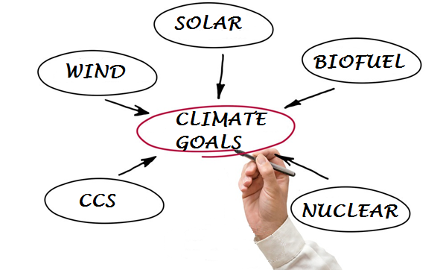
Motivation
A variety of energy technologies are available that could impact U.S. emissions of CO₂

Slide 3
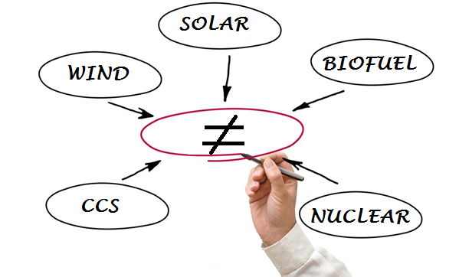
Motivation
A variety of energy technologies are available that could impact U.S. emissions of CO₂
However, these technologies differ in terms of cost, availability, reliability and environmental impacts

Slide 4
Motivation
Therefore, we evaluated environmental tradeoffs among pathways for three end-points
energy-related water demands
air pollutant emissions, including
primary fine particulate matter (PM_{2.5}), sulfur dioxide (SO₂) and nitrogen oxides (NO_{x})
PM_{2.5}-related health impacts

Slide 5
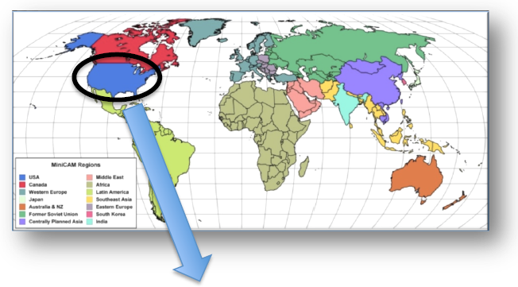
Research tool: GCAM-USA
The Global Change Assessment Model with U.S. state-level resolution
A dynamic-recursive partial equilibrium integrated assessment model developed by PNNL
32 economic and energy regions globally + 51 U.S. states
5-year time steps, extending from 2005 to 2100
Technology-rich energy system detail
Emission coverage:
GHGs (e.g., CO₂, CH₄, N₂O)
Air pollutants (e.g., SO₂, NO_{x}, PM_{2.5} etc.)
GCAM global model
51-state energy system representation
Zhou et al., Applied Energy 2014;
Shi et al., Applied Energy 2017

Slide 6
Incorporate PM_{2.5} health impacts into GCAM-USA
$/ton
Reference: Fann, N., Baker, K. R., & Fulcher, C. M. (2012). Characterizing the PM2.5-related health benefits of emission reductions for 17 industrial, area and mobile emission sectors across the U.S.. Environment International, 49, 141-151

Slide 7
Method – scenario design
 | CO₂ reduction target (relative to 2005 emissions)
Technology Scenario | None (REF) | 50% reduction | 80% reduction
BASE (All available) | BASEREF | BASE50 | BASE80
RE (no new builds of nuclear or CCS, low cost of renewables) | REREF | RE50 | RE80
NUC/CCS (low cost of nuclear/CCS, limited supply of biomass) | NUC/CCSREF | NUC/CCS50 | NUC/CCS80

Slide 8
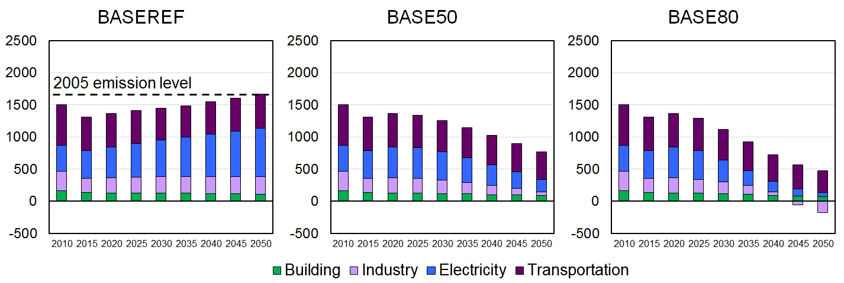
How CO₂ targets are met
Emission reductions start from electric and industrial sectors
Industrial sector has negative CO₂ emissions from biofuel production coupled to CCS

Slide 9
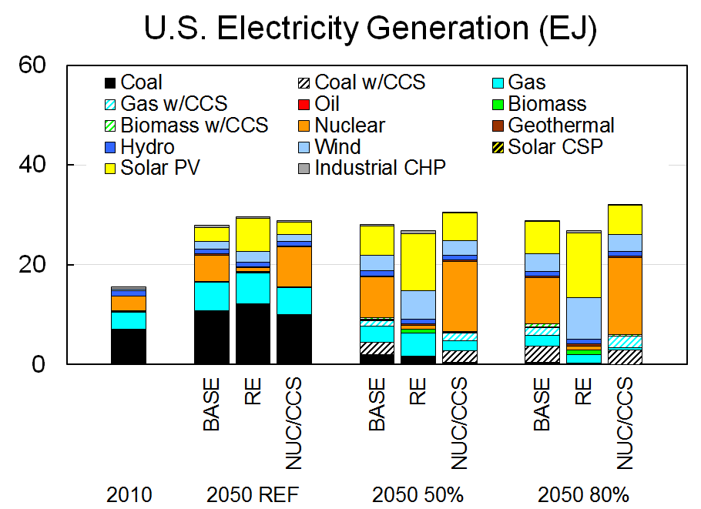
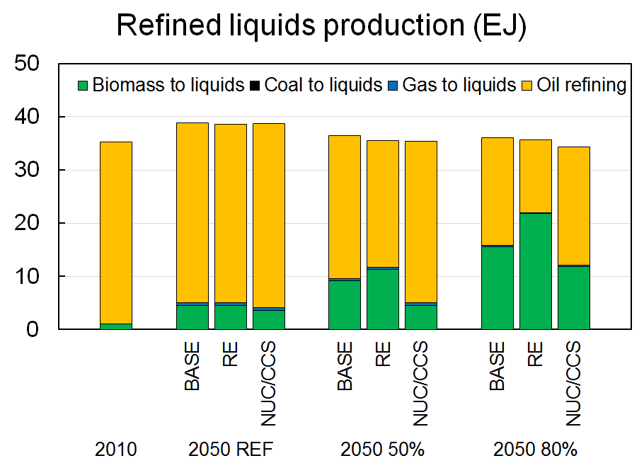
Energy supply (electricity and refinery)
NUC/CCS has more electrification
RE has greater use of bioenergy and biofuels

Slide 10
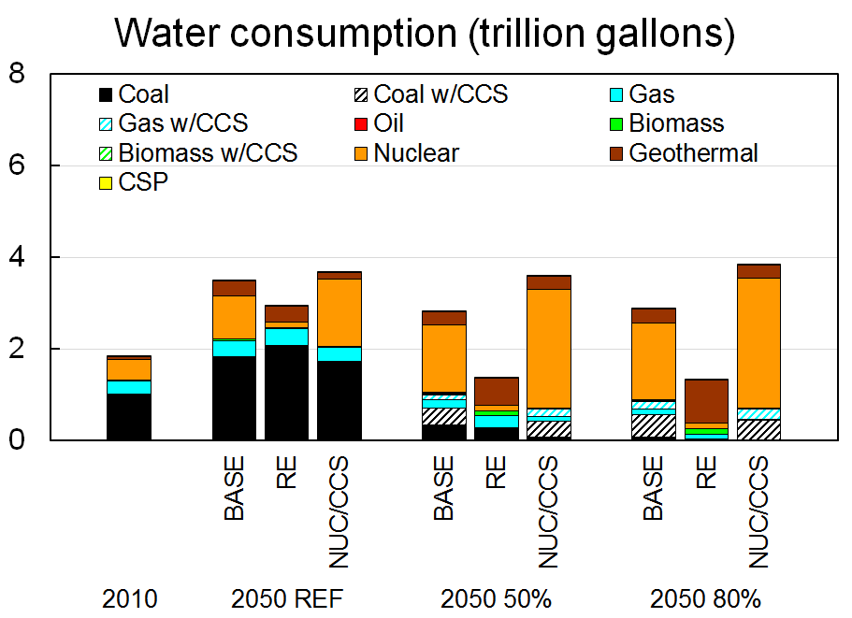
Electricity Water demand (RE is lowest)
Strong water consumption associated with particular generation technologies
nuclear in NUC/CCS, geothermal in RE
RE has remarkably lower water consumption

Slide 11
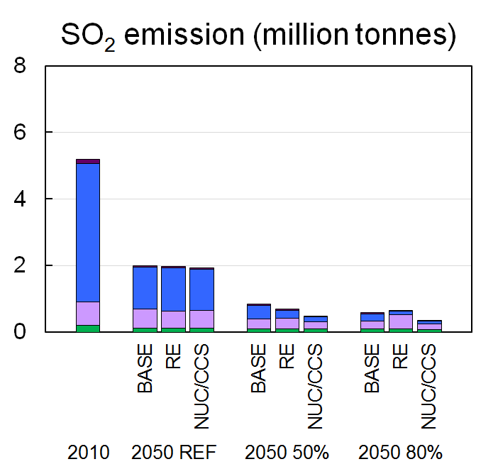
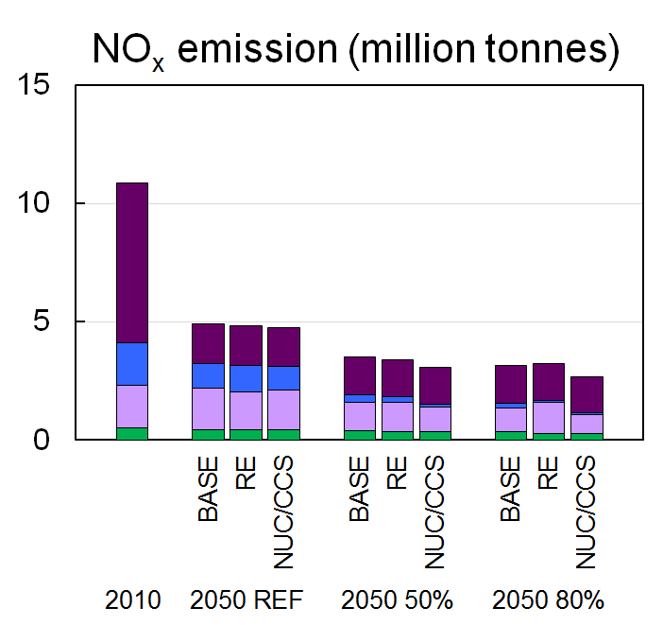
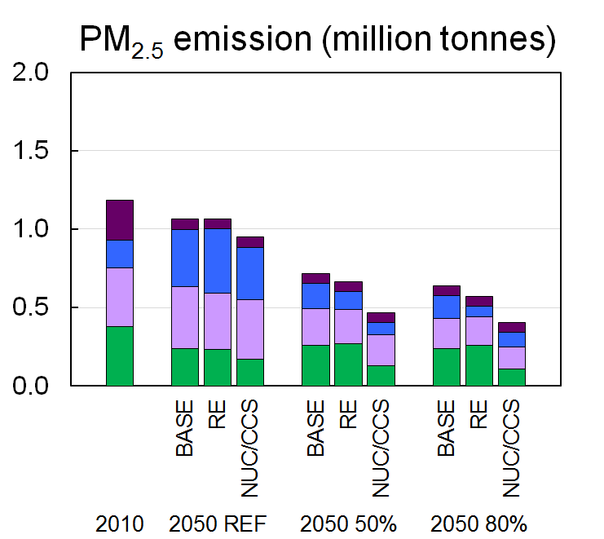
Pollutant Emissions (NUC/CCS is lowest)
Current air pollutant regulations drive the NO_{x} and SO₂ reductions through 2050
Higher bioenergy penetration (in RE) results in higher PM_{2.5} emissions in buildings sector

Slide 12
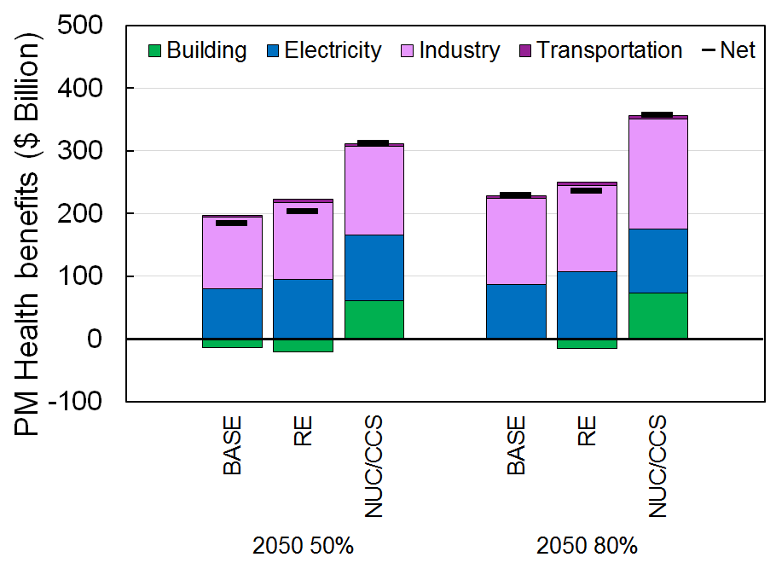
PM-health benefits relative to BASEREF in 2050 (NUC/CCS is highest)
Health benefits mainly come from industrial and electric sectors
Health benefits are greatest for NUC/CCS
RE and NUC/CCS greatly differ in the buildings sector, where RE yields disbenefit!

Slide 13
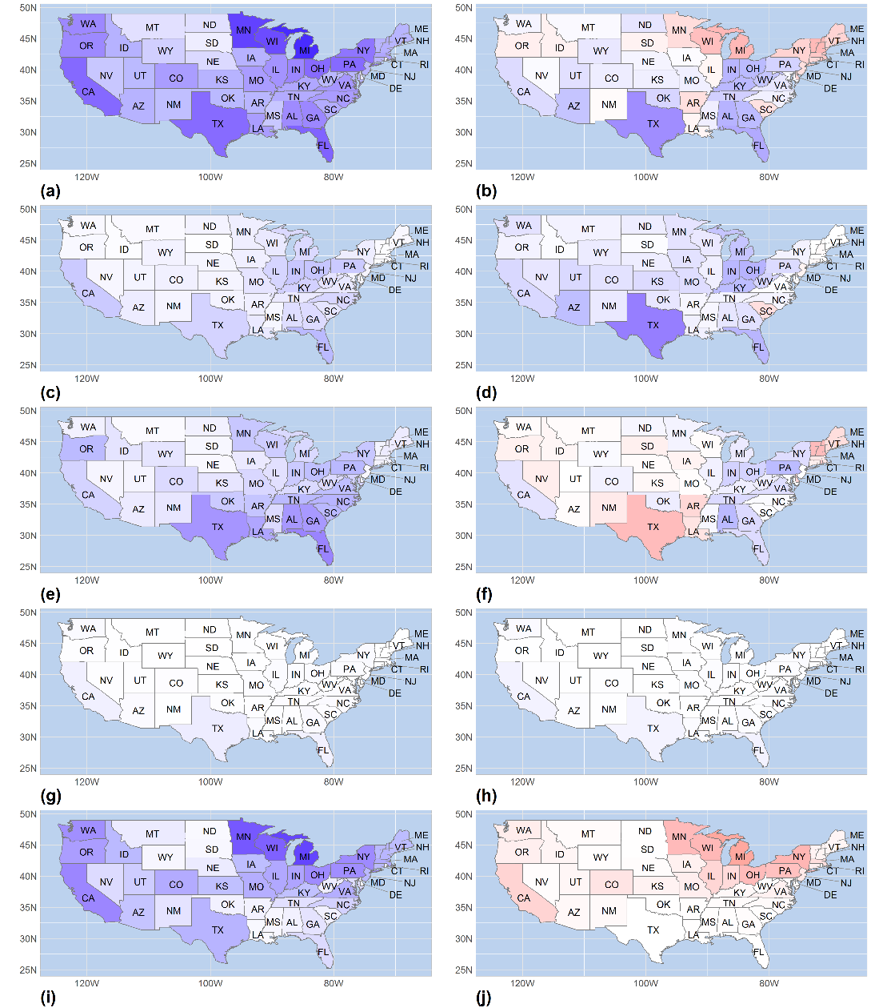
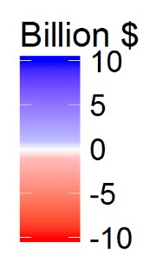
Spatial distribution of PM health benefits
NUC/CCS80 – BASE80
RE80 – BASE80
The buildings sector is responsible for the differences in benefits between RE and NUC/CCS, particularly where historic biomass use is high.
Total
Elec
Indus
Benefit
Trans
Build
Cost

Slide 14
Conclusions
There are clearly trade-offs among different technology assumptions
RE is best for reducing water demand, but NUC/CCS best reduces air pollutant emissions and health impacts

Slide 15
Conclusions
There are clearly trade-offs among different technology assumptions
RE is best for reducing water demand, but NUC/CCS best reduces air pollutant emissions and health impacts
A source that plays a minor role in reducing CO₂ – residential wood combustion – can be a major source of air pollution

Slide 16
Questions?
Contact information:
Yang Ou, U.S. EPA, ORD/UNC-Chapel Hill – Ou.Yang@epa.gov
Dan Loughlin, U.S. EPA, ORD – Loughlin.Dan@epa.gov
Chris Nolte, U.S. EPA, ORD – Nolte.Chris@epa.gov
Disclaimer: The views expressed in this presentation are those of the authors and do not necessarily represent the views or policies of the U.S. Environmental Protection Agency.

Slide 17
Previous study: EMF 24 U.S. Technology Scenarios
Study design
The costs of meeting two GHG reduction targets were evaluated under a number of different technological pathways
Major findings
There was no clear conclusion about whether one energy production technology is of more value than the others
EMF 24 did not evaluate other environmental implications, such as air pollution or water demand.

Slide 18
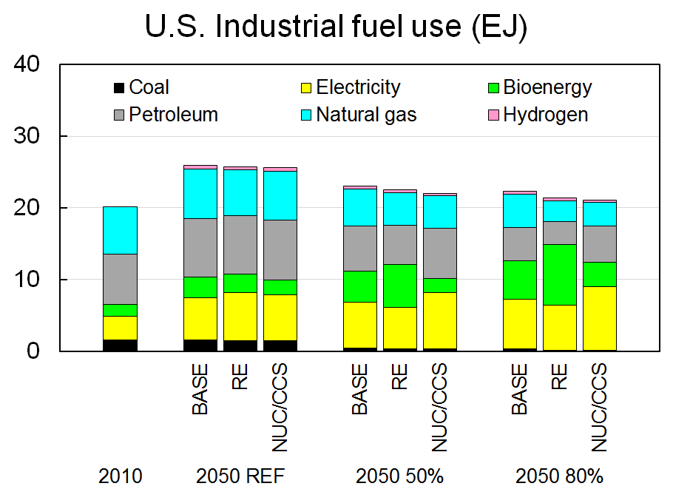
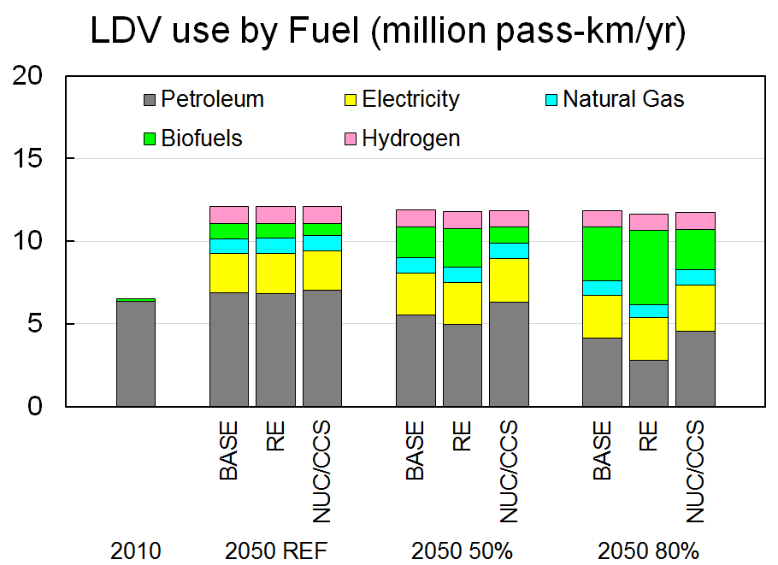
Energy end-use (Industrial and LDV)
NUC/CCS has higher electrification of end-use technology (e.g., heat pumps)
RE has higher biomass utilization in industry and liquid fuels (e.g., LDV using biofuels)

Slide 19
Caveats
“NUC/CCS” and “RE” are intended to explore energy system dynamics, and do not capture the potential for a wide range of feasible technology pathways, or represent future U.S. policies.
Using impact factors (for example, PM health benefit factors) derived from reduced form approaches assumes a linear relationship between changes in emissions and benefits, an assumption that may not be valid for large changes in emissions.
Impact factors applied uniformly across the U.S., without geographical heterogeneity.

