Slide 1
Examining Projected Changes in Ozone at 2050 and 2090 under Two CMIP5 Scenarios
C. Nolte, T. Spero, P. Dolwick, B. Henderson, R. Pinder
U.S. Environmental Protection Agency, Research Triangle Park, NC
CMAS Users Conference
25 October 2017

Slide 2
Introduction
We are interested in how future environmental conditions will impact air quality
General approach:
Use WRF to dynamically downscale CMIP5 scenarios over North America
Use these as meteorological inputs to CMAQ to simulate changes in air quality for some future period
U.S. emissions of NO_{X}, SO₂, and VOCs have declined substantially since 1990, and are projected to continue to decline in the coming decades due to already-adopted AQ regulations
We allow biogenic emissions to vary with simulated meteorology, but use same anthropogenic emissions inventory and chemical boundary conditions for both base and future periods to isolate the effect of changing average weather patterns

Slide 3
Modeling Configuration
CESM data (0.9° × 1.25°) downscaled with WRFv3.4.1
36-km domain over most of North America (199 × 127 grid points)
34 layers up to 50 hPa
Continuous WRF runs (no reinitialization) from 1995-2005 and 2025-2100
Spectral nudging of wavelengths >1500 km toward CESM fields, above PBL only
This work examines conditions at 2050 and 2090 under RCP4.5 and RCP8.5, relative to 2000 using 11-year simulation periods
CMAQ 5.2 beta with CB05 chemical mechanism over Continental U.S. domain (148 × 110 grid cells)
Projected 2040 anthropogenic emissions developed as reference case for regulatory impact analysis of HD GHG rule
Relative to 2011 NEI: −51% NO_{X}, −66% SO₂, −14% VOC
Wildfires unchanged, no LNOx, windblown dust, or bidirectional exchange of NH₃

Slide 4
Previous Work – Changes at 2030
RCP4.5
RCP6.0
RCP8.5
(2025–2035) minus (1995–2005)
JJA daily max temperature
K
JJA maximum daily 8-h O₃
ppb
Increases of 0.5-4 K under RCP4.5 and RCP6.0 and 1-6 K under RCP8.5
O₃ increases by 0.5-4.5 ppb in areas generally collocated with increased T
Southwest and especially Southeast show little to no change in T and slight decrease in O₃ in Gulf Coast

Slide 5
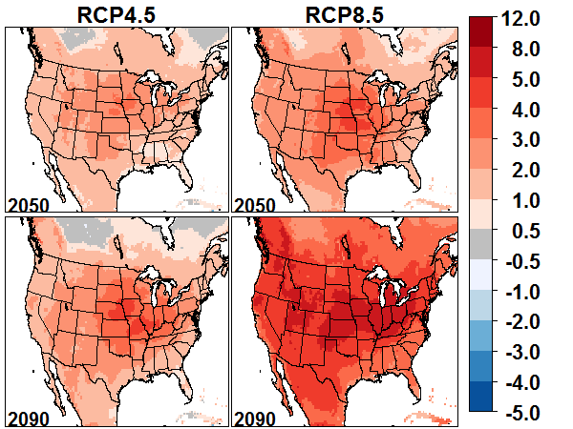
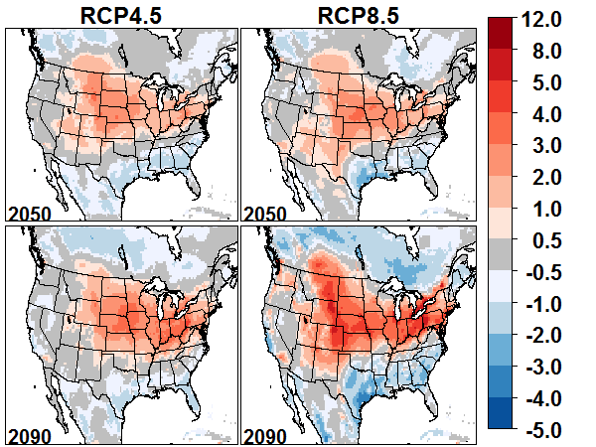
Changes at 2050 and 2090
JJA daily max temperatures
JJA MDA8 O₃
Strong temperature increases, especially at 2090 under RCP8.5
O₃ increases 1-4 ppb in Upper Midwest, Ohio Valley, and Northeast, exceeding 8 ppb at 2090 under RCP8.5
Warming is least in Southeast, with actual decreases in O₃ in Gulf Coast
What is causing these O₃ decreases in the Southeast?
Notes:
Pattern of temperature and O3 increases is similar for daily maximum vs daily means, as well as for JJA and May-Sept months.

Slide 6
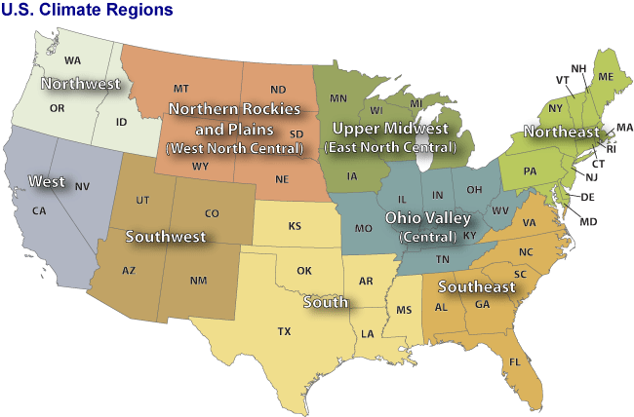
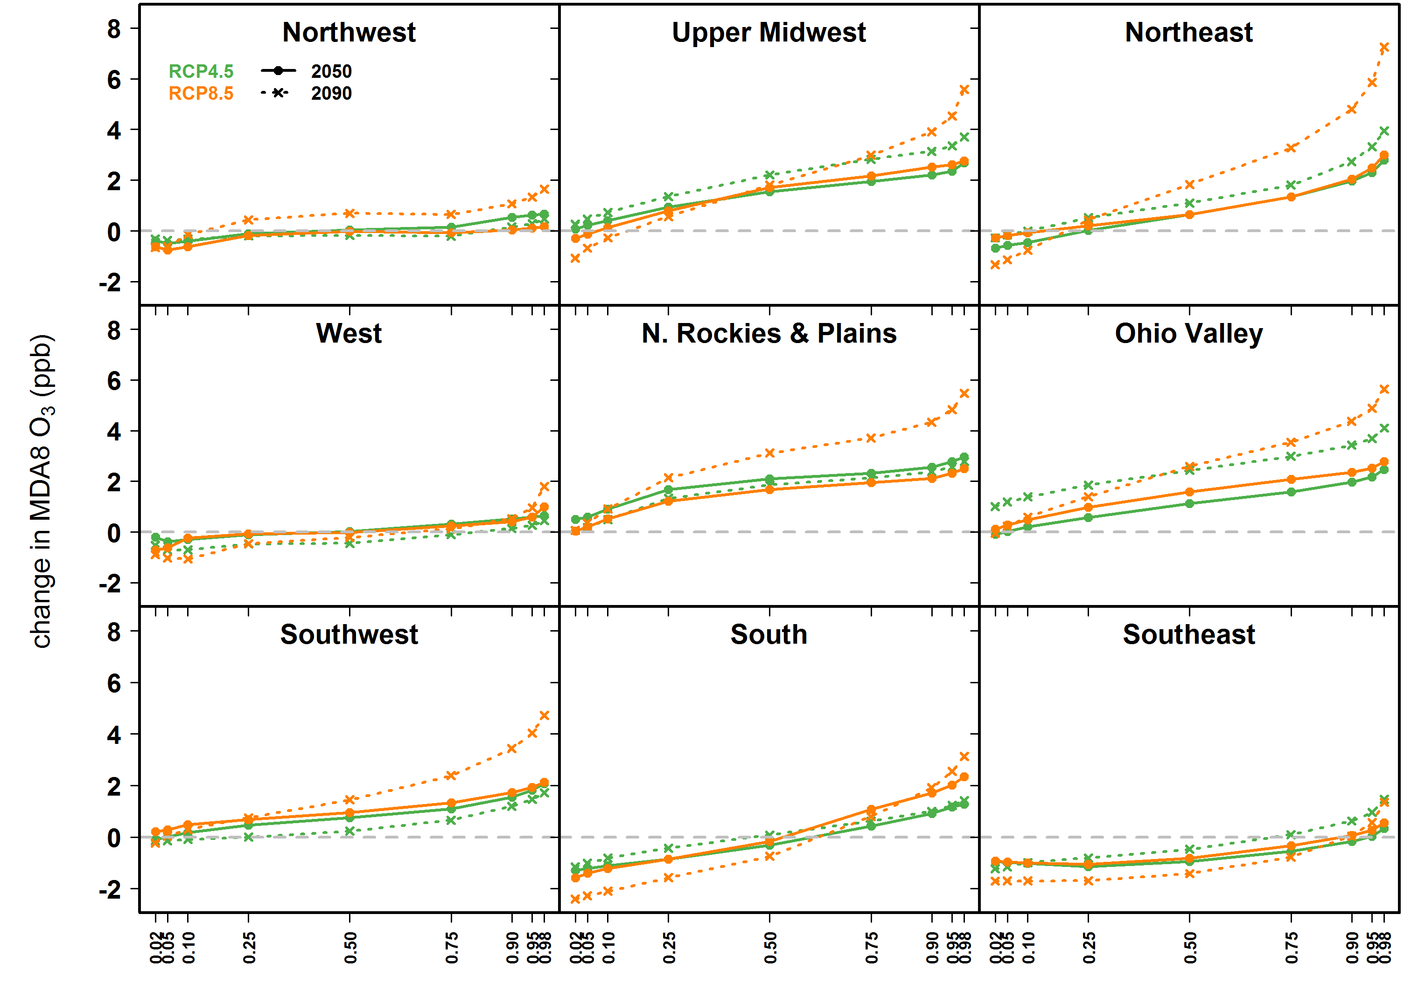
Regional Change in O₃ Distribution
Regional change in O₃ distribution

Slide 7
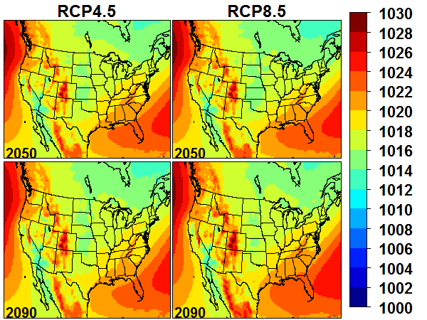
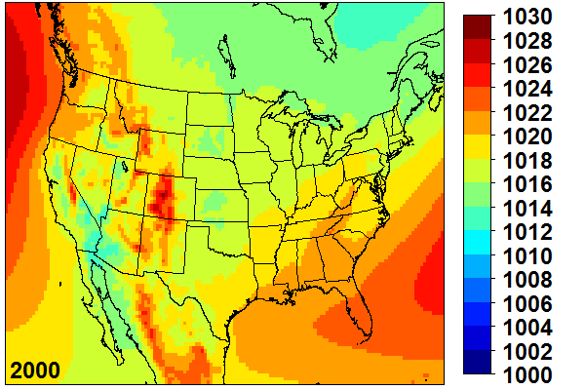
Mean Sea-level Pressure
Little change in mean SLP pattern
Suggests change in O₃ not primarily due to changes in transport

Slide 8
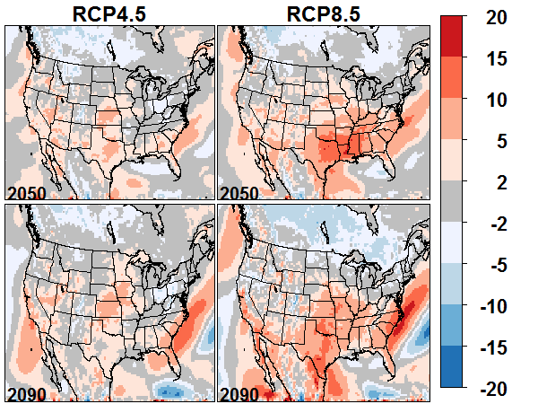
Wind Speed
% change in JJA average 10-m wind speed
Change in JJA average MDA8 O₃ (ppb)
Stronger increase in wind speeds in TX-LA-MS in RCP8.5 may be contributing to lower O₃?
Wind speeds also increase in KS-IA in RCP4.5, and O₃ increases there.

Slide 9
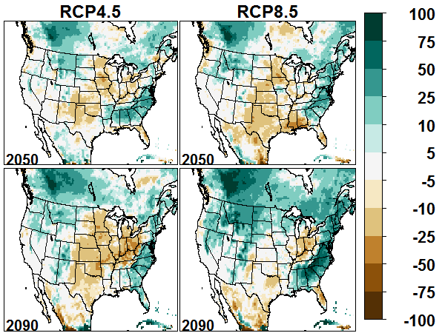
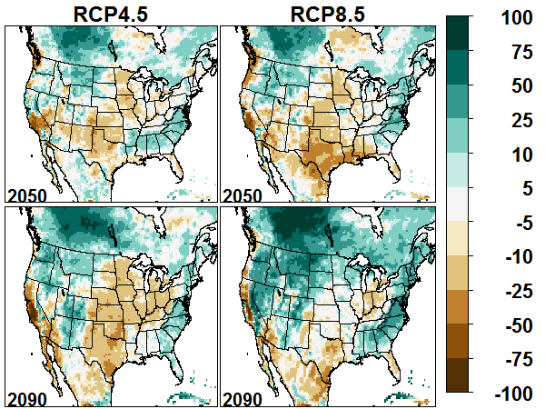
Precipitation
Change in JJA average precipitation (mm/mon)
Change in JJA average precipitation (%)
Decreases in central US and Ohio Valley, increases in Southeast, particularly at 2090 under RCP8.5

Slide 10
Precipitation
Change in JJA average precipitation (mm/mon)
Change in JJA average MDA8 O₃ (ppb)
Decrease in central US and Ohio Valley consistent with increased O₃
Increases in Southeast generally consistent with areas of decreased O₃
Anomalous behavior in Southeast TX and LA

Slide 11
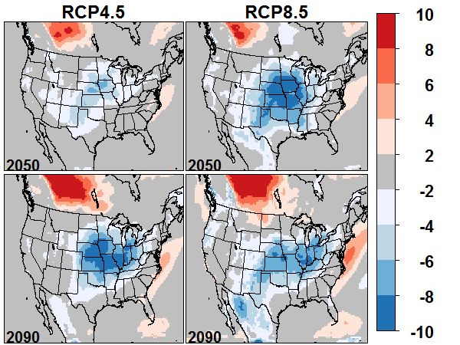
Relative Humidity
Change in JJA average RH
Change in JJA average MDA8 O₃ (ppb)
Better matches pattern of change in O₃

Slide 12
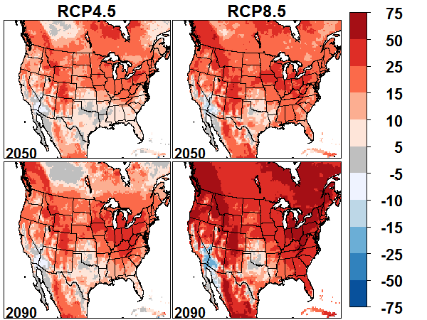
Biogenic Isoprene Emissions
Percent change in isoprene emissions
Change in JJA average MDA8 O₃ (ppb)
Isoprene emissions depend on both temperature and solar radiation (PAR)
Smaller increase in Southeast may partially explain lower O₃ than Ohio Valley
Does not account for absolute decreases in O₃

Slide 13
Summary
Strong warming projected across continental US. Warming is higher at 2090 than at 2050, and under RCP8.5 than under RCP4.5
Changes in future weather conditions result in projected increases in O₃ of 1-4 ppb in parts of Central US and Ohio Valley under RCP4.5, exceeding 8 ppb at 2090 under RCP8.5
Decreases in O₃ of 1-3 ppb simulated in Southeast US
These findings are preliminary—further investigation is needed to determine which processes are most important in accounting for anomalous behavior in Southeast

Slide 15
Regional Change in O₃ Distribution

Slide 16
Regional change in O₃ distribution

Slide 17
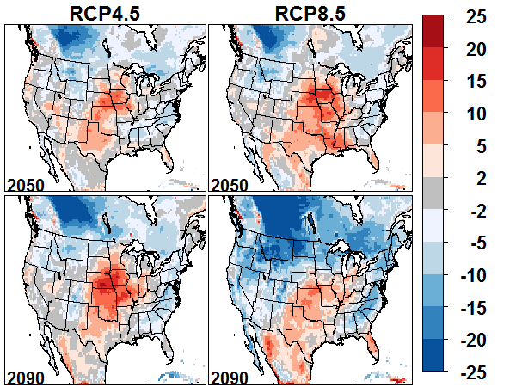
Percent change in PBL Height

