Slide 1
Characterization of CMAQv5.2:
Science Processes, Performance and Development
Benjamin Murphy, Bill Hutzell, David Wong, Kristen Foley, Havala Pye, Jeff Youngª, Hosein Foroutan^{b}, Daiwen Kang, Golam Sarwar, K. Wyat Appel, Christian Hogrefe, Deborah Luecken, Kathleen Fahey, Jesse Bash, Donna Schwede, Matthew Woody, Tanya Spero, Sergey Napelenok, Chris Nolte, Limei Ran, Shawn Roselle and Jon Pleim
Office of Research and Development
U.S. Environmental Protection Agency
ªRetired; ^{b}Now at Virginia Polytechnic and State University, Blacksburg, VA
Zac Adelman* and Liz Adams
UNC Institute for the Environment
*Now at LADCO
24 October 2017
Community Modeling and Analysis System Conference
Chapel Hill, NC

Slide 2
Features of CMAQv5.2: Released June 2017
CMAQ Website also released June 2017: www.epa.gov/cmaq
Code repository: https://github.com/USEPA/CMAQ
Instrumented models – DDM-3D available on GitHub repo now as branch 5.2_DDM-3D
Aerosols
  New POA and SOA modeling (Pye et al., ES&T, 2015; Pye et al., ACP, 2017; Murphy et al., ACP, 2017)
  New wind-blown dust model (Foroutan et al., J. Adv. Model. Earth Syst, 2017)
Gas Chemistry
  CB6 chemical mechanism w/ selected HAPs
  CRI mechanism in research version
  Halogen Chemistry – included in CB05eh51 mechanism (Sarwar et al., ES&T, 2015)
Lightning
  Improved precipitation via assimilation of lightning data in WRF (Heath et al., J. Adv. Model. Earth Syst, 2016)
  Improved NO_{x} production (Presentation by Daiwen Kang – Wed. 2:40)
Strat-Trop ozone exchange for hemispheric configuration
Two-way coupled WRFv3.8-CMAQv5.2

Slide 3
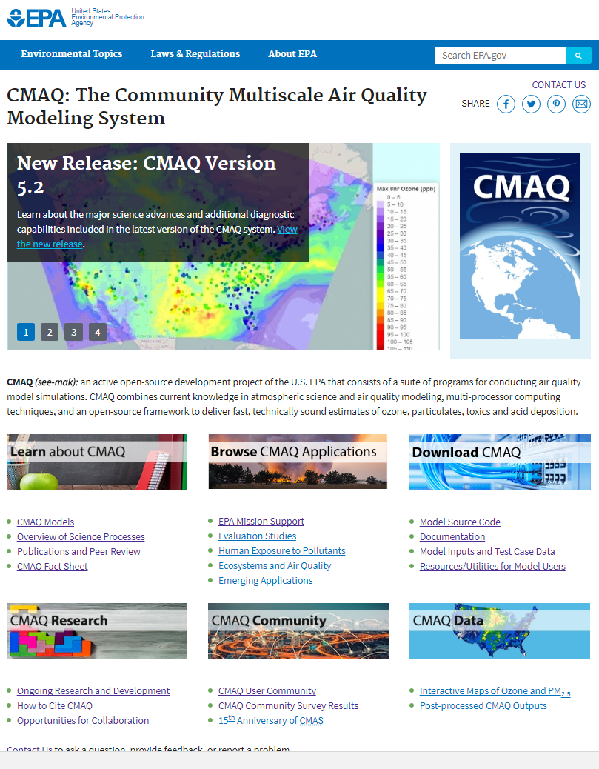
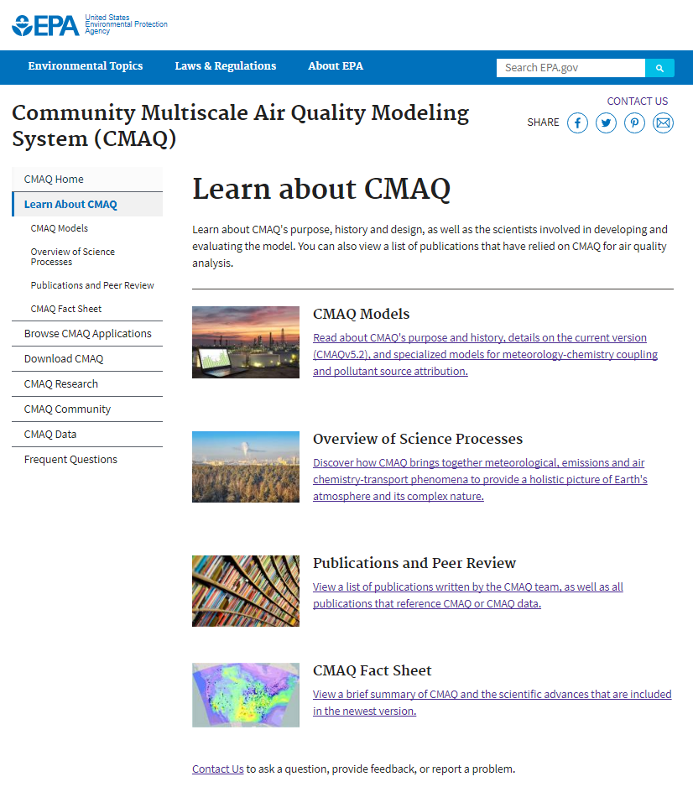
New CMAQ Website: www.epa.gov/cmaq
Resource Improvements
Model Improvements
Evaluation
Research Directions

Slide 4
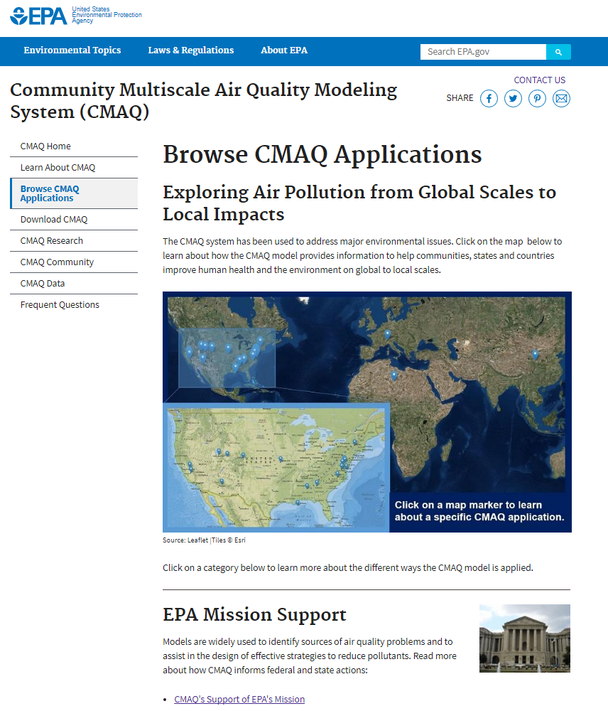
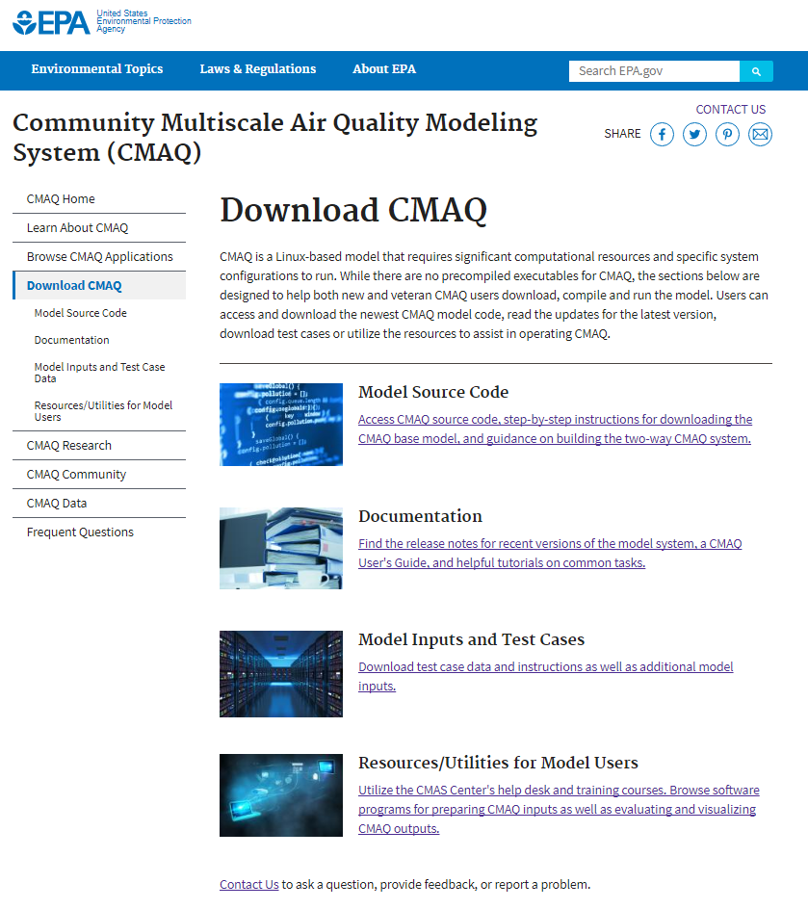
New CMAQ Website: www.epa.gov/cmaq
Resource Improvements
Model Improvements
Evaluation
Research Directions

Slide 5
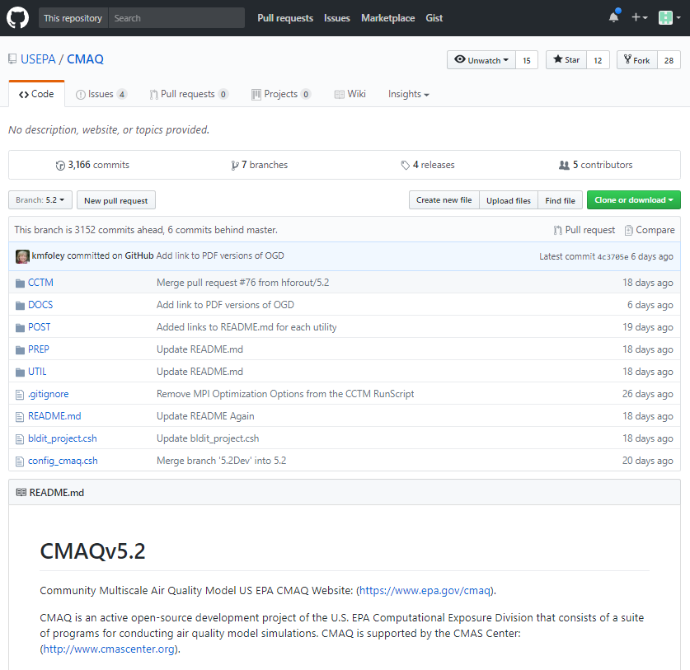
Open Source Development Via GitHub: github.com/USEPA/CMAQ
Migrated two decades worth of CTM code development and history to GitHub, Fall 2016
Enhanced the detailed documentation of quality control practices including benchmark testing and code review
Built GitHub–ready documentation: https://github.com/USEPA/CMAQ/blob/5.2/DOCS/User_Manual/README.md
Created a Guide for Developers, documenting the procedure when incorporating outside feature contributions. To be finalized and publically released this year.
Visit the EPA Booth outside for follow-up and demo!
Resource Improvements
Model Improvements
Evaluation
Research Directions

Slide 6
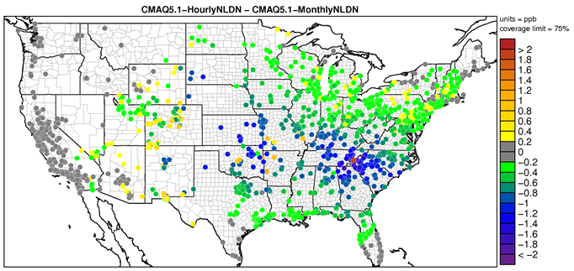
Improving Estimates of Lightning NO_{x} Generation
CMAQv5.1: monthly climatological data from the National Lightning Detection Network (NLDN) were associated with WRF’s gridded convective rainfall rate to distribute lightning strikes per grid cell.
CMAQv5.2: hourly raw NLDN data may be used to generate gridded hourly lightning NO, resulting overall in ~30% decrease in lightning NO, yielding improved O₃ throughout the east US.
Worse Bias
Improved Bias
Monthly NLDN
Using hourly NLDN data decreases bias in hourly O₃ at 79% of sites
Monthly Domain Total NO (moles x 10⁶ )
Hourly NLDN
Courtesy: Daiwen Kang
Resource Improvements
Model Improvements
Evaluation
Research Directions

Slide 7
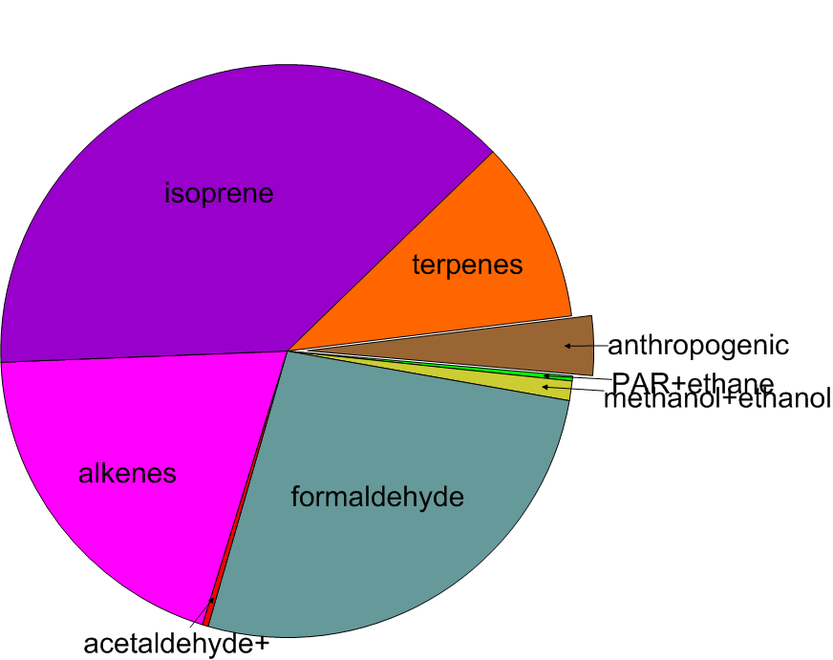
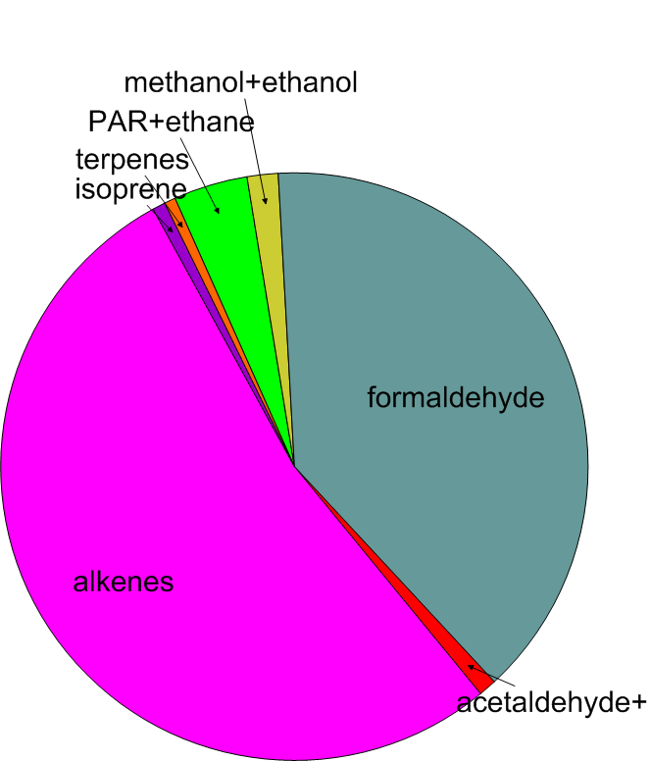
Gas-phase chemistry and HAPs
CB6r3 extended to predict concentrations of 41 Hazardous Air Pollutants (HAPs), used in 2014 National Air Toxics Assessment, to identify those air toxics which are of greatest potential concern in terms of contribution to population risk
Users can now easily change model output to subset the 41 HAPs for their own applications
Example: Use of CMAQ to quantify the VOCs that contribute the most to ambient formaldehyde in the Southeast from all VOCs (left) and breakdown from anthropogenic sources (right)
Example: Some of the important HAPs predicted by CMAQv5.2, including those which have been identified as national and regional cancer and noncancer hazard drivers.
All VOCs
Anthropogenic portion
Resource Improvements
Model Improvements
Evaluation
Research Directions

Slide 8
Improving chemistry in marine environments
1) Halogen chemistry and deposition to water are key sinks for O₃ in marine environments
2) Their accurate representation impacts predictions of both long-range transport and ambient levels in coastal areas.
Mean O₃ without halogen chemistry
Sarwar et al., ES&T, 2015
Impact of enhanced deposition
Impact of halogen chemistry
Resource Improvements
Model Improvements
Evaluation
Research Directions

Slide 9
9
Biogenic Secondary Organic Aerosol
Particulate Organic Nitrate Aerosols
NO_{x} reductions → substantial OA reductions via NO_{x} participation in organic nitrate formation
Organic Nitrates!
Ng et al., ACP, 2017
(Percentage of total OA mass in cyan)
Pye et al., ES&T 2015
Resource Improvements
Model Improvements
Evaluation
Research Directions

Slide 10
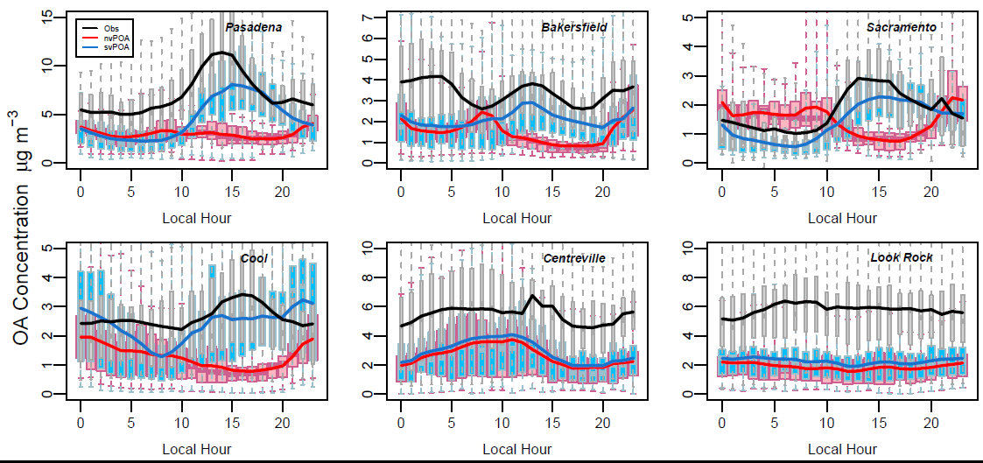
10
Anthropogenic Organic Aerosol Volatility
Primary OA Secondary OA
OA Diurnal profiles for California 4-km simulation. May-June 2010.
Organic aerosol in the atmosphere:
Semivolatile
Dominated by secondary formation
Organic aerosol in CMAQv5.1:
Dominated by nonvolatile Primary species
Reduces wintertime OC fractional bias by 50-90%
CMAQv5.1
CMAQv5.2
Murphy et al. (2017), ACP, 2017
Resource Improvements
Model Improvements
Evaluation
Research Directions

Slide 11
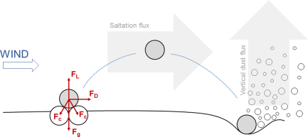
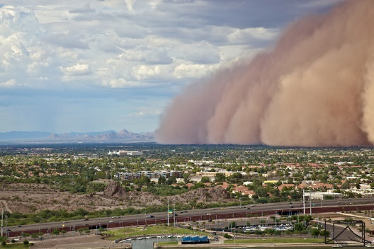
Physics-Based Windblown Dust Module
Major changes to the windblown dust module for CMAQv5.2 release
More physical treatment of dust generation process
Addresses unrealistic spikes in PM from dust in CMAQv5.1
Haboob in Phoenix, AZ
Update | Implications
Threshold friction velocity | More realistic values of the threshold velocity smoothly distributed
Roughness factor | Include the effect of roughness elements (both solid and vegetation)
Surface roughness | Develop a new relation for surface roughness based on data from several different studies
Vegetation cover fraction | Spatially and temporally variable vegetation fraction based on satellite observations
Resource Improvements
Model Improvements
Evaluation
Research Directions

Slide 12
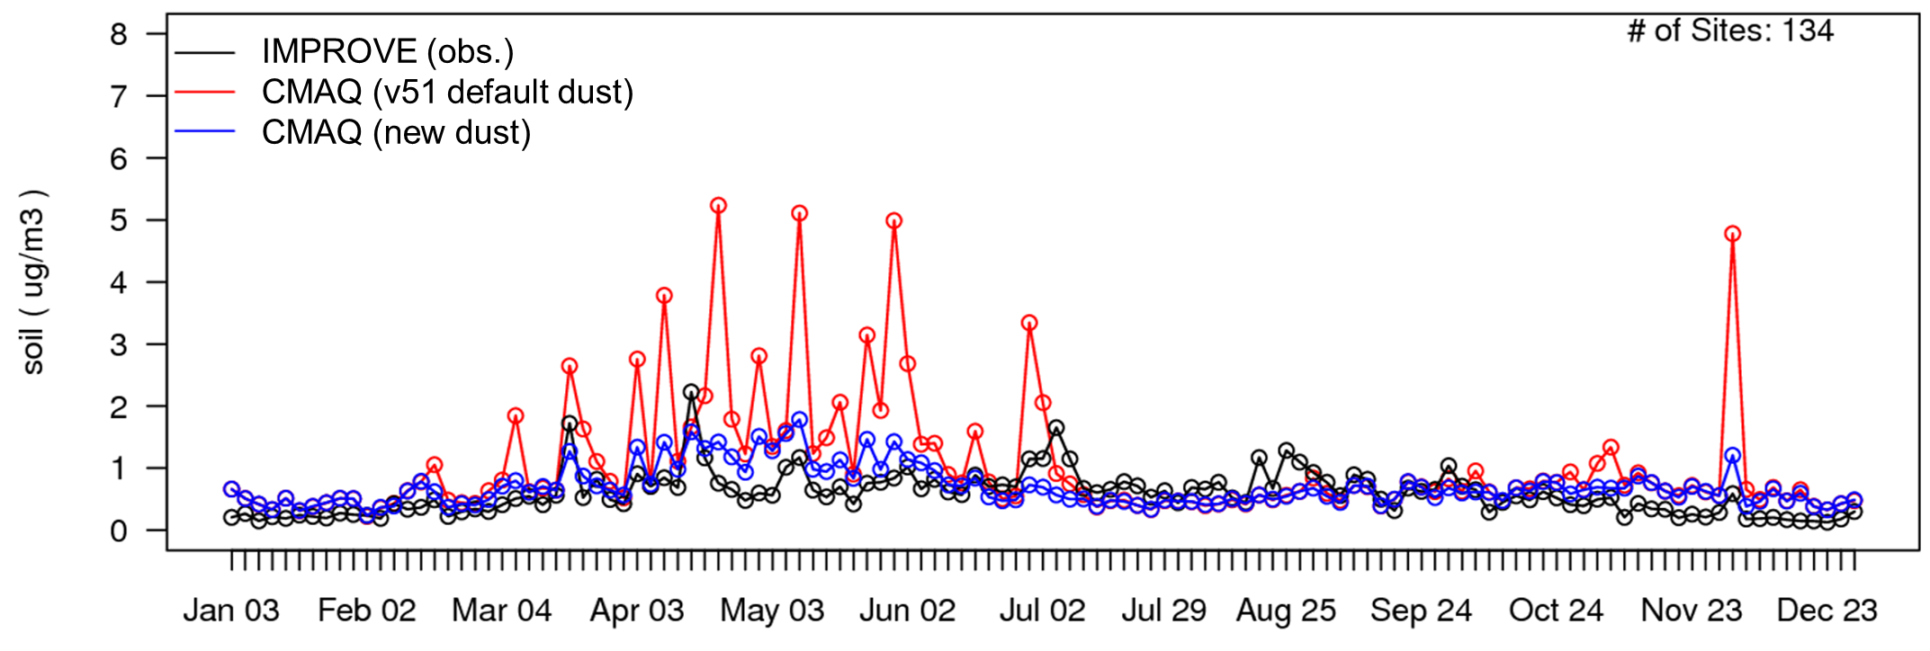
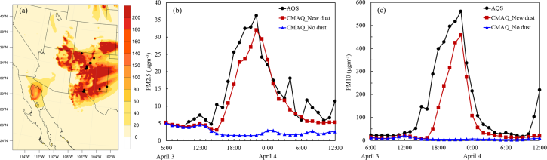
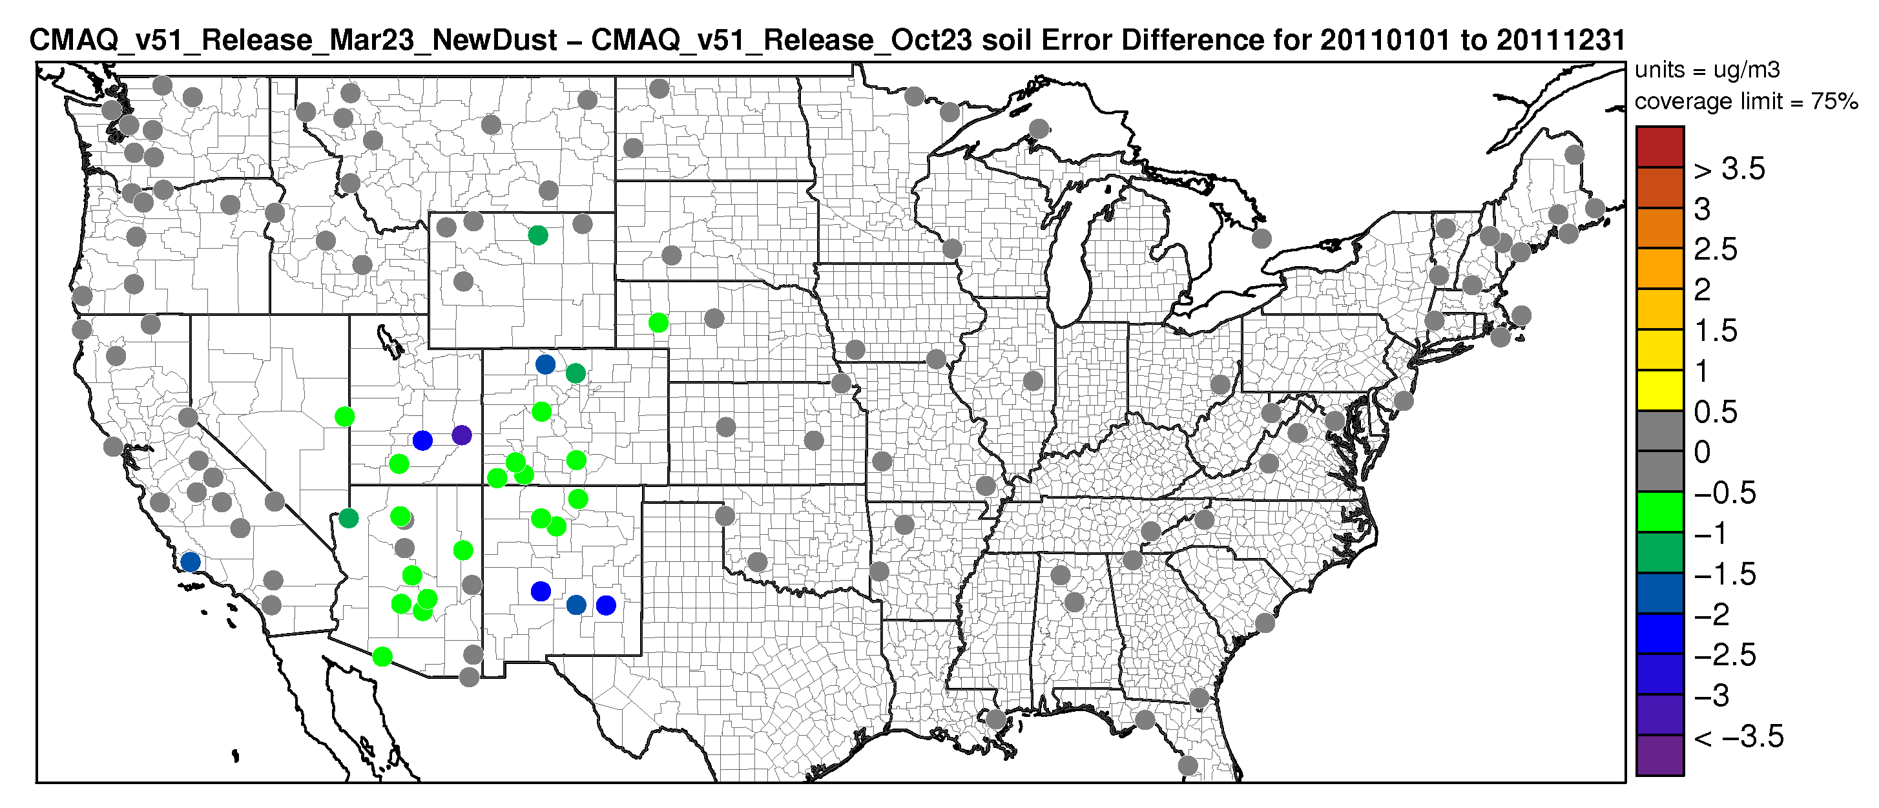
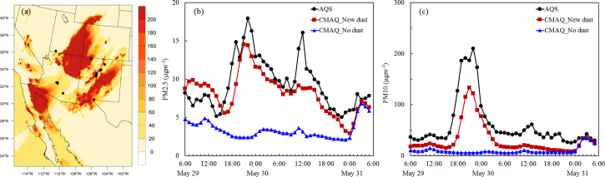
Physics-Based Windblown Dust Module
Enhanced accuracy during Severe Dust Outbreaks
Time series of fine particulate soil for IMPROVE sites (CONUS, 2011)
Difference in soil error for entire year 2011 (CMAQv5.2 – CMAQv5.1)
Increase in Error
Decrease in Error
(98% of sites)
Foroutan, et al. JAMES, 2017
Resource Improvements
Model Improvements
Evaluation
Research Directions

Slide 13
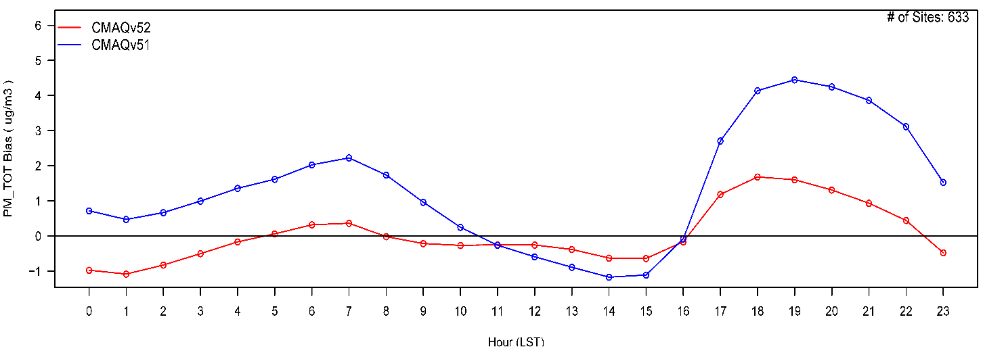
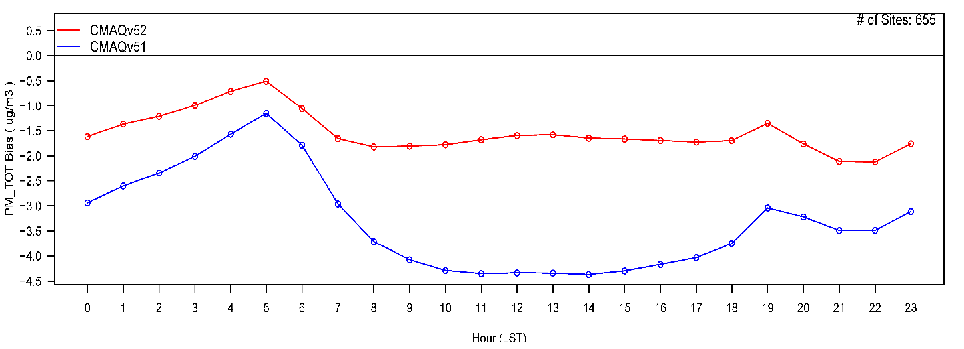
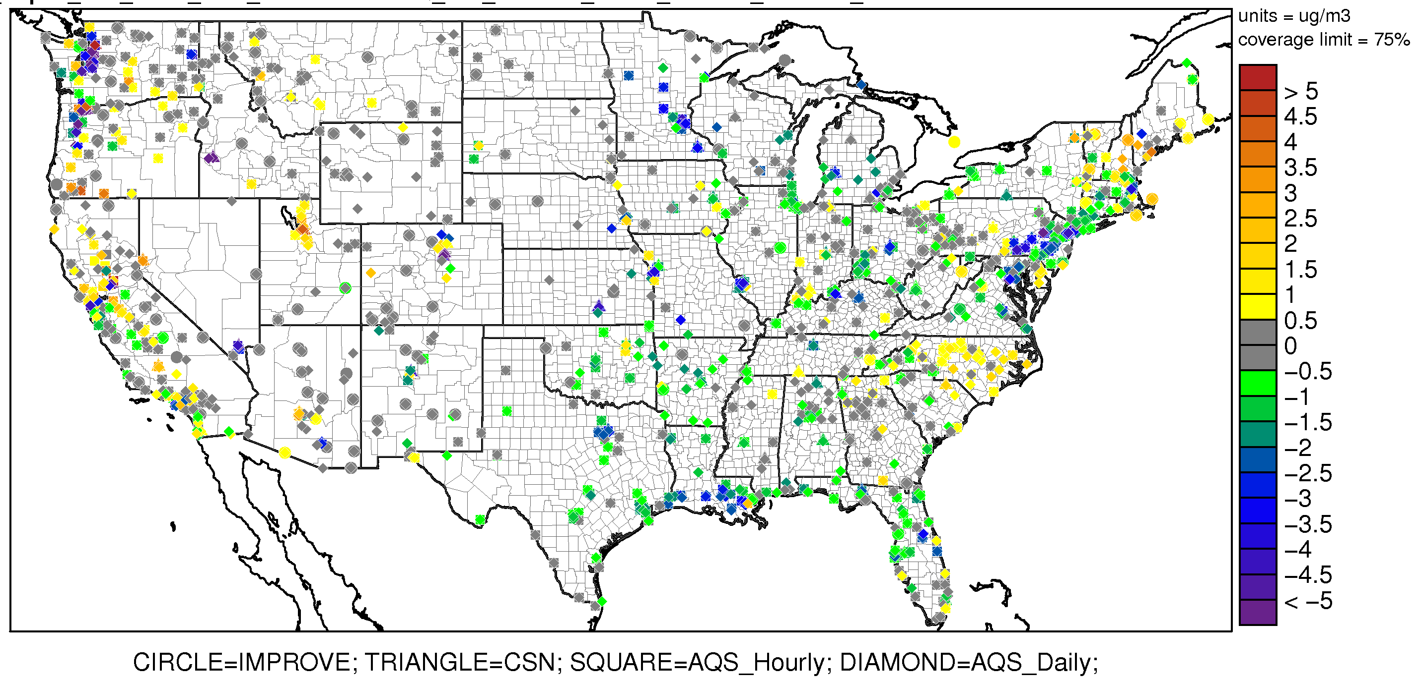
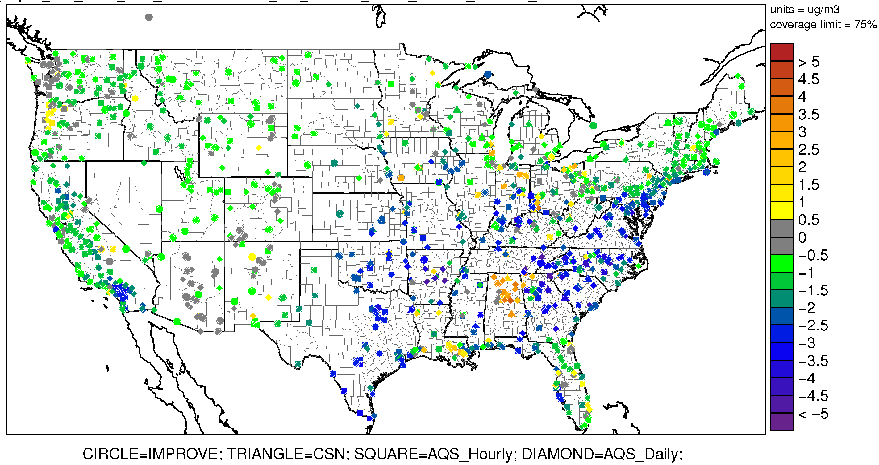
PM_{2.5} Biases
CMAQv5.1 CMAQv5.2
January 2011
July 2011
CMAQv5.2– CMAQv5.1 – Difference in PM_{2.5} Absolute Bias
Worse Bias
Worse Bias
Improved Bias
Improved Bias
Resource Improvements
Model Improvements
Evaluation
Research Directions

Slide 14
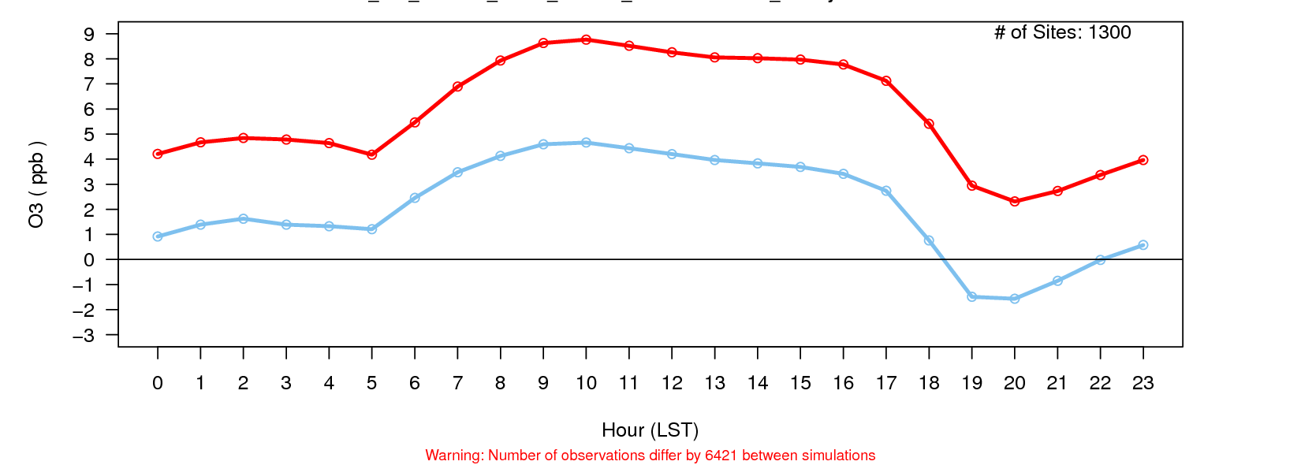
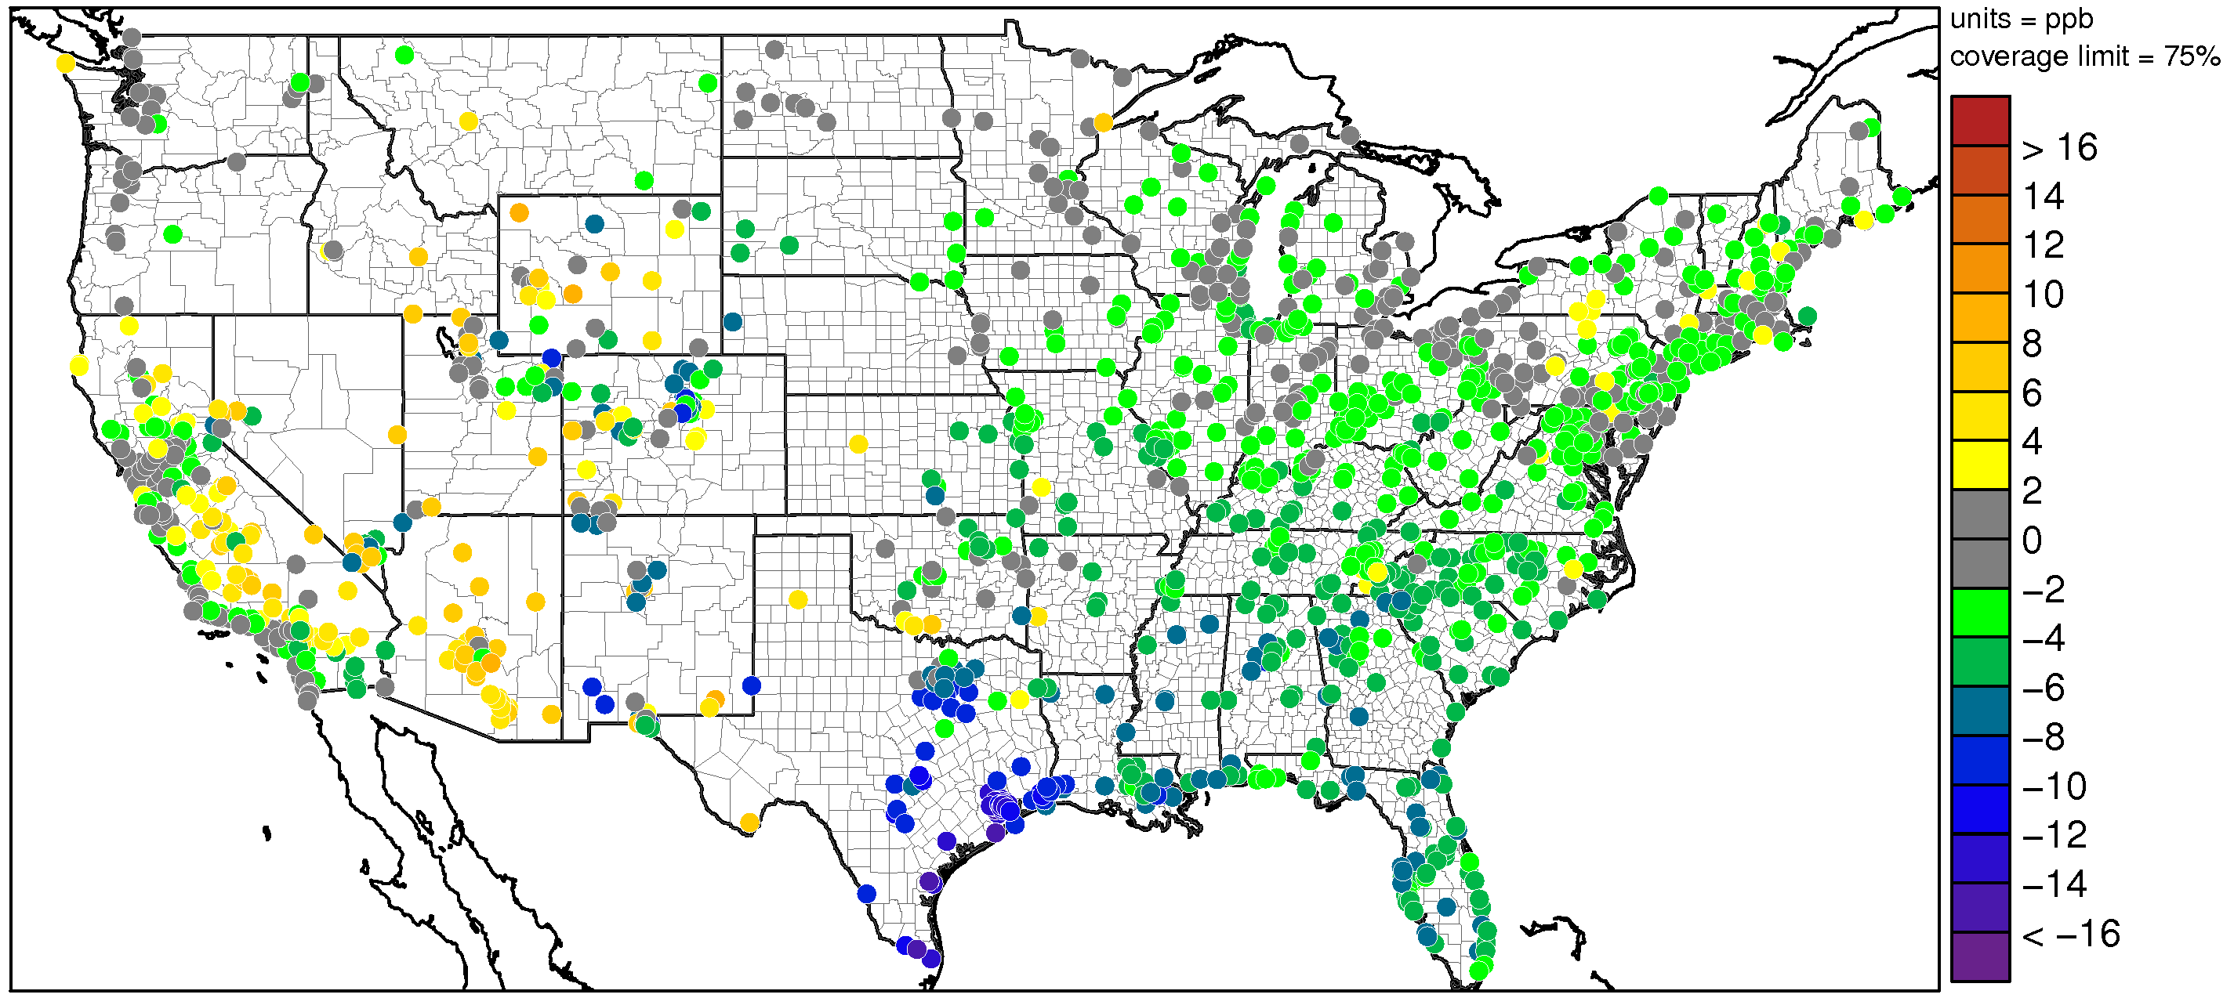
O₃ Biases
Diurnal Bias Characteristics:
Consistent decrease in O₃ bias across all hours at AQS sites in v5.2 compared to v5.1
v5.1
v5.2
CMAQv5.2– CMAQv5.1 – Difference in O₃ Absolute Bias
Worse Bias
July 2011:
Bias in modeled O₃ decreases at most locations from v5.1 to v5.2
Improved Bias
Resource Improvements
Model Improvements
Evaluation
Research Directions

Slide 15
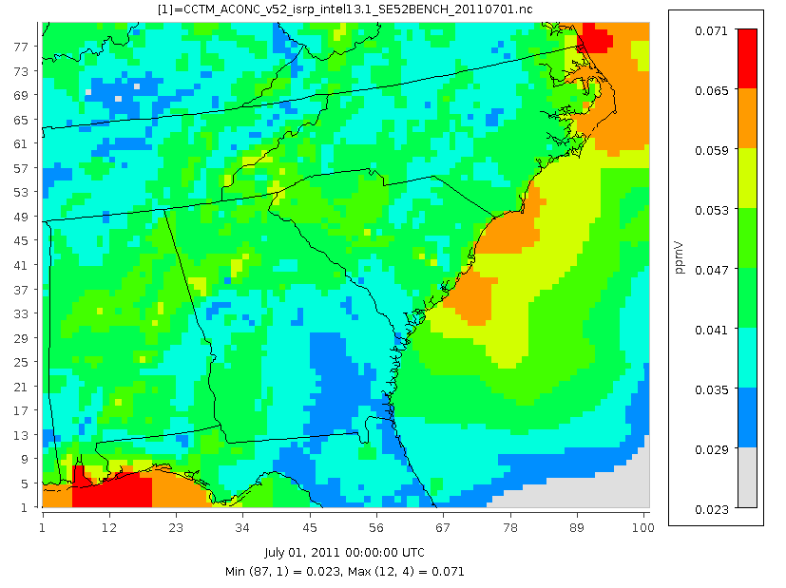
CMAQv5.2 Runtime Performance
Southeast US Benchmark Case
80 row, 100 col, 35 lay = 297,500 cells
2011 July 1-14
Both Simulations utilized CB6r3 Chemistry
Resource Improvements
Model Improvements
Evaluation
Research Directions

Slide 16
Future Research and Development Themes
Emerging and Ongoing Science Challenges:
  Wildfire emissions, pollutant transport and chemistry
  Regional-scale deposition and role in nitrogen cycle
  Cloud-aerosol interactions
  Ammonia and amine emissions, semivolatile partitioning and uptake
  Impacts of photosynthesis on vegetation, local surface-atmosphere energy balance, and carbon cycle
  Bottom-up chemical mechanisms focusing on accurate representation of individual chemical species
  Ultrafine particles
  Coupled Global Meteorology-Air Quality Modeling: the Next Generation Model will couple CMAQ routines with a new meteorological model, MPAS. (Pleim: 11:20)
  For more info: https://www.epa.gov/cmaq/browse-cmaq-applications
Accessibility and Outreach:
  Wiki for Community applications: www.cmascenter.org → Resources → Wiki → Application Blog
  Further streamline compilation and execution
  Online data visualization tools
  Data sharing via FTP
25 km
92 km
Water vapor mixing ratio
Resource Improvements
Model Improvements
Evaluation
Research Directions

