Slide 1
Multi-Year (2013-2016) North American Population Exposure to PM_{2.5} Emissions from Wildfires Estimated from Operational Air Quality Forecasts
Rodrigo Munoz-Alpizar¹, Radenko Pavlovic¹, Mike Moran², Jack Chen³, Sylvie Gravel³, Sarah Henderson⁴, Sylvain Ménard¹,Jacinthe Racine¹, Annie Duhamel¹, Samuel Gilbert¹, Paul-André Beaulieu¹, Hugo Landry¹, Didier Davignon¹, and Sophie Cousineau¹
¹Air Quality Modelling Applications Section, Environment and Climate Change
Canada (ECCC), Montreal, Quebec, Canada
²Air Quality Research Division, ECCC, Toronto, Ontario, Canada
³Air Quality Research Division, ECCC, Montreal, Quebec, Canada
⁴Environmental Health Services, BC Centre for Disease Control, Vancouver,
British Columbia, Canada
16th Annual CMAS Conference Oct. 23-25 2017 Chapel Hill, North Carolina

Slide 2
Acknowledgements
  Natural Resources Canada
    Canadian Wildland Fire Information System (CWFIS)
    Canadian Forest Service: Kerry Anderson, Peter Englefield
U.S. Forest Service
    BlueSky team: Susan O’Neill
Environment Canada
    Alexandru Lupu and Cassandra Bolduc

Slide 3
Talk Outline
Background and overview
Short description of ECCC FireWork system (clone of regular operational AQ forecast system + near-real-time biomass-burning emissions)
Methodology
Results: wildfire smoke impacts and exposure
Related study
Conclusions

Slide 4
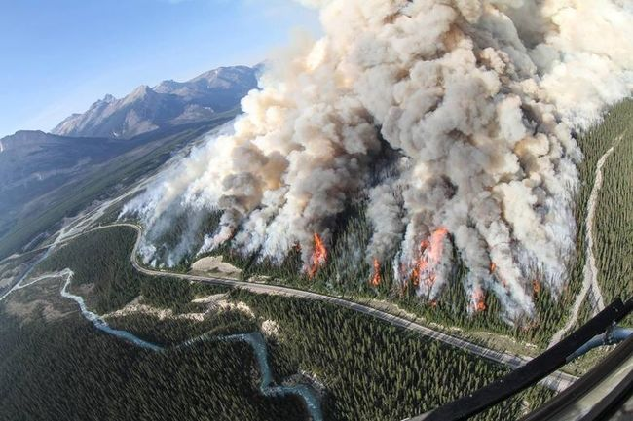
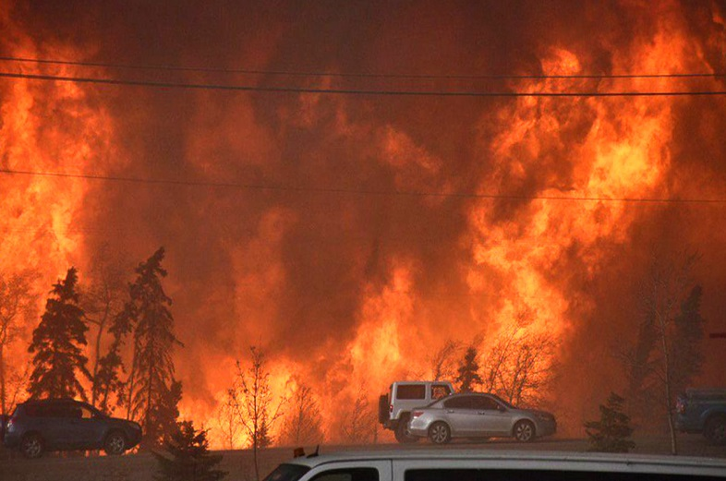
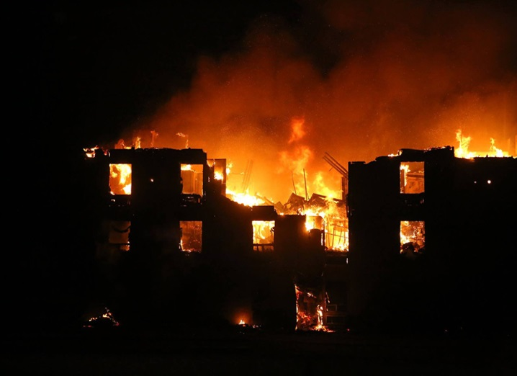
Background
Biomass burning (BB) from both natural processes (wildfires) and anthropogenic activities (prescribed burns) can emit significant amounts of pollutants that can adversely impact local and regional air quality (AQ), public health and climate
During the last decade an average of 7000 wildfires occurred each year in Canada and burned an average of 2.6 million ha per year (larger than Vermont); annual costs of wildfire suppression in Canada range from about $0.5 billion to $1 billion
Fort McMurray wildfire from 1 May to 4 July 2016 burned 590,000 ha, forced evacuation of ~90,000 people, & caused damages of ~$9.5 billion

Slide 5
Study Overview
Objectives:
  To quantify the contribution of fire-originated fine particulate matter (“fire-PM_{2.5}”) to PM_{2.5} pollution in North America based on FireWork forecasts for the 5-month “fire season” (May to September) over the past four years (2013-2016)
  To help public health professionals, policymakers, and the general public better understand the health impacts of wildfire-related PM_{2.5} pollution.
Scientific Questions:
  What is the size of the area affected by wildfire smoke?
  What is the extent of population exposure to wildfire PM_{2.5} pollution?
  How often does wildfire smoke cause exceedances of Canadian daily PM_{2.5} standard (CAAQS)?

Slide 6

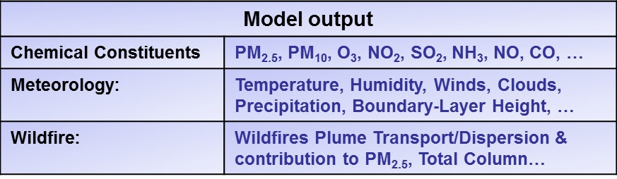
Current ECCC Operational Wildfire Forecast System: FireWork
Emission Inventories
CAN (2010), USA (2011 NEI), Mexico (1999)
Wildfire emissions dataflow
GEM and Obs.
Meteorology valid at local noon
Fire information
AVHRR/MODIS
Area sources
Non-road sources
Mobile sources
Point sources
SMOKE (Sparse Matrix Operator Kernel Emissions)
Converts daily total wildfire emissions into hourly values, and converts VOC, NOx, PM into explicit model species. Emissions are then combined with other GEM-MACH emissions and provided as major point sources to FireWork
CWFIS
(Canadian Wildland Information System)
Hotspots for US and CA
Wildfire location by lat/lon
Estimated fuel type/consumption
-
Biogenic Emissions
Area
Emissions
Major Point Emissions with Near-Real Time Wildfire Emissions
BLUE SKY (FEPS only)
Estimates total daily emissions per hotspot for PMs, VOCs, NOx, SO₂, CO and NH₃
GEM-MACH
Global Environmental Multiscale
Modelling Air Quality and CHemistry
Initial Conditions
Regional 4DVar analysis for meteorological variables
No assimilation of chemical constituents
Dynamics
Tracer Advection
Physics
Radiation; PBL; vertical diffusion; convec.; conden.; cloud microphysics; surface process; etc.)
Chemistry processor
Emissions; vertical diffusion of chemical tracers; chemistry: gas phase, aqueous, and heterogeneous; dry/wet deposition, plumerise/spread, SOA, aerosol dynamics and microphysics.
Boundary Conditions
Meteorology from the Regional Deterministic Prediction System at 10km
Seasonal climatology for chemical constituents
run twice daily (00z, 12z) from April to October

Slide 7
Methodology (1)
FireWork Timeline:
  2013: FireWork system was first run in an experimental mode at ECCC’s Canadian Centre for Meteorological and Environmental Prediction (CCMEP). Also run in summer 2014 and summer 2015
  2016: FireWork system became operational in April 2016
  FireWork is identical to the ECCC operational Regional Air Quality Prediction System (RAQDPS), except for the inclusion of satellite- derived, near-real-time biomass burning emissions from natural, prescribed, and agricultural fires
Forecast Periods : Multi-year (2013-2016) for May-Sept.
  FireWork was re-run retrospectively for added periods
Year | Experimental/Operational FireWork |  | Added periods
 | Start | End
2013 | June 1 | August 31 | May 1‒31; Sep. 1‒31
2014 | June 9 | October 1 | May 1‒June 8
2015 | May 21 | October 31 | May 1‒20
2016 | April 1 | October 31 | ‒

Slide 8
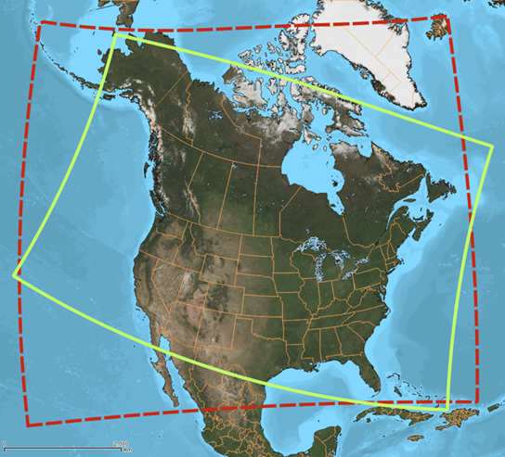
Methodology (2)
Modelling Set-Up:
Grid configuration | Limited Area Model over North America (LAM) with Rotated Latitude-Longitude grid.
Horizontal and Vertical Resolution | 10km x 10km; 80 Hybrid Levels up to 0.1 hPa (~60 km)
Model time step | 300 s for meteorology; 900 s for chemistry
On-line chemistry processes | Representation of Gas and Aerosol Chemistry: Gas-Phase Chemistry: ADOM-II (42 species, 114 reactions) Aerosol Representation: 2 size bins (0 -2.5 um, 2.5 – 10 um); 8 chemical species (SO₄, NO₃, NH₄, EC, pOC, sOC, crustal material, sea salt) Aerosol Dynamics & Microphysics Aqueous & Inorganic heterogeneous chemistry Secondary Organic Aerosol Chemistry Cloud processing (aerosol activation, aqueous-phase chemistry, wet removal of gas and aerosols) Dry deposition for aerosol particles and gases. One-way coupling (meteorology affects chemistry )
FireWork domain boundaries prior (red) and post (green) Operational (April-October) ECCC's AQ system in September 7th 2016.

Slide 9
Methodology (3)
Wildfire Emissions’ Contribution to PM_{2.5} Pollution :
  fire-Pm2.5 = FireWork PM_{2.5} – RAQDPS PM_{2.5}
  Different concentration thresholds were used to assess areas affected by wildfire smoke : 0.2, 1, 5, 10 and 28 µg/m³ (annual standard and daily standard CAAQS )
Population Exposure Estimation:
  Combining FireWork fields of direct contributions of fire-PM_{2.5} to total surface PM_{2.5} concentration with population data.
  Used population data from the 2016 Canadian census (dissemination-area level) and from the 2010 U.S. census (census-tract level)

Slide 10
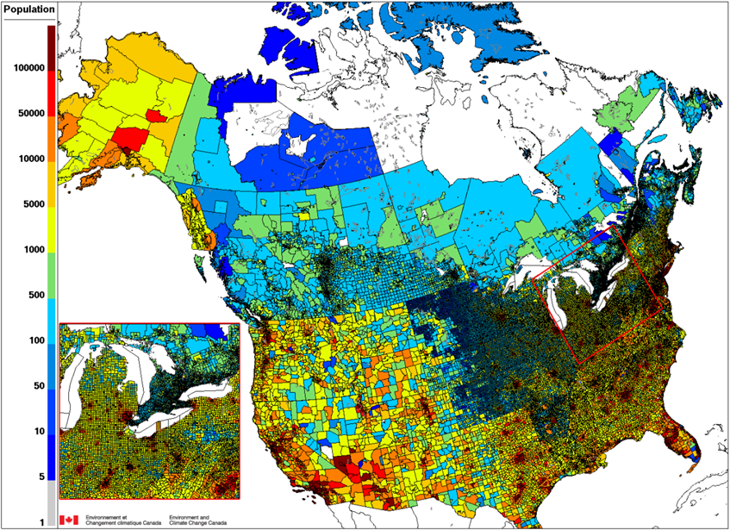
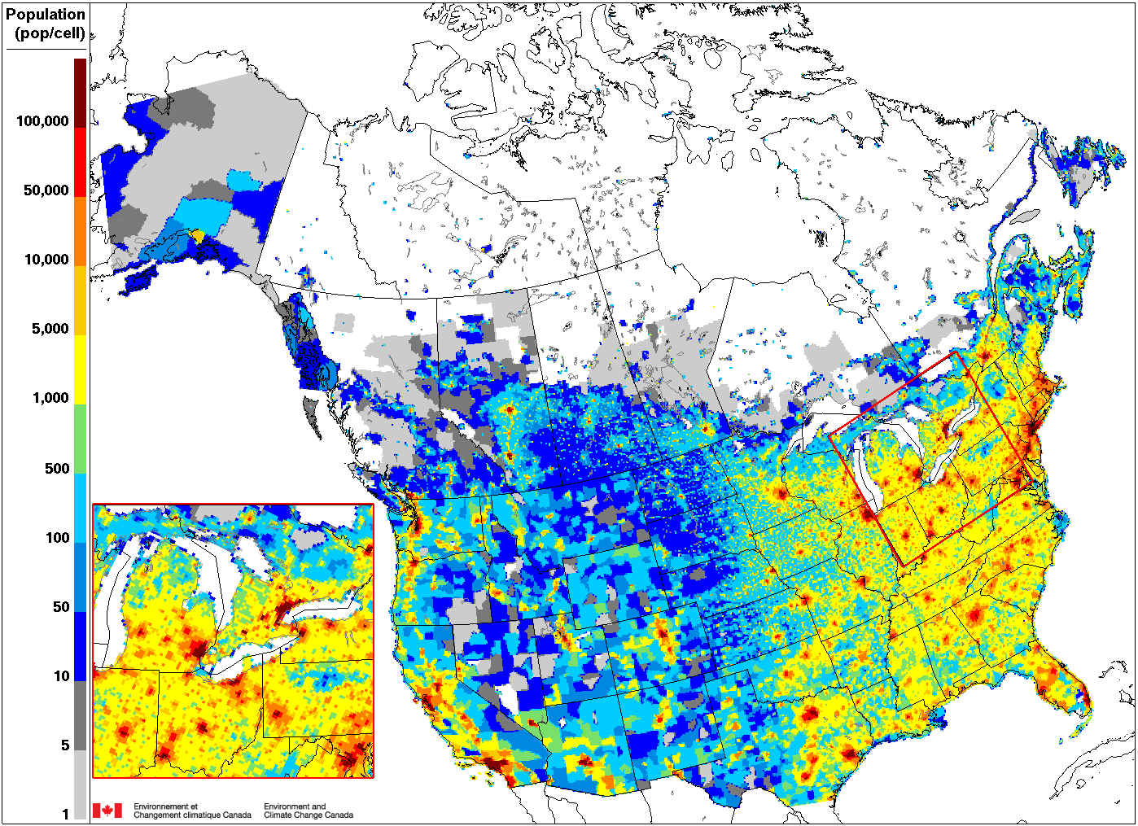
Methodology (4)
Population shapefiles to FireWork grid cells
Exposure Frequency Estimation:
  To characterize exposure frequency, the number of occurrences of hourly or daily fire-PM_{2.5} concentrations above specific thresholds for individual grid cells were used : 1, 5, 10, 28 µg/m³.

Slide 11
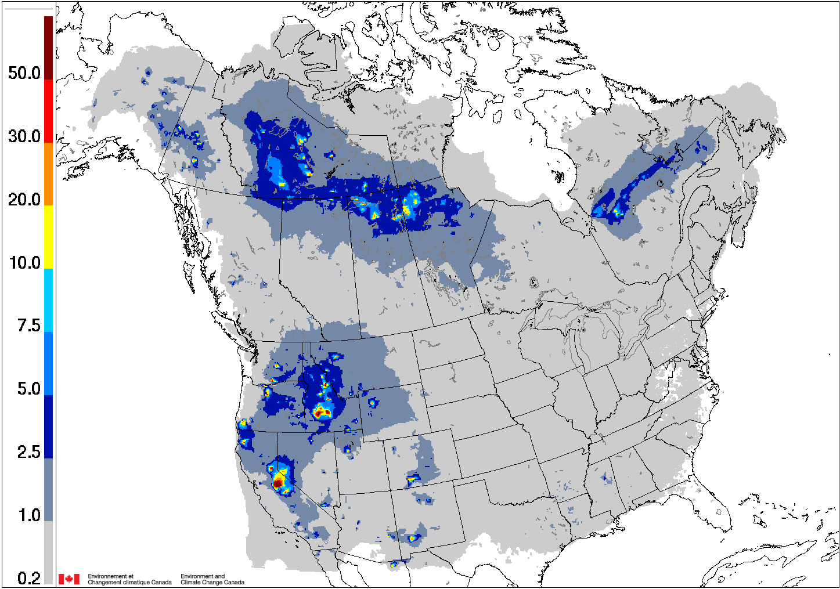
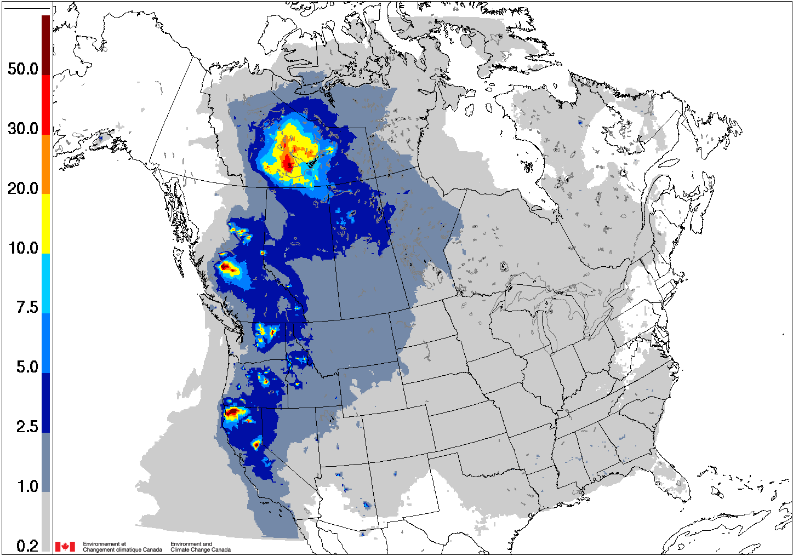
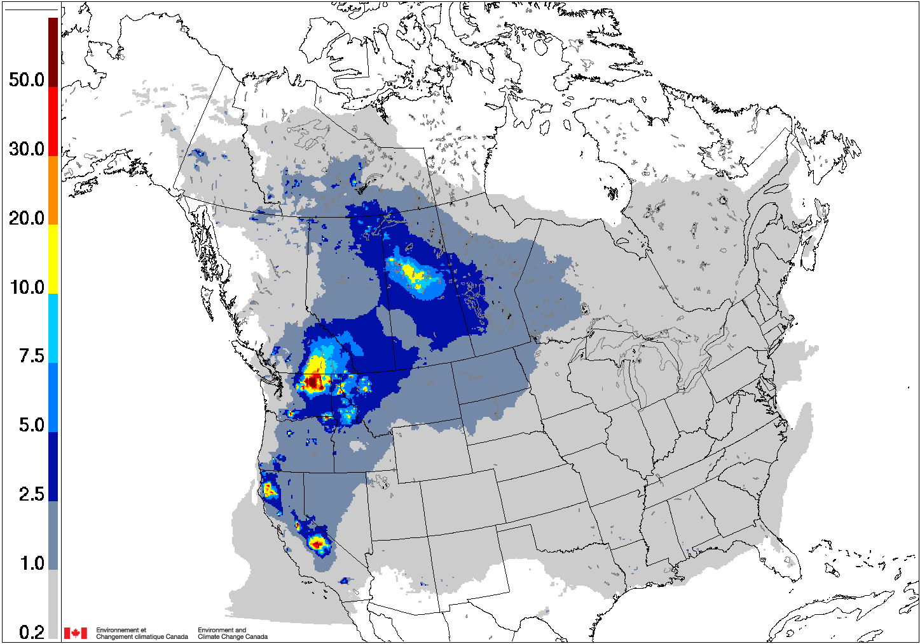
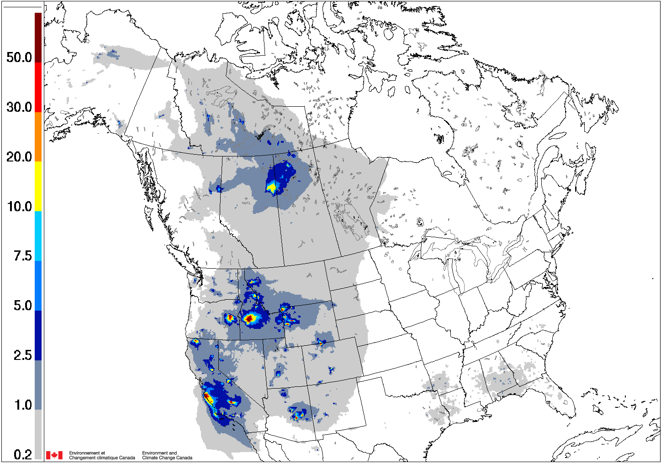
Results
Area Affected by Wildfire Smoke (1)
Average seasonal fire-PM_{2.5} footprint
2013
2014
2015
2016

Slide 12
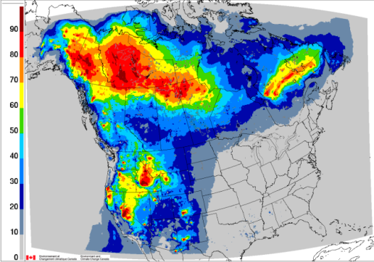
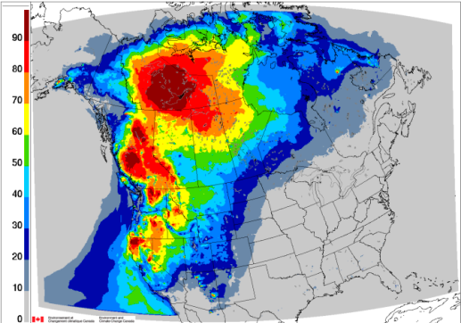
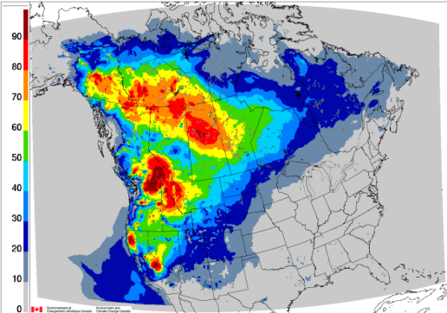
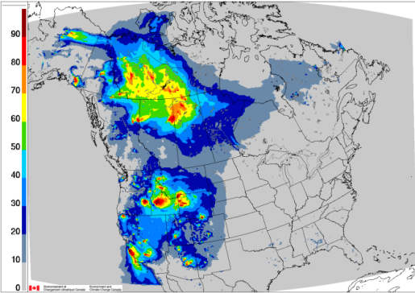
Area Affected by Wildfire Smoke (2)
Average seasonal percentage of fire-PM_{2.5} contribution to average seasonal PM_{2.5} FireWork concentrations
2013
2014
2015
2016

Slide 13
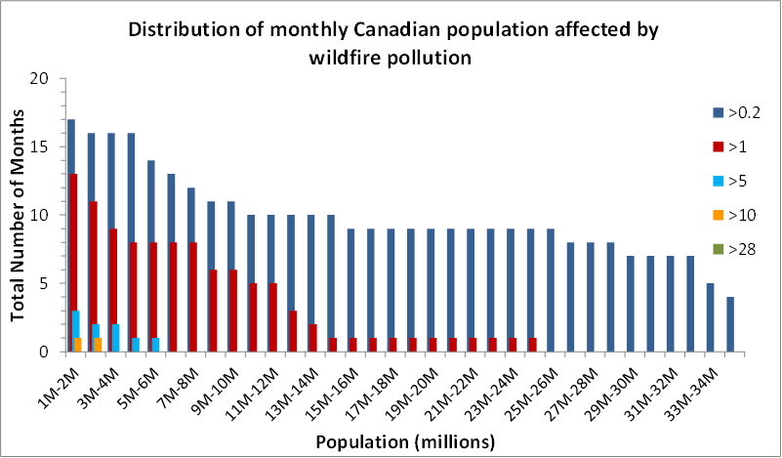
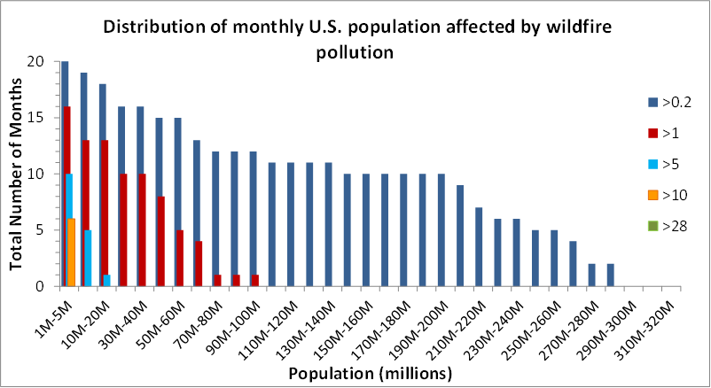
Results
Population Exposure to Wildfire Pollution (1)
In 17 of the 20 months considered, more than 1 million Canadians (3% of the population) were estimated to have been affected by average monthly fire-PM_{2.5} > 0.2 µg/m³
more than 14 million Canadians (39% of the population) were affected by average monthly fire-PM_{2.5} > 0.2 µg/m³ in 10 of the 20 months, and over 32 million Canadians (90% of the population) were affected in 7 months.
In the U.S., more than 200 million people (65% of the population) were exposed to average monthly fire-PM_{2.5} > 0.2 µg/m³ during nine of the 20 months considered

Slide 14
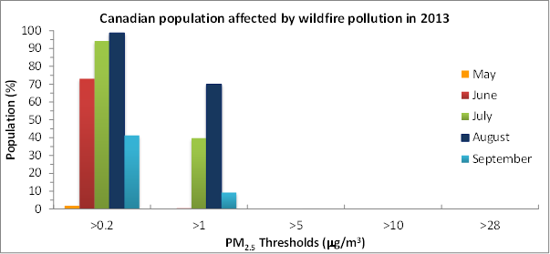
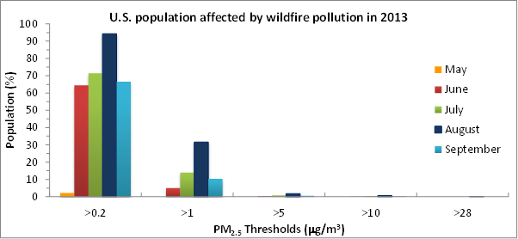
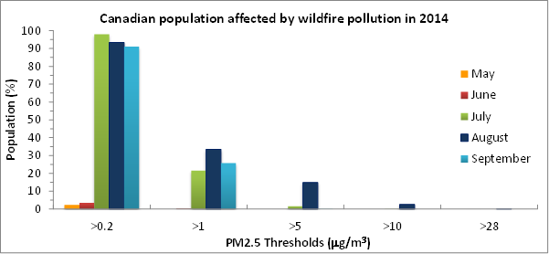
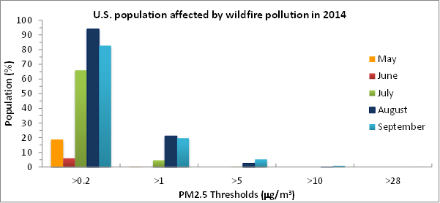
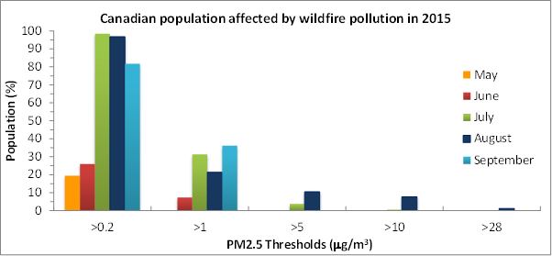
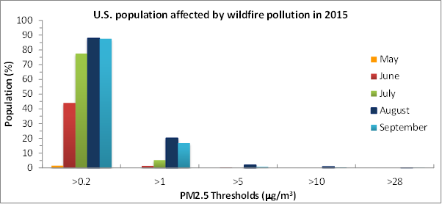
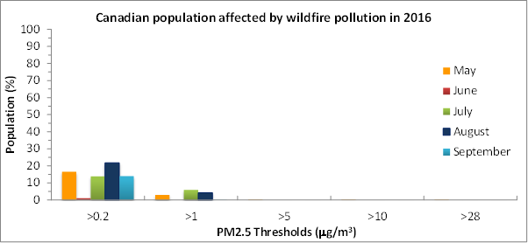
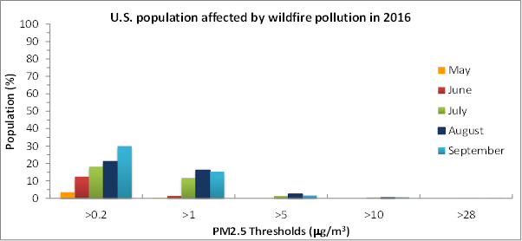
Population Exposure to Wildfire Pollution (2)
July and August were the months affecting the most people (with August 2015 being the worst for average monthly fire-PM_{2.5} > 10 µg/m³)
The total percentages of the U.S. population affected by seasonal fire-PM_{2.5} > 0.2 µg/m³ ranged from 21% (2016) to 90% (2015), and the corresponding range above 1 µg/m³ was 5% (2015) to 15% (2014).

Slide 15
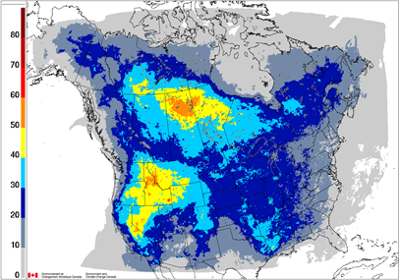
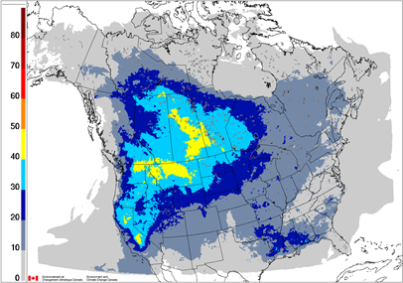
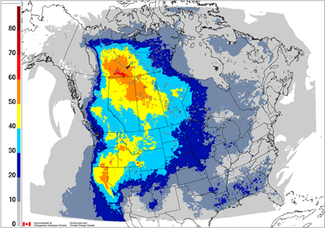
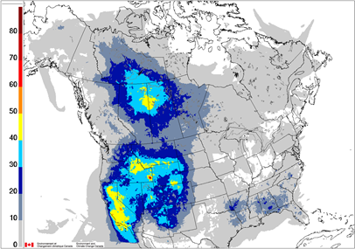
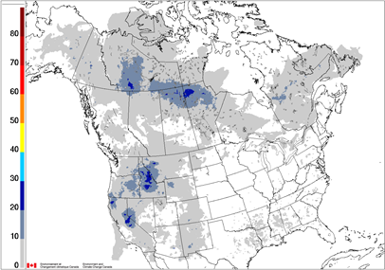
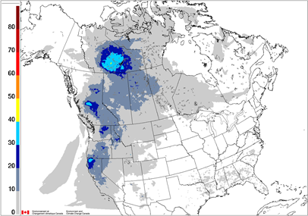
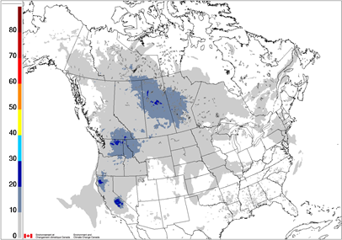
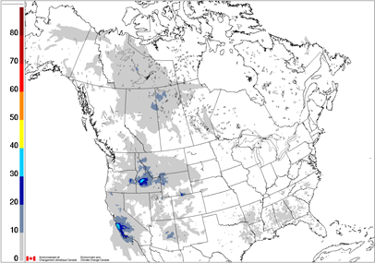
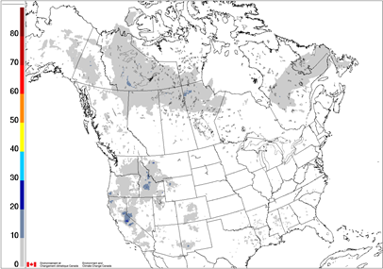
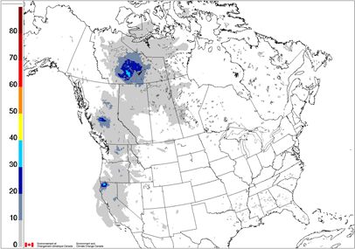
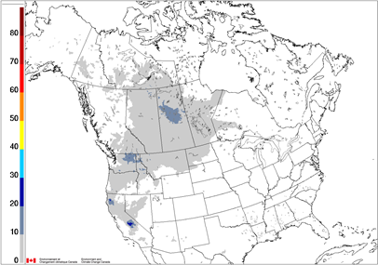
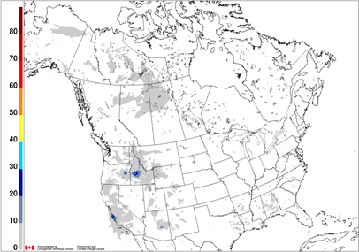
Results
Frequency of Wildfire-Related Pollution Events
(Percentage of days with predicted 24-hr PM_{2.5} concentration above threshold)
> 1 µg/m³ from fire-PM_{2.5} contribution
2013
2014
2015
2016
> 10 µg/m³ from fire-PM_{2.5} contribution
2013
2014
2015
2016
> 28 µg/m³ from fire-PM_{2.5} contribution
2013
2014
2015
2016

Slide 16
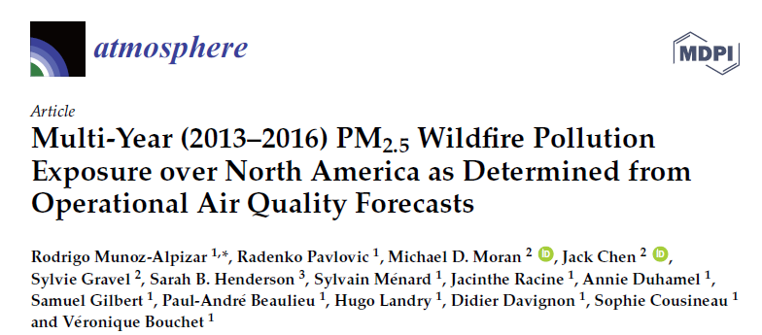
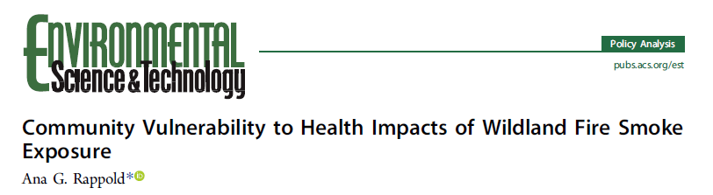
Related Study (1)
Atmosphere 2017, 8, 179; doi:10.3390/atmos8090179
, Jeanette Reyes, George Pouliot, Wayne E. Cascio, and David Diaz-Sanchez,
ES&T, 2017, 51, 6674-6682, doi:10.1021/acs.est.6b06200

Slide 17
Related Study (2)
Paper | Rappold et al. (2017) | This Study
Period | 2008-2012 | 2013-2016
Domain | Continental U.S. | North America
Model | CMAQ | GEM-MACH
Type | Retrospective | Prospective
Emissions | SMARTFIRE v2 | CWFIS / FEPS
Munoz-Alpizar et al. (2017) concluded that the two studies estimated comparable exposure impacts from wildfire PM_{2.5} over the continental U.S.

Slide 18
Conclusions (1)
Comparison of average monthly fire-PM_{2.5} surface concentration fields showed large year-to-year variations in both timing and spatial locations of wildfires between 2013 and 2016
For both Canada and the U.S., July and August had the maximum fire-PM_{2.5} levels, although intense wildfires can also occur in September in the western U.S., likely due to a longer summer season
Monthly and seasonal analyses of the mean forecasted fire-PM_{2.5} suggested that, on average, over 76% of Canadians and 69% of Americans were at least minimally affected by wildfire smoke during the four-year study period
Calculations of the number of days with forecasted fire-PM_{2.5} above concentration thresholds from 1 µg/m³ to 28 µg/m³ showed that most wildfire events over North America occurred in the western part of the U.S. and in western, northern, and central Canada

Slide 19
Conclusions (2)
During months of extreme wildfire activity, some areas in northwestern Canada and the western U.S. had up to 20% of days where the fire-PM_{2.5} was > 28 µg/m³. The eastern U.S. and eastern Canada had fewer days with threshold exceedances, but most of North America was affected by fire-PM_{2.5} > 1 µg/m³ on at least one day per year
FireWork is a valuable prognostic tool used as guidance by AQ meteorologists to issue forecasts on a daily basis, allowing advance warnings to populations at risk to reduce their exposure
FireWork is also useful for retrospective analysis of past wildfire events. The statistical analyses of these forecasts over multiple years can be used by public health researchers, AQ regulators and policymakers, and others interested in wildfire impacts to understand and characterize exposure to wildfire smoke and its interannual and geographic variability

Slide 20
Thank you for your attention!

