Slide 1
Impact on Recent North American Air Quality Forecasts of Replacing a Retrospective U.S. Emissions Inventory with a Projected Inventory
Michael Moran¹, Qiong Zheng¹, Junhua Zhang¹, Radenko Pavlovic², and Mourad Sassi²
¹Air Quality Research Division,
Environment and Climate Change Canada (ECCC), Toronto, Ontario, Canada
²Air Quality Modelling Applications Section, ECCC, Montreal, Quebec, Canada
16th Annual CMAS Conference Oct. 23-25, 2017 Chapel Hill, North Carolina

Slide 2
Talk Outline
Background
Description of Updated Emissions
Impact of Updated Emissions
Summary

Slide 3
Background (1)
To make AQ forecasts we should use current emissions
National emissions inventories are generally retrospective, that is, representative of a past base year
A mismatch occurs when emissions are changing significantly from year to year, as has been the case in North America for the past decade or more

Slide 4
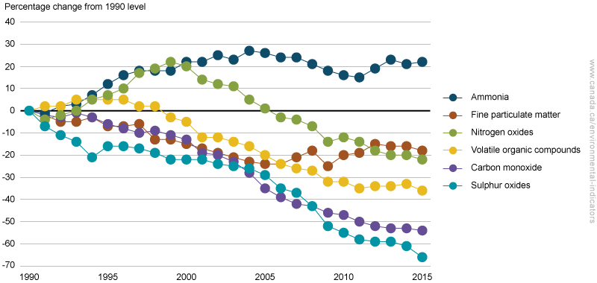
Canadian Relative Annual Air Pollutant Emissions Trends, 1990-2015
Modellers’ inventories:
2006
2010
2013
[From http://ec.gc.ca/indicateurs-indicators/default.asp?lang=en&n=E79F4C12-1]

Slide 5
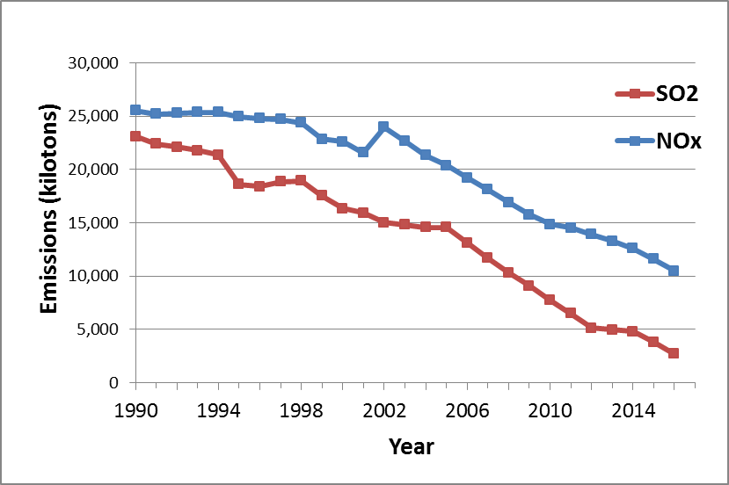
U.S. SO₂ and NO_{x} Annual Emissions Trends, 1990-2016
2011
2017
[from https://www.epa.gov/air-emissions-inventories/air-pollutant-emissions-trends-data]

Slide 6
Background (2)
At last year’s CMAS conference Heather Simon (EPA) gave a presentation summarizing concerns over NOx emissions levels in the 2011 NEI:
Simon, H., D. Sonntag, M. Beardsley, K. Foley, C. Owen, C. Toro, N. Possiel, and A. Eyth. “Ongoing EPA efforts to evaluate modeled NO_{y} budgets”, 2016 CMAS.
It is possible that some of these concerns were due to the use of 2011 NEI emissions for later years
Also at last year’s CMAS conference, when I raised this mismatch concern with Alison Eyth (EPA), she responded:
“Why not use the projected 2017 NEI for AQ forecasting?”
Indeed. Why not? I had used a projected 2012 NEI before.

Slide 7
Recent Updates to RAQDPS Emissions
RAQDPS: Regional Air Quality Deterministic
Prediction System
Emissions last updated in mid 2015 (SET2.1.1):
Canada 2010 APEI v1
U.S. 2011 NEI v1
Mexico 1999 (no change)
Proposed 2017 update (SET3):
Canada 2013 APEI v1
U.S. 2017 projected NEI v2
Mexico 2008

Slide 8
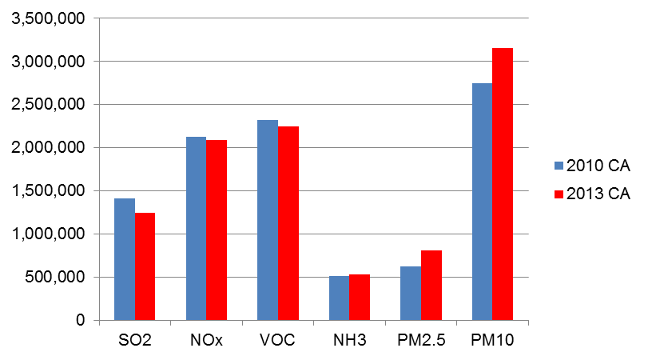
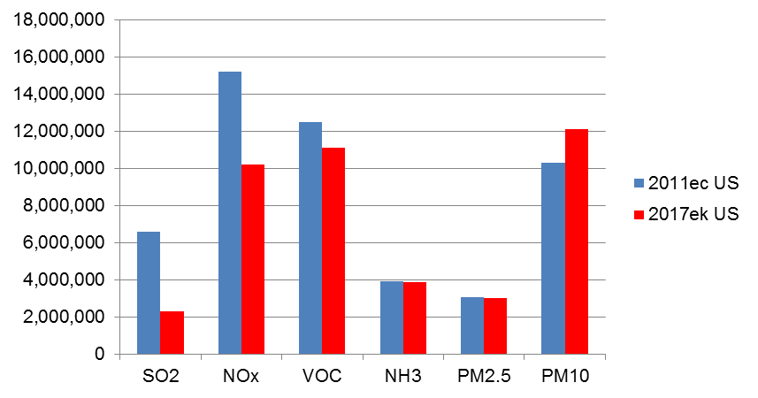
Comparison of Old and New Canadian and U.S. Emissions Inventories
-4%
-2%
Canada,
2010 vs. 2013
-12%
-33%
-11%
U.S.,
2011 vs. 2017
-65%

Slide 9
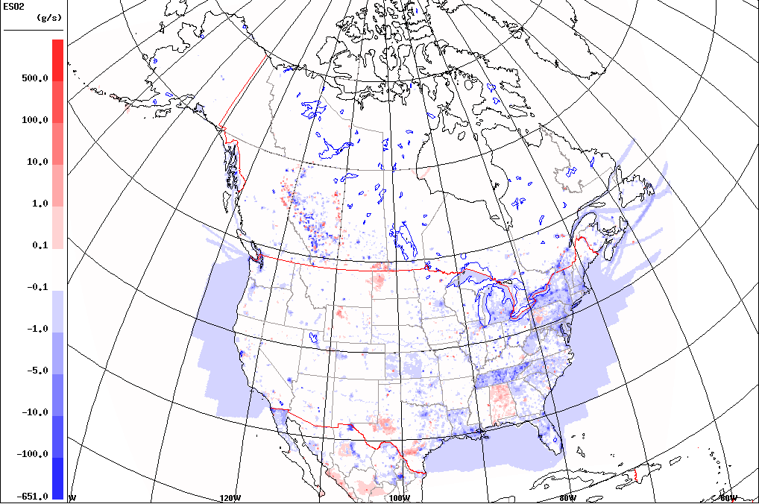
Spatial Distribution of Changes in July SO₂ Emissions (New – Old; tonnes/grid cell)

Slide 10
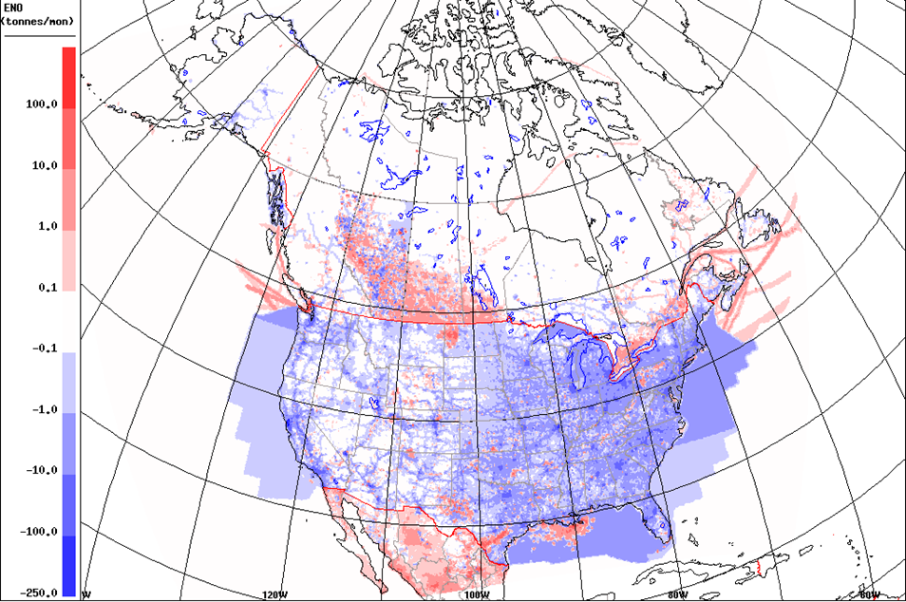
Spatial Distribution of Changes in July NO Emissions (New – Old; tonnes/grid cell)

Slide 11
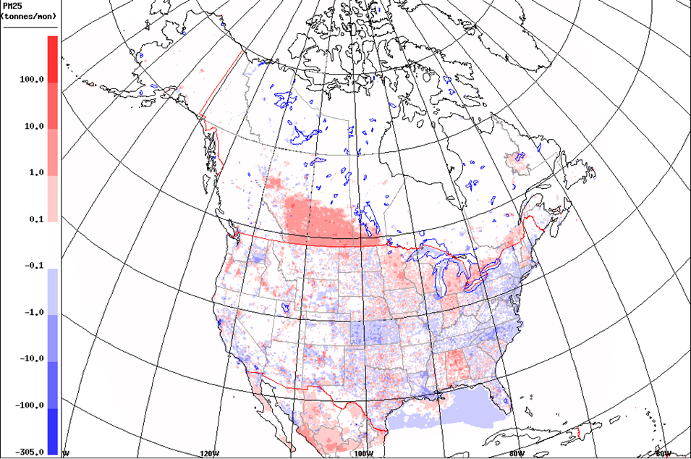
Spatial Distribution of Changes in July PM_{2.5} Emissions (New – Old; tonnes/grid cell)

Slide 12
Tests of New Emissions
Ran two versions of RAQDPS:
operational code, operational emissions (SET2.1.1)
operational code, new emissions (SET3)
Ran for two 6-week periods:
summer 2016 (July 1‒Aug. 16, 2016)
winter 2017 (Jan. 1‒Feb. 18, 2017)

Slide 13
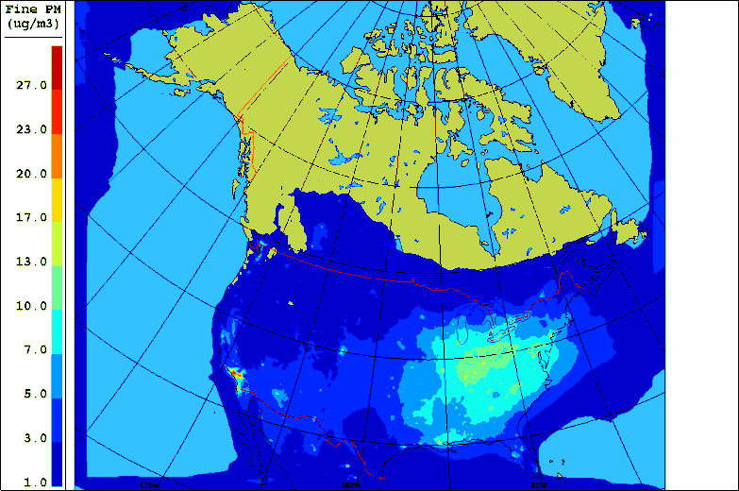
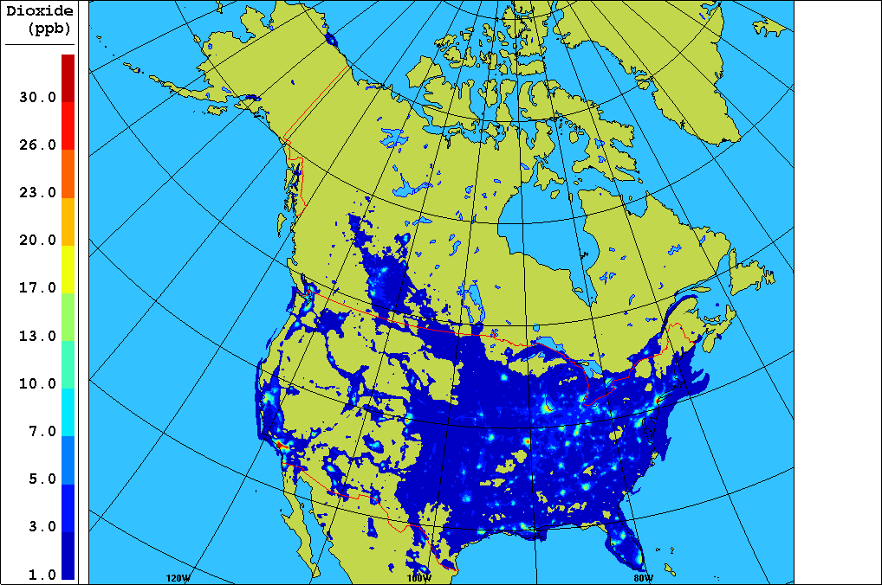
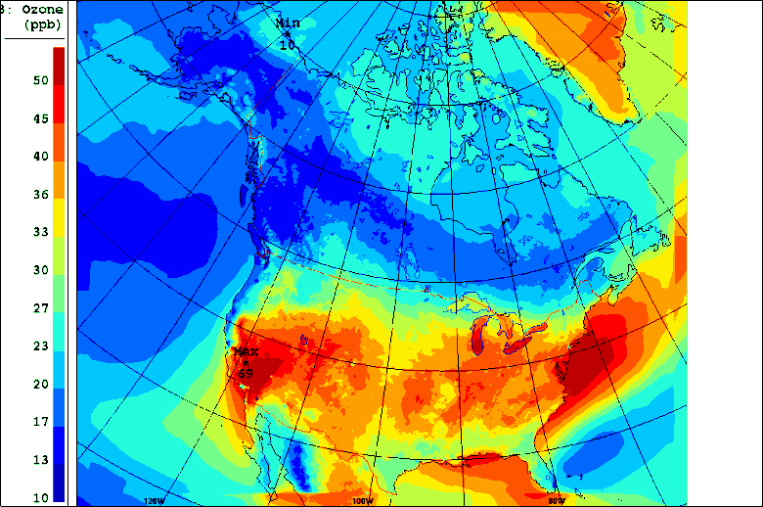
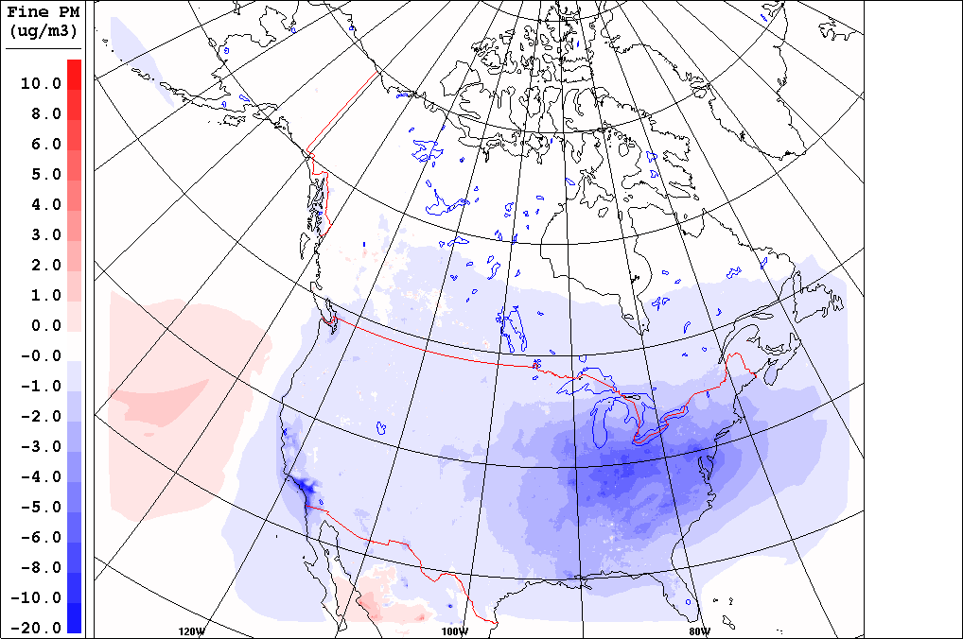
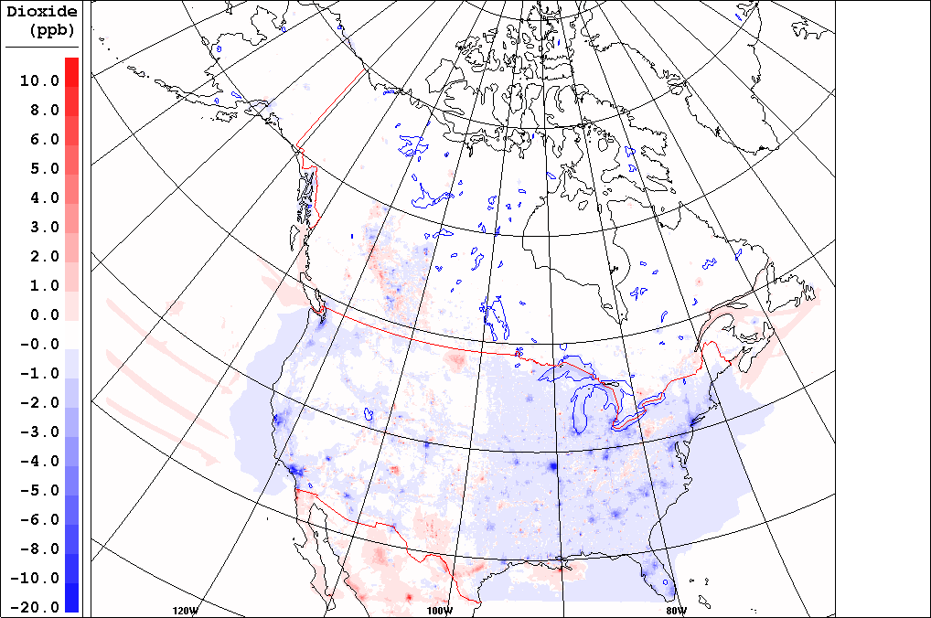
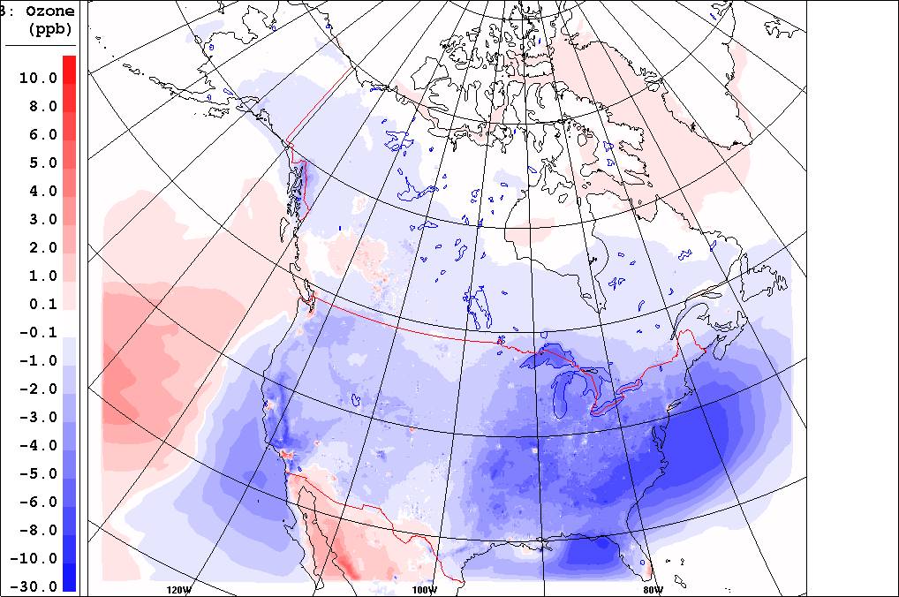
Base-Case (OPS) Average Concentrations – Summer 2016
PM_{2.5}
NO₂
O₃
DIFFERENCES: RAQDPS(SET3) – RAQDPS (OPS)

Slide 14
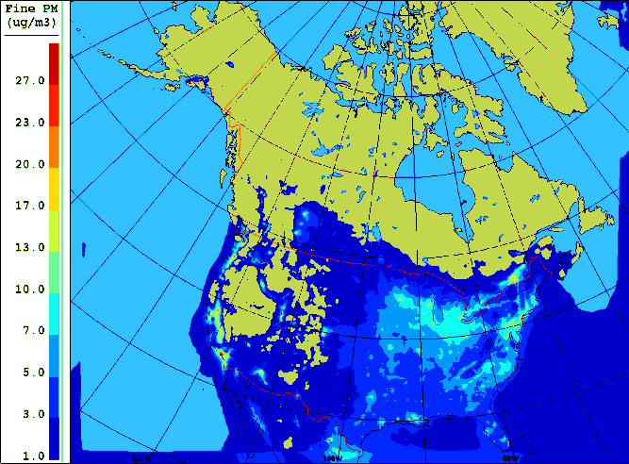
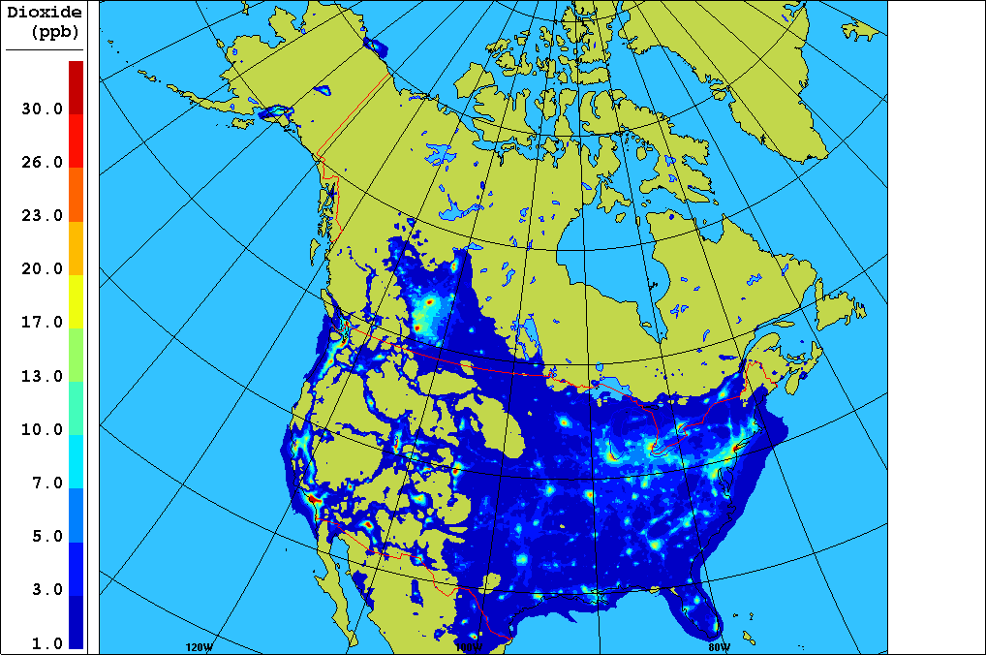
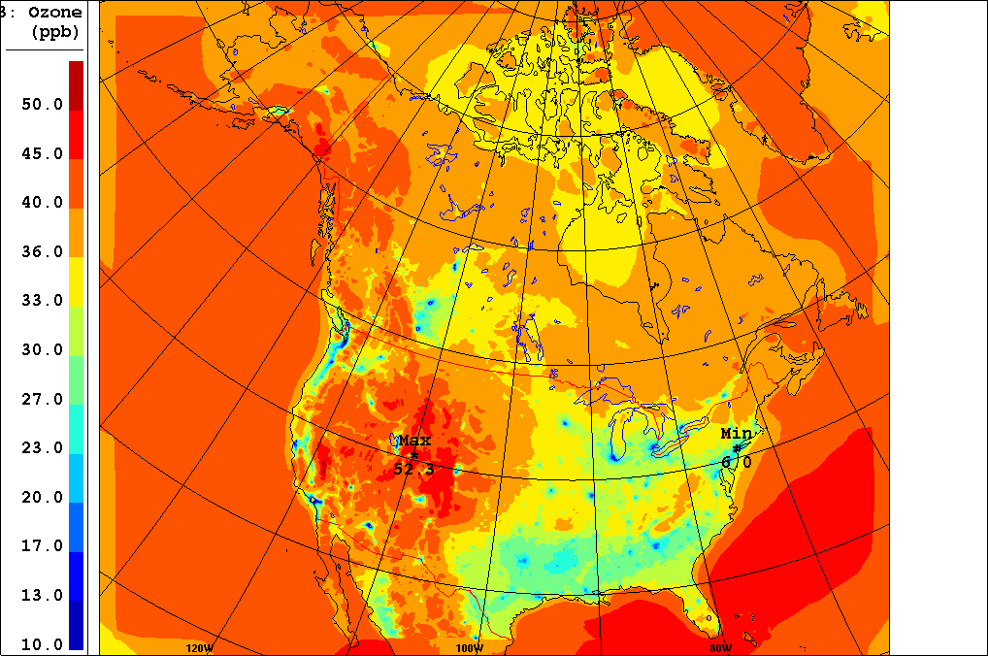
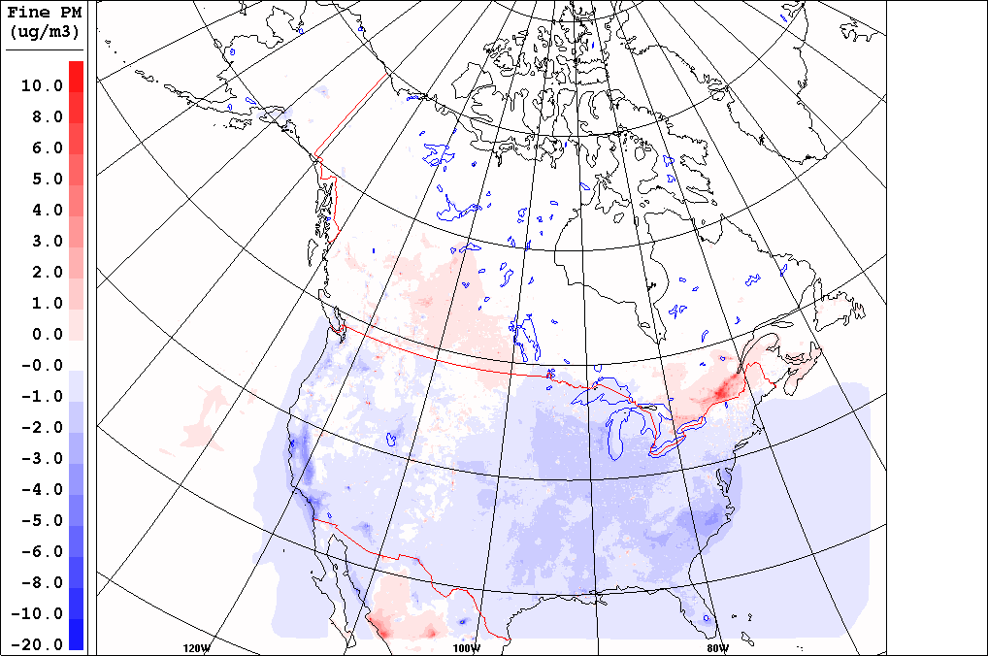
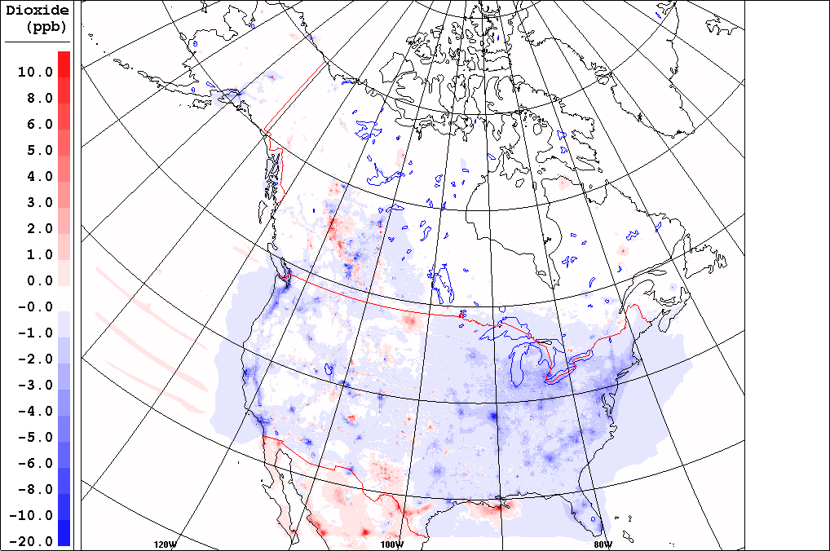
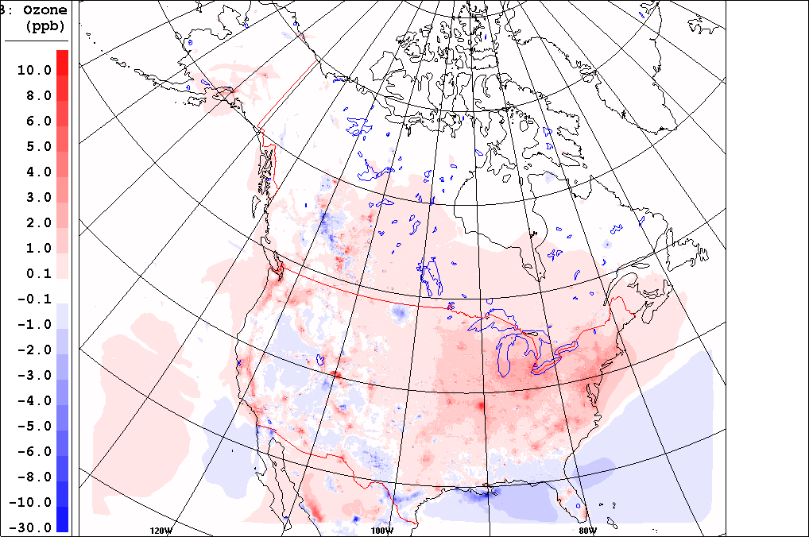
Base-Case (OPS) Average Concentrations – Winter 2017
PM_{2.5}
NO₂
O₃
DIFFERENCES: RAQDPS(SET3) – RAQDPS (OPS)

Slide 15
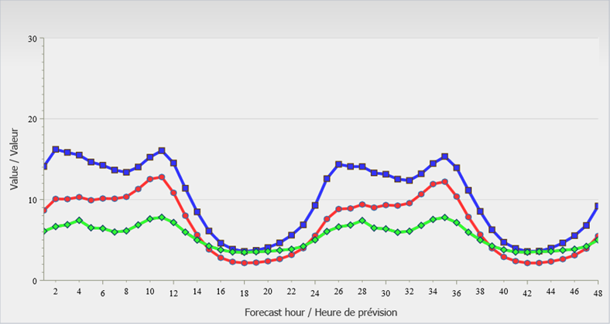
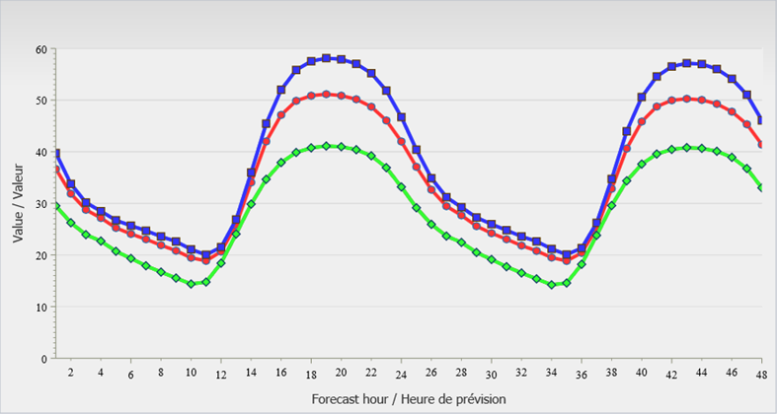
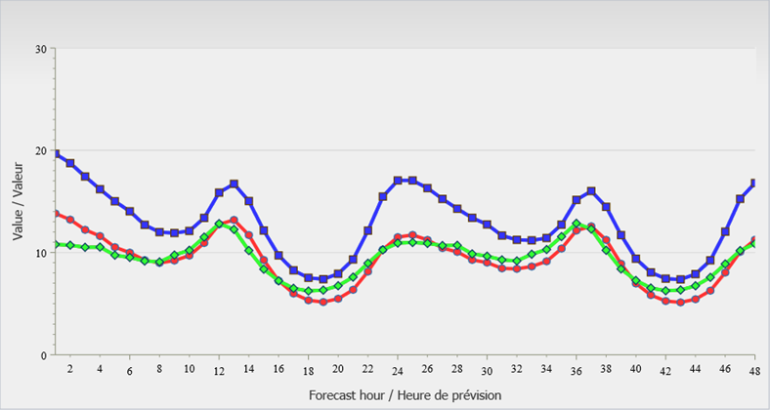
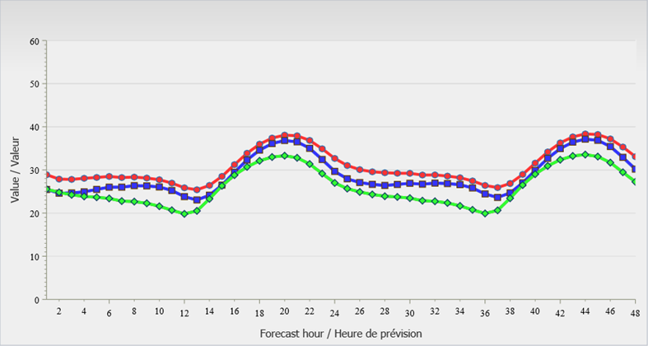
Comparison of 48-hour NO₂ and O₃ Time Series for Eastern U.S.
SUMMER
NO₂
SUMMER
O₃
SET2.1.1
SET3
OBS
WINTER
NO₂
WINTER
O₃

Slide 16
Hourly Objective Scores for NO₂, O₃, and PM_{2.5} by Region
SUMMER
WINTER

Slide 17
Summary
A projected emissions inventory incorporates assumptions about expected socioeconomic changes and impacts from implementation of existing control legislation
Relative to the 2011 U.S. NEI (v1), annual NOx, SO₂, VOC, and CO emissions for a projected 2017 U.S. NEI are lower by 33%, 65%, 11%, and 24%, respectively
Tests have been performed for summer 2016 and winter 2017 in which the 2017 projected NEI replaced the 2011 U.S. NEI (v1) in an operational AQ forecast model
Use of the projected 2017 U.S. inventory resulted in overall improvements to AQ forecasts for 2016 and 2017, including NO₂ and ozone forecasts over the eastern U.S.

Slide 18
Thank you for your attention!

Slide 19
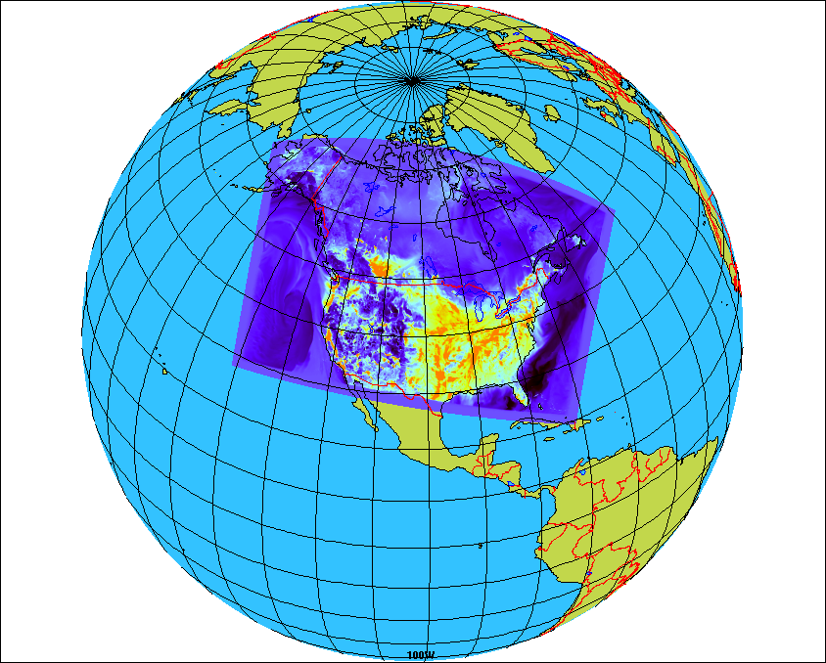
Overview of Regional GEM-MACH
GEM = Global Environmental Multiscale
MACH = Modelling Air quality & CHemistry
GEM-MACH version 1 in operation since 2009; replaced by version 2 in 2016
Regional grid covers much of North America
10 km horizontal grid spacing
80 vertical levels with lid at 0.1 hPa (~10 levels in 1st km above surface)
GEM-MACH is also the FireWork base model
One-way coupling (meteorology affects chemistry) for operational version
Full representation of oxidant and aerosol chemistry processes:
gas-, aqueous- & heterogeneous chemistry mechanisms
aerosol dynamics, microphysics, and SOA formation
dry and wet deposition (including in- and below-cloud scavenging)
2-bin sectional representation of PM size distribution (i.e., 0-2.5 μm and 2.5-10 μm); each size bin has 8 chemical components
Notes:
19
Regional yet more than 37 million sq km

Slide 20
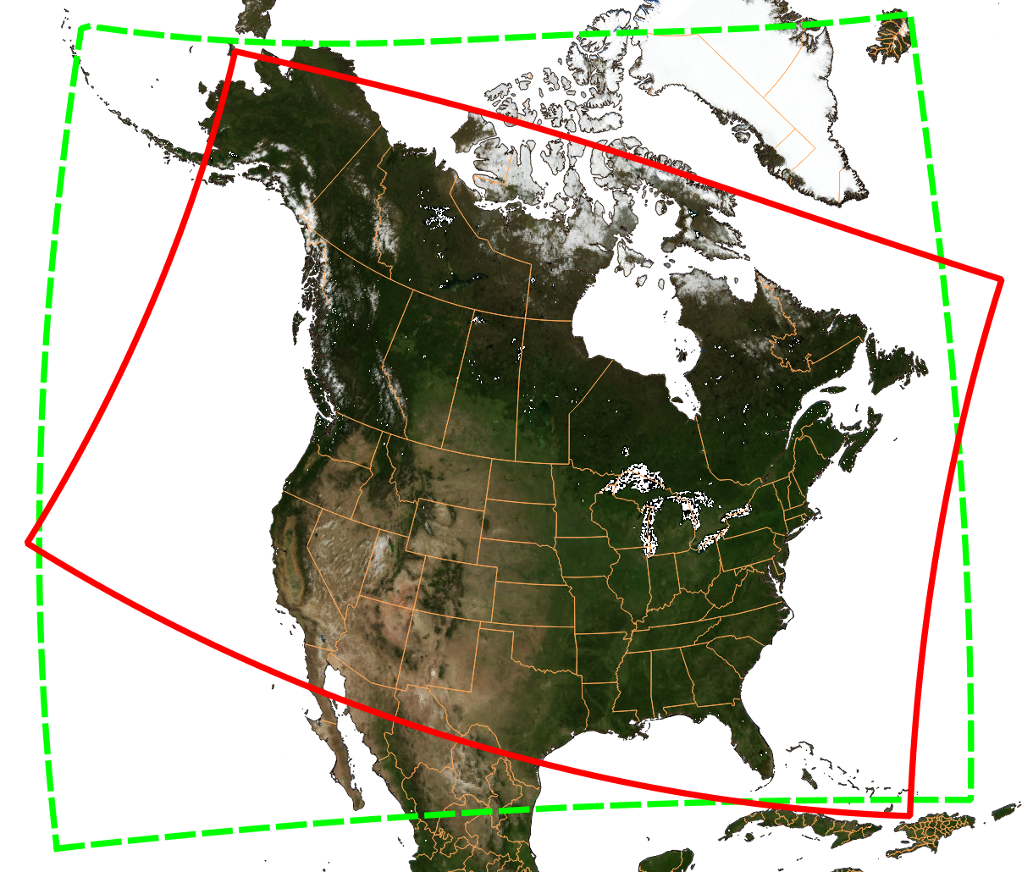
Change in Forecast Domain from GEM-MACHv1 to GEM-MACHv2

