Slide 1
Impact of a Major Update to VOC Emissions Processing on Regional Air Quality Model Predictions
Junhua Zhang, Michael Moran, Paul Makar,
Qiong Zheng, and Verica Savic-Jovcic
Air Quality Research Division, Environment and Climate Change Canada
Toronto, Ontario, Canada
16th CMAS Conference Chapel Hill, North Carolina Oct. 23-25, 2017

Slide 2
Presentation Outline
Motivation and opportunity
Overview of the methodology used to generate VOC speciation profiles for ADOM-II chemical mechanism
Impacts on processed VOC emissions on a North American modeling grid at 10-km resolution
Impacts on AQ predictions of O₃, PM_{2.5}, and NO₂ for a one-month summer simulation
Conclusions

Slide 3
Motivation
ADOM-II gas-phase chemical mechanism is used at ECCC by both operational AQ forecast system and AQ policy platform
Current library of chemical speciation profiles built for ADOM-II mechanism (Makar et al., 2003) are mainly based on VOC (TOG) speciation profiles contained in EPA’s SPECIATE V3.2 database
SPECIATE database has gone through 5 updates since V3.2; the most recent update is V4.5, which was released in Sept. 2016
SPECIATE V3.2 contains 567 speciation profiles and 789 individual chemical species. 1052 new VOC (TOG) profiles and 1069 new chemical species were added to newer versions of the SPECIATE database (v4.0-4.5)
Many of the new profiles are location- and process-specific, such as basin-specific profiles for the U.S. oil and gas industry
Therefore, VOC (TOG) speciation profile library used by ECCC for emissions processing should be updated
Notes:
ADOM: Acid Deposition and Oxidant Model

Slide 4
Opportunity
One major source of AQ modelling system uncertainty is the input emissions, which are impacted by uncertainties in both (a) magnitudes of inventory emissions and (b) emissions processing, including spatial allocation, temporal allocation, and speciation
Comparing model predictions based on emissions processed using both the old ADOM-II VOC profile library and new VOC profile library provides a sensitivity test of opportunity
Notes:
ADOM: Acid Deposition and Oxidant Model

Slide 5
Generation of VOC Speciation Profiles (1)
SPECIATE4.5 1858 detailed chemical species
Equivalent
Expanded 35 (32+3) NAPAP (National
Acid Precipitation Assessment Program) TOG species
13 ADOM-II VOC species
Reactivity
ADOM-II Name | Description
CH4 | Methane
C2H6 | Ethane
C3H8 | Propane and other slowly reacting organics, reacts as propane
ALKA | C4 and greater alkanes
ETHE | Ethene
ALKE | Propene and higher alkenes
TOLU | Monoalkylbenzenes, dominated by toluene
AROM | More reactive aromatics including xylenes, other polyalkyl benzenes and polycyclic aromatics
HCHO | Formaldehyde
ALD2 | C2 and greater aldehydes, reacts as acetaldehyde
MEK | Lumped ketones, largely methyl ethyl ketone
CRES | Lumped cresols
ISOP | Isoprene
OTHE | Other unknown or unreactive species
Notes:
ADOM: Acid Deposition and Oxidant Model

Slide 6
Generation of VOC Speciation Profiles (2)
NAPAP35 NAME | ADOM-II NAME | NAPAP_Mass_Fraction | Reactivity Weights
Methane | CH4 | 1 | 1
Ethane | C2H6 | 1 | 1
Propane | C3H8 | 1 | 1
Alkanes (0.25-0.50) | ALKA | 1 | 0.5447
Alkanes (0.50-1.00) | ALKA | 1 | 0.8496
Alkanes (1.0-2.0) | ALKA | 1 | 1.2482
Alkanes (>2.0) | ALKA | 1 | 1.5079
Alkane/Aromatic Mixture | ALKA | 0.5 | 1.3242
Alkane/Aromatic Mixture | AROM | 0.5 | 0.09
Ethene | ETHE | 1 | 1
Propene | ALKE | 1 | 1
Alkenes (Primary) | ALKE | 1 | 1
Alkenes (Internal) | ALKE | 1 | 1
Alkenes (Primary/Internal Mixture) | ALKE | 1 | 1
Benzene and Halobenzenes | C3H8 | 1 | 1.03
Aromatics (<2) | TOLU | 1 | 1
Aromatics (>2) | AROM | 1 | 1
Phenols and Cresols | CRES | 1 | 1
Styrenes | TOLU | 0.74032 | 1
Styrenes | ALKE | 0.25968 | 1
Formaldehyde | HCHO | 1 | 1
Higher Aldehydes | ALD2 | 1 | 1
Acetone | OTHE | 1 | 1
Higher Ketones | MEK | 1 | 1
Organic Acids | OTHE | 1 | 1
Acetylene | C3H8 | 1 | 0.66
Haloalkenes | OTHE | 1 | 1
Unreactive | OTHE | 1 | 1
Others (<0.25) | C3H8 | 1 | 0.78
Others (0.25-0.50) | ALKA | 1 | 0.6865
Others (0.50-1.00) | ALKA | 1 | 0.9561
Others (>1.00) | ALKA | 1 | 1.3364
Unidentified | OTHE | 1 | 1
Unassigned | OTHE | 1 | 1
Isoprene (anthropogenic) | ISOP | 1 | 1
Alpha-Pinene (anthropogenic) | ALKE | 1 | 1
Other monoterpenes (anthropogenic) | ALKE | 1 | 1

Slide 7
Changes Made for Processing AQ-Model-Ready Emissions (1)
Inventories: 2013 Canadian, projected 2017 U.S., and 2008 Mexican
New VOC speciation cross-reference file based on EPA 2011 V6.3 Platform
2017 U.S. | OLD PROFILES |  |  | NEW PROFILES
 | v3.2 | Legacy (CEPS) | Total | V3.2 | v4.0-v4.5 | Total
CMV | 3 | 0 | 3 | 1 | 1 | 2
nonpoint | 37 | 13 | 50 | 42 | 29 | 71
nonroad | 2 | 0 | 2 | 0 | 3 | 3
np_oilgas | 1 | 1 | 2 | 9 | 18 | 27
offshore | 12 | 1 | 13 | 9 | 2 | 11
pt_oilgas | 72 | 20 | 92 | 70 | 25 | 95
ptegu | 9 | 0 | 9 | 10 | 0 | 10
ptnonipm | 237 | 43 | 280 | 236 | 52 | 288
rail | 1 | 0 | 1 | 0 | 1 | 1
rwc | 2 | 0 | 2 | 1 | 1 | 2
seca | 1 | 0 | 1 | 1 | 0 | 1
on-road | 4 | 0 | 4 | 1 | 3 | 4
TOTAL | 381 | 78 | 459 | 380 | 135 | 515
seca profile:
Old |  |  | New
0001 | External Combustion Boiler - Residual Oil | V3.2 | 2480 | Industrial Cluster, Ship Channel, Downwind Sample - 1993 | V3.2
Notes:
Legacy: legacy profiles from the Canadian Emissions Processing System (CEPS, Moran et al., 1997)

Slide 8
Changes Made for Processing AQ-Model-Ready Emissions (2)
2013 CAN | OLD PROFILES |  |  | NEW PROFILES
 | v3.2 | Legacy (CEPS) | Total | V3.2 | v4.0-v4.5 | Total
point | 23 | 7 | 30 | 27 | 10 | 37
oarea | 24 | 5 | 29 | 19 | 15 | 34
aircraft | 3 | 0 | 3 | 0 | 1 | 1
marine/rail | 3 | 0 | 3 | 1 | 2 | 3
nonroad | 3 | 0 | 3 | 2 | 6 | 8
onroad | 4 | 0 | 4 | 0 | 4 | 4
uog | 7 | 2 | 9 | 6 | 1 | 7
TOTAL | 67 | 14 | 81 | 55 | 39 | 94
2008 MEX | OLD PROFILES |  |  | NEW PROFILES
 | v3.2 | Legacy (CEPS) | Total | V3.2 | v4.0-v4.5 | Total
point | 112 | 19 | 131 | 111 | 14 | 125
area | 16 | 2 | 18 | 12 | 12 | 24
nonroad | 3 | 0 | 3 | 1 | 2 | 3
onroad | 1 | 0 | 1 | 0 | 3 | 3
TOTAL | 132 | 21 | 153 | 124 | 31 | 155

Slide 9
Impact on VOC Emissions Prepared for a North American Continental Grid
Change of domain-total VOC emissions for the ADOM-II mechanism
SPECIES | OLD | NEW | Change | MW | K_{OH}(298k) | Old*K_{OH} | New*K_{OH} | Change
 | t/month | t/month | Mass (%) |  | Mol⁻¹cm⁻³s⁻¹ | cm⁻³ s⁻¹ | cm⁻³ s⁻¹ | Reac (%)
ALKA | 658,312 | 614,937 | -7% | 93.43 | 4.56E-12 | 1.93E+22 | 1.81E+22 | -7%
TOLU | 99,597 | 67,334 | -32% | 92.13 | 6.19E-12 | 4.03E+21 | 2.72E+21 | -32%
AROM | 91,303 | 75,325 | -17% | 117.97 | 3.94E-12 | 1.84E+21 | 1.51E+21 | -17%
EC38 | 78,760 | 147,902 | 88% | 44.09 | 1.18E-12 | 1.27E+21 | 2.38E+21 | 88%
ALKE | 71,786 | 67,262 | -6% | 57.03 | 3.88E-11 | 2.94E+22 | 2.75E+22 | -6%
ETHE | 24,347 | 25,316 | 4% | 28.05 | 8.54E-12 | 4.46E+21 | 4.64E+21 | 4%
HCHO | 23,473 | 12,543 | -47% | 30.03 | 1.11E-11 | 5.22E+21 | 2.79E+21 | -47%
ALD2 | 14,363 | 11,662 | -19% | 44.05 | 1.59E-11 | 3.12E+21 | 2.53E+21 | -19%
MEK | 11,992 | 9,151 | -24% | 72.1 | 9.85E-13 | 9.86E+19 | 7.53E+19 | -24%
CRES | 10,619 | 3,118 | -71% | 108.13 | 4.00E-11 | 2.36E+21 | 6.94E+20 | -71%
ISOP | 1,347 | 336 | -75% | 68.11 | 8.03E-11 | 9.56E+20 | 2.38E+20 | -75%
TOTAL | 1.09E+6 | 1.03E+6 | -5% |  |  | 7.21E+22 | 6.32E+22 | -12%

Slide 10
Comparisons of Spatial Distribution
of Selected VOC Emissions
over the Continental Grid

Slide 11
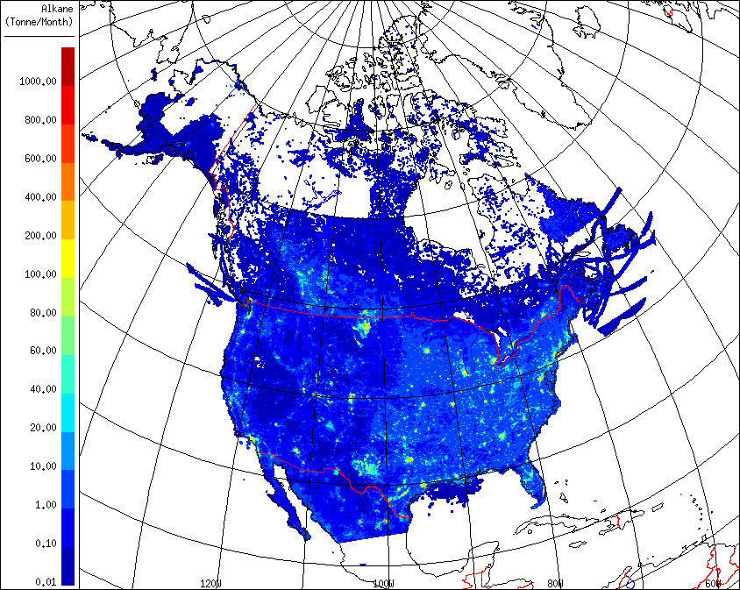
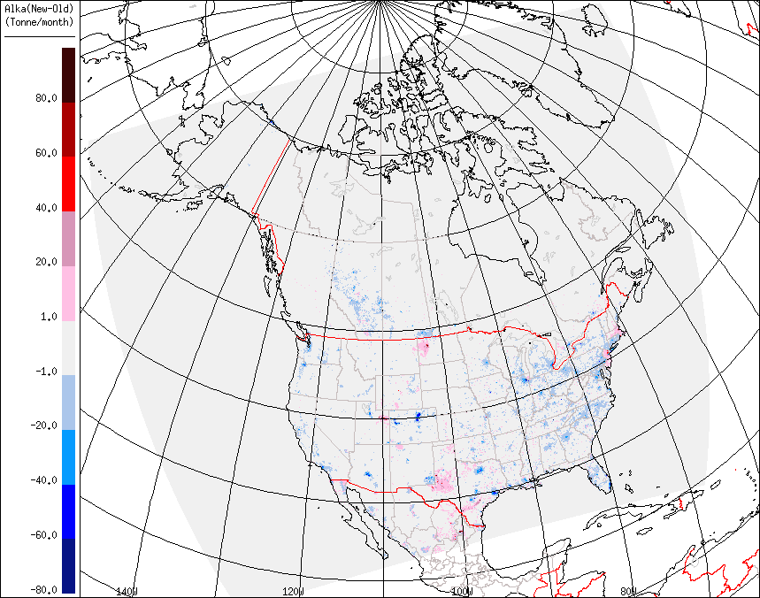
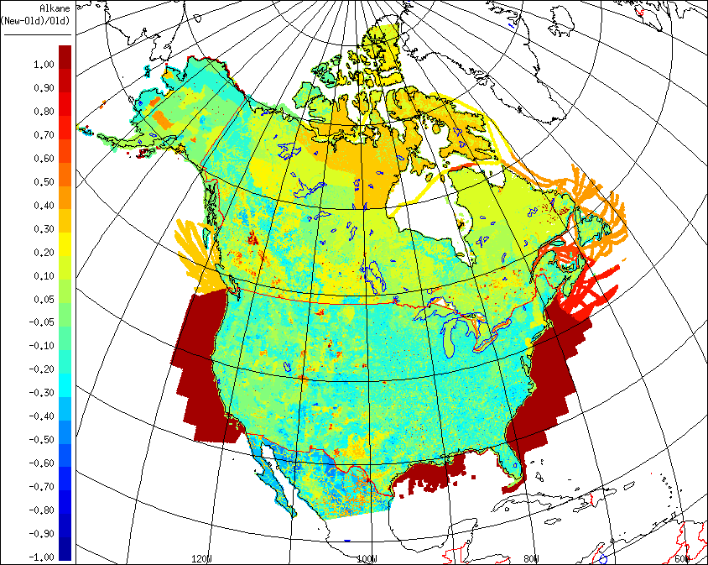
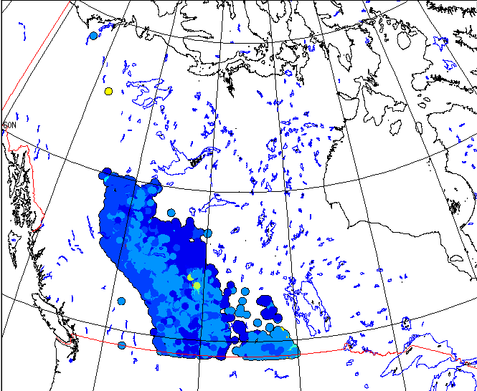
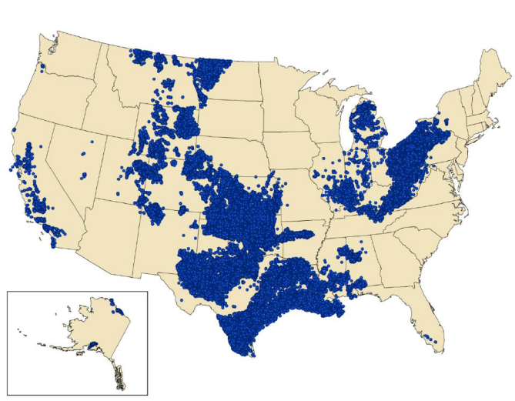
Higher Alkanes: Base Case
Higher Alkanes: New - Base
Higher Alkanes: Relative Change
Canadian oil and gas well locations
Figure 2-4. 2012 active oil and gas well locations developed by ERG, Inc.
Adelman, Z., Emissions Modeling Platform Spatial Surrogate Documentation, prepared for EPA, 2015

Slide 12
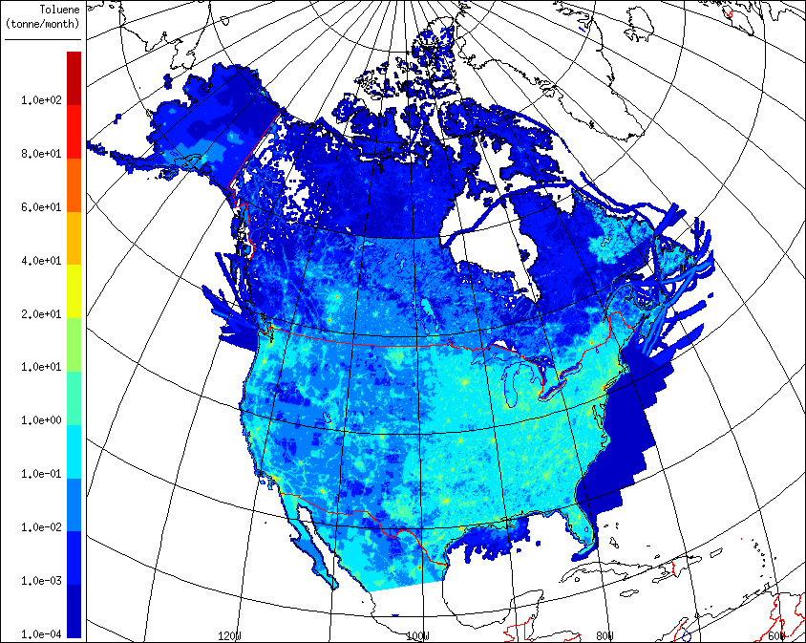
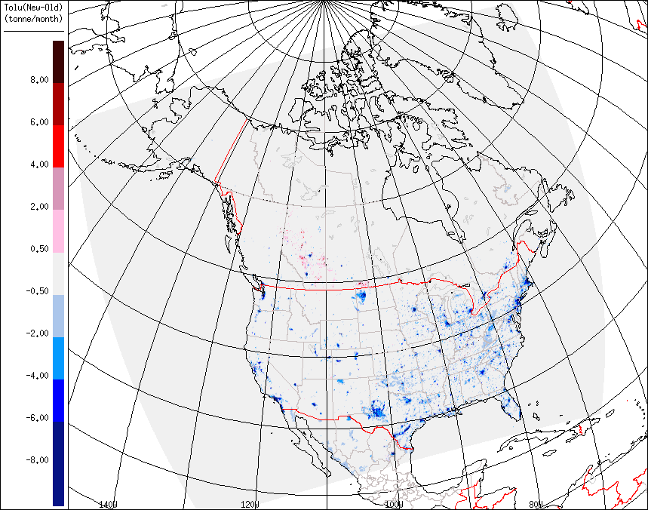
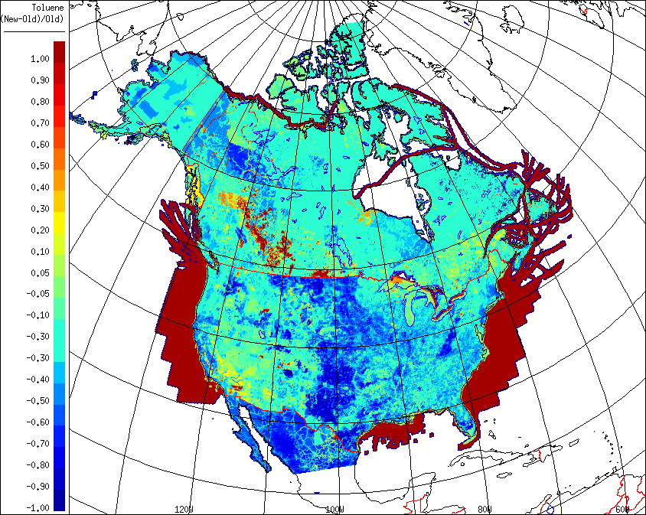
Toluene: Base Case
Toluene: New - Base
Toluene: Relative Change
Canadian oil and gas well locations
Figure 2-4. 2012 active oil and gas well locations developed by ERG, Inc.
Adelman, Z., Emissions Modeling Platform Spatial Surrogate Documentation, prepared for EPA, 2015

Slide 13
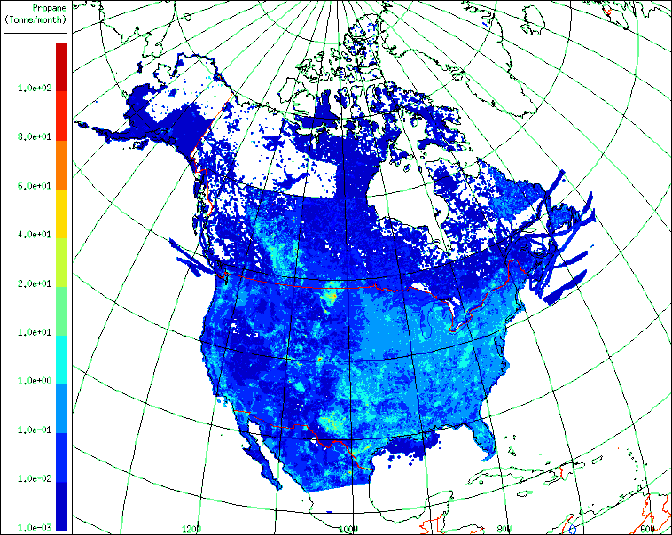
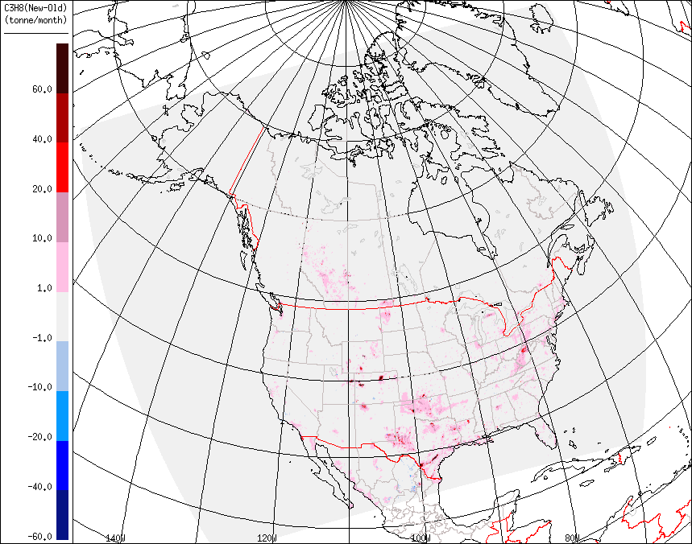
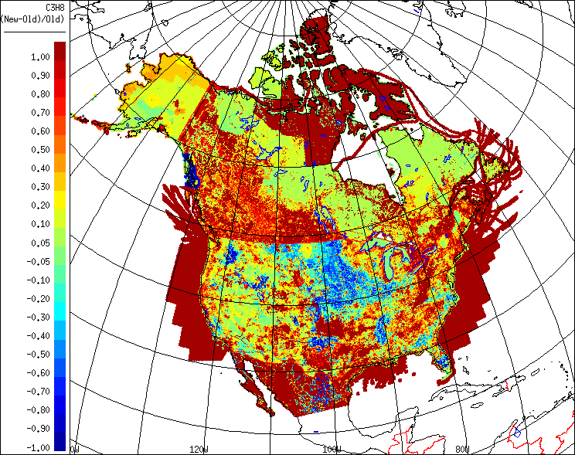
C₃H₈: Base Case
C₃H₈ : New - Base
C₃H₈: Relative Change
Canadian oil and gas well locations
Figure 2-4. 2012 active oil and gas well locations developed by ERG, Inc.
Adelman, Z., Emissions Modeling Platform Spatial Surrogate Documentation, prepared for EPA, 2015

Slide 14
Impacts on AQ Model (GEM-MACH) Predictions of Gas and Particle Species
4-Week Summer Simulation for July 2016

Slide 15
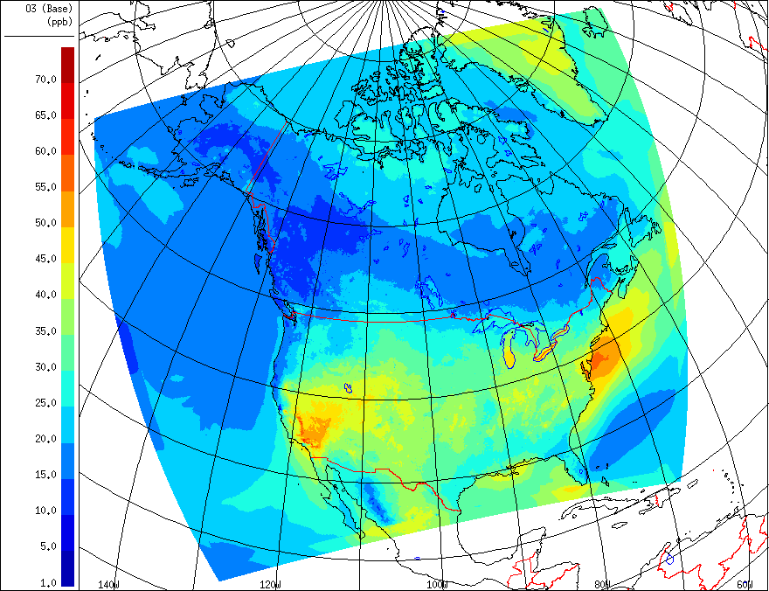
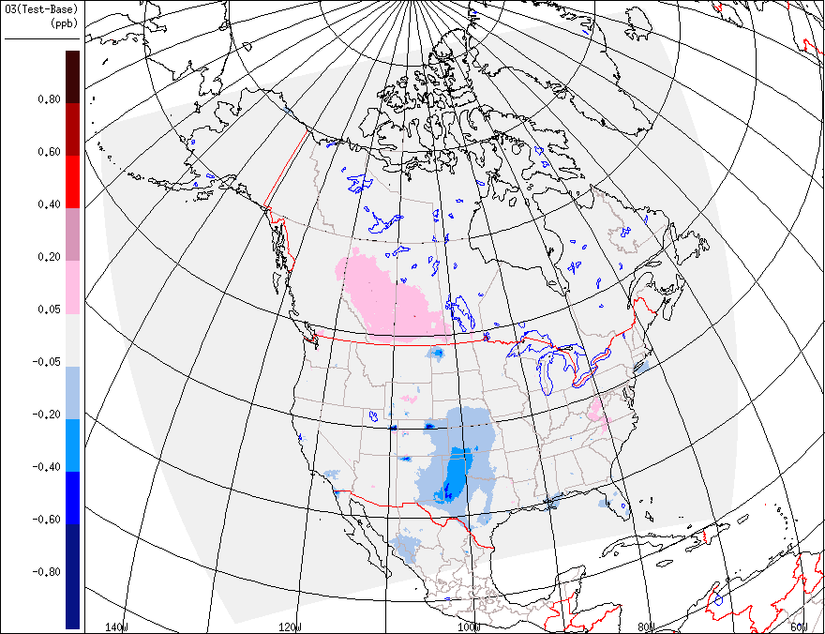
Ozone: Differences of Hourly Average Concentration
O₃ July Hourly Average - BASE
O3 Difference: TEST-BASE
Significant impact of O₃ concentration locally, mainly over oil & gas fields
Impact on O₃ predictions is also seen for some large urban areas, but the impact is relatively small

Slide 16
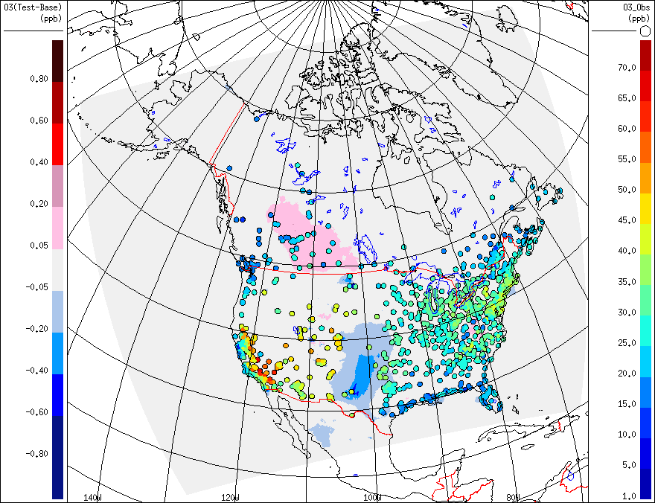
Ozone: Domain-Wide Statistics
O3 Difference: TEST-BASE
O3 Difference: TEST-BASE (with Obs)
Comparison of Statistics:
 | N | FAC2 | MB | MGE | NMB | NMGE | RMSE | R
Base Case | 798639 | 0.8259 | 2.4494 | 10.0719 | 0.0798 | 0.3283 | 13.3528 | 0.73249
Test Case | 798639 | 0.8261 | 2.4369 | 10.0625 | 0.0794 | 0.3280 | 13.3392 | 0.73252

Slide 17
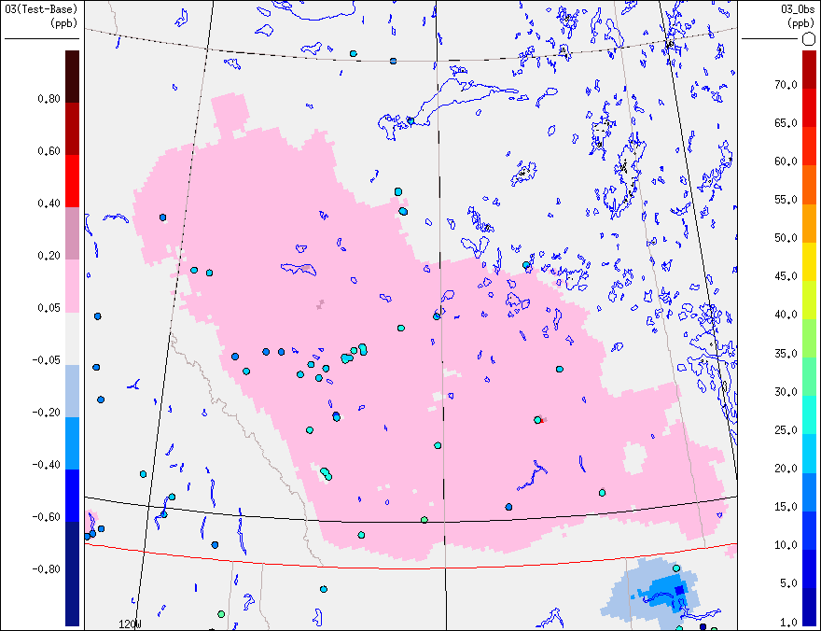
Ozone: Western Canada Oil and Gas Region
O3 Difference: TEST-BASE
Comparison of Statistics :
 | N | FAC2 | MB | MGE | NMB | NMGE | RMSE | R
Base Case | 27061 | 0.7006 | -4.9448 | 8.8664 | -0.2129 | 0.3817 | 11.1980 | 0.6431
Test Case | 27061 | 0.7021 | -4.8489 | 8.8487 | -0.2088 | 0.3810 | 11.1839 | 0.6434

Slide 18
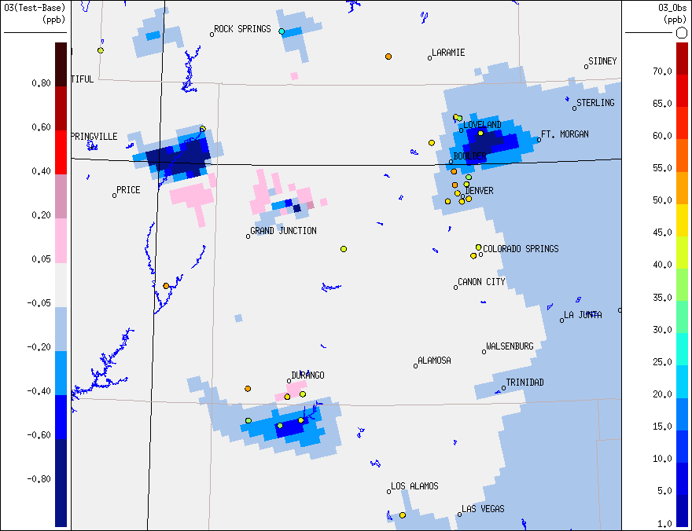
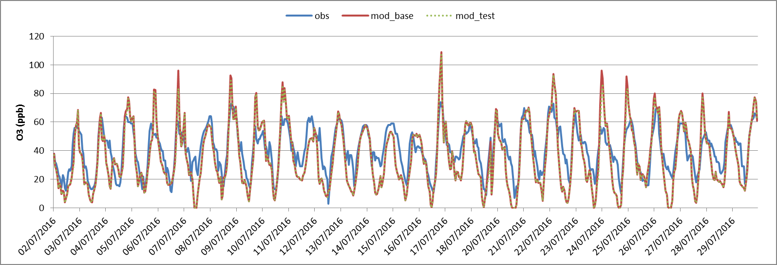
Ozone: U.S. Uinta, Denver, & San Juan Basins
O3 Difference: TEST-BASE
More than 10 ppbv improvement for O₃ bias is seen for some hours at one station in Denver Basin

Slide 19
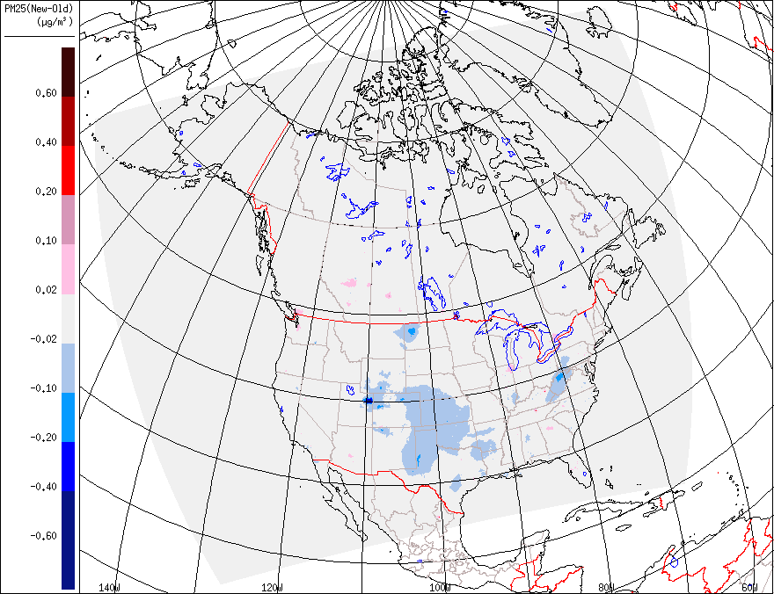
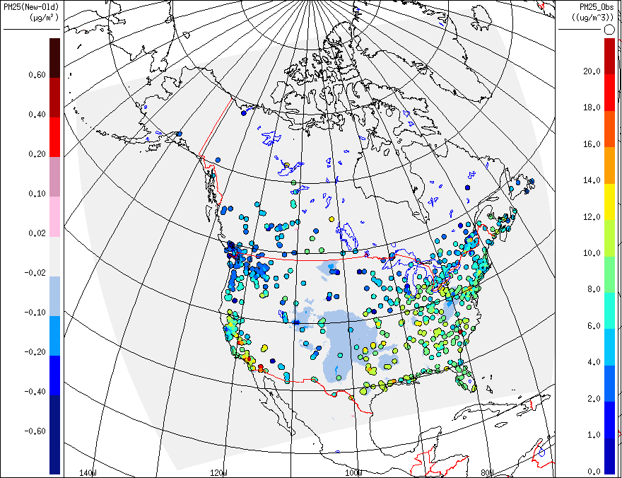
PM_{2.5}: Domain-Wide Statistics
PM_{2.5} Difference: TEST-BASE
PM_{2.5} Difference: TEST-BASE (with Obs)
Comparison of Statistics:
 | N | FAC2 | MB | MGE | NMB | NMGE | RMSE | R
Base Case | 491034 | 0.4210 | -2.8988 | 4.6674 | -0.3997 | 0.6436 | 7.1392 | 0.2530
Test Case | 491034 | 0.4207 | -2.8961 | 4.6709 | -0.3994 | 0.6441 | 7.1431 | 0.2523

Slide 20
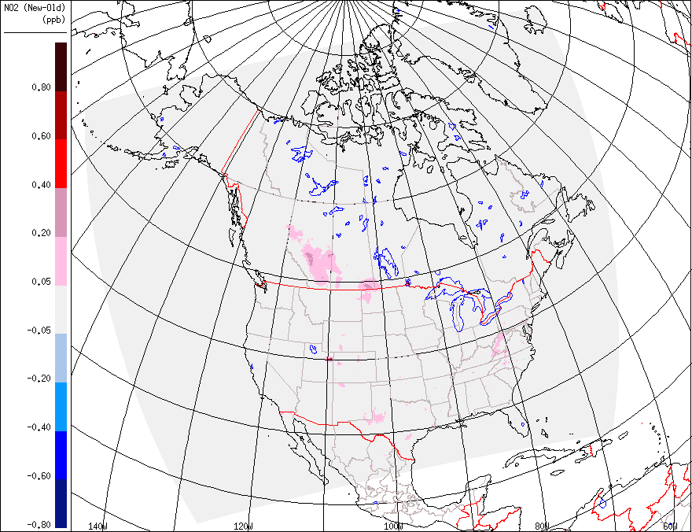
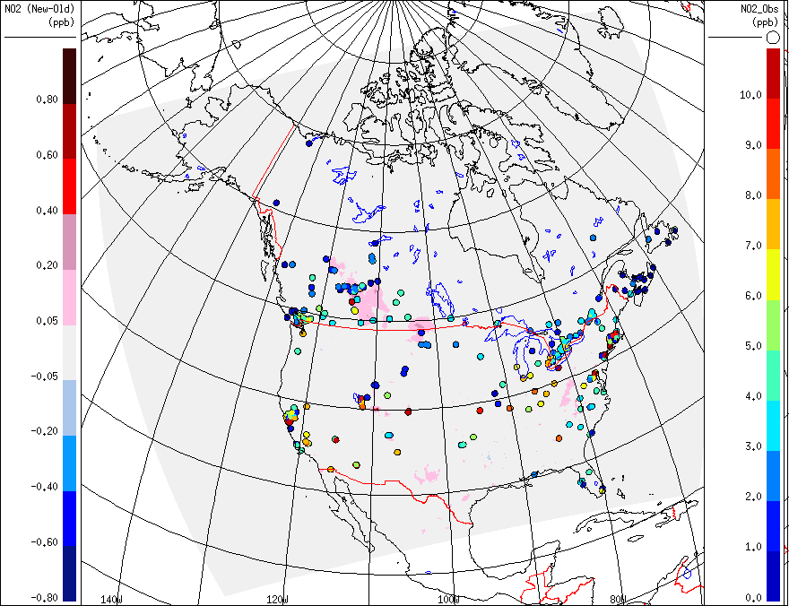
NO₂: Domain-Wide Statistics
NO₂ Difference: TEST-BASE
NO₂ Difference: TEST-BASE (with Obs)
Comparison of Statistics:
 | N | FAC2 | MB | MGE | NMB | NMGE | RMSE | R
Base Case | 183436 | 0.4481 | 2.1840 | 4.2567 | 0.4836 | 0.9427 | 7.3452 | 0.5675
Test Case | 183436 | 0.4475 | 2.2035 | 4.2713 | 0.4880 | 0.9459 | 7.3728 | 0.5667

Slide 21
Conclusions
Use of an updated VOC profile library changed speciated VOC emissions by 5 to 10%
Oil and gas industry (38% and 27% of national total VOC emissions for Canada and U.S., respectively) is affected the most, while changes over large cities are also seen
Changes to model VOC emissions can have a significant impact on predicted O₃, PM_{2.5}, and NO₂ concentrations locally, particularly over some oil and gas basins
Impact on AQ predictions for large cities is relatively small
Small impact was seen for comparisons with observations over the whole domain. However, impact on some stations can be significant, particularly for O₃ predictions

Slide 22
THANK YOU!
QUESTIONS?

Slide 23
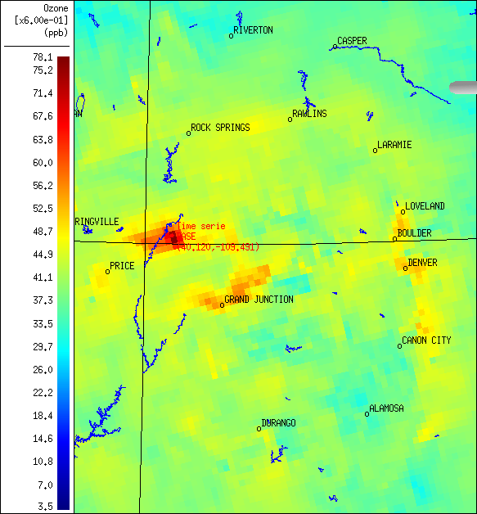
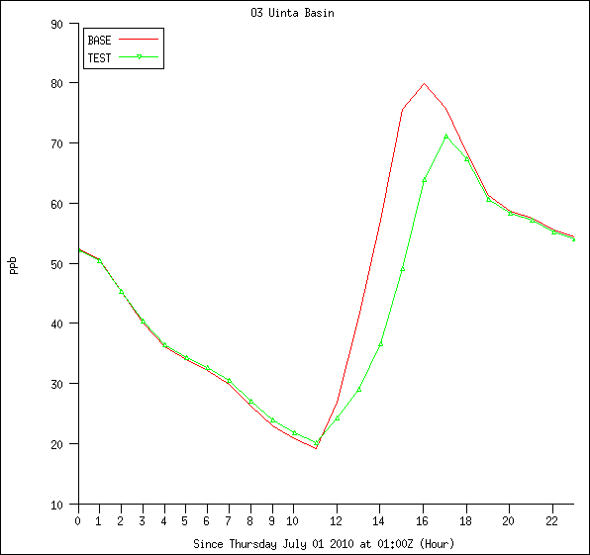
O₃ Time Series over a Grid Cell in Uinta Basin, Utah

Slide 24
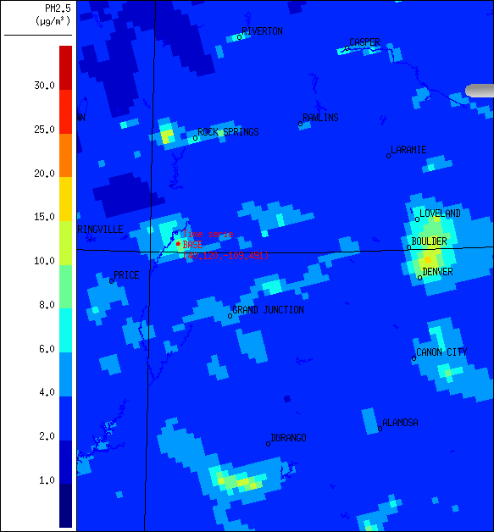
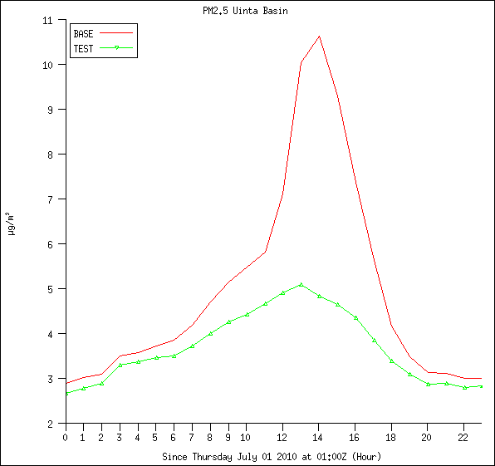
PM_{2.5} Time Series over a Grid Cell in Uinta Basin, Utah

