Slide 1
Modeling Ozone in the Eastern U.S. using a Fuel-Based Mobile Source Emissions Inventory
Brian McDonald^{1,2}, Stuart McKeen^{1,2}, Yuyan Cui^{1,2}, Ravan Ahmadov^{1,3}, Si-Wan Kim^{1,2}, Gregory Frost², Ilana Pollack^{1,2}, Thomas Ryerson^{1,2}, John Holloway^{1,2}, Martin Graus^{1,2}, Carsten Warneke^{1,2}, Joost de Gouw^{1,2}, Jennifer Kaiser⁴, Frank Keutsch⁴, Thomas Hanisco⁵, Glenn Wolfe^{5,6}, Michael Trainer²
CIRES, Univ. of Colorado, Boulder, CO
Chemical Sciences Division, NOAA ESRL, Boulder, CO
Global Sciences Division, NOAA ESRL, Boulder, CO
Dept. of Chemistry, Univ. of Wisconsin, Madison, WI
Atmospheric Chemistry and Dynamics Laboratory, NASA Goddard, Greenbelt, MD
Joint Center for Earth Systems Technology, Univ. of Maryland-Baltimore, Baltimore, MD
Acknowledgments: NASA ROSES ACMAP and NOAA’s High Performance Computing Program.
2017 CMAS Conference

Slide 2
Recent Studies Suggest Overestimate in NEI 2011 NO_{x} Emissions
Year | Region | Measurement | Findings
2011 | Baltimore/DC | Aircraft (DISCOVER-AQ) | Mobile sources overestimated by 50-70% [Anderson et al., Atmos. Environ. 2014]

Slide 3
Recent Studies Suggest Overestimate in NEI 2011 NO_{x} Emissions
Year | Region | Measurement | Findings
2011 | Baltimore/DC | Aircraft (DISCOVER-AQ) | Mobile sources overestimated by 50-70% [Anderson et al., Atmos. Environ. 2014]
2013 | Southeast | Aircraft (SEAC⁴RS) | Reduce mobile and industrial sources by 30-60% [Travis et al., Atmos. Chem. Phys. 2016]

Slide 4
Recent Studies Suggest Overestimate in NEI 2011 NO_{x} Emissions
Year | Region | Measurement | Findings
2011 | Baltimore/DC | Aircraft (DISCOVER-AQ) | Mobile sources overestimated by 50-70% [Anderson et al., Atmos. Environ. 2014]
2013 | Southeast | Aircraft (SEAC⁴RS) | Reduce mobile and industrial sources by 30-60% [Travis et al., Atmos. Chem. Phys. 2016]
2013 | Urban Texas | Satellite Inversion | Reduce mobile, area, point sources by 30-60% [Souri et al., Atmos. Env. 2016]

Slide 5
Recent Studies Suggest Overestimate in NEI 2011 NO_{x} Emissions
Year | Region | Measurement | Findings
2011 | Baltimore/DC | Aircraft (DISCOVER-AQ) | Mobile sources overestimated by 50-70% [Anderson et al., Atmos. Environ. 2014]
2013 | Southeast | Aircraft (SEAC⁴RS) | Reduce mobile and industrial sources by 30-60% [Travis et al., Atmos. Chem. Phys. 2016]
2013 | Urban Texas | Satellite Inversion | Reduce mobile, area, point sources by 30-60% [Souri et al., Atmos. Env. 2016]
2013 | Southeast | Aircraft (SEAC⁴RS) | Reduce total anthropogenic emissions by 14% [Li et al., Atmos. Chem. Phys. Disc. 2017]

Slide 6
Research Objectives
Assess “Bottom-Up” Mobile Source Emissions
Focus on NO_{x}, but CO and VOCs can also be assessed
Construct fuel-based inventory and compare with EPA MOVES2014
Perform “Top-Down” Model Evaluation
Evaluate emissions with aircraft- and ground-based measurements during Southeast Nexus (SENEX) Study in 2013
(3) Test sensitivity of ground-level O₃ to mobile source NO_{x} and biogenic VOC emissions

Slide 7
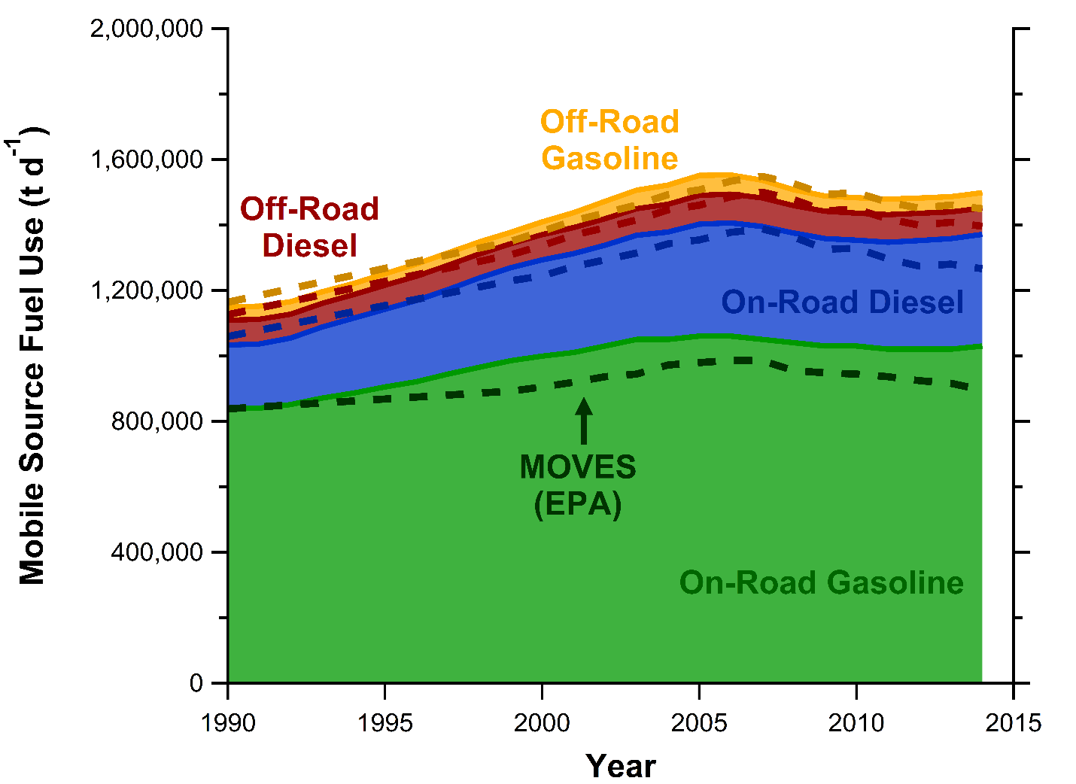
Trends in U.S. Mobile Source Activity (Fuel Use)
Emissions = Activity (kg fuel) x Emission Factor (g/kg fuel)
Fuel estimates based on
FHWA and EIA surveys
Similar to fuel use
reported in MOVES2014
Fuel Use (t/d)
Year

Slide 8
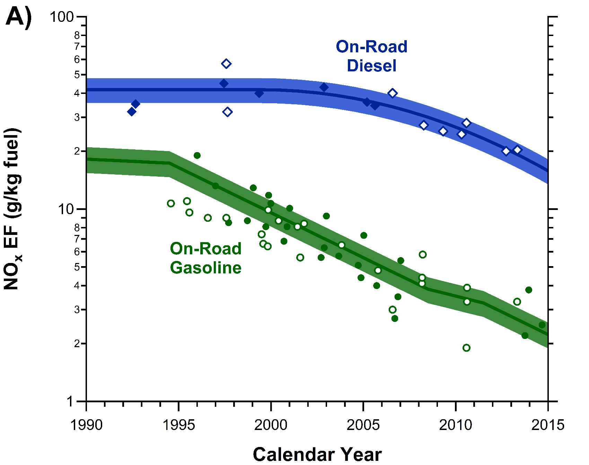
Long-Term Trends in On-Road NO_{x} Emission Factors
Emissions = Activity (kg fuel) x Emission Factor (g/kg fuel)
NO_{x} EF (g/kg fuel)
Year

Slide 9
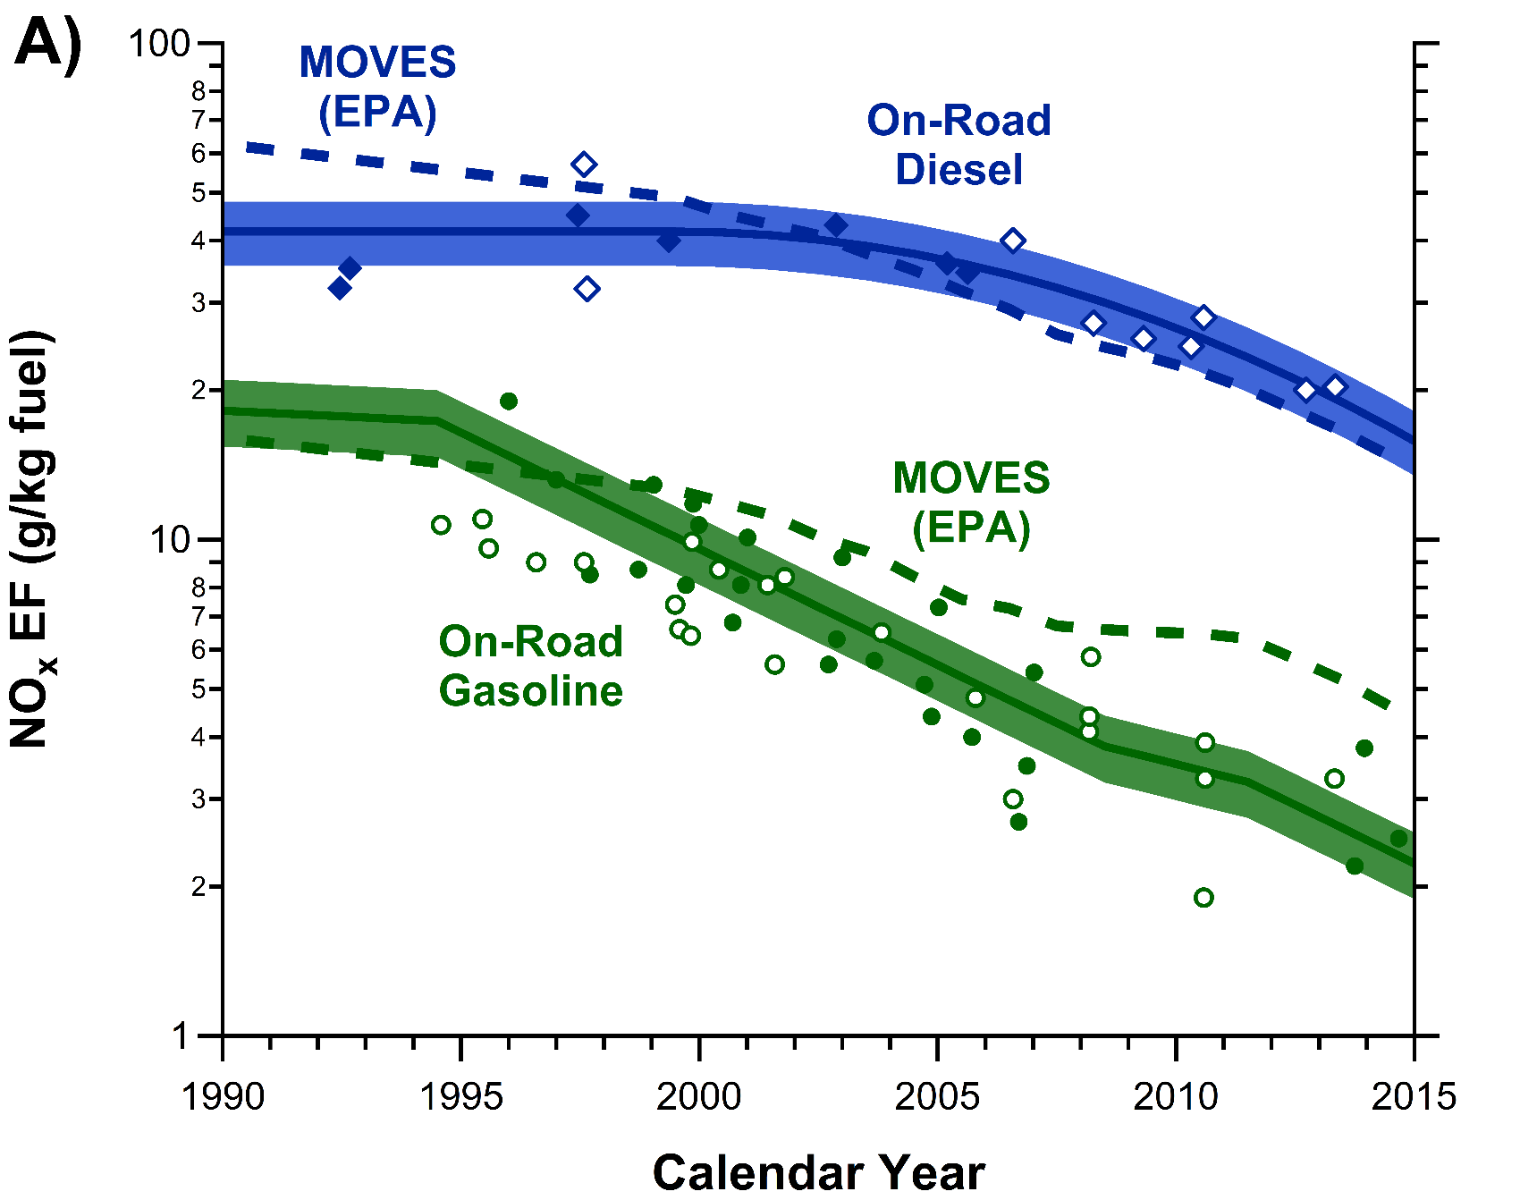
Long-Term Trends in On-Road NO_{x} Emission Factors
Emissions = Activity (kg fuel) x Emission Factor (g/kg fuel)
Diesel EF
within ~20%
NO_{x} EF (g/kg fuel)
Gasoline EF high
by factor of ~2
MOVES EF are default values
Year

Slide 10
NO_{x} Emissions by Mobile Source Category (FIVE vs. MOVES)
Consistent with literature
Anderson et al., Atmos. Env. 2014 Travis et al., Atmos. Chem. Phys. 2016

Slide 11
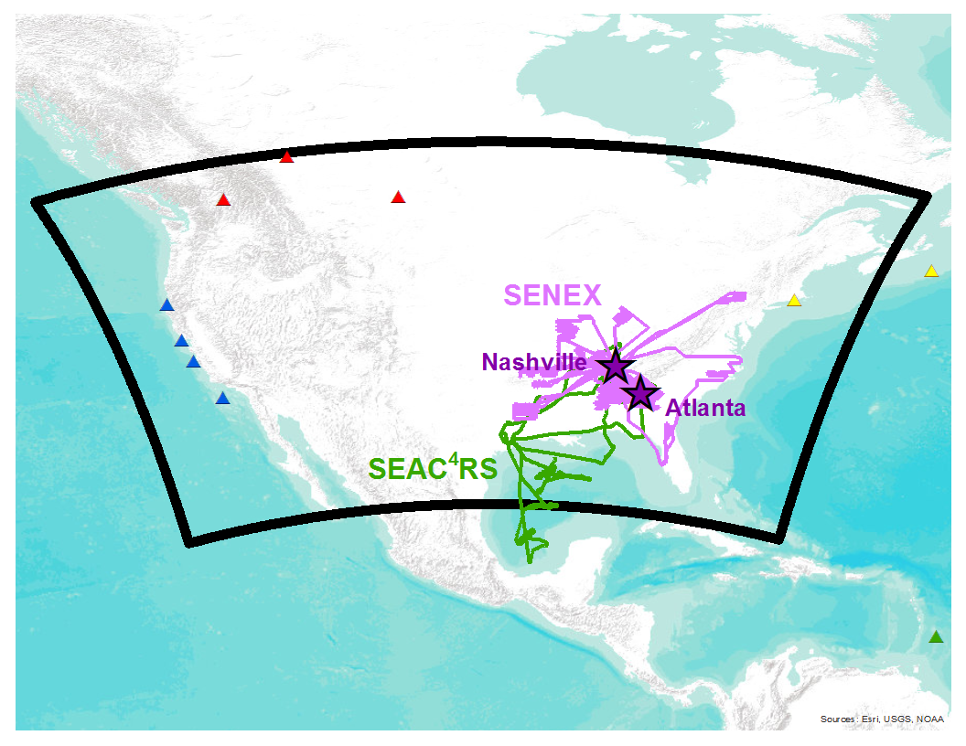
WRF-Chem Modeling for Southeast Nexus (SENEX) Study
Model run from 6/1 – 7/15 in 2013
WRF-Chem Model v3.7
12 km x 12 km
61 vertical layers
ECMWF-Era-Interim
RACM_ESRL Chemistry
Static Chemical B.C.
Emission Cases:
NEI11 + 1 * BEIS ISO
NEI11 + 2 * BEIS ISO
FIVE13 + 1 * BEIS ISO
FIVE13 + 2 * BEIS ISO

Slide 12
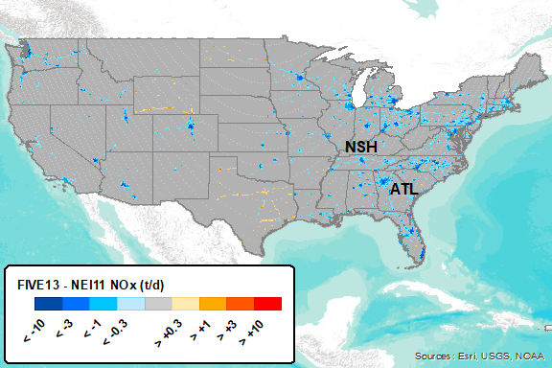
Revise Mobile Source Emissions Only (NEI11 → FIVE13)
Total U.S. NO_{x} emissions decreases by ~15%

Slide 13
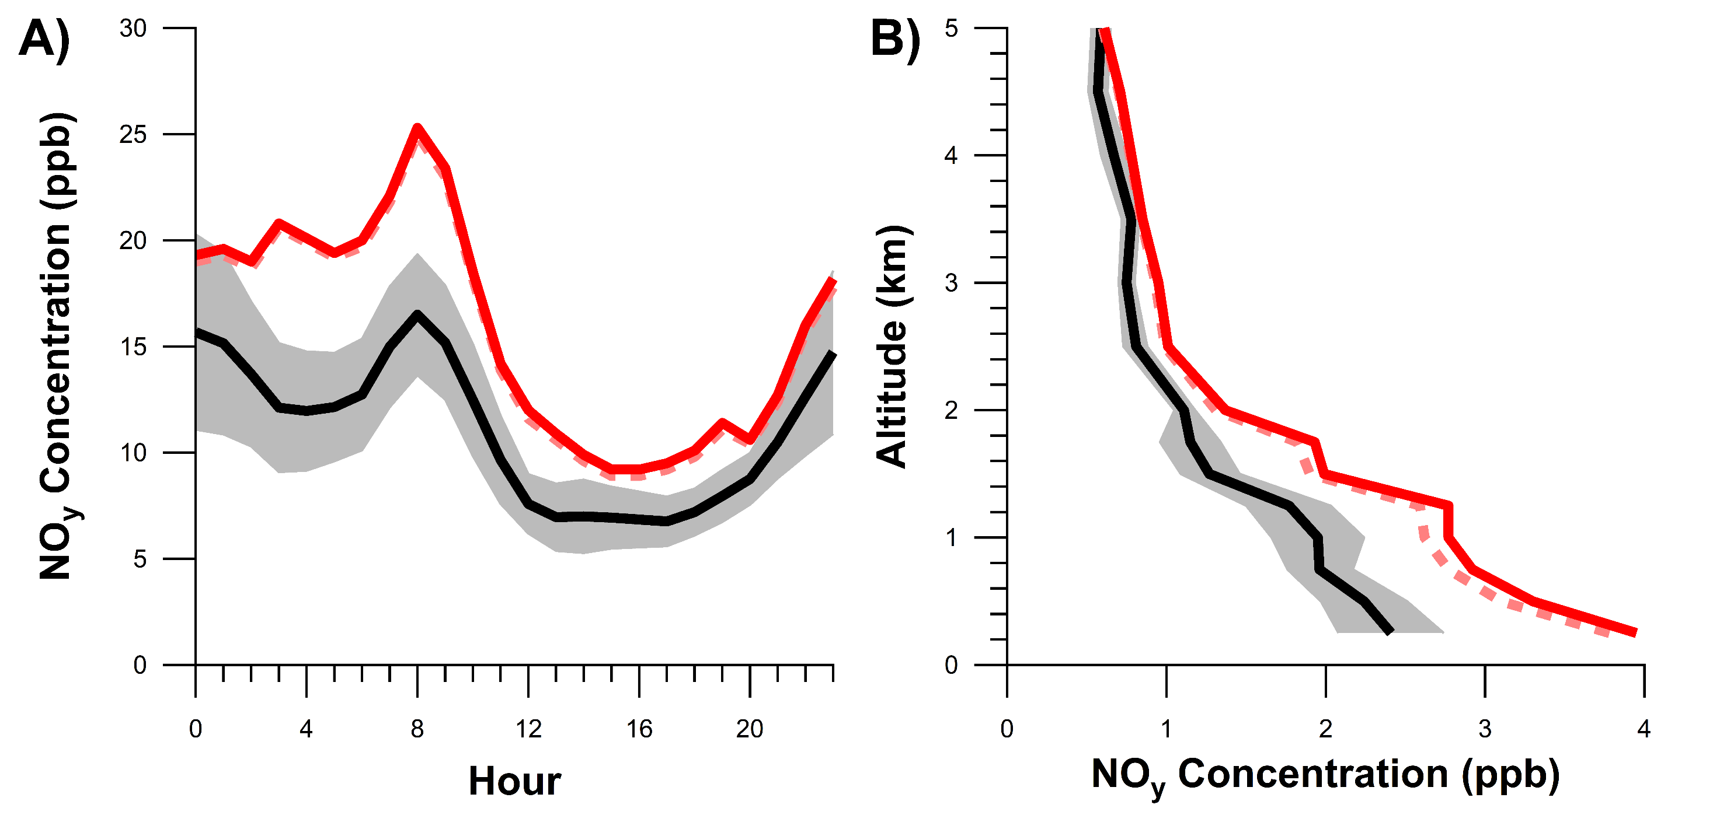
Model Evaluation of NO_{x} Emissions in Urban Plumes
Atlanta (SEARCH site)
Nashville (P-3 aircraft)
NEI11
Obs
NEI11
Obs

Slide 14
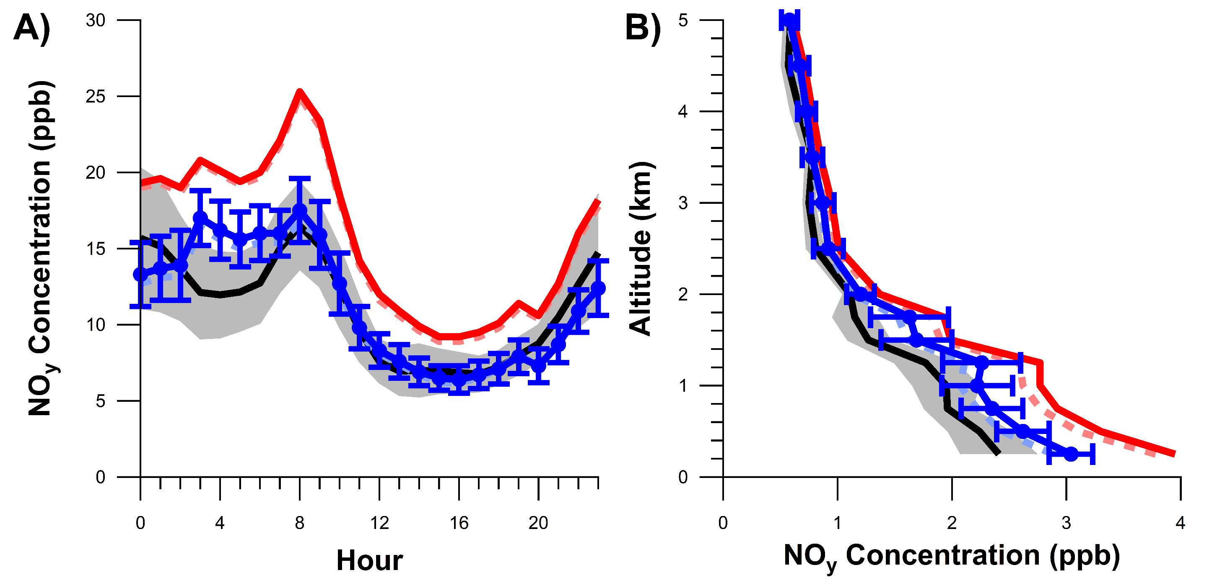
Model Evaluation of NO_{x} Emissions in Urban Plumes
Atlanta (SEARCH site)
Nashville (P-3 aircraft)
NEI11
FIVE13
Obs
NEI11
Obs
FIVE13

Slide 15
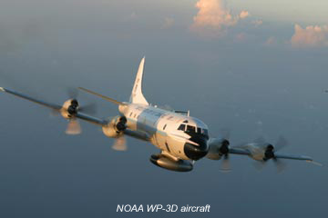
Model Evaluation of NO_{y} and O₃ across Southeastern U.S.
Emissions Case | NO_{y} (ppb) | O₃ (ppb)
P-3 Obs. NEI11 + 1 * BEIS ISO NEI11 + 2 * BEIS ISO FIVE13 + 1 * BEIS ISO FIVE13 + 2 * BEIS ISO | 2.1 2.9 (+43%) 2.8 (+34%) 2.5 (+21%) 2.3 (+13%) | 47 56 (+9) 54 (+7) 53 (+6) 50 (+3)
Emissions Case | NO_{y} (ppb) | O₃ (ppb)
P-3 Obs. | 2.1 | 47
Emissions Case | NO_{y} (ppb) | O₃ (ppb)
P-3 Obs. NEI11 + 1 * BEIS ISO NEI11 + 2 * BEIS ISO | 2.1 2.9 (+43%) 2.8 (+34%) | 47 56 (+9) 54 (+7)

Slide 16
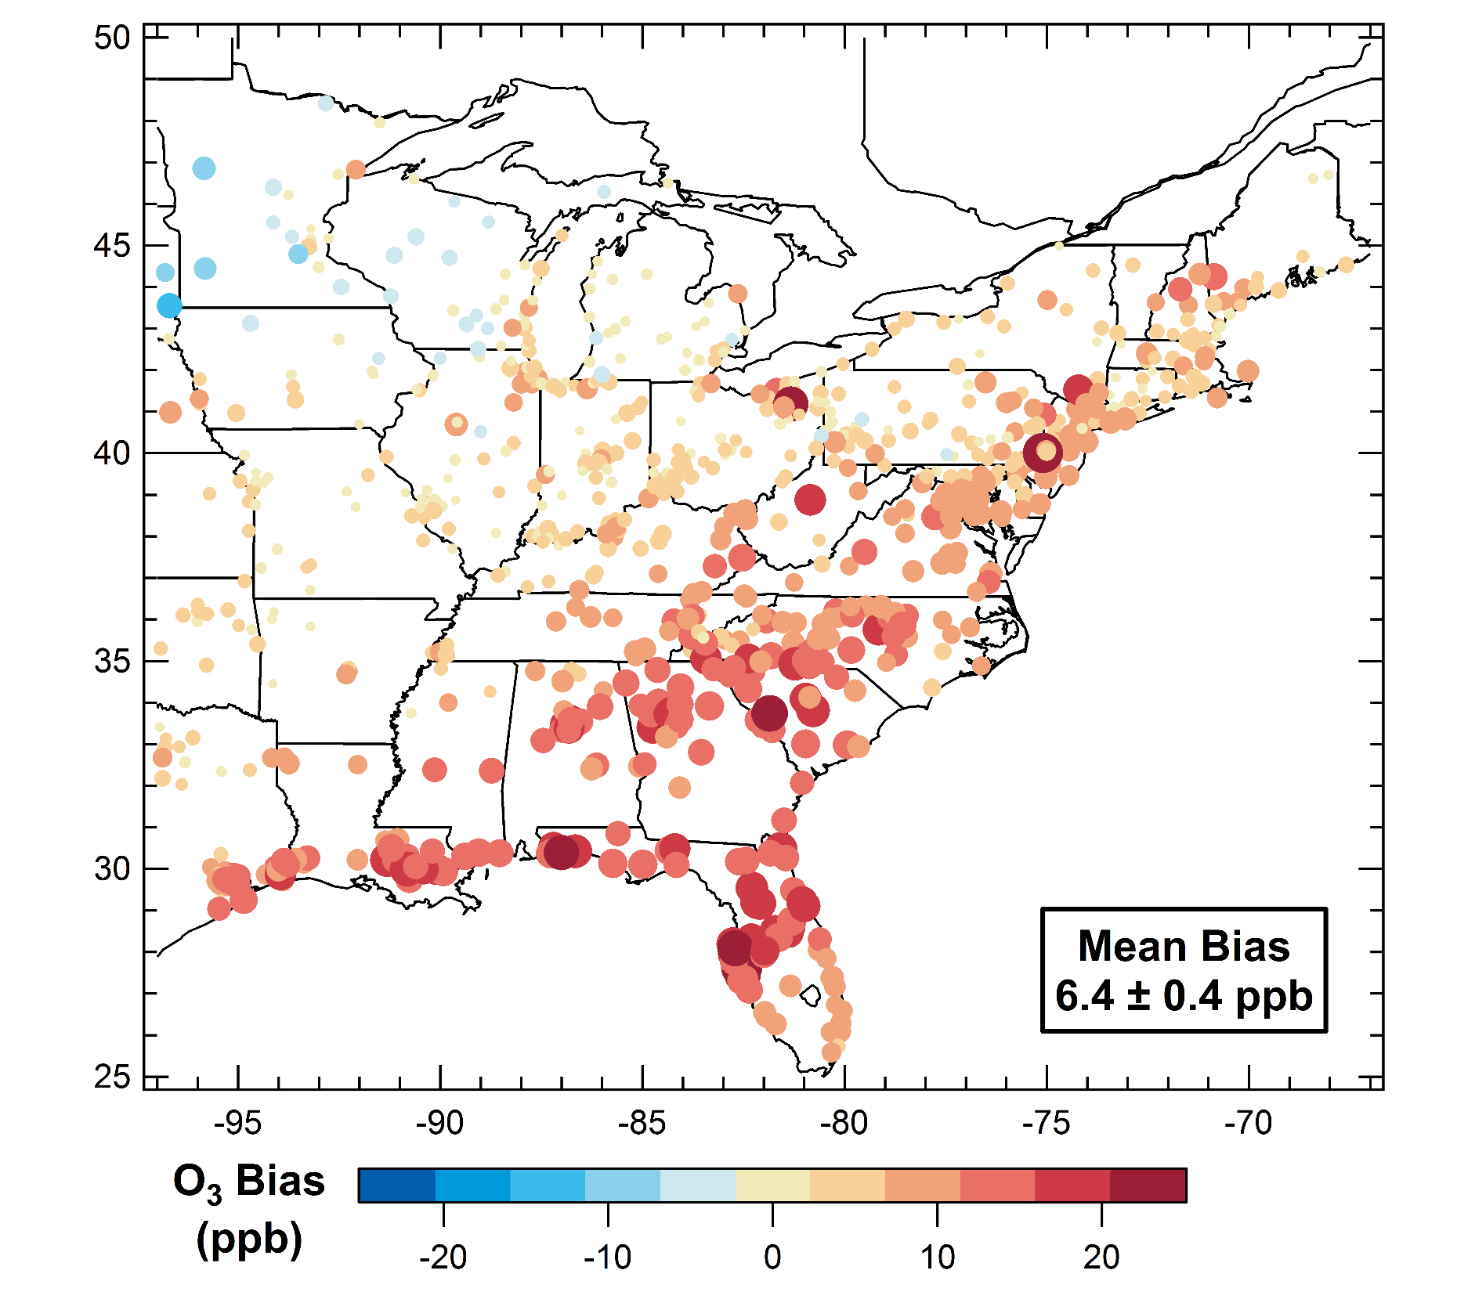
Evaluation of Model O₃ with AQ Monitoring Sites (NEI 2011)
Model bias =
1220 days
Bias in summer 2013 mean daily 8-h maximum
modeled with NEI 2011 vs. AQS data

Slide 17
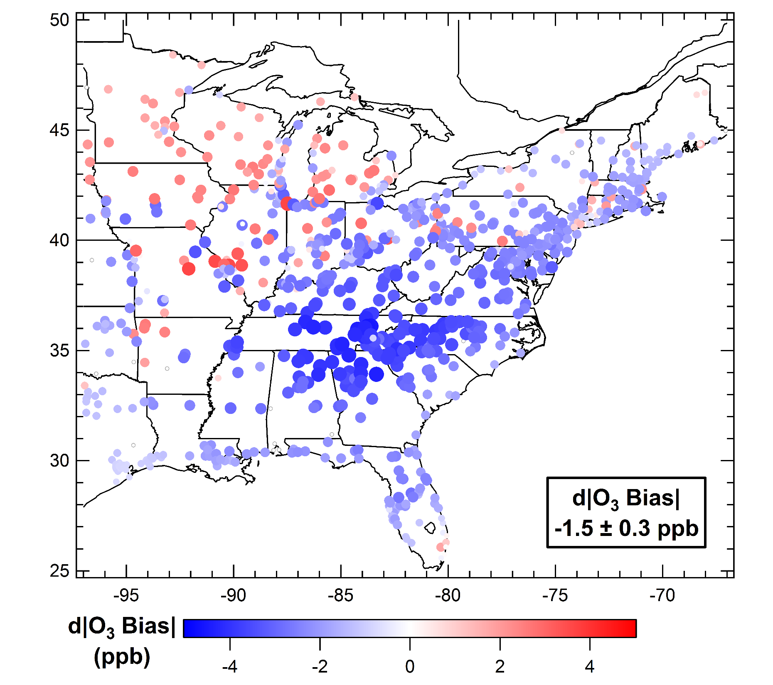
Improvement in Model O₃ when Reducing Mobile Source NO_{x}
Model bias =
1220 days
Bias in summer 2013 mean daily 8-h maximum
modeled with NEI 2011 vs. AQS data
← FIVE is better
FIVE is worse →

Slide 18
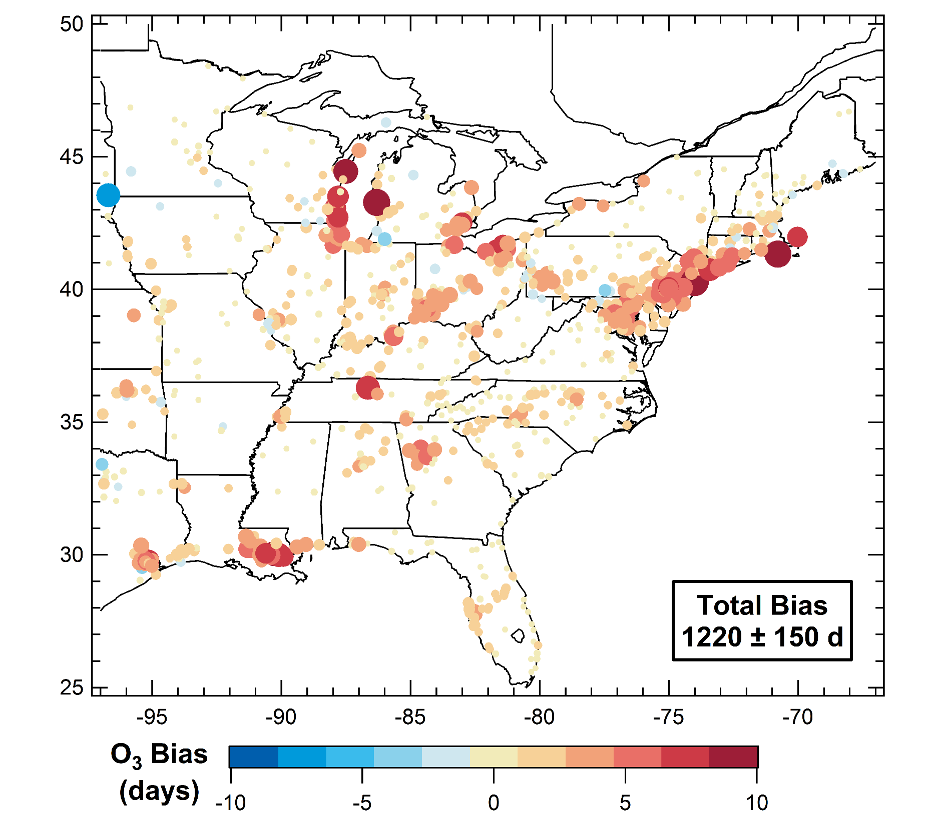
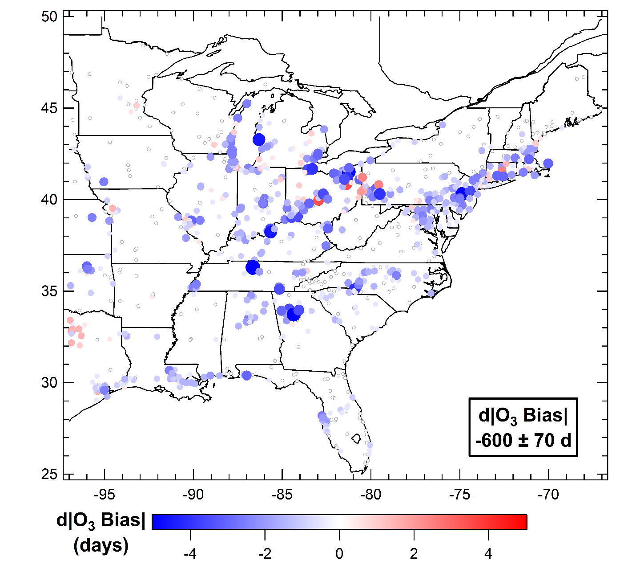
Evaluation of Model on High Ozone Days (>70 ppb)
Bias in summer 2013 O₃ exceedance days
(>70 ppb) modeled with NEI 2011 vs. AQS data
← FIVE is better
FIVE is worse →

Slide 19
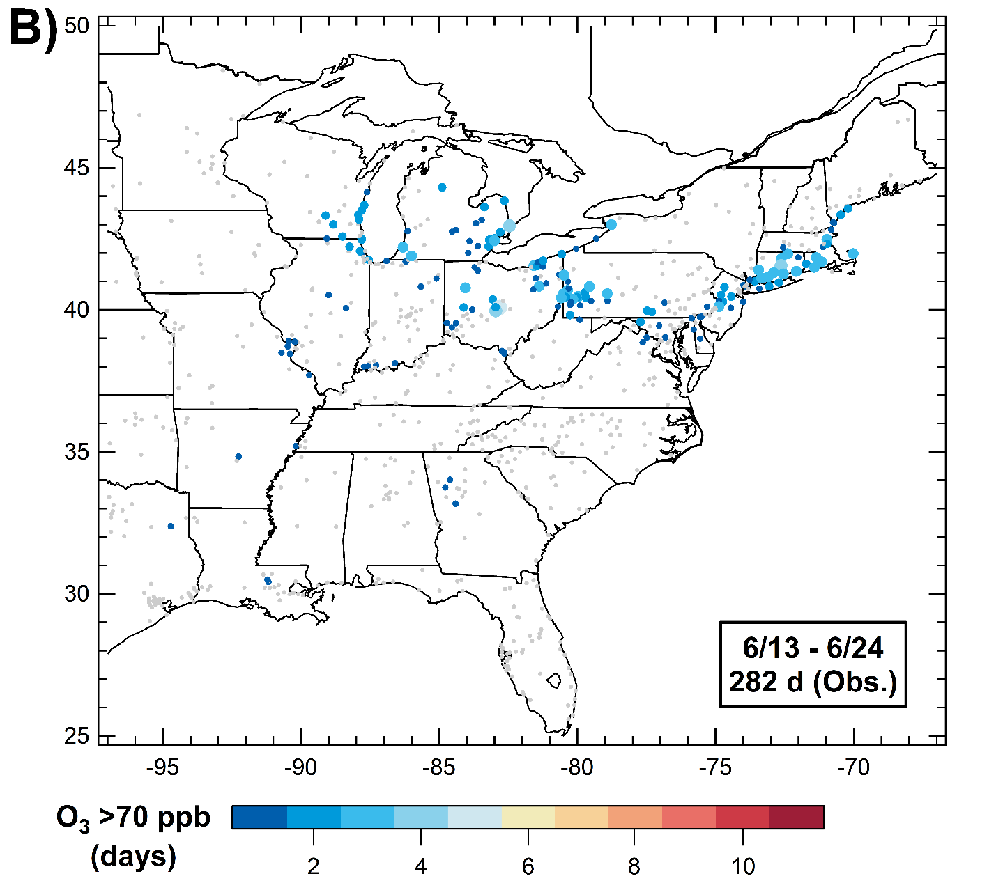
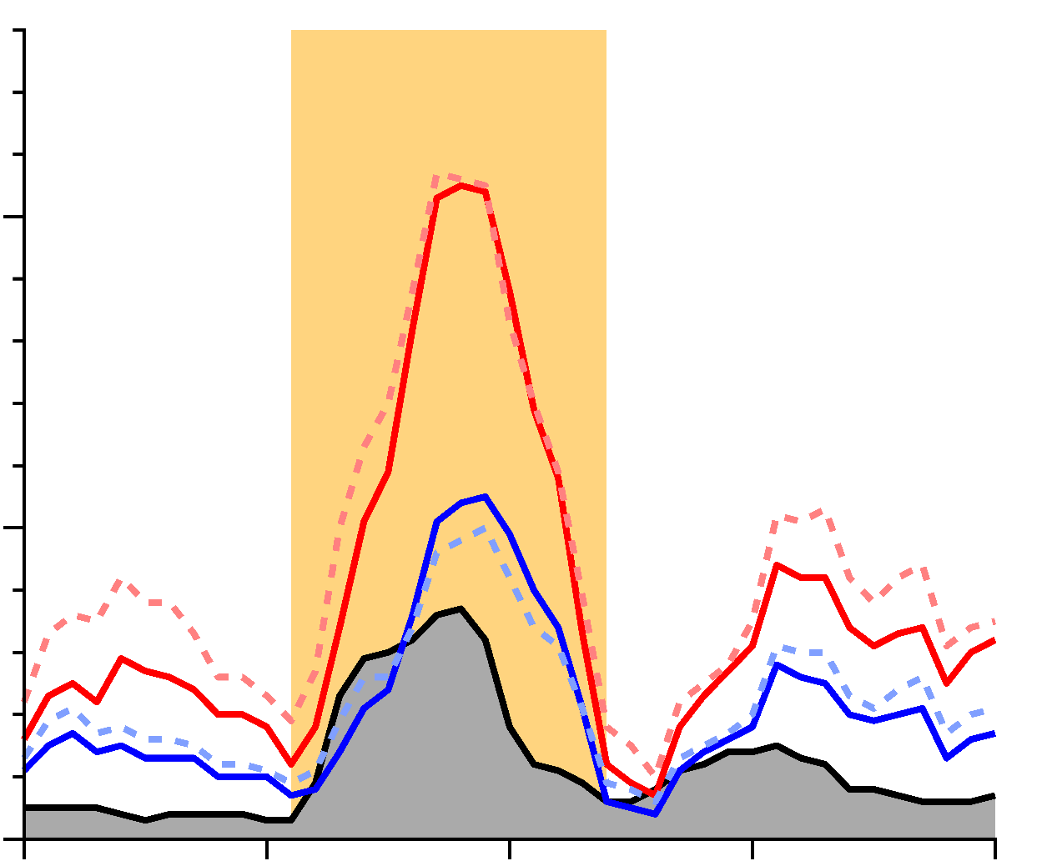
High Ozone Days Sensitive to Mobile Source NO_{x}
Episode
100
NEI11
No. of Sites (>70 ppb)
FIVE13
50
Obs
0
6/1
6/11
6/21
7/1
7/11

Slide 20
Summary
NO_{x} overestimate seen in model, and partially explained by biases in mobile source emissions
Biggest discrepancies found in the on-road gasoline sector
Suggest reducing mobile source NO_{x} emissions by 20-30% to be consistent with roadside studies and ambient measurements of NO_{y}
In Eastern U.S., ozone sensitive to mobile source NO_{x}
Small changes in transportation NO_{x} → significant effects on high O₃ days

