Slide 1
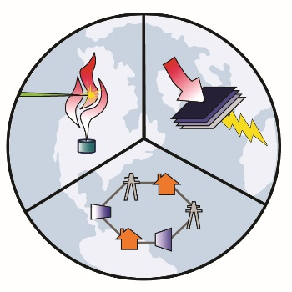
Assessing the Combustion Performance, Emissions, and Air Quality (AQ) Impacts of Renewable Fuel Blending in the Natural Gas System in California
Michael Mac Kinnon, Ph.D.
Senior Scientist
Advanced Power and Energy Program
University of California, Irvine

Slide 2
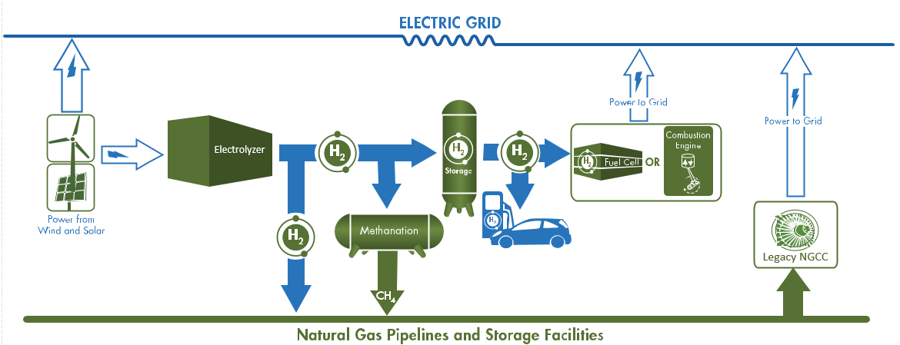
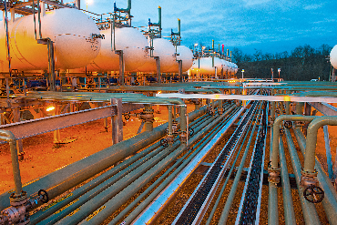
Introduction and Motivation
Interest in increasing the use of renewable gaseous fuels in California as a means of decarbonizing end-use sectors
Biomethane and hydrogen from renewable sources
Power-to-Gas
Injection into the existing natural gas grid as a means of storage and transmission

Slide 3
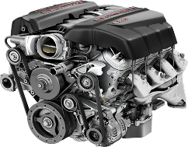
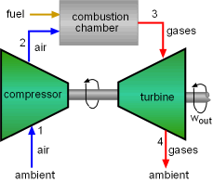
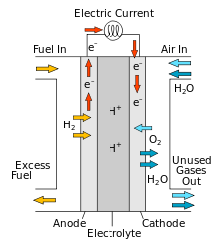
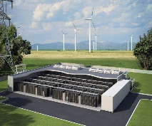
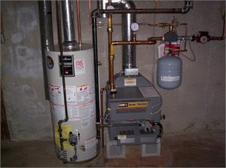
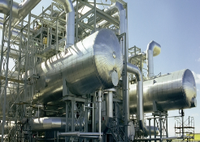
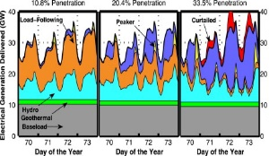
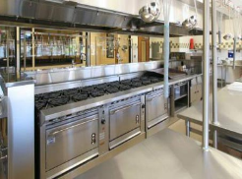
Natural Gas System Evolution
Potential pathway to a near-zero emission, renewable gas system
Renewable H₂ converted by fuel cells for generation and motive power
Provide remaining energy portion not met by electrification
Challenges and Research Areas
Combustion performance, emissions, and AQ impacts of NG/H₂ blends
H₂ production and dynamics
Leakage from NG pipeline
NG pipeline material impacts (embrittlement, fatigue)
Economic viability
Combustion
Electrochemical
Fossil Gas
(CH₄)
Fossil & Renewable Gas (CH₄ & H₂)
Renewable Gas
(H₂)
All End-use Sectors
Complementary Generation
Challenging Sectors to Electrify

Slide 4
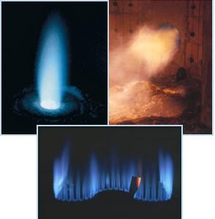
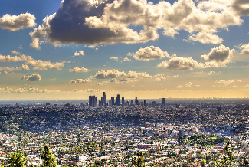
Potential Emissions and AQ Impacts
Varying fuel composition can impact combustion devices optimized for operation on unadulterated natural gas
Performance – stability, efficiency, emissions, etc.
Investigate the potential impact of emissions on AQ in California
Provide technical insight on how to maximize the GHG and AQ co-benefits of renewable fuels
?
?
Notes:
Electricity generation, industry, service, residential, commercial

Slide 5
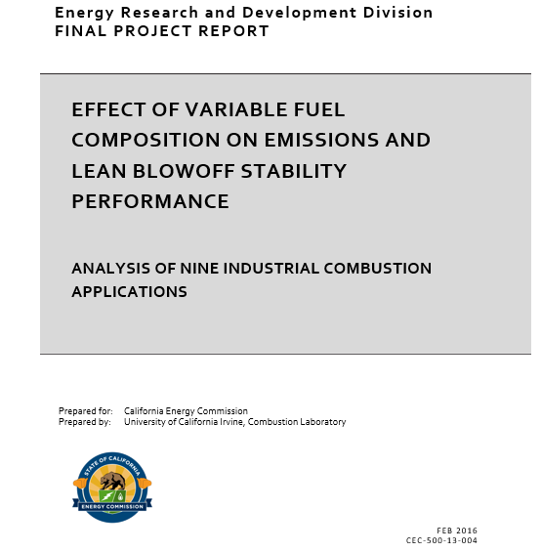
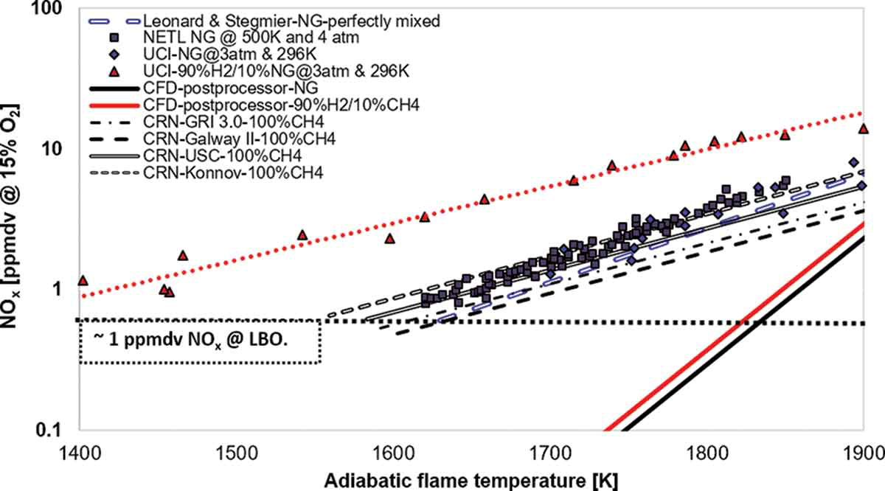
Approach – Combustion and Emission Impacts
Assessed emission impacts of fuel blending for nine industrial burners
Requires numerical models (CFD) and reaction mechanisms with detailed chemical kinetics (CRN)
3 burner types experimentally validated
Industrial Burners
Low-swirl Burner (LSB)
Surface Stabilized Burner (SSB)
Micro Turbine Combustor (MTC)
Oxygas Burner
High Speed Jet Burner (HSJ)
Gas Turbine Combustor (GTC)
Radiant Tube (RT)
Infrared Burner (IRB)
Slot Burner (SB)
H₂ addition increases NO_{x}
Fuels | Mixture
Hydrogen | 76% CH₄ - 24% H₂
Biogas | 98% CH₄ - 2% CO₂
Ethane | 94% CH₄ - 6% C₂H₆
Propane | 95% CH₄ - 5% C₃H₈
Good agreement between UCI method and experimental data
CFD solution alone not able to predict NO_{x} shift
Colorado, Andres; McDonell, Vincent. (University of California Irvine, Combustion Laboratory- UCICL). 2016. Effect of Variable Fuel Composition on Emissions and Lean Blowoff Stability Limits. California Energy Commission. Publication number: 500-13-004
Notes:
Computational fluid dynamics and chemical reactor networks for all 9
Experimental validation at UCICL for (1) The low-swirl burner (LSB), (2) surface stabilized combustion burner (SSCB) and (3) a micro-turbine combustor (MTC)

Slide 6
Results – Combustion and Emission Impacts
Quantified change in NO_{x} and CO emissions for renewable fuel blends relative to operation on 100% Natural Gas (CH₄)
Significant variation for burners, pollutants, and fuels
 | 1. LSB |  | 2. SSB |  | 3. MTC |  | 4. Oxygas |  | 5. HSJ
Fuel Mixture (% by volume w/ CH₄) | NO_{x} | CO | NO_{x} | CO | NO_{x} | CO | NO_{x} | CO | NO_{x} | CO
Hydrogen (24%) | 111% | -40% | -64% | -40% | 200% | -50% | 16% | -20% | 48% | -11%
Biogas (2% CO₂) | -5% | 11% | -3% | 3% | -17% | 1% | -4% | 3% | -2% | 3%
Ethane (6%) | 5% | 8% | 2% | 3% | 3% | 4% | 5% | 8% | 3% | 4%
Propane (5%) | 9% | 3% | 3% | 6% | 5% | 4% | 4% | 6% | 8% | 5%
 | 6. GTC |  | 7. RT |  | 8. IRB |  | 9. SB
Fuel Mixture | NO_{x} | CO | NO_{x} | CO | NO_{x} | CO | NO_{x} | CO
Hydrogen (24%) | -20% | -50% | 233% | -35% | -60% | -10% | 58% | -13%
Biogas (2% CO₂) | -3% | 0% | -2% | 2% | -3% | -3% | -2% | 5%
Ethane (6%) | 3% | 3% | 0% | 4% | 2% | -5% | 3% | 4%
Propane (5%) | 3% | 3% | 5% | 4% | 1% | -5% | 8% | 6%
Key (NO_{x}/CO)
% Increase
% Decrease
No Change

Slide 7
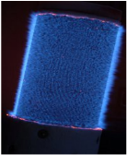
Approach – Scenario Development
Scale-up to economy-wide scenarios in California in 2035
Requires detailed understanding of feasible applications in energy sectors
Three burner types mapped – Micro Turbine Combustor, Gas Turbine Combustor, and Surface Stabilized Burner
Food and Agriculture
Process Heaters
Heater-treater
Oil and Gas
Steam – Pasteurization
Oil Heating - pumping
Manufacturing/Industrial
Surface Stabilized Burner
Service/Commercial
Notes:
Alzeta SSL
Oil and gas water separator, heater treater
Oil heaters at pumping stations to pull something out, transmission
Everything but reciprocating engines
They are already in that market
FLUID HEATING
Service and Commercial
Anything for steam generation
Food and Ag
Making steam at milk processing plant (CA dairies)
Juice pasteurizing (Naked juice)
Not radiant heat ovens like cooking but like steam being generated
Indirect heat for milk drying
No reason it couldn’t be
Manufacturing and industrial
Steam generation yes
Other things no
Semi-conductor manufacturing major client
Petroleum Refining
No
Electricity and Co-Gen
No
Trends applicable for all SSL

Slide 8
Results – Scenario Development
Burner Type | Fuel Injection | NO_{x} Impact | CO Impact | Impacted Sources
Gas Turbine Combustor (GTC) | Hydrogen | -20% | -50% | Electric Utility (turbines) Cogeneration (turbines) Manufacturing and Industrial (turbines) Service and Commercial (turbines)
 | Biogas | -3% | None
Micro Turbine Combustor (MTC) | Hydrogen | +200% | -50% | Electric Utility (turbines) Cogeneration (turbines) Manufacturing and Industrial (turbines) Service and Commercial (turbines)
 | Biogas | -17% | +1%
Surface Stabilized Burner (SSB) | Hydrogen | -64% | -40% | Oil and Gas (process heaters, boilers) Manufacturing and Industrial (boilers) Service and Commercial (boilers, water heaters) Food and Ag (process heaters)
 | Biogas | -3% | +3%

Slide 9
Results – Total NO_{x} and CO Emissions
Net emission impacts in 2035 are generally beneficial
Exception for NO_{x} MTC operating on H₂
Biogas cases has small impact
Hydrogen Cases
Biogas Cases
GTC
SSB
MTC
GTC
SSB
MTC
Potential Impacts on NO_{x}
H₂: -3.1% to +1.3%
BG: Up to 0.2% reduction
Notes:
Points:
Hydrogen has a larger impact than biogas which makes sense as biogas is CO2. There are other concerns with biogas related to air toxics generated from contaminants.
The SSBL case has a much larger impact overall due to the sources it impacts, i.e., industrial emissions.

Slide 10
Approach – Air Quality Modeling
Simulations of atmospheric chemistry and transport
AQ Model: CMAQ 5.2 w/ 4 km x 4 km grid, Emissions: SMOKE 4.0
Two seasonal episodes: WRF 3.7
Summer (July 8-21) for ozone & PM_{2.5} concentrations
Winter (January 1-14) for PM_{2.5} concentrations
Summer 2035 1-hr Ozone
Winter 2035 24-hr PM_{2.5}
Notes:
Model performance evaluation from CARB hourly ozone (145 stations) and daily PM_{2.5} (17 stations) data
Mean normalized bias and mean normalized gross error within acceptable parameters according to guidelines from the U.S. EPA

Slide 11
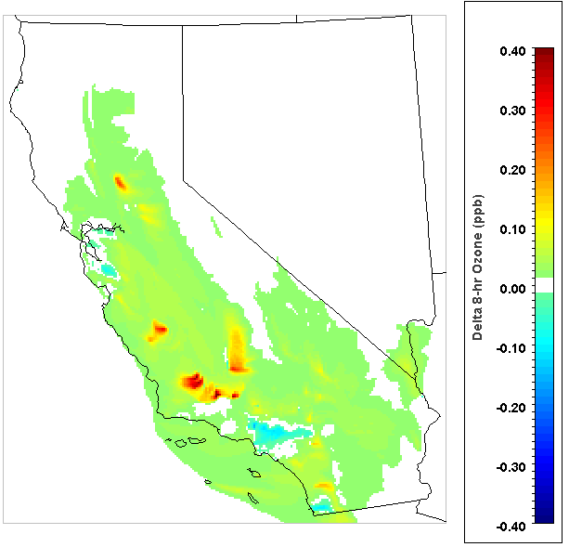
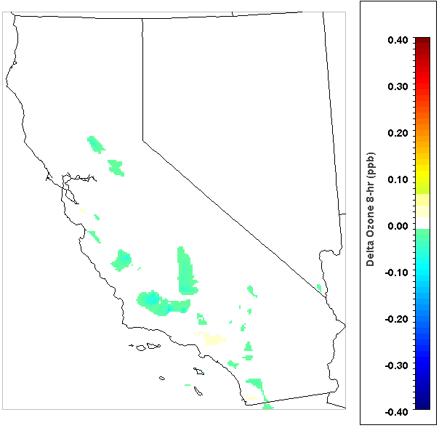
MTC and GTC H₂ – Summer Ozone
MTC H₂ Case
200% Increase in NO_{x} Emissions
GTC H₂ Case
20% Decrease in NO_{x} Emissions
+0.49 ppb Max 8-hr O₃
-0.10 ppb Max 8-hr O₃
Notes:
These results demonstrate the impact on maximum 8-hr average ground-level ozone from the changes in Nox emissions presented last slide. As would be expected the MTC Case results in worse AQ (increasing ozone levels) and the GTC Case improves AQ (reducing ozone levels). The changes in ozone scale to the emission reductions with peak impacts in the MTC Case an order of magnitude higher due to all impacted sources in the cases being exactly the same (this wouldn’t be true if different sources were impacted). In particular, large natural gas power plants in the south central valley have a major impact. Overall it should be noted that the impacts are fairly minor as the standard for max 8-hr ozone is 75 ppb and the impacts in the MTC Case is .49 ppb. This is because the electricity sector in CA is relatively low-emitting overall due to stringent environmental regulations leading to high levels of renewables and cleaner natural gas plants.

Slide 12
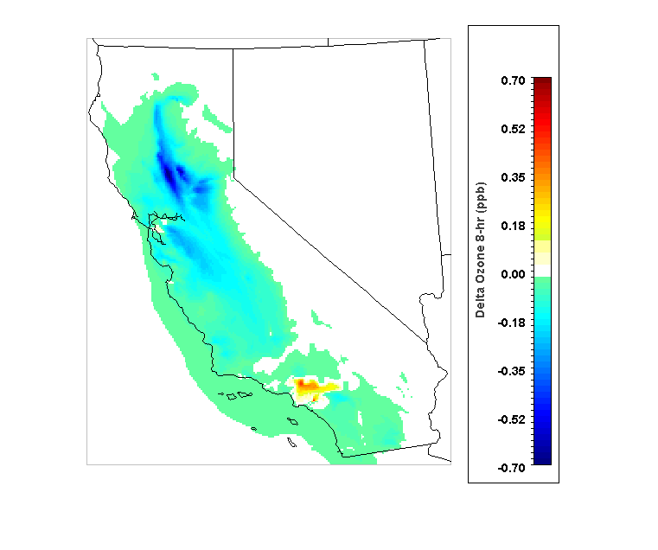
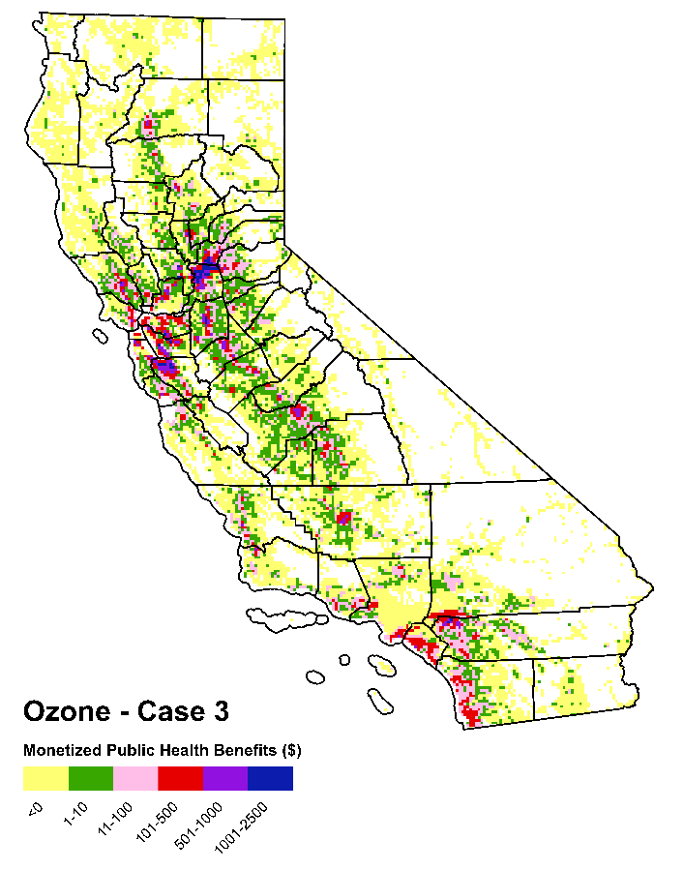
SSBC H₂ – Summer Ozone and Short-term Health Impacts
SSBL H₂ Case: 64% Decrease in NO_{x}
Short-term Health Impacts from BenMAP-CE
̴$386,000/day
Ozone -Summer
-0.75 ppb Max 8-hr O₃
Notes:
These results demonstrate the impact on NOx emissions and ground-level ozone for the SSBL H2 case. The results highlight the importance of how emissions from different sectors and sources impact air pollution differently. For example, the SSBL burners are used in different industries that impact ozone in Northern California while the MTC and GTC impact the Bay Area and Central Valley. Further, the 64% decrease achieves a greater peak impact on ozone in terms of magnitude as the MTC case with a 200% increase.

Slide 13
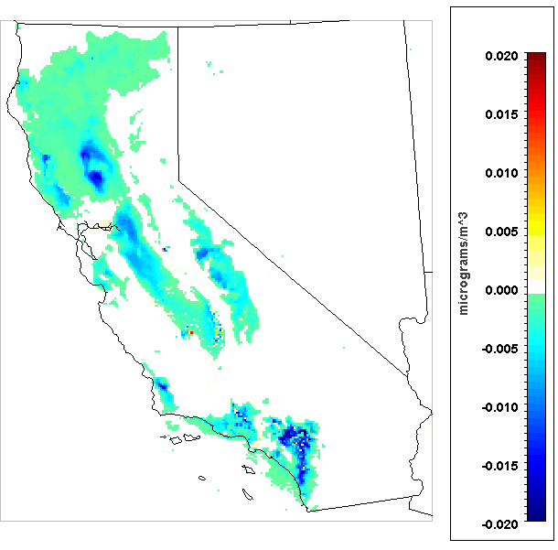
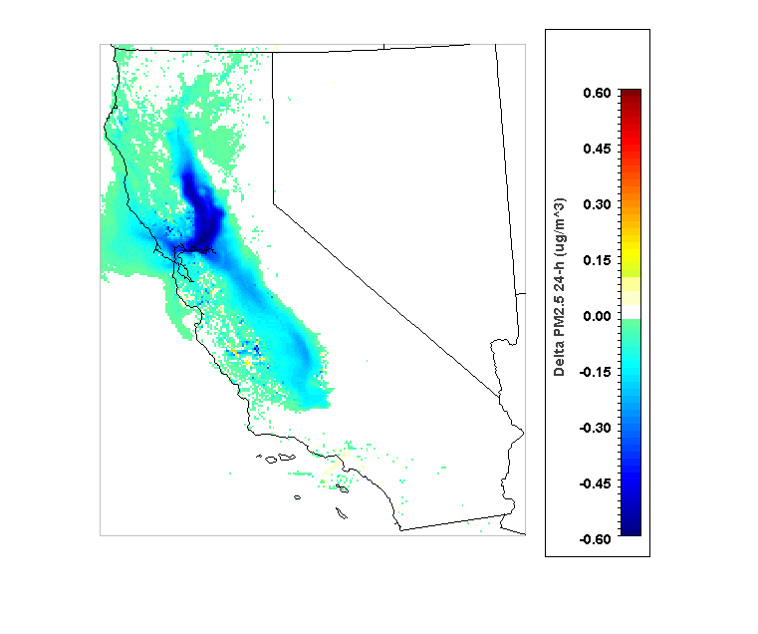
SSBC H₂ – Summer and Winter PM_{2.5}
SSBL H₂ Case: 64% Decrease in NO_{x}
SSBL H₂ Case: 64% Decrease in NO_{x}
-0.08 ug/m³ 24-hr PM_{2.5}
-0.64 ug/m³ 24-hr PM_{2.5}
Notes:
These results demonstrate the impact on NOx emissions and ground-level ozone for the SSBL H2 case. The results highlight the importance of how emissions from different sectors and sources impact air pollution differently. For example, the SSBL burners are used in different industries that impact ozone in Northern California while the MTC and GTC impact the Bay Area and Central Valley. Further, the 64% decrease achieves a greater peak impact on ozone in terms of magnitude as the MTC case with a 200% increase.

Slide 14
Next Steps
Source Impacts
Complete industrial burners – Funded
Residential/commercial appliances – Funded
Integrated source impacts – Funded
Spatial consideration of resource blending
Integrated planning document for managing potential impacts in California
Reciprocating engines
Project Goal
Quantification and monetization of short-term and long-term health impacts via BenMAP-CE
Health Impacts
Scenarios

Slide 15
Conclusions
Use of existing NG system potentially important mechanism to store and transport renewable gaseous fuels including hydrogen and biomethane
Achieve GHG policy targets, complement renewable generation
Technically feasible but significant challenges must be addressed
Renewable fuel blending can reduce or increase emissions from end-uses
Dependent on fuel mixture, burner configuration, pollutant species, etc.
AQ impacts of industrial burners vary by region and season
Generally, minor improvements are expected for assessed cases
Future burner deployment strategies may require foresight
Certain areas may require specific burner types, others may not
Seasonal impacts may require seasonal mitigation strategies

Slide 16
Acknowledgements
UCI
Professor Vince McDonnell
Professor Andres Colorado
Dr. Marc Carreras-Sospedra
Dr. Shupeng Zhu
Professor G. Scott Samuelsen
Dr. Li Zhao
Jeremiah A. Blackburn
Alejandra Hormaza-mejia
California Energy Commission
Marla Mueller
Yu Huo
Thank You!
mam@apep.uci.edu

Slide 17
Backup Slides

Slide 18
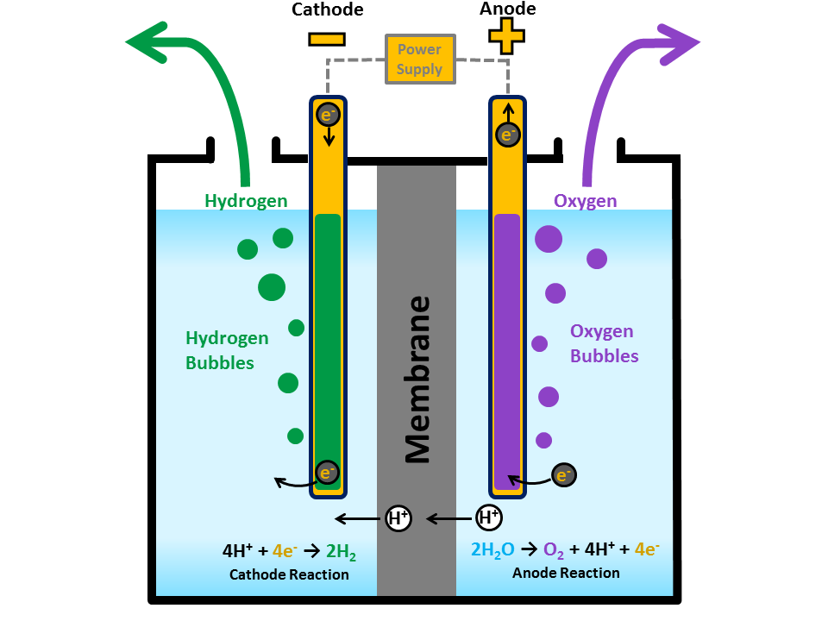
Electrolysis
Proton Exchange Membrane Electrolyzer
Water reacts at the anode to form oxygen and positively charged hydrogen ions (protons)
The electrons flow through an external circuit and the hydrogen ions selectively move across the PEM to the cathode
At the cathode, hydrogen ions combine with electrons from the external circuit to form hydrogen gas.

Slide 19
Power-to-Gas (P2G)
Use excess renewable electricity to generate H₂ or CH₄ ( after methanation) to complement dynamics of solar and wind
Support renewable integration by providing seasonal-scale storage, grid management and renewable energy transportation and distribution

Slide 20
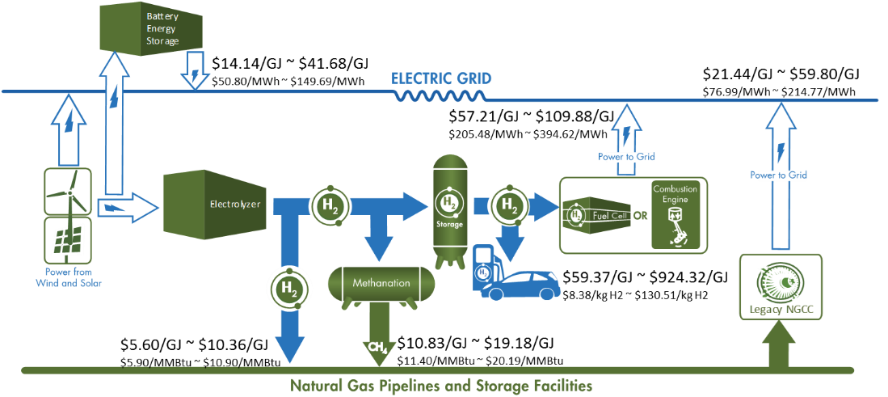
Economic Viability
Levelized Cost of Returned Energy (LCORE)
Future Costs & Efficiencies
50% capacity factor for all equipment

Slide 21
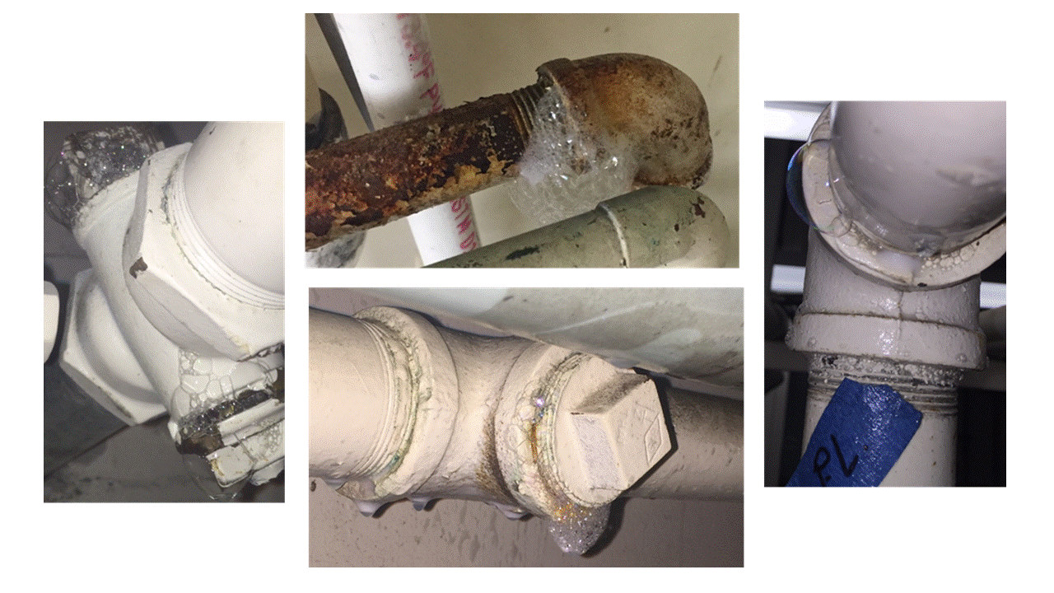
Impacts: System Leakage
Test commercially available mitigation measure
Copper epoxy applied (Ace Duraflow®)
After application
Original

Slide 22
Impacts: System Leakage
Conducted laboratory testing of existing customer-side infrastructure
Preliminary results indicate NG, H₂/NG mixtures, H₂ leak at same rate

Slide 23
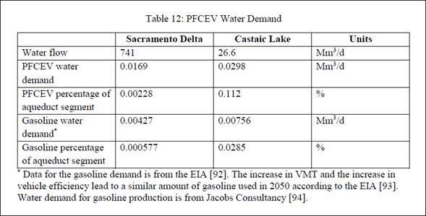
Water Consumption
Water consumption for P2G provision of hydrogen fuel for the entire LDV sector in California in 2050
Very small fraction of key Northern California (0.02%) and Southern California (0.11%) supply reservoirs

Slide 24
BenMAP Summary
Valuation of health effects from short-term exposure
Thousands of $ per day
Case | Pollutant | Premature Deaths Avoided, All Causes | Reduced Morbidity Incidence | Total
GTC Summer | Ozone Exposure | -31.98 | -1.03 | -98.48
 | PM_{2.5} Exposure | -62.76 | -2.71
MTC Summer | Ozone Exposure | 8.61 | 0.27 | 21.63
 | PM_{2.5} Exposure | 12.23 | 0.52
SSB Summer | Ozone Exposure | 239.38 | 6.77 | 385.70
 | PM_{2.5} Exposure | 133.89 | 5.67

Slide 25
Health Impact Assessment
BenMAP-CE 1.3 to quantify and monetize health impacts
Daily avoided costs in $/day for the SSB Case in Summer

Slide 26
Health Effects: Incidence
Premature Deaths Avoided, All Cause
Endpoint - Health Effects Estimates (# incidences/ppl/yr) | SSB - Summer | MTC - Summer | GTC-Summer
Short-Term Ozone Exposure | 0.0189 (0.0021 ; 0.0357) | -0.0025(-0.0048 ; -0.0003)" | 0.0007(0.0001 ; 0.0013)
Short-Term PM2.5 Exposure | 0.0106 (0.0081 ; 0.0130) | -0.0049(-0.0038 ; -0.0061)" | 0.0010(0.0007 ; 0.0012)
Reduced Morbidity Incidence: Short-Term Ozone Exposure
Emergency Room Visits, Asthma | 0.3461 (0.0624 ; 0.6289) | -0.0557(-0.0100 ; -0.1014)" | 0.0141(0.0025 ; 0.0256)
Hospital Admissions (HA), All Respiratory | 0.0214 (-0.0064 ; 0.0491) | -0.0025(0.0008 ; -0.0058)" | 0.0007(-0.0002 ; 0.0016)
Hospital Admissions (HA), Asthma | 0.0054 (0.0028 ; 0.0081) | -0.0009(-0.0004 ; -0.0013)" | 0.0002(0.0001 ; 0.0003)
Minor Restricted Activity Days^ | 71.0 (29.3 ; 112.6) | -9.6(-4.0 ; -15.2)" | 2.6 (1.1 ; 4.1)
School Loss Days, All Cause | 20.7 (-2.4 ; 43.7) | -3.3(0.4 ; -7.0)" | 0.8(-0.1 ; 1.8)
Short-Term PM2.5 Exposure
Acute Myocardial Infarction, Nonfatal | 0.0029 (0.0011 ; 0.0078) | -0.0014(-0.0037 ; -0.0005)
Asthma Exacerbation (Wheeze, Cough, Shortness of Breath) | 1.1496 (-0.0744 ; 2.6312) | -0.5213(-1.1931 ; 0.0337)
Asthma, New Onset (Wheeze)** | 0.1853 (-0.0815 ; 0.4515) | -0.0863(0.0379 ; -0.2104)
HA, All Cardiovascular (less Myocardial Infarctions) | 0.0115 (0.0078 ; 0.0148//) | -0.0055(-0.0070 ; -0.0037)
HA, All Respiratory (less Asthma)* | 0.0105 (0.0064 ; 0.0138) | -0.0050(-0.0066 ; -0.0031)
HA, Ischemic Stroke | 0.0060 (0.0020 ; 0.0120) | -0.0029(-0.0010 ; -0.0058)
HA and ED Visits, Asthma | 0.0075 (-0.0013 ; 0.0203) | -0.0034(-0.0092 ; 0.0006)
Lower Respiratory Symptoms | 0.6475 (0.2460 ; 1.0483) | -0.2915(-0.1107 ; -0.4720)
Upper Respiratory Symptoms | 1.2625 (0.2294 ; 2.2942) | -0.5684(-0.1033 ; -1.0330)
Minor Restricted Activity Days^ | 27.9 (22.8 ; 33.1) | -12.8(-10.4 ; -15.1)
Work Loss Days | 4.8 (4.1 ; 5.6) | -2.2(-1.9 ; -2.5)
* This is pooled from HA, Chronic Lung Disease (less Asthma) (18-64) and HA, All Respiratory (65 or older).
** Valuation functions (VFs) for Asthma, New Onset (Wheeze) were not applied, correspondingly not shown in the valuation tables, because SCAQMD did not apply such VFs in their 2016 socioeconomic report; there are VFs for ages 0-18, but the health effects here are estimated for ages 35-99.

Slide 27
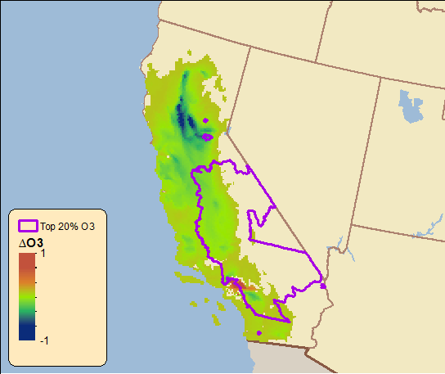
SSB – Summer Ozone and Disadvantaged Communities
Census tracts most impacted (20%) by ozone air pollution
CalEnviroScreen 3.0
Largest improvements not located in critical regions
Still beneficial!
Illustrate the importance of considering impacts spatially

Slide 28
MTC – Summer Ozone and Disadvantaged Communities
GTC H₂ Case
20% Decrease in NO_{x} Emissions
Census tracts most impacted (20%) by ozone air pollution
CalEnviroScreen 3.0
MTC and GTC summer ozone impacts notable
Bakersfield region

Slide 29
Method
NO_{x} emissions as predicted with a CFD (non-kinetic) model, CRN with complete chemistry and experimental results collected at UCI an elsewhere
Source: Colorado, Andres, and Vincent McDonell. "Exploring computational methods for predicting pollutant emissions and stability performance of premixed reactions stabilized by a low swirl injector." Combustion Science and Technology (2017): 1-20.

Slide 30
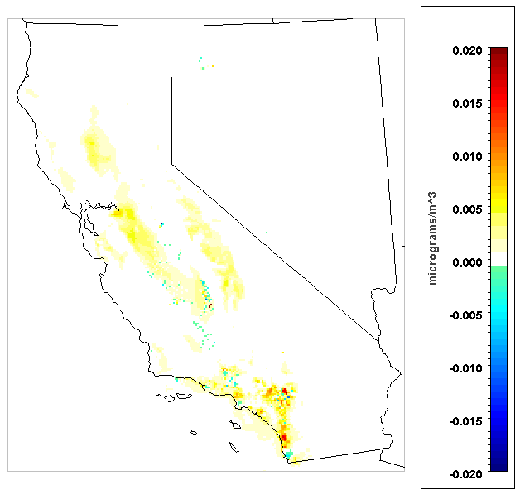
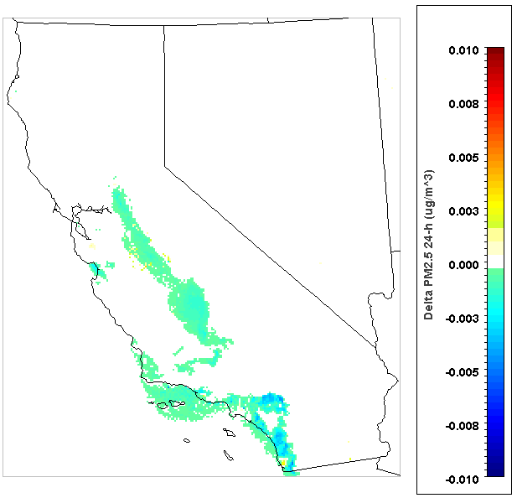
MTC and GTC H₂ – Summer PM_{2.5}
MTC H₂ Case
200% Increase in NO_{x} Emissions
GTC H₂ Case
20% Decrease in NO_{x} Emissions
+0.024 ug/m³ 24-hr PM_{2.5}
-0.005 ug/m³ 24-hr PM_{2.5}
Notes:
These results demonstrate the impact on maximum 8-hr average ground-level ozone from the changes in Nox emissions presented last slide. As would be expected the MTC Case results in worse AQ (increasing ozone levels) and the GTC Case improves AQ (reducing ozone levels). The changes in ozone scale to the emission reductions with peak impacts in the MTC Case an order of magnitude higher due to all impacted sources in the cases being exactly the same (this wouldn’t be true if different sources were impacted). In particular, large natural gas power plants in the south central valley have a major impact. Overall it should be noted that the impacts are fairly minor as the standard for max 8-hr ozone is 75 ppb and the impacts in the MTC Case is .242 ppb. This is because the electricity sector in CA is relatively low-emitting overall due to stringent environmental regulations leading to high levels of renewables and cleaner natural gas plants.

Slide 31
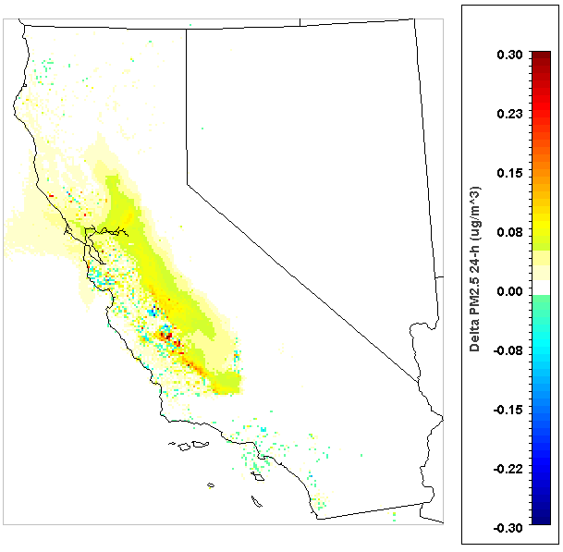
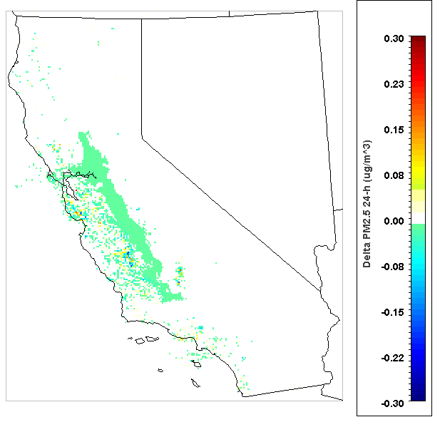
MTC and GTC H₂ – Winter PM_{2.5}
MTC H₂ Case
200% Increase in NO_{x} Emissions
GTC H₂ Case
20% Decrease in NO_{x} Emissions
+0.38 ug/m³ 24-hr PM_{2.5}
-0.31 ug/m³ 24-hr PM_{2.5}
Notes:
Points:
Winter ozone not generally a concern due to low background levels
Impacts on PM in winter are larger and in different areas spatially highlighting the seasonal importance, difference in PM formation dynamics,

Slide 32
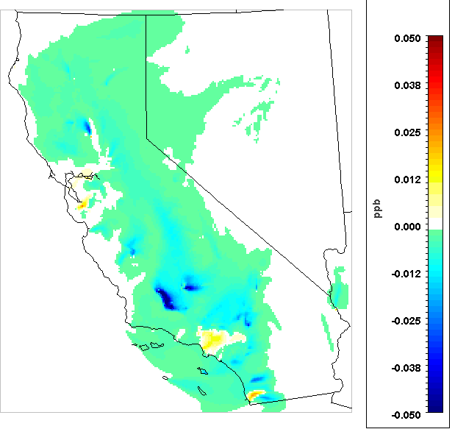
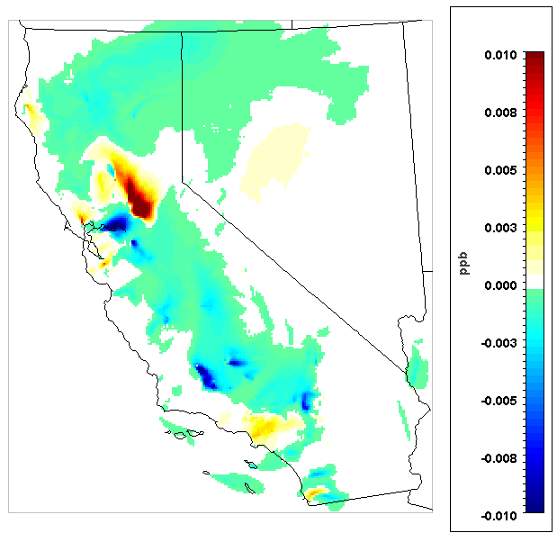
MTC and GTC BG – Summer Ozone
MTC BG Case
17% Decrease in NO_{x} Emissions
GTC BG Case
3% Decrease in NO_{x} Emissions
-0.085 ppb Max 8-hr O₃
-0.013 ppb Max 8-hr O₃
Notes:
These results demonstrate the impact on maximum 8-hr average ground-level ozone from the changes in Nox emissions presented last slide. As would be expected the MTC Case results in worse AQ (increasing ozone levels) and the GTC Case improves AQ (reducing ozone levels). The changes in ozone scale to the emission reductions with peak impacts in the MTC Case an order of magnitude higher due to all impacted sources in the cases being exactly the same (this wouldn’t be true if different sources were impacted). In particular, large natural gas power plants in the south central valley have a major impact. Overall it should be noted that the impacts are fairly minor as the standard for max 8-hr ozone is 75 ppb and the impacts in the MTC Case is .242 ppb. This is because the electricity sector in CA is relatively low-emitting overall due to stringent environmental regulations leading to high levels of renewables and cleaner natural gas plants.

Slide 33
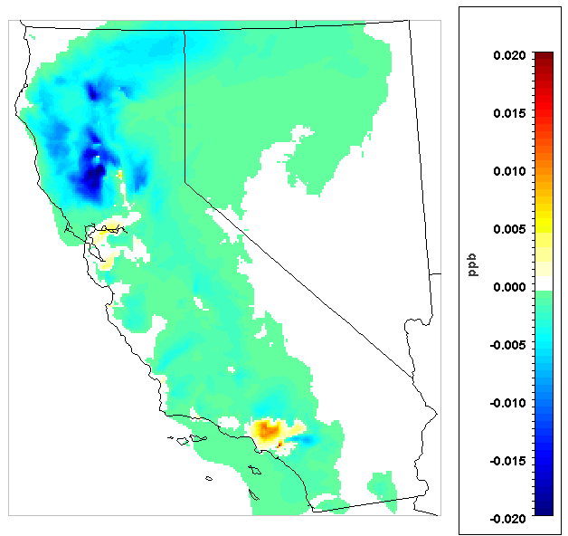
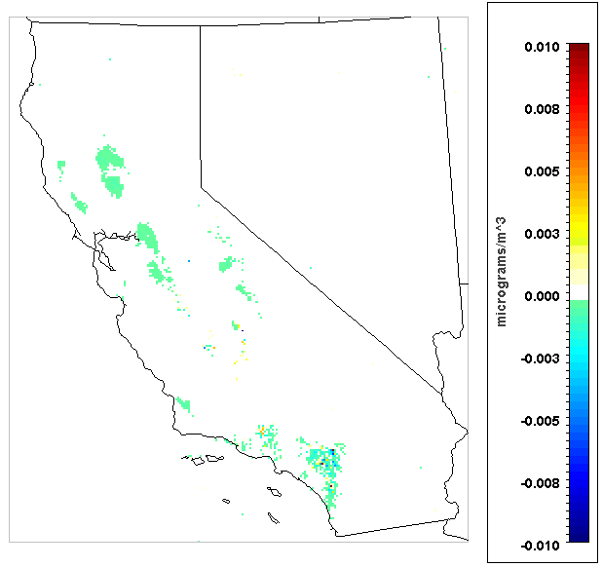
SSBC BG – Impact on 8-hr Ozone and 24-h PM_{2.5}
SSBL BG Case
3% Decrease in NO_{x}/3% Increase in CO
SSBL BG Case
3% Decrease in NO_{x}/3% Increase in CO
-0.024 to +0.019 ppb Max 8-hr O₃
0.014 to +0.032 ug/m³ 24-hr PM_{2.5}
Notes:
These results demonstrate the impact on NOx emissions and ground-level ozone for the SSBL H2 case. The results highlight the importance of how emissions from different sectors and sources impact air pollution differently. For example, the SSBL burners are used in different industries that impact ozone in Northern California while the MTC and GTC impact the Bay Area and Central Valley. Further, the 64% decrease achieves a greater peak impact on ozone in terms of magnitude as the MTC case with a 200% increase.

Slide 34
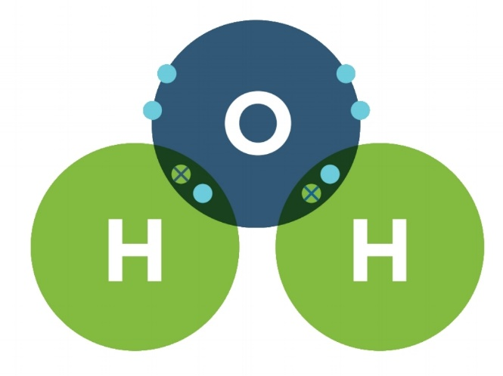
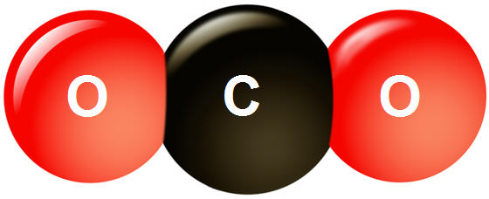
+
-
Renewable Electricity
Electrolyzer
Hydrogen
Water
CO₂

Slide 35
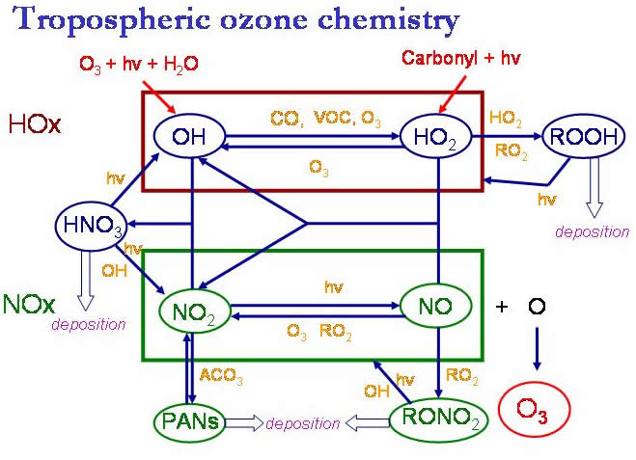
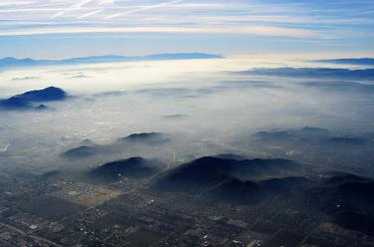
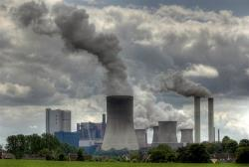
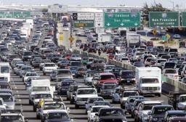
Understanding Air Quality Impacts
+
=
Atmospheric Chemistry
Dilution/Mixing/Transport
Ambient Concentrations
Deposition
+
[Ozone]
[Particulate Matter]
Emissions
Solely quantifying emissions neglects atmospheric impacts
Robust assessment includes simulations of atmospheric chemistry/transport
Effects on Receptors
NO_{x}
SO₂
VOC
Morbidity & Mortality
PM
CO

Slide 36
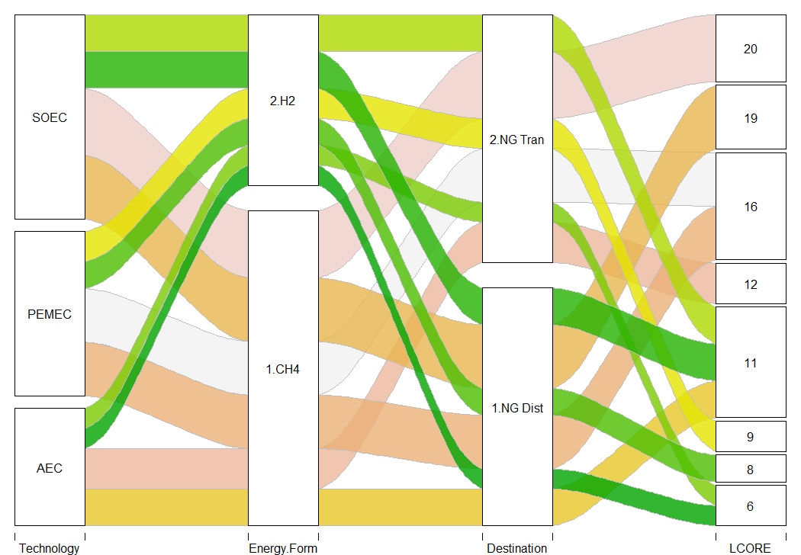
Impacts: Economic Viability
Direct injection of hydrogen into the natural gas distribution or transmission system (P2H₂) yield a lower LCORE than the power-to-methane (P2CH₄) cases
Methanation increases the costs and introduces conversion efficiency penalties
LCORE Results ($/MMBtu): P2H₂ vs. P2CH₄ Only Future Costs/Future Efficiencies, 50% Capacity Factor

Slide 37
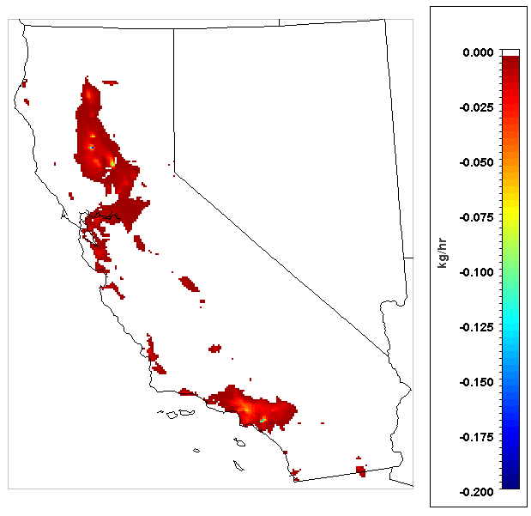
SSBC H2 – Impact on 24-h NOx
SSBL H₂ Case
64% Decrease in NO_{x}
-0.172 kg/hr NO_{x}
Notes:
These results demonstrate the impact on NOx emissions and ground-level ozone for the SSBL H2 case. The results highlight the importance of how emissions from different sectors and sources impact air pollution differently. For example, the SSBL burners are used in different industries that impact ozone in Northern California while the MTC and GTC impact the Bay Area and Central Valley. Further, the 64% decrease achieves a greater peak impact on ozone in terms of magnitude as the MTC case with a 200% increase.

Slide 38
Peak Impacts
 | Summer |  | Winter
Scenario | Δ Max 8-hr Ozone | Δ 24-hr PM_{2.5} | Δ Max 8-hr Ozone | Δ 24-hr PM_{2.5}
GTC_H2 | -0.10 | -0.31 |  | -0.31
MTC_H2 | +0.49 | +0.38 |  | +3.8
SSBL_H2 | -0.75 | -0.08 | +2.16 | -0.64
GTC_BG | -0.013 to +0.020 | -0.279 to +0.039
MTC_BG | -0.085 to +0.029 | -0.014 to +0.009
SSBL_BG | -0.024 to +0.019 | 0.014 to +0.032

Slide 39
Power-to-Gas (P2G) Overview
Potential pathway to a near-zero emitting, 100% renewable gas system
Gas Supply | Fossil (CH₄) | Fossil & Renewable (CH₄ and H₂) | Renewable (H₂)
Conversion | Combustion | Combustion/Electrochemical | Electrochemical
End-uses | All | Complementary Generation | Challenging to electrify

Slide 40
Power-to-Gas (P2G) Overview
Potential pathway to a near-zero and renewable gas system
Renewable H₂ used by zero-emission fuel cells for generation and motive power
Electrification/batteries with priority
Remaining end-uses and to provide complementary generation for renewables
Combustion
Electrochemical
Fossil Gas
(CH₄)
Fossil & Renewable Gas (CH₄ & H₂)
Renewable Gas
(H₂)
All End-use Sectors except Transportation
Complementary Generation
Challenging Sectors to Electrify

Slide 41
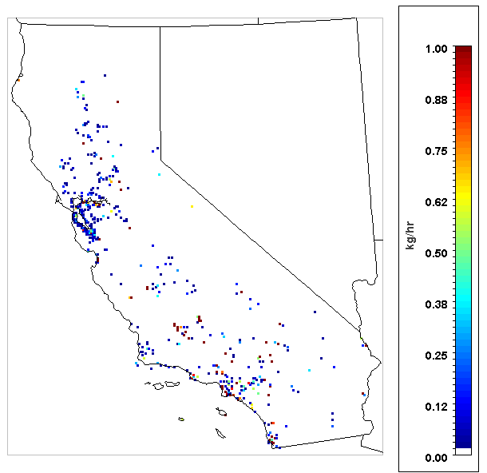
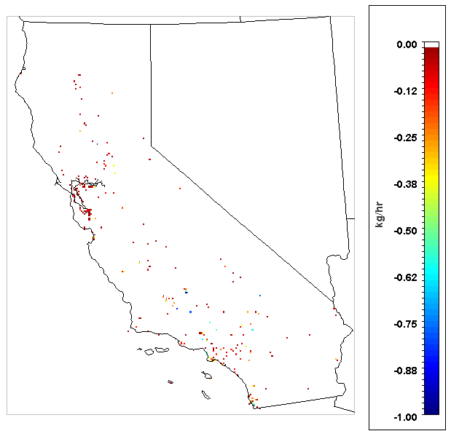
Results – Spatial and Temporal Emissions
MTC H₂ Case
200% Increase in NO_{x} Emissions
GTC H₂ Case
20% Decrease in NO_{x} Emissions
+8.02 kg/hr Δ 24-h NO_{x}
-1.61 kg/hr Δ 24-h NO_{x}
Notes:
These results demonstrate the impact on emissions (directly emitted) of nitrogen oxides (NOx) when hydrogen is blended into the pipeline and combusted by end-use combustion devices utilizing microturbine combustors (MTC) and gas turbine combustors (GTC). Each dot of color represents a 4km x 4km grid cell that may contain one or more sources of emissions.

Slide 42
Approach – Combustion and Emission Impacts
Assessed impacts of fuel blending (H₂ and biogas) for nine prototype and commercial industrial burners
Requires numerical models (CFD) and reaction mechanisms with detailed chemical kinetics (CRN), 3 burner types experimentally validated
Industrial Burners
Low-swirl Burner (LSB)
Surface Stabilized Burner (SSB)
Micro Turbine Combustor (MTC)
Oxygas Burner
High Speed Jet Burner (HSJ)
Gas Turbine Combustor (GTC)
Radiant Tube (RT)
Infrared Burner (IRB)
Slot Burner (SB)
Fuels | Mixture
Hydrogen | 76% CH₄ - 24% H₂
Biogas | 98% CH₄ - 2% CO₂
Ethane | 94% CH₄ - 6% C₂H₆
Propane | 95% CH₄ - 5% C₃H₈
NO_{x} emissions for low swirl burner as predicted with a CFD model, CRN with complete chemistry and experimental results
Source: Colorado, Andres, and Vincent McDonell. Combustion Science and Technology (2017): 1-20.
Notes:
Computational fluid dynamics and chemical reactor networks for all 9
Experimental validation at UCICL for (1) The low-swirl burner (LSB), (2) surface stabilized combustion burner (SSCB) and (3) a micro-turbine combustor (MTC)

Slide 43
Project Goal
Investigate the potential impact of fuel variability in the natural gas system on emissions and AQ in California
Determine potential emission changes from relevant sources
Develop plausible future scenarios at the energy sector level
Assess the impacts of emission changes on regional AQ
Provide technical insight on how to maximize the GHG and AQ co-benefits of renewable fuels
?
?

Slide 44
SSBC H₂ – Summer Ozone
SSBL H₂ Case: 64% Decrease in NO_{x}
Summer
-0.75 ppb Max 8-hr O₃
Notes:
These results demonstrate the impact on NOx emissions and ground-level ozone for the SSBL H2 case. The results highlight the importance of how emissions from different sectors and sources impact air pollution differently. For example, the SSBL burners are used in different industries that impact ozone in Northern California while the MTC and GTC impact the Bay Area and Central Valley. Further, the 64% decrease achieves a greater peak impact on ozone in terms of magnitude as the MTC case with a 200% increase.

Slide 45
Pathway Forward
Integrated planning document for combustion end-uses in California
Health Impact Assessment
Comprehensive Scenarios
Reciprocating Engines
Res. And Com. Appliances – Ongoing
Industrial Burner Assessment - Funded

