Slide 1





Air Quality Impacts of Projections of Natural Gas-Fired Distributed Generation
Jeremy R. Horne, Marc Carreras-Sospedra,
Donald Dabdub
K. Max Zhang, Bo Yang
Paul Lemar
Uarporn Nopmongcol, Tejas Shah, Greg Yarwood
David Young, Stephanie L. Shaw, Eladio M. Knipping
CMAS Conference, 2017
Resource Dynamics
Corporation

Slide 2
Centralized vs. Distributed Generation
lost excess heat
Combined Heating and Power (CHP) for DG
lost excess heat
η_{electric} = 40-60%
η_{thermal} = 30-40%
CHP
fuel in
η_{electric} = 30-40%
Central Power Plant
DG
η_{Total} = 40-60%
η_{Total} = 60-80%

Slide 3
Outline
Single-source, near-field air quality modeling of fossil-fueled distributed generation
Regional air quality modeling of future scenarios of fossil-fueled distributed generation deployment
Resource Dynamics
Corporation

Slide 4
Single-source, near-field air quality modeling of fossil-fueled distributed generation

Slide 5
Comprehensive turbulent aerosol dynamics and gas chemistry (CTAG) model
Computational fluid dynamics (CFD)-based turbulent reacting flow model for complex atmospheric environments
Extensive evaluated for transportation air quality applications with over 20 peer reviewed publications
This project provided an opportunity to further develop, evaluate and implement CTAG for stationary sources.

Slide 6
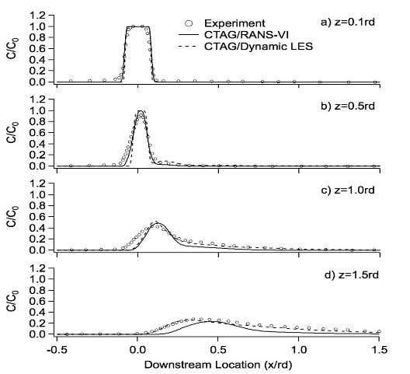
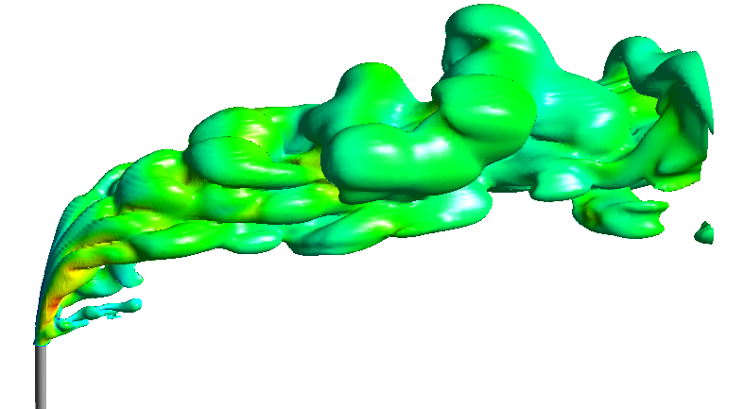
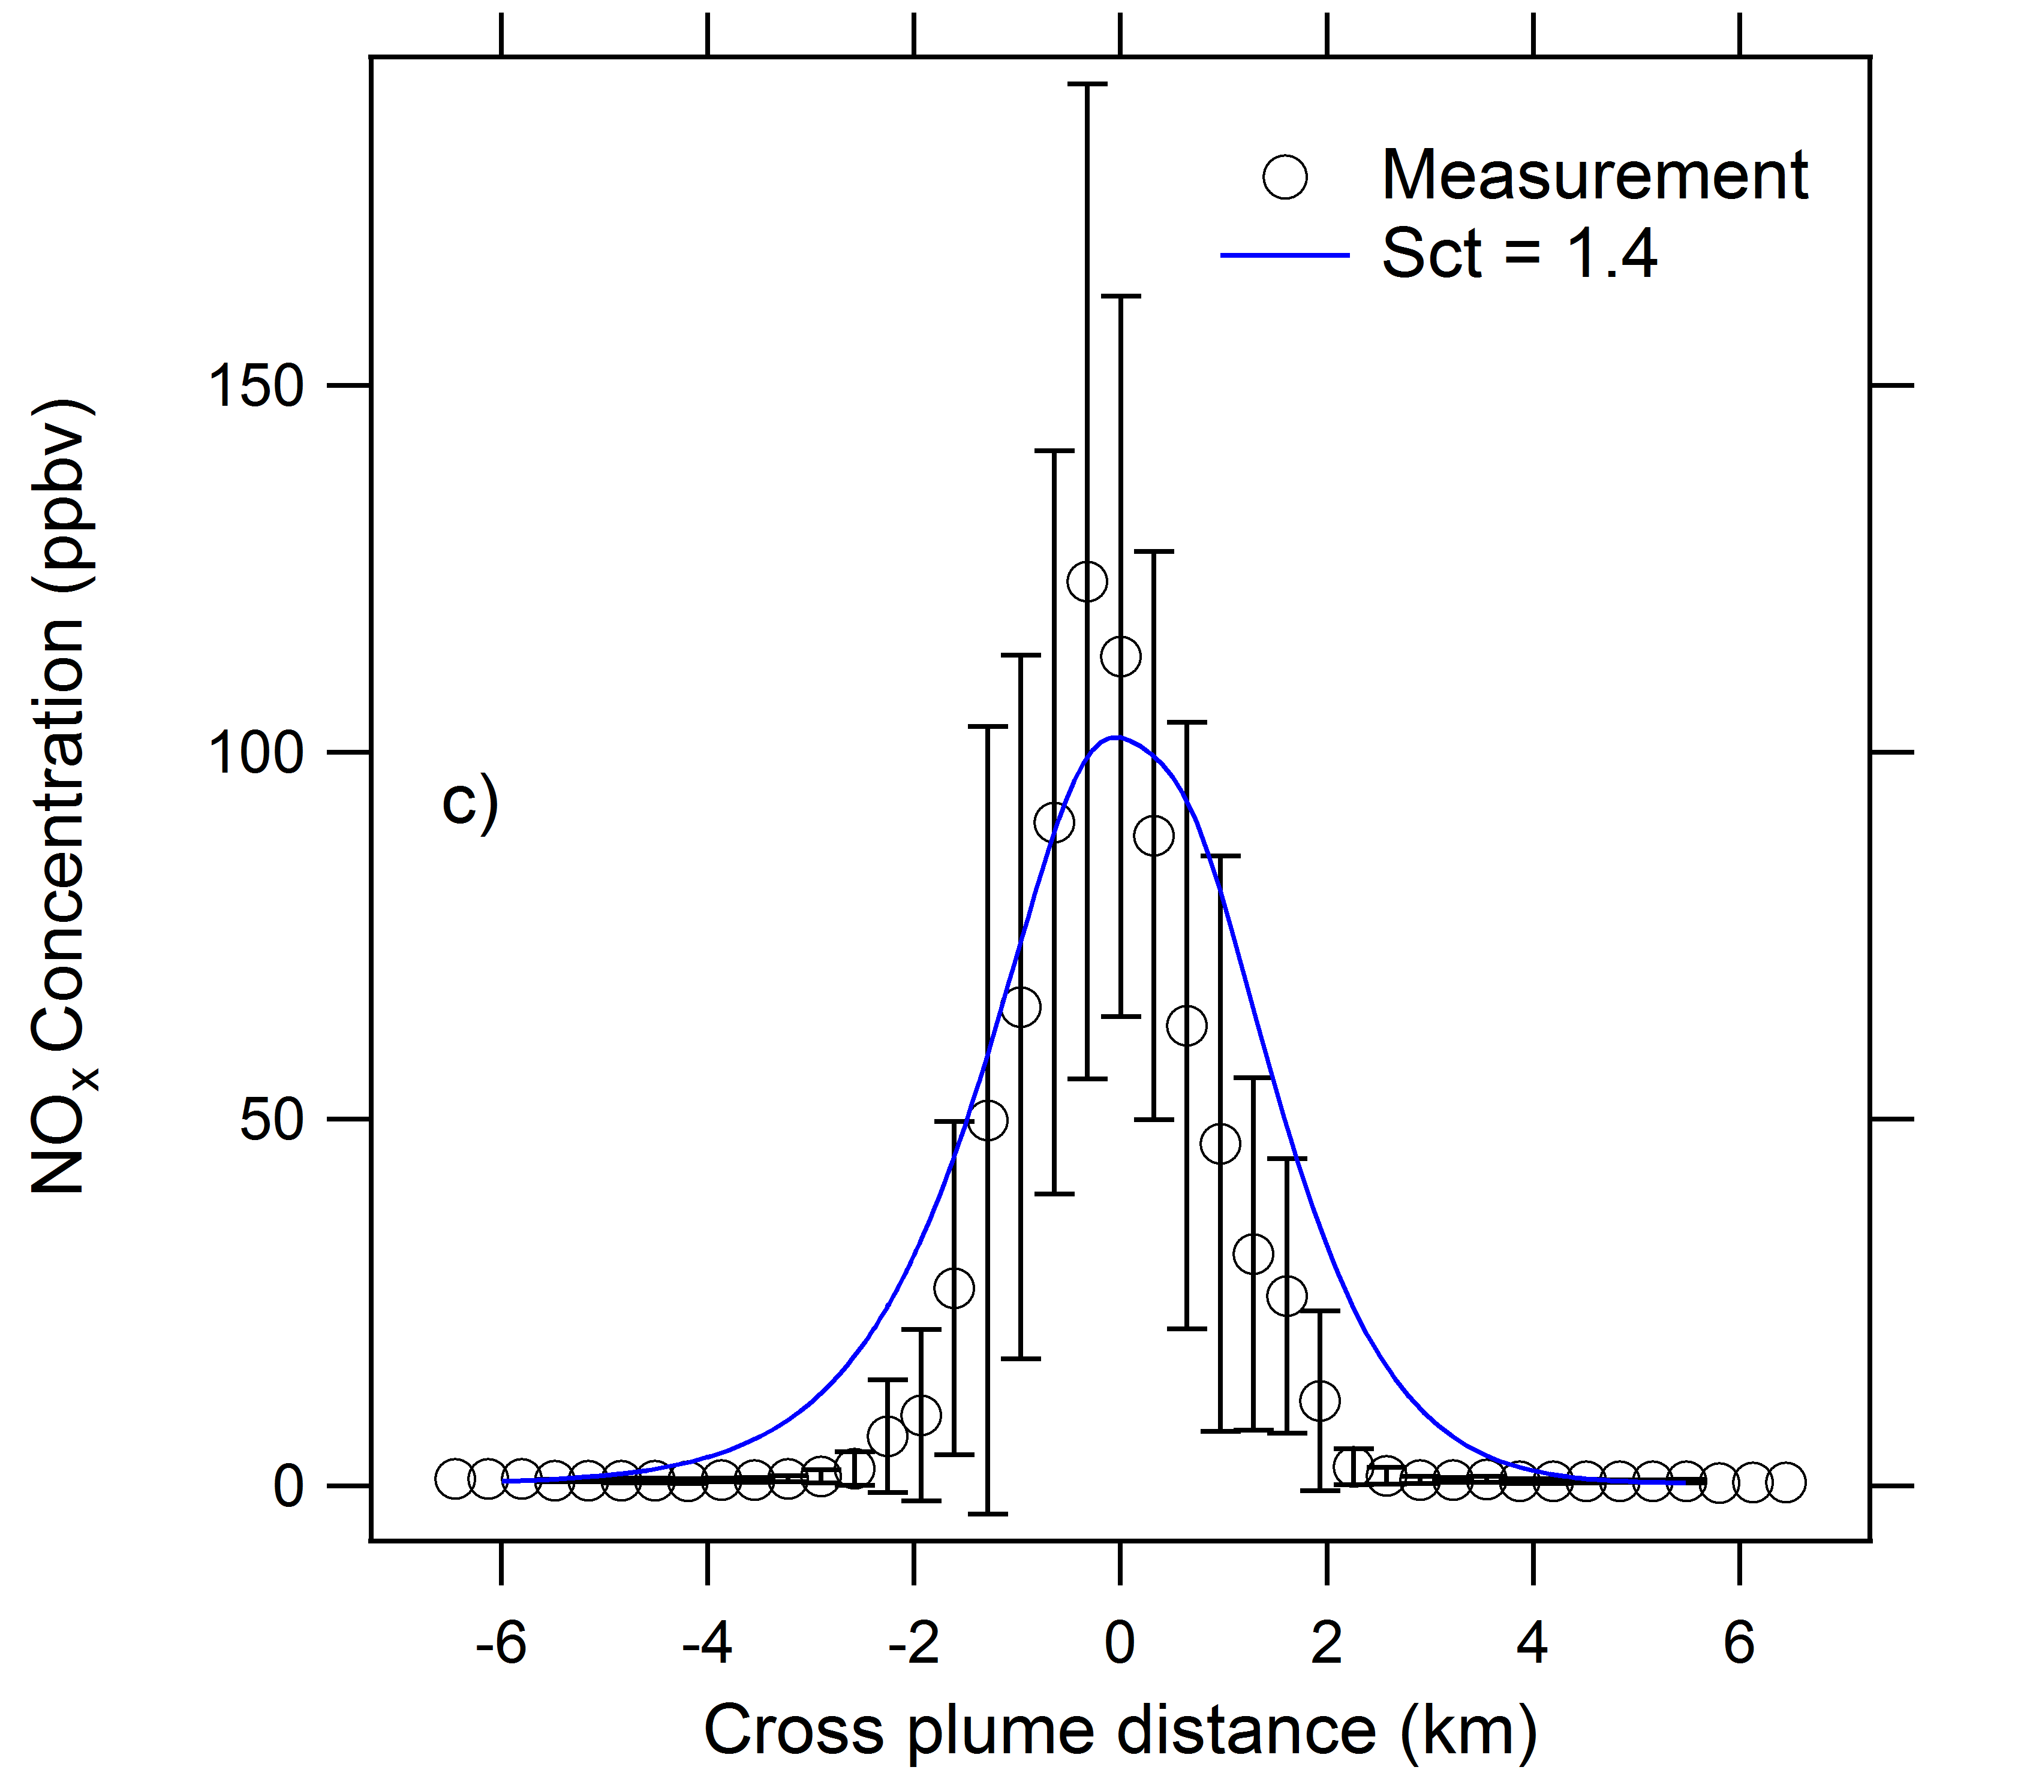
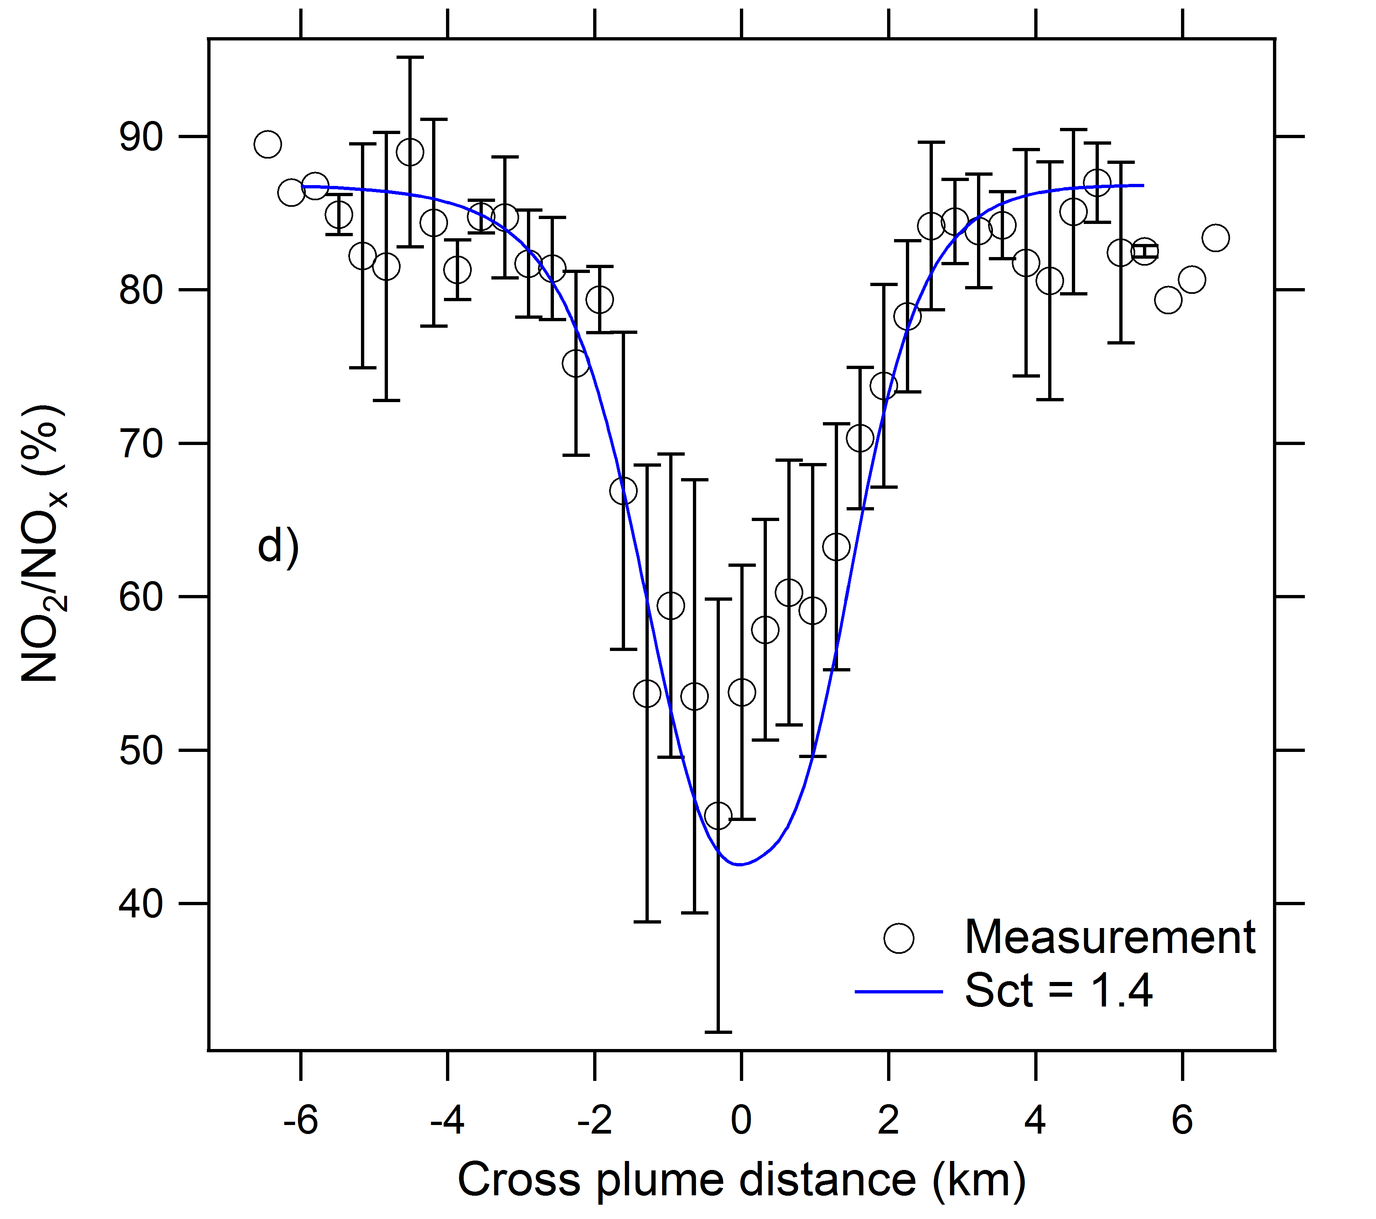
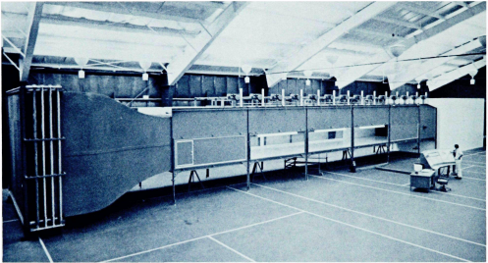
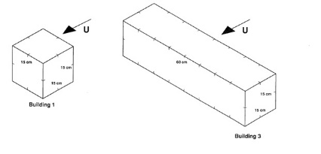
Plume Environment : Experiment : Evaluation
Jet-dominated region
Ambient-dominated region
Building-dominated region

Slide 7
Case study: Simple-cycle NG turbine w/ and w/o heat recovery
Method: A new integrated modeling framework
More accurate
More computationally efficient
Analysis
A new concept called the heat recovery amplified factor (HRAF), defined as the ratio between the maximum ground-level concentrations (GLC) with HR system and that without HR system, as an indicator of HR impact
We investigated the HR impact on NOx concentrations near a simple cycle gas turbine located in Brentwood, NY, and found very small GLCs (<10 ppb)
HRAF was shown to be much more sensitive to temperature in the Unstable, Low Wind condition than in the Stable, High Wind condition
GLC
HRAF
Yang and Zhang, manuscript submitted

Slide 8
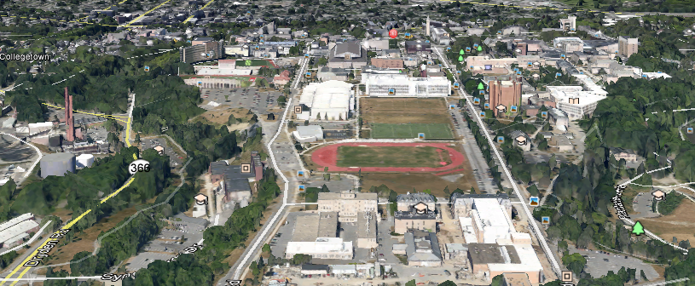
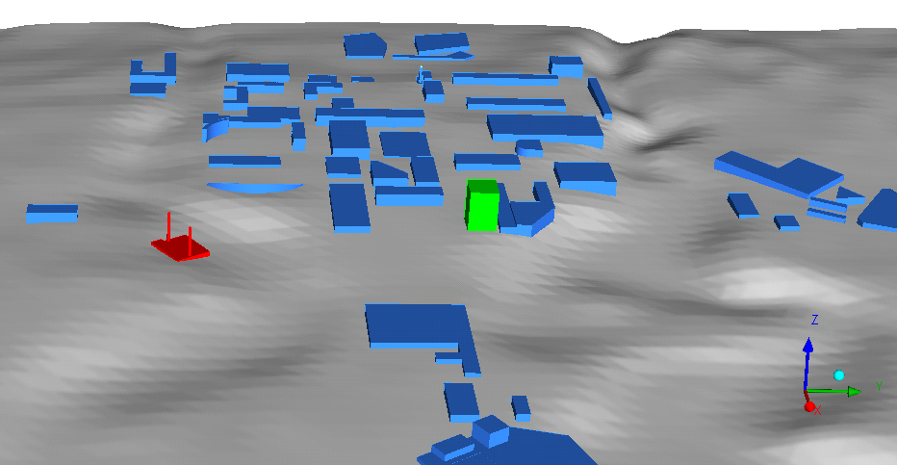
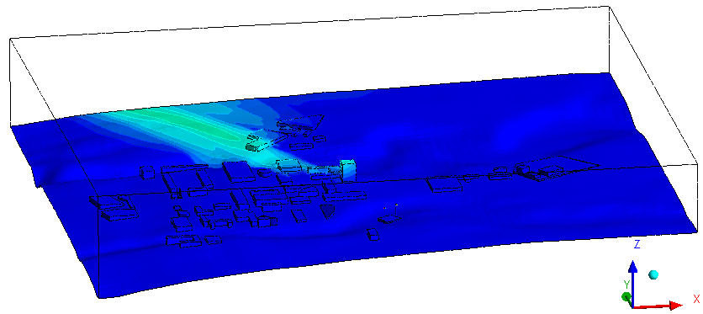

Case study: Distributed Combined and Heat Power Facility
Tall building
Tall building
CHP
CHP
A comparison between the measured emission rates in 2010 and 2015 did not reveal significant difference.
NOx (ppb)
CTAG simulations using measured emission rates as inputs suggest low ground level concentrations of air pollutants.
Yang and Zhang, manuscript in preparation

Slide 9
Regional air quality modeling of future scenarios of fossil-fueled distributed generation deployment
Resource Dynamics
Corporation

Slide 10
Regional Air Quality Modeling: Workflow
Projection of Future DG Deployment
US-REGEN Modelling of Central EGUs
Emissions Processing for Central EGUs
Air Quality Modeling
Spatial Allocation of DG
Emissions Processing for DG
Resource Dynamics
Corporation
Notes:
The regional air quality modeling project brings together several teams of researchers. First, RDC (experts on the economics and deployment of CHP/DG systems) will project the deployment of these units from present-day to 2050. This information is used in order to displace central-station EGUs in the REGEN model and the new make-up of the central-station fleet is determined. Using the “unit commitment” mode of the US-REGEN model, electricity generation from different units is calculated and this information is sent to Ramboll-ENVIRON for emissions processing. In parallel, RDC determine the spatial (and temporal) allocation of CHP/DG generation and this information is sent to UCI for emissions processing. UCI takes together the processed emissions from CHP/DG and central-station EGUs and performs the final air quality simulations.
The circles with black bold outlines are those activities on which we’ve made significant progress to date. We expect work to ramp up on all circles of this flowchart and to have results available to present late this year.

Slide 11
National Assessment of DG Market Potential
Factors to estimate DG market potential
  Utility electricity tariffs, monthly state gas prices
  DG/CHP price and performance information
  Database of manufacturing facilities and commercial buildings with load characteristics
  Economic incentives for CHP

Slide 12
Economic Potential, by Sector and DG/CHP Classification to 2050
The “Base Case” (“Low DG”) and
the “Aggressive Case with $4 Natural Gas” (“High DG”)
were used for air quality modeling
Notes:
This is directly from RDC (I haven’t had time to edit in my own words, but it would simplify what is stated. Note that economics reflect a <10 yr payback period.
In 2014, a National assessment of DG/CHP potential for EPRI was conducted using RDC’s DISPERSE model, with about 14 GW of total economic CHP potential found across the United States
Utility electricity tariffs, monthly state gas prices, and DG/CHP price and performance information used to evaluate economics
Estimated total economic potential using database of manufacturing facilities and commercial buildings with load characteristics; known existing CHP installations were identified and removed from results
Due to benefits of thermal energy and 10% investment tax credit (ITC) for CHP systems, CHP was economically favorable to power-only DG
A market adoption model was applied to the results of 2014 Assessment, estimating potential adoption through 2050 assuming economics remain similar and pool of potential sites unchanged
For this assessment, more aggressive price and performance parameters were considered, favoring power-only DG installations; also, a sensitivity was performed using $4/MMBtu natural gas price
The Aggressive DG price and performance provided stronger economics for power-only DG applications, but lower installed costs also improved the economics for some CHP installations
Value of recovered thermal energy is still an important economic factor
Lowering the cost of gas to $4/MMBtu had more of an effect on DG economics, creating larger spark spread and limiting the value of thermal energy from potential CHP applications
The $4/MMBtu gas sensitivity nearly doubled the estimated economic potential for the Aggressive DG scenario

Slide 13
Projected Market Adoption of DG through 2030
Adoption increases over time as new customers adopt DG
  Based on applying adoption percentages total economic potential
  Decision to adopt re-evaluated every 5 years
Market adoption in 2030 used for:
  Modeling of central EGUs
  Spatial allocation of DG
Payback Period | Likelihood of Adoption
0-1 year | 100%
1-2 years | 67%
2-3 years | 60%
3-4 years | 37%
4-5 years | 37%
5-6 years | 18%
6-7 years | 10%
7-10 years | 5%

Slide 14
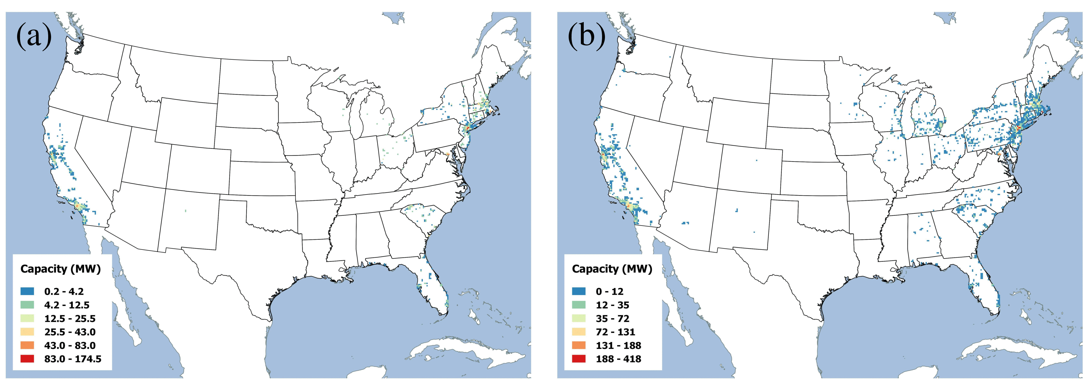
Spatial Allocation of DG in 2030
Low DG Penetration Scenario High DG Penetration Scenario
Total installed capacity for the Low DG Scenario is 7.6 GW Total installed capacity for the High DG Scenario is 25.4 GW

Slide 15
Emission Factors
Emission factors account for geographical differences in regulations
NOX
VOC
CARB
Limits
CARB
Limits
Notes:
Emission factors and emission limits are compiled from the DER technology survey “The Evolving Emissions Profile of Distributed Energy Resource Technologies” (EPRI, 2015). DG units with size <1 MW – 5 MW are assumed to be RICE. DG units with size 5+ MW are assumed to be gas turbines. The emission factors used for the baseline and aggressive $4 gas cases are based on the maximum value reported from manufacturer/test data, with the constrain that they cannot exceed the regional emission limits applicable:
DG emission factor = MIN ( MAX(manufacturer data, test data) , Regional Emission Limits )
If no regulatory limit , emission factors are based on manufacturer data, test data, and literature sources. See section 4 of the methodology report.

Slide 16
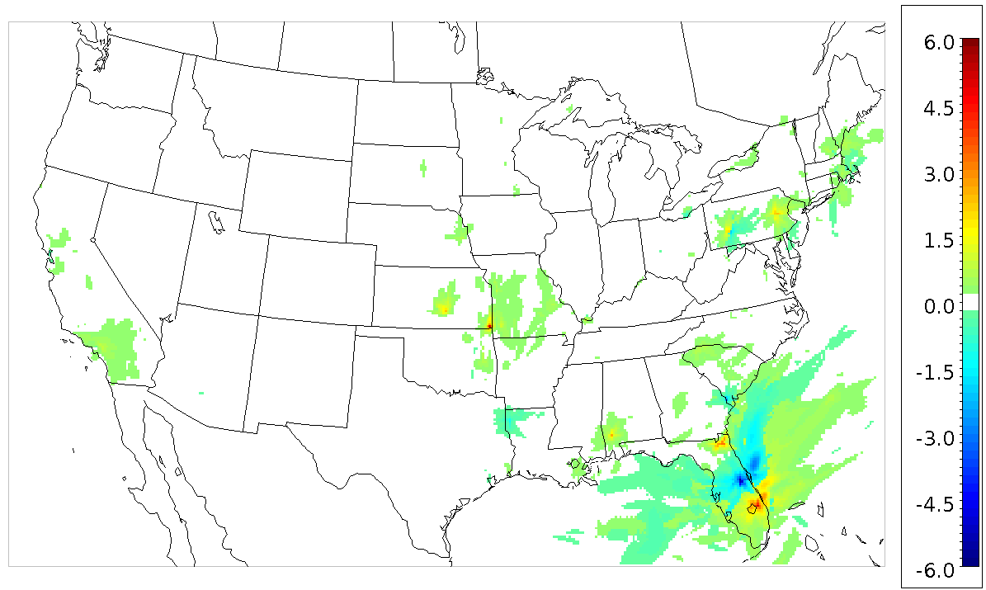
Low DG Penetration – Summer O₃ Impacts
Peak delta in maximum daily 8-hr average O₃ during summer episode

Slide 17
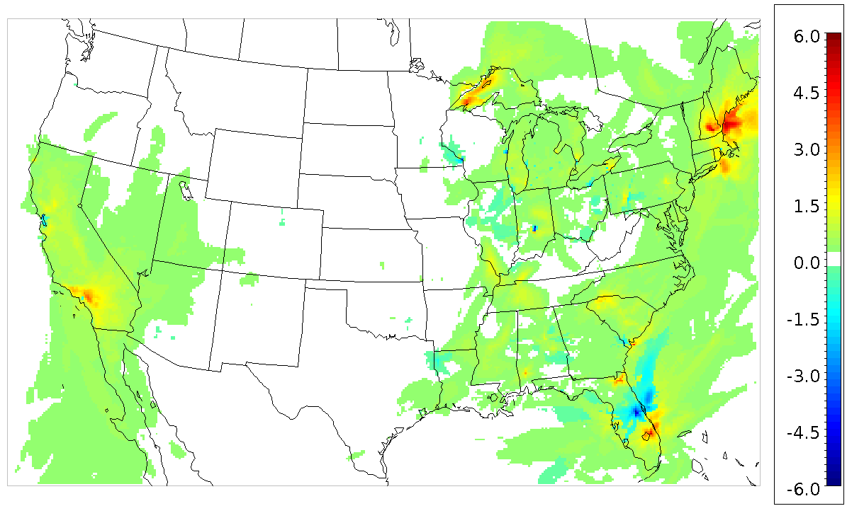
High DG Penetration – Summer O₃ Impacts
Peak delta in max daily 8-hr average O₃ during summer episode

Slide 18
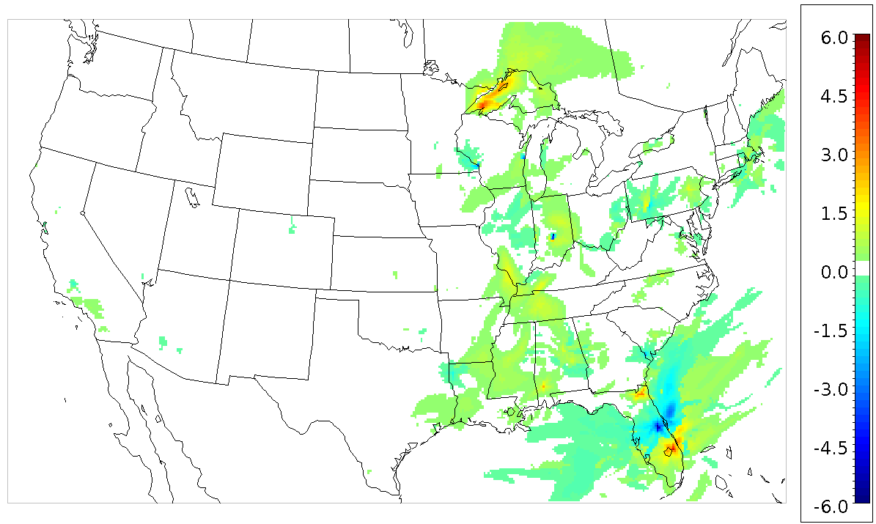
CARB Certification Scenario – Summer O₃ Impacts
Peak delta in max daily 8-hr average O₃ during summer episode

Slide 19
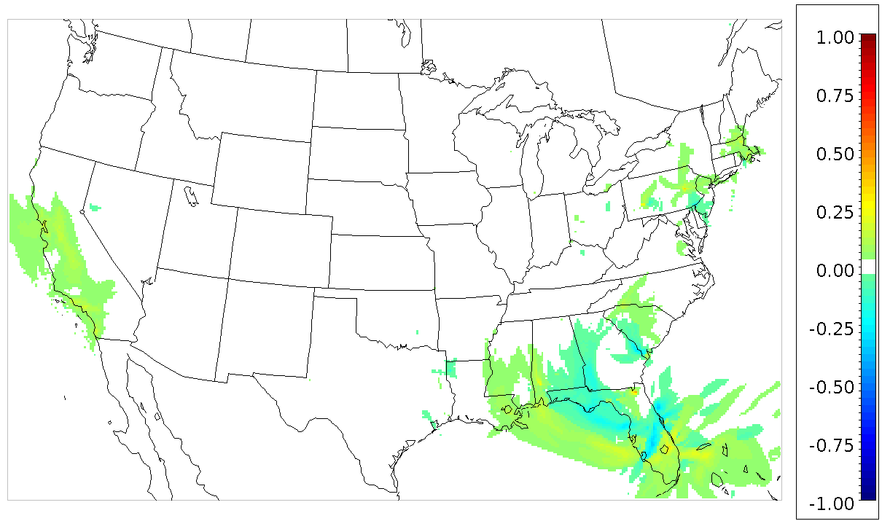
Low DG Penetration – Winter PM_{2.5} Impacts
Peak delta in 24-hr average PM_{2.5} during winter episode

Slide 20
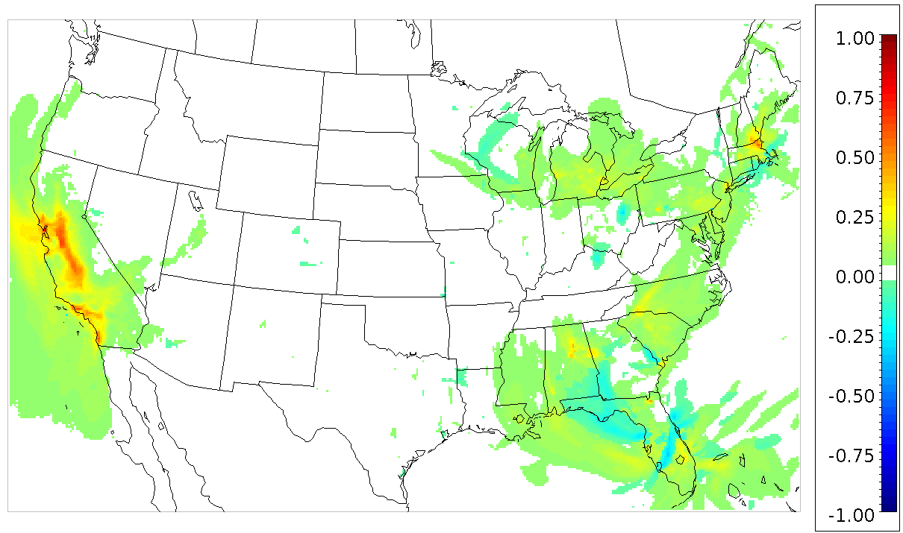
High DG Penetration – Winter PM_{2.5} Impacts
Peak delta in 24-hr average PM_{2.5} during winter episode

Slide 21
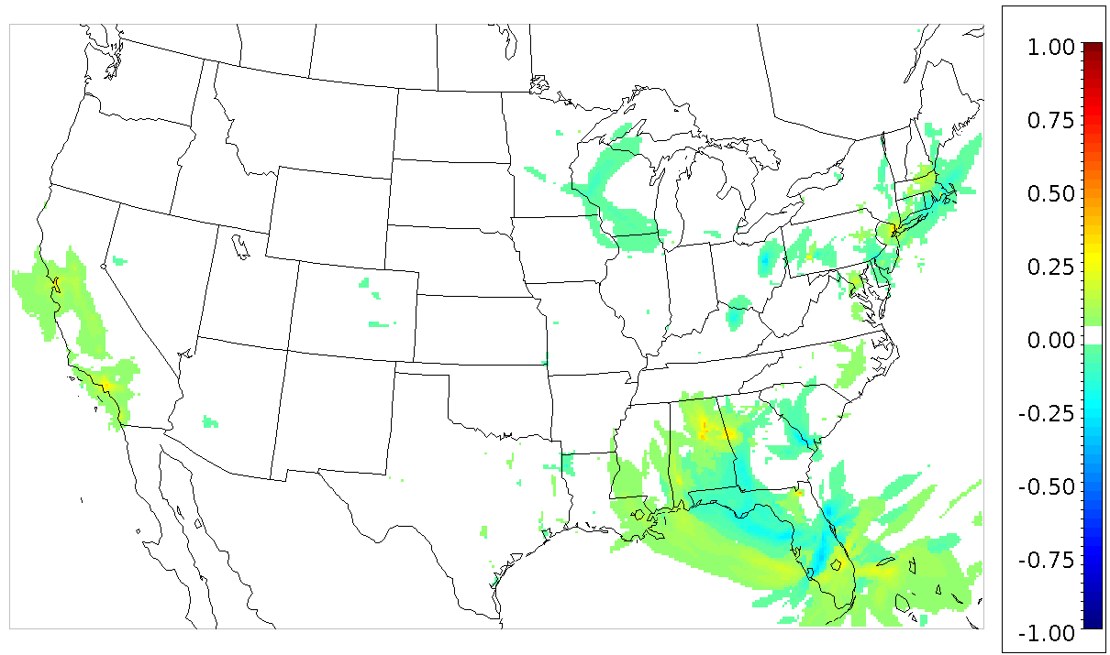
CARB Certification Scenario – Winter PM_{2.5} Impacts
Peak delta in 24-hr average PM_{2.5} during winter episode

Slide 22
Conclusions – Regional Impacts of DG
Northeast and southwest are most impacted by DG
  Some effects in the southeast, mostly due to changes in EGU emissions in FL (based on dispatch model results)
Implementing CARB limits minimizes impact of DG on O₃ and PM_{2.5}
  CA and NEUS see the greatest air quality benefits

Slide 23
Manuscript Now Available
Regional Modeling
J.R. Horne, M. Carreras-Sospedra, D. Dabdub, P. Lemar, U. Nopmongcol, T. Shah, G. Yarwood, D. Young, S.L. Shaw, E.M. Knipping. Air quality impacts of projections of natural gas-fired distributed generation. Atmospheric Environment 2017. 168, 8-22.
https://doi.org/10.1016/j.atmosenv.2017.08.046

Slide 24
Manuscripts Available, Submitted and In Preparation
Single-Source Modeling
Yang, B., & Zhang, K. M. (2017) CFD-based turbulent reactive flow simulations of power plant plumes. Atmospheric Environment 2017. 150, 77–86. https://doi.org/10.1016/j.atmosenv.2016.11.049
Yang, B., & Zhang, K. M. The effect of heat recovery on near-source plume dispersion of a simple cycle gas turbine. Manuscript submitted to Atmospheric Environment.
Yang, B., & Zhang, K. M. The near-source impacts of a distributed combined and heat power facility: Emission characterization and numerical simulations. Manuscript in preparation

