Slide 1
Chemical histories of pollutant plumes in East Asia:
Use of HYSPLIT-CMAQ tracking tool during the 2015 MAPS-Seoul campaign
Hyun Cheol Kim ^{1,2}, MinAh Bae³, Tianfeng Chai^{1,2}, Fong Ngan^{1,2}, Ariel Stein^{1,2},
Changhan Bae³, Eunhye Kim³, Byeong-Uk Kim⁴, and Soontae Kim³
¹ Air Resources Laboratory, National Oceanic and Atmospheric Administration, College Park, MD
² Cooperative Institute for Climate and Satellites, University of Maryland, College Park, MD
³Ajou University, Dept. of Environmental Engineering, Suwon, Korea
⁴ Georgia Environmental Protection Division, Atlanta, GA

Slide 2
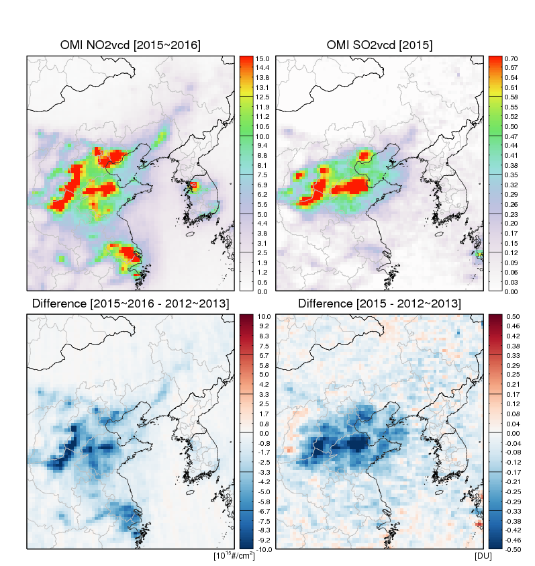
Motivation
Being located downwind side of strong emission sources, Korea has been affected by regional and local emission sources.
Understanding formation, removal and transport of aerosols and their chemical characteristics is crucial to improve air quality in this region.

Slide 3
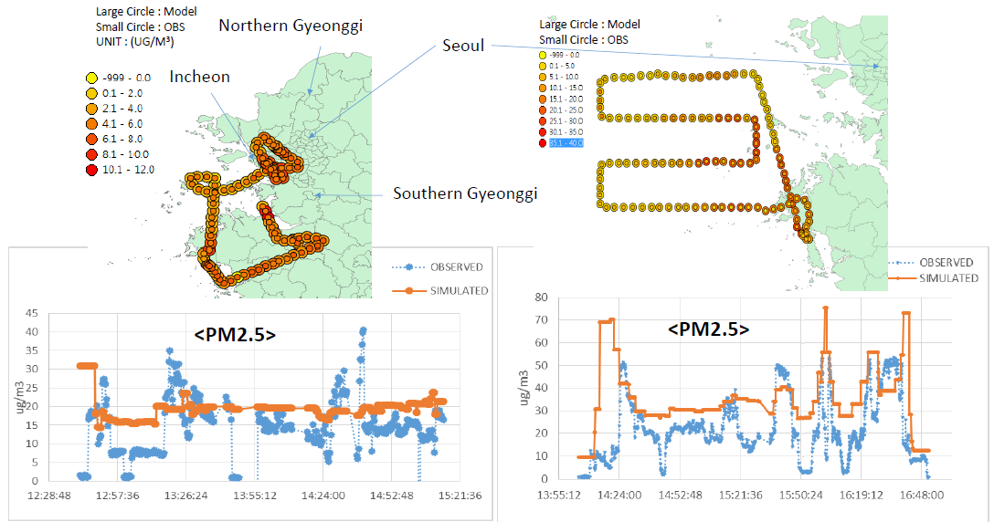
MAPS-Seoul 2015 campaign
The Megacity Air Pollution Studies-Seoul (MAPS-Seoul, 2015) is a preparatory campaign for KORUS-AQ (2016).
7 in-situ aircraft measurements were conducted during May 18 – June 13, 2015.
(Kim et al., 2015, IWAQRF)

Slide 4
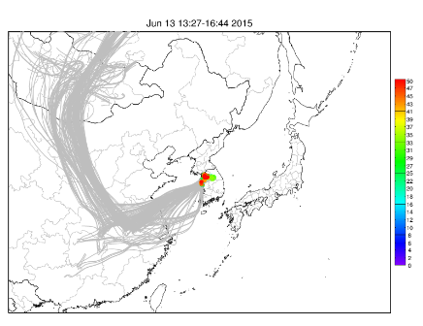
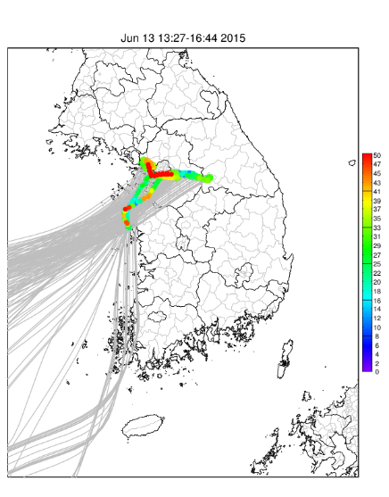
Approaches: Development of BMA
The Backward-tracking Model Analyzer (BMA) tool is designed to analyze chemical histories of transport plumes for surface or aircraft measurements.
HYSPLIT
Meteorology
WRF
MPE
Observations
Release
time/location
Trajectory
Dispersion
CMAQ
Parallelized
Simulations
Probability
Process Analysis
path
Chemical History
MAPS (Jun13) flight 7
3-day backward trajectories

Slide 5
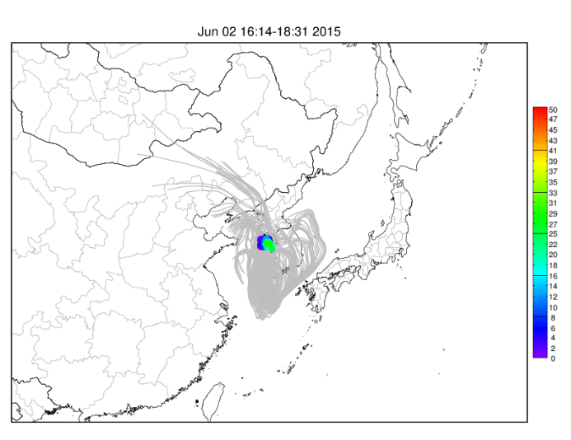
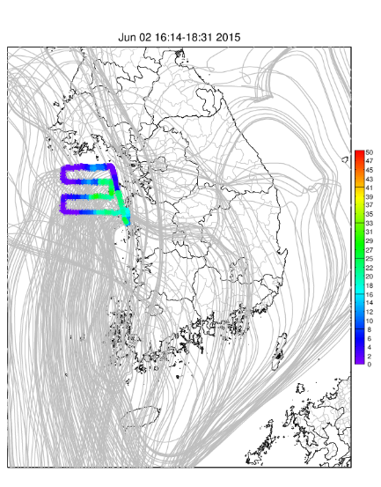
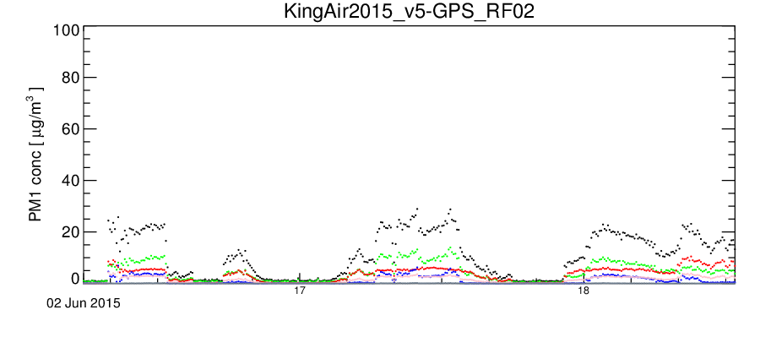
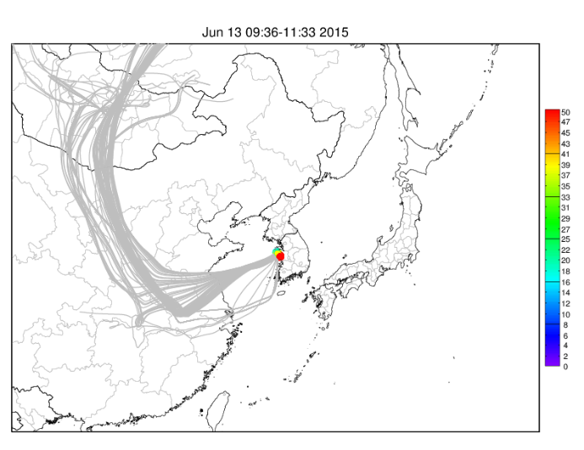
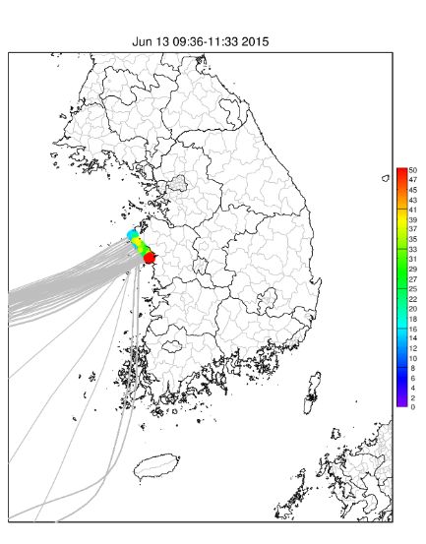
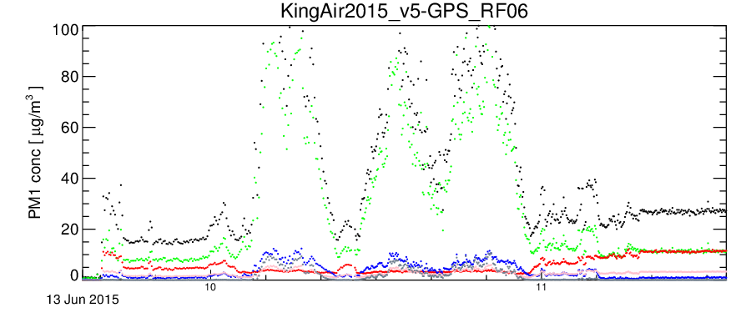
Not the best decision…
Flight RF02
Local circulation… Offshore measurements
Flight RF06
Long range transport… Local sources

Slide 6
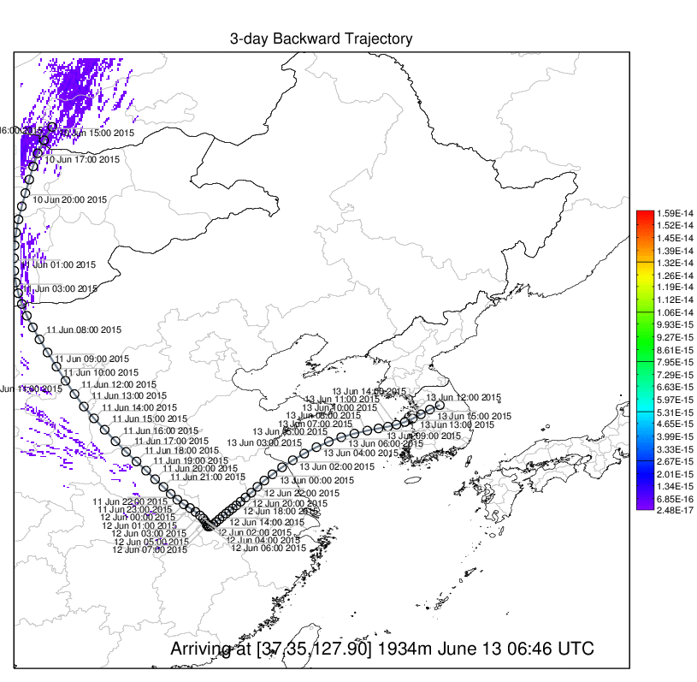
Linkage of HYSPLIT & CMAQ
Four linkage methods
Trajectory
Trajectory-Column
Dispersion
Dispersion-Column
Release backward trajectories or particles at each aircraft path location/time

Slide 7
Inside the BMA
Designed to link HYSPLIT trajectory/particle geoinformation to CMAQ model grid indices.
Utilizes 3 types of HYSPLIT outputs: tdump (trajectory), cdump (column-integrated concentration), and pardump (particle location/time)
“never-read-same-data-again” strategy
Trajectories
Particles
[Lat,Lon,Alt,Time]
Group Indexing
Unique
Indices
Model
[ix,iy,iz,it]
Comparison
Reverse Indexing
~ hundreds points
Paired model data
~ millions points

Slide 8
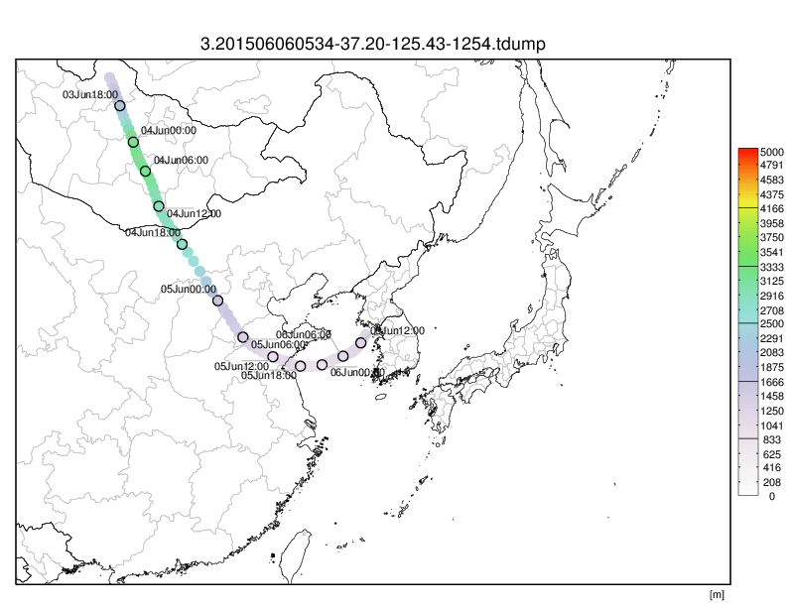
3-days backward trajectory arriving at [37.2,125.43] (1254m) June 6 14:34 2015 (KST)

Slide 9
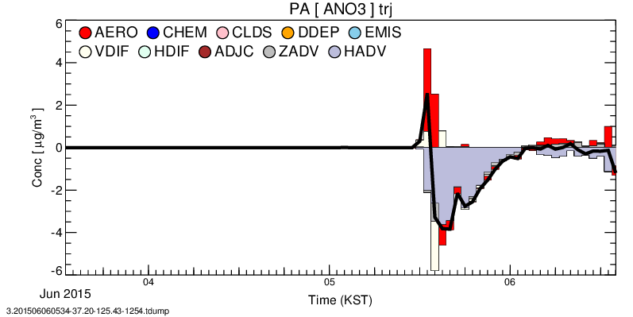
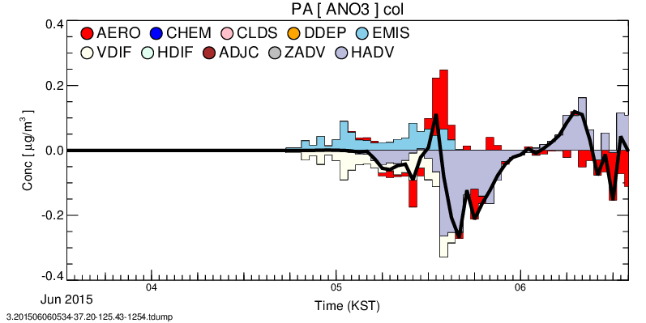
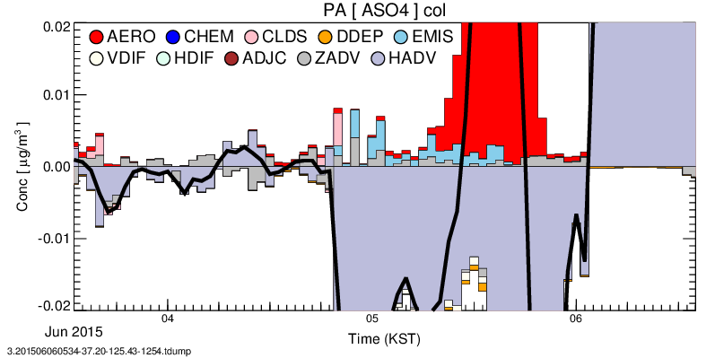
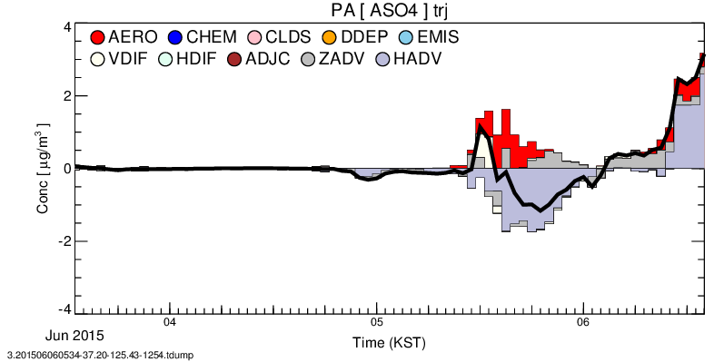
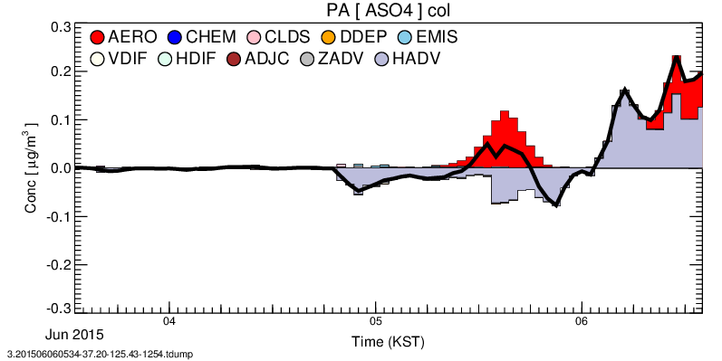
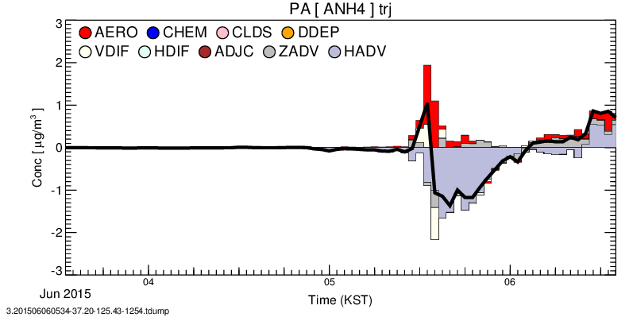
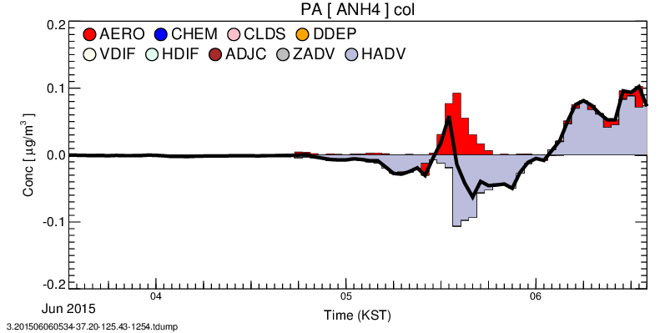
Trajectory method
Column method

Slide 10
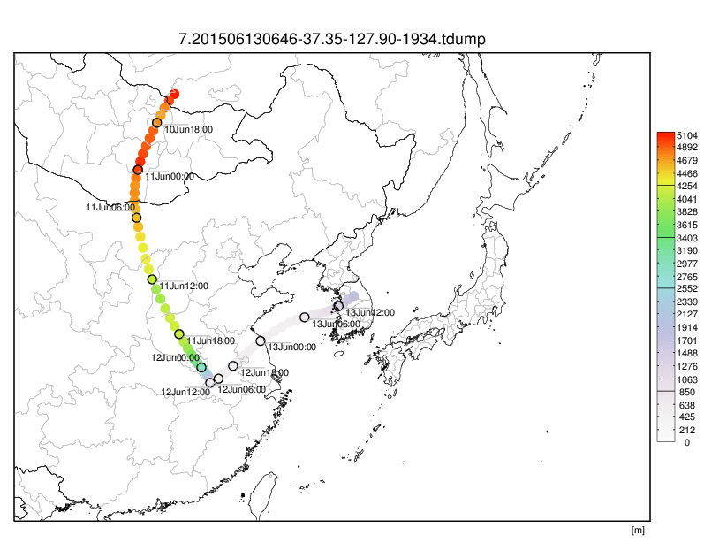
3-days backward trajectory arriving at [37.35,127.90] (1934m) June 13 15:46 2015 (KST)

Slide 11
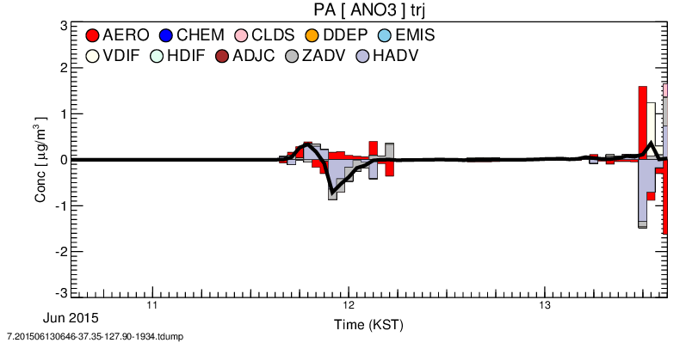
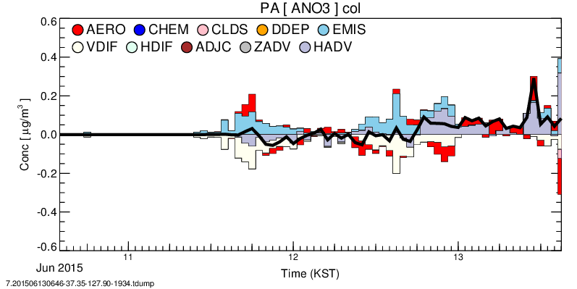
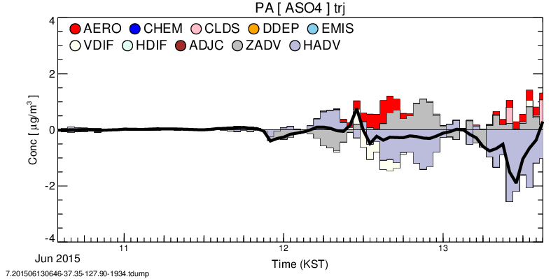
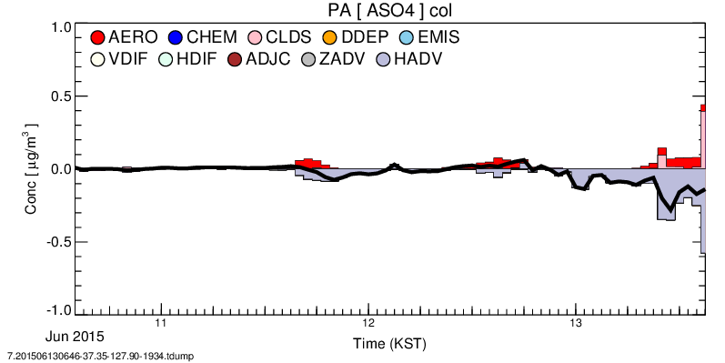
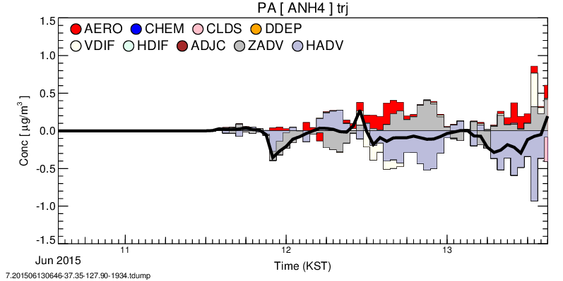
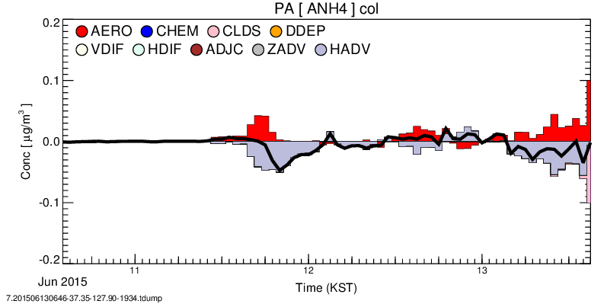
Trajectory method
Column method

Slide 12
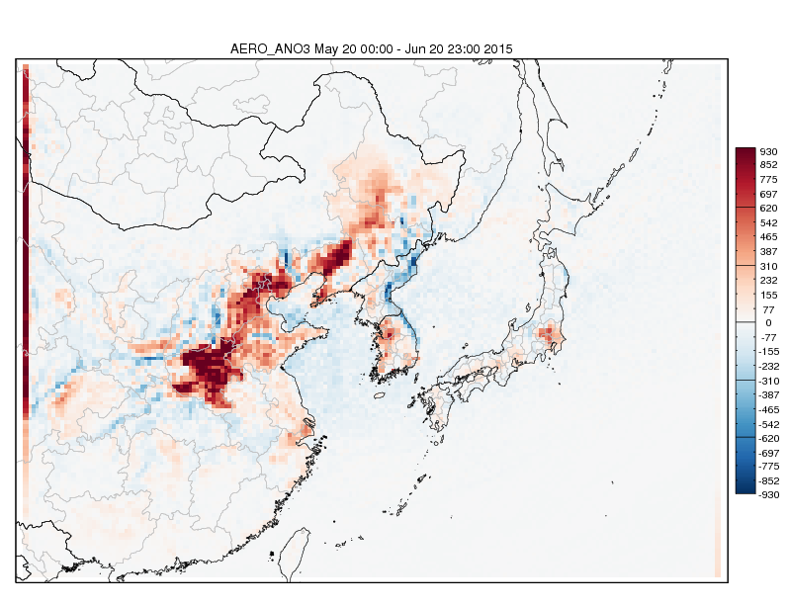
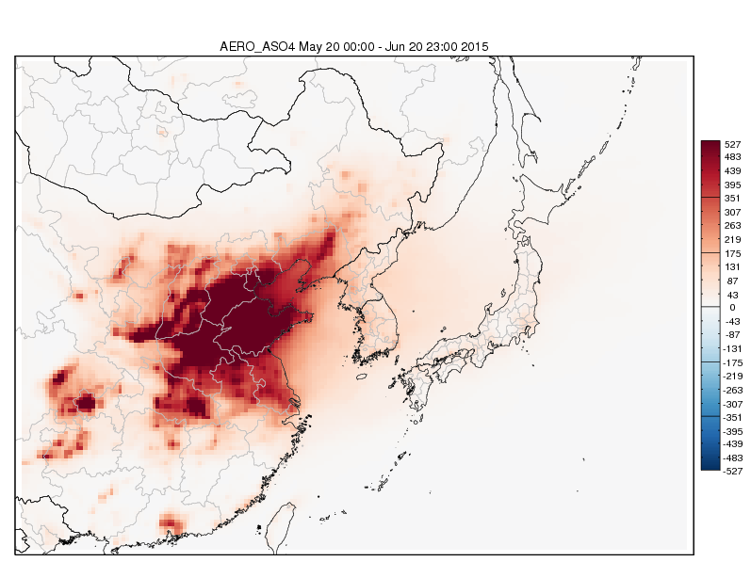
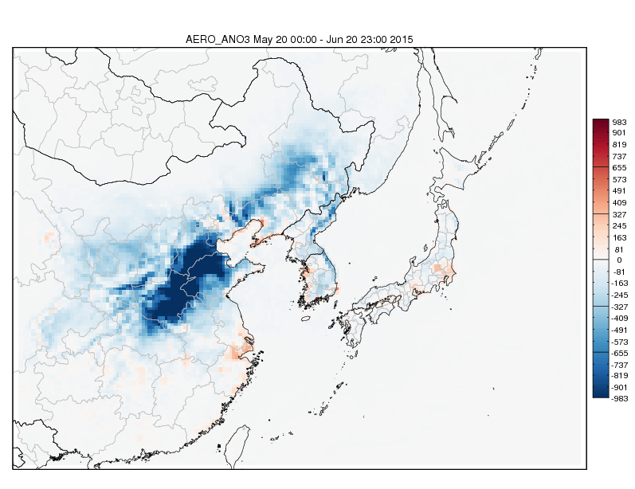
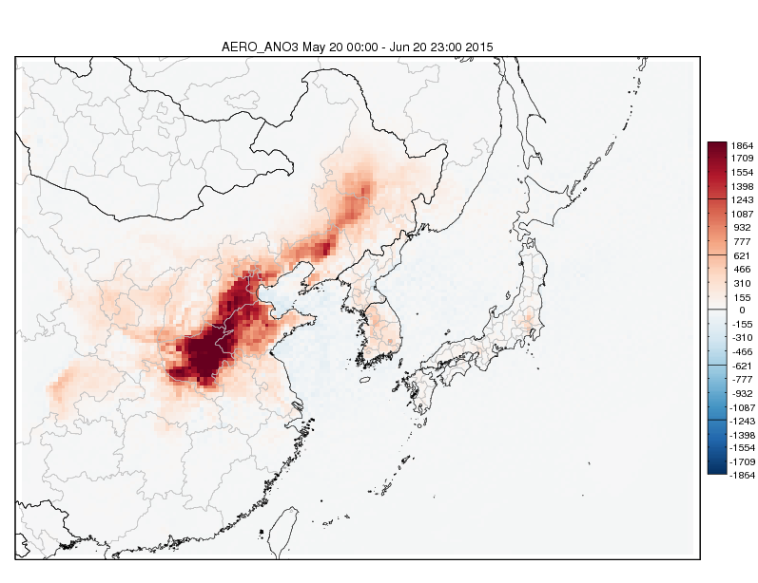
Where Aerosols Form?
AERO_ANO3
AERO_ASNO4
AERO_ANO3 (layers 1-5)
AERO_ANO3 (layers 6-10)
Averages over May 20 – June 20, 2015

Slide 13
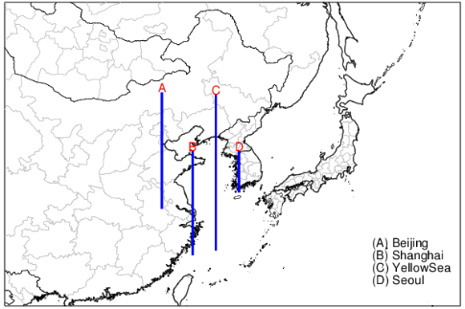
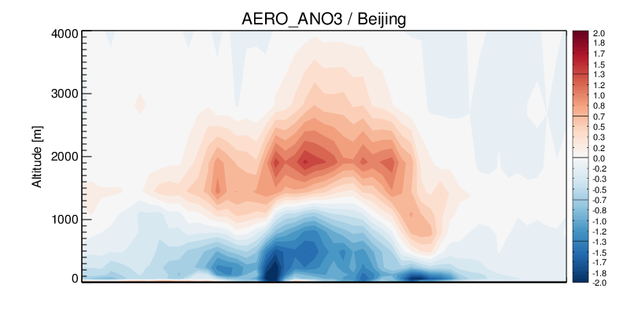
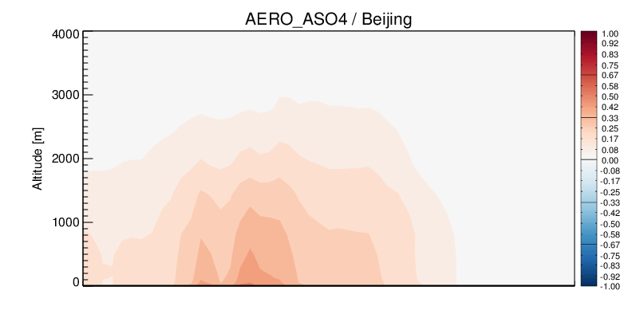
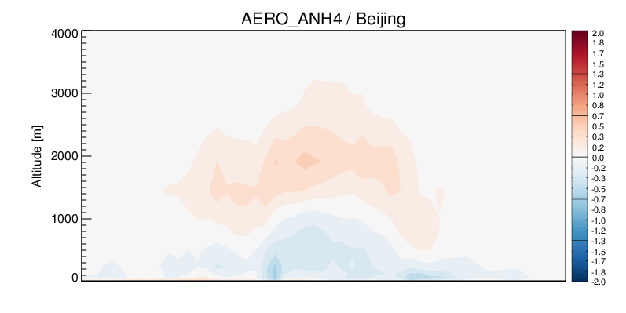
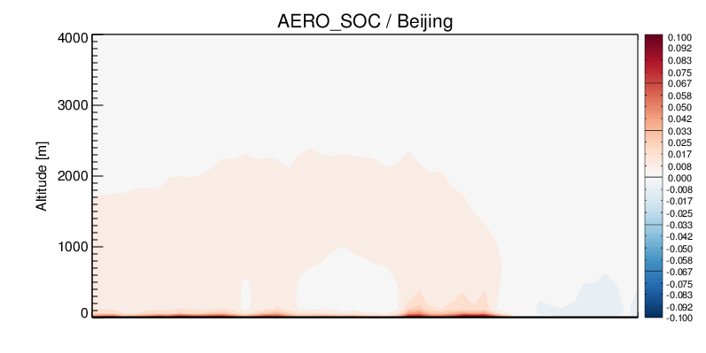
Aerosol Process (CMAQ PA)
Cross Section (A) through Beijing
South
Hebei
Beijing
North
South
Hebei
Beijing
North
South
Hebei
Beijing
North
South
Hebei
Beijing
North
Averages over May 20 – June 20, 2015

Slide 14
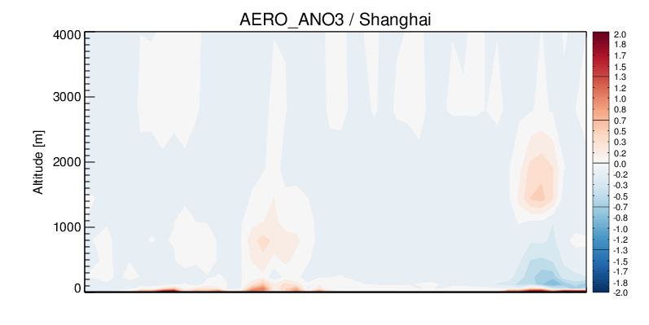
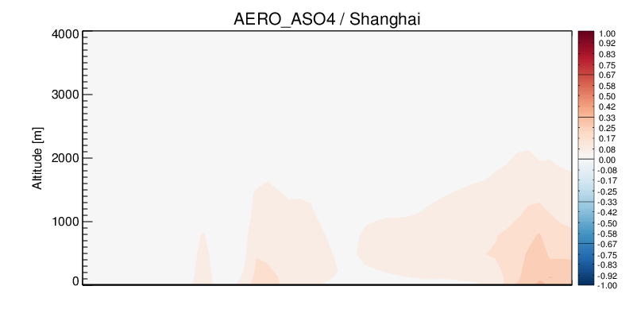
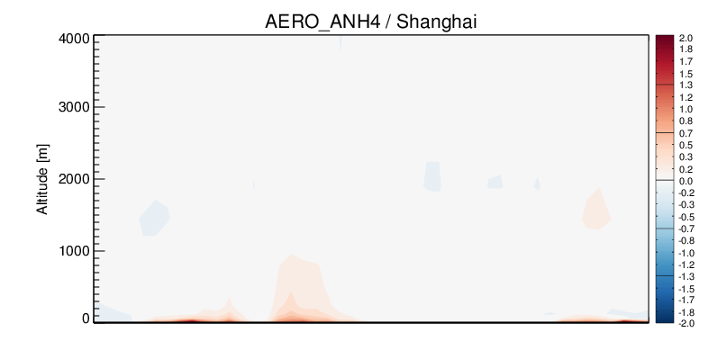
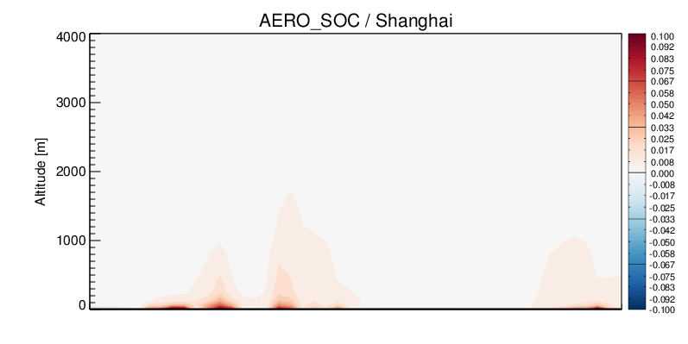
Aerosol Process (CMAQ PA)
Cross Section (B) through Shanghai
South
Shanghai
North
South
Shanghai
North
South
Shanghai
North
South
Shanghai
North
Averages over May 20 – June 20, 2015

Slide 15
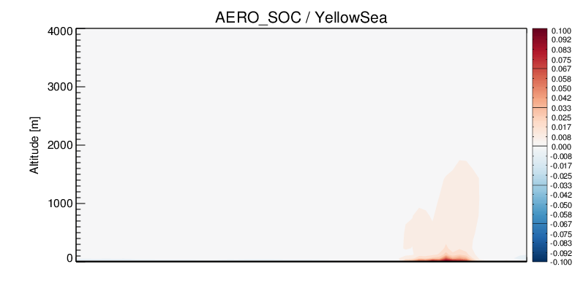
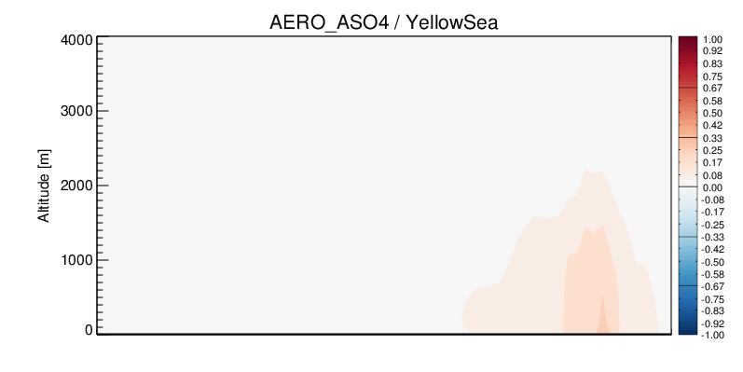
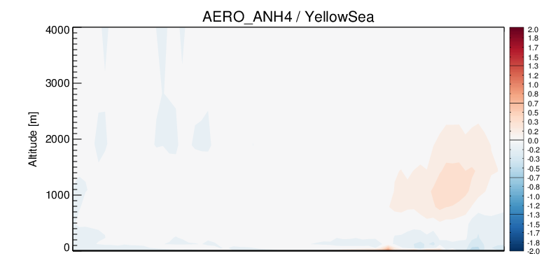
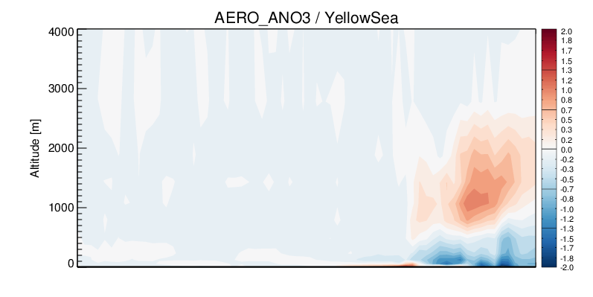
Aerosol Process (CMAQ PA)
Cross Section (C) through Yellow Sea
North
South
Yellow Sea
Shenyang
South
Yellow Sea
Shenyang
North
Yellow Sea
Shenyang
South
North
South
Yellow Sea
Shenyang
North
Averages over May 20 – June 20, 2015

Slide 16
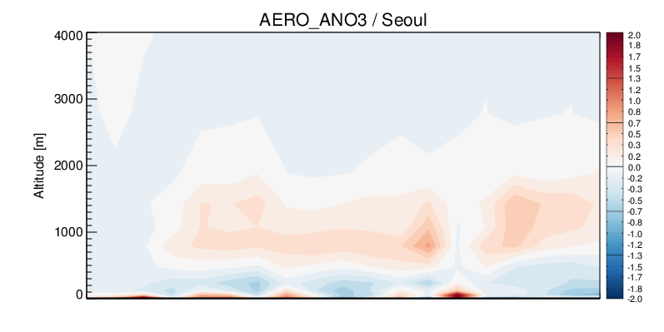
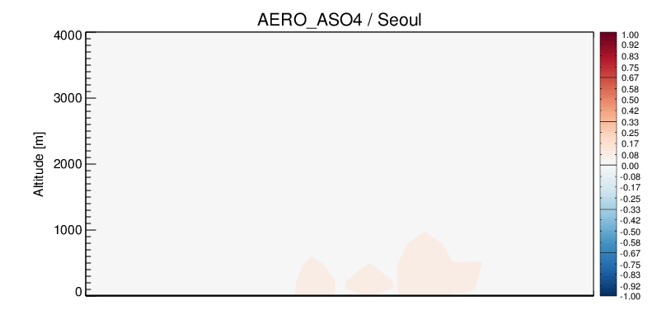
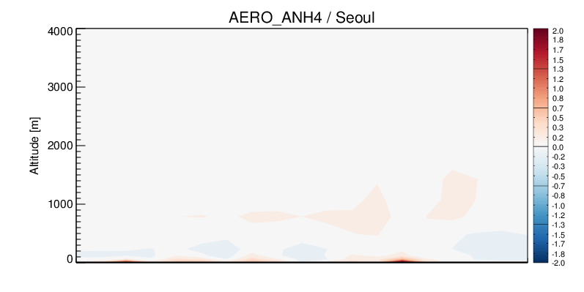
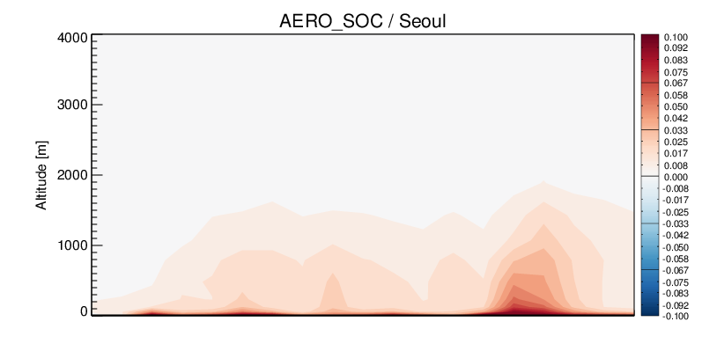
Aerosol Process (CMAQ PA)
Cross Section (C) through Yellow Sea
Local or Transport?
North
South
North
South
Seoul
Seoul
Seoul
North
South
Seoul
South
North
Averages over May 20 – June 20, 2015

Slide 17
Discussions & Next steps
Aerosol formations differ by location, altitude and composition. Tracking pollutant and precursor plume transport is important to understand downwind region’s air quality.
Over northern China, sulfate aerosol formation may be related to not only the intensity of nitrate aerosol formation, but also the altitude of aerosol formation. It implies that SO₂ emission control may affect the transport efficiency of long-range transport to neighboring countries.
Will apply similar approach to KORUS-AQ 2016 campaign.
Need to investigate aerosol formation/transport mechanism responding to Chinese SO₂ emission control.
South
Hebei
Beijing
North
South
Seoul
North

Slide 18
Summary
Understanding formation process of pollutants and quantifying contributions from local and remote emission sources, especially during the transport across the Yellow Sea, are crucial to explain the SMA region’s air quality and to set a direction of emission regulation policy.
A hybrid tool to efficiently track pollutant plumes’ movement and to analyze physical and chemical processes within the plume was developed using NOAA ARL HYSPLIT model and EPA CMAQ chemical transport model.
Using in-situ aircraft measurements during the Megacity Air Pollution Studies – Seoul (MAPS-Seoul) 2015 campaign, the newly developed tool could provide chemical histories of each pollutant plumes based on the CMAQ PA analysis.
CMAQ PA simulations show varying aerosol formations and losses, depending on geographical coverages, vertical extent, and chemical components. Over northern China, nitrate shows strong loss near surface and production in higher altitude, while sulfate show consistent aerosol production from surface to upper level. Balancing between formation of ammonium sulfate and ammonium nitrate is likely explains there relative production and loss.

