Slide 1
Photochemical Modeling of Industrial Flare Plumes with SCICHEM 3.1
Prakash Karamchandani¹, Lynsey Parker¹, Greg Yarwood¹, Ron Thomas², Marvin Jones²
¹Ramboll Environ, Novato, CA
²Texas Commission on Environmental Quality, Austin, TX
16th Annual CMAS Conference
Chapel Hill, North Carolina, October 23-25, 2017

Slide 2
Acknowledgement
This study was supported by the Texas Commission on Environmental Quality (TCEQ) under Work Order No. 582-17-71123-20

Slide 3
Background & Objectives
HRVOC emissions from industrial flares can promote active photochemistry and ozone formation
PGMs cannot adequately resolve fine scale features of individual flare plumes
Objectives of study:
Explore possible improvements in modeling industrial flare plumes
Understand the impact of flare emissions on ozone
Demonstrate SCICHEM reactive puff model application for HRVOC flares
Demonstrate the use of SCICHEM as an Appendix W Tier 2 single-source model

Slide 4
Flare Modeling with SCICHEM 3.1
Lagrangian 3-D puff model
Puff dispersion based on SCIPUFF (Second Order Closure Integrated Puff Model)
CB6r2 chemistry mechanism
Previously used successfully to simulate the HRVOC-NOx-ozone chemistry of the Houston Ship Channel (HSC) plume*:
Model results compared with downwind aircraft measurements of HSC plume
Model reproduced peak ozone formation in plume at multiple downwind distances
Good comparisons with aircraft NOz and formaldehyde measurements
*Karamchandani, P., D. Parrish, L. Parker, T. Ryerson, P. Wennberg, A. Tong, J. Crounse and G. Yarwood. 2015. Reactive Plume Modeling of HRVOC Emissions from the Houston Ship Channel. 14th Annual CMAS Conference, Chapel Hill, North Carolina, October 5-7, 2015.

Slide 5
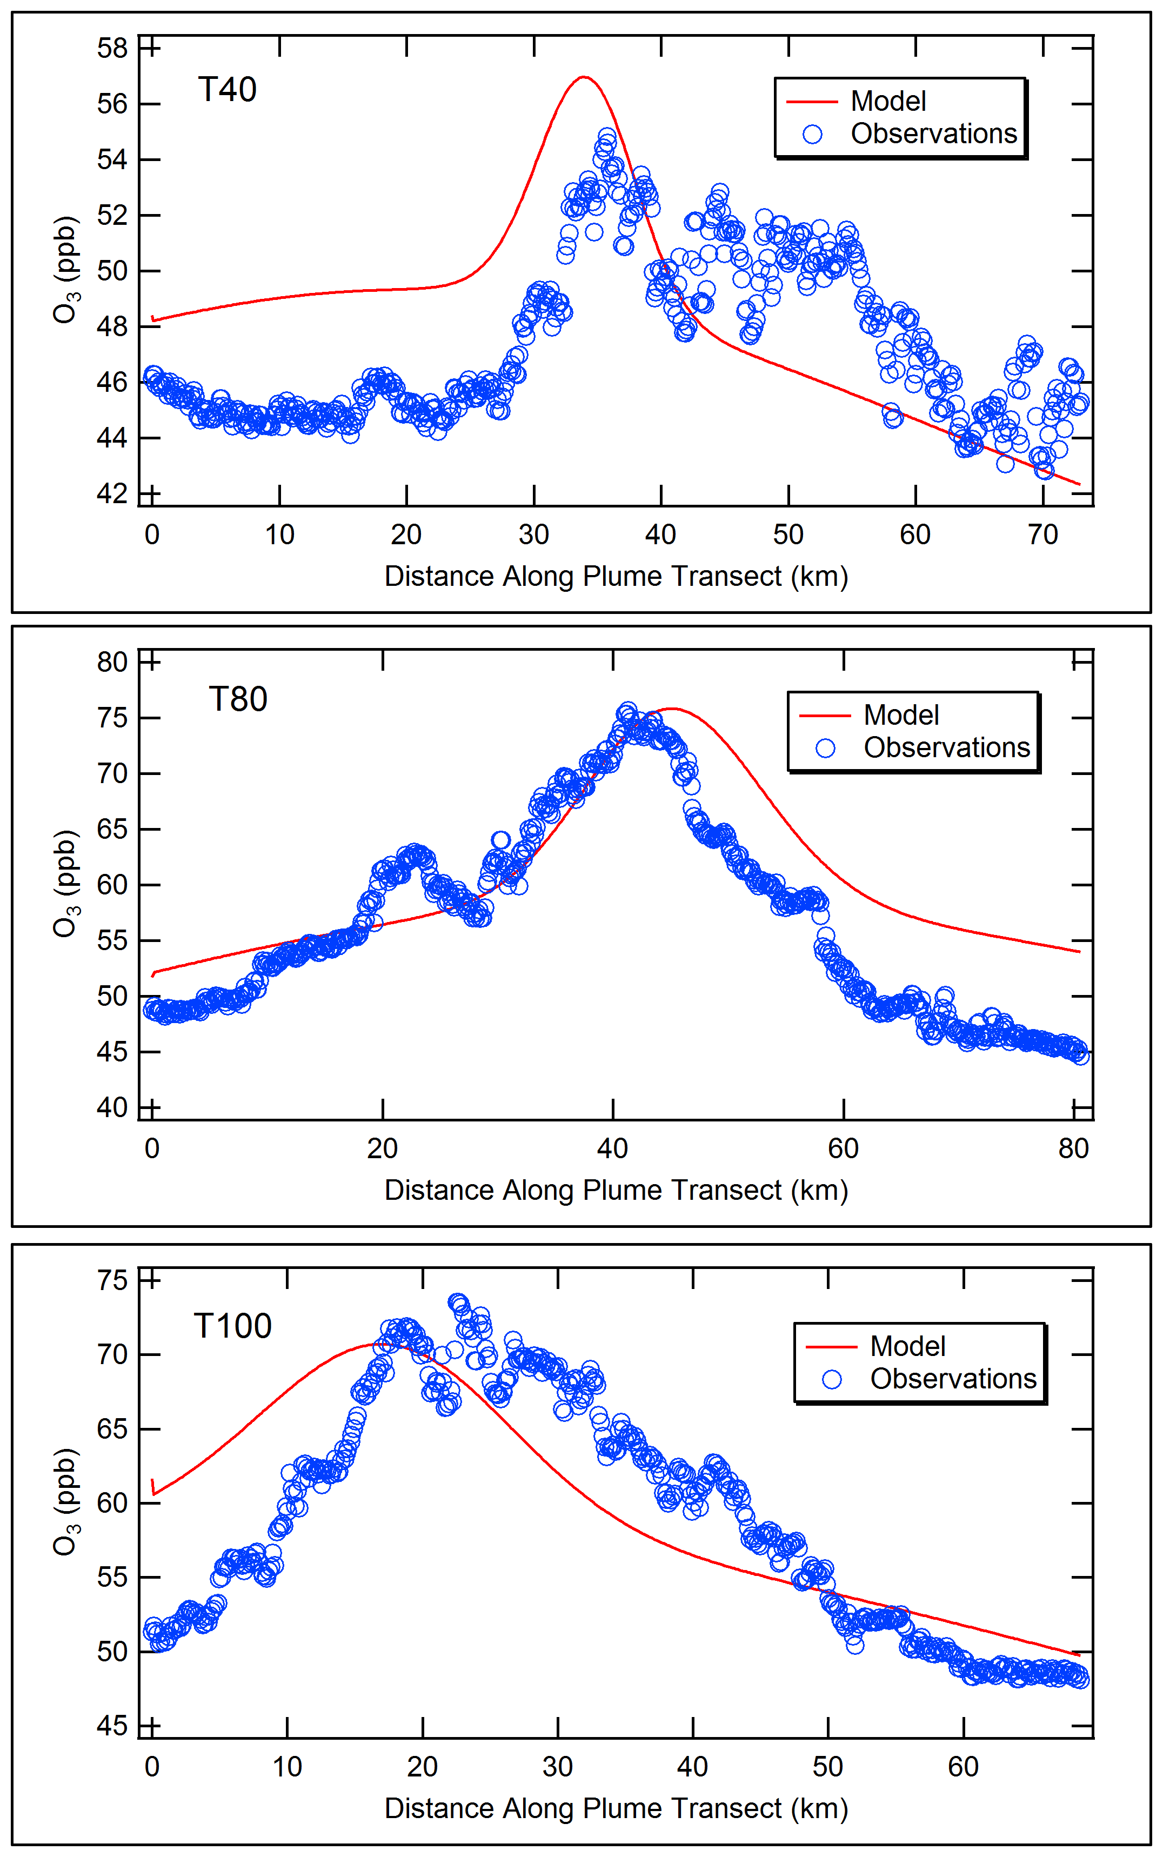
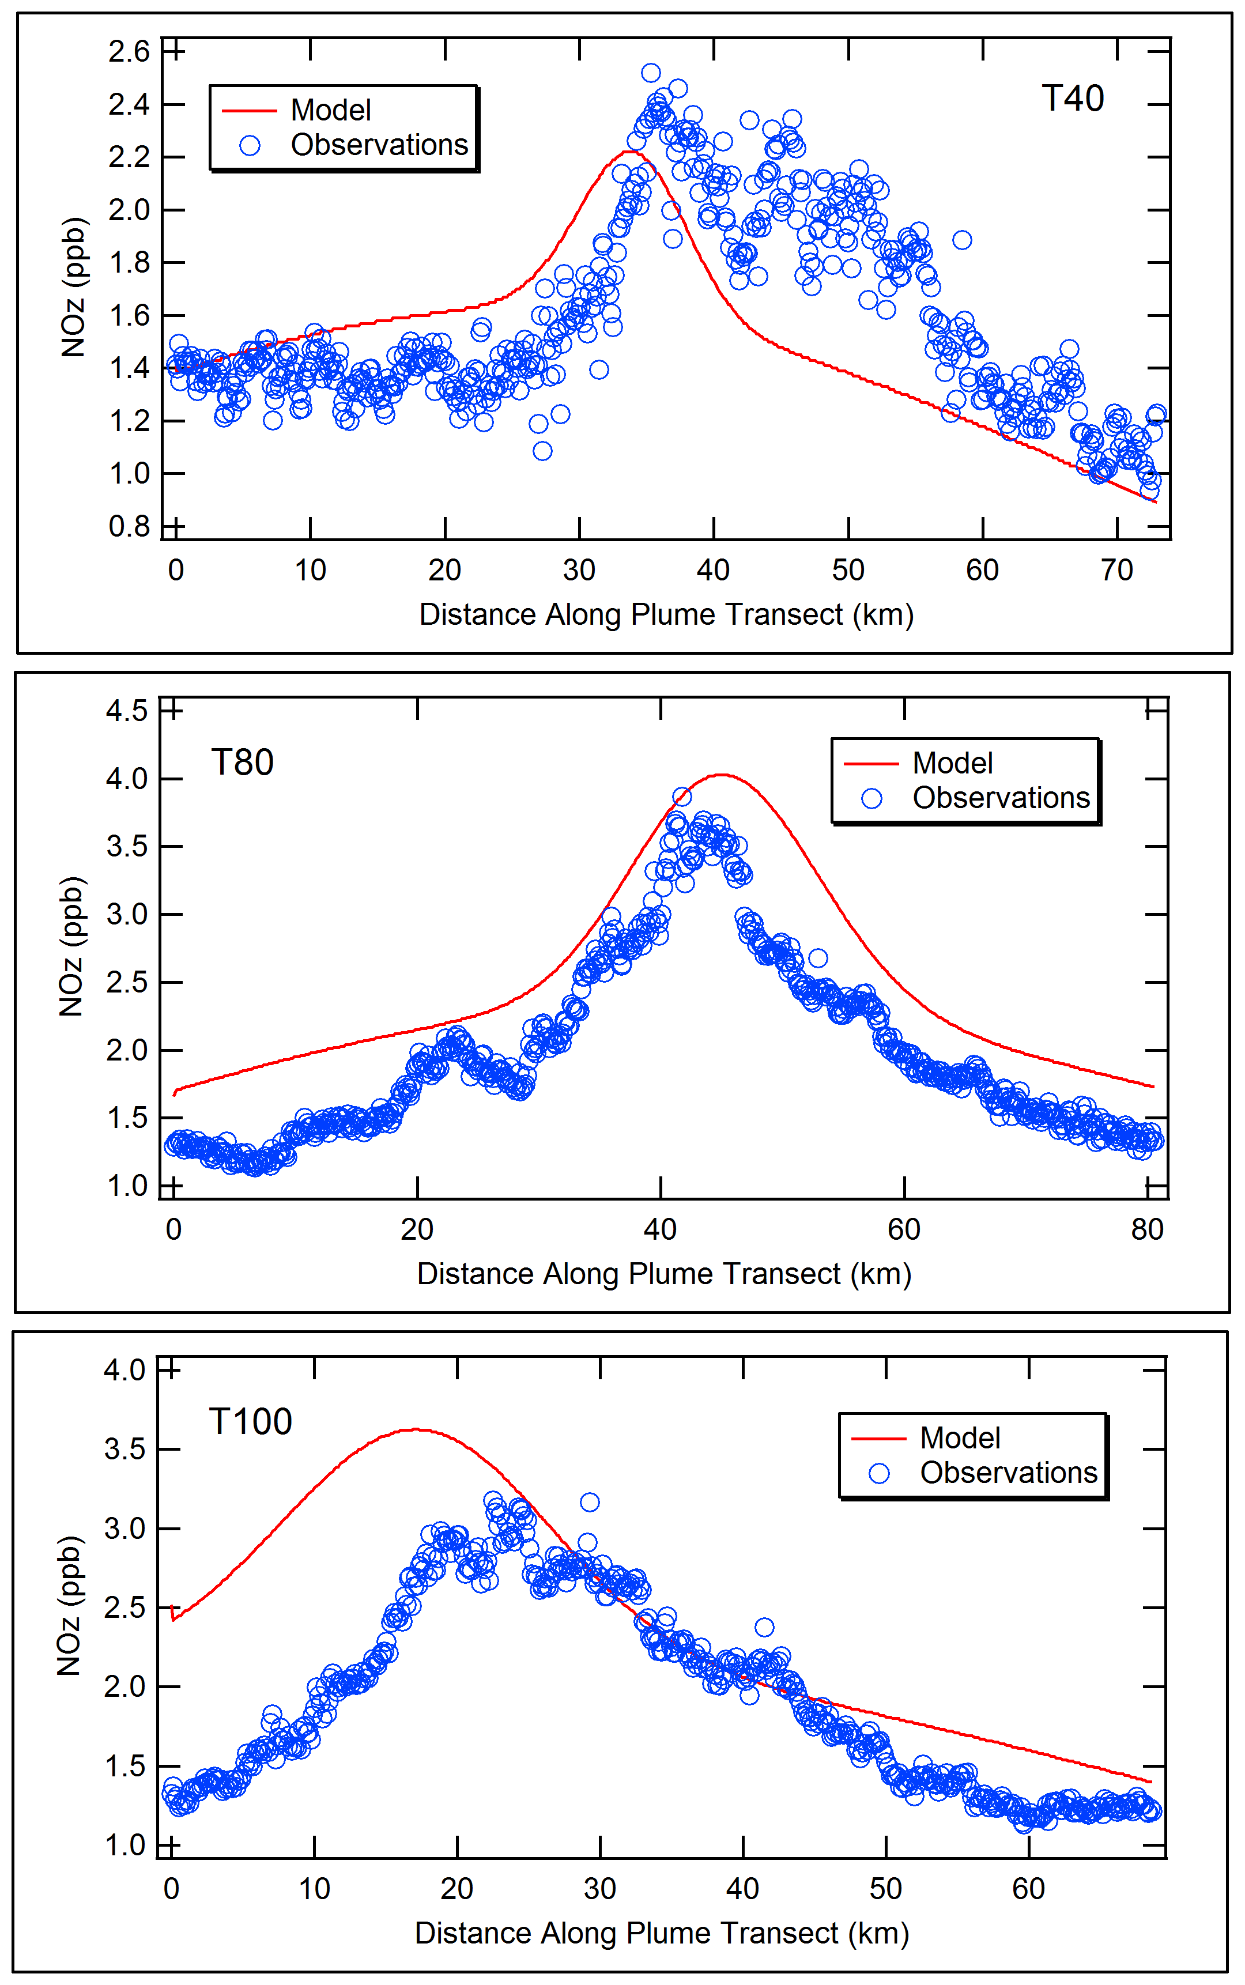
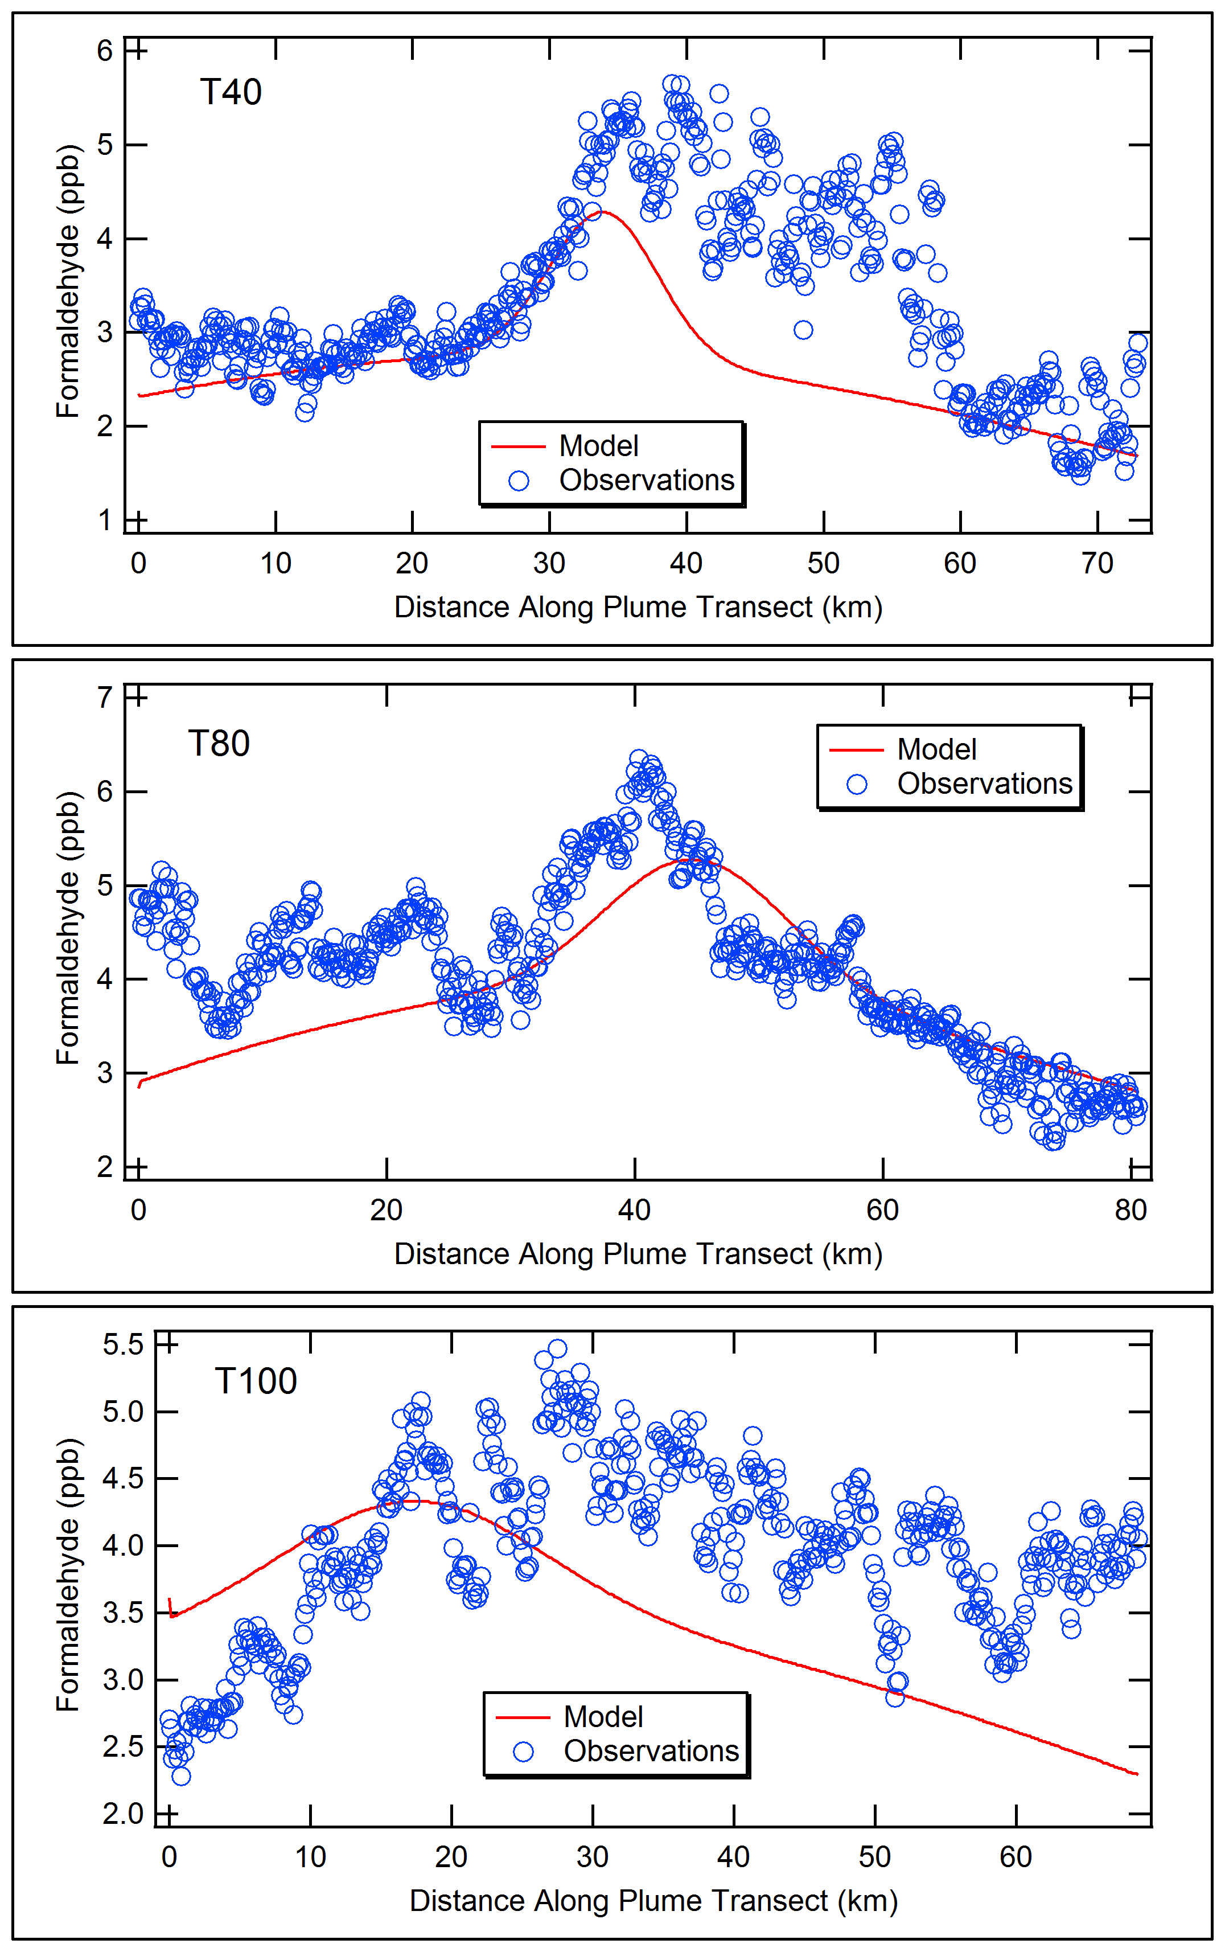
SCICHEM Modeling of Houston Ship Channel Plume
O₃
HCHO
40 km
NOz
80 km
100 km

Slide 6
Flare Modeling Approach
Select flaring events
Gather local meteorological data
Obtain speciated HRVOC and NOx emissions for flare
Specify background concentrations for plume chemistry:
Regional background: from SCICHEM 3.1 distribution for SE Texas (from processing CAMx outputs)
Local background: include nearby facilities in SCICHEM so that flare plume can entrain nearby emissions for secondary formation of ozone

Slide 7
Flare Selection
Texas Flares and Monitoring
1335 flares reported to the Texas emissions database in 2009 from 545 sites
72 ozone monitors operating in Texas
32 Auto-GC VOC monitors operating in Texas
HRVOC Flares in Texas
Oil & gas sites (many have flares) don’t emit sufficient HRVOC for rapid ozone formation
Focus on refineries and petrochemical plants that make or use olefins (HRVOCs)
2011 HRVOC Flare Special Inventory survey
183 flares at 69 sites responded

Slide 8
Selection Approach
Isolated flares
Would ideally provide isolated, singular, non-confounding plumes
Found no remote/isolated examples across the entire state that were close enough to any downwind ozone monitors
“Events” from the 2011 TCEQ HRVOC Flare Special Inventory emissions survey (2009 and part of 2006)
Flaring episodes with conditions favoring ozone formation
High HRVOC emission rates and background NOx, and
Auto-GC HRVOC emissions detected downwind, and/or
Ground level ozone monitors downwind of the flare that potentially detect effects of the flare event
Check prevailing wind direction
Check event window with HYSPLIT
Notes:
HGB HRVOC flare operators are required to keep operating data (e.g., flow rates, emission rates, composition) for five years, and
Most flare survey respondents provided hourly operating data for 2009 and part of 2006
3 Flares selected

Slide 9
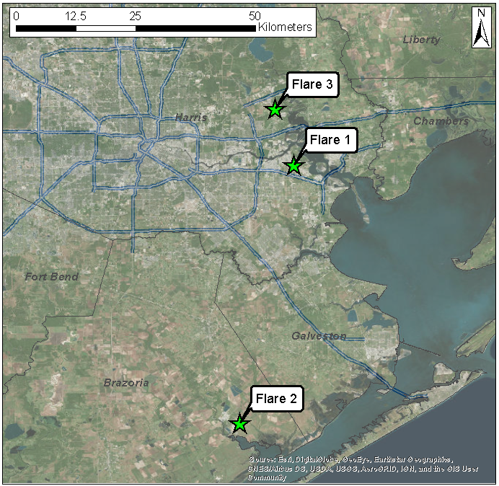
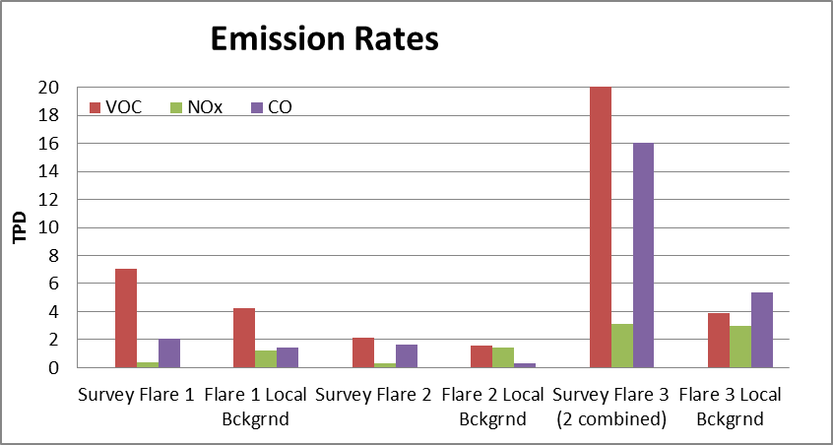
Selected Flares
Flare 1: Deer Park, June 2, 2006
Flare 2: Chocolate Bayou, June 4, 2006
Flare 3: Channelview, December 4 and 5, 2009

Slide 10
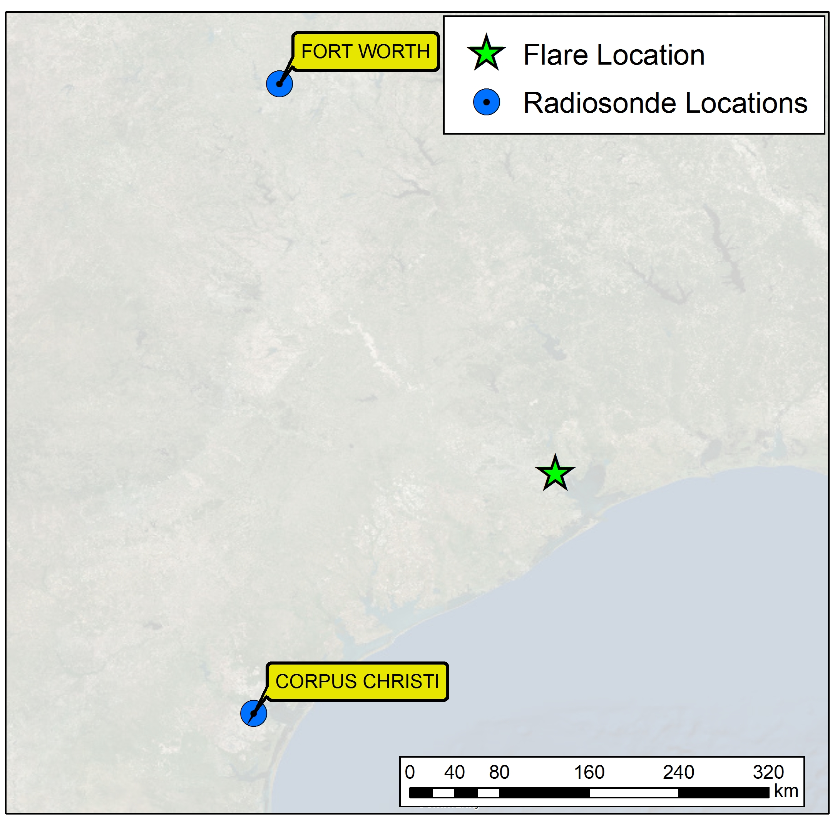
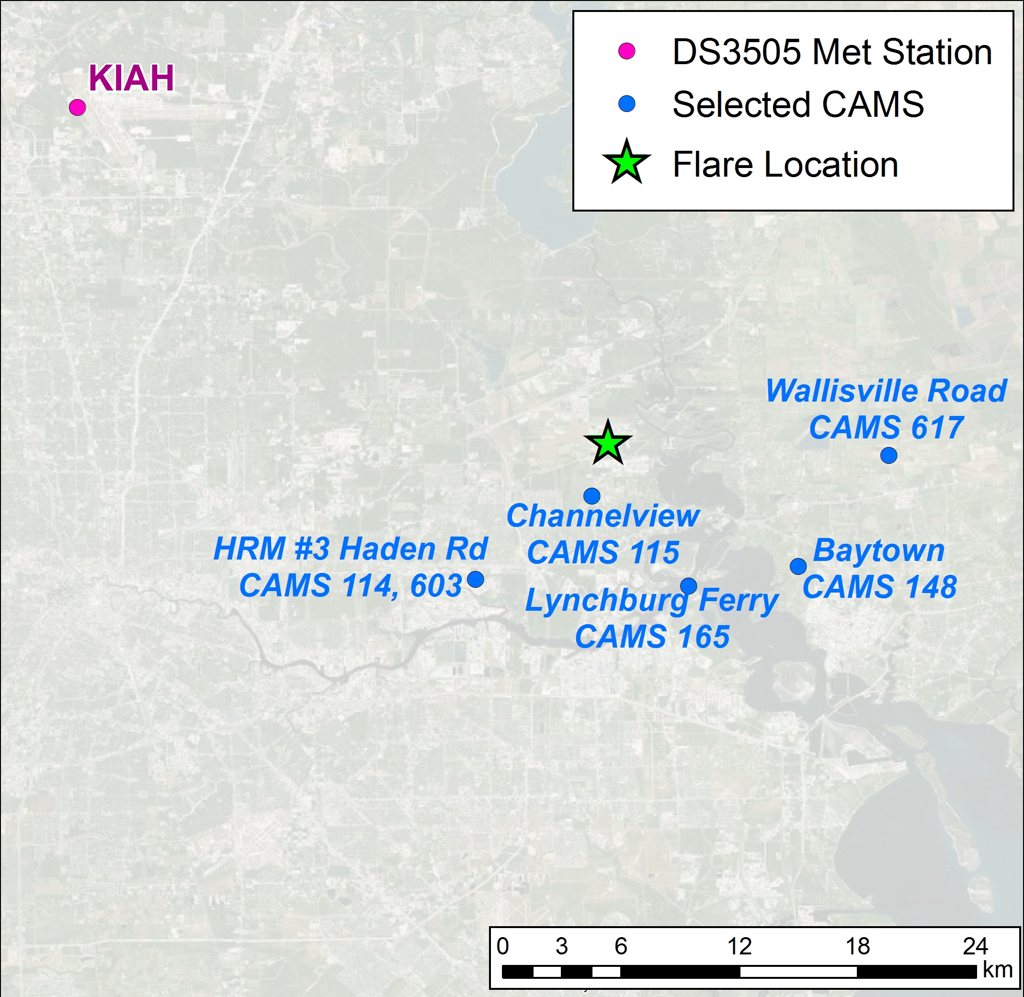
Modeling Flare 3: Meteorological Data
Notes:
Upper air from Fort Worth and Corpus Christi. Surface met from KIAH and multiple CAMS.

Slide 11
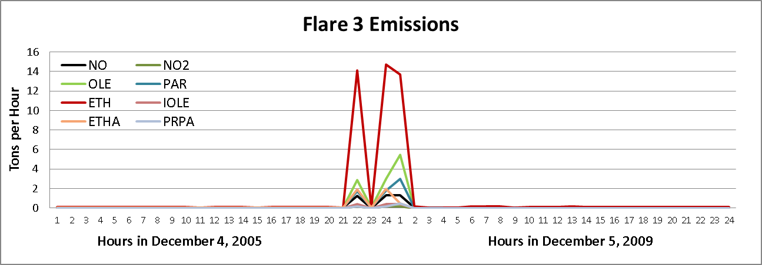
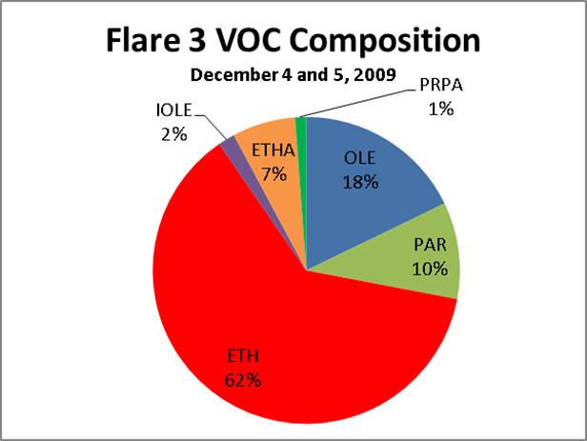
Channelview Flare (Flare 3) HRVOC Emissions
2 flare events during night of Dec. 4, 2009 and early morning of Dec. 5, 2009
Peak 1-hr ozone levels of 20 to 40 ppb at 2 nearby monitors
TCEQ trajectory analysis shows transport of flare towards south
High HRVOC levels at CAMS 115 to south of flare
Notes:
Channelview is centrally located in the Ship Channel area, so the meteorology will drive emissions and photochemistry to any number of monitors in the area.

Slide 12
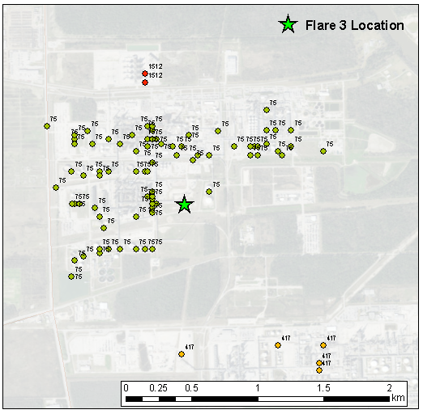
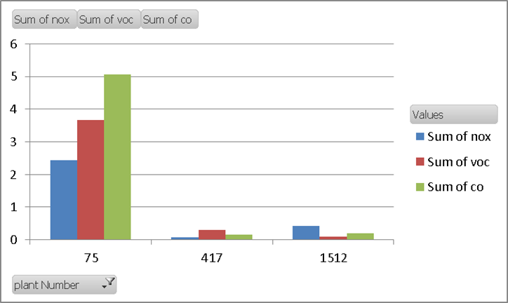
Flare 3: Neighboring Sources and Their Emissions
Facility 1512
Facility 417
Nearby facilities within a 2 km by 2 km box around flare (data provided by TCEQ)
Each nearby facility modeled as a single source in flare simulation
Source parameters for facility determined using the median of the distribution of the cluster of the sources for each facility
Facility 75
Notes:
Modeled with regional background only as well as with regional + local background.

Slide 13
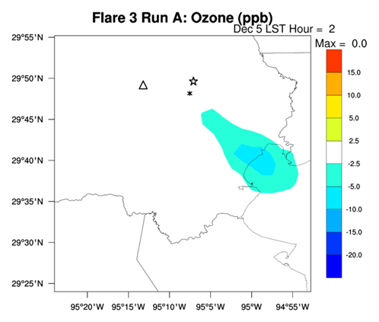
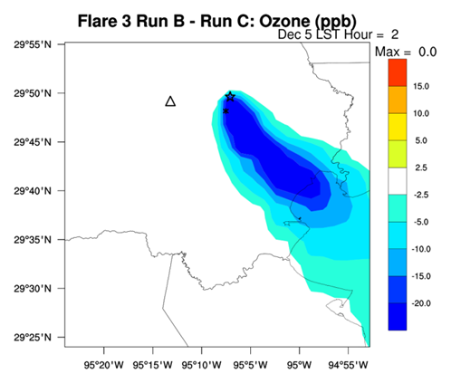
Flare 3 Impacts on Surface Ozone: 2 am, Dec 5
Flare with Regional Background
Flare with Regional & Local Background
→ Greater Ozone Depletion
Notes:
More ozone titration with local source NOx emissions.

Slide 14
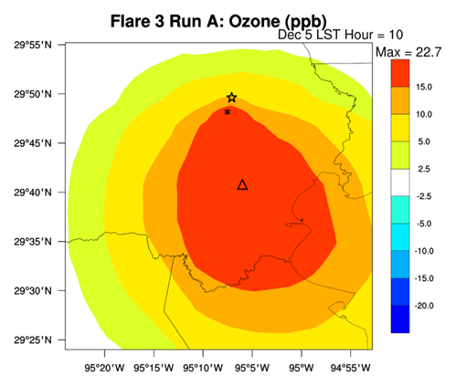
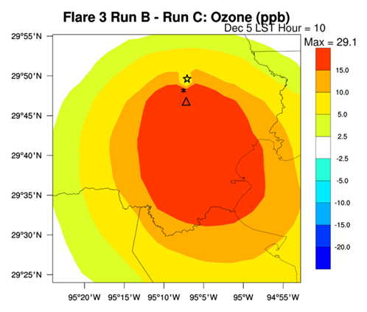
Flare 3 Impacts on Surface Ozone: 10 am, DEC 5
Flare with Regional Background
Flare with Regional & Local Background
→ Greater Ozone Production
Notes:
More ozone formation with local source NOx emissions.

Slide 15
Summary
SCICHEM 3.1 used to model two summer flaring events and one winter event
Results shown for winter flaring event that had largest HRVOC emissions
During the night, ozone is titrated by NOx in the flare plume. Including NOx emissions from nearby sources enhances the depletion of ozone in the plume.
The peak ozone impact due to flare HRVOC emissions at 10 am is nearly 23 ppb with regionally averaged background NOx concentrations. Including NOx emissions from nearby sources enhances the flare ozone impact by about 7 ppb.

Slide 16
Conclusions
SCICHEM demonstrated for Appendix W Tier 2 single-source model situations
Previous studies have shown that SCICHEM simulates observed ozone production in elevated EGU NOx plumes as well as HRVOC plumes from the Houston Ship Channel
This study demonstrates that SCICHEM resolves fine scale features of flare plumes and simulates ozone production in the plume
SCICHEM is simpler than a PGM to setup and apply for single-source modeling
PGM ability to model single source plumes enhanced by using plume-in-grid treatments, e.g., CAMx and CMAQ-APT

