Slide 1
The Load of Lightning-induced Nitrogen Oxides and Its Impact on the Ground-level Ozone during Summertime over the Mountain West States
Daiwen Kang¹, Rohit Mathur¹, Robert Gilliam¹, George Pouliot¹, David Wong¹ , and Pius Lee²
Computational Exposure Division, National Exposure Research Laboratory, U.S. Environmental Protection Agency, Research Triangle Park
Air Resources Laboratory (ARL), NOAA, College Park, MD
16th Annual CMAS Conference
Chapel Hill, North Carolina, USA
23-25 October, 2017

Slide 2
NO emissions from lightning strikes
Lightning is one of the major natural sources to produce NO_{X} in the atmosphere
The global lightning NO_{X} (LTNO_{X}) production is estimated to be in the range 2-8 Tg N yr⁻¹ (compare with present-day anthropogenic and biomass burning sources of ~26 Tg N yr⁻¹; ~10-15% of the total NO_{X} budget)
Lightning activity varies spatially over the course of a year, and consequently so do the NO emissions from lightning strikes.
The bulk of the lightning-induced NO is initially injected into the upper troposphere, but can eventually affect surface level air quality due to mixing and transport in the atmosphere.

Slide 3
Lightning NO Production in CMAQ
To more accurately estimate lightning NO production, in CMAQv5.2, we enhanced the lightning NO production algorithm to utilize hourly NLDN (National Lightning Detection Network) lightning strike data.
The NO yield per lightning flash used in this study is 350 moles/flash.
The vertical distribution of lightning NO is the same in previous CMAQ versions, which is based on Pickering, et al. (1998, JGR).
Detailed model performance evaluations using lightning NO algorithms will be presented tomorrow afternoon at 2:40 in the Model Evaluation and Analysis section.

Slide 4
Model configuration and simulations
Two-way Coupled WRF-CMAQ
Modeling System (WRF3.8 and CMAQ5.2) with WRF lightning assimilation (Heath et al., 2016)
Domains: 12km horizontal resolution with 35 vertical layers. (1) The continental US (2011) and (2) centered over Boulder, Colorado (2014)
Boundary conditions: hemispheric CMAQ simulations
Simulation period: April-September, 2011 and July-August, 2014
Emissions: 2011 NEI (for 2014 with 3 state specific oil/gas sector emissions and 2024-specific emissions for EGU/fire/biogenic sectors), NH3 bidi, inline biogenic emissions
Without lightning NO (Base) and with lightning NO (NLDN)

Slide 5
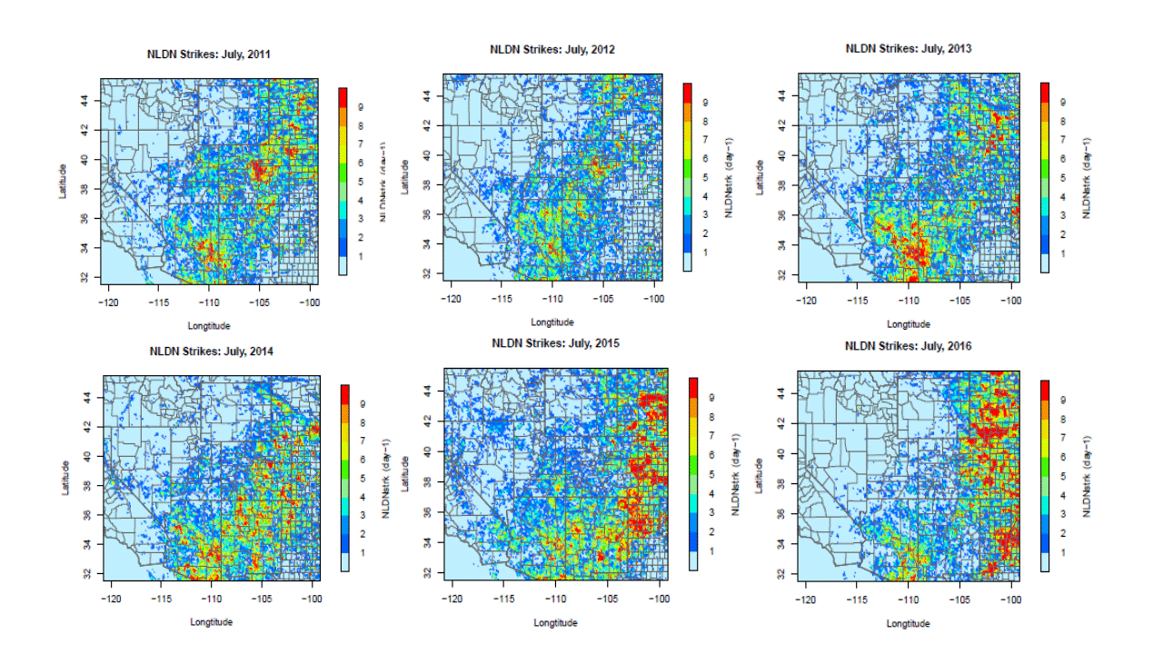
Lightning strikes in July over MWS
2011
2012
2013
Frequent lightning activity was observed over the Mountain West States (MWS) during summer time across many years. Even though the specific locations may change from year to year, the overall lightning strikes seem to be persistent (heavy lightning strikes formed a pattern extending from south-west to north-east).
2014
2015
2016

Slide 6
Lightning strikes in August over MWS
2011
2012
2013
The lightning strike pattern in August is different from that in July, but significant frequency of strikes still occurs across the years
2014
2015
2016

Slide 7
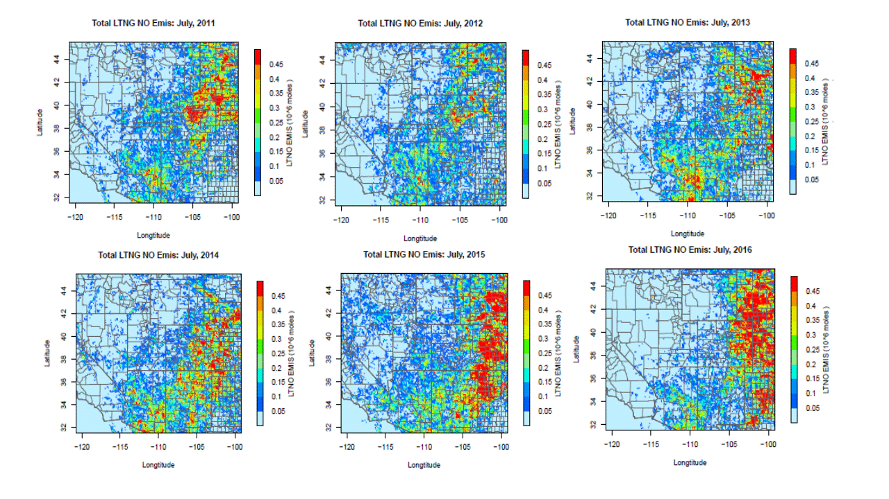
Lightning NO emissions in July over MWS
2011
2012
2013
The total column lightning NO emissions when estimated from lightning strikes using the CMAQ lightning production algorithm.
2014
2015
2016

Slide 8
Lightning NO emissions in August over MWS
2011
2012
2013
Same as last slide, but for August
2014
2015
2016

Slide 9
Major sources for NO_{X} emissions over MWS
Total Anthropogenic
Soil
Lightning
July
August

Slide 10
Contribution of Lightning to NO Budget over MWS
The lightning NO emissions contribute up to 50% of the total NO_{X} emissions on specific days in this region and the overall monthly contribution for both months is about 30% of the total NO_{X} emissions.

Slide 11
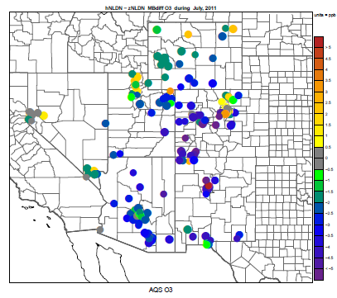
Model performance with lightning NO
MB Difference (NLDN - Base)
July, 2011
MB Difference
(NLDN - Base)
AQS
Base
NLDN
MB Difference
(NLDN-Base)
Lighting Strikes

Slide 12
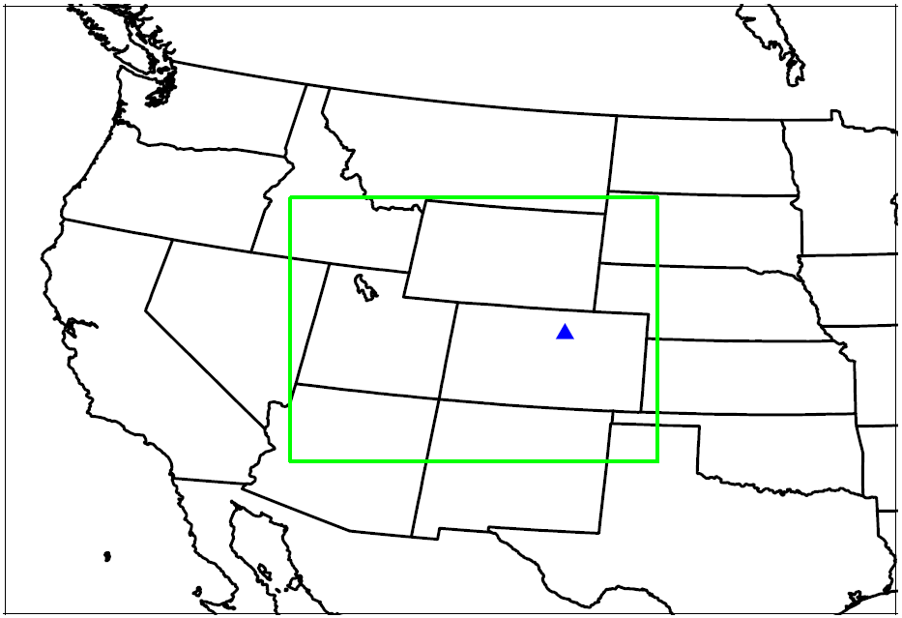
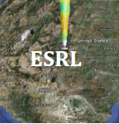
Lidar Measurements and Model Simulations during DISCOVER-AQ Denver 2014 Field Study
The TOLNet Lidar Ozone (O₃) data is available during July and August, 2014
Lidar provides temporal and vertical characteristics of the observed O₃
Two-way coupled WRF-CMAQ simulation with/without lightning NO were performed during this period over the 12km domain centered over Colorado.
12km CMAQ domain
Lidar Measurement at The Boulder Atmospheric Observatory (BAO) ESRL Site

Slide 13
Daily maximum O₃ concentrations across the vertical model layers that have Lidar observations
Identify episodic time periods when the model significantly under or over estimated the observed values.
July 26-29:
Greatest O₃ mixing ratios were observed, but not captured by the model
Lidar
Base
NLDN

Slide 14
Max daily O₃ (Lidar) and the 24-hr lightning strikes in the vicinity of the location
LTStrike: the sum of the lightning strikes in about 100x100 km² area centered at BAO Site. This is only a qualitative analysis in terms of the LTStrike impact on O₃ production without considering the effects of transport and mixing. But the correlation is rather surprising and the correlation coefficient for July is close to 0.7.
Lightning Active Days

Slide 15
24-hour lightning strikes detected by the National Lightning Detection Network
July 26
July 27
BAO Site
July 28
July 29

Slide 16
Lidar and Model Predicted Hourly O₃ Profiles
Lidar O₃ gridded into the model vertical layers
CMAQ (Base) predicted O₃ vertical profiles
July 26
July 27
July 28
July 29
July 26
July 27
July 28
July 29
Mid-Layer Height(m)
Hour (MDT)
Hour (MDT)
Lidar observations show that higher O₃ levels were always initiated at the upper middle layers during the photo-chemically active hours, but the model case without lightning NO completely missed the episode.

Slide 17
Lidar and Model Predicted Hourly O₃ Profiles
Lidar O₃ gridded into the model vertical layers
CMAQ (NLDN) predicted O₃ vertical profiles
July 26
July 27
July 28
July 29
July 26
July 27
July 28
July 29
Mid-Layer Height(m)
Hour (MDT)
Hour (MDT)
When lightning NO is included in the model simulation, the predicted O₃ levels were elevated and came closer to the observed values.

Slide 18
Simulated Hourly O₃ difference (NLDN – Base)
Mid-Layer Height(m)
July 26
July 27
July 28
July 29
When lightning NO is included, the O₃ mixing ratios:
Mainly decreased on July 26 at upper layers with significant decrease after 12 pm across all vertical layers.
Increased from July 27 to 29 with significant increase on the last two days (up to 20 ppb increase on July 29)
Hour (MDT)

Slide 19
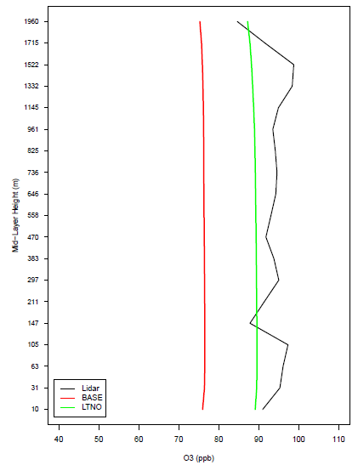
Observed and Simulated Maximum Hourly O₃ Across Vertical Layers (1-19)
Mid-Layer Height(m)
Lidar
Base
NLDN
July 26
July 27
July 28
July 29
O₃ (ppb)
O₃ (ppb)
O₃ (ppb)
O₃ (ppb)
O₃ (ppb)
O₃ (ppb)
O₃ (ppb)
From July 26 to July 29, the Base model changed from overestimation to significant underestimation
Inclusion of lightning NO reduced the overestimation on July 26, and also reduced the underestimation on July 28 and 29.
This episode led to the increase of surface O₃ mixing ratios by almost 20 ppb

Slide 20
Observed and Simulated Maximum Hourly O₃ Across Vertical Layers (1-30)
Mid-Layer Height(m)
Lidar
Base
NLDN
July 26
July 27
July 28
July 29
O₃ (ppb)
O₃ (ppb)
O₃ (ppb)
O₃ (ppb)
The same as the previous slide, but show the model predicted vertical profiles beyond the range of the Lidar measurements.
The high O₃ mixing ratios were formed in the upper troposphere and not transported down from stratosphere.

Slide 21
Summary
Lightning strikes produce significant amount of NO_{X} in the Mountain West States during summer time; the CMAQ calculated lightning NO emissions contributed up to 50% of the total column NO_{X} budget on a daily basis and 30% on a monthly basis.
Model simulations including lightning NO captured the variability in surface and aloft measured O₃ much better than the case without lightning NO.
With lightning NO, the modeled O₃ vertical profiles were significantly improved compared with Lidar measurements.
During the 4-day episode (July 26-29, 2014), the surface O₃ mixing ratios were observed to be elevated by more than 20 ppb, which are attributable to lightning NO emissions.

Slide 22
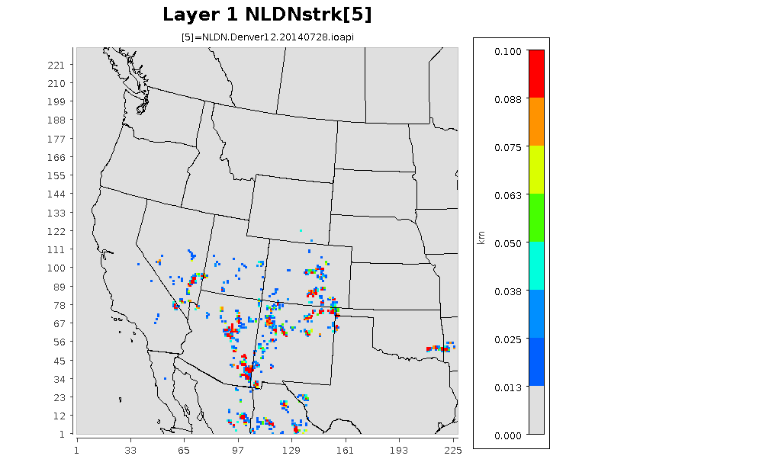
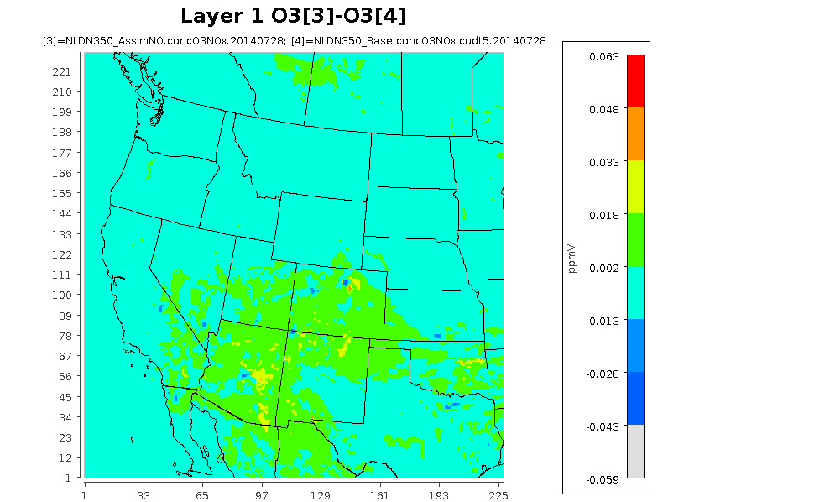
Animation of lightning strikes and surface O₃ difference
Hourly NLDN Strikes
Layer 1 O₃ (NLDN – BASE)

Slide 23
Acknowledgement
We thank NASA for the Tropospheric Ozone Lidar Network (TOLNet) and NOAA Earth System Research Laboratory (ESRL) for the Lidar data used in the analysis.

