Slide 1
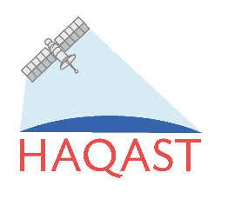
HiRes-X: Scientific and Geographic Extension of an Operational, High Resolution Air Quality Modeling System Providing Smoke Impact Forecasts for Health Protection, Ecosystem Management and Economic Development Yongtao Hu¹, Talat Odman¹, Armistead G. Russell¹,Ha Hang Ai¹, Ambarish Vaidyanathan², Scott Goodrick³
¹Georgia Institute of Technology
²Center for Disease Control and Prevention
³US Forest Service, Southern Research Station
2017 Annual CMAS conference, October 24, 2017

Slide 2
Our Collaborators
Daniel Chan
Di Tian
Chris DuClos & Melissa Murray Jordan

Slide 3
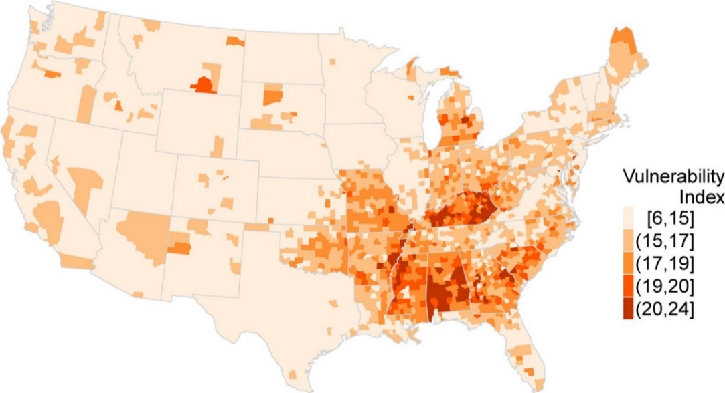
Motivation: Wildland fire, air quality and public health
Wildland fire smoke has specifically been associated with negative health effects by a large number of epidemiological studies. [Reid et al., Environ. Health Perspect., 2016]
Over 40% of Americans are estimated to live in areas with a moderate or high contribution of wildland fires to ambient PM_{2.5} concentrations. [Rappold et al., Environ. Sci. Technol., 2017]
More than 10 million experience unhealthy air quality caused by wildland fires multiple times per year. [Rappold et al., Environ. Sci. Technol., 2017]
Community health-vulnerability Index (CHVI) to Health Impacts of Wildland Fire Smoke Exposure.
Rappold et al., Environ. Sci. Technol., 2017

Slide 4
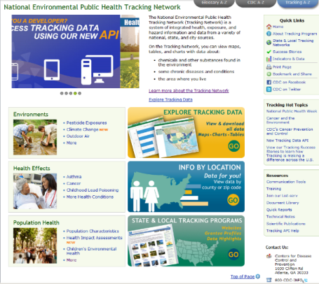
An example use of smoke impacts: CDC’s Environmental Public Tracking Network
A system of integrated health, exposure, and hazard information and data from a variety of sources, that is accessible through a public web portal for educational to policymaking purposes
https://ephtracking.cdc.gov
In Development

Slide 5
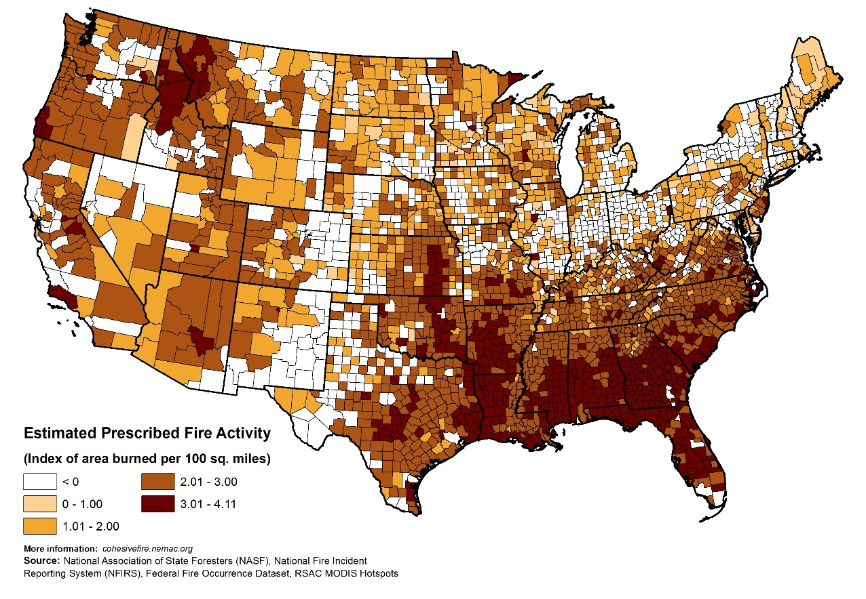
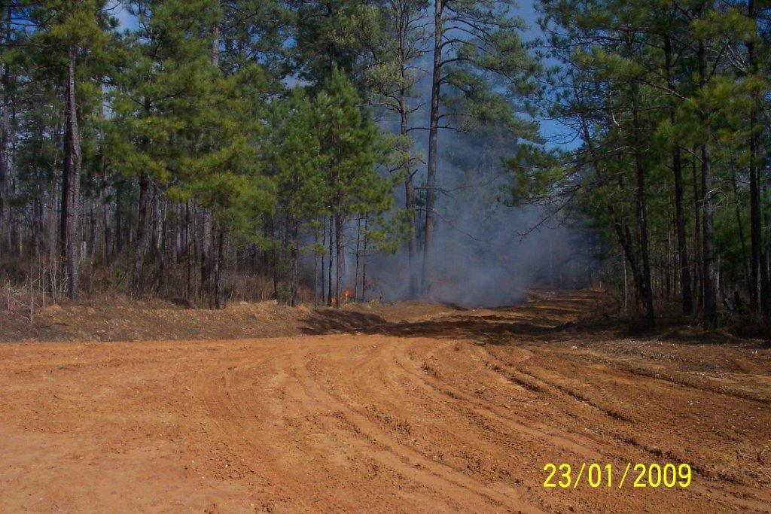
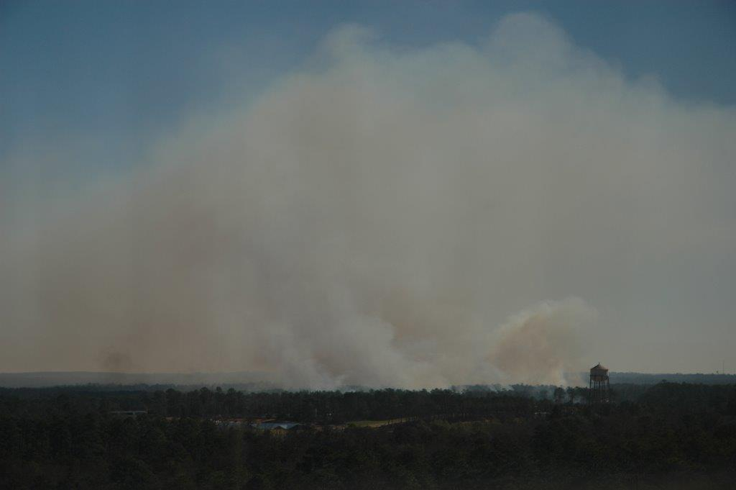
We focus on Prescribed Burning, the preferred land management tool in the Southeast, which is a large source of PM.
Georgia
Fort Benning, Georgia
23/01/2009

Slide 6
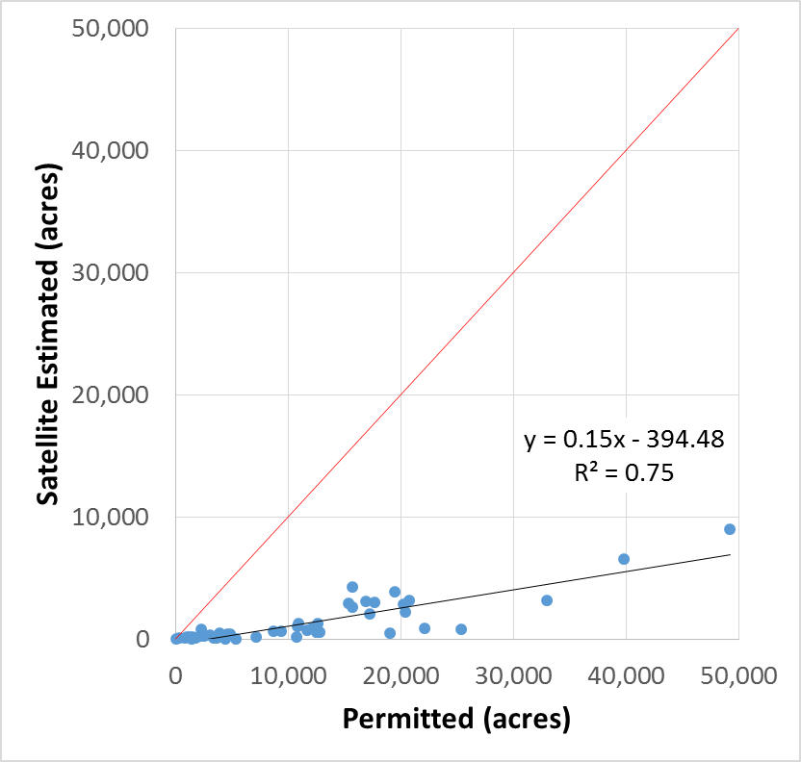
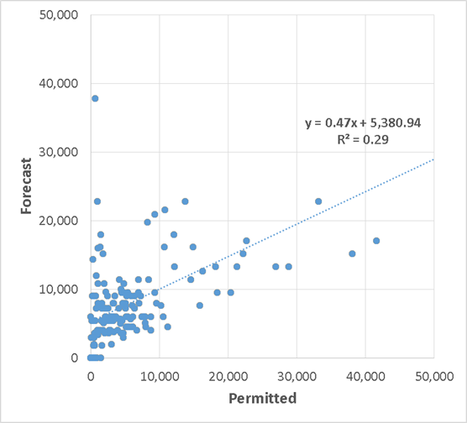
Hi-Res2 Air Quality and Burn Impact Forecasting System ( https://forecast.ce.gatech.edu )
Forecasting burn activity, burn emissions and burn impacts on air quality
Forecasts compared qualitatively to NOAA’s Hazard Mapping System Fire and Smoke Analysis and quantitatively to NOAA’s Biomass Burning Emission Product blended from GOES-E, GOES-W, MODIS, and AVHRR as well as Georgia Forestry Commission’s burn permit database
Fire & Smoke from Satellite
Satellite vs. Permitted
Burn Areas
Our Burn Impact Forecast
Forecast vs. Permitted
Burn Areas
See Ran Huang’s presentation tomorrow
Notes:
Note that we only forecasts burns for Georgia.

Slide 7
NASA Health and Air Quality Applied Sciences Team (HAQAST) HiRes-X: A HAQAST project (https://haqast.org)
Main goal: To extend and expand the potentially large public health and economic benefits that are currently being realized in Georgia to the Southeastern US.
Objectives:
Enhance the HiRes II to the HiRes-X burn impact forecasting system using additional (and coming) Earth observations, as well as additional monitoring using air quality sensors.
Work with air quality, agriculture and forest service-related agencies in the Southeast to adapt the current HiRes system to states outside of Georgia, particularly Florida, South Carolina, and Alabama.
Provide forecasts of forest and crop prescribed burning-related air quality impacts to local and state public health agencies.
Provide forecast burn impacts to the CDC and its state partners on a real-time basis and perform source apportionment analysis for CDC to conduct an epidemiologic assessment using retrospective data.
Notes:
Work with public schools to maintain a sensor network and provide educational opportunities to increase student and teacher knowledge about air quality and health linkages and the related application of Earth observations.

Slide 8
HiRes-X modeling system features
WRF-CMAQ for air quality forecast
DDM for source impacts
Weather- and pattern-based prescribed burn forecasting
MODIS AOD, HMS, routine networks and low-cost sensors for model calibration/evaluation
Bias tracking near-real time emission adjustments
WebGIS-based dissemination of forecast products (and other data presentation)
Exposure, health burden and vulnerability analyses

Slide 9
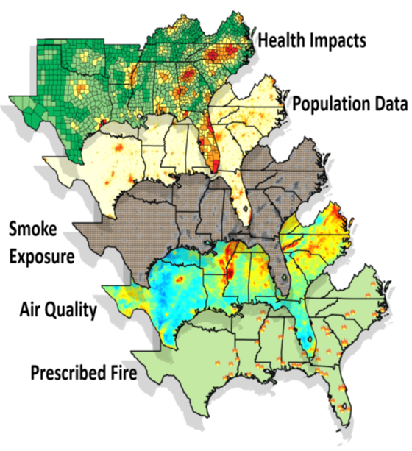
Different layers of HiRes-X’s Products: Design of a WebGIS based tool
Leaflet and OpenStreetMap for WebGIS, D3.js for data presentation, and MySQL for database
Geo Locations of sites and burns and GeoJSON format of spatial products (raster2polygon)
Overlay of air quality and impacts, and overlay of forecasts, satellite, permits, population, health index
Alerting function

Slide 10
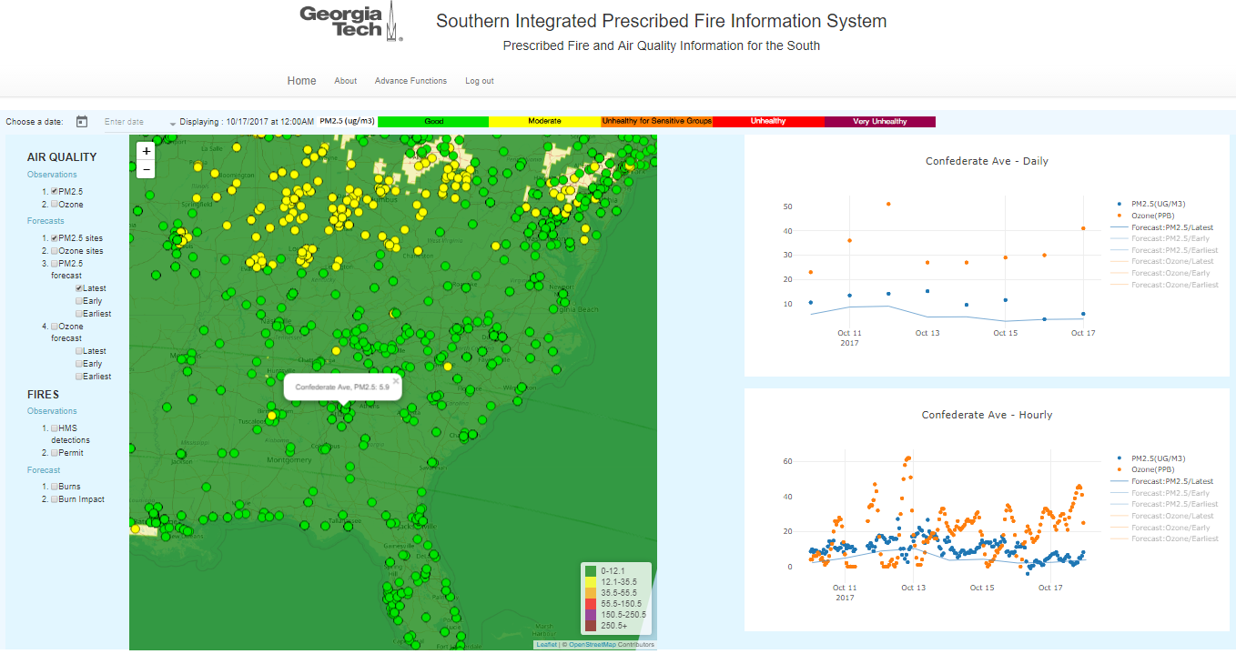
Air Quality Forecast

Slide 11
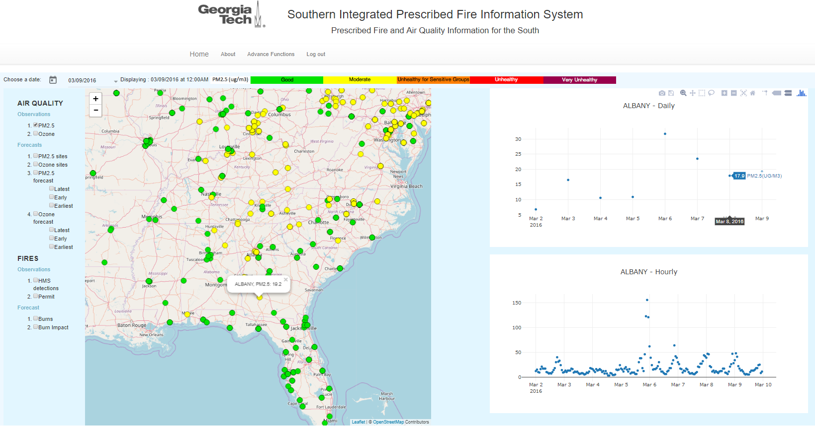
Air Quality Observation database

Slide 12
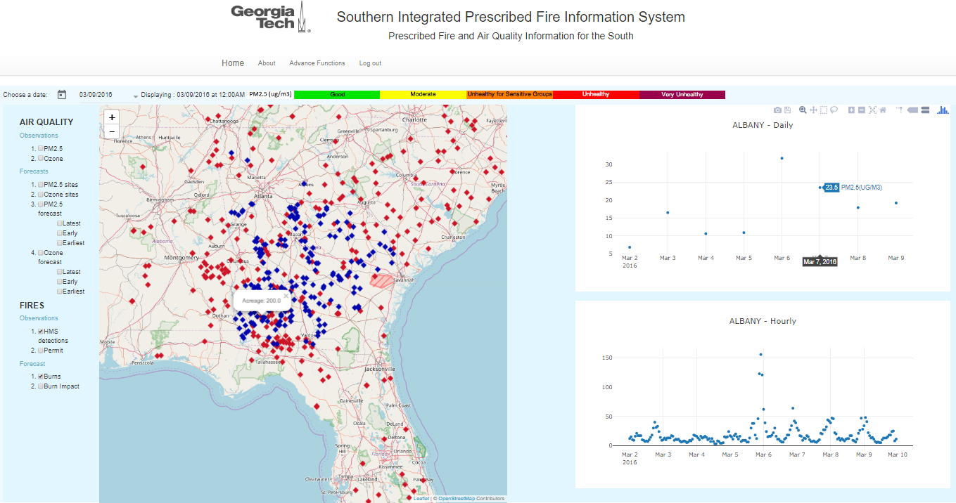
Forecast burns and Detected burns

Slide 13
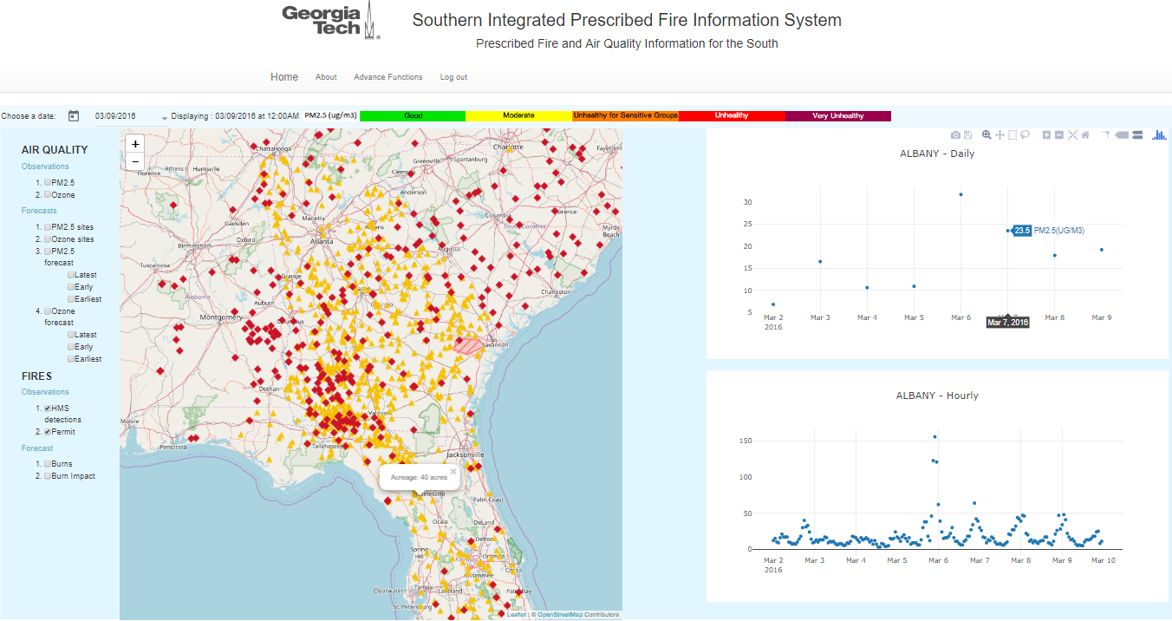
Detected burns and burning permitts

Slide 14
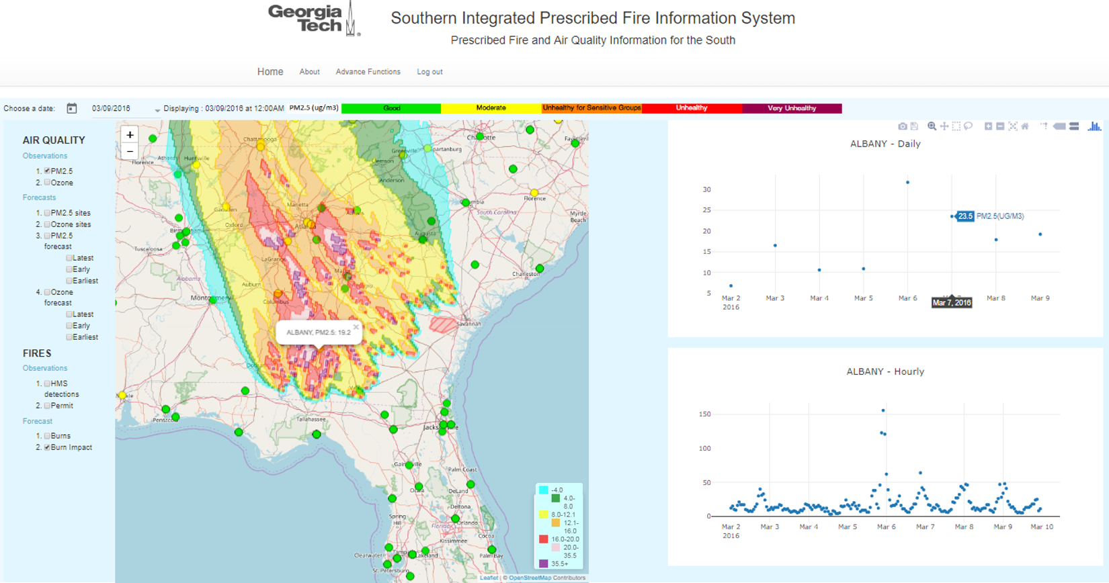
Burn Impact Forecast

Slide 15
Next Steps: Smoke Exposure and Health Burden
Health Layer will include the following components:
Population weighted PM_{2.5} exposure
Population exposed to PM_{2.5} levels at AQI grades thresholds
Population exposed to PM_{2.5} levels weighted by Vulnerability
Health Burden
Utilize burn impact on PM_{2.5} concentrations one can calculate health burden using the following formula:
$$∆H=H_{0}∗\left(1−e^{−β∆x}\right)$$
$H_{0}$ is baseline health rate
$β$ is effect estimate coefficient obtained form C-R function
$∆x$ is the burn impact on PM_{2.5} concentration

Slide 16
Summary
We have developed the Hi-Res II system to forecast prescribed burn impacts on air quality in Georgia.
Funded by NASA HAQST, we are expanding and extending Hi-Res II to Hi-Res X.
Hi-Res X will be beneficial to air quality, forest and health service-related agencies in Southeast.
A WebGIS tool is developed to disseminate the Hi-Res X forecasting products in different layers, extending from prescribed burns, air quality, burn impact, all the way to human exposure and health burden

