Slide 1
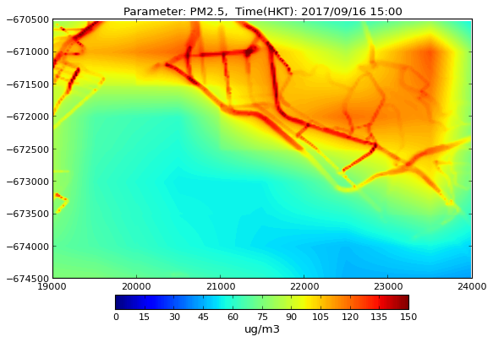
High-resolution air quality forecasting for Hong Kong
Christina Hood, Jenny Stocker, David Carruthers, William Grayson, Jonathan Handley, Jimmy Fung, David Yeung
16th Annual CMAS Conference
October 2017

Slide 2
Outline
Motivation
ADMS-Urban Regional Model Link system
Hong Kong forecasting implementation
Computational performance
Concentration outputs
Further work

Slide 3
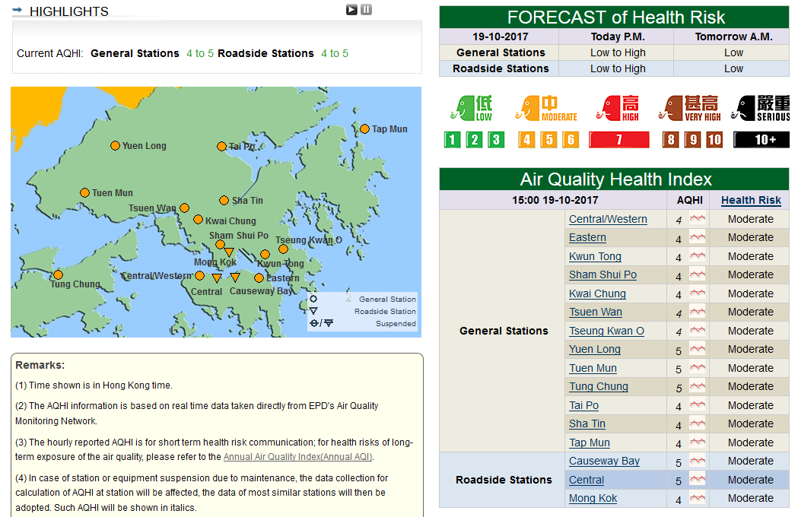
Motivation
Current ‘air quality health index’ at 16 monitoring sites
aqhi.gov.hk

Slide 4

Motivation
Current ‘air quality health index’ at 16 monitoring sites
Limited forecast (next day)
No detail for wider urban area
Personalised Real time Air quality Informatics System for Exposure (PRAISE-HK) project will
  Create high-resolution air quality forecast for Hong Kong
  Publish forecast via mobile app
  Include route planning and personal health alerts
praise.ust.hk

Slide 5
ADMS-Urban Regional Model Link system
Combines regional model output (CMAQ, CAMx, EMEP4UK, CHIMERE, WRF-Chem) and local ADMS-Urban modelling for street-scale concentration output
Avoids double-counting emissions by separating regional and local modelling using ‘mixing time’
Concentration within nested domain | = | Regional modelling of emissions | - | Gridded locally modelled emissions (ΔT) | + | Explicit locally modelled emissions (ΔT)
cerc.co.uk/RML

Slide 6
ADMS-Urban Regional Model Link system
Combines regional model output (CMAQ, CAMx, EMEP4UK, CHIMERE, WRF-Chem) and local ADMS-Urban modelling for street-scale concentration output
Avoids double-counting emissions by separating regional and local modelling using ‘mixing time’
Initial concept published 2012, automated system 2014
Developments since 2014:
  Support for CHIMERE and WRF-Chem added
  System re-built on Linux and automation increased
  Option to apply interpolation to regional model output
cerc.co.uk/RML

Slide 7
ADMS-Urban RML Windows
Graphical interface, Run Manager for distributing runs across PCs

Slide 8
ADMS-Urban RML Linux
RML Controller and Run Manager replaced by scripts
Graphical interface replaced by text input files
ADMS-Urban and utilities re-compiled for Linux

Slide 9
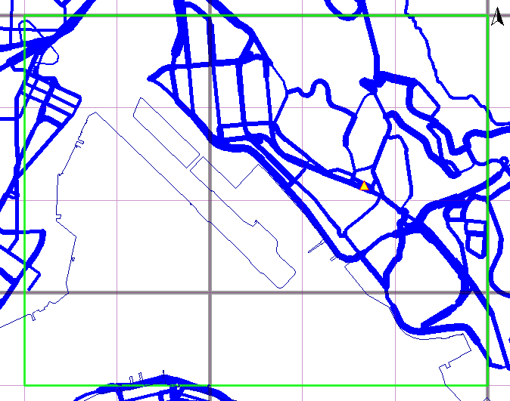
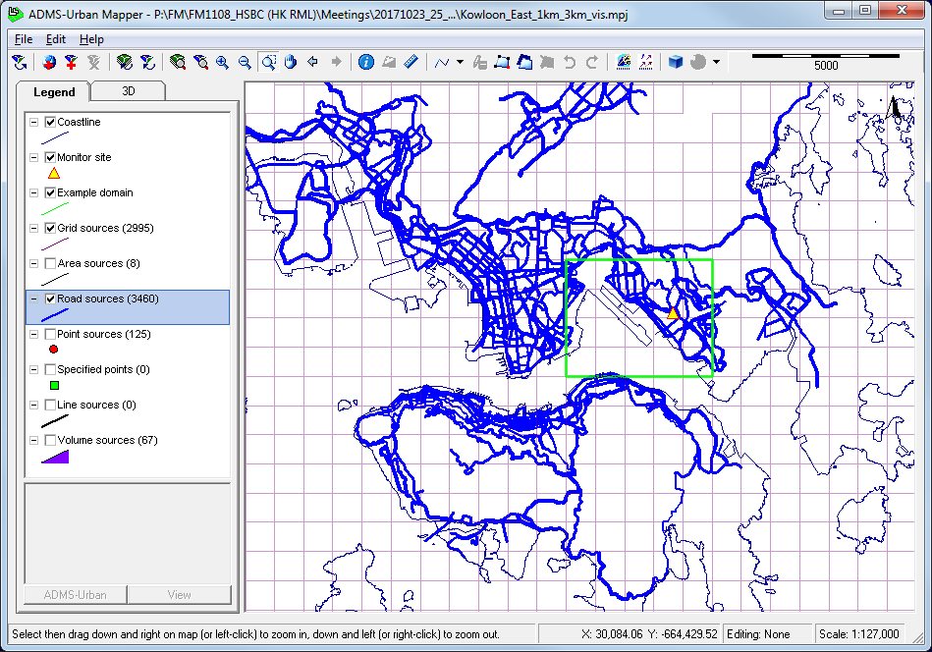
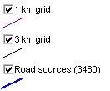
Hong Kong Forecasting Implementation
Example 5x4 km domain

Slide 10
Hong Kong Forecasting Implementation
Example 5x4 km high resolution domain
3 day forecast, run starts 4 am each day
7 output species
  NO₂, NO_{x}, O₃, PM_{2.5}, PM₁₀, SO₂, CO
Regional modelling from WRF and CMAQ
  Domain resolutions 27 km, 9 km, 3 km, 1 km
2010 emissions inventory
Output concentrations displayed in Google Maps
Trial period: 5th September – 2nd October 2017 (4 weeks)

Slide 11
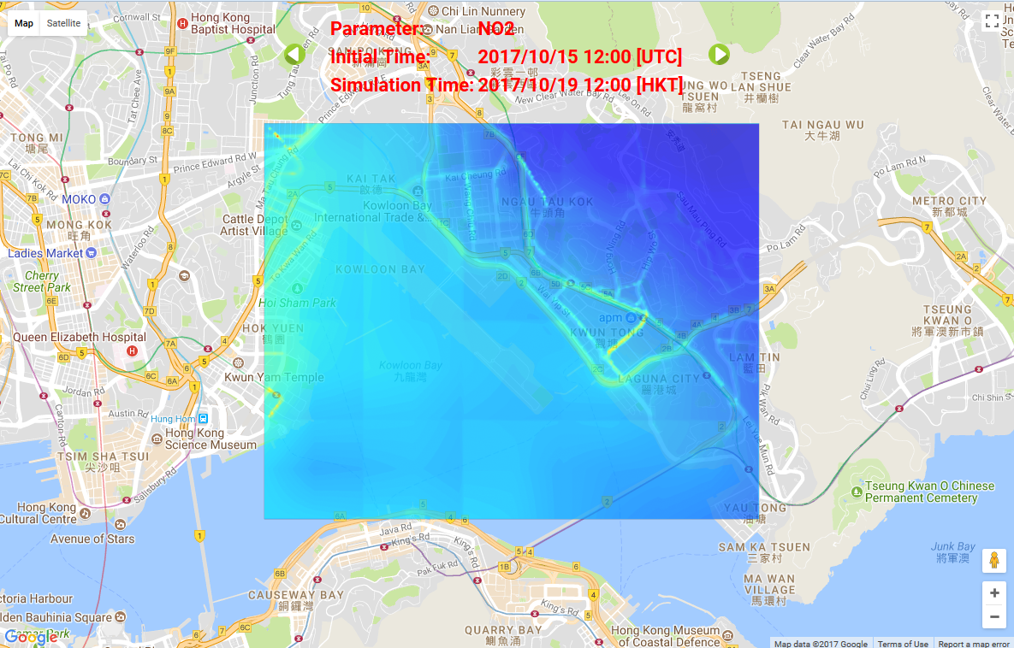
Hong Kong Forecasting Implementation
Output concentrations displayed in Google Maps

Slide 12
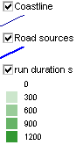
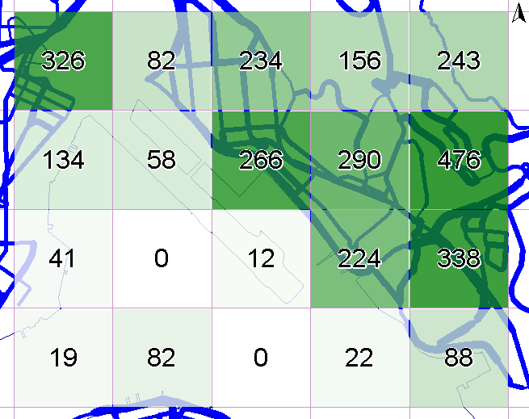
Computational performance: run time
Short run time relative to regional modelling
  WRF 1.8 hours, CMAQ 2.5 hours, ADMS-Urban RML 25 minutes (all per forecast day)
ADMS-Urban RML run time dominated by ADMS-Urban local model runs with explicit sources
  varies with density of road segments

Slide 13
Computational performance: File size
Total output file size for high-resolution domain smaller than CMAQ
File size normalised by output area larger than regional models due to increased output point density
  Average 4577 points/km²
  File size per output point smaller than CMAQ (fewer species)
Model domain | Extent cells |  | Cell size km | File size
 | x | y |  | Total MB | Norm MB/km²
CMAQ 3 km | 152 | 110 | 3 | 213 | 0.001
CMAQ 1 km | 179 | 125 | 1 | 278 | 0.012
ADMS-Urban RML | 5 | 4 | (1) | 66 | 3.300

Slide 14
Concentration outputs: Time series

Slide 15
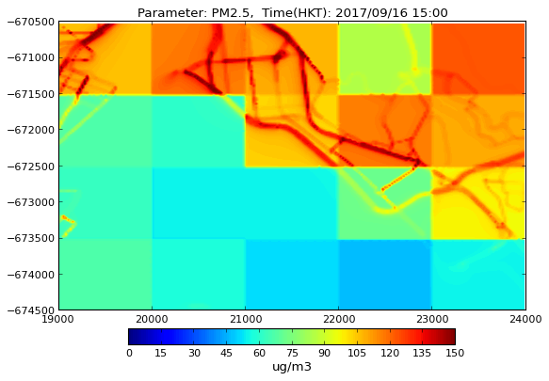
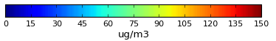
Concentration outputs: Interpolation
Option to apply interpolation to regional model output
  Example PM_{2.5} concentrations for 16th September 2017 3pm local time

Slide 16
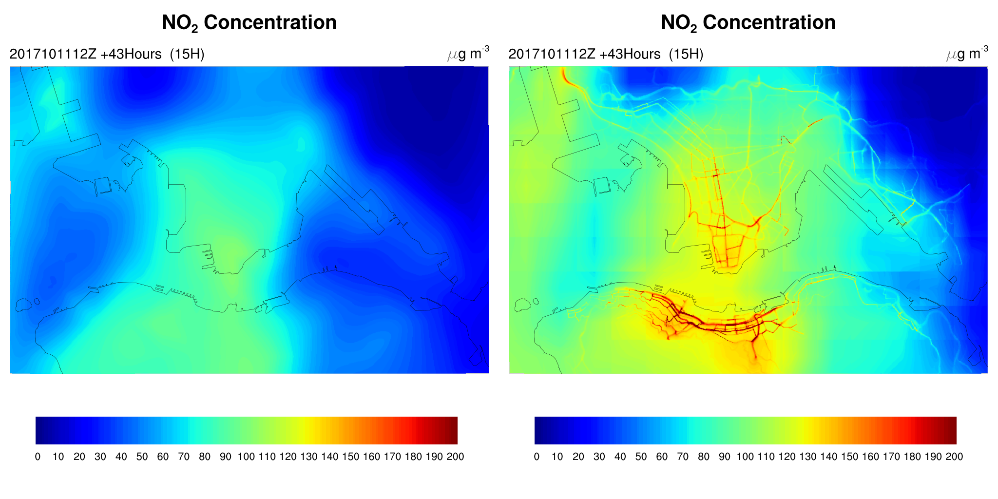
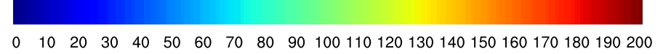
Further work
Expand to bigger domain covering main urban areas of Hong Kong and Kowloon
  Example NO₂ for 3pm local time 13th October 2017
CMAQ
ADMS-Urban RML
NO₂ µg/m³

Slide 17
Further work
Expand to even bigger domain covering HKSAR
Update emissions
  3D grid source in ADMS-Urban, automatic emissions conversion from CMAQ to ADMS-Urban
  Time-varying profiles for individual roads
Evaluate concentrations against all available monitors
Release initial app (late 2018)
Incorporate real-time traffic flow and concentration data
Calculate indoor concentrations from outdoor forecast
Include route planning and personalised alerts in app

Slide 18
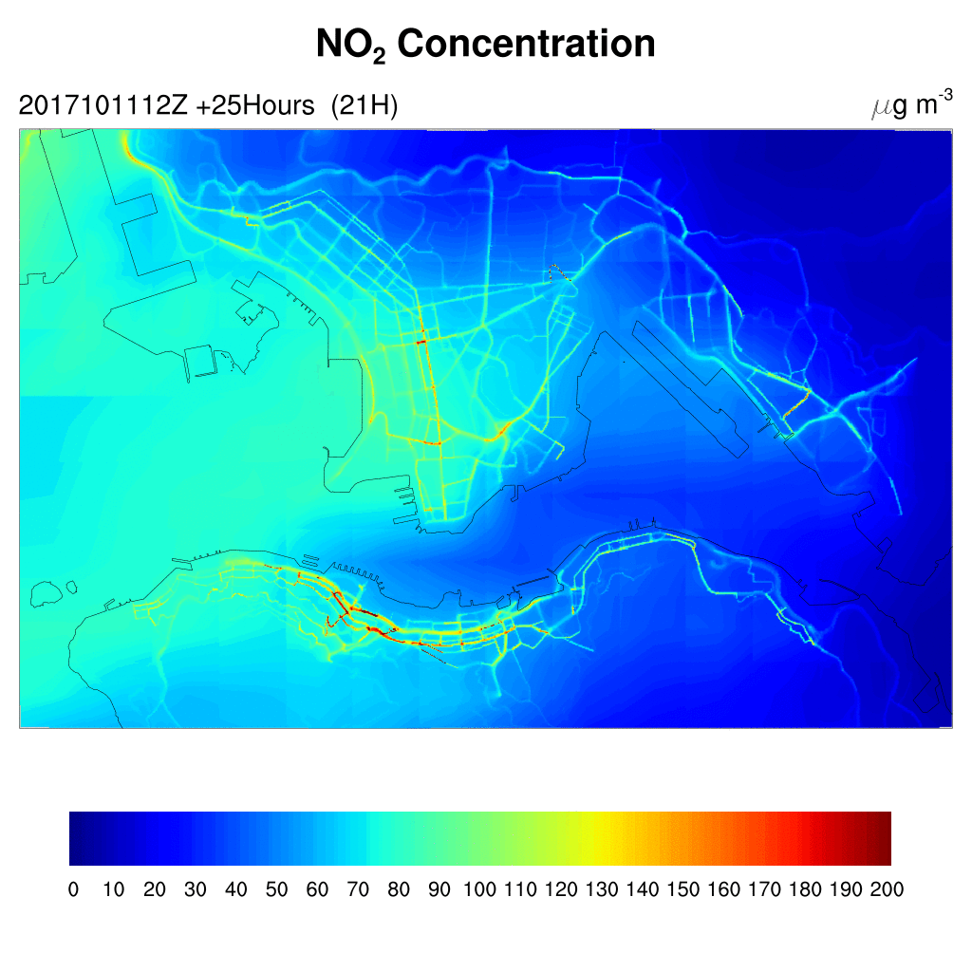
Thank you

Slide 19
Extra slides

Slide 20
System implementation
Meso-scale meteorological data (WRF)
Regional model concentration output
Regional model grid information
Key
Utility
Data
Model run
Meteorological data for use in local model
Local upwind background
Local model
Gridded run for background (0.5 hr)
Emissions data
Nesting background
Local model
Main gridded run (ΔT)
Local model
Main explicit run (ΔT)
Concentration within nested domain | = | Regional modelling of emissions | - | Gridded locally modelled emissions | + | Explicit locally modelled emissions

