Slide 1
Evaluation of NOx Emissions and Modeling
Presenter: Barron H. Henderson¹
Authors: H. Simon¹, B. Timin¹, P. Dolwick¹, C. Owen¹, A. Eyth¹, K. Foley², C. Toro⁵, K. Baker¹, M. Beardsley⁴, K. W. Appel², B. McDonald⁶
US EPA, ¹Offices of Air Quality Planning and Standards, ²Research and Development, ⁴Transportation and Air Quality,
⁵ORISE fellow hosted by Office of Transportation and Air Quality
⁶Cooperative Institute for Research in Environmental Sciences

Slide 2
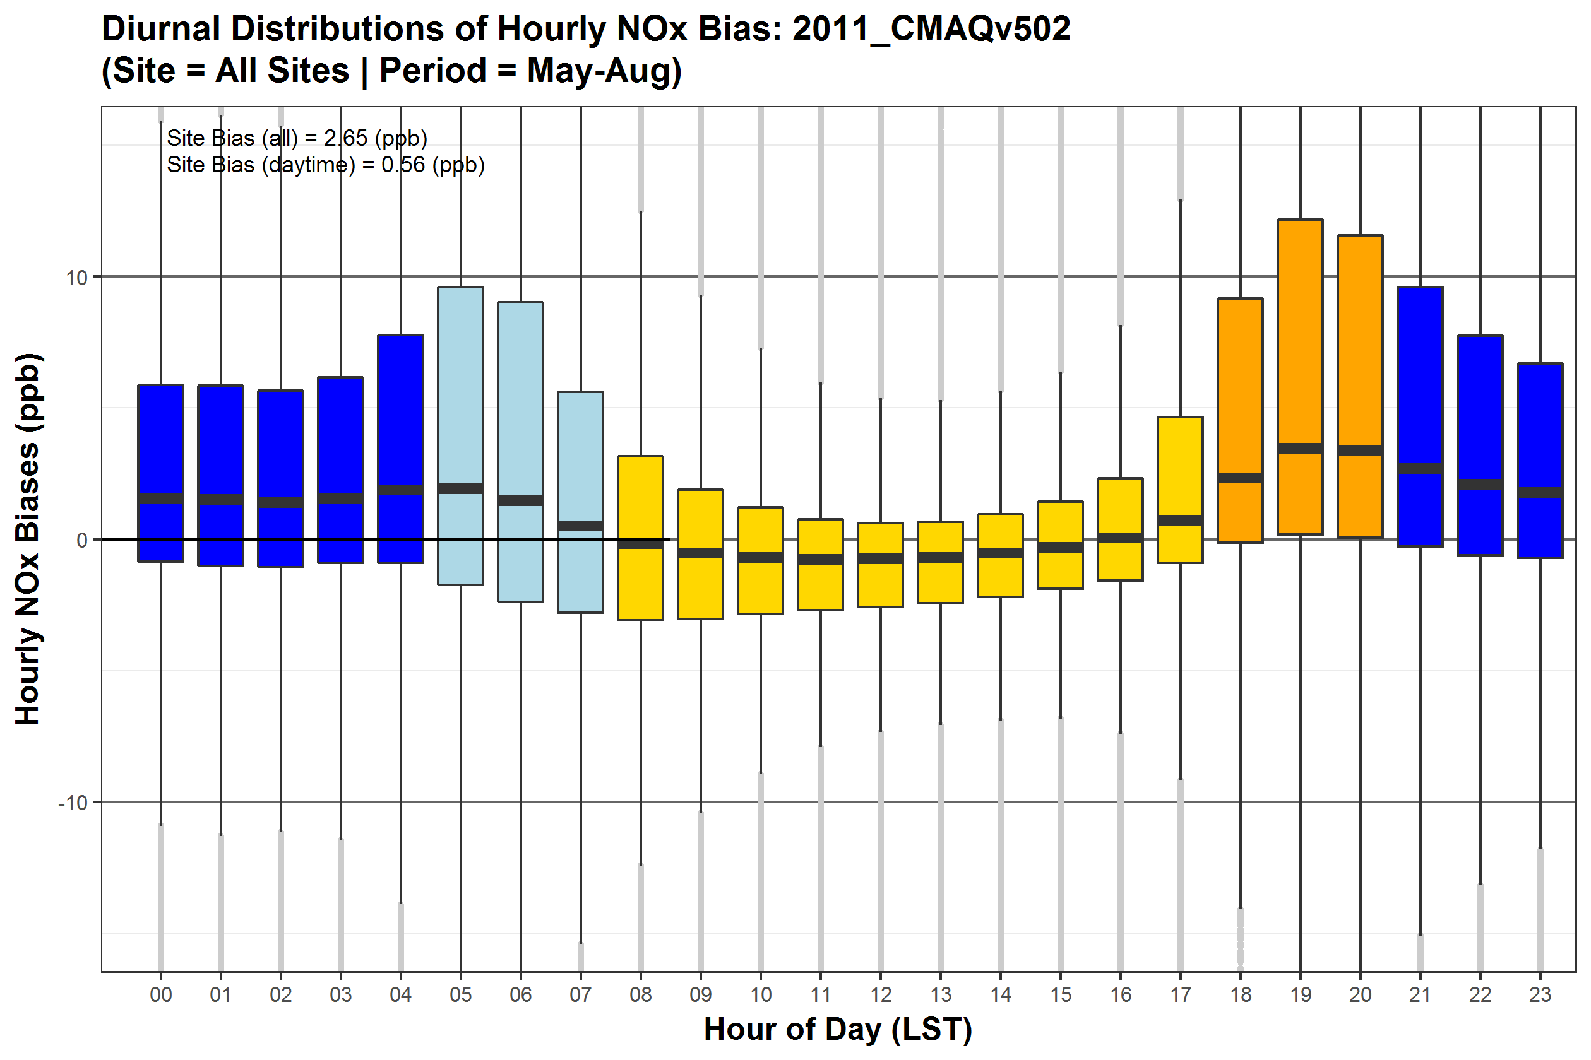
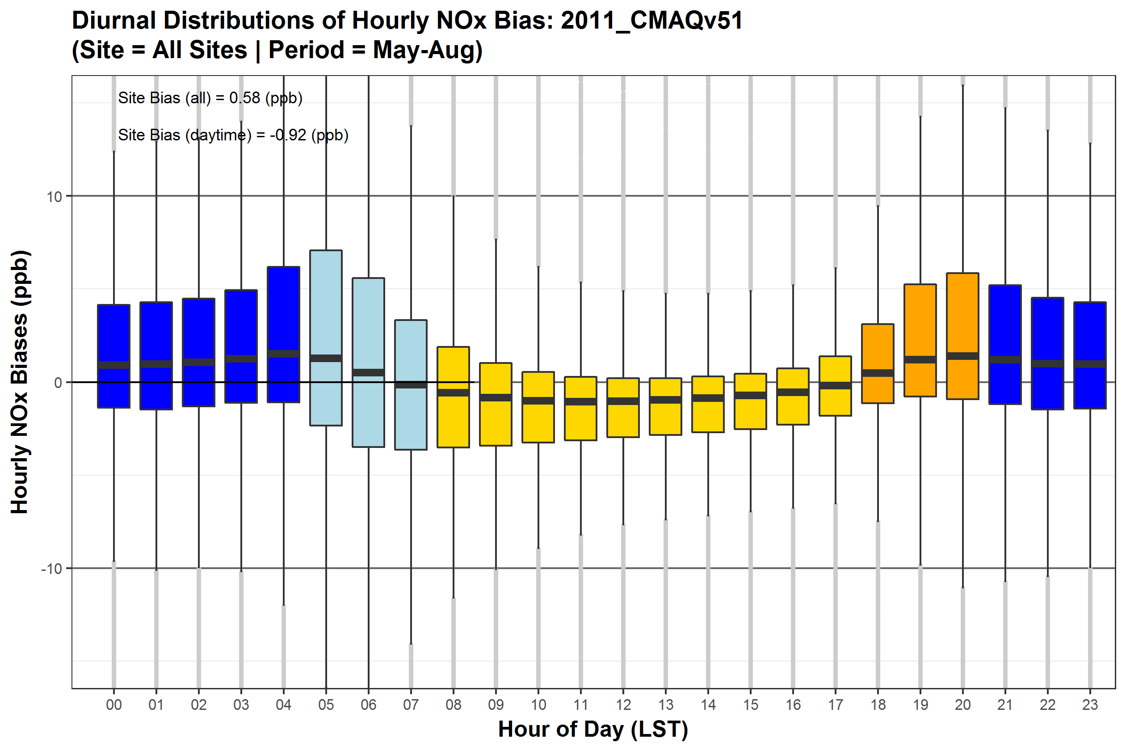

Past, Present, and… Future?
CMAQv5.0.2
NOx bias – all AQS sites
May-Aug 2011
CMAQv5.1
NOx bias – all AQS sites
May-Aug 2011
CMAQv5.2
NOx bias – all AQS sites
May-Aug 2011
10
NOx Bias (ppb)
0
-10
NOx is generally unbiased or under-predicted during daytime but is over-predicted in morning and evening transition hours and at night
NOx biases decrease with each CMAQ version update: v5.0.2 → v5.1 → v5.2
  CMAQv5.1 has improved characterization of mixing in morning/evening transitions and at night
  NO₂ decreases across much of the US from CMAQv5.1 to CMAQv5.2 due to multiple model updates
Notes:
CMAQv5.02 NOx bias: 3.1 ppb; CAMx v6.2 NOx bias: -0.5 ppb; CMAQv5.1 NOx bias: -1.4 ppb
CMAQv5.02 NOy bias: 5.2 ppb; CAMX v6.2 NOy bias: 1.6 ppb; CMAQv5.1 NOy bias: 0.9 ppb

Slide 3
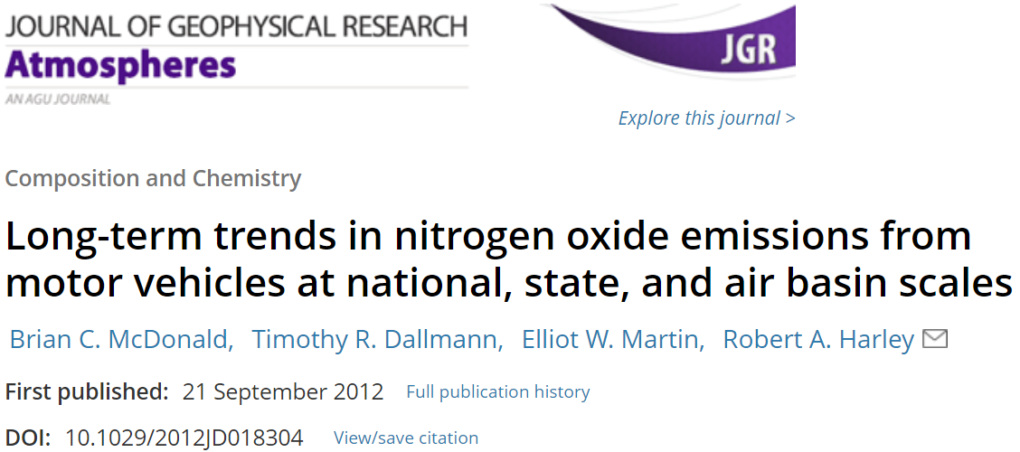
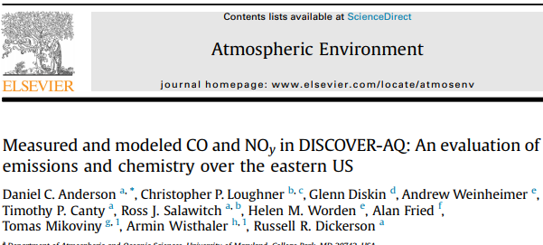
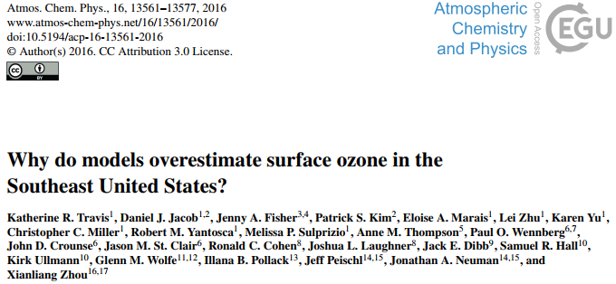
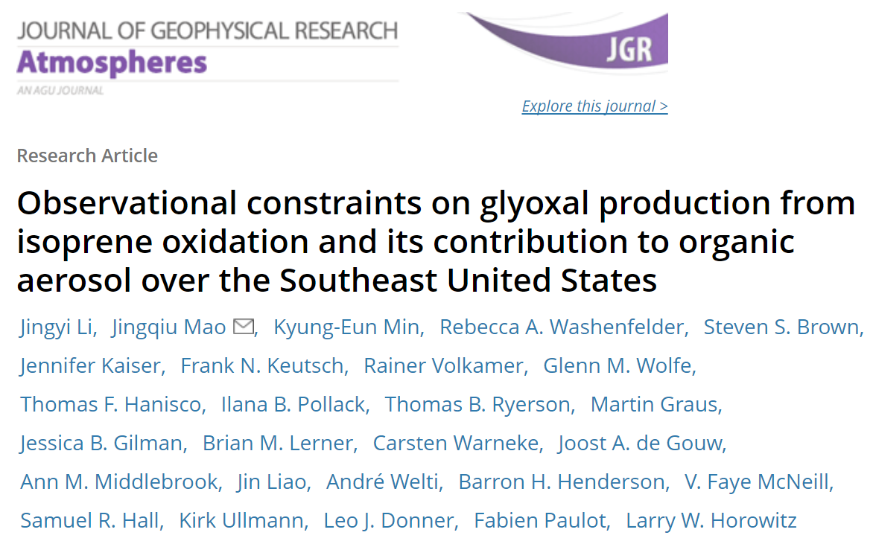
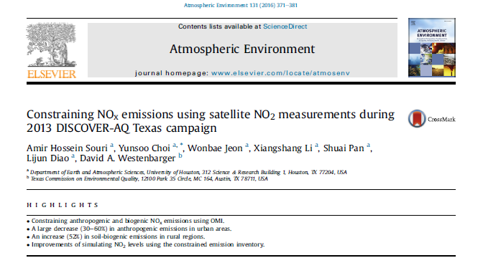
Literature consistent regarding reported high bias
Mobile NOx over (2x)
Mobile NOx over (1.7x)
Non-Power NOx over (1.3-1.6x)
Range of results: 1.14-2
Is it right?
Non-Power NOx over (1.14x)
Mobile NOx over (1.3x)

Slide 4
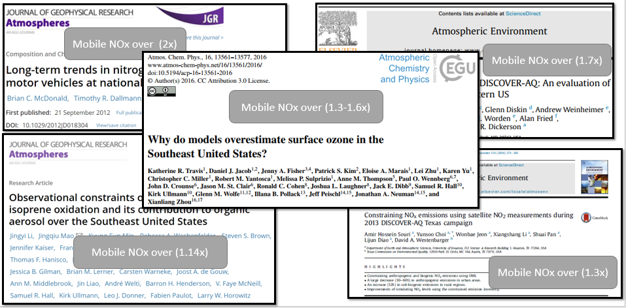
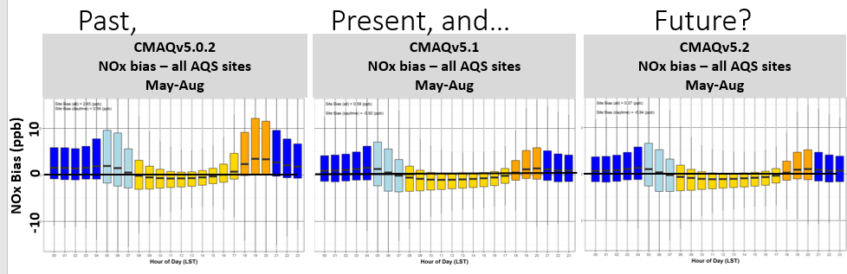
Coordinated efforts within the agency and across agencies
Technical discussions on Emissions and Atmospheric Modeling (TEAM)
  Cross-agency coordination
  Point of contact: Barron Henderson, Greg Frost (NOAA) and Barry Lefer (NASA)
  3 Webinars have been held; sessions at IEIC, CMAS
  Upcoming session at the American Geophysical Union (AGU) conference in New Orleans in Dec 2017
Cross-Office NOx Evaluation Work
  OAQPS, OTAQ, ORD
  Diverse perspectives, systematic and continual review
  Targeting research to address community questions.

Slide 5
High priority hypotheses Status
Spatial allocations (county to grid cell) are incorrect for onroad emissions | TBD
Spatial allocation (county to grid cell) of nonroad equipment is incorrect. | TBD
Spatial allocation onroad activity by MOVES from national to county-level | TBD
Nonroad emissions spatial distribution (national to county) is wrong | TBD
Nonroad emission rates are too high | TBD
Dry deposition velocities for NOy species are too low in models | In process
Model bias caused by mismatch of modeling grid-cell average compared to measurement location | In process: initial results insufficient
Model bias is due to some unique feature of 2011 platform | Rejected
Onroad emissions rates are too high | Sonntag @ 2PM
National nonroad equipment population/activity is overestimated | Timin Monday poster
Biased temporalization of onroad HD, non-CEMS EGU and nonroad | Timin Monday poster
Near-road CO/NOx methods for estimating NOx emissions bias are biased | Simon Monday poster
Model bias caused by issues related to vertical mixing | Toro Monday poster
MOVES default national inputs inflate emissions / MOVES inputs used in emissions platform inflate emissions | Sonntag @ 2PM
Ambient CO/NOy Methods for estimating NOx Emissions bias are biased | ?
NOy monitoring network and/or field campaign measurements are uncertain | ?

Slide 6
Hypothesis: Vertical mixing is under predicted causing high bias in NO_{x}
5am LST model and obs at 210 AQS sites across the country (excluding CA)
NOx observations increase from summer to winter
Model NOx decreases!
  Mobile emissions decrease
  Planetary boundary layer (PBL) heights increase on average
  → Emissions or vertical mixing could be driving the error in the seasonal trend – or both!
How can we untangle the influence of emissions vs met on the high modeled NO_{x} bias in the summer?

Slide 7
Hypothesis: Vertical mixing is under predicted causing high bias in NO_{x}
5am LST model and obs at 210 AQS sites across the country (excluding CA)
Results suggest both met and emissions are contributing to bias
See Toro Poster for more details
Looking just at sites where average PBL heights decrease from summer to winter (i.e. sites with more vertical mixing in summer)
Model NOx does increase from summer to winter
→ Now getting the seasonal trend correct, however:
  NOx is still biased low in winter
  Summer NOx still biased high even at these sites that have more vertical mixing

Slide 8
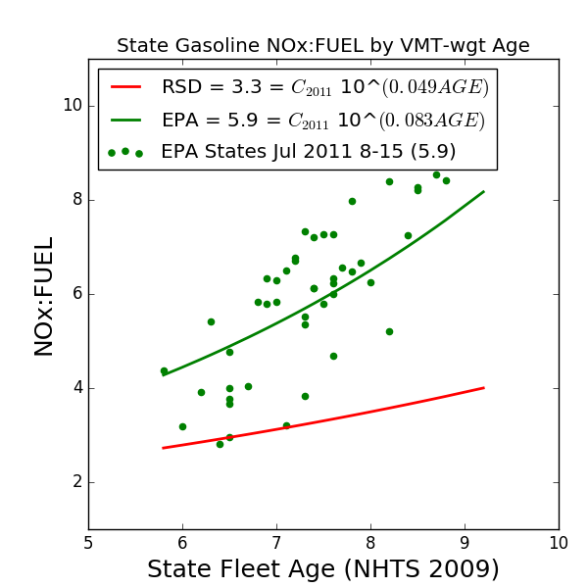
NOx:FUEL ratios gives us a different perspective on emissions
NOx:FUEL ratios can compare roadside measurements and EPA platform for light duty gasoline vehicles
Measurements not sensitive to meteorology.
Exploring explanations for why these differ.
  Estimated average age alone doesn't explain differences between states.
More info at 2 pm (Sonntag)
$Eq1:NOx:FUEL=10^(β_{0}$+$β_{1}Δy$+$β_{2}A)=C_{y}10^(β_{2}A)$

Slide 9
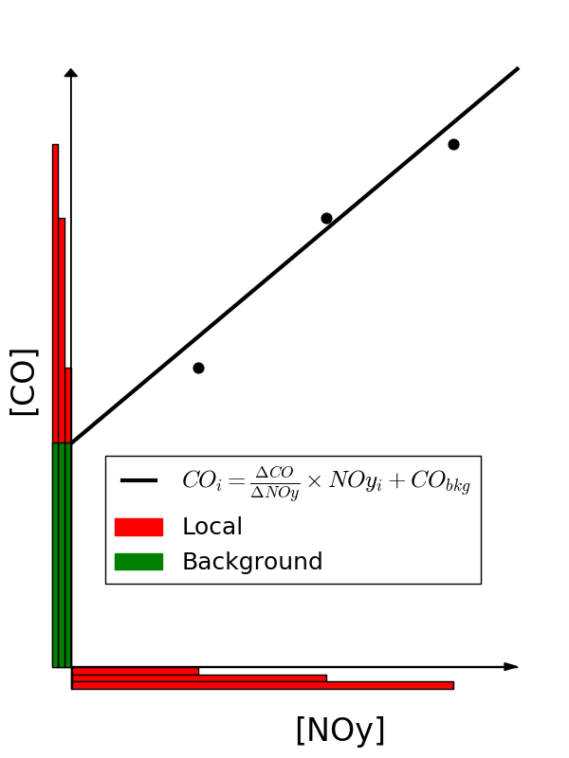
Hypothesis: Methods used in literature for estimating NOx emissions bias are biased
Background: Relationships between CO and NOy have been used evaluate inventories
  CO acts as a tracer and therefore is assumed to normalize for any uncertainties in mixing
  e.g., Anderson et al (2014) compared to emissions ratios for DISCOVER-AQ campaign
Source apportionment ground truth
  Evaluates reasonability of bias attribution to a single sector (e.g., onroad sector)
  Evaluates the impacts of photochemical aging on ambient ∆CO:∆NOy.
  Evaluate influence of measurement uncertainty on ambient ∆CO:∆NOy
Simon et al. submitted

Slide 10
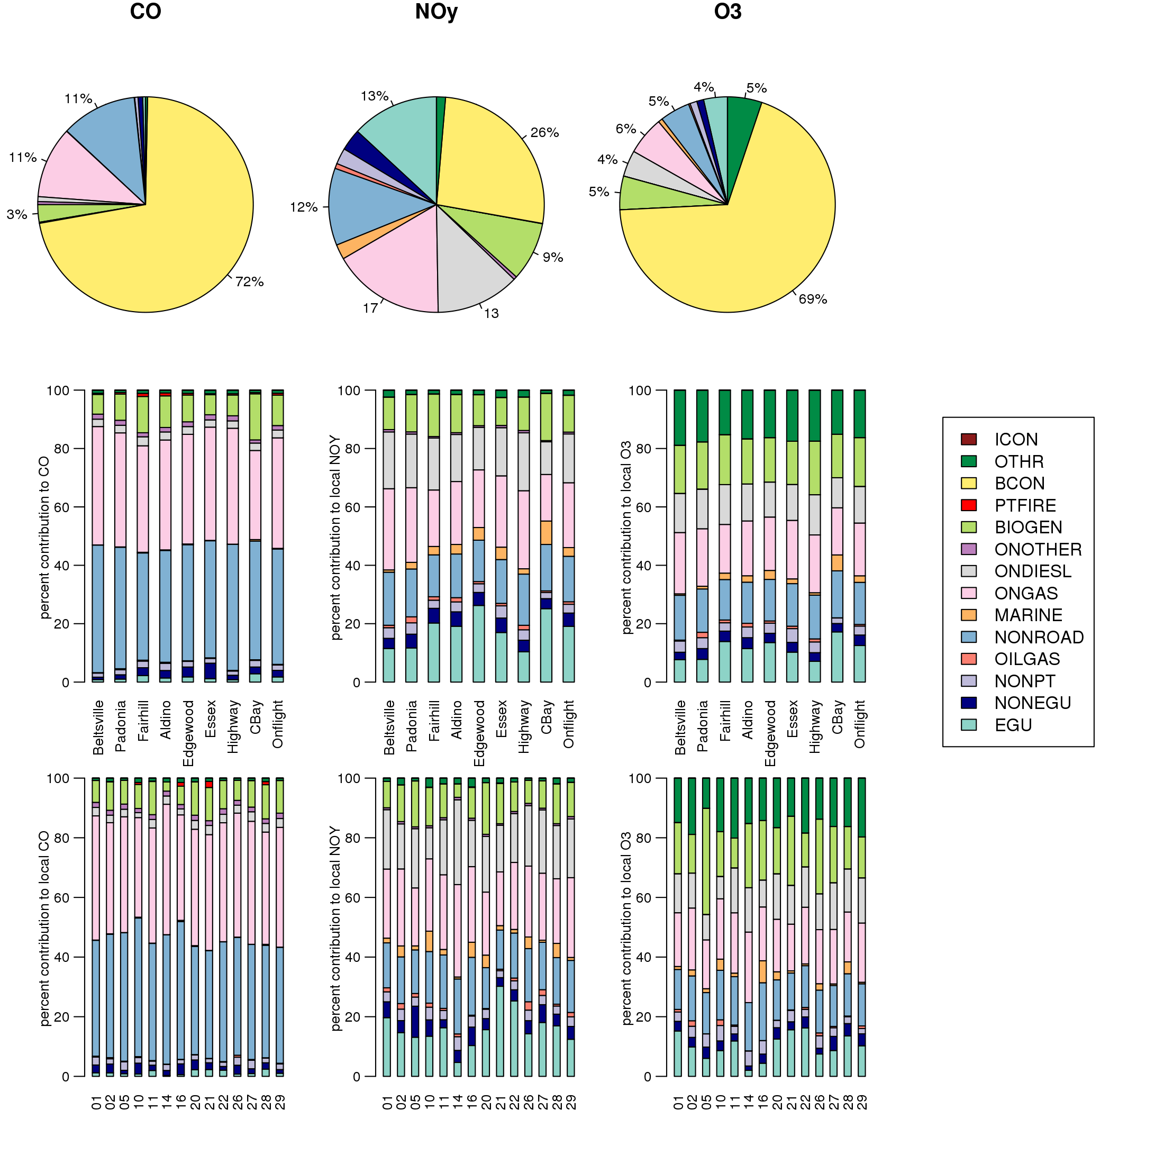
Assigning bias depends on assumed uncertainty
CO
NOy
Model NOy contributions
  Nonroad ~ OnGas ~ OnDiesl
  Nonroad has high uncertainty
Attribution inferred from good point source assumption, ignores NONROAD and aging.
Simon et al. submitted
Methods used in literature for estimating NOx emissions bias are biased : confirmed

Slide 11
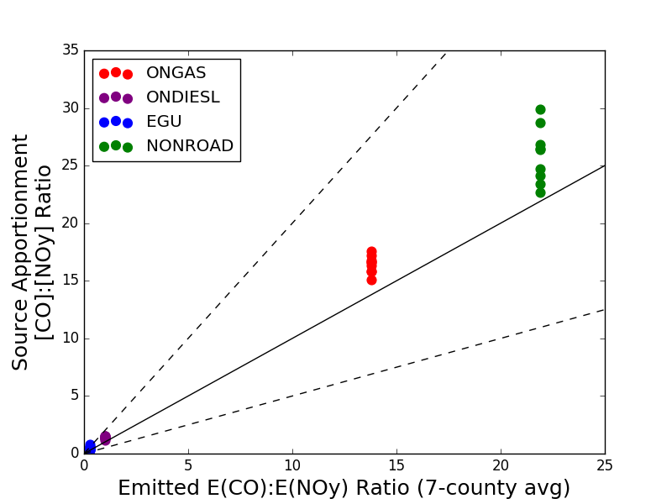
Cannot compare ∆CO: ∆NOy to emissions
Sector Concentrations by site
  Sites: Aldino, Beltsville, Chesapeake Bay, Edgewood, Essex, Fairhill, Highway, Onflight, and Padonia
  Sectors: On-road gasoline, on-road diesel, EGU, and Non-road
  Emissions averaged for 7-county area (similar to Anderson 2014 Fig 4)
  Inter-county varies for EGU and Nonroad; not so for gas
Ratios in concentrations are higher than in emissions.
On road gas: 10-30% of bias is attributable to aging within sector
Concentration ratios as a function of emitted ratios
Simon et al. submitted
Methods used in literature for estimating NOx emissions bias are biased : confirmed
Notes:
Regressions are OLS, but using orthogonal regressions increases the ambient ratio and increases discrepancy.
Using source apportionment allows us to track CO:NOy as a function of source.
Sector Concentrations by site
Sites: Aldino, Beltsville, Chesapeake Bay, Edgewood, Essex, Fairhill, Highway, Onflight, and Padonia
Sectors: On-road gasoline, on-road diesel, EGU, and Non-road
Emissions averaged for the 7-county area; assumes low variability from site-to-site in emissions (similar to Anderson 2014 Fig 4)
EGU and NONROAD emitted ratios actual vary a lot
On-road gasoline do not
On road gas: 10-30% of bias is attributable to aging within sector
Ignores cross-sector net-aging

Slide 12
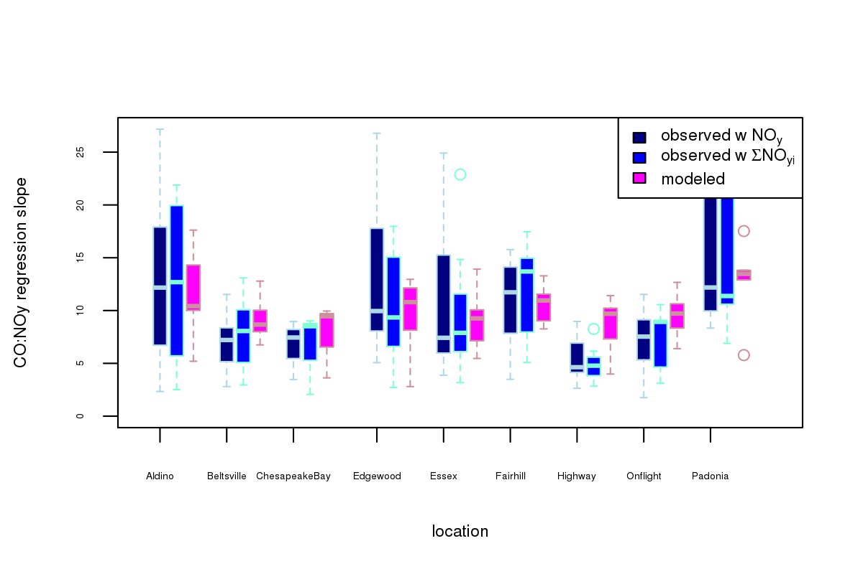
Not all NOy is equal: observations and models
Simon et al. submitted
CO:NOy slopes:
  Ordinary Least Squares
  Measurements: Total NOy and Sum of NOy(i)
  Model: Sum of NOy(i)
Total and Sum of NOy slopes
  1/3 of regressed measurements are statistically inconsistent (slope CI95% non-overlapping).
  Filtered where regressions by both measurements agree.
Modeled ∆CO:∆NOy slopes
  Are not rejected by t-test except over highway location
  Day-to-day variability was much lower
CO:NOy regression slope
Figure shows comparison of modeled and measured ∆CO:∆NOy for days/locations with statistically significant regression slopes
Methods used in literature for estimating NOx emissions bias are biased : confirmed
Notes:
Aldino: 10 days
Beltsville: 7 days
Chesapeake Bay: 3 days
Edgewood: 8 days
Essex: 7 days
Fairhill: 7 days
Highway: 10 days
Onflight: 7 days
Padonia: 6 days

Slide 13
Discussion/Conclusions
Multiple lines of literature-based evidence that NOx emissions in the modeling platform are over-estimated
EPA is continuing cross-office evaluation of multiple factors contributing to model bias
Morning biases show strong seasonal sensitivity associated with meteorology that prevent isolation of variables
  Morning bias changes from summer to winter, reflecting changes in both emissions and meteorology
  NOx errors should not be attributed to a single model input without more diagnostic evaluation to better isolate the source(s) of model error
Tests of CO/NOy regression show
  Interpretation complexity
  Sensitivity to measurement discrepancies
  Theoretical weakness due to chemical/physical aging
  Conclusions not applicable to near-road CO/NOx -- see Simon poster
NOX:FUEL ratio is a useful observation-based metric
  Not sensitive to: meteorological variability, chemical aging
  Needs more evaluation to understand the root of the differences

