Slide 1
Source Apportionment Modeling to Investigate Background, Regional, and Local Contributions to Ozone Concentrations in Denver, Phoenix, Detroit, and Atlanta
Kenneth Craig, Garnet Erdakos,
Lynn Baringer, and Shih Ying Chang
Sonoma Technology, Inc.,
Petaluma, CA
16th Annual CMAS Conference
October 23, 2017
620000-6759

Slide 2
Outline
Introduction
Motivation
Modeling objectives
Modeling approach
Results
  Background ozone estimates from source apportionment and zero-out modeling approaches
  Source apportionment results from sample receptors
  Ozone estimates from source apportionment with reduced on-road NO_{X} emissions
Summary of findings

Slide 3
Motivation
Introduction
Background ozone analysis is increasingly important for addressing NAAQS attainment issues.
Source apportionment can be used to quantify source impacts on downwind ozone, assess background ozone, and guide policy decisions (e.g., CSAPR, ozone NAAQS).
STI and EPRI conducted new source apportionment modeling with detailed tagging to support stakeholder needs throughout the United States.

Slide 4
Modeling Objectives
Introduction
Objectives
  Assess ozone contributions from local, regional, and background emission sources (source apportionment modeling).
  Compare background ozone derived from source apportionment with “zero-out” modeling approaches.
  Assess the impact of uncertain on-road NO_{X} emissions on ozone attribution (brute-force and source apportionment analysis).
Domain
  United States
Focus Cities
  Phoenix, Denver, Atlanta, Detroit

Slide 5
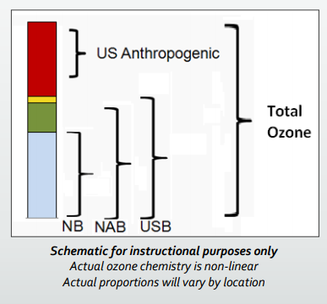
Background Ozone
Introduction
Natural Background (NB)
  Ozone formed from natural sources of ozone precursor emissions (i.e., no anthropogenic emissions)
North American Background (NAB)
  Ozone concentrations in the absence of North American anthropogenic emissions
U.S. Background (USB)
  Ozone concentration in the absence of United States anthropogenic emissions
From U.S. EPA

Slide 6
Background Ozone
Introduction
Natural Background (NB)
  Ozone formed from natural sources of ozone precursor emissions (i.e., no anthropogenic emissions)
North American Background (NAB)
  Ozone concentrations in the absence of North American anthropogenic emissions
U.S. Background (USB)
  Ozone concentration in the absence of United States anthropogenic emissions
z
From U.S. EPA

Slide 7
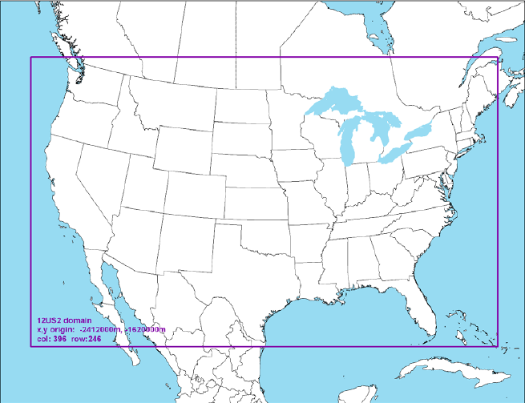
Modeling Approach
Approach
2011 ozone season (April to September) simulation with CAMx version 6.3.
Domain, inputs, and configurations based on EPA’s 2011 modeling platform.
  WRF version 3.4
  GEOS-Chem boundary conditions
  Carbon Bond 6r2
Ozone Source Apportionment Technology (OSAT) Version 3.
12 km CONUS modeling domain.

Slide 8
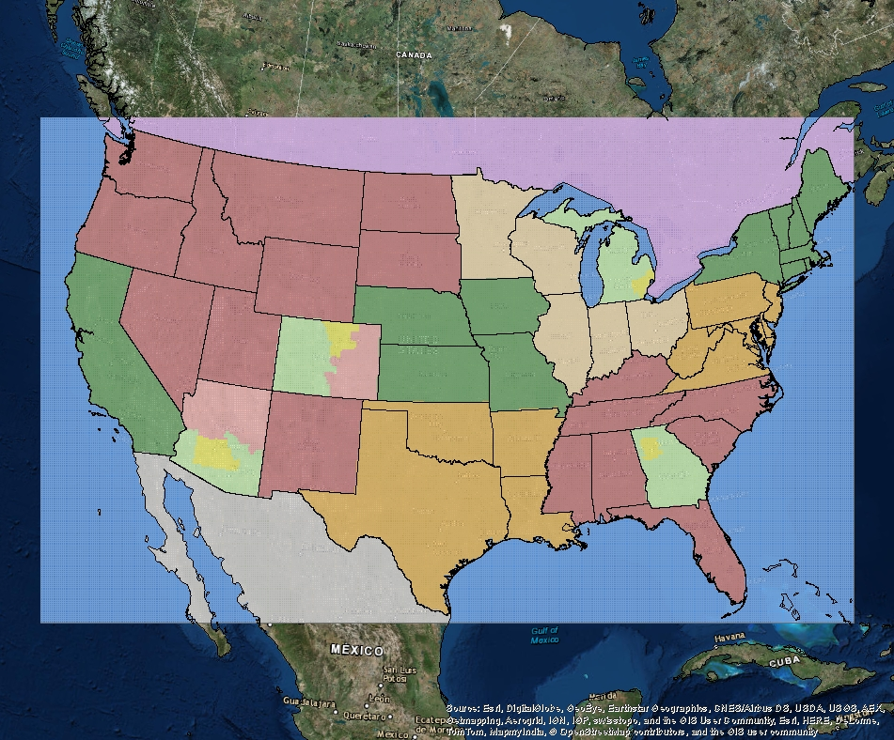
OSAT Source Group Regions (1)
Approach
Canada
LADCO
NESCAUM
WRAP
MI*
CenSARA (N)
MARAMA
CA
CO*
SESARM
AZ*
GA*
CenSARA (S)
Mexico
Offshore
*Arizona, Colorado, Georgia, and Michigan contain multiple source regions.

Slide 9
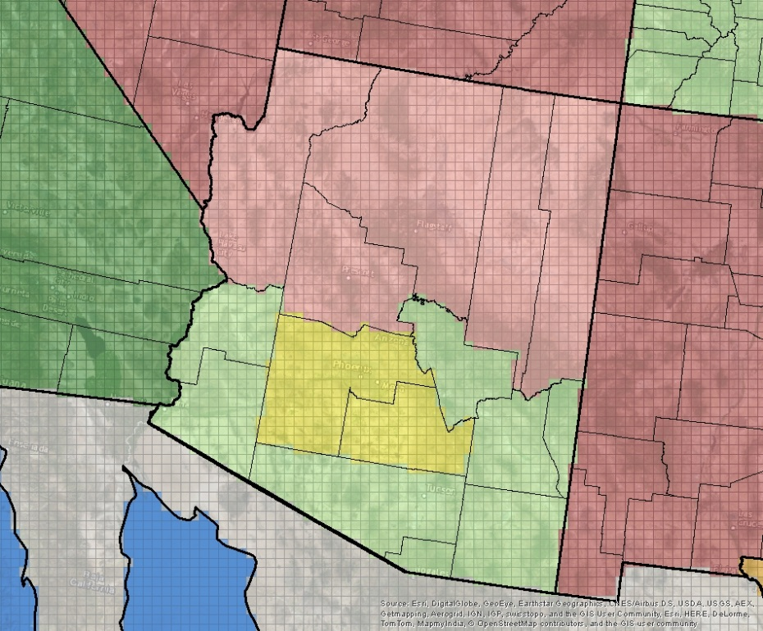
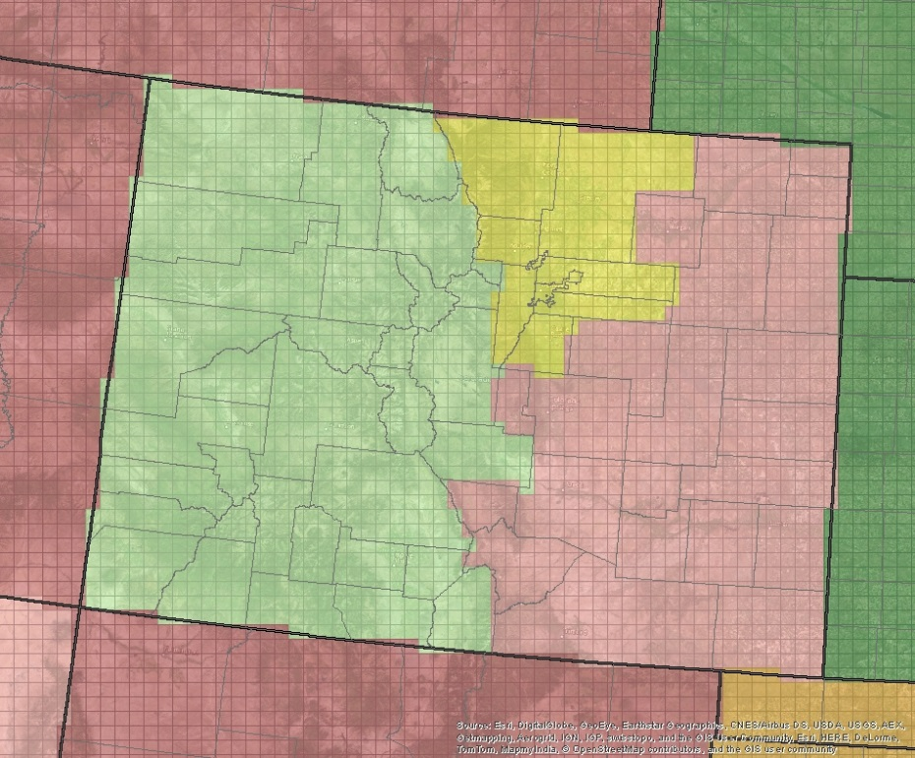
OSAT Source Group Regions (2)
Approach
Northern AZ
Denver Metro
Western CO
Phoenix Metro
(MAG)
Eastern CO
Southern AZ
Phoenix Metro Area: Counties within the Maricopa Association of Governments (MAG).
Denver Metro Area: Counties in the Denver Metro area and Northern Front Range region.

Slide 10
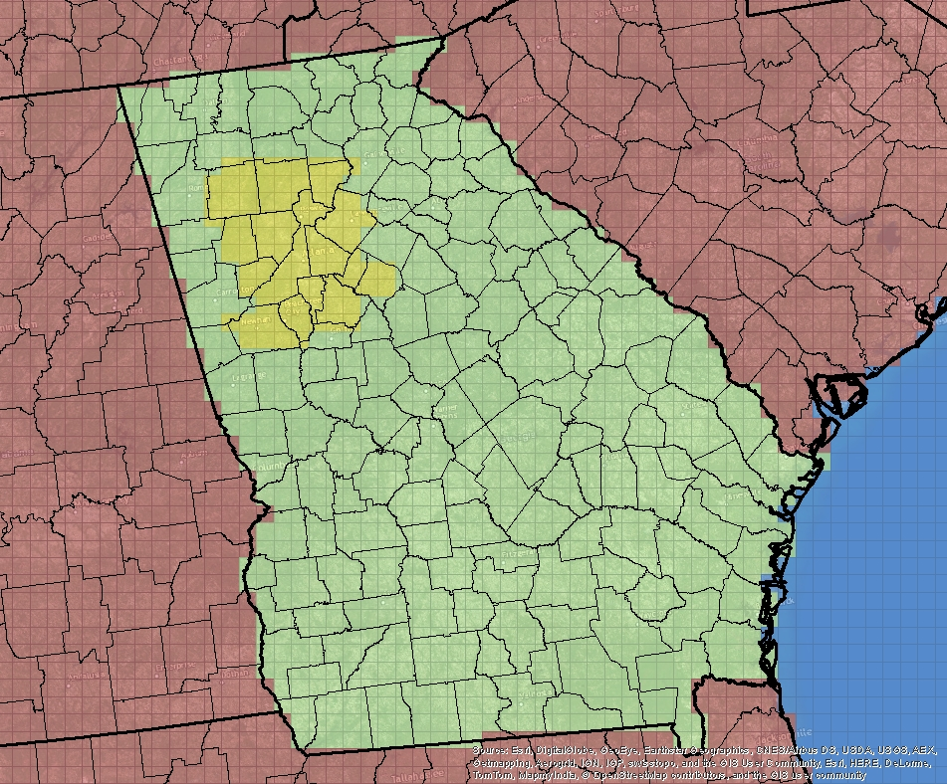
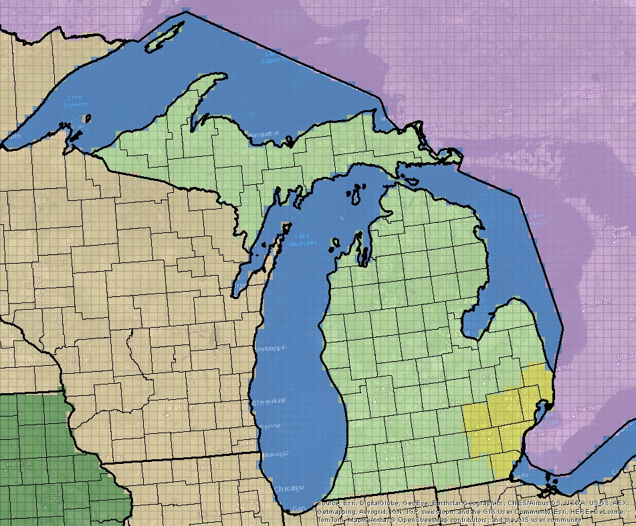
OSAT Source Group Regions (3)
Approach
Atlanta Metro
Other MI Counties
Other GA Counties
Detroit
Metro
Atlanta Metro Area: Counties within the Atlanta ozone non-attainment area.
Detroit Metro Area: Counties within the Southeast Michigan Council of Governments (SEMCOG).

Slide 11
Source Apportionment Tagging
Approach
Simulation | Description
1 | Natural Sources
2 | Electrical Generating Unit (EGU) Point Source
3 | On-Road Sources
Natural sources include biogenic, lightning (0.52 Tg/yr), and fire emissions.
Other anthropogenic sources (e.g, non-road, non-EGU point) are calculated as the residual.
Tagging strategy includes contributions from top and lateral boundary conditions.

Slide 12
OSAT Post-Processing
Approach
Hourly gridded
OSAT results
Daily peak 8-hr O₃ contributions
for each tag and receptor
Receptor Locations
(O₃ monitors in AZ, CO, GA, MI)
Reflects contributions during time periods when ozone concentrations are highest.
Guarantees that daily ozone contributions from all source tags sum to the total modeled 8-hr concentration.
Subsequent analysis focuses on ozone contributions on high monitored ozone days (>70 ppb).

Slide 13
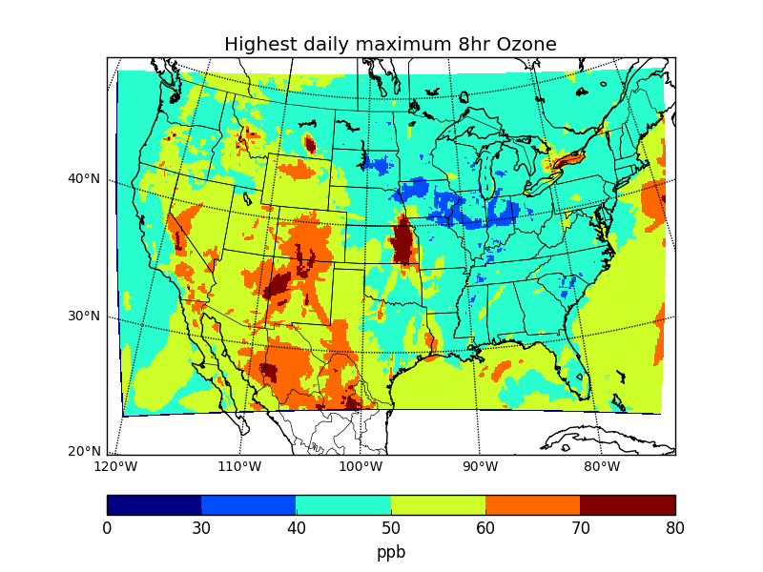
U.S. Background Ozone (OSAT):
Highest Maximum Daily 8-hr Ozone
Results
Background = boundary conditions, fires (wild and prescribed), lightning, biogenic sources, and international anthropogenic sources.
Highest daily values are associated with fire emissions.

Slide 14
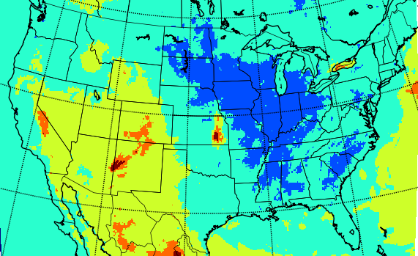
U.S. Background Ozone (OSAT):
Fourth-Highest Maximum Daily 8-hr Ozone
Results
Background = boundary conditions, fires (wild and prescribed), lightning, biogenic sources, and international anthropogenic sources.
Highest daily values are associated with fire emissions.

Slide 15
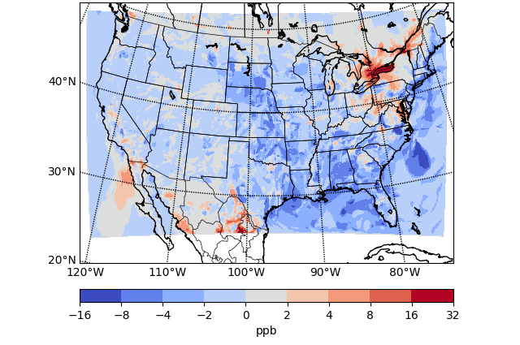
Difference in Highest Daily U.S. Background Ozone (OSAT – Zero-Out)
Results

Slide 16
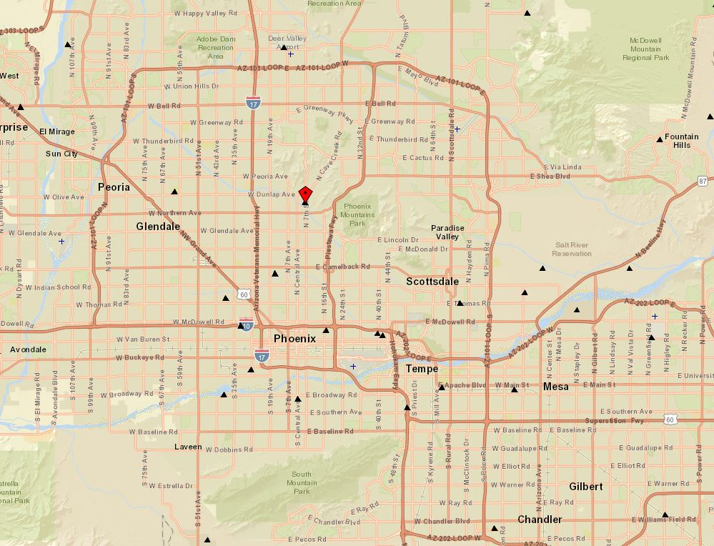
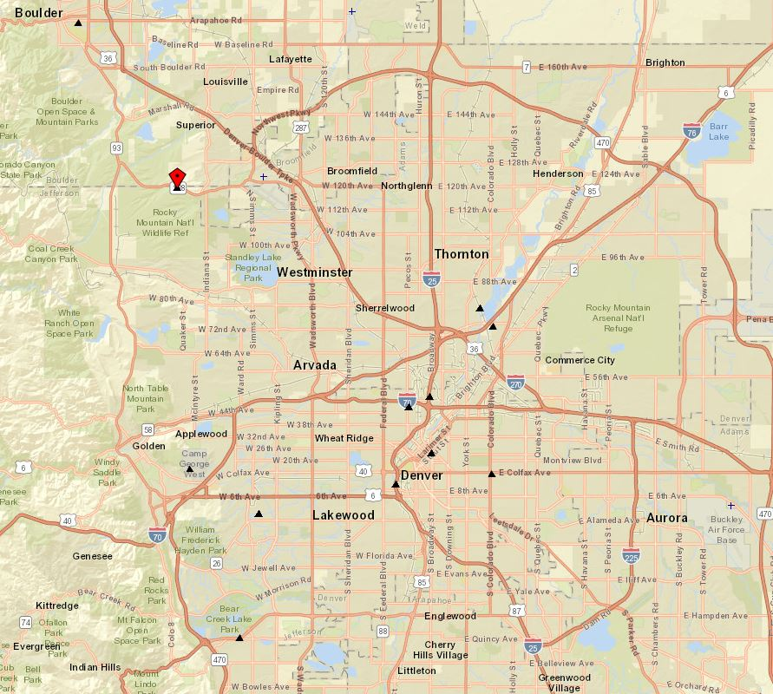
Focus Receptors (1)
Results
Rocky Flats
North Phoenix
Phoenix
Denver

Slide 17
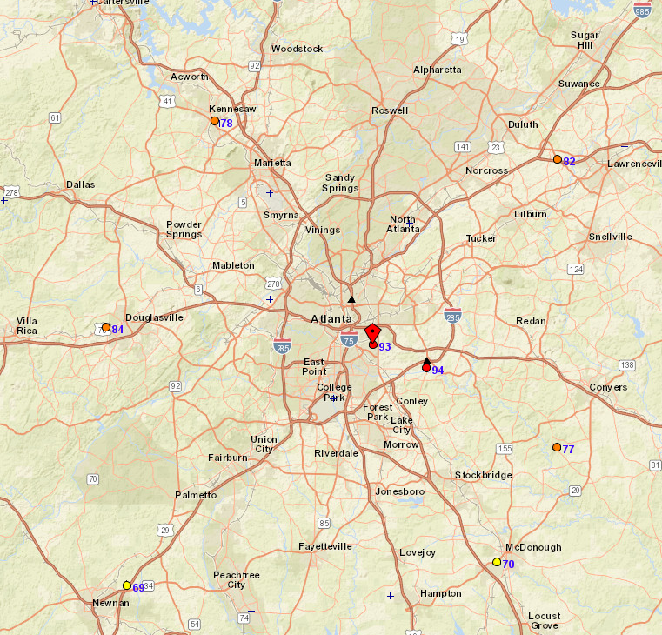
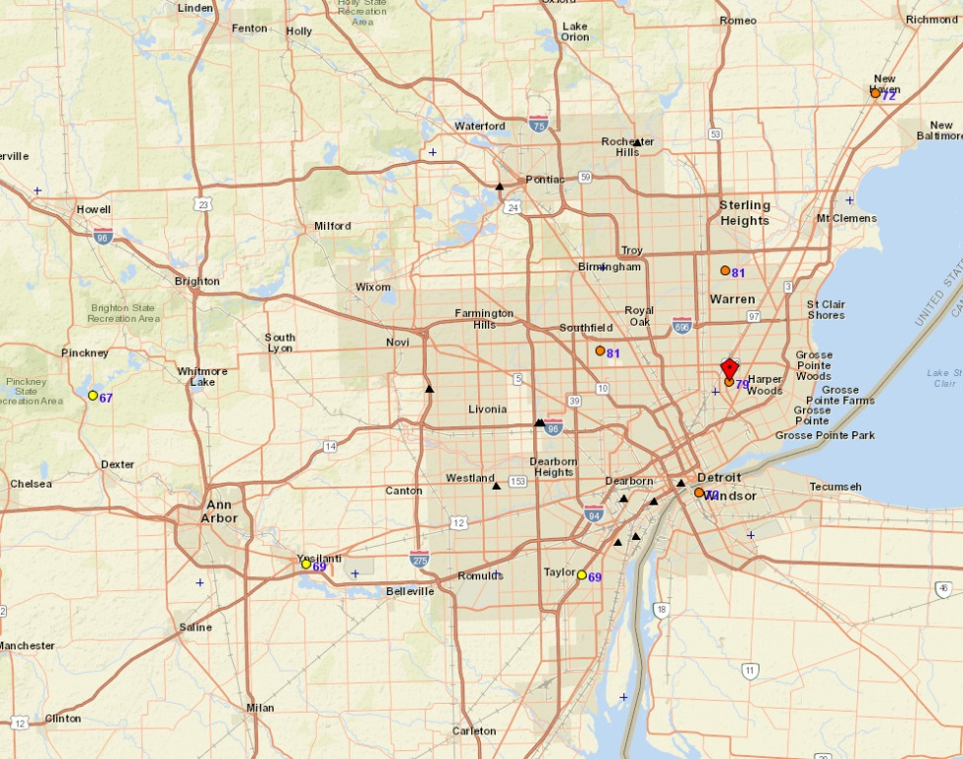
Focus Receptors (2)
Results
East 7 Mile
Confederate
Atlanta
Detroit

Slide 18
Ozone Source Contributions
Results – Focus Receptors
Averages when monitored 8-hr ozone > 70 ppb
Boundary conditions include out-of-domain international and offshore contributions and recirculated U.S. contributions from the global model.

Slide 19
In-State Ozone Source Contributions
Results – Focus Receptors
Averages when monitored 8-hr ozone > 70 ppb

Slide 20
Results – NO_{X} sensitivity
50% NO_{X} Reduction Impacts on Ozone
Fourth-highest maximum daily 8-hr ozone concentration differences

Slide 21
Summary of Findings (1)
Modeled USB ozone in 2011 OSAT simulation
  Highest daily values: 50 to 70 ppb in the West; 40 to 60 ppb in the East
  Fourth-highest daily values: 40 to 60 ppb in the West; 30 to 50 ppb in the East
  Larger percentage of total ozone in the West than in the East
  Zero-out background ozone simulation results were generally higher than OSAT results, with differences largest in the East
  Average modeled contribution of boundary conditions to peak daily 8-hr ozone—and as a percentage of USB— is larger in the West than in the East
  Average modeled in-state anthropogenic contributions to ozone at the selected monitoring sites – 10-20% of total ozone, except at the Confederate Ave. site in Atlanta (32%)

Slide 22
Summary of Findings (2)
Reducing on-road NO_{X} emissions by 50%
  Reduced modeled fourth-highest ozone throughout most of the U.S.
  Outside of California, reduced ozone more in the East (2 to 8 ppb) than in the West (< 2 ppb); reduced ozone even more in the Southeast around Atlanta
  Increased ozone concentrations within several large urban areas (e.g., Los Angeles, San Francisco Bay Area, Seattle, Denver, offshore Chicago, and New York City), likely due to VOC-limited ozone chemistry

Slide 23

Contact
sonomatech.com
Garnet Erdakos
Atmospheric Modeling Group
gerdakos@sonomatech.com
707.665.9900
sonomatech.com @sonoma_tech

