Slide 1
MOVES-Based NO_{x} Analyses for Urban Case Studies in Texas
Song Bai, Yuan Du, Annie Seagram, and Kenneth Craig
Sonoma Technology, Inc.
Petaluma, California
2017 Community Modeling and Analysis System (CMAS) Conference
Chapel Hill, NC
October 23, 2017
STI-6760

Slide 2
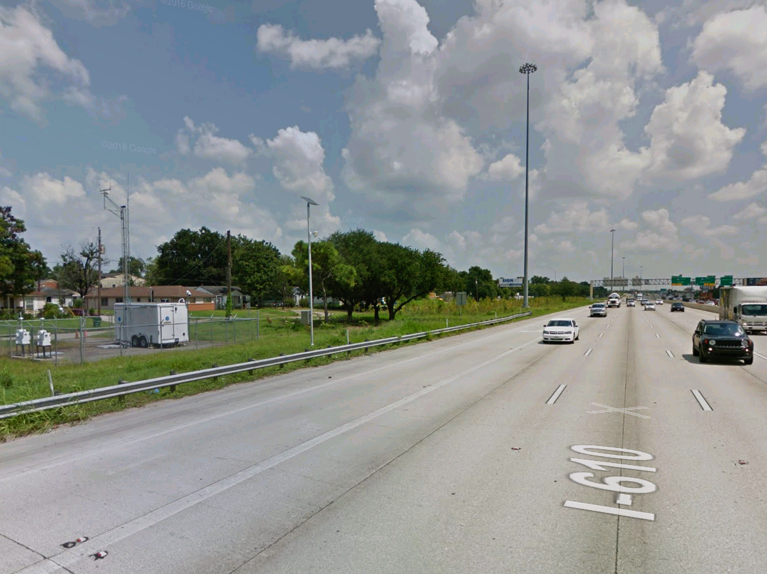
How do we reconcile mobile NO_{x} emissions?
Emitted
Monitored
Modeled
(Inventory)

Slide 3
Research Questions
Does MOVES overestimate NO_{x} emissions?
What MOVES input data are important for NO_{x} emissions estimates?
Emissions reconciliation analysis
Compare near-road monitoring data to output from MOVES to examine NO_{x} emissions estimates
Emissions sensitivity analysis
Identify input parameters that have larger influence on MOVES-based NO_{x} emissions

Slide 4
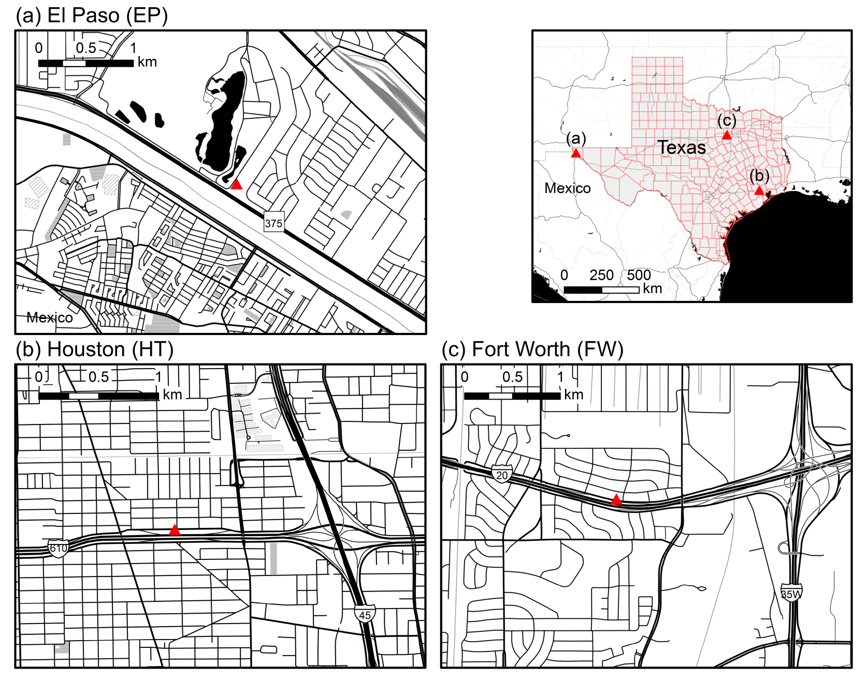
Case Study Settings

Slide 5
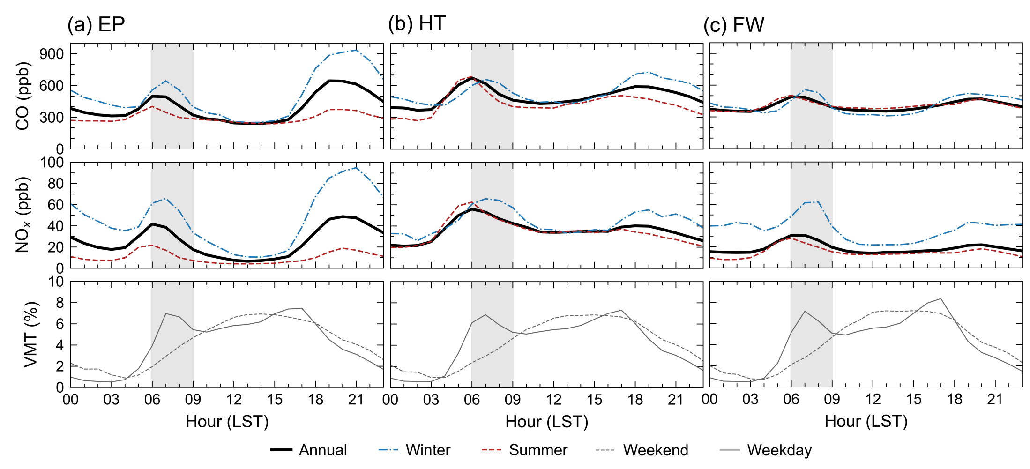
Ambient Data
2015
Near road
06:00 – 09:00
Monitor downwind
CO/NO_{x} ratios

Slide 6
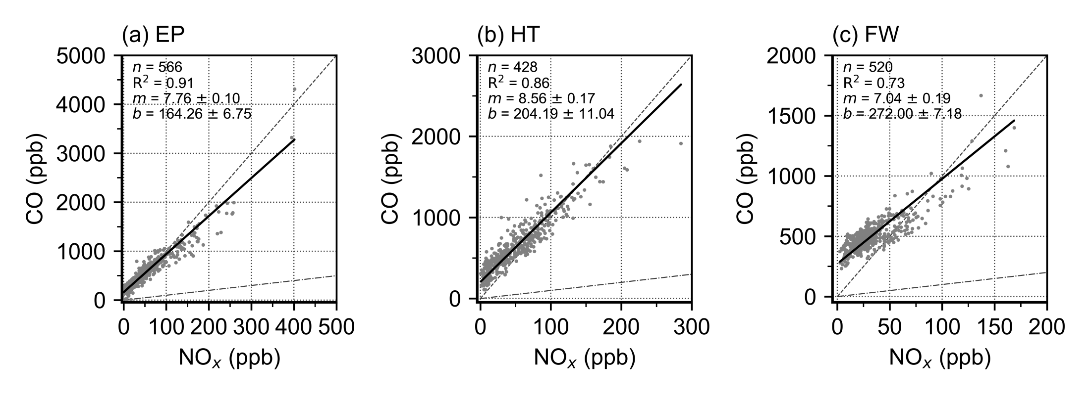
Ambient CO/NO_{x} Ratios
2015
Reference lines
Total linear least-squares regression

Slide 7
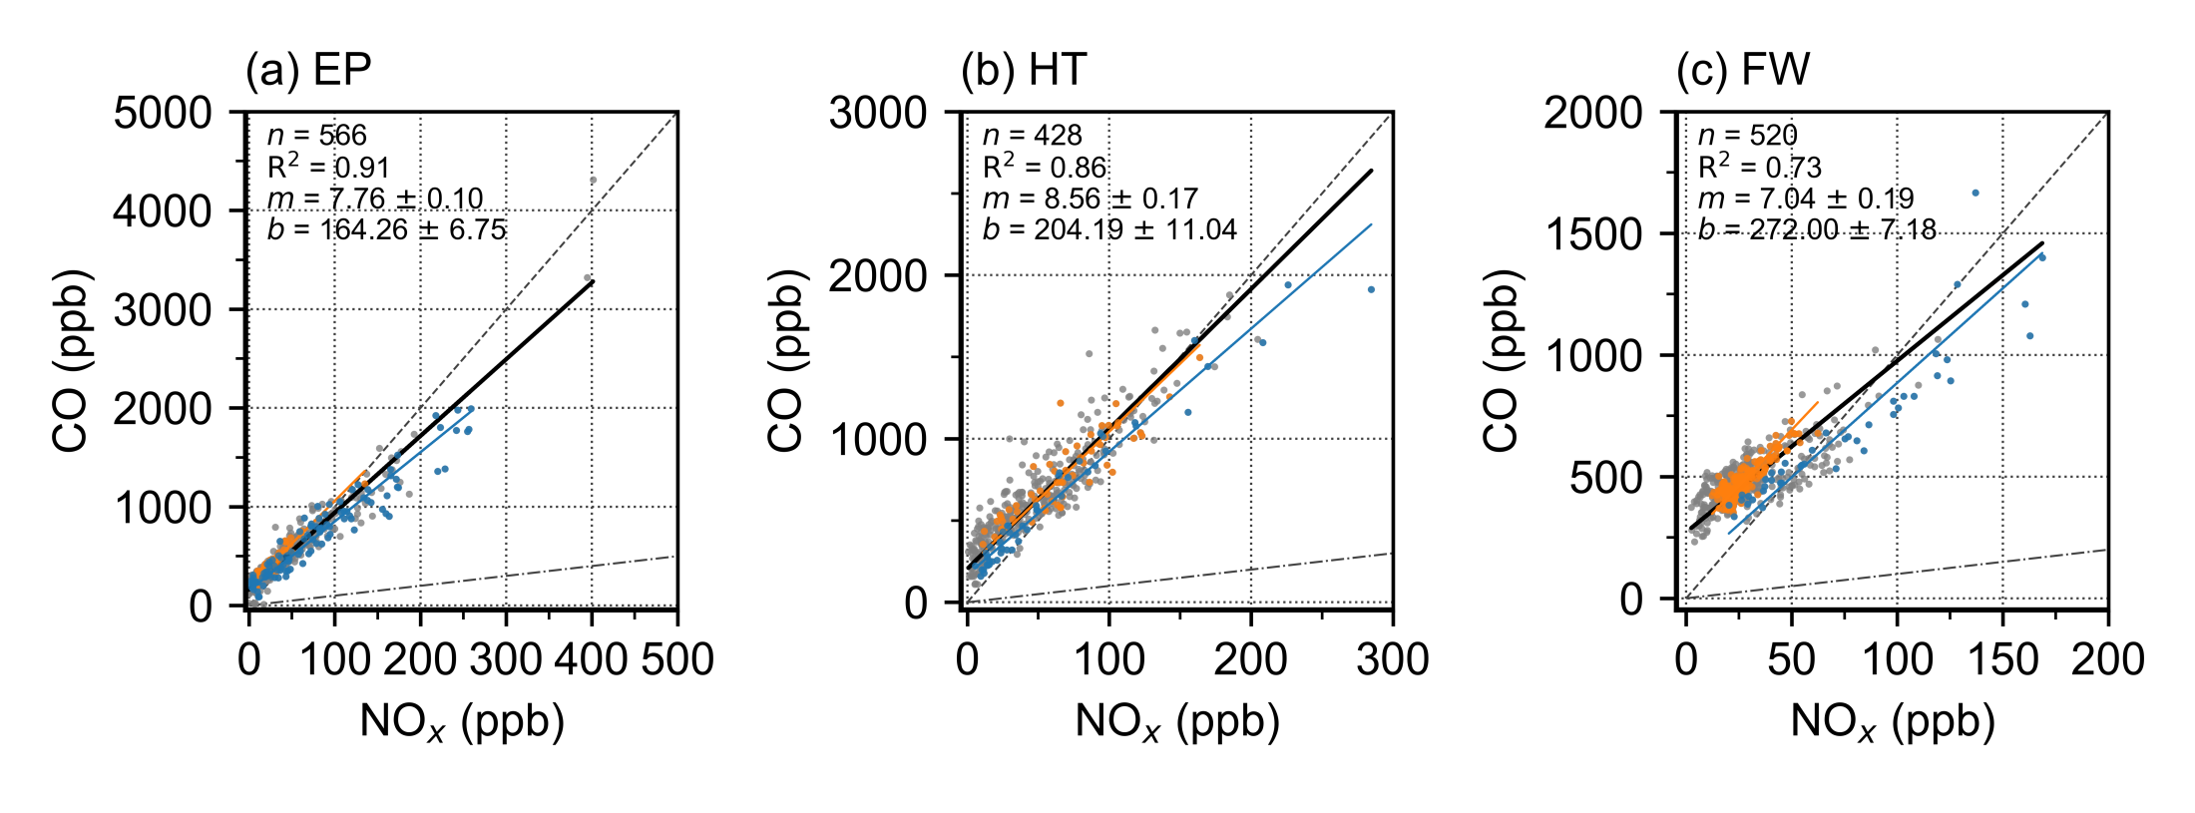
Ambient CO/NO_{x} Ratios
2015
Reference lines
Total linear least-squares regression
Annual, Summer (Jun-Aug), Winter (Dec-Feb)

Slide 8
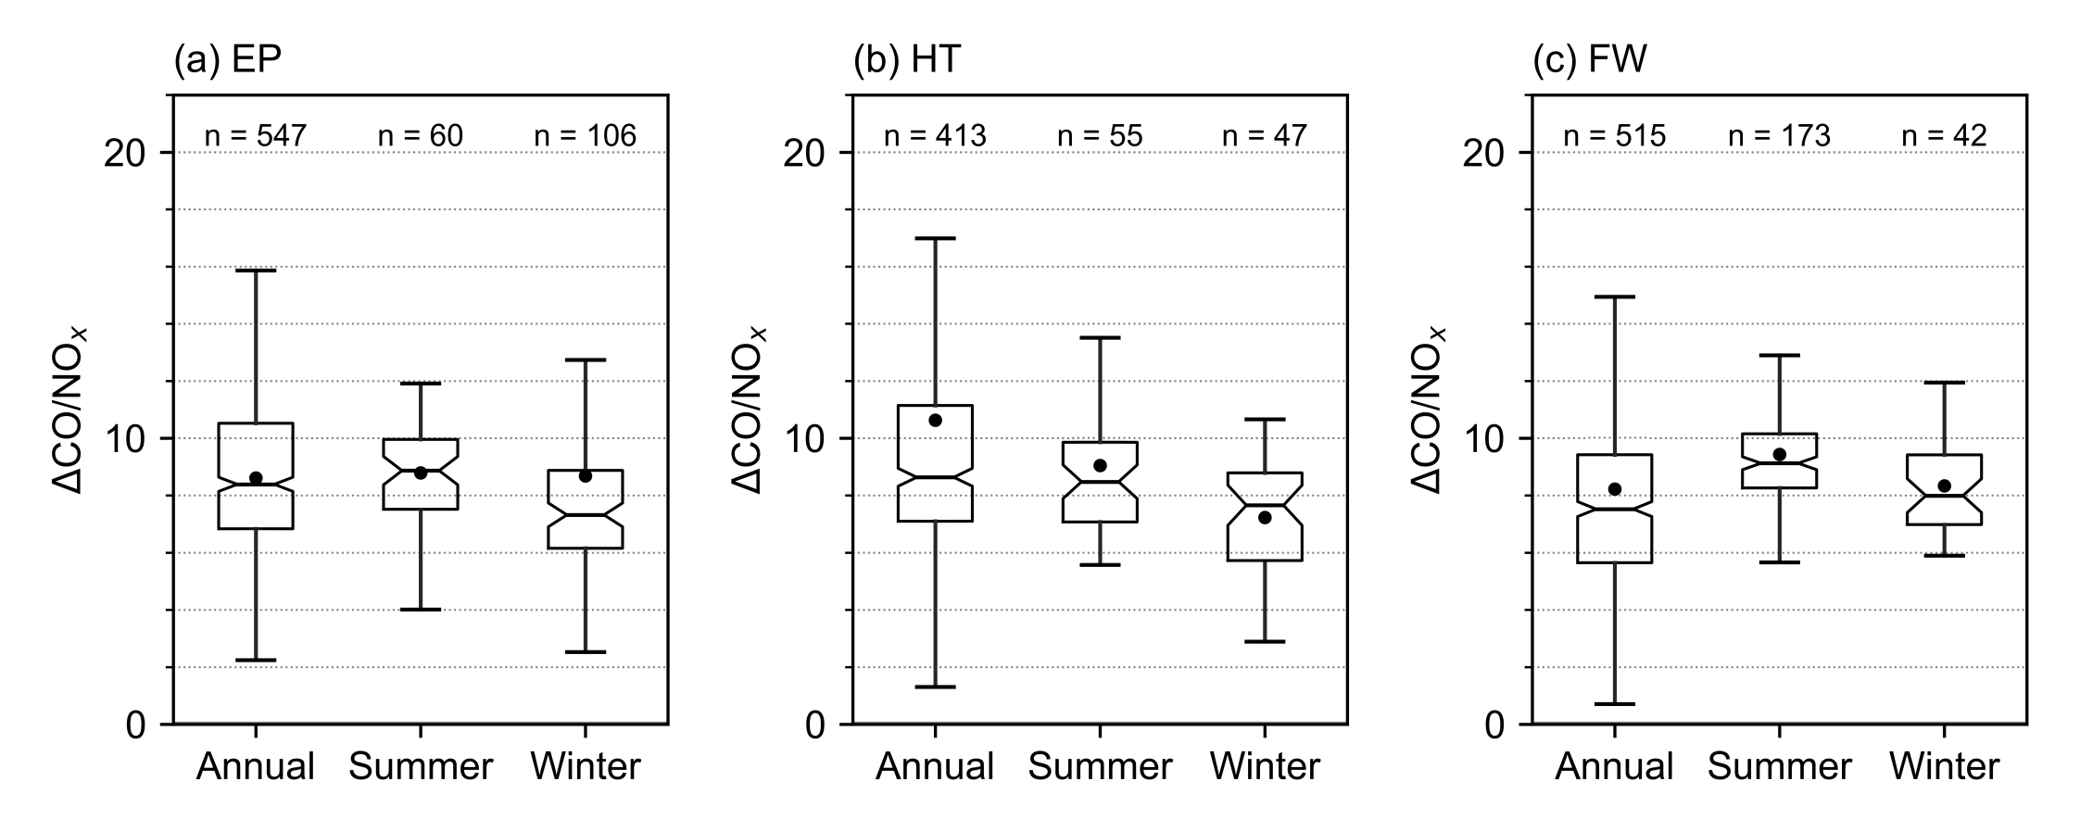
Comparison of CO/NO_{x} Ratios
Ambient mean

Slide 9
MOVES Modeling
2014a
Section | Setting
Scale
Domain/Scale | County
Calculation Type | Inventory
Time Span
Aggregation Level | Hour
Year | 2015
Months | All
Days | Weekend, Weekday
Hours | Start Hour: 6, End Hour: 9
Geographic Bounds | Texas Counties: El Paso, Harris, Tarrant
Vehicles/Equipment | All
Road Type | Urban restricted-access roads
Pollutants and Processes
Processes | Running Exhaust, Crankcase Running Exhaust
Species | CO, NO, NO₂

Slide 10
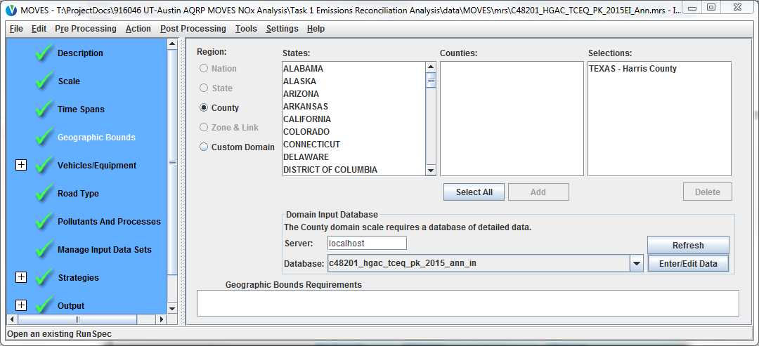
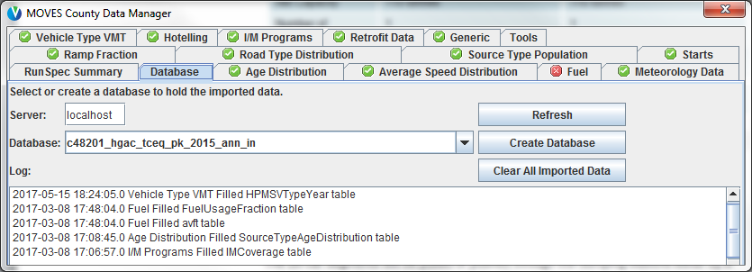
MOVES Modeling
Default scenario:
MOVES2014a national default inputs
Best Available Local (BAL) scenario:
MOVES county databases (CDBs) from TCEQ, HGAC, NCTCOG
Local activity data from TxDOT Roadway Inventory

Slide 11
Comparison of CO/NO_{x} Ratios
Ambient mean

Slide 12
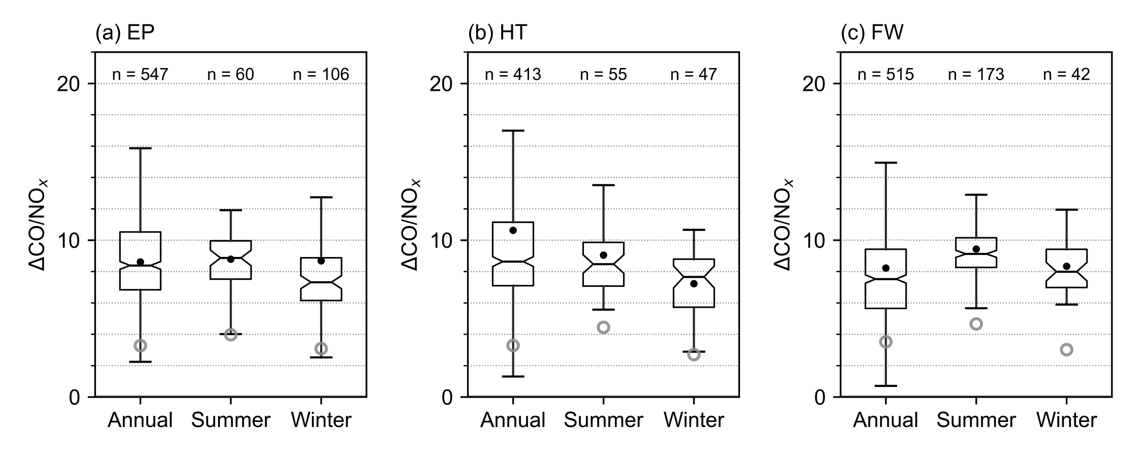
Comparison of CO/NO_{x} Ratios
CO/NO_{x} ratios based on MOVES Default are much lower than ambient-based ratios
Ambient mean
MOVES Default

Slide 13
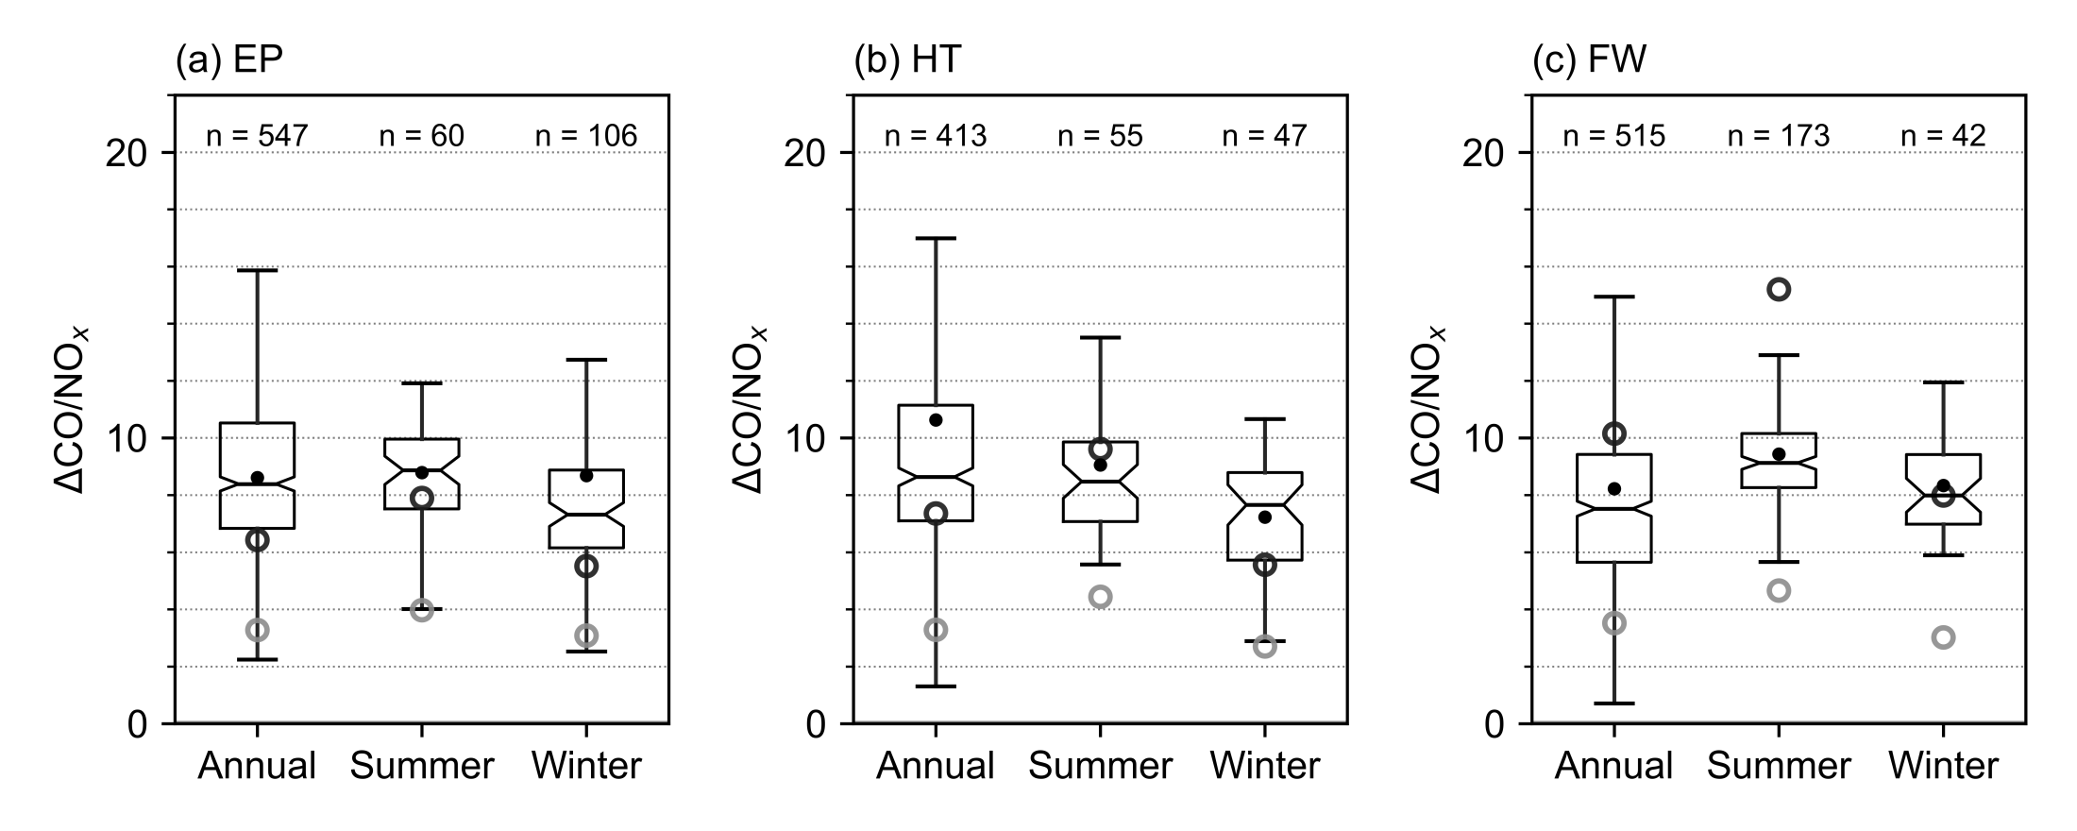
Comparison of CO/NO_{x} Ratios
CO/NO_{x} ratios based on MOVES Default are much lower than ambient-based ratios
MOVES-based ratios using BAL inputs and ambient-based ratios are in good agreement
Ambient mean
MOVES Default
MOVES BAL

Slide 14
Reconciliation Analysis: Findings
MOVES emissions for CO or NO_{x} or both pollutants based on Default inputs did not reasonably represent on-road mobile sources
MOVES emission ratios using BAL inputs are comparable with the respective ambient ratios (within the acceptable 25-50% range of agreement)
Using BAL inputs is key to generate reasonable emissions estimates

Slide 15
Emissions Sensitivity Analysis
Scenario | Speed Distribution | Truck % | Age Distribution | Temperature and RH
Base | BAL | BAL | BAL | BAL
Speed Base-Default | Default | BAL | BAL | BAL
Speed Low | Low | BAL | BAL | BAL
Speed Medium | Medium | BAL | BAL | BAL
Speed High | High | BAL | BAL | BAL
Truck Base-Default | BAL | Default | BAL | BAL
Truck 0 | BAL | 0 | BAL | BAL
Truck 5 | BAL | 5 | BAL | BAL
Truck 10 | BAL | 10 | BAL | BAL
Truck 20 | BAL | 20 | BAL | BAL
Truck 30 | BAL | 30 | BAL | BAL
Age Base-Default | BAL | BAL | Default | BAL
Age Old | BAL | BAL | Old | BAL
Age Mid | BAL | BAL | Mid | BAL
Age New | BAL | BAL | New | BAL
Season Base-Default | BAL | BAL | BAL | Default
Season Half | BAL | BAL | BAL | 6 month mean
Season Quarter | BAL | BAL | BAL | 3 month mean
Season Month | BAL | BAL | BAL | 1 month mean
Speed
Fleet Mix
Age
Met.

Slide 16
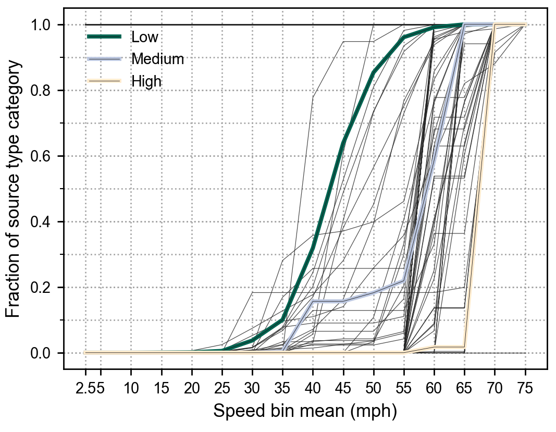
Emissions Sensitivity Analysis
Scenario | Speed Distribution | Truck % | Age Distribution | Temperature and RH
Base | BAL | BAL | BAL | BAL
Speed Base-Default | Default | BAL | BAL | BAL
Speed Low | Low | BAL | BAL | BAL
Speed Medium | Medium | BAL | BAL | BAL
Speed High | High | BAL | BAL | BAL
Truck Base-Default | BAL | Default | BAL | BAL
Truck 0 | BAL | 0 | BAL | BAL
Truck 5 | BAL | 5 | BAL | BAL
Truck 10 | BAL | 10 | BAL | BAL
Truck 20 | BAL | 20 | BAL | BAL
Truck 30 | BAL | 30 | BAL | BAL
Age Base-Default | BAL | BAL | Default | BAL
Age Old | BAL | BAL | Old | BAL
Age Mid | BAL | BAL | Mid | BAL
Age New | BAL | BAL | New | BAL
Season Base-Default | BAL | BAL | BAL | Default
Season Half | BAL | BAL | BAL | 6 month mean
Season Quarter | BAL | BAL | BAL | 3 month mean
Season Month | BAL | BAL | BAL | 1 month mean
Speed
Fleet Mix
TX counties
Age
Met.

Slide 17
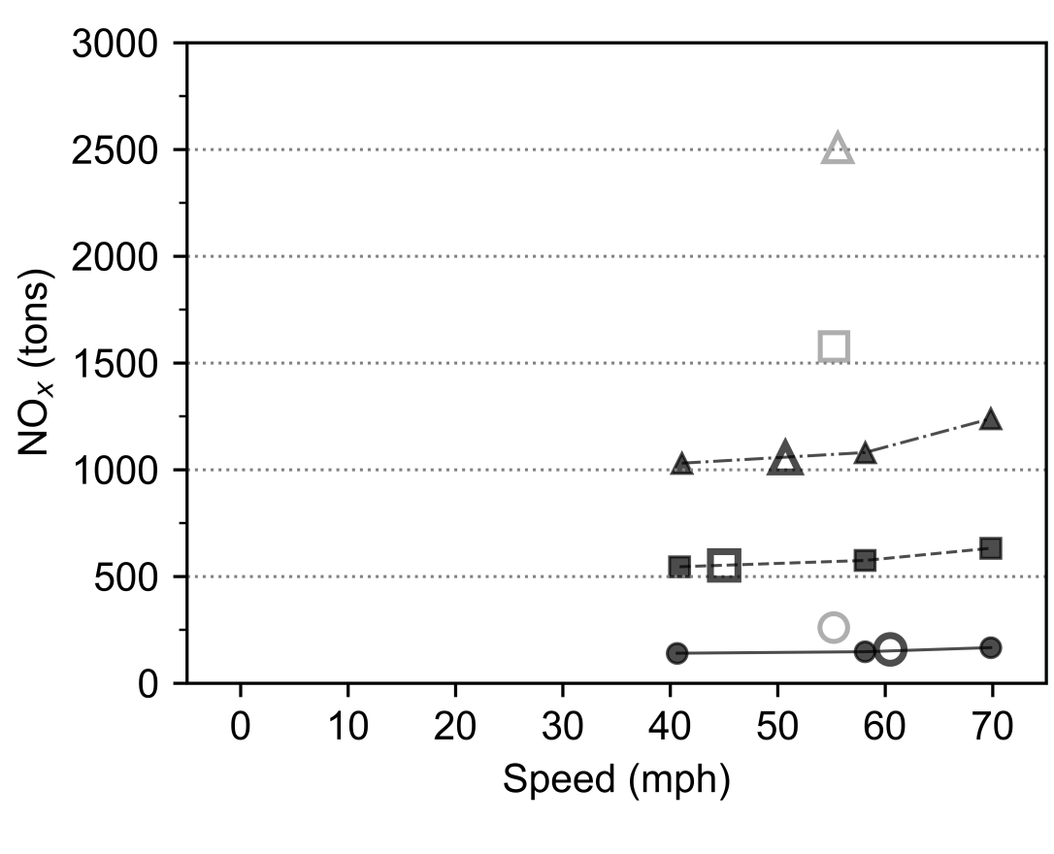
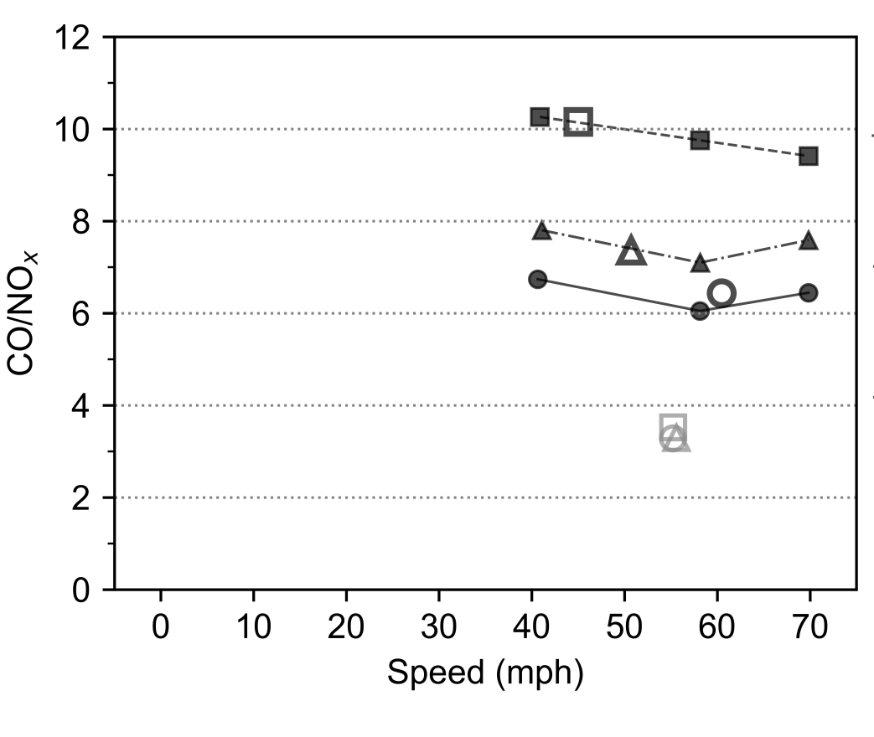
Sensitivity: Speed

Slide 18
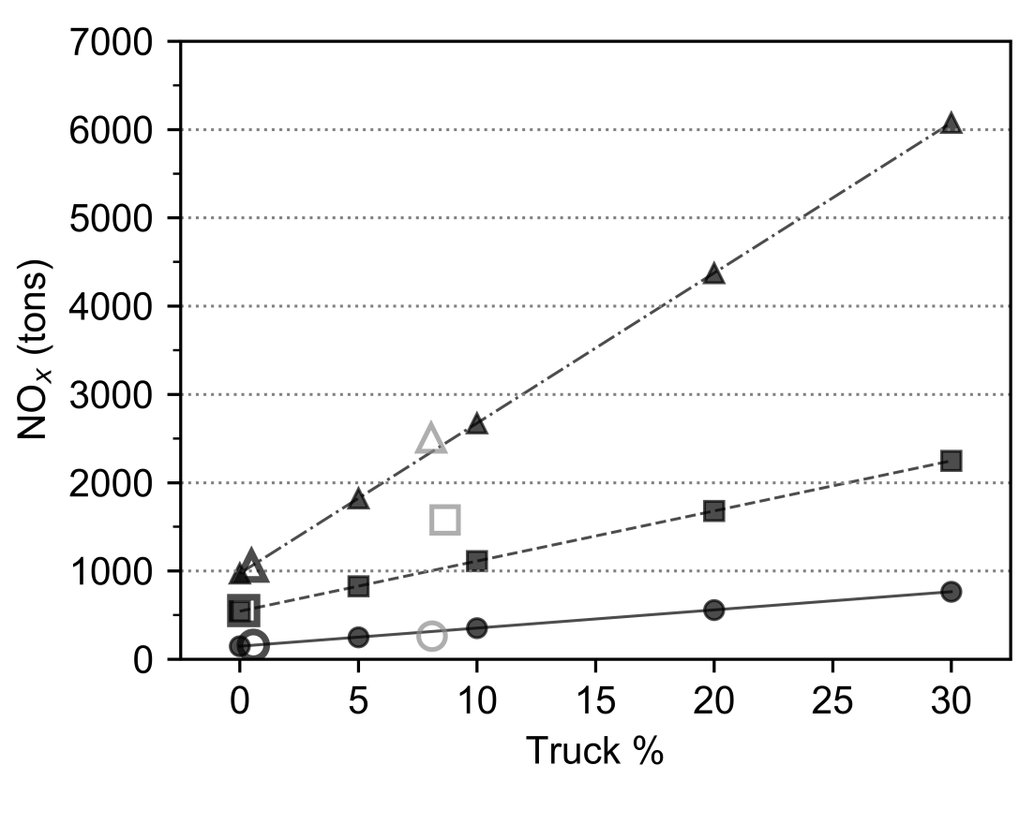
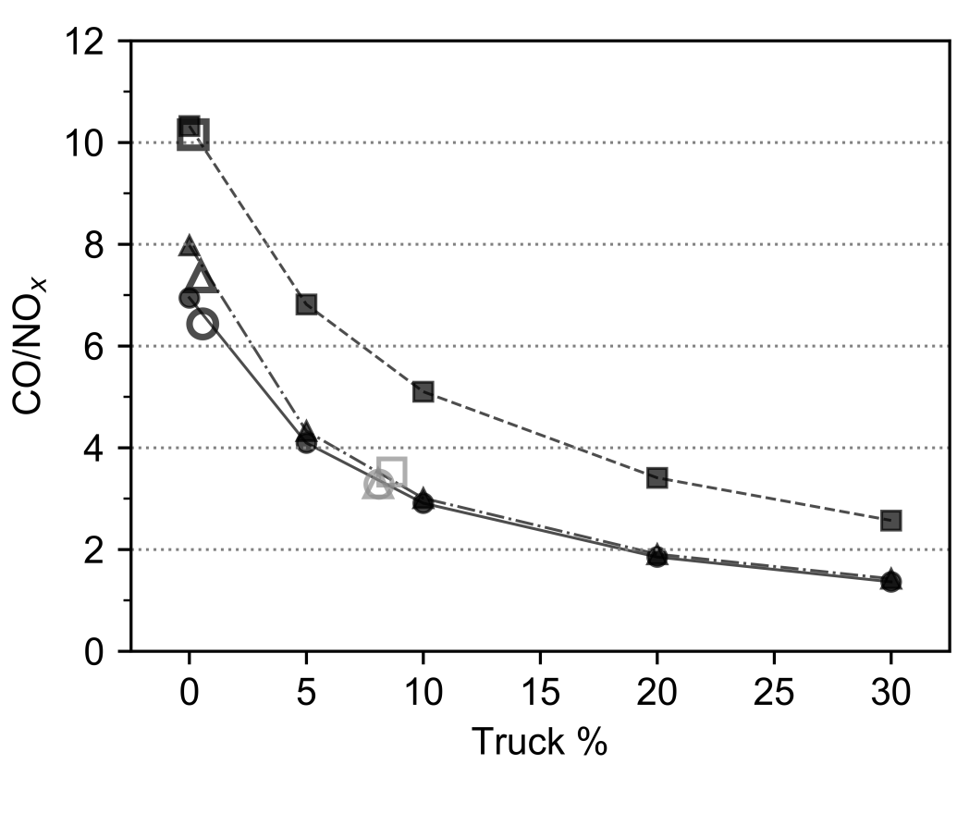
Sensitivity: Fleet Mix

Slide 19
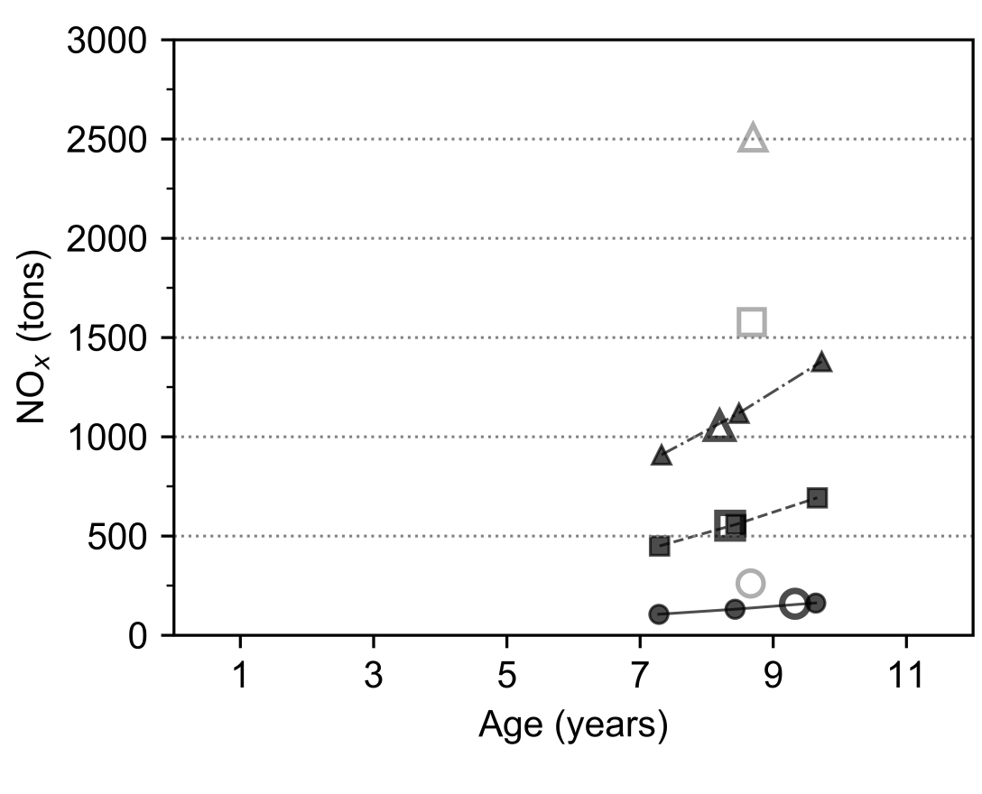
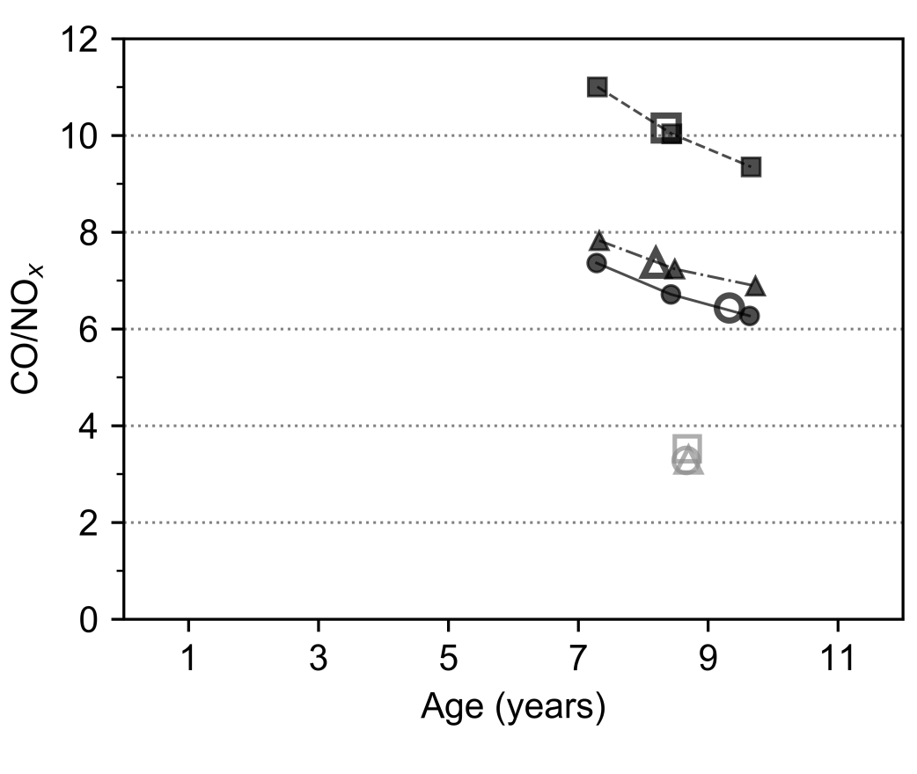
Sensitivity: Age

Slide 20
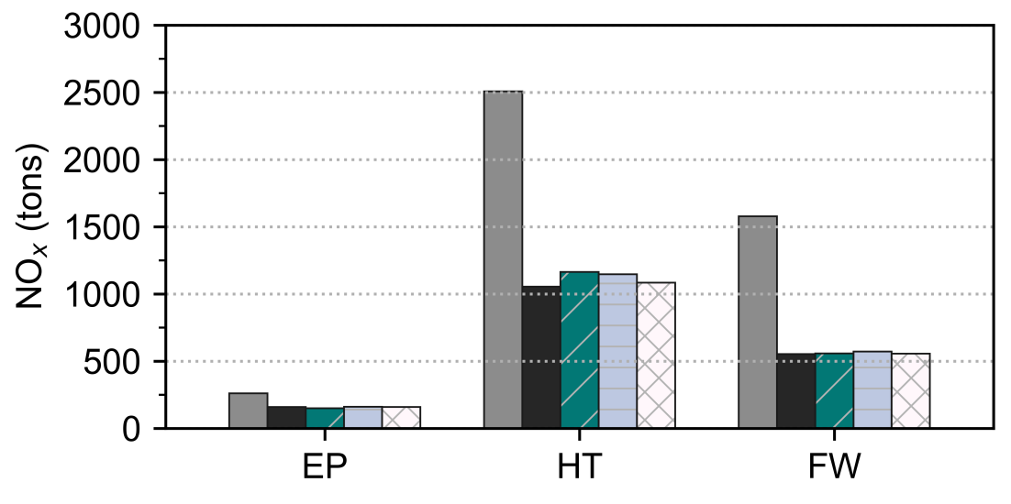
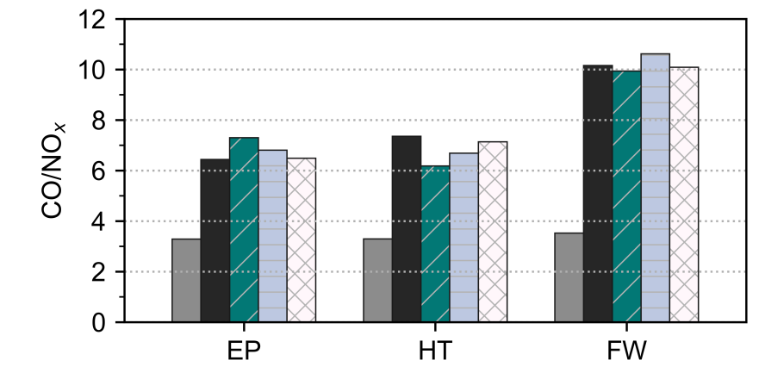
Sensitivity: Meteorology

Slide 21
Conclusions
Does MOVES overestimate NO_{x} emissions?
What MOVES input data are important for NO_{x} emissions estimates?
MOVES Default inputs can generate biased ratios and lead to incorrect emissions assessment
Using local (BAL) input data, MOVES emissions-based ratios are comparable to ambient-based ratios—no substantial over-estimation was found
Priority for local data collection and quality assurance should be given to parameters that emissions are more sensitive to, e.g., truck percentage and vehicle age distribution.

Slide 22
Acknowledgments
This presentation is based on work supported by the State of Texas through the Air Quality Research Program (AQRP) administered by The University of Texas at Austin by means of a Grant from the Texas Commission on Environmental Quality (TCEQ). The project team would like to acknowledge:
Gary McGaughey, Maria Stanzione (AQRP)
Chris Kite, Mary McGarry-Barber (TCEQ)
Jenny Narvaez (North Central Texas Council of Governments)
Graciela Lubertino (Houston-Galveston Area Council)
The opinions, findings, and conclusions from this work are those of the authors and do not necessarily reflect those of the AQRP or the TCEQ.

Slide 23
Questions?

