Slide 1
Developing Strategies to Attain Air Quality Standards in the South Coast Air Basin of California and Evaluating Precursor Emission Trading Ratios for PM2.5 Formation
2017 CMAS Conference
October 23rd, 2017
Marc Carreras-Sospedra, Sang Mi-Lee
South Coast Air Quality Management District

Slide 2
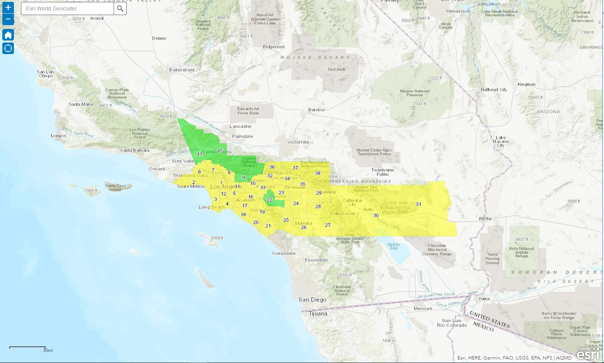
California’s South Coast Air Basin
4 Counties – Over 10,000 Square Miles
16+ Million People and 12+ Million Vehicles
Combined Ports of Long Beach and Los Angeles = nation's largest cargo gateway
Over 27,000 stationary sources

Slide 3
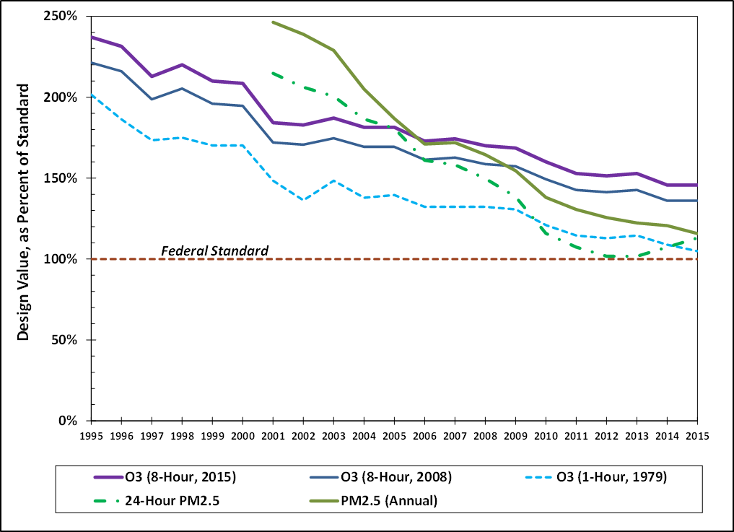
Ozone & PM2.5 Air Quality Trends

Slide 4
NOx Reductions Needed for O₃ Attainment
Needed by 2023
Needed by 2031
Source: 2016 AQMP Summer Planning Emissions Inventory – December 2016

Slide 5
PM_{2.5} Precursors
What is the contribution of precursors to total PM_{2.5}?
How do precursor emission reductions affect PM2.5 design values?
Total PM_{2.5}
OH
OH
NH₃
SO_{X}
NO_{X}
OH
PM_{2.5}
VOC

Slide 6





Precursor Trading Determination
$$β_{{PM}_{2.5}}=\frac{∆{PM}_{2.5}}{{∆Emis}_{{PM}_{2.5}}}$$
PM_{2.5}
ΔPM_{2.5}
$$β_{NOx}=\frac{∆{PM}_{2.5}}{{∆Emis}_{NOx}}$$
ΔPM_{2.5}
$$β_{SOx}=\frac{∆{PM}_{2.5}}{{∆Emis}_{SOx}}$$
ΔEmis_{NOx}
ΔEmis_{VOC}
$$β_{VOC}=\frac{∆{PM}_{2.5}}{{∆Emis}_{VOC}}$$
Emis
This requires 2×(Number of pollutants)
annual simulations
$$β_{{NH}_{3}}=\frac{∆{PM}_{2.5}}{{∆Emis}_{{NH}_{3}}}$$

Slide 7
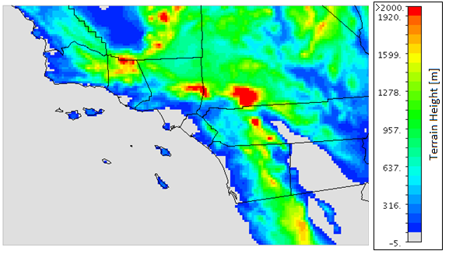
Modeling Set-up
AQ Model: CMAQ 5.0.2, SAPRC07 mechanism
Resolution: 4km x 4km
Meteorology: WRF 3.6, simulated for year 2012
Emissions for 2012 and 2025
Mira Loma
Central Los Angeles

Slide 8
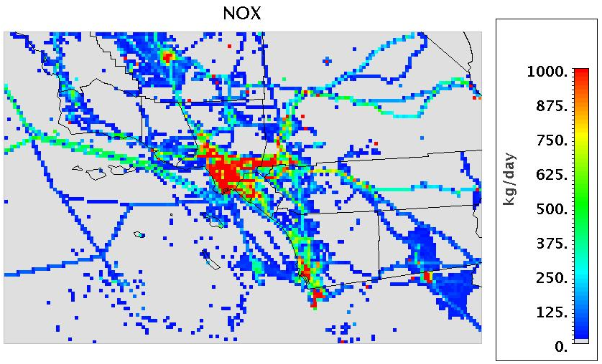
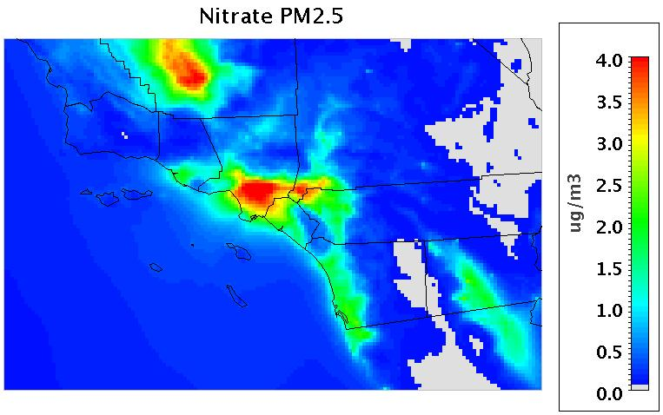
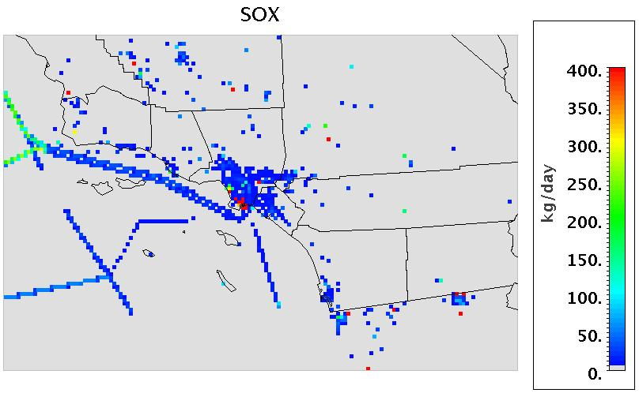
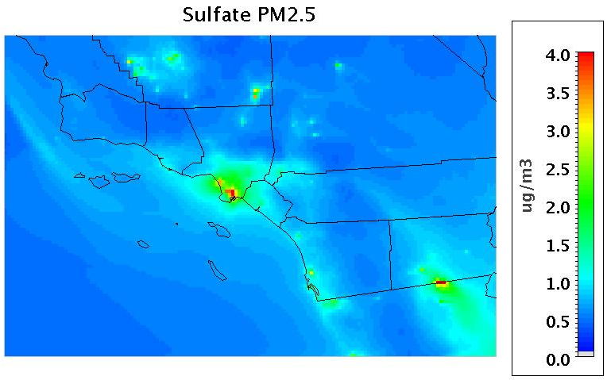
Emissions vs Concentrations

Slide 9
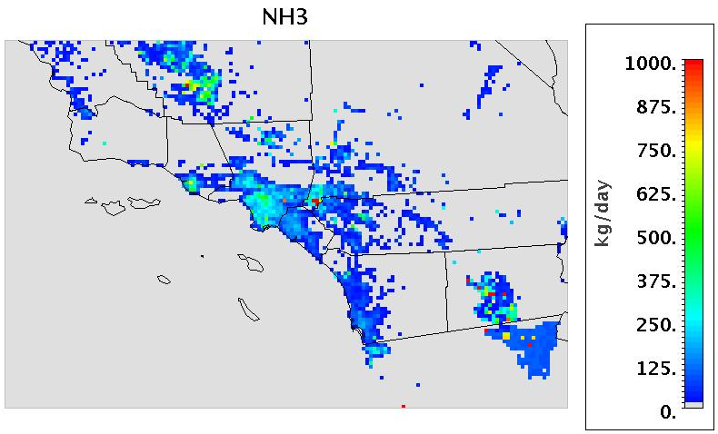
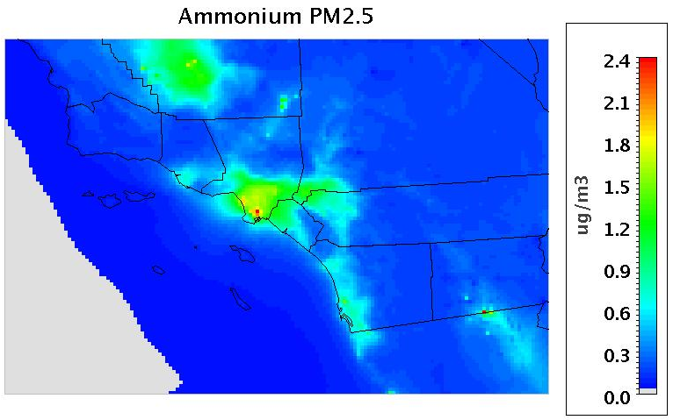
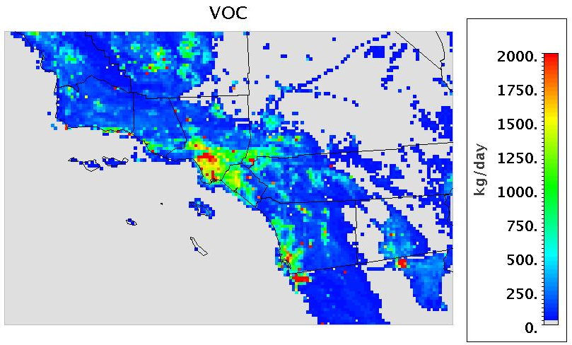
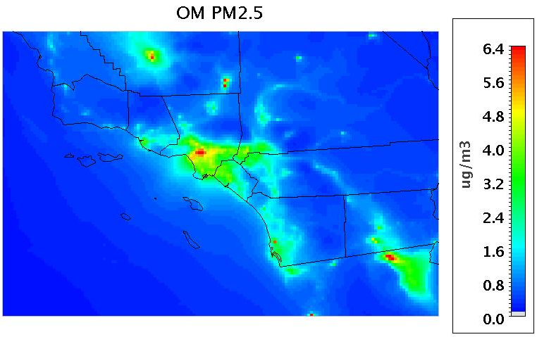
Emissions vs Concentrations

Slide 10
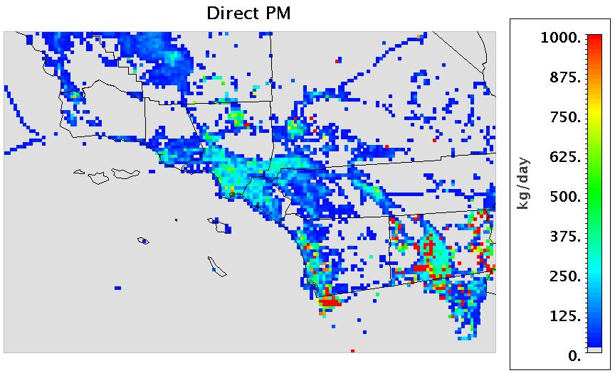
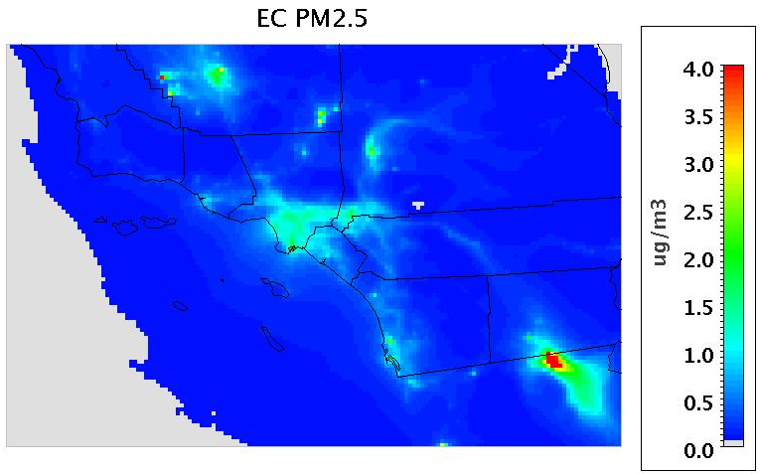
Emissions vs Concentrations

Slide 11
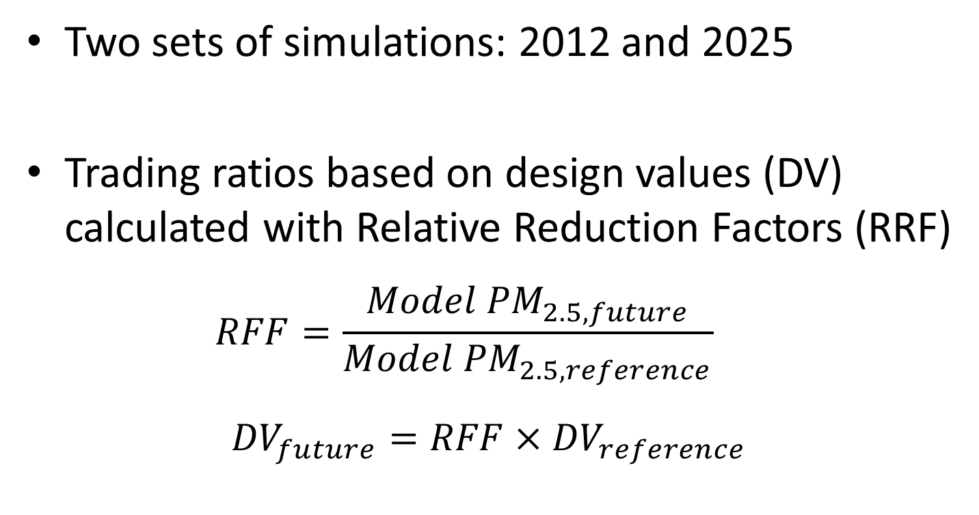
Summary of Simulations
Two sets of simulations: 2012 and 2025
Trading ratios based on design values (DV) calculated with Relative Reduction Factors (RRF)
  $$RFF=\frac{Model {PM}_{2.5, future}}{Model {PM}_{2.5, reference}}$$
  ${DV}_{future}=RFF×{DV}_{reference}$

Slide 12
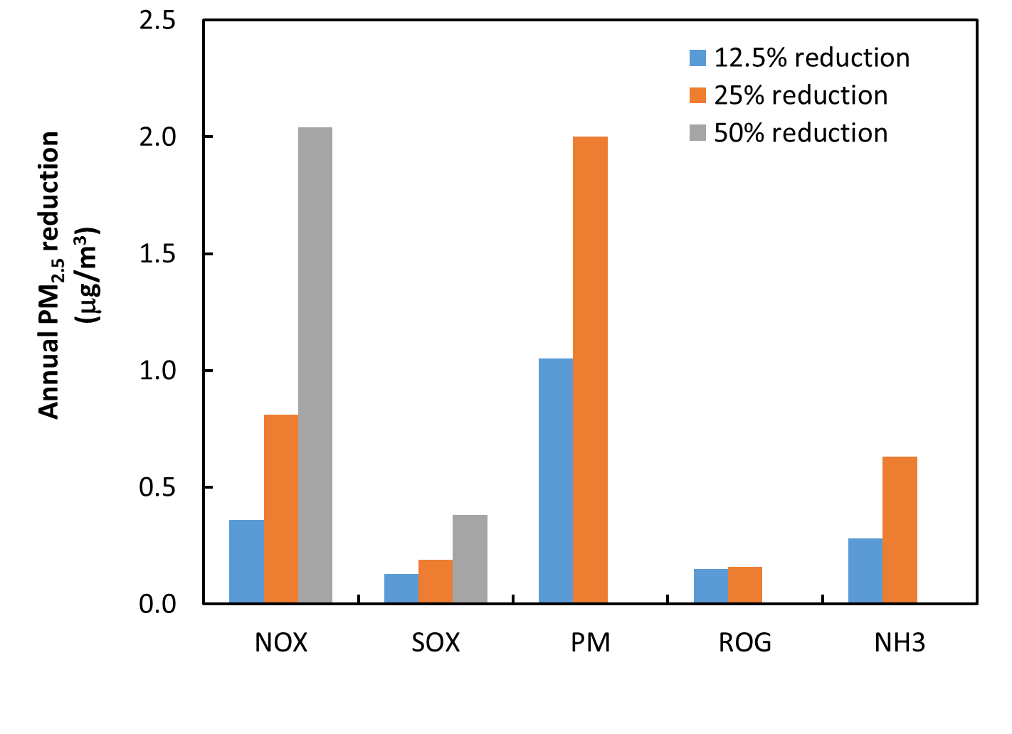
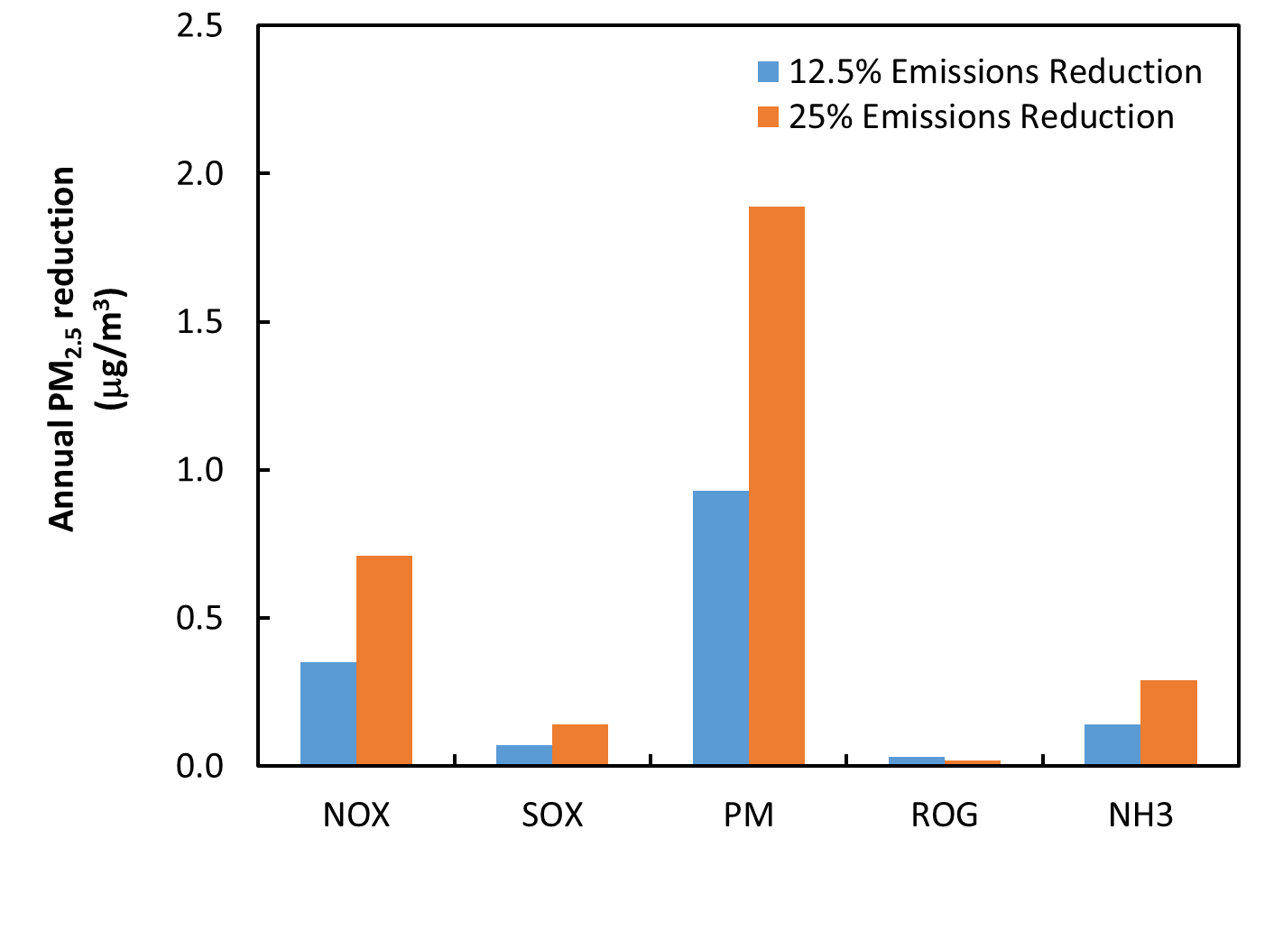
Annual PM2.5 Sensitivity in MRLM
2012
2025

Slide 13
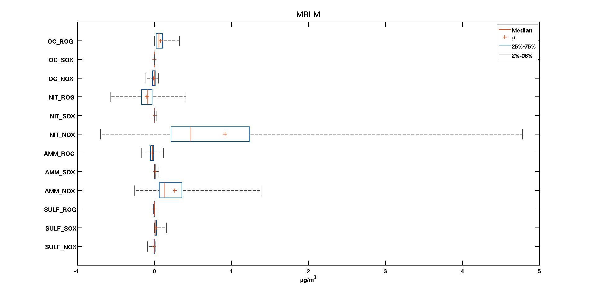
CMAQ-DDM Sensitivity for PM_{2.5}
ROG
SOX
NOX
OC
ROG
SOX
NOX
NO₃⁻
ROG
SOX
NOX
NH₄⁺
ROG
SOX
NOX
SO₄²⁻
CMAQ-DDM shows qualitative agreement with brut force methods,
but yields lower sensitivity

Slide 14
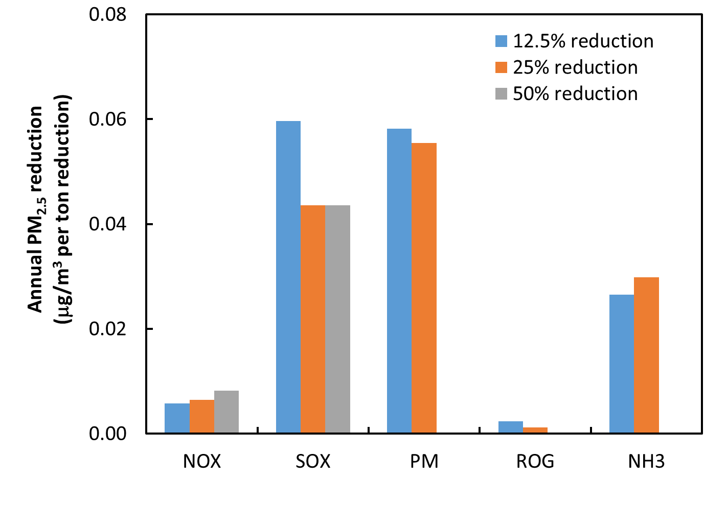
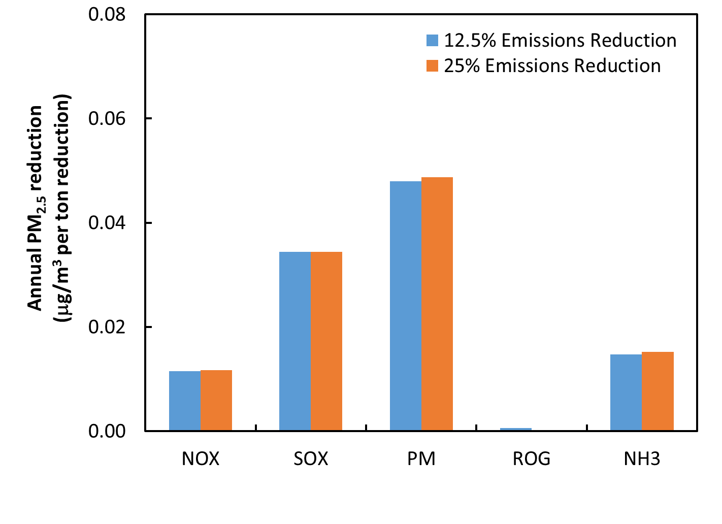
Annual PM2.5 Trading Ratios for MRLM
2012
2025
Sensitivity to precursors is almost linear in 2025

Slide 15
Annual Trading Ratios by Location
2012
2025
Sensitivity to precursors increases in downwind locations except for SO_{X}
Sensitivity to precursor decrease with time, except for NO_{X}

Slide 16
PM_{2.5} Reductions in Baseline
2012
NO_{X}
283 t
SO_{X}
1 t
PM_{2.5}
2 t
ROG
127 t
NH₃
9 t
Std
Baseline Baseline
2012 2025
Error between trading ratio-based DV and full scale simulation is < 2%

Slide 17
Proposed PM_{2.5} Control Measures
Commercial cooking, manure and green waste management
NO_{X} = 26 t
PM_{2.5} = 3 t
Std
Central LA
Mira Loma

Slide 18
Proposed PM_{2.5} Control Measures
On-road and Off-road mobile sources (locomotives, ports, construction)
NO_{X} = 120 t
PM_{2.5} = 3 t
Std
Central LA
Mira Loma

Slide 19
Conclusions
Trading ratios serve as an initial tool to determine overall efficiency of control measures
Trading ratios depend on geographical location and baseline emissions
Trading ratios become almost linear in future, under lower precursor emissions
CMAQ-DDM yields lower sensitivity, need to explore HDDM

Slide 20
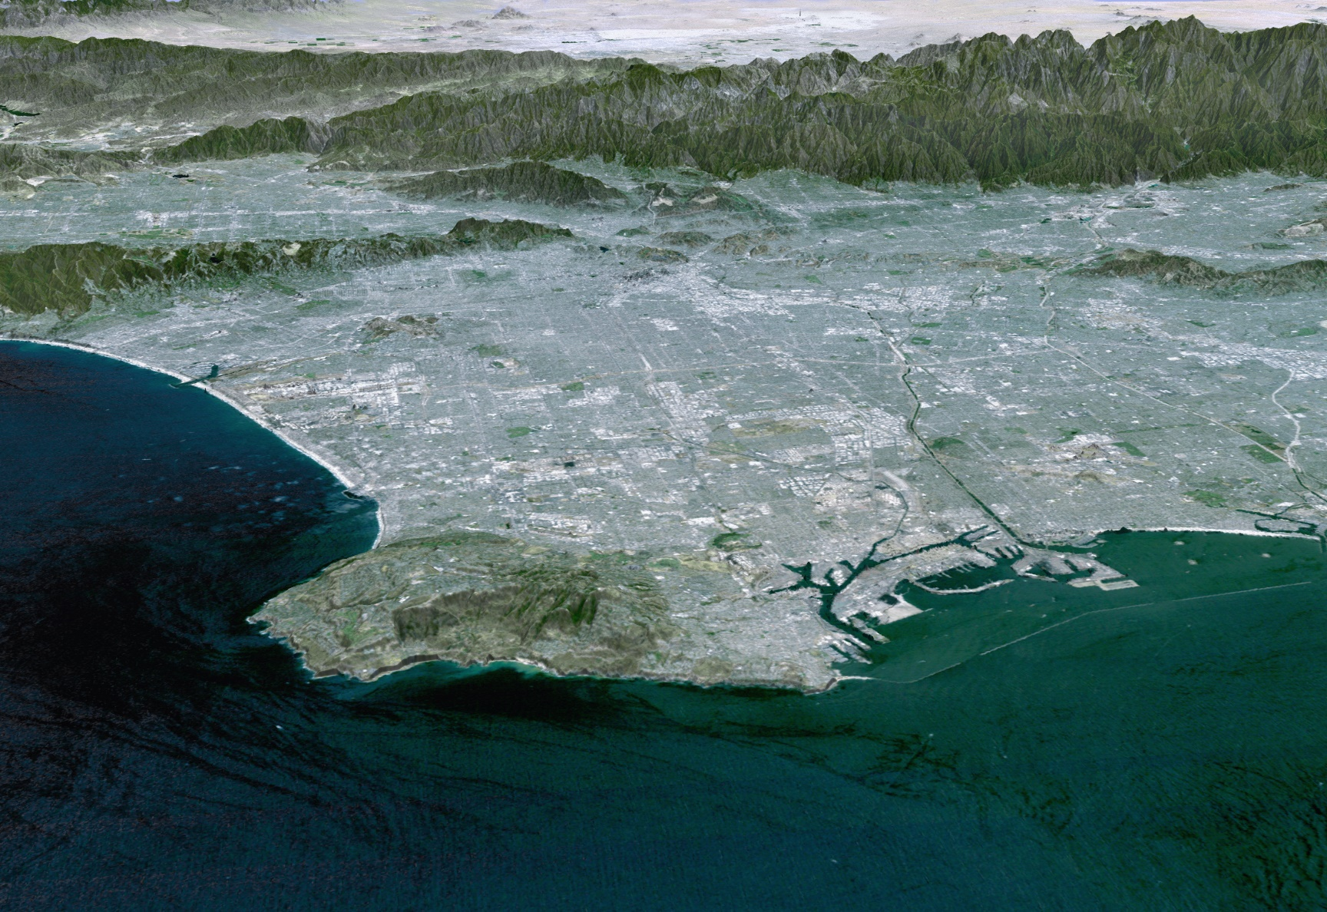
Questions?

