Slide 1
A Novel Approach for Identifying Dust Storms with Hourly Surface Air Monitors in the Western United States
Barry Baker^{1,2} and Daniel Tong^{1,2}
¹National Oceanic and Atmospheric Administration
Air Resources Laboratory
College Park, MD 20740
² Cooperative Institute for Climate and Satellites
University of Maryland
College Park, MD 20740

Slide 2
Outline
Quick review of other methods
Introduce Algorithm
Quality Control
Example of Dust event in El Paso, March 2017
Comparison with Tong et al. (2011)
Dust Trend in Phoenix area
Conclusions

Slide 3
Past methods
Ganor et al. (2009)
Designed for dust emissions using only 30 min PM10 average
Designed for Tel Aviv
Tong et al. (2011)
Uses a clustering technique with speciated data from the IMPROVE network
One 24 hour average value every three days
Sparse coverage and mainly in remote areas ~150 sites
Suggested a simplified technique using a ratio of 0.2 between PM2.5 and PM10
Appel et al. (2013)
CSN and IMPROVE
Soil = (2.20 × Al) + (2.49 × Si) + (1.63 × Ca)+ (2.42 × Fe) + (1.94 × Ti)
~ 350 sites

Slide 4
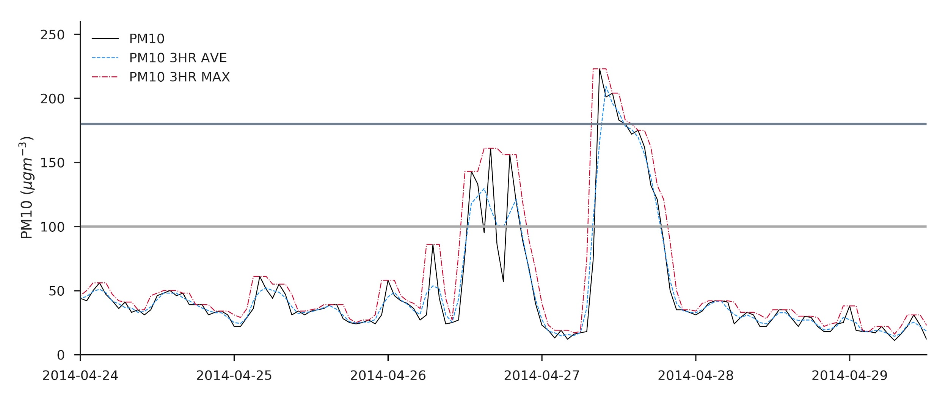
New Method (NM)
The new method is based upon a modified Ganor et al. (2009) method
Uses hourly averages rather than half hourly data
Requires a 3 hour maximum of > 140 ugm-3
Requires a minimum 3 hr rolling average of 100 ugm-3 and maintained for 3 hours
Uses EPA AQS or AirNOW data
Could use OpenAQ in the future for global
Uses the most amount of information at each site
If PM2.5 is available apply Tong et al. method
If WS is available apply threshold
Ganor et al. Dust Detection
3Hr Rolling Max
Maximum threshold to high
Minimum threshold to high
3Hr Rolling Average

Slide 5
NM - Continued
PM10
Revised Ganor
PM2.5
Hybrid Tong
Ganor
Wind Speed
Ganor+WS
Tong + WS

Slide 6
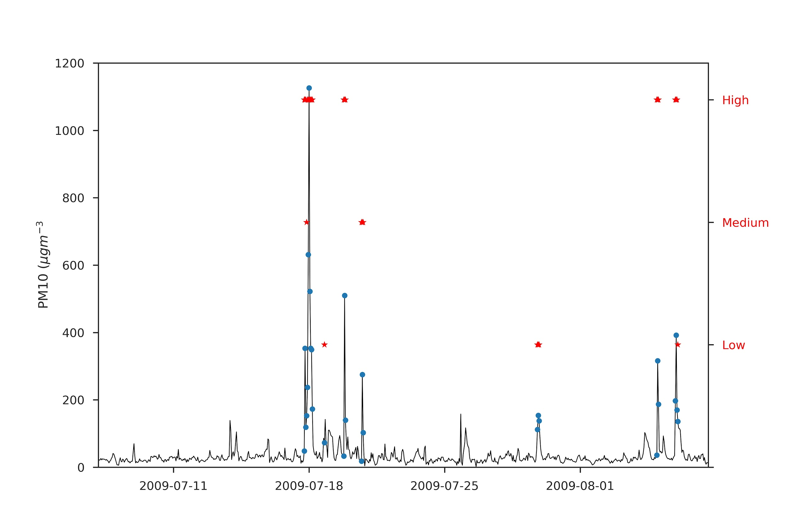
NM - Quality Flag
High confidence
1) Only Ganor Method and 3hr rolling max is > 300 ug/m3,
2) At least 2 measurements are used and 3hr max is greater than 250
3) if PM10, PM2.5 and WS are used in combination
Medium confidence
1) if only Ganor method detects but 3hr rolling max > 200
2) At least 2 measurements are used and 3hr rolling max > 180
Low confidence
1) Only Ganor method able to be used
2) 2 or more measurements are used

Slide 7
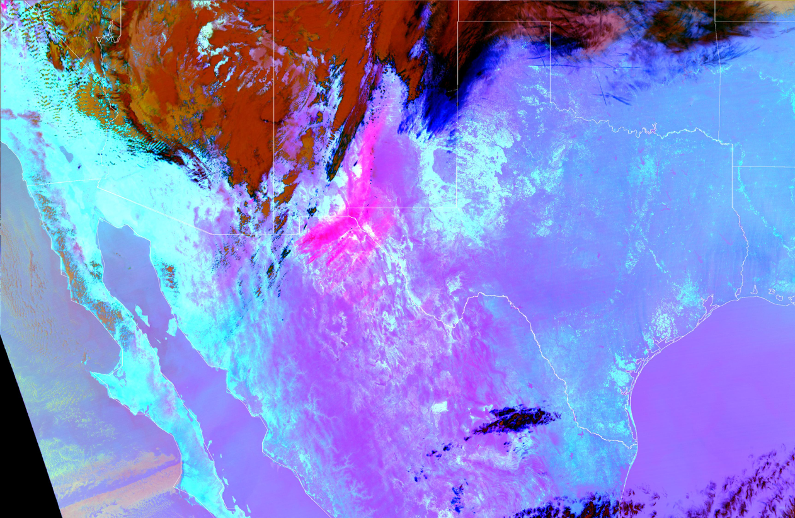
Example Dust Event Detection - March 31 2017
VIIRS Dust Detection
March 31 2017 19 UTC
Dust Event occurred originating from northern Mexico. The dust plume passed over an AirNOW monitor just outside of El Paso Texas. The new algorithm detected the dust storm at the same time as a VIIRS overpass.
(Courtesy of Shobha Kondragunta)

Slide 8
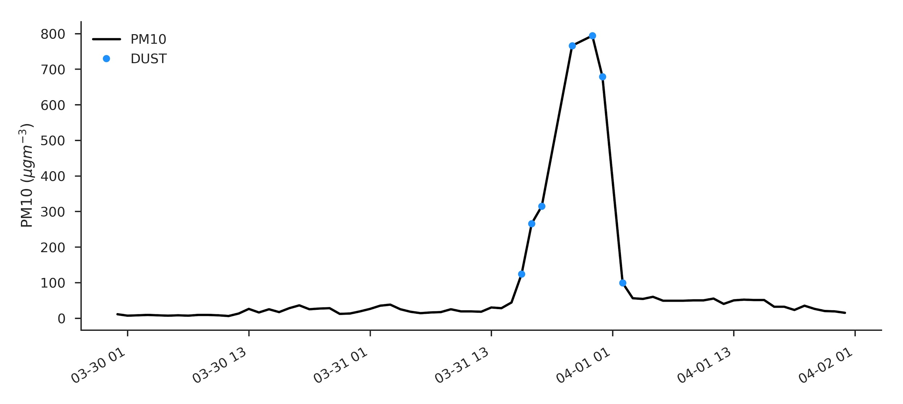
Example Dust Event Detection - March 31 2017
VIIRS Dust Detection
March 31 2017 19 UTC
Dust Event occurred originating from northern Mexico. The dust plume passed over an AirNOW monitor just outside of El Paso Texas. The new algorithm detected the dust storm at the same time as a VIIRS overpass.
(Courtesy of Shobha Kondragunta)

Slide 9
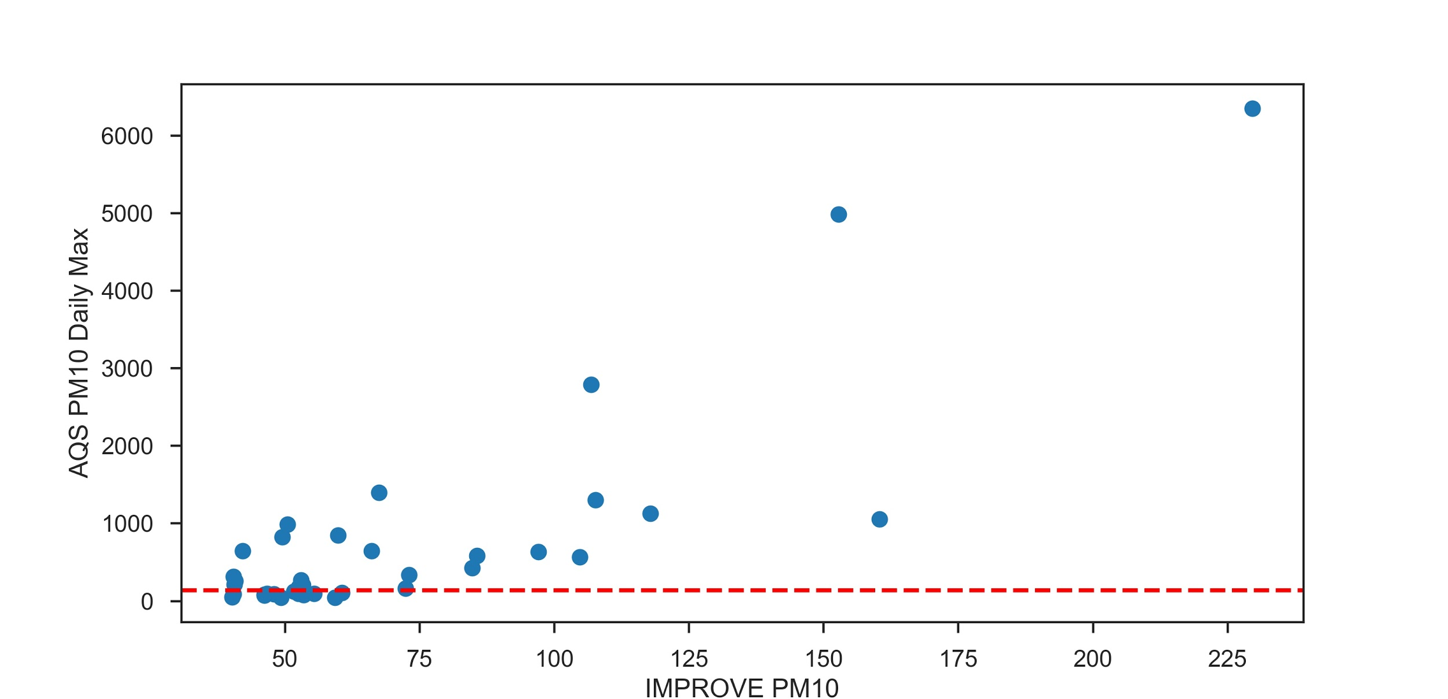
Comparison with Tong IMPROVE
Overall, 64% of dust events detected by the Tong et al. (2011) method using the PHOE1 IMPROVE monitor and the collocated 040139997 was detected using the new algorithm

Slide 10
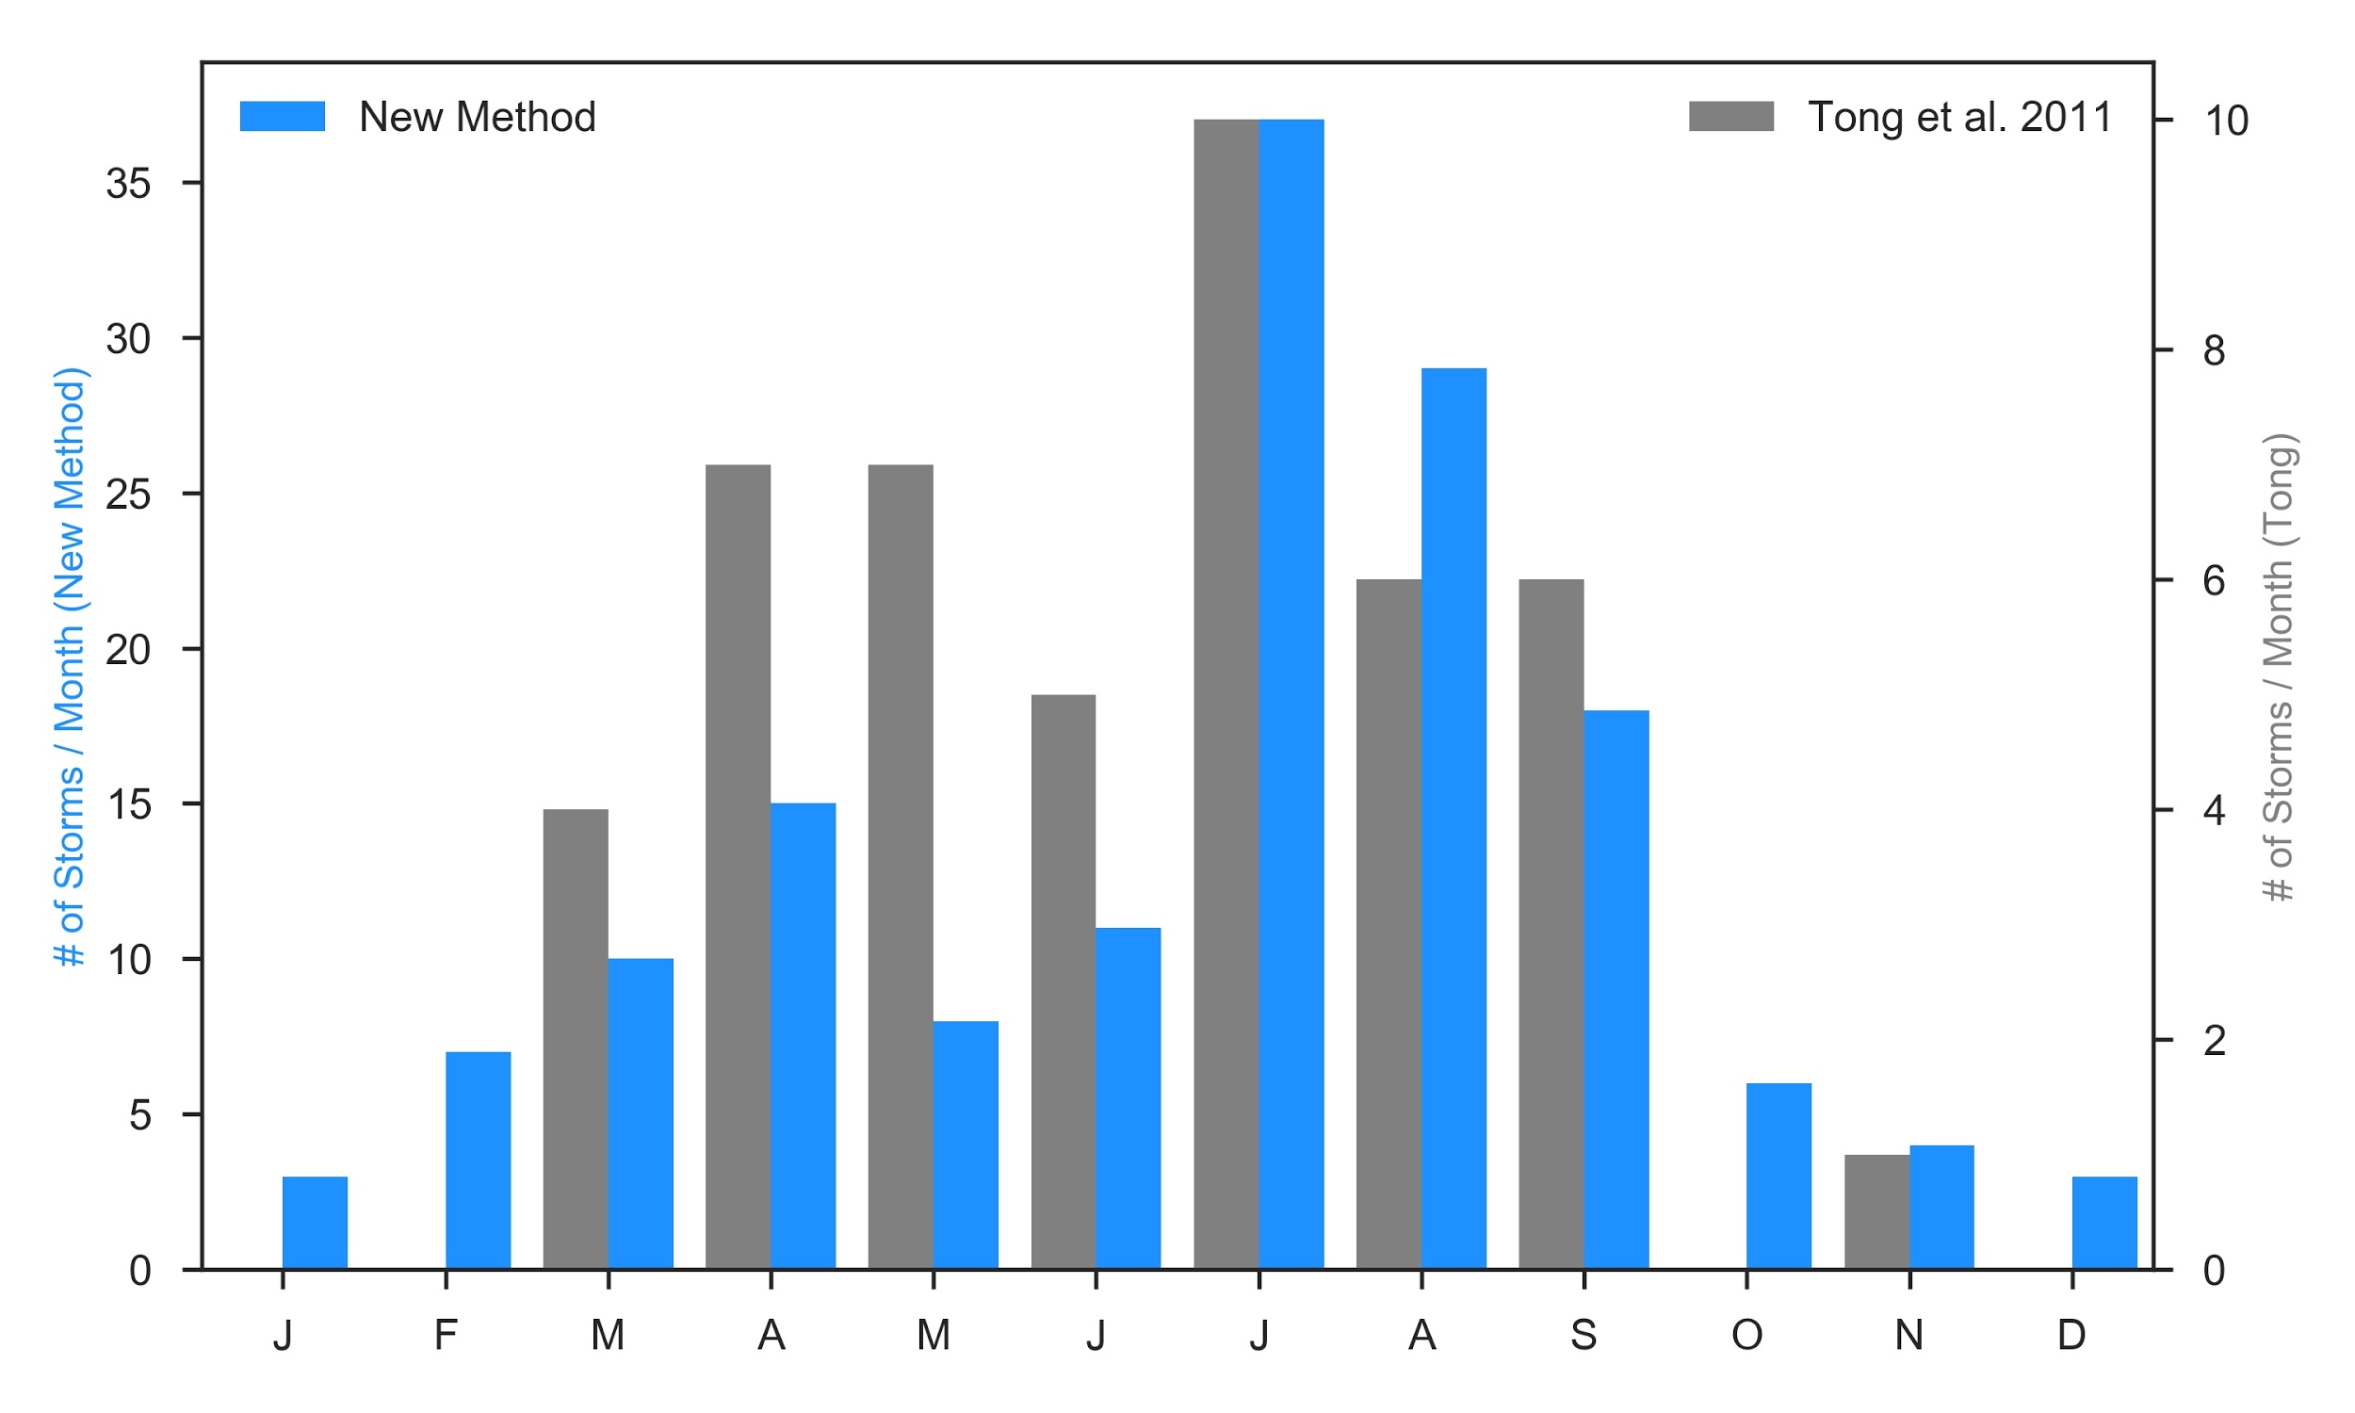
Comparison with Tong IMPROVE
Dust events from the PHEO1 IMPROVE monitor and the colocated 040139997
New method detects many more dust events due to higher temporal coverage
Sees same seasonal distribution as the Tong et al. Method but with ~3 times more coverage
Also shows that the Tong et al. 2011 Method is still applicable and able to show long term trends
Less pronounced spring time dust event trend but still an increase around April
Peak dust season appears to be in July/August in Phoenix

Slide 11
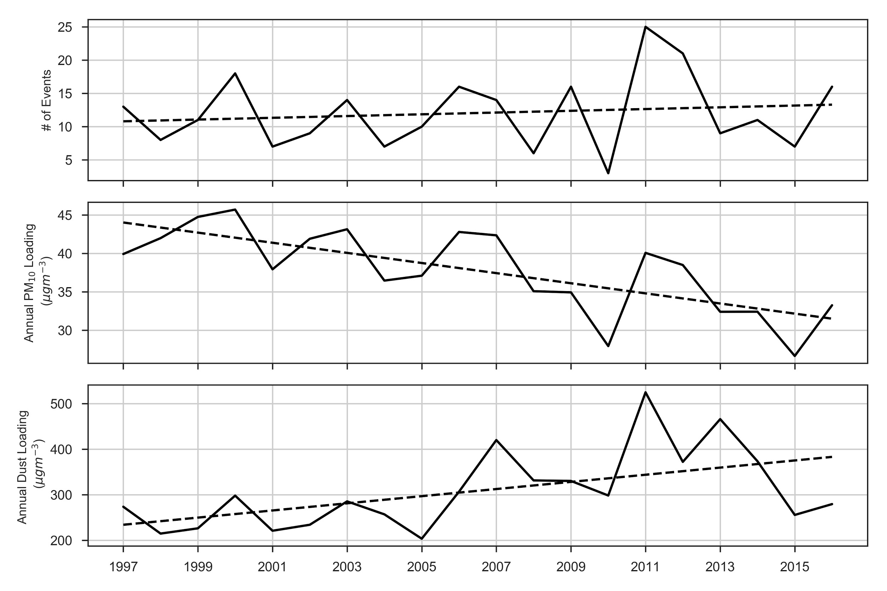
Trend in the Phoenix Area
Dust events from EPA AQS Monitor 040133002
The number of dust events are increasing in the U.S. This is consistent with Tong et al. (2017)
The Annual PM10 Loading is decreasing in the past two decades
Although the PM10 Loading is decreasing the annual PM10 due to dust is increasing

Slide 12
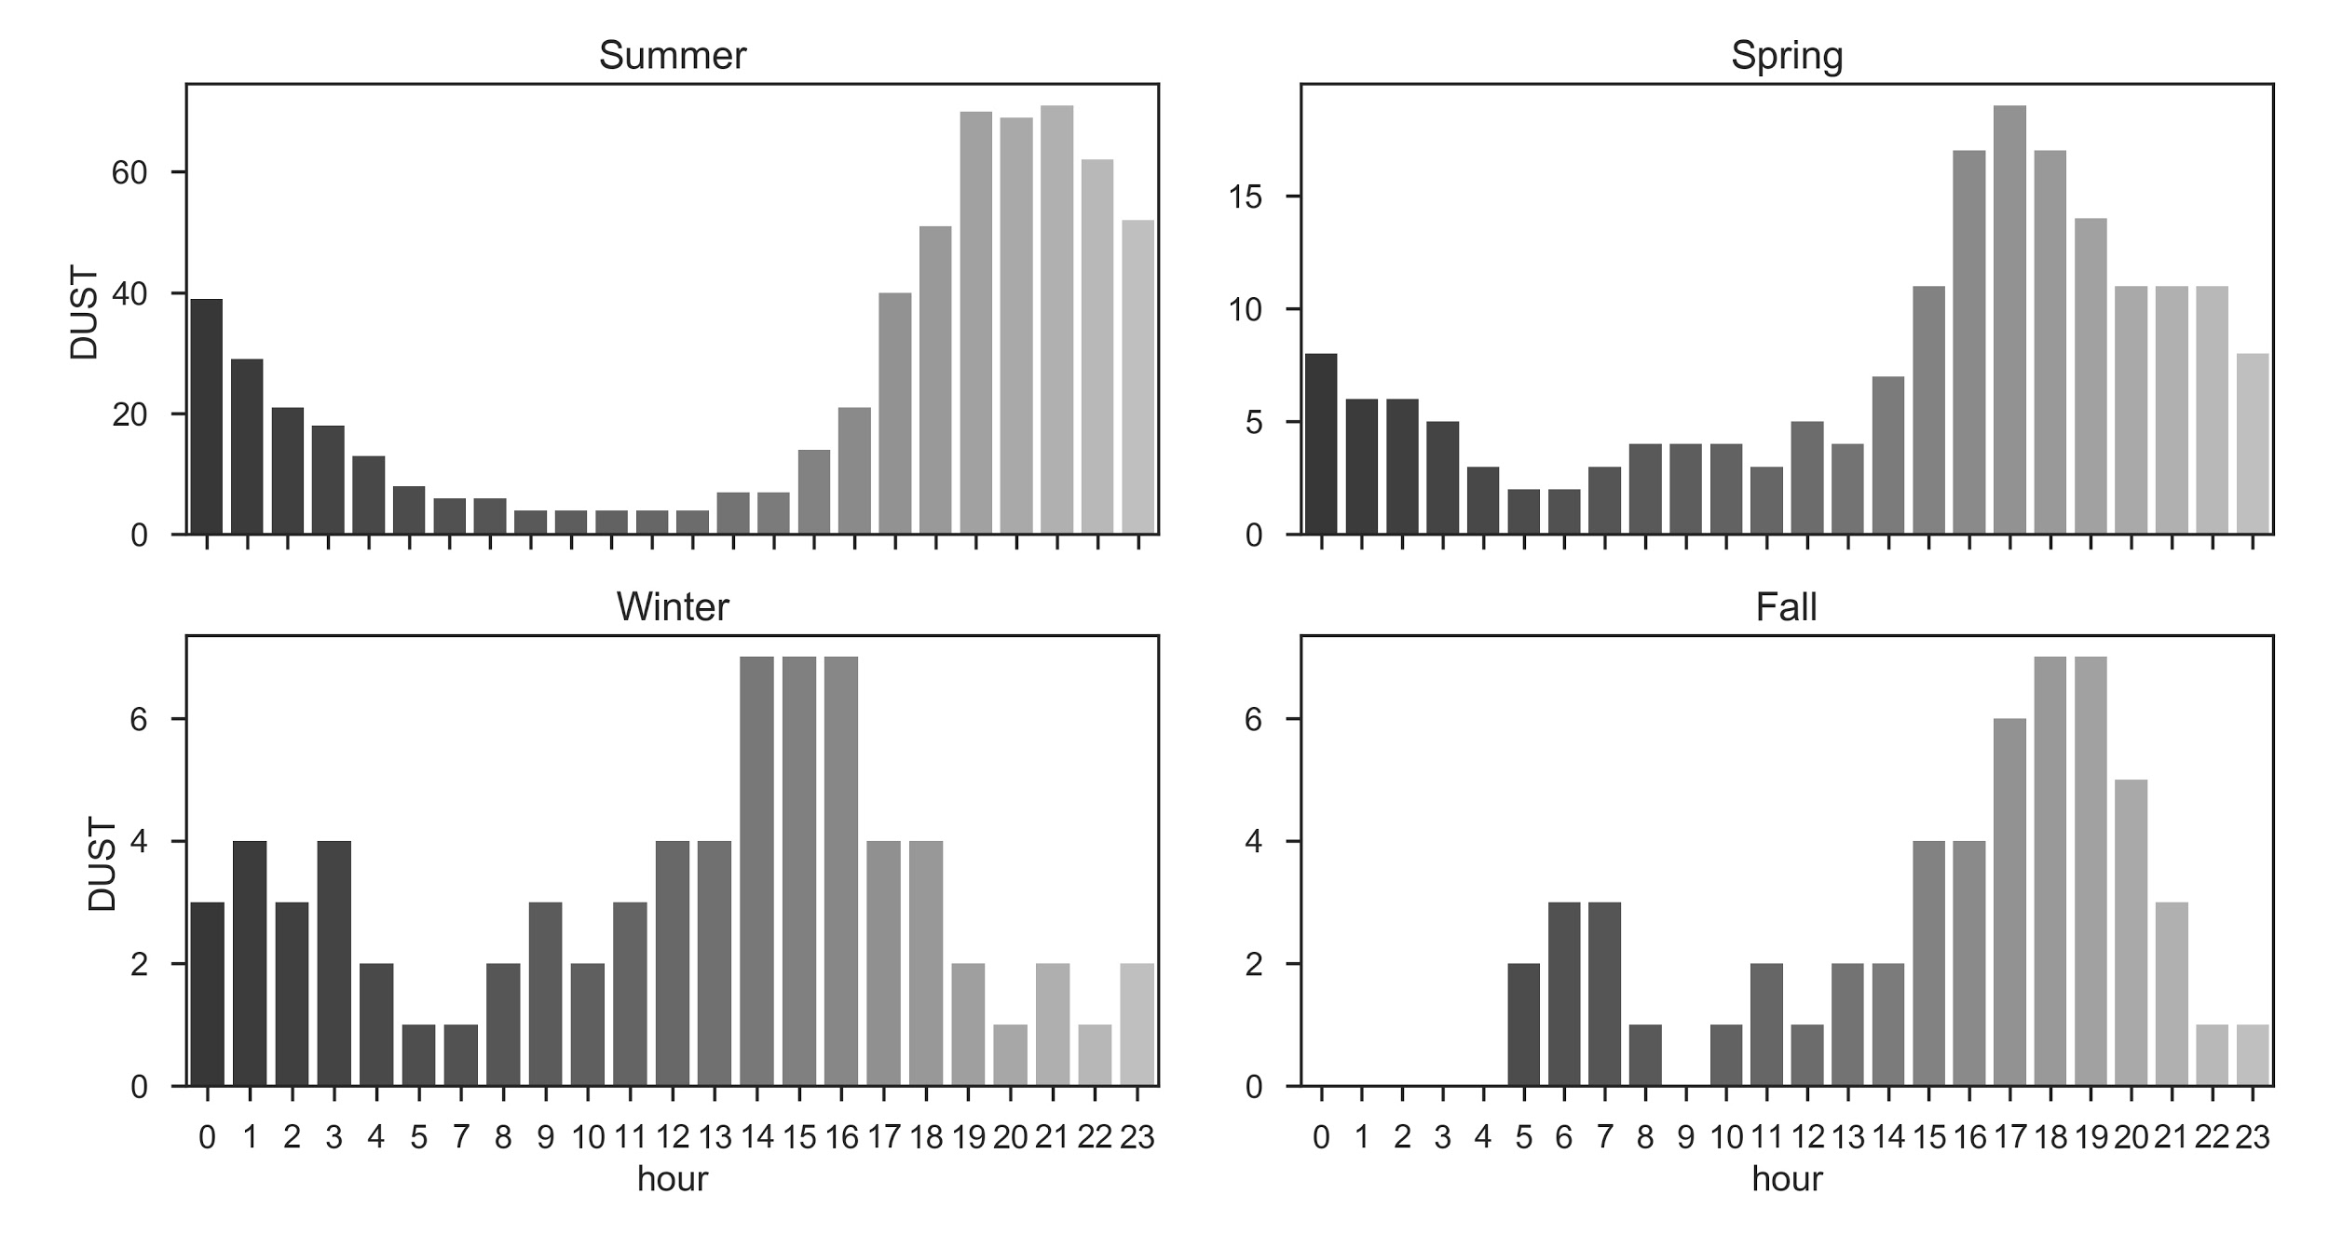
Seasonal Diurnal Capture of Dust Events
Seasonally as shown previously the summer showed the highest number of dust events followed by spring.
As expected the starting hour of dust events in the Phoenix area typically occurs in the late evening around sunset
Few dust events in all seasons from early morning to mid afternoon.

Slide 13
Conclusions
A new dust algorithm is established using collocated hourly surface air quality monitors.
The algorithm uses the most amount of information at each site
The algorithm is quality controlled
The new algorithm detected 64% of dust events detected by the Tong et al. (2011) method.
The maximum concentrations in the IMPROVE monitor typically < 50 umg-3 during missed events
The new algorithm corroborates previous methods used for analysis in the southwest U.S., i.e. Tong et al (2011, 2017) showing a similar monthly distribution of dust events
Dust storm frequency and loading is increasing while annual PM10 loading is decreasing.
Dust storms are becoming more important for forecasting PM10 concentrations as background levels decrease
Increased importance for human health (i.e. Tong et al. (2017)) and wind erosion
Dust storms are found to begin in the late evening no matter the season
Dust storms occur mainly in the summer and spring

Slide 14
Questions?

Slide 15
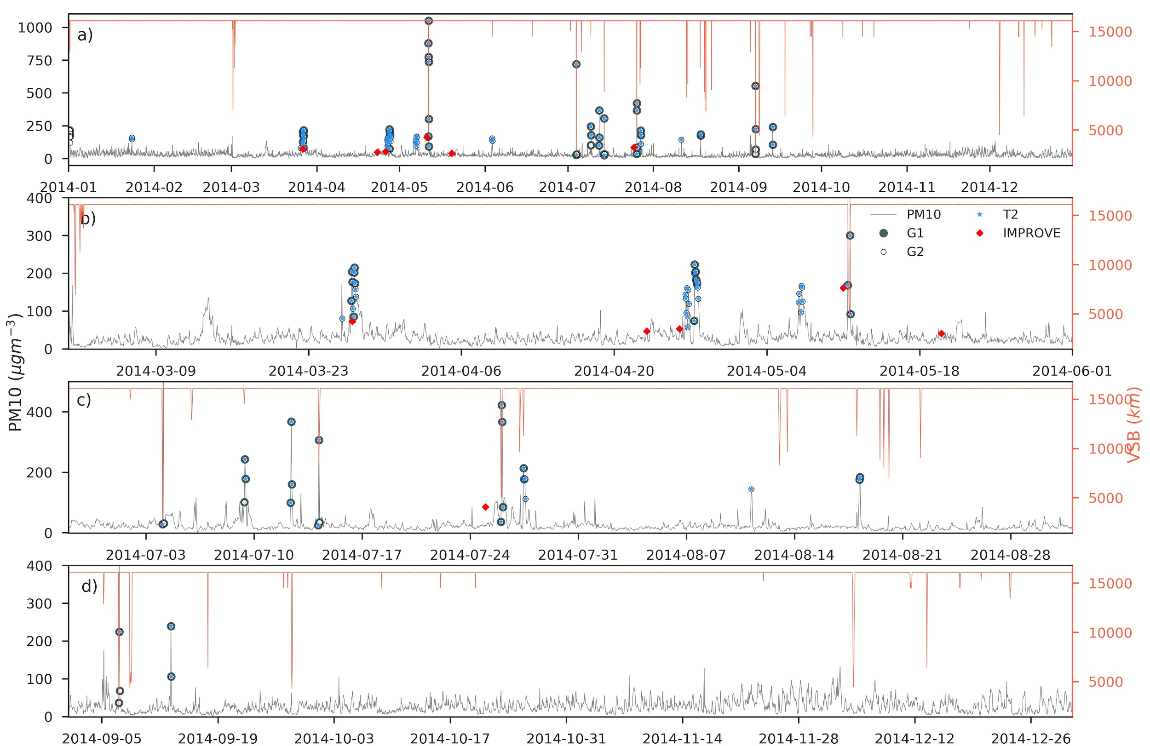

Slide 16
