Slide 1
Influence of different canopy reduction functions on biogenic NO emission patterns in northern Europe
Jan A. Arndt, Volker Matthias, Armin Aulinger
Notes:
Thanks XX for your introduction.
Ladies and Gentleman, i would like to introduce myself and my topic. My name is Jan Arndt, i I am holding a Master degree in Meteorology. Now i am a doctoral student at the HZG, institute of coastel reserach, department for air pollution modelling in northern Germany and working on natural emissions of nitrogen.
My topic i would like to present you today is my fist research topic about natrual sinks of nitrogen and is called „Influence of different canopy reduction functions on biogenic NO emission patterns in northern Europe”.
I will give you at first a brief overview, what canopyreduction is, where it is implemented in the Models 3 chain and afterwards what we have done and found out.

Slide 2
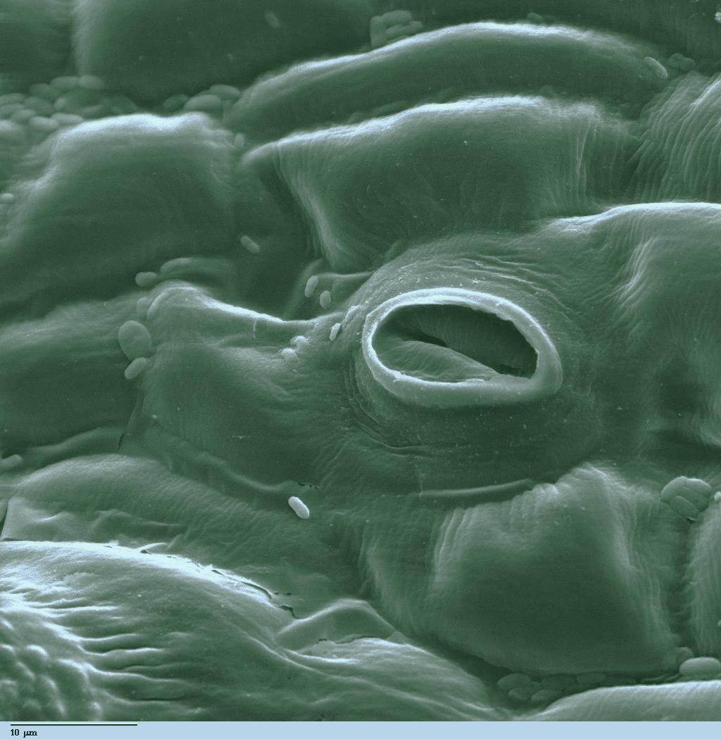
What is Canopy Reduction?
NO
NO₂
O₃
Uptake in stomata
NO₂
NO₂
NO
NO₂
NO
NO₂
NO₂
Notes:
This is an illustartion what canopy reduction is about.
As you can see, there is a tree, with leafes, and there is soil. In soil, microbes are consuming differnet types of nutrients and convert them.
Some microbes nitrificate and denitificate. Those that denitificate release in their reaction chain nitrogen monoxide gas that emmits from soil to the atmosphere. Because nitrogen monixide is higly reactive, a certai share of it reacts to nitrogen dioxide. Nitrogen dioxide then flows through the canopy of trees and other plants.
At the plant leafs, stomatas for gas-exchange of the plant with the atmosphere take up nitrogen dioxide in e certain ammount an incorporate it into the plant.
This process depends on the ambient air concentration, of nitrogen dioxide, but for polluted sites this flux to the plant is dominant.
This is canopy reduction.

Slide 3
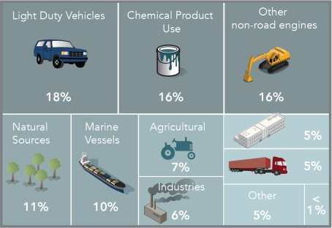
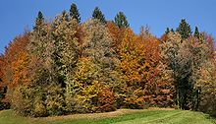
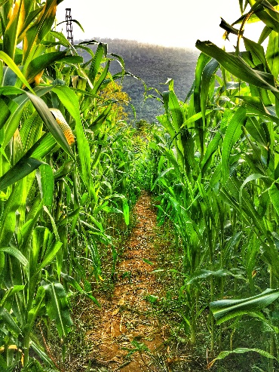
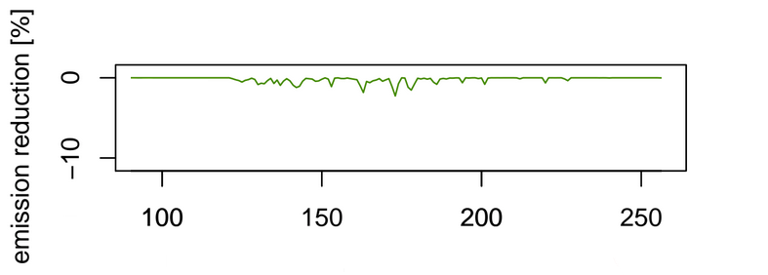
What is Canopy Reduction?
SMOKE EU
ISOP
AREA
…
HRNO.f
POINT
…
NITROGEN MONOXIDE
BIOG
May 2012
http://www.efi.int/portal/
Photos by different Authors from https://upload.wikimedia.org/
Day of 2012
Notes:
Here we see a simplyfied diagramm of the SMOKE model.
In the model, the Biogenic emission inventory system BEIS is used to calculate biogenic emissions.
In the HRNO routine, there is a very basic implementation of the previosly shown process.
We performed a test, how much influence the build-in canopy reduction has. It is shown in the plot on the lower right.
In the spatial plot the relative emission reduction from biogenic sources is plotted for the month with the higest reduction potential.
Additionaly, we have chosen a 240 by 240 km odeling domnin over a rural part of europe, dominated by mixed crop and woodland, for a temoral profile.
As you can see, the influence of the build-in parameterization in rural and wooded areas is unexpected low
As you can see in the left map of forrests in europe, where greener colors indicate more woods, norway, sweden and the baltic states sould be considerably more affected..
Compared to other studies, it sould be in the magnitude of about 20 percent.
We tried to close this gap with other already developed parameterizations for the canopy reduction.

Slide 4
The tested parameterizations
Yienger and Levy (1995)
Reduction factor for primary biogenic NO soil emissions, based on Leaf Area Index (LAI) and Stomata Area Index (SAI).
Made for annual total emission correction, modified with annual and daily profiles of LAI and SAI.
$$\frac{e^{−(ks × SAI)}+e^{−(kc × LAI)}}{2}$$
Wang et al. (1998)
Based on Jacob and Bakwin‘s (1991) study about cycling of nitrogen oxides in tropical forest canopies. Reduction factor for primary biogenic NO soil emissions, based on stomatal resistance ($R_{Stomata }$) and the ventilation velocity ($V_{vent}$) considering leaf area index (LAI), wind velocity (FF) and land-use categorie
$$\frac{R_{Stomata}}{R_{Stomata}+V_{vent}(LAI, FF,LandUse)}$$
NO
NO
NO
NO
NO
Stomatal Resistance
WIND
LAI & SAI ~ Land Use
LAI ~ Land Use
CANOPY
CANOPY AS GRAY ABSORBER
Ventilation
~ Land Use
Notes:
This both parameterizations were chosen and testet in our model framework.
the parameteization on the left side of the slide is a parameterization developed by yienger and levy in 1995.
They have developed it for a global scale soil emission model and it relies on factors that are suitiable, or representable, for larger regions and grid cells.
It is analogous designed as radiation trasport models with a grey absorber atmosphere.
Here, the stomata and the curticula o the leaves act as a gray absorber. More or less, the ammount taken up by the plants is proportional to the LAI.
The parameterization on the right side of the slide is one following the approach of Wang et al. In 1998.
They created a canopy reduction function for the application in dispersion models.
It does not simply have a propotional dependance of the absorption to the LAI, it also takes an information about the stomatal resistance and the ventialtion of the canopy into account.
Both approaches are BIGLEAF and UNIDIRECTIONAL FLOW parameterizations.
There are multilayer-approaches and bi-directional flux appoaches out there, but: we are mainly interested in polluted regions.
My work presented here is focused on north and central europe, where even rural areas have a certain ammount of anthropogenic emission influence. As stated in different studies, for example Ganzeveld 2002, this bigleaf-unidirectional apprioaches ar suitible for pulluted regions.
For those of you who might be interested in studies in very natrual regions, like the tropical rain forest, this assumptions might be unsiuitable and more complex modles must be used.

Slide 5
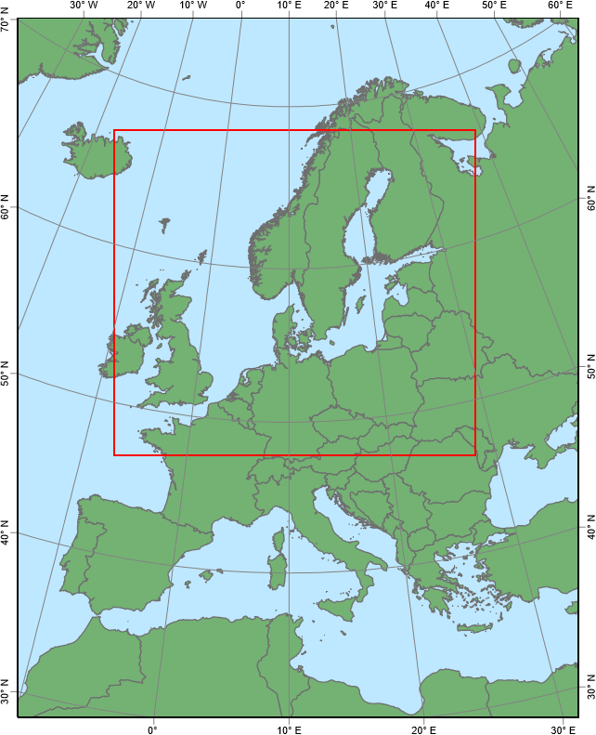
Model Domain and Setup
Year 2012, June, July and August
Coarse Grid resolution: 64x64 km²
Nested Grid resolution: 16x16 km²
SMOKE – EU SMOKE v3 Inv. EMEP, EDGAR and Bieser et al. (2011)
Biogenics: BEIS 3.14
Landuse: USGS GLC2000
CMAQ v5.0.1, CB05 tucl AE6aq mechanism
Meteorology: Offline COSMO-CLM
Coarse Boundary Condition: MACC
Initial Conditions by 30 day Spin-up
VP02: As is
WA98: Wang et al. (1998)
YL95: Yienger and Levy (1995)
Notes:
To test the three parameterizations, we defined 2 grids, one 64x64 km² grid with an extend from greenland to northern africa and a nested – research area – 16x16km2 grid covering northern and central europe.
We analysed the LAI and found, that for the three Summer month june, july and august the LAI is highest.So we set the Summer of 2012 as our test bed.
Anthorpogenic emissions were created with SMOKE for Europe, an adapted version for europe created by a member of our working group, with the emission inventories of EMEP, EDGAR and other comiled sources. Biogenic emissins were caluslated offline and seperatly with beis 3.14, for the WA98 and >L95 case with the respective parameterizations.
CMAQ in ist version 5.01. with the CB5 mechanism is used for atmopheric modeling.
The Meteorology is calculated offline with the COSMO CLM model, the climate version of the local geramn weather service model.
It is forced with erainterim reanalysis data fpor 2012.

Slide 6
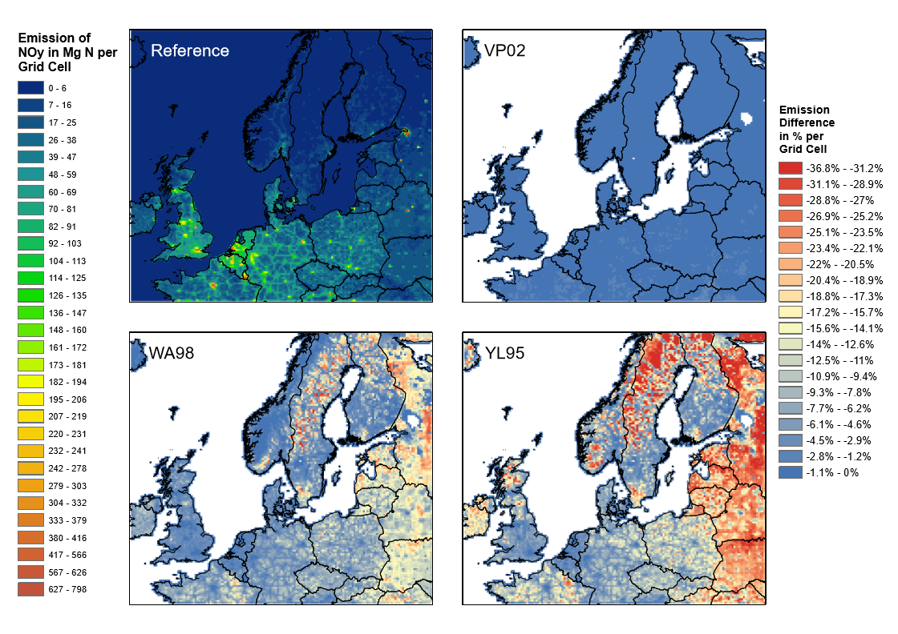
Impact on Emission
Notes:
On this graphic i will show you the results of the emission calculation.
Displayed is the total Emission of Noy, all oxidised nitrogen species considered in cmaq, and the relative differences for the three parameterizations we have tested.
Denoted as VP02, the original parameterization leads to very small emission reduction with some spots of about 1 % scattered over central europe.
The both other tested parameterizations WA98 and YL95 show significant higher emission reductions with yl95 about twice the size of reduction effect.
The YL95 canopy reduction has mainly a stronger impact on trees.
This is explainable by the physical conception of the absorbtion model, wehere the LAI is dominating.
When taking the ventilation throug the canopy into account, the reduction is less high, as can be seen in WA98.

Slide 7
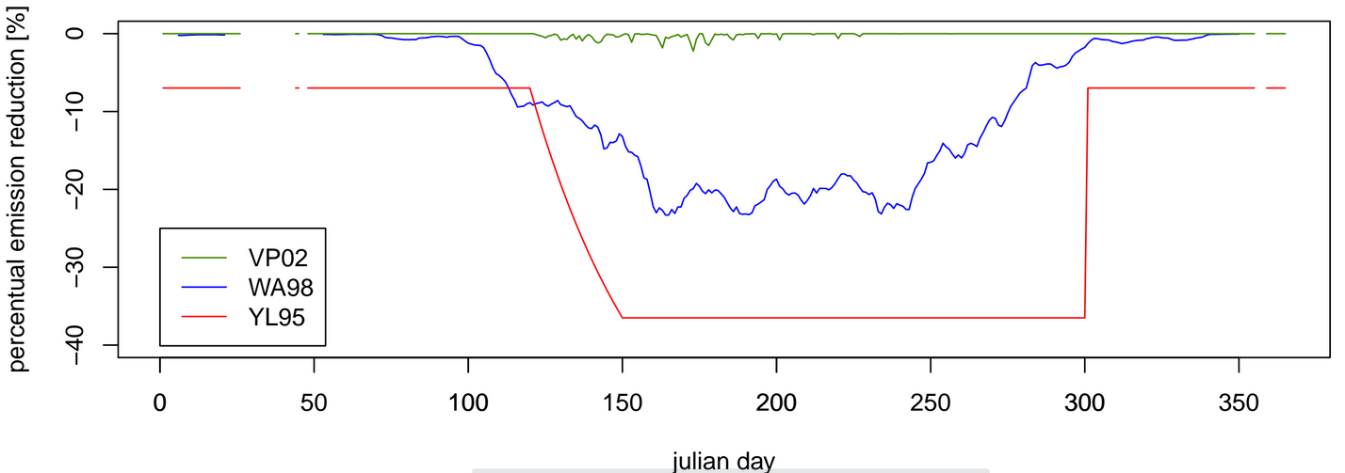
Impact on Emission
http://www.efi.int/portal/
Day of 2012
Notes:
To have a more direct comparison, we used the same 240x240 km² evaluation area in a rural part of eastern europe as on the slides before.
Woodland and crops are dominating the landuse in this area.
When tracking the biogenic emission reduction, we can clearly see the different reduction ammoubnts that corresponds to the findings on the slide before.
Also we can see the LAI-Profile that is dominat for the YL95 parameterization.
This profile is constucted in the same way as it is constructed in the vegetation adjustemnt facto for the VP02 BAIS bulild in parameterization, but has a siginificant different impact on the emission reduction.

Slide 8
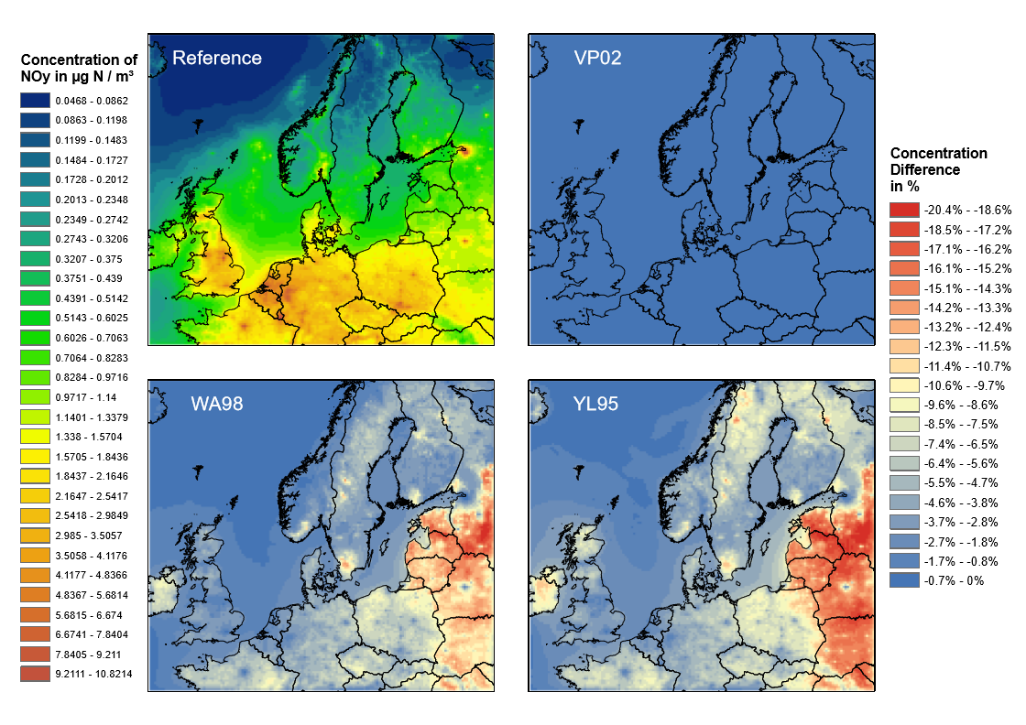
Impact on Concentration
Notes:
In the concentration field we found comparable reduction effecst as in the emission analysis for the WA98 and YL95 functions.
They are blurred due to the atmospheric dispersion modeling and with less magnitude due to ist dilution in the atmosphere.
As you can see for Minsk in belarus, spots with high ammounts of anthropogenic emissions, even if they are surrounded by high reduction potential, are not affected.
Now you igth think: Okay, fine, this looks interesting, but how realistic is this?

Slide 9
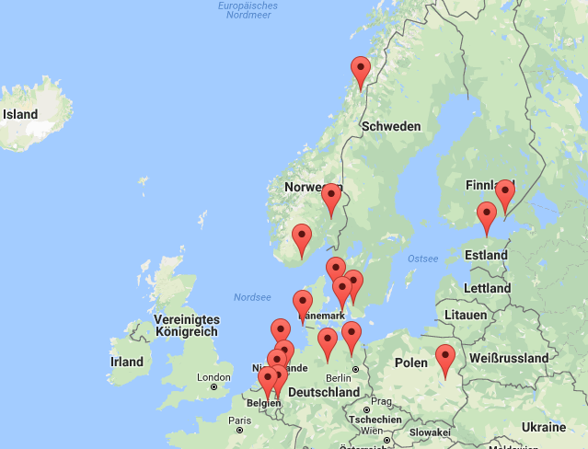
Validation efforts
EMEP Measurement Stations
without
VP02
WA98
YL95
No Stations in the area of interest – no significant improvement in correlation!
Satellite comparison for small changes over short time period is not convincing.
Notes:
Here is the short answere: The only reliable stations for the time period we found are out of the main area of our interest, so we cannot definitly say if there is an improvement.
Those we listed here are in the modeling domain but mainly distubuted in the antrhopogenic utilised parts of europe.
But, as you can see, the correlation for the wa98 parametization is slightly higher than for the reference case or the vp02 parameterization.
We performed a hypothesis t-test on the correlation coefficients and tested, if they are significantly different from ech other.
We found out, that the hypothetis could not be rejected what means that we could not tell if we have an improvement, or if the difference is just of random nature.
In order to try a different validation method, we used data from the OMI satellite for NO2 coulumn densities. The data we used is sampled data of two weeks around the 1st of august in 2012. But we found that for small changes that are made over short time period the satellite comparion is not convincing.

Slide 10
Conclusion
Basic implementation does not consider non-agricultural plants
Underestimates effect in summer and in rural areas
WA98 and YL95 are in magnitude considered by literature
Effect in pollued region of minor importance
Validation due to small impact is complicated
Longer time series for validation
Emission scenarios to state importance of small emission sources and sinks in future
Notes:
So lets summarize and conclude what i just presented to you.
The basic implementation, we called it the VP02 parameterization, does only consider agricultural plants for the effect of canopy reduction. This is an insufficent assumption, because trees would reduce biogenic nitrogene monoxide emissions as well.
This leads to an underestimation of the effect in summer in rural areas, wich we tried to improve wih the implementation of two other, very common approaches taht a considered in the literature.
We found that the effect is of minor importance in anthopogenically utilized areas with an higher ammount of air pollution, but can be up to the order of 20% of total NOY emission in rural areas.
The valiadation of our cases is difficult, the measurment stations are mainly disturbuted in anthopogenically utilized regions and those are not are not that confident in compariosn with the model what we would like to have.
Further research is planned on scenario calculation and on the evaluation of these small emission changes.

Slide 11
Summary
Results
Basic implementation does not consider non-agricultural plants, Underestimates effect in summer and in rural areas
WA98 and YL95 are in magnitude considered by literature
Effect in pollued region of minor importance
Validation due to small impact is complicated
SETUP
Year 2012, June, July and August
Grid resolution: 16x16 km²
SMOKE – EU Inv. EMEP, EDGAR and Bieser et al. (2011)
Biogenics: BEIS 3.14
CMAQ v5.0.1, CB05 tucl AE6aq mechanism
Wang et al. (1998)
NO
NO
Stomatal Resistance
WIND
LAI ~ Land Use
CANOPY
Ventilation
~ Land Use

