Slide 1
Evaluation and Comparison OF Methods to Construct Air Quality Fields for Exposure Assessment
RD83479901
haofei yu, jim mulholland, howard chang, ran huang, sunni ivey, ted russell, and a cast of many from git and emory

Slide 2
Acknowledgements
EPRI
Funding, discussions
Emory
Paige Tolbert, Jeremy Sarnat, Stefanie Sarnat, Matt Strickland, Lindsey Darrow, Yang Liu, and many others
Georgia Tech
Rodney Weber, Yongtao Hu, Talat Odman, many additional graduate students and post-docs
ARA and Southern Company
A great set of data, discussions, support
Eric Edgerton & John Jansen
US EPA
Funding for SCAPE and other research
NASA and others
All of the views expressed are my own, and do not reflect those of any agency or organization.

Slide 3
Objectives
Better understand the implications of using various exposure modeling methods
Many methods are used
Study outcomes reflect methods used
13 methods applied in Atlanta, GA region
Urban level application of observation-, air quality model-, model-data fused- and satellite-based methods
Comprehensive comparison and evaluation

Slide 4
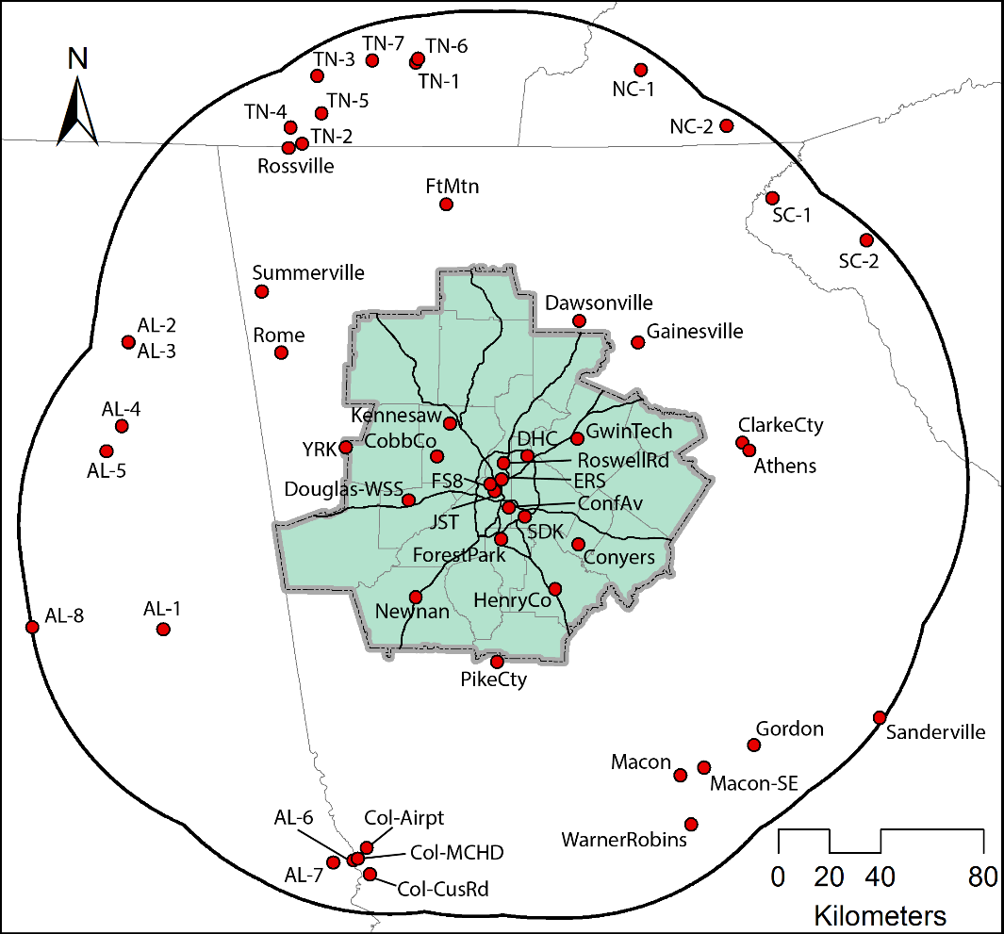
Atlanta Study Region
8 pollutants:
CO, NO₂, SO₂, O₃
PM_{2.5}, EC, OC & SO₄
20 county region
Center in Atlanta
Year 2011
Detailed performance evaluated at:
JST (urban)
YRK (rural)

Slide 5
Methods
Central Site Monitor (CM)
Obs. data from one monitor (SDK)
Spatial Average (SA):
Average all obs. data in domain
3 spatial interpolation methods (4km):
Use obs. within 100 km buffer of the region
Inverse Distance Weighting (IDW)
Tessellation (TESS)
Cut area into polygons, each with one monitor, assign monitor data to each polygon
Kriging (KRIG)
SDK

Slide 6
Methods (cont’d)
RLINE (250m):
Dispersion model, only on-road vehicular emissions
CO, PM_{2.5}
CMAQ (12km):
CMAQ Chemical transport model
CMAQ-krig adjust (12km):
Adjust CMAQ concentration using spatially kriged CMAQ/observation ratios at monitors

Slide 7
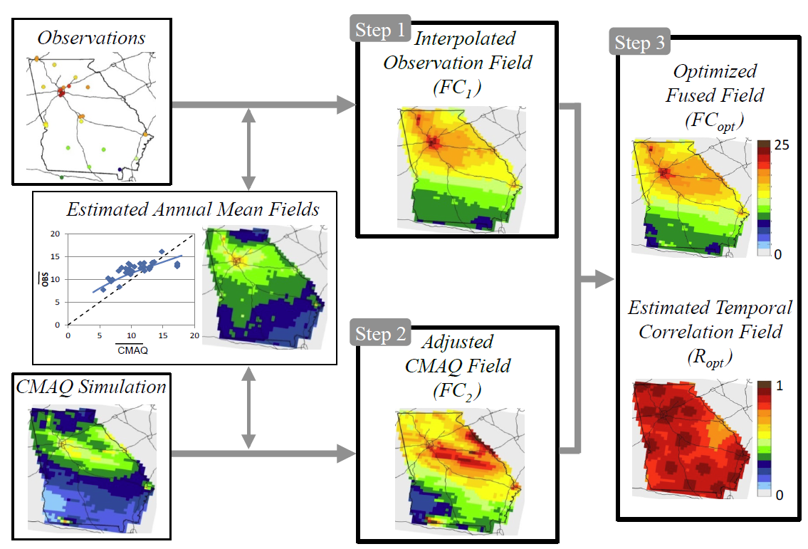
Methods (cont’d)
CMAQ-data-fusion (12 km)
Statistically blend spatial structure of CMAQ with temporal variations of obs. (Friberg et al., 2015)
Notes:
Friberg, M. D., Zhai, X., Holmes, H. A., Chang, H. H., Strickland, M. J., Sarnat, S. E., ... & Mulholland, J. A. (2016). Method for Fusing Observational Data and Chemical Transport Model Simulations To Estimate Spatiotemporally Resolved Ambient Air Pollution. Environmental science & technology, 50(7), 3695-3705.
Hu, Y., Balachandran, S., Pachon, J. E., Baek, J., Ivey, C., Holmes, H., ... & Russell, A. G. (2014). Fine particulate matter source apportionment using a hybrid chemical transport and receptor model approach. Atmospheric Chemistry and Physics, 14(11), 5415-5431.
Ivey, C. E., Holmes, H. A., Hu, Y. T., Mulholland, J. A., & Russell, A. G. (2015). Development of PM 2.5 source impact spatial fields using a hybrid source apportionment air quality model. Geoscientific Model Development, 8(7), 2153-2165.

Slide 8
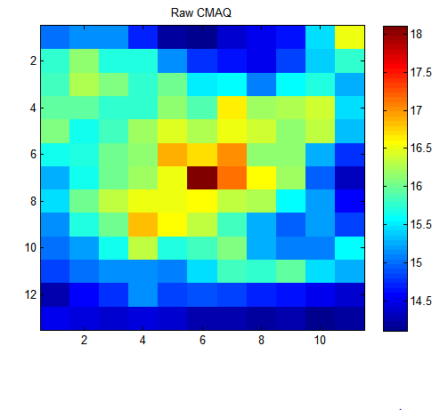
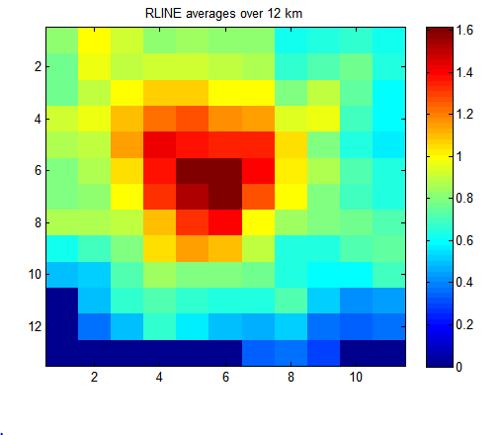
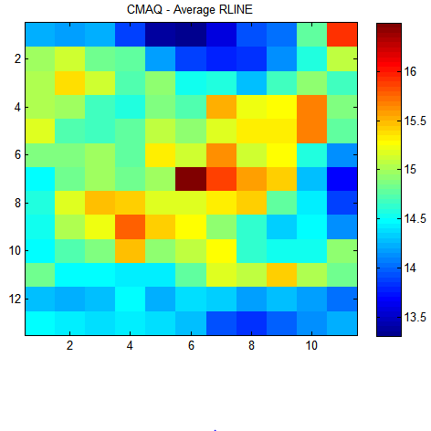
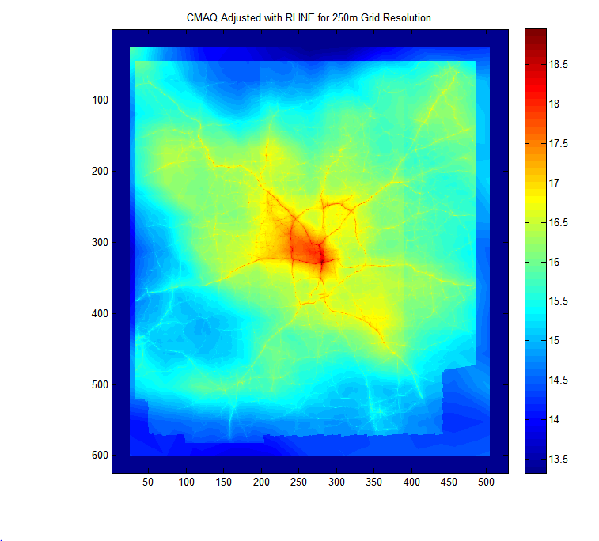
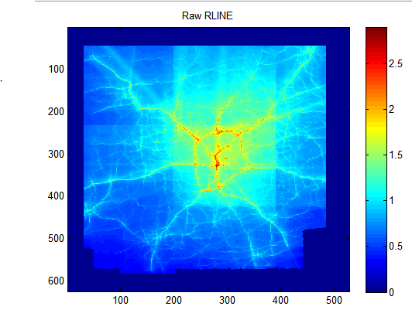
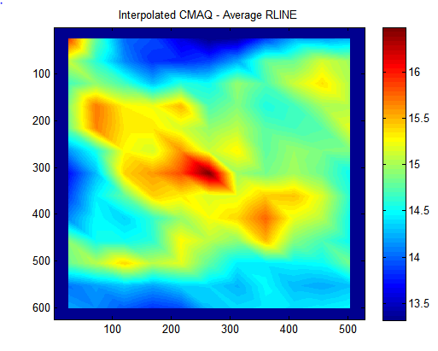
CMAQ-DF-RLINE (or CMAQ-RLINE-obs)
Used calibrated RLINE (line source dispersion model) to provide 250 m resolution mobile source impacts in Atlanta
Used in birth cohort study with detailed address information
RLINE independently evaluated and fused with observations
Daily 12 km CMAQ-datafusion
Annual avg. 12 km RLINE
12 km species “without” on-road
Interpolate to 250m
Daily 250m PM_{2.5} field
Ann. Avg. 250m RLINE
250m smoothed

Slide 9
Methods (cont’d)
Satellite aerosol optical depth (AOD) method using two-stage model (PM_{2.5} only, 1 km) (Chang et al., 2015)
Land use regression (PM_{2.5} only, 1 km)
CMAQ-hybrid (36 km)
CMAQ-CMB for source impact fields
Adjust CMAQ fields using hybrid source apportionment optimization (Hu et al., 2014; Ivey et al., 2015)

Slide 10
Spatial fields of EC

Slide 11
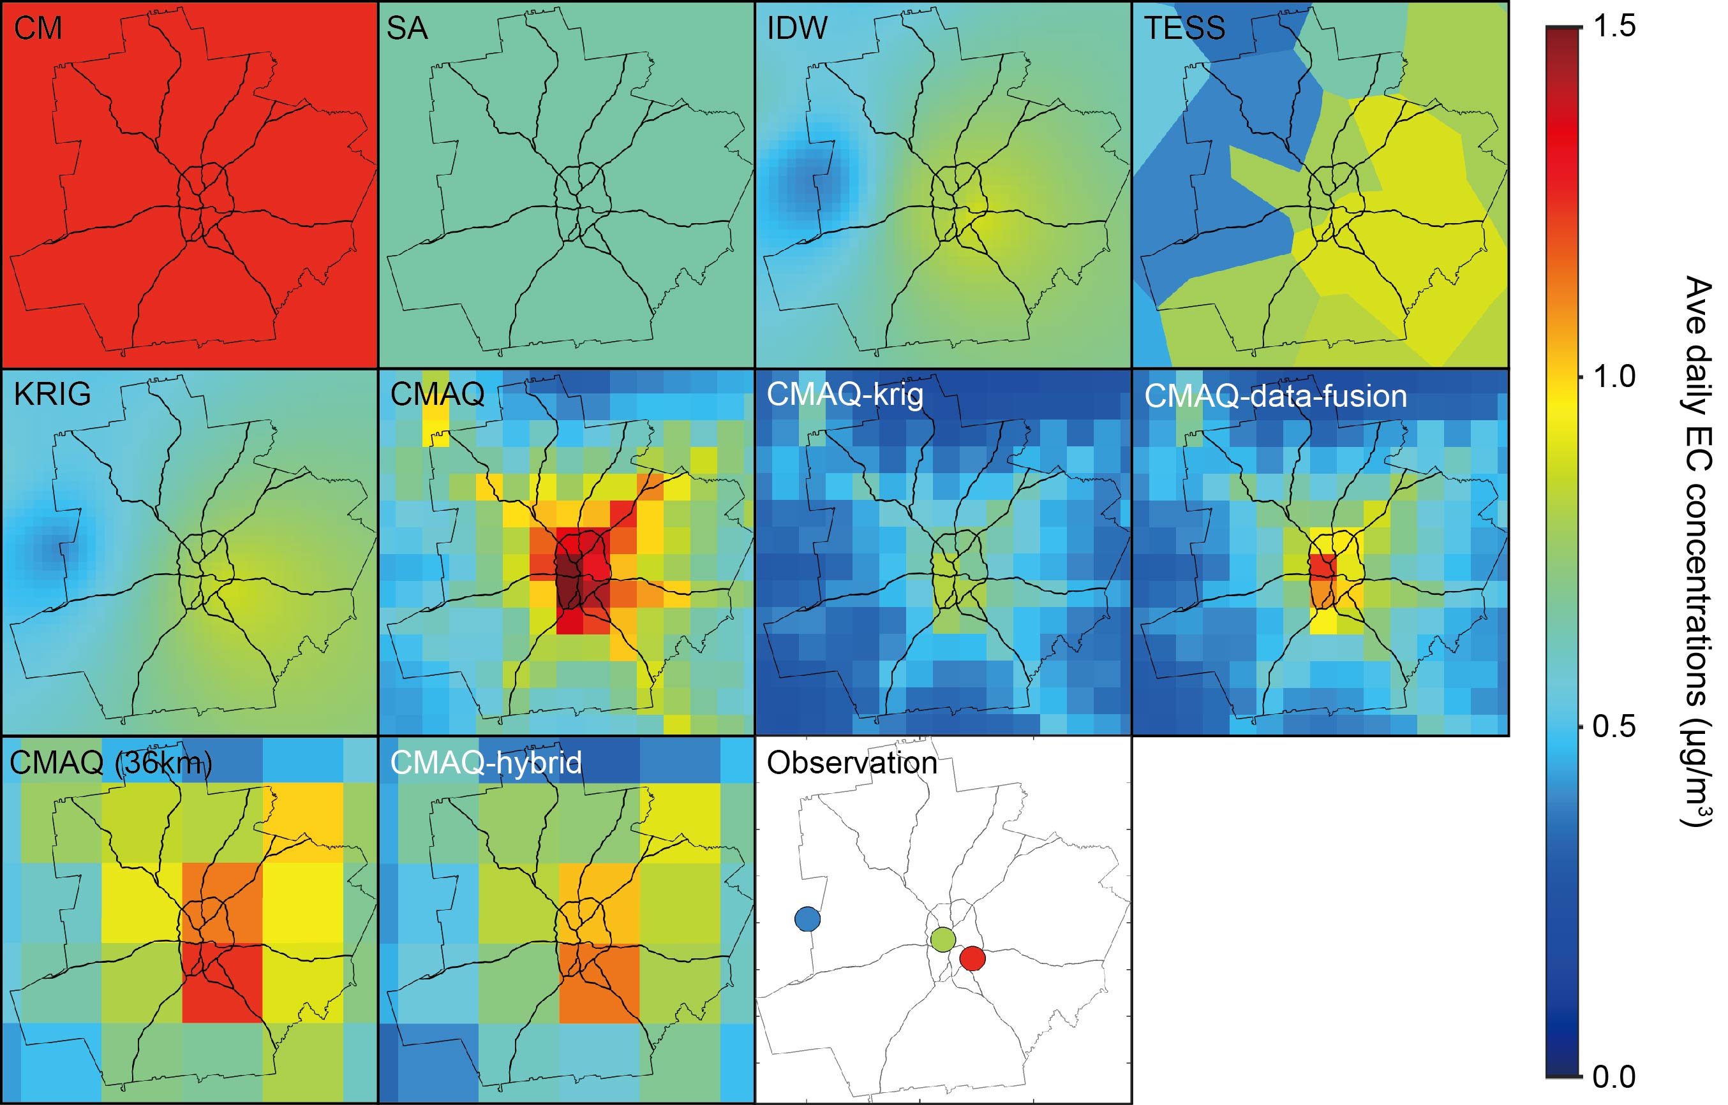
Spatial fields of EC
Vary significantly and lack spatial information
1 in 3/6 sampling; few monitors; SA can include very low or high locations

Slide 12
Spatial fields of EC
Similar spatial pattern
Abrupt concentration changes for tessellation

Slide 13
Spatial fields of EC
CMAQ:
Reasonable spatial pattern
Significant biases and error
CMAQ-krig and data fusion
Preserved CMAQ spatial pattern
Corrected CMAQ biases and errors

Slide 14
Spatial fields of EC
Different spatial pattern for 12 and 36 km CMAQ
Different emission inventory
CMAQ-hybrid also corrected some CMAQ (36km) biases and errors

Slide 15
Spatial fields of CO

Slide 16
Spatial fields of CO
RLINE captured high concentration near roads
Misses regional impacts
CMAQ-RLINE-obs incorporated regional impact
250 m resolution vs 12 km for CMAQ
High resolution desired for exposure analysis

Slide 17
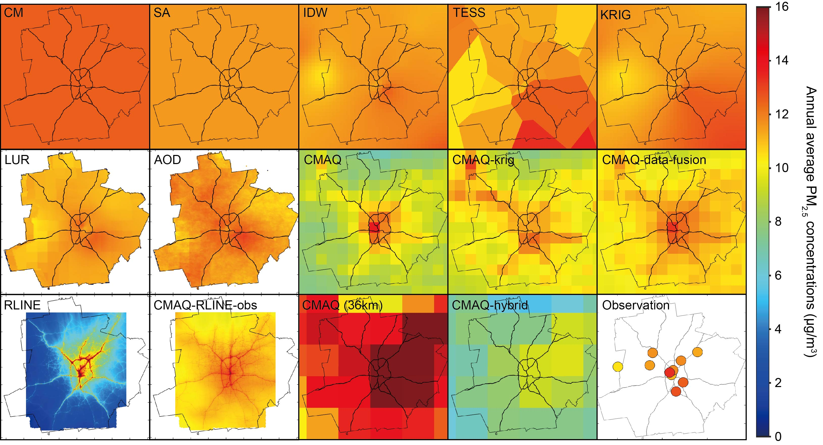
Spatial fields of PM_{2.5}

Slide 18
Spatial fields of PM_{2.5}
LUR simulates similar fields as kriging
None of the land use variables here have sufficient predicting power due to limited monitors
AOD field resembles some features of data fusion methods, though more flat

Slide 19
Method PM_{2.5} temporal R² at all monitors
L1O: leave-one-out cross validation
Observation based methods show similar performance
Use nearby measurement to infer unknown locations

Slide 20
Method PM_{2.5} temporal R² at all monitors
RLINE and CMAQ perform worst
Data fusion substantially improved performance
CMAQ-data-fusion performs better than CMAQ-krig
L1O: leave-one-out cross validation

Slide 21
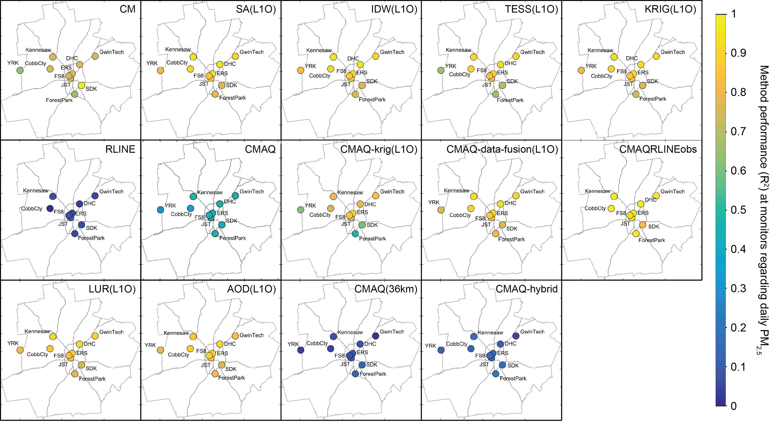
Method PM_{2.5} temporal R² at all monitors
LUR & AOD performs well
CMAQ-data-fusion performs slightly better or on-par with LUR and AOD
L1O: leave-one-out cross validation

Slide 22
Spatial correlation of PM_{2.5}
Purely observation based methods:
negative spatial correlation
CMAQ and data-integrated methods: positive correlation
*leave-one-out cross validation results
Notes:
You might note that CM is zero (it must be).

Slide 23
Conclusions
Methods lead can lead to different estimated levels of exposure
Interpolation methods (IDW and kriging) lead to similar patterns
Lack much spatial variation (and temporally-limited)
Model-based methods
Raw model outputs can be very biased and have large errors
Great caution should be taken
Integrating observations dramatically improves performance
Can readily integrate models of different scales
Attractive because they allow range of pollutants and scales and provide source impacts
AOD and model-data fusion methods led to similar concentration fields
AOD limited to a few species, has missing data
Insufficient number of monitors available in area to adequately apply LUR approach
LUR+AOD also lacked spatial texture
Notes:
Change “Should not be used” to “Great caution should be taken”. You can note that not only are the spatial and temporal correlations low, but the interspecies correlations and autocorrelations (if you have that as well) can be very different when using the model results directly. You can note that the spatial R2 would suggest caution even when used for long term exposure studies.

Slide 24
Thanks

