Slide 1
15th Annual CMAS Conference
Impact of Biomass Burning Aerosols
on
Regional Climate of the Southeastern U.S.
Peng Liu*, Yongtao Hu, Armistead G. Russell, Athanasios Nenes
Georgia Institute of Technology, Atlanta, GA, 30332
* Now National Exposure Research Laboratory, U.S. Environmental Protection Agency, Research Triangle Park, NC, 27711, USA
DOEesm
Oct 24, 2016

Slide 2
Motivation & Goals
Biomass burning (BB) aerosols can be important to
1) air quality
2) weather and extremes
3) regional climate
In the southeastern US (especially during main burning season), BB aerosols:
1) essential to particulate matter (PM) and potentially to the adverse health effects related to PM
2) regional climate ---rarely studied
This research is to provide a quantitative estimate:
under the current climate conditions, if aerosols from all emission sources do have an impact on the regional climate of SEUS, how much of the impact can be attributed to the BB aerosols.

Slide 3
Simulation Design
Modeling tools
WRF --- regional climate model
WRF-CMAQ --- regional climate model coupled with chemical transport model
Cases simulated (12km resolution):
CONT: WRF no aerosols (driven by 32km resolution NARR)
ALL: coupled WRF-CMAQ including biomass burning emissions
NOFIRE: coupled WRF-CMAQ excluding biomass burning emissions
Difficulties
1)large variance in the responses of clouds to BB
2)ensemble necessary which usually involves multi-year simulation and is computationally expensive
Limitations: no aerosol indirect effect; no brown carbon

Slide 4
?
RH
LOW RH
NO clouds
buoyance from
surface heating
Surface cooling
Large uncertainties related to
Atmospheric conditions
Intensity of biomass burning events
Optical properties of absorbing compositions in biomass burning aerosols

Slide 5
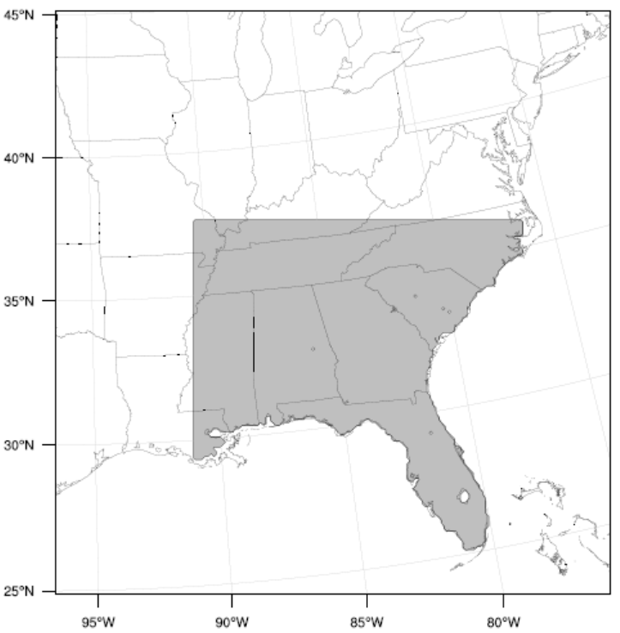
Simulation Design----Cont’d
Concept of short ensembles: (Wan et al., 2014 GMD)
1) climate is the long-term mean of weathers.
2) aerosol-related processes in the atmosphere is short/fast compared with climate.
3) ensembles of short-period simulation is able to reflect the impact of past processes on climate, because fast processes produce a model response to a perturbation on a timescale of days.
In this study, 16 ensembles
for each case:
Jan-Apr in 2006-2009
3-year averaged biomass burning
emissions (Odman, 2014)
c. simulate 22 days for each member,
first 8 days as spin-up
spectral nudging above PBL
at scales > 800 km
An efficient way to sampling is needed !
simulation domain & region of interest (shaded)

Slide 6
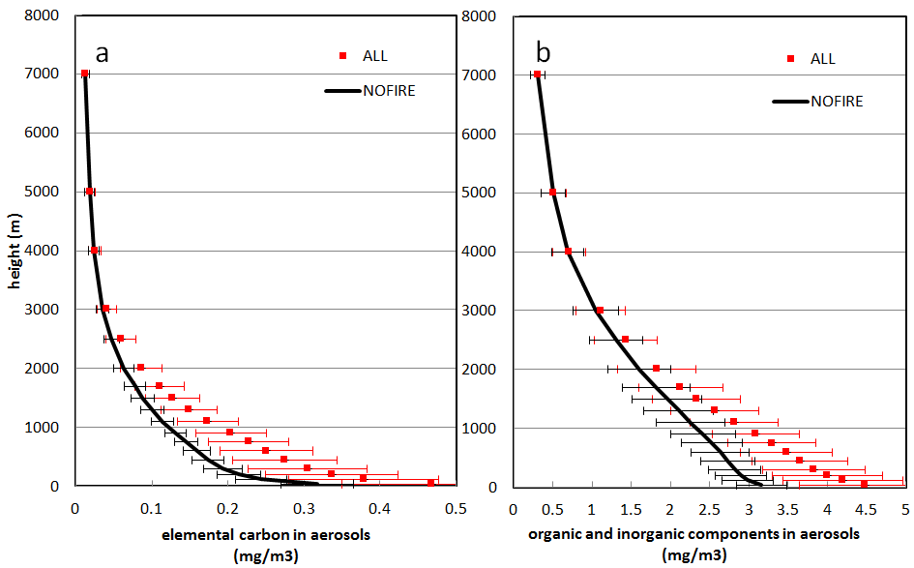
BB Aerosols Loading with Height
BB contributes significantly from surface to about 3km, which may affect the radiation distribution vertically.
Larger variance in aerosol loading when BB is included
(Liu et al., in prep)

Slide 7
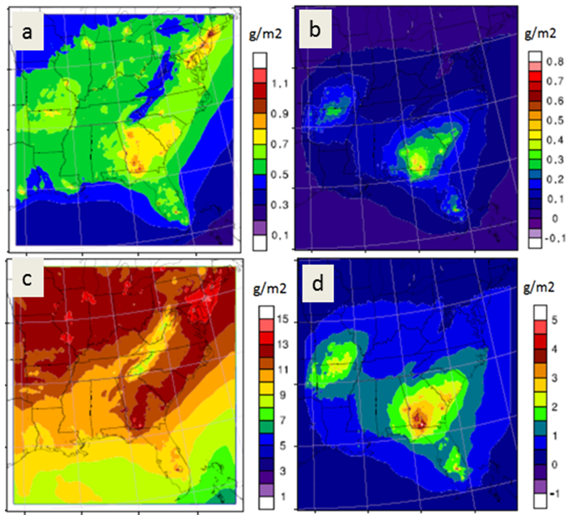
Spatial Distribution of Column Total BB Aerosols Loading
all aerosols BB aerosols
Absorbing components
BB also increase the spatial gradient of aerosol loading, which may potentially influence the circulations.
Scattering components

Slide 8
Radiative Forcing of BB Aerosols in SW
Unit (W/m²) | all emissions | biomass burning
Surface | -5.0 (1.57) | -0.6 (0.54)
Model top | -2.1 (0.89) | 0.0 (0.03)
Atmosphere | +2.5 (1.05) | +0.5 (0.45)
positive: warming effect
negative: cooling effect
( ) : standard deviation
BB contributes to about 10% to surface cooling and 20% to heating in atmosphere
At model top, absorbing in BB cancels out with scattering in BB
To flip the cooling effect of all emissions at model top, EC in BB has to increase by a factor of 4

Slide 9
Radiative Forcing of Clouds
Unit W/m² |  | CASE
 |  | CONT | ALL | NOFIRE
Surface | SW | -39.9 | -49.7 | -49.8
 | LW | 12.5 | 18.2 | 18.2
Model top | SW | -35.5 | -42.3 | -42.4
 | LW | 34.8 | 34.7 | 34.7
Atmosphere | SW | -2.5 | -1.3 | -1.3
 | LW | 23.2 | 17.6 | 17.6
positive: warming effect negative : cooling effect
Contribution of BB aerosols to the change in radiative forcing of clouds.
Change in radiative forcing of clouds due to existence of all aerosols
Radiative forcing change in clouds due to aerosol is stronger than radiative forcing of aerosols.
BB contributes little to the change in cloud radiative forcing.

Slide 10
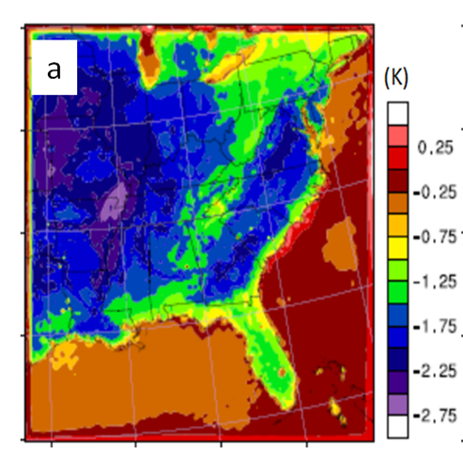
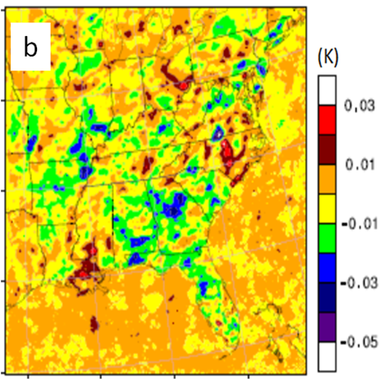
Does BB Aerosols Matter to Regional Climate?
Surface Air Temperature
cooling due to total aerosols
contribution from BB aerosols
Total aerosols result in significant surface cooling in the SE U.S., but contribution from BB is minor on average.

Slide 11
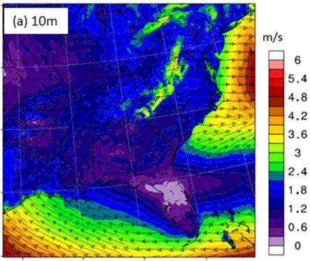
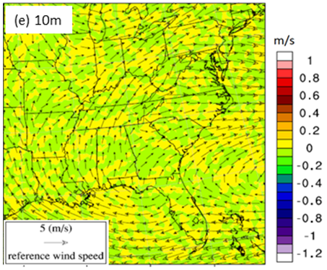
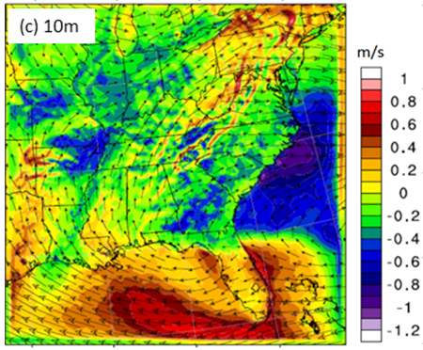
Does BB Aerosols Matter to Regional Climate?----Cont’d
Circulations at Surface
WRF case
contribution from BB aerosols
wind change due to all aerosols
Total aerosols reduce the surface wind speed by about 20% in the SE U.S., but contribution from BB is little with spatial perturbations at smaller scales.
(Liu et al., in prep)

Slide 12
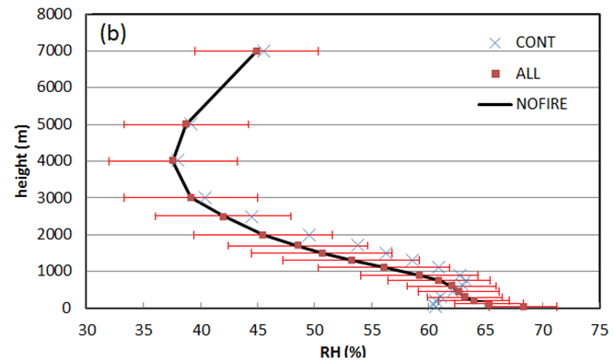
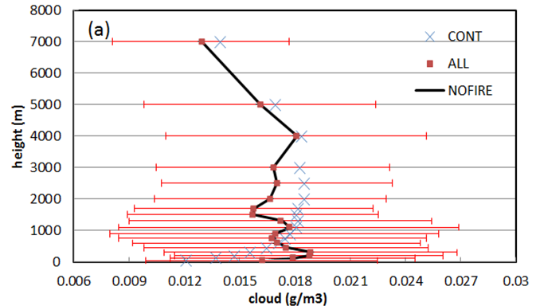
Does BB Aerosols Matter to Regional Climate?----Cont’d
Hydro-Fields
Total aerosols modify the vertical distribution of hydro-fields, but contribution from BB is little, and hydro-fields are not sensitive to the variance in BB aerosols.

Slide 13
Does BB Aerosols Matter to Regional Climate?----Cont’d
Distribution of Column Total Water Vapor
change due to total aerosols
Frequency
Kg/m2
contribution from BB aerosols
Frequency
Kg/m2

Slide 14
Conclusions & Future Work
The ensemble designed successfully cover the large variance in meteorological conditions and biomass burning.
Though total aerosols can modify the regional climate in the southeastern U.S, the contribution from biomass burning aerosols is very small.
This study provides a first-degree quantitative estimate of the radiative forcing and climate response of BB aerosols during the main BB season in the SEUS. Continuous efforts in the future would be needed to include the aerosols indirect effect and conduct the simulations at cloud-resolved resolutions. It would be very interesting to find out to what extent the conclusions drawn in this study may change.
THANK YOU !

Slide 15
References
Odman, M. T. (2014), "Emissions and Air Quality Modeling for SEMAP" Final Report to Southeastern States Air Resource Managers (SEMAP), Inc., 526 Forest Parkway, Suite F Forest Park, Georgia
Wan, H., Rasch, P. J., Zhang, K., Qian, Y., Yan, H., and Zhao, C. (2014), Short ensembles: an efficient method for discerning climate-relevant sensitivities in atmospheric general circulation models, Geosci. Model Dev., 7, 1961-1977
Lee, S. S., Feingold, G., McComiskey, A., Yamaguchi, T., Koren, I., Vanderlei Martins, J., and Yu, H. (2014), Effect of gradients in biomass burning aerosol on shallow cumulus convective circulations, J. Geophys. Res. Atmos., 119, 9948–9964

