Slide 1
15th Annual CMAS Conference
October 24-26, 2016
Using Response Surface Model for Hemispheric Transport of Air Pollution (HTAP)
Jiani Tan, Joshua S. Fu, Xinyi Dong, Kan Huang
University of Tennessee, Knoxville, TN, USA
October.26th, 2016
Notes:
Transport
Not transportation

Slide 2
Outline
Introduction
  Introduction of HTAP phase II
  Background and motivation of this study
Method
  Framework of CMAQ/ Response Surface Model (RSM)
  Emission and control variables
Results
  Model evaluation
  Source-Receptor (SR) relationship
Discussion & Summary
Notes:
15 second
This results we only show the results of NA

Slide 3
Brief Introduction of HTAP Phase II
Task Force on Hemispheric Transport of Air Pollution (TF HTAP) was developed by Convention on Long-range Transboundary Air Pollution (LRTAP) Convention in 2004
700 individual experts from more than 28 countries
15 oversea meetings or workshops
This study participants in the phase II starting from 2008
Home page: http://www.htap.org/
Wiki page: http://iek8wikis.iek.fz-juelich.de/HTAPWiki/
Notes:
redo
Organize
History-2001, model, papers
PhaseII, what we want to know, why start phase II

Slide 4
Background and Motivation
Both observational and model evidence: slow down increase of O₃ in Europe and North America due to long time control of emissions
But at the same time
  Increasing background O₃ concentration
  Trans-oceanic air flow carrying air pollutants.
Issue for policy-maker
  How long-term transport affect receptor regions?
  Will it offset the improvement from emission control policy?
This study focus on:
Pattern and impact of long-term transport of pollutants
Develop a source-receptor relationship for hemispheric transport
Predict the air quality under multiple pollution scenarios and help regional air quality control in the future
Notes:
Why is important to know the inter-continental transport?
Background transport
Local air quality control
Previous results: bar plot-> background, transport, compare percentage

Slide 5
Framework of CMAQ/RSM
Control Variables
Precursors: SO₂,NO_{x},NH₃, NMVOC
Regions: 7
Sectors: 5
Meteorology
WRFv3.6
Emission
HTAPv2.2
+ Megan
+ GFEDv4
MCIP
Latin Hypercube Sampling (LHS)
Air Quality Model
CMAQv4.7.1
Control Matrix
Response Surface Model (RSM)
Source-receptor Relationship
Notes:
How to transfer from background to method?
1) We define the control factors, and use LHS to create a control matrix

Slide 6
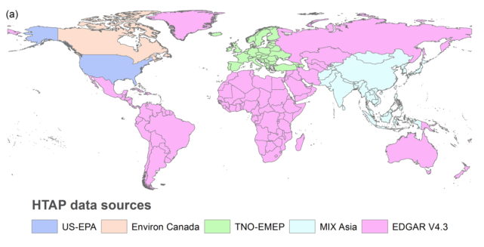
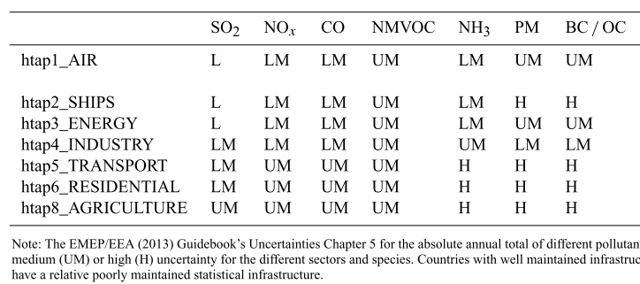
Emission Inventory
Compiled emission inventory
USA – NEI from US EPA
Canada - Environment Canada
Europe - the European Monitoring and Evaluation Programme (EMEP) and Netherlands Organisation for Applied Scientific Research (TNO)
Asia: Model Inter-comparison Study for Asia (MICS-Asia III)
South America, Africa, Russia- Emissions Database for Global Atmospheric Research (EDGARv4.3)
0.1° × 0.1° spatial resolution
Uncertainty of different emission sectors
Low (L), low-medium (LM), upper-medium (UM), and high (H).
(Janssens et al, 2015)
Notes:
Import! Where the emission come from!
We will discuss the results with uncertainty later

Slide 7
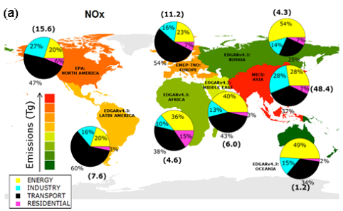
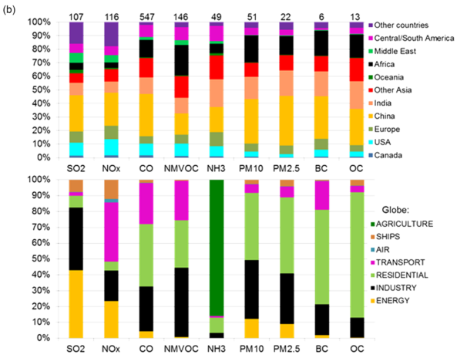
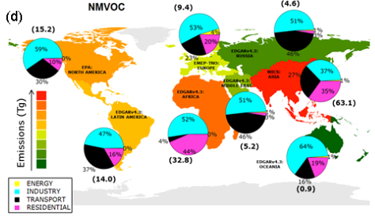
Control Variables
Control sector
Control regions
In this study, we use…
}
  SO₂: Industry Energy
  NH₃: Agriculture
  NOx: Industry Transport Energy
      NMVOC: Industry Transport Resident
PM_{2.5}
O₃
}
(Janssens et al, 2015)
Notes:
Why and how we choose control variables
On the basis of the emission inventory, we are able to see the biggest contributor of air pollutions.

Slide 8
Control Region and Scenario
RSM scenarios design
1 base run
3 all region emission reduce 20%, 50% and 80%
7 each source region emission reduce 20%
300 runs from LHS control matrix to cover all source categories for factor of 0~1.2
Model set-up
Spatial resolution: 108 km×108 km
Vertical resolution: 44 layers
Chemical options: CB05, aero5
Run period: Jan, Apr, Jul, Dec of 2010
CPU hours: 0.7 million hours
1-North America (NA) 2-Europe (EU)
3-Russia, Kazakhstan, Uzbekistan (RS)
4-South Asia (SA) 5-East Asia (EA)
6-Southeast Asia (SEA)
7 – North Africa, Mid-East (AM))
Notes:
Color
Model setup – physical and chemical, resolution, top and bottom
Cpu hour, how many runs

Slide 9
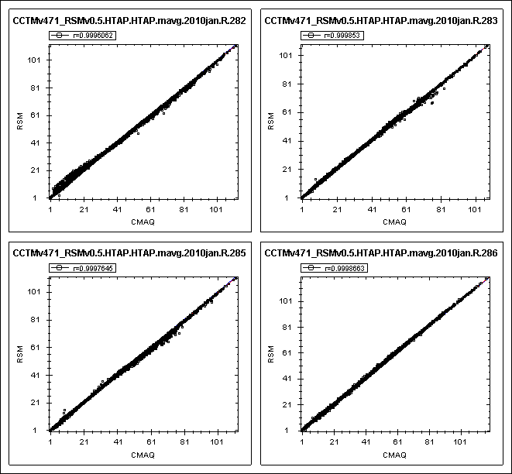
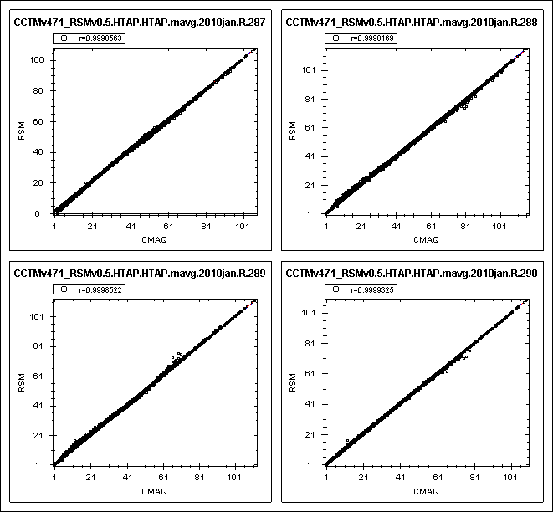
Evaluation of RSM
282 CMAQ results to develop RSM
The rest results to validate RSM using
out of sample method
The RSM model agrees well with the CMAQ model
Notes:
Color
Model setup – physical and chemical, resolution, top and bottom
Cpu hour, how many runs

Slide 10
Source - Receptor Relationship of PM_{2.5}
- North America Region
Notes:
na-north america

Slide 11
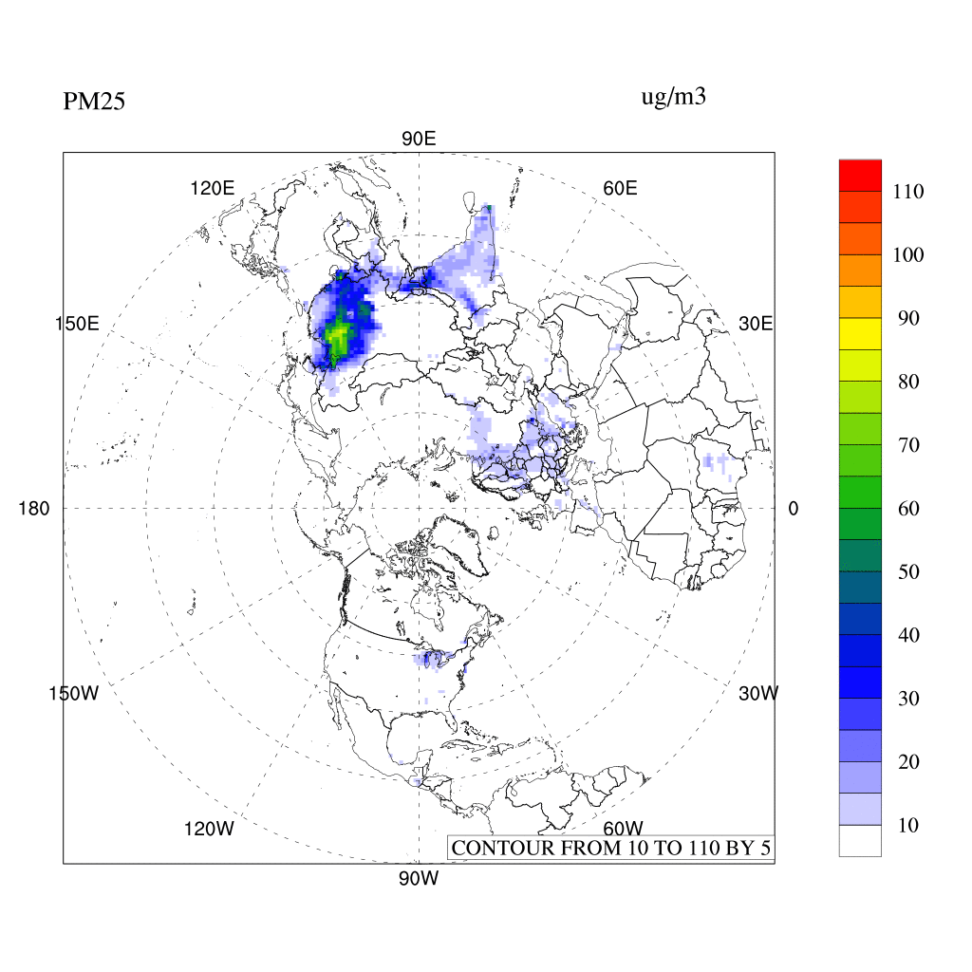
Hemispheric Transport of PM_{2.5} in Spring
unit: µg/m³

Slide 12
North America as Source Region of PM_{2.5}
Notes:
Na as source , no

Slide 13
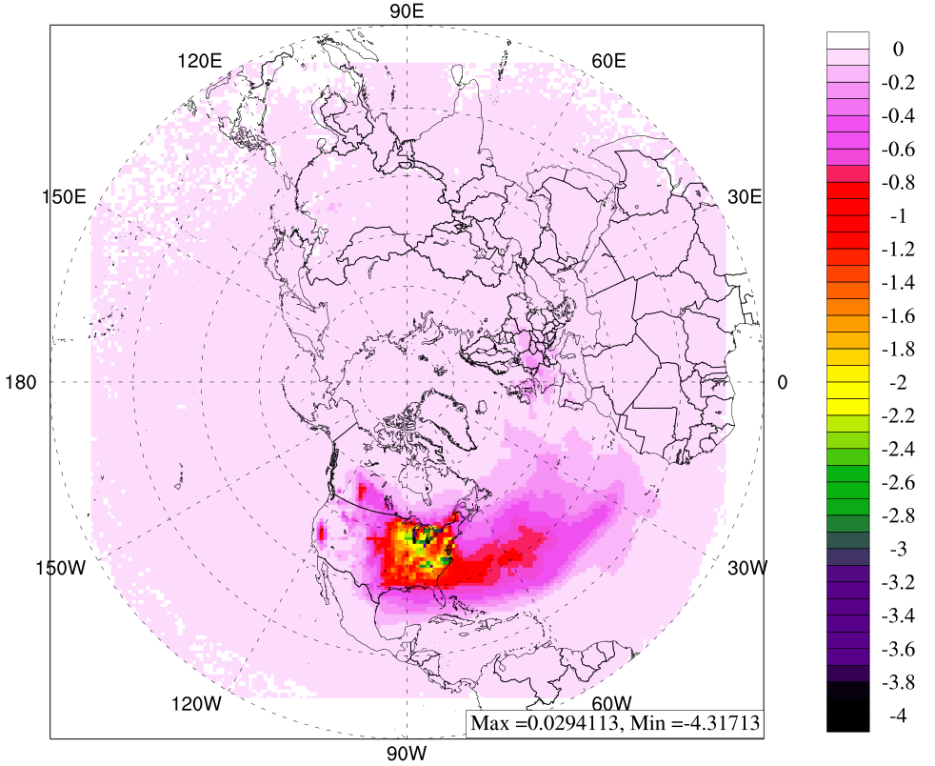
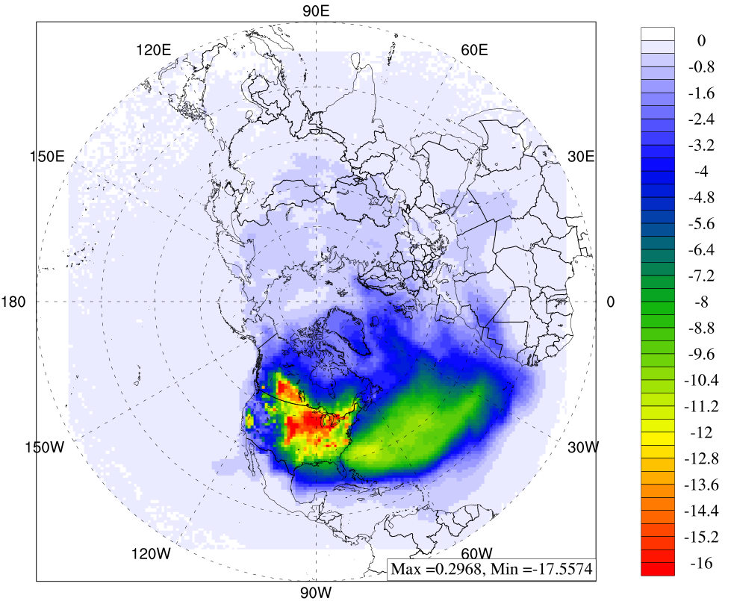
Response to 20% Emission Reduction in North America for PM_{2.5}
Absolute concentration in spring
Percentage of change in spring
unit: µg/m³
unit: %
Change in receptor regions | Europe | Africa & Mid-East | East Asia | South Asia | Russia
Concentration (µg/m³) | -0.112 | -0.037 | -0.008 | -0.025 | -0.006
Percentage (%) | -0.860 | -0.409 | -0.039 | -0.110 | -0.446
Notes:
Single color
1 figure + table
Among the receptor regions, Europe receives the biggest influence
Winter paper by Xinyi
Among the four season, Spring has highest inter-continental transport

Slide 14
Impact of North America to Europe and North Africa and Mid-East of PM_{2.5}
(a) NA to Europe
(b) NA to North Africa and Mid-East
Strong seasonal dependent: High hemispheric transport in Spring due to strong westerlies.
Almost linear response in receptors PM_{2.5} concentration with emission control in North America.
Much stronger impact on Europe than North Africa and Middle East.
Notes:
From left to right, the emission control rate is increased from 10% to 50%.
Make sure why the winter is increase

Slide 15
North America as Receptor Region of PM_{2.5}

Slide 16
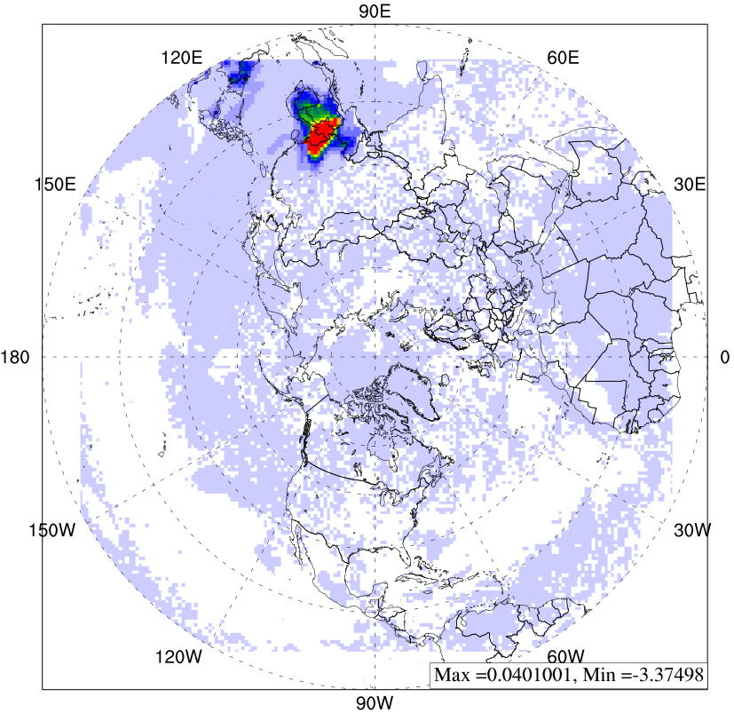
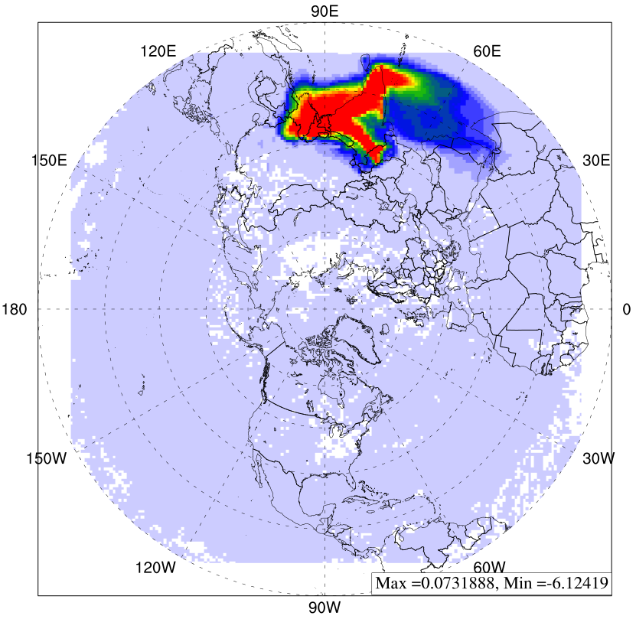
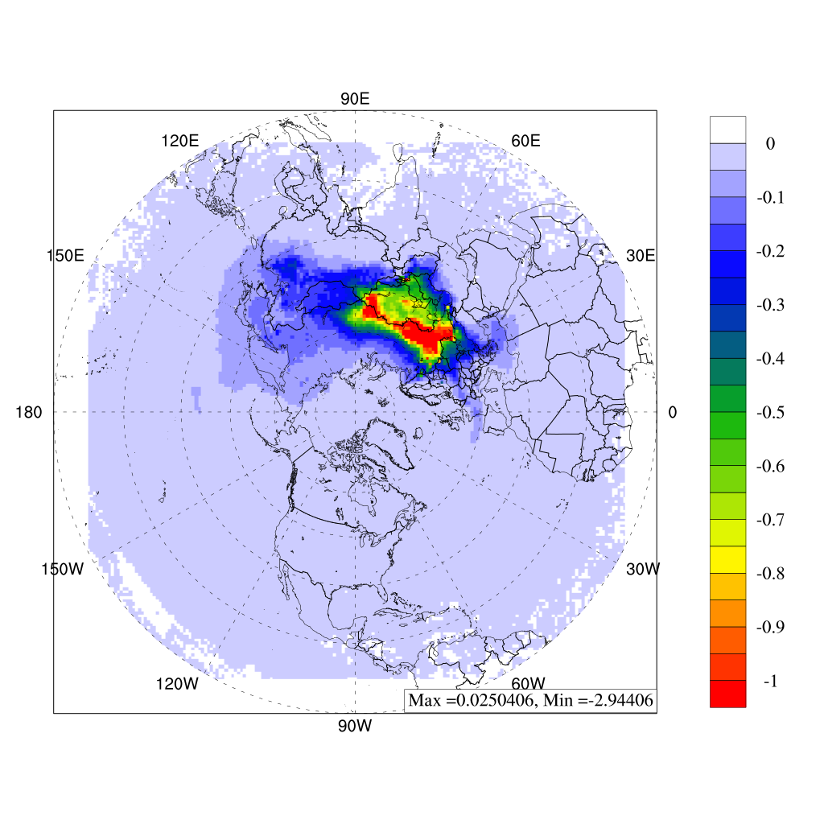
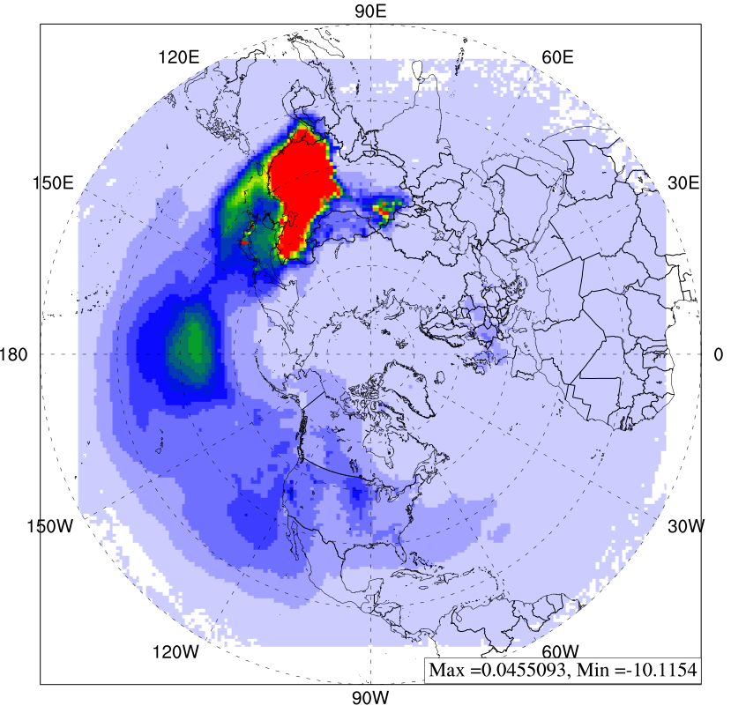
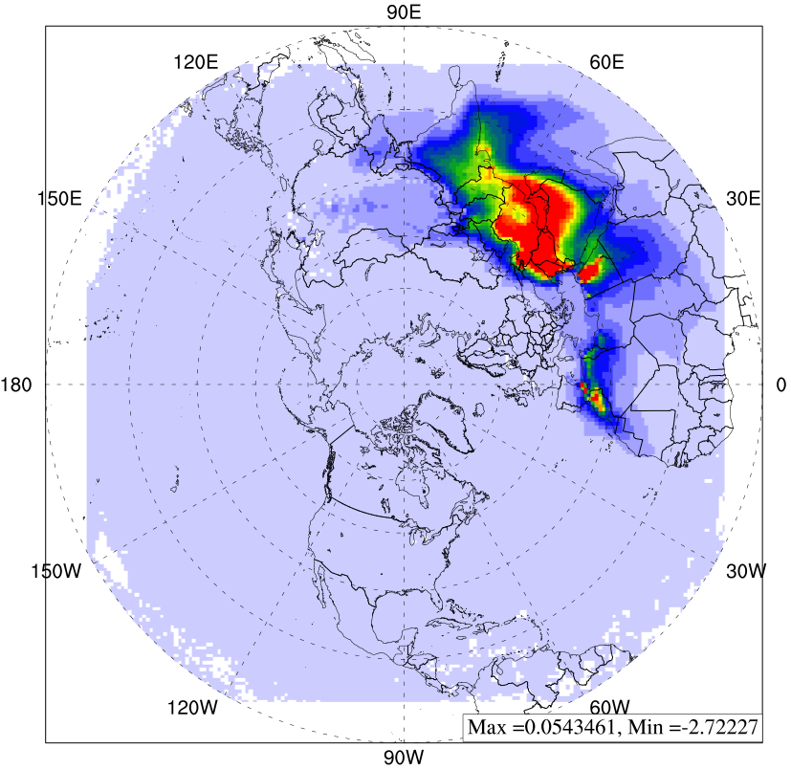
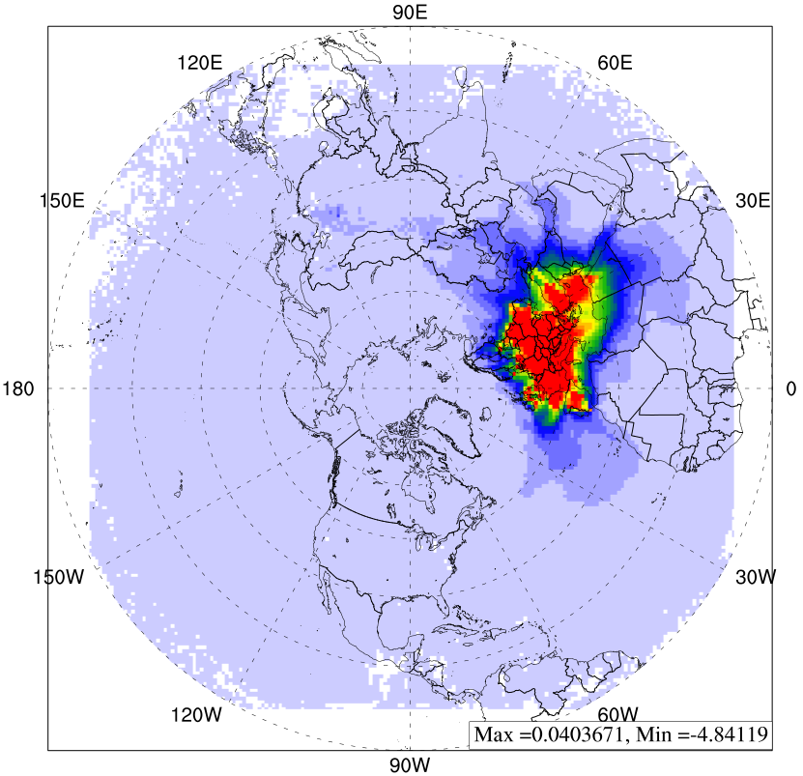
What Would Happen to PM_{2.5} in North America if Control 20% Emission in…
South East Asia
South Asia
unit: µg/m³
North Africa
Middle East
East Asia
Russia
Europe
(2010 spring)

Slide 17
Hemispheric impact on North America for PM_{2.5}
50% of impacts come from Asia
Impact from Asia
Spring
High efficiency to control the emissions from East Asia
The reduction of PM_{2.5} is close to linear response to the emission reduction in other continents
Asia regions accounts for 50% of the hemispheric transport to North America
Notes:
Sample
Explain how to read this figure
unit
Domain and monthly averge
Compare with current results

Slide 18
Source-Receptor Relationship of O₃
- North America Region

Slide 19
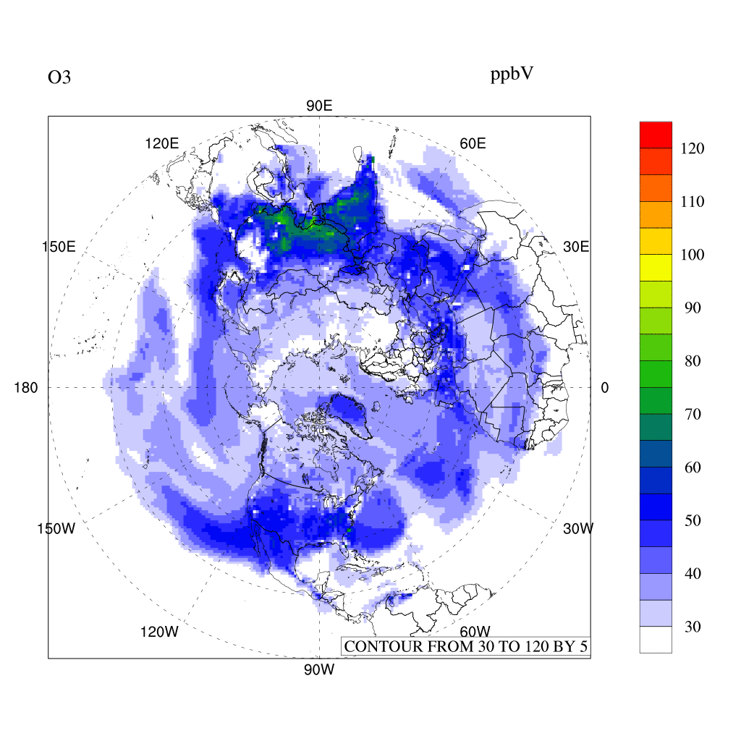
Hemispheric Transport of O₃ in Spring
unit: ppbV

Slide 20
North America as Source Region of O₃

Slide 21
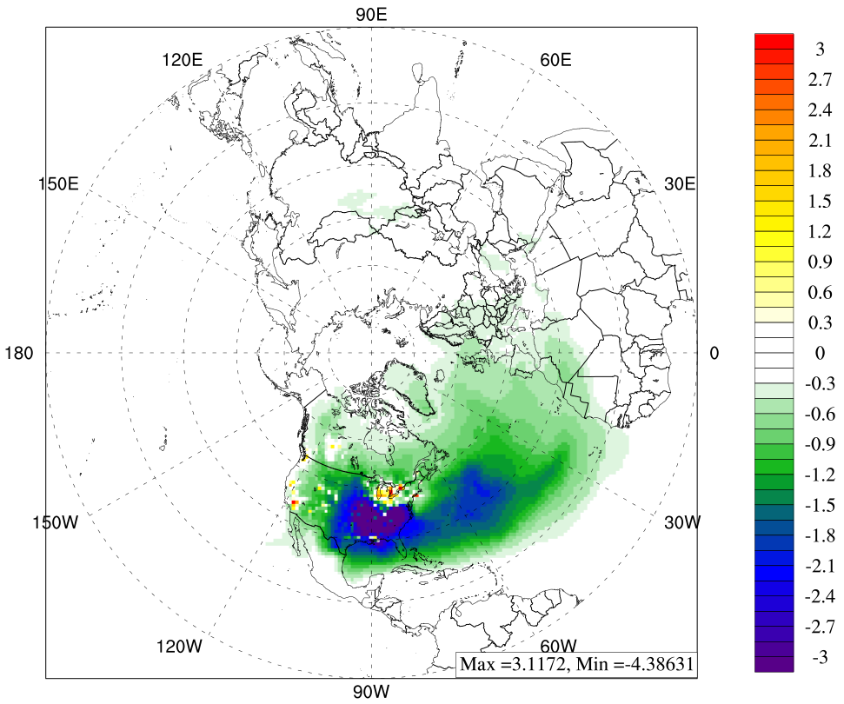
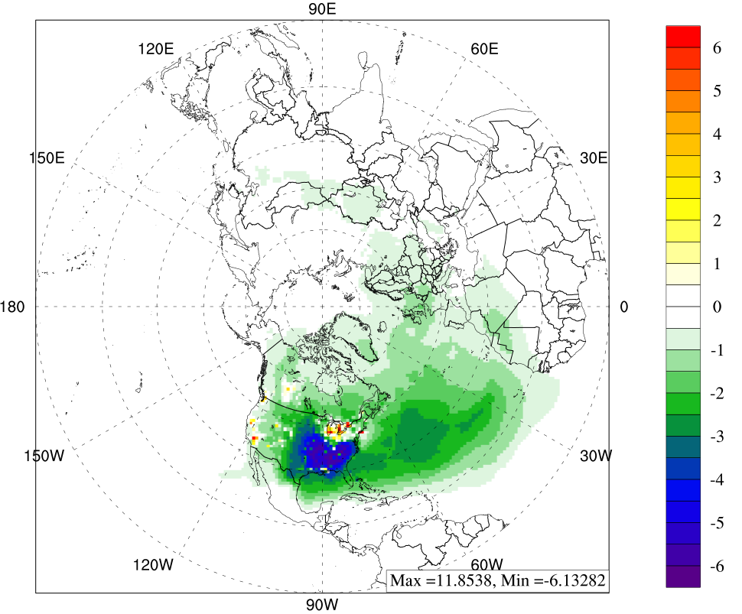
Response to 20% Emission Reduction in North America for O₃
Absolute concentration in spring
Percentage of change in spring
unit: ppbV
unit: %
Change in receptor regions | Europe | Africa & Mid-East | East Asia | Russia
Concentration (ppbV) | -0.312 | -0.131 | -0.038 | -0.087
Percentage (%) | -0.625 | -0.219 | -0.069 | -0.215
Notes:
Single color
1 figure + table
Among the receptor regions, Europe receives the biggest influence
Among the four season, Spring has highest inter-continental transport

Slide 22
Impact of North America to Europe for O₃
Spring has the highest hemispheric transport from North America to Europe.
Almost linear O₃ reduction in Europe with more emission control in North America.
Notes:
From left to right, the emission control rate is increased from 10% to 50%.

Slide 23
North America as Receptor Region of O₃

Slide 24
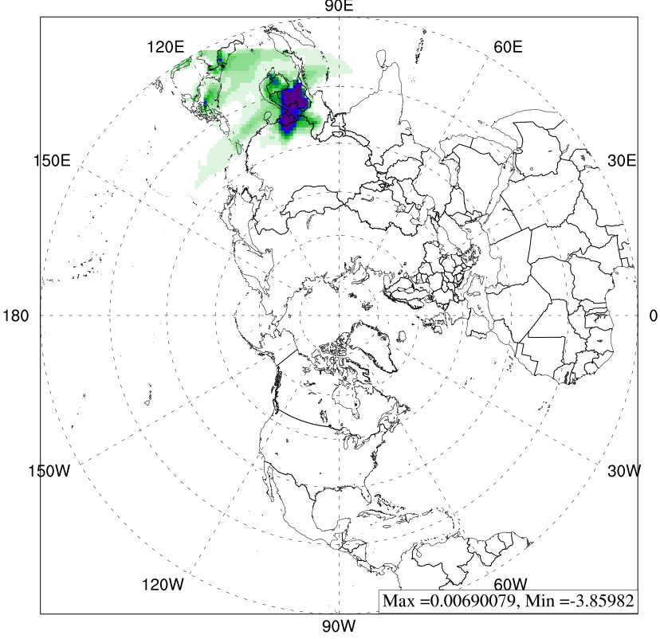
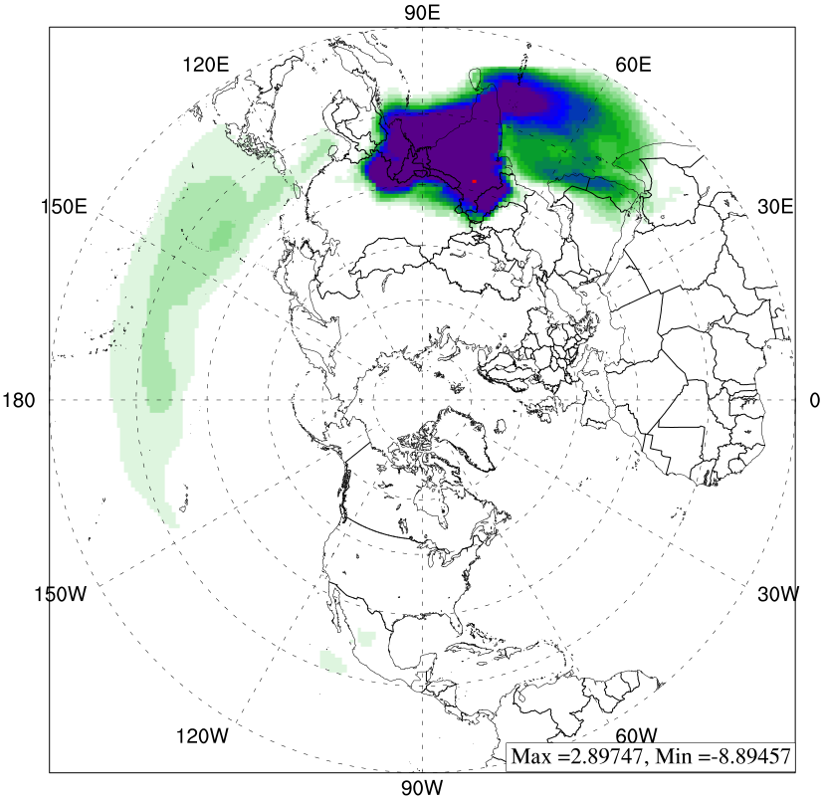
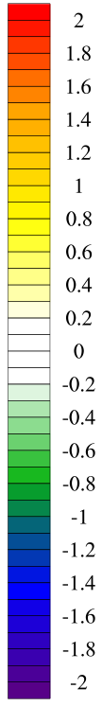
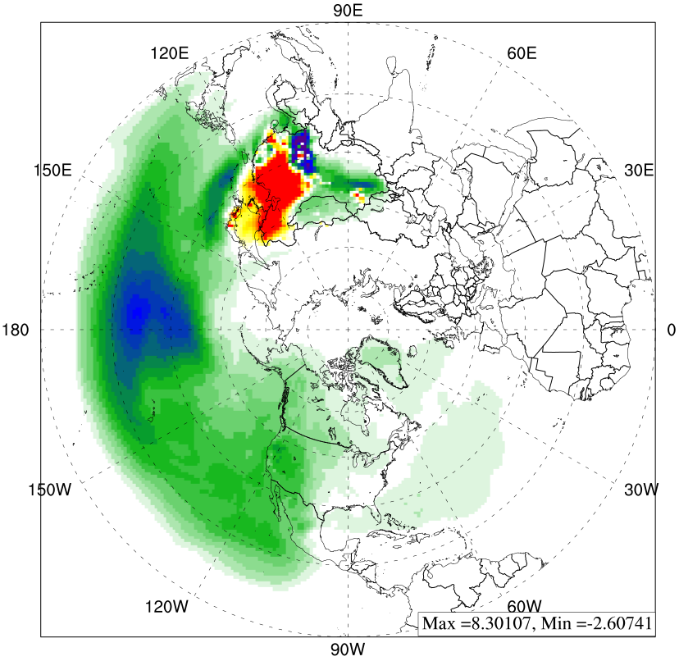
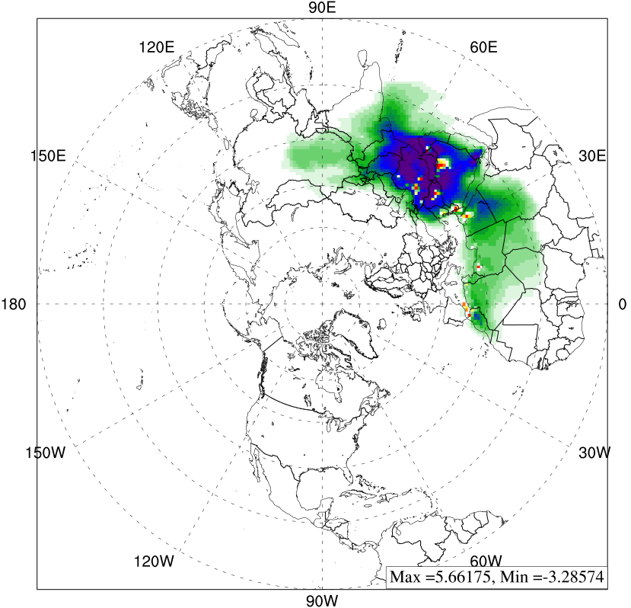
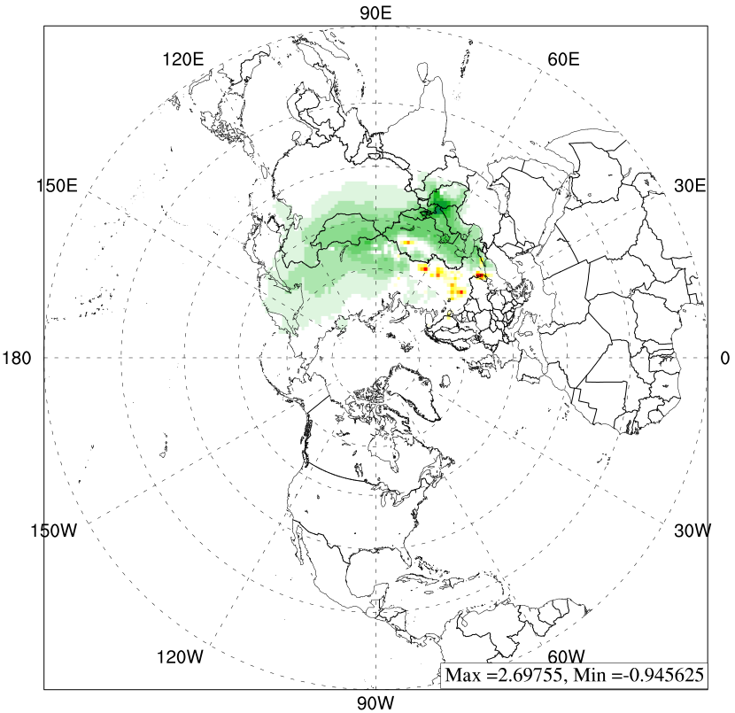
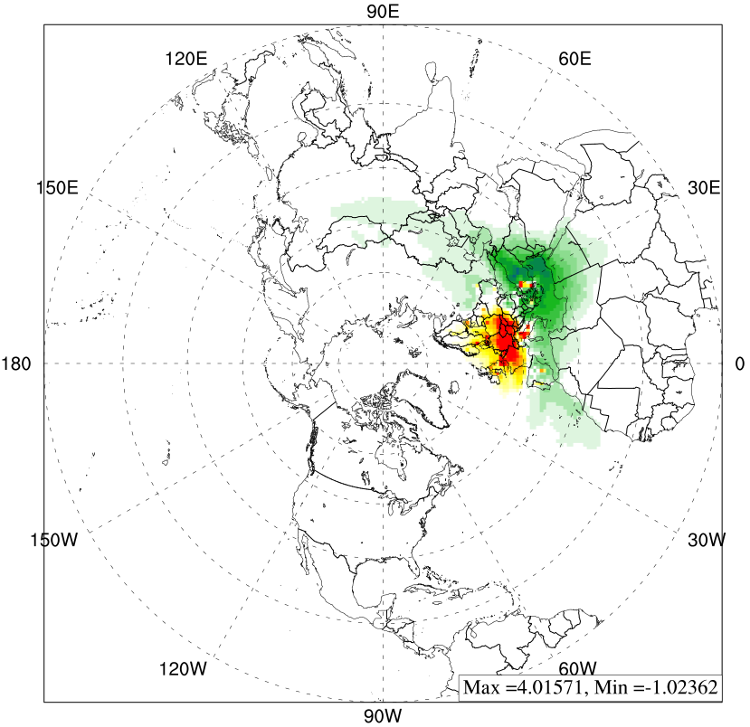
What Would Happen to O₃ in North America if Control 20% Emission in…
South East Asia
South Asia
unit: ppbV
North Africa
Middle East
East Asia
Russia
Europe
(2010 spring)

Slide 25
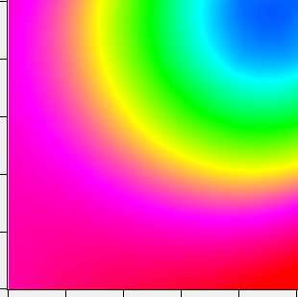

Hemispheric Impact on North America for O₃
O₃ response contour in Chapel Hill, NC
1.0
0.8
0.6
0.4
0.2
0
51.8
51.5
51.2
50.8
50.5
50.2
VOC emission ratio_EA
ppbV
Control NOx emission in most source regions could reduce the O₃ concentration in Los Angeles
Control VOC emission would increase the O₃ concentration
0 0.2 0.4 0.6 0.8 1.0
NOx emission ratio_EA
O₃ concentration in Chapel Hill has non-linear response to NOx and VOC emissions from East Asia
Notes:
O3 - > nonlinear response
Nox -> capi
O3 nonlinear response contour

Slide 26
Summary
Preliminary Conclusions:
  Strong hemispheric transport found in spring season.
  North America as source of hemispheric transport:
    Europe receives the highest impact.
    More stringent emission control in North America would result in continuous reduction of PM_{2.5} and O₃ concentrations in Europe.
  North America as receptor of hemispheric transport:
    For PM_{2.5,} Asia accounts for up to 50% of the hemispheric transport to North America, among which East Asia contributes the most in Spring.
    For O₃, control NOx emission in source regions reduces the O₃ concentration in Los Angeles, but control VOC has opposite result.
Next steps:
  The transport of air pollutants in upper layer of atmosphere.
  Impact of long-term transport on regional scale collaborating with MICS-Asia project.

Slide 27
Acknowledgement
We acknowledge UT’s National Institute for Computational Sciences (NICS) and ORNL’s OLCF (NCCS) for providing the computer sources for model simulations of this research.

Slide 28
Thank you for your attention !
Questions ?

