Slide 1
Assessing the impact of grid resolution on forward and backward sensitivity results
Melanie Fillingham, Burak Oztaner, Shunliu Zhao, Amir Hakami, Carleton University, Ottawa, Ontario

Slide 2
Outline
Coarse vs Fine: Spatial Dilution Averaging
Fine Resolution Sensitivity Modeling
Approach 1: Forward Sensitivity
Approach 2: Adjoint Sensitivity
Future Work

Slide 3
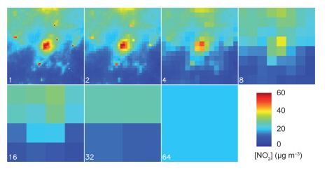
Coarse vs. Fine Resolution Modeling
Coarse resolution modeling →poor spatial representation
Dilution in concentrations due to averaging over the grid
Peaks are weakened (locations of highs or lows)
Bias in predicted concentrations → underestimation in urban areas, overestimation in rural
Figure shows simulated annual mean NO₂ conc. for varying resolutions (Ridder et al., 2014)

Slide 4
Forward Sensitivity shows where influences are seen
Input/Sources
Fine Grid
Outputs/Receptors
Fine Grid

Slide 5
Adjoint Sensitivity shows where influences come from
Input/Sources
Fine Grid
Outputs/Receptors
Fine Grid

Slide 6
Sensitivity & Fine Grid Benefits
Can help determine contribution of specific emission sources (adjoint) or the impacts on specific receptors (forward/DDM), helping to optimize pollution control strategies
Useful in municipal decision making → future urban planning & mass transit decisions
Input/Sources
Fine Grid
Outputs/Receptors
Fine Grid

Slide 7
Methodology
Grid resolution impact
Approach 1: Forward Sensitivity
Approach 2: Adjoint (Backward) Sensitivity
CMAQv5.0.2-DDM
added sensitivity parameter for horizontal grid resolution
CMAQv4.5.1-adj run at progressively refined resolutions
Differentiation the model equations with respect to model grid size
Thesis: 36, 12, 4 and 1 km
CMAS: Preliminary Study: 36 and 12km

Slide 8
Approach 1: Forward Sensitivity: Direct Decoupled Method

Slide 9
Approach 1: Forward Sensitivity Methods
Direct Decoupled Method (DDM)
Differentiated atmospheric diffusion equation with respect to grid resolution
Atmospheric functions that we considered with respect to grid resolution (extensive parameters):
Horizontal and Vertical Diffusion
Horizontal Advection
Still to consider:
Clouds
CMAQv5.0.2-DDM, base case 12km data, 34 layers
$Sensitivity=\frac{∂C_{i}}{∂ε},$ Where ε is the grid resolution
Output: ∆ ppb per ∆ 1 km grid resolution

Slide 10
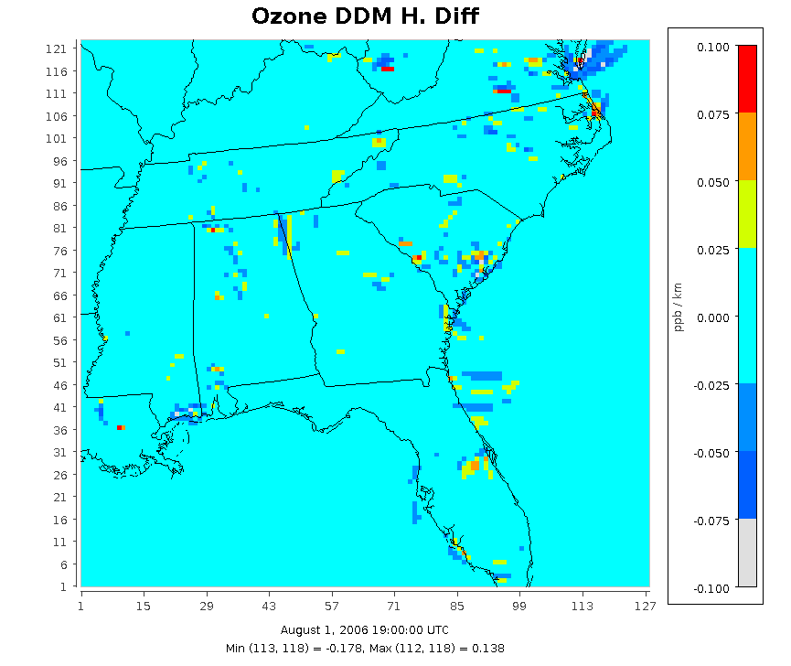
Approach 1: DDM Results Horizontal Diffusion
Chesapeake Bay
Effects show only impacts grid size has on horizontal diffusion
Other transport processes were switched off (horizontal and vertical advection and vertical diffusion)
Charleston
Richmond
Charlotte

Slide 11
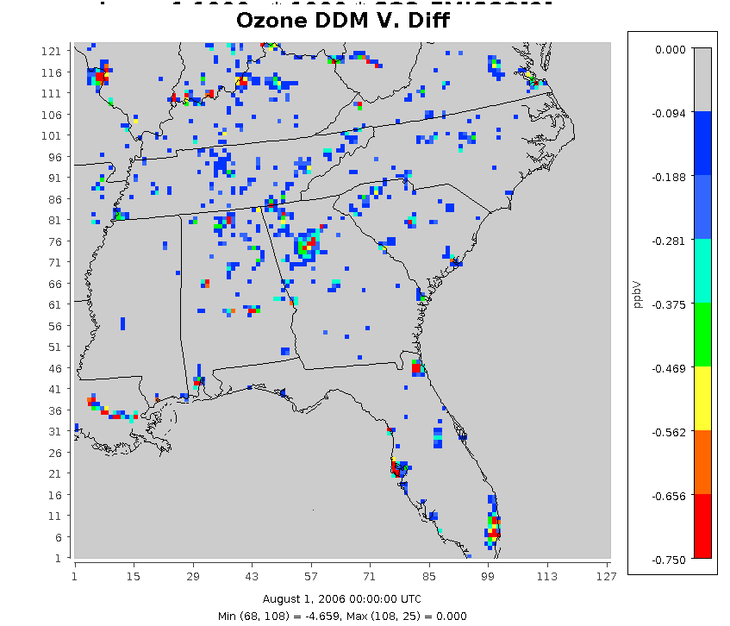
Approach 1: DDM Results Vertical Diffusion
St, Louis
Effects show only impacts grid size has on vertical diffusion
Other transport processes were switched off
Atlanta
Miami

Slide 12
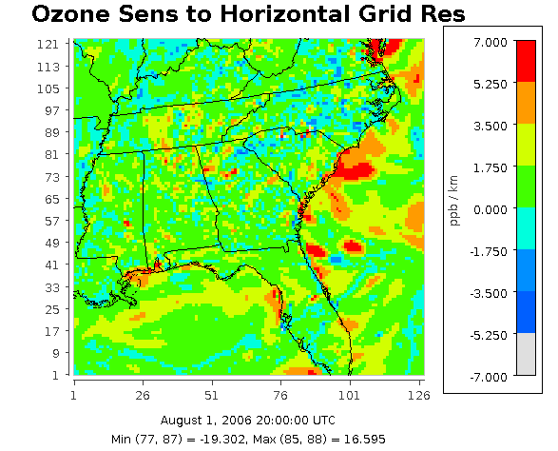
Approach 1: DDM Results Horizontal Advection
Large values may indicate error
Work in progress

Slide 13
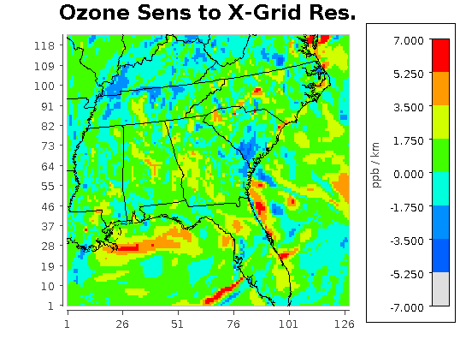
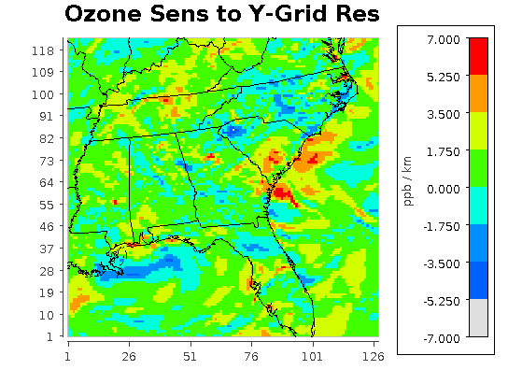
Horizontal Advection: X vs. Y Direction

Slide 14
All processes
Impacts that grid size has on vertical diffusion, horizontal diffusion and horizontal advection
Highest influence from horizontal advection

Slide 15
Approach 2: Adjoint (backward) Sensitivity

Slide 16
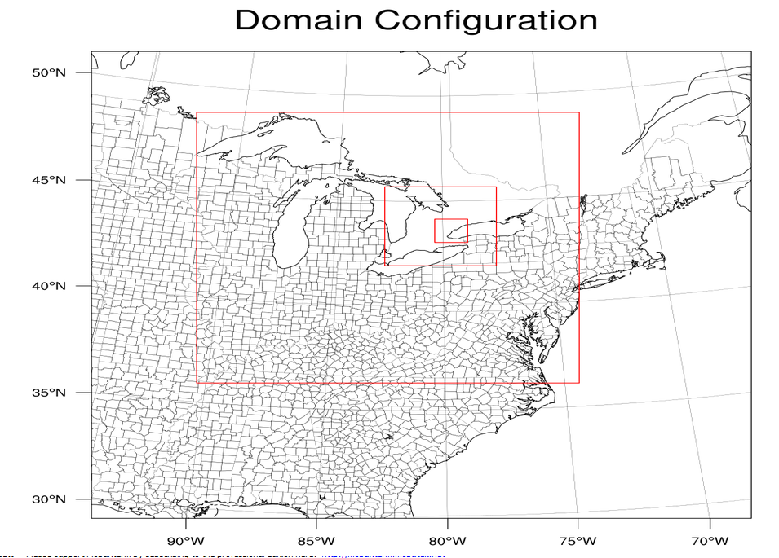
Approach 2: Adjoint Sensitivity Thesis Project Methods
Model: CMAQv4.5.1-adj
WRF run at each domain
Episode: 1 Month Ozone Season, 2012
Fine resolution emission data (developed at 1km, 4km 12km and 36km), nested domains
Ozone with respect to NOx emissions

Slide 17
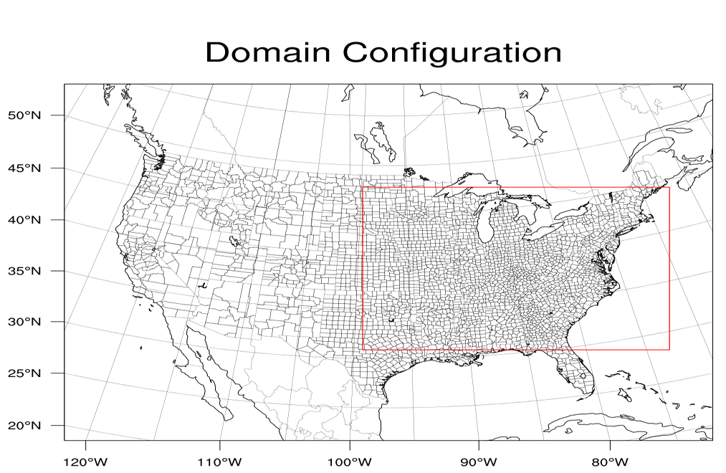
Approach 2: Adjoint Sensitivity Preliminary Methods
Model: CMAQv4.5.1-adj
Domain: 36 km CONUS with nested 12 km eastern US
Episode: First week of April, 2008
WRF: Run for both 12km and 36km domains
Adj Cost Function: Total 8-hour maximum ozone over the domain
Emission data for 36 km regridded to 12 km resolution
Results will only show the effects of grid resolution on meteorological and transport/chemistry functions

Slide 18
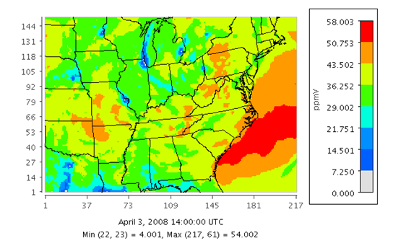
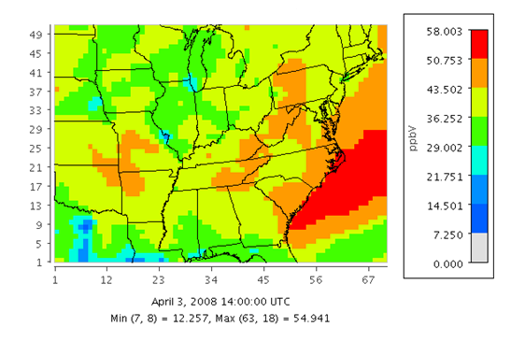
Forward O₃ Concentration Results
Minneapolis
Detroit
Chicago
12 km output
36 km output

Slide 19
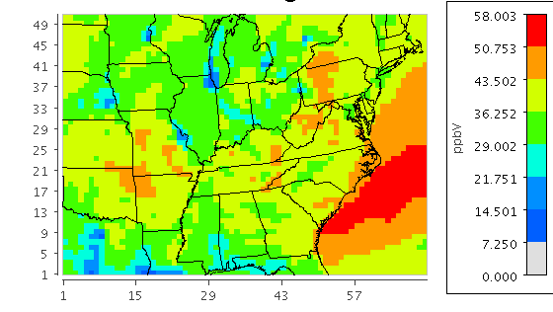
Forward O₃ Concentration Results 12km Aggregated to 36km
Average of 9 cells regridded to 1
(12km → 36km)

Slide 20
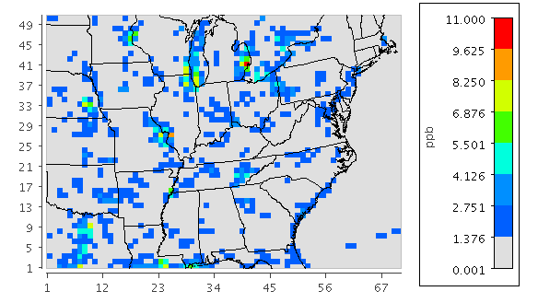
Standard Deviation within Regridded Subgrid Data
Detroit
Chicago
Lincoln
St. Louis

Slide 21
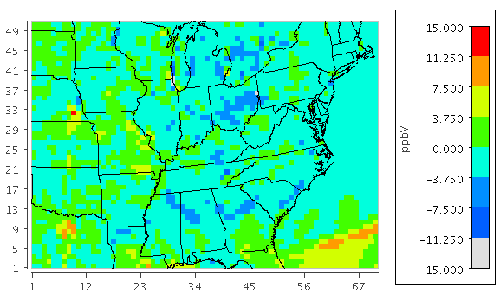
Subgrid Maximum vs. Forward 36km Model Run Output
Detroit
Chicago
Lincoln
Maximum within 9 cell subgrid
36km forward results
Difference

Slide 22
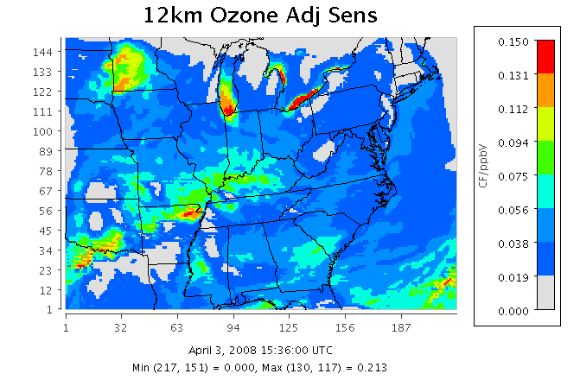
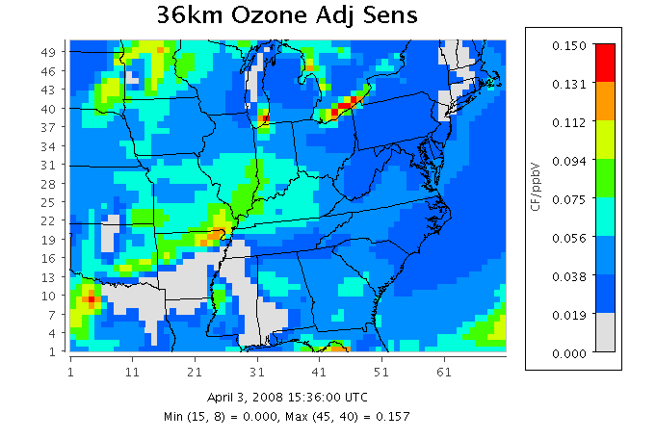
O₃ Adjoint Sensitivity Results
12 km output
36 km output

Slide 23
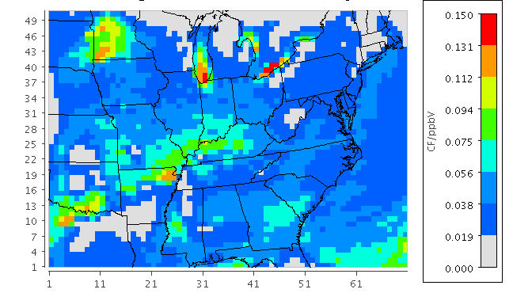
Adjoint Results 12km aggregated to 36km
Average of 9 cells regridded to 1 (12km → 36km)

Slide 24
Standard Deviation within Regridded Subgrid Data

Slide 25
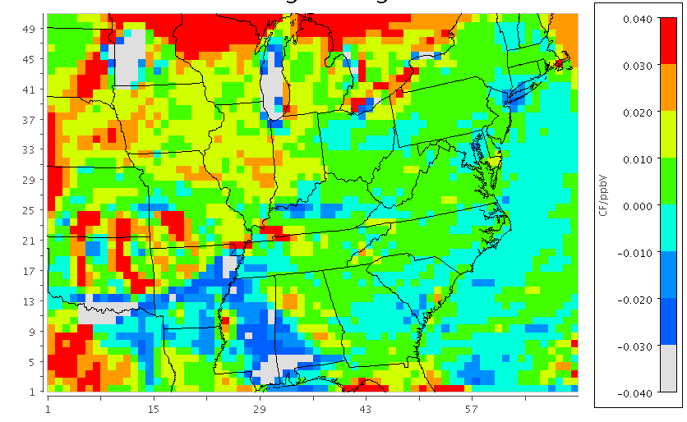
Adjoint Regridded vs. 36km Model Run Output
36 km adjoint run results
12 km adjoint results averaged and regridded to 36 km
Difference

Slide 26
Future Work
Finish Approach 1: DDM
Add cloud processes
Check horizontal advection differentiation
Run CMAQ-adj for progressively refined resolutions (36, 12, 4 & 1km) over the Greater Toronto Area.
Emission data was developed for each resolution (not regridded)
See impact with emission resolution and without emission resolution

Slide 27
Conclusions
Resolution of meteorological data and chemical transport changes the predicted downwind concentrations and the sensitivity results
Locations of high sensitivities with respect to grid resolution can be determined, these are the areas in which a higher resolution modeling would be most beneficial

Slide 28
Thank you

Slide 29
References
[1] Ridder, K., Viaene, P., van de Vel, K., Brasseur, O., Cheymol, A., and F. Fierens. 2014. “The impact of model resolution on simulated ambient air quality and associated human exposure.” Atmosfera 26: 403-401.

