Slide 1
Modeled Source Apportionment of Reactive Nitrogen in the Greater Yellowstone Area
Tammy M. Thompson: Colorado State University (now at AAAS); Michael G. Barna, Bret A. Schichtel: National Park Service; C. Thomas Moore: Western States Air Resources Council (WESTAR)
CMAS Annual Conference, October 24-26, 2016, Chapel Hill, NC

Slide 2
Outline
Modeling Platform
Details, Why Use?
Model Performance within the Grand Tetons based on National Park Service Special Study
Source Apportionment
Regions/Sectors
Grand Tetons
Ammonia concentrations
Total Nitrogen Deposition
The Greater Yellowstone Area

Slide 3
Why care about N deposition
It’s a fertilizer, and can foster ecosystem change in sensitive environments
Diatom communities in alpine lakes
Wildflowers -> sedges
GYA nitrogen ‘critical load’ at 3 kg/ha/yr
See Fenn et al. (2003) for review of N deposition ecological effects
Notes:
3

Slide 4
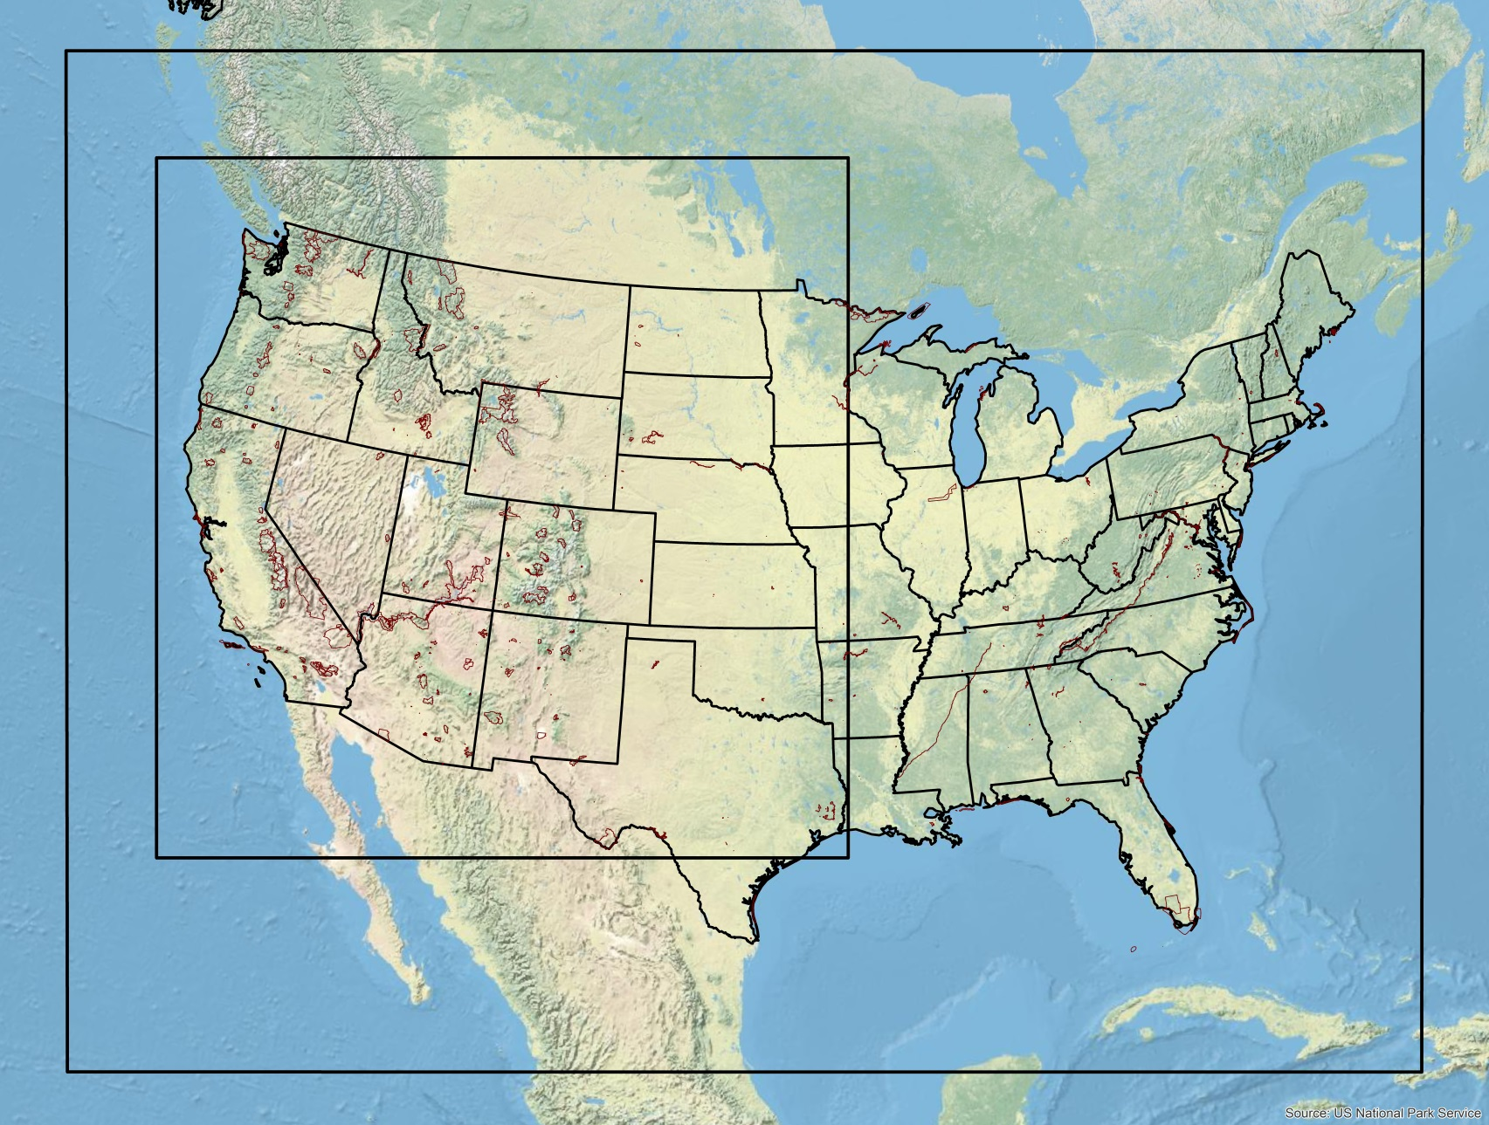
Inter-Mountain West Data Warehouse 2011 Modeling Domain (NPS & Class 1 in Red)
36km / 12km Domains focused on the Western US
2011 National Emissions Inventory with Improvements
Oil and Gas
Agriculture
Weather Research and Forecasting (WRF) 2011 met modeling by IWDW for Western US
MOZART BCs
Comprehensive Air Quality Model with Extensions (CAMx)
Fully Evaluated by IWDW

Slide 5
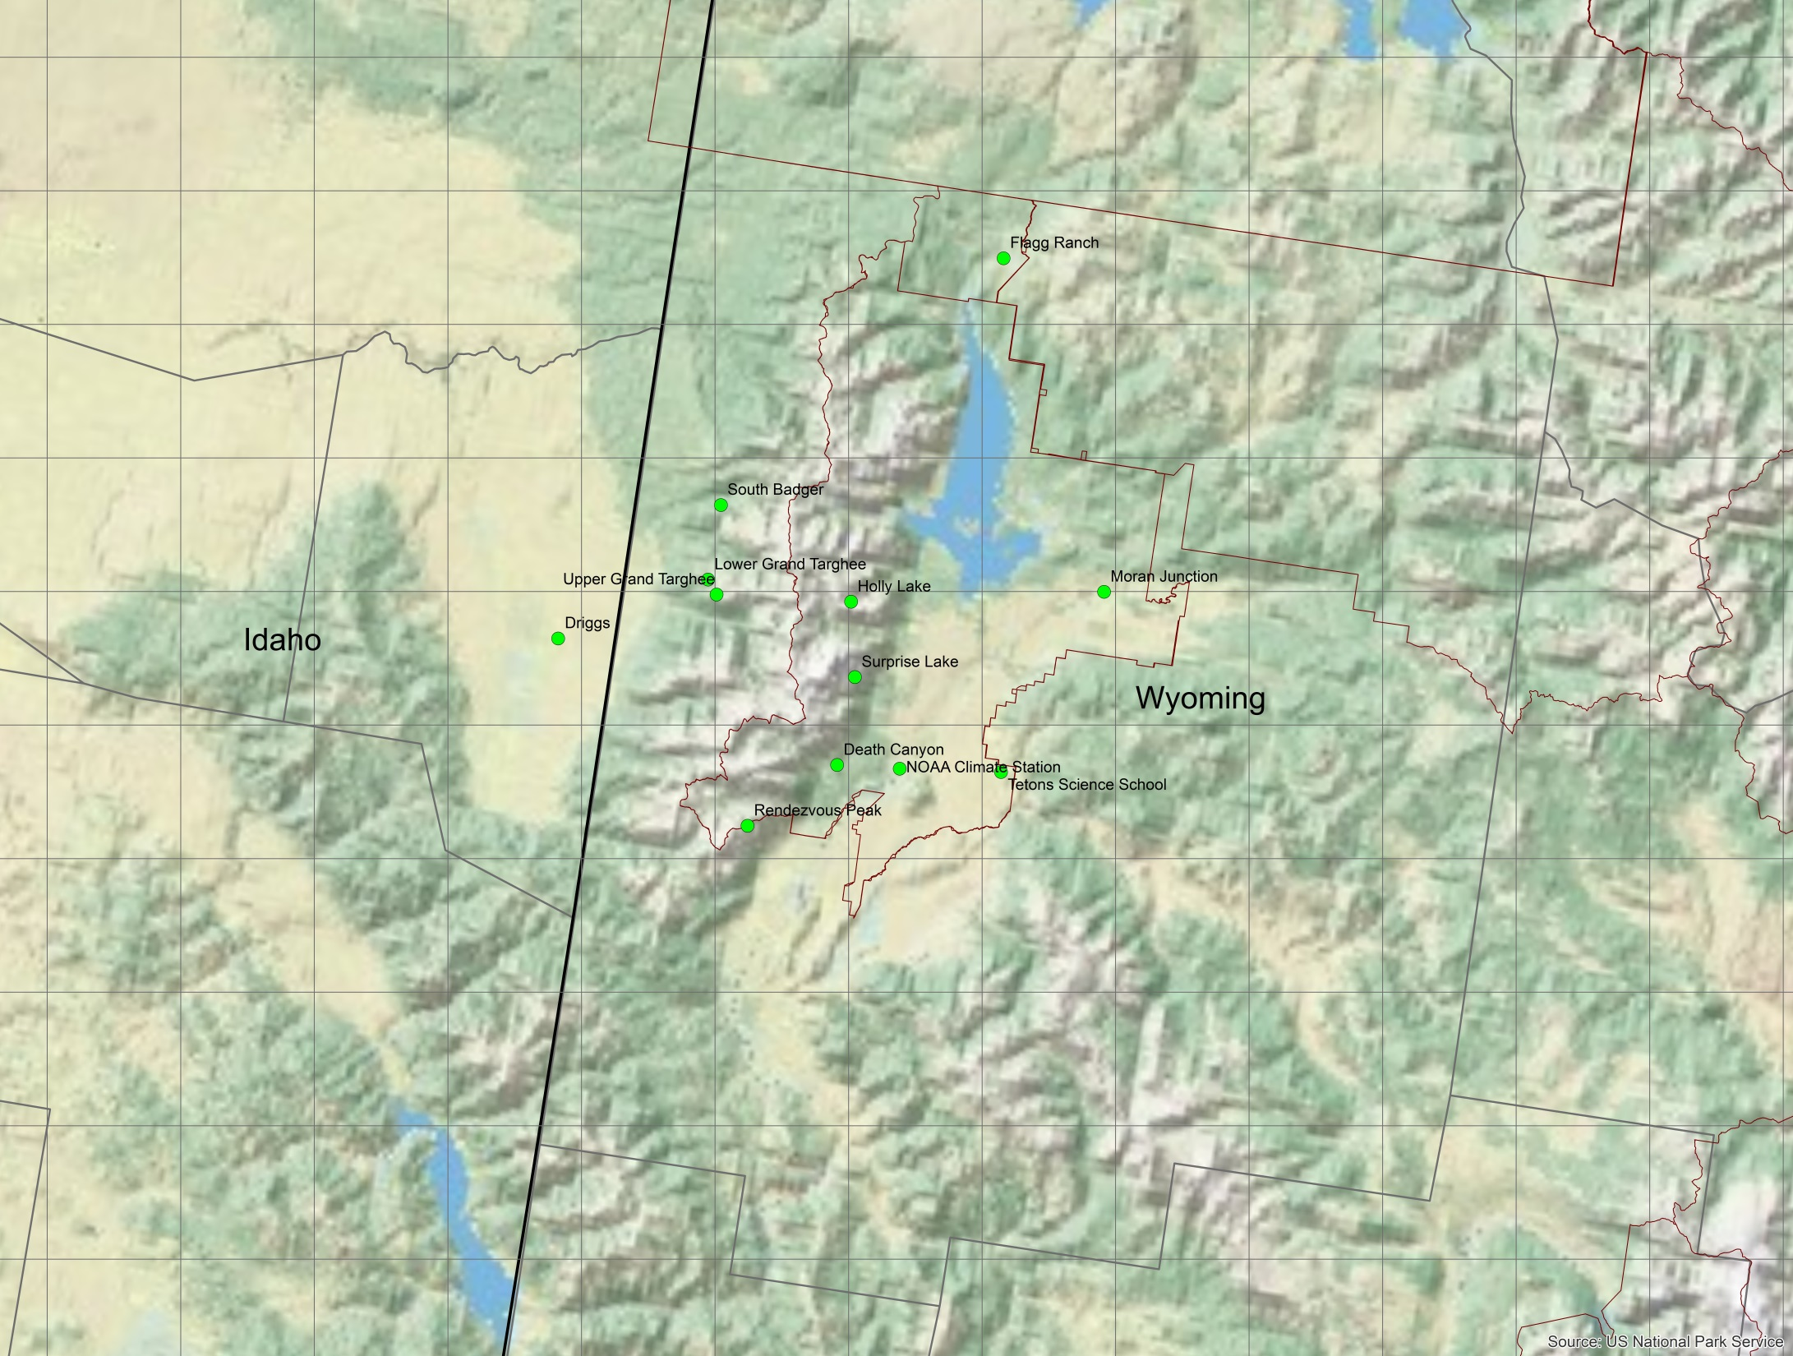
Grand Trends Study Area
Field campaign: April – September, 2011
Measure N species across Grand Teton National Park

Slide 6
Annual Average Agricultural NH3 Emissions 2011: Tons/year/km²

Slide 7
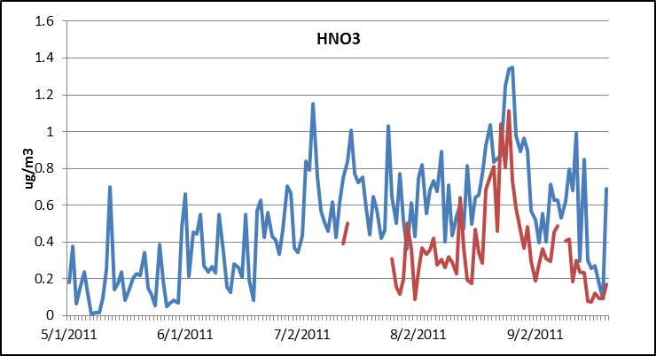
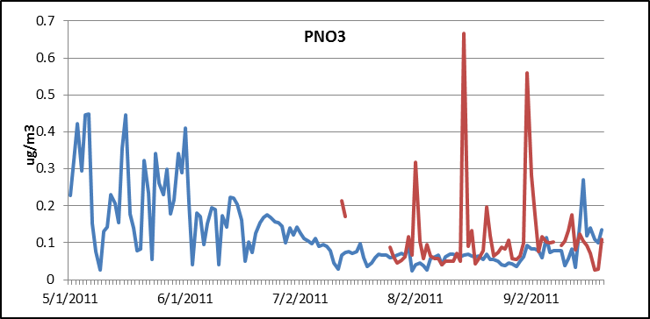
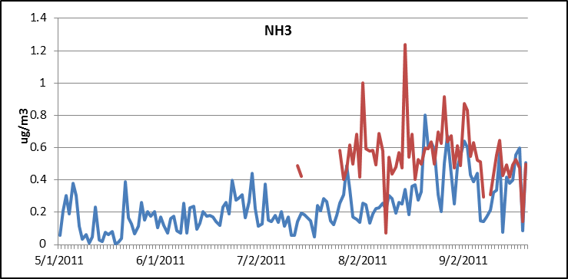
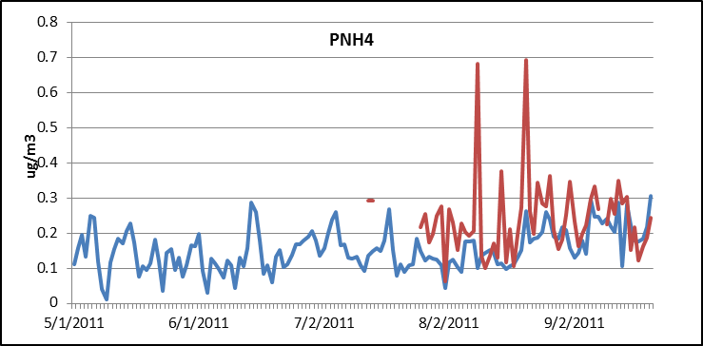
Nitric Acid
Particle Nitrate
Ammonia
Particle Ammonium
Upper Grand Targhee shows good model performance for key measured Nitrogen Species
Model Values in Blue Measured Values in Red
All Values in µg/m³

Slide 8
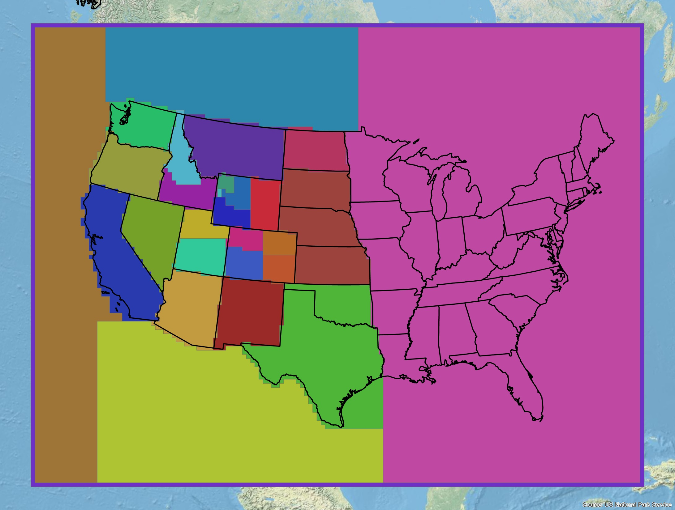
Source Regions
From Each Region, Trace Source Sectors Individually:
Agriculture
Oil and Gas
Model Domain Boundaries
All Other Source Sectors

Slide 9
Trace Regional Air Pollution Emissions to their Contributions in Grids Cells in Grand Tetons NP. We’ll look at three grid cells moving from West to East across the park

Slide 10
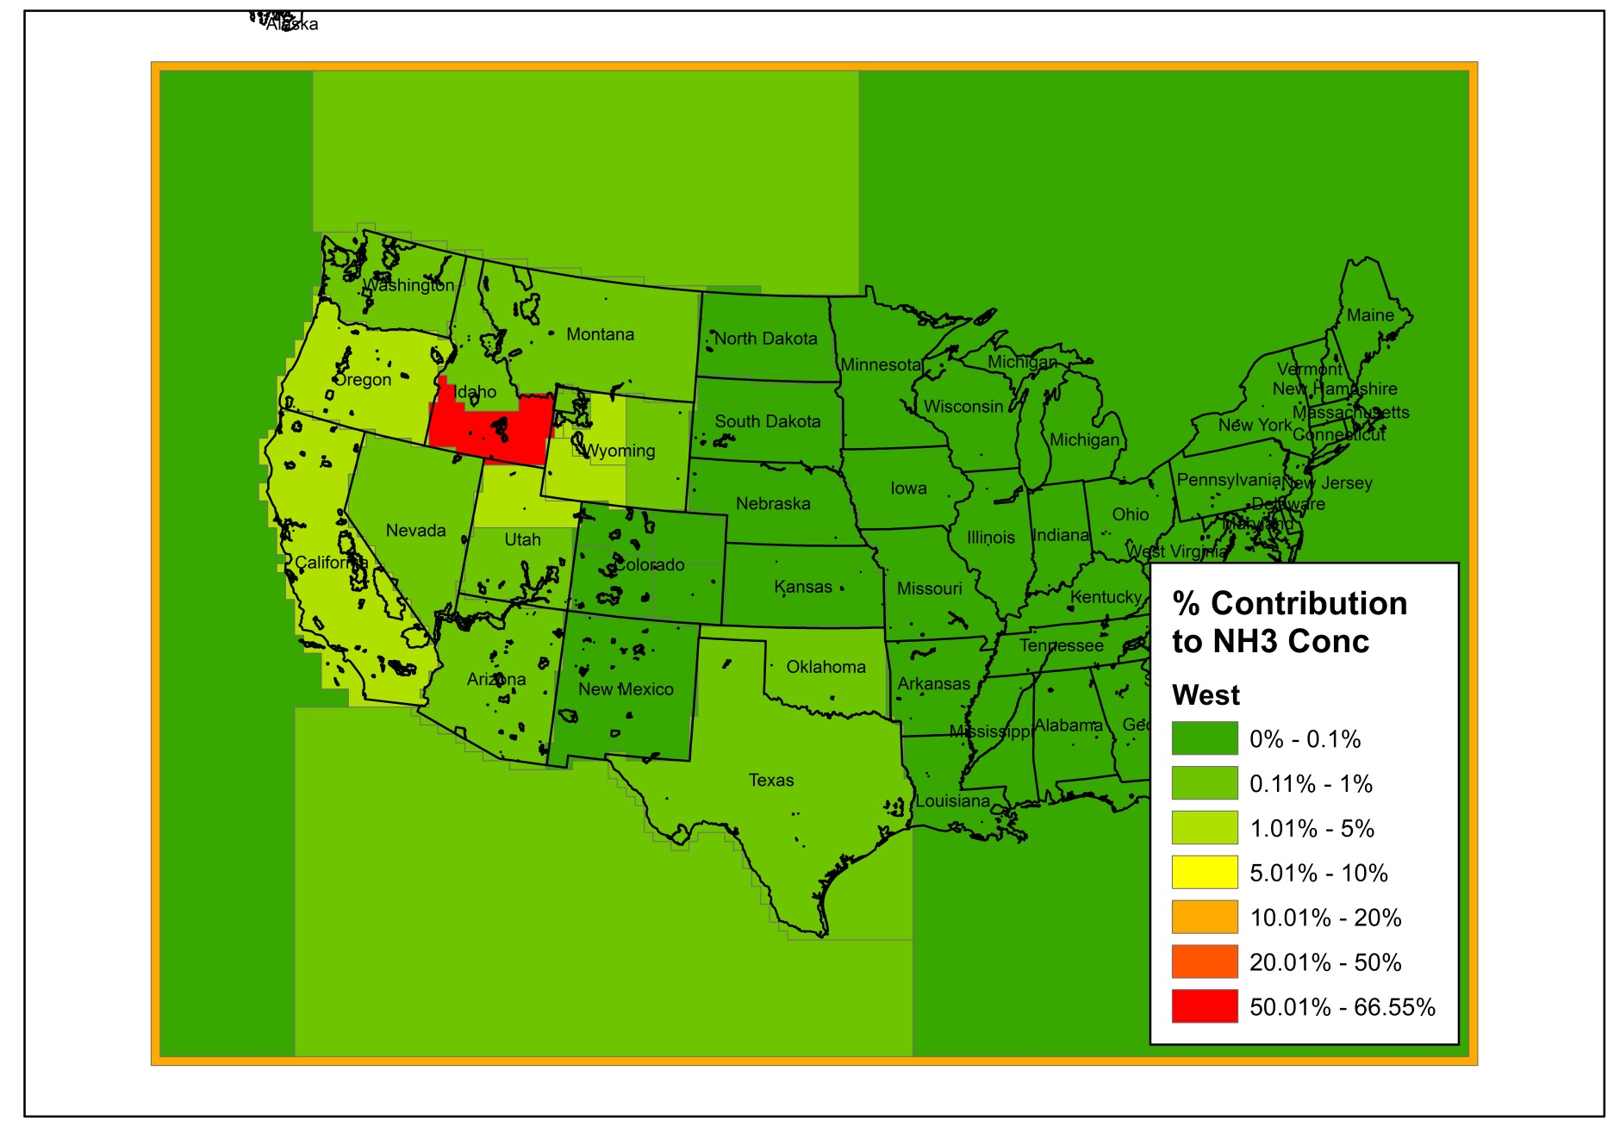
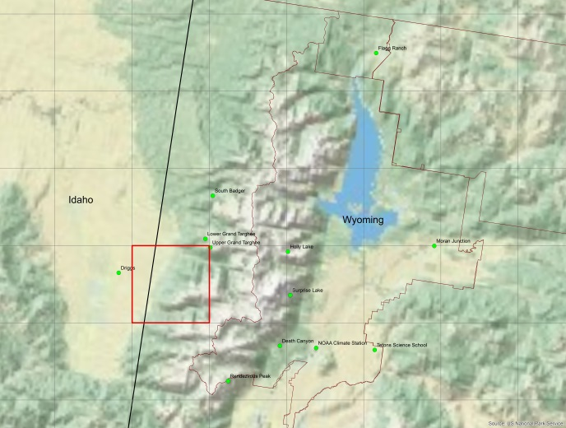
Who is Contributing to Ambient NH₃ Concentration on the Western Side of Grand Tetons NP? (2011 Annual Average)

Slide 11
Who is Contributing to Ambient NH₃ Concentration on the Center of Grand Tetons NP? (2011 Annual Average)

Slide 12
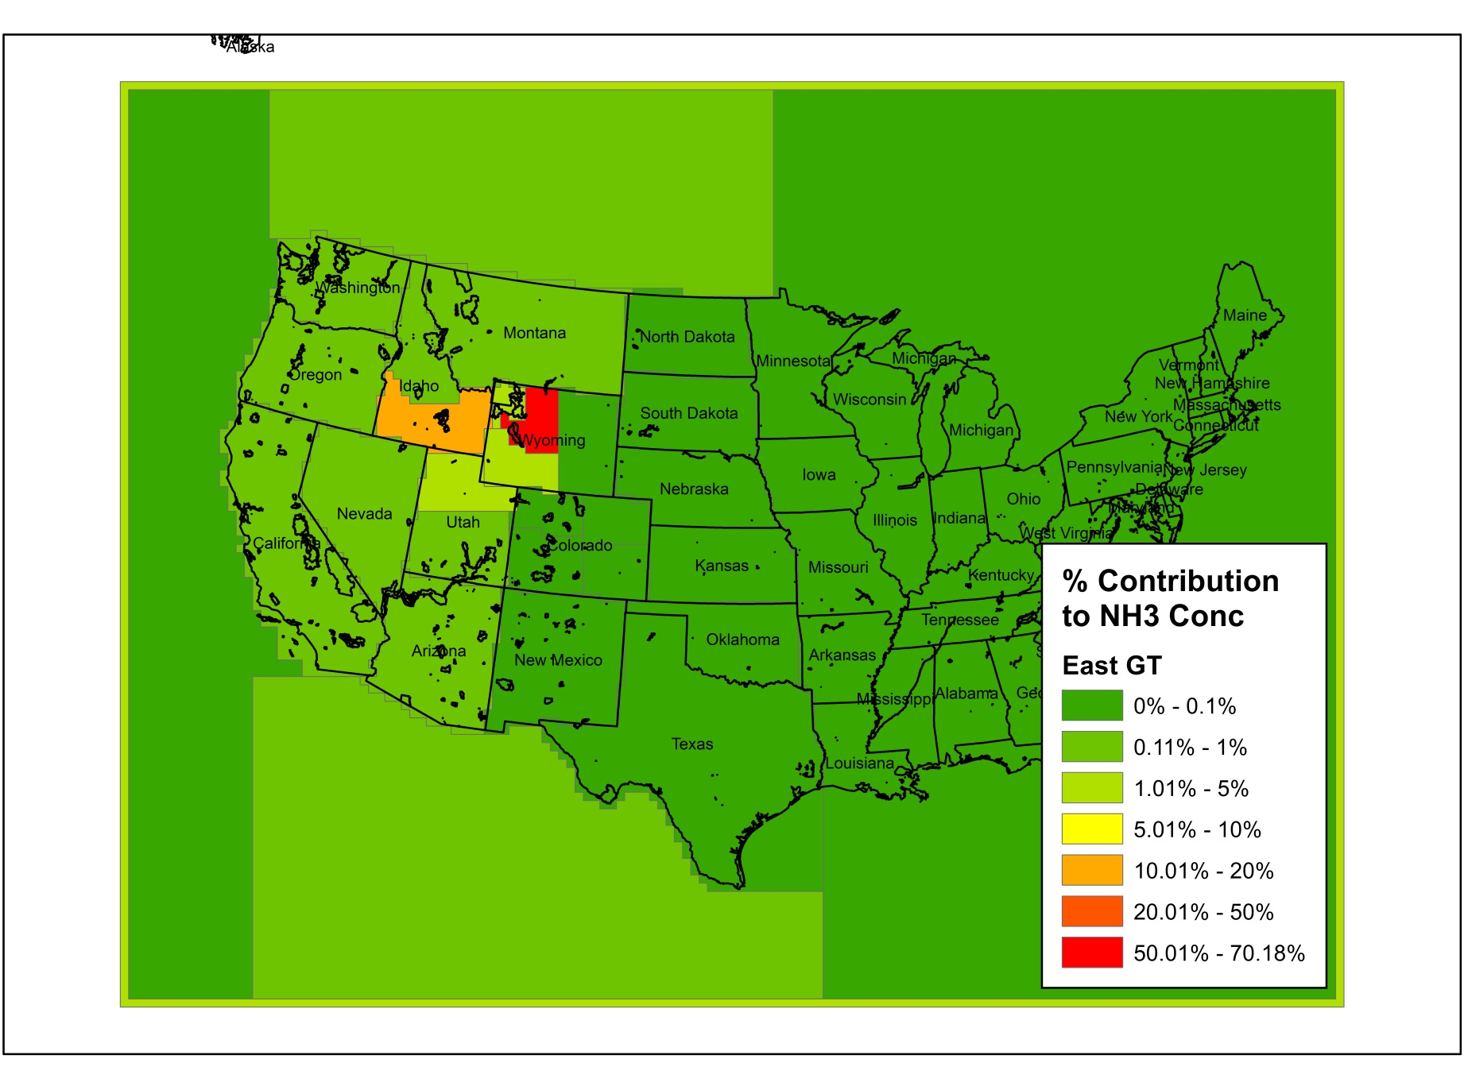
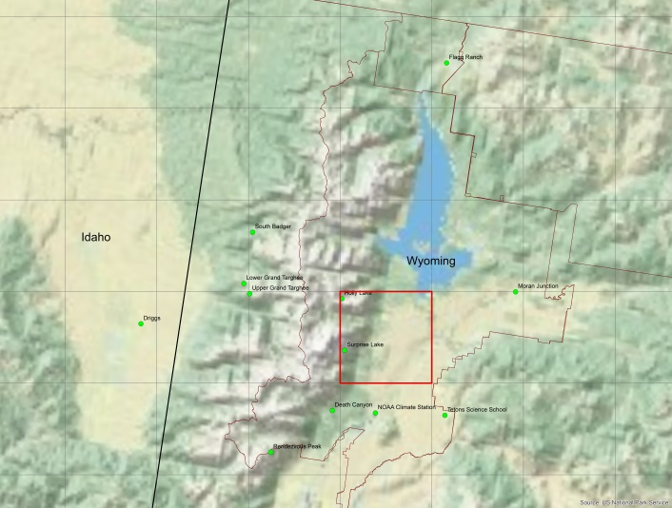
Who is Contributing to Ambient NH₃ Concentration on the Eastern Side of Grand Tetons NP? (2011 Annual Average)

Slide 13
Inorganic Reactive N deposition budgets
Modeled Measured
Note the importance of reduced N deposition
Notes:
The relative importance of N deposition pathways depends on the amount of precipitation (DR v GT).
Dry deposition of ammonia is important in GTNP.
In June and July, precipitation at Driggs (~54 mm each month) was greater than at NOAA Climate Center (~30 mm), consistent with their locations upwind and downwind of the
Teton Range, respectively. Wet nitrogen deposition was also greater at Driggs. In August and September, monthly precipitation was less than 10mmat both Driggs and NOAA Climate Center, while at the higher elevation site, Upper Grand Targhee, 29 mm of precipitation fell in August and 36 mm fell in September. The highest average volume-weighted ion concentrations were of ammonium, calcium, nitrate, and sulfate at all three sites. At both Driggs and NOAA Climate Center, precipitation ion concentrations (μN) decreased in the order NH4 +>NO3 >Ca2+>SO4 2, while at Upper Grand Targhee, the order was NH4 +>Ca2+>NO3 >SO4 2. Nitrogen species were always more abundant than sulfur, on a molar basis, in the precipitation samples.
The absolute amount of precipitation in 2011 was higher than the historical average during the wet period, indicating that dry deposition of NH3 may typically be a more important contributor also to spring nitrogen deposition than that observed during GrandTReNDS

Slide 14
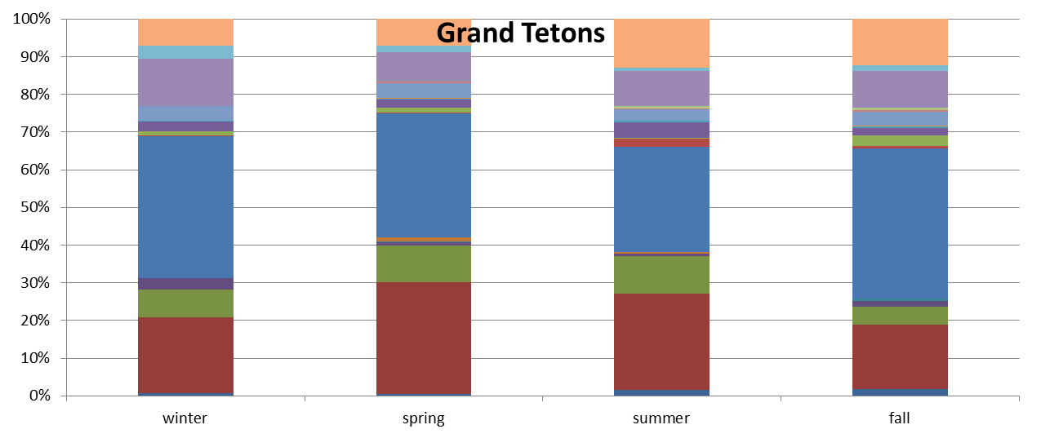
Source Contribution by Region
ID
CA
BC
(Surprisingly) large contribution from boundary and California
Idaho the most significant source
Wyoming and Utah also make significant contributions

Slide 15
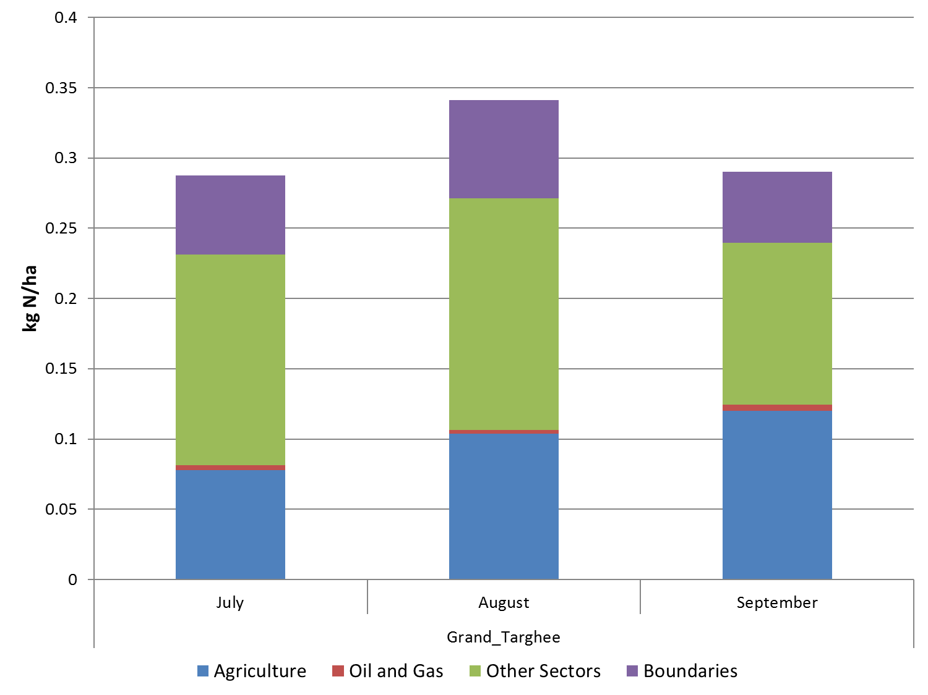
Monthly Total Deposition by Source Sector

Slide 16
Conclusions
Most of the N dep at GYA from Idaho; BC’s, CA, UT and Wyo also important
Need better treatment of ammonia
Measurement studies happening in RMNP now
Evaluating models with bi-directional flux ammonia modeling capabilities
If industrial agriculture is a large source (it is), then how to address for mitigation?
Expanding both measurement and model capabilities for organic nitrogen

