Slide 1
Inherent uncertainty in the prediction of ozone and particulate matter for NE US
Marina Astitha¹, S.T. Rao², Jaemo Yang¹, Huiying Luo¹,
¹Department of Civil & Environmental Engineering, University of Connecticut, Storrs-Mansfield, CT, USA
²Department of Marine, Earth & Atmospheric Sciences, North Carolina State University, Raleigh, NC, USA
14th Annual CMAS Conference (Oct 5-Oct 7, 2015), Chapel Hill, NC

Slide 2
MOTIVATION
The “best-we-can-do” question: what is the lowest bound for errors and variability in predicted atmospheric and air quality variables using the current state-of-the-science numerical models?
How do we best use atmospheric modeling systems for assessing the impact of emission reductions?
What is the confidence in using source apportionment methods and address compliance with NAAQS and emissions control strategies?
This presentation is the pilot study in the view of addressing the above questions and focuses on the impact of inherent uncertainties on air pollutant concentrations and source apportionment.

Slide 3
OUTLINE
Model configuration & initial data
Variability of atmospheric fields for NE US
Variability of air pollutants for continental and NE US
Variability of O₃ source apportionment
Remarks & future work

Slide 4
Model Configuration
RAMS/ICLAMS (Solomos et al. 2011-ACP; Kushta et al. 2014-JGR) modules:
Online production of desert dust and sea salt emissions (Solomos et al. 2011; Kushta et al. 2014)
Rapid Radiative Transfer Model (RRTM) [Mlawer et al., 1997; Iacono et al., 2008]
Desert dust and sea-salt radiative effects as a function of sizeand water content (Solomos et al. 2011; Kushta et al. 2014)
Explicit treatment of desert dust and sea salt as CCN, GCCN and IN particles (Nenes and Seinfeld, 2003; Fountoukis and Nenes, 2005)
Cloud microphysics: Two-moment bulk scheme [Walko et al., 1995; Meyers et al., 1997] with 5 ice condensates species.
CAMx v5.40 (Environ, 2011) Air quality simulations:
Emissions inventory for 2005 on 0.1x0.1deg resolution (EDGAR-JRC)
Gas, aqueous and aerosol phase chemistry (CB-V, ISORROPIA)
Dry and wet deposition
OSAT

Slide 5
Model Configuration
Gridded domains
25km
5km
34 Vertical levels up to 20km
Simulation period:
10-19 June 2006

Slide 6
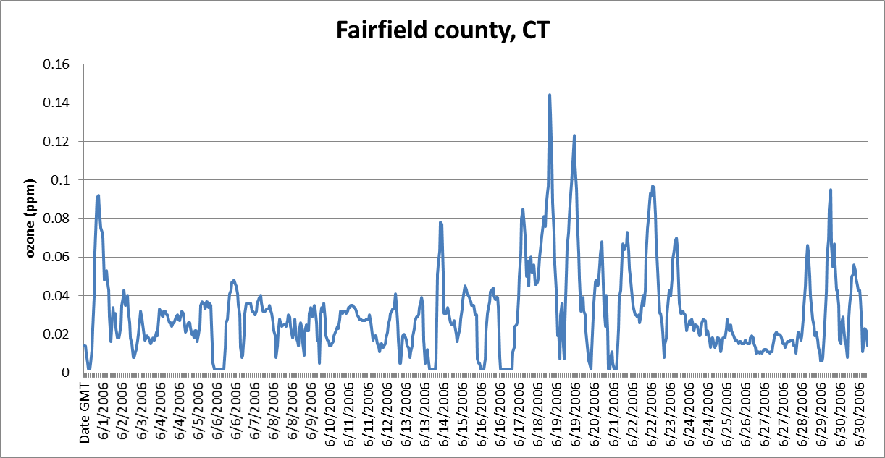
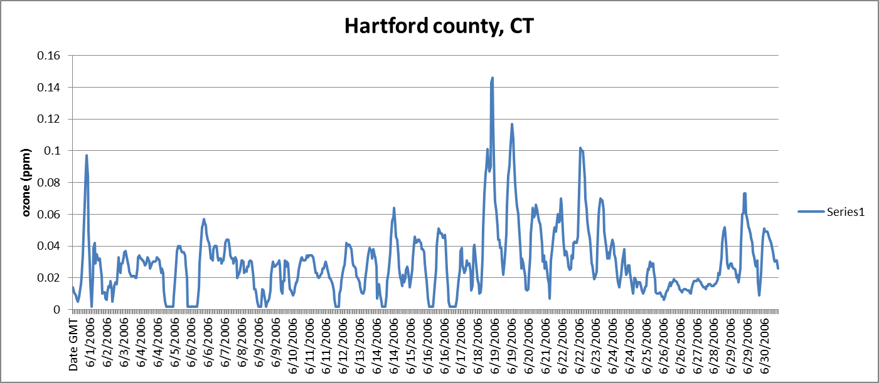
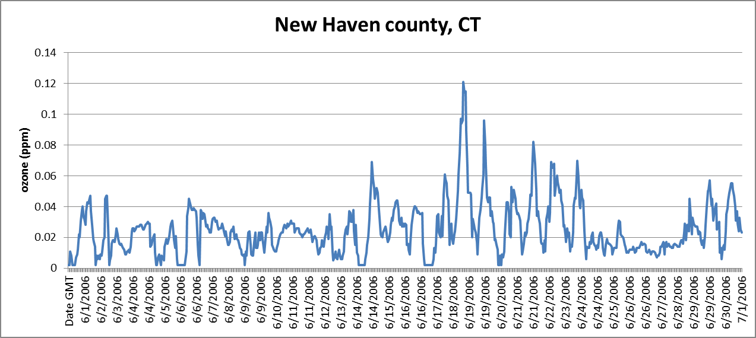
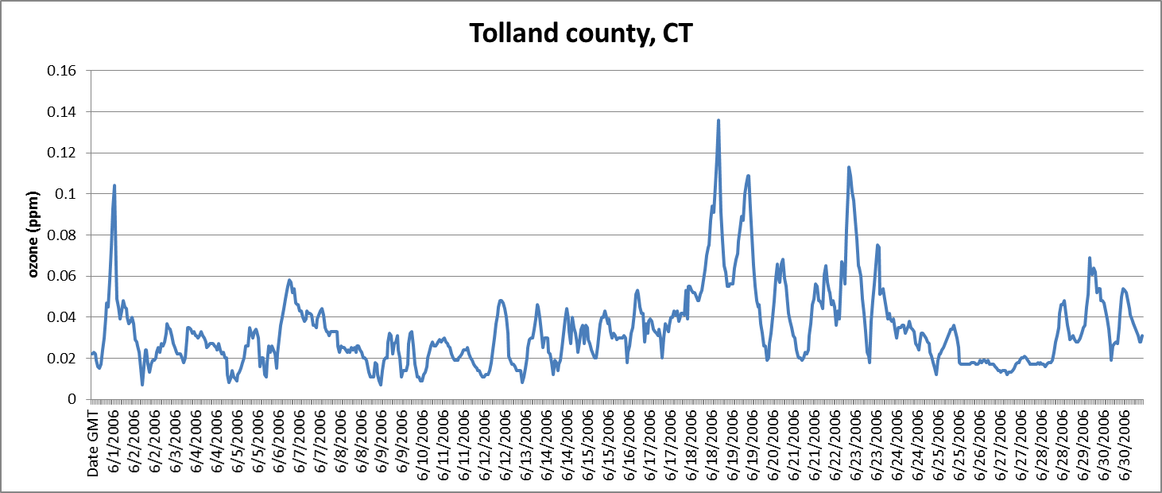
Selection of the simulation period
Ozone concentrations
18 June 2006
Hourly O₃ measurements: EPA’s AQS

Slide 7
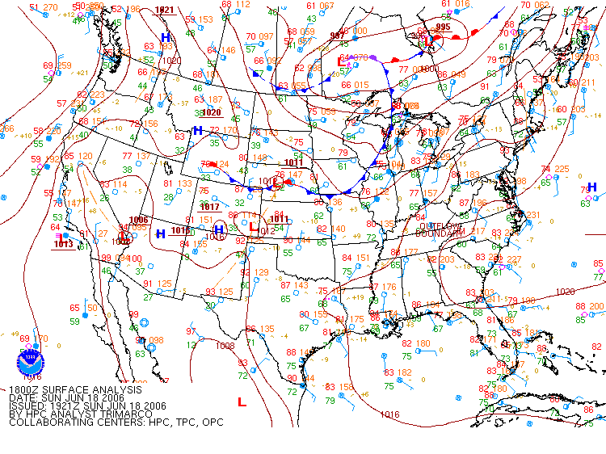
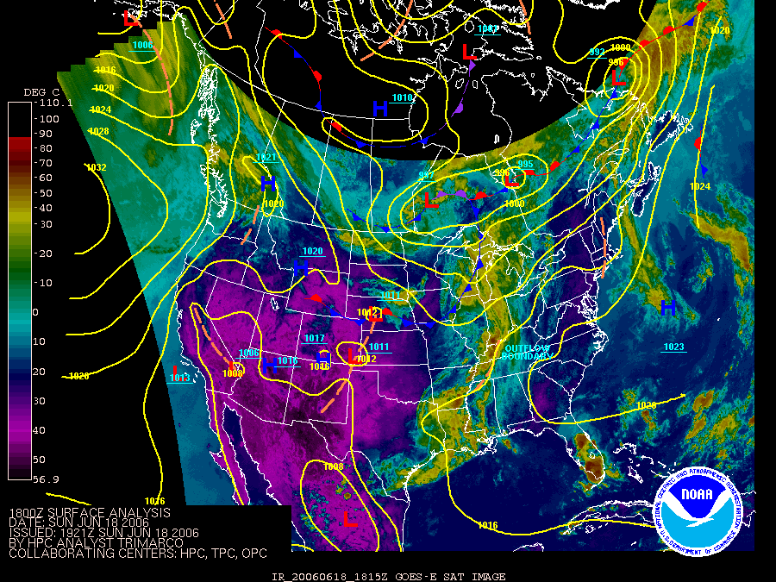
Meteorological conditions
06/18/2006 18UTC
Bermuda High pressure system
Low S-SW winds

Slide 8
Initialization data
NCEP Global Forecast System (GFS) Analyses (1x1deg)
NCEP FNL (Final) Operational Global Analyses data (1x1deg) (uses Global Data Assimilation System (GDAS), which continuously collects observational data from the Global Telecommunications System (GTS) and other sources)
European Center for Medium-Range Weather Forecasts (ECMWF) Analyses (1x1deg)
Four Dimensional Data Assimilation (FDDA) (analysis nudging) is implemented in all three simulations

Slide 9
Variability in the global analysis fields
for NE US
FNL, GFS and ECMWF

Slide 10
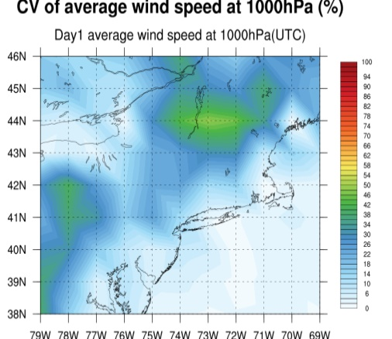
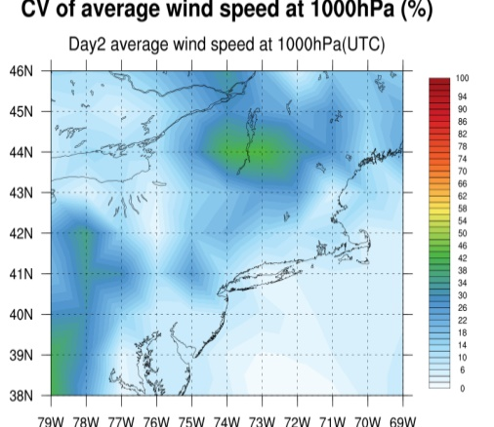
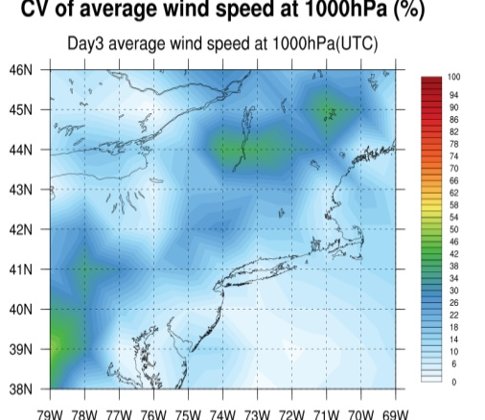
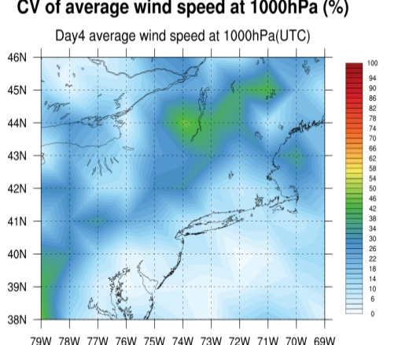
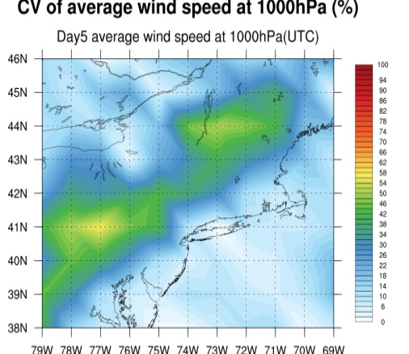
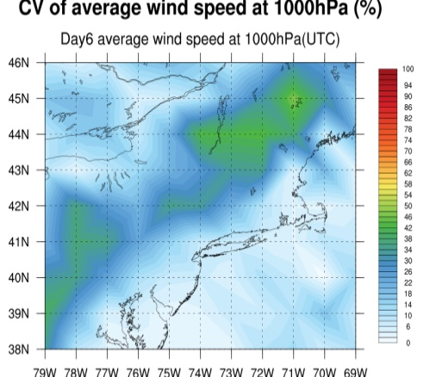
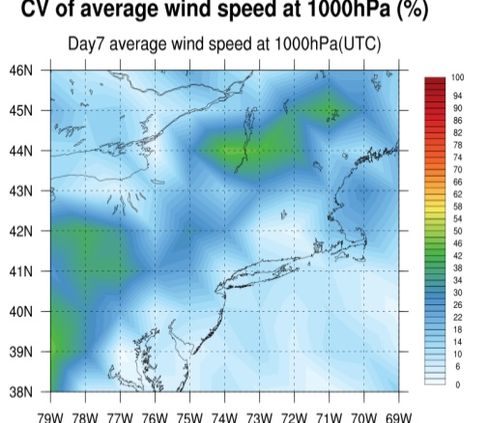
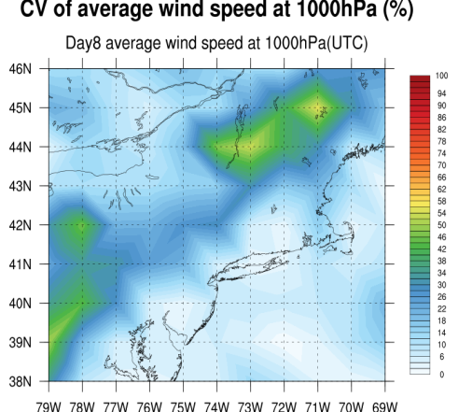
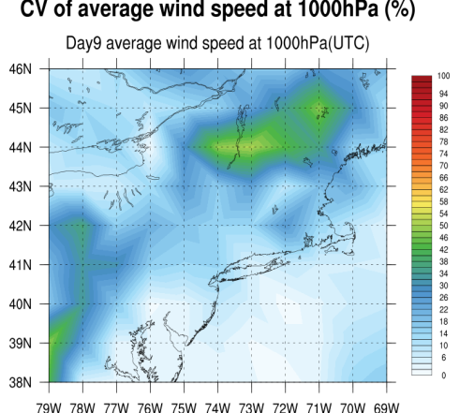
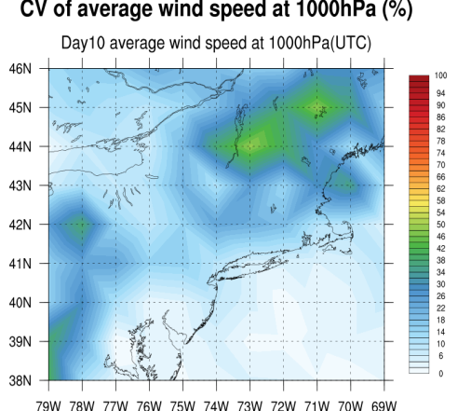
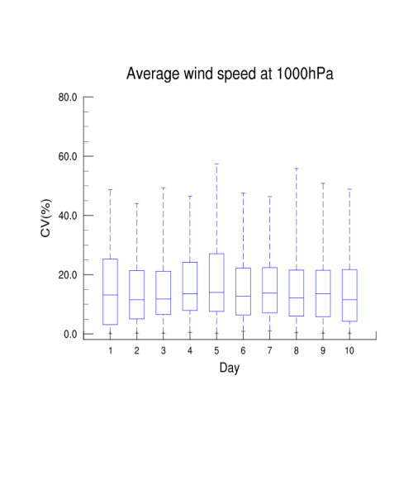
Variability of wind speed@1000hPa
$$CV=\frac{σ}{mean}$$
Notes:
CV=stdev/mean

Slide 11
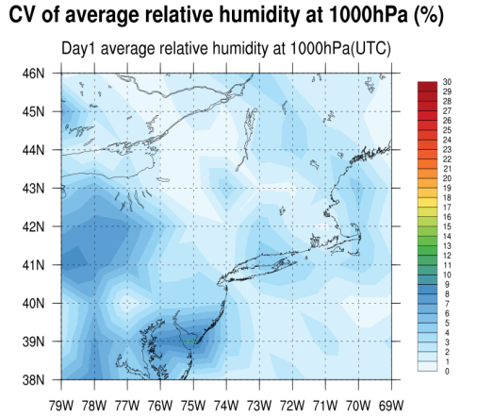
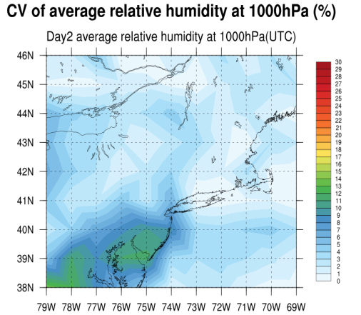
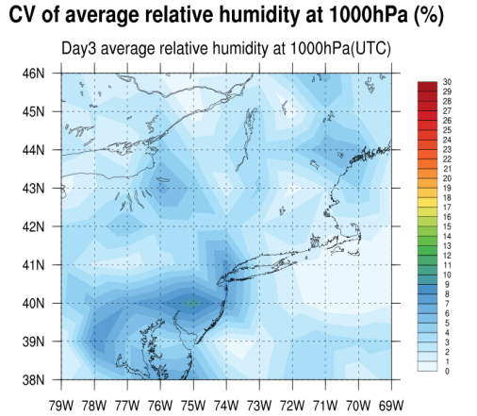
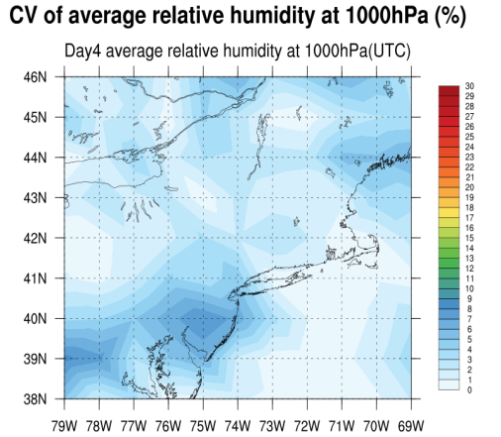
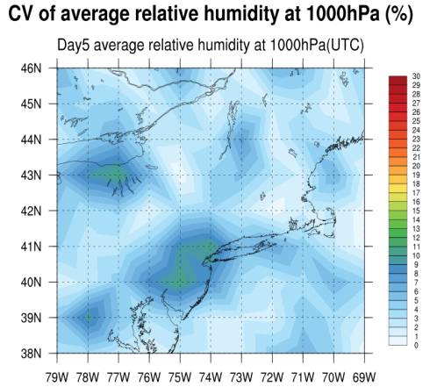
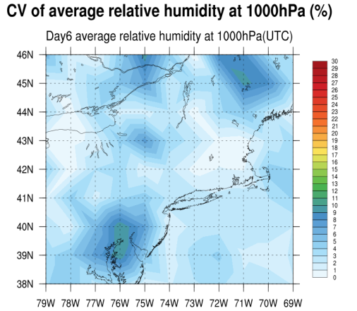
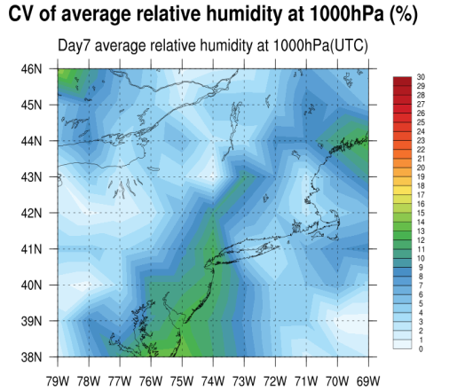
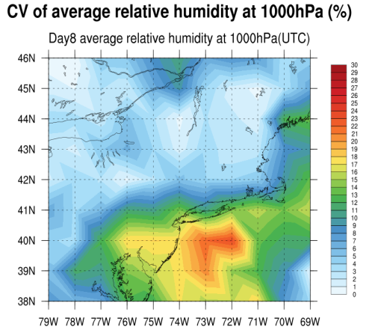
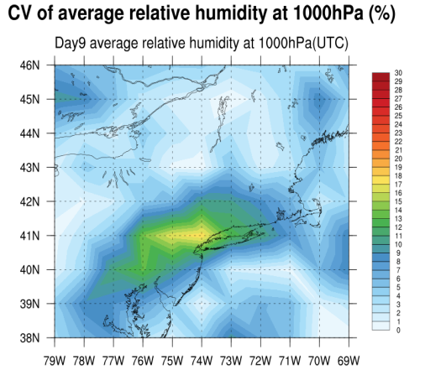
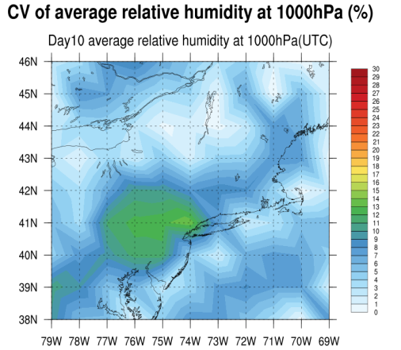
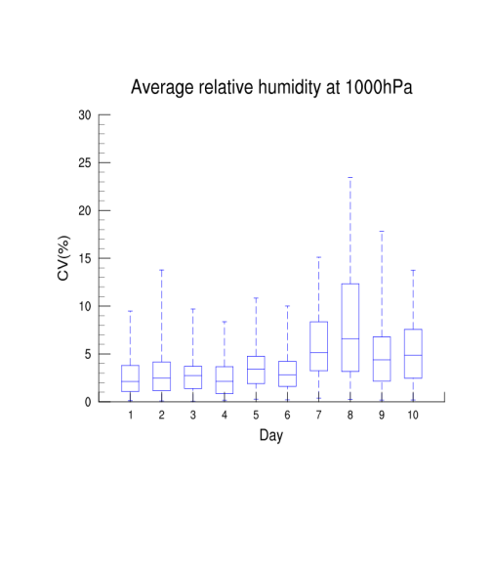
Variability of RH@1000hPa

Slide 12
Variability in the modeled atmospheric fields for NE US

Slide 13
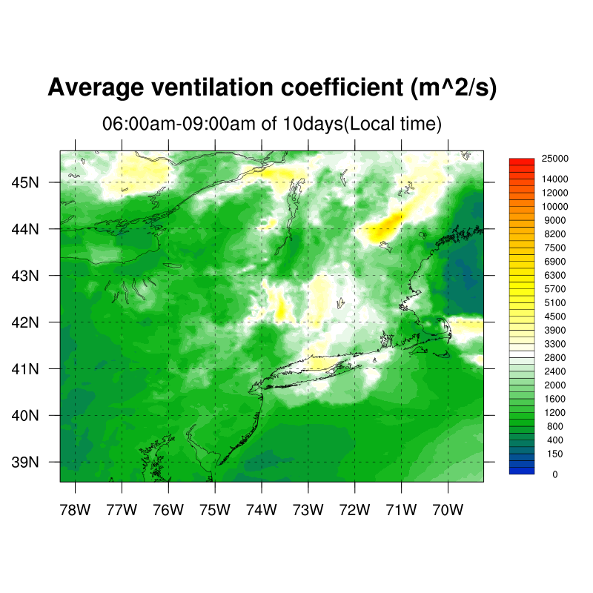
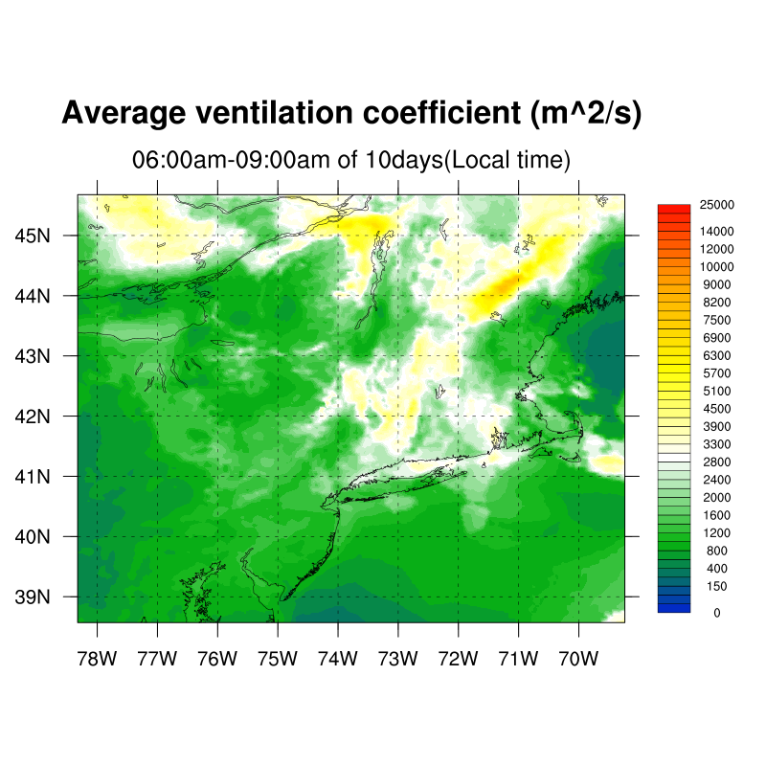
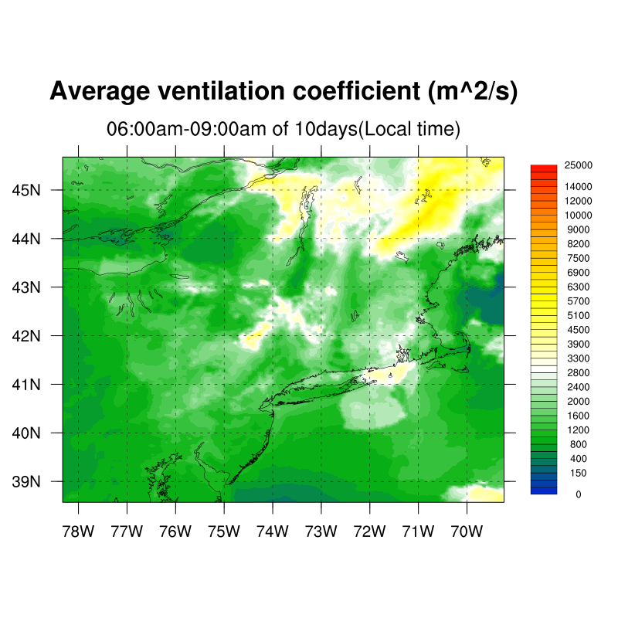
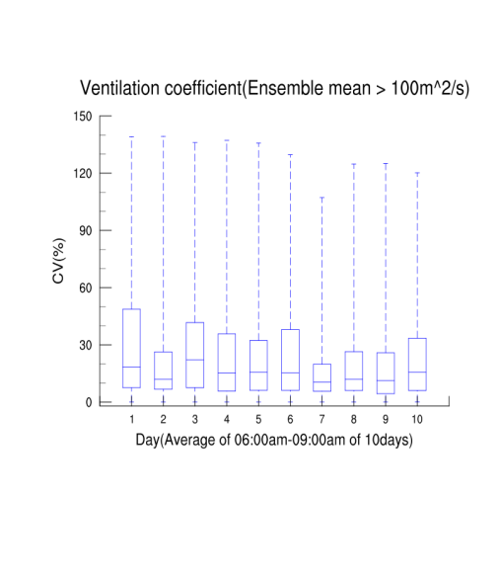
Variability of ventilation coefficient
Daytime ventilation coefficient (wind@10m * mixing height)
(6am-9am)
FNL
GFS
ECMWF

Slide 14
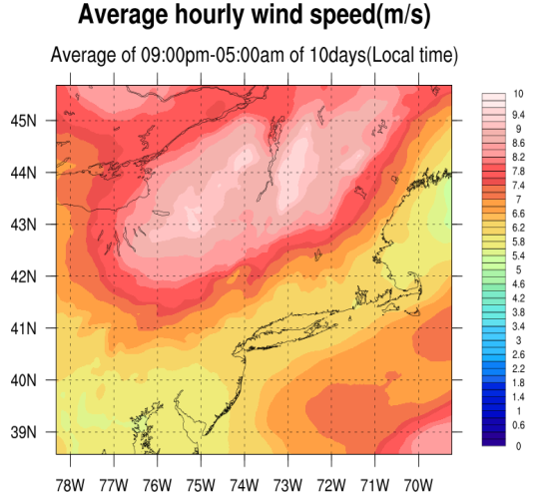
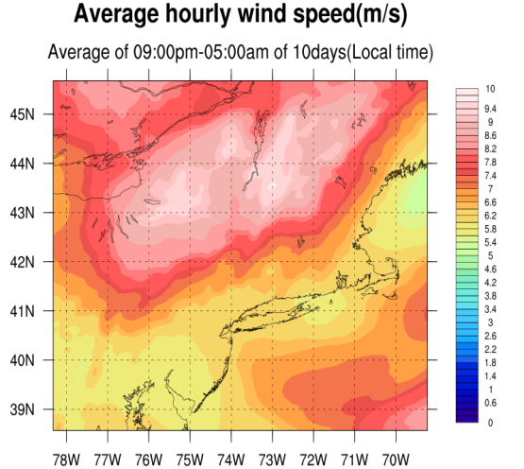
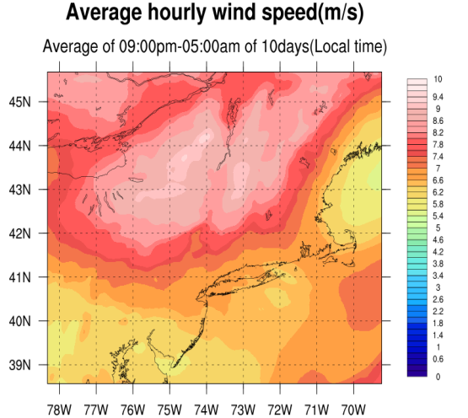
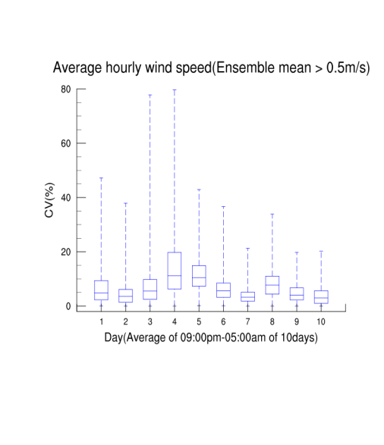
Variability of wind speed at the steering level
Nighttime average (09:00pm-05:00am)
FNL
GFS
ECMWF

Slide 15
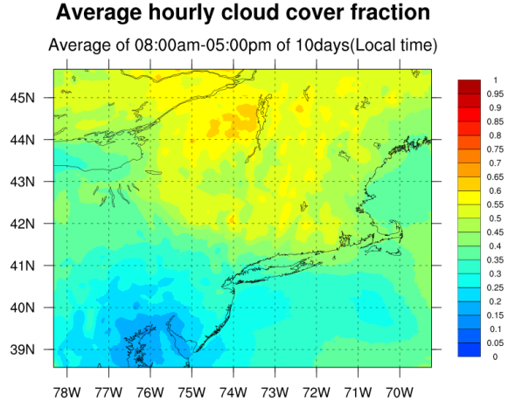
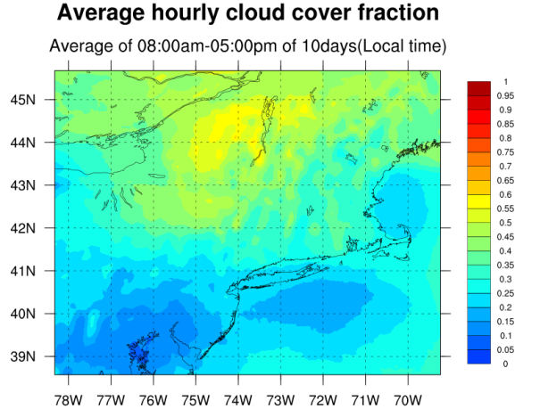
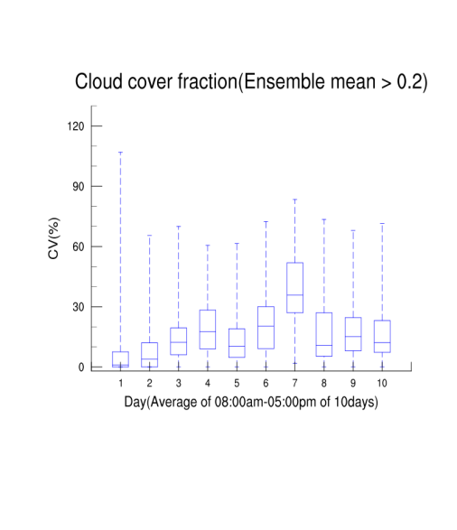
Variability of cloud cover
Daytime average (08:00am-05:00pm )
FNL
GFS
ECMWF

Slide 16
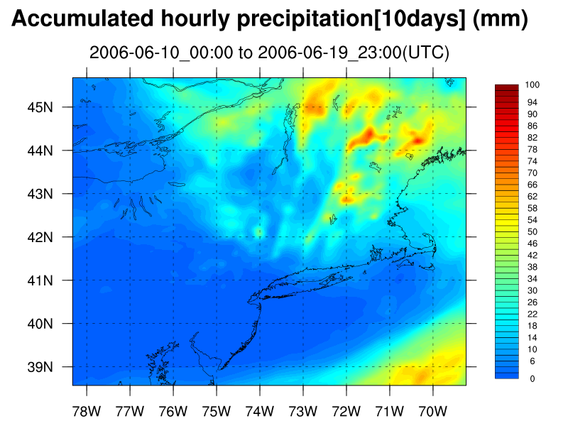
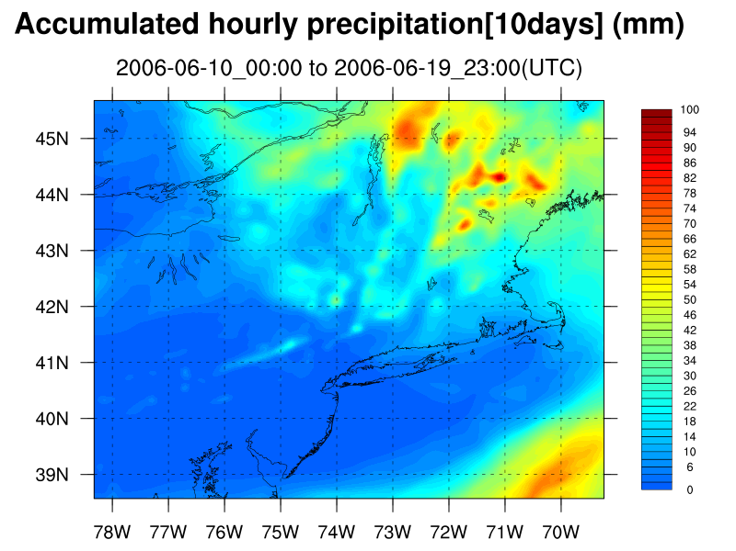
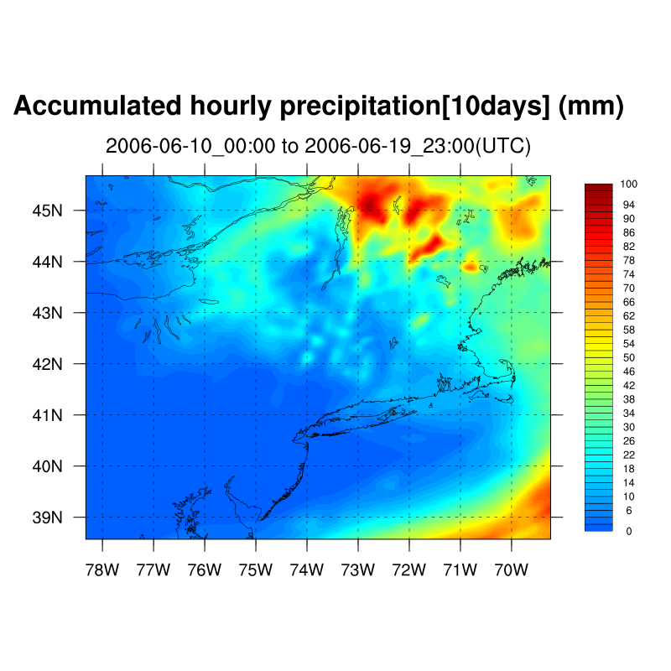
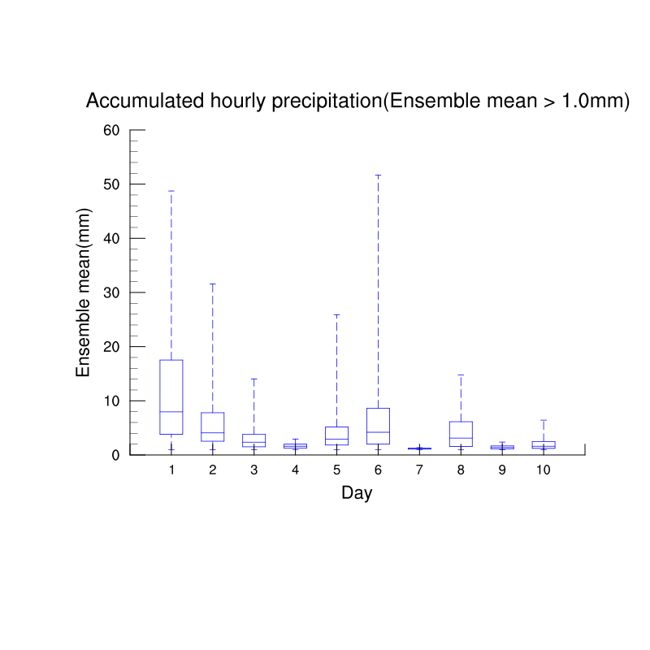
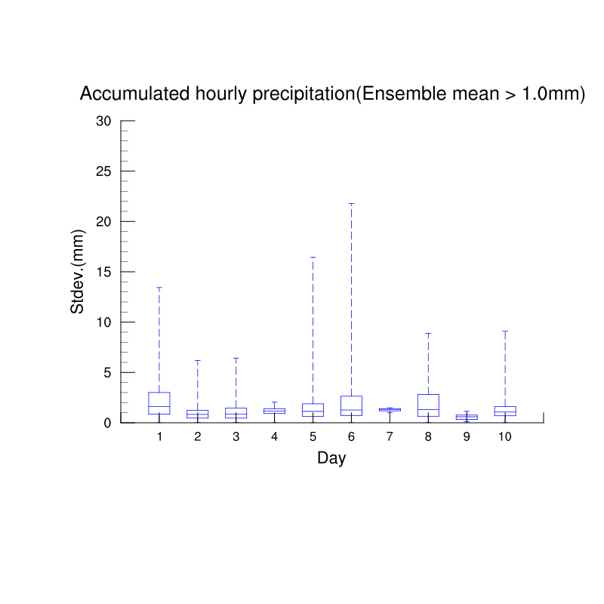
Variability of accum. precipitation
FNL
GFS
ECMWF

Slide 17
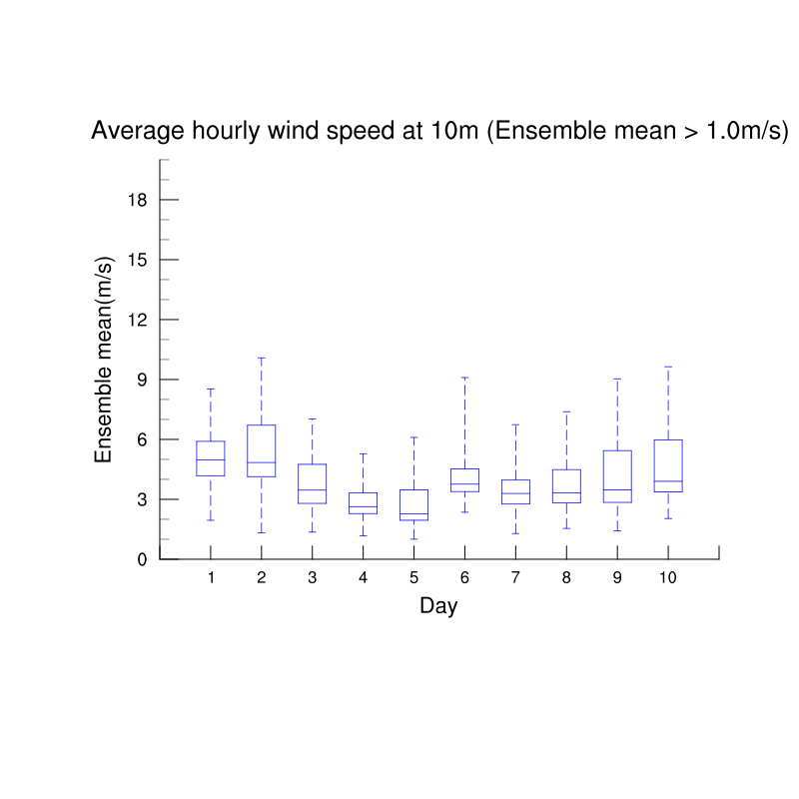
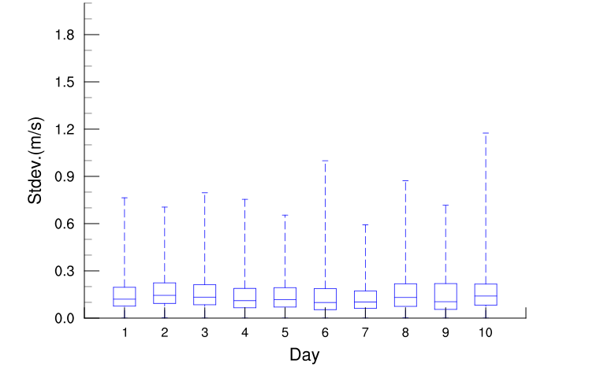
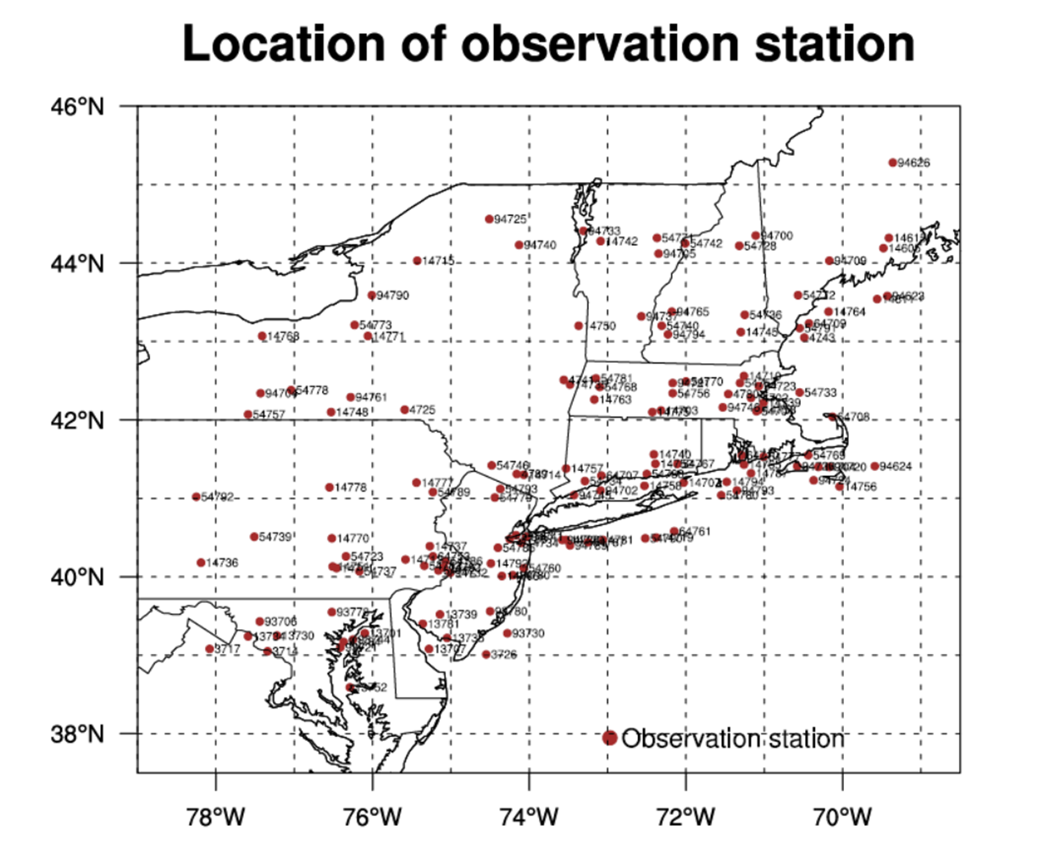
Model error as a function of time
NE domain

Slide 18
Variability of modeled aerosol concentration (natural sources)

Slide 19
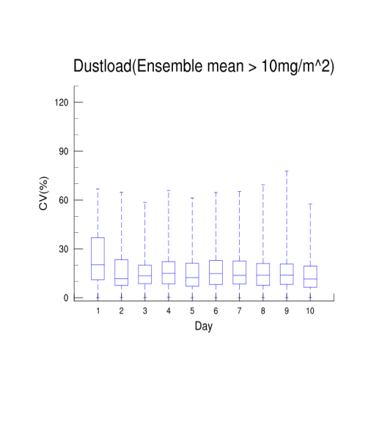
Variability of desert dust load
FNL
GFS
ECMWF
Particle sizes:
8-size bin scheme

Slide 20
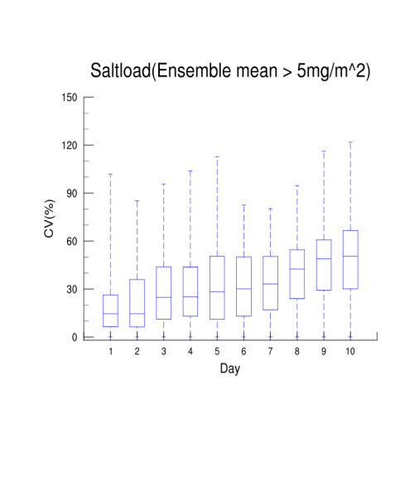
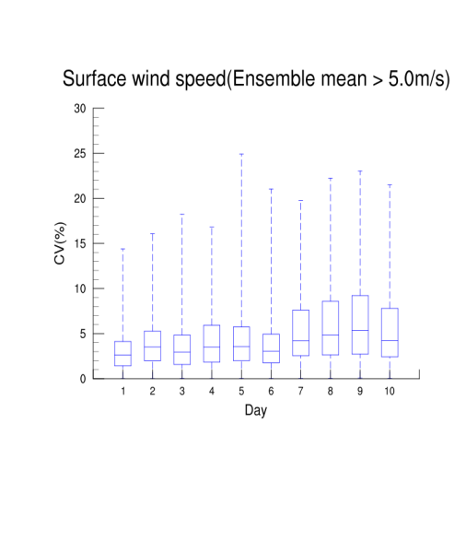
Variability of sea salt load
FNL
GFS
ECMWF
Particle sizes:
Accumulation + coarse mode

Slide 21
Variability of modeled daily
maximum O₃

Slide 22
Variability of daily maximum O₃
Coefficient of Variation (mean > 0.5ppb) for each simulation day

Slide 23
Variability of daily maximum O₃
Daily max Ozone concentration (ppb) for June 18, 2006
max=70.5ppb
max=74ppb
max=80.5ppb
FNL
GFS
ECMWF
June 18, 2006

Slide 24
Variability of daily maximum O₃
Coefficient of Variation (mean > 0.5ppb) for each simulation day

Slide 25
Source Apportionment Variability
Ozone Source Apportionment Technology (OSAT) in CAMx v5.40 (Environ, 2010)
Propagation of inherent uncertainty to the geographic source apportionment for maximum surface ozone concentrations
Sensitivity Test No1:
13 Geographic source regions (states); 1 emission group; anthropogenic NOx and VOC precursors only

Slide 26
Source Apportionment Variability
Ozone precursor contribution to O₃ max by source area
((Ozone from NOx+VOC)/total; percentages)
PRELIMINARY RESULTS

Slide 27
Source Apportionment Variability
Ozone precursor contribution to O₃ max by source area MA (ppb)
PRELIMINARY RESULTS
Remaining Questions
How important is the variability in source apportionment when applied for attainment demonstration and/or emission control strategies?
Can we identify a lower bound of errors in the model prediction and thus improve the confidence in model predictions for regulatory assessments?
FNL, ~10ppb max
GFS, ~7ppb max
ECMWF, ~5ppb max

Slide 28
FEW REMARKS
We have investigated the inherent uncertainty in atmospheric and air quality models by examining the impact of various initial conditions on weather variables and air pollutant concentrations
The most impacted atmospheric fields are precipitation, cloud cover, ventilation coefficient, and sea salt loading
Ozone daily maximum concentration has shown substantial variability (20-30%) that is more pronounced at the coarser resolution simulations
Propagating inherent uncertainty to the source apportionment shows substantial variability of the source attribution to max ozone values
Further research is needed to quantify the confidence that can be placed in modeled concentrations for policy analysis and regulatory assessments

Slide 29
FUTURE WORK
Dynamic evaluation of air quality model predictions from long-term simulations to analyze the features embedded in model outputs and observations
Determine the influence of inherent uncertainty on PMs in the context of model applications for regulatory assessments (emission reduction policies, design values etc)
Explore emission source contributions to downwind exceedances as influenced by changes in initial state
Determine the confidence by using additional source apportionment and/or sensitivity analysis methods

Slide 30
Acknowledgements
This work was partially supported by the Northeast Utilities project “Damage Modeling and Forecasting System of the NU Center Bridge-Funding”. Northeast Utilities and Department of Civil and Environmental Engineering, School of Engineering, University of Connecticut (PI:E. Anagnostou, Co-PI: M. Astitha, B. Hartman, M. Rudnicki). Award: $1.100.000, 04/15/2013-05/31/2015.
Part of this work was also supported by the Center for Environmental Science and Engineering (CESE) at the University of Connecticut (www.cese.uconn.edu) through the PhD fellowship for Jaemo Yang.
Email: astitha@engr.uconn.edu
Website: www.airmg.uconn.edu and cee-wrf.engr.uconn.edu

